Slide 1
Longitudinal bunch profile measurements using WCM and streak camera techniques
Kurt Hahn
Supervisors: Leandro Intelisano, Giulia Papotti

Slide 2
Accelerator Systems (SY)
ABT
AR
BI
EPC
STI
Radio Frequency (RF)
AC
CS
SRF
LIS
MKS
LL
Beams & RF Studies (BR)

Slide 3
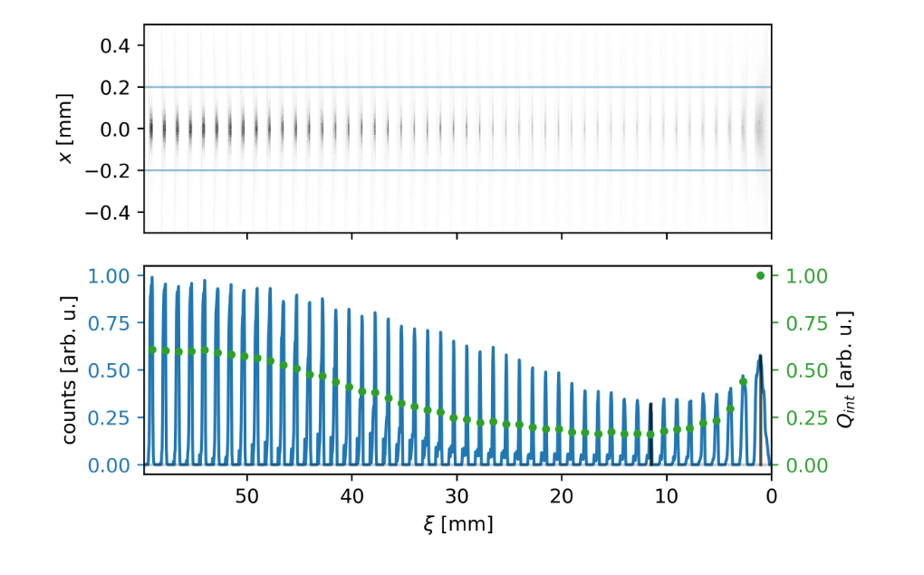
Propagation of bunch beams
[1]
Transverse
Axis
Bunch intensity (arb. units)
Bunch charge (arb. units)
Propagation (Longitudinal) Axis
[1] Turner, M., & Muggli, P. (2024). Understanding time-resolved images of AWAKE proton bunches (arXiv:2409.18771). arXiv. https://doi.org/10.48550/arXiv.2409.18771

Slide 4
Extracting and measuring bunches
AWAKE
Advanced Proton Driven Plasma Wakefield Experiment
Streak Camera
Proton Bunch
Bunches “turn” around the SPS thousands of times before being “extracted”
SPS
Super Proton Synchrotron
Wall Current Monitor

Slide 5
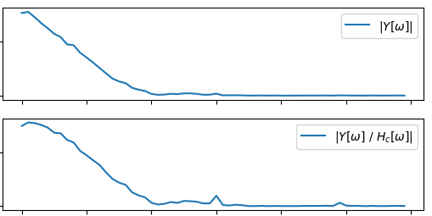
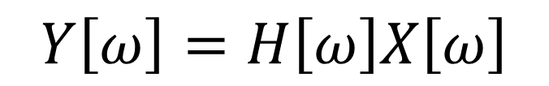
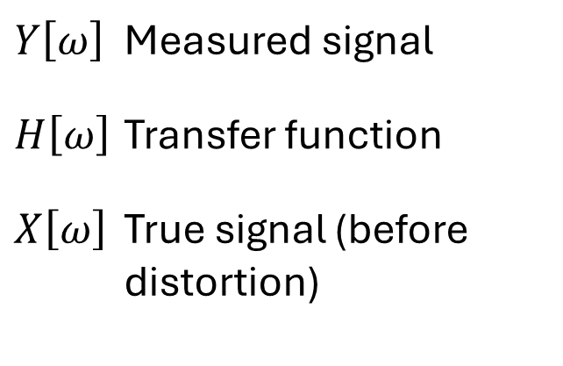
Determining transfer function of streak camera
Beam signals are distorted due to:
Cables
Attenuators
Other electronics
[2]
$$Y\left[ω\right]=H\left[ω\right]X\left[ω\right]$$
$$Y\left[ω\right]$$ | Measured signal
$$H\left[ω\right]$$ | Transfer function
$$X\left[ω\right]$$ | True signal (before distortion)
DFT of Beam Signal
[2] Flowerdew, J., Intelisano, L., Lasheen, A., & Papotti, G. (n.d.). Cable Transfer Function Measurements and Bunch Length Analysis in the SPS.
Frequency (GHz)

Slide 6

What do I want to learn?
More French/German!
Particle/Beam physics
New places and people
Lifestyles
Opportunities

