Slide 1
Modelling of dust charging and beam-dust interactions at CERN
C. Wiesner, A. Lechner, R. Schmidt, D. Wollmann, P. Ziegler
Topical meeting on FCC-ee beam-dust interactions, June 19th, 2025

Slide 2
Contents
Modelling of LHC UFO dynamics
  Historic overview
  UFO dynamics simulation tool
  Required extensions for the FCC-ee beam
  Comparison with beam-loss measurements
  Beam-based reconstruction of dust motion
Study of dust charging and release mechanisms
  Modelling of dust charging mechanisms
  Workshop on Dust Charging and Beam-Dust Interaction in Particle Accelerators
  Studies on dust release mechanisms
Studies with EPFL Lausanne
Conclusions

Slide 3
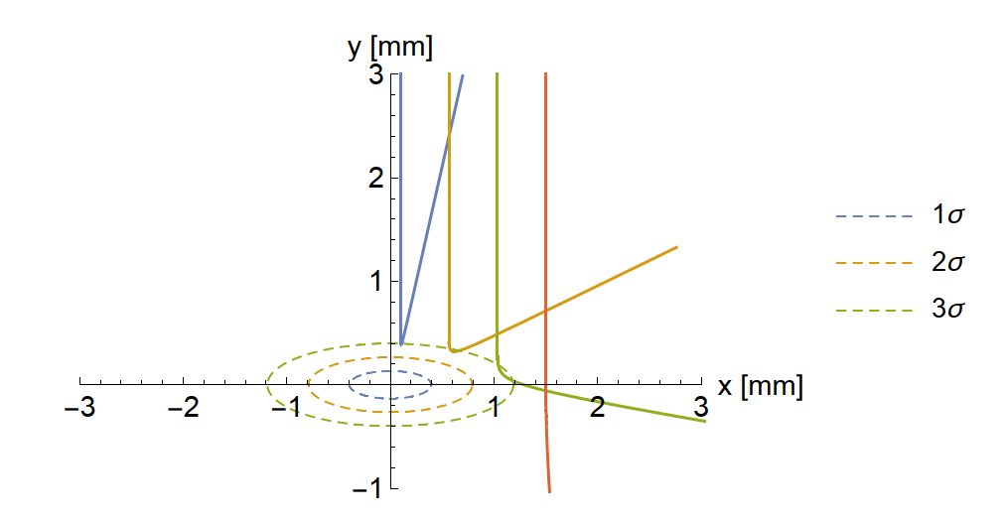
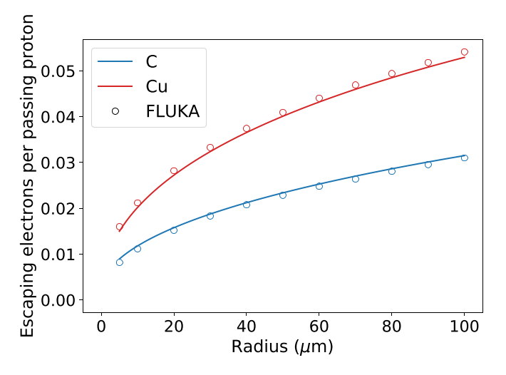
Modelling of LHC UFO dynamics – history (1/2)
Calculation of the macroparticle dynamics incl. charging rate and beam losses:
  IPAC 2011, F. Zimmermann, T. Bär et al.: Simulation Studies of Macroparticles Falling into the LHC Proton Beam
Improved numerical model for beam-dust interactions as well as Monte-Carlo simulations in Mathematica:
  IPAC 2015, B. Auchmann, S. Rowan et al.: Interactions between Macroparticles and High-Energy Proton Beams
Translation of code to Python (2016/2017) - UFO Dynamics Simulation Tool (UFODyST):
  R. Schmidt, 2016/2017
Object-oriented refactoring, improvement and upgrades of Python code:
  Master thesis 2018, P. Belanger: Unidentiﬁed Falling Objects in the Large Hadron Collider: Formation, Charging Mechanisms and Dynamics of Dust Particulates in a High Energy Proton Accelerator

Slide 4
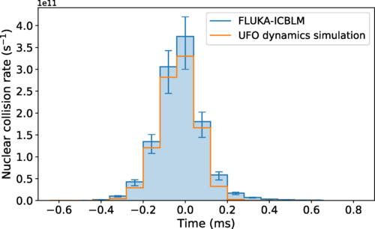
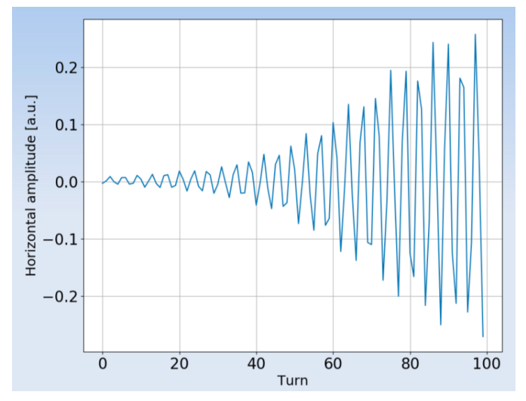
Modelling of LHC UFO dynamics – history (2/2)
Updating of code and applied to understand beam-loss measurements at LHC:
  PRAB 2020, B. Lindstrom et al., Dynamics of the interaction of dust particles with the LHC beam
Modelling of charging mechanisms of dust grains for LHC and lepton machines:
  PRAB 2022, P. Belanger et al., Charging mechanisms and orbital dynamics of charged dust grains in the LHC
Not covered in this presentation: modelling of beam-plasma interactions and dust-induced instabilities:
  L. Mether et al., 16L2: Operation, Observations and Physics Aspects, LHC Performance Workshop 2018,

Slide 5
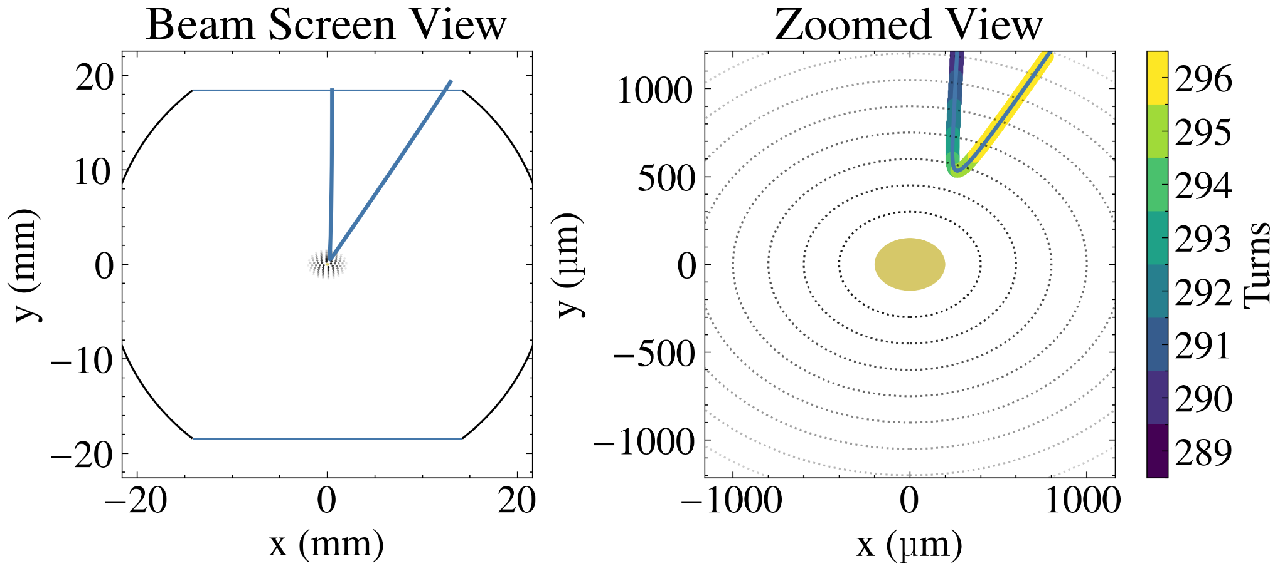
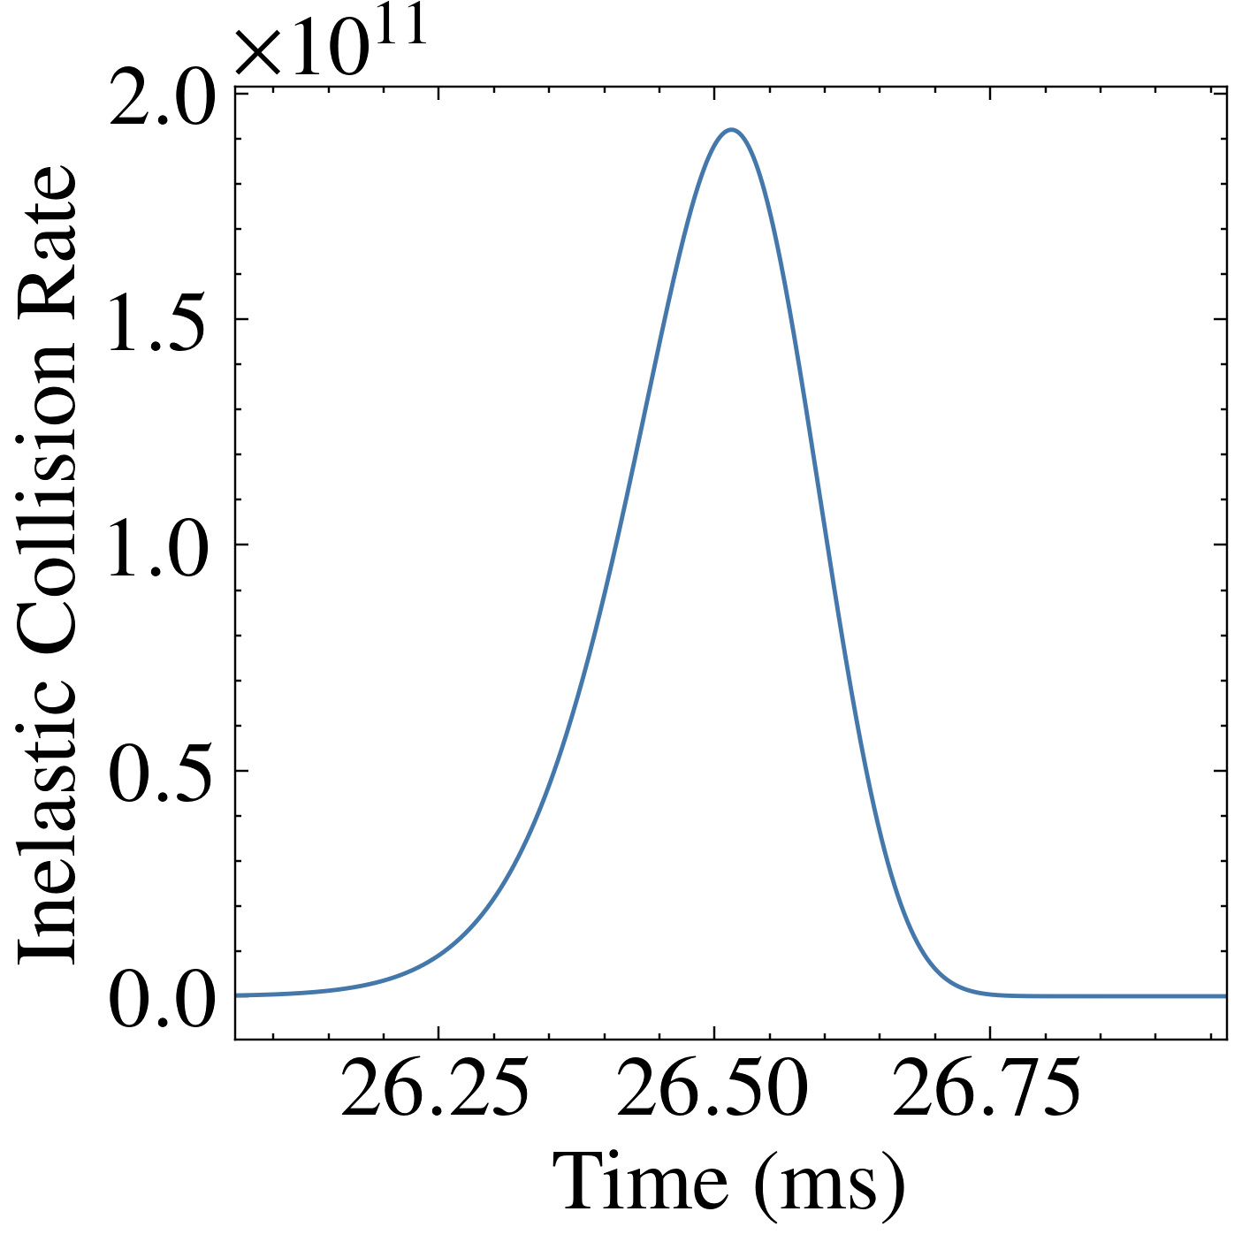
UFO Dynamics Simulation Tool (UFODyST)
Model
  Developed for beam-dust interactions at LHC
  Numerically solves the equation of motion considering the forces due to gravity and the electric field of the beam for a dust grain with certain initial conditions (starting position, size, material, pre-charge)
  Electric field of beam is described by Bassetti-Erskine formula
  Time-resolved computation of the
    ionization rate due to escaping knock-on electrons
    Number of inelastic collisions with the nuclei of the dust grain (beam losses)
Assumptions
  Gaussian-distribution of beam particles in x and y
  No change of beam properties during the interaction time
  Dust grain is small compared to beam ⇒ constant flux of protons over the volume of the dust grain

Slide 6
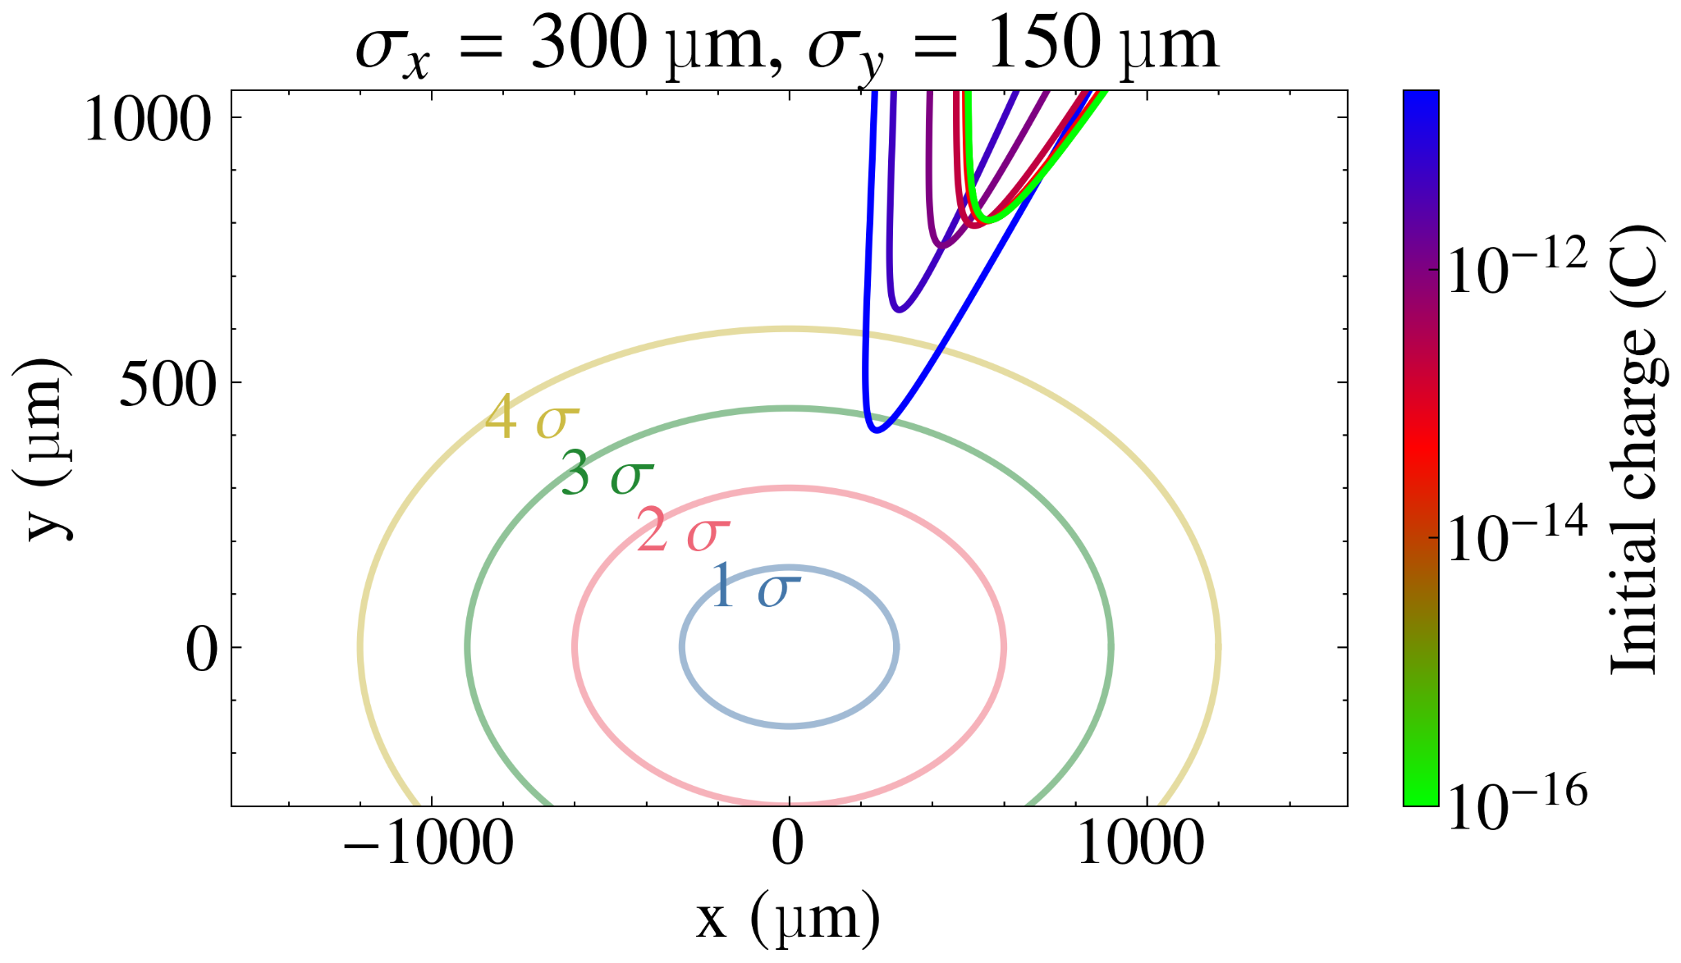
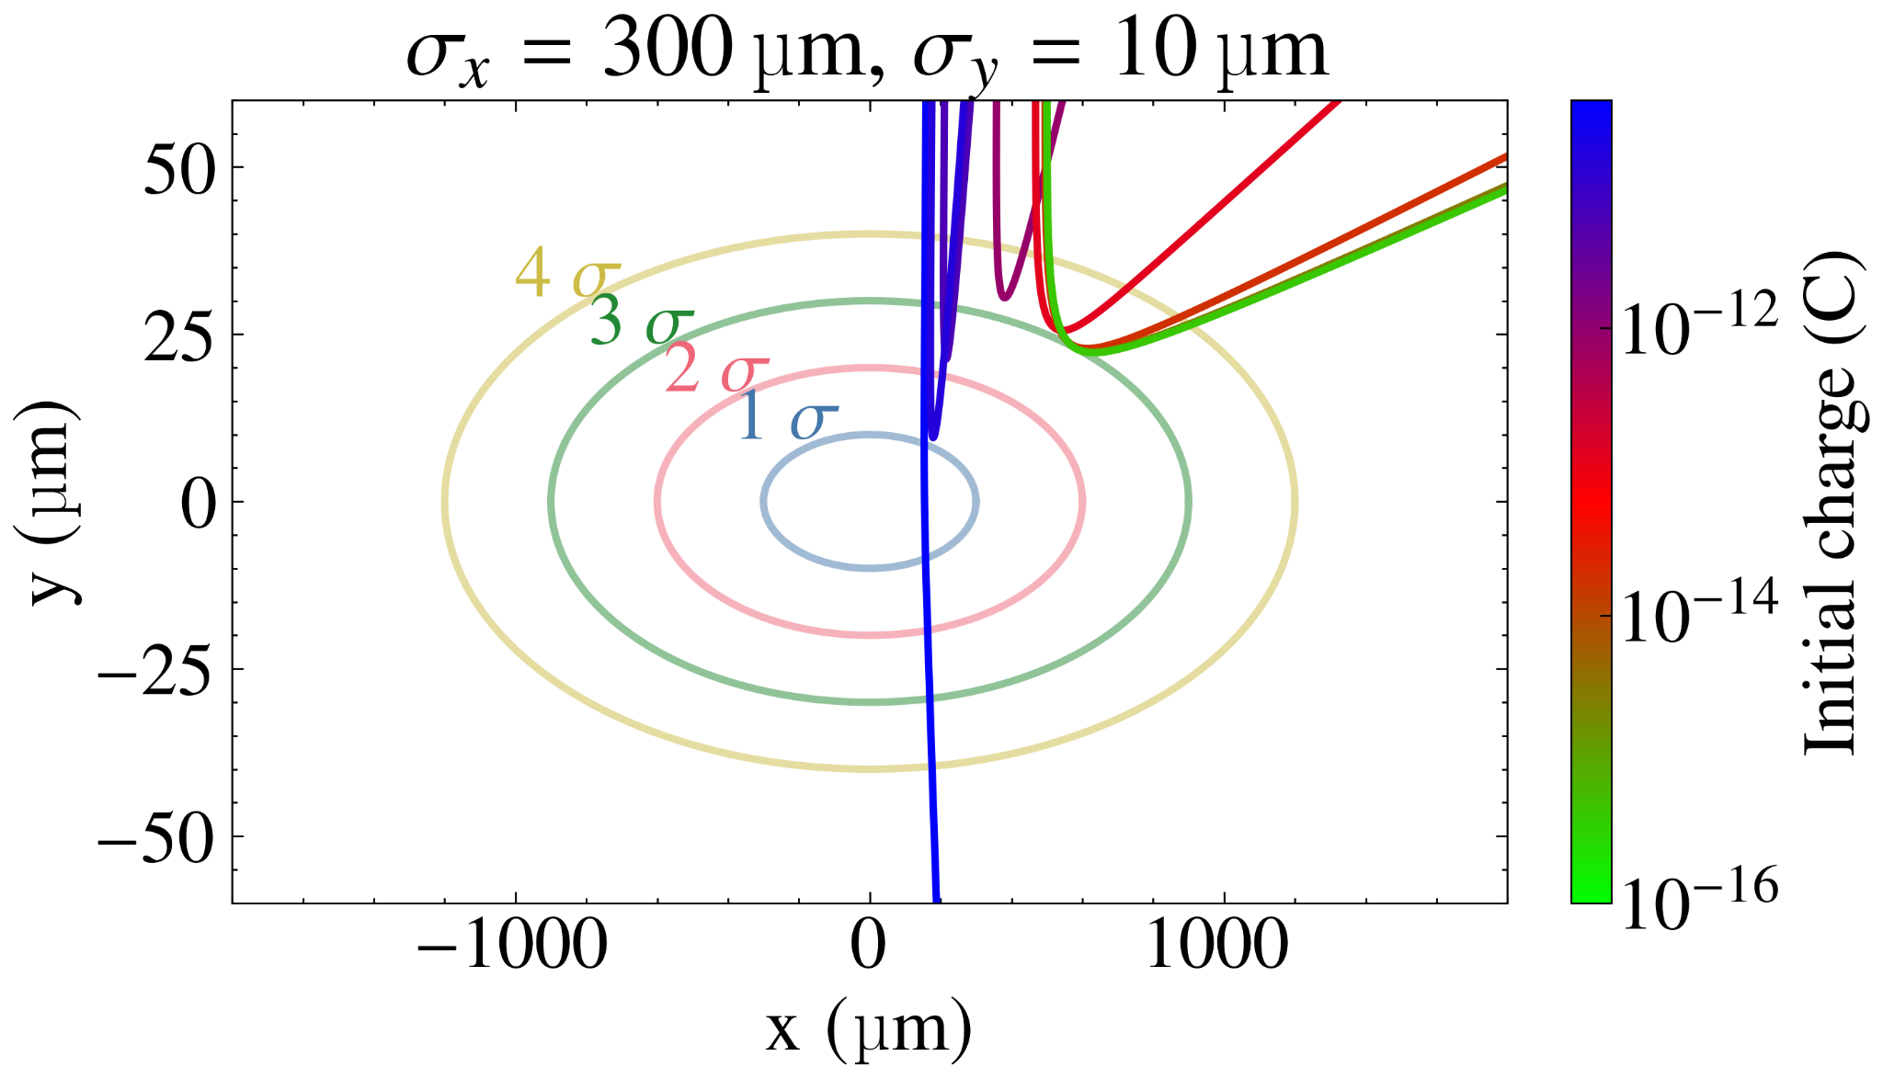
Extension of model to FCC-ee beams
Model assumption that dust grain is small compared to the beam and thus exposed to a constant particle flux is not valid anymore
Extension of existing dynamics model required
Current plan
  Consider inhomogeneous particle flux within dust grain
  Review ionisation cross-section for leptons (no significant change expected)
  Compute heating of dust grain per time step
  Assess relevant effects on beam particles
Simulation Parameters:
6.8 TeV
4.5e14 protons
r_dust = 30 µm
Material: Cu
Q = -10⁻¹⁶ … -10⁻¹¹ C
Q/m ≤ -9.8e-3 C/kg
r_0 = (0.5, 18.44) mm
dust grain
Simulation results for illustration purposes

Slide 7
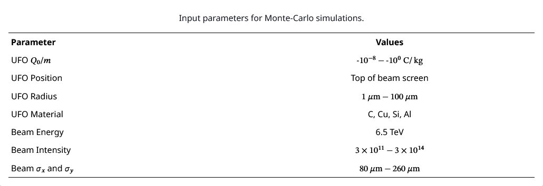
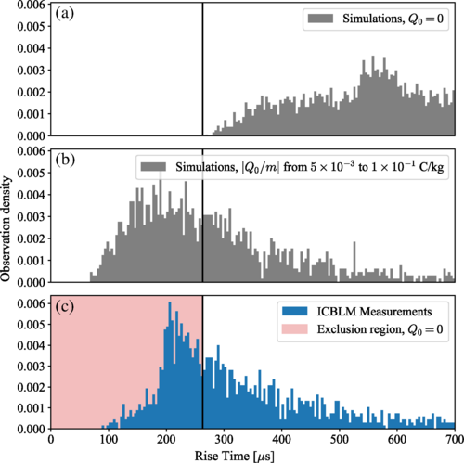
Comparison with LHC measurements
Input parameters for Monte-Carlo simulations
Systematic comparison of simulation results to measured beam losses at LHC
Overall, measured beam losses are well reproduced by model – if assuming a negatively pre-charged dust grain (5x10^{–3} to 1x10^{–1} C/kg)
  Simulated charge-to-mass ratios are consistent with observations in cosmic dust (10⁻⁴ to 10⁻¹ C/kg).
Simulations for initially neutral dust grain
Fastest rise time for initially neutral dust grain (260 µs)
Example of LHC beam loss measurement compared to simulated best-fit event
Simulations for initially negatively charged dust grain
Beam loss measurements (~3000 events)
More comparisons in: A. Lechner et al., PRAB 25, 041001 (2022)
B. Lindstrom et al., PRAB 23, 124501 (2020); P. Belanger, M.Sc. thesis (2020)

Slide 8
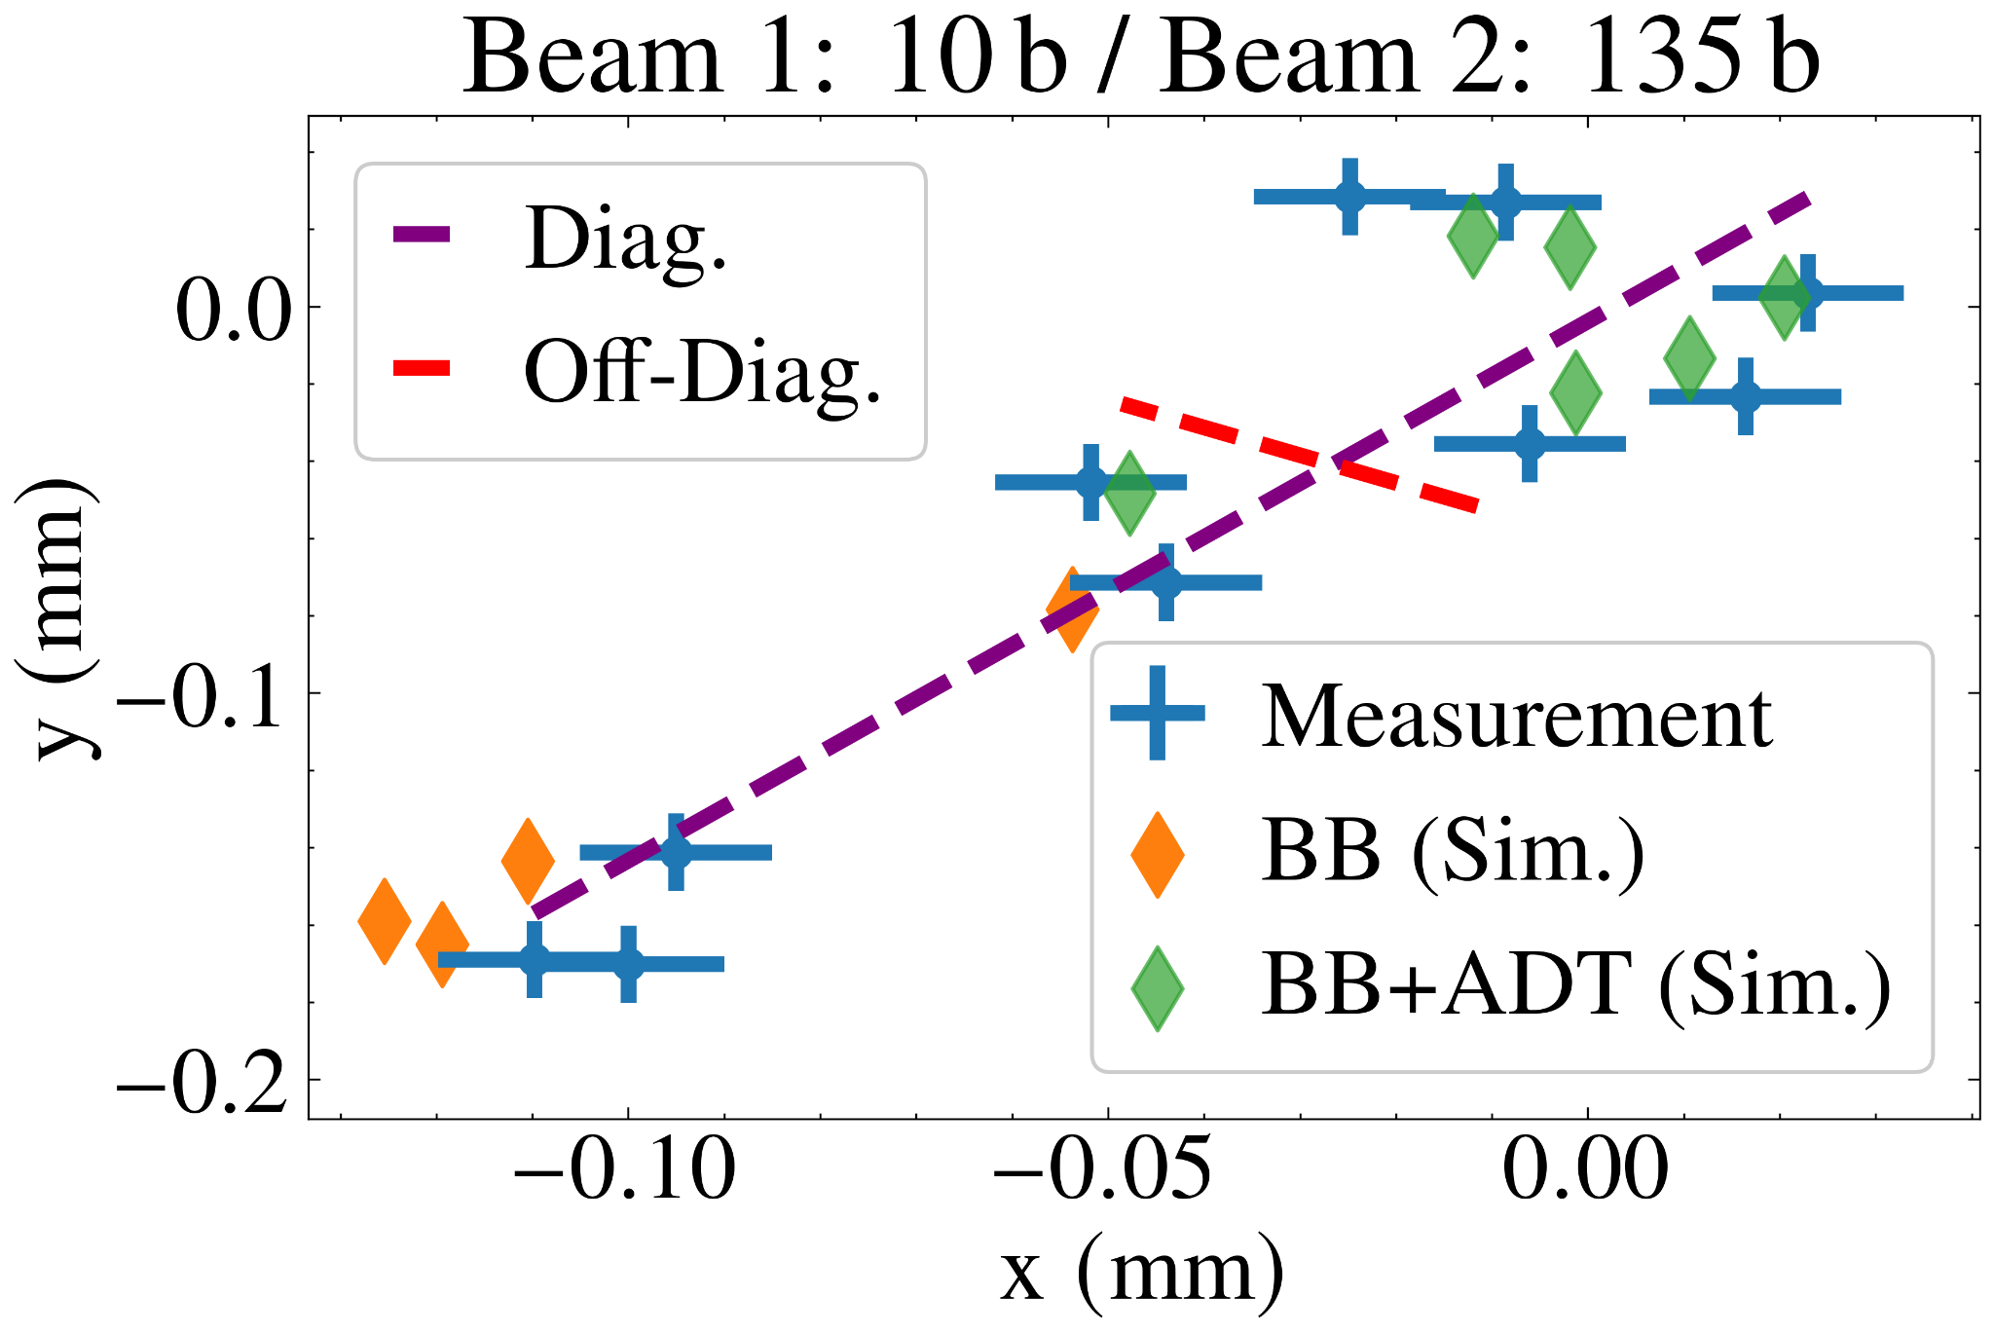
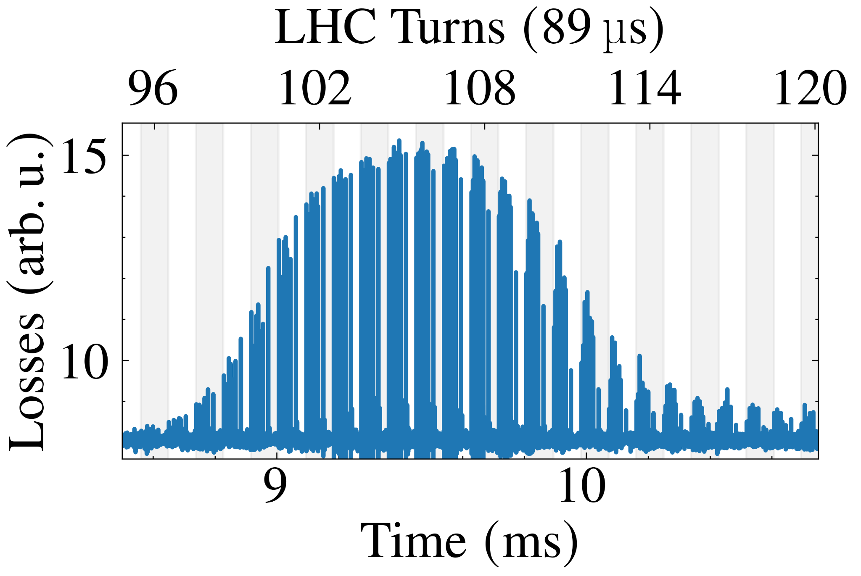
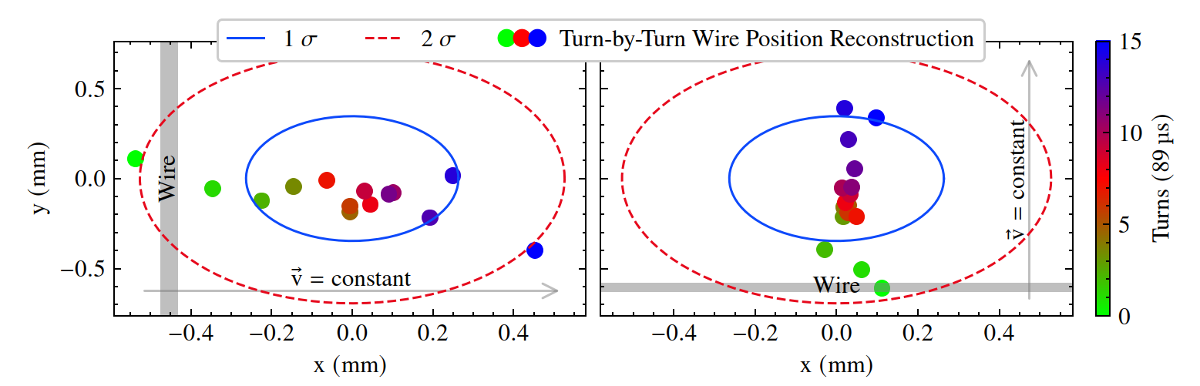
Beam-based reconstruction of dust motion
Bunch positions
Measured beam losses
at the primary collimators
Novel method to reconstruct motion of macro-particle based on:
  Position of transversely displaced bunches
  Beam losses caused by the macro-particle and measured with bunch-by-bunch resolution
Successful proof of principle experiment performed at the LHC using the 30 µm thick wire of the LHC wire scanners as controlled macro-particle (MD10483)
Next Step:
  Reconstruct motion of real dust events using bunch displacements due to beam-beam effect
  Determine incoming direction of motion and initial conditions
6.8 TeV
Reconstructed wire motion
P. Ziegler et al., Proc. IPAC'25, Taipei, Taiwan, Jun. 2025, doi:10.18429/JACoW-IPAC25-MOPM021
Horizontal wire scan
Vertical wire scan

Slide 9
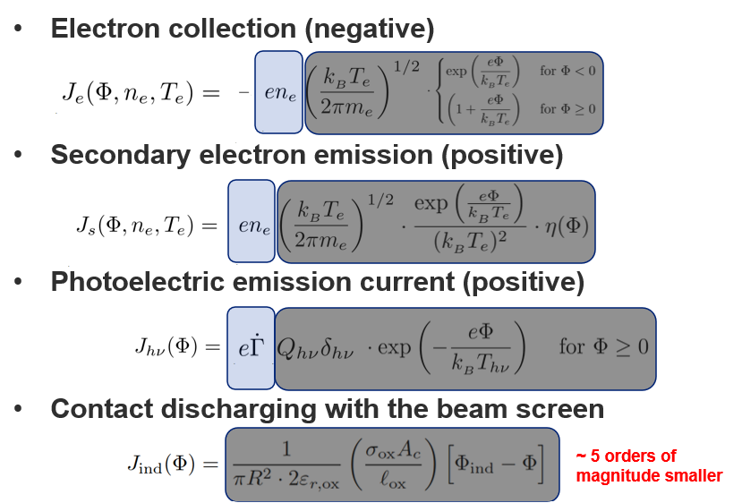
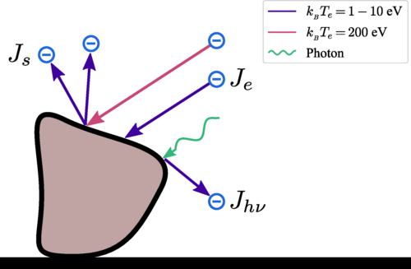
Dust charging mechanisms
Open questions:
  How is the dust grain initially charged before entering the beam? Will it be positively or negatively pre-charged?
  How is the (charged) dust grain released from the surface?
Modelling of charging mechanisms
  Theoretical model for dust charging in hadron and lepton rings: P. Belanger et al., PRAB 25, 101001 (2022)
  Main contributions: Synchrotron radiation and electron clouds
  (Simplified) findings:
    Negatively charged dust grains expected in presence of high-density e-cloud (LHC)
    Positively charged dust grains in presence of low-density electron cloud
P. Belanger

Slide 10
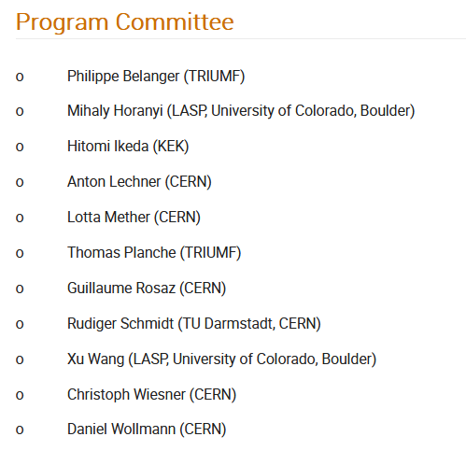
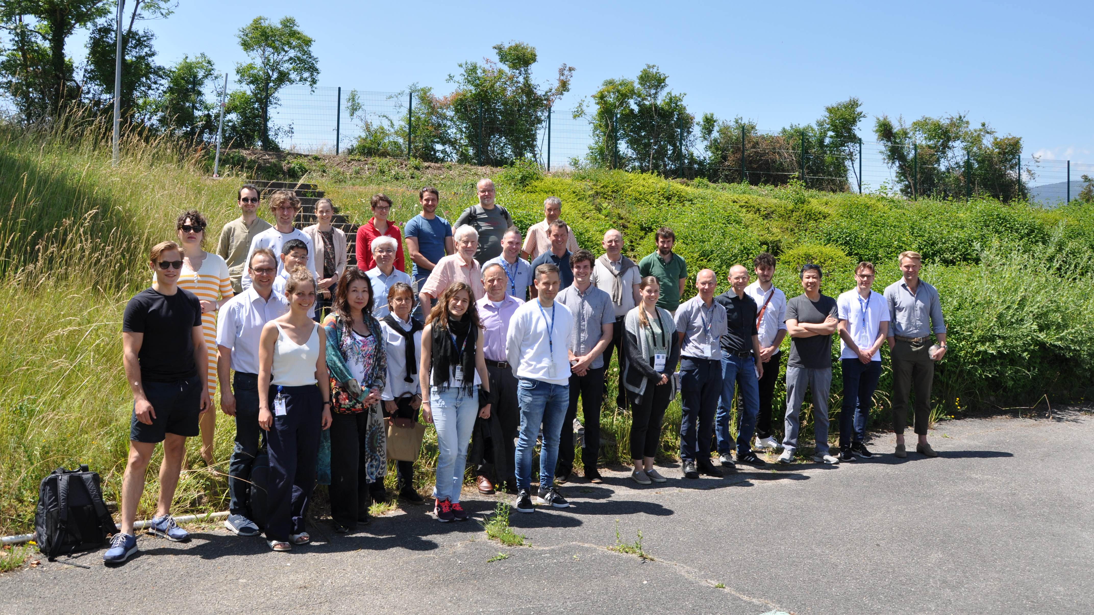
Workshop on Dust Charging and Beam-Dust Interaction in Particle Accelerators
Workshop took place at CERN, June 13th-15th, 2023
  ~60 participants from CERN, KEK, Colorado University (CU) Boulder, KTH (Stockholm), DESY, TRIUMF, TU Darmstadt, …
  24 presentations (see Indico), e.g.:
    Dust-charging: synchrotron radiation and electron clouds, SBL, Dust and beam instabilities, Analysis of dust grains extracted from the LHC
Detailed workshop report available
  Includes list of ~80 references relevant for the topic
Bringing communities together
  First workshop that brought together experts from the accelerator, space-research, and nuclear-fusion community to discuss dust-related matters in particle accelerators

Slide 11
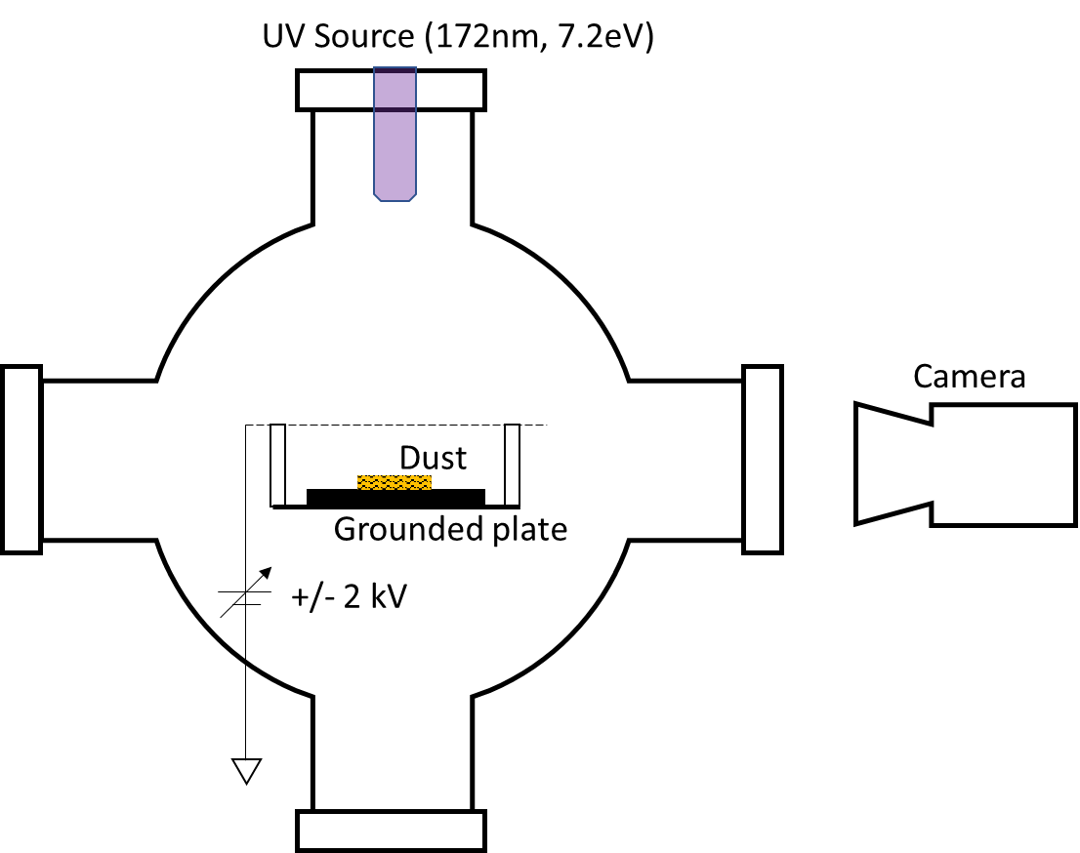
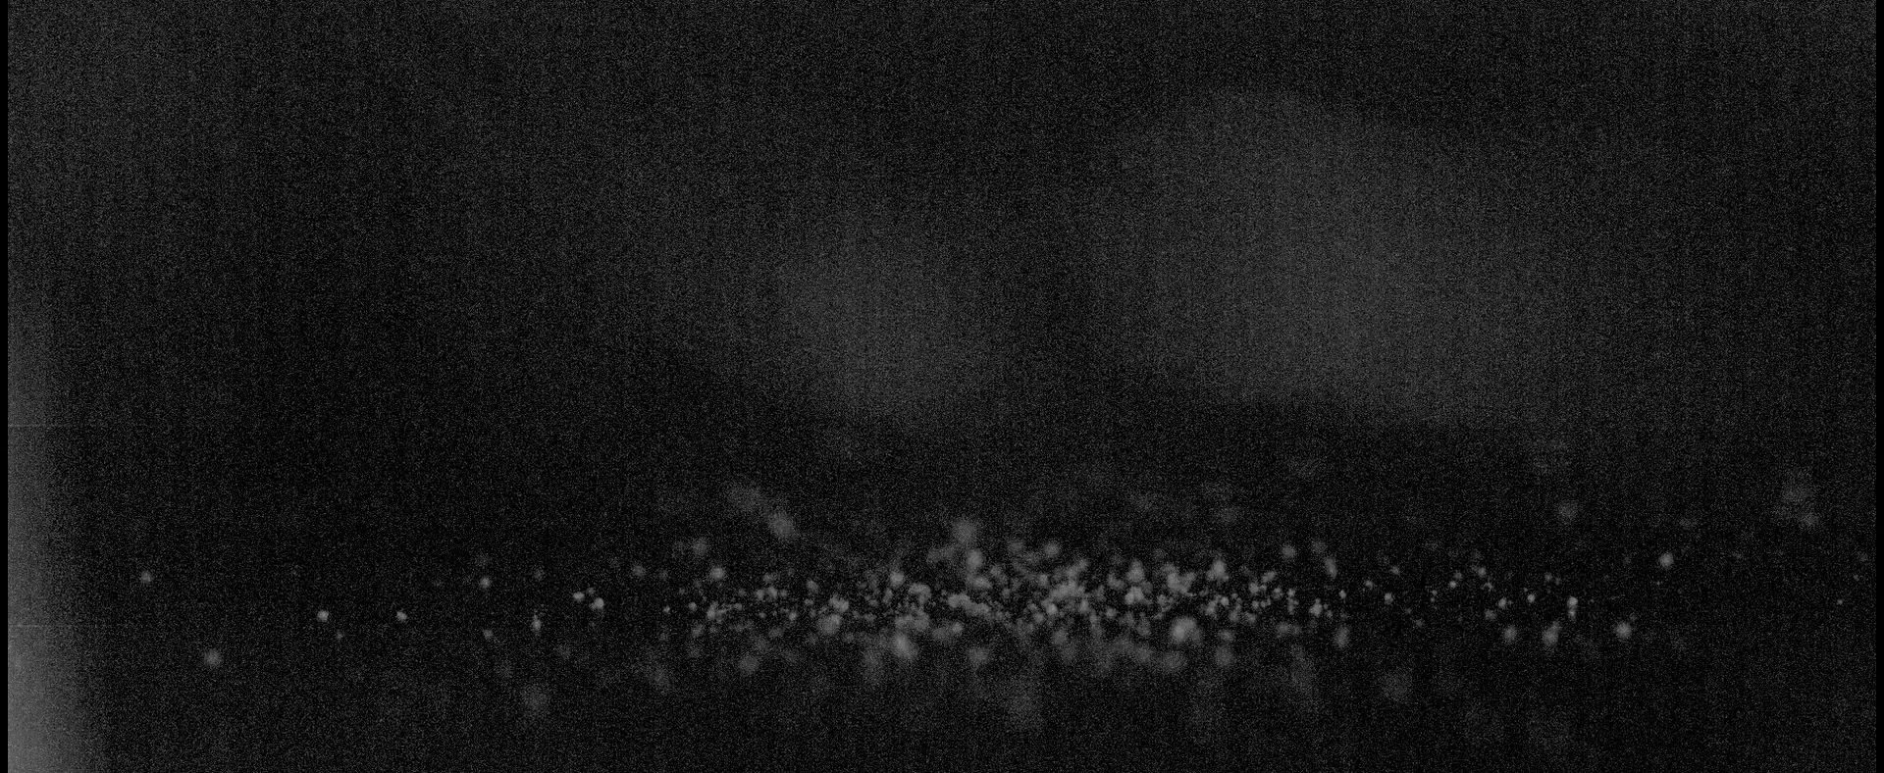
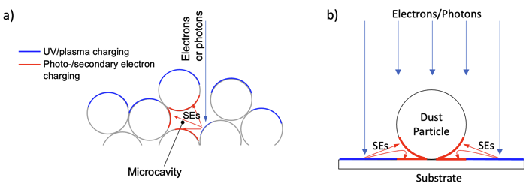
Studies on dust release with CU Boulder
Experimental set-up
Space community has decade long experience in studying dust charging and dusty plasmas
Experimental studies of dust release (Boulder University)
  Well-defined dust on grounded plate
  Charging via electron beam or UV light
  Apply HV on mesh
  Observation of dust movement via high-speed camera
Theoretical understanding requires extending existing patched charge model for multilayered dust to monolayered dust
UV charging with negative HV → dust grains are lofted in vertical trajectories
Multi-layer Dust
Mono-layer Dust
Phys. Plasmas, Vol.31, 073703 (July 2024)

Slide 12
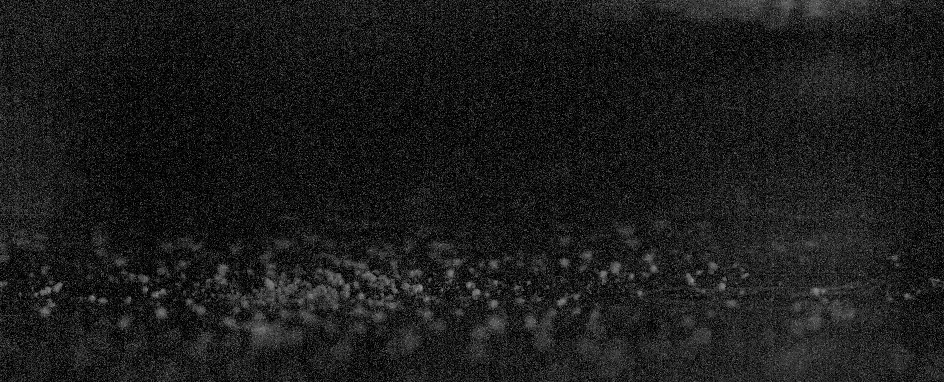
Studies on dust release with CU Boulder
Experimental set-up
Space community has decade long experience in studying dust charging and dusty plasmas
Experimental studies of dust release (Boulder University)
  Well-defined dust on grounded plate
  Charging via electron beam or UV light
  Apply HV on mesh
  Observation of dust movement via high-speed camera
Theoretical understanding requires extending existing patched charge model for multilayered dust to monolayered dust
UV charging with positive HV → dust grains spin and “bounce” on the surface
Multi-layer Dust
Mono-layer Dust
Phys. Plasmas, Vol.31, 073703 (July 2024)

Slide 13
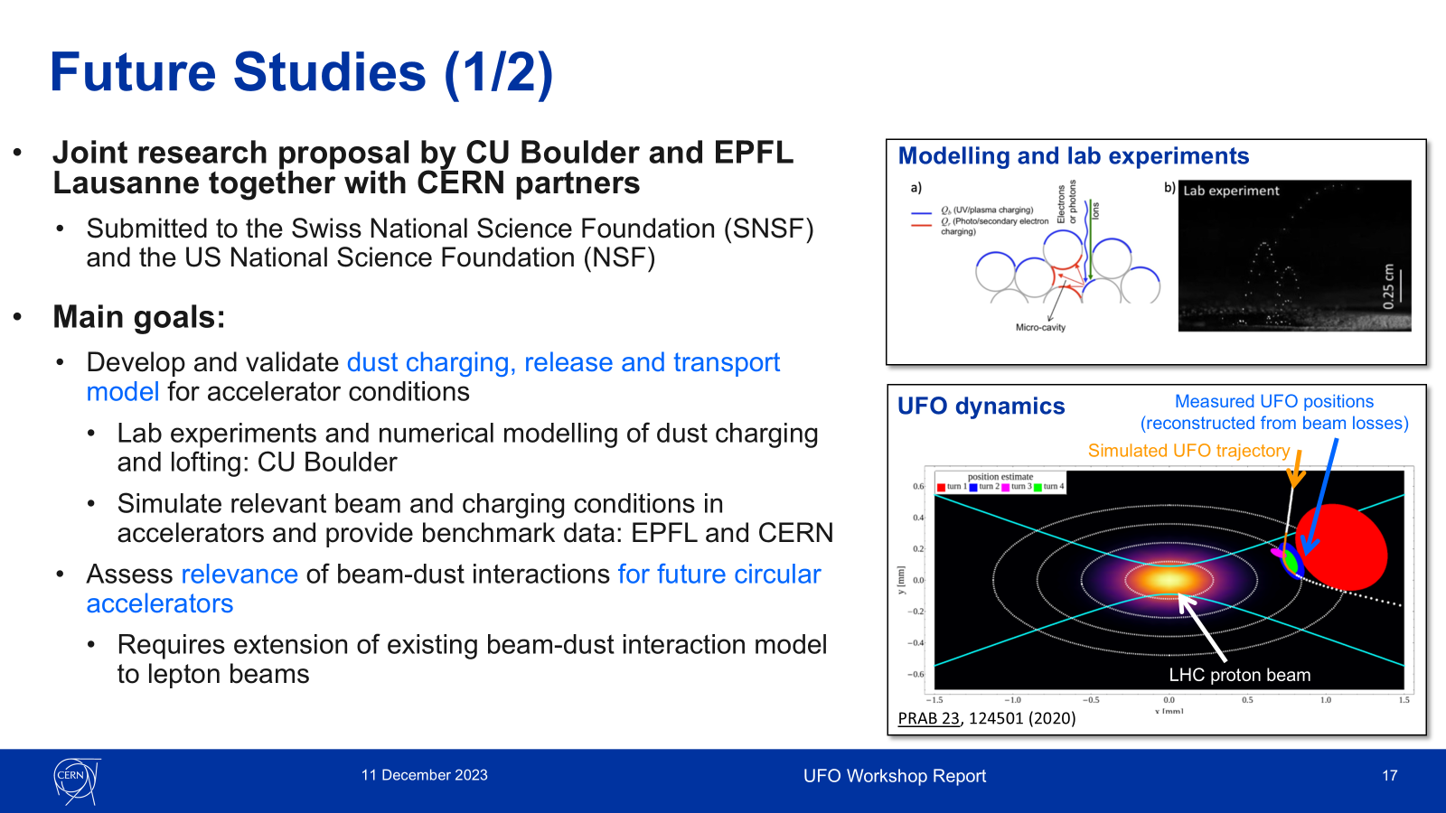
Studies with EPFL Lausanne
  Joint research proposal to NSF/SNSF by CU Boulder and EPFL Lausanne (T. Pieloni, M. Seidel) together with CERN partners (2023)
    Strong reviews from the Swiss side but not approved on the US side because not seen as priority for the plasma division
  New proposal to be submitted to the Japanese–Swiss funding scheme by EPFL and KEK together with CERN partners
    Request for one post-doc working on beam-plasma interactions
C. Wiesner, Report on Workshop on Dust Charging and Beam-Dust Interaction in Particle Accelerators and Prospects of UFO studies, TE-TM, 11.12.2023

Slide 14
Conclusions
UFO Dynamics Simulation Tool
  Model development started >10 years ago and was successively improved
  Numerically solves the equation of motion, computes the ionization rate and provides the number of inelastic collisions
  Characteristics of measured beam losses events at LHC are well reproduced by model – if assuming negatively pre-charged dust grains
  Assumes that dust grain is small compared to the beam and thus exposed to a constant particle flux → not valid for FCC-ee-like beam → extension of existing model required
  Novel beam-based method for reconstructing the dust motion was successfully demonstrated in a proof of principle experiment and could give important insights into the dust release mechanism
Dust pre-charging and release mechanisms
  Essential element to assess criticality of dust events
  Synergies with space research community
Common effort required to study beam-dust interactions for FCC-ee parameters

Slide 15
Thank you very much for your attention!
https://www.bbcearth.com/news/is-this-how-aliens-could-rule-the-universe

Slide 16
Backup Slides

Slide 17
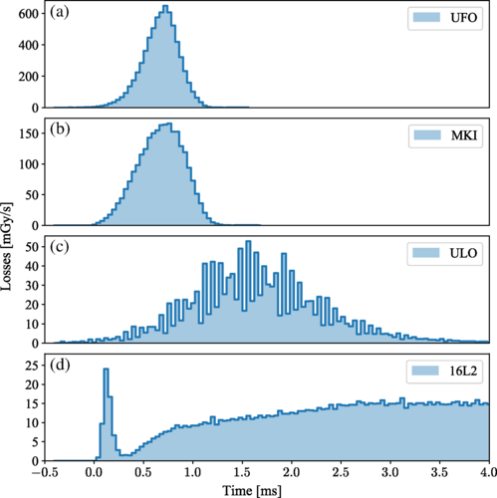
Loss types observed at LHC

Slide 18
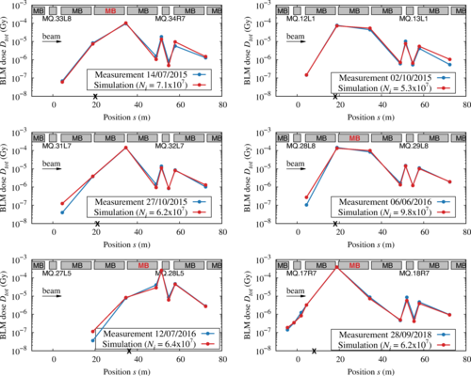
FLUKA simulations
A. Lechner et al., PRAB 25, 041001 (2022)

Slide 19
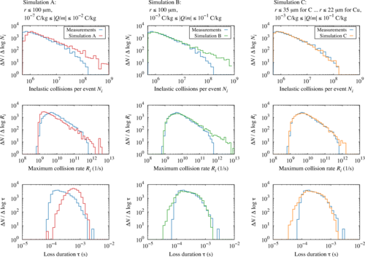
Comparisons
A. Lechner et al., PRAB 25, 041001 (2022)

