Slide 1

Modeling of Beam-Plasma Interactions at LBNL
Chad Mitchell and Jean-Luc Vay
Lawrence Berkeley National Laboratory
Topical meeting on FCC-ee beam-dust interactions
CERN, June 19, 2025

Slide 2
Overview
Overview of the BLAST modeling toolkit
Features of the codes HIPACE++ and ImpactX
Multi-pass modeling of beam-plasma interaction (targeting SuperKEKb)
Conclusion and next steps toward contributing to FCC-ee

Slide 3
Beam Plasma & Accelerator Modeling Toolkit (BLAST)

Slide 4













LBNL Created and Leads the Beam Plasma and Accelerator
Simulation Toolkit
Open Source
blast.lbl.gov
Applications:
- BeamBeam3D
- FBPIC
- HiPACE++
- Impact/ImpactX
- LW3D
- Posinst
- Wake-T
- WarpX
--------
- ARTEMIS
- GEMPIX
Originally the Berkeley
Lab
Accelerator Simulation Toolkit
Libraries & standards:
- ABLASTR
- LASY
- openPMD-api
- PICSAR-QED
- PICMI
- Optimas
…
…
A unique suite of interoperable codes – a multi-institutional international collaboration
4

Slide 5

BLAST: integrated beam physics across accelerator subsystems
Imagine a future, hybrid particle accelerator, e.g., with conventional and plasma elements.
(S)RF Gun
LPA/LPI
Plasma Stage
Plasma Stage
Source
Injector
Booster
Injector
Storage Ring
Storage Ring
IP
IP
cooling
Legend
BLAST
CPU-only
or injection into an FEL linac
Goal:
Start-to-end modeling in an open software ecosystem.
BLAST CPU+GPU
Linac
FEL
Notes:
Imagine a future, hybrid...
The goal is...

Slide 6
BLAST: integrated beam physics across accelerator subsystems
Imagine a future, hybrid particle accelerator, e.g., with conventional and plasma elements.
(S)RF Gun
LPA/LPI
Plasma Stage
Plasma Stage
ImpactX
IMPACT-Z
Source
Injector
Booster
s-based PIC
uses s instead of t as
independent variable
+ symplectic maps for
accelerator elements
Warp
WarpX
IMPACT-T
Injector
Storage Ring
t-based electrostatic
or electromagnetic PIC
Storage Ring
BeamBeam3D
IP
IP
HiPACE++
cooling
Quasistatic PIC
separates the timescale
for plasma wakefield and beam evolution
Legend
POSINST
buildup of electron clouds, secondary electron yield
BLAST
CPU-only
LW3D
modeling of radiative & space-charge effects
Goal:
Start-to-end modeling in an open software ecosystem.
BLAST CPU+GPU
FEL
Notes:
The BLAST suite contains codes for specialized modeling of beam physics in a range of accelerator subsystems.
(Point out some)
To enable interoperability and to prepare for new Exascale architectures, many codes are being completely rewritten in modern C++ for GPUs.

Slide 7



Software stack for the BLAST ecosystem
Desktop
to
HPC
Notes:
Figure shows BLAST’s software dependencies. Upper components depend on and share lower blocks in the schema.
Vendor frameworks for a variety of hardware architectures
Computer science – portability layer & data structures of AMReX, scalable I/O, common math packages
Shared libraries – ABLASTR contains common particle-in-cell routines for re-use
Applications – domain-specific BLAST codes
Python bindings and standardized interfaces are used for coupling to AI/ML frameworks.

Slide 8
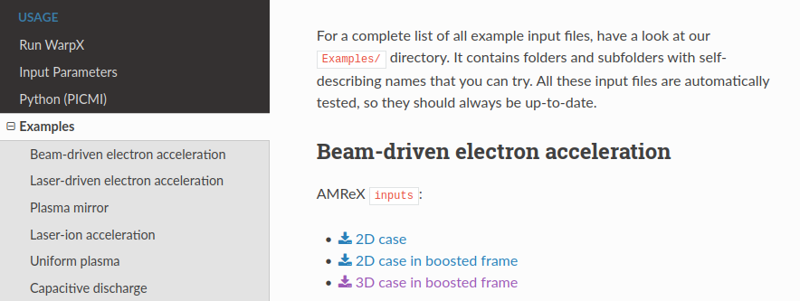
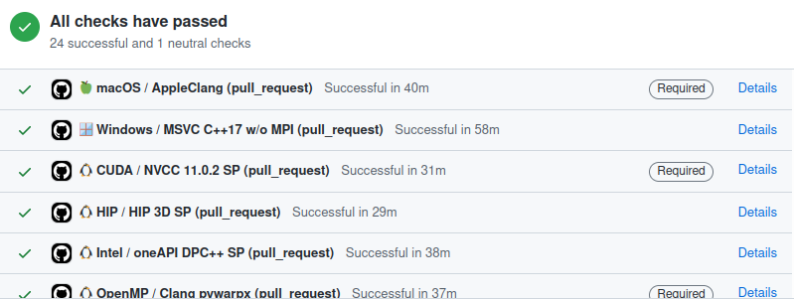


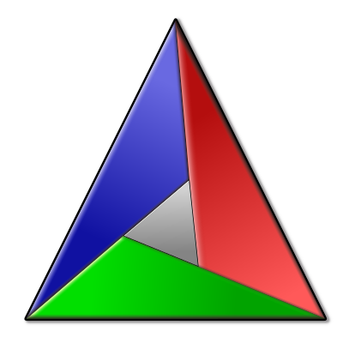


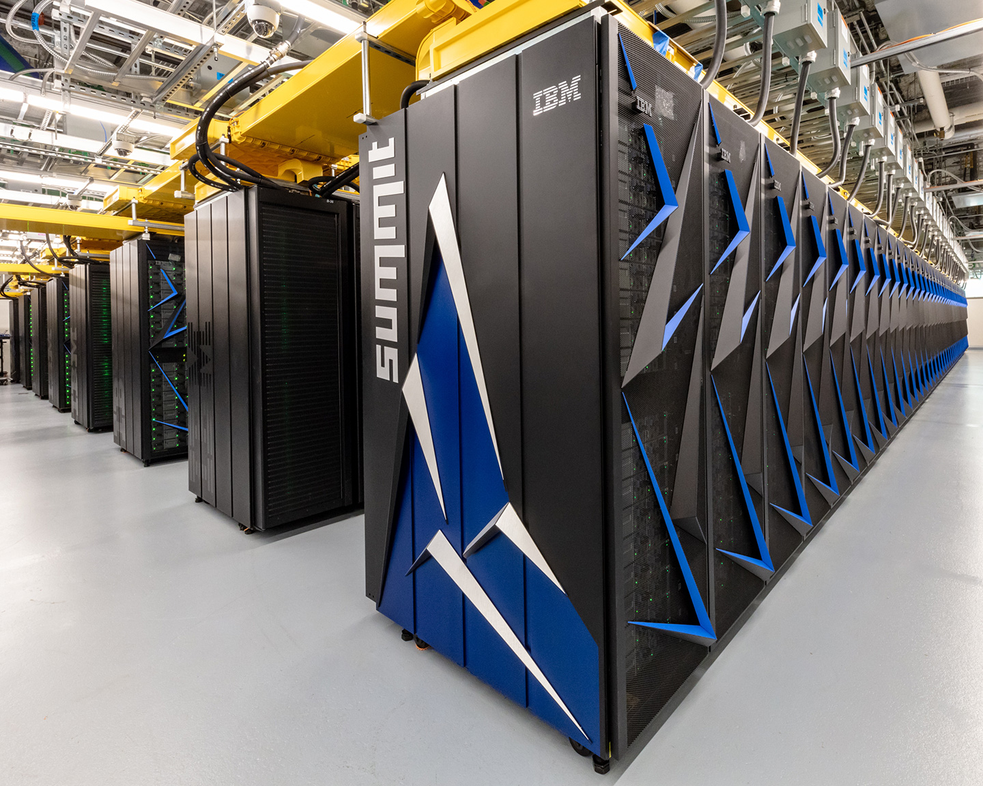

Documentation & Testing is Part of Our Development
Online Documentation:
warpx|hipace|impactx.readthedocs.io
Open-Source Development & Benchmarks:
github.com/BLAST-WarpX
See backup slides for verification & validation with theory & experiments.
264 physics benchmarks run on every code change of WarpX
86 physics benchmarks for ImpactX
Rapid and easy installation on any platform:
conda install
-c conda-forge warpx
spack install warpx
spack install py-warpx
cmake -S . -B build
cmake --build build --target install
brew tap ecp-warpx/warpx
brew install warpx
module load warpx
module load py-warpx
python3 -m pip install .

Slide 9
Features of the codes HIPACE++ and ImpactX

Slide 10
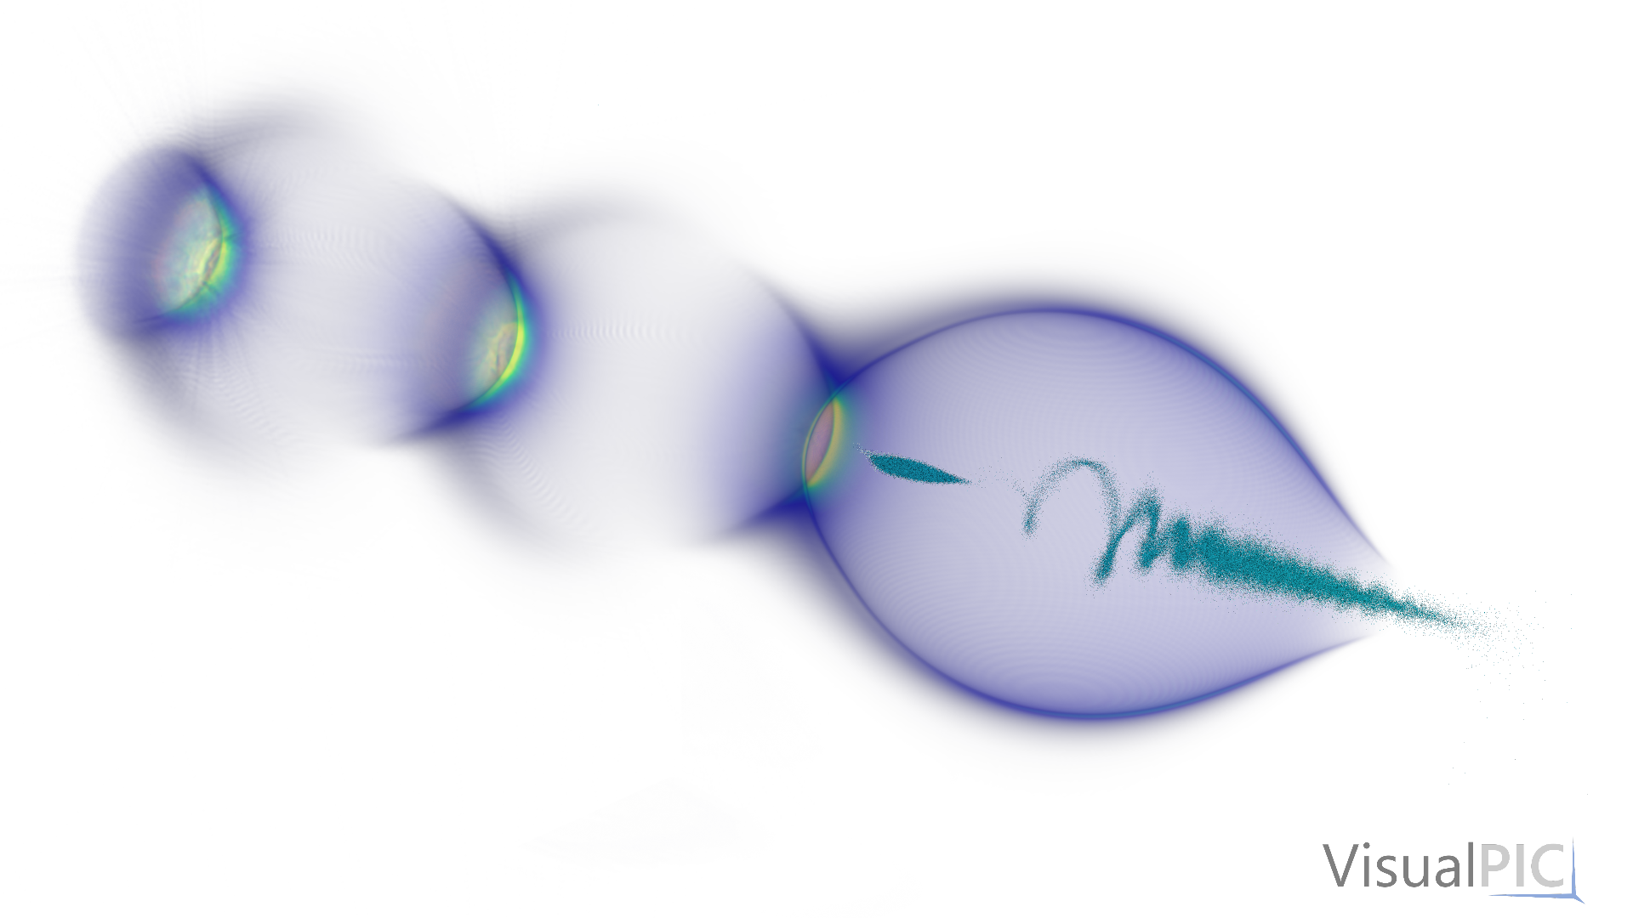





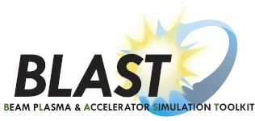
HIPACE++: quasi-static PIC on GPU for plasma acceleration
Supports multiple beam and plasma species
Built on top of AMReX framework (LBNL)
Data structures and communications
Performance-portability layer: supports NVIDIA & AMD GPUs
HPC programming standards
  Documented, open-source
  Automated testing (CI)
openPMD I/O
3D quasi-static PIC code
Developed by DESY & LBNL
PI: Maxence Thévenet
https://github.com/Hi-PACE/hipace
Doc: https://hipace.readthedocs.io
Diederichs et al., CPC 278, 108421 (2022)
HiPACE++
Notes:
WarpX is a modernization of the particle-in-cell code Warp.
Used primarily for t-based modeling with support for full electromagnetic PIC.
Contains many routines specialized for modeling of laser-plasma accelerators.
Provided the first full-scale runs at the first demonstrated Exascale machine, Frontier.
Uses standardized I/O to enable ease of data exchange with other BLAST codes.

Slide 11
Quasistatic approximation uses separation of scales
Fast time scale - 2-D slice of plasma is stepped “backward” (with small steps) through the beam field and its self-field (solving iteratively 2-D Poisson-like equations at each step).
2-D slice of plasma (fast)
3-D beam + driver
(slow: frozen during interaction)
Quasi-static approximation (QSA)
  Sprangle, P. et al., PRL 64.17 (1990): 2011

Slide 12
Quasistatic approximation uses separation of scales
Fast time scale - 2-D slice of plasma is stepped “backward” (with small steps) through the beam field and its self-field (solving iteratively 2-D Poisson-like equations at each step).
2-D slab of plasma (fast)
3-D beam + driver + wake
(slow: frozen during interaction)
Quasi-static approximation (QSA)
  Sprangle, P. et al., PRL 64.17 (1990): 2011

Slide 13
Quasistatic approximation uses separation of scales
Fast time scale - 2-D slice of plasma is stepped “backward” (with small steps) through the beam field and its self-field (solving iteratively 2-D Poisson-like equations at each step).
2-D slab of plasma (fast)
3-D beam + driver + wake
(slow: frozen during interaction)
Quasi-static approximation (QSA)
  Sprangle, P. et al., PRL 64.17 (1990): 2011

Slide 14
Quasistatic approximation uses separation of scales
Fast time scale - 2-D slice of plasma is stepped “backward” (with small steps) through the beam field and its self-field (solving iteratively 2-D Poisson-like equations at each step).
Slow time scale - 3-D beam is pushed far down the plasma with large time steps.
Fast time scale - 2-D slice of plasma is stepped “backward” (with small steps) through the beam field and its self-field (solving iteratively 2-D Poisson-like equations at each step).
repeat
2-D slab of plasma (fast)
3-D beam + driver + wake
(slow: frozen during interaction)
Quasi-static approximation (QSA)
  Sprangle, P. et al., PRL 64.17 (1990): 2011

Slide 15
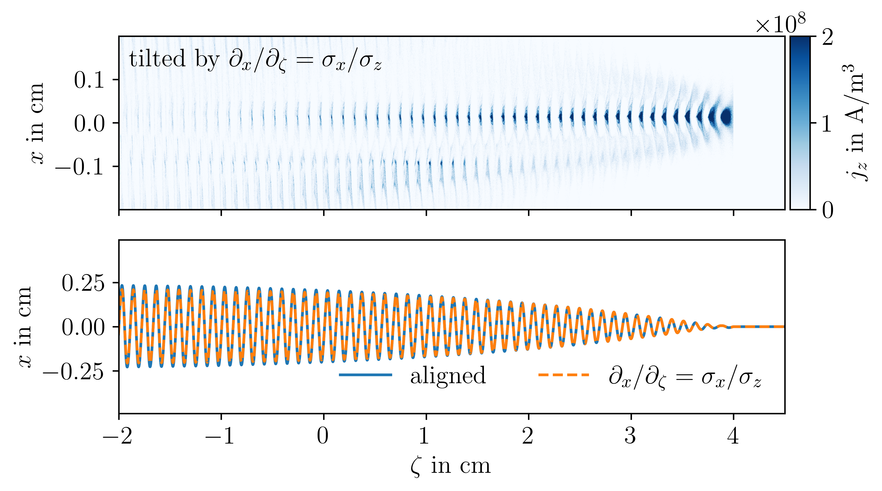
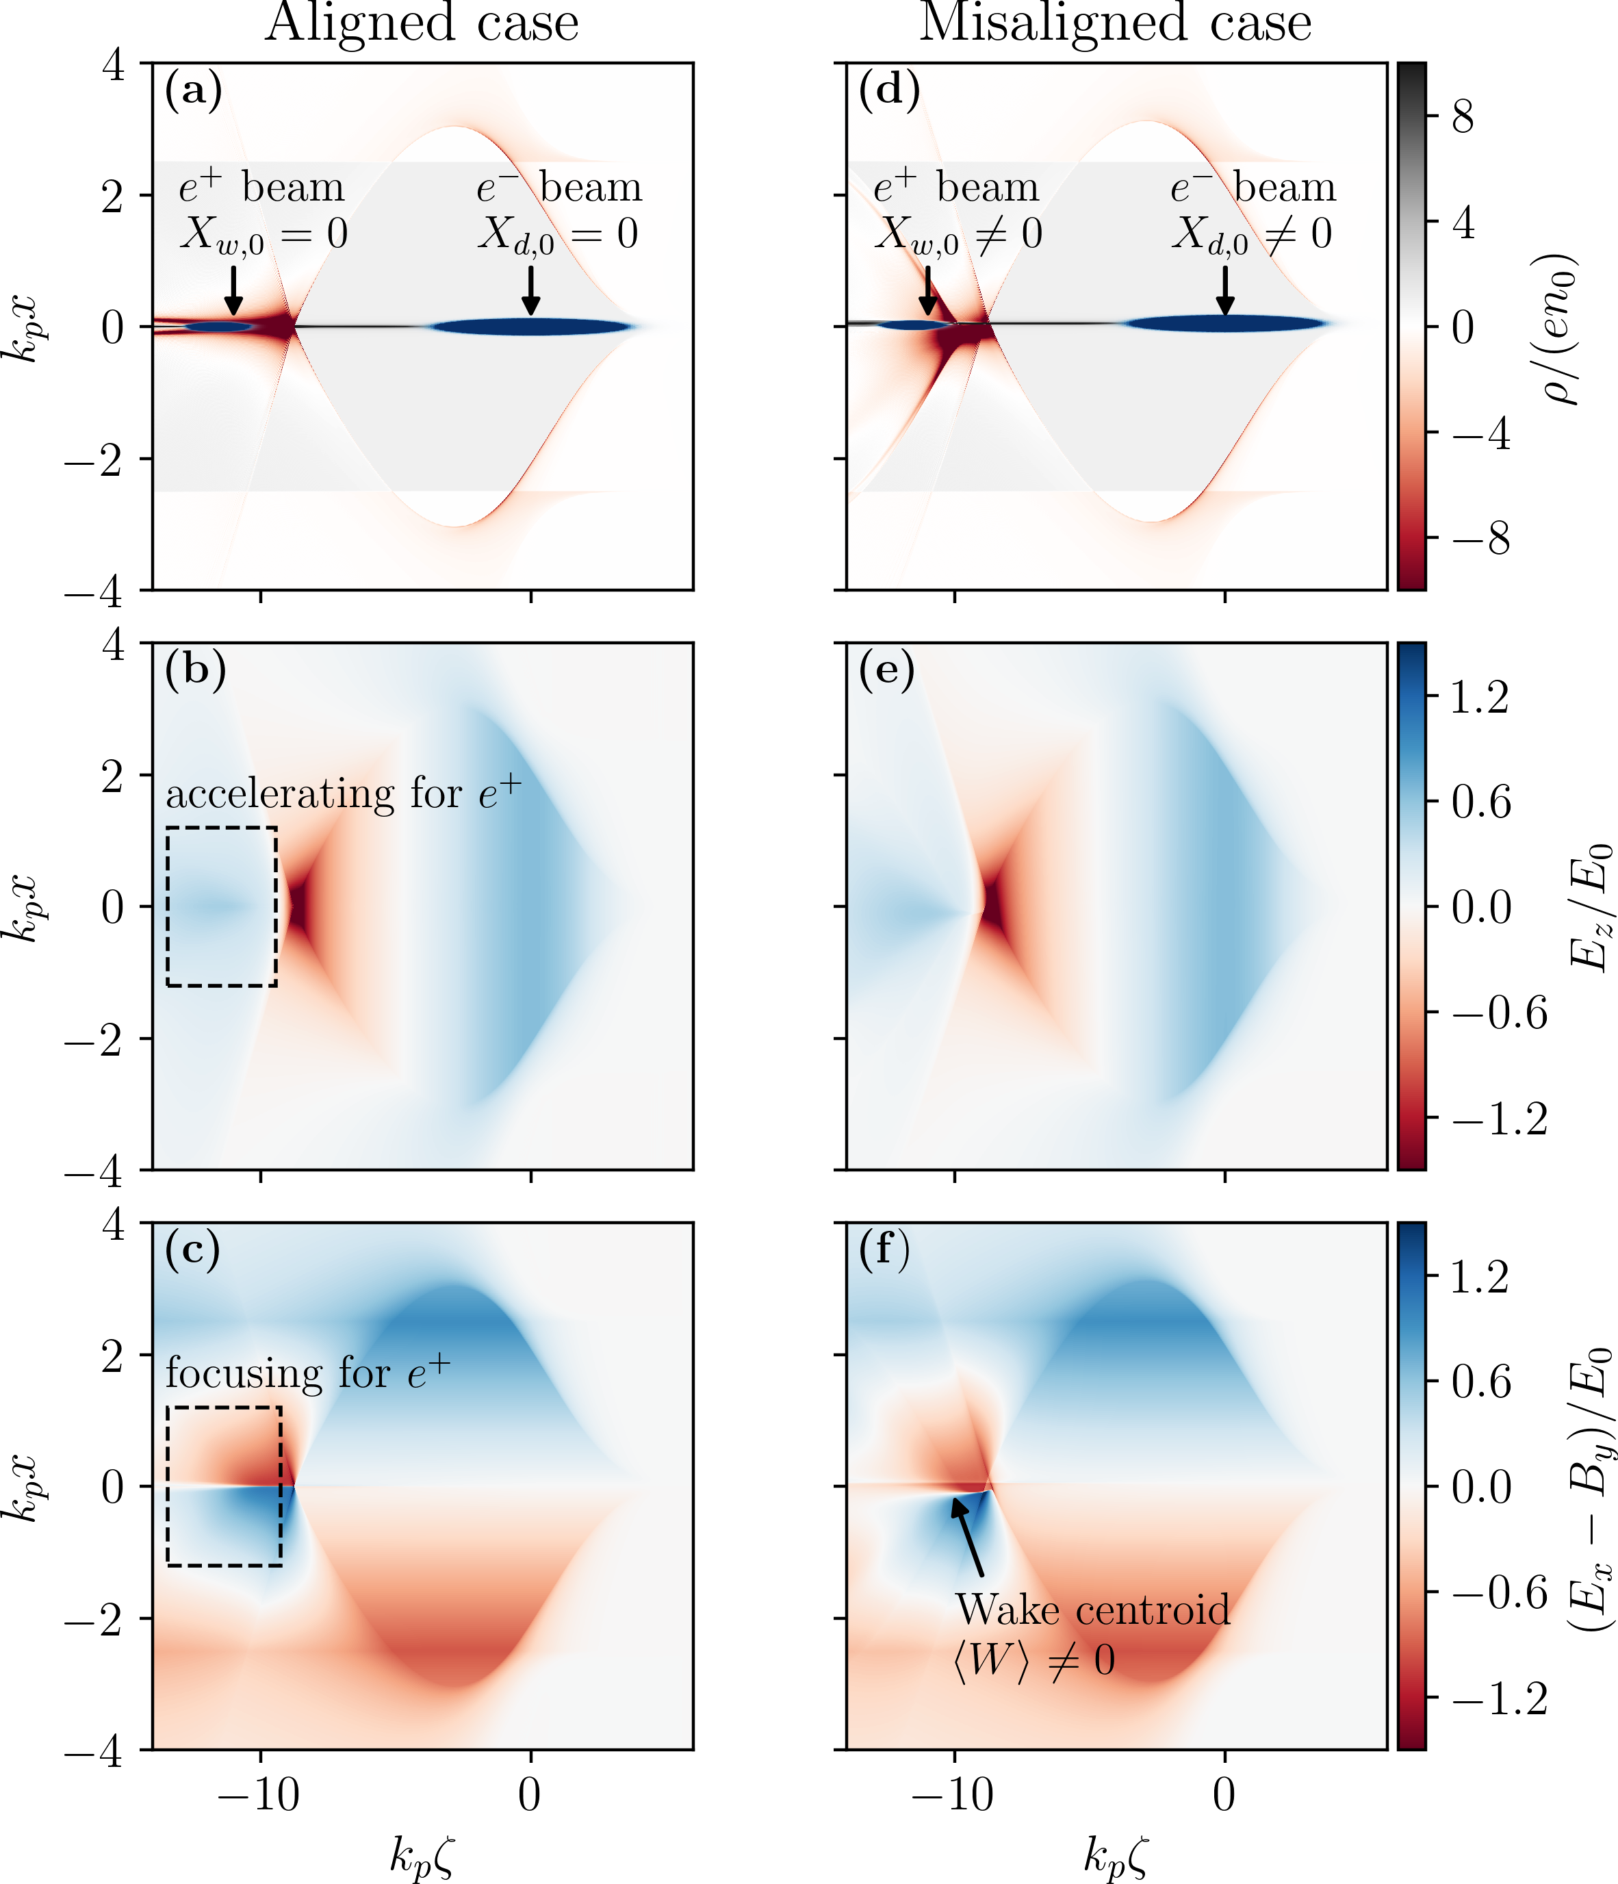
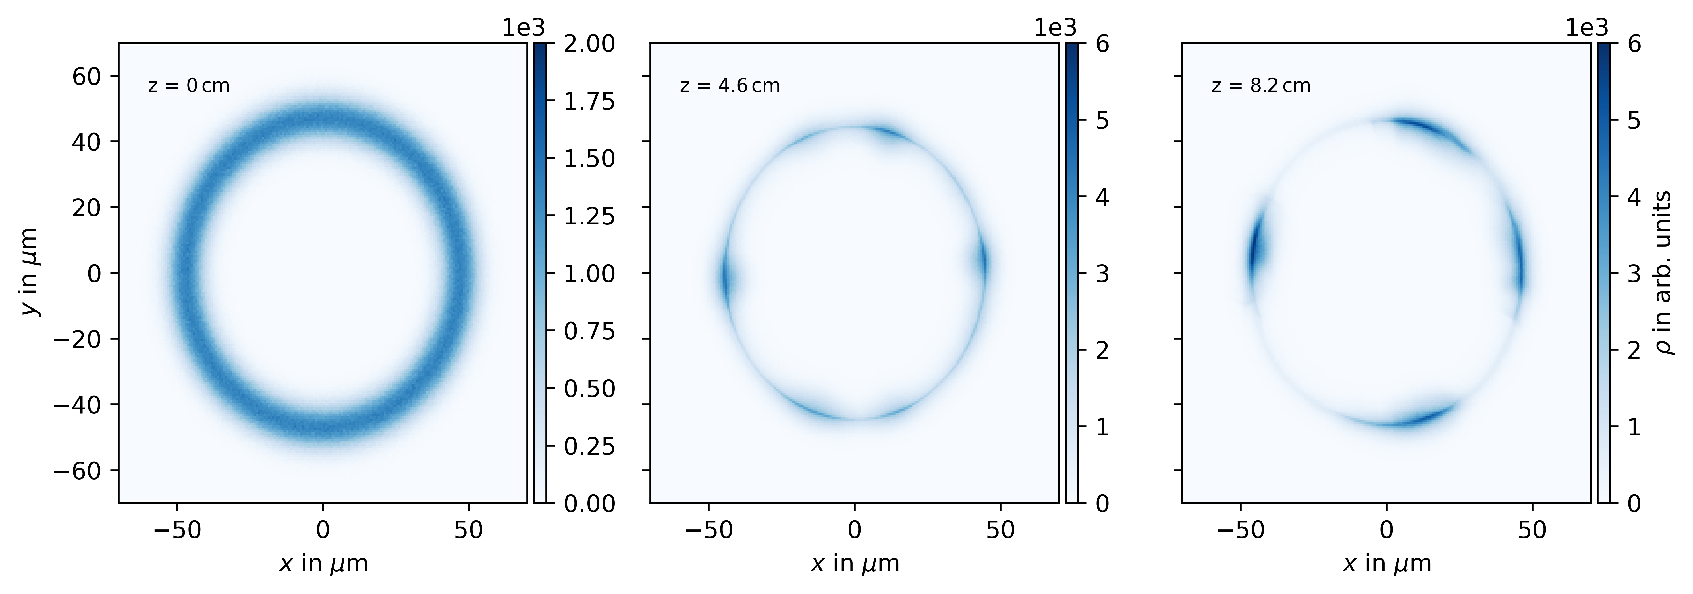
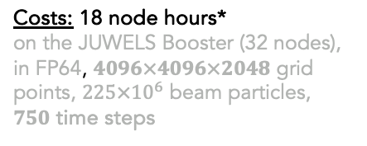

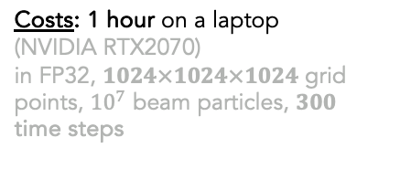
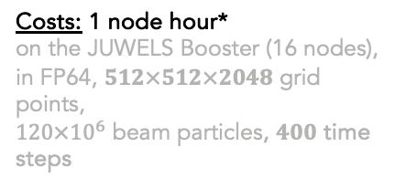

Examples: Applications of HIPACE++
*Our JUWELS allocation: 26 000 node hours
“large JUWELS allocation”: 156 000 node hours
Tilted proton bunch in AWAKE
$e^{+}$ acceleration in a plasma column
$e^{+}$ acceleration with hollow-core driver
(Jain et al., PRL 2015)
Long beam, many beam particles,
long simulation box, long plasma
Standard 3D simulation
High-resolution, sharp plasma spikes,
many time steps, many beam particles
Costs: 1 node hour*
on the JUWELS Booster (16 nodes),
in FP64, $512×512×2048$ grid points,
$120×{10}^{6}$ beam particles, $400$ time steps
Costs: 18 node hours*
on the JUWELS Booster (32 nodes),
in FP64, $4096×4096×2048$ grid points, $225×{10}^{6}$ beam particles,
$750$ time steps
Costs: 1 hour on a laptop
(NVIDIA RTX2070)
in FP32, $1024×1024×1024$ grid points, ${10}^{7}$ beam particles, $300$ time steps
Notes:
WarpX is a modernization of the particle-in-cell code Warp.
Used primarily for t-based modeling with support for full electromagnetic PIC.
Contains many routines specialized for modeling of laser-plasma accelerators.
Provided the first full-scale runs at the first demonstrated Exascale machine, Frontier.
Uses standardized I/O to enable ease of data exchange with other BLAST codes.

Slide 16
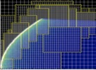


ImpactX: GPU-, AMR- & AI/ML-Accelerated Beam Dynamics
Physical Model based on IMPACT-Z
s-based tracking with symplectic maps
detailed RF cavity models and standard magnetic elements (w/soft-edge models)
exact nonlinear maps for sbends, drifts
space charge included using a split-operator approach
User-Friendly
single-source C++, full Python control
fully tested
fully documented
Multi-Node parallelization
MPI: domain decomposition
dynamic load balancing (in dev.)
On-Node Parallelization
GPU: CUDA, HIP and SYCL
CPU: OpenMP
Scalable, Parallel I/O
openPMD
in situ analysis
💡 Same Script
CPU/GPU & MPI
Space Charge Model
3D electrostatic in the bunch rest frame
Multi-Level, Multi-Grid Poisson solver
based on AMReX
Triple Acceleration Approach
GPU support
Adaptive Mesh Refinement
AI/ML & Data Driven Models
github.com/BLAST-ImpactX/impactx
LDRD
Notes:
ImpactX is a fundamental rewrite in C++ for GPUs with an interface to couple to AI/ML frameworks.
The physical model is based on IMPACT-Z.
Unlike IMPACT-Z, by default it uses a Multi-Level, Multi-Grid Poisson solver for space charge, allowing adaptive mesh refinement.

Slide 17
Modeling of beam-plasma interaction (targeting SuperKEKb)

Slide 18
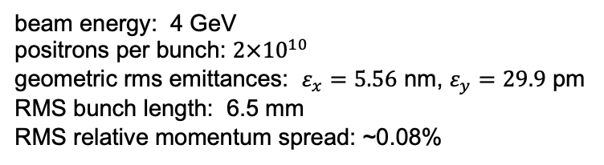
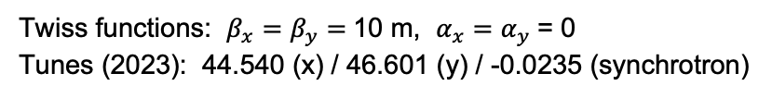
Beam and lattice parameters (modeled in HIPACE++)
Positron bunch
Parameters targeting sudden
beam loss event March 2024
(SuperKEKb)
beam energy: 4 GeV
positrons per bunch: $2×{10}^{10}$
geometric rms emittances: $ε_{x}=5.56$ nm, $ε_{y}=29.9$ pm
RMS bunch length: 6.5 mm
RMS relative momentum spread: ~0.08%
Lattice focusing
Twiss functions: $β_{x}=β_{y}=$10 m, $α_{x}=α_{y}$= 0
Tunes (2023): 44.540 (x) / 46.601 (y) / -0.0235 (synchrotron)
Plasma / e-cloud
Plasma / e-cloud over 10 cm length – for several values of density in the range 10¹¹ – 10¹⁷ / m³
Dynamical effects on a single pass become visible at plasma e- densities ~ 10¹⁶ / m³
Model multiple passes of a bunch interacting with the same plasma (via one-turn map)

Slide 19
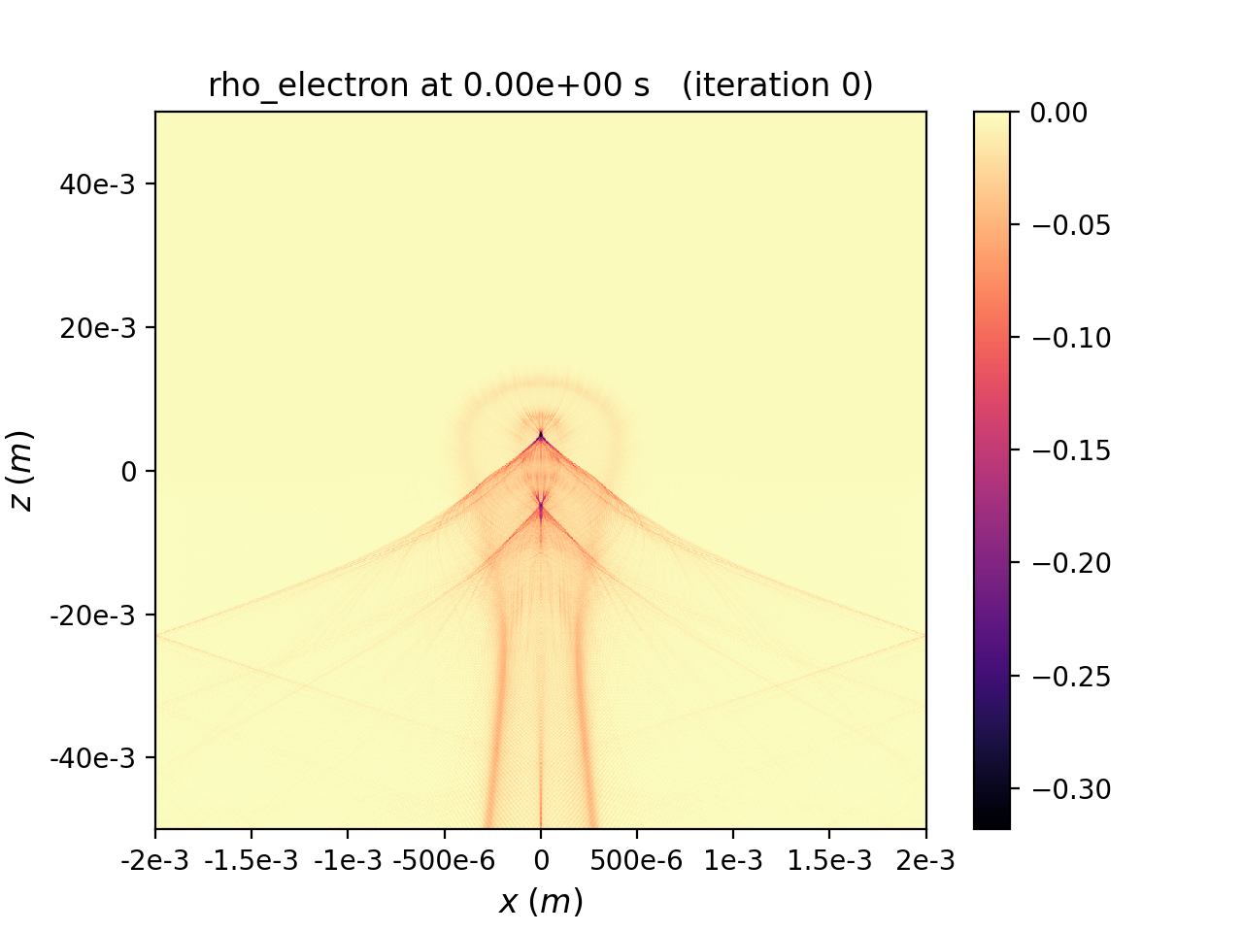
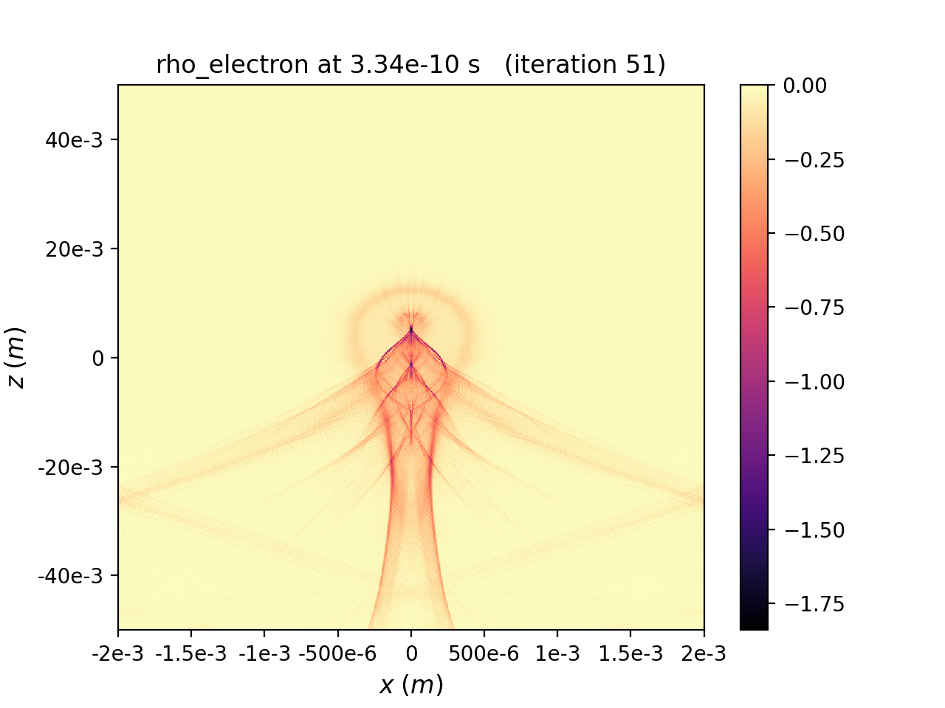
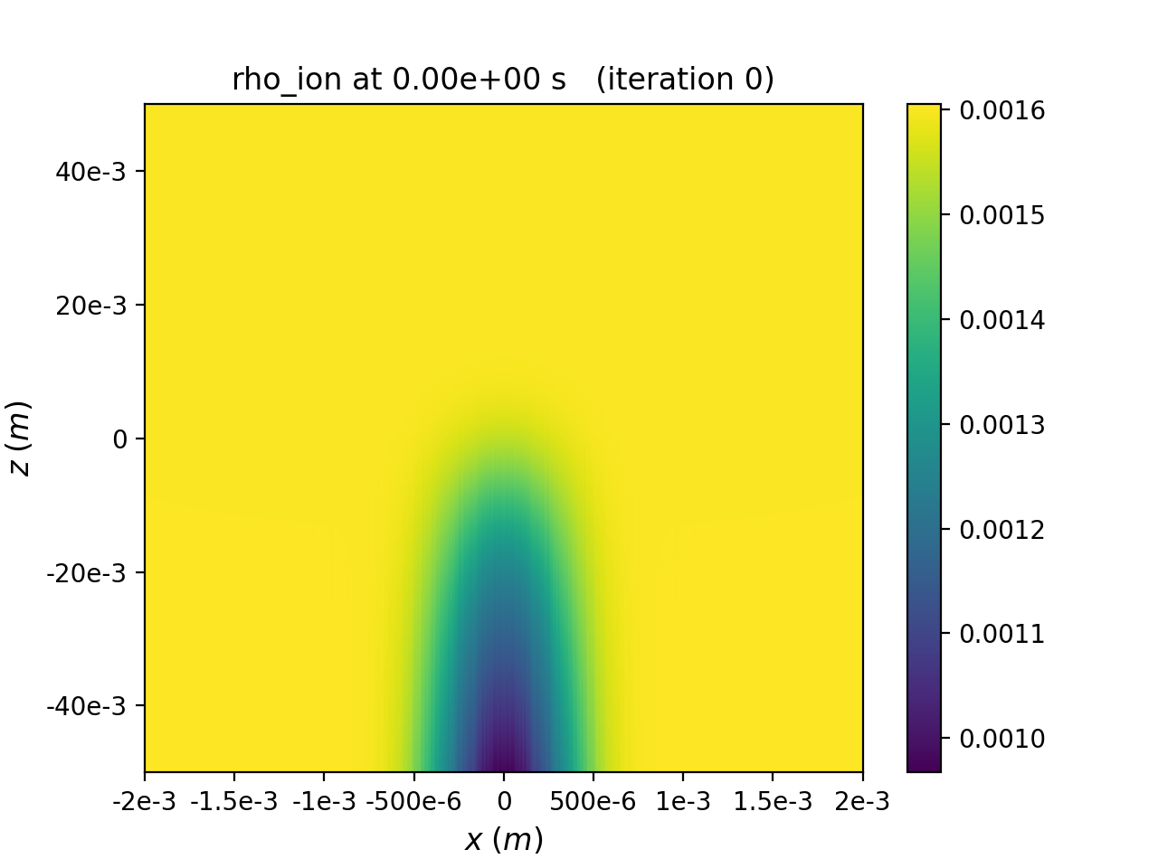
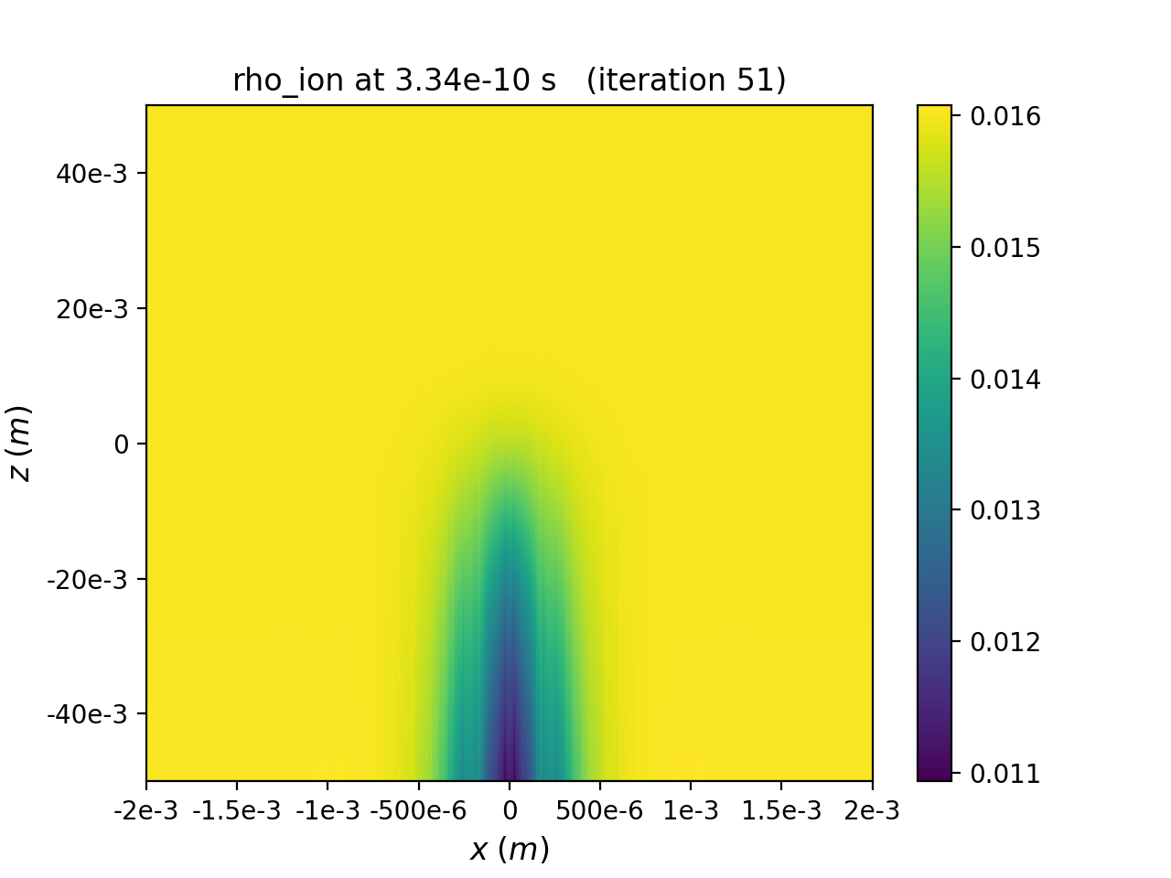
Plasma evolution for a 0.1 m plasma of density 10¹⁷/m³
Plasma electrons
Initial
After 10 passes
10 passes of the
positron bunch
Visualization using
openPMD-viewer
(Jupyter notebook)
Plasma ions
Initial
After 10 passes

Slide 20
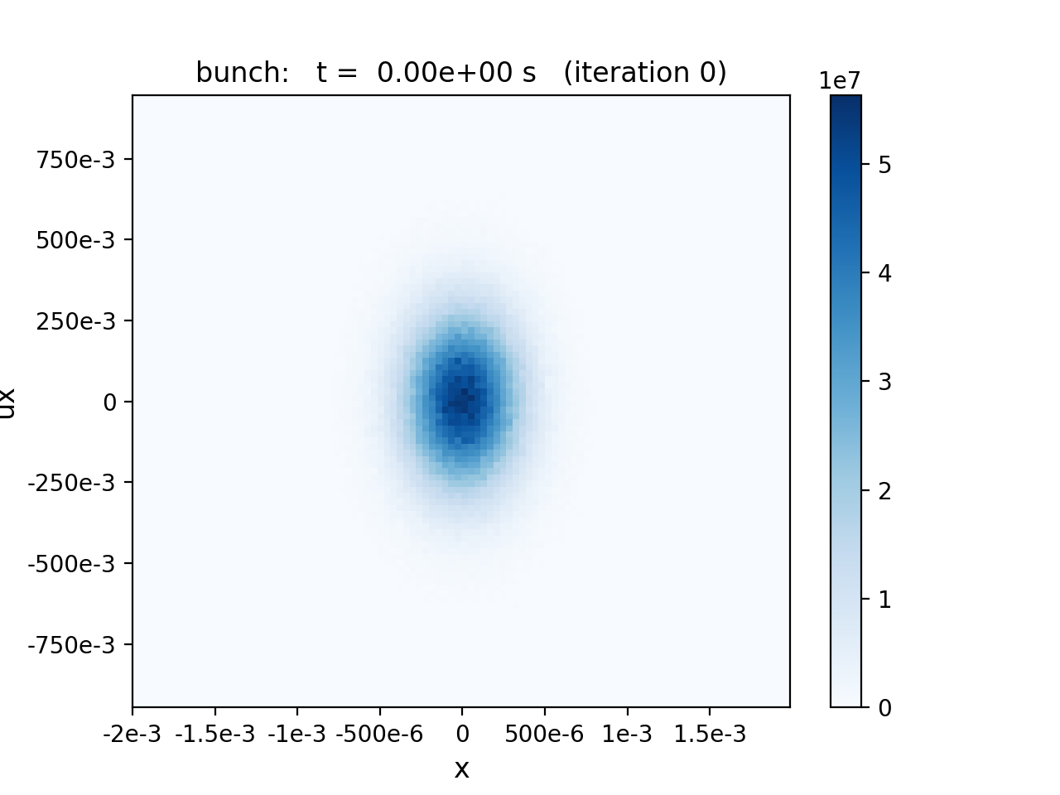
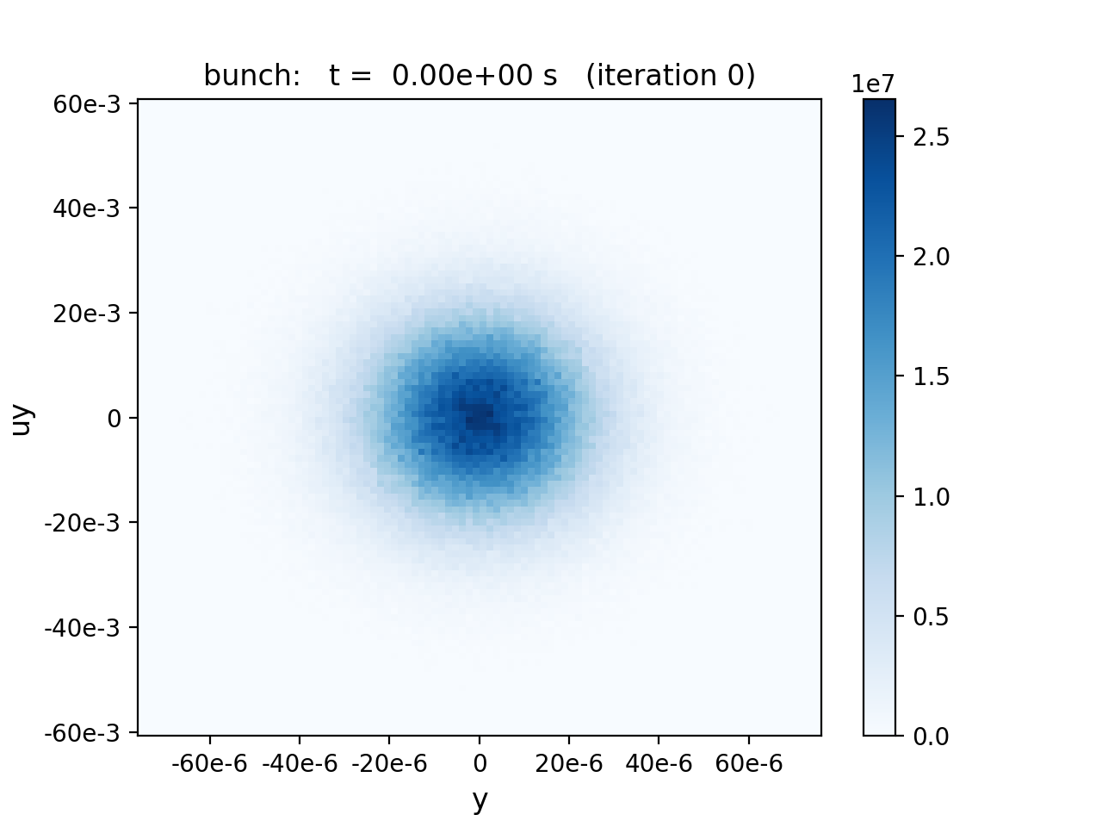
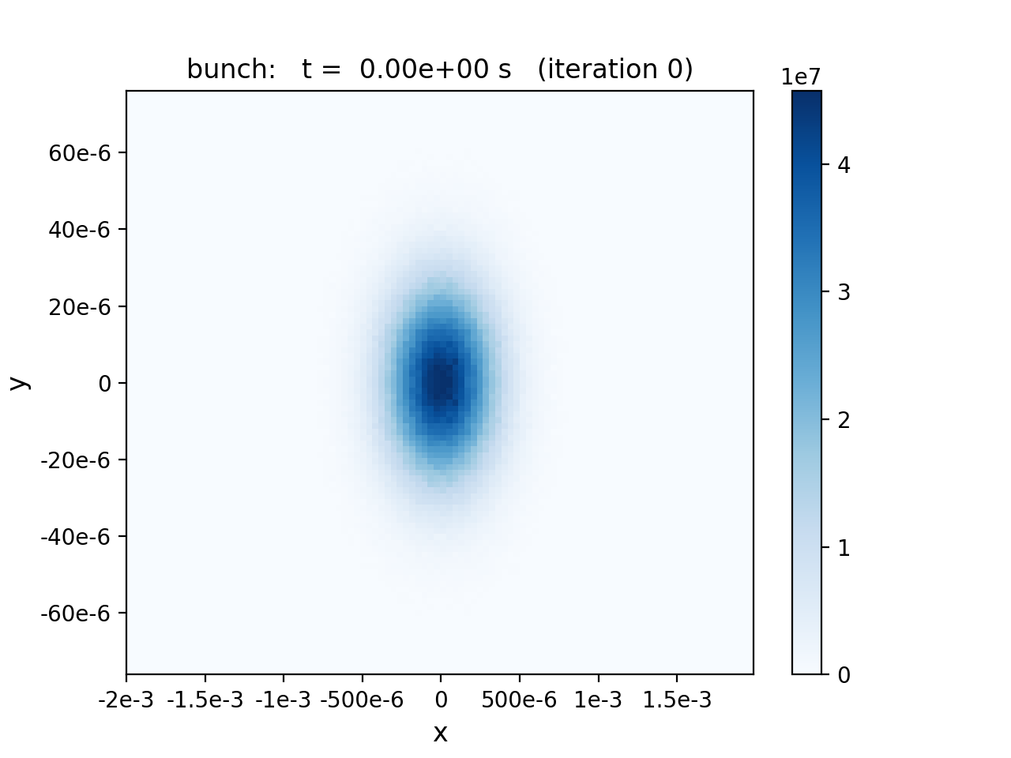
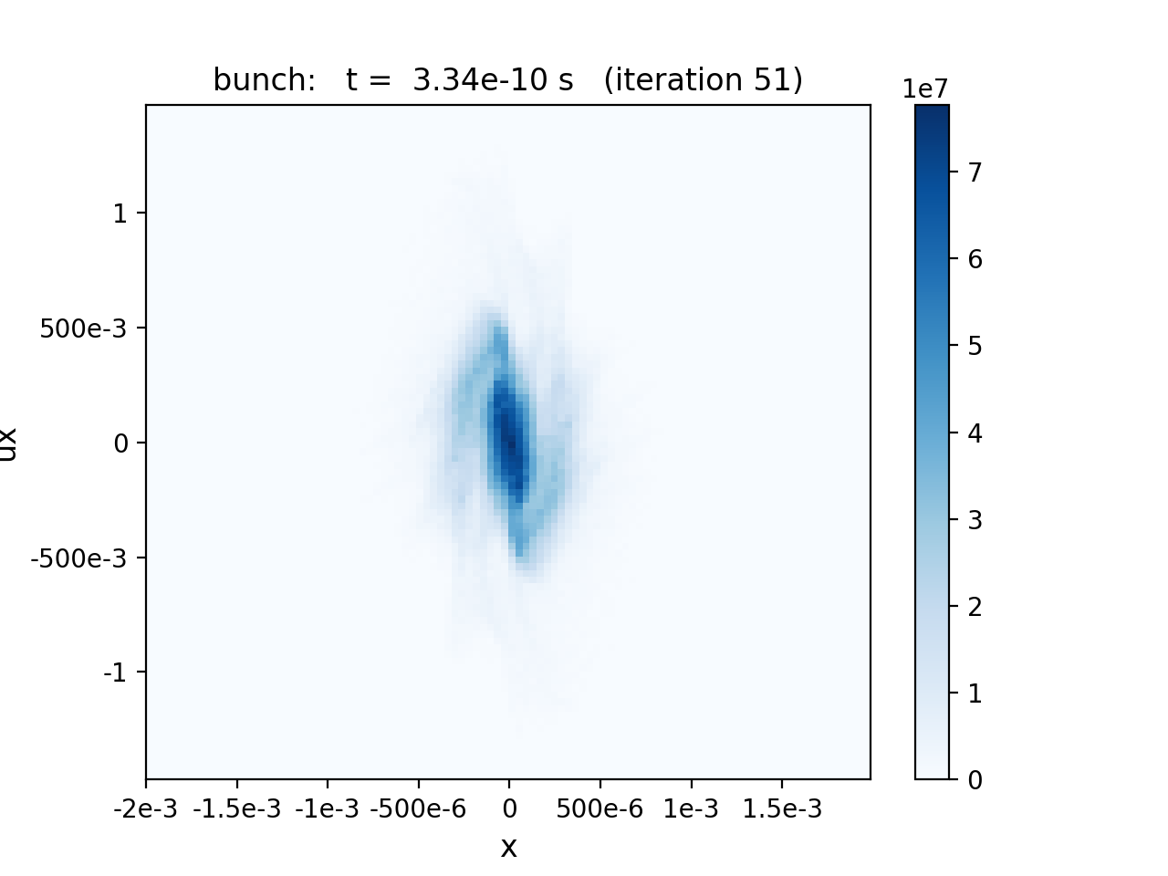
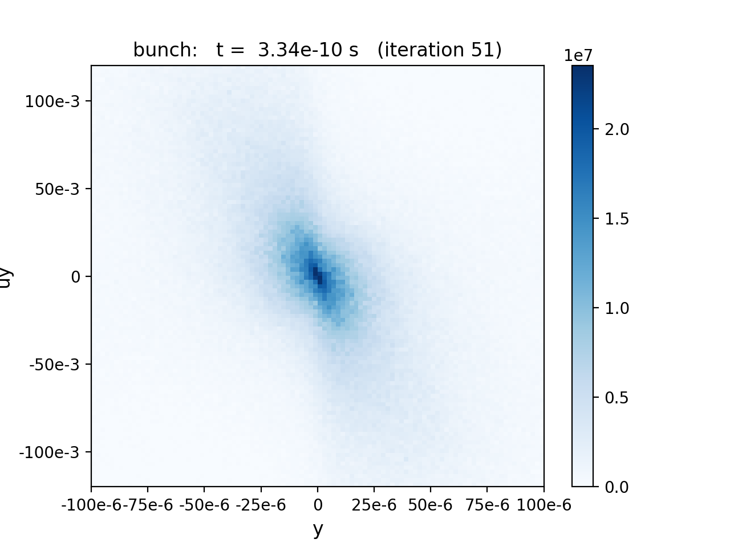
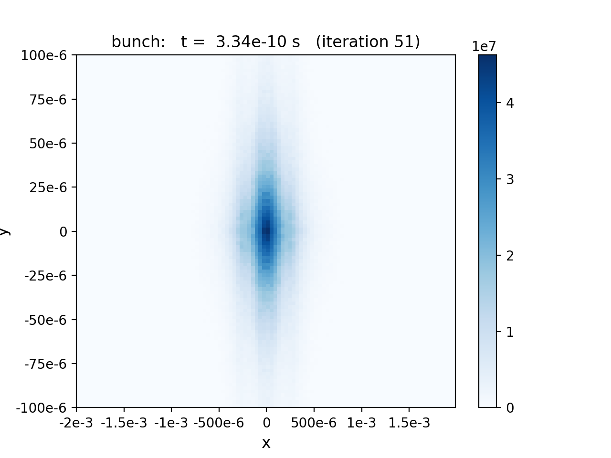






Beam evolution in a 0.1 m plasma of density 10¹⁷/m³
Initial bunch
XP_{x}
YP_{y}
XY
$σ_{x}$= 0.2356 mm
$σ_{y}$ =17.33 $μ$m
$ε_{xn}$ = 43.49 $μ$m
$ε_{xg}$ = 5.556 nm
$ε_{yn}$ = 0.2349 $μ$m
$ε_{yg}$ = 30.01 pm
After 10 passes
vertical
blowup
$∆σ_{x}$ = -9.37%
$∆σ_{y}$ = 207%
$ε_{yn}$ = 16 $× initial$
$∆ε_{xn}$ = 57.9%

Slide 21
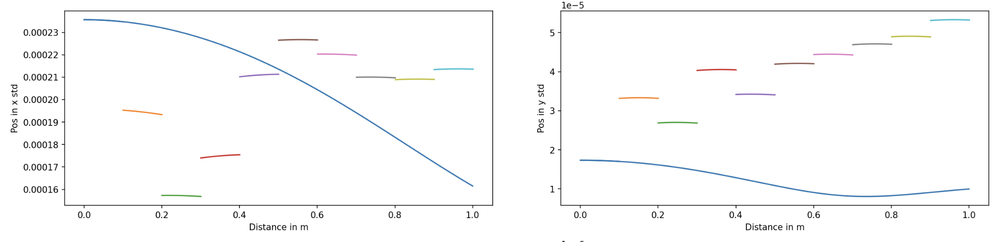
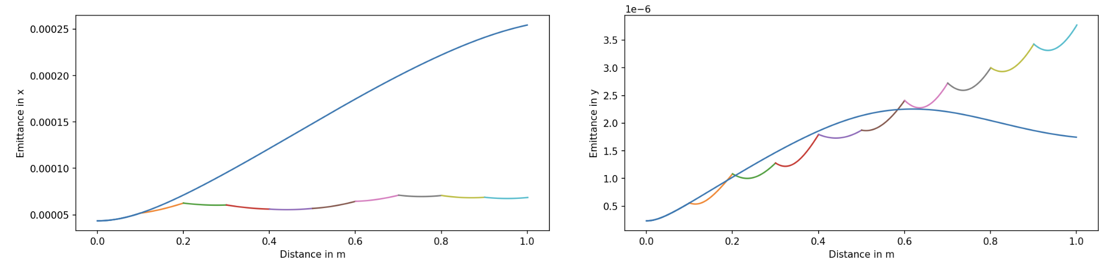
Comparing 10 passes through 0.1 m plasma
vs. 1 m continuous plasma (density 10¹⁷/m³)
horizontal rms beam size (m)
vertical rms beam size (m)
distance (m)
distance (m)
horizontal emittance (m)
continuous
plasma
vertical emittance (m)
distance (m)
distance (m)

Slide 22
Conclusions and Next Steps
BLAST is an open interoperable ecosystem of PIC codes for particle accelerator modeling
                - HIPACE++ – for relativistic t-based modeling of beam-plasma interaction
- ImpactX – for s-based beam dynamics modeling in linacs and rings, ...
Preliminary (ongoing) studies of multi-pass beam-plasma interaction relevant to SuperKEKb
Next Steps:
Extend HIPACE++ simulation workflow to incorporate multiple bunches (e.g. 12-14 ns spacing)
Integrate existing simulations with ImpactX to support lattice transport through portions
of the beamline (to include additional beam dynamics, e.g. wakes, as needed)
Assess community modeling needs for FCC-ee beam-dust interaction studies
Collaborate toward benchmark comparisons of available codes with experimental data

Slide 23




Backup material

Slide 24
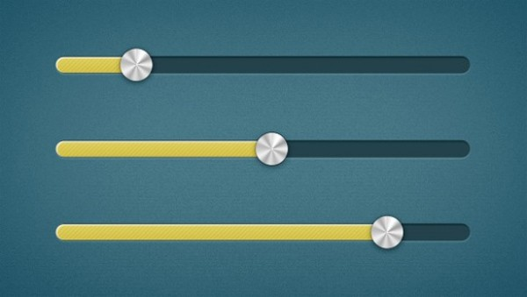

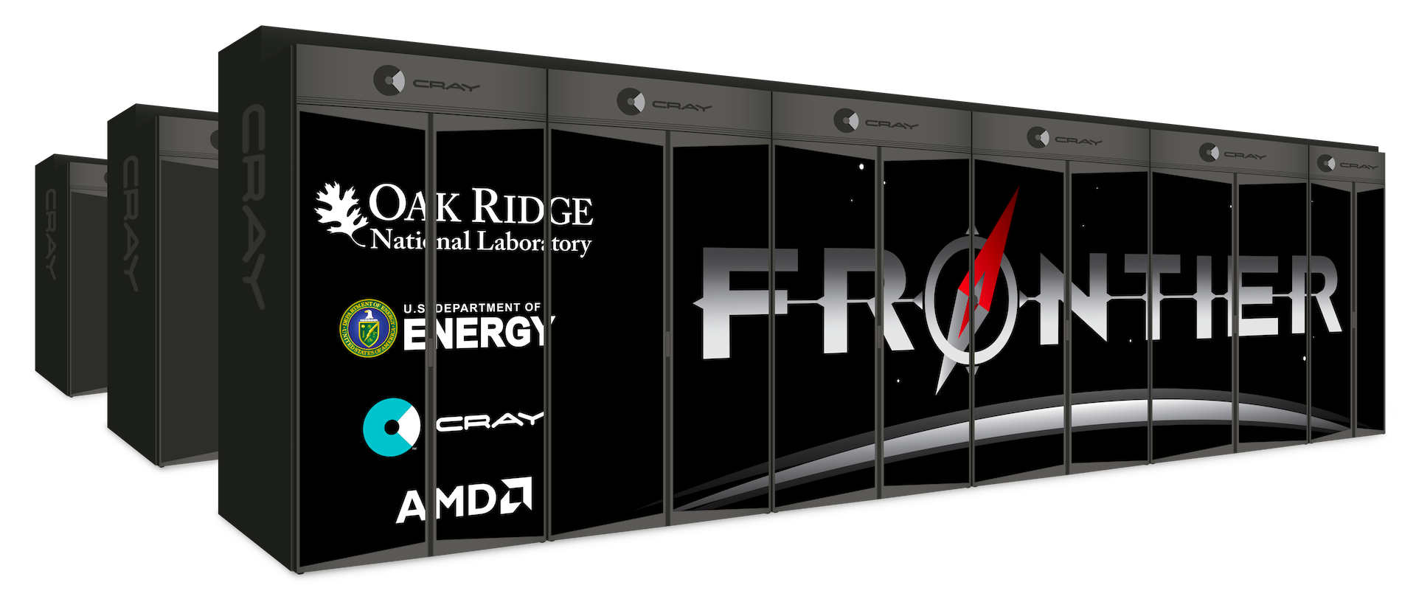
Goal: provide user an integrated ecosystem with on-the-fly tunability
Idealized laser/plasma profiles,
no collisions,…
Experimental laser/plasma profiles + collisions + …
Speed
Fidelity
Fast
&
as
accurate
as
possible
Reduced physics
Full physics
Accurate
&
as
fast
as
possible
Reduced models
First principles
1D-1V
3D-3V
Low resolution
High resolution
Surrogates
Including from AI/ML
Hybrid Fluid-PIC
Quasistatic
PIC
PIC

Slide 25

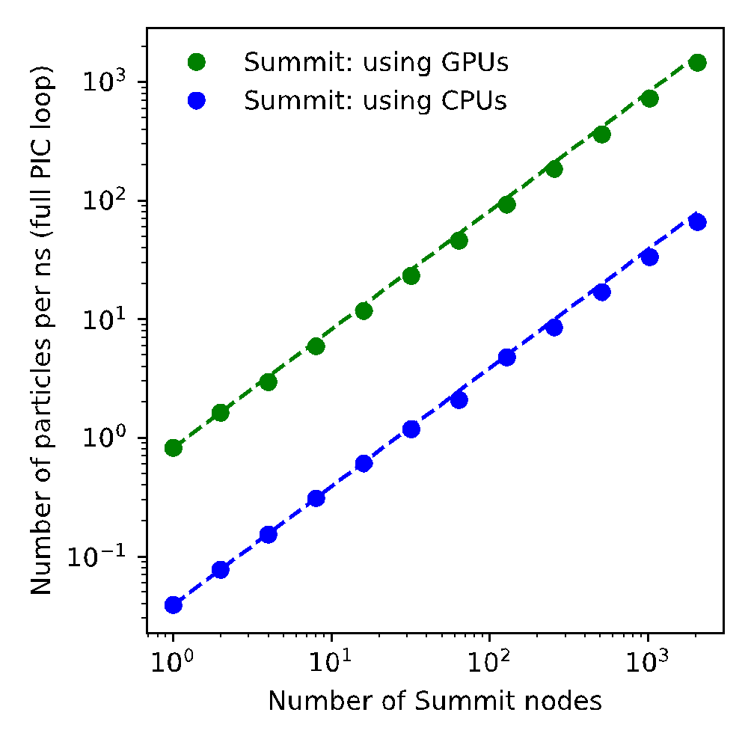
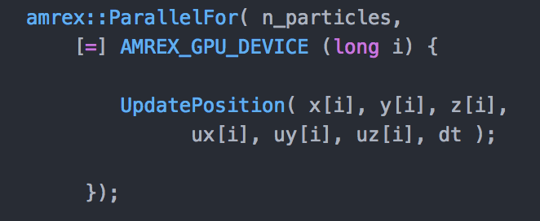
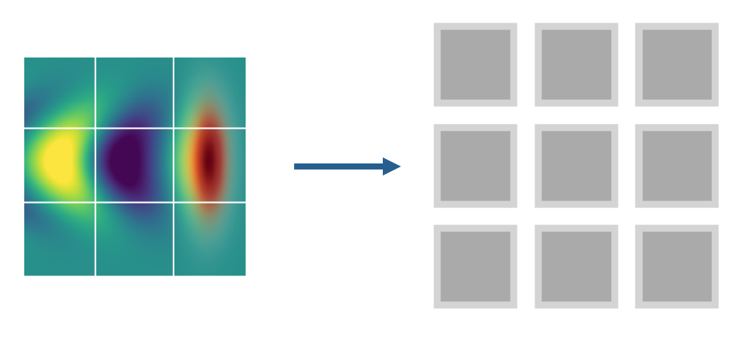

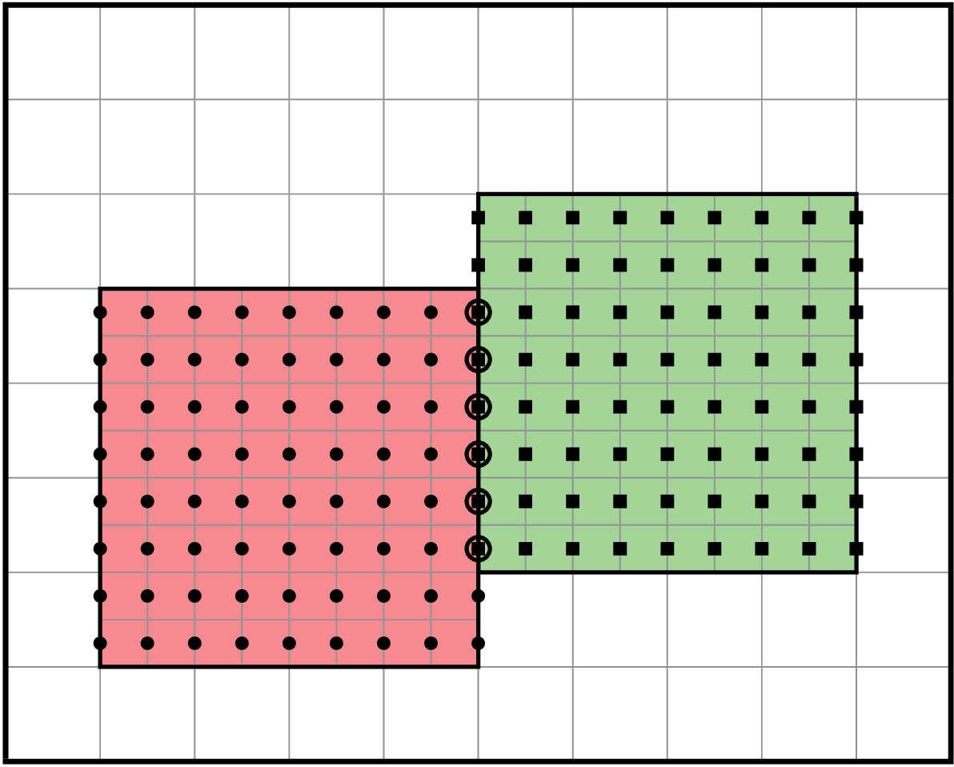
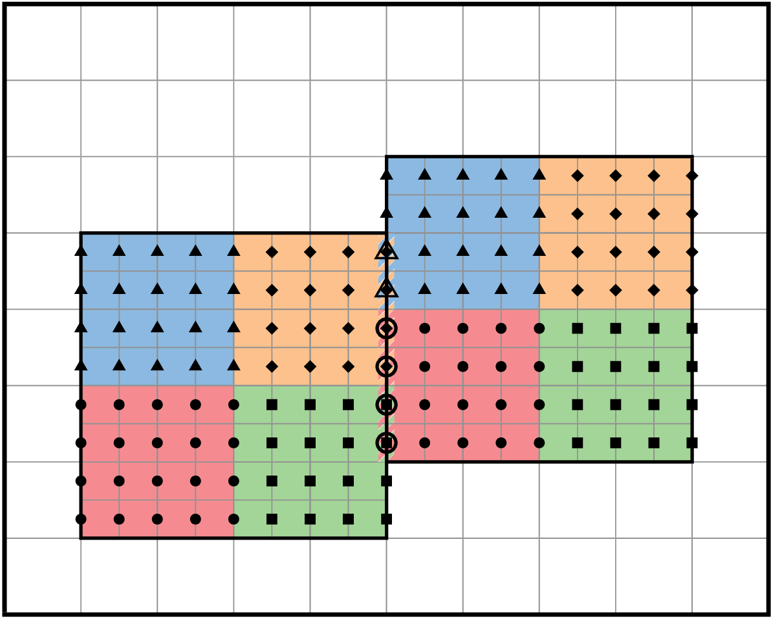
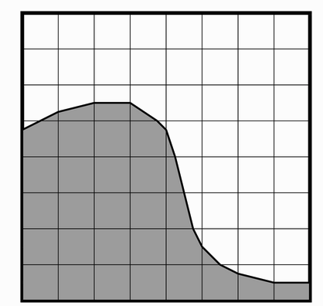
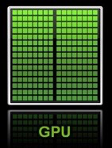

Modernizing BLAST through an Exascale Programming Model
AMReX library
  Domain decomposition & MPI
  communications: MR & load balance
  Performance-Portability Layer: GPU/CPU/KNL
Write the code once, specialize at
compile-time
ParallelFor(/Scan/Reduce)
A100 gives additional ~< 2x
Parallel linear solvers
(e.g. multi-grid Poisson solvers)
Embedded
boundaries
Runtime parser for user-provided math expressions (incl. GPU)
Data Structures
without tiling
with tiling
A. Myers et al., “Porting WarpX to GPU-accelerated platforms,” Parallel Computing 108, 102833 (2021)
Notes:
To run efficiently at scale on GPUs requires: 1) multi-level parallelism, 2) multi-paradigm programming, 3) special attention to dynamic load balancing.
This is done through a portability layer based on the AMReX library.
A single-source approach is used to program for both CPUs and GPUs via a performance portability layer in AMReX.
AMReX software framework contains Muli-Level, Multi-Grid Poisson solvers that support Adaptive Mesh Refinement.

Slide 26
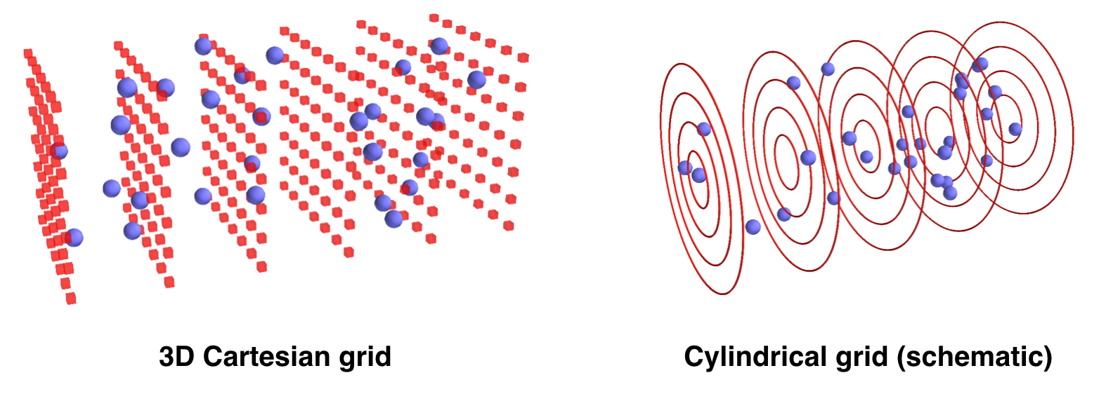




WarpX is a GPU-Accelerated PIC Code for Exascale
Geometries
1D3V, 2D3V,
3D3V and
RZ (quasi-
cylindrical)
Available Particle-in-Cell Loops
electrostatic & electromagnetic (fully kinetic)
Push particles
Gather fields
Deposit currents
Multi-Node parallelization
MPI: 3D domain decomposition
dynamic load balancing
On-Node Parallelization
GPU: CUDA, HIP and SYCL
CPU: OpenMP
Scalable, Standardized I/O
PICMI Python interface
openPMD (HDF5 or ADIOS)
in situ diagnostics
Solve fields
Advanced algorithms
boosted frame, spectral solvers, Galilean frame, embedded boundaries + CAD, MR, ...
Multi-Physics Modules
field ionization of atomic levels, Coulomb
collisions, QED processes (e.g. pair creation), macroscopic materials
Notes:
WarpX is a modernization of the particle-in-cell code Warp.
Used primarily for t-based modeling with support for full electromagnetic PIC.
Contains many routines specialized for modeling of laser-plasma accelerators.
Provided the first full-scale runs at the first demonstrated Exascale machine, Frontier.
Uses standardized I/O to enable ease of data exchange with other BLAST codes.

Slide 27
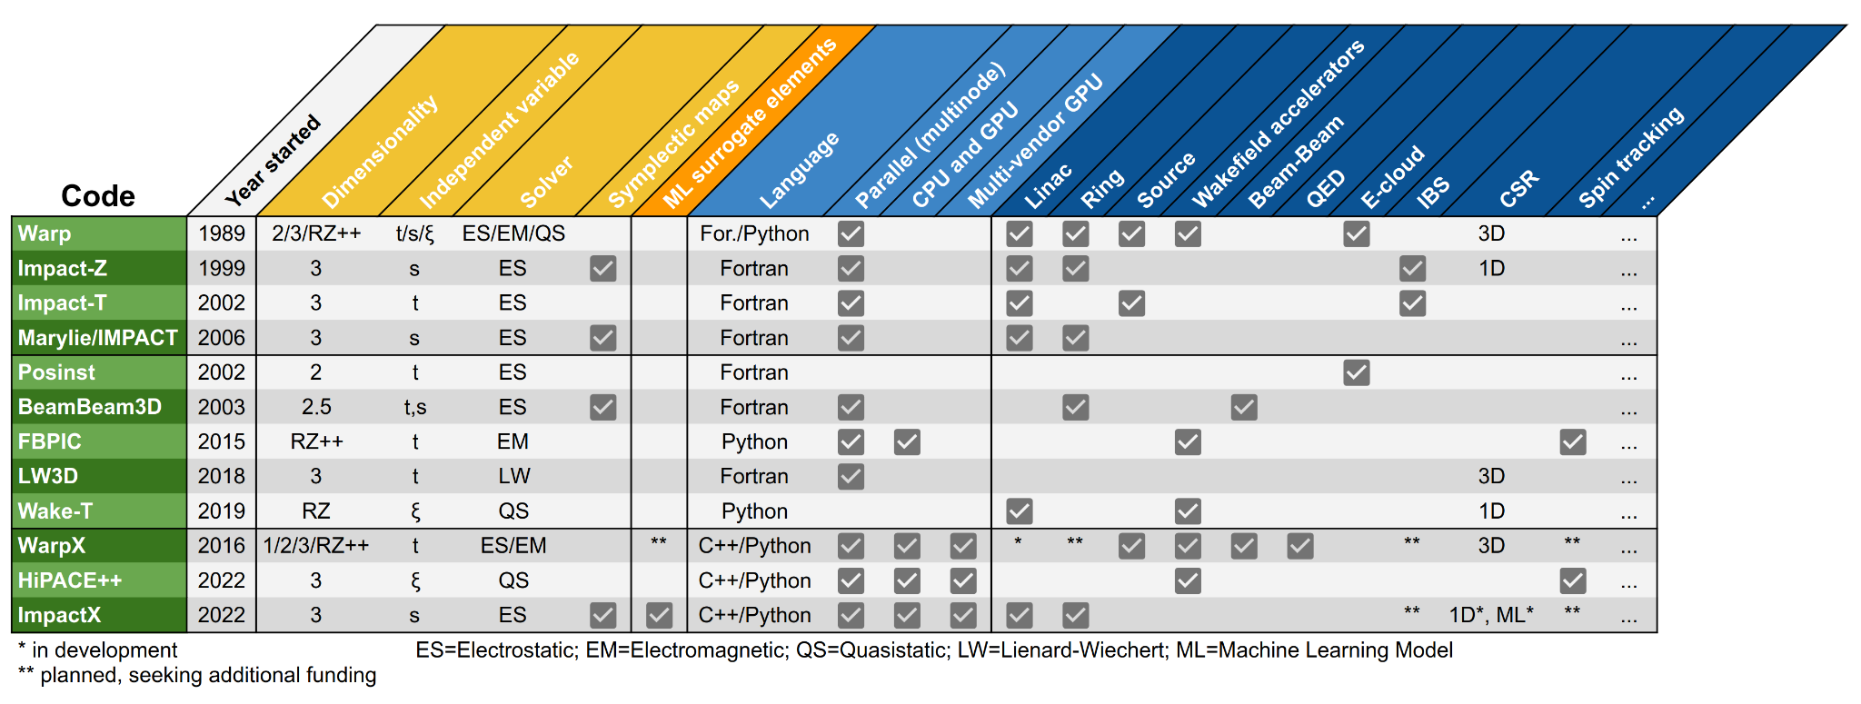
BLAST Codes by Features
speed
analytical
data-driven
level of
detail
accuracy
simulation
Notes:
https://docs.google.com/spreadsheets/d/1xYNslYIV-Oi4k9R4yAB5PUIJ6D4UXVIRzqvlucrAhsI/edit?gid=0#gid=0

Slide 28
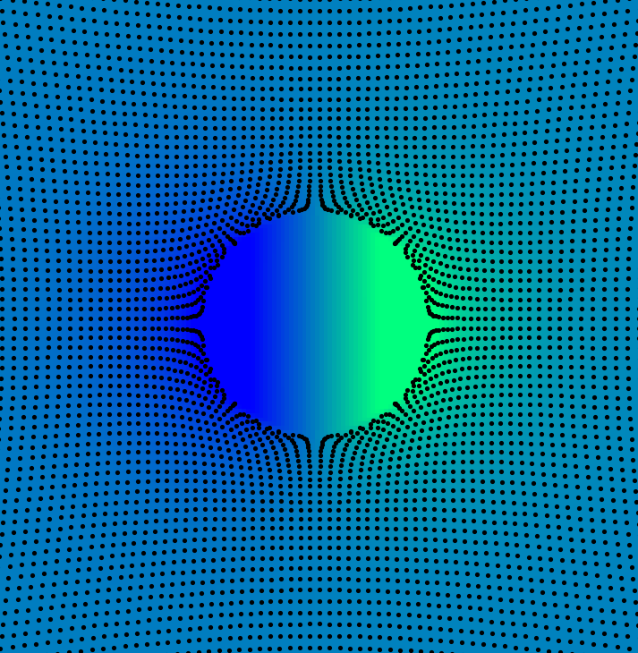
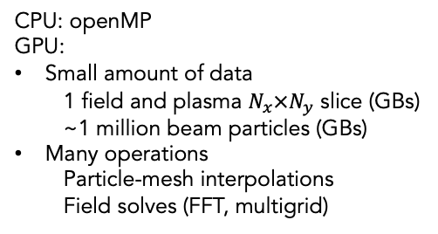
Parallelization: a new pipeline algorithm
Transverse
Longitudinal
Several CPU cores
Single GPU
vs.
CPU: openMP
GPU:
Small amount of data
  1 field and plasma $N_{x}×N_{y}$ slice (GBs)
  ~1 million beam particles (GBs)
Many operations
  Particle-mesh interpolations
  Field solves (FFT, multigrid)
Spatial decomposition: send plasma & field data
Temporal decomposition: send beam data → much less data

Slide 29
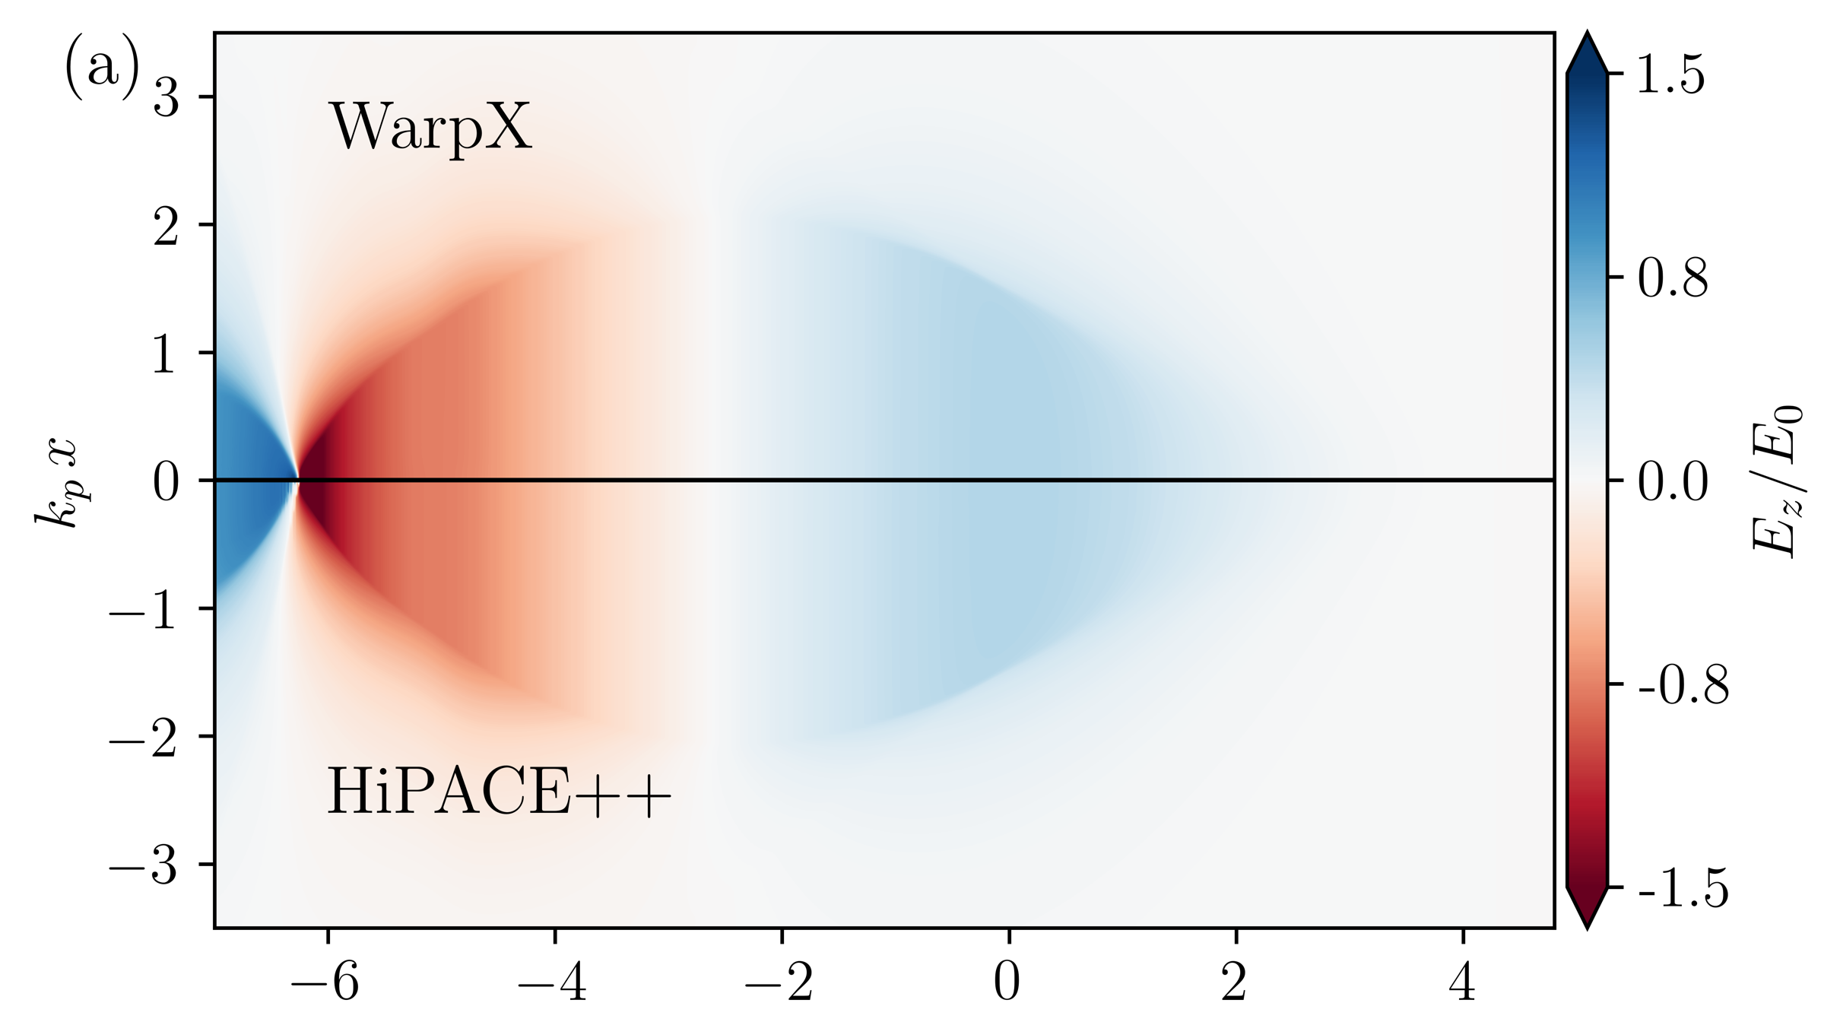
Accuracy & performance benchmarks
1 GPU MUCH faster than many CPU cores
Summit
Successfully benchmarked
Large speedup w.r.t. CPU
High-resolution simulations within minutes
Production simulations possible on a laptop (float)
Juwels
Excellent scaling to hundreds of GPUs

