Slide 1
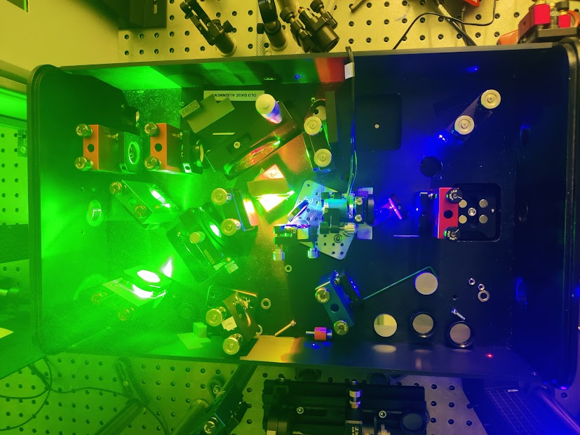
Power Stabilization of a SHG Crystal via Automated Oven and Grating Control in the MELISSA & RILIS Laser Labs
Gabriel Brenner, Ralitsa Mancheva, and Line Le

Slide 2
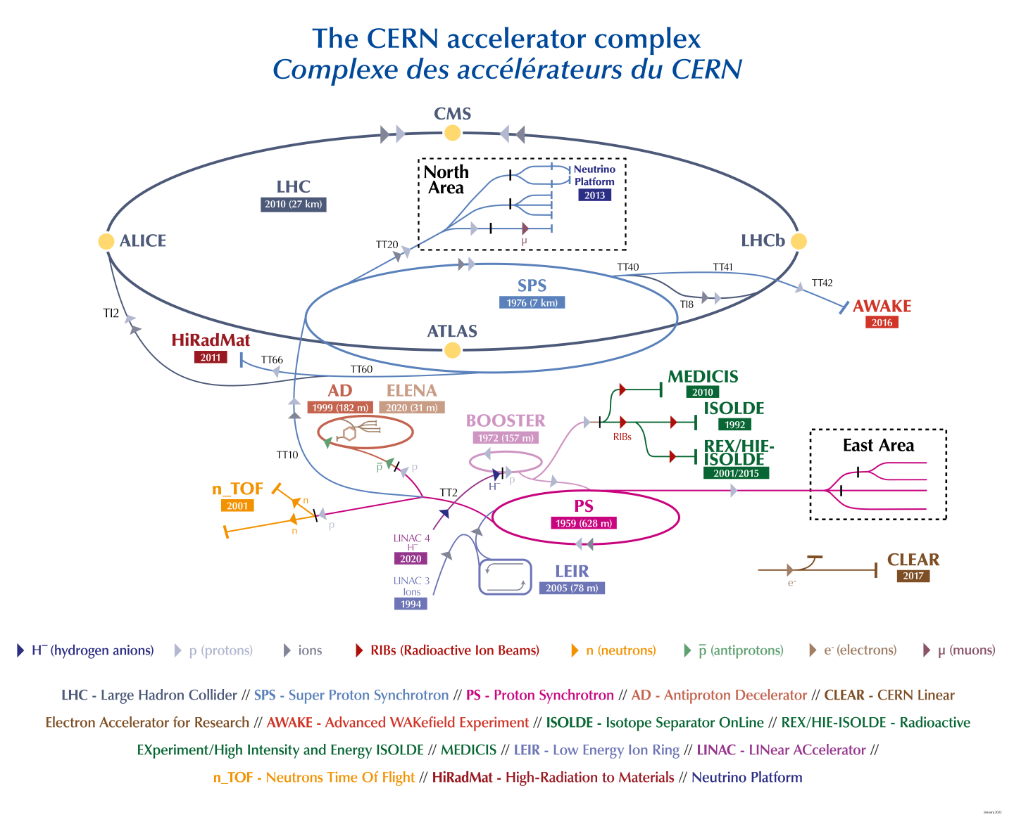

Slide 3
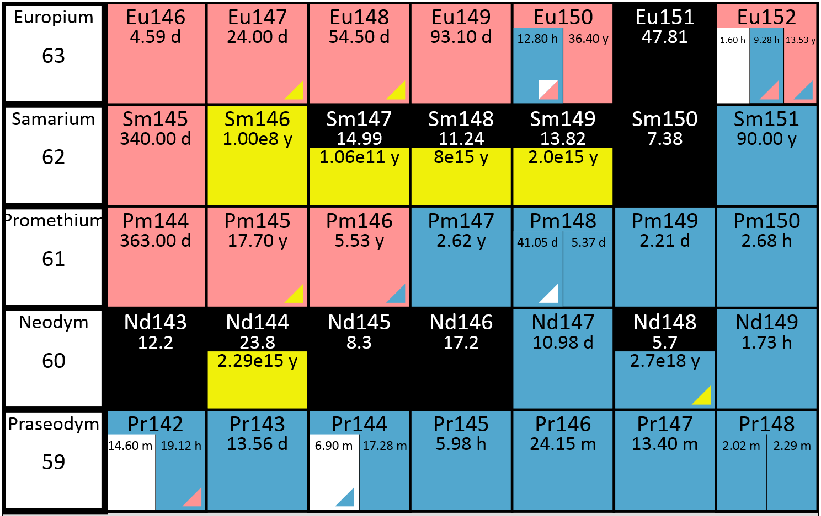
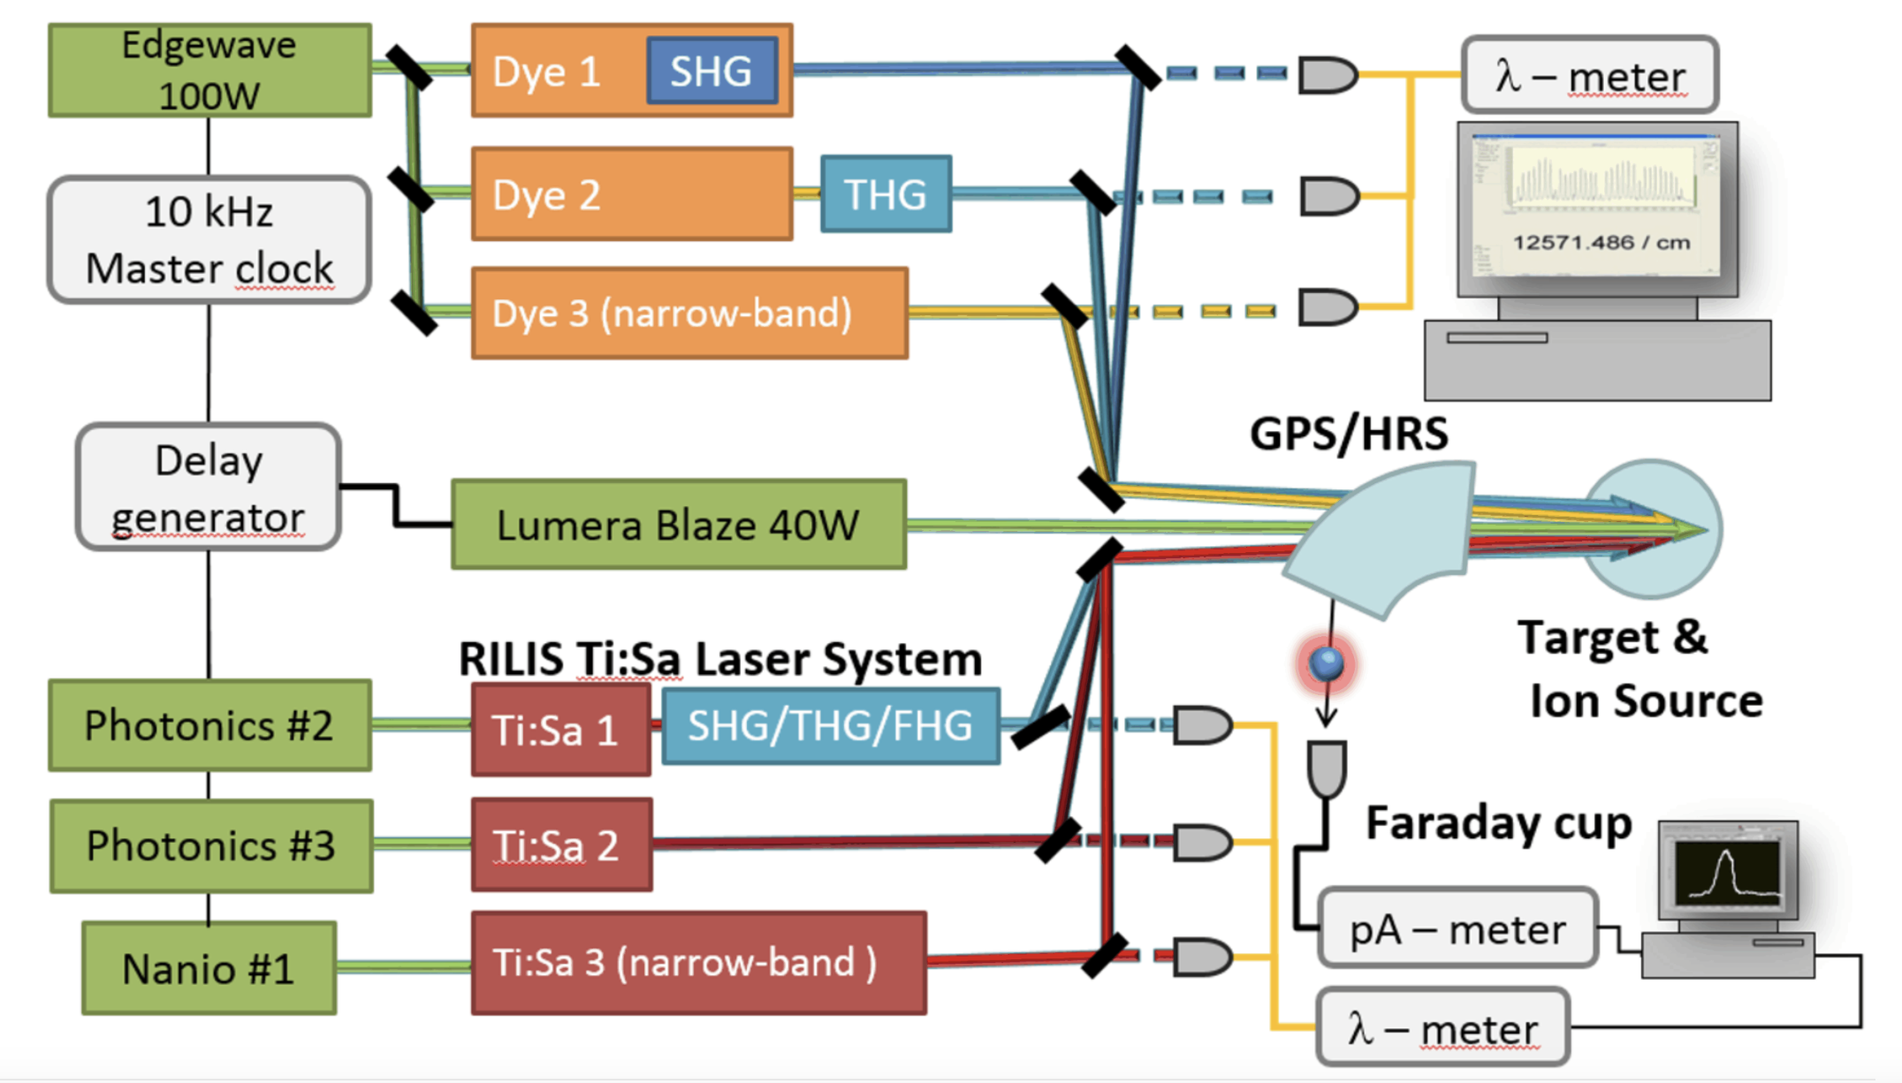
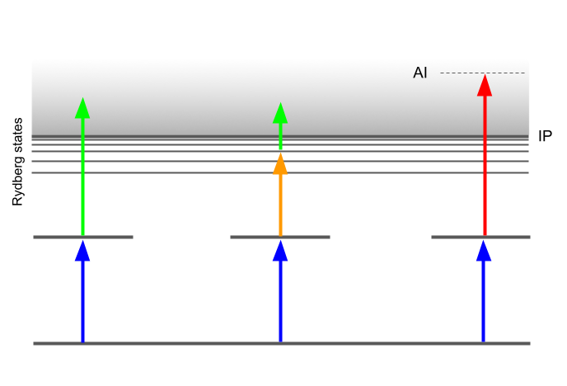
ISOLDE-RILIS Laser Lab
Laser ionization
Mass separation

Slide 4
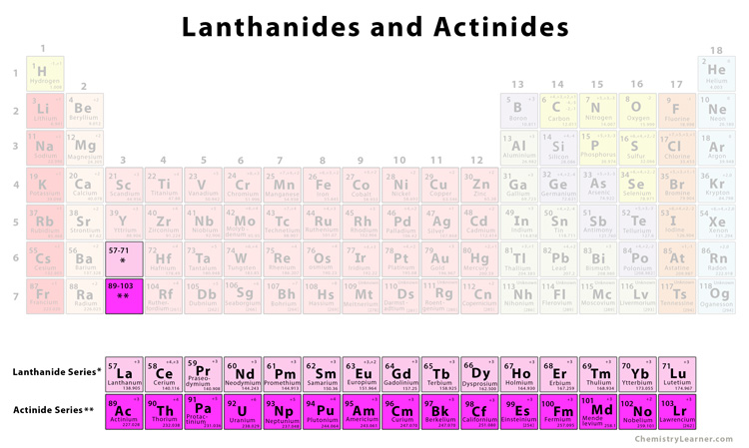
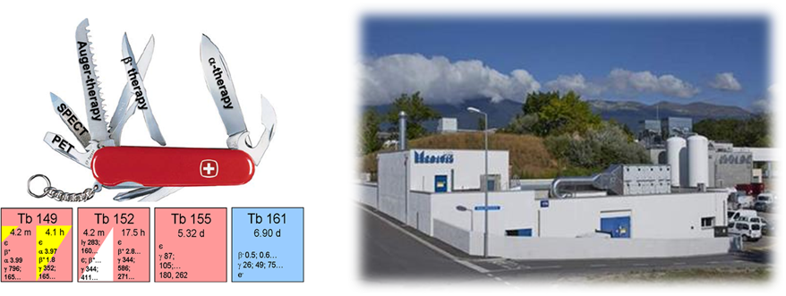
CERN-MEDICIS
MEDical Isotopes Collected from ISOLDE
Medically relevant isotopes of Tb, Tm, Cs, Yb, Er, Ac, Sm, Ba and more (mainly lanthanides and actinides)
“Medically relevant” = good decay properties, appropriate half-life etc

Slide 5
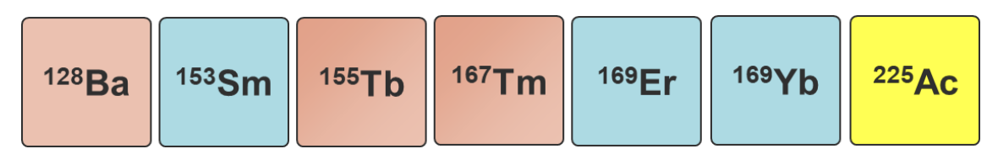
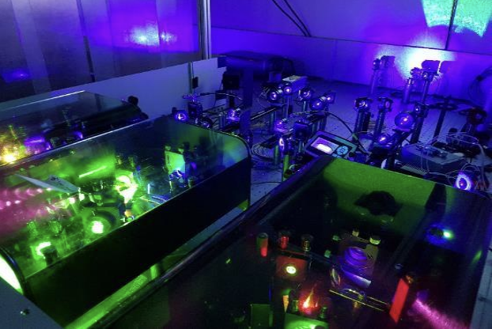
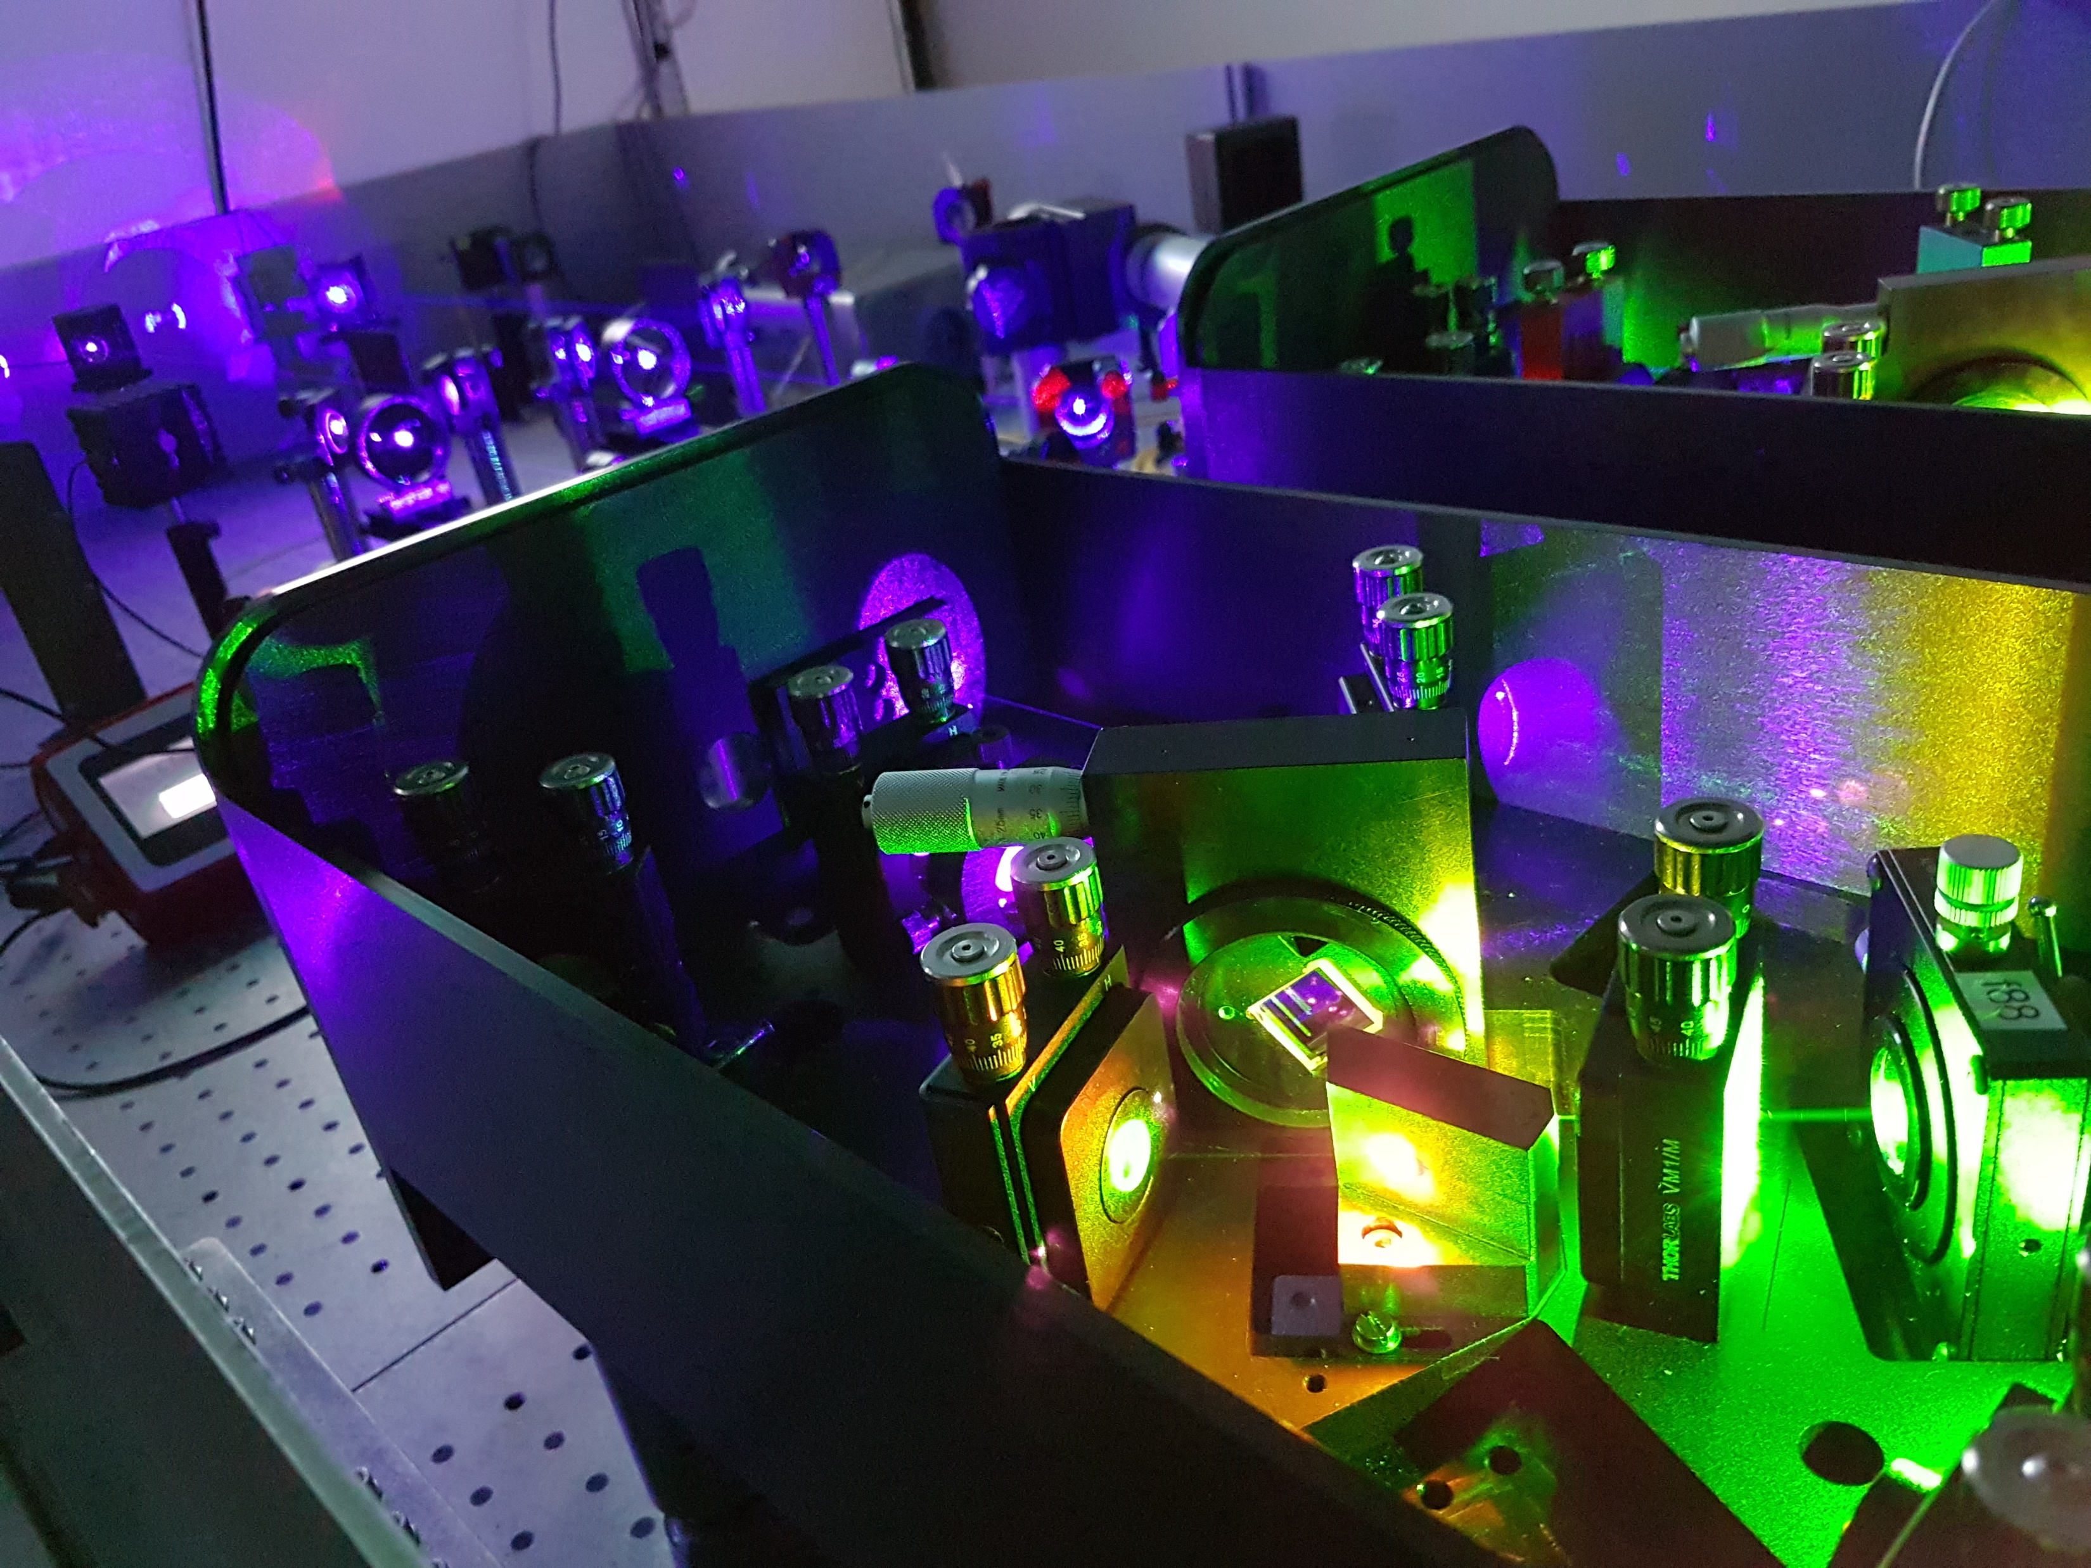
MEDICIS-MELISSA
Used for ionization of 80% of the MEDICIS portfolio
Received nonlinear optics + laser safety training
Performing tests of my program in the MELISSA laser lab

Slide 6
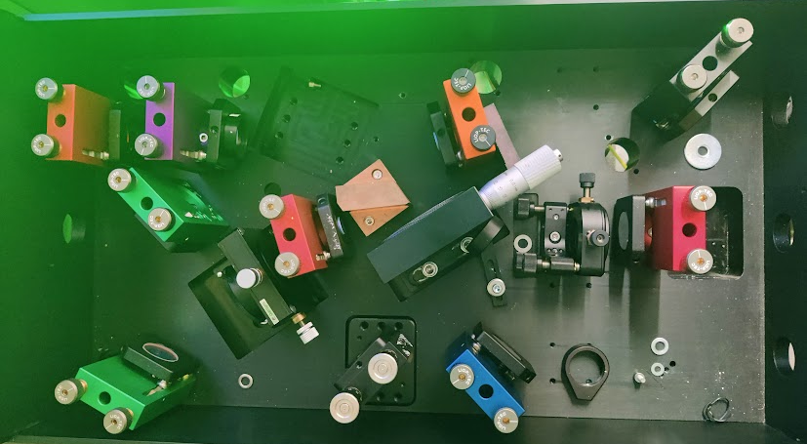
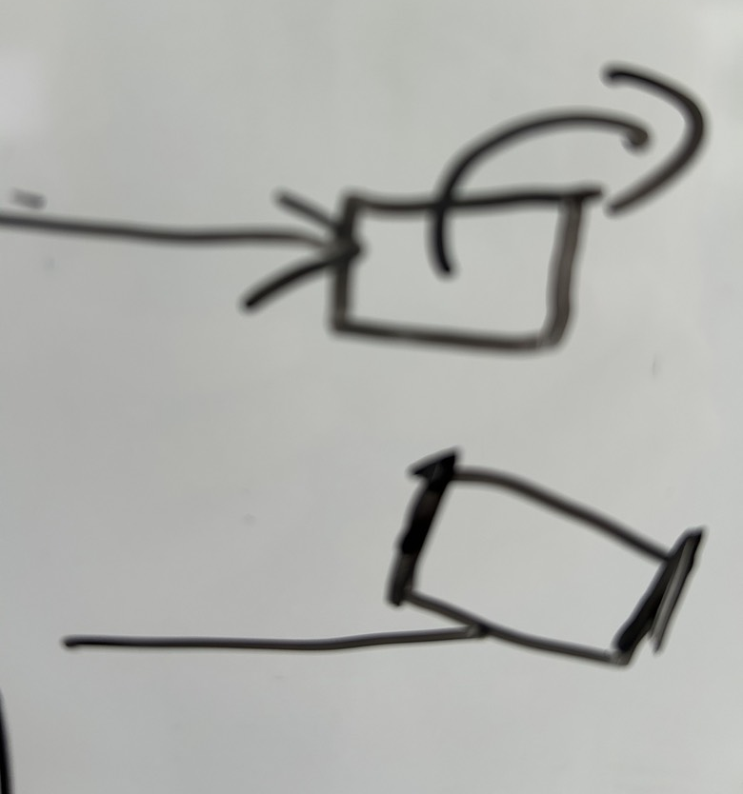
The TiSa laser with second harmonic generation
SHG crystal phase matching:
Angle of incidence
Temperature
Diffraction
Grating
SHG crystal
1. Wavemeter
2. Power meter
3. Faraday cup
Notes:
6

Slide 7
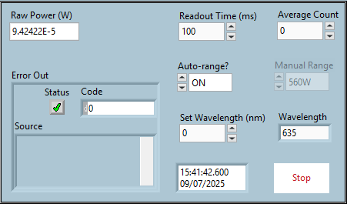
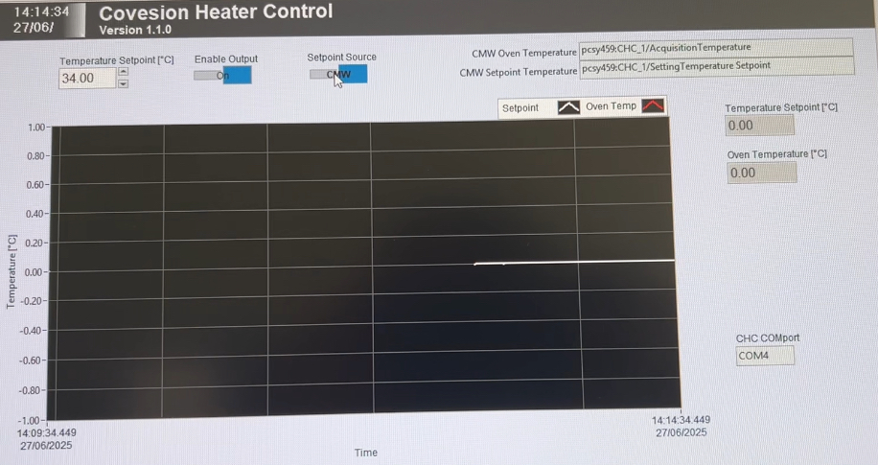
Power Meter Program

Slide 8
Oven Control Program

Slide 9
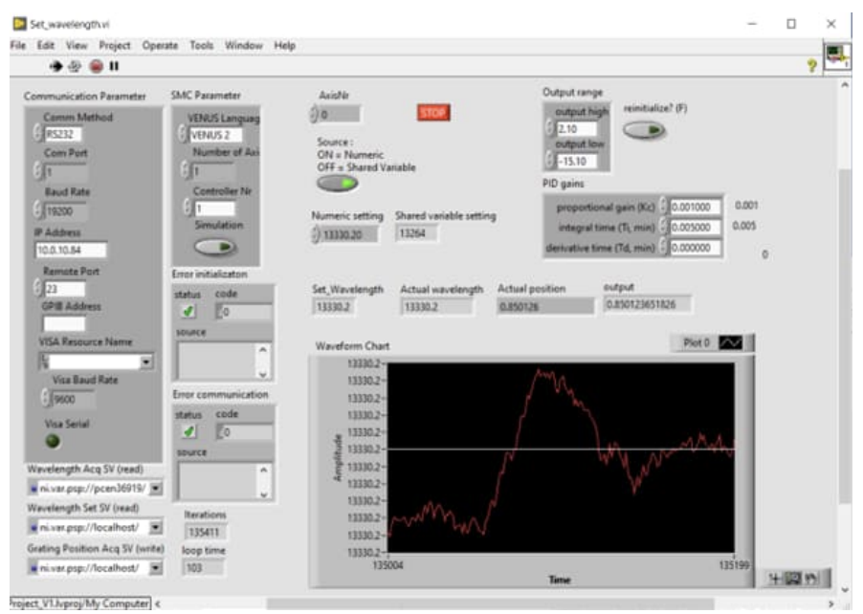
Diffraction Grating Program (in Progress)

Slide 10
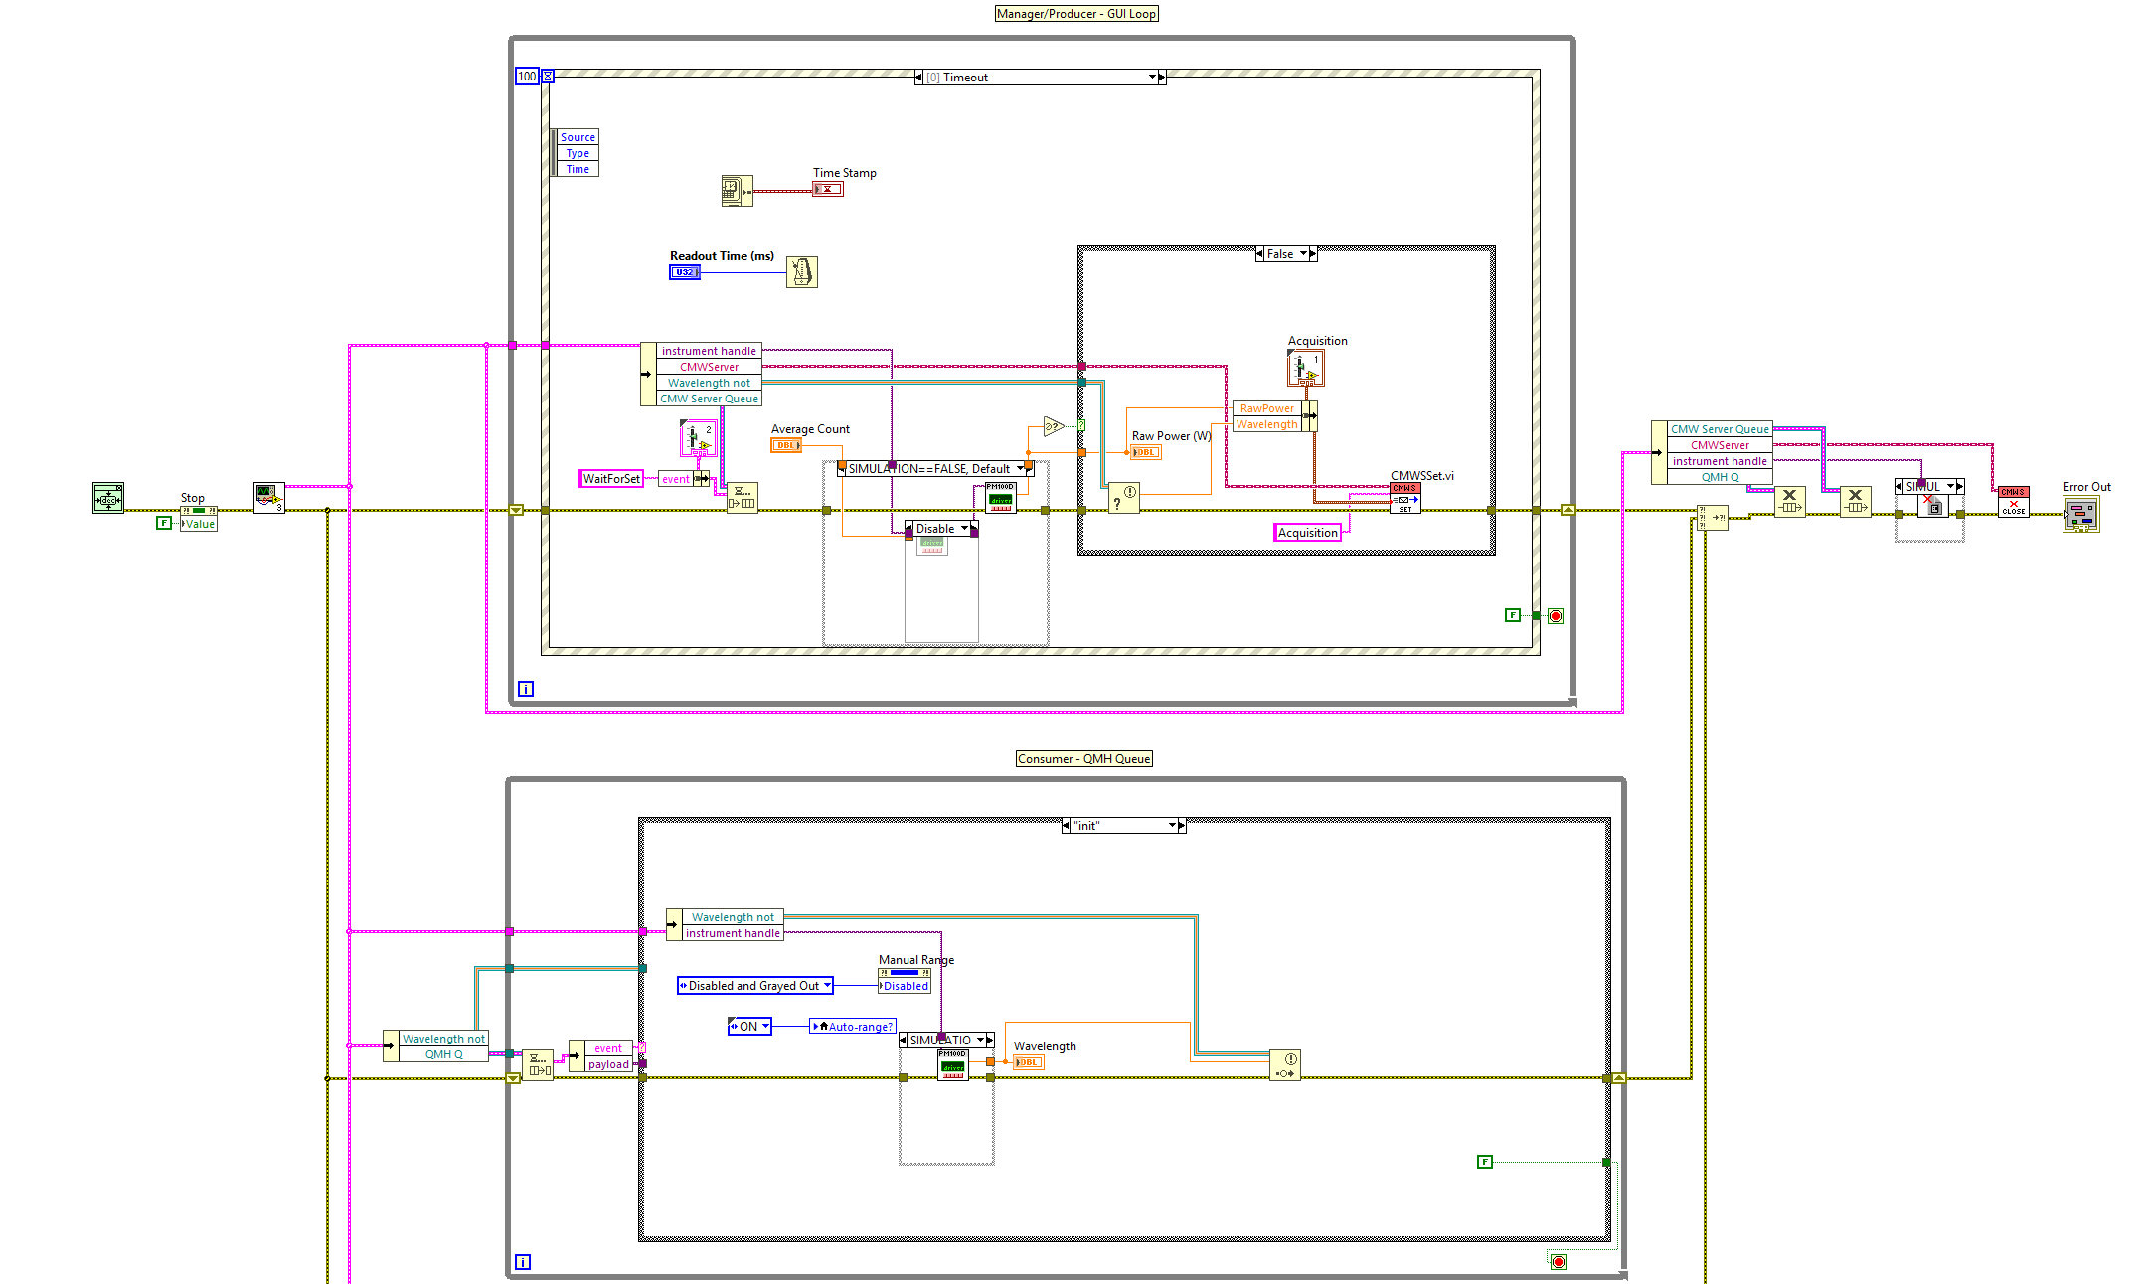
Power-Consumer Design

Slide 11
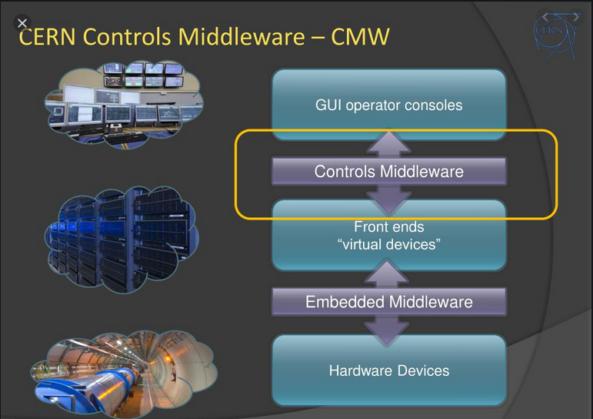
CERN CMW (Controls Middleware Project)
Provides a common software communication infrastructure for CERN accelerator controls. I’m implementing this into all my programs!

Slide 12
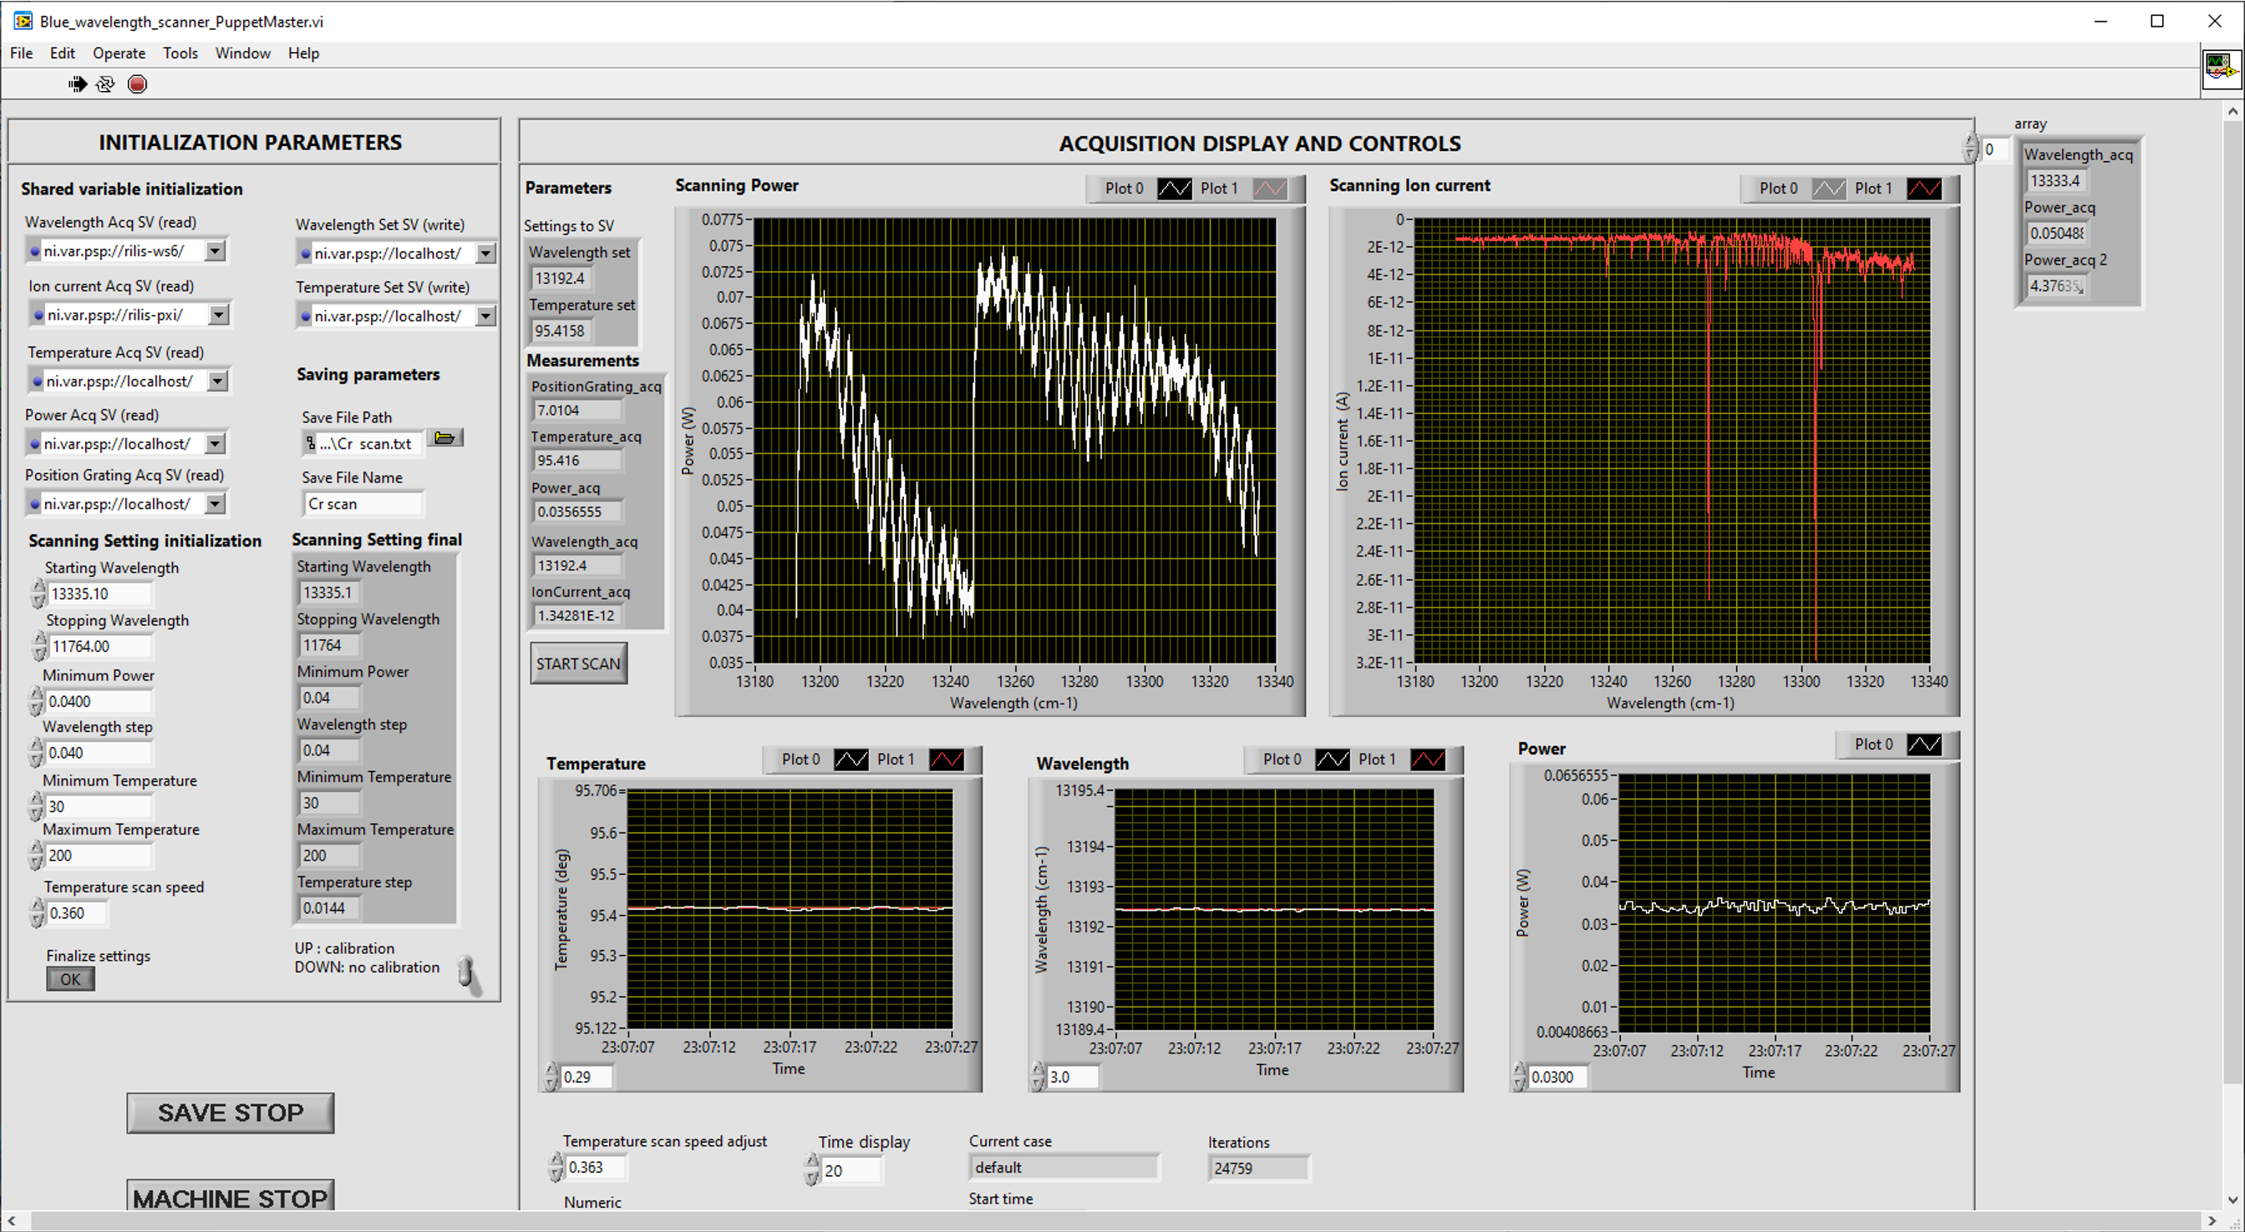
Scanning of the laser wavelength

Slide 13
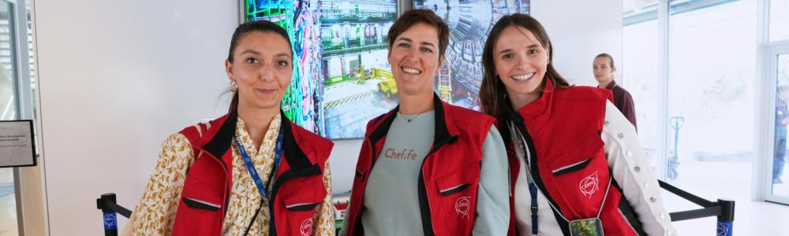
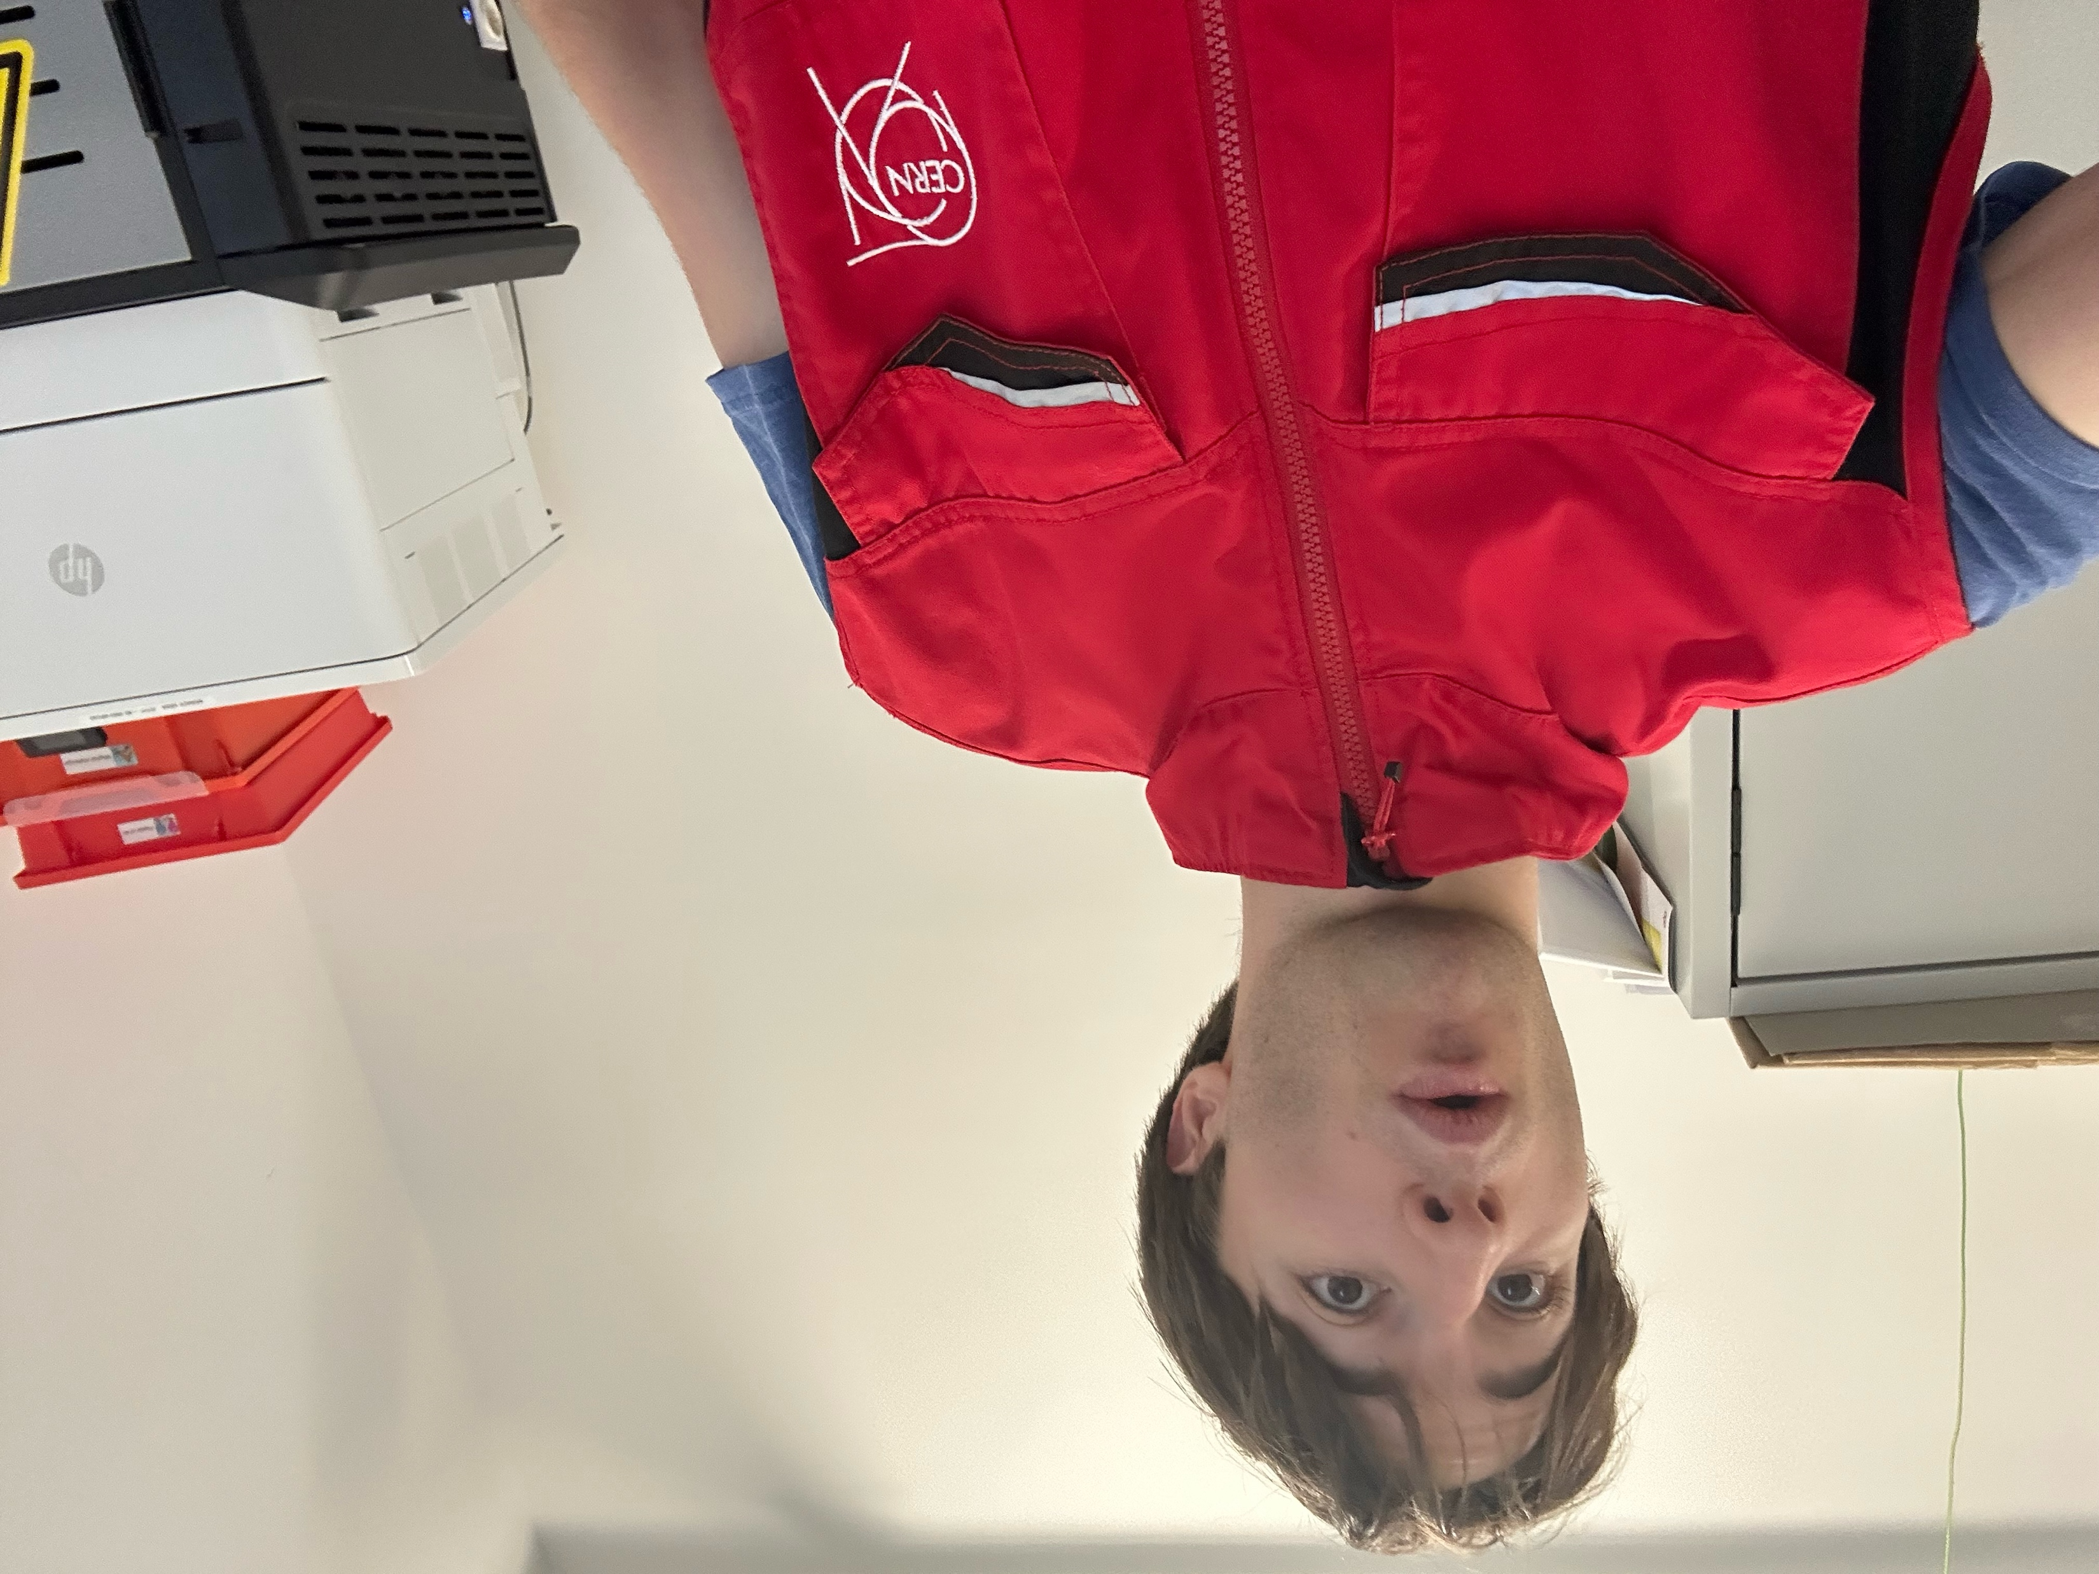
Side quest: I became a CERN guide!

Slide 14
Merci!

