Slide 1
Testing Radiation Hard Fibers for the LUCID-3 Prototype
Cole Morrison
August 8th, 2025

Slide 2
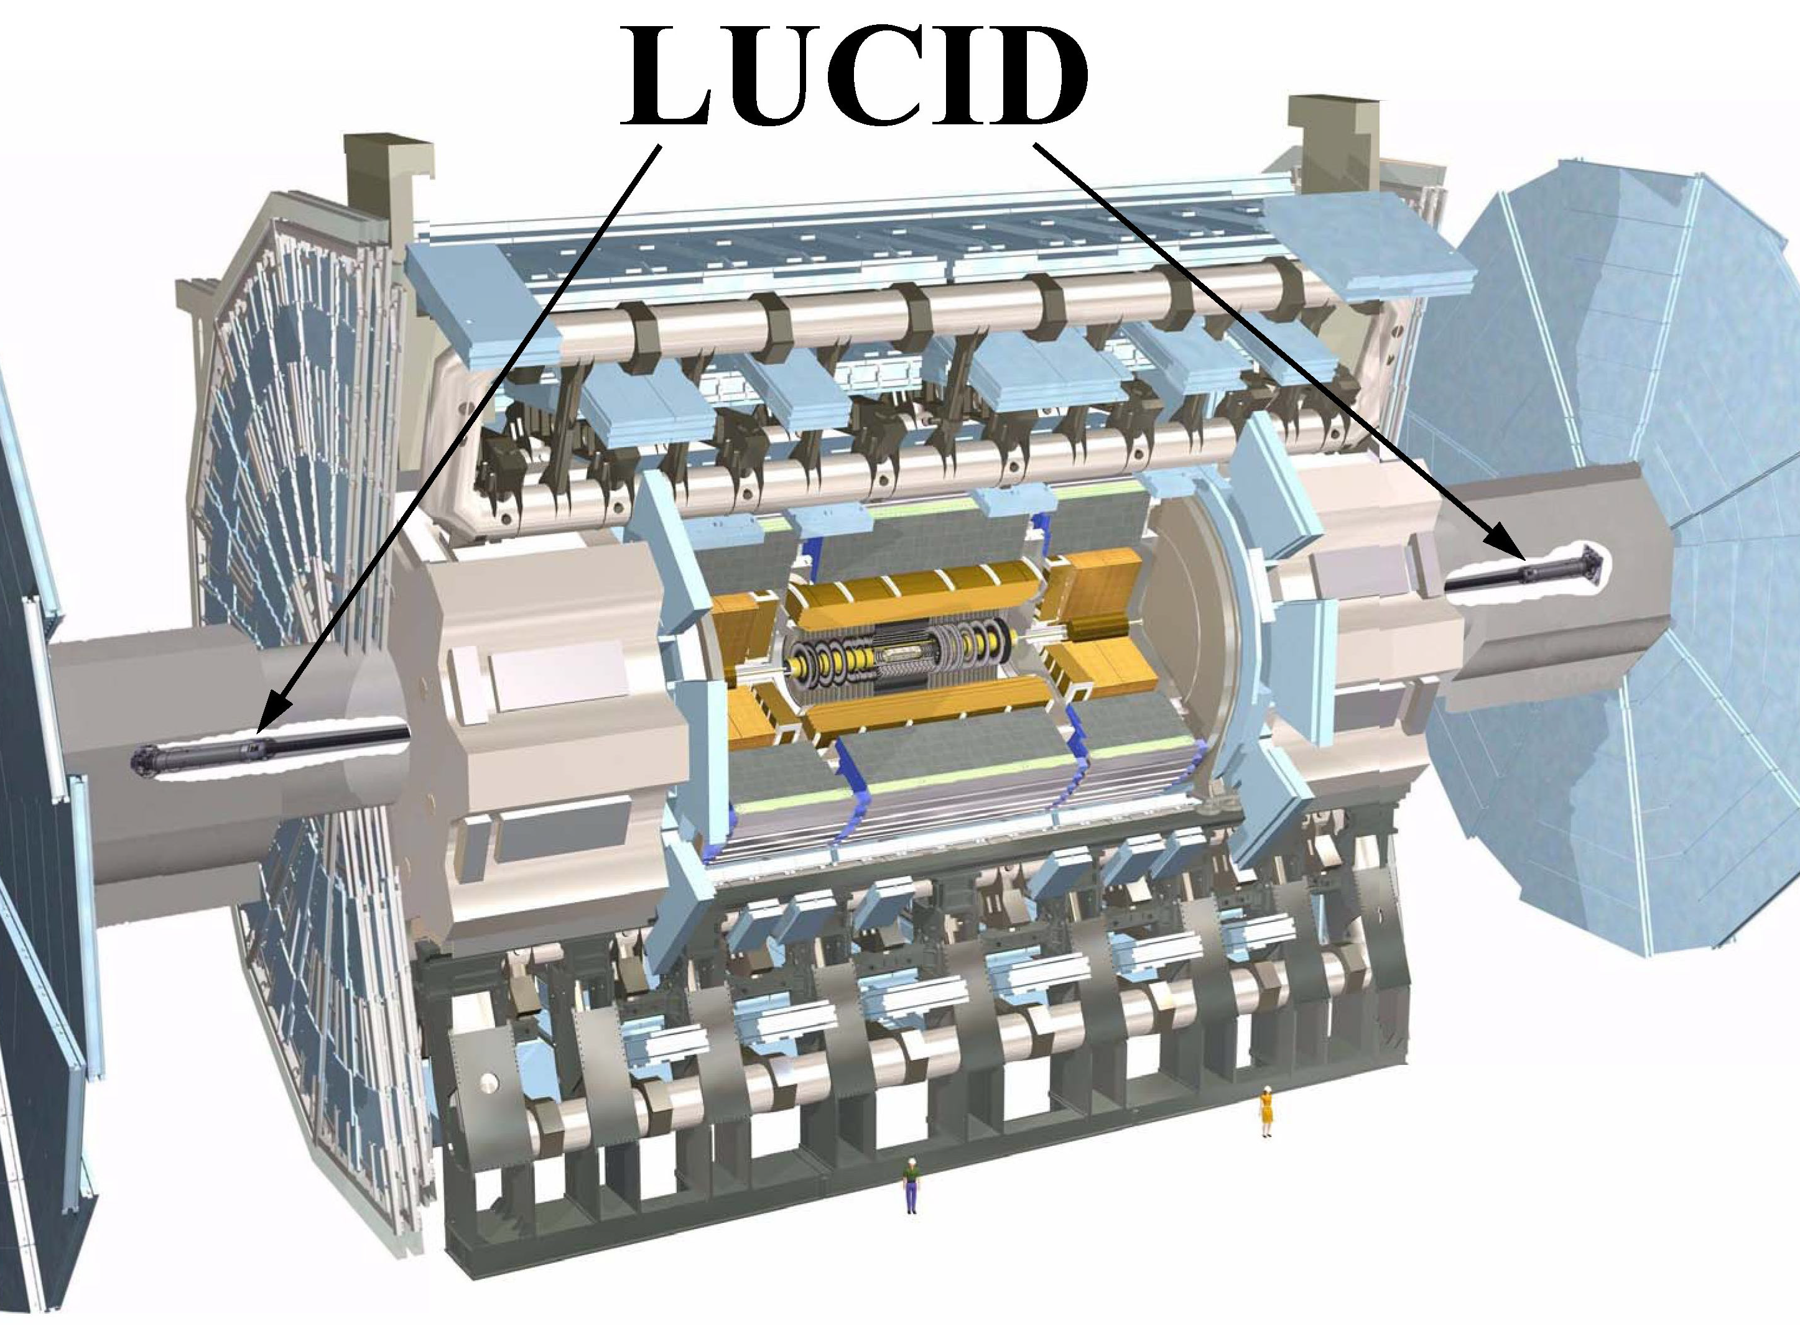
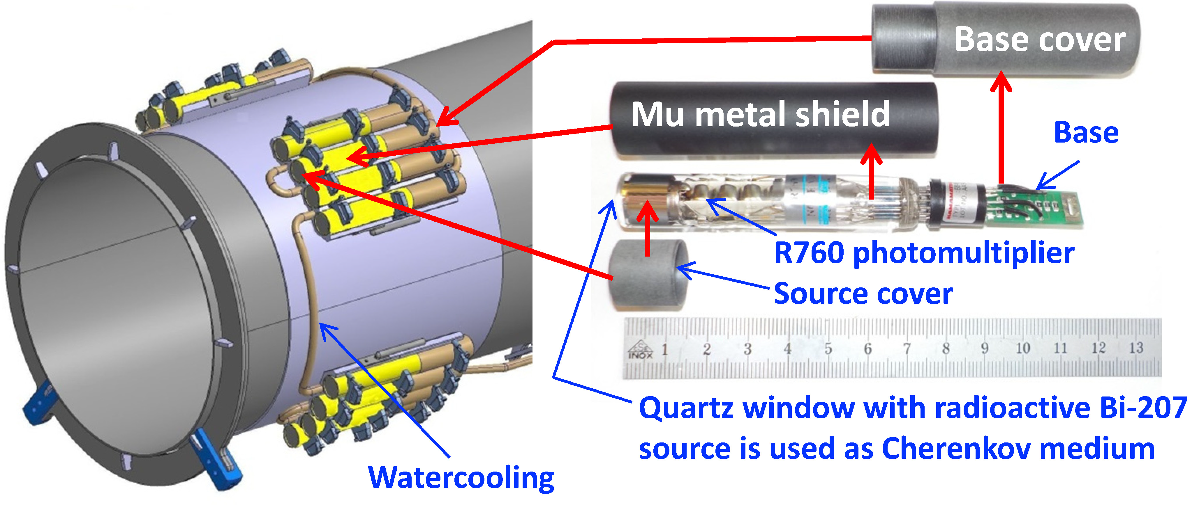
The LUCID-2 Detector
Lucid is the main luminosity detector within Atlas
Two modules are connected 17 meters on either side of the interaction point.
The current Lucid detector has PMT’s attached to the beam pipe exposing them to radiation

Slide 3
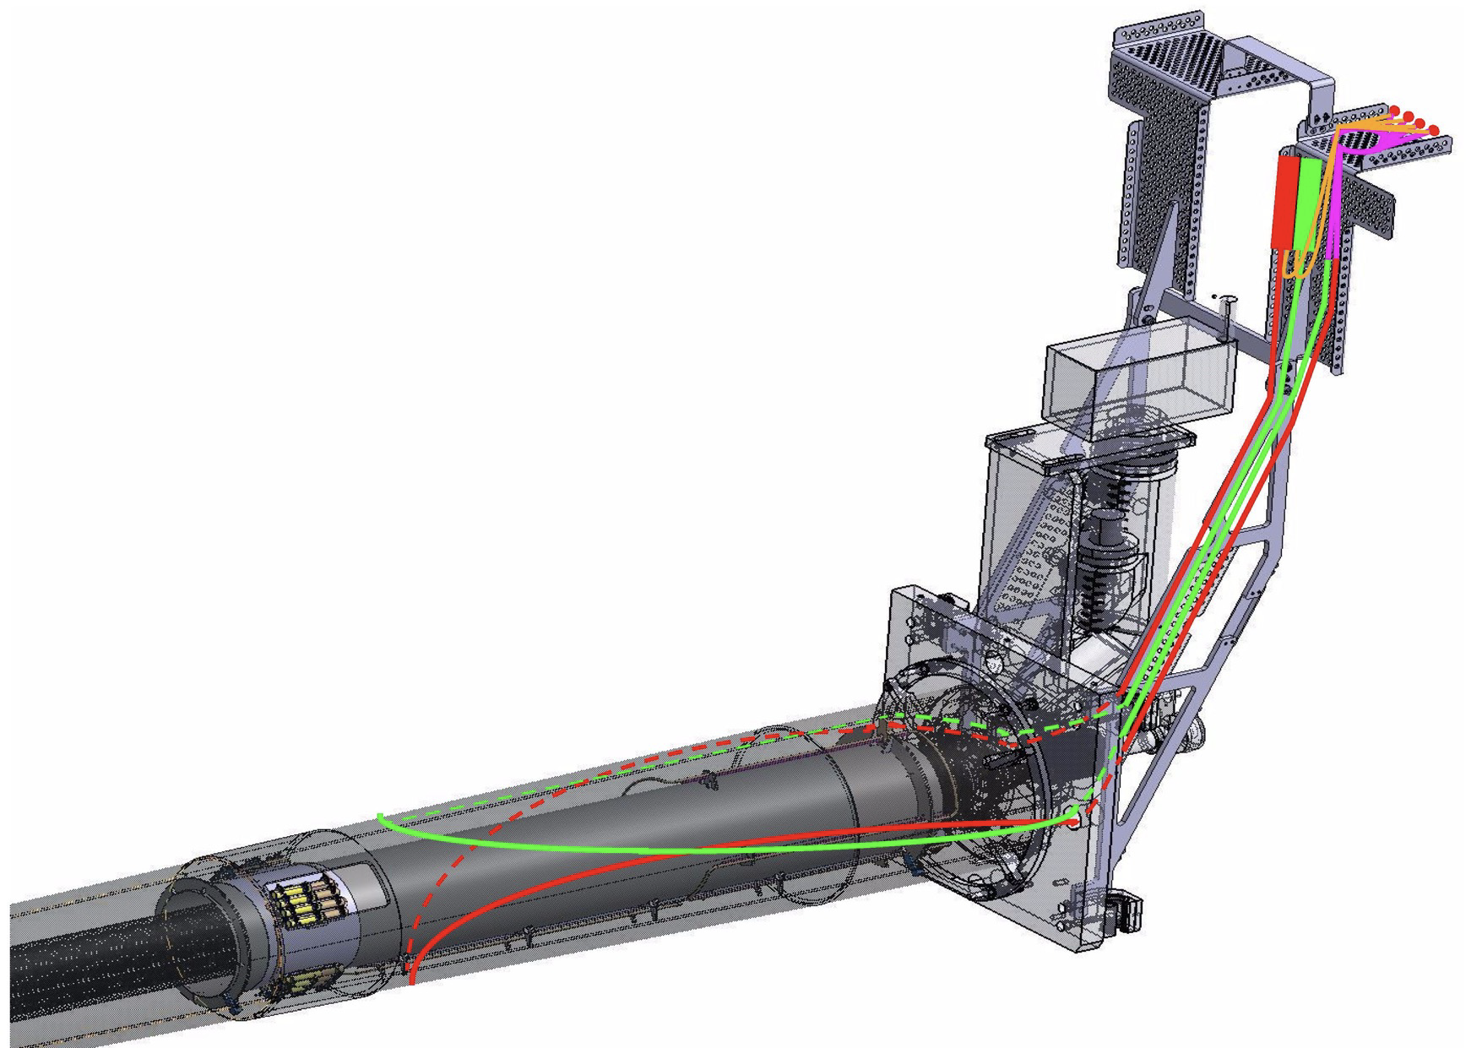
My Project and Supervisors
My project is working on the LUCID-3 detector prototype
This detector will use radiation hard optical fibers to move the PMT’s farther away from the interaction point
I will be completing benchmark transmission measurements on the fibers to establish a baseline for post-irradiation comparison
My Supervisors are Dr. Federico Lasagni and Dr. Antonello Sbrizzi

Slide 4
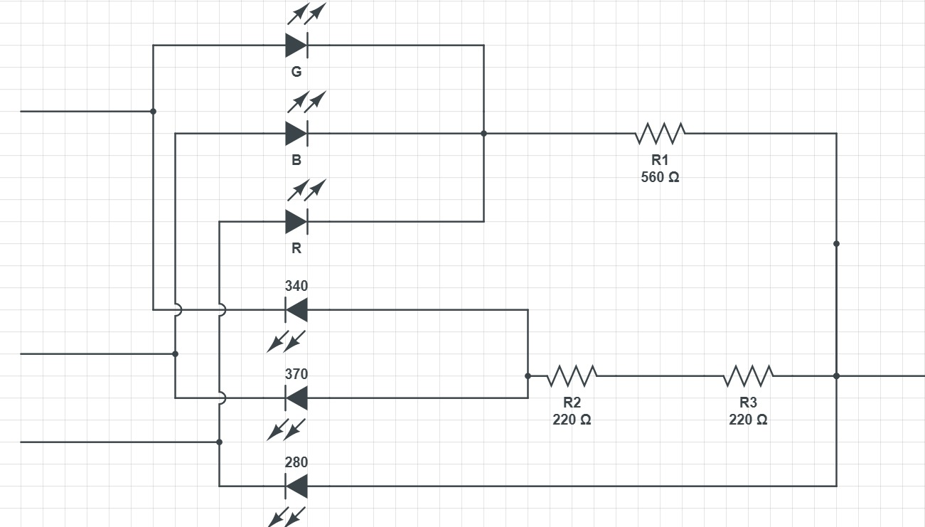
Testing Setup
RGB Array
Six LED’s of varying wavelengths were used
This custom circuit was built to reduce the number of cables needed
The six LED’s are then connected to a 4-3 distribution network

Slide 5
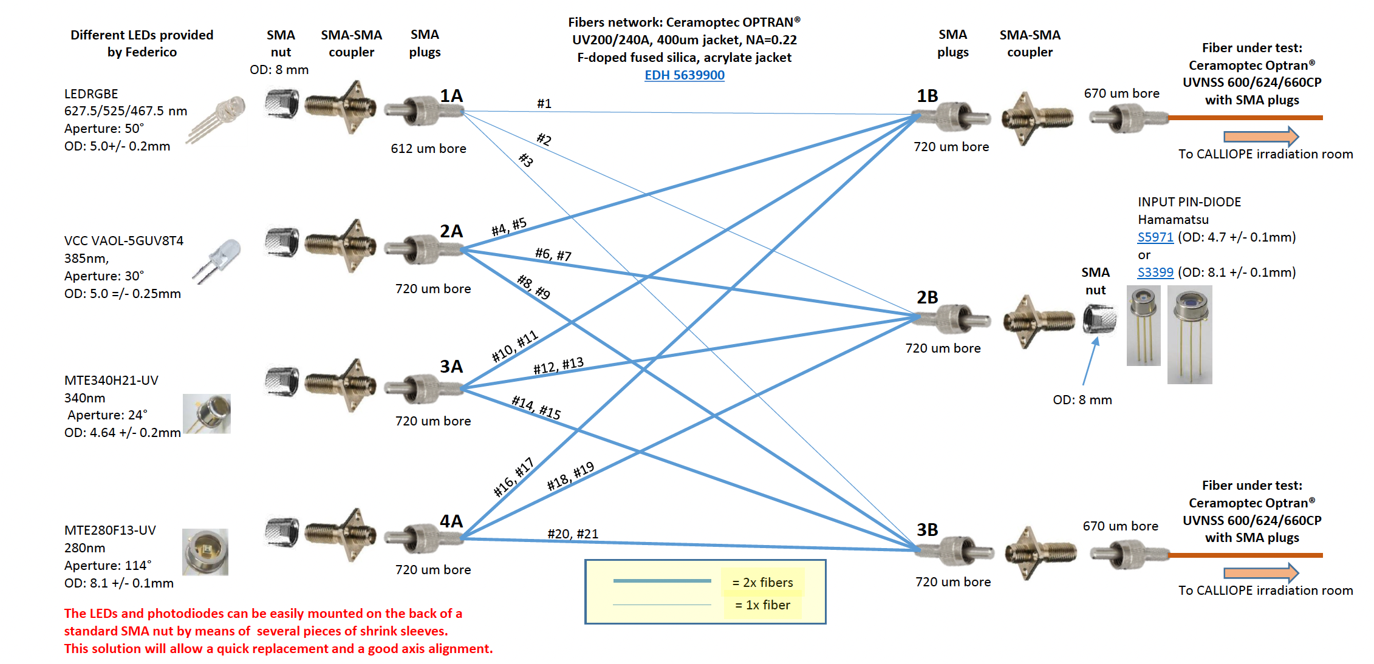
LED Distribution Network
Picoammeter
Sourcemeter
Second Picoammeter possible

Slide 6
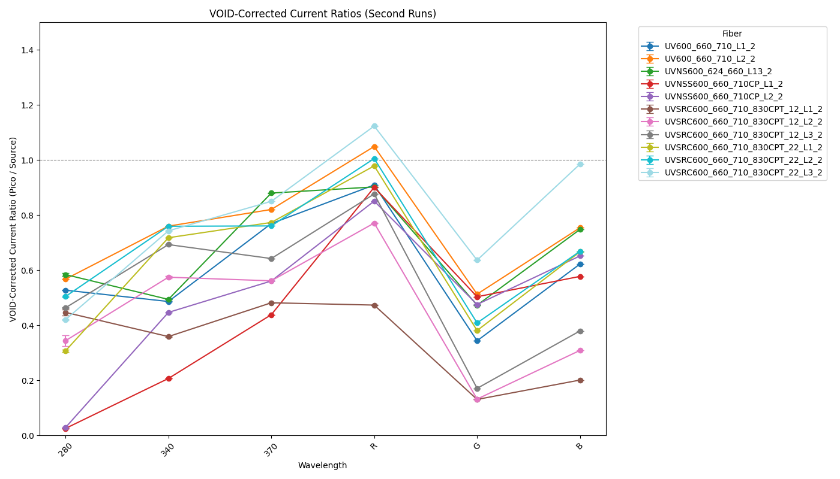
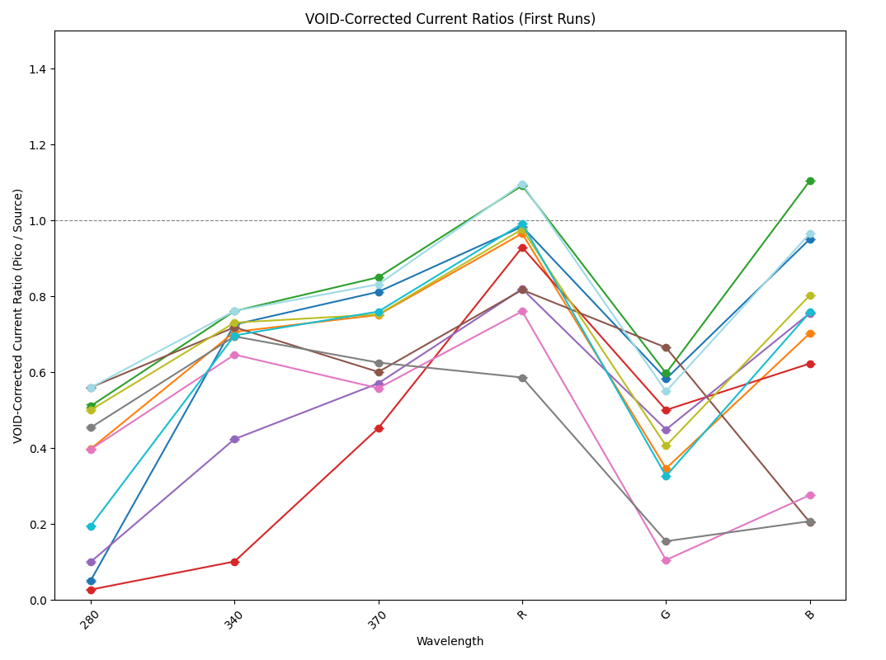
Fiber Data
Two graphs show the ratio of the picoammeter to the sourcemeter in runs 1 and 2
A difference in transmission between run 1 and run 2

Slide 7
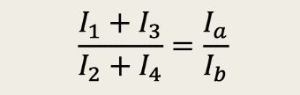





Pin Diode Corrections
$$I_{1}=Q_{a}I_{a}$$
The pin diodes convert the incident light to current
Each pin-diode has an associated quantum efficiency
Another run was done with the pin diodes flipped
This allowed the quantum efficiency to be completely canceled out
$$I_{2}=Q_{b}I_{b}$$
$$I_{3}=Q_{b}I_{a}$$
$$I_{4}=Q_{a}I_{b}$$
$$\frac{I_{1}+I_{3}}{I_{2}+I_{4}}=\frac{(Q_{a}+Q_{b})I_{a}}{(Q_{a}+Q_{b})I_{b}}$$

Slide 8
Corrections for the 280 nm Data
An external power supply was used to supply the correct voltage to the LED
Even after previous corrections the spread in the 280 data remained
The 280 nm LED requires 7 V of tension but only 5 V was being provided with the Arduino

Slide 9
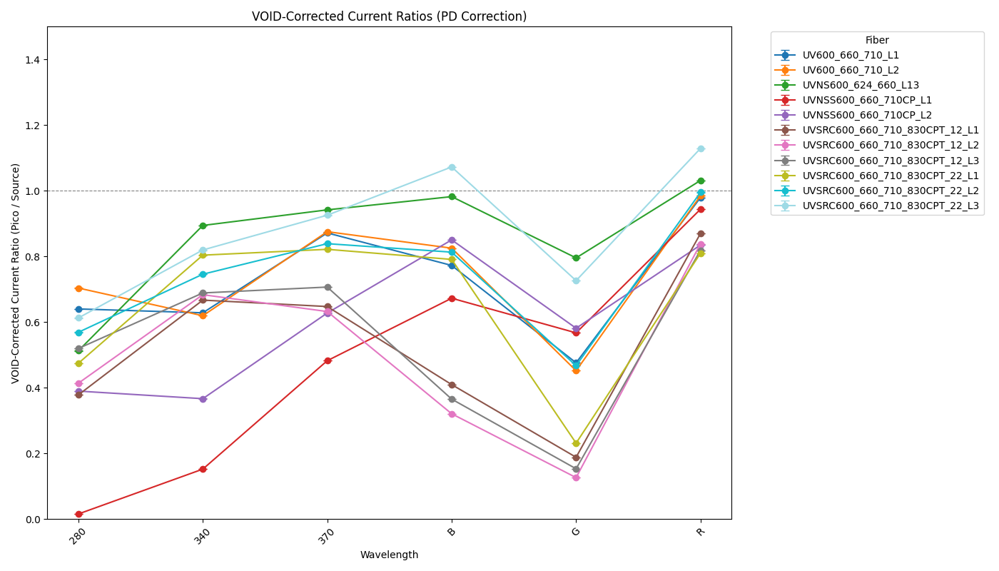
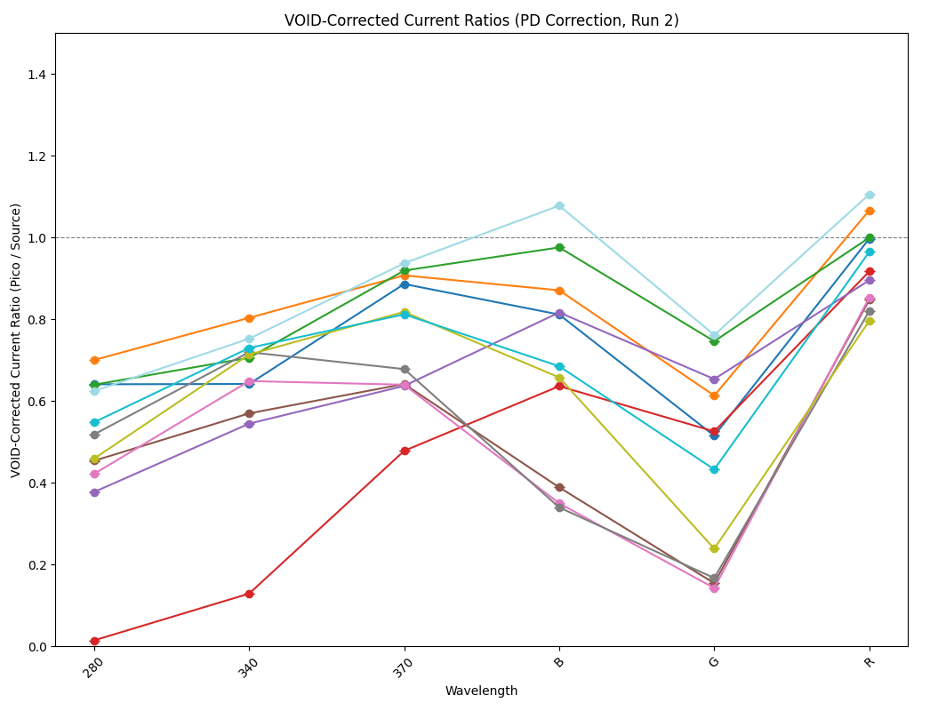
Fiber Transmission Data

Slide 10
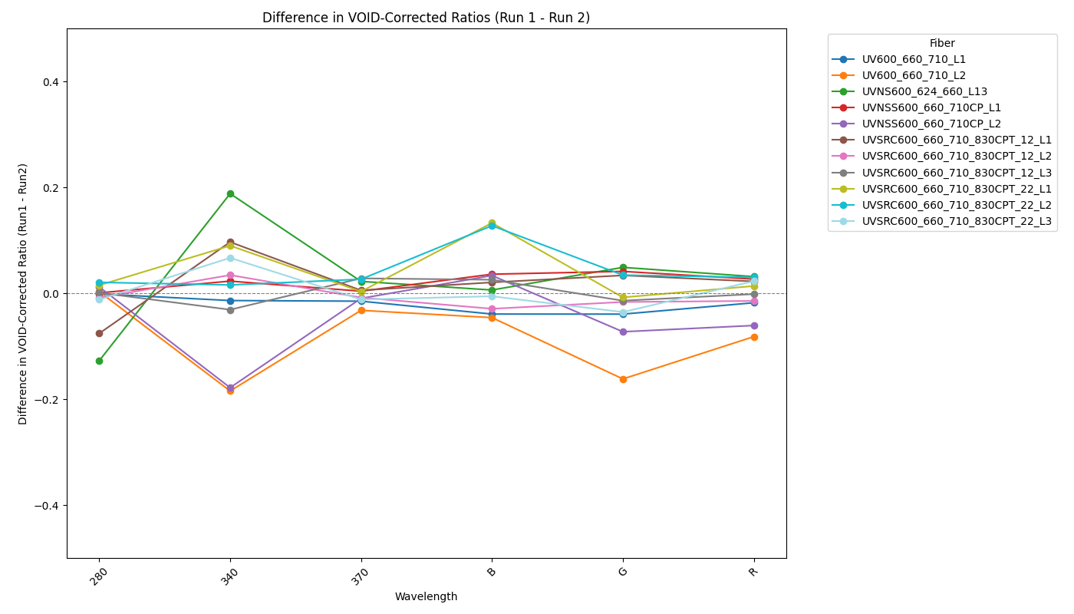
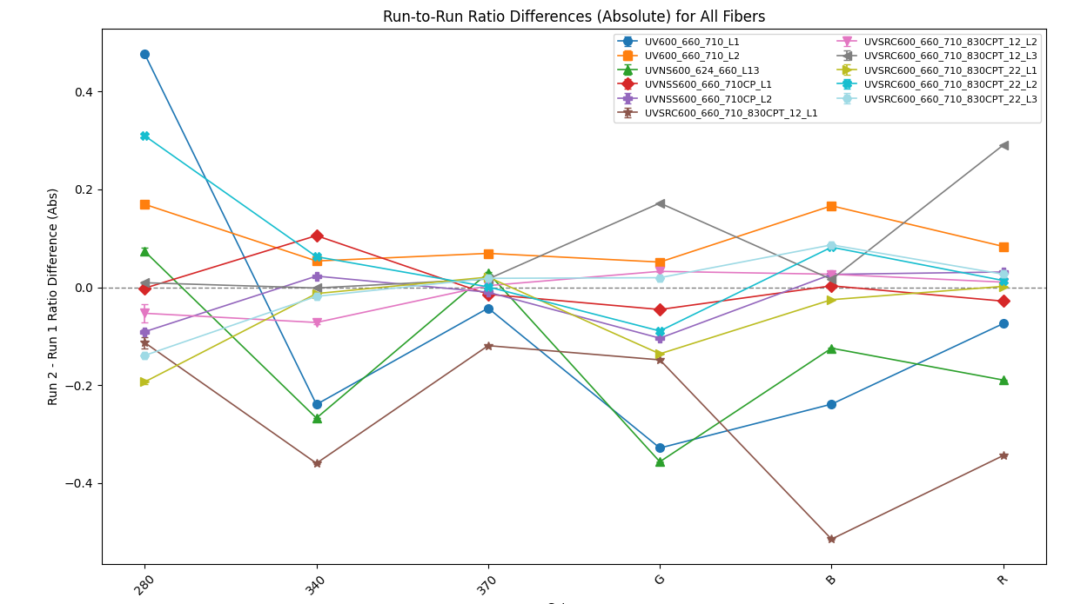
Reproducibility

Slide 11
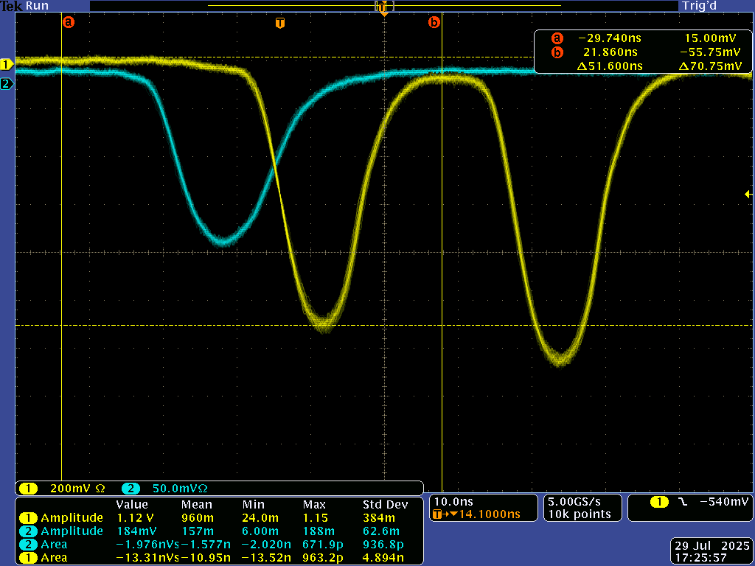
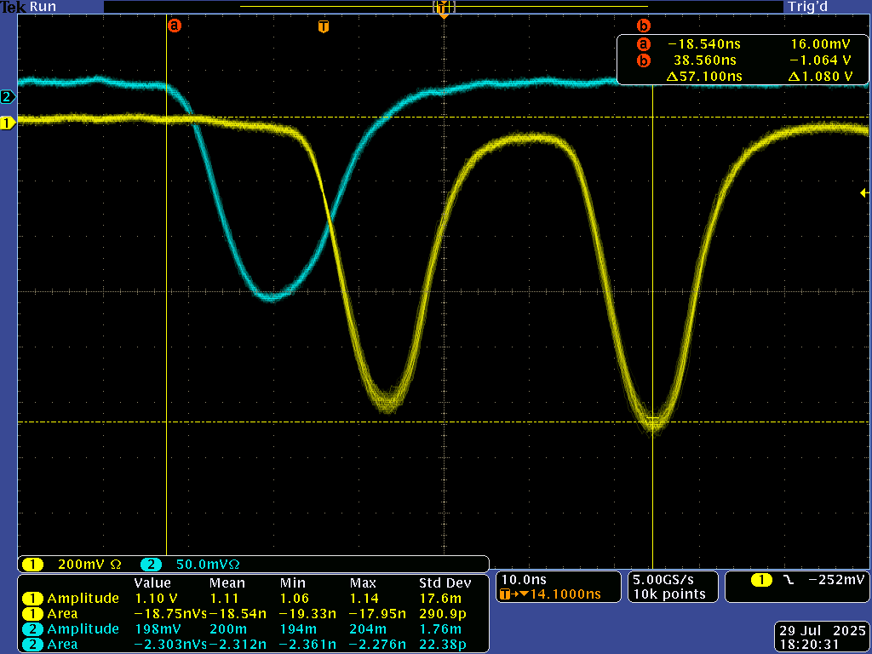
External Testing for 340 Wavelength

Slide 12
Comparison Tables from PMT Data
 | PMT testing | LED testing run 1 | LED testing run 2 | Percent Difference from Run 1 | Percent Difference from Run 2
UVNS 600/624/660/L13 | 0.788529 | 0.8944 | 0.7059 | 12.58 | 11.06
UVNSS 600/660/710 L2 | 0.725252 | 0.3666 | 0.5447 | 65.70 | 28.43
UV-SRC 600/660/710/830CPT NA=0.22 | 0.811097 | 0.8039 | 0.7525 | 0.89 | 7.50
UV-SRC 600/660/710/830CPT NA=0.12 | 0.34083 | 0.6669 | 0.5699 | 64.71 | 50.30
UV600/660/710P NA = 0.22 | 0.781341 | 0.6282 | 0.8036 | 21.73 | 2.81
UVNSS 600/624/660 NA = 0.28 irradiated | 0.151781 | 0.0642 | 0.0405 | 81.10 | 115.75
UVNSS OLD Non-irradiated | 0.832078 | 0.6934 | 0.6072 | 18.18 | 31.25
UVNSS 600/624/660 NA = 0.22 irradiated | 0.779058 | 0.8004 | 0.6585 | 2.70 | 16.77

Slide 13
Future Work for LUCID
The UVNSS fiber will need to undergo further investigation
The 280 nm LED correction suggests in the post-irradiation setup something capable of providing more than 5 Volts will be needed
The fibers will need to undergo more testing post-irradiation

Slide 14
What I have Learned
Improved skills in coding for data acquisition and data analysis
Improved my ability to work with lab equipment including circuits, oscilloscopes, and optical equipment
Better grasp on how to take a research question and develop it into a scientific report
Developed my cross-cultural communication and collaboration skills

Slide 15
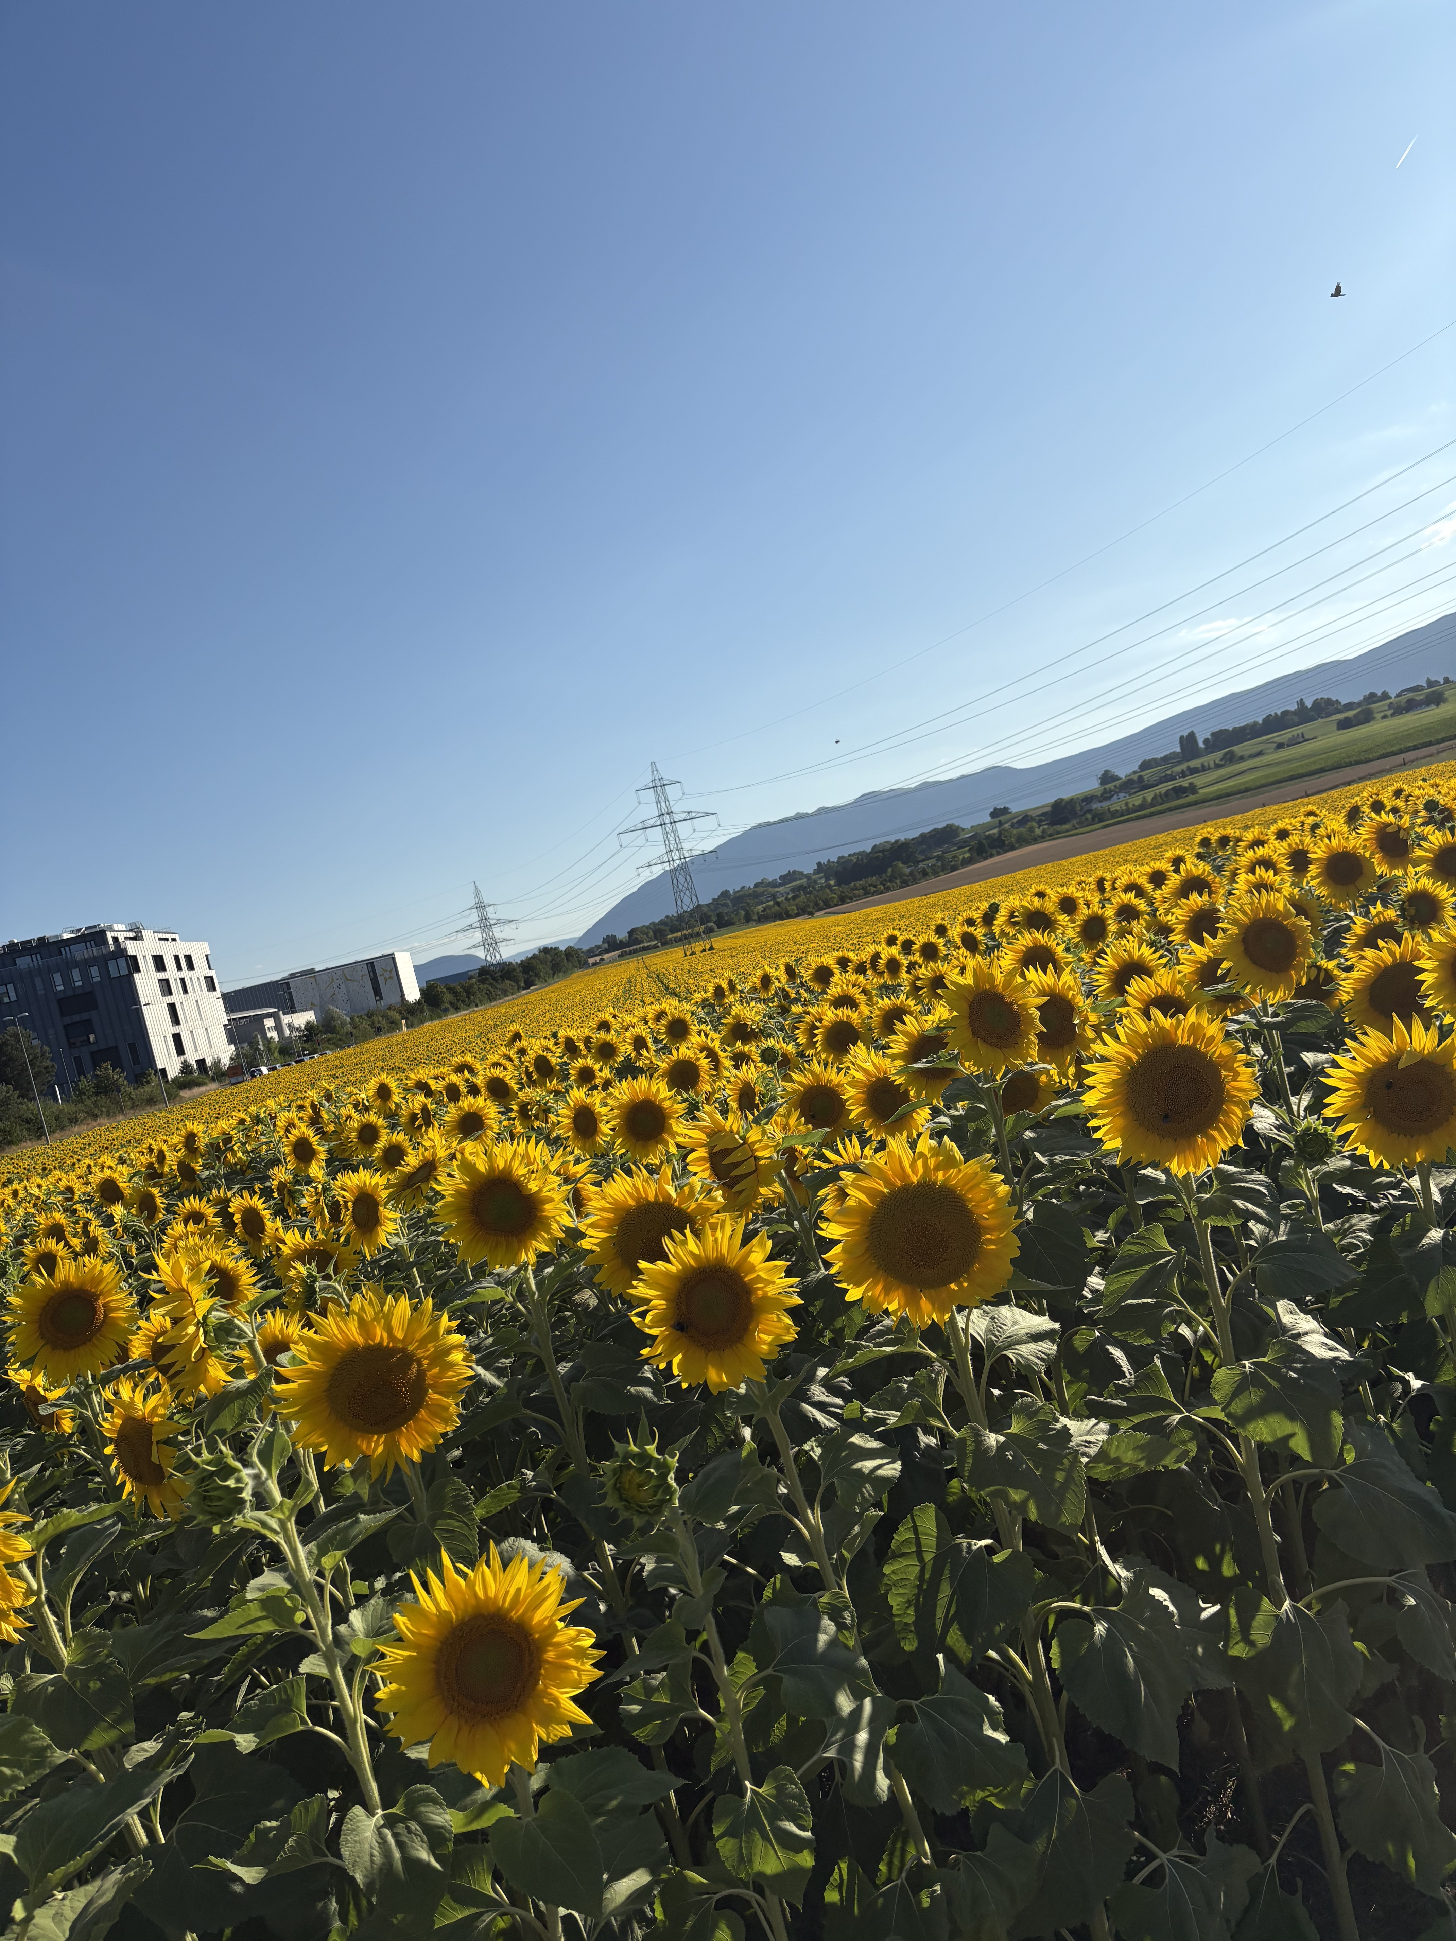
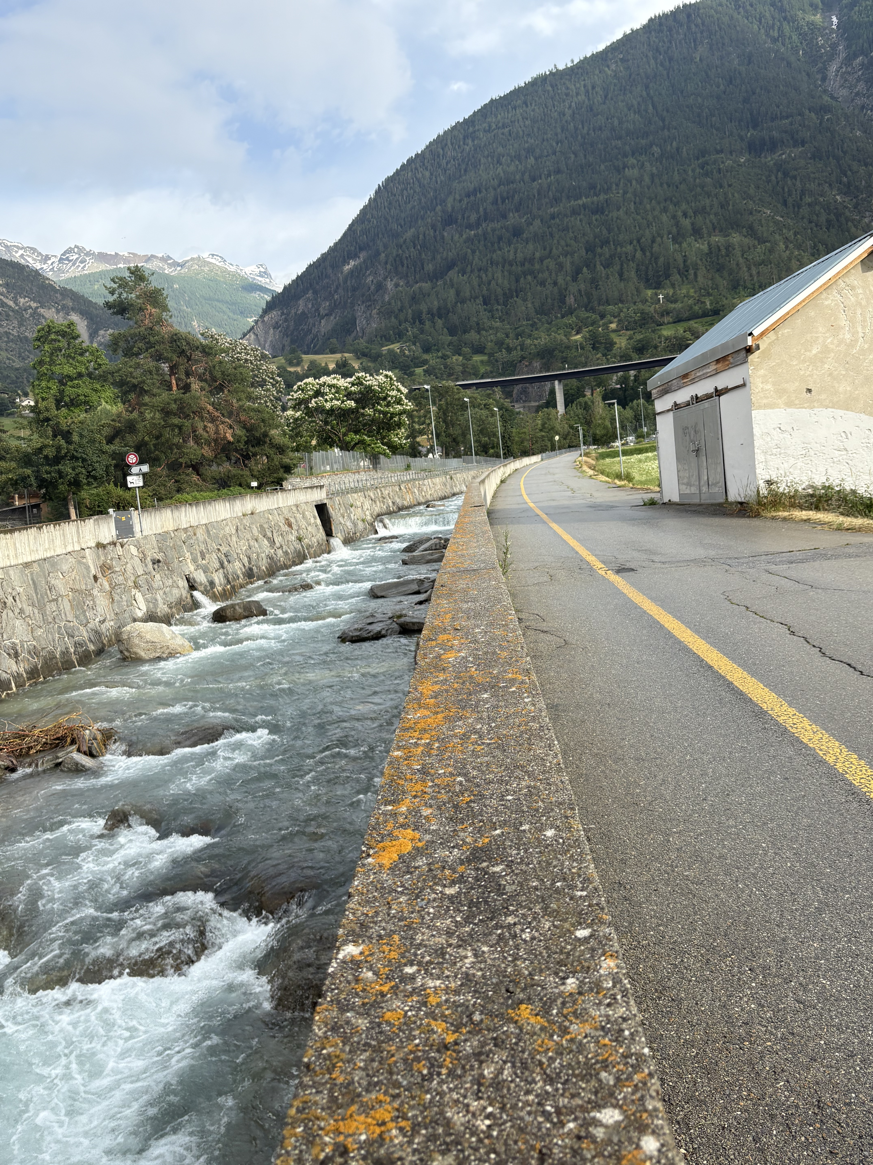
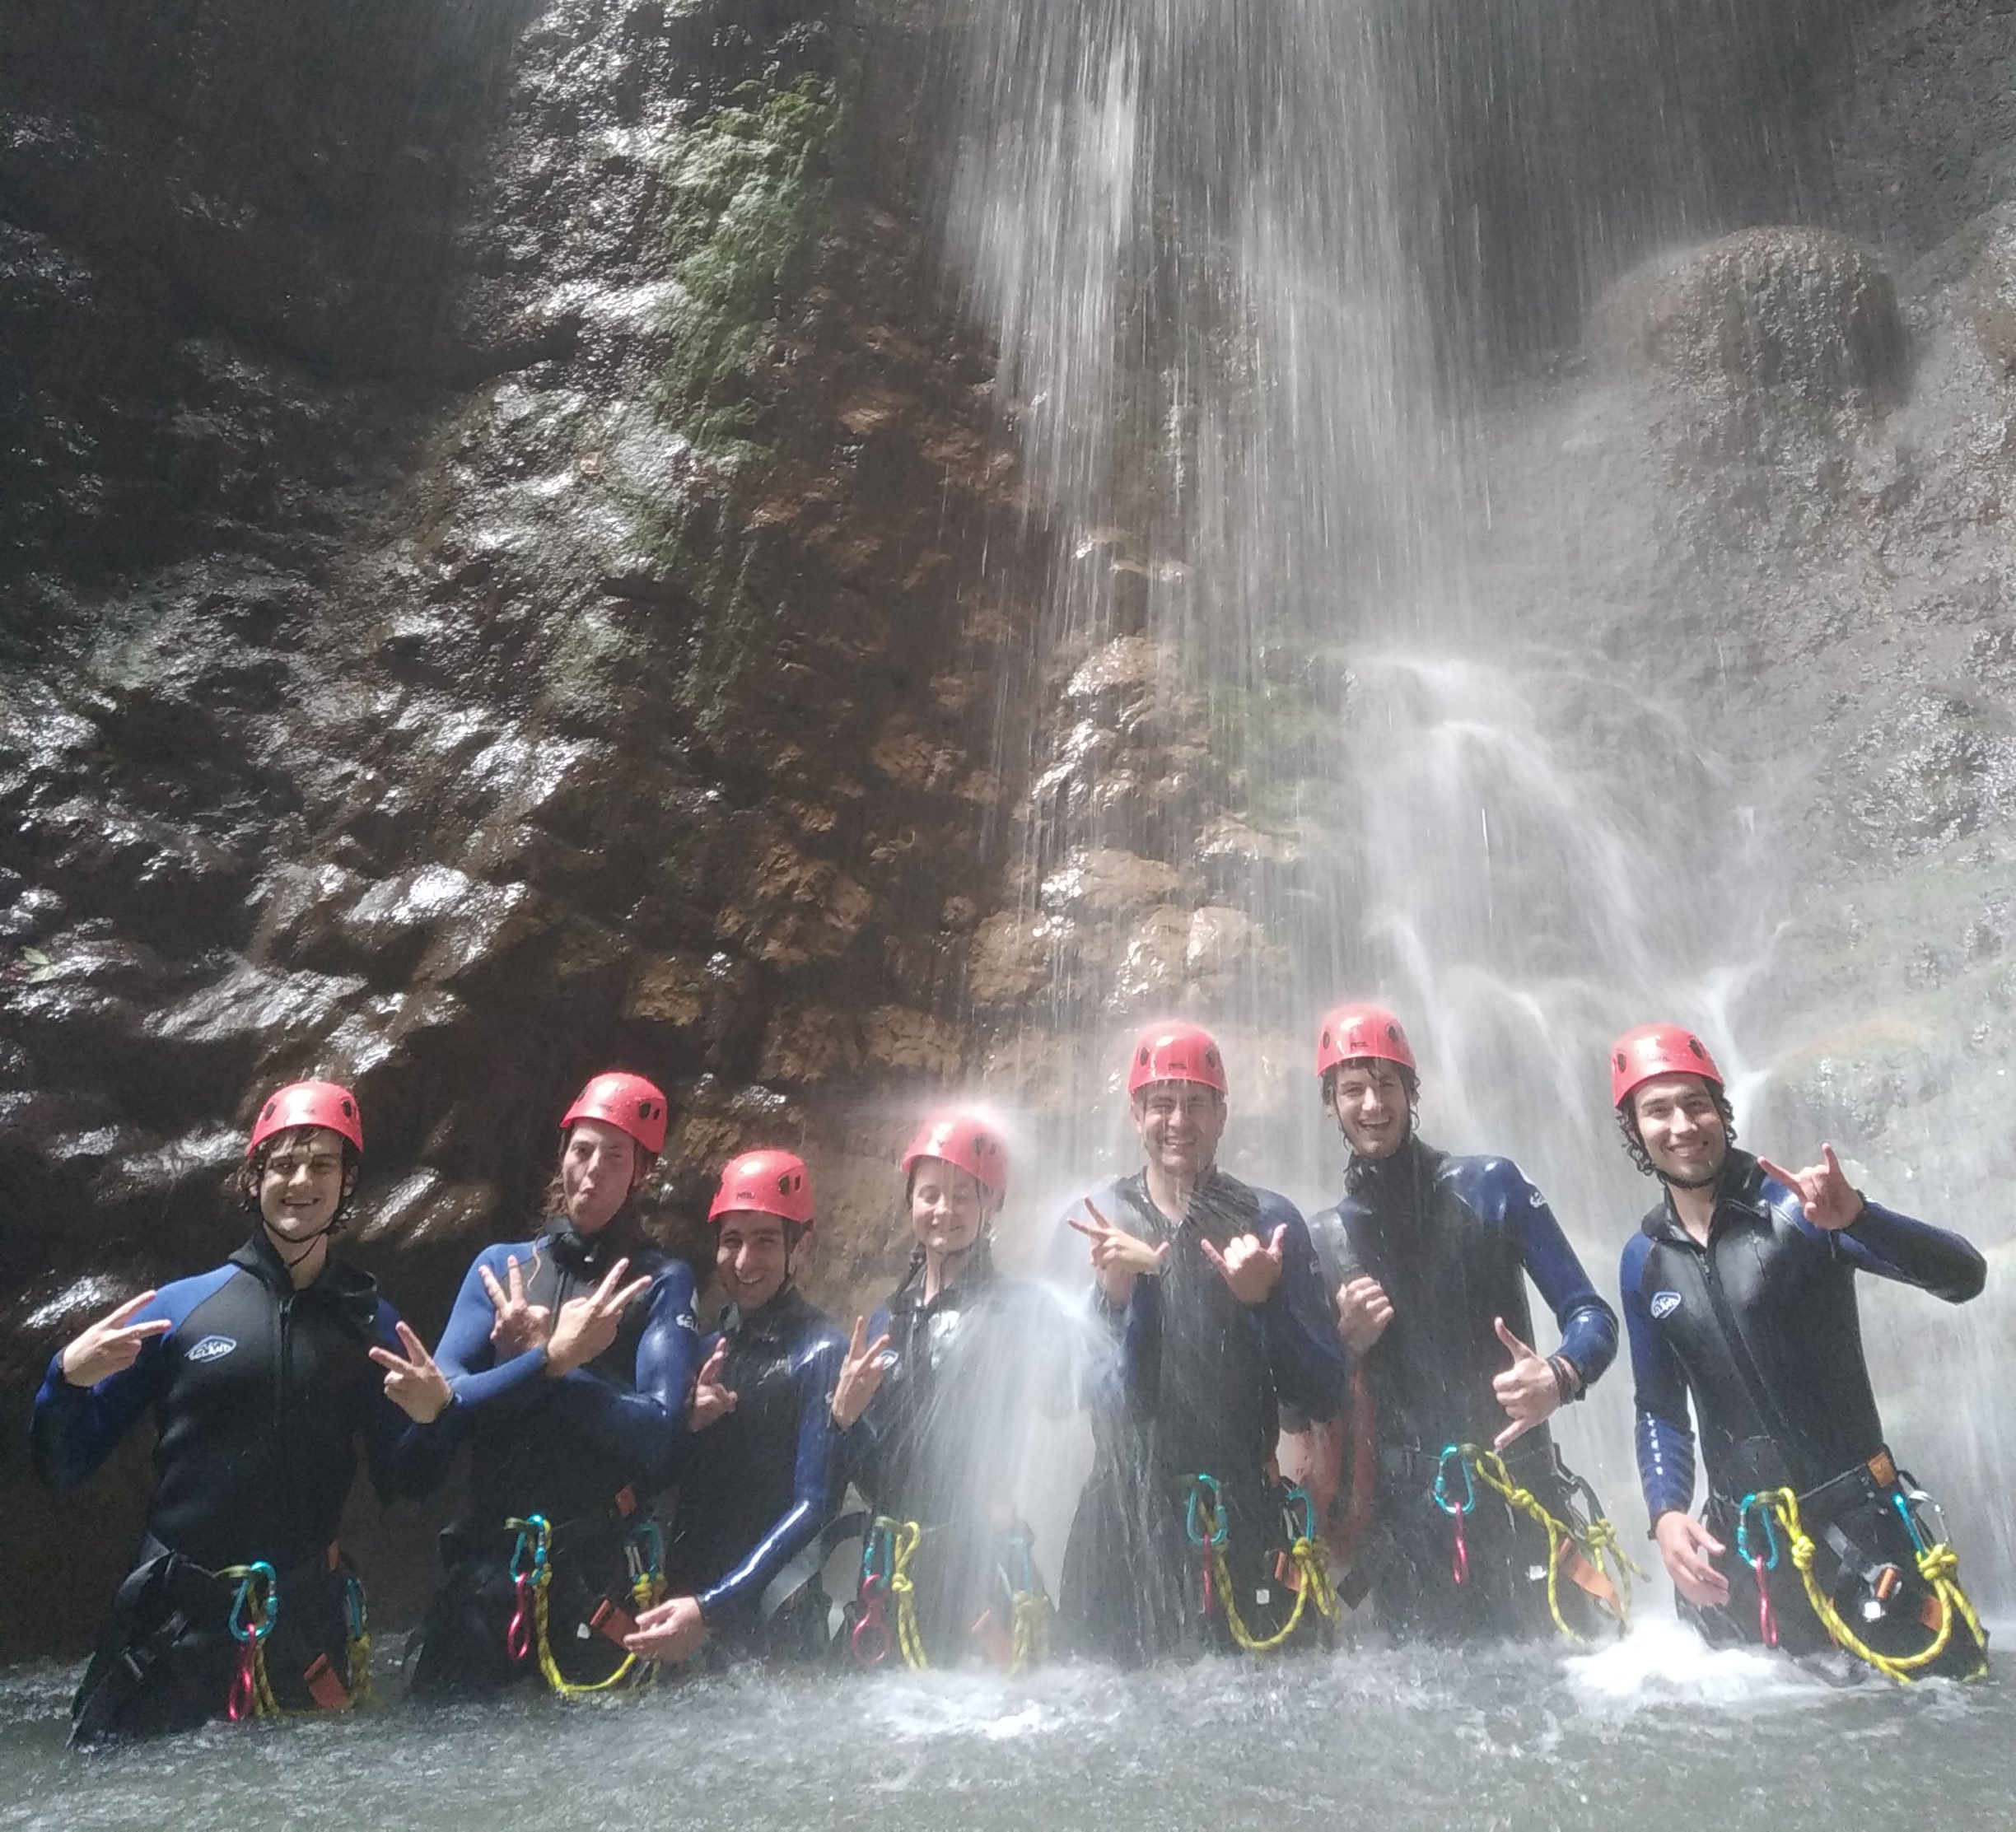
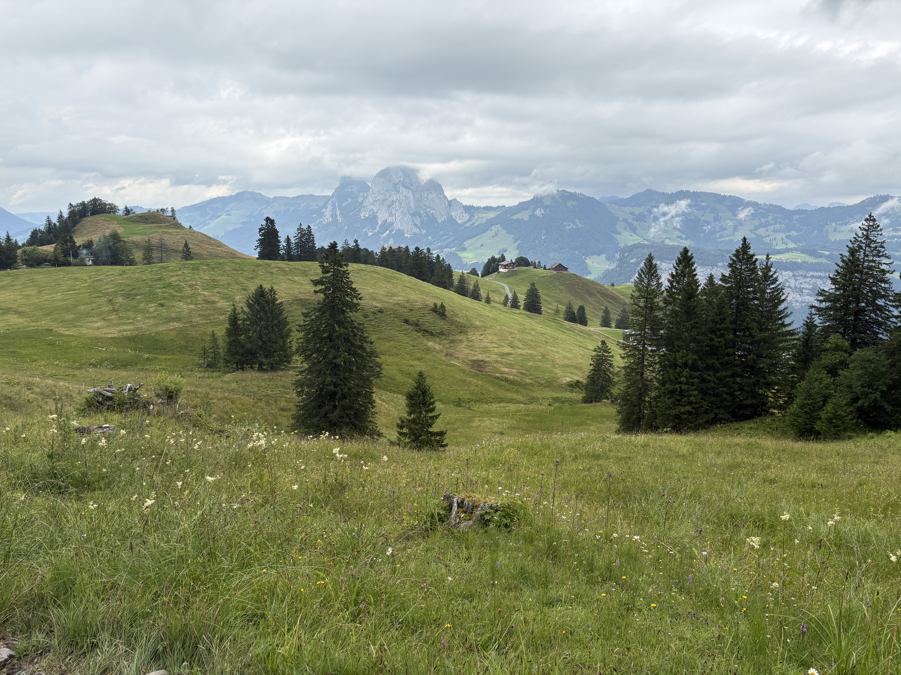
Thank You!

