Slide 1
Helium compressor Transport and Installation – 2nd draft
HI-ECN3 WP4 – C. Duran Gutierrez – EN-HE
06/06/2025

Slide 2
Content
Service Building – Equipment installation
CV Rooms – He Compressor
Conclusion
The purpose of this presentation is to establish a starting point for preparing the installation procedure for the equipment inside the new service building (B.754)
The first item to be assessed is the Helium Compressor, which will be installed in the CV room on the ground floor.
As of today (06/06/2025), it is the largest and heaviest piece of equipment.

Slide 3
Service Building – Equipment installation
1) Handling and rotation with the crane in B.911
Door dimensions
W > 2000
L > 3000
Helium Compressor Part (Ground floor)
Dimensions | 1900 x 5000 x 2300 (mm)
Weight | 12T
1900
911
911
He compressor
754
911 crane/trolley
2300

Slide 4
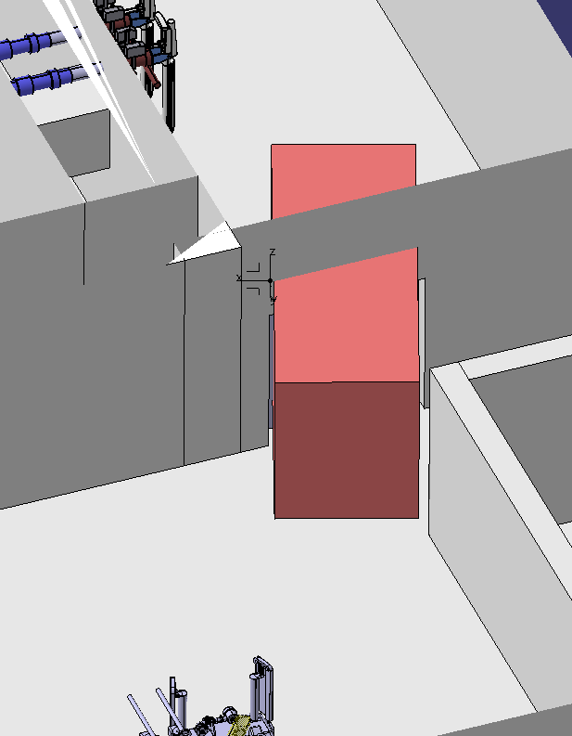
Service Building – Equipment installation
2) Transport inside B.754
754
Helium Compressor Part (Ground floor)
Dimensions | 1900 x 5000 x 2300 (mm)
Weight | 12T
Door | 2068 (w) x 2100 (h)
754
He compressor
754 crane
If the internal layout of B.754 changes, we can reconsider the option of moving the volume with a trolley.
Difficult access with trolley

Slide 5
Service Building – Equipment installation
2) Transport inside B.754
Helium Compressor Part (Ground floor)
Dimensions | 1900 x 5000 x 2300 (mm)
Weight | 12T
H. Service cell = 6500 mmm
754
Based on the current building layout:
The space to manoeuvre a trolley in front of the doors is limited
The only viable option to transport the compressor is by using the crane. However:
Limited height clearance → collision with the separating wall
A dedicated compact spreader could be designed
7300
2300
He compressor
5500
This wall height must be reduced to pass with the compressor (H < 3500)

Slide 6
Service Building – Equipment installation
2) Transport inside B.754
Helium Compressor Part (Ground floor)
Dimensions | 1900 x 5000 x 2300 (mm)
Weight | 12T
The 1st floor mezzanine should be positioned at a higher level
Based on the current building layout:
The space to manoeuvre a trolley in front of the doors is limited
The only viable option to transport the compressor is by using the crane. However:
Limited height clearance → collision with the separating wall
A dedicated compact spreader could be designed
Once in the telemanipulator zone, the doors must meet the requirement dimensions to allow the compressor to pass through
Width = 2068 (could be ok)
Height = to be further discussed in conjunction with the transport trolley
Assess space for maintenance after telemanipulator installation.

Slide 7
Service Building – Equipment installation
3) Transport into the CV Room
Helium Compressor Part (Ground floor)
Dimensions | 1900 x 5000 x 2300 (mm)
Weight | 12T
CV Room Ground floor
Height | 3600 mm
Door | 2460 (w) x 2500 (h)
Current clearance – 1300 mm
The height of the 1st floor must be increased:
To provide space for a transport trolley
Dimensions to be determined
To accommodate a larger door
Height to be decided (based on the means of transport)
He compressor

Slide 8
Service Building – Equipment installation
3) Transport into the CV Room
Helium Compressor Part (Ground floor)
Dimensions | 1900 x 5000 x 2300 (mm)
Weight | 12T
CV Room Ground floor
Height | 3600 mm
Door | 2460 (w) x 2500 (h)
He compressor
Current clearance – 1300 mm
The height of the 1st floor must be increased:
To provide space for a transport trolley
Dimensions to be determined
To accommodate a larger door
Height to be decided (based on the means of transport)
Installation sequence to be carefully studied and planned.

Slide 9
Service Building – Equipment installation
3) Transport into the CV Room
Questions
Layout
Will there be a second Helium compressor?
What are the maintenance requirements of the different pieces of equipment?
Are there any short-term decommissioning possibilities?
He compressor

Slide 10
Service Building – Equipment installation
3) Transport into the CV Room
Questions
Layout
Will there be a second Helium compressor?
What are the maintenance requirements of the different pieces of equipment?
Are there any short-term decommissioning possibilities?
Assess
Rotation and installation of the Helium compressor using rollers or a hoist (>12T)
1 hoist (or multiple)
Water Tanks rotation
Compact crane (?)
xT rails
15T rail
He compressor

Slide 11
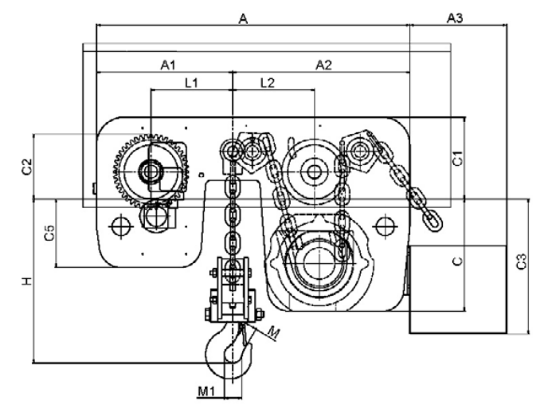
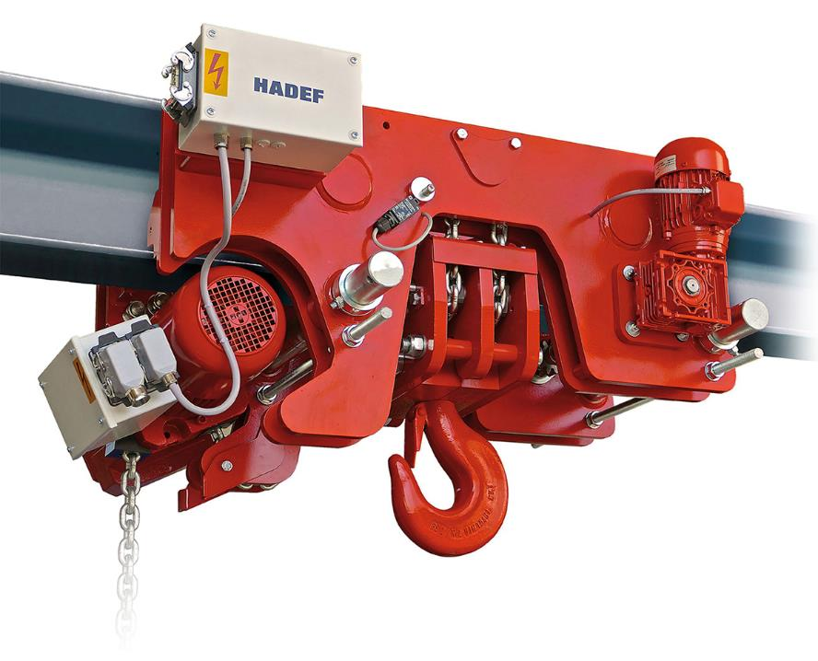
Service Building – Equipment installation
Handling tooling proposals for the CV Rooms
16T TRAVELLING ELECTRIC CHAIN HOIST – ground floor
Electric chain hoist 29/06 EE HADEF
Min. headroom = 487 mm

Slide 12
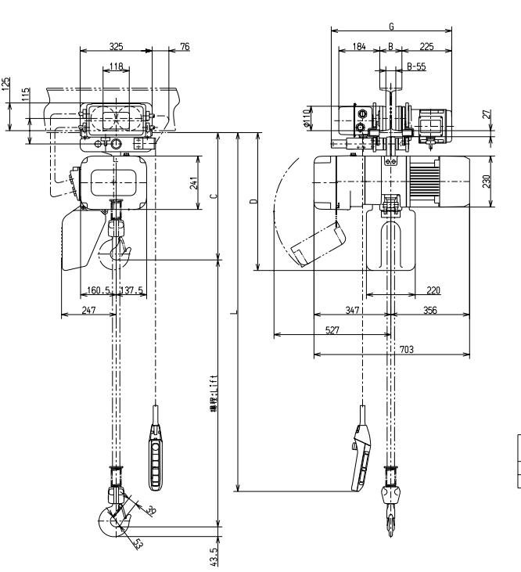
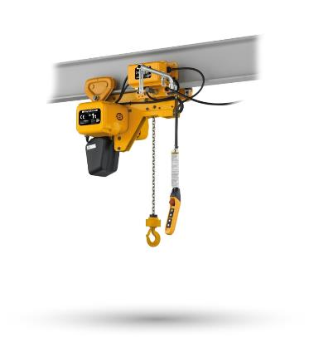
Service Building – Equipment installation
Handling tooling proposals for the CV Rooms
Electric chain hoist / KITO
2T TRAVELLING ELECTRIC CHAIN HOIST – 2nd floor
Min. headroom = 585 mm

Slide 13
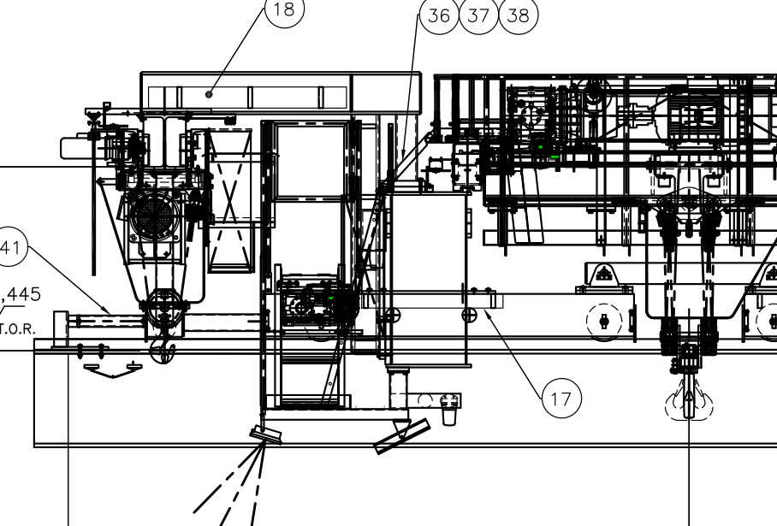
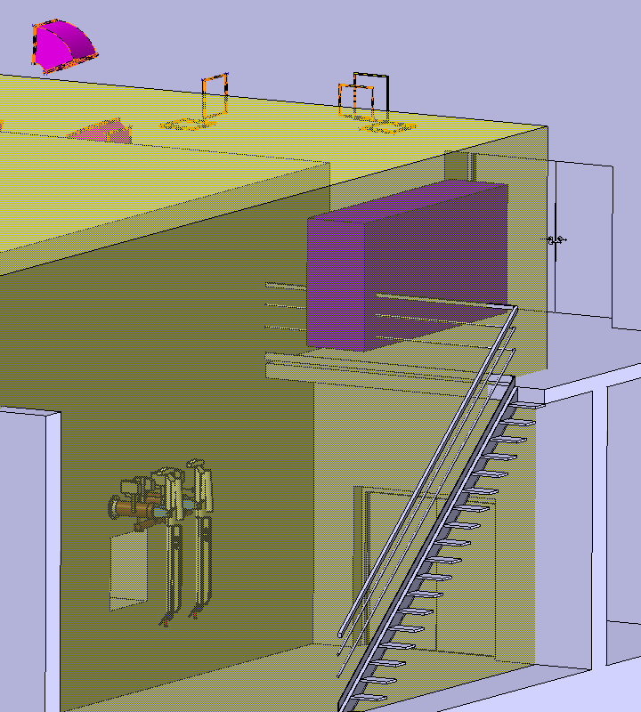
Service Building – Equipment installation
CV Rooms – 1st floor access
Example of auxiliary hoist (PR 806)
CV Room – First floor
CV-Room Door | 2500 (H) x 2068 (W)
CV-Room Height | 4190 mm
CV Room – Equipment (first draft)
AHU unit | 4000 x 1000 x 1000 (h) | 600 kg
Filters | 2314 x 650 x 1746 (h) | 500 kg
Carbon Filter | 3870 x 888 x 1746 (h) | 1110 kg
3300 + 500
Auxiliary hoist (extra crane coverage)
Capacity to be defined (around 2.5 t)
Extra height of 500 mm approx.
If the first-floor height is increased, we must ensure that material can still be dropped into the mezzanine.

Slide 14
Conclusion
Conclusion
Building | Comment | Constraint
911 | Keep the door that connects the building with B.754 at its current dimensions.
754 | We must evaluate the appropriate means of transport once inside the building. There is no space at ground level in the Handling hall to manoeuvre a trolley in front of the doors | Weight (12T) Dimensions Fragility
 | The height of the separating wall between the Handling Hall and the Telemanipulator Zone must be reduced to allow handling the compressor with the crane and passing above it.
 | Once in the Telemanipulator Zone, an assessment must be carried out to study the available space for maintenance operations (if the telemanipulators are installed). | New equipment to be installed while the facility is operational
 | The two consecutive doors providing access to the CV rooms must comply with the required dimensions to accommodate the He-compressor (at least 2100mm width and 3000mm height, subject to further study and based on the means of transport used) | Means of transport to bring the compressor into the room (forklift, trolley, platform…)
 | To enlarge the doors and to install the compressor inside the room, the height of the 1st floor mezzanine and the ceiling inside the CV room must be increased. Between 500 – 1000 mm extra height would be desirable to accommodate a monorail with hoist inside the room (up to 15T) | Crane coverage – ensure material can still be dropped to the 1st floor mezzanine (auxiliary hoist) Means of transport to bring the compressor into the room (forklift, trolley, platform…)
 | The installation sequence for the He-compressor inside the CV room must be carefully studied and planned. A compact monorail with hoist might be the most appropriate solution to rotate and transport the He compressor inside the room. | To be studied - How the Helium compressor will be rotated and positioned in its final location Building structure

