Slide 1
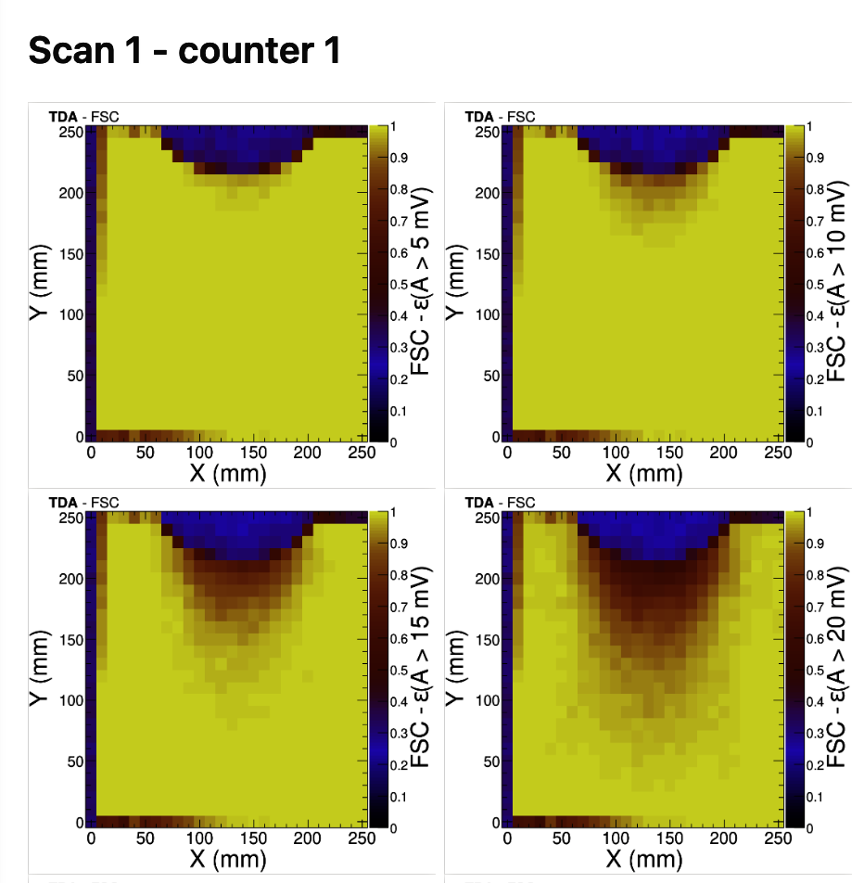
ZDC Status 13th June 2025, MJM

