Slide 1


sMDT Detector Commissioning
Summer at CERN 2025 Progress Presentation #1
Andrew Kiesling, Jiajin Ge, Chihao Li, Bing Zhou

Slide 2
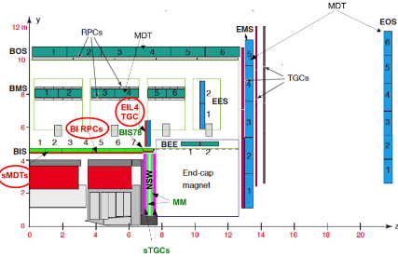
MDT’s at ATLAS
MDT = Monitored Drift Tubes
  Together with RPC’s (Resistive Plate Chamber) and TGC’s (Thin Gap Chamber) they make up the ATLAS MS (Muon Spectrometer)
    In the barrel of ATLAS, RPC’s handle event triggering and MDT’s measure muon momenta.
    The RPC’s and MDT’s are layered (20 layers) concentrically for ideal muon spectrometry.
The ATLAS MS is the largest in the world, there are over 380,000 drift tubes in the detector!
https://cds.cern.ch/record/2905756/files/ATL-MUON-SLIDE-2024-269.pdf

Slide 3
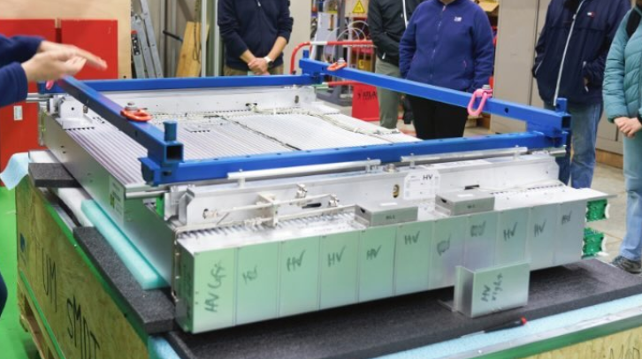
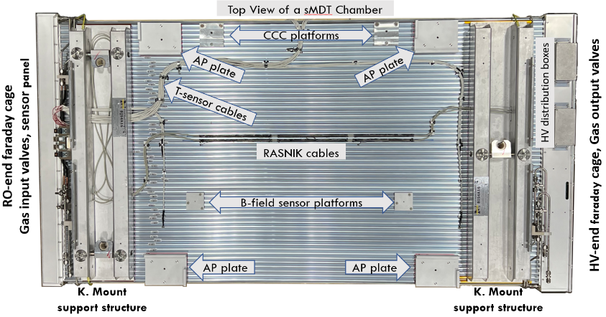
How do MDT’s work
MDT’s are filled with a mixture of 97% Argon, 3% CO2. Running through the center of each tube is a thin copper wire biased to 2.7 kV
  This gas mixture is very cheap, and also very efficient at achieving an ionization signal
As muons pass through the RPC, they cause an event trigger and data is then collected from the MDT chamber.
  Each chamber contains 8 layers of tubes grouped into 2 multi-layers (4 layers each)
https://arxiv.org/pdf/2211.00714

Slide 4
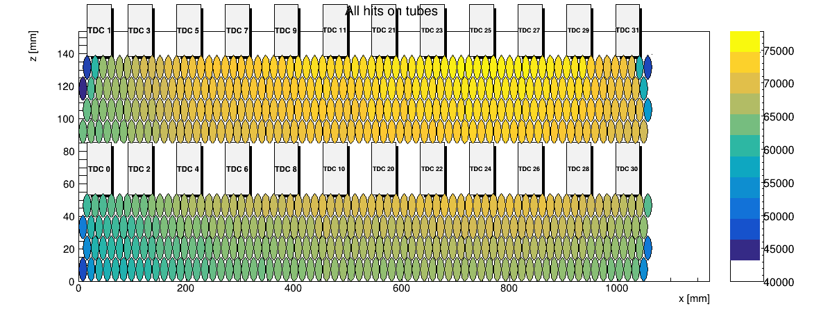
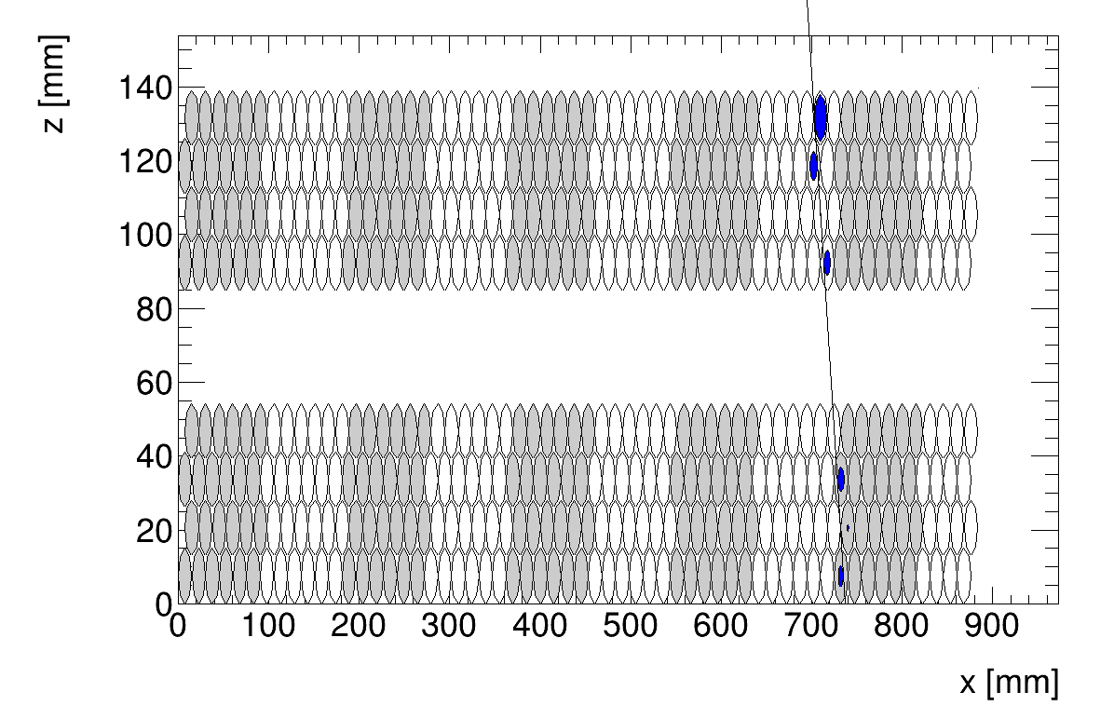
MDT Muon Spectrometry
There are B-field platforms present on the chambers, which cause the Muon tracks to curve. As they pass through the tubes, they ionize electrons in the gas mixture which then drift to the copper wire.
  Using the drift time of the electrons in tandem with the event trigger we are able to reconstruct the Muon path, and after analyzing this path we can discern the muon momenta.

Slide 5
What is a sMDT?
In the HL LHC, the background rates in the barrel of ATLAS are expected to increase by nearly 10 times
  To cope with this larger background, the sMDT’s (small MDT) were developed
    The smaller size of the sMDT’s (15mm as opposed to 30mm) allow for a much higher rate capability in the detector
    Additionally, the smaller size of the MDT’s allows for a new layer of RPC’s to be installed in the barrel of ATLAS
There are currently some sMDT’s already installed in ATLAS. An additional 100 were designed in parallel at MPI and UM
  There are over 45,000 tubes in this sMDT upgrade alone!
Production of sMDT drift tubes at MSU
Production of sMDT chambers at UM
Commissioning and testing of sMDT chambers at CERN

Slide 6
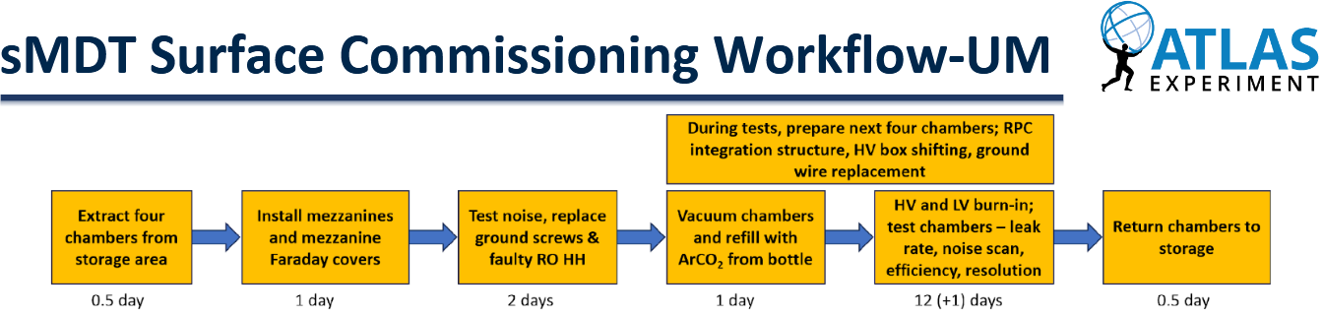
The Day-to-Day of sMDT Commissioning
The UM commissioning team works on an 18 day schedule:
https://indico.cern.ch/event/1555116/contributions/6557899/attachments/3091122/5476729/Status%20of%20UM%20sMDT%20Commissioning_20250624_MuonWeek.pdf
Every day of the working week we must perform the necessary tasks to stay on schedule. Generally speaking, the workflow involves hardware in the morning, and analysis in the afternoon.

Slide 7
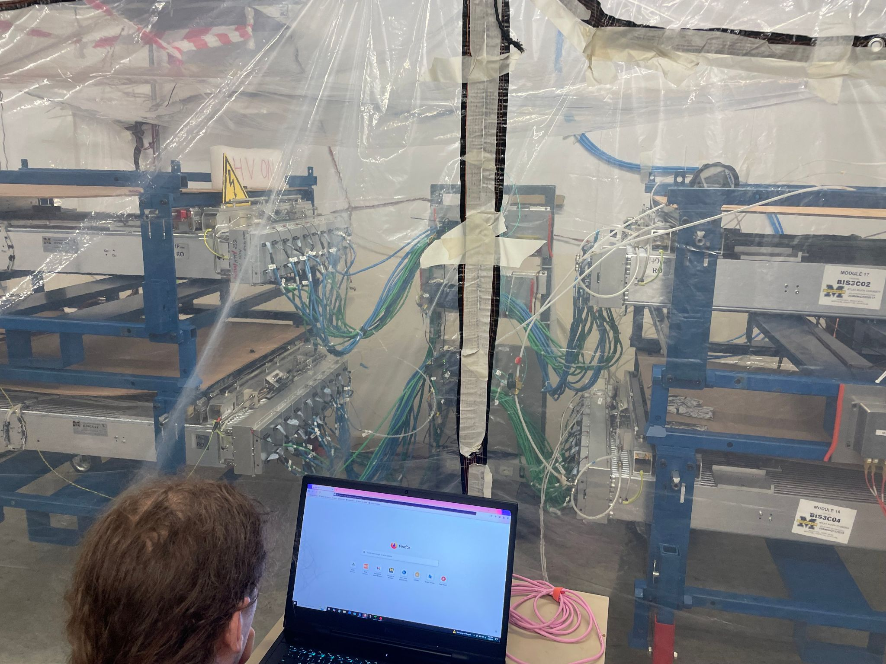
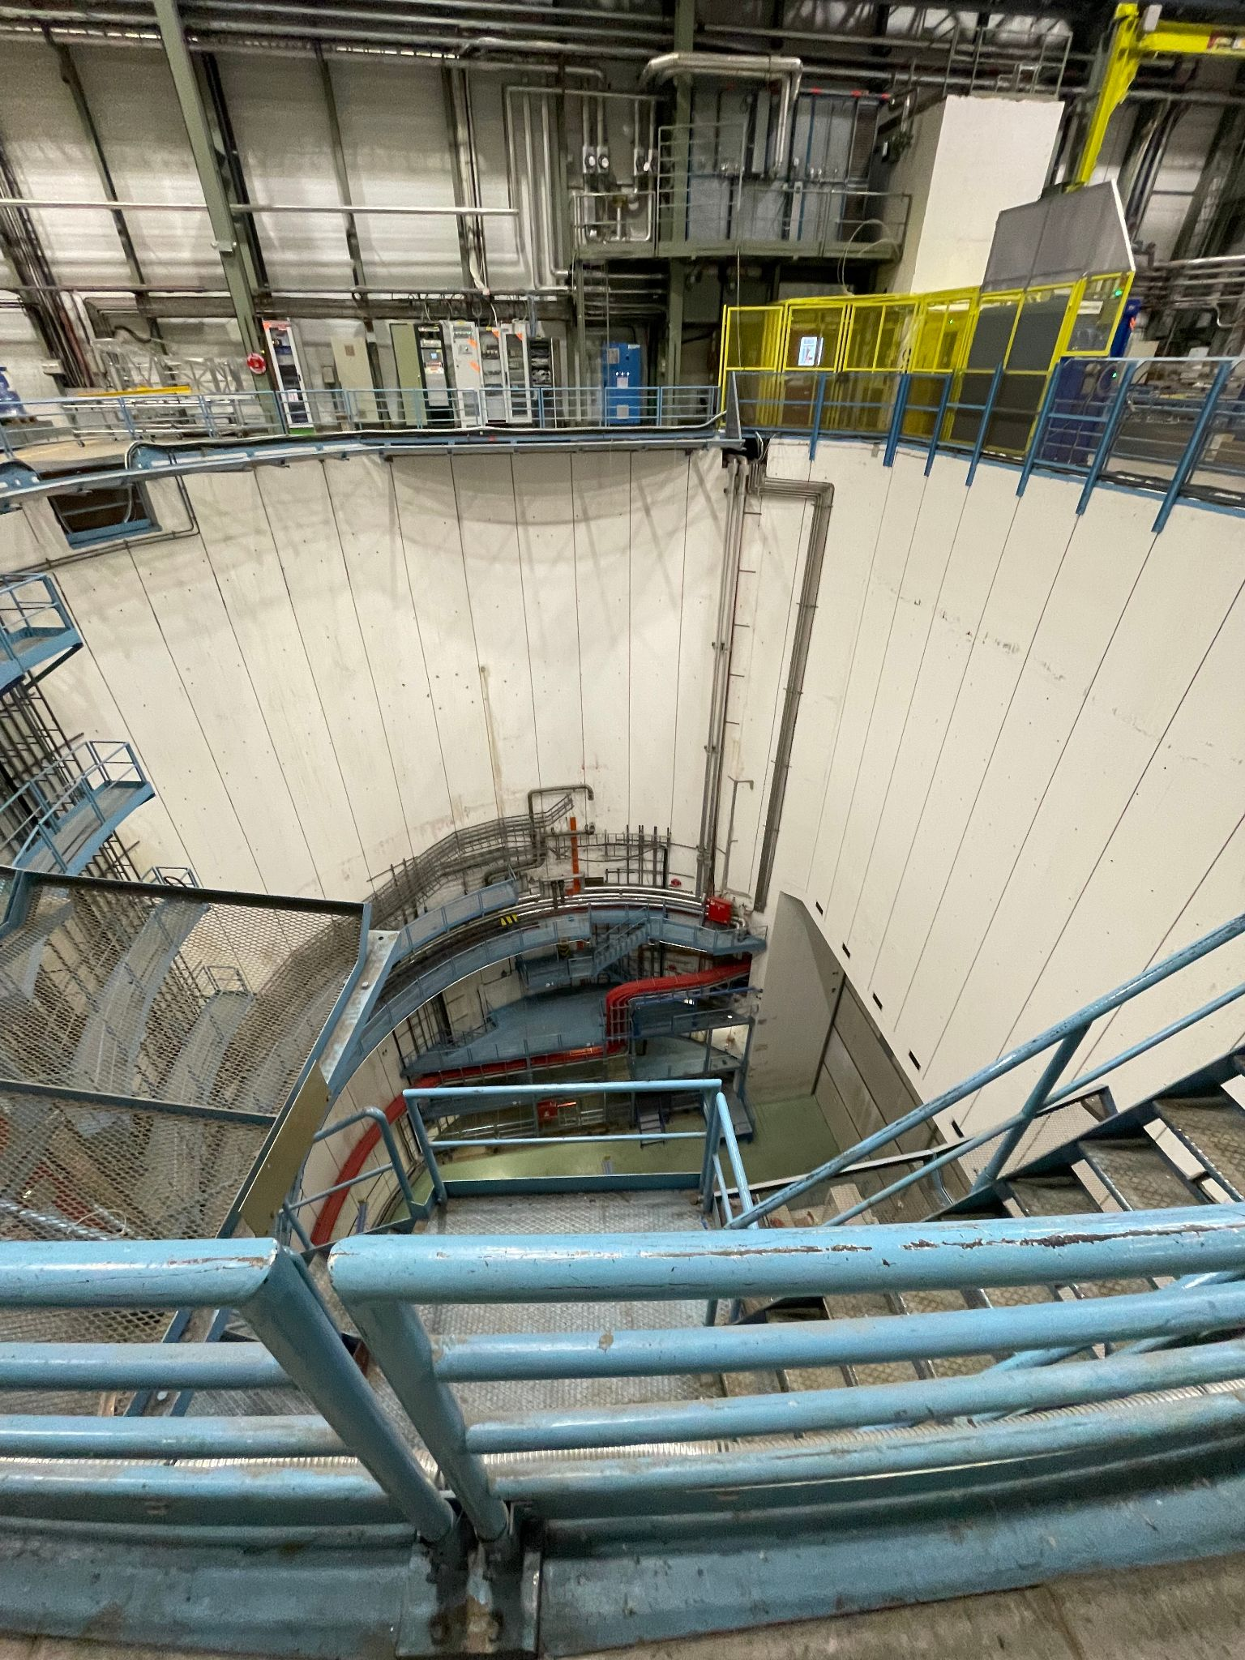
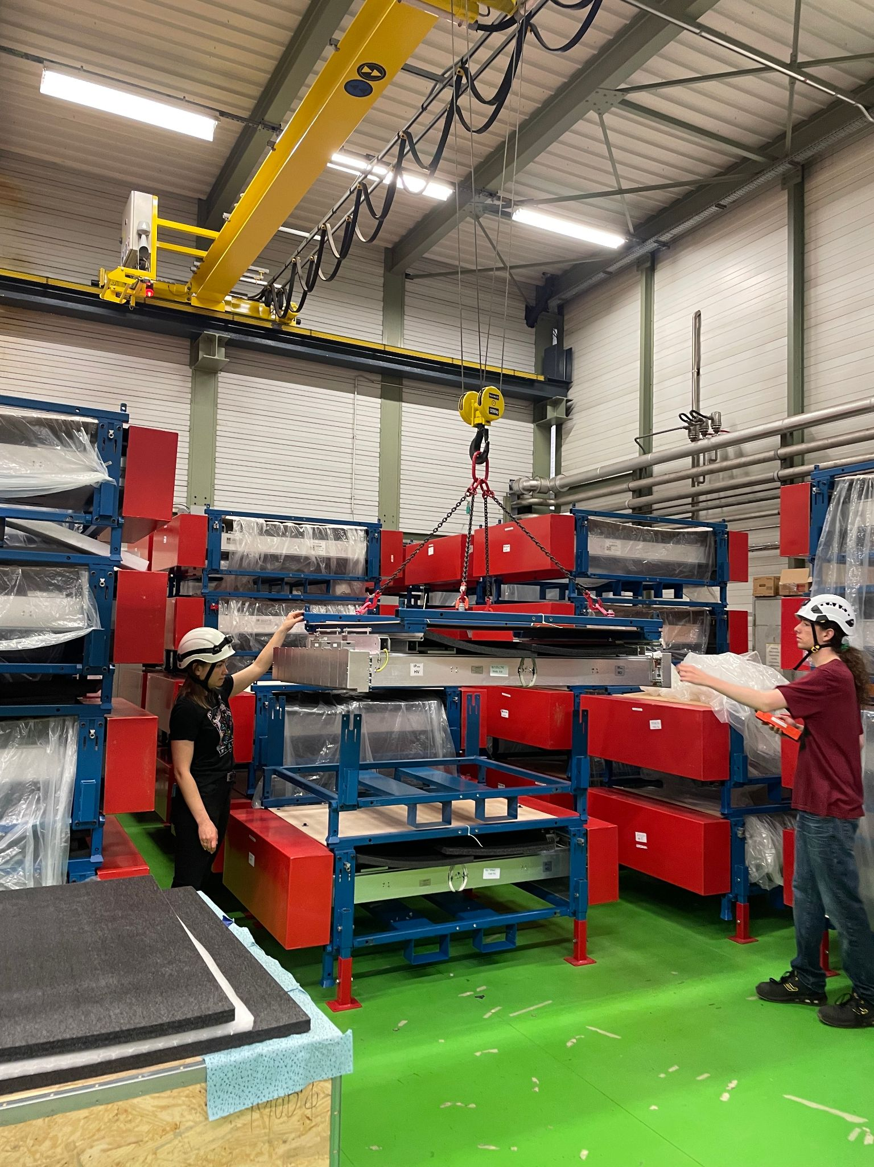
BB-5
The sMDT commissioning work is done at BB-5 (B899)
  We have currently commissioned 40 out of the 50 chambers sent to CERN by UM.

Slide 8
sMDT Electronics
sMDT chambers have an electronic data readout system, via Mezzanine Cards
  The MZ cards contain 4 chips: one TDC (Time-Digital Converter) chip and three ASD (Amplifyer/Shaper/Discriminator) chips. Together these chips send event data to our DAQ system.
  Each chamber has 20 MZ cards, and each card is connected to up to 24 tubes
The ASD chips convert the input charge to a digital pulse, and the TDC chips record time data about the event.
We possess a mini-DAQ system in the BB-5 testing room to send data to our local server before it is uploaded to the cluster.

Slide 9
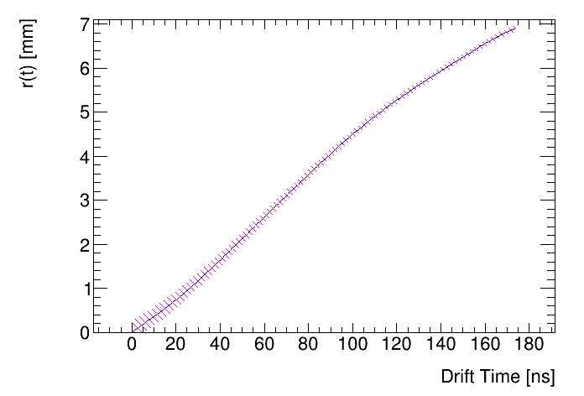
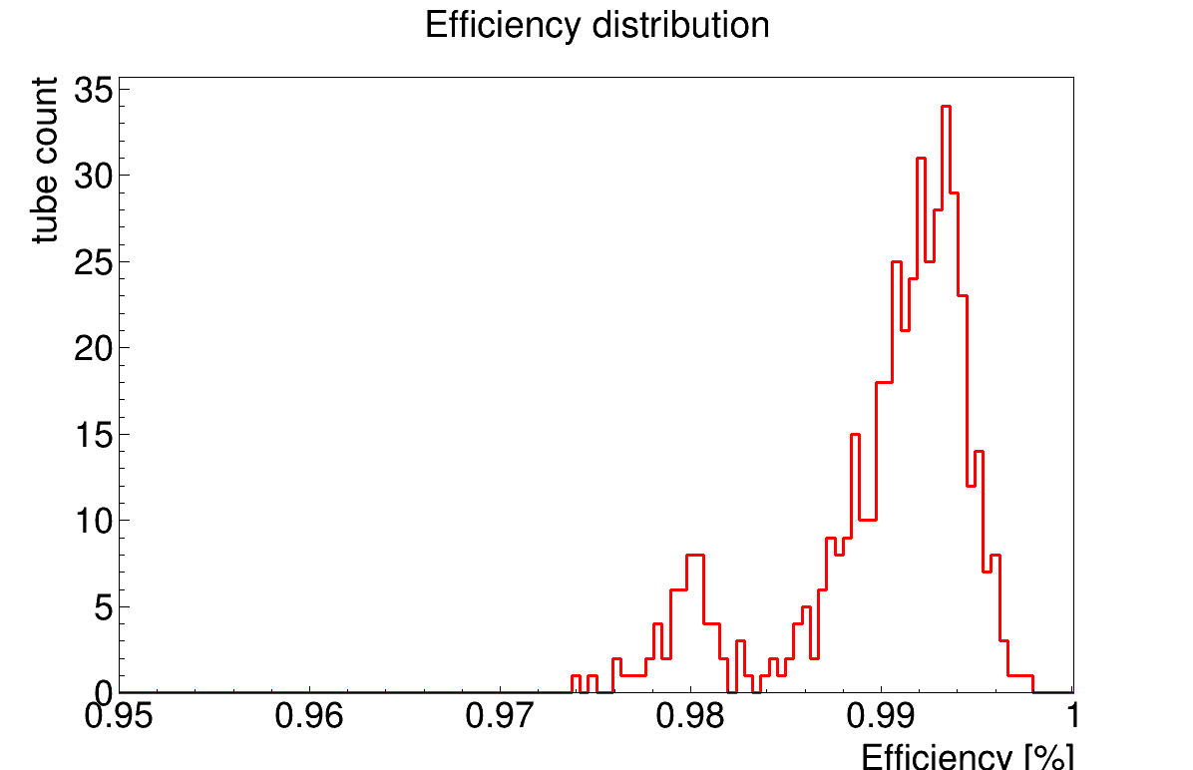
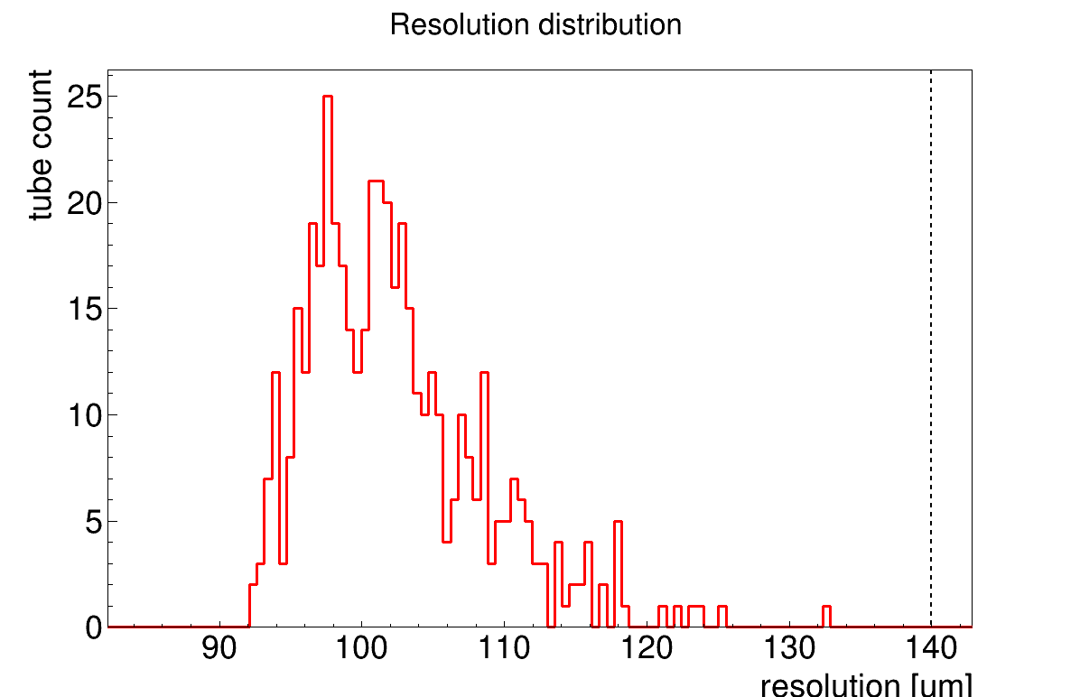
sMDT Offline Data Analysis
Upon cosmic ray data collection, the data must be processed in the cluster. Our processing scheme runs through the data and performs fits for position reconstruction of the muon paths.
  The processing takes about 24 hours to complete on a given cosmic ray run
After being processed, the data is analyzed with a few different scripts to extract granular information about each tube in the run
RT Function
Module 44 BIS6C14

Slide 10
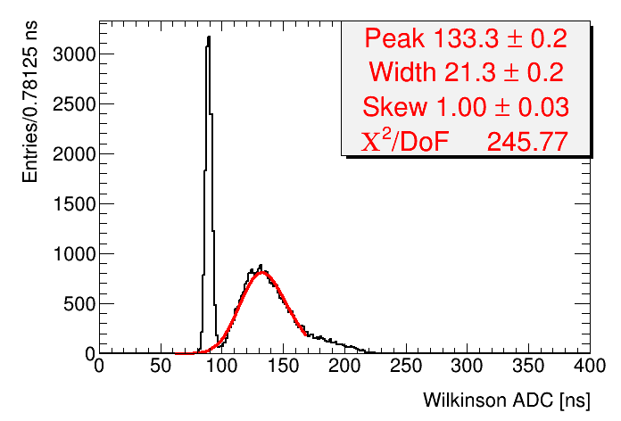
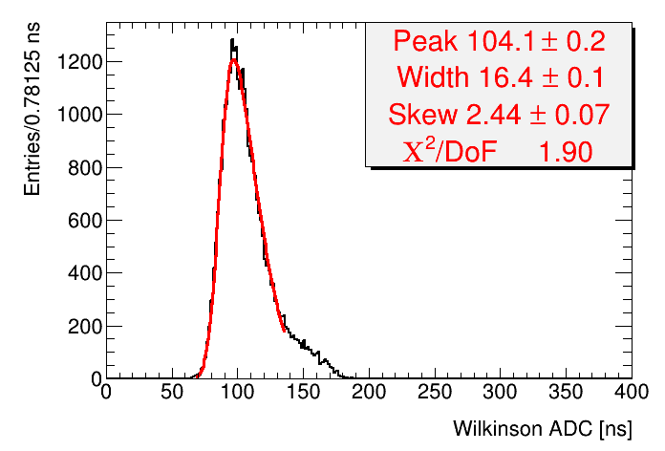
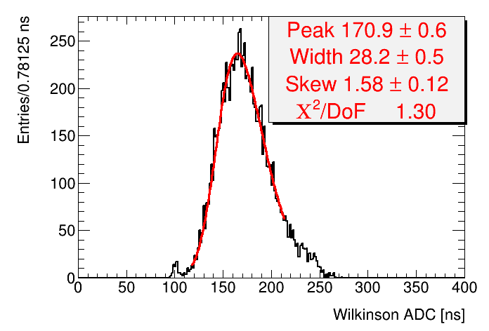
sMDT Offline Data Analysis
In addition to chamber-wide data, a crucial component of the analysis is to identify bad tubes (or bad Mezzanine cards)
Module 8 BIS1A16
Module 8 BIS1A16
Module 45 BIS6A16
As long as we keep to schedule, after identifying these issues we can tweak and replace parts of the chamber, then run cosmic ray tests again until the chambers meet ATLAS specifications.

Slide 11
Summary
The sMDT chambers are planned to be implemented in the next long shutdown, to be ready for HL-LHC
  Michigan is currently on pace to have everything ready by this September, which is when RPC integration will begin
Since arriving at CERN, I have contributed to many fascets of the commissioning process:
  Completing hardware commissioning tasks
    HV Glue application
    RPC Spacing bar and bearings installation
    Mezzanine Card installation
    RASNIK testing (sMDT chamber alignment tests)
    Testing room / miniDAQ installation
  Processed Cosmic Ray Data
  Analyzed process data to look for anomalies
  Reported and fixed these anomalies

Slide 12



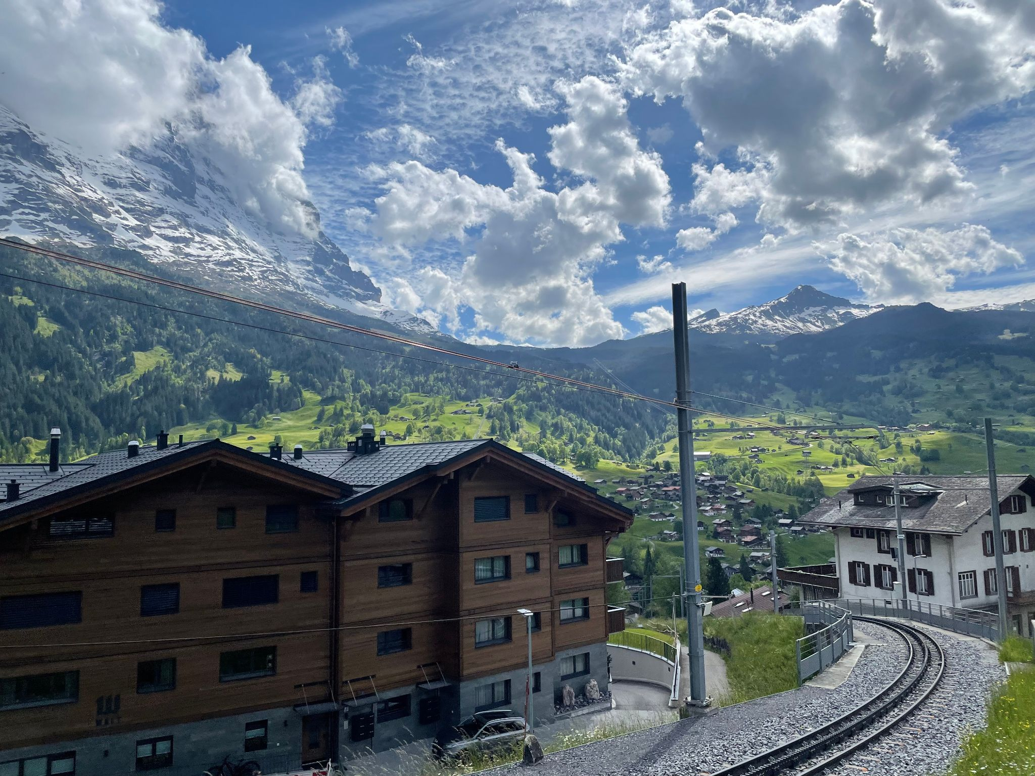

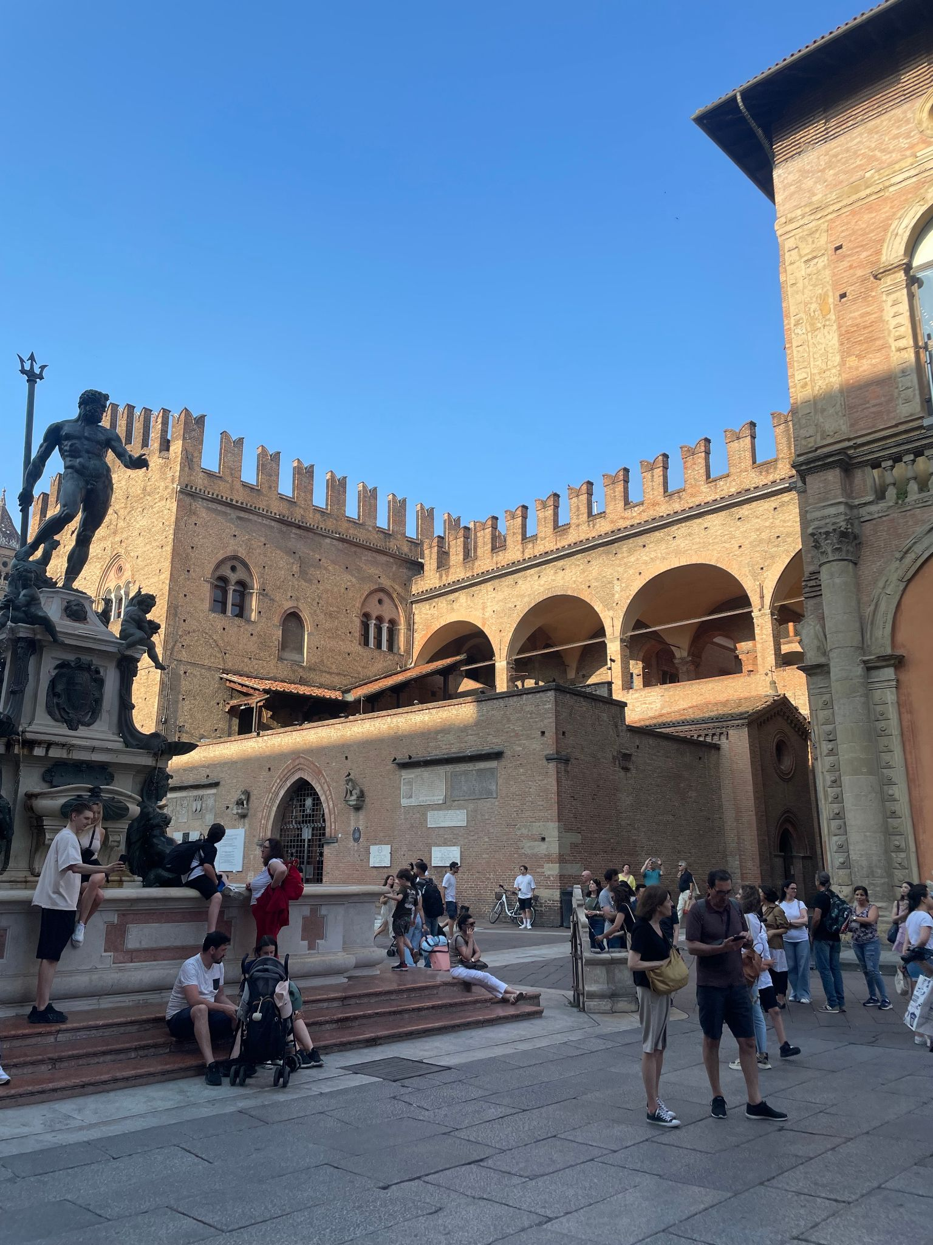

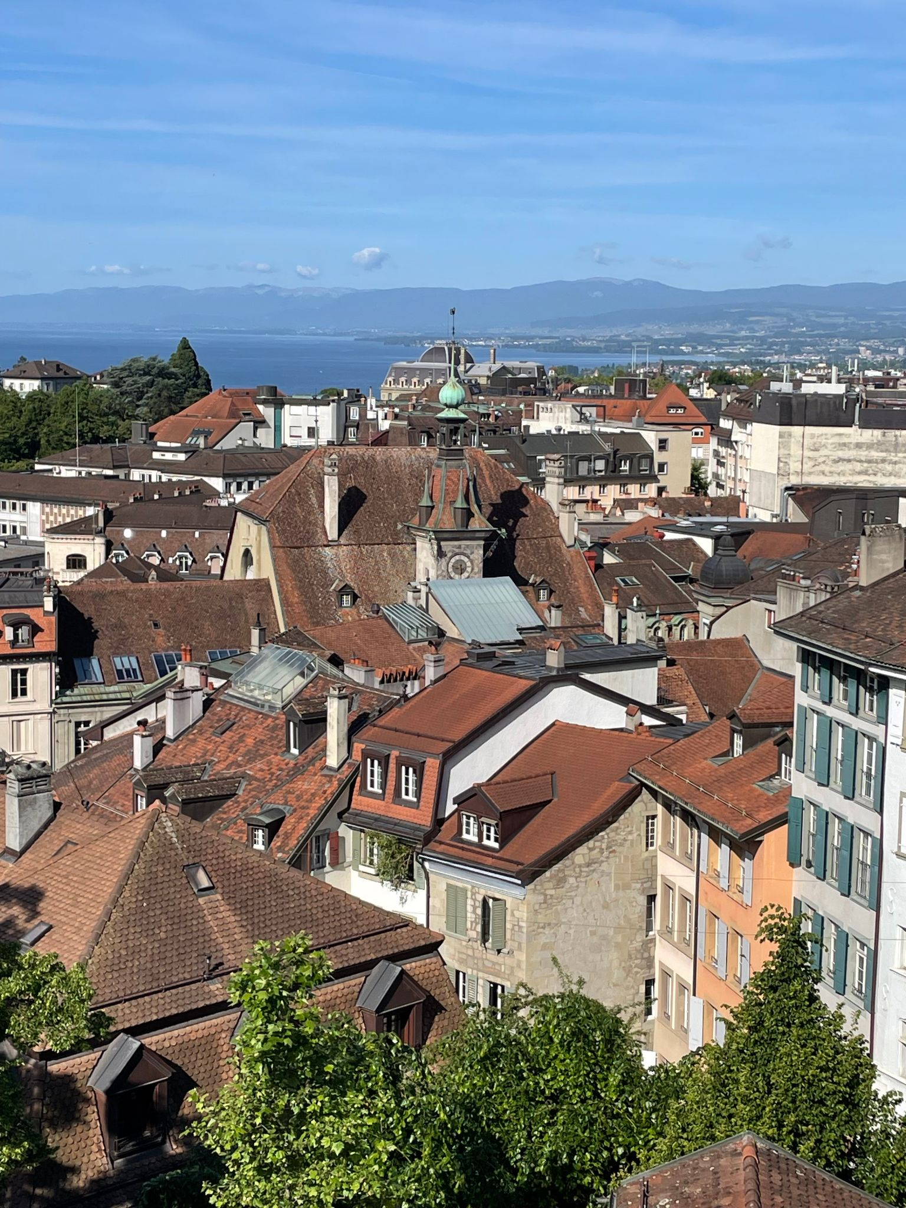


Travel!

Slide 13
Resources
https://arxiv.org/pdf/2211.00714
https://arxiv.org/pdf/2011.11699
https://arxiv.org/pdf/2205.13475
https://link.springer.com/article/10.1134/S1063778821040281
https://cds.cern.ch/record/2905756/files/ATL-MUON-SLIDE-2024-269.pdf
https://indico.cern.ch/event/1555116/contributions/6557899/attachments/3091122/5476729/Status%20of%20UM%20sMDT%20Commissioning_20250624_MuonWeek.pd

