Slide 1


FCC-ee Straw Tracker dE/dx Simulations
Peter Mourad, Chihao Li, Junjie Zhu
6/25/25

Slide 2
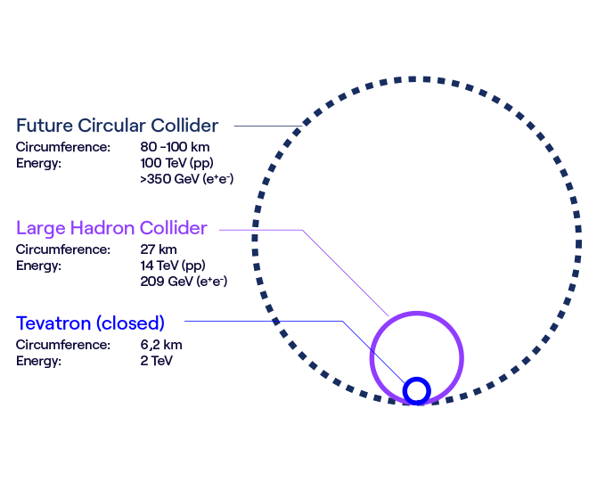
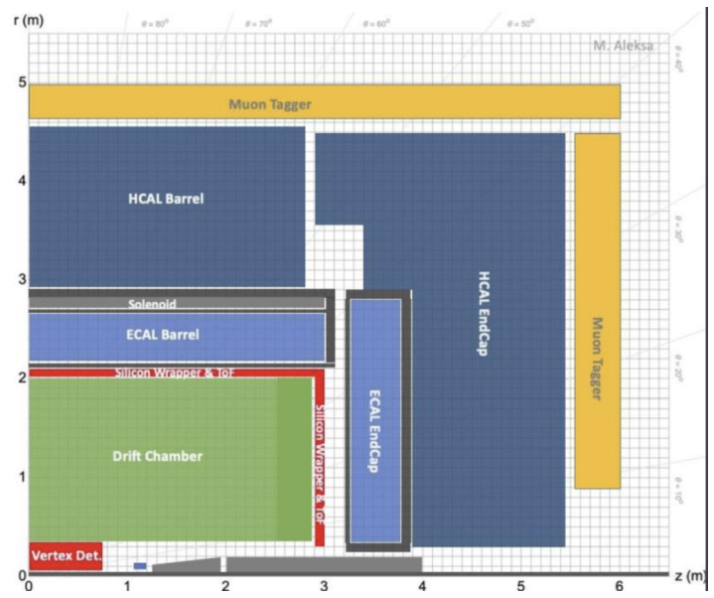
The FCC: Future Plans
Feasibility study: 2021 - 2027
  If positive, construction in mid-2030s
  FCC-ee operating around 2045, FCC-hh from 2070 onwards
  FCC-ee for Higgs and other precision measurements
  FCC-hh for new discoveries - at least 100 TeV center of mass energy
Detector Designs
  CLD: full silicon vertex, strip trackers
  IDEA & ALLEGRO: silicon vertex and ultra-light tracker with different calorimeters and outer systems
ALLEGRO Detector Design

Slide 3
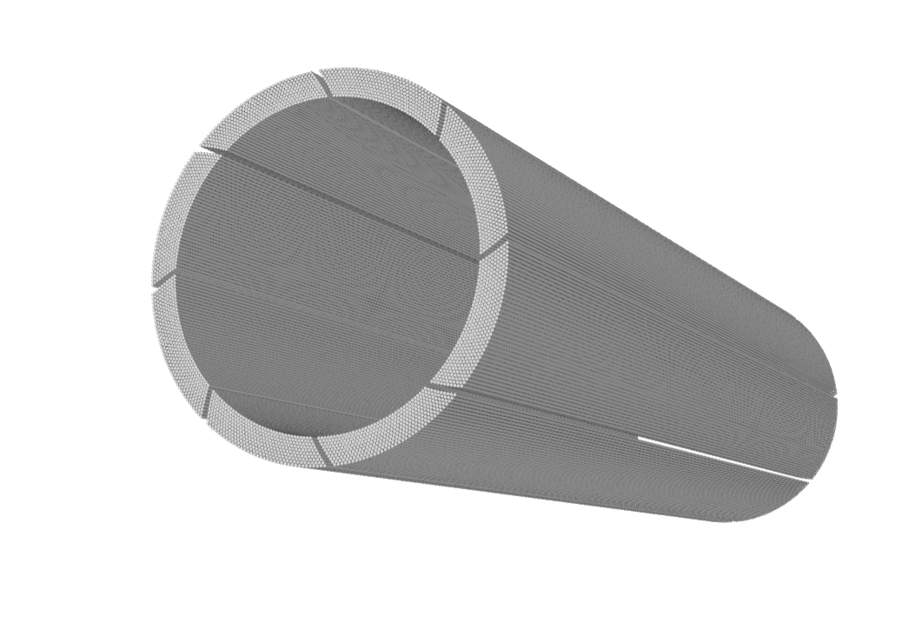
The Inner Straw Tracker
Proposed as the ultra-light inner tracker for ALLEGRO (or IDEA)
FCC-ee requires excellent momentum resolution for charged particles
Straw tracker has reasonable single hit resolution: 100 ~ 130 µm
  Similar or better momentum resolution than the IDEA pixel-only detector (more hits detected)
Low material and less multiple scattering with thin-wall straws
Potential for high performance particle identification and tracking

Slide 4
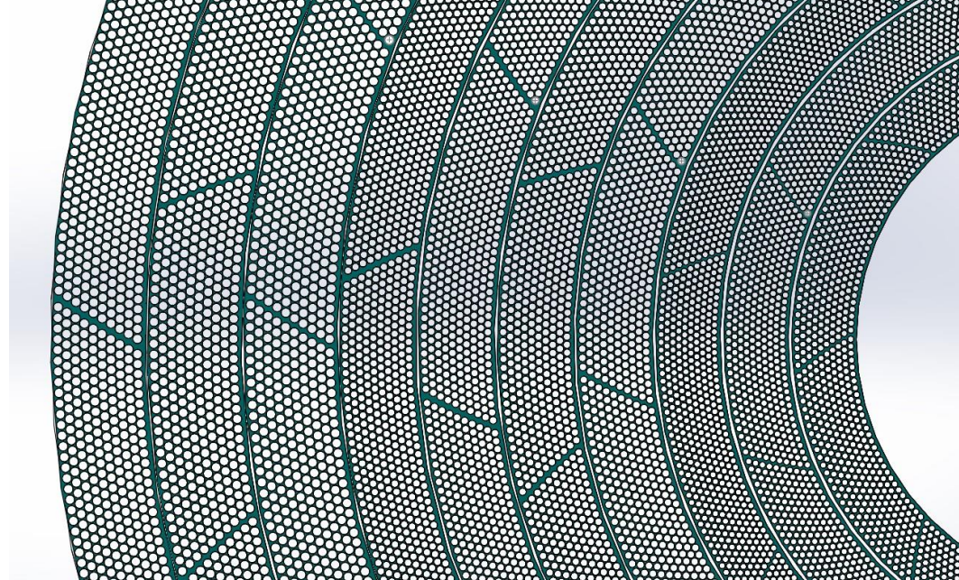
Inner Straw Tracker Structure
10 multilayers, 10 sublayers per multilayer, O(100k) tubes
3 multilayers of 10mm diameter tubes
4 multilayers of 12mm diameter tubes
3 multilayers of 10mm diameter tubes
Tungsten wires (20 µm diameter)
Mylar wall (12 µm thickness)
Straw tracker will span the distance between 42-180 cm from the center of the detector radially

Slide 5
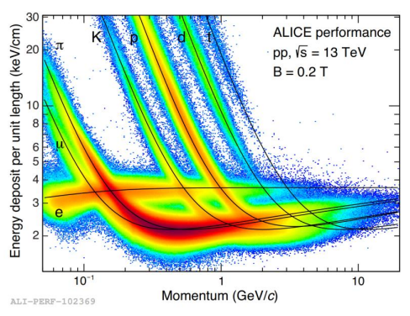
Project Goals
Build an algorithm to obtain dE/dx from Geant4 simulations for the inner straw tracker
Perform separation power simulations
  Study the performance of PID using dE/dx across different momentum ranges
Adjust different geometry parameters of the Straw Tracker - study dE/dx response
  Gas mixture ratio inside tubes
  Number of multilayers
  Number and size of tubes in each layer

Slide 6
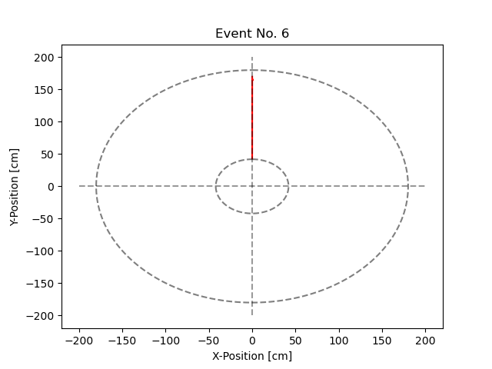
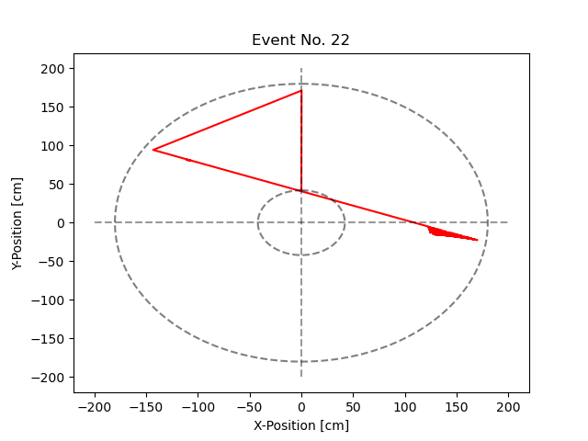
Test Simulations
Simulation Parameters
  1-25 GeV initial KE
  5000 Events per simulation
  Nominal straw tracker geometry
  Kaons and Pions fired in the direction (0, 1, 0)
  No B field
  Pure GHe inside tubes
Event Visualization
  Reconstruction of hits within the tracker for different events
  Examples at right: 1 GeV Kaons fired in the direction (0, 1, 0)
  Scattering possibly because of secondary particles

Slide 7
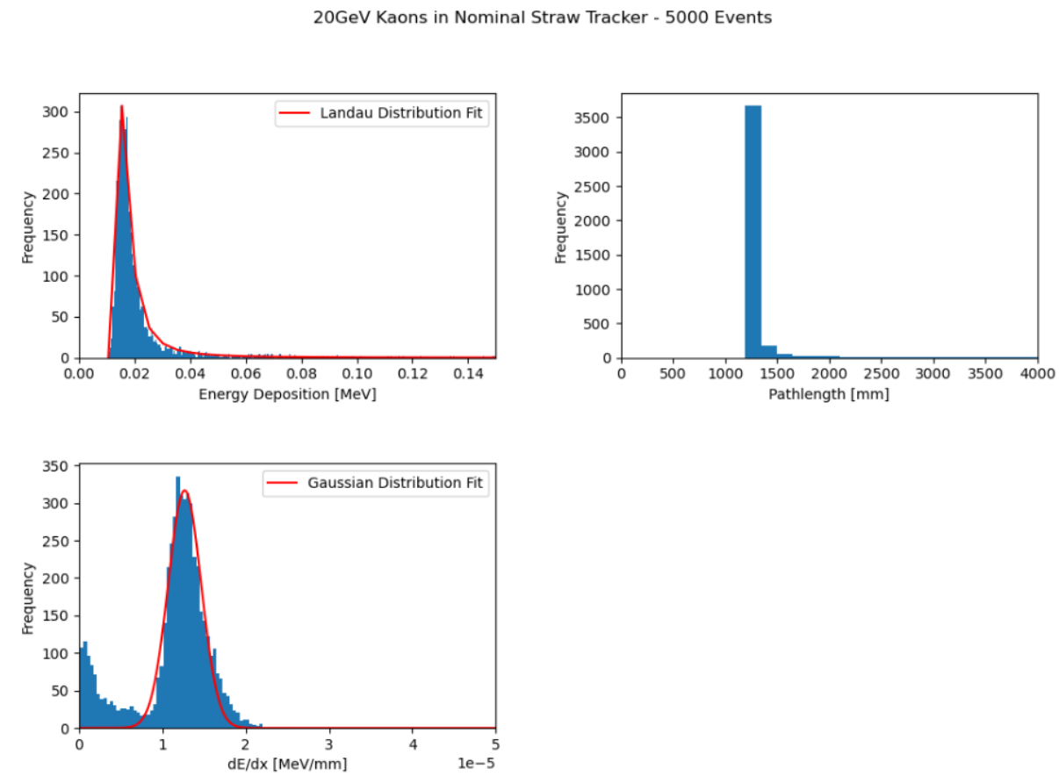
dE/dx Algorithm
Within each event:
  Time-sort hits
  Only count energy deposition (dE) and pathlength (dx) in straw tracker
  Calculate 3D dx using x, y, z position readout
  Sum dx and dE - calculate dE/dx
Fit Gaussian distribution to get dE/dx mean and SD
Histograms of events
  dE, dx, dE/dx

Slide 8
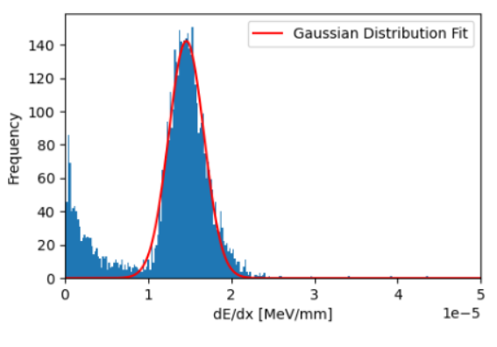
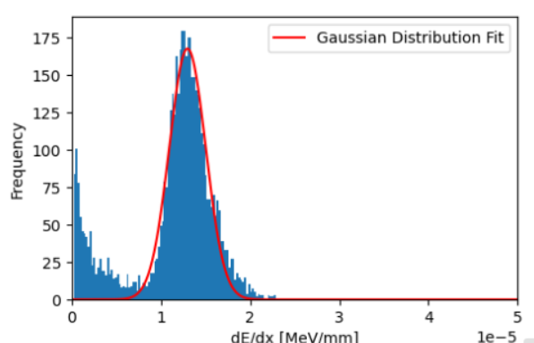
Comparing dE/dx Gaussians
25 GeV Pions (top)
  Mean dE/dx: 1.459e-05 [MeV/mm]
  SD: 2.118e-06 [MeV/mm]
25 GeV Kaons (bottom)
  Mean dE/dx: 1.296e-05 [MeV/mm]
  SD: 2.049e-06 [MeV/mm]

Slide 9
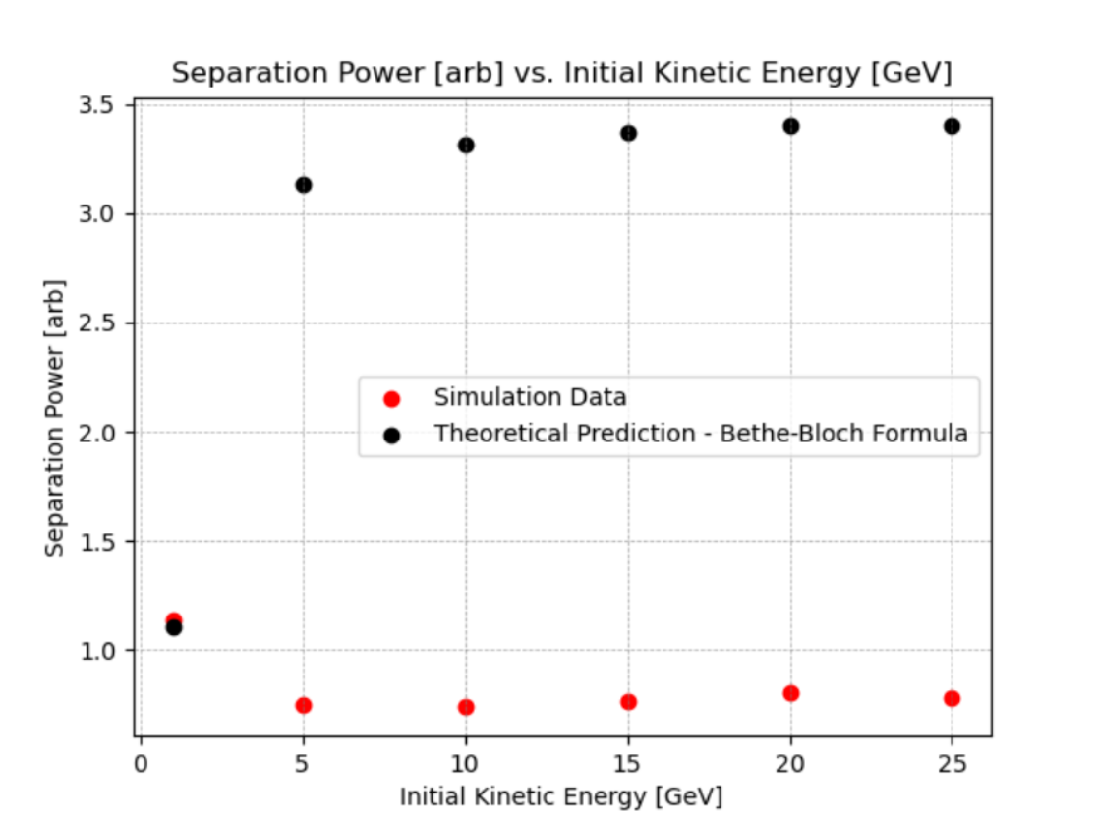
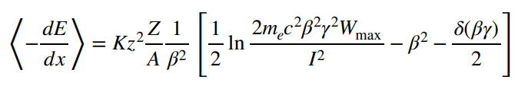
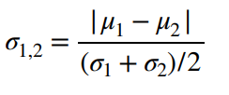
Separation Power
Calculate Kaon-Pion separation power for each initial kinetic energy (right)
dE/dx theoretical calculation with Bethe-Bloch formula (left)
For theoretical calculation, assume same width of dE/dx Gaussian as simulations
Major differences between theory and simulation
  Overestimation of dx?
  Underestimation of dE?

Slide 10
Simulation Enhancements
Change gas from pure He to 90-10% He - Isobutane mixture
  Closer to real implementation
  Suppress showering for events - more accurate dx
Improved pathlength algorithm
  Track the tube that each hit in each event occurs in
  Parameterize pathlength between hits and tube boundaries
  Only consider kaon pathlength that occurs in tubes
  Find and use intersections to exclude pathlength outside tube volumes
  Also exclude pathlength corresponding to secondary particles
Truncated mean method
  Cut a percentage of events with the highest dE
  Reduce impact from secondary particles
  Test different cut % for each initial KE
  Calculate dE/dx for the remaining uncut events
  dE/dx mean and SD from gaussian fitting

Slide 11
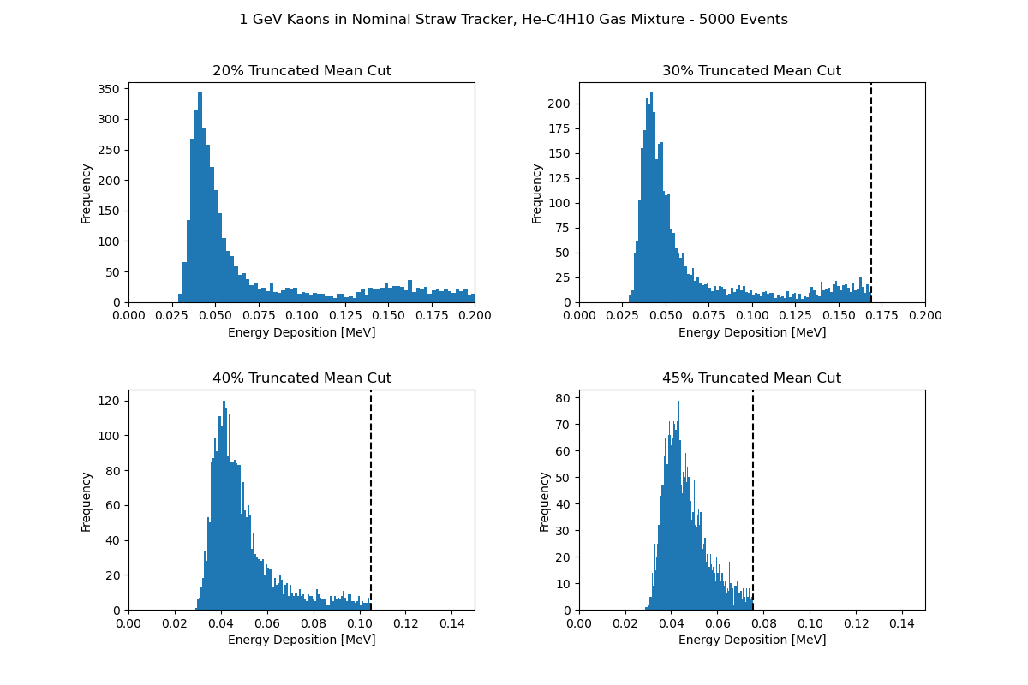
dE Truncated Mean Cuts

Slide 12
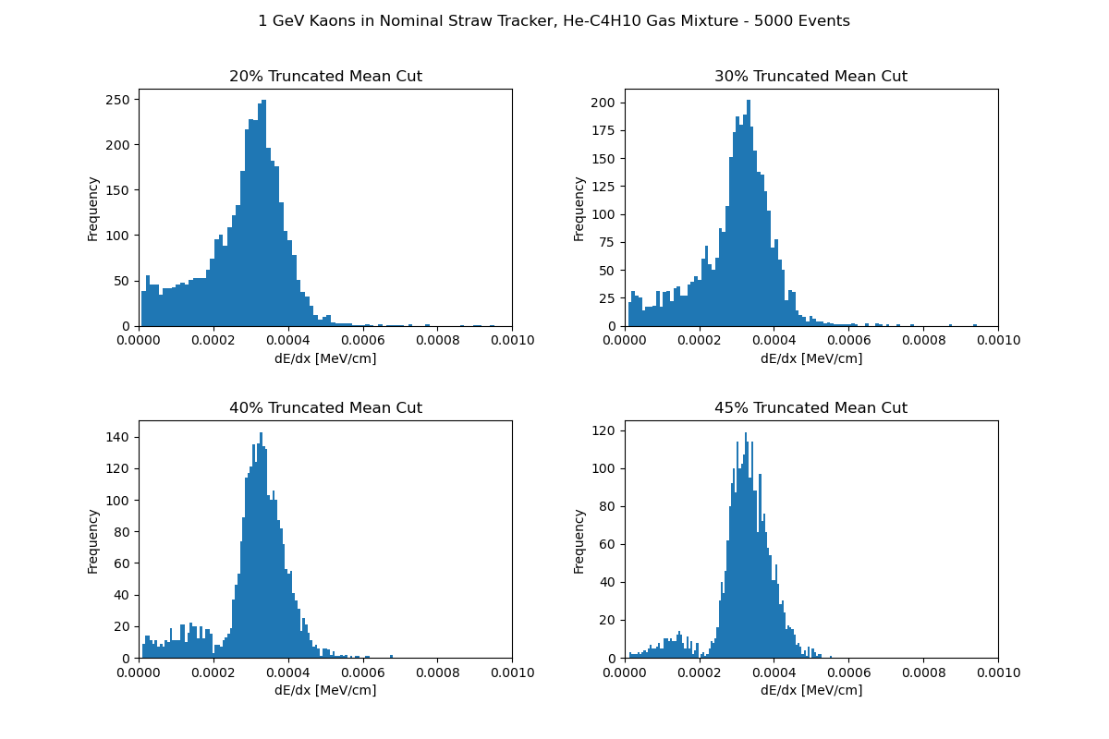
dE/dx Histogram Response

Slide 13
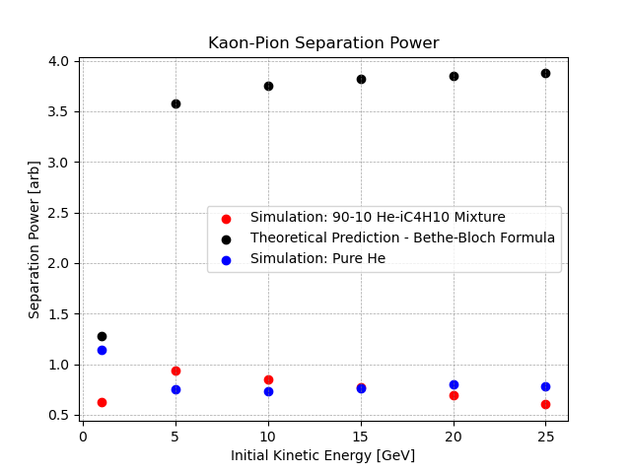
Separation Power
New simulation still very different from theory
Inner straw tracker is ~140cm in length
  dx readout reasonable
Underestimation of dE?
  The calculated dE for each event using Geant4’s dE readout is lower than the theoretical value
  Currently investigating this issue - potentially calculate dE based on Geant4 momentum readout instead

Slide 14
Moving Forward
Finalize dE/dx algorithm
Accurate separation power measurements
  π-K, K-p
Adjusting physical straw tracker parameters
Studying PID performance using dE/dx

Slide 15

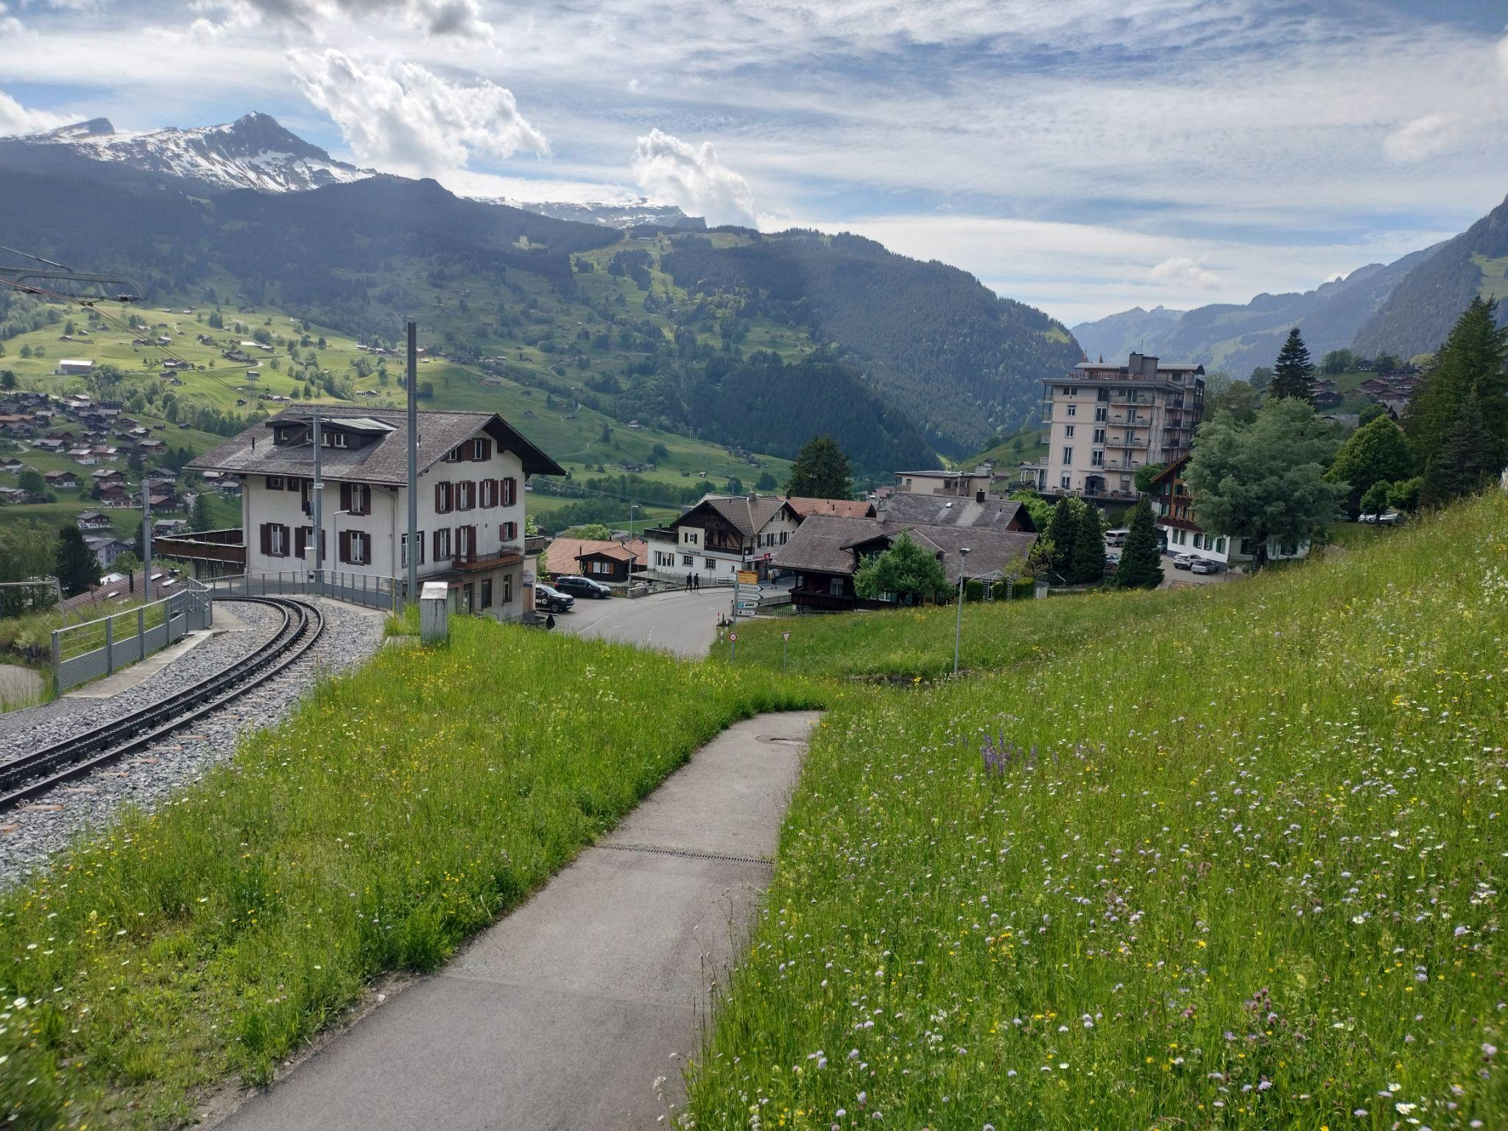


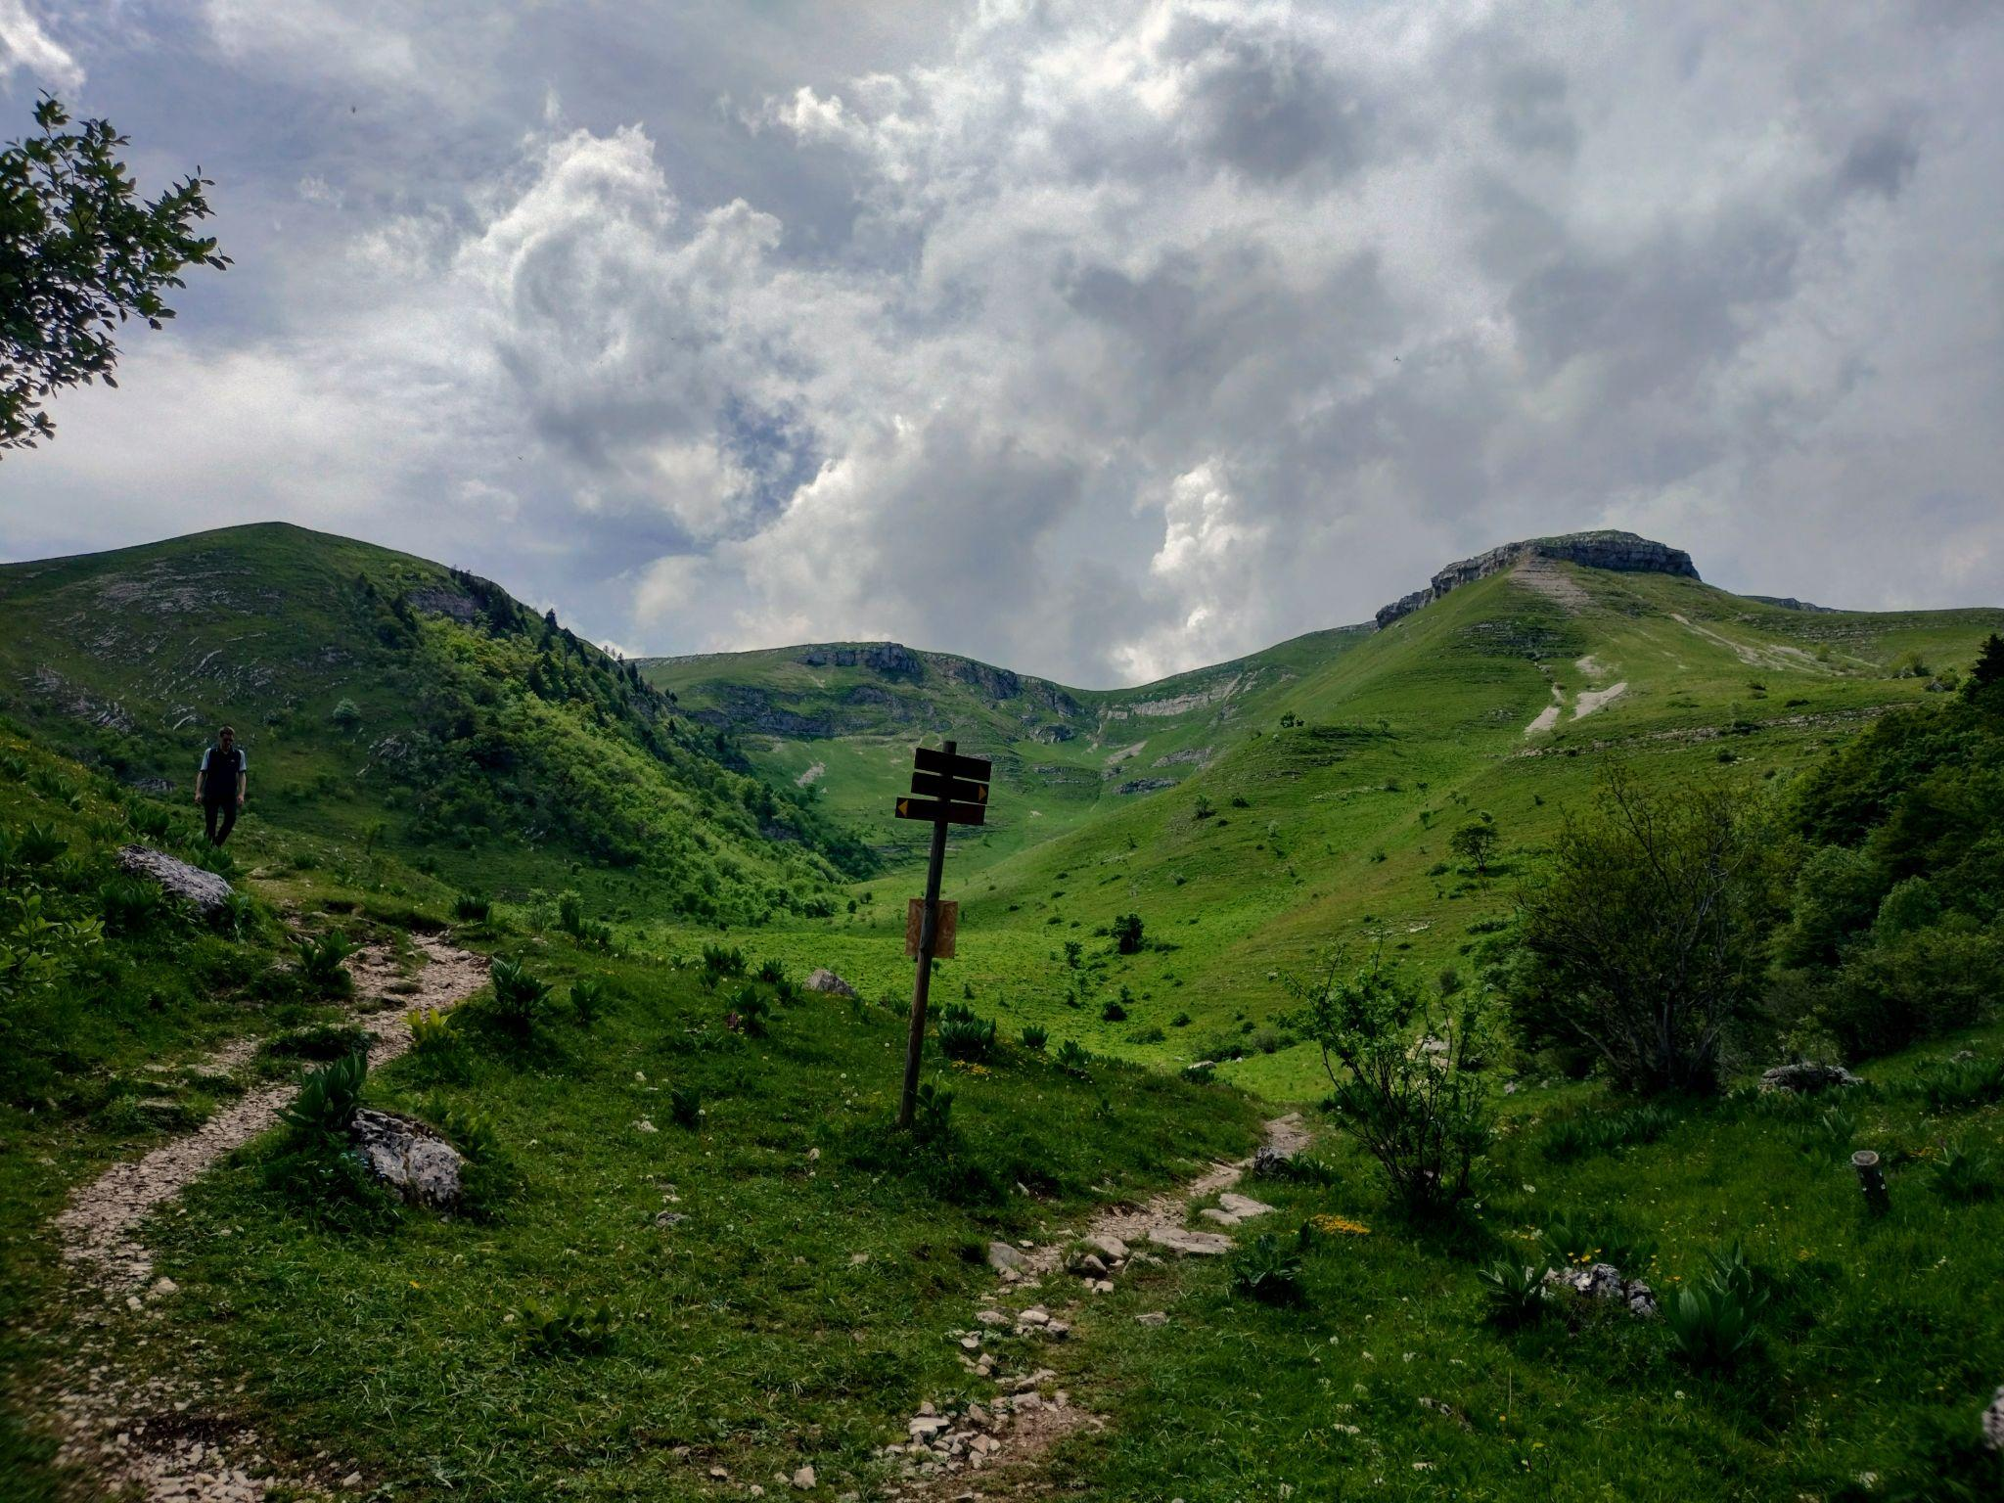
Travels

Slide 16
Backup

Slide 17
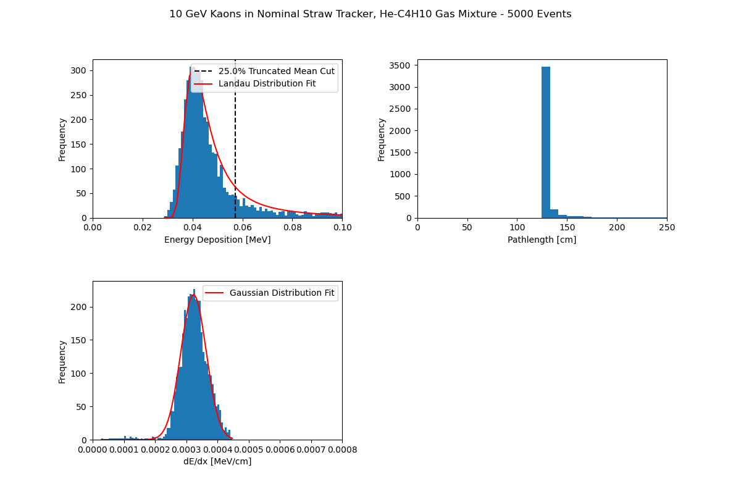
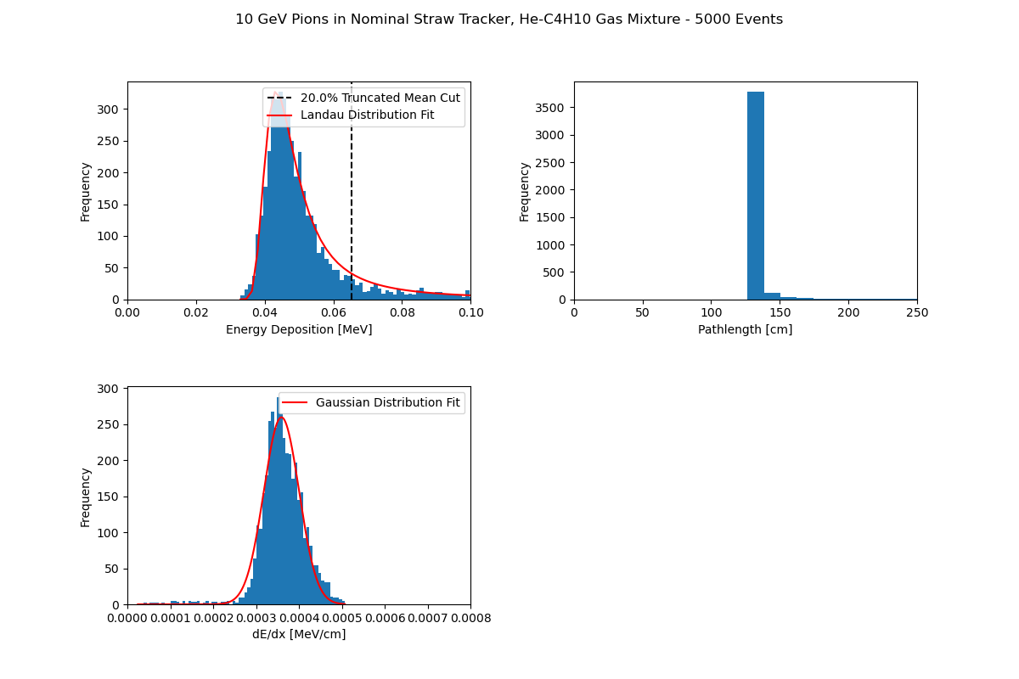
More Simulations

