Slide 1


dE/dx Simulations for the FCC-ee Straw Tracker - Update
Peter Mourad, Chihao Li, Junjie Zhu
7/16/25

Slide 2
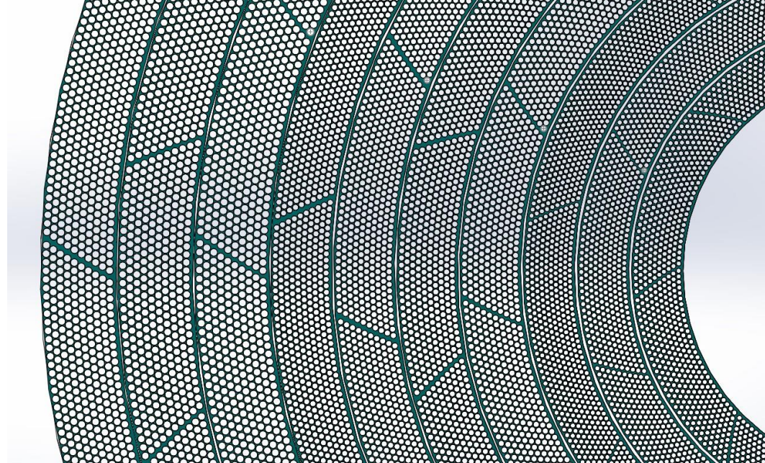
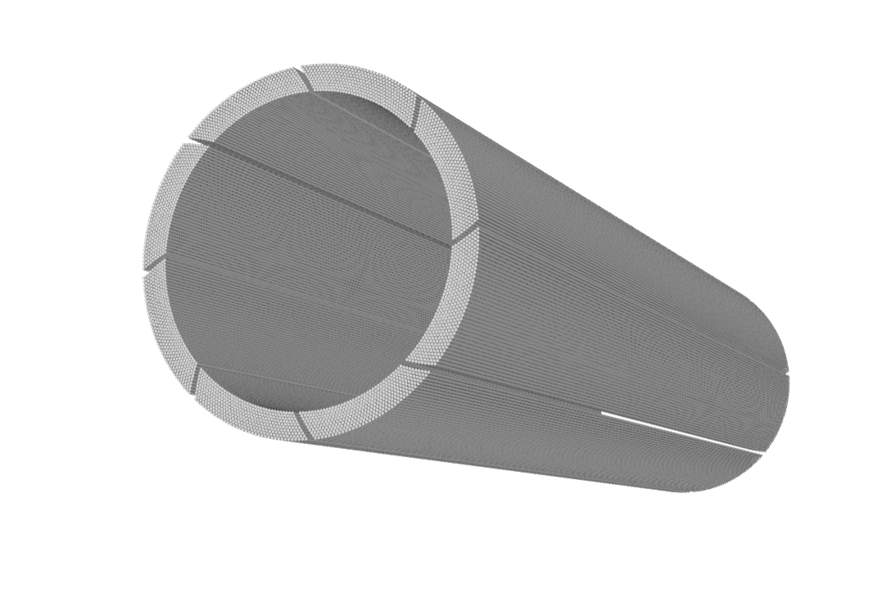
Recap: Inner Straw Tracker
Proposed as the ultra-light inner tracker for the ALLEGRO detector of the FCC-ee
Low material and small amount of multiple scattering with thin-wall straws - potential for high performance particle identification and tracking
10 multilayers, 10 sublayers per multilayer, O(100k) tubes
Spans the radial distance of 42-180 cm from the center of the detector
Previous inaccuracies in dE/dx simulations - need to verify dE readout from Geant4 and dx calculation from algorithm

Slide 3
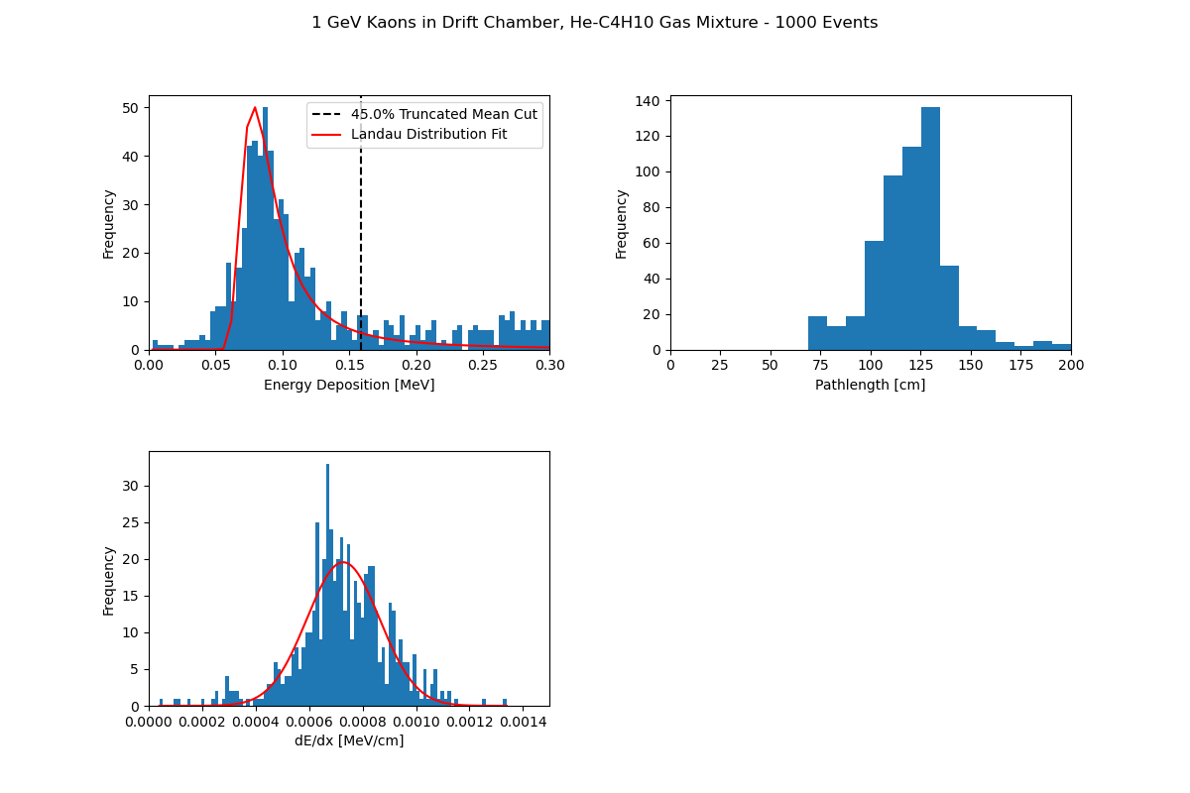
Testing dE: Drift
Chamber Simulation
Parameters
  1000 Events
  Cylinder of 90-10% He-Isobutane Gas Mixture
  Same dimensions as inner straw tracker
  No B field, 1 GeV Kaons fired in the direction (0, 1, 0)
Theoretical Value: 7.79e-4 [MeV/cm]
Gaussian Mean dE/dx: 7.27e-4 [MeV/cm]
Gaussian SD dE/dx: 1.36e-4 [MeV/cm]

Slide 4
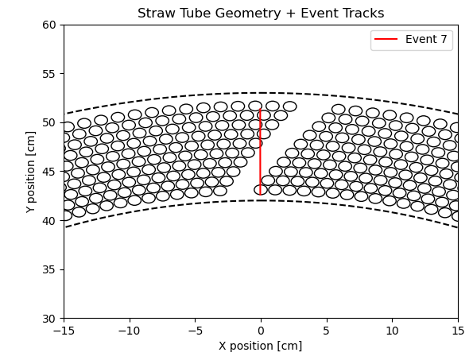
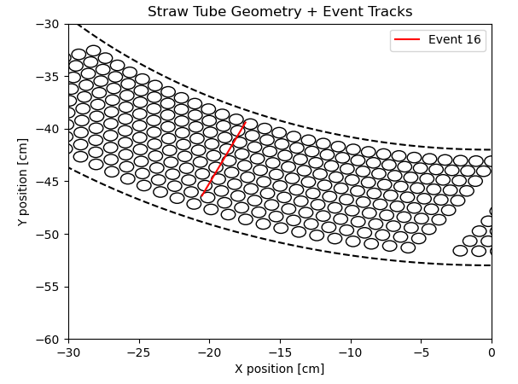
Testing dx: Pathlength Visualization
Corrected an incorrect definition of tube geometry from last version of my algorithm
Test calculation from new version
  Obtain and visualize placements and dimensions of all tubes in the 0th multilayer
  Overlay particle track from one event
  Compare visual approximation of dx to value calculated from algorithm
Calculation approximately matches visualization
Appx. dx: 4.73 cm
Appx. dx: 6.59 cm

Slide 5
dE/dx Algorithm Structure
Within each event:
  Time-sort hits
  Parameterize path of particle and tube boundaries
  Calculate approximate particle dx inside tube volumes only
  Sum dE from hits to get dE from event
  Truncated mean method
    Cut certain % of events with the highest dE - excludes events with excess scattering and secondary particle generation
  Calculate dE/dx from remaining events & fit Gaussian distribution to dE/dx histogram to get mean and std. dev.

Slide 6
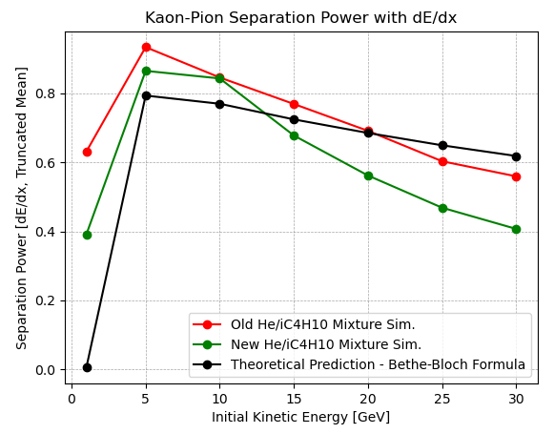
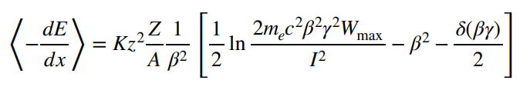
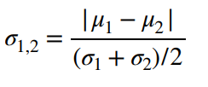
Separation Power
Calculate Kaon-Pion separation power for each initial kinetic energy (right)
Check with dE/dx theoretical calculation with Bethe-Bloch formula (left)
For theoretical calculation, assume same width of dE/dx Gaussian as simulations
Improved theoretical calculation
  Density correction term
  Rigorously calculating Wmax instead of approximating

Slide 7
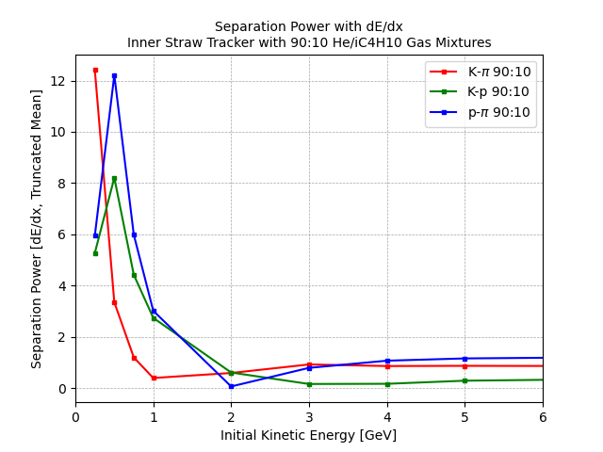
Separation Power
Simulations with more particles - kaon, pion, proton
More interesting data at lower energy ranges
New simulations for .25-5 GeV
Separation power trends are similar to other simulations performed using dE/dx for different geometries
Unusual behavior at 250 MeV and below - currently troubleshooting

Slide 8
Separation Power
Simulations with more particles - kaon, pion, proton
More interesting data at lower energy ranges
New simulations for .25-5 GeV
Separation power trends are similar to other simulations performed using dE/dx for different geometries
Unusual behavior at 250 MeV and below - currently troubleshooting

Slide 9
Gas Mixture Optimization
Test the performance of different gas mixtures that could be used in the tubes for the straw tracker
  80:20 He/iC4H10
  70:30 He/iC4H10
Simulate separation power for each mixture between the energies .5-5 GeV
Compare PID performance between mixtures
In the future, could be interesting to perform accurate simulations at lower energies (250 MeV, 100 MeV, etc.)
Varied results across energy range, but generally, mixtures with higher and higher iC4H10 content show improvements in separation power

Slide 10
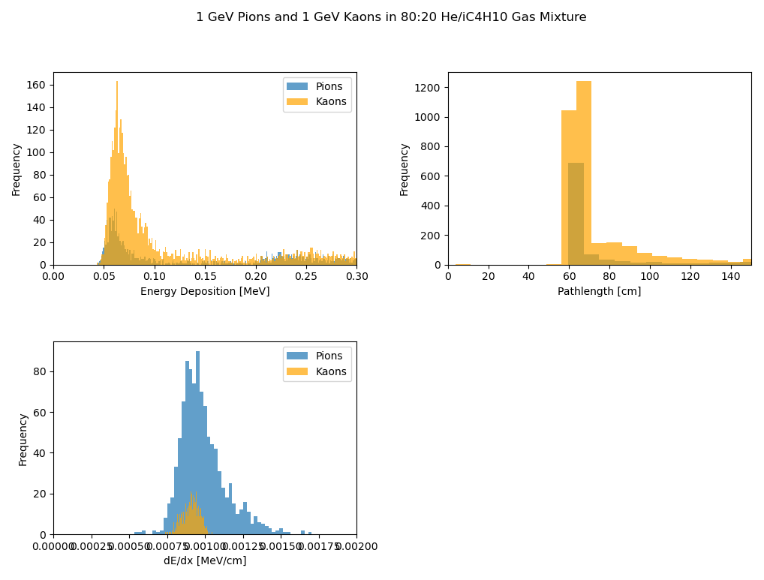
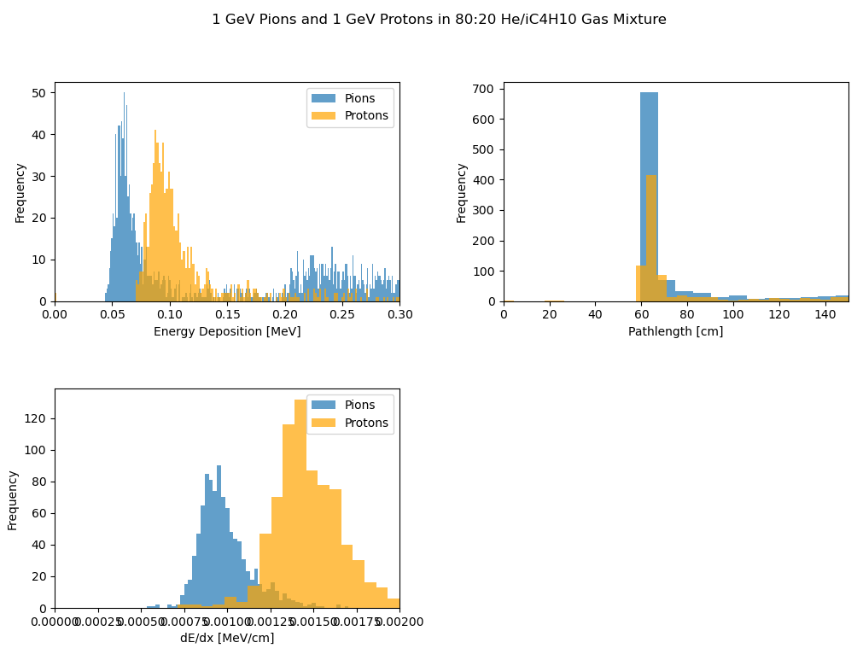
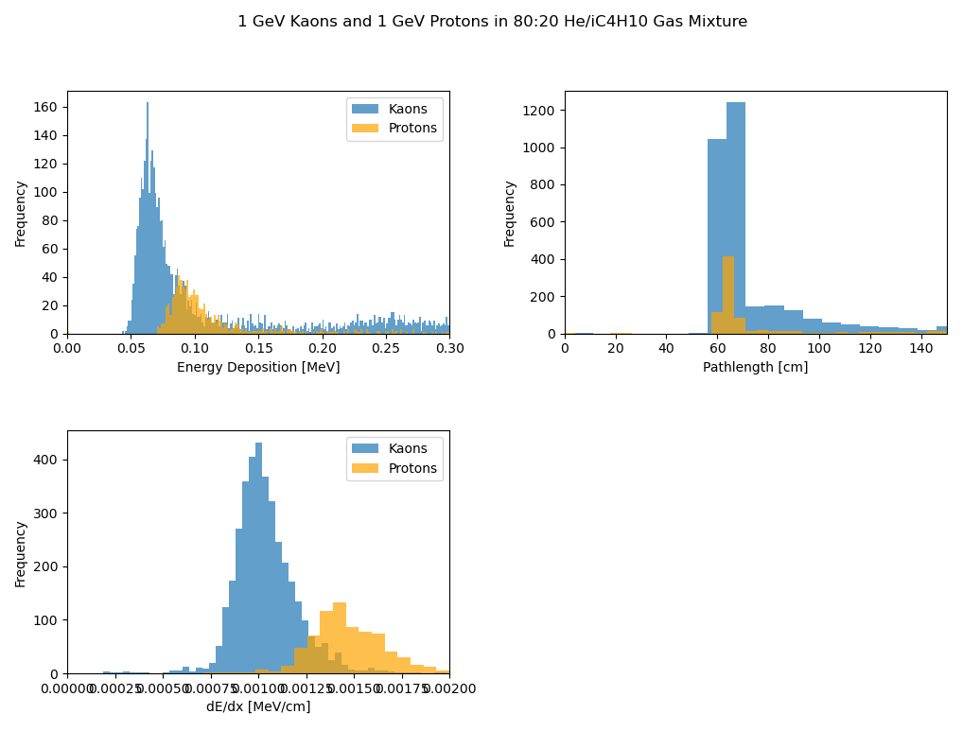
Example Visualizations

Slide 11
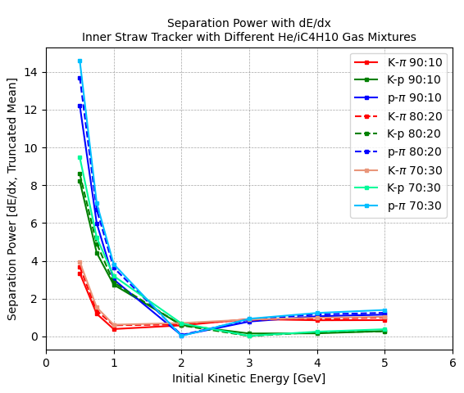
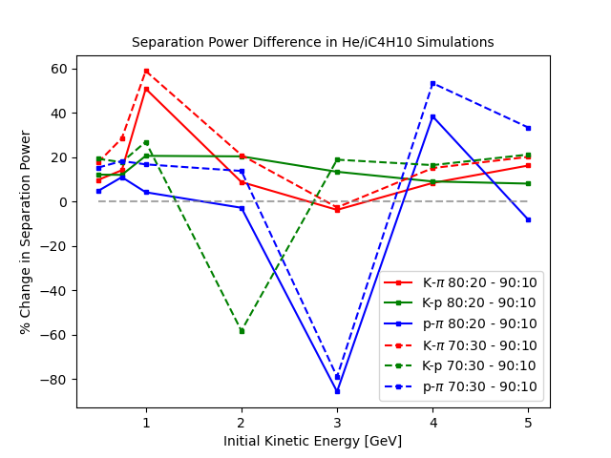
Gas Mixture Study Results

Slide 12
Next Steps
Others have performed dE/dx simulations with a simpler geometry in Garfield ++ using 90:10 He/iC4H10 gas
  Garfield ++ describes the properties of one cell of a drift chamber, but cannot simulate large-scale detector geometries like Geant4
  Geant4 works well for studying full scale detectors and collider events, but particle interactions are based on approximations - will be used for most simulations moving forward
Perform dE/dx simulations with the simpler geometry with Geant4
  Compare results to find the correction factor, if any, between Garfield ++ and Geant4
If new straw tracker geometries are proposed, perform dE/dx simulations
H4 beam test at CERN Prevessin site

Slide 13
Backup

Slide 14
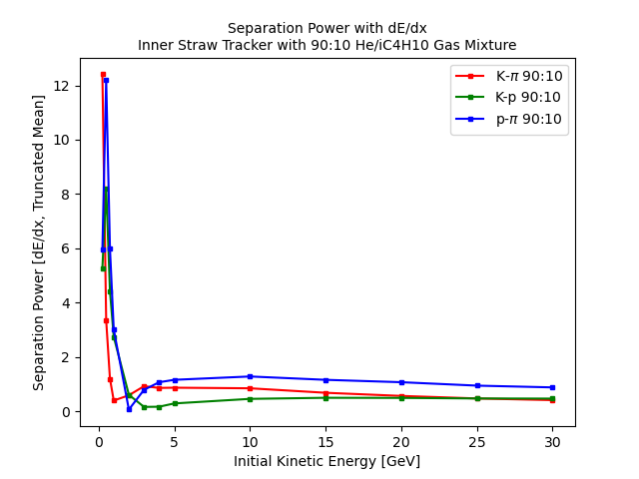

Slide 15
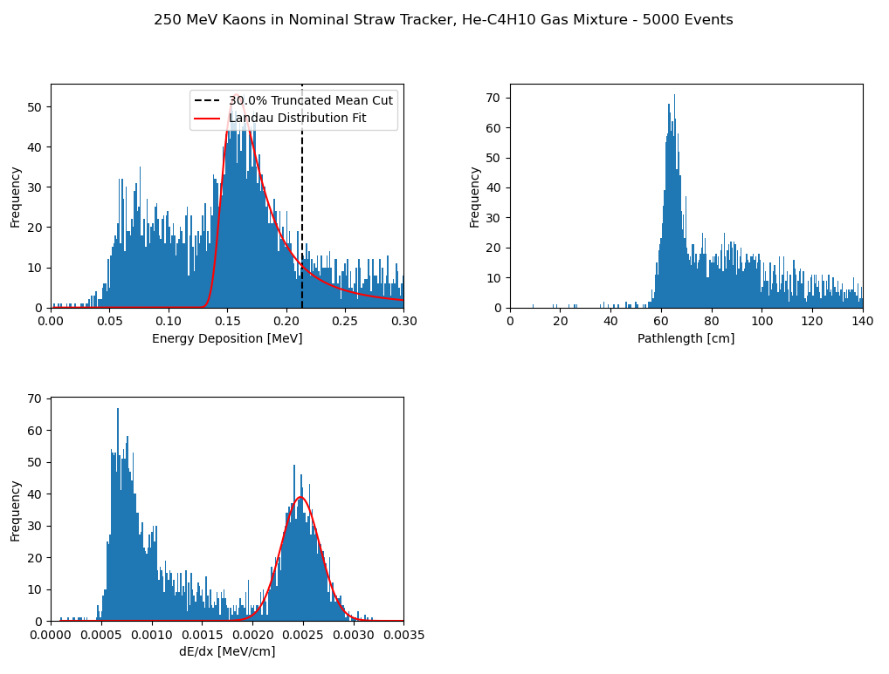
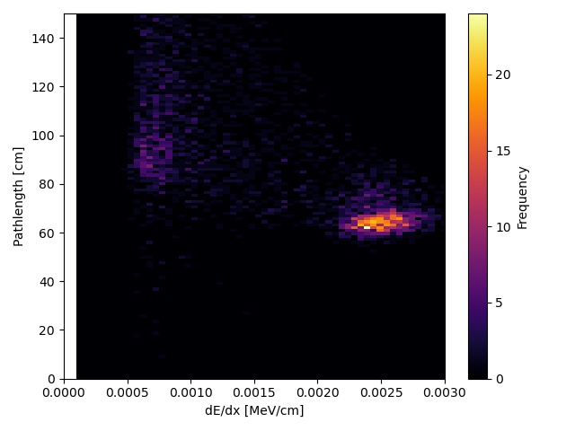
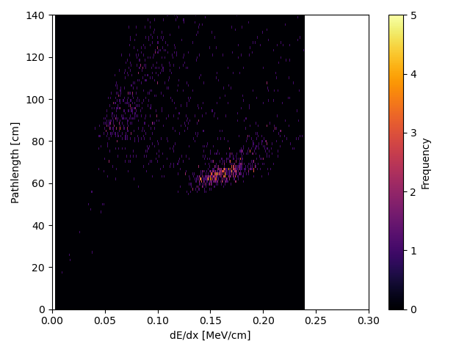


Slide 16
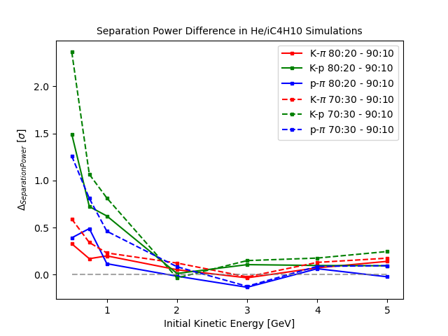

Slide 17
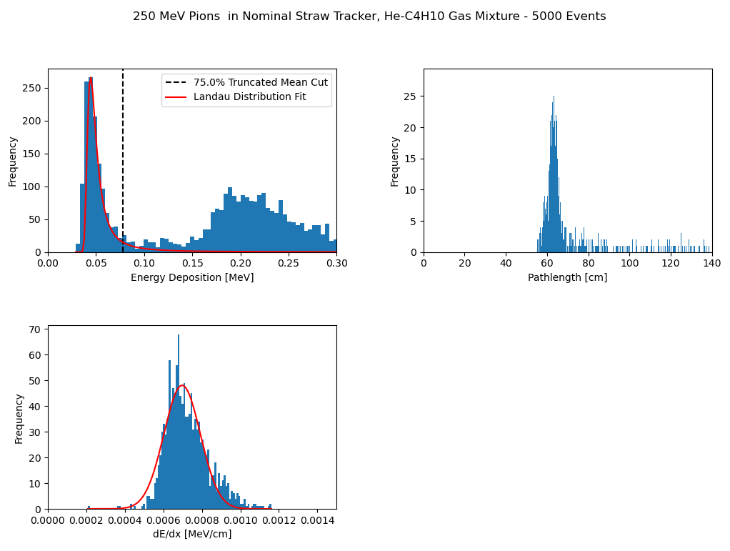
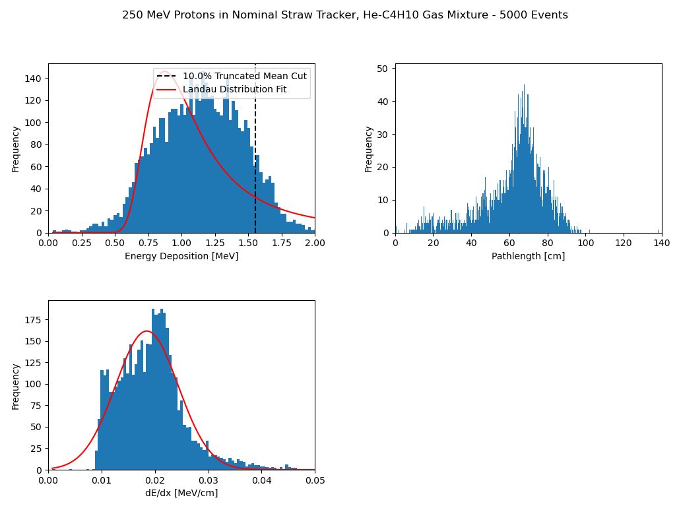

Slide 18
