Slide 1



Search for Long-Lived Particles with HCAL Segmentation in CMS at the Large Hadron Collider
Katia Avanesov, Harvey Newman, Kiley Kennedy, Gillian Kopp, Cristian Peña, Chris Tully, Si Xie
Katia Avanesov
Progress presentation 16/07/25

Slide 2
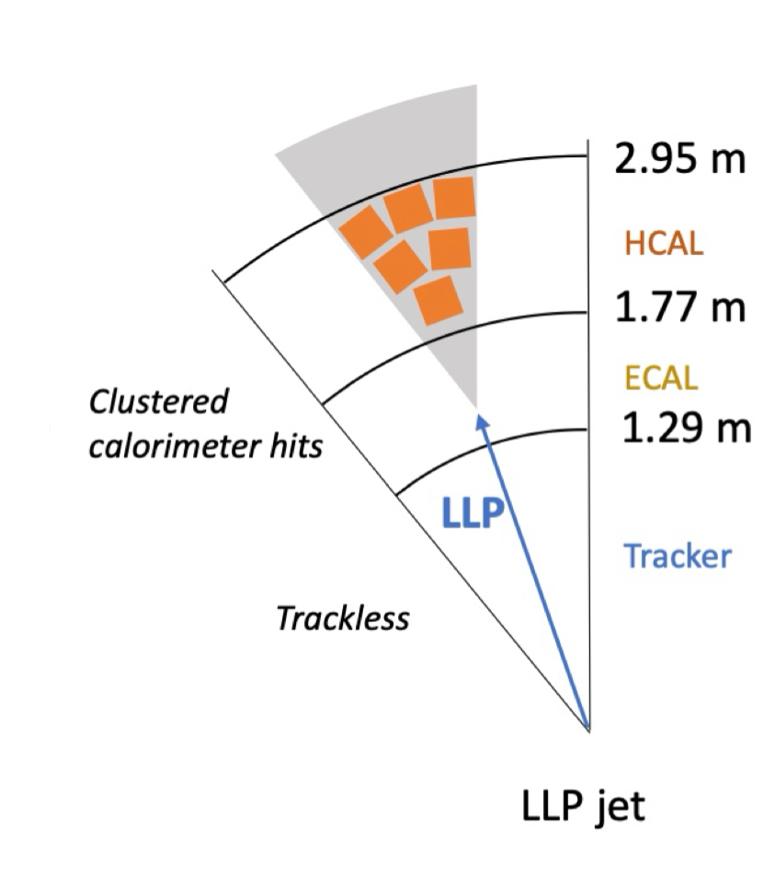
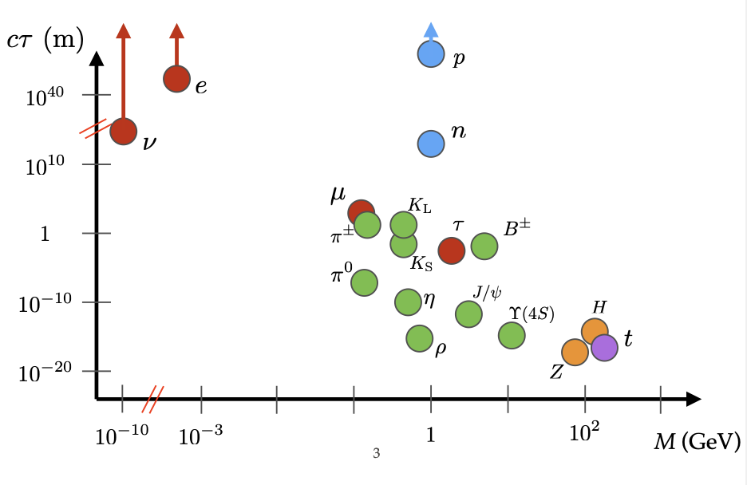
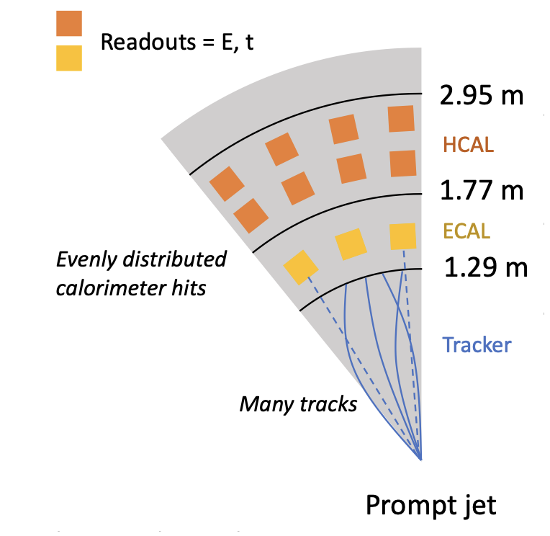
Long Lived Particles (LLPs)
LLPs have lifetimes greater than 0.1 nanoseconds
LLPs feature in both the Standard Model and predicted in numerous Beyond the Standard Model (BSM) theories
Trackless due to decays in the HCAL
Displaced vertex
Narrower energy spread
Longer lived particles will deposit less energy in the earlier layers of HCAL
Delayed due to longer lifetime and path length
Katia Avanesov
Progress presentation 16/07/25
Notes:
Long lived particles can really be thought of as any particle with a lifetime of greater than 0.1 nanoseconds, before they decay and they’re not uncommon in the standard model, as we know we have electrons, protons and neutrinos which all live much longer, than that. What we’re interested in, is probing for long lived particles beyond the standard model, which translates to searching for particles in this region here. And one reason why we would want to do that is of course because there are many that have been predicted, in a lot of intersection of many important theories like the matter-antimatter asymmetry, or dark matter, and supersymmetry.
Actually the CMS detector is optimized for short-lived partciles that decay almost instantly like the Higgs boson. This is because all of its subdetectors are primarily for extracting information about the tracks of the decay particles, their charge, their energy and momenta to then reconstruct this into the original particle. All these compoents work together to piece together one actual particle. But what about for LLPs? – decaying to jets

Slide 3
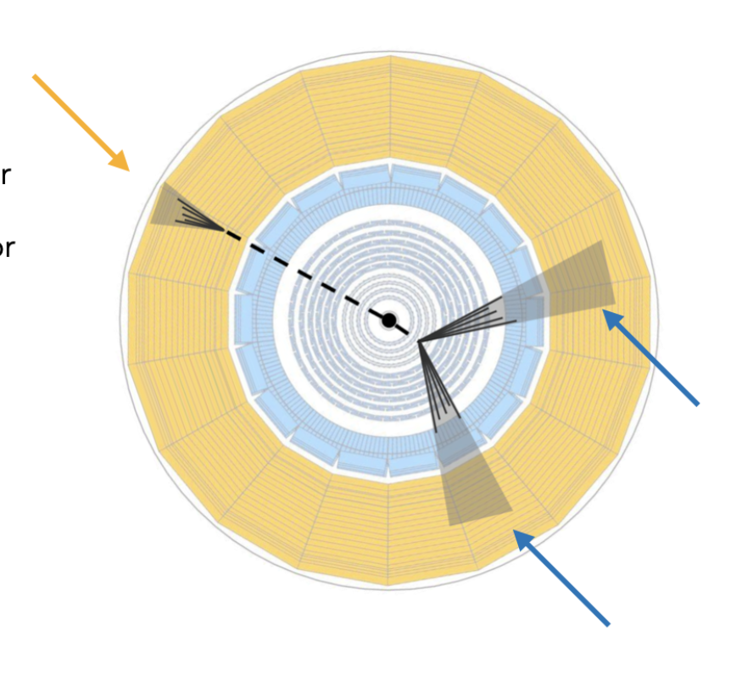
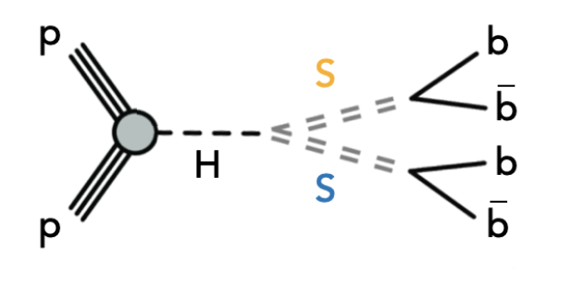
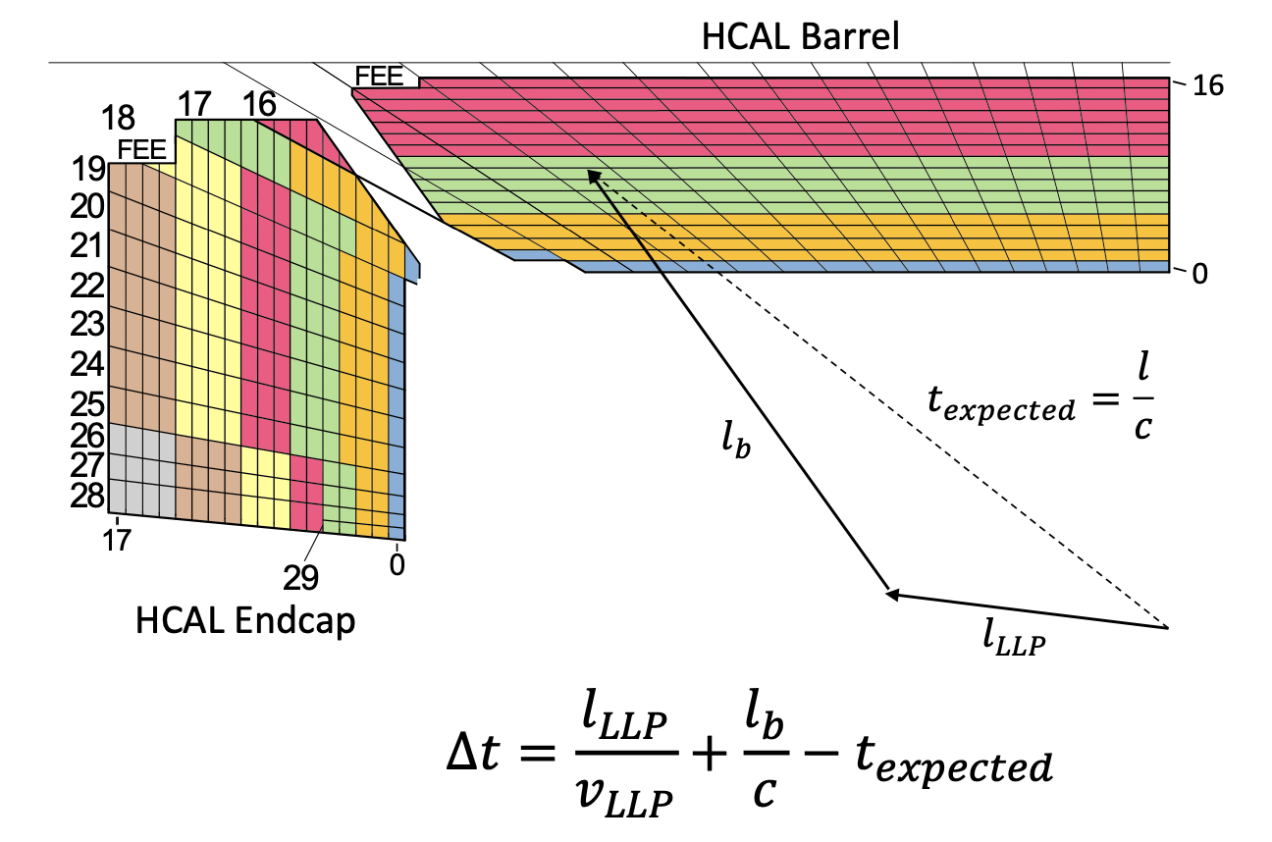
Search Strategy
Searching for H→ss→bbbb
Decays in HCAL
Use 4 layer HCAL depth segmentation
Free to decay anywhere
Katia Avanesov
Progress presentation 16/07/25
Notes:
And so yes our entire search strategy is on exploiting these differences, in the LLP signatures and what’s more, we are looking for decays within the HCAL because we see that this is where we could extract a lot of information, especially with the new updated HL-LHC upgrades. And so a broad outline of what has been done and ongoing work is here.
With the trigger in place, the core of this problem boils down to the offline analysis, and the way to further maximise signal and reject background to get overall better statistical significance for our final analsysis. And so while we have yet to actually produce our analysis, what we’ve been working on is developing the tools of successful analysis, which is this LLP classifier, which I was in charge of/ led.

Slide 4
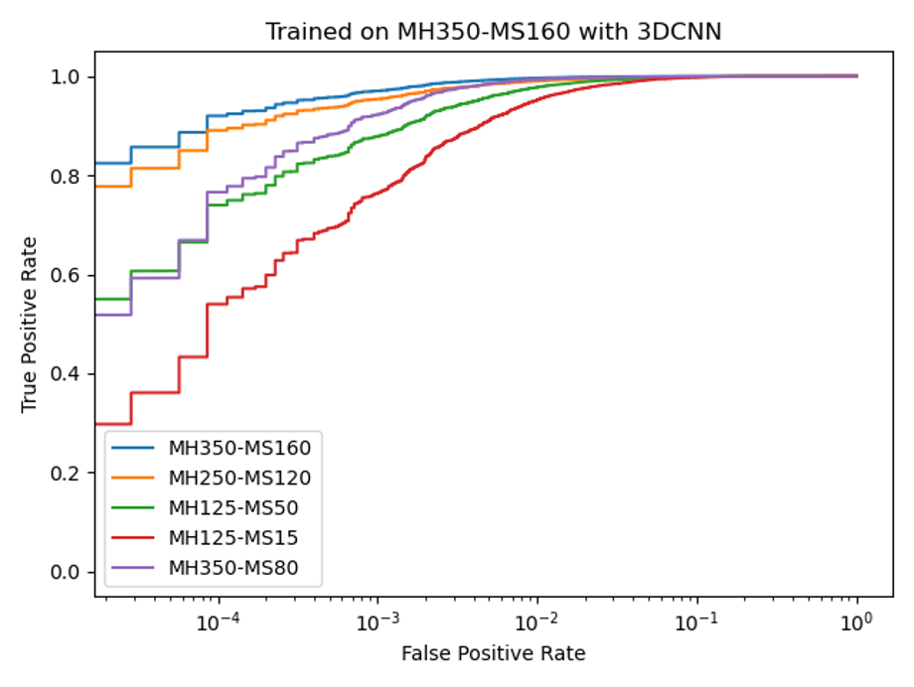
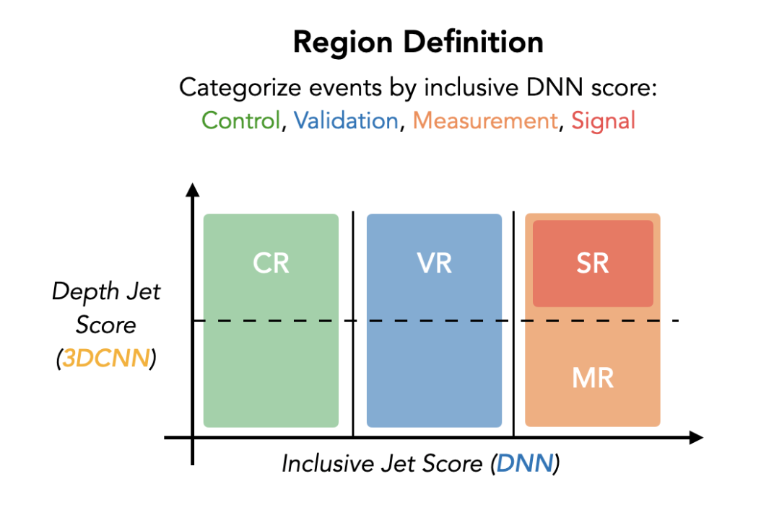
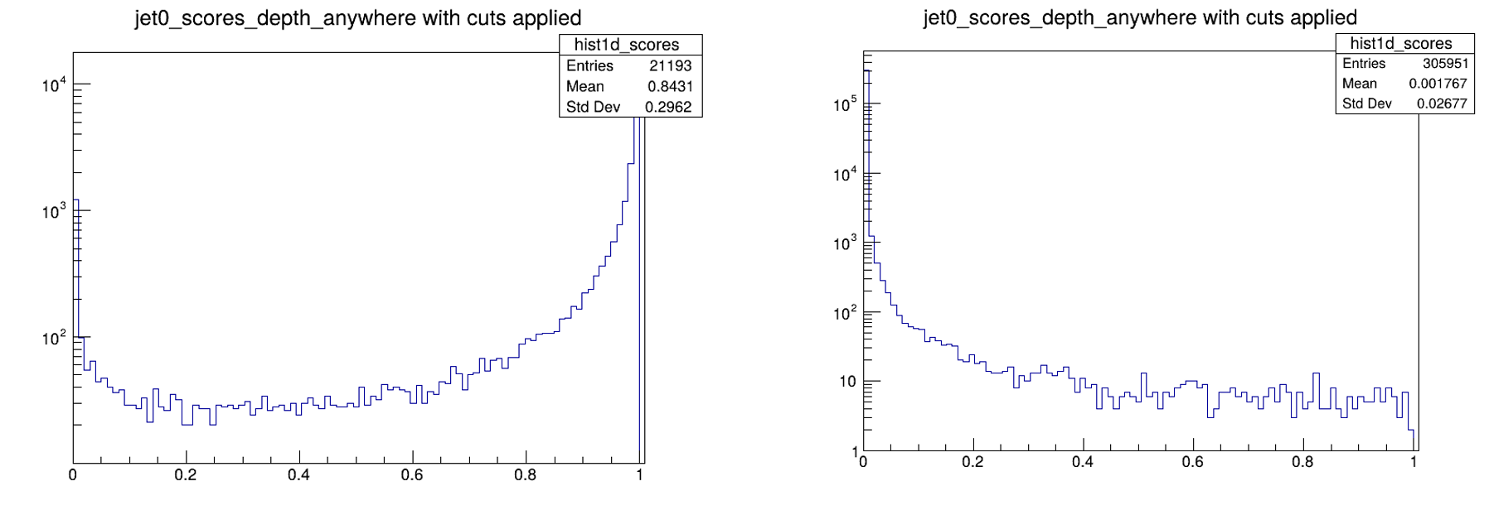
Analysis Strategy
Train two Neural Networks to Classify the LLPs
Perform a counting experiment
Signal
Background
Katia Avanesov
Progress presentation 16/07/25

Slide 5
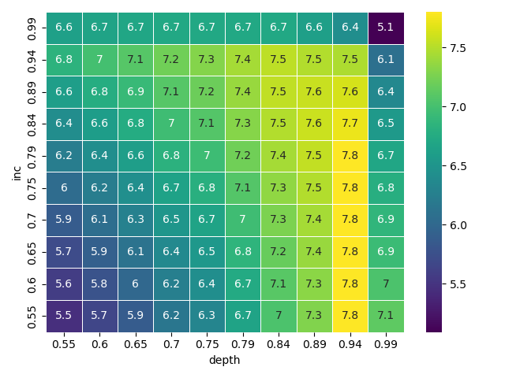
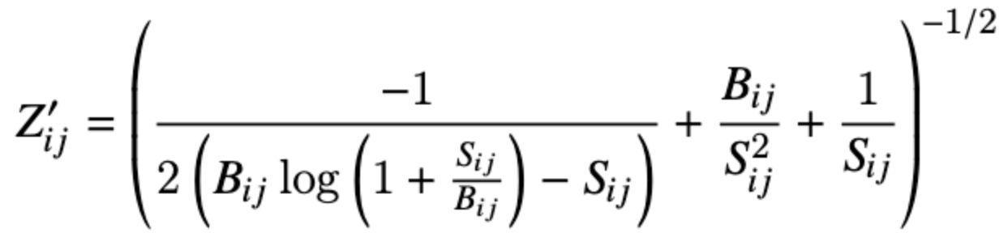
Progress
Aim to optimize threshold selection to maximize significance of counting experiment
2D ‘scan’ of significance for various thresholds
Low signal approximation formula:
Significance
Procedure:
Calculate (predicted) number of events in signal and background for each cut
Calculate significance for each combination
Neural network score
Neural network score
Katia Avanesov
Progress presentation 16/07/25

Slide 6
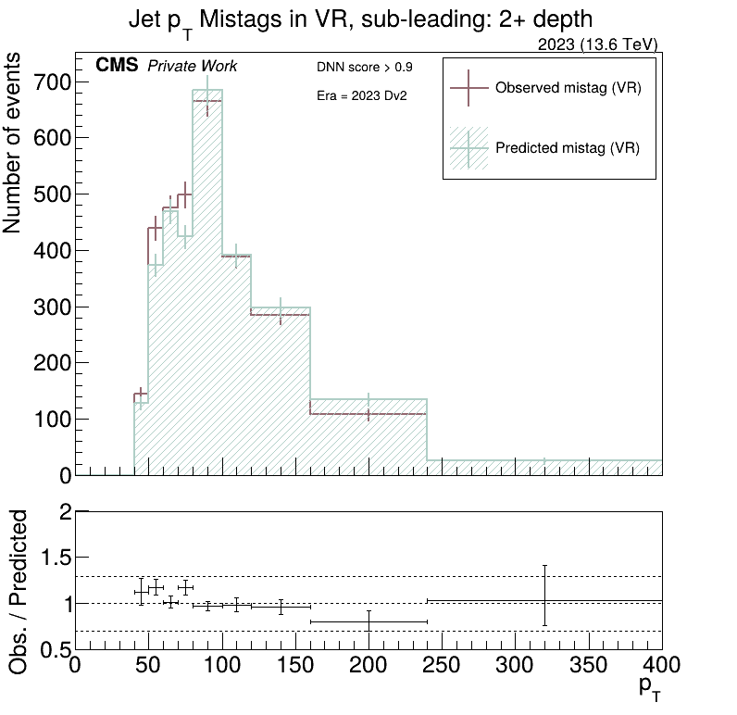
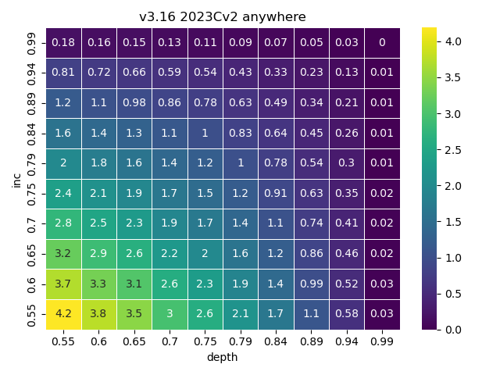
Additional Info
Prediction of Mistag rate as a function of jet pT
Scan of # events in a background file

