Slide 1

sMDT Detector Commissioning
Andrew Kiesling
Jiajin Ge, Chihao Li, Bing Zhou
04.08.2025

Slide 2
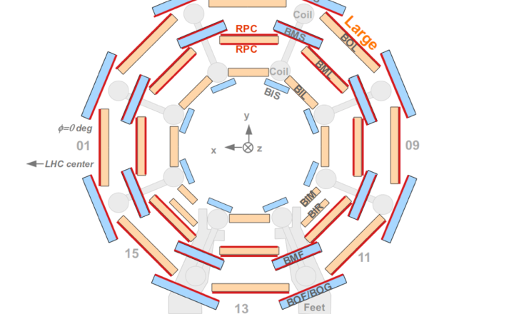
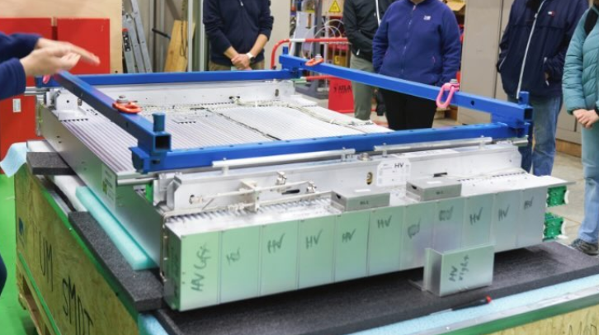
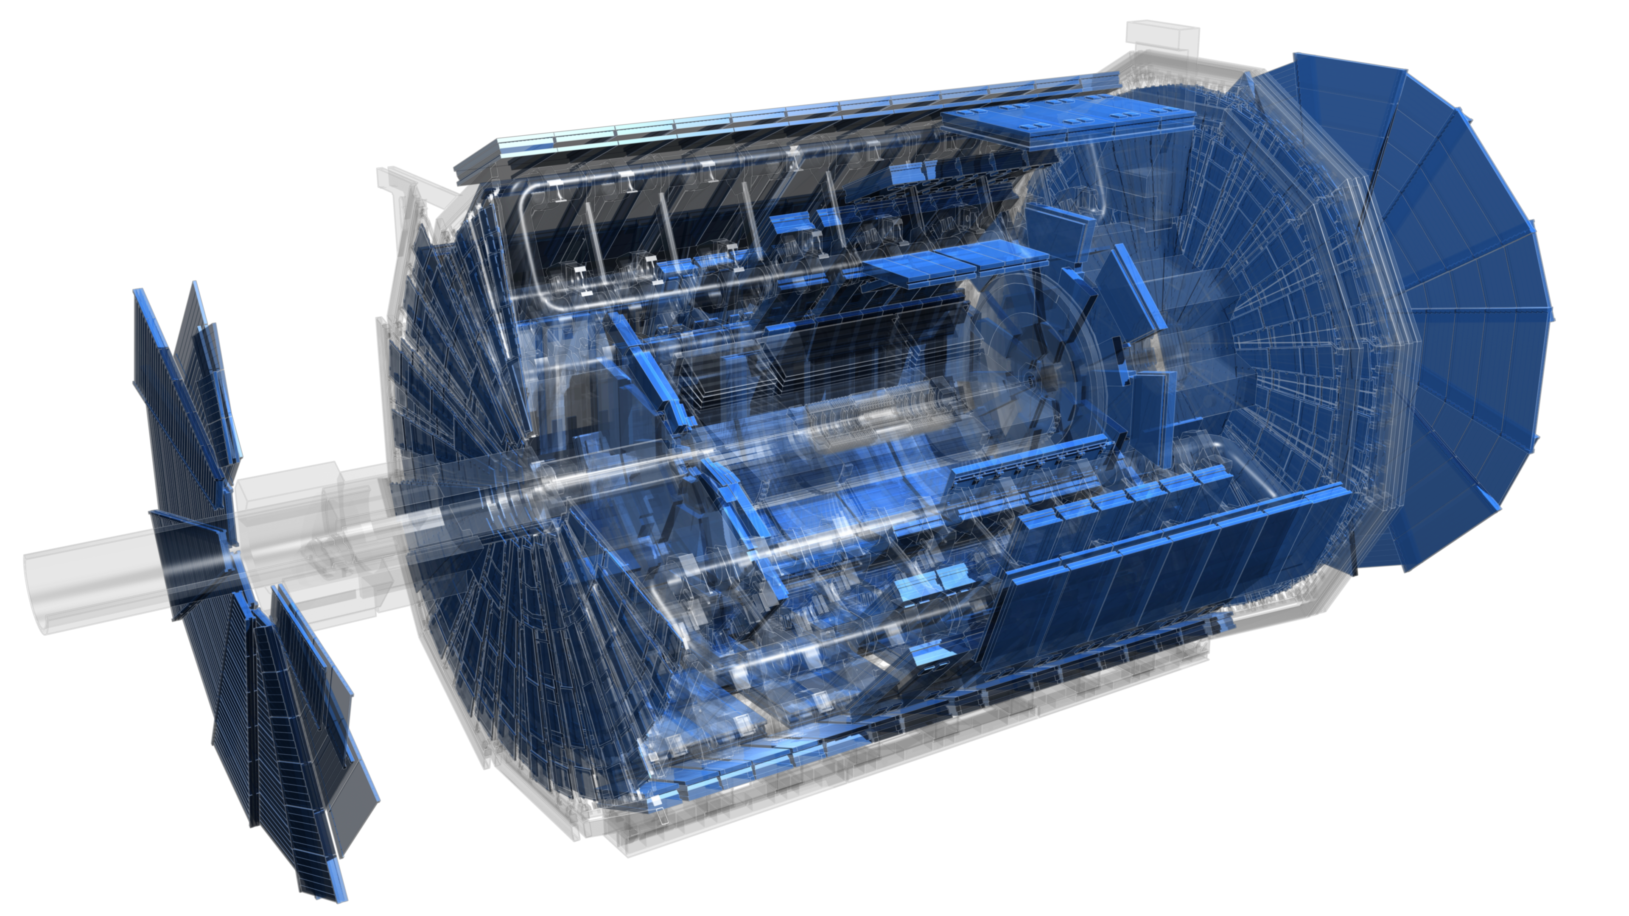
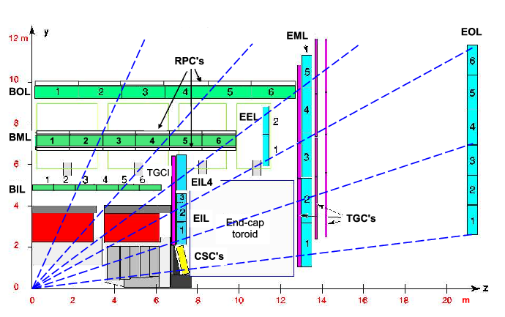
Muon Spectrometers at ATLAS
Within ATLAS are 5 major technologies to aid in Muon spectrometry:
MDT’s
TGC’s
RPC’s
sTGC’s
MicroMega’s
The two main motivators for muon spectrometry are looking for collision products, and event triggering.

Slide 3
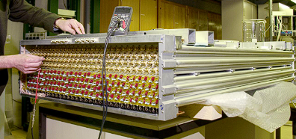
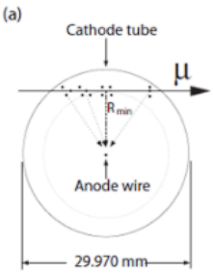
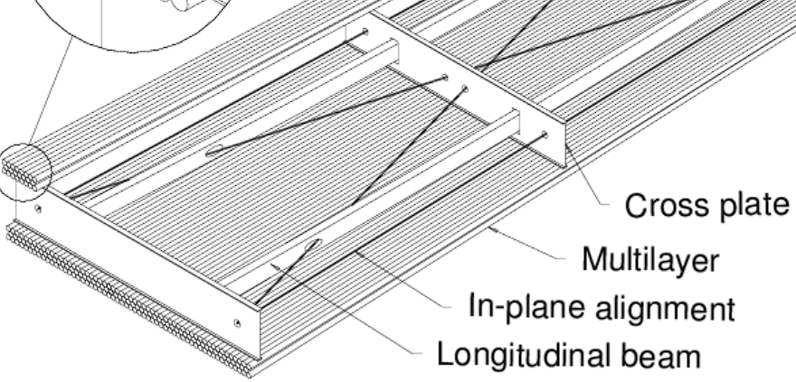
How MDT’s Work
MDT’s (Monitored Drift Tubes) read out charge from ionized electrons.
Filled with a noble gas mixture (Ar/CO2)
93/7 mixture, 3 bar of pressure
Central wire biased to 3.08 kV
Muons pass through a tube
The muons create electron-ion pairs
Electrons drift towards the central wire
Tube reads out resultant charge delta
A single MDT Chamber consists of 8 layers of tubes (2 sets of 4), with each layer possessing around 60 tubes. Specifically, BIS1 chambers have 70 tubes, while all other chambers have 58.

Slide 4
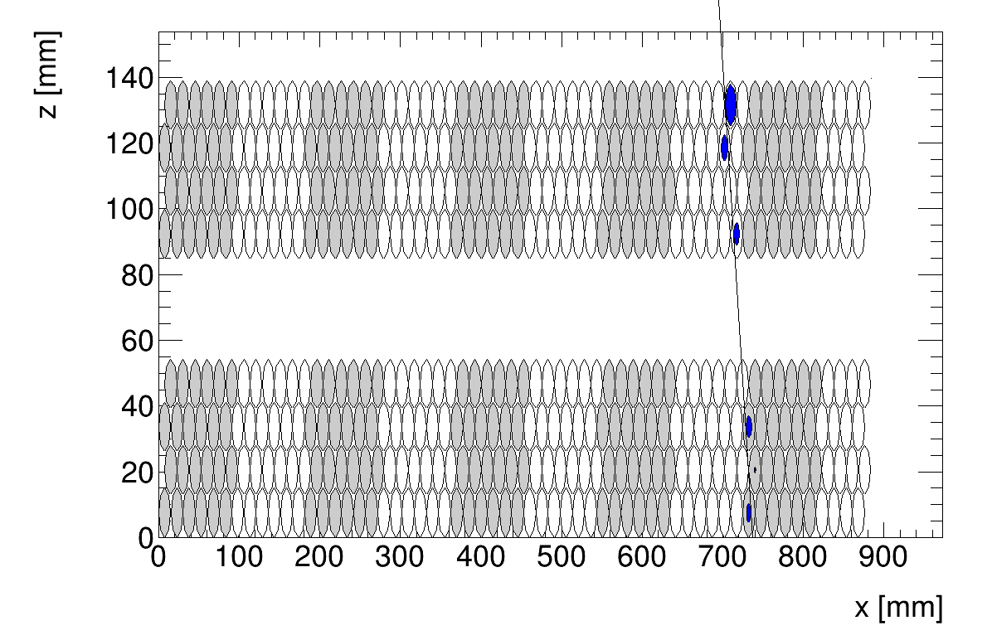
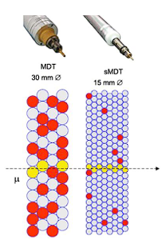
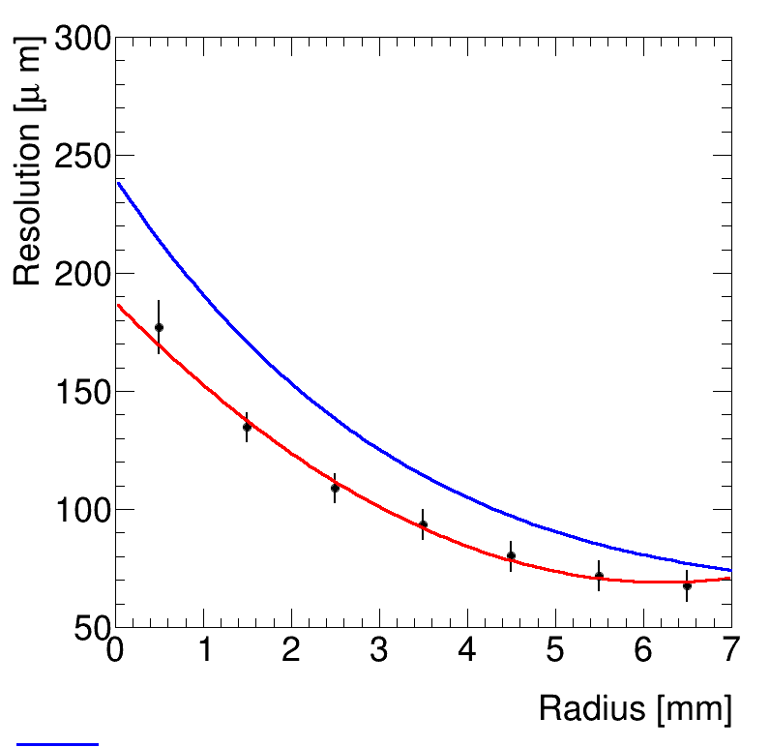
The Motivation of sMDT’s
The HL-LHC Upgrade Posed some Potential Problems for the Current MDT Technology:
Significantly increased background rates meant that increased time resolution was needed
Solution? Make the tubes smaller!
sMDT tubes have half the diameter of MDT tubes
Smaller tubes meant average event radius was lower, so drift times reduced -> faster trigger
Smaller chamber sizes allow for an extra layer of RPCs to be installed, allowing for trigger windows to be further reduced in the ATLAS inner barrel.
One drawback is that the smaller tubes have a worse event resolution.
 | MDT | sMDT
Diameter | 30 mm | 15 mm
Resolution | ~80 μm | ~100 μm
HV Bias | 3080 V | 2730 V

Slide 5
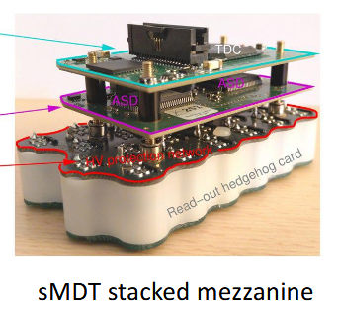
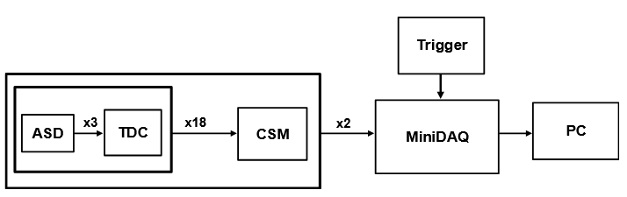
sMDT Electronics
sMDT chambers have 20 Mezzanine Cards, which read out data from each tube
Each card has 3 ASD (Amplifier, Shaper, Discriminator) chips, which create an integrated charge readout
3 ASD p. Mezzanine -> 8 tubes per ASD
Wilkinson ADC (Analog-Digital Converter) converts integrated charge to a pulse
The output of the 3 ASD Chips is fed into a TDC (Time-Digital Converter) chip
0.78 ns time resolution
BIS1 chambers have 24 cards

Slide 6
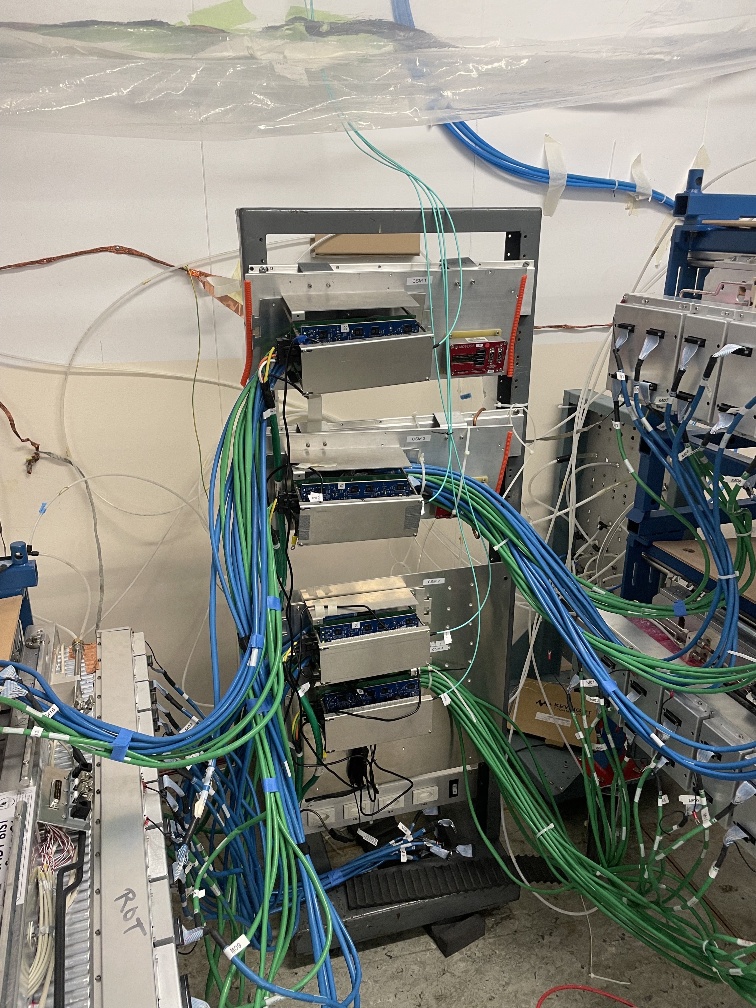
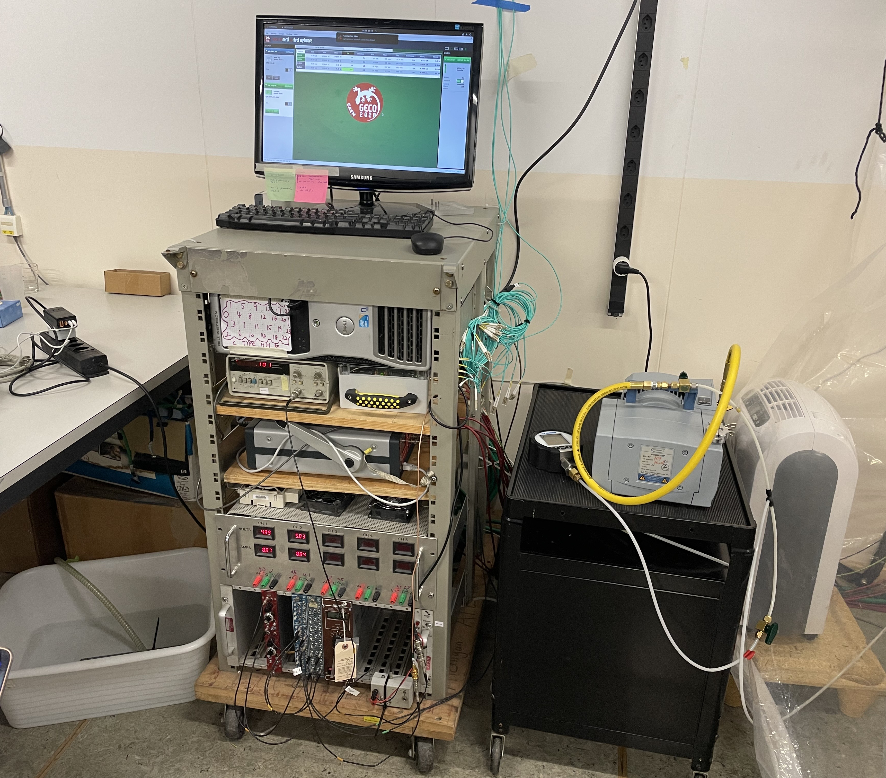
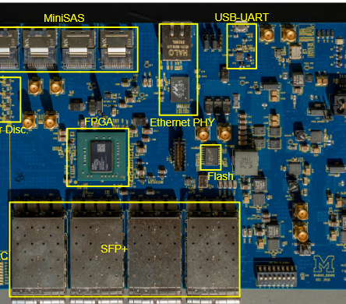
sMDT DAQ
CSM output, together with scintillator trigger, is sent to the MiniDAQ system.
MZ Output goes to a CSM (Chamber Service Module) which multiplexes the data from all the tubes. Serves as a transceiver between the chamber and DAQ.
The MiniDAQ outputs data via USB to a PC, as well as long term storage via ethernet

Slide 7
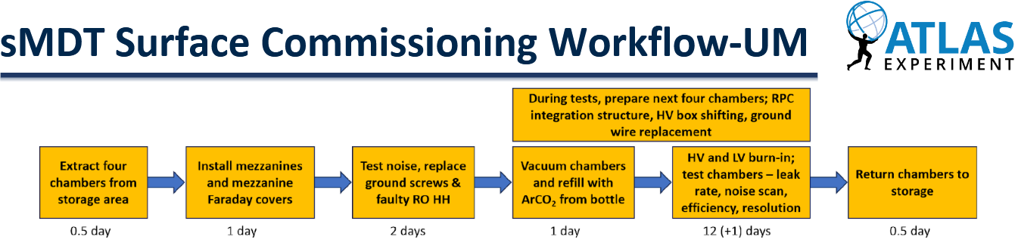
My Project: Contribute to sMDT Commissioning at BB-5
Hardware Commissioning
Offline Data Analysis
Installation of chamber parts
Mezzanine cards
Faraday Cages
HV Glue
RPC Bearings
HV Box Shifting (when needed)
Insertion/Extraction from testing room
HV Installation
DAQ Installation
Noise testing
Checking tube noise before/after HV burn in and gas exchange
Cosmic Ray testing
Test chamber effectiveness on real cosmic ray data

Slide 8
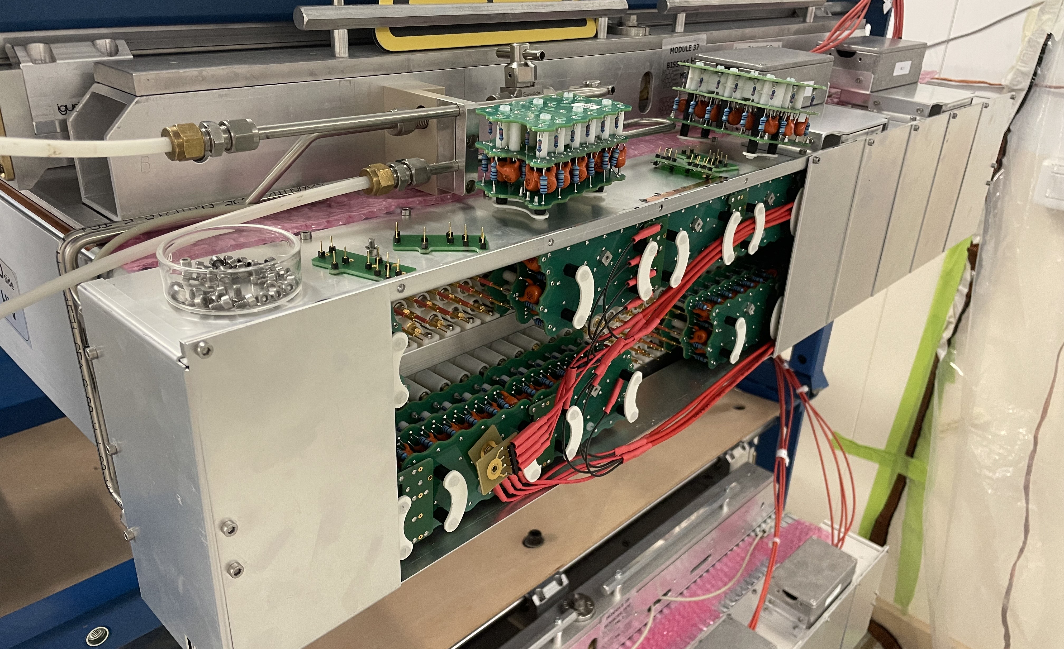
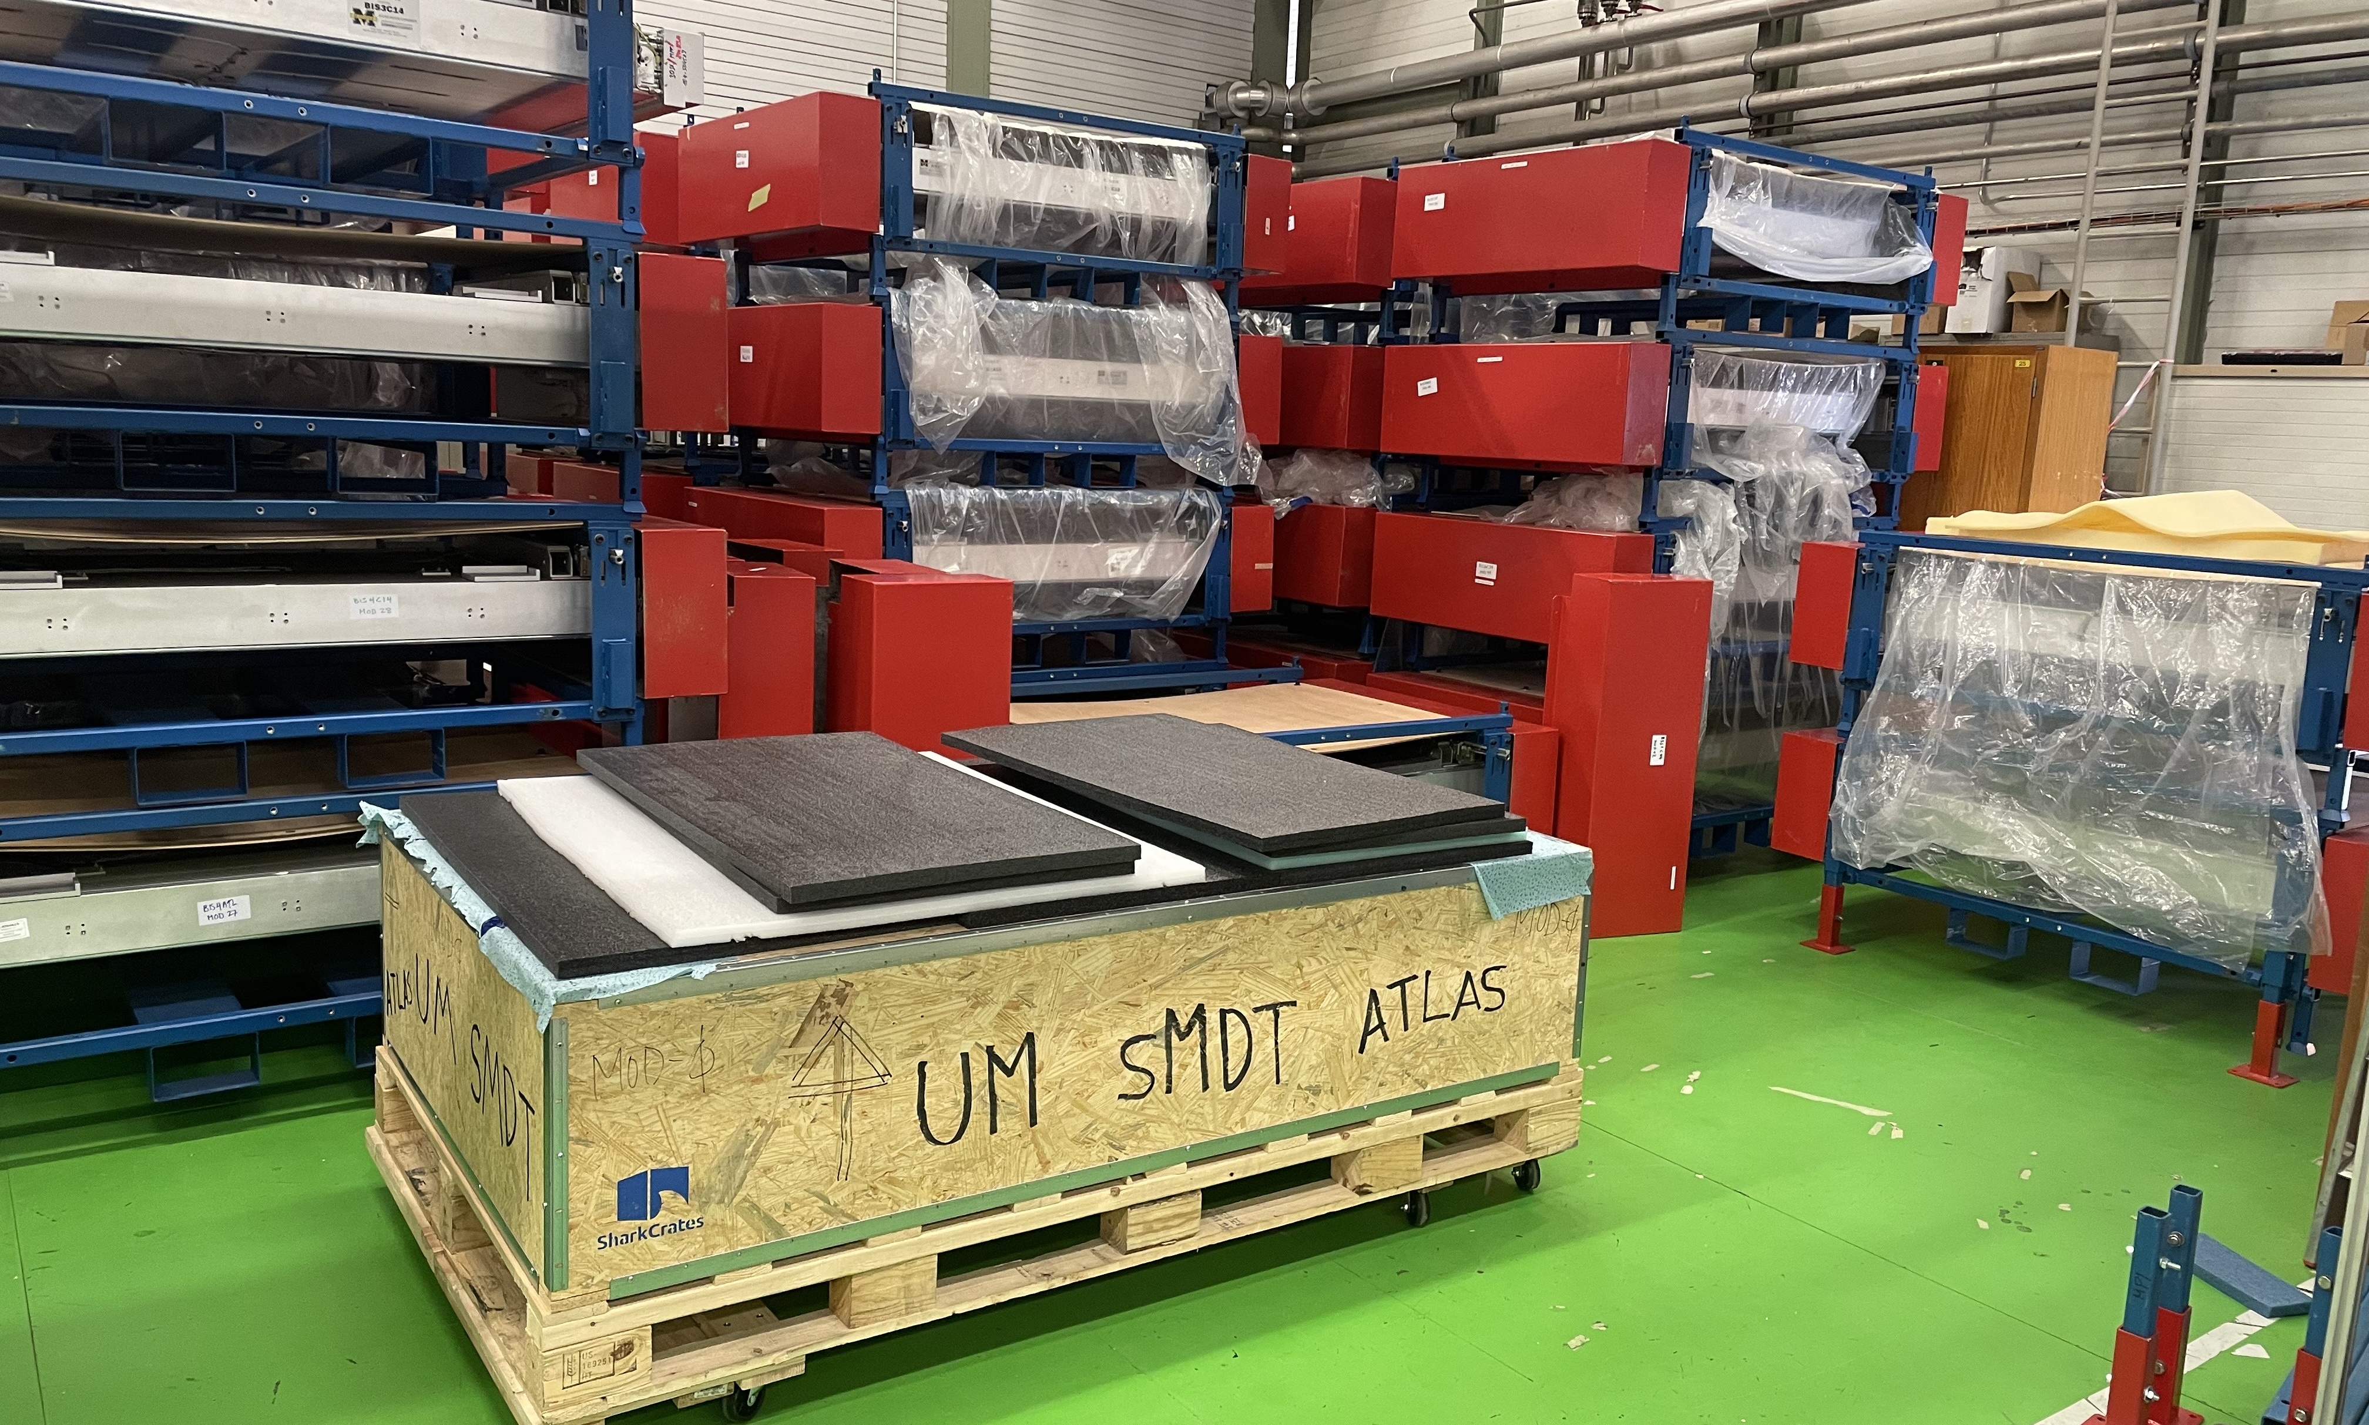
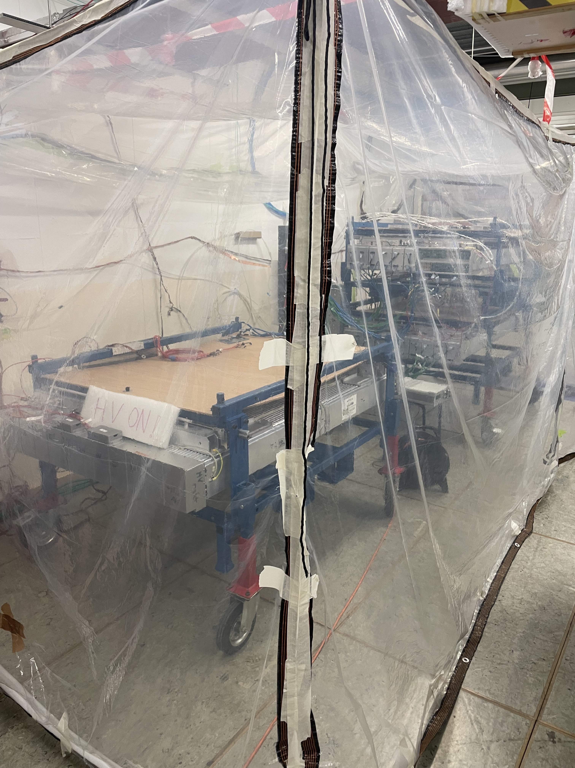
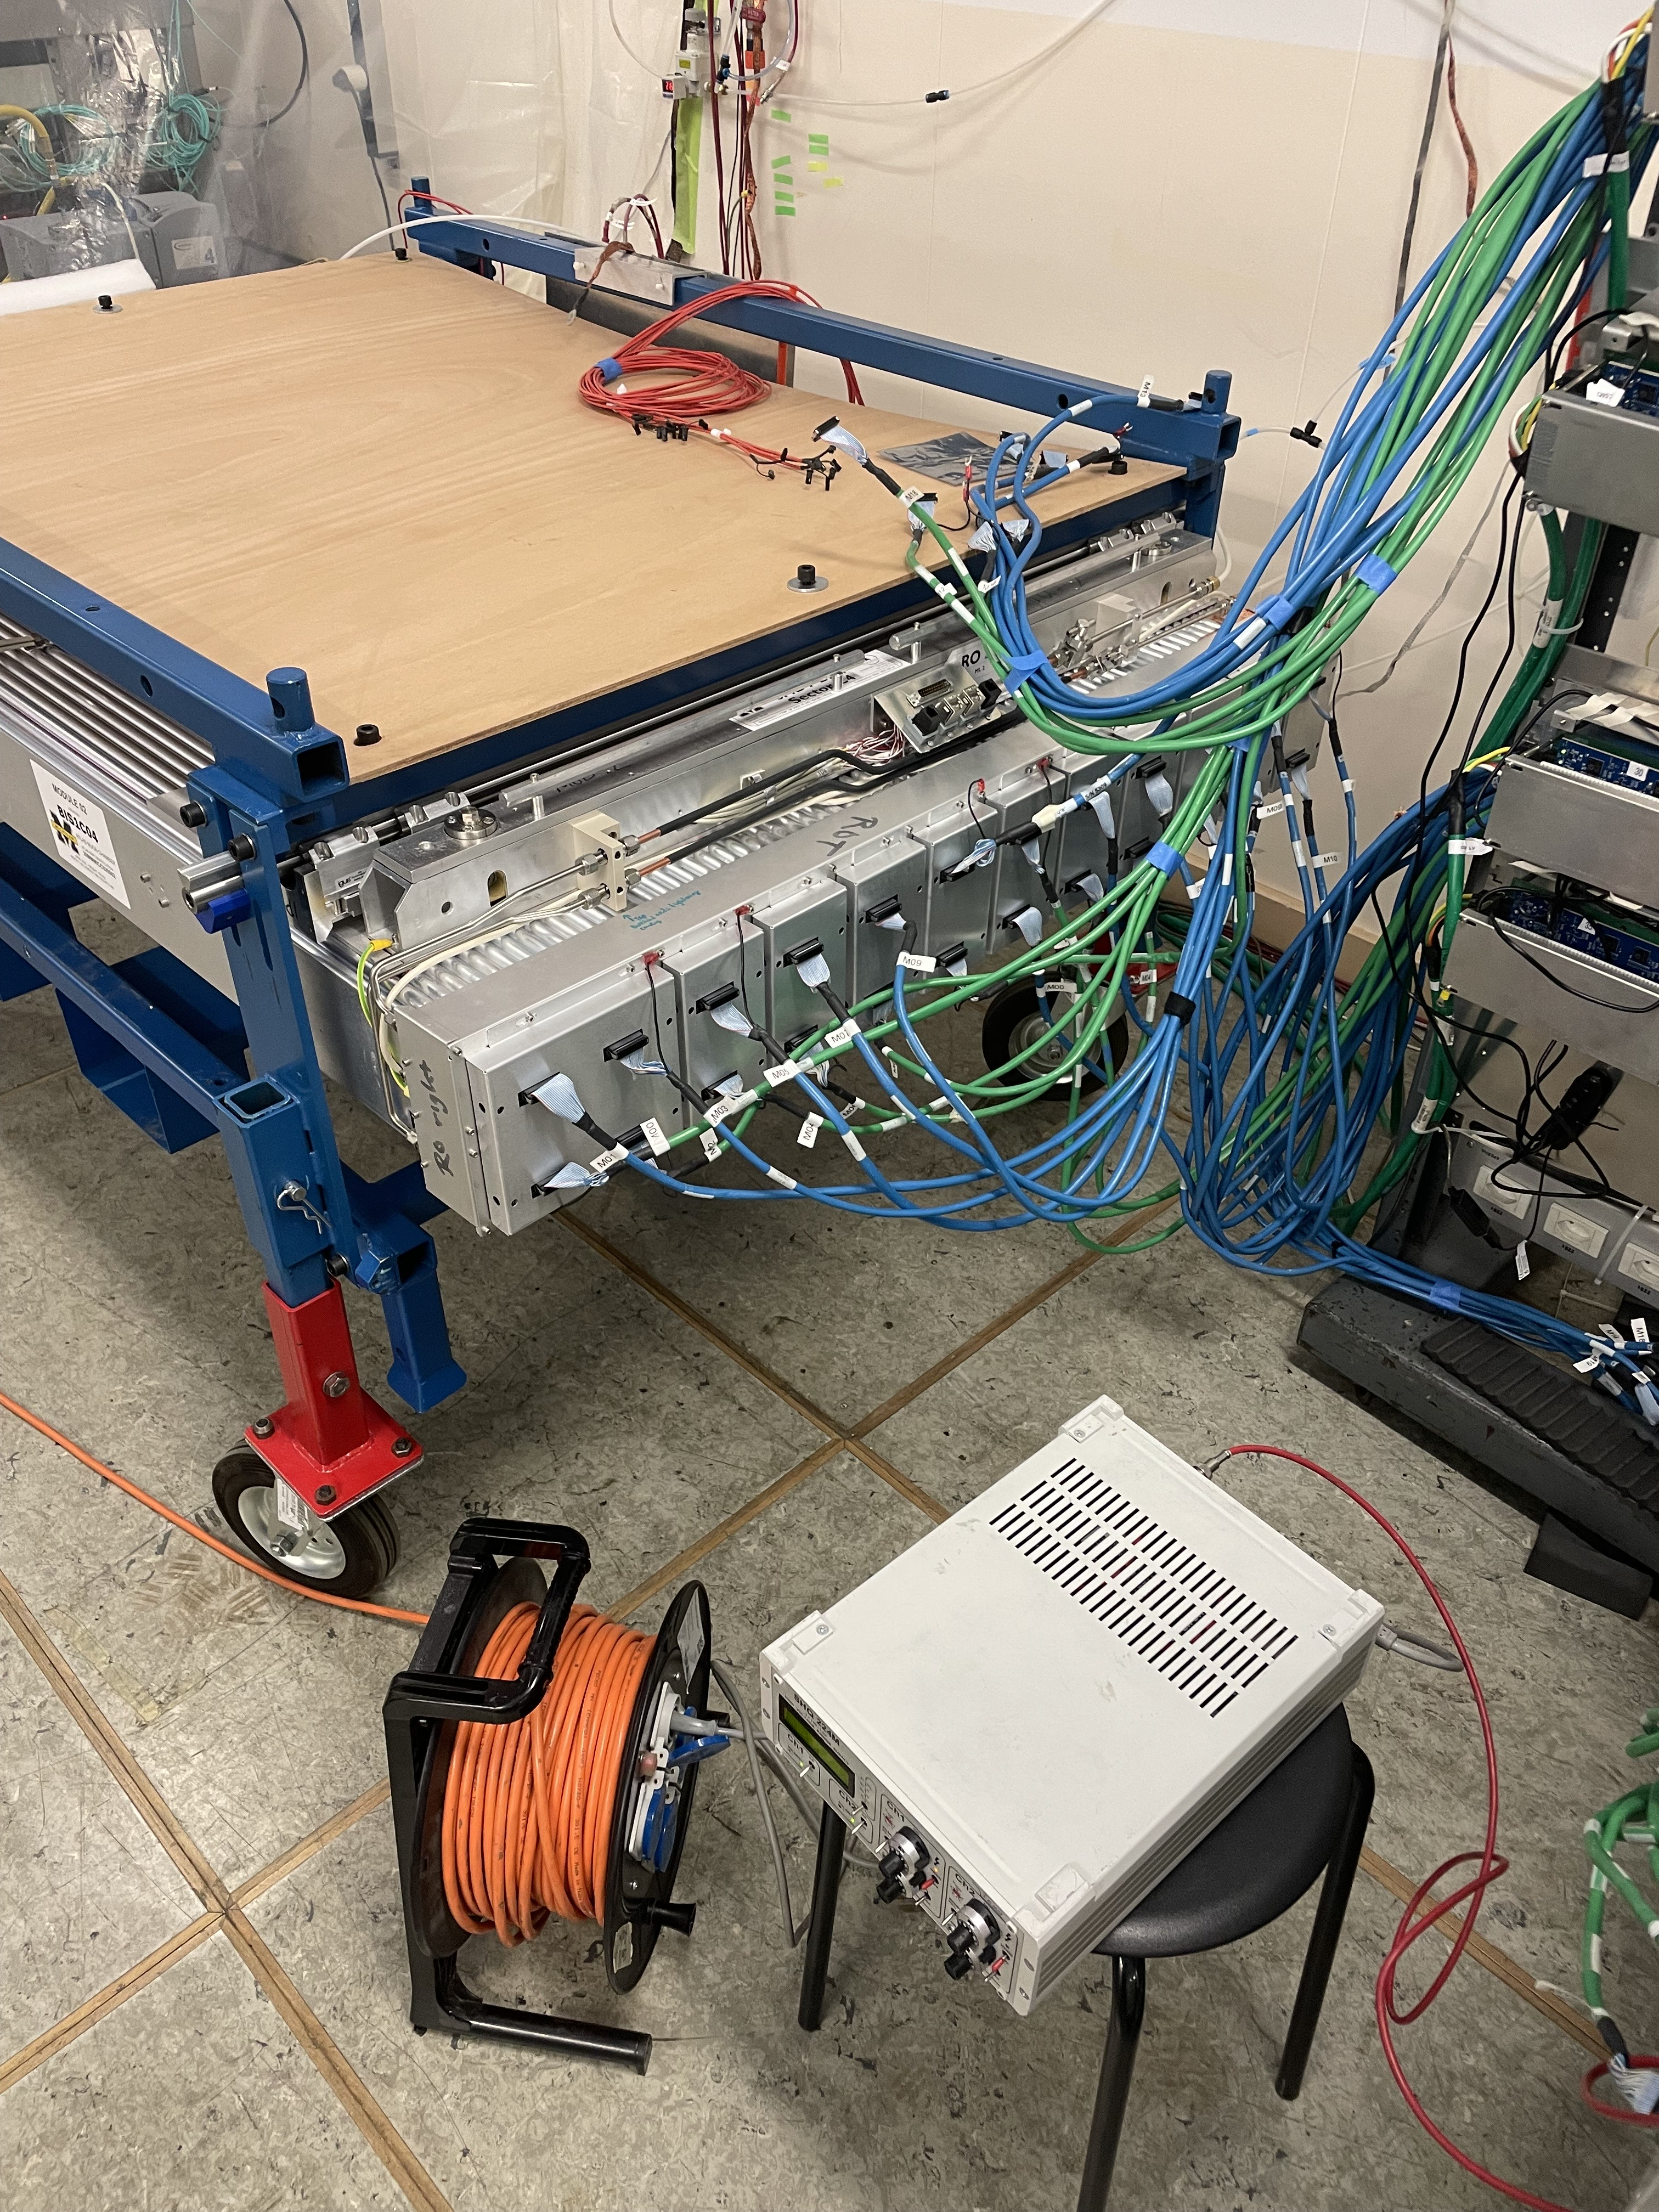
The sMDT Commissioning Setup at BB-5
The main two components are the storage area and the testing room.
Chambers spend time in long term storage in between tests
upgrades performed on the UM bench
Testing room with tent to prevent humidity buildup during tests
Tube burn-ins, gas exchange, and MZ card exchange performed in testing room

Slide 9
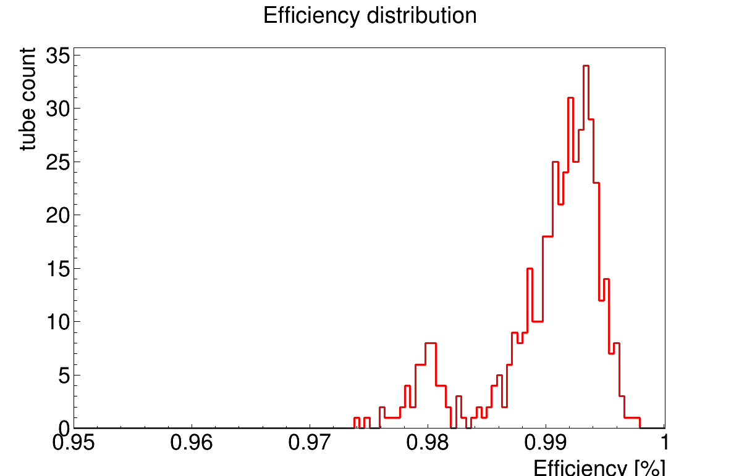
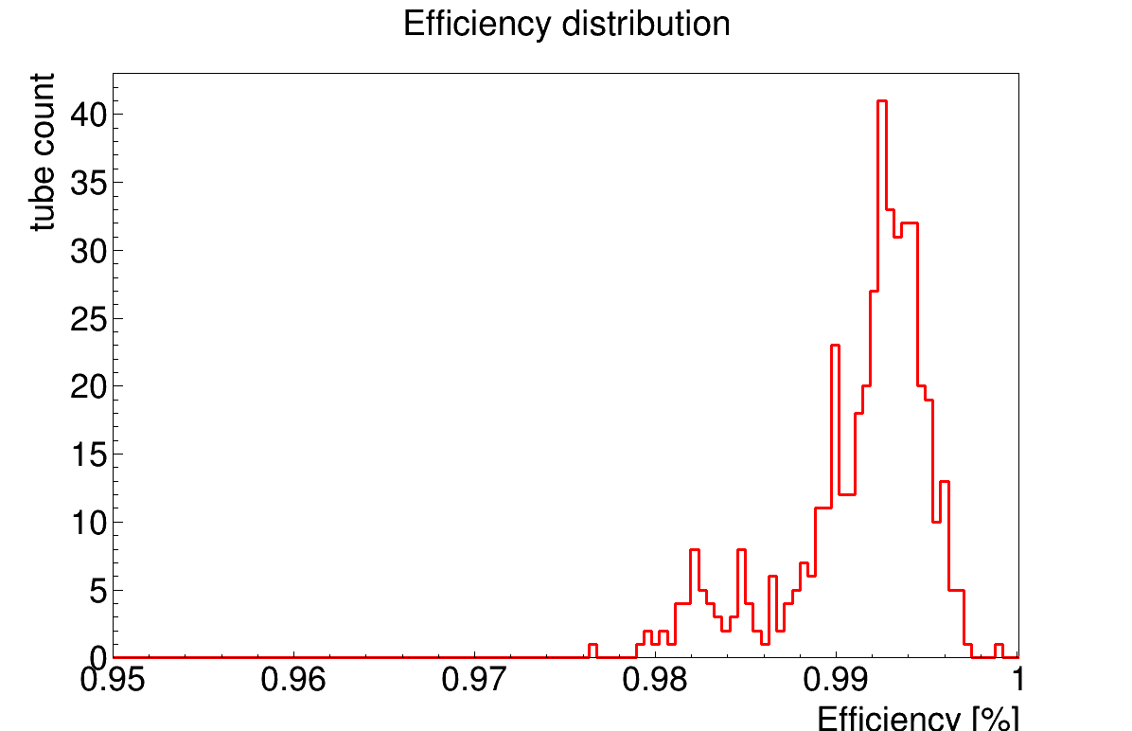
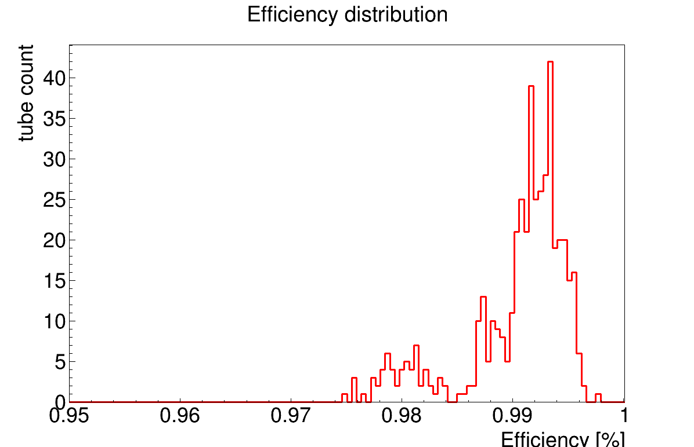
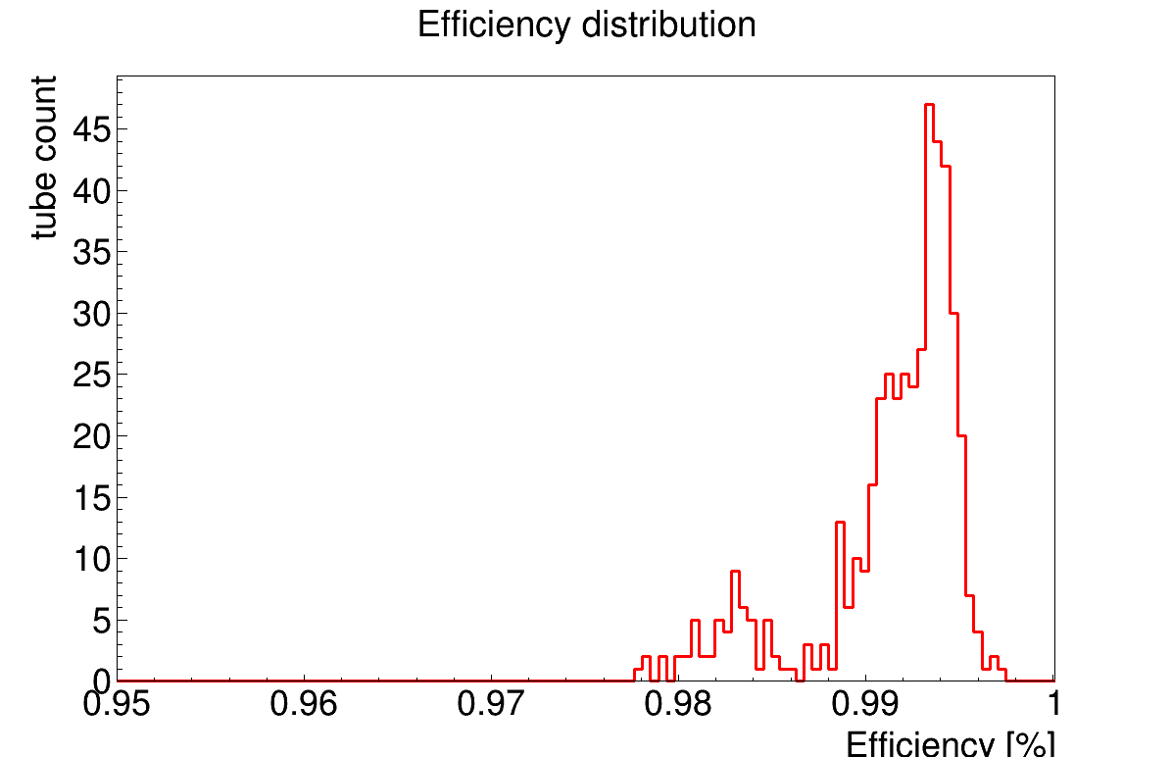
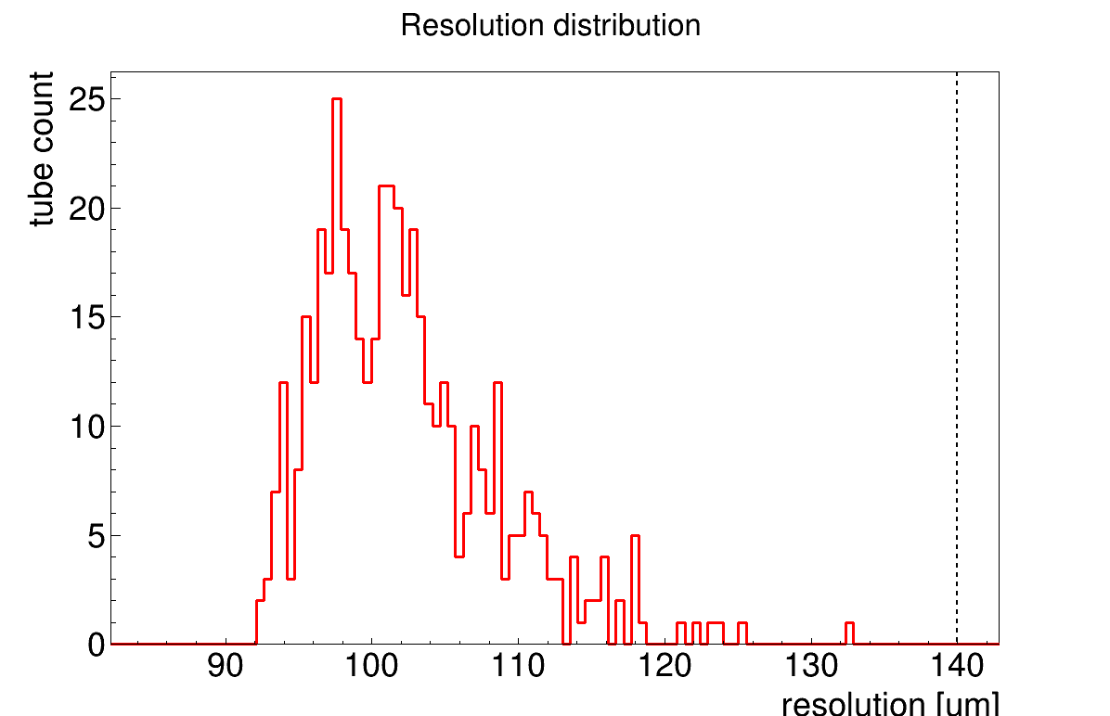
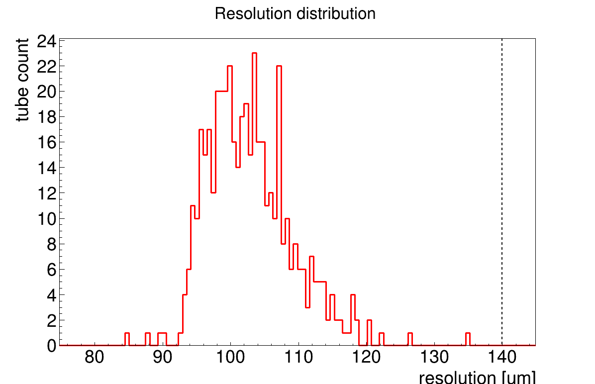
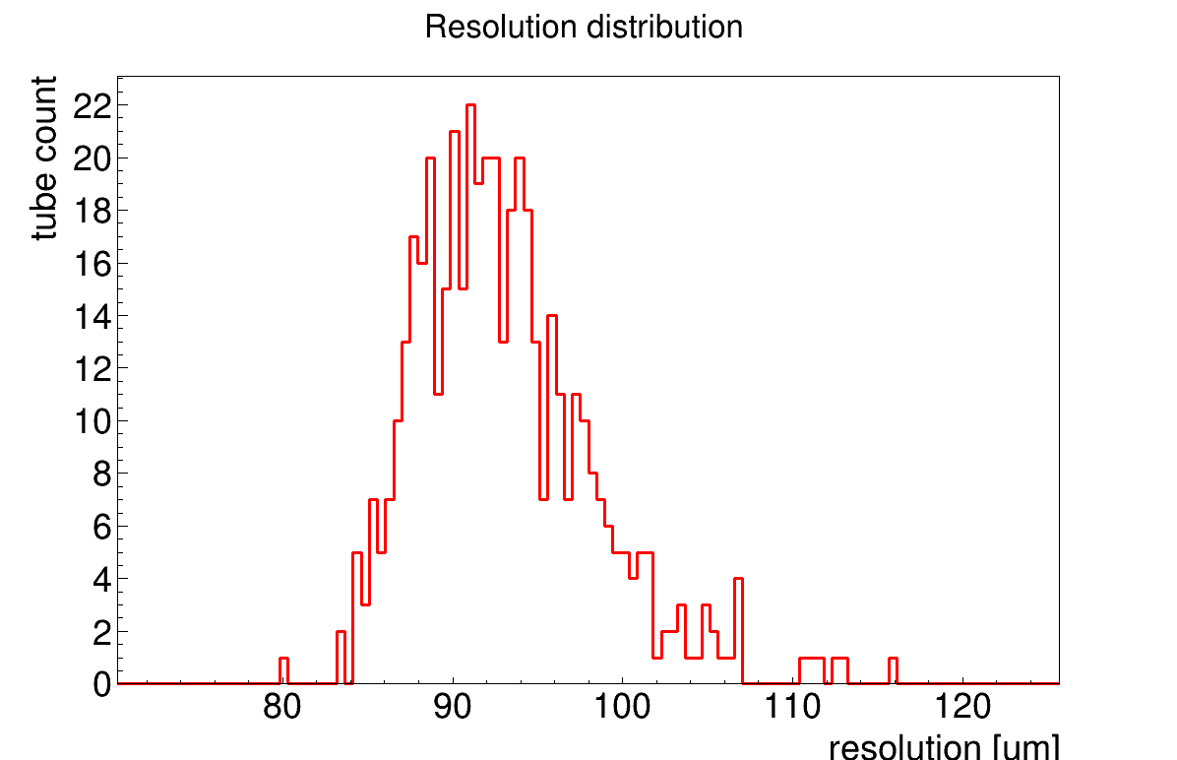
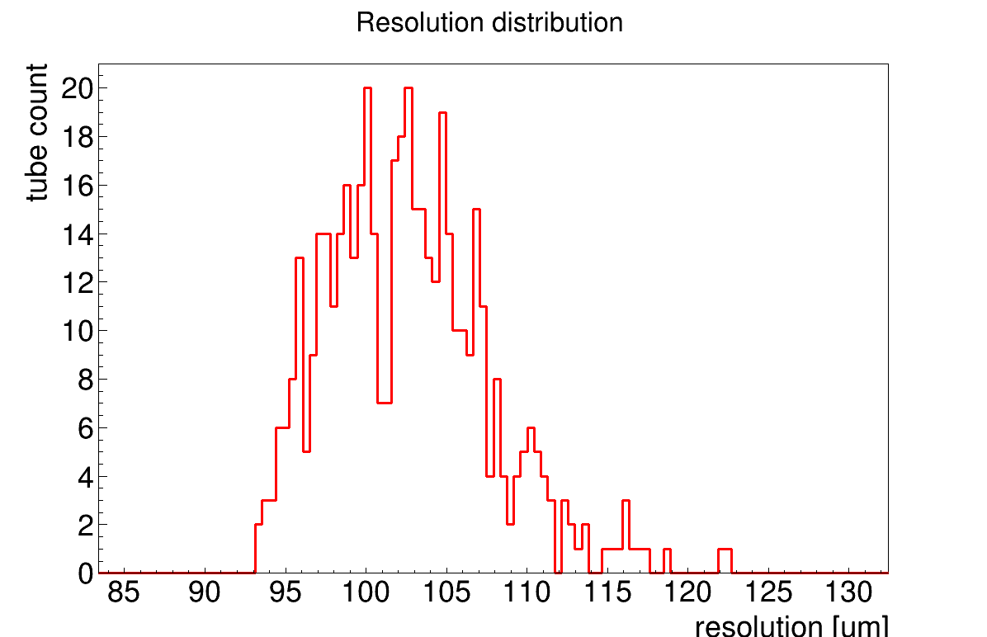
Cosmic Ray Testing: Efficiency and Resolution
Module 44
Module 45
Module 36
Module 18

Slide 10
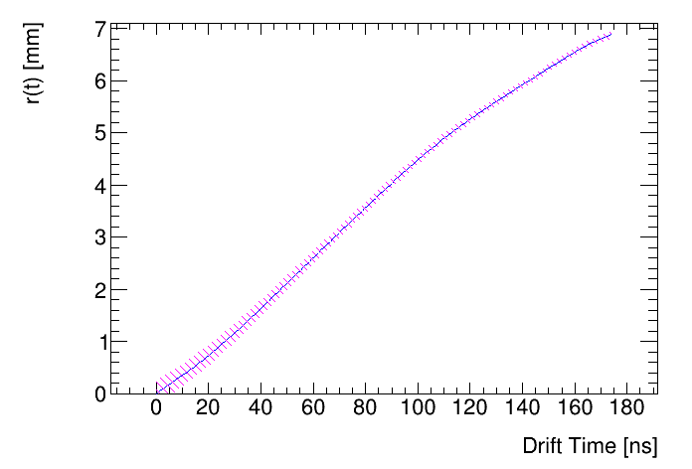
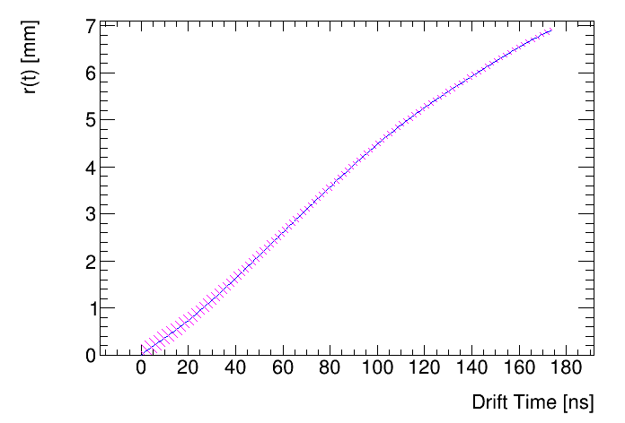
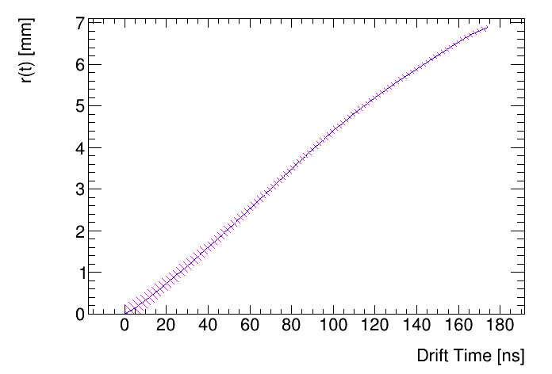
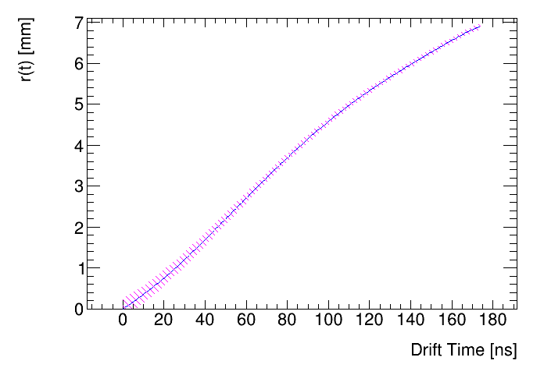
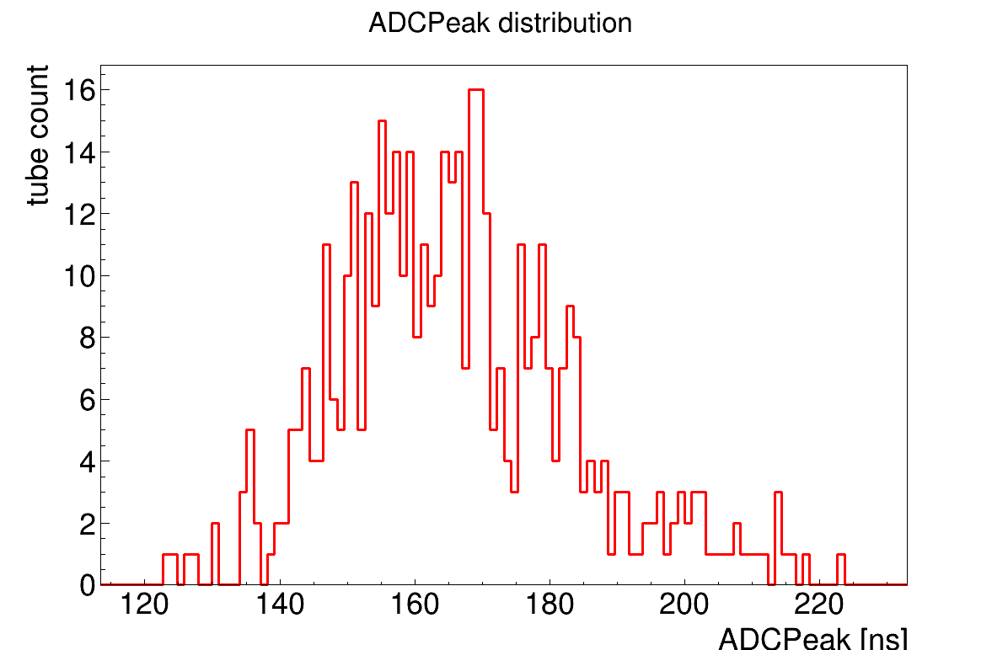
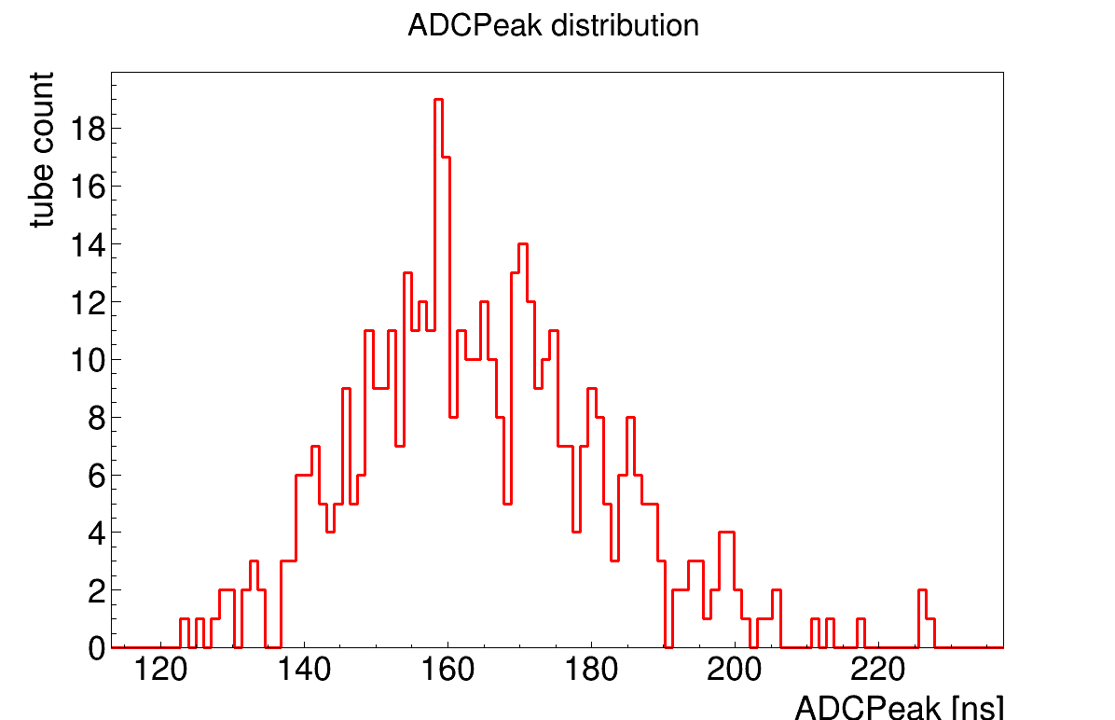
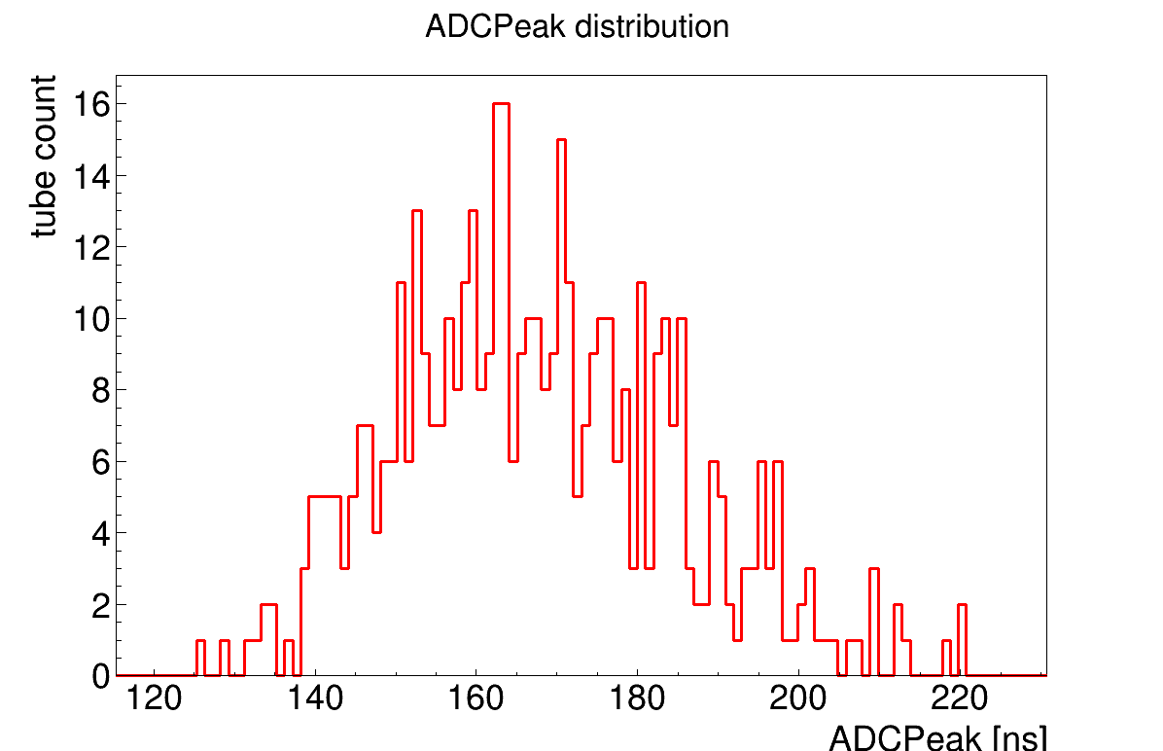
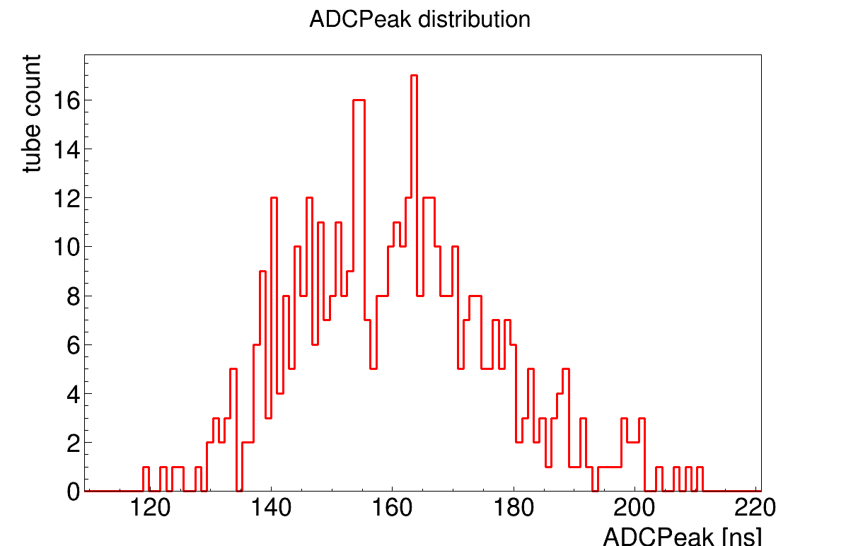
Cosmic Ray Testing: R(t) Functions, ADC Peaks
Module 44
Module 45
Module 36
Module 18

Slide 11
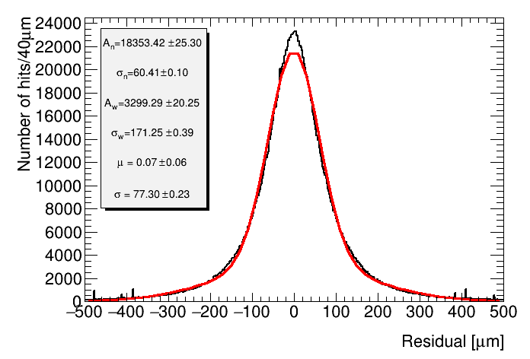
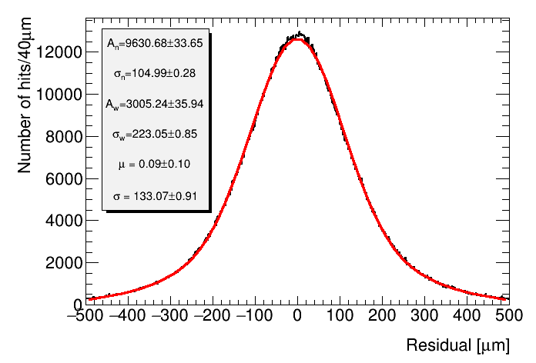
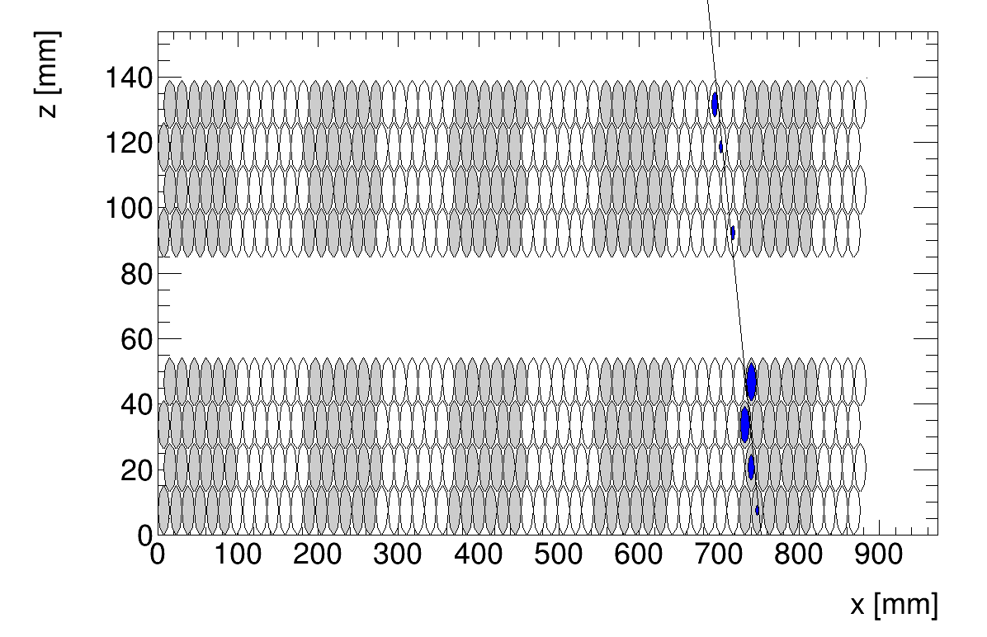

Cosmic Ray Testing: Residuals, Truth Resolution
Both biased and unbiased residuals are calculated
Residuals are calculated via the difference between RT function predicted position and the actual track reconstruction
Biased “fit” residuals are calculated directly from the fit, including all hits on tubes
Unbiased “hit” residuals are calculated by procedurally removing 1 hit at a time from a track fitting, and recalculating the residual with the missing hit
Module 18 – Fit Residual
Module 18 – Hit Residual

Slide 12
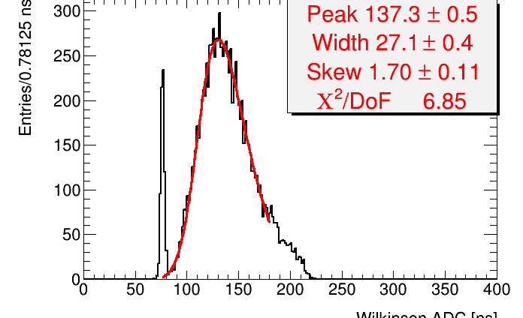
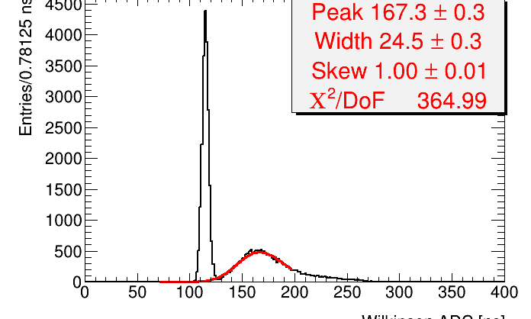
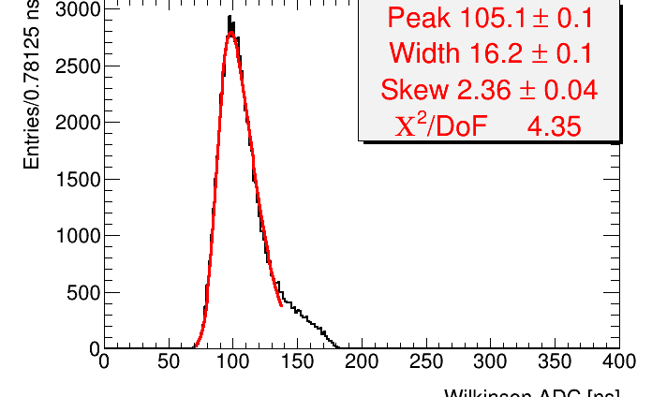
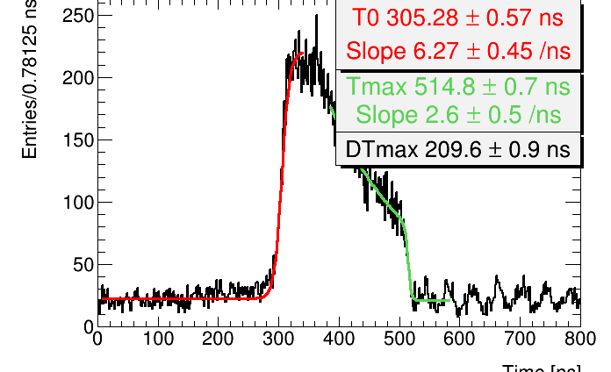
Cosmic Ray Testing: Noise and Gain Issues
Every chamber has 464 tubes (BIS1 chambers have 560)
Even though they go through many stages of QA, their sheer number means some are bound to have issues.
The MZ Cards fitted to the chambers at BB-5 also commonly have performance issues and need to be replaced.
It is important to discover these problems quickly so that we can make necessary fixes before moving chambers back into storage from the testing room.

Slide 13
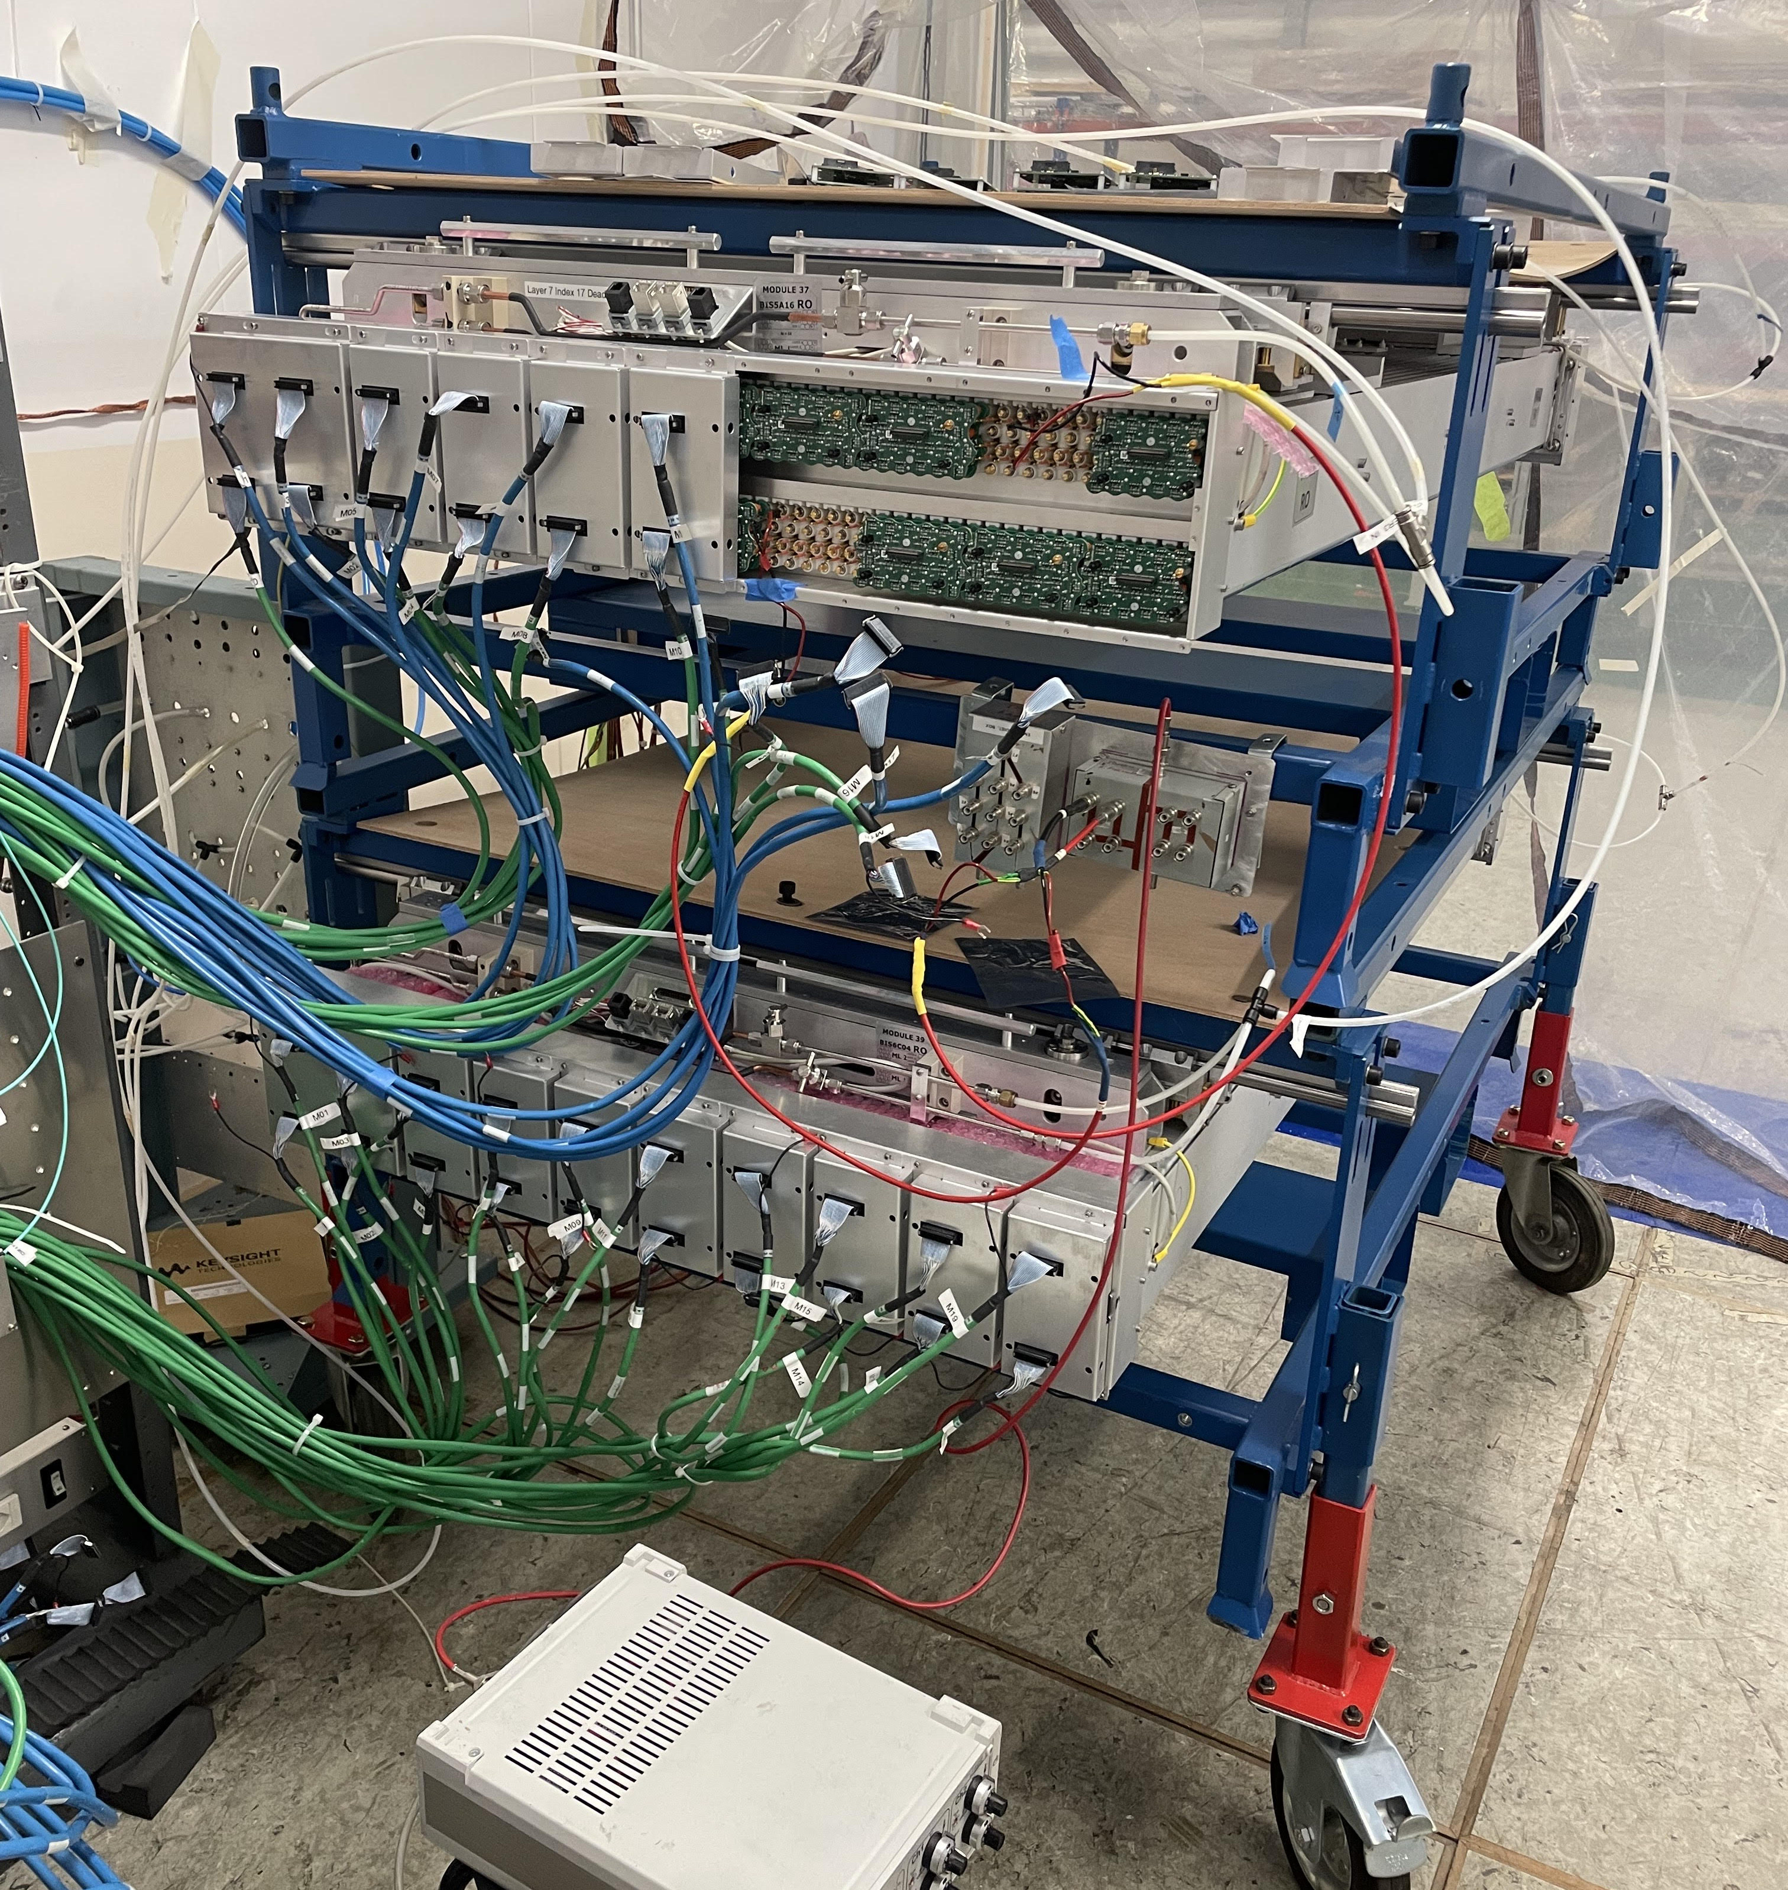
Challenges
There are a variety of possible symptoms to check for when performing cosmic ray analysis.
Sometimes getting all the data processed and analyzed on time was hard to do
Maintaining a schedule required very careful planning, as processing takes about 24 hours per run
Additionally, sometimes we encounter issues with the hardware upgrades.
Modules 23 and 24 had leak issues, which took (continue to take) a lot of debugging
We encountered a couple major DAQ noise issues, which after a week of painful debugging resolved themselves

Slide 14
What I have accomplished
During my time here over the summer, I have processed, analyzed, and reported the status of 12 UM sMDT chambers
I have also processed data for more chambers which other members of the BB-5 group proceeded to analyze
This equates to over 20% of the total sMDT chambers that Michigan is responsible for providing ATLAS during the next long shutdown
I have also participated in physical debugging and hardware upgrades for all sMDT chambers commissioned this Summer
This includes installing hundreds of mezzanine cards to the chambers, as well as cataloguing the current backlog of cards and updating our database of bad cards
For the final three weeks of the Summer, I also joined the sMDT team for the H4 test beam, to test cluster counting for PID with the FCC Straw Tracker group

Slide 15
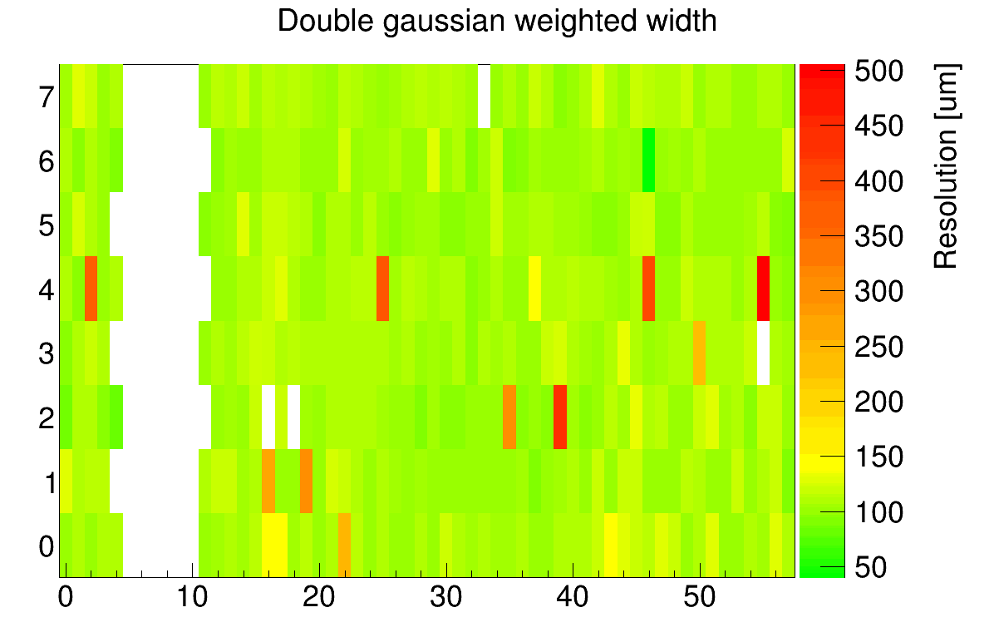
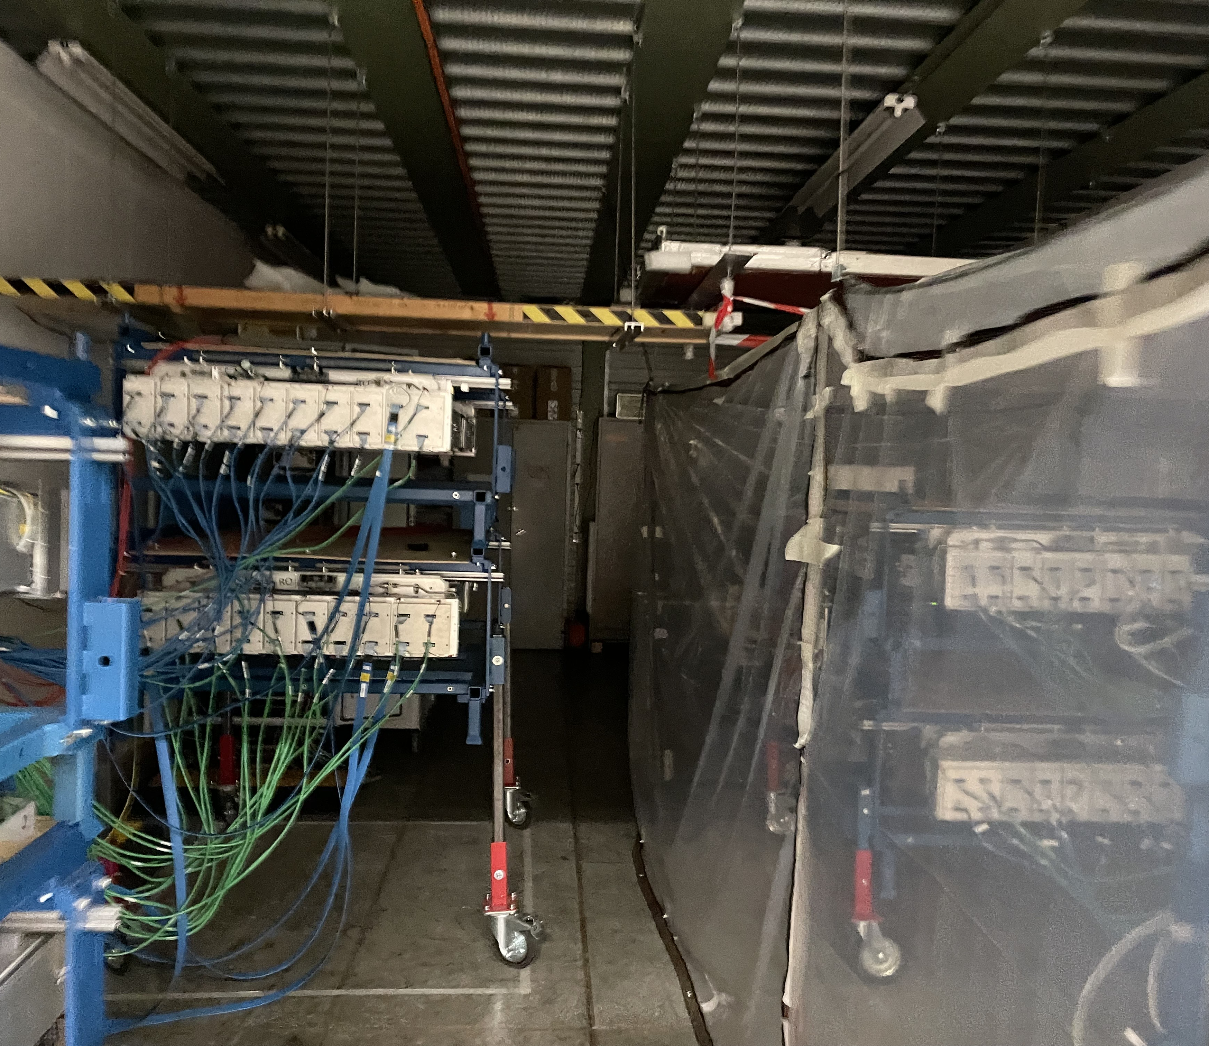
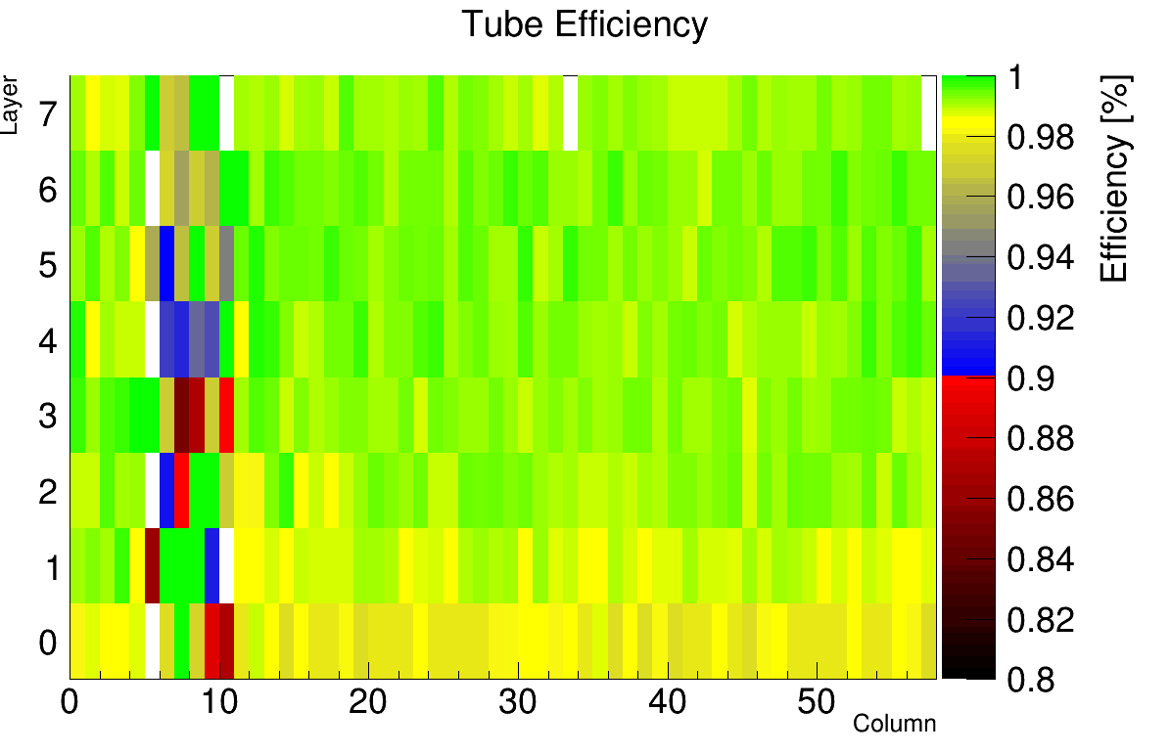
What is left to do?

Slide 16
What did I learn
Throughout the Summer program, I have learned and polished many different research skills:
On the hardware side
I learned a lot about RO, DAQ, and trigger electronics
Gained experience on working with a team to meet regular deadlines
How muon detectors work!
On the analysis side
Polished skills in C++ and Python
Learned how to use root for data visualization
Optimized data processing via shell
I also gained a lot of experience in presenting research results to my group!

Slide 17
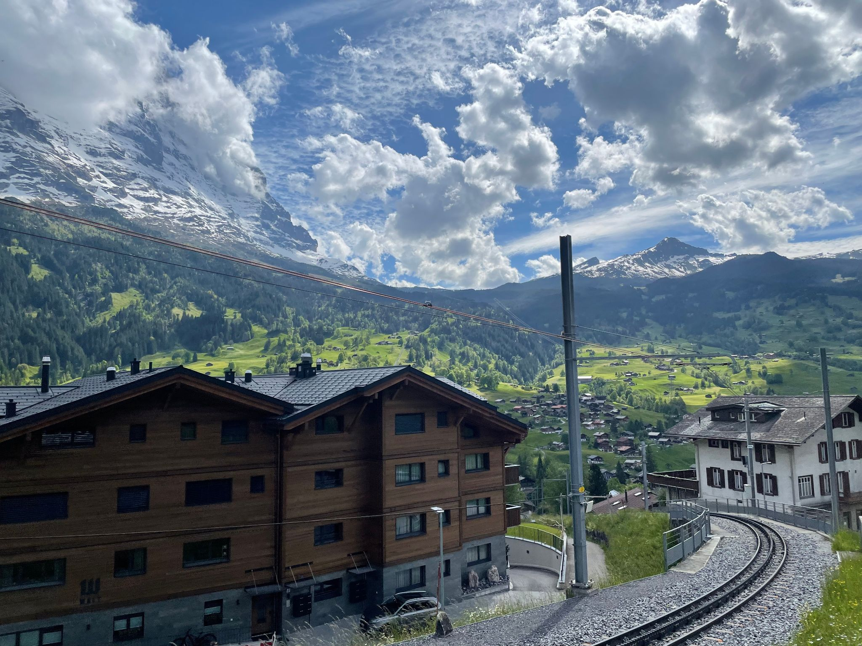
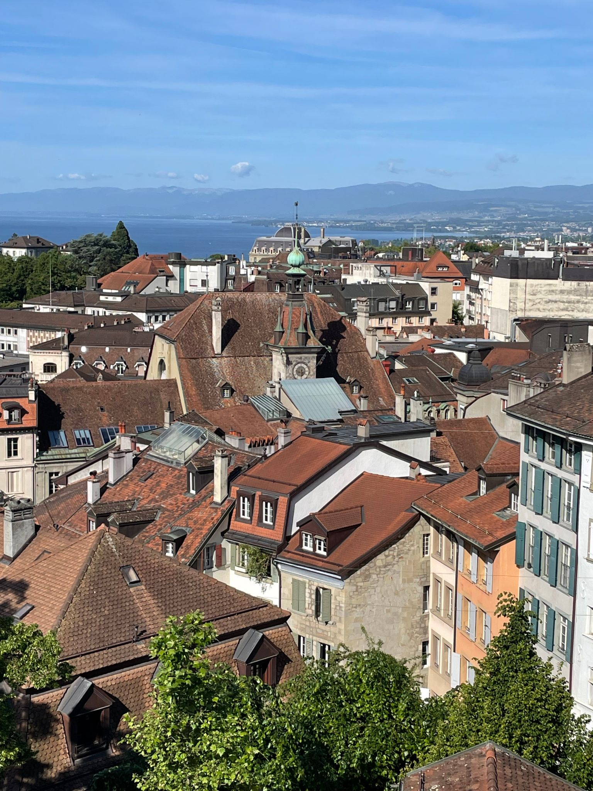
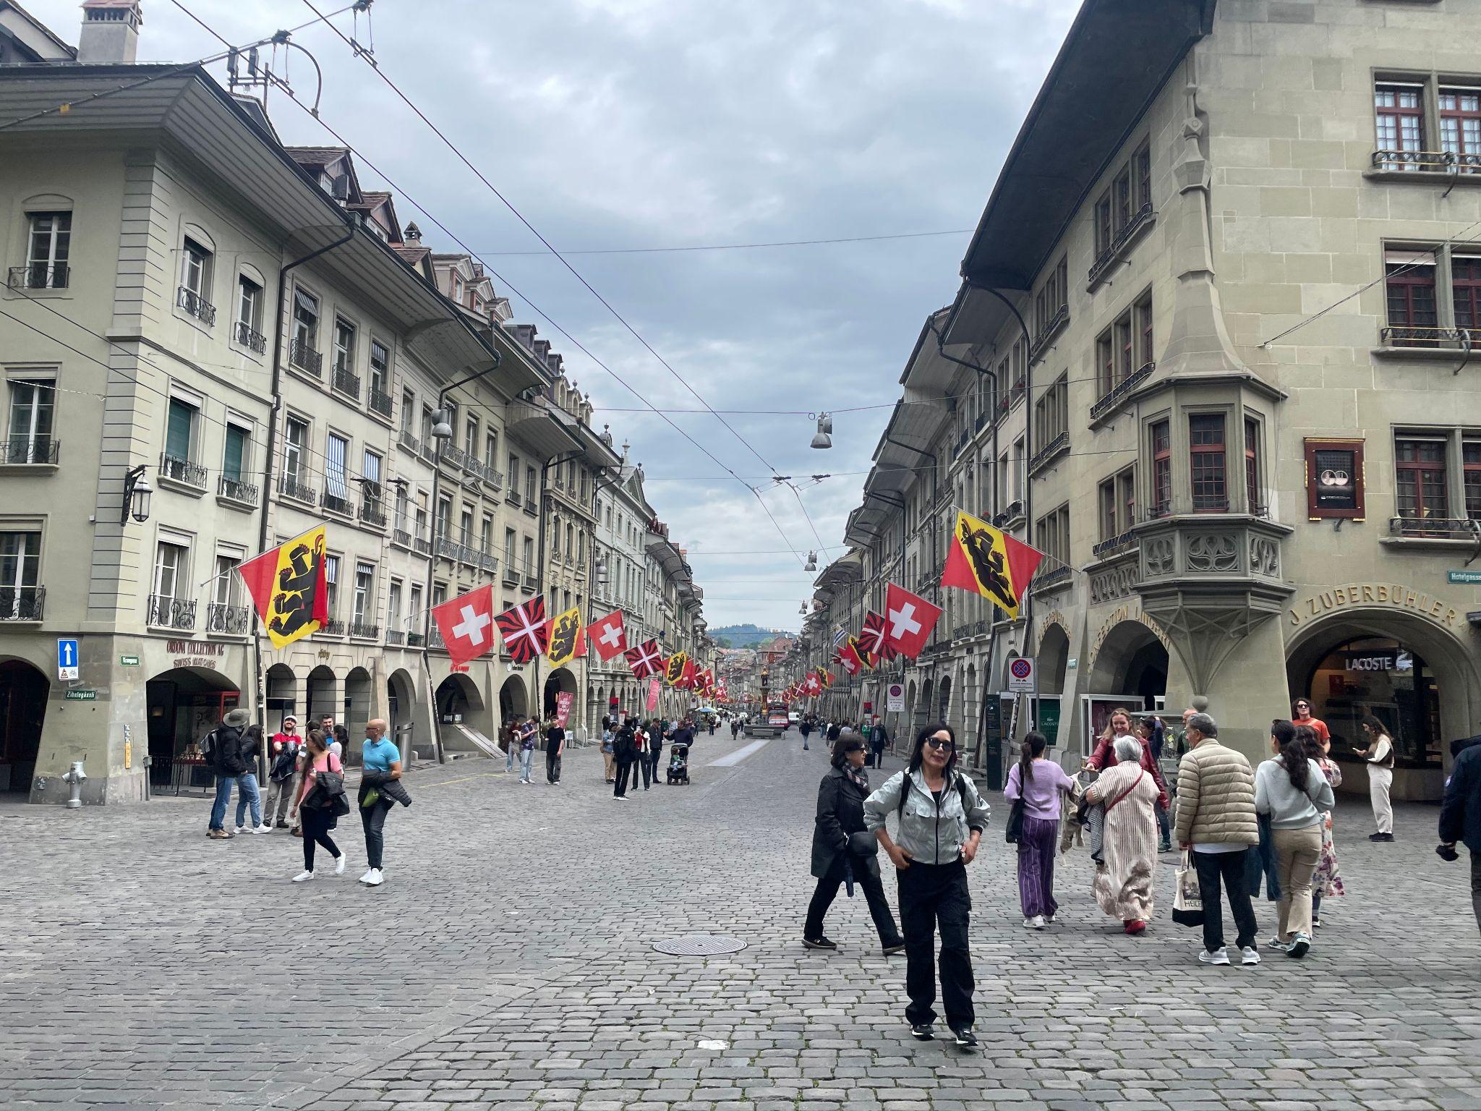





Thank you!

