Slide 1

Search for tWZ production
using ATLAS Run 2 + Run 3 Data
Mentor Hui-Chi Lin | Prof. Jianming Qian’s Group
Researcher Tarasenko Vika
Date 04.08.2025

Slide 2


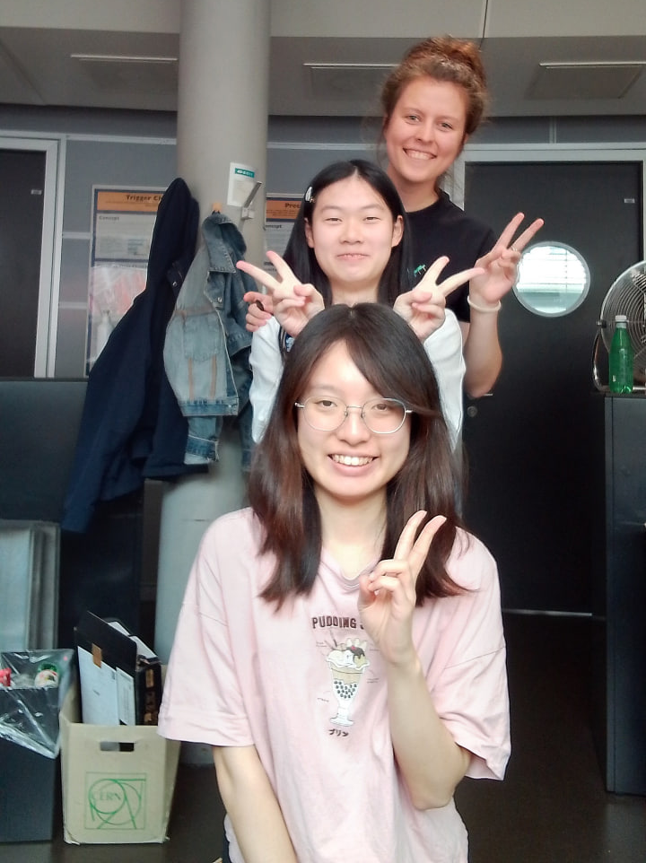
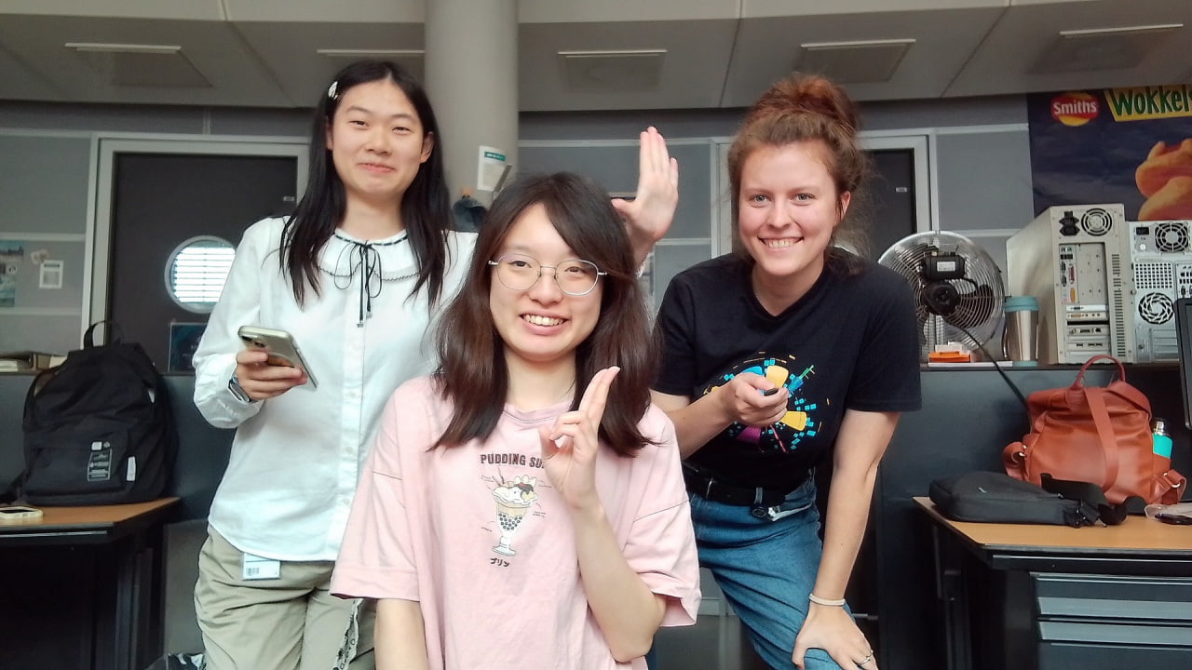
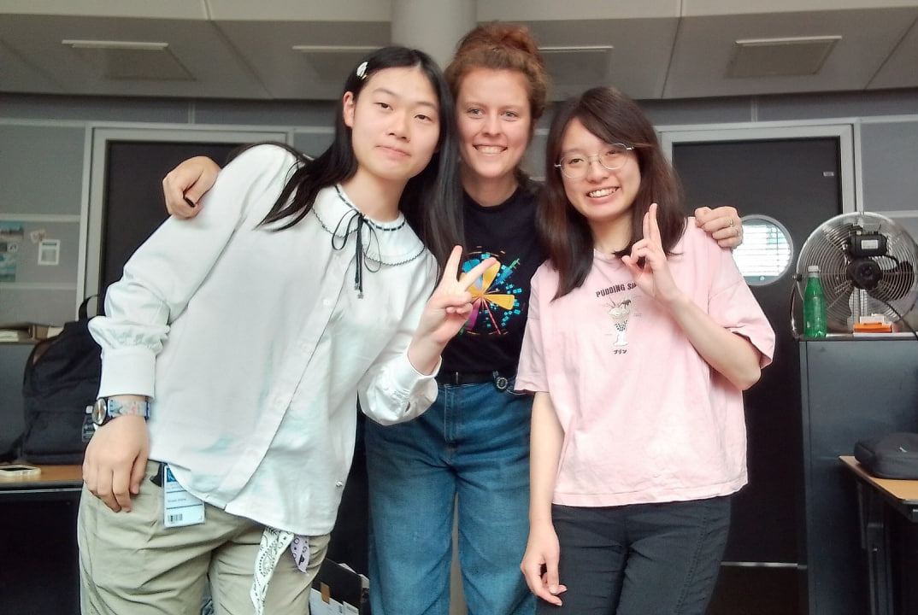
Research Team Squad
Mentor: Hui-Chi Lin.
3rd year PhD Research
Teammate: Xinzhi Zhou
Undergraduate
Student: Tarasenko Vika
Undergraduate
Tarasenko Vika
4 August 2025
2

Slide 3
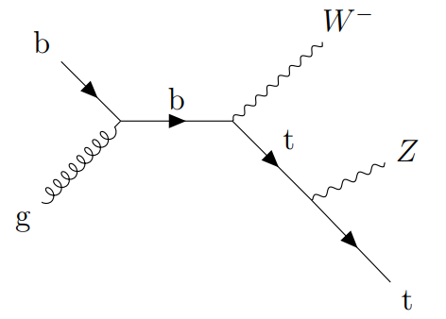
Project Objective
These background processes pose challenges for extracting the rare signal in particle physics experiments. Our research aims to improve analysis strategies that will better estimate the background and increase the sensitivity for detecting the tWZ signal.
Tarasenko Vika
4 August 2025
3

Slide 4
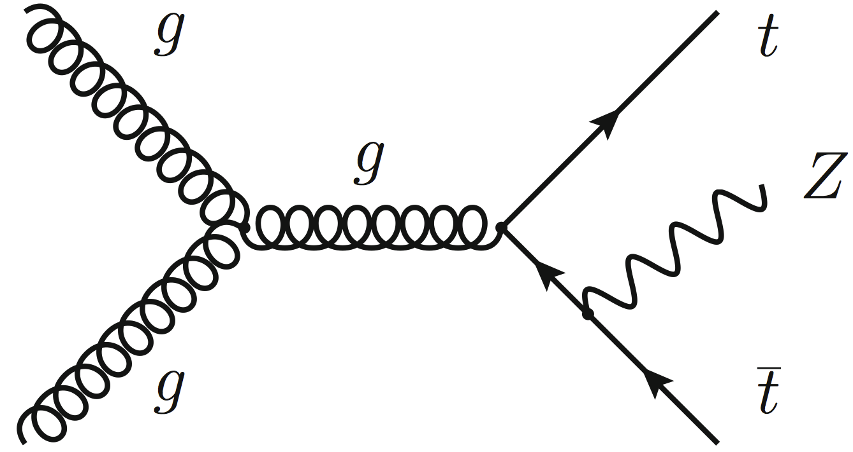
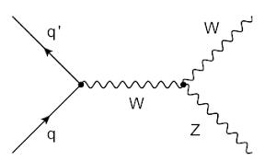
Signal & Backgrounds
Signal - tWZ
  The production of a top quark in association with a W and a Z boson (tWZ) is a small Standard Model (SM) process that has not been observed yet. tWZ is also a background for analyses of many other processes.
Main Background - ttZ, WZ
  The backgrounds have similar kinematics as the signal, and thus are selected in the signal-enriched region in the analysis.
Tarasenko Vika
4 August 2025
4

Slide 5
Machine Learning for Signal/Background Separation
Model creation:
Train a machine learning model to distinguish between the tWZ signal and background events.
Model architecture is a MLP (Multilayer Perceptron) - Deep Neural Network (DNN).
Score as Fit Variable:
The score output by the trained ML model will be used as the fit variable in the Signal Region (SR).
Tarasenko Vika
4 August 2025
5

Slide 6
Preselection
Lepton selection: 3 tight leptons with p_{T} > 30,20,10
all m_{OSSFu} >10 GeV Exactly 1 Z Candidate |m_{OSSFu} - m_{Z} | < 10 GeV
Jet selection: ≥ 2 jets, ≥ 1 b-tagged jet
0 | 1 | 2 | 3
tWZ | ttZ | WZ | VV, ttH, ttW, triboson, fake, tZq
  Included the following variables as model inputs:
nJets, nBjets, HT_all, met_met, met_phi, jet_pt, lepton_pt, lepton_eta,
lepton_phi, jet_eta, jet_phi, jet_quantile.
Tarasenko Vika
4 August 2025
6

Slide 7
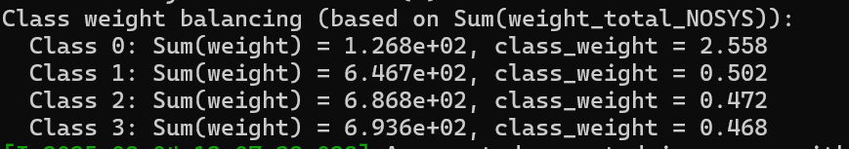
Challenges For The Input Files
Class weights:
One of the main challenges we faced was the strong class imbalance: the number of tWZ signal events was significantly smaller than the number of events for other classes like ttZ, WZ, and background.
To handle class imbalance :
Class Weights → to compensate for class imbalance
Sample Weights → to adjust individual event importance
Tarasenko Vika
4 August 2025
7

Slide 8
Challenges For The Model
Hyperparameters:
The model's performance depended on hyperparameters: the number of layers, dropout rate, learning rate and others.
Manual tuning was time-consuming and often led to suboptimal or inconsistent results.
Need for Optimization Strategy:
Needing an intelligent and automated method
This led us to use Optuna, to find the optimal hyperparameters for the model.
Tarasenko Vika
4 August 2025
8

Slide 9
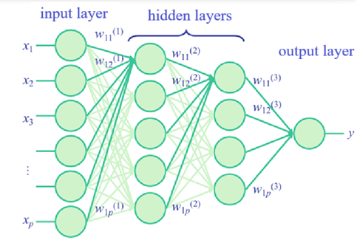
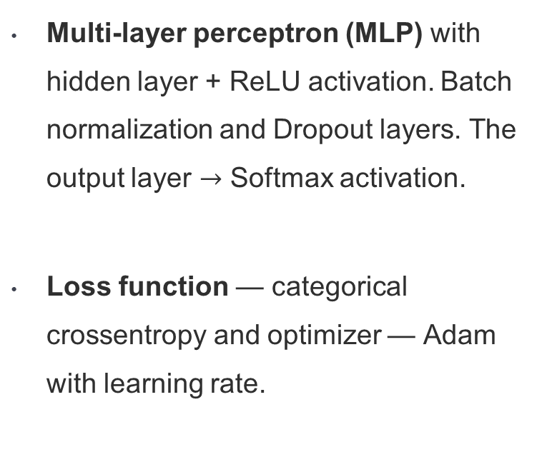
OptimaL Model Architecture
  Multi-layer perceptron (MLP) with hidden layer + ReLU activation. Batch normalization and Dropout layers. The output layer $→$ Softmax activation.
  Loss function — categorical crossentropy and optimizer — Adam with learning rate.
Tarasenko Vika
4 August 2025
9

Slide 10
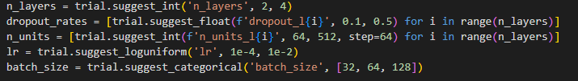
Optuna Parameter Estimation
  Definition of Optuna: special library to make an automatic hyperparameter optimization to find the best settings (architecture) for training neural networks.
  Range of values for each hyperparameter (like number of layers, dropout rate, batch size).
  Tests different combinations using a Bayesian optimization — it learns from past results.
  Each trial trains the DNN and evaluates performance (e.g., validation accuracy); uses this to guide future choices.
  Optuna selects the hyperparameters that gave the best performance (f1-score)
Tarasenko Vika
4 August 2025
10

Slide 11
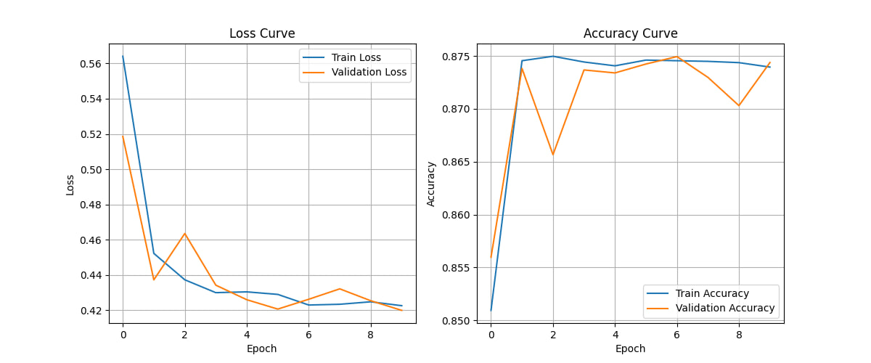
Loss and Accuracy
Tarasenko Vika
4 August 2025
11

Slide 12
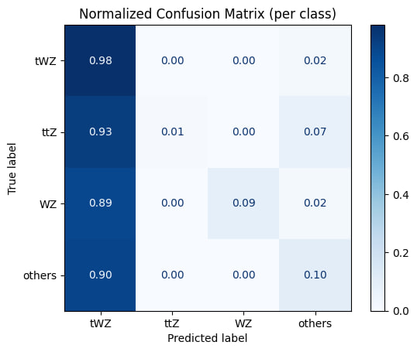
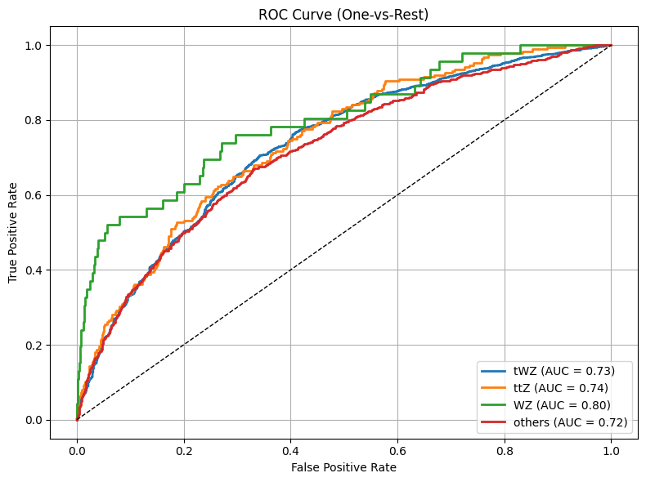
Confusion Matrix & ROC curve + AUC
Tarasenko Vika
4 August 2025
12

Slide 13
Next Steps
  Include all remaining input ROOT files to extend the training dataset and improve model prediction.
  After retraining, we will analyze the updated results, focusing on classification performance and signal detection efficiency.
  Based on the insights gained, we will adjust our strategy — possibly refining the architecture, balancing methods, or input features — to further enhance the model's ability to identify tWZ events.
Tarasenko Vika
4 August 2025
13

Slide 14

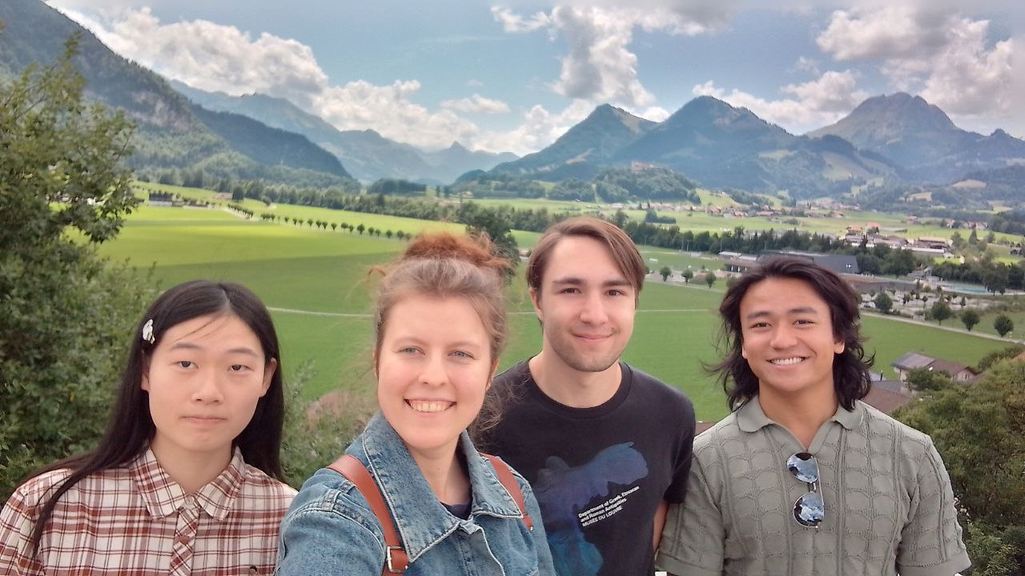
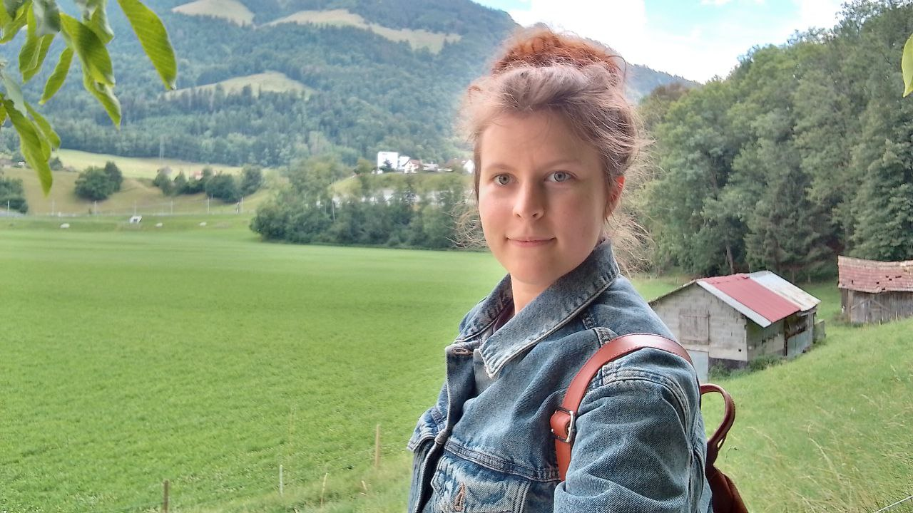
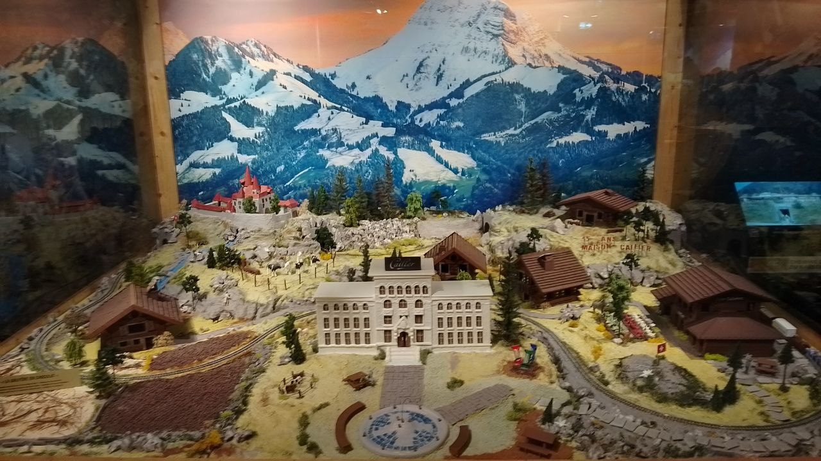
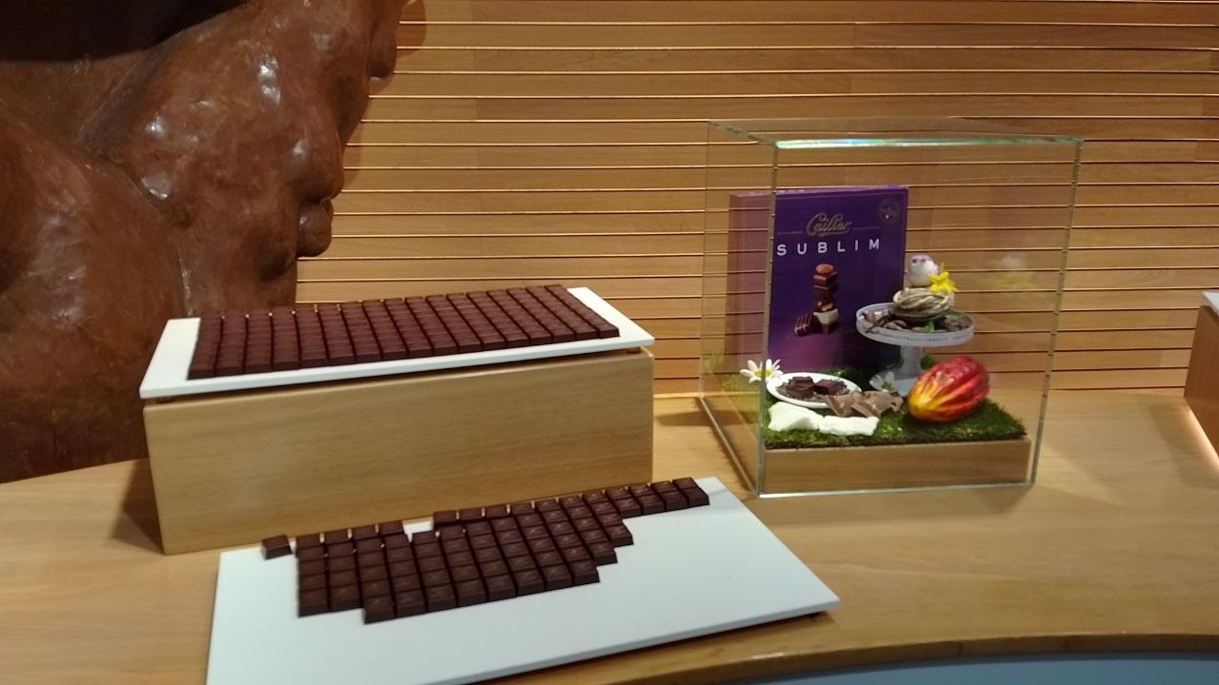
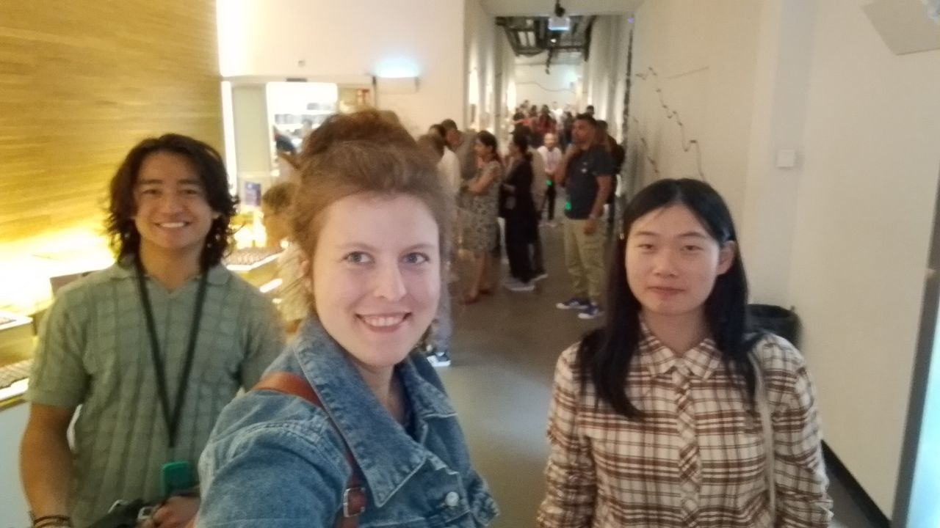
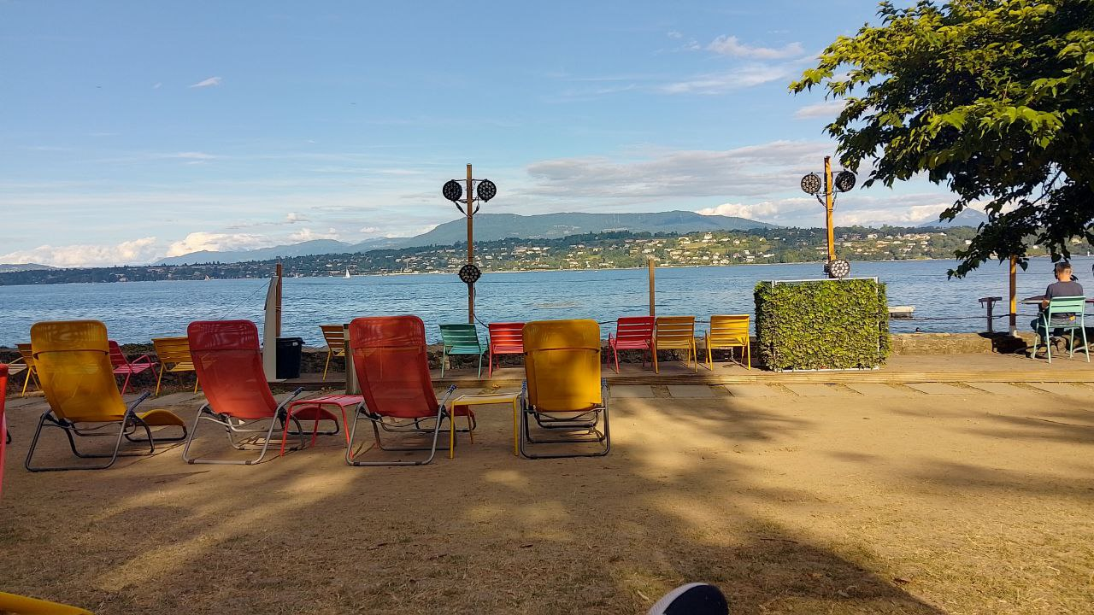
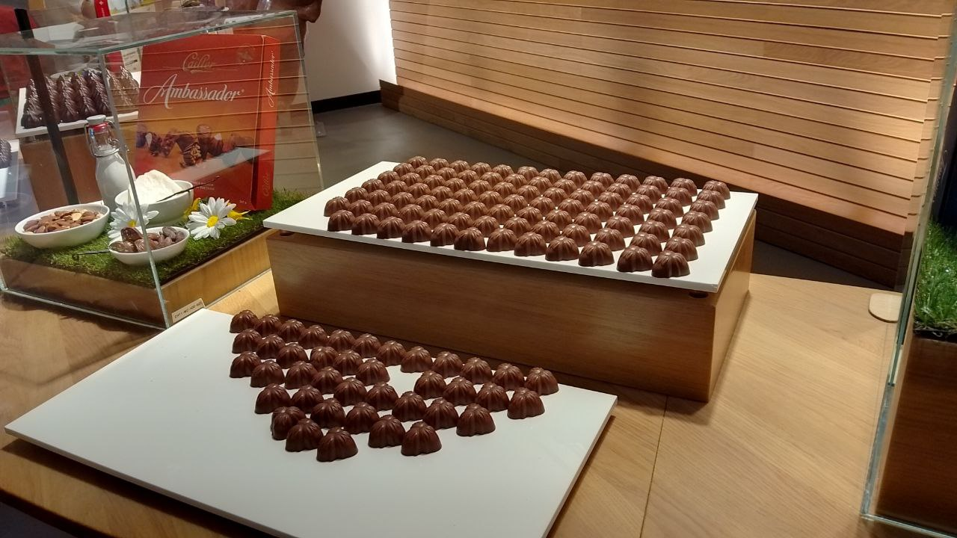
Photo Gallery
Tarasenko Vika
4 August 2025
14

Slide 15

Thank you all for everything!
It’s been an incredible journey.

