Slide 1
AccGPT - LLMs for CERN!
Vision and Use Case
Florian Rehm, Luke Van Leijenhorst, Verena Kain, Juan Manuel Guijarro, Sofia Vallecorsa
01.07.2025 - IML Machine Learning Working Group: Chatbots at CERN

Slide 2

Content
What is AccGPT
The AccGPT-Search model
Current and future researches

Slide 3
Introduction
AccGPT (Accelerating Science GPT).
  Our vision: Accelerating CERN research with AI.
AccGPT Pilot Service: The entire service.
  Providing LLMs to CERN researchers.
  LLM access via UI (similar to ChatGPT) and API.
  Assisting with LLM use case implementations.
AccGPT-Search Model: Advanced expert-model.
  An example use case: A chatbot for CERN internal knowledge search.

Slide 4
AccGPT Pilot LLM Service

Slide 5
AccGPT Pilot LLM Service
Goal:
One central AI/LLM unit to provide access to LLMs (internal and external ones) and assist developers with expertise and usage examples.
  Hosting and developing expert models.
  Depending on resource dedication also consultancy.
Current Status:
Still in pilot phase.
CERN has not yet decided on further AI/LLM investment.
  Though, support across all CERN hierarchy levels (next slide).
Very limited resources (manpower and hardware).
  PoC models are possible. Perfect production models difficult.

Slide 6
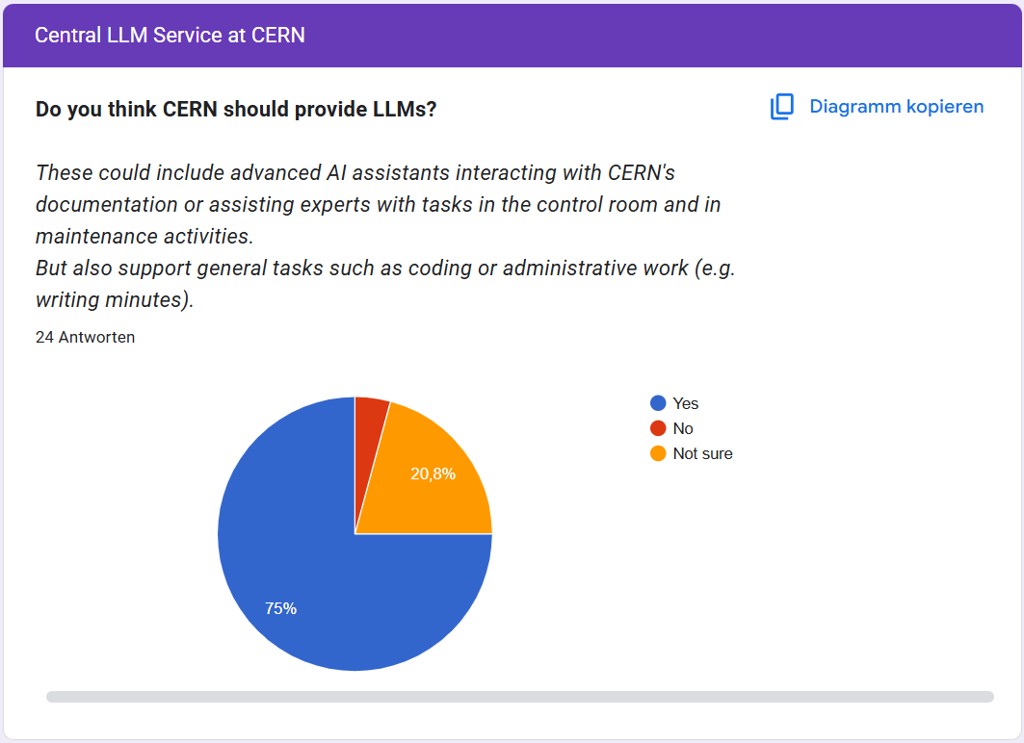
CERN Wants LLMs!
ATS-Sector-wide Survey:
Participants well distributed across the entire ATS sector.
24 groups participated.
ATS users expressed a clear interest in having a central LLM service for expert and non-expert use cases!

Slide 7
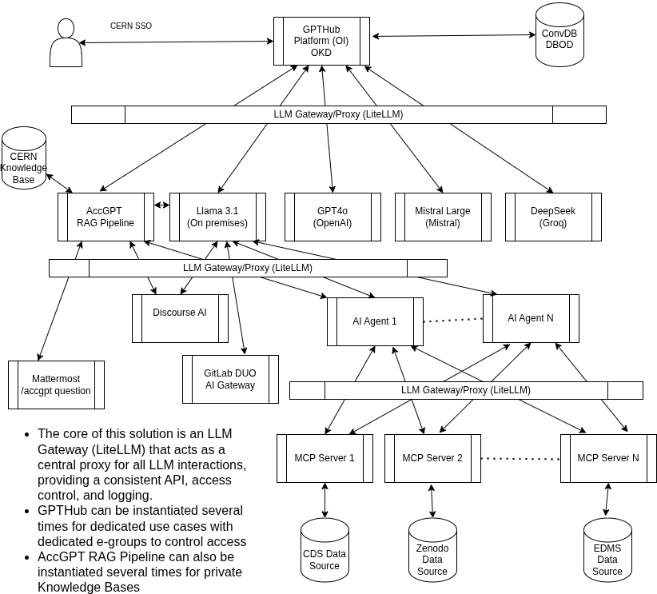
How Could it
Look Like?
Draft LLM Gateway Platform
For brainstorming with and within the IT department.
By Juan Manuel Guijarro

Slide 8
Why AccGPT?

Slide 9

Why AccGPT?
A First PoC Model: Enhancing CERN knowledge retrieval.
Challenge: CERN has many and HUGE data bases:
  Challenging to find information without knowing its location.
  >> 50 knowledge (web) domains for documentation.
    Confluence (Wiki), CDS, CERN home, CERNbox, EDMS
    and more domains …
    Individual documentations.
    Support tickets.
→ Objective: Leverage AccGPT to improve knowledge finding, user support, streamline development processes, and enhance onboarding experiences.
By GPT4

Slide 10
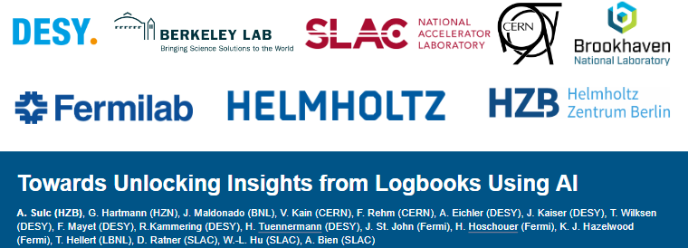
What Else?
Numerous software frameworks (such as FESA, UCAP, GeOFF, NXCALS, … ).
  With steep learning curves to use them.
  → AI assistance for learning and utilizing them.
Coding assistance:
  Many documentations contain code.
    „Generate me a code template of …“
Future AccGPT applications:
Enhancements to machine and shift logbooks.
Code Agents.
Future ++:
AI assistant in the control room: conversational UI / controls.
IPAC’24 - 15th International Particle Accelerator Conference

Slide 11
Inside of AccGPT-Search

Slide 12
Inside of AccGPT-Search – Conventional Setup
AccGPT-Search: A knowledge retrieval chatbot.
The (core) AccGPT pipeline*:
Based on two core models:
  Embedding model:
    Retrieves „relevant content“ from database.
  Large Language Model (LLM):
    Formulates responses using the „relevant content“.
    Focus on open-source models.
    Possibility to use commercial models.
Accompanied by a
self-created knowledge
data base.
Request
LLM
Relevant Content
Embedding
Database
Response
Retrieval Augmented
Generation (RAG)
* In reality the AccGPT pipeline has progressed and is more complex.

Slide 13
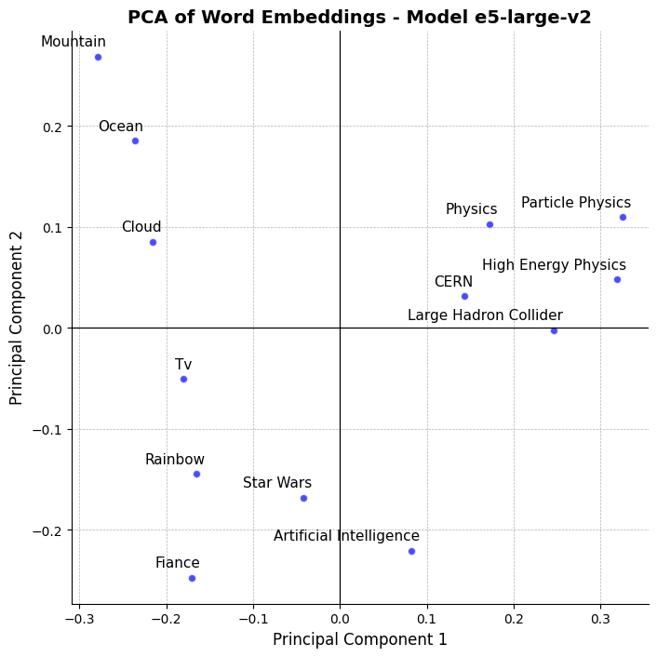
1. The Embedding Model
Function:
  Maps textual data into a latent space (1 024 dimensional).
  Embed single words, sentences, or entire paragraphs.
Representation:
  Related phrases are close in the latent space.
In AccGPT-Search:
  Retrieve the most relevant content from our database based on user questions.
  This is done by taking the closest data point(s) to the question in the latent space.

Slide 14
2. The Large Language Model (LLM)
Definition:
  Huge deep learning models trained on vast amounts of text to understand and generate human-like language.
Capabilities:
  Deep text understanding and context-awareness.
Our implementation:
Using pre-trained open-source LLMs: LLaMA.
  We (currently) don’t fine-tune LLMs.
Combined with external models, currently by Groq*.
LLM Input
System Prompt
+
User Prompt
(Question)
+
Relevant Context
LLM Response
*Groq designs ultra-fast AI inference hardware and hosts open-source LLMs via API, while Grok is a chatbot by xAI.

Slide 15
Some AccGPT Examples

Slide 16
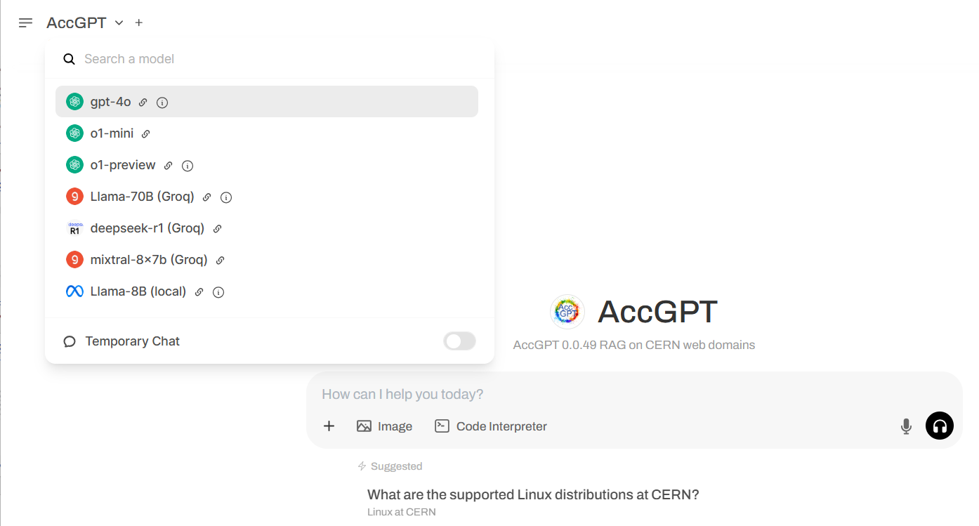
The AccGPT User Interface

Slide 17
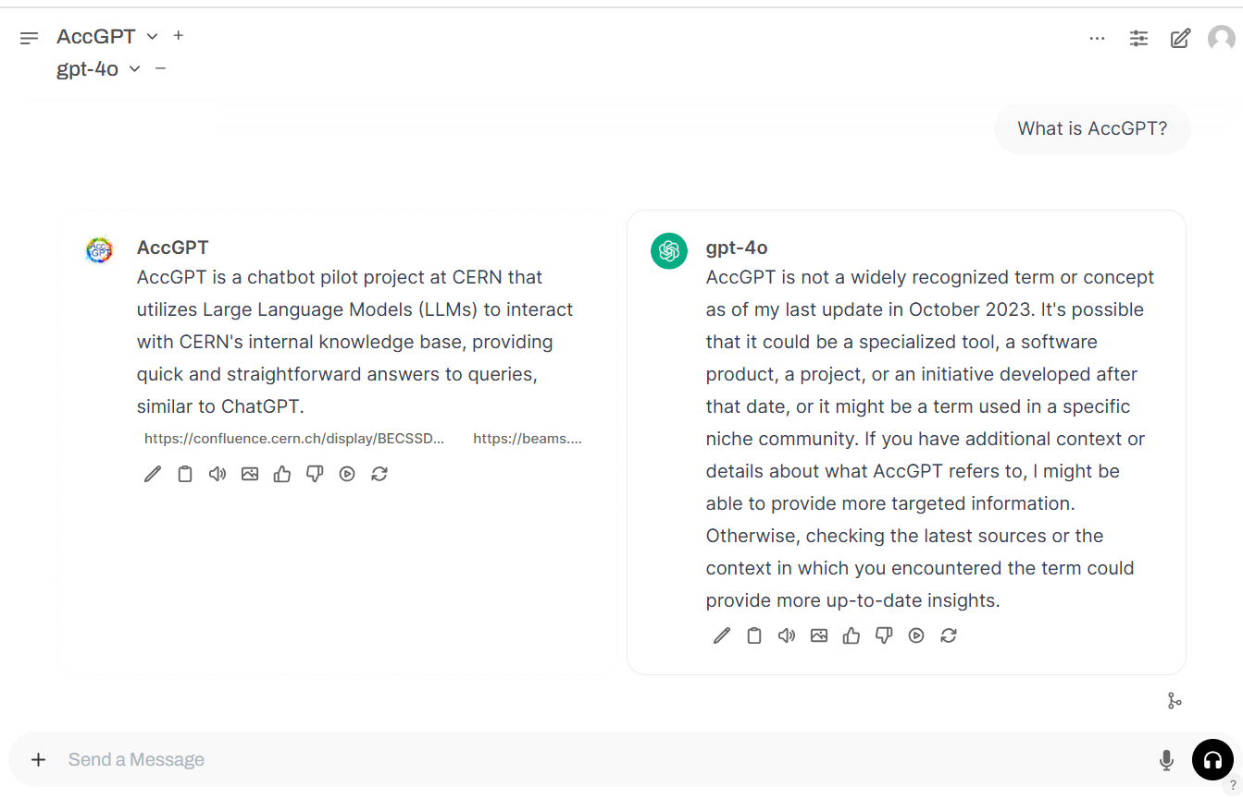
AccGPT: Example 1

Slide 18
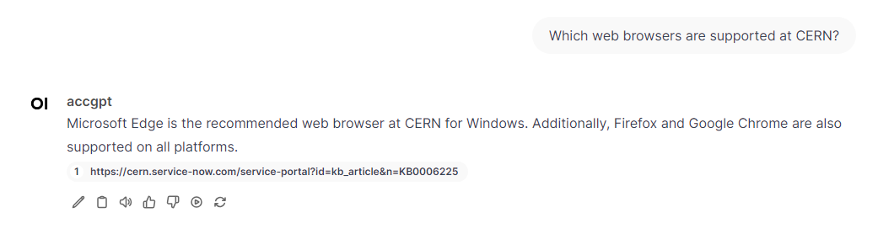
AccGPT: Example 2
References
Disclaimer:
We do not guarantee the accuracy or completeness of the provided responses. We strongly encourage users to verify the information.
Feedback

Slide 19
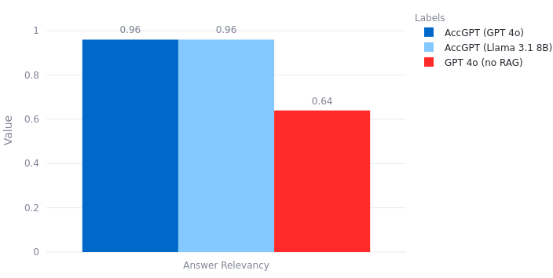
Accuracy: RAG vs non-RAG
(RAG: Retrieval Augmented Generation)
With RAG (AccGPT):
  AccGPT performs extremely well, independently of the LLM.
  For Q&A set, RAG retrieves the correct knowledge in >90% of cases (not shown).
Without RAG:
  Accuracy drops, as default LLM is not aware of CERN knowledge.
  Not zero, since many questions are not exclusive to CERN.
Answer Relevancy:
Evaluates how accurately the LLM response matches experts' questions on CERN related topics.
(Curated dataset from experts)

Slide 20

Data Quality Importance
Not only AccGPT determines the accuracy:
Data quality is KEY !!!
(garbage in … garbage out)
Important aspects:
  Keep documentations updated.
  Keep documentations detailed.
  Duplicates make the model struggling.
  Text based information is best.
  Ideally: FAQs and examples.
For coding:
  Templates or examples make it easier for the model.
By GPT 4
→ Keep this in mind if you plan to make your
documentation accessible to chatbots.

Slide 21
New Feature

Slide 22
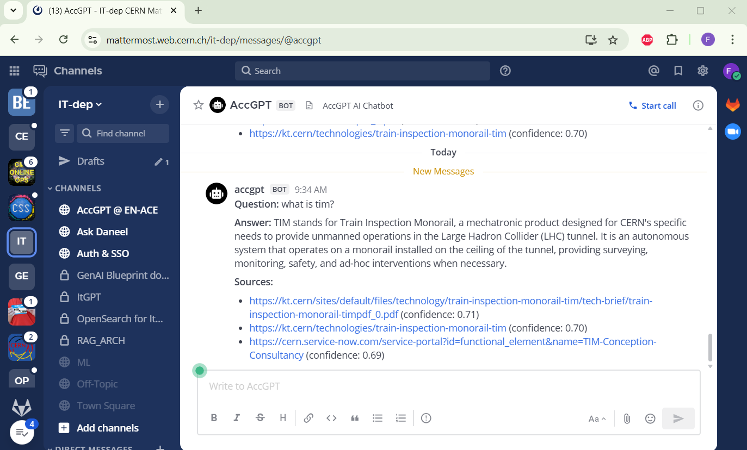
AccGPT in Mattermost !!!
Usage:
/accgpt [message]
Where?
Dedicated chat.
Within every chat.
Sometimes buggy…
Still older AccGPT
version.

Slide 23
Next Steps

Slide 24
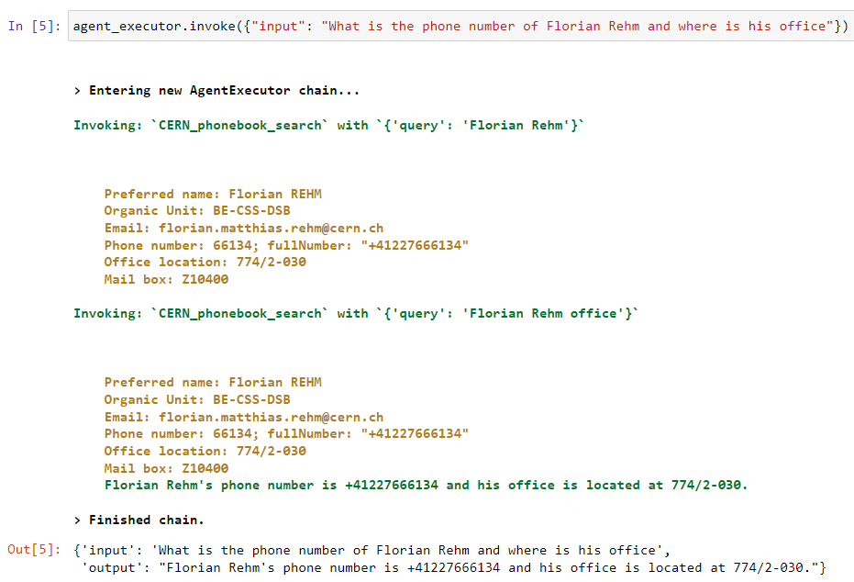
AccGPT: Next Steps - Agents
Agents can do sub-tasks by calling functions.
For example:
  Querying the CERN phonebook.
  However:
  The phonebook feature will not come (soon),
  due to data privacy reasons.

Slide 25
AccGPT-Agentic
Making AccGPT agentic:
  Normal RAG: simple single-step retrieval workflow.
  Agentic RAG: multi-step adaptive workflow.
Strength:
  Answers are more detailed and complete.
Weakness:
  Sequential process, slower than AccGPT,
  more LLM calls required.
Currently the only tool is RAG search. More tools to come.
Example Question:
What were the major activities and upgrades carried out during each of CERN’s Long Shutdowns?
Step | Agentic retrieval steps
1 | CERN Long Shutdowns
2 | Timeline Long Shutdown
3 | LS1 activities and upgrades
4 | LS2 activities and upgrades
5 | LS3 activities and upgrades

Slide 26
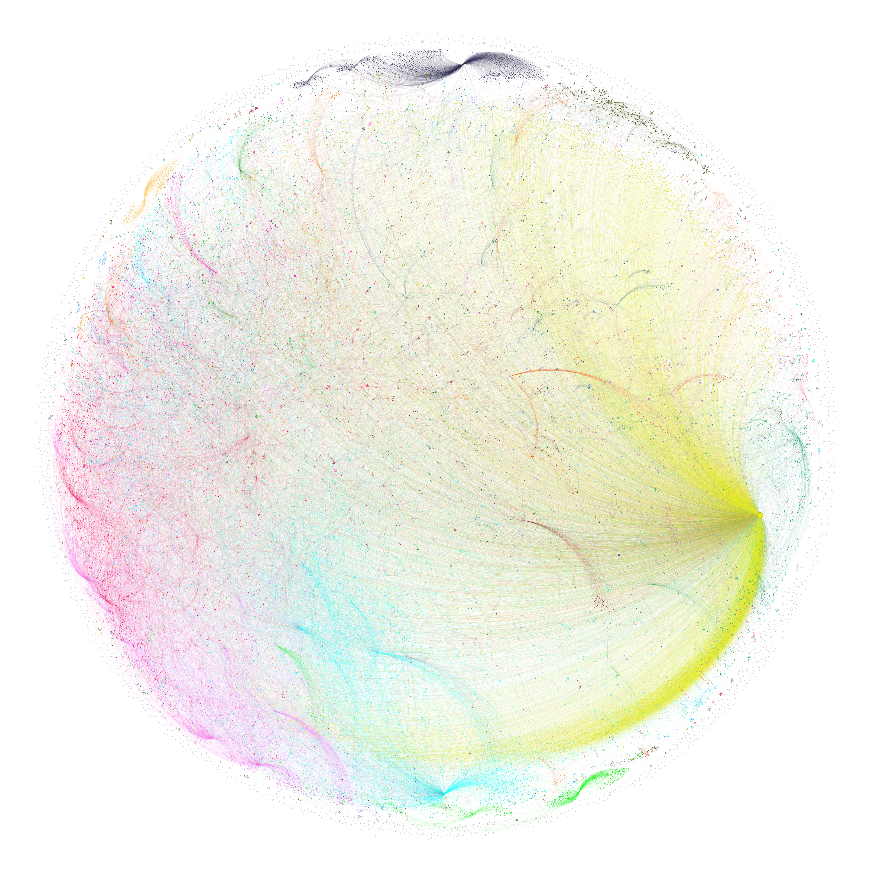
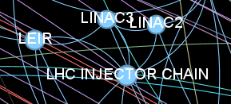
AccGPT-GraphRAG
Utilization of a Knowledge Graph instead of simple RAG.
  Knowledge Graph: A network of connected entities and relationships that captures structured information.
    Graph generated by LLMs.
Strengths:
    Enables precise retrieval across complex, interlinked data structures.
    Generates high-level, coherent overviews across large
    knowledge domains.
Weaknesses:
    Graph creation is expensive
    and time-consuming
    (~1 million LLM calls).

Slide 27
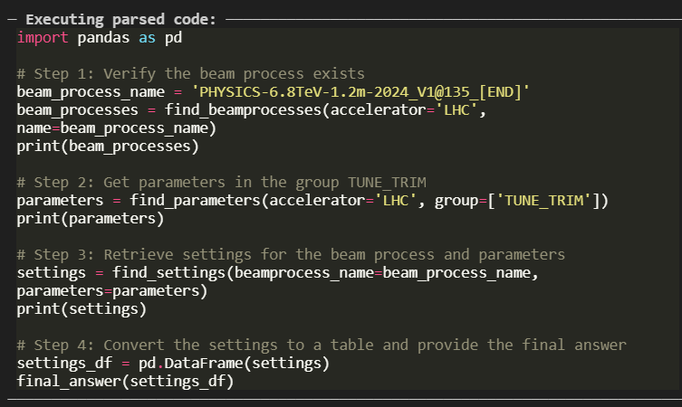
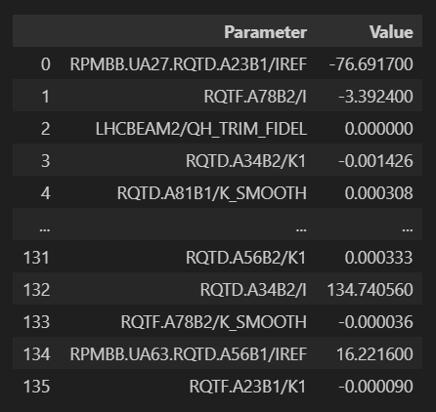
Coding Agents
Coding Agents differ from standard LLM Agents by using programmatic reasoning and executing complete code workflows, rather than relying on step-by-step API calls.
Generate a table of the settings of the parameter group TUNE_TRIM in LHC BP for the beam process name 'PHYSICS-6.8TeV-1.2m-2024_V1@135_[END]'

Slide 28
Embedding Model Fine-Tuning
Fine-tuning a full LLM → (currently) not feasible (hardware constraints).
Fine-tuning an embedding model → feasible:
  Much smaller (hundreds of millions of parameters).
  For AccGPT-search (RAG):
    Accurate embedding retrieval is key for high performance.
  Inspired by ChATLAS:
    Building a Q&A dataset for fine-tuning.
Work in progress.

Slide 29
Summary

Slide 30
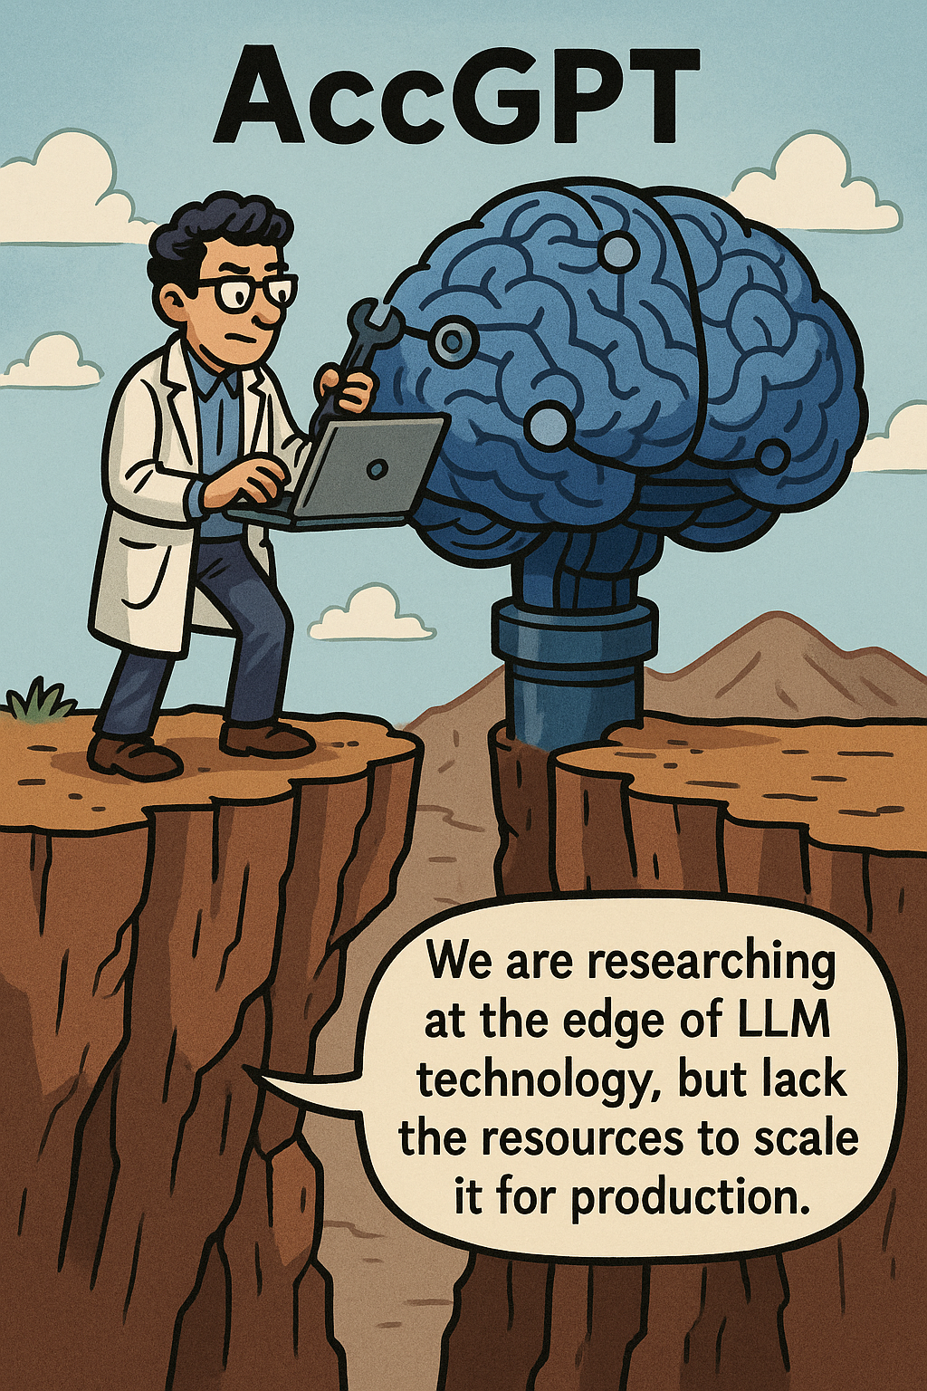
Summary
AccGPT: A CERN LLM service pilot.
AccGPT-Search: A PoC model for knowledge retrieval.
  Good accuracy, growing capabilities.
  Achieved a lot with limited resources.
  Much potential, but lacking production-scale support.
Many developments and researches in the pipeline.
AccGPT Resources:
  Knowledge sources.
  Landing page & registration.
  User interface.

