Slide 1

Update on polymer irradiation damage studies for accelerator magnets
C. Scheuerlein, TE-MSC-SMT
TE-TM meeting, 14 July 2025
https://indico.cern.ch/event/1557591/

Slide 2
Outline
Radiation sources and materials
Radiation hardness of resins for casting and vacuum impregnation of accelerator magnet coils
Towards qualification of epoxy resin systems for FCC-hh final focus magnets up to 80 MGy
A cryocooler set-up for polymer radiation damage studies representing irradiation conditions in superconducting magnets

Slide 3
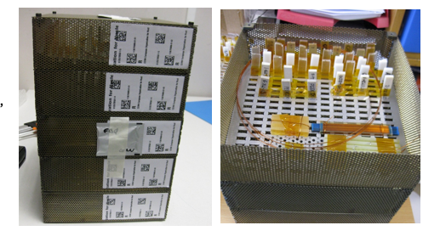
Gamma irradiation in ambient air, the workhorse of polymer irradiation damage studies
⁶⁰Co source at the Gammatec facility of the company STERIS.
Dose rate 2 to 3 kGy/h (about 0.4 MGy/week)
Large sample volume (20 cm x 20 cm x 30 cm)
Good dose homogeneity
Precise dosimetry
Controlled irradiation temperature 20-25°C
Samples are not activated
Ongoing irradiation campaign up to 30 MGy will be completed by the end of July 2025.
12 sample holders were irradiated to dose levels ranging from 1.6 MGy to 30 MGy.
A new gamma irradiation campaign to additional 30 MGy is planned to be started in 2025.
Five sample holders, each 20 cm x 20 cm x 6 cm, with dosimeters for gamma irradiation at Gammatec facility.

Slide 4
Irradiated materials: Resins for impregnation and encapsulation
Epoxy resin systems
CTD101K (HL-LHC magnets)
Polab Mix (CCT, SMC, ERMC coils)
Araldite F (ASG and SPS MBB magnets)
CTD425 epoxy cyanate ester blend (ITER)
736 KR Tech (PSI magnets)
Damisol 3420 (PSB magnets)
CEA Mix (CEA magnets)
Araldite G 285 (LHC MCBX magnets)
Stycast 2850FT/23LV-filled resin (box test)
Mix 61 (box test, SMC coils)
MY750 (box test, SMC coils)
MSUT (box test, SMC coils)
Damisol 3418
Stycast EE4215/HD3561
Resoltech 1050
Araldite 2011 adhesive (HL-LHC)
Loctite Ablestik 286 adhesive (HL-LHC)
GTS AS1084 adhesive (HL-LHC)
Wax
Polarit 54/56+10% carnauba wax with 45 vol.% Al2O3 (PSI development for coil impregnation)
HA with 45 vol.% Al2O3 (from PSI)
HB with antioxidant with 45 vol.% Al2O3 (from PSI)
Polarit 54/56+antioxidants (from PSI)
Polarit 54/56 + UV stabilizer 1% (from PSI)
T19/45PB4 (from PSI)
Parafin wax Polarit A55
Bees wax
TeCe Ozekerit Z130
Polyurethanes for casting
Robnor ResinLab EL110H
SikaBiresin RE700-04+RE106
SikaBiresin RE820+RE102
Duromer (FAIR project)

Slide 5
Irradiated materials: Elastomers, composites, 3D printable materials
Silicone elastomers
Silastic RTV 4250-S
Silastic RTV 4234-T4
Polyurethane elastomers
A&P Pad ShA 75 (SPS, LHC alignment jacks)
A&P Pad ShA 90 (SPS, LHC alignment jacks)
SikaBiresin UR350
Synthene HPE 70 A
RobnorResinLab EL217C
Vulkollan D15 ShA 90 (SPS MBB)
Composites
G11CR (LHC MQXA from FNAL)
G11CR (LHC MQXA KEK)
ISOPREG 2704 (LHC MCBY)
CTD101K-S2 glass (HL-LHC)
Parafin wax Polarit A55-S2-glass
3D printable polymers
ULTEM 9085 FDM (HL-LHC)
ULTEM 1010 FDM (HL-LHC)
PEEK FDM (HL-LHC)
HELIOS PEEK FDM
PEKK FDM
Accura 25 SLA
RG35 SLA
PA6 FDM
PA2200 SLS
Others
Polyimide Kaneka Apical 200AV (HL-LHC)
Ryton R4-XT, injection moulded (HL-LHC)
ULTEM 1000, injection moulded (HL-LHC)
DuPont Nomex 994 pressboard (PSB)
Siligaine SG01

Slide 6
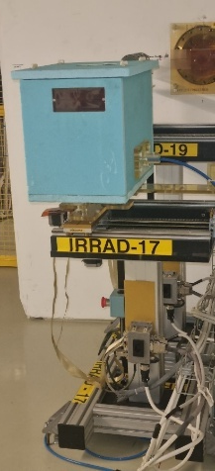
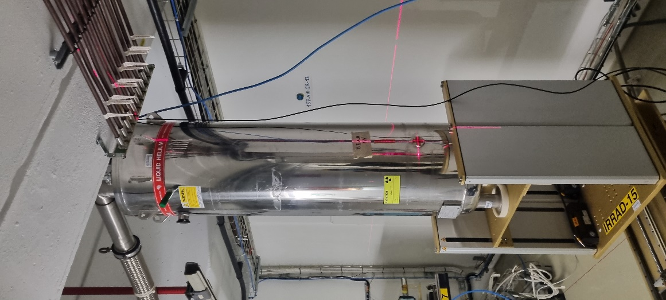
24 GeV/c proton irradiation at IRRAD
Proton beam with about ø=15 mm.
Dose in 20 cm distance of the proton beam is about 6 orders of magnitude smaller than in the irradiated sample area. This enables installation of radiation sensitive equipment.
Irradiation in different environments :
ambient air
inert gas
liquid Helium
Proton fluence is measured with ±7% uncertainty (from the activation of Al witness samples).
Up to 4 MGy per week can be achieved in a sample cross section of 10 mm × 10 mm.
(a)
(b)
(a) Box for irradiation in inert gas and (b) cryostat for irradiation in liquid He installed at the IRRAD facility. Courtesy F. Ravotti and G. Pezzullo.

Slide 7
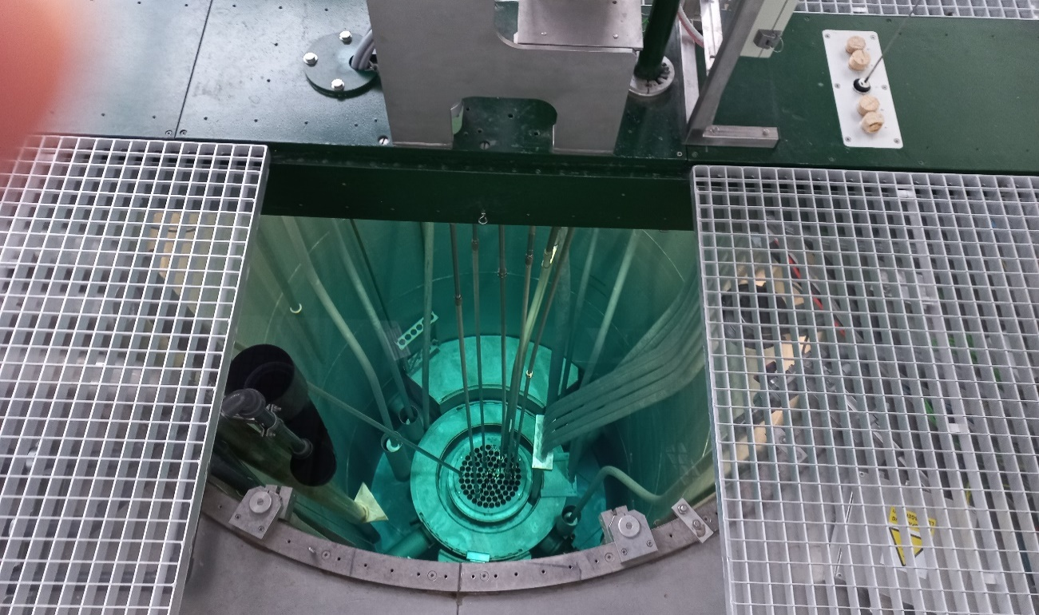
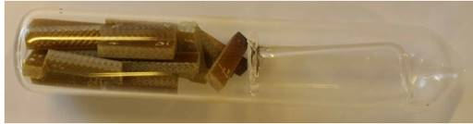
Mixed gamma/neutron irradiation at TU Vienna
Irradiation at the central sample position of a TRIGA Mark II reactor.
Very high dose rate of 140 MGy per week (600 kGy/h gamma and 260 kGy/h neutron).
Sample temperature rise to about 70 °C during irradiation is estimated.
Gas released during irradiation can be collected in in sealed quartz capsules and can be analysed afterwards.
Irradiation conditions are comparable with those of previous studies for the ITER project.
TRIGA Mark II reactor core.
Sealed irradiation capsule with samples.

Slide 8
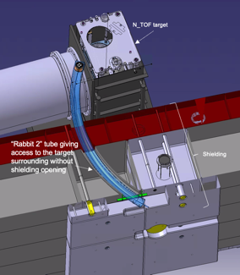
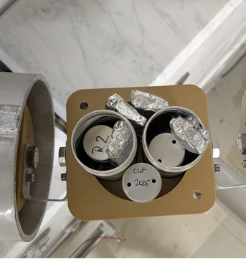
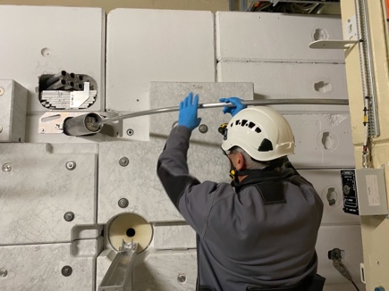
Mixed neutron/gamma irradiation at NEAR n_TOF
Irradiations in parasitic mode at the neutron spallation source of the CERN n_TOF facility.
Dose is determined by FLUKA simulations.
75% of the dose is due to neutrons.
About 2 MGy/year in a typical epoxy (at Rabbit 2 position).
.
Rabbit 2 location at the n_TOF target.
Sample holder and sample transfer through the n_TOF target shielding at Rabbit 2. Courtesy of A.-P. Bernardes and O. Aberle.

Slide 9
Dynamic Mechanical Analysis (DMA) for monitoring cross-linking and chain scission
Dose dependent DMA measurements are used to monitor irradiation induced cross-linking and chain scission.
Increase of glass transition temperature (T_{g}) indicates that formation of new cross links prevails, decreasing T_{g} that chain scission dominates.
Increase of G’_{rubbery} (storage modulus above T_{g}) indicates cross-linking, decrease of G’_{rubbery} indicates chain scission.
T_{g}
(c)
(a)
(b)
G’rubbery
Araldite F (a) storage modulus (G’) and (b) loss modulus (G’’) as a function of temperature after different proton doses absorbed in ambient air. (c) Chain scission induced T_{g} and G’_{rubbery} reduction.

Slide 10
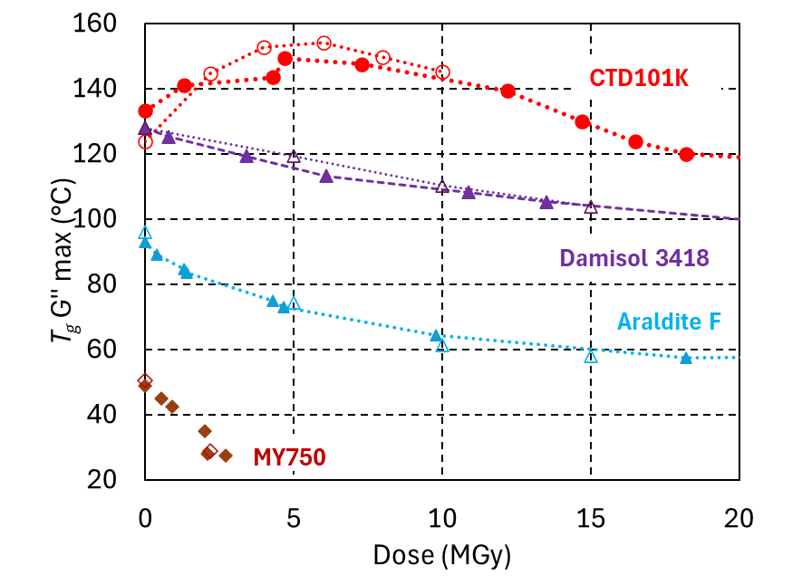
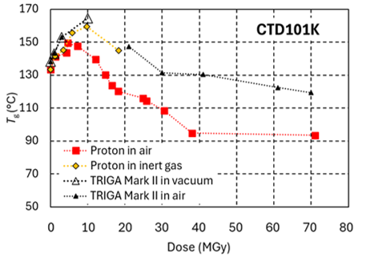
Cross-linking and chain scission by different radiation types
Efficiency for producing new cross-links and for chain scission is compared based on DMA results.
The same dose absorbed from ⁶⁰Co gamma and 24 GeV/c proton irradiation has nearly identical effect.
Significantly higher cross-link density after the same dose absorbed in TRIGA Mark II reactor, possibly due to:
limited oxygen diffusion into the sample
higher sample temperature during reactor irradiation.
T_{g} of different epoxy resin systems as a function of dose absorbed in ambient air. Full symbols represent proton irradiation and empty symbols gamma irradiation.
T_{g} of CTD101K as a function of proton dose and mixed neutron/gamma dose in the TRIGA Mark II reactor.

Slide 11
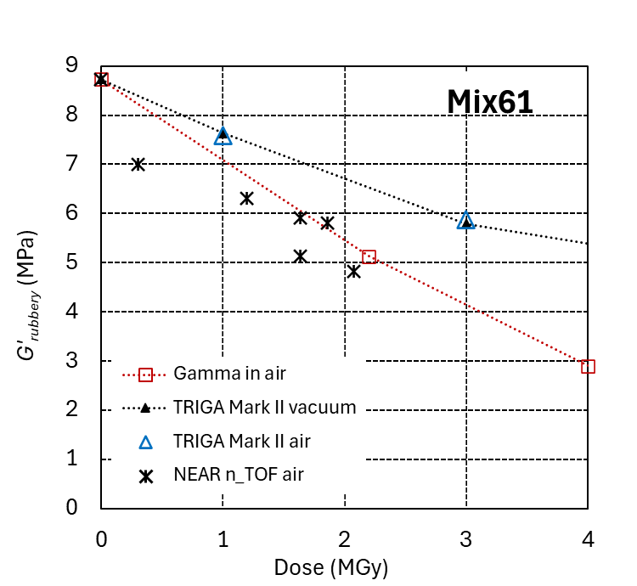
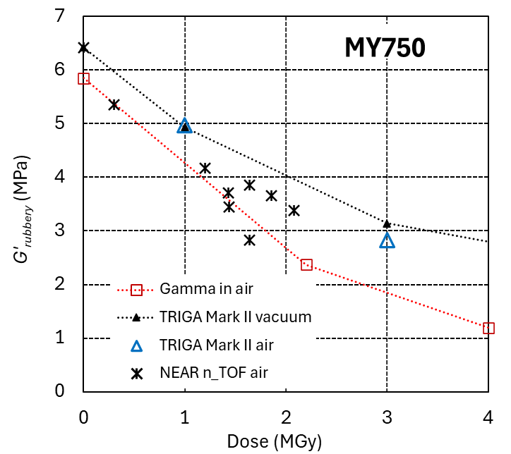
Effect of neutrons
At NEAR n_TOF 75% of the dose in the epoxy samples is from neutrons.
⁶⁰Co gamma and neutron dominated NEAR n_TOF irradiation cause similar irradiation damage.
NEAR n_TOF Rabbit 2 irradiations to 6 MGy are ongoing and will allow to compare damage efficiencies more precisely.
Comparison of the G’_{rubbery} evolution of amine-based epoxy resin systems Mix61 and MY750 as a function of dose absorbed at a ⁶⁰Co source, at the NEAR n_TOF spallation source, and in the TRIGA Mark II reactor.

Slide 12
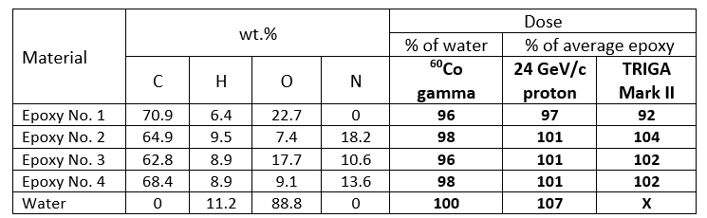
Comparing radiation damage from different sources
Assumption: Polymer irradiation damage is determined by the absorbed dose, independent of the radiation type (radiation damage is mainly caused by secondary electrons, the primary radiation has a comparatively small effect).
Dosimetry:
Gamma ray dose is measured with Perspex or alanine dosimeters.
Proton fluence is determined from the activation of Al witness samples and the dose is calculated for a typical epoxy resin composition (3.35×10¹⁵ p/cm² corresponds with 1 MGy) [1]).
Combined gamma/neutron dose in the TRIGA Mark II reactor is determined from the irradiation duration, assuming an average epoxy resin composition.
The dose absorbed at a certain fluence is materials dependent (see Table 1).
In the present study, for ⁶⁰Co irradiation the water equivalent dose is used, and for 24 GeV/c proton and reactor irradiation an average epoxy resin dose is used.
Table 1: Elemental composition of 4 epoxy resin systems, ⁶⁰Co gamma and 24 GeV/c proton dose relative to the dose absorbed by water, and combined neutron/gamma dose absorbed in the TRIGA Mark II reactor. Courtesy F. Ravotti, CERN and M. Eisterer, TU Vienna.
[1] F. Ravotti, "Dosimetry Techniques and Radiation Test Facilities for Total Ionizing Dose Testing", IEEE Transactions on Nuclear Science, vol. 65, no. 8, pp. 1440-1464, (2018)

Slide 13
Requirements of impregnation resins for FCC-hh superconducting magnets
Main magnets in the arcs
Only few training quenches are acceptable.
Resins that are not extremely radiation hard can be considered, e.g.:
Epoxy resin systems with high toughness
Wax
Polyurethanes
Final focus magnets
Choice of the impregnation resin is dictated by high radiation doses.
4 cm-thick tungsten shielding is needed to limit the irradiation dose to 80 MGy [2],[3].
The higher the dose that the organic materials resist, the less shielding is needed and the better the performance of the magnet.
Training quenches are not a big problem.
[2] Future Circular Collider Study. Volume 3: The Hadron Collider (FCC-hh) Conceptual Design Report, preprint edited by M. Benedikt et al. Eur. Phys. J. Spec. Top. 228 (2019) 755-1107.
[3] B. Humann, “Energy Deposition Studies for the Experimental Insertions of FCC-hh”, Diplomarbeit, TU Wien, (2019)

Slide 14
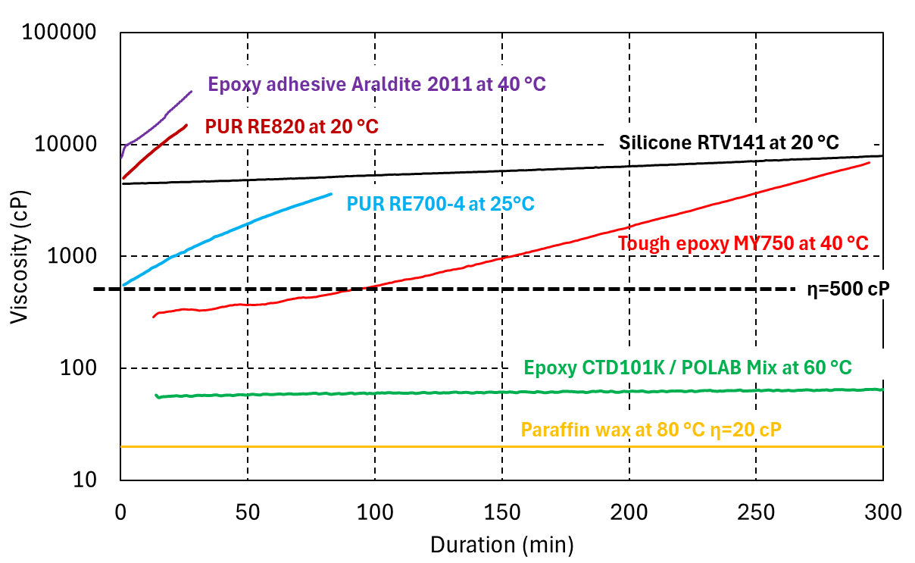
Choice of impregnation resins: processibility
Viscosity as a function of duration at the processing temperature. Courtesy C. Urscheler and M. Albeck.

Slide 15
Radiation hardness of polyurethanes and silicones

Slide 16
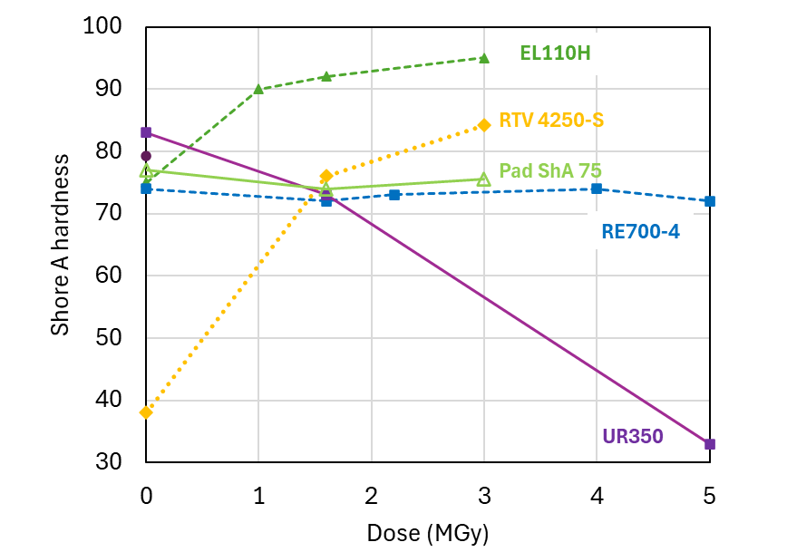
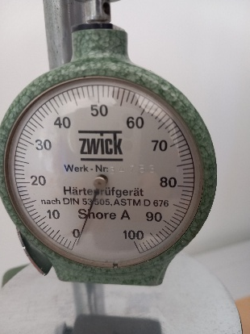
Irradiation induced cross-linking and chain scission revealed by hardness changes
Cross-linking dominated-hardness increases (polyurethane EL110H and silicone RTV 4250-S).
Chain scission dominated-hardness decreases (polyurethane UR350).
Hardness of polyurethanes RE700-4 and Pad ShA 75 changes only slightly, indicating similar rates of cross-linking and chain-scission.
Shore A hardness of silicone RTV 4250 and as a function of the dose absorbed in ambient air.

Slide 17
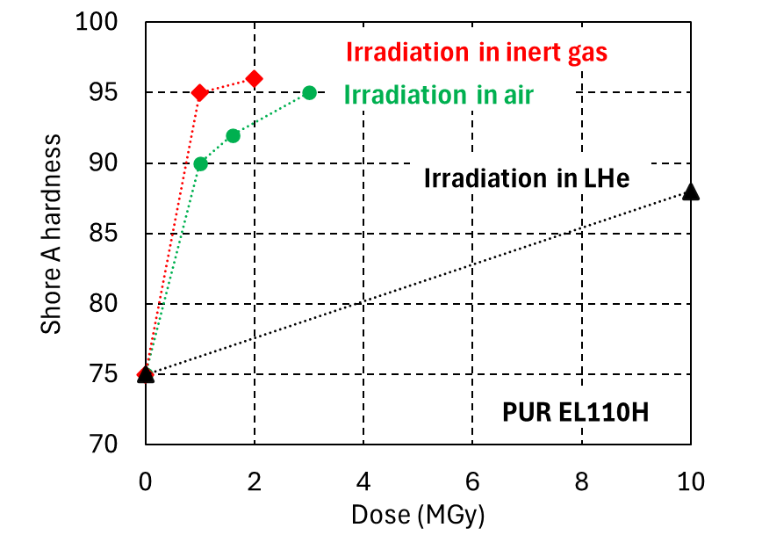
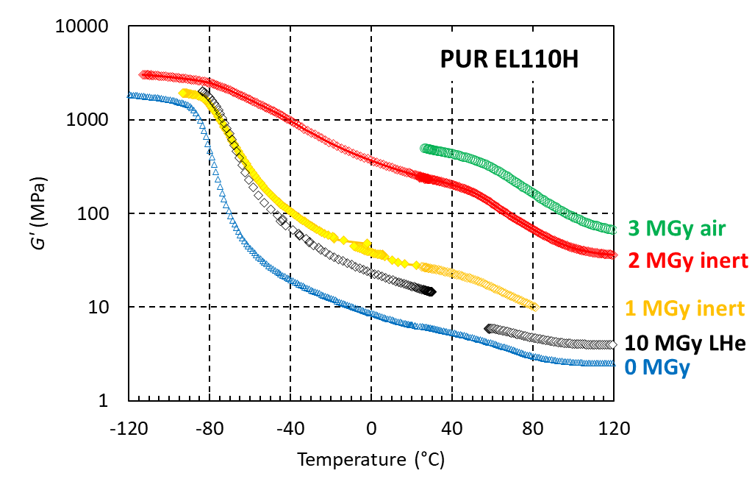
Irradiation induced cross-linking: Effect of irradiation temperature
Irradiation induced cross-linking in EL110H is revealed by increase of hardness and of G’_{rubbery} (cross-link density is proportional to G’_{rubbery}).
The irradiation temperature an environment have a strong influence on cross-linking rates.
1 MGy at RT has a stronger effect than 10 MGy at 4.2K.
(a)
(b)
PUR EL110H (a) Shore A hardness (b) G’(T) before irradiation and after proton irradiation in different environments.

Slide 18
What is the dose limit? Effect of the mechanical test temperature
Dose limit of elastomers is often defined as the dose at which the tensile strain at fracture (ɛ_{max}) is reduced by 50% [4]).
The effect of irradiation on ɛ_{max} can be strongly dependent on the mechanical test temperature.
Effect of 1.6 MGy on silicone RTV4250-S is an extreme example.
Cross-link density is increased by a factor of 5 (determined by DMA).
Elastic modulus at RT is increased by a factor of 5 and at 77K elastic modulus is nearly unchanged.
ɛ_{max} at RT: -96% and at 77K: +48%
(a)
(b)
(a) RT tensile and (b) 77K flexural stress-strain curves of a silicone elastomer before and after 1.6 MGy irradiation.
[4] M. Tavlet, A. Fontaine, H. Schönbacher, “Compilation of Radiation Damage Test Data Part II, 2nd edition: Thermoset and thermoplastic resins, composite materials”, CERN 98-01, 1998 ( https://cds.cern.ch/record/357576?ln=en )

Slide 19
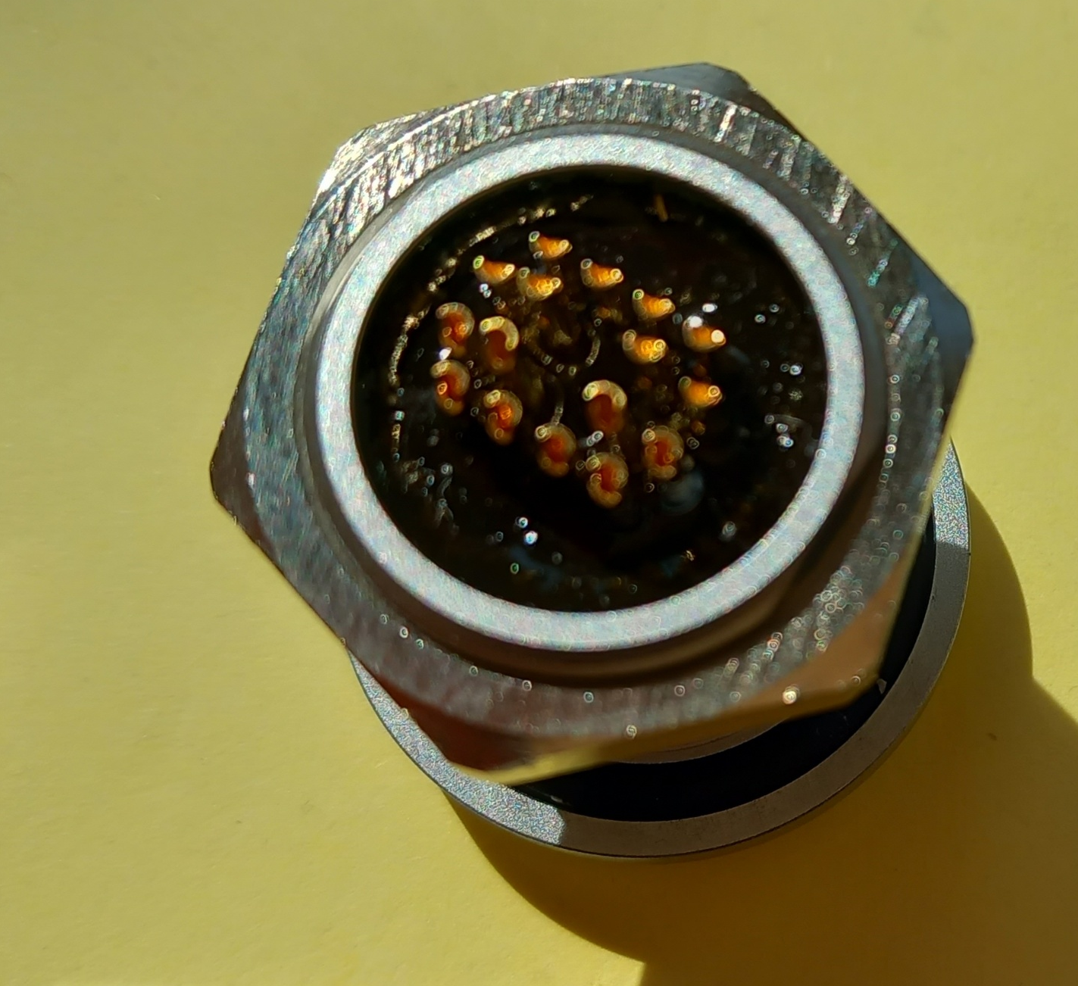
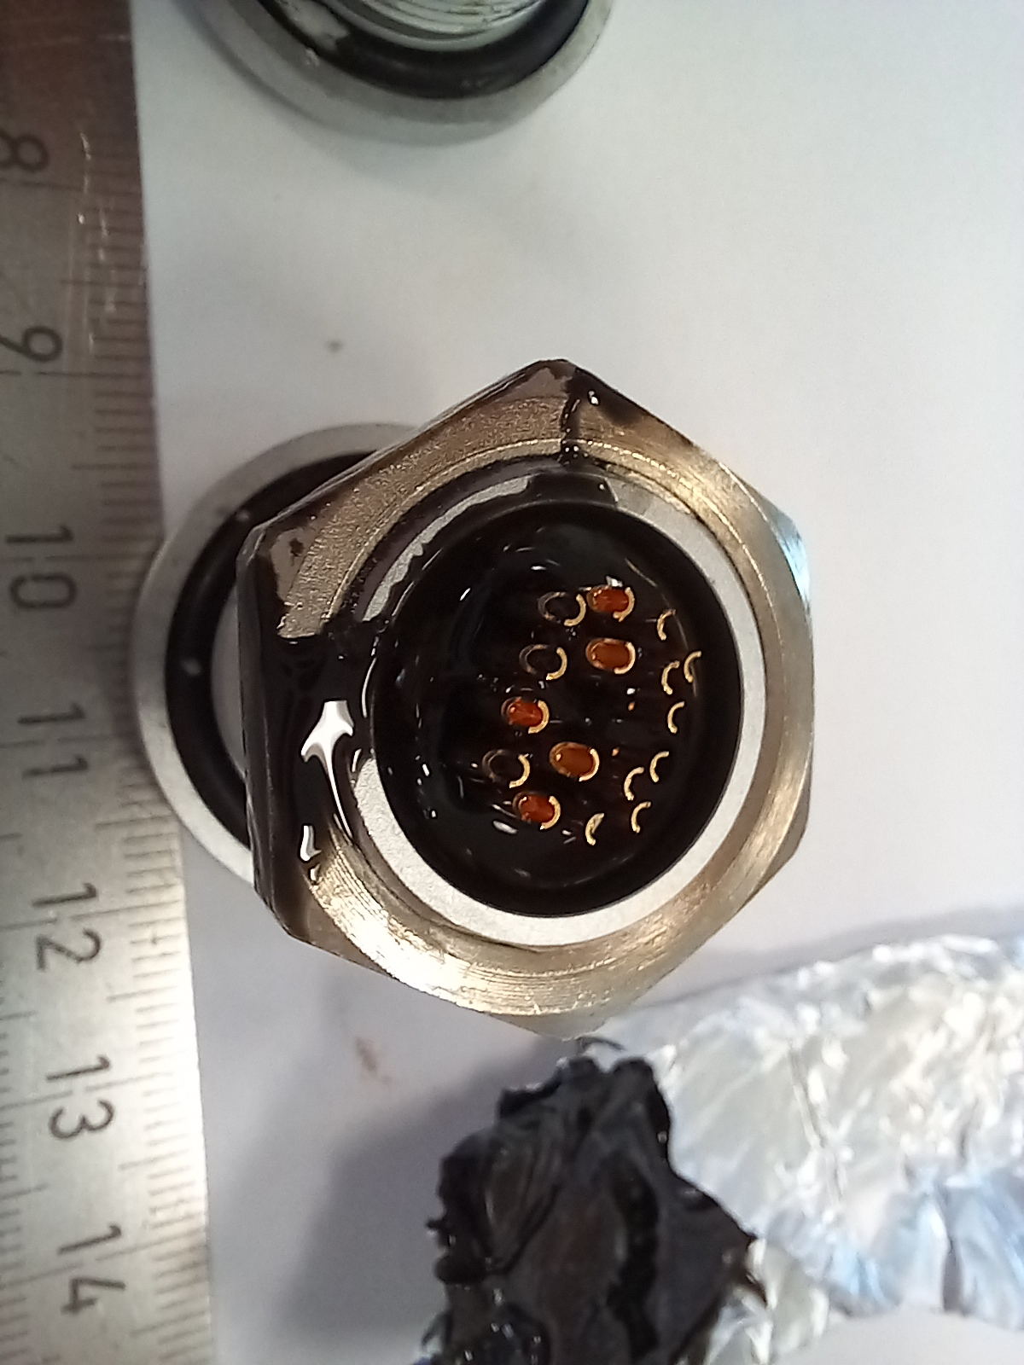
Irradiation induced chain scission and liquification
Polyurethane-epoxy blend used for sealing and dielectric insulation of multipin connector.
Due to irradiation induced chain scission the resin is liquified after a dose of 3 MGy.
Before irradiation
After 3 MGy
Prototype multipin connector sealed with with polyurethane-epoxy blend before and after 3 MGy ⁶⁰Co irradiation in ambient air.

Slide 20
Radiation hardness of wax

Slide 21
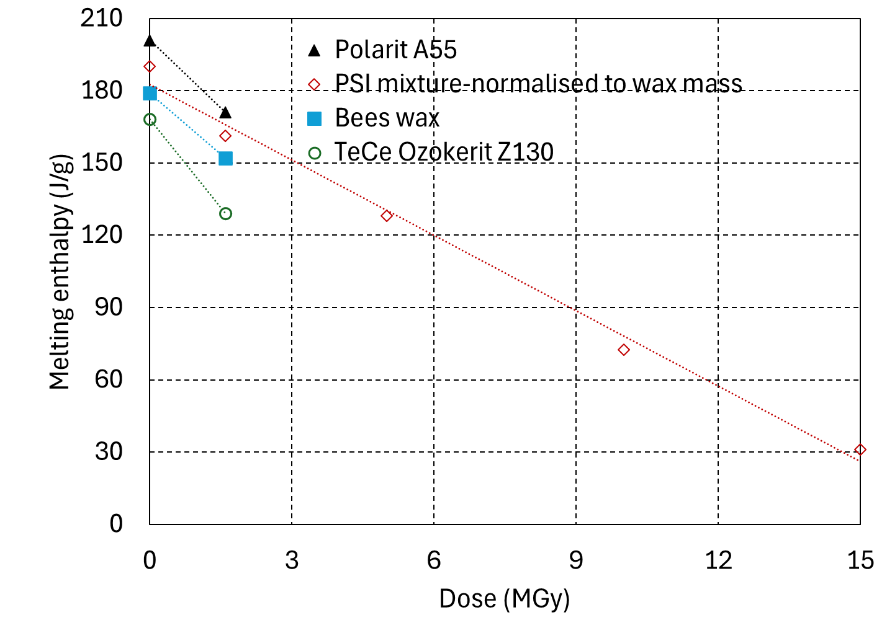
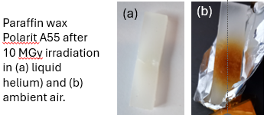
Radiation hardness of wax
Training quenches can be avoided when using wax as impregnation resin [5].
PSI developed coil impregnation with Al₂O₃ particle filled paraffin/carnauba wax mixture [6].
At CERN wax impregnation of a SMC coil is in preparation.
Radiation damage of different wax types is compared by melting enthalpy measurements using Differential Scanning Calorimetry (DSC).
10 MGy gamma irradiation in air of eight different wax types will be achieved by end of July 2025.
The visual aspect of wax after 10 MGy in liquid helium suggests that low temperature irradiation causes less damage than air irradiation.
Melting enthalpy of different wax types as a function of the absorbed gamma dose.
[5] M. Daly et al., “Improved training in paraffin-wax impregnated Nb3Sn Rutherford cables demonstrated in BOX samples,” Supercond. Sci. Technol., vol. 35, no. 5, Apr. 2022, Art. no. 055014.
[6] A. Brem et al, “From Hot to Cold: Advanced Materials and Processes for Nb3Sn Based Magnets”, IEEE TRANSACTIONS ON APPLIED SUPERCONDUCTIVITY, VOL. 34, NO. 5, (2024), Art. No. 7700105, https://ieeexplore.ieee.org/stamp/stamp.jsp?tp=&arnumber=10339837

Slide 22
Towards qualification of epoxy resin systems for FCC-hh final focus magnets up to 80 MGy

Slide 23
Pre-selection of most radiation hard epoxy resins based on DMA results
Most radiation hard resins can be distinguished by a comparatively smaller decrease of G’_{rubbery} with increasing dose.
Epoxy resin systems with amine-based hardeners degrade at much lower doses than those with anhydride-based hardeners.
Proton doses >100 MGy will be achieved at IRRAD by the end of 2025.
anhydride based
amine based
G’_{rubbery} of epoxy resins with anhydride and amine-based hardeners as a function of dose absorbed in ambient air.

Slide 24
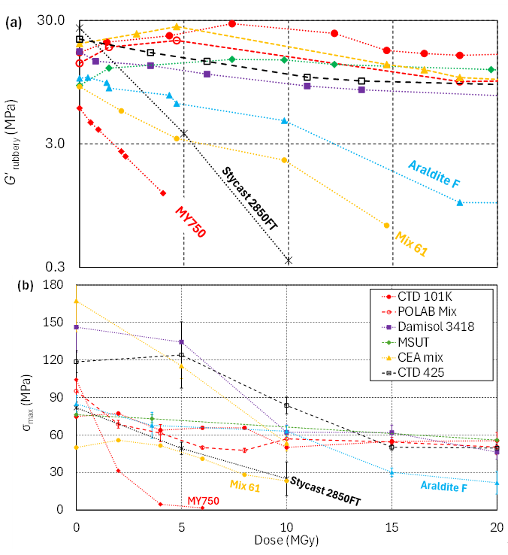
Comparison of DMA and mechanical test results
DMA measurements are complemented by mechanical tests (3-point bending).
Similar dose dependence of G’_{rubbery} and the maximum bending stress (σ_{max}).
After 10 MGy the systems with anhydride hardener exhibit σ_{max} of 55-65 MPa.
Further increasing the dose to 20 MGy changes σ_{max} only slightly.
Gamma irradiation of mechanical test samples is ongoing.
30 MGy by end of July 2025.
60 MGy to be completed by end 2026.
(a) G’_{rubbery} and (b) σ_{max} as a function of dose.

Slide 25
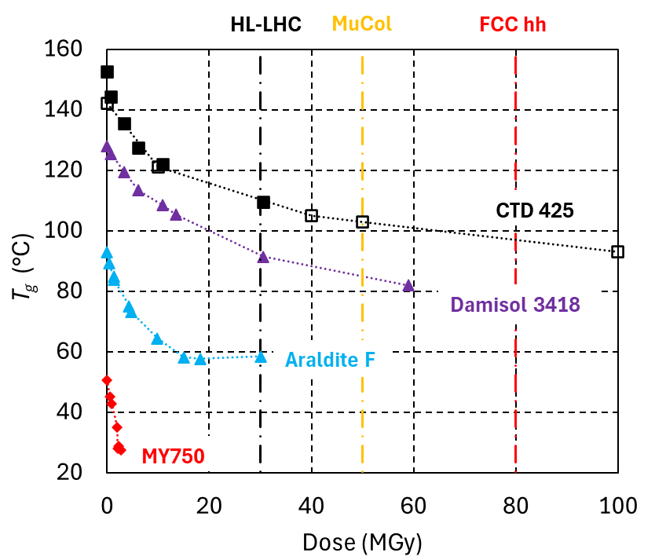
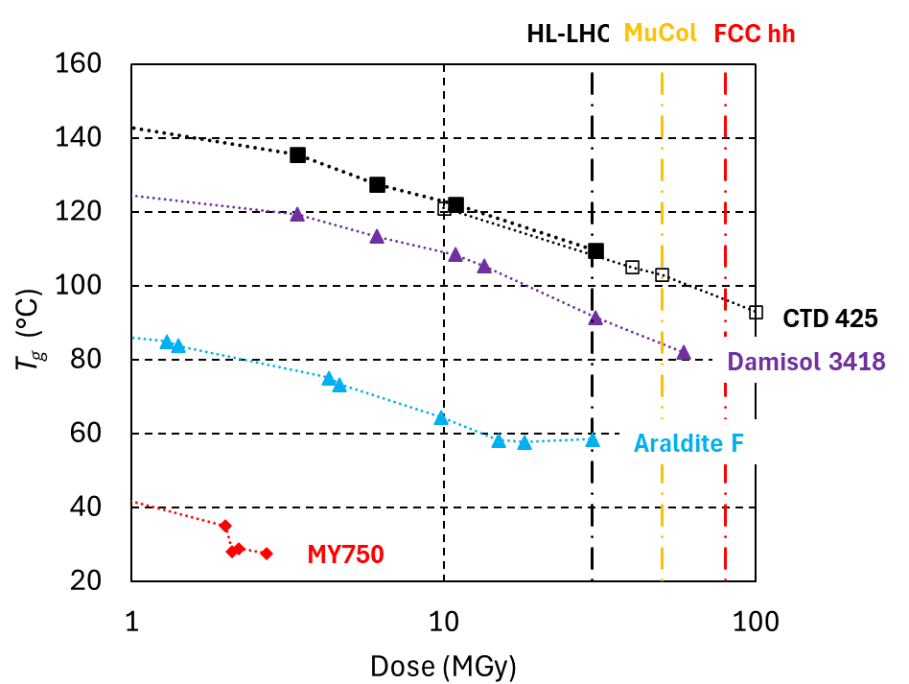
Can we extrapolate radiation damage data?
T_{g}, G’_{rubbery} and mechanical strength evolutions suggest that chain scission rates decrease with increasing dose.
T_{g} as a function of dose*. Assumed HL-LHC, Muon Collider and FCC hh final focus magnet dose limits are indicated by dashed vertical lines.
* Empty symbols represent CTD425/S2-glass composite samples from a previous gamma radiation campaign to 100 MGy [7], which have been reanalysed by DMA.
[7] A. Musso, et al., “Characterisation of the radiation resistance of glass fibre reinforced plastics for magnet systems”, IEEE Trans. Appl. Supercond. 32(6), 2022

Slide 26
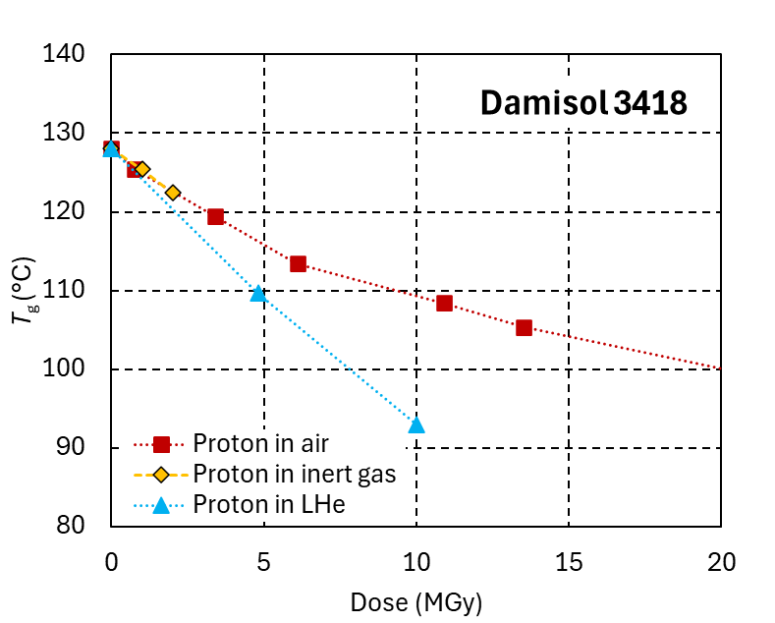
Influence of irradiation temperature on cross-linking and chain scission of epoxy systems
Cross-linking is strongly reduced in liquid helium.
The temperature effect on chain-scission is materials dependent.
To predict the dose limits of organic materials in superconducting magnets, irradiations need to be performed at cold [8].
Glass transition temperature (T_{g}) of epoxy resins MSUT MY750 and Damisol 3418 as a function of proton dose absorbed in ambient air, inert gas and in liquid He.
[8] D.M. Parragh, C. Scheuerlein, N. Martin, R. Piccin, F. Ravotti, G. Pezzullo, T. Koettig, D. Lellinger, “Effect of irradiation temperature and atmosphere on aging of epoxy resins for superconducting magnets”, Polymers 2024, 16(3), 407

Slide 27
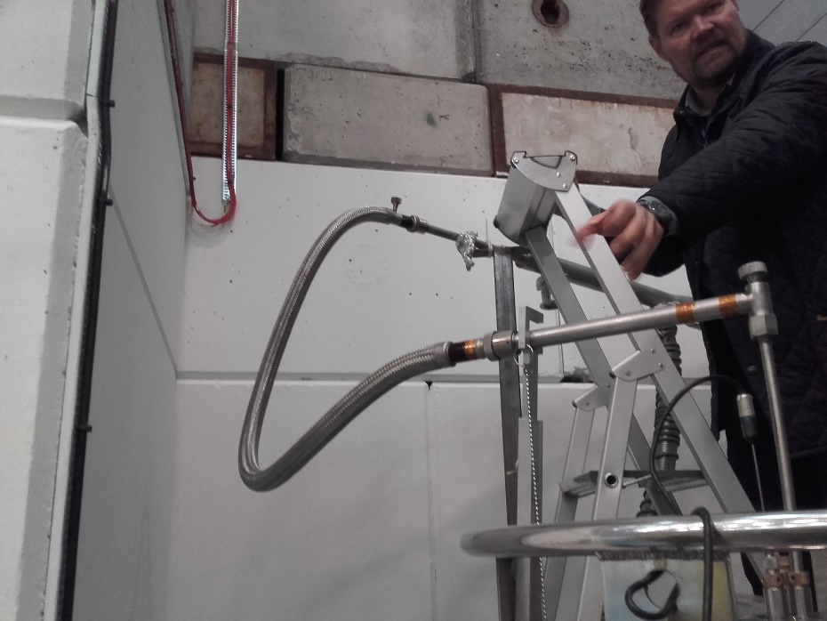
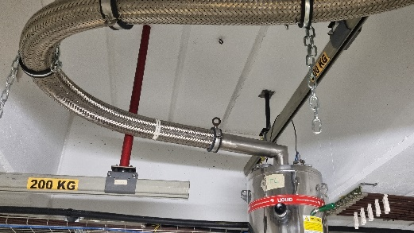
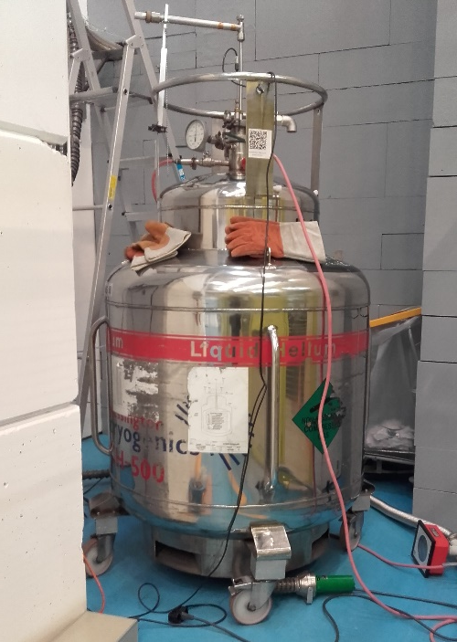
24 GeV proton irradiation in liquid helium
Liquid helium cryostat temporarily installed at IRRAD needs to be refilled daily with LHe from outside of the IRRAD facility via a flexible helium transfer line.
Irradiation durations in LHe are limited typically three weeks per year.
Three dose steps were obtained at the end of 3 operational years (3 MGy in 2022, 5 MGy in 2023, 10 MGy in 2024).
Liquid helium cryostat in the IRRAD facility
LHe transfer from dewar outside IRRAD. Courtesy T. Köttig, Cryolab, and IRRAD team.

Slide 28
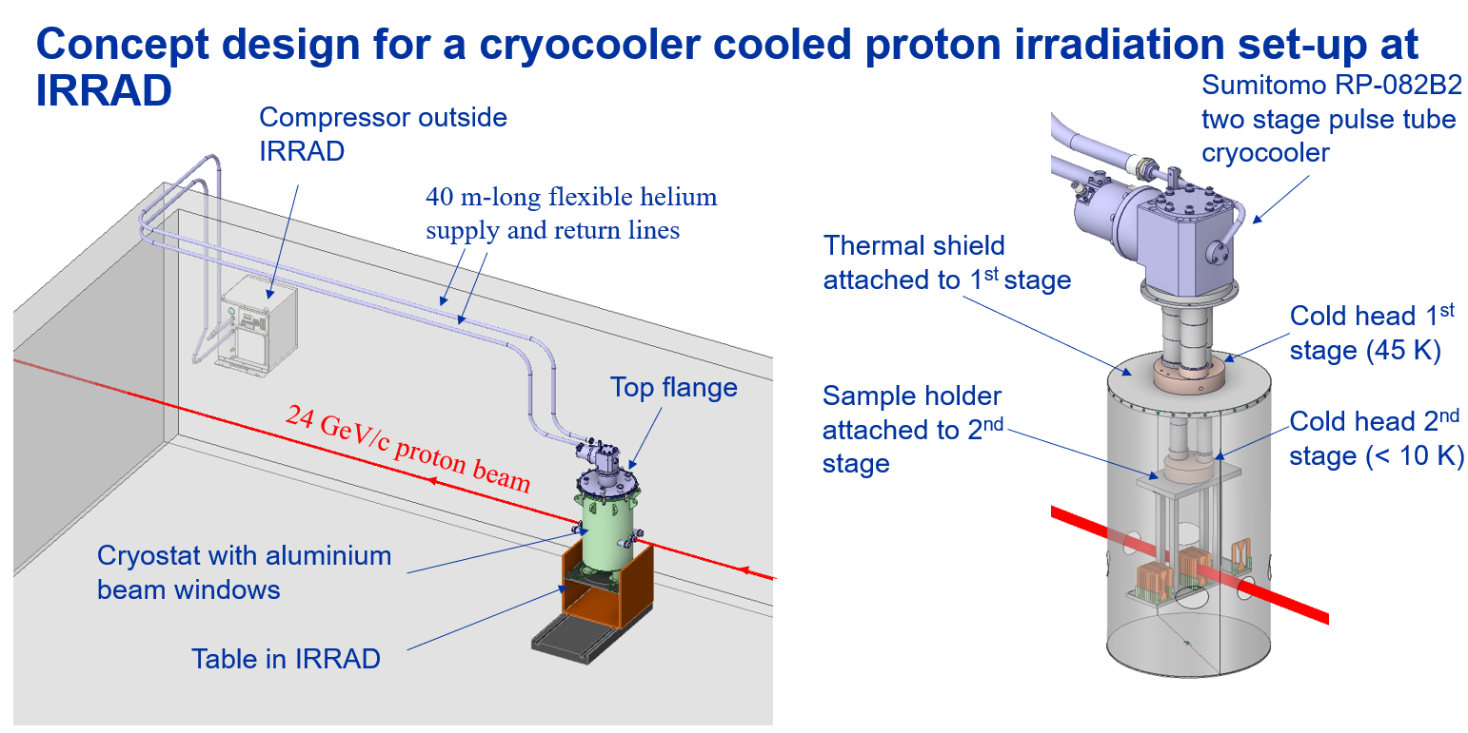
From Lukas Wolf, https://indico.cern.ch/event/1541953/

Slide 29
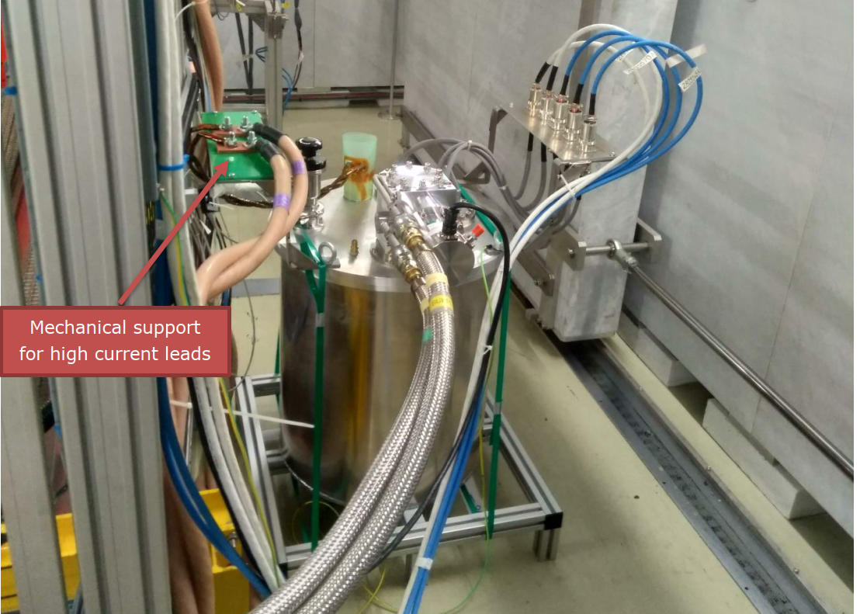
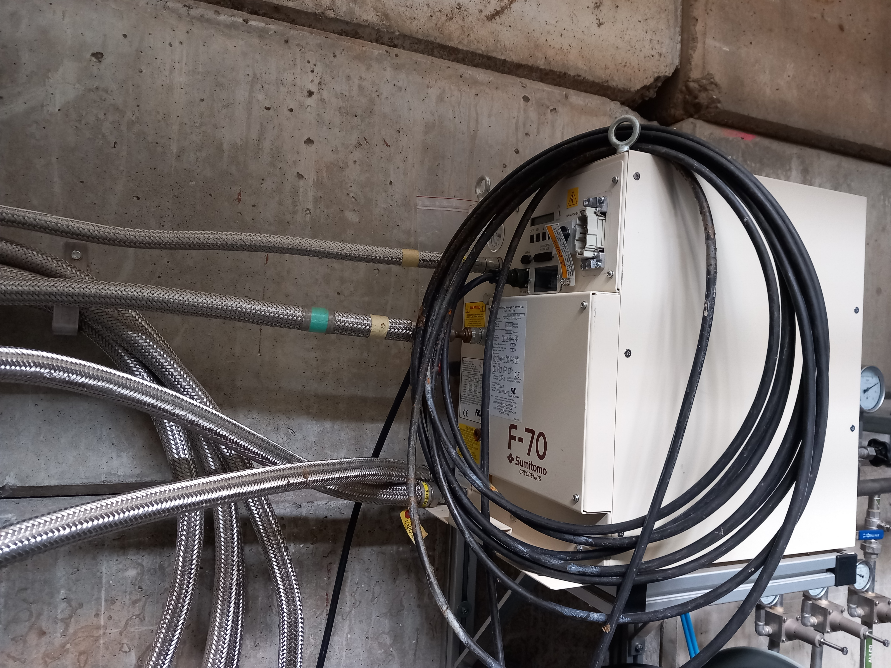
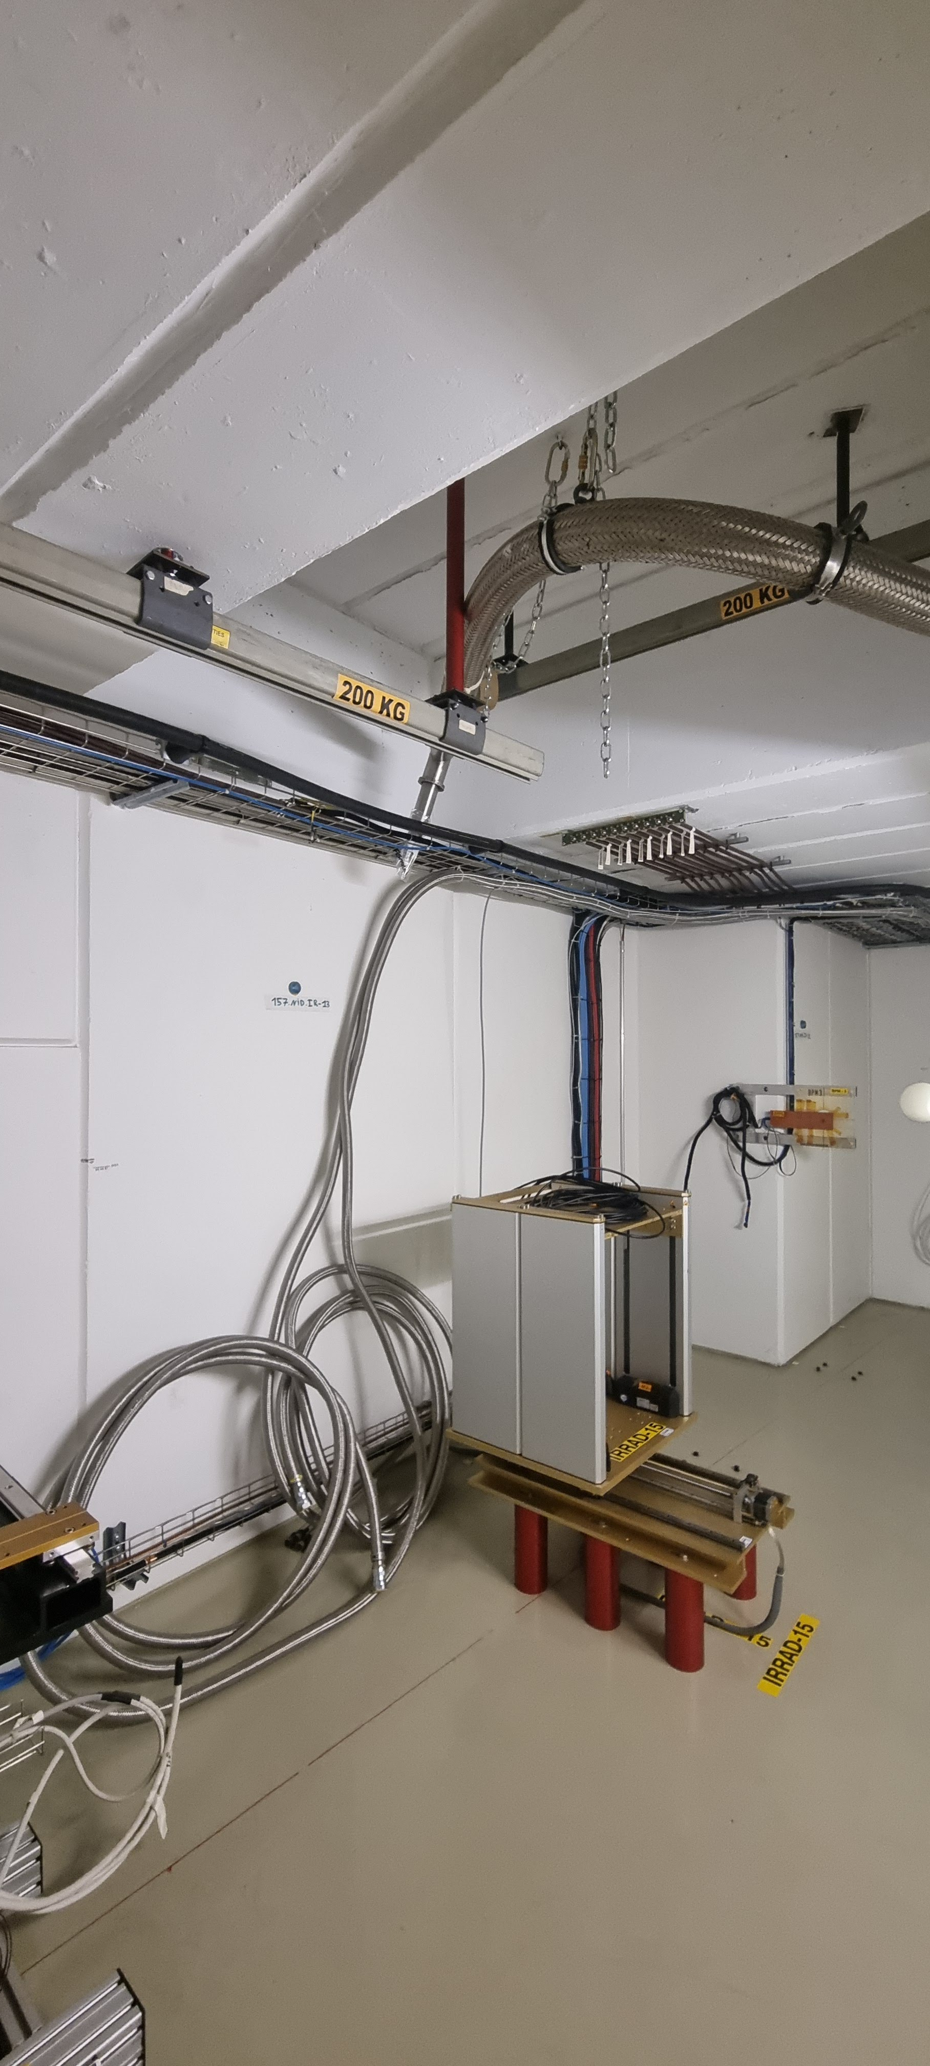
Previous set-up used at CHARM facility Helium transfer line rooting to IRRAD
Sumitomo RP-082B2 cryocooler with 40 m long helium supply lines was already used at CHARM facility for cold radiation hardness testing of protection diodes for HL-LHC [9].
The entire set-up including cryocooler was irradiated (targeted dose 30 kGy and 5x10¹⁴ n/cm²).
We can reuse the compressor already installed at IRRAD/CHARM.
New He transfer lines have been tested and were routed to the IRRAD zone 3.
(a)
(b)
(c)
(a) Set up for cold radiation hardness tests of bypass diodes in the CHARM irradiation zone [9].
(b) Table for cryostat and 40 m long helium supply lines in IRRAD zone 3. (c) Compressor outside IRRAD Curtesy G. Pezzulo and F. Ravotti, IRRAD.
[9] D. Wollmann, et al., “Characterisation of the radiation hardness of cryogenic bypass diodes for the HL-LHC inner triplet circuit”, Proceedings 10th International Particle Accelerator Conference, Melbourne, Australia, 19–24 May 2019

Slide 30
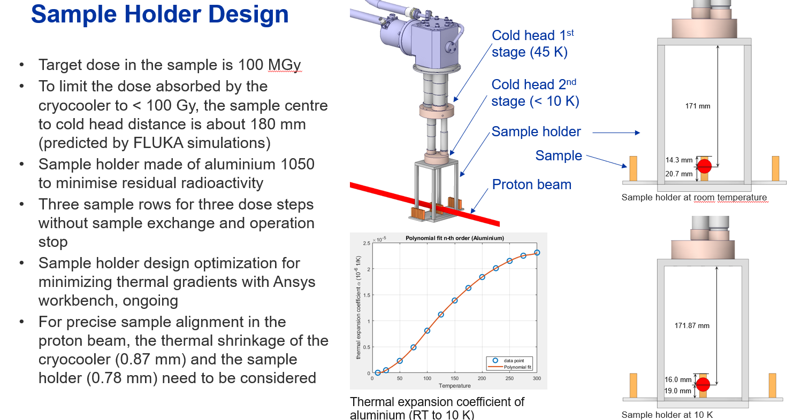
From Lukas Wolf, https://indico.cern.ch/event/1541953/

Slide 31
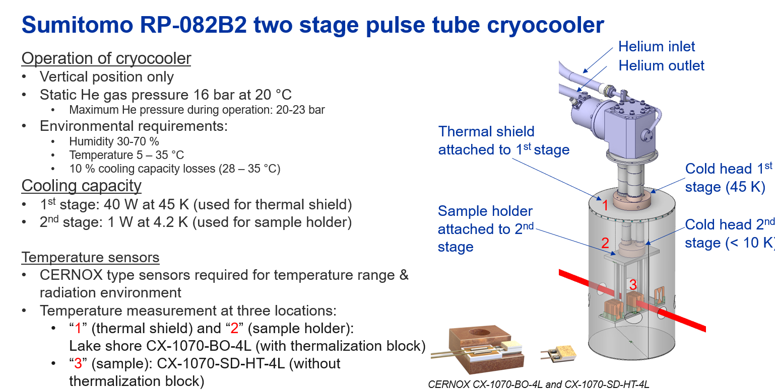
From Lukas Wolf, https://indico.cern.ch/event/1541953/

Slide 32
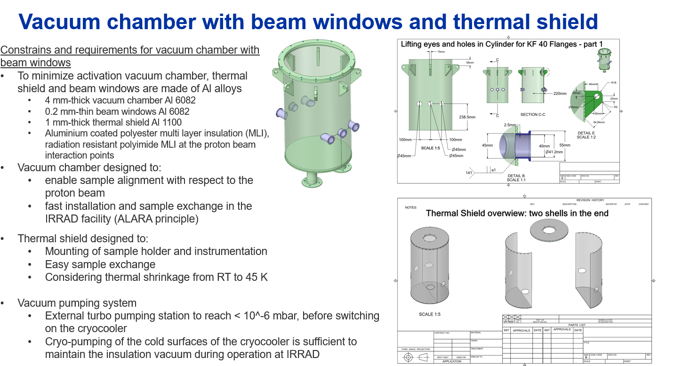
From Lukas Wolf, https://indico.cern.ch/event/1541953/

Slide 33
Conclusion and outlook
Different requirements for impregnation resins of FCC-hh main and final focus magnets.
Highest possible radiation hardness in final focus magnets
Optimum materials properties to avoid training quenches in main magnets
Gamma irradiation of a wide range of polymers for possible application in particle accelerators and detectors is ongoing.
30 MGy by 30 July 2025
60 MGy can be achieved by the end of 2026
Proton and reactor irradiation of the most radiation hard impregnation materials to >100 MGy will be achieved by the end of 2025.
To determine the dose limits of organic materials in superconducting magnets, irradiations at magnet operating temperature are needed.
A new cryocooler based set-up for cold irradiations is under production, to be installed in the IRRAD facility in 2025.

Slide 34
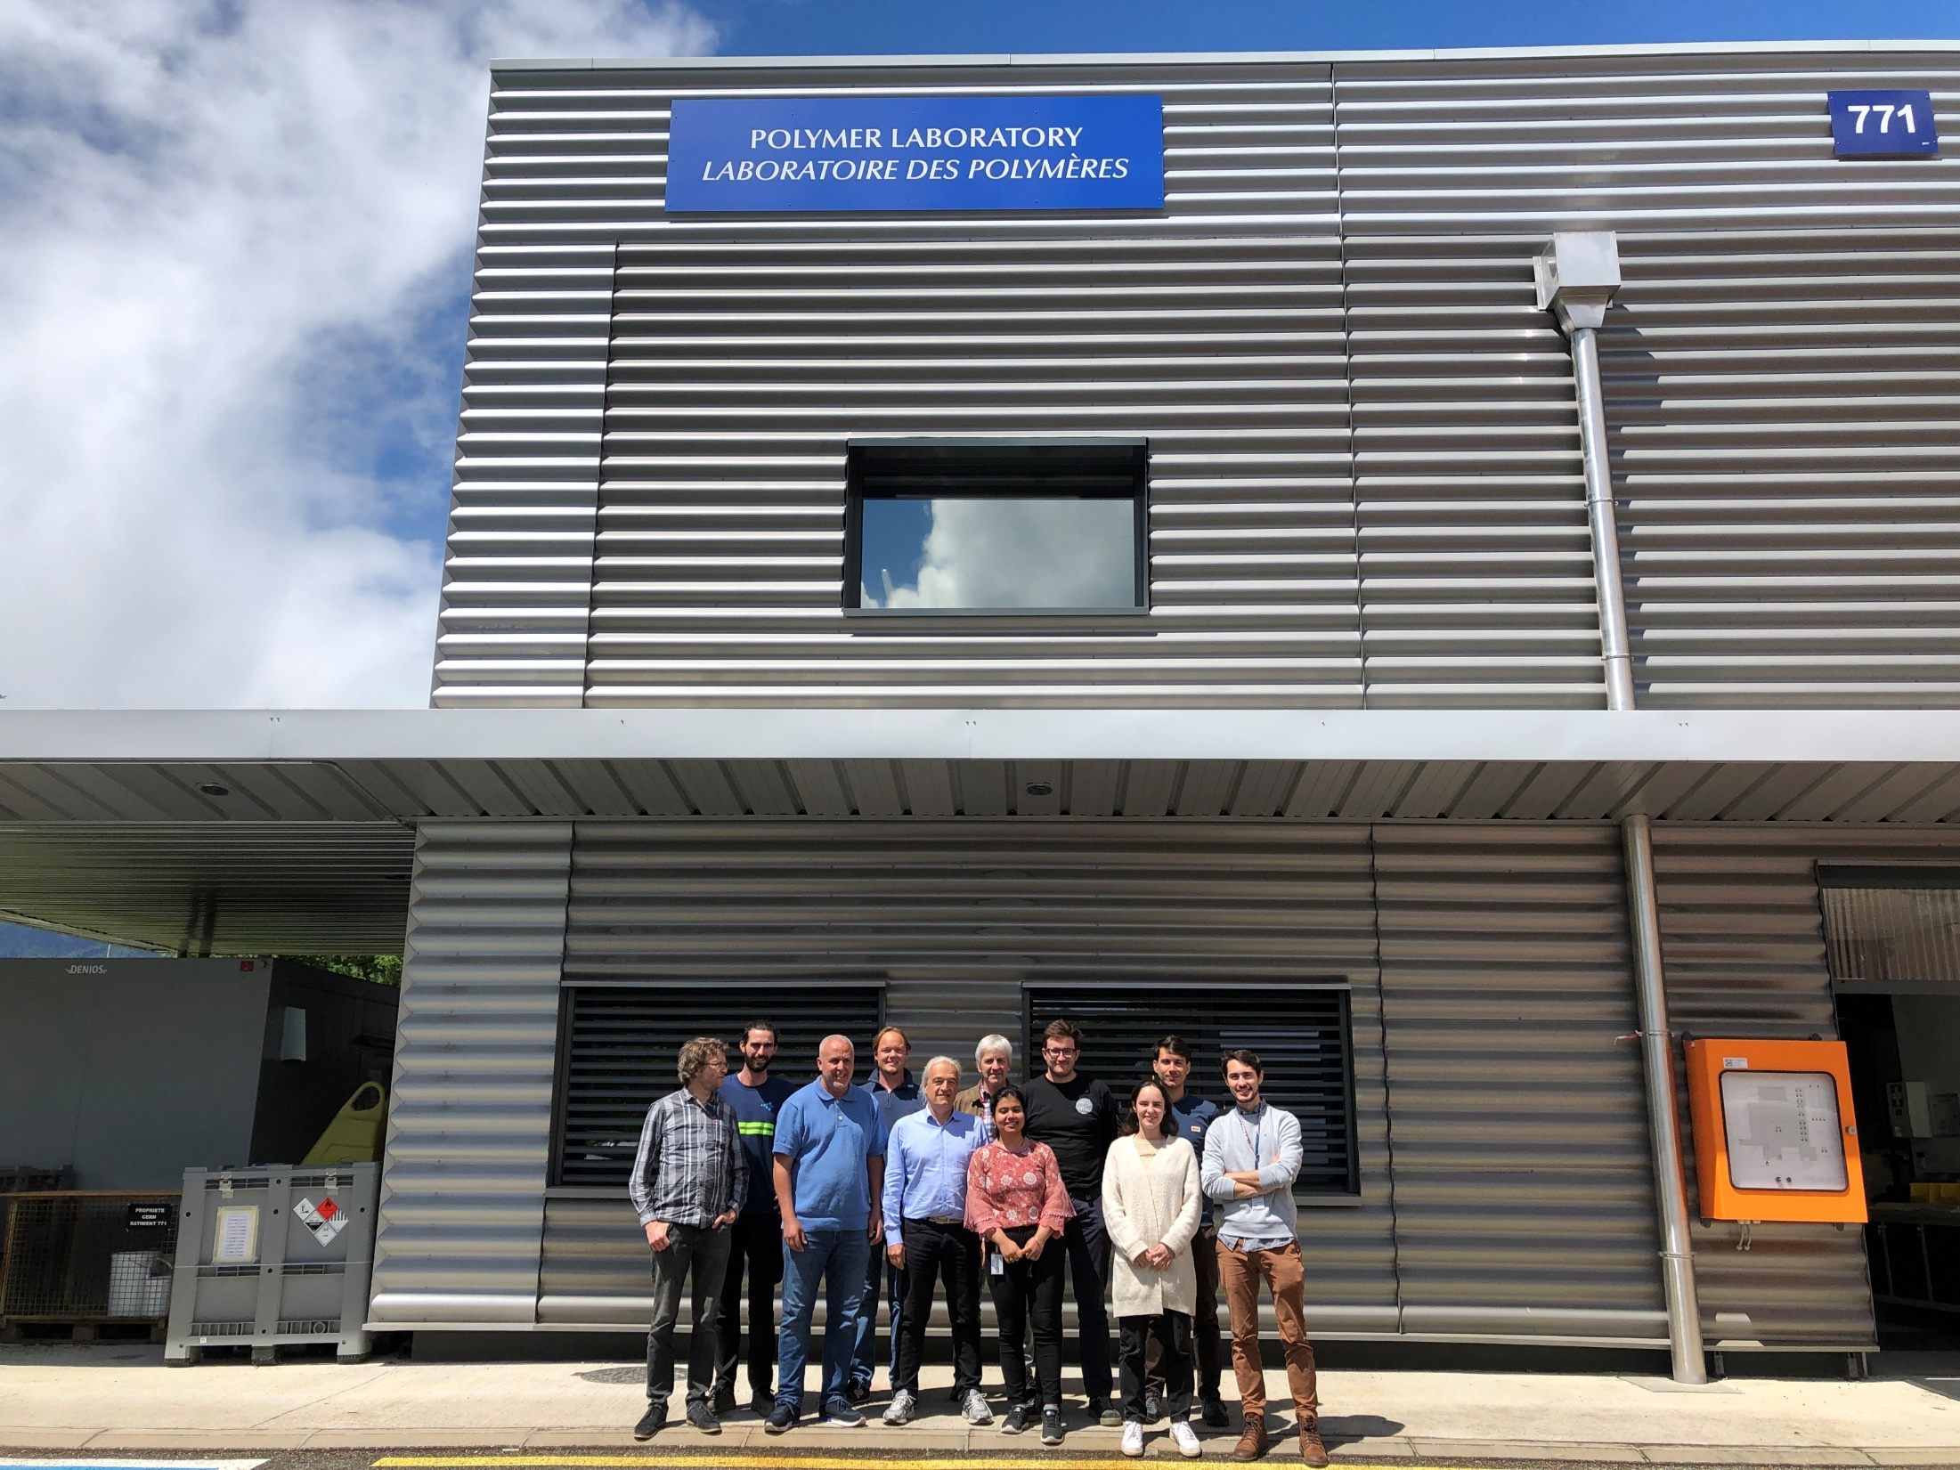
Thank you for your attention

Slide 35
Extra slides

Slide 36
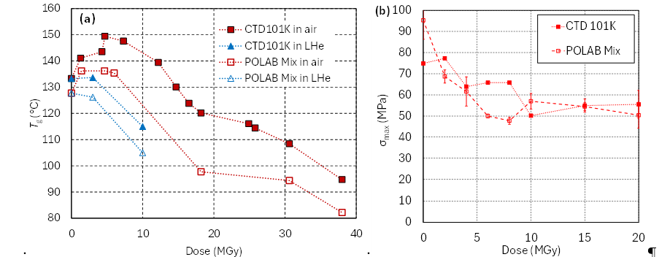
Radiation hardness of CTD101K and Polab Mix
Polab Mix is an epoxy resin system based on CTD101K, with improved mechanical properties due to addition of the flexibiliser Araldite DY040 [10].
Addition of flexibiliser reduces T_{g} of Polab Mix. T_{g} vs dose evolution of both systems is similar, indicating similar chain scission rates.
Mechanical properties after 10 MGy to 20 MGy of both systems are identical within experimental uncertainties.
CTD101K and Polab Mix T_{g} and 3-point bending stress at fracture as a function of dose.
[10] A. Gaarud, C. Scheuerlein, D.M. Parragh, S. Clement, J. Bertsch, C. Urscheler, R. Piccin, F. Ravotti, G. Pezzullo, R. Lach, “Fracture toughness, radiation hardness and processibility of polymers for superconducting magnets” Polymers 2024, 16(9), 1287

Slide 37
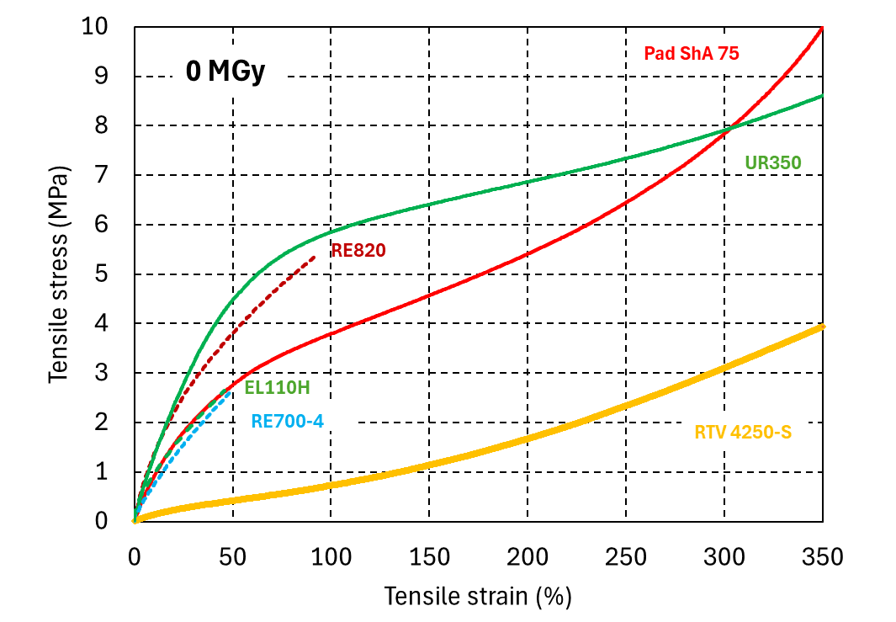
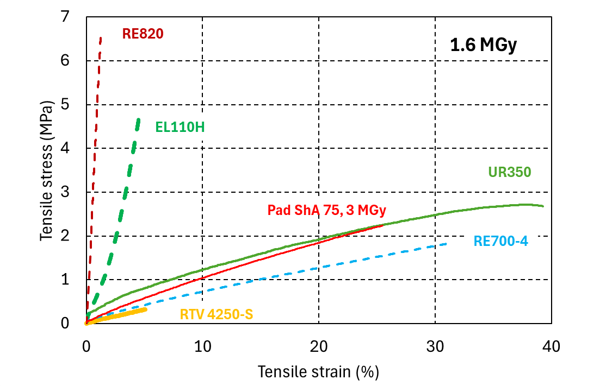
Radiation hardness of polyurethanes and silicones
Uniaxial tensile engineering stress-strain curves of silicone and PUR (a) before and (b) after 1.6 MGy gamma irradiation. Courtesy Melanie Albeck.

Slide 38
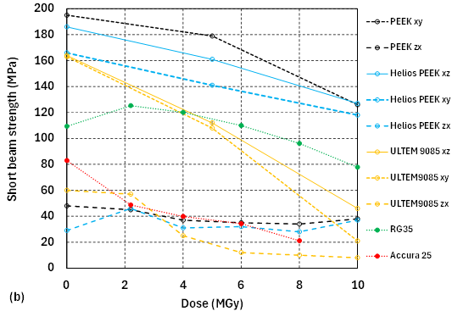
Radiation hardness of 3D printable materials
Flexural stress-strain curves of SLA and FDM 3D printed materials at RT and at 77 K.
PEEK, Helios PEEK, ULTEM9085, RG35 and Accura 25 (short beam strength as a function of dose [11].
Short beam force vs displacement curves of (a) RG35 and (b) Accura 25 measured at RT before and after irradiation up to 10 MGy.
[11] C. Scheuerlein, D.M. Parragh, J. Vielhauer, A. Gaarud, N. Martin, R. Piccin, “Thermomechanical properties and irradiation induced aging of SLA and FDM 3D printed high performance polymers”, 2025 IOP Conf. Ser.: Mater. Sci. Eng. 1327 012209

Slide 39
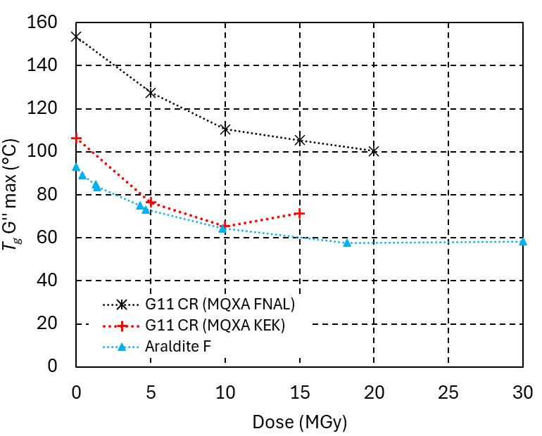
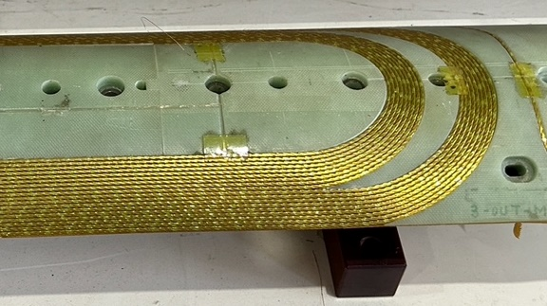
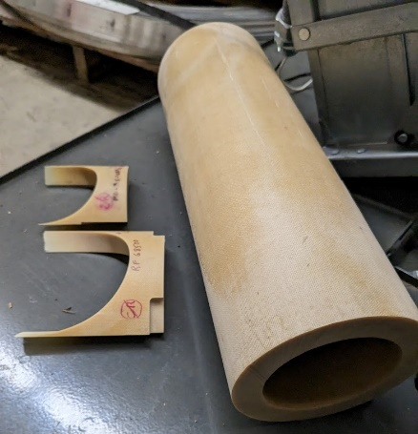
Radiation hardness of LHC MQXA coil end spacers
Goal: Confirm the dose limits of the wedges and spacers installed in the LHC MQXA magnets from FNAL and KEK (LHC Triplet Task Force)
Up to 15 MGy in ambient air, the chain scission rate in the epoxy matrix of both EP GC3 (G11-CR) composites is comparable to that of Araldite F.
30 MGy will be reached by end July 2025.
LHC MQXA inner triplet magnet end spacers made of EP GC3 (also known as G11-CR) (a) from KEK and (b) from FNAL.
T_{g} as a function of the gamma dose absorbed in ambient air.

Slide 40
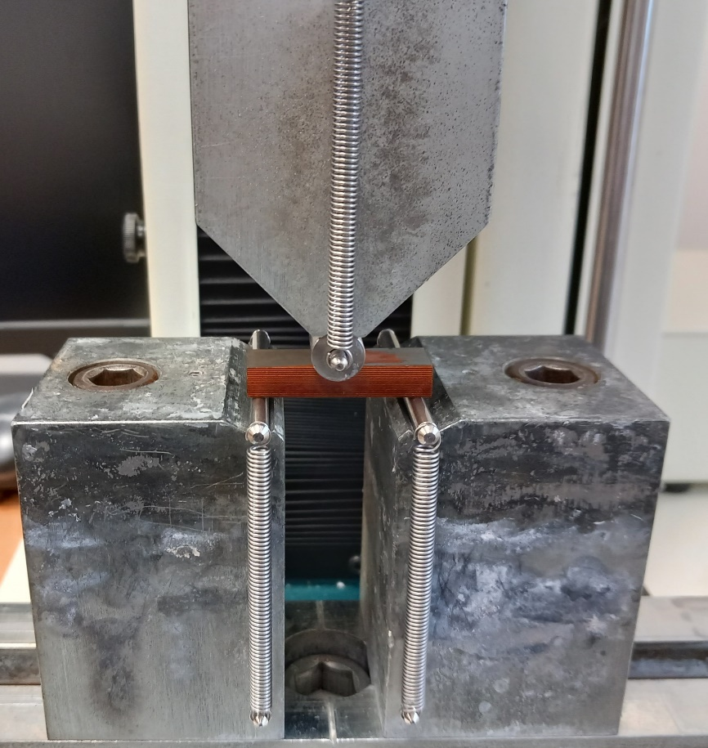
Radiation hardness of Araldite G 285/Texaco D400 epoxy system in LHC corrector magnets
3-point bending tests of Araldite G 285/Texaco D400 impregnated coil block samples in short beam configuration.
Coil block samples were cut from a pre-series MCBC coil (Nb-Ti/Cu wires are aligned in loading direction).
3-point bending strength of the non-irradiated sample is not reached with the 5 kN test machine.
3-point bending strength decreases with increasing dose, indicating an irradiation induced degradation of the epoxy impregnation.
(a) 3-point bending test of coil block sample in short beam configuration. (b) 3-point bending stress – strain curves of MCBC coil block samples before and after irradiation to 8 MGy.

