Slide 1
ACCELERATOR FAULT TRACKING AT CERN –
OVERVIEW, RECENT DEVELOPMENTS, NEXT STEPS
Anti Asko, Lukas Felsberger, Jack Heron, Jan Uythoven, Daniel Wollmann
Many thanks to M. Hostettler, G. Langlois, B. Mikulec, C. Roderick, M. Schenk, R. Steerenberg, B. Todd

Slide 2
Structure
Introduction - The Why, What and Who
Main Users and Use-Cases
Recent Developments & Next Steps

Slide 3
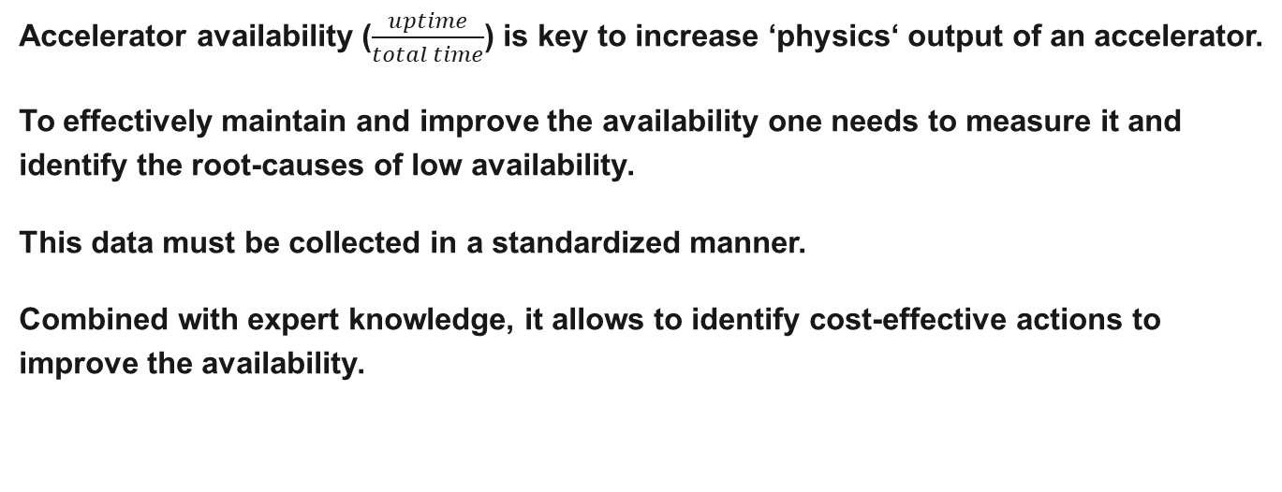
Why is accelerator fault tracking important?
Accelerator availability ($\frac{uptime}{total time}$) is key to increase ‘physics‘ output of an accelerator.
To effectively maintain and improve the availability one needs to measure it and identify the root-causes of low availability.
This data must be collected in a standardized manner.
Combined with expert knowledge, it allows to identify cost-effective actions to improve the availability.
Notes:
You can mention that at the moment, at least for LHC, that operation is that much optimised with beta* levelling, crossing angle changes etc. that the main parameter for optimising lumi at the moment is the availability.

Slide 4
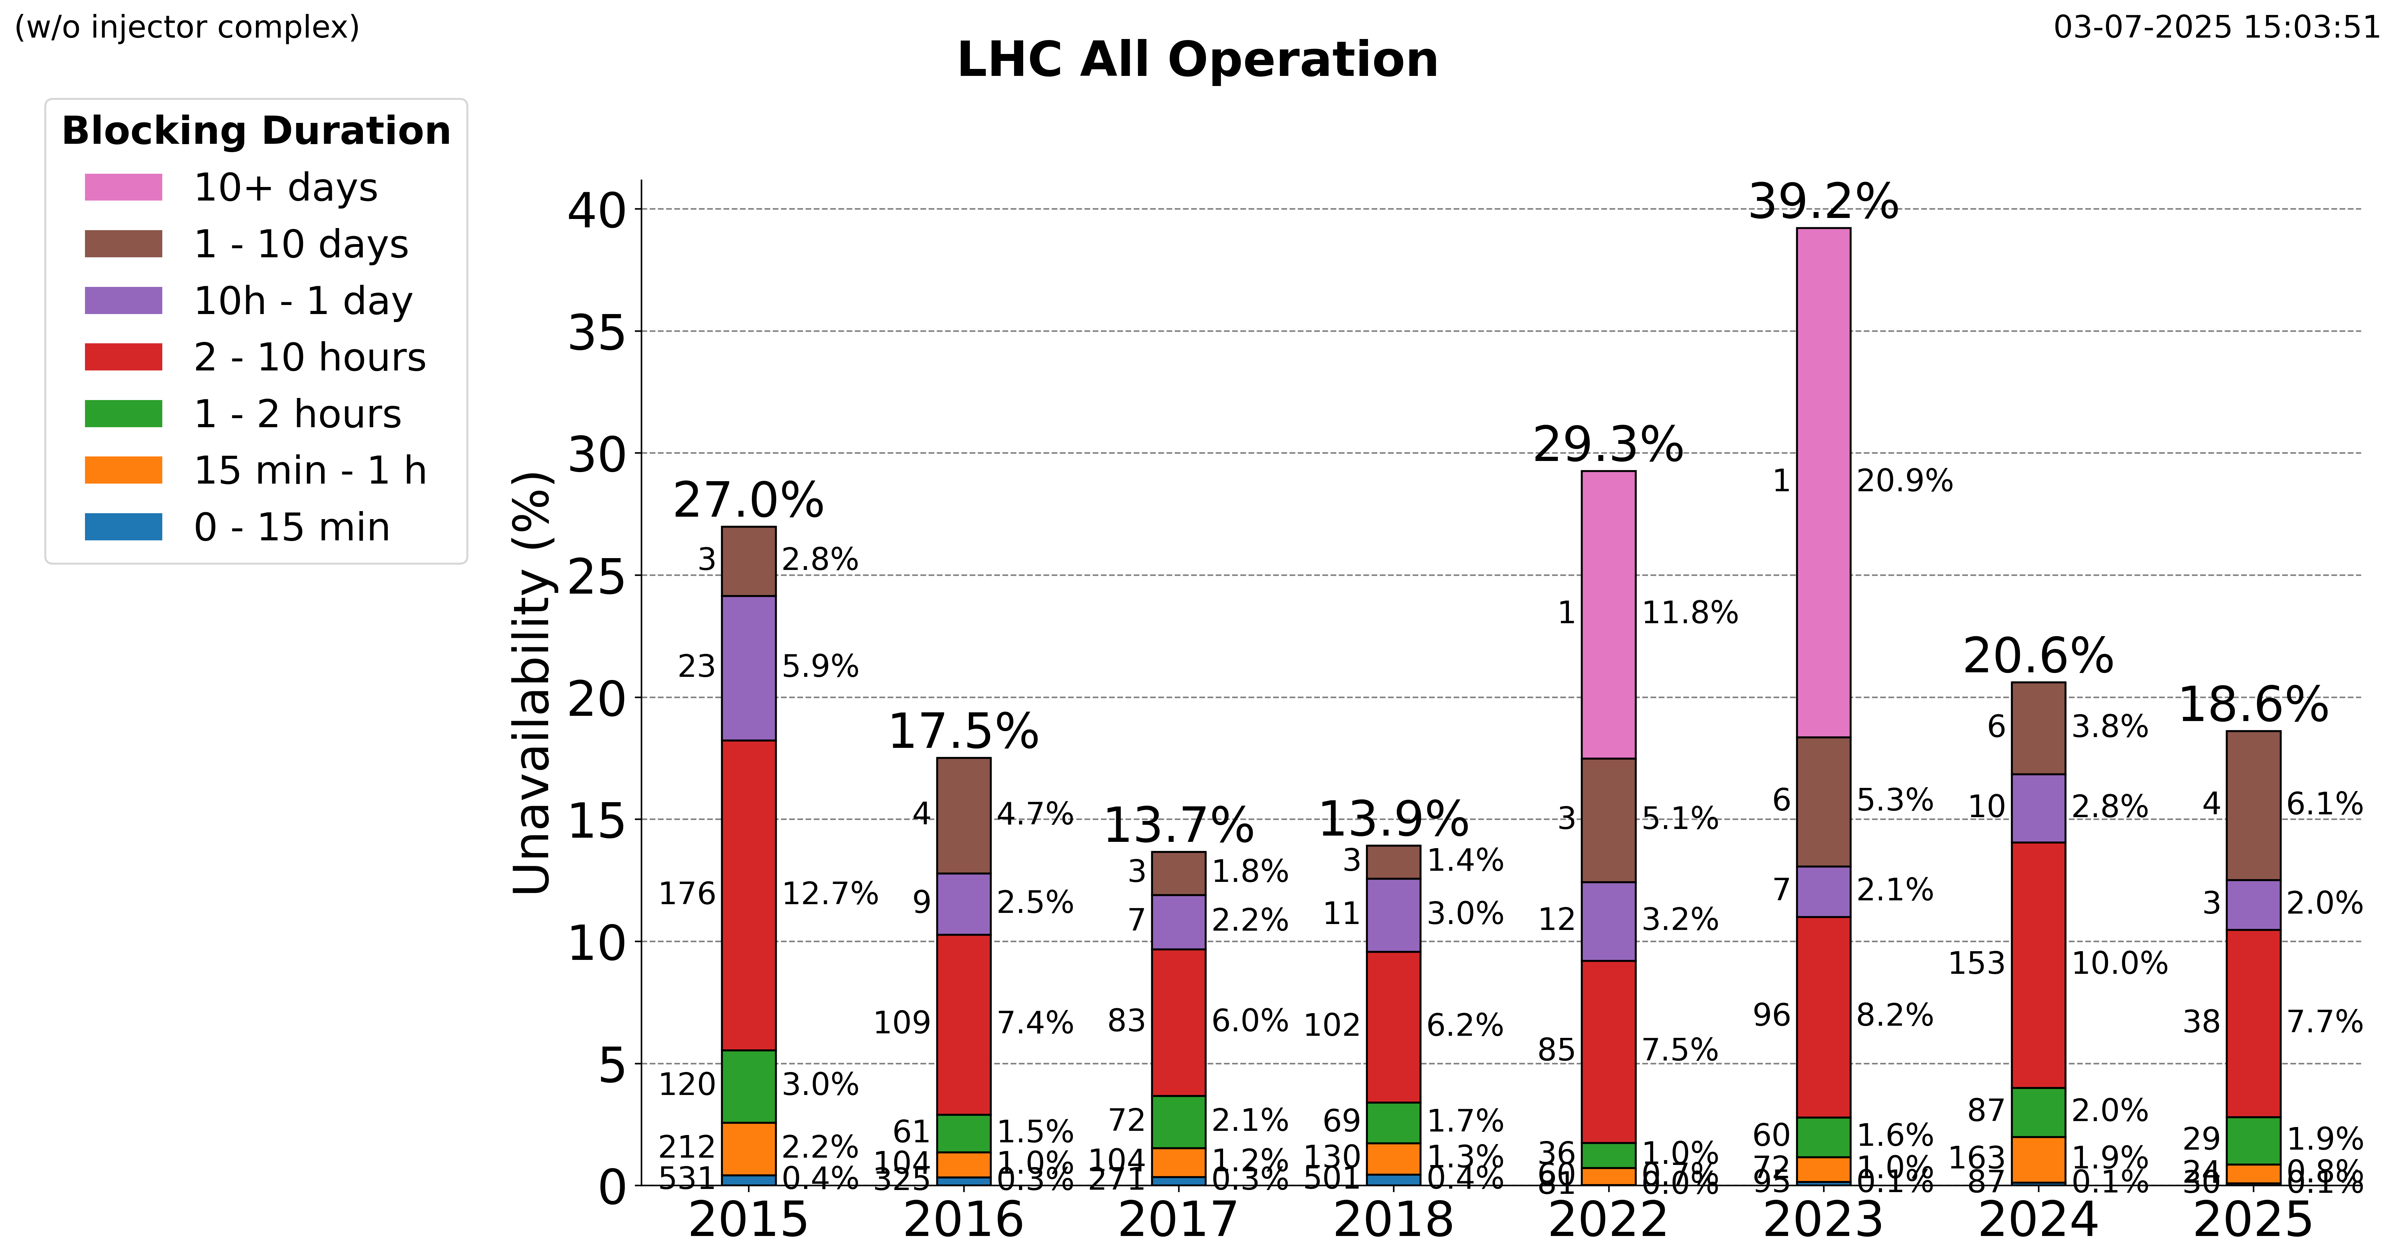
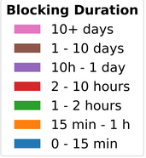
AFT in Action: 2023 – LHC, is it falling apart?
LS1
LS2
5 longest events of 2023 contributed 60% of downtime!
  4 of 5 events due to inadequate specifications or non-conformities
  2 of 5 events possibly related to aging of LHC, in combination with a non-conformity or increased beam intensity
  3 of 5 events due to more recent changes (LS2)
https://aft-stats.web.cern.ch/LHC_all_OP/Whole_Machine/#unavailability-by-systems

Slide 5
AFT in Action: 2023 – LHC, is it falling apart?
LS1
LS2
5 longest events of 2023 contributed 60% of downtime!
  4 of 5 events due to inadequate specifications or non-conformities
  2 of 5 events possibly related to aging of LHC, in combination with a non-conformity or increased beam intensity
  3 of 5 events due to more recent changes (LS2)
Preparation and execution of LS3 is crucial for Run4!
Continuous efforts to maintain availability ongoing and crucial.
https://aft-stats.web.cern.ch/LHC_all_OP/Whole_Machine/#unavailability-by-systems

Slide 6
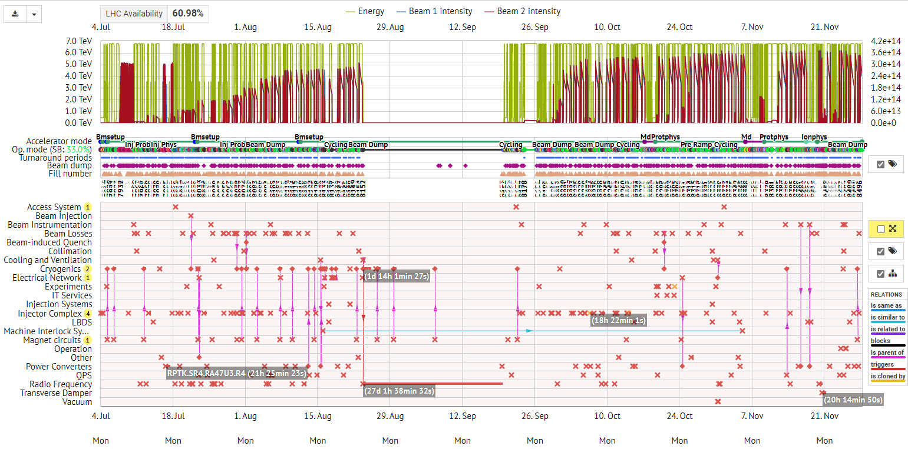
What does AFT look like? – LHC Cardiogram

Slide 7
What does AFT look like? – LHC Cardiogram
Explore yourself:
https://aft.cern.ch (live dashboard and tool)
https://aft-stats.web.cern.ch/ (up-to-date statistics)

Slide 8
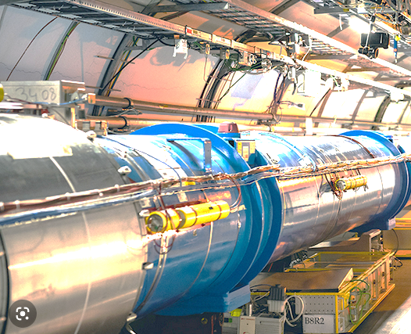
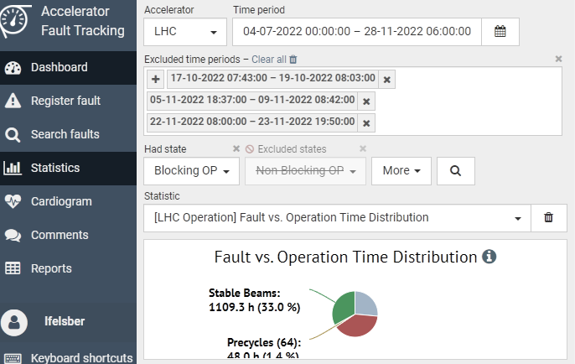
Who is involved and how?
Define tool requirements
BE-CSS
Reliability & Availability WG
Accelerators
AFT tool
Review faults
Follow-up on reviews
Operate accelerators
Log faults (partially automated)
Build and maintain
Operations
Equipment groups
Follow-up on fault logging
Notes:
Start with the players
Add interaction

Slide 9
Structure
Introduction - The Why, What and Who
Main Users and Use-Cases
Recent Developments & Next Steps

Slide 10
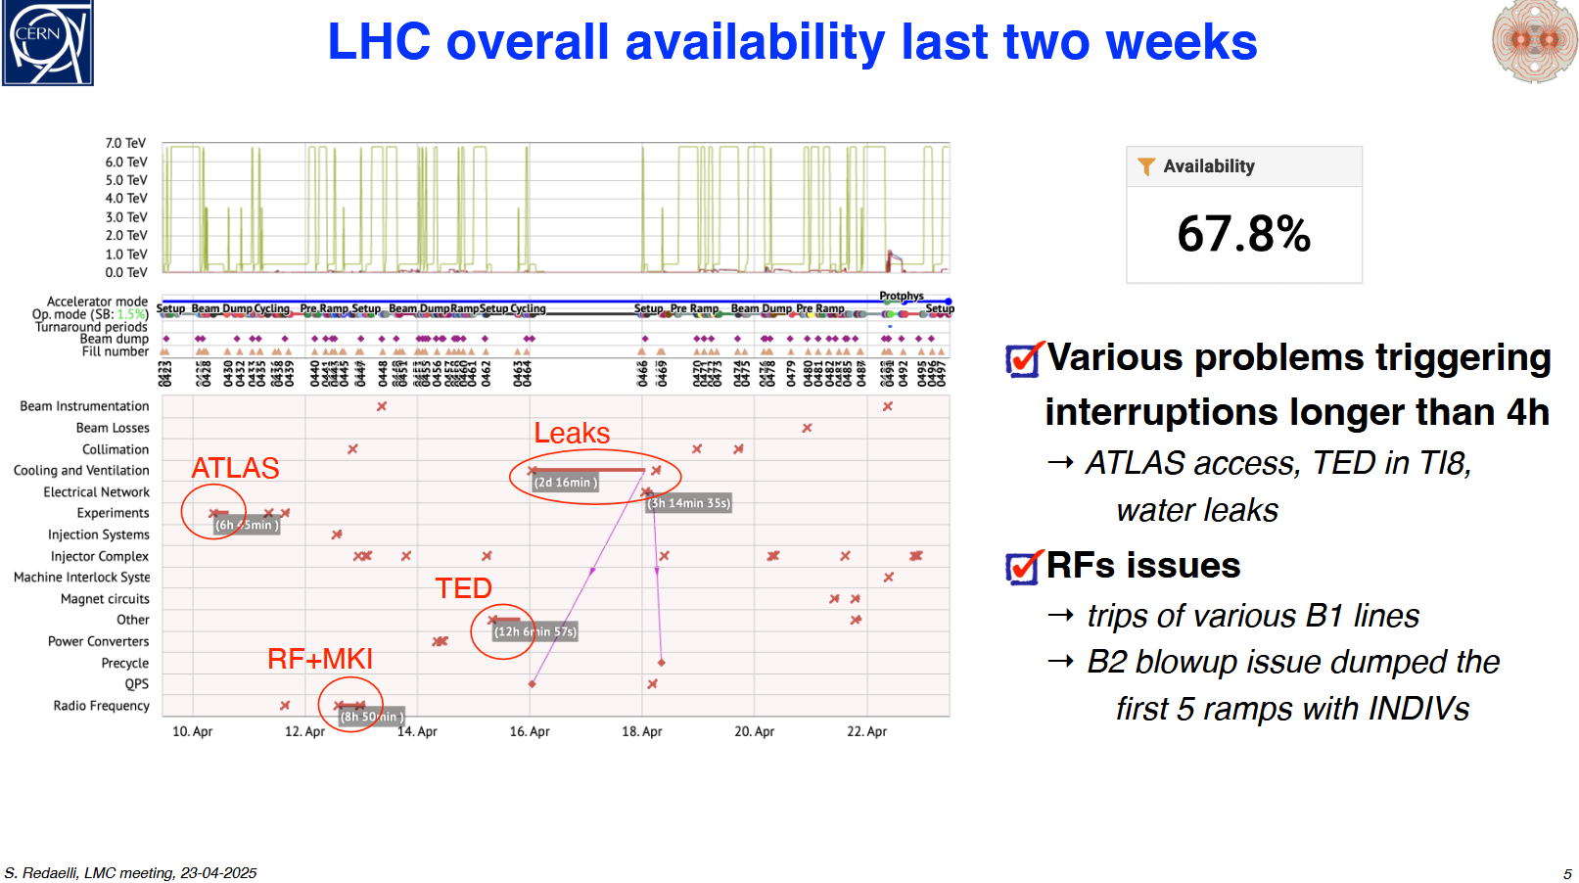
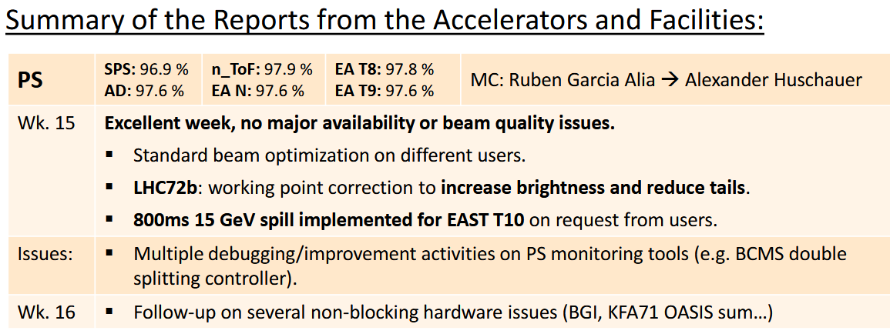
Usage – Operations – (bi)weekly Reporting
Facilities Operational Meeting (FOM)
LHC Machine Committe (LMC)
AFT workflow ensures fault awareness and commonly agreed set of data.
Enables provision of consistent & standardised statistics, analyses, reports.

Slide 11
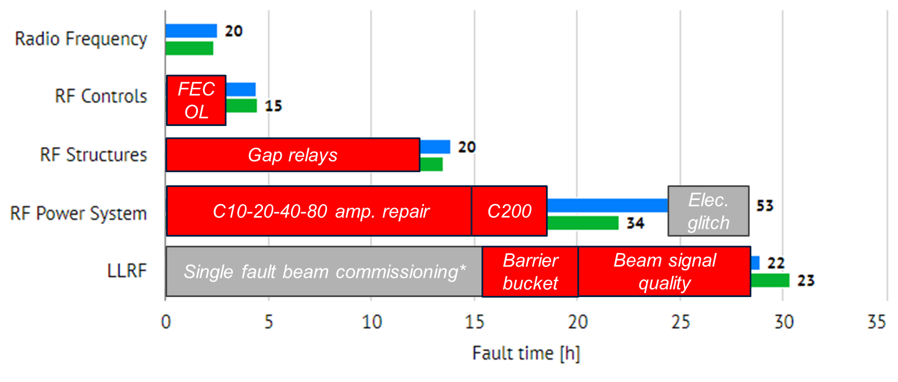
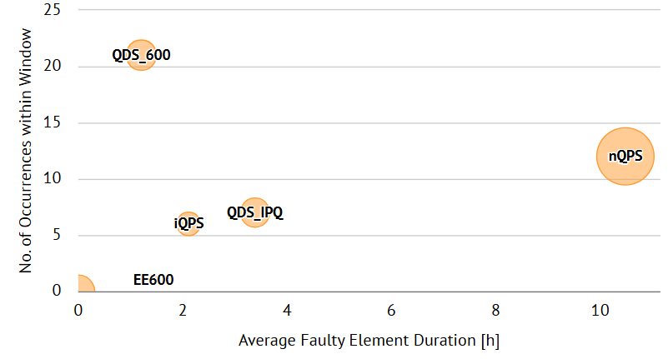
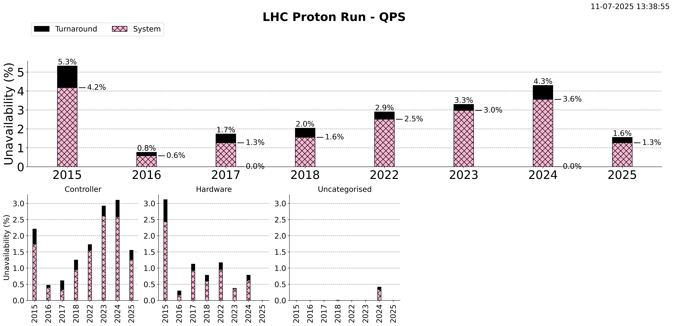
Usage – Equipment Groups
Annual RF Operations Review:
LHC Quench Detection Systems:
QDS downtime 2024 by detector type: QDS unavailability:
PS RF Downtime 2024 analysis:
CONS ongoing
Targeted mitigations (incl. nQPS & iQPS R2E upgrades in IP1, 2, 5, 8) significantly reduced failures in 2025
https://aft-stats.web.cern.ch/LHC_protons/QPS/
AFT tool useful for equipment groups and ensures transparency between their systems
– limitations exist:
  Fault tracking limited to beam operation periods (while e.g. infrastructures needed year-round)
  AFT is not an asset management tool (e.g. for spares management) → pursue integration with EAM

Slide 12
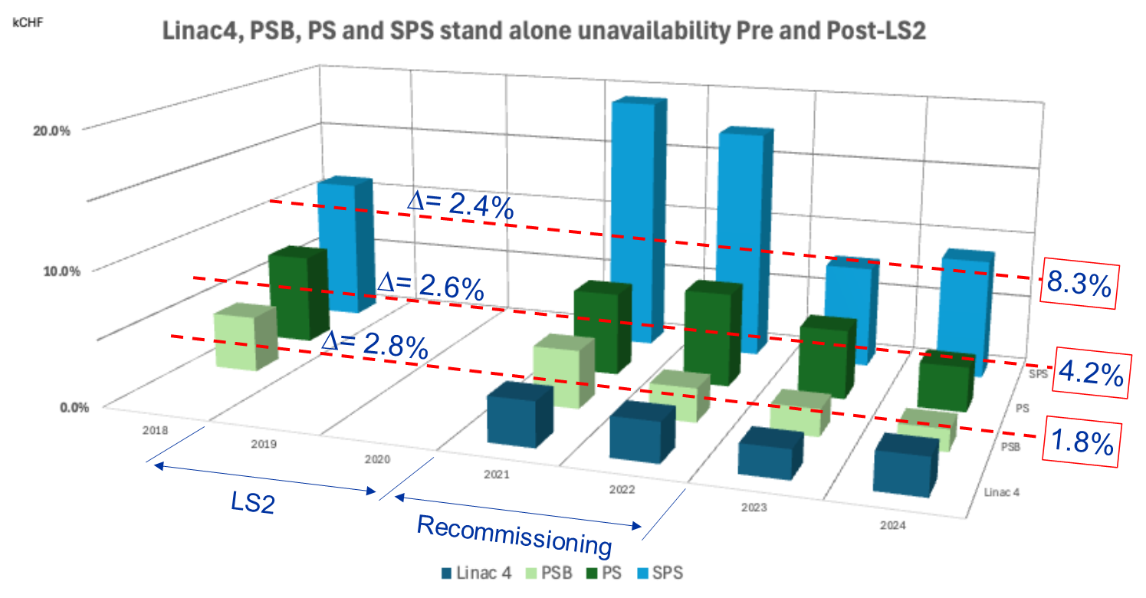
Usage – Accelerator Consolidation
R. Steerenberg, Chamonix 2025
Yearly availability & failure rate trends are valuable CONS input.
Limitations exist:
  Triggering consolidation based on increased failure rate may be too late.
  Consolidation decision needs to account for other factors (synergies, spares, obsolescence, …).
Reliability & Availability WG scores CONS requests on projected operational impact → input for yearly arbitration exercise
The LHC injectors upgrade and ACC-CONS projects during LS2 may have improved the overall availability by ~2.6%
Other factors may have impacted these availability figures positively and negatively

Slide 13
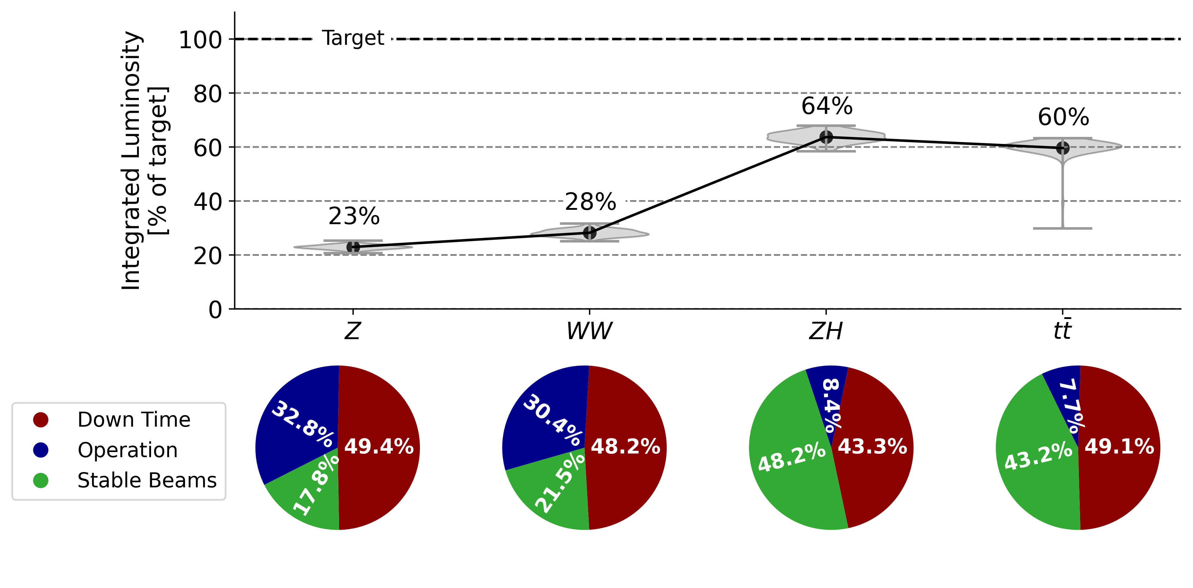
Usage – Reliability & Availability Working Group
AFT statistics are used for reliability studies of existing and future systems
  AFT has generated the most complete accelerator specific failure data set in our domain.
  Enables accelerator reliability and availability studies for internal (e.g. FCCee) and external (e.g. MYRRHA ADS) purposes.
FCCee Availability Study: Projected integrated luminosity (relative to target) and operational efficiency based on comparable existing systems performance (from AFT data):
J. Heron, FCC Week – Vienna, 2025

Slide 14
Structure
Introduction - The Why, What and Who
Main Users and Use-Cases
Recent Developments & Next Steps

Slide 15
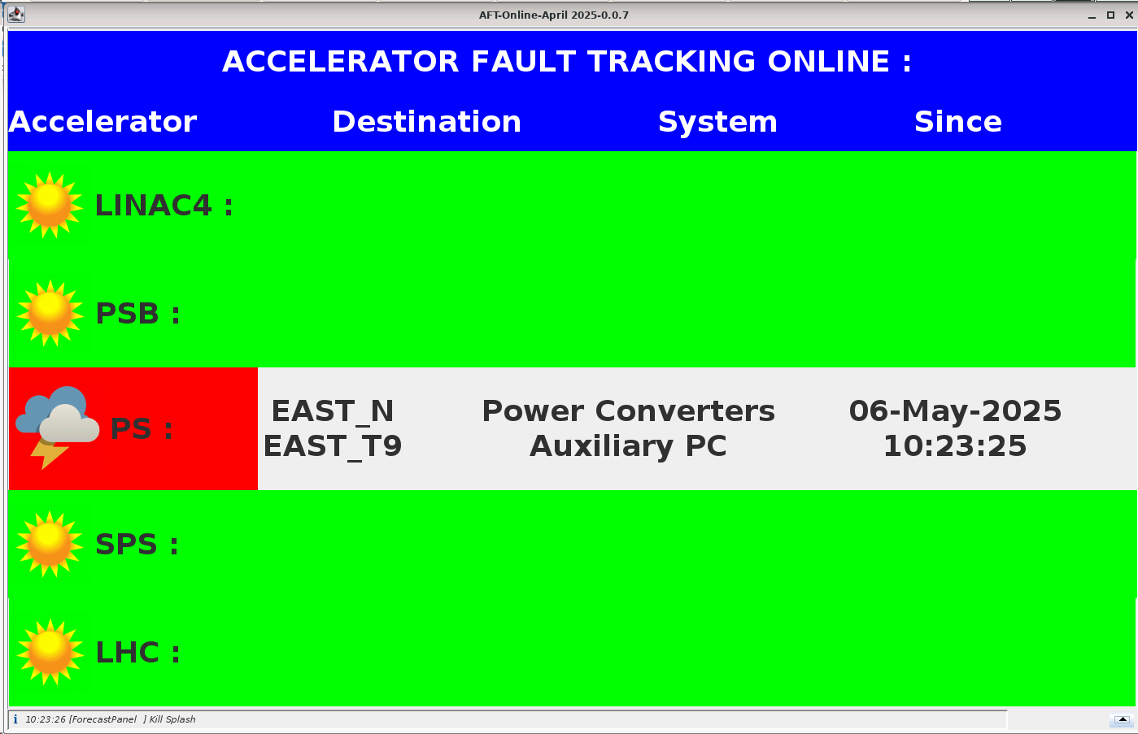
Automatic Fault Recording
East Area
ISOLDE
AD
ELENA
Linac4
PSB
PS
N_TOF
North Area
Automatic Fault Recording was put in place by BE-OP across proton chain.
  Significantly reduces workload of shifters & improves accuracy
  (no faults missed in fast cycling machines)
  Faulty equipment identification via read-out from beam/software interlock systems, LASER, BigSister, equipment monitoring…
Upstream faults block downstream machines
  Automatic fault recording instances expose status to other machines in complex
  Downstream machines link faults upstream
Awake
AFR operational
AFR possible long-term
SPS
HiRadMat
No AFT
AFR passive
LHC
Notes:
it might be worth to mention here (orally, does not have to put it on the slide) the difference between the LHC and the injectors with the fast cycles and many short faults, you have it in the brackets, but it is very important.

Slide 16
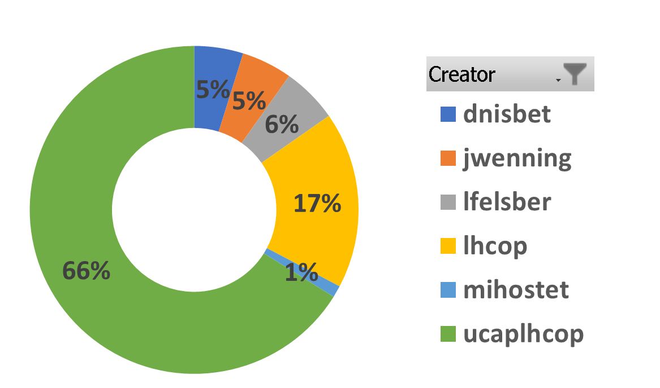
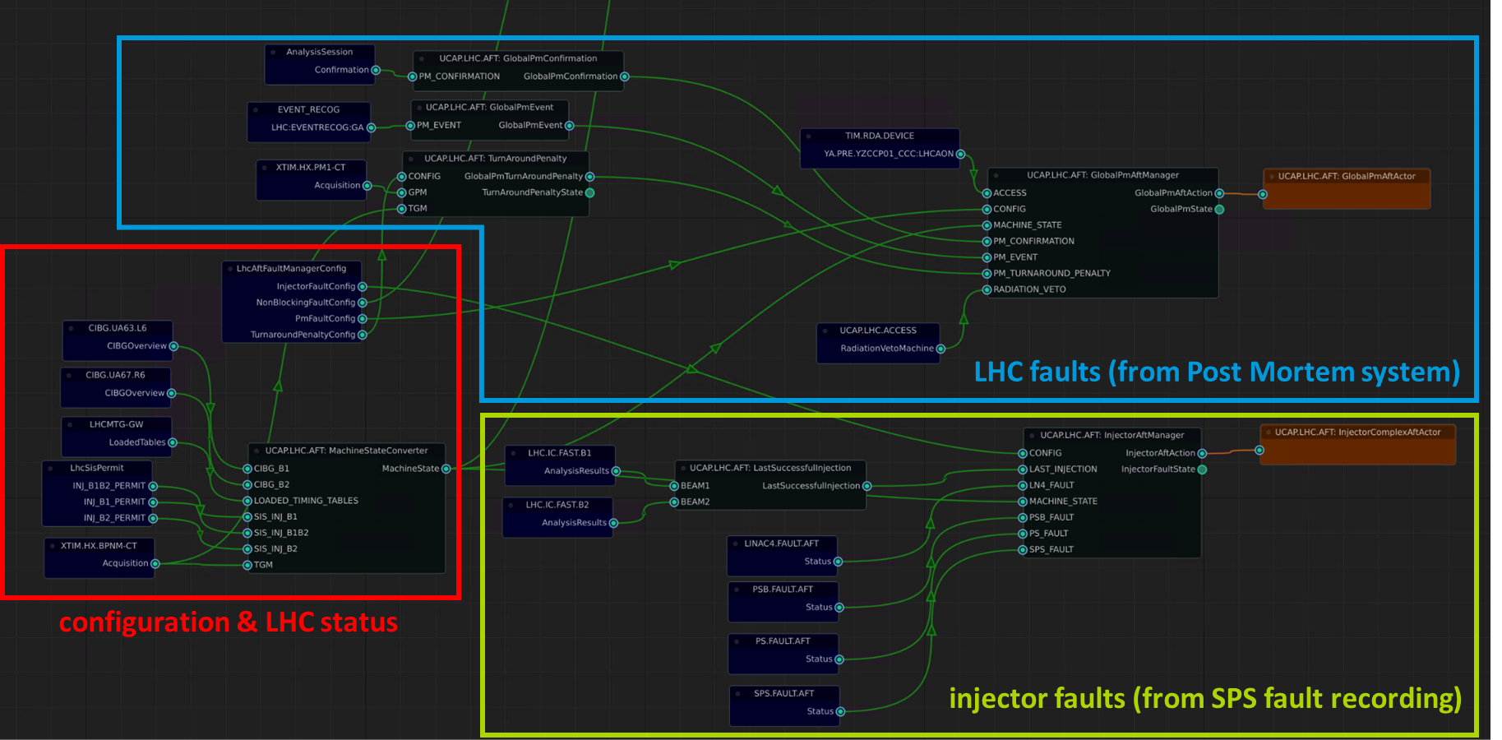
Automatic Fault Recording – LHC
Relies on LHC configuration & status, interlock/post mortem data, & injector fault status.
LHC 2023: 66% of all faults recorded automatically in AFT

Slide 17
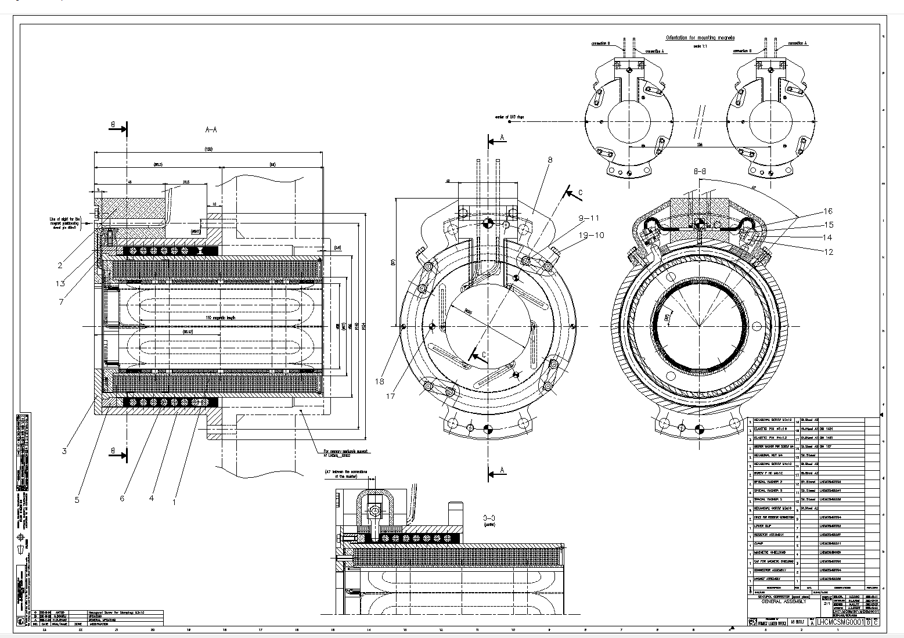
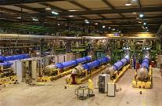
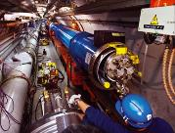
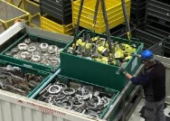
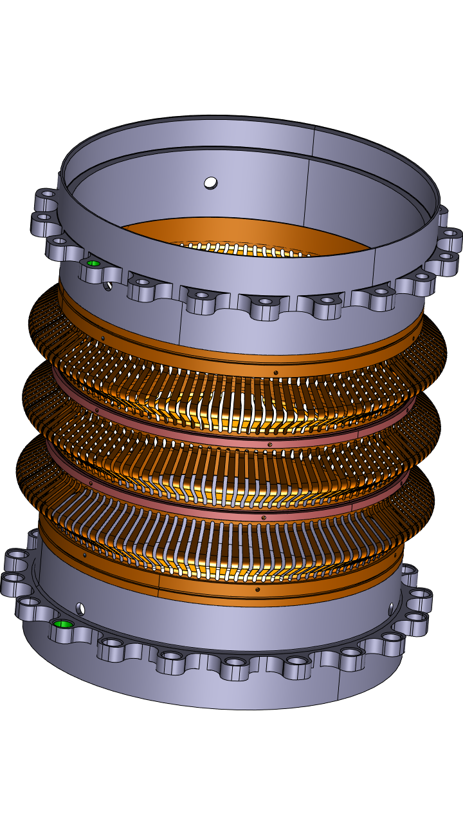
Integration with Asset Management Tools – EAM
Making sense out of failure data often requires aggregated and properly linked asset information.
CERN’s installations have very long lifecycles and important information is generated in each phase.
It is essential to capture this information and manage the links between data originating from the different lifecycle phases: The Digital Thread of engineering data.
P. Jursco, G. Perinic
50+ years
Specification & Requirements
Design
Manufacturing
Installation & Commissioning
Operation & Maintenance
Dismantling
& Waste management

Slide 18
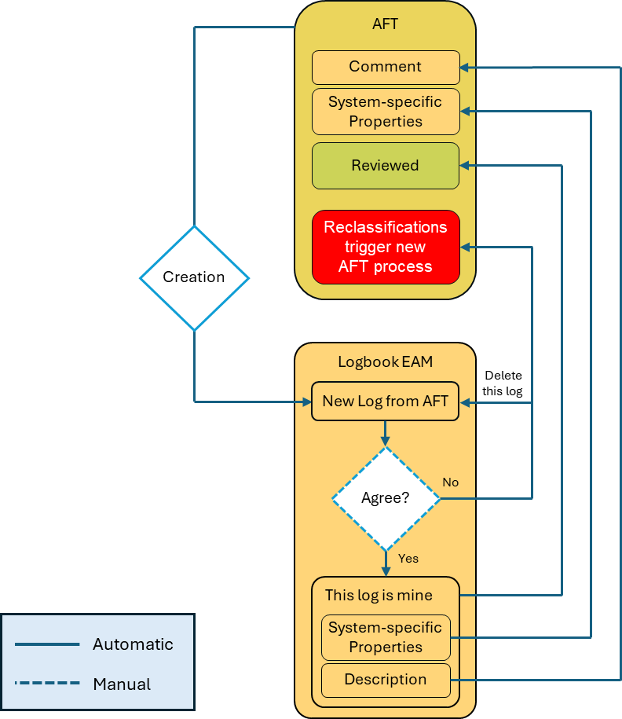
Integration with Asset Management Tools
G. Langlois, EAM & AFT Integration Meeting Series, 2025
Integration with EAM considered most relevant
  Link faults to the Digital Thread of the asset
  Avoid double bookkeeping
  Reduce reviewing effort
  Ongoing meeting series with major EAM users (CRG, CV, EL, TIOC) to define integration.
  Integration prototyped and workflow is being finalized
  Goal is to fully exploit it as of run 4

Slide 19
Structure
Introduction - The Why, What and Who
Main Users and Use-Cases
Recent Developments & Next Steps

Slide 20
Timeline of AFT
Run 1
Run 2
Run 3
Run 4
2010–2013
objective view of availability not possible = weaknesses in data captured
AWG proposed the AFT tool to solve data issues
2014–2015
AFT launched by BE/CO, BE/OP and TE/MPE
AFT was extensively used for availability data analysis (in LHC only)
2016–2018
AFT gradually extended to injectors & fixed target experiments;
Integrations with OPlogbook, layoutDB, logging,…
2021 to now
Automatic fault recording rolled out across proton chain
Tool limitations more evident (e.g. for fixed target beamlines)
Now to 2028
Aim to renovate AFT & consolidate functionality to meet changed requirements
AFT tool celebrates tenth anniversary

Slide 21
RAWG AFT Survey – Motivating AFT2.0
In 2023/4, RAWG carried out survey among major AFT users.
Three thematic blocks with situation, recommendations, and objectives emerged:
AFT consolidation
AFT & automation
AFT integrations
AFT evolved beyond original use-case
Current design prevents new features
Technologies partially obsolete
Automatic Fault Recording (AFR): very valuable; typically extracted from interlock systems
Different platforms (UCAP, SIS)
Toolsets and workflows vary by equipment group
Functionality through integration with existing tools (e.g. EAM)
EPA WPs 8 & 9:
extend, standardize and drill down to equipment level
AFT2.0: Complete redesign, incl. underlying data model
Reduce double bookkeeping and review efforts
Aggregated and properly linked data
Reduce manual workload
Increase data quality, simplify prognostics
Ensure lifetime until end of HL-HLC
M. Schenk, Chamonix 2025

Slide 22
AFT 2.0 – Next Steps
A roadmap for a major overhaul of the tool has been drafted and presented in the CTTB.
Aim is to provide consolidated tool for Run4 injector restart (2028).
The requirements are to be finalized and development started by Q4 2025 to deliver on time.
Required resources:
  1.5 FTE per year for 3 years in BE-CSS
  0.2 FTE per year for 3 years in TE-MPE
  0.4 FTE for the last year in BE-OP
A resource gap was identified and is still being addressed.

Slide 23
Summary
AFT is a widely accepted empirical and statistical tool and resource used to promote reliability and availability across the CERN accelerator complex.
A consistent set of availability data is gathered across the CERN accelerator complex for several years of operation. This allows for evidence-based decision making to address availability issues.
AFT owes its success to an organization-wide joint effort of many people.
AFT serves the needs of a variety of users (Operation, Equipment Groups, Management,…) and use-cases.
To continue AFT’s past success and adapt it to a growing user-base and changed requirements, a tool consolidation is being prepared.

Slide 24
Backup

Slide 25
Main Stakeholders & Users
AFT Main Users
Operation
Equipment groups
Management (CONS)
Prioritization of consolidation based on AFT data
Weekly availability reports (FOM/LMC/…)
Manage fault reviews & follow-up
Decision making based on AFT data
Ensuring fault visibility (& follow-up)
Manage fault reviews & follow-up
Internal benchmarking
Fault Logging
Reliability & Availability WG
Availability reports & insights
Input for avaliability modeling
Manage fault reviews & follow-up
Data Consumption
Data Creation / Manipulation

Slide 26

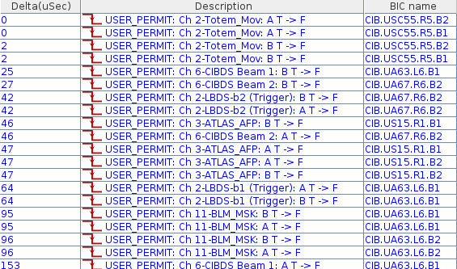
A note on system dependencies
M. Hostettler, Accelerator Reliability Workshop 2024
the obvious fault may not be the root cause
TOTEM interlock
TOTEM (movable devices close to the beam) interlock!
… but why ATLAS_AFP (similar system) triggered as well?

Slide 27
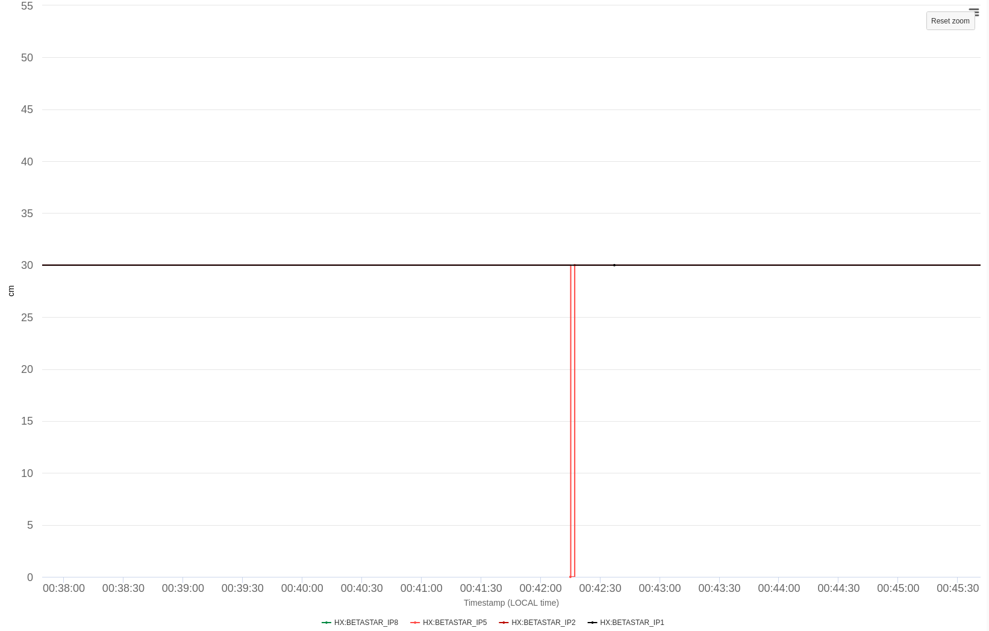
A note on system dependencies
M. Hostettler, Accelerator Reliability Workshop 2024
the obvious fault may not be the root cause
TOTEM/AFP interlocks depend on the beam size (β*)
TOTEM interlock
β* publication
β* = 30cm – as expected
β* = 0 ???
that explains the interlock of both TOTEM and AFP: but why did β* jump to 0 for one second?

Slide 28
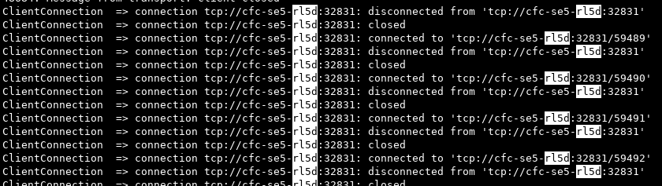
A note on system dependencies
M. Hostettler, Accelerator Reliability Workshop 2024
the obvious fault may not be the root cause
β* is reconstructed from magnet currents by SIS and distributed through the timing system
TOTEM interlock
ERROR BetaStarValueConditionExtImpl => No data for : RPHSA.RR53.RQ7.L5B1_DATA
ERROR BetaStarValueConditionExtImpl => Error - b* computation not valid
or data out of range IR5
β* publication
lost current subscriptions
SIS lost subscriptions for magnet currents from power converters, connection drop: network issue?

Slide 29
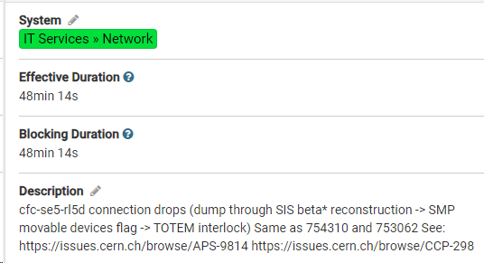
A note on system dependencies
M. Hostettler, Accelerator Reliability Workshop 2024
the obvious fault may not be the root cause
after further investigation:
problem traced to a faulty network switch port
TOTEM interlock
[…]
We believe that that the switch port 33 is the root cause, in the coming hours we will patch the outlet 3319/05 on a different switch port.
[…]
β* publication
lost current subscriptions
faulty network switch port

