Slide 1
Nb₃Sn Strand
Trilogy
Conductors for protection – Nb₃Sn
WP4.5-T2-D1
M. Wozniak
10.06.2025

Slide 2
The trilogy
Magnetization
Jc scaling
AC loss
For each:
Progress
Issues
Next steps
Key paper conclusion

Slide 3
Magnetization - progress
Measurements:
done for MQXF strand at 2mm / 8 turns sample
sample volume calculated and understood from linear density
Simulations:
4.2 K sim with coarse mesh and guessed Jc(B, T) – next slides
Wire size and area corrections are still needed – next slides

Slide 4
Digitized cross-sections (to be used across all 3 papers)
Measured values ¹⁾ -> |  | n/a | 0.8523 | 1.1455 | n/a
Geometry ID | Date | Number of points | Wire diameter | Cu/NonCu ratio²⁾ | Cu/Layer ratio^{2),5)}
0 | 2024.11.19 | older files not checked
1 | 2025.05.15 | 2243 | 0.852393 | 1.236884 | 1.67188
2 | 2025.05.21 | 2246 | 0.871926 | 1.225278 | 1.65317
3 | 2025.06.04 | 5091 | 0.871926³⁾ | 1.170553⁴⁾ | 1.56585
¹⁾ Simon’s email on 14.05.2025, ²⁾ Neglecting diffusion barriers areas,
³⁾ 2.3% above measured, ⁴⁾ 2.7 % above measured,
⁵⁾ This ratio is used for J_{c,layer} which is used directly in the simulation.

Slide 5
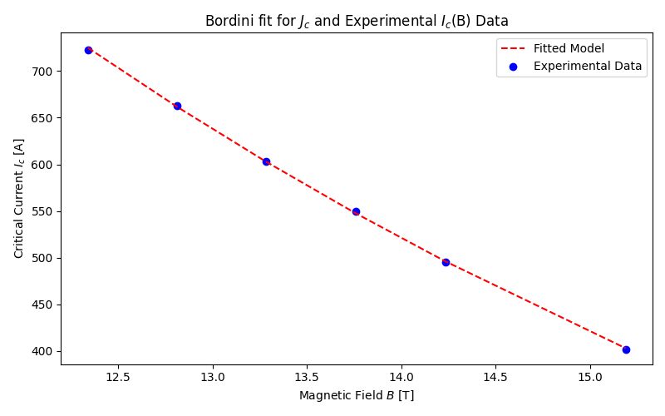

Jc scaling guess – transport
Used fit in Simon’s presentation:
https://indico.cern.ch/event/1510243/
(numbers in brackets are Simon’s for MQXF)
$J_{c,non−Cu}\left(B,T\right)=\frac{C_{0}}{B_{p}}{\left(1−t^{ν}\right)}^{α}{\left(1−t^{2}\right)}^{α}b^{p}{\left(1−b\right)}^{q}$
With self-field correction as in the transport data
Calculated with Cu/noCu ratio: 1.2381 (vs 1.2)
Tc0: 17.7234 K (vs 16.25 K)
Bc20: 28.9113 T (vs 29.56 T)
C0: 225615879888 AT/m²
(vs: 220303000000)
α | 1
ν | 1.52
p | 0.5
q | 2
Geometry data has these ratios:
(without accounting for diffusion barriers area)
Cu/noCu ratio: 1.236884
Cu/Layer: 1.67188
For J_{c,layer} (which is used in the simulations):
C0: 279709748639 AT/m²
Transport data from Joanna, no idea if this is the same strand

Slide 6
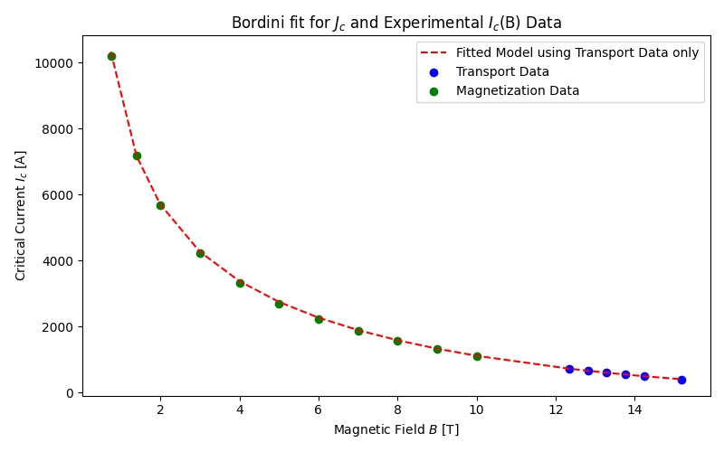
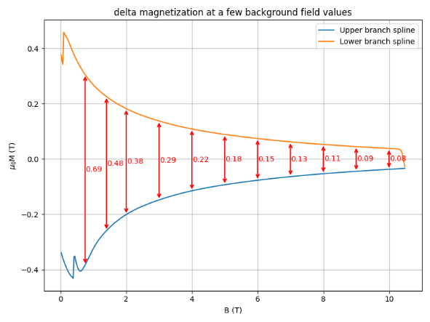
Extracting Jc from magnetization at 4.2 K
C0 = 279709748639 A T/m²
Bc20 = 28.9113 T
Tc0 = 17.7234 K
Jc = 5422147073 A /m² at B=10.0 T and T=4.25 K
d_eff for layer Jc and rod (circular) filaments is 25.99 um
delta_M (mT) = 4 / (3 * π) * d_eff * Jc * mu0

Slide 7
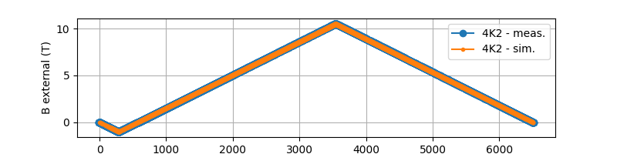
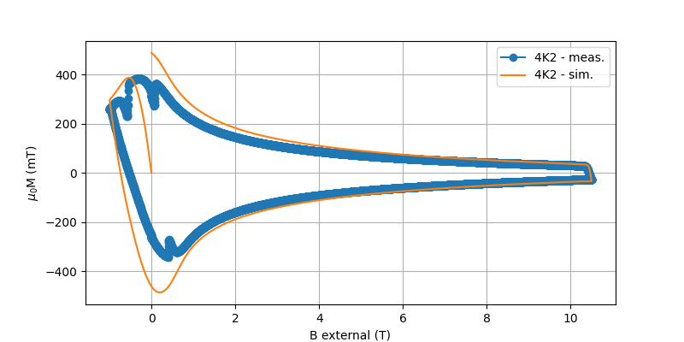

Exact ramping scheme used in simulation
Sample does not appear to be field cooled (it is not in virgin state).
Is it possible to warm up above T_{c} before ramp?
Alternatively, we can simulate ‘from non-virgin state’.
Volume = 0.04225 cm³ (sample volume from linear density)
Measurement volume normalization:
M(emu/cm³)$=\text{"}\text{m}\text{_}\text{raw}\text{_(}\text{emu}\text{)"}$/ Volume (cm³)
M(A/m)$=$ M(emu/cm³) *1000
Simulations volume normalization:
m(A m) – magnetic moment is direct output of sim.
M(A/m) = m(A m)/filaments_area
Dividing by filaments area as this area is what the Jc is normalized to
The lower the field the worse is the agreement.
Still a bit off at 10 T, wrong wires size?
Need to correct the Jc scaling to make this match.
Still some thinking required.

Slide 8
Magnetization – Next steps
Measurements:
Is more MQXF wires to be measured at at different geometry?
PIT to be measured?
Simulations:
Need to still correct the wire diameter and Cu/NonCu ratio
Jc (B, T) – low filed scaling needs an update
Mesh sensitivity (in progress)
Disable CATI coupling as it has no impact for low ramps (speed up)
Simulations for all measured temperatues
Transition from Mariusz to Josef running sims

Slide 9
Magnetization – key paper conclusions
Some ideas:
Validation of simulation and model inputs for exact geometry and layer Jc.
Obtain Jc magnetization from magnetization measurement in as corrected way as possible (preliminary using the simple formula is wrong). This is to be used in Jc scaling paper.
Comparison of magnetization for more geometries (all undeformed):
  Exact geometry – with filament holes (i.e. using layer Jc)
  Exact geometry – filled filament (i.e. using nonCu Jc)
  The two above cases, but for hex (ideal) filaments
  As above but for round filaments
Discussion of the meaning of d_{eff} as geometrical quantity and how does it compare to the diameter of filaments in the above cases
Deformed geometry magnetization simulation – how much different is it (need for additional exact deformed geometry if this is in scope)?
Direction of applied filed (strands are not rotationally symmetric), so this already has impact on the simulated result and it would be nice to discuss it. Simulations at varying angle of applied field are possible. In the measurement it is averaged for twisted strand.

Slide 10
Jc scaling - progress
Need more work for getting magnetization simulation and measurement to agree. This will give the Jc based on magnetization at low field.
Do we simply tweak the pinning parameters (p and q) or introduce additional term in the equation?

Slide 11
Jc scaling – next steps
Need transport data for the same spool as magnetization
Need to align transport data and magnetization data and wire cross-sections.
We can simulate E-I curves to match transport data if available.
Do we work ‘only’ on RRP or also on PIT?
The self-field correction for Jc in transport measurements seems to be done with peak B. Are we sure this is correct? (sorry, a bit off topic)

Slide 12
Jc scaling – key paper conclusions?
New fitting parameters/equation valid for low field
Show the methodology of how the fit was obtained with supporting transport and magnetization data. Rely on magnetization paper for the Jc magnetization.

Slide 13
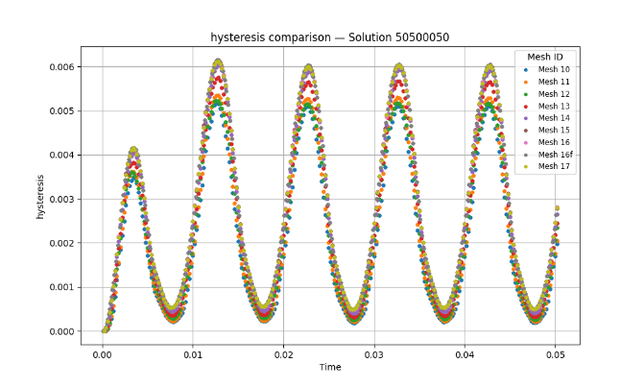
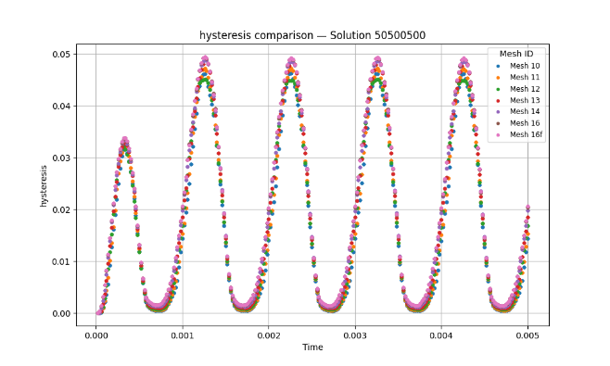
AC loss - progress
Mesh sensitivity study for 5 T DC, 50 mT AC, and 50, 500 and 1500 Hz, with geometry “3”
As expected, the hysteresis loss is the most sensitive to mesh size
50 Hz
500 Hz

Slide 14
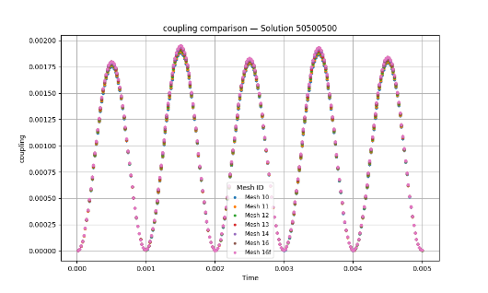
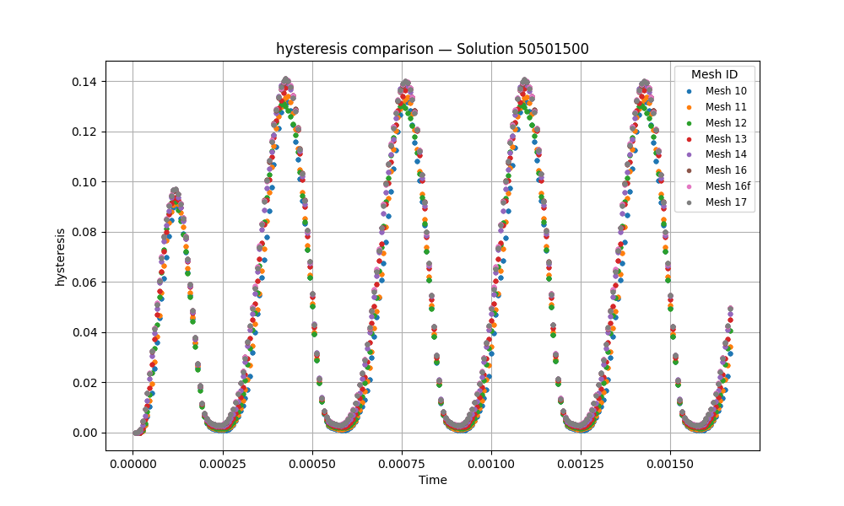
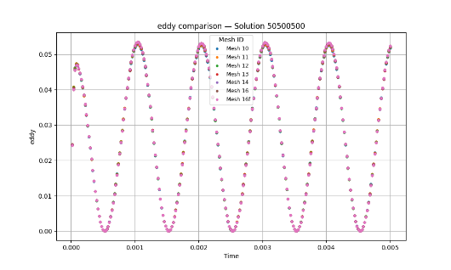
AC loss - progress
Other loss components less sensitive to mesh
1500 Hz

Slide 15
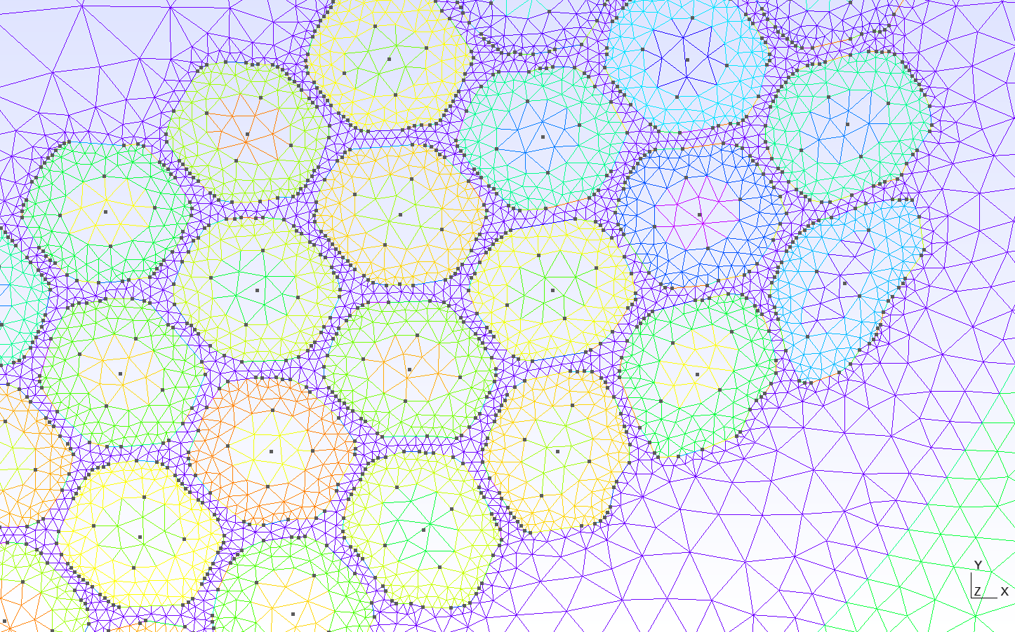
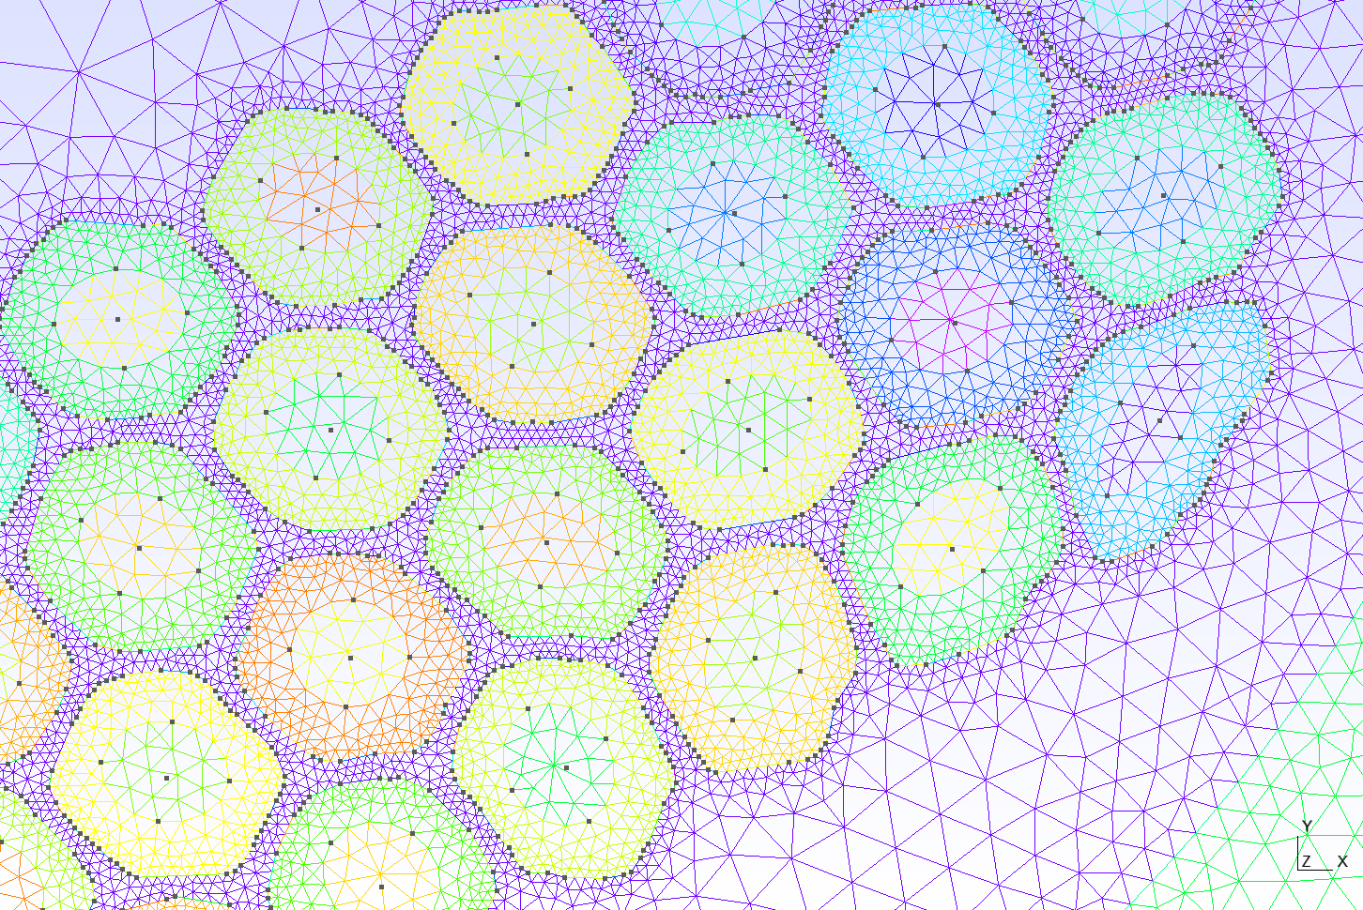
AC loss - progress
Note:
For mesh 14 there is good match of points spacing to mesh size.
No penalty at the solution level for using 5091 points to resolve geometry “3”
Mesh 13 – too coarse
Mesh 14 – just about fine

Slide 16
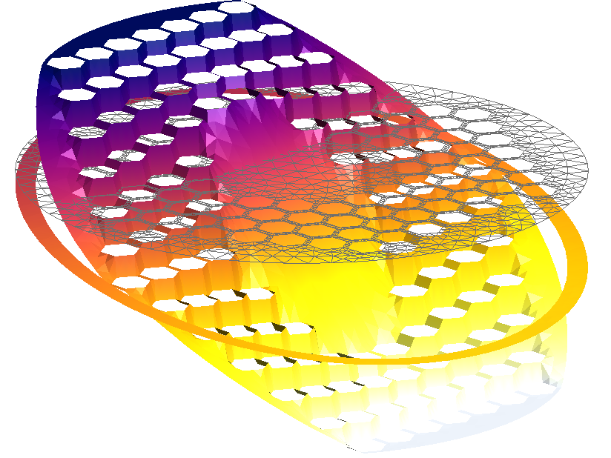
AC loss – progress – global diffusion barrier added to CATI model capability
This functionality is needed for PIT
It allows discontinuity of coupling currents and should affect AC loss vs frequency
After update of PIT geometry a reference solution will give the first idea of how important this is.

Slide 17
AC loss - issues
Only preliminary result run as many things are still off in the inputs
Need to correct for diffusion barrier area. They are not present in the geometry but define as line with thickness. Surface of the barriers accounts for 3.34 % of total wire cross-section. Is this value expected from the wire design? How is the thickness calculation done?
What is the resistivity of diffusion barriers around filament and global for PIT?
What do we know about Cu RRR distribution in the wire cross-section (RRP and PIT)?
Could we introduce at the digitized geometry an additional region around filaments for RRP for which we assign lower RRR?
Need corrected dimensions and Cu/NonCu for PIT digitized strand

Slide 18
AC loss – next steps
Work on magnetization and Jc scaling first as otherwise the AC loss hysteresis part (dominant in many cases) is going to be wrong
Measurement at 4 BDC, 4 B AC and 10 frequencies – agree with Arend what they will be and launch ‘reference’ simulations
Adjust material properties to see how sensitive the results are to RRR of Cu and diffusion barriers resistivity
Arrange a visit to Twente to participate in measurements – tbc.

Slide 19
AC loss – key paper conclusion steps
Reference AC loss for RRP and PIT wires as measured
Validation of model inputs to best match the measurements
With validated inputs, computation of full amplitude and frequency loss map for the two wires
Discussion of key loss components for AC loss-based protection

