Slide 1
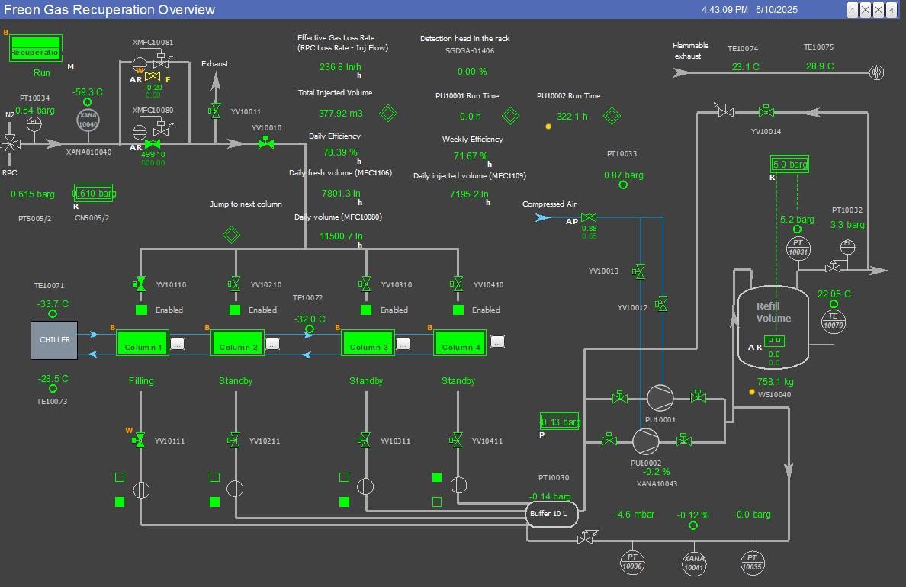
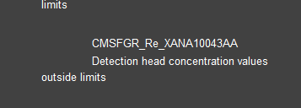
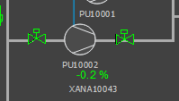
NEW PIQUET ALARM
In case you receive this alarm it means the compressor of the recovery system is leaking. I will usually intervene to solve the problem but if you need to fix the problem →

Slide 2
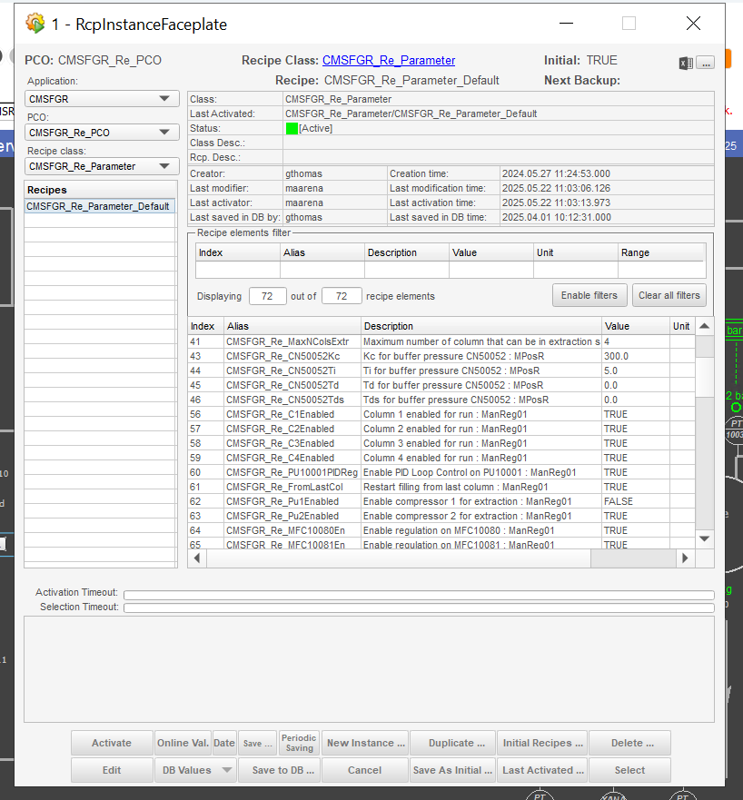
Select the other compressor for operation in the recipes

