Slide 1
The Frontier Technologies Group
Alberto Di Meglio
FTI Group Leader – Head of IT Innovation

Slide 2
The Frontier Technologies and Initiatives Group manages the IT Departments collaboration programmes and frameworks on new technologies in collaboration with the IT Technical Delivery groups, the CERN community, industry and other academic and international organisations. It also oversees the communication, outreach and education activities to support the execution of the IT strategy, develop skills in emerging technologies, and maximise the visibility and impact of the IT Department on science and society
IT-FTI
Frontier Technologies and Initiatives

Slide 3
FTI Group Structure
Collaborations and Partnerships
Physics Software Engineering
Computing and Data Science
Technology Infrastructures
Learning and Education
Communications and Outreach

Slide 4
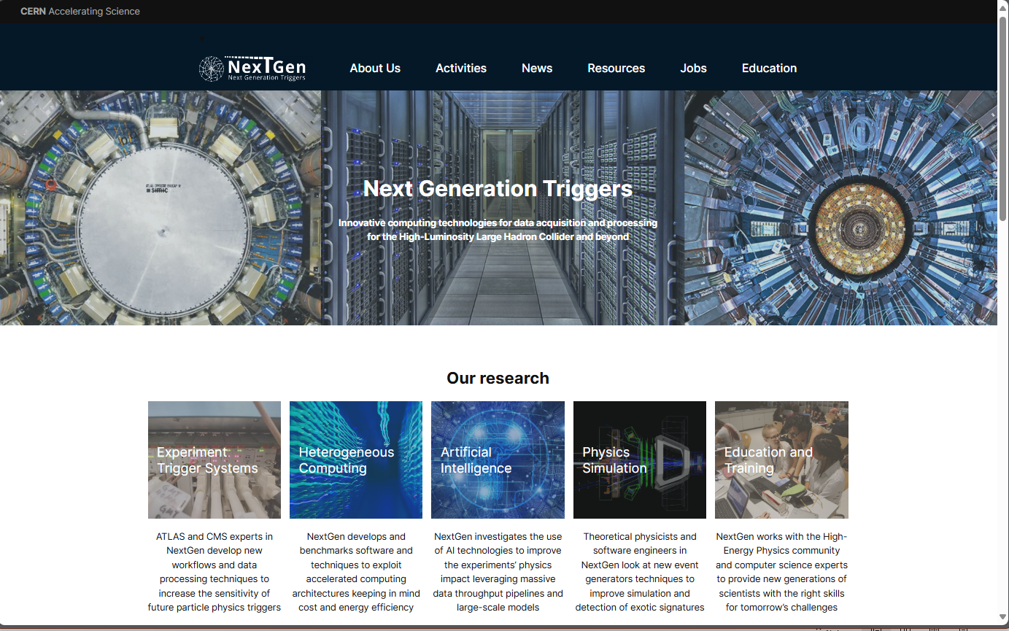

Slide 5
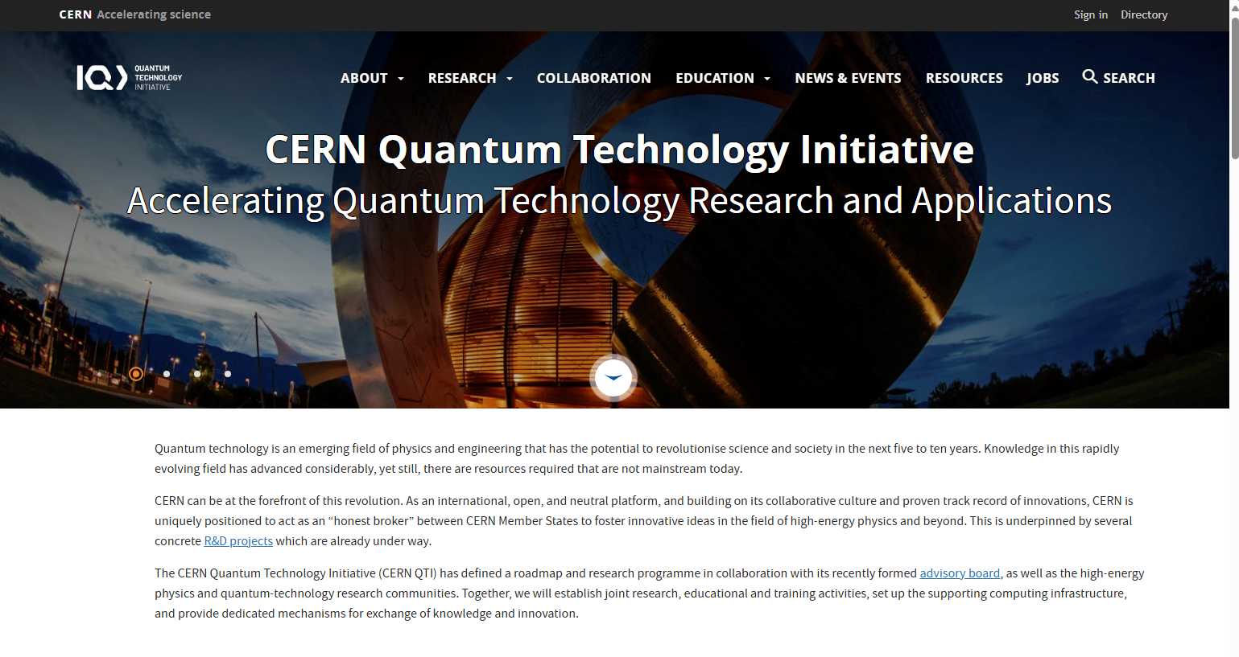

Slide 6
Technology Infrastructures and Partnerships
Heterogeneous Architecture Testbed
On-premise and cloud resources for R&D and testing (CERN openlab)
Cloud Operating Model and FinOps
Multi-cloud framework for procuring, provisioning and monitoring public clouds
High-Performance Computing Collaborations
Projects and resource access through collaborations with HPC centres
AI Platform and Services
Design, deployment and operation of a common AI platform and services for the CERN communities, including LLMs

Slide 7
CERN has a long tradition of excellence on AI in Particle Physics (since 1987) with several developments now enabling advances in technology, medicine, and society at large​ Recent advancements in AI technologies are disrupting science and industry with the potential for scientific breakthroughs, operational optimisation, productivity gains, and more A broader and more coherent strategy for CERN is being developed, including technical strategies from each CERN sector (Accelerators and Technologies, Research and Computing, Finance and Human Resources) and a CERN-level initiative to design a common governance and supporting procurement, legal, data privacy, and risk management frameworks The meeting today is part of this initiative and aims at establishing an initial common ground between several CERN teams and experts and Mistral AI as the base for further discussions on collaboration, co-development, joint participation in projects and activities, and commercial opportunities
Artificial Intelligence Initiatives

Slide 8


FTI
Frontier Technologies
and Initiatives
Thanks!

