Slide 1
Production Test Suite as testing platform
Alvaro Martinez Landete
BE-CEM-MTA

Slide 2
Table of contents
Introduction
Production Test Suite (PTS)
  Software considerations
Production Test Suite Framework
Developing an application
  Workflow as end-user
External users
Impact
Goals
Further steps
Conclusions

Slide 3
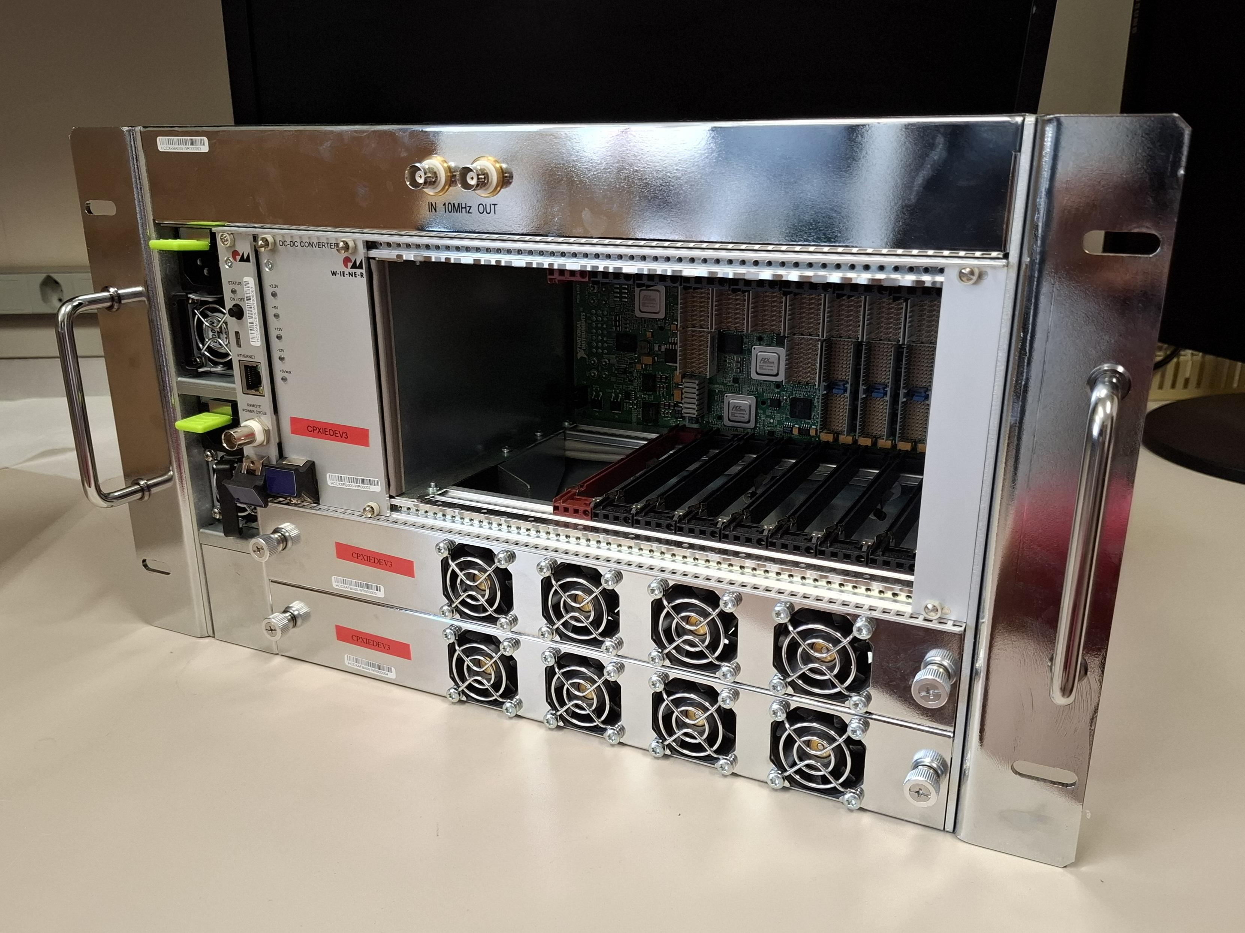
Introduction
COTS components cannot always meet CERN requirements
  Support across decades
  Radiation tolerance
  Redundancy
  In-field repairability
Test and validation strategies
  Every test and validation has a cost
  Lack of test and validation has even higher costs
Sambuca High Availability Chassis
Notes:
Why we design custom electronics at CERN?
LHC tunnel is a harsh environment
Radiation
Toxic gases

Slide 4
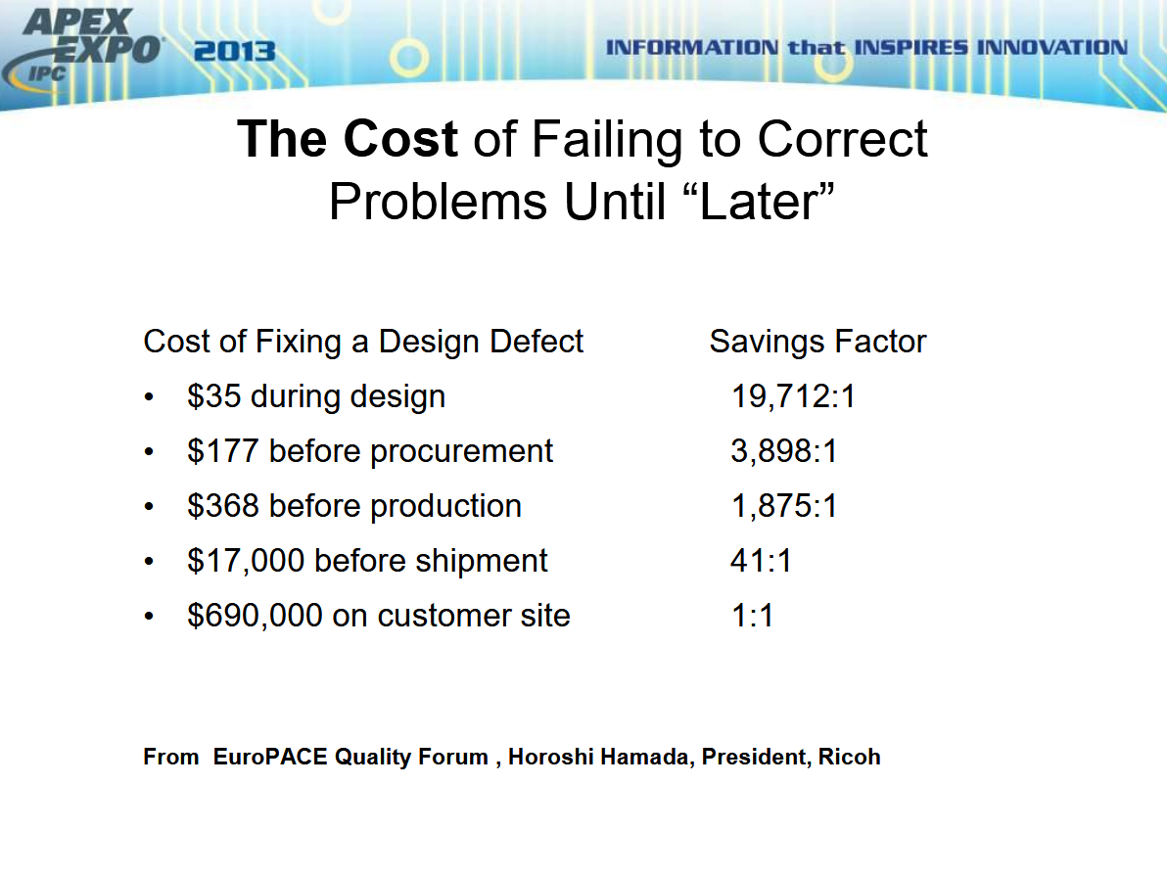
Introduction
Cost during development vs cost during production
1 hour of LHC downtime -> Estimated 130 kCHF
Improving Product Reliability through HALT & HASS Testing of Electronics and PCB’s
Mark R. Chrusciel
Cincinnati Sub Zero

Slide 5
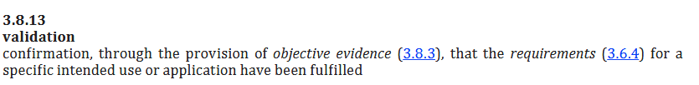
Introduction
ISO9000:2015
Notes:
Testing is a very broad concept
No formal definition from IEEE nor similar organizations
what is testing? What do we use it for when developing electronics?

Slide 6
Introduction
What is testing?
“A systematic process of applying a stimulus to a component, sub-assembly, or final product and measuring and evaluating the corresponding response to determine if it meets specified requirements.”
Testing allows to:
  Ensure compliance to performance and reliability standards
  Schedule interventions
  Plan preventive and corrective maintenance ahead, by considering failure metrics
  And many many more

Slide 7
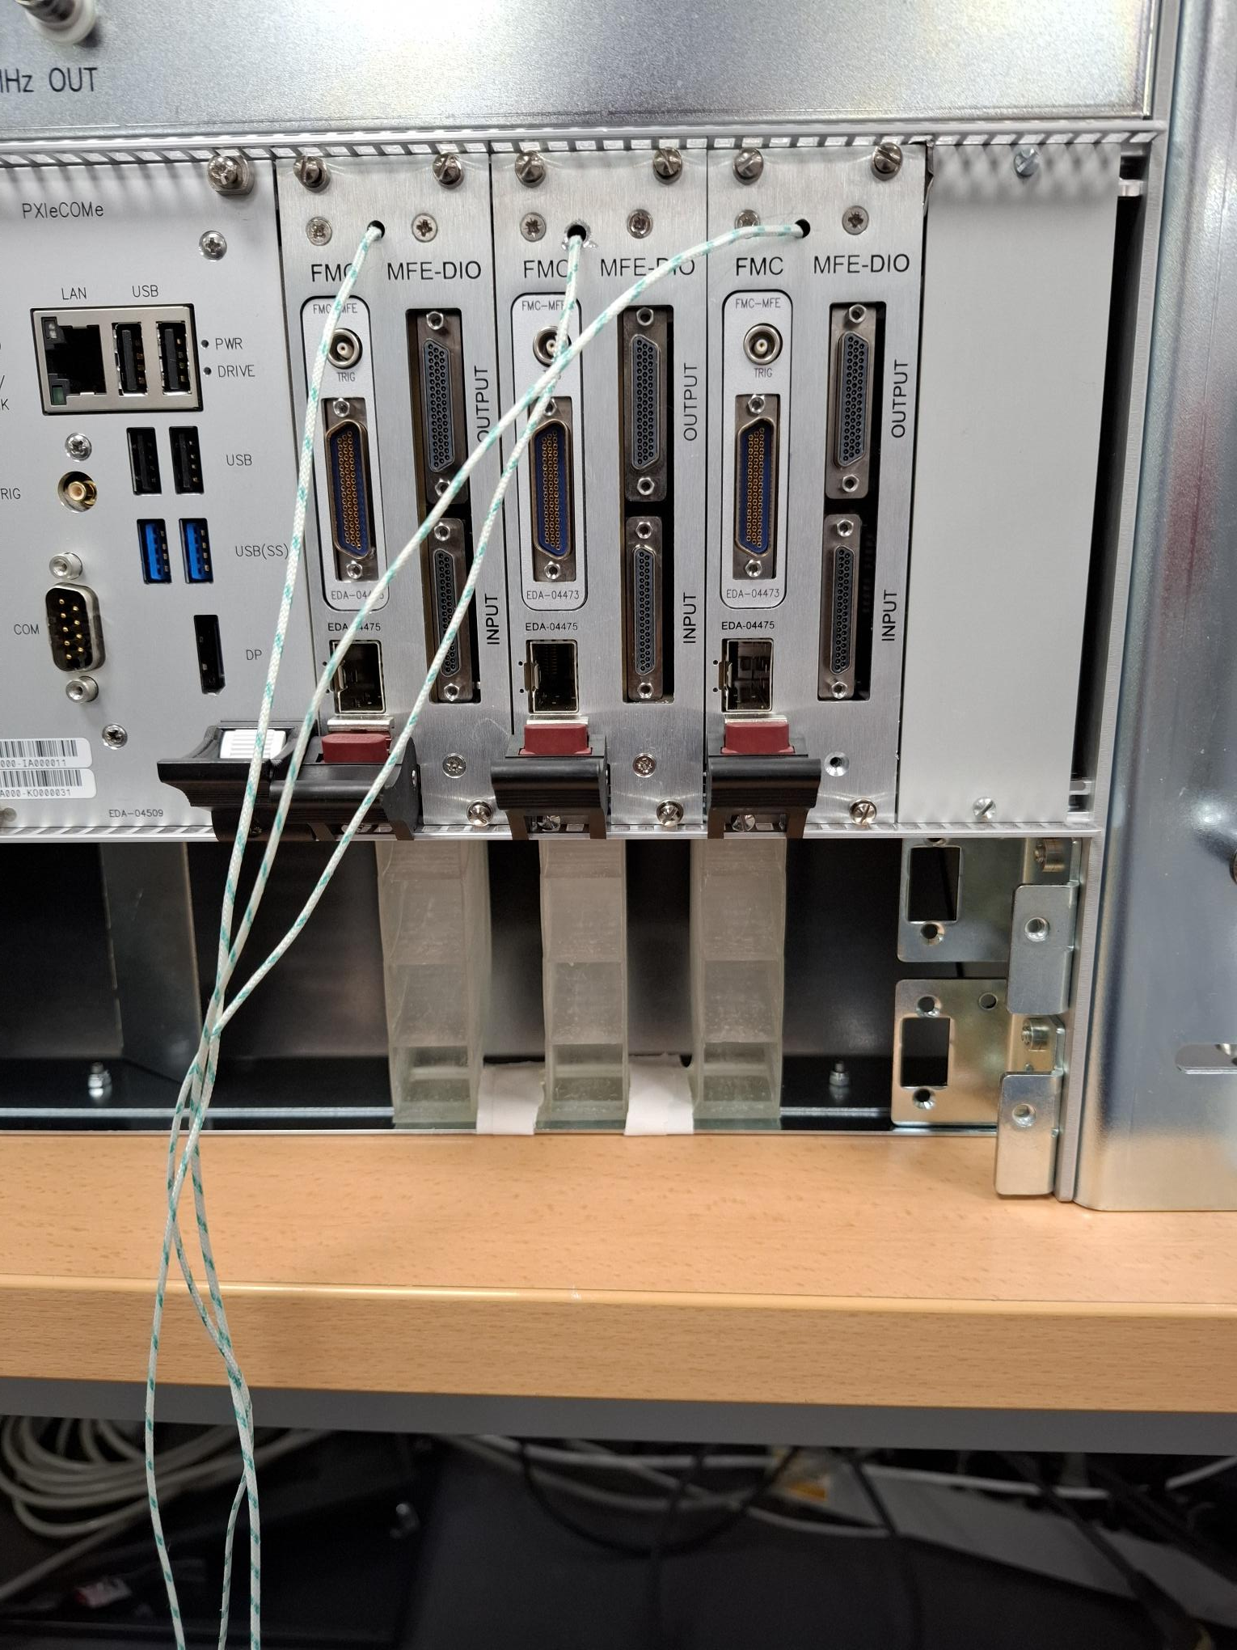
Introduction
Different testing stages:
  Burn-in
    Eliminates early-failure units by operating them under stress conditions before deployment
  Functional testing
    Validation of design functionality against specification
    Sophisticated instrumentation may be required
  End-of-line testing
    Validation of each unit straight after production
    A manual process description may be required
  Characterization, calibration and referencing
    Transfer function characterization
MFEs being tested
Notes:
Difference between functional and EOL
Functional validates specs that may require sophisticated instruments
EOL may be simpler, as the it’s only testing the assembly
Testing three MFE in sambuca chassis

Slide 8
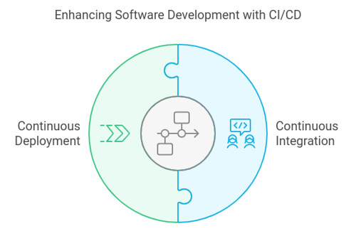
Introduction
Additional Testing stages during development:
Regression testing allows developers to test new software and gateware builds
Continuously testing functionalities against specification is a form of regression testing
In software, Continuous Integration is the practice of integrating changes frequently
  By integrating HW testing into CI, gateware and software issues may be detected early during development
  Allows extending test catalog
"ci-cd-process" by riberagorka
licensed under CC BY-SA 2.0.
Notes:
- Gateware can also be know as ‘FPGA firmware’, as an FPGA contains gates that are interconnected as desired

Slide 9
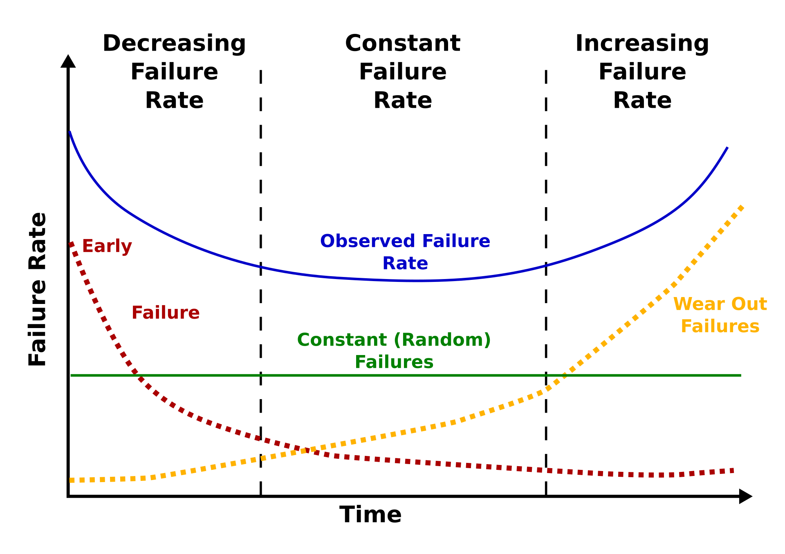
Introduction
Lifecycle of Electronics Testing at CERN
Prototyping and Design:
  Functional design to validate design against specs
  Characterization and calibration to understand the hardware’s transfer function
Production and commissioning:
  Pre-burn-in to remove early-life failure
  End-of-line testing to validate every unit
Operation and maintenance:
  Better scheduling interventions and planning preventive/corrective maintenance
WikiMedia, Public Domain
Notes:
Speak of the bathtub
Explain more in detail the consequences of the burn-in, goals…
Better scheduling because it can complement or improve models provided by components manufacturers

Slide 10
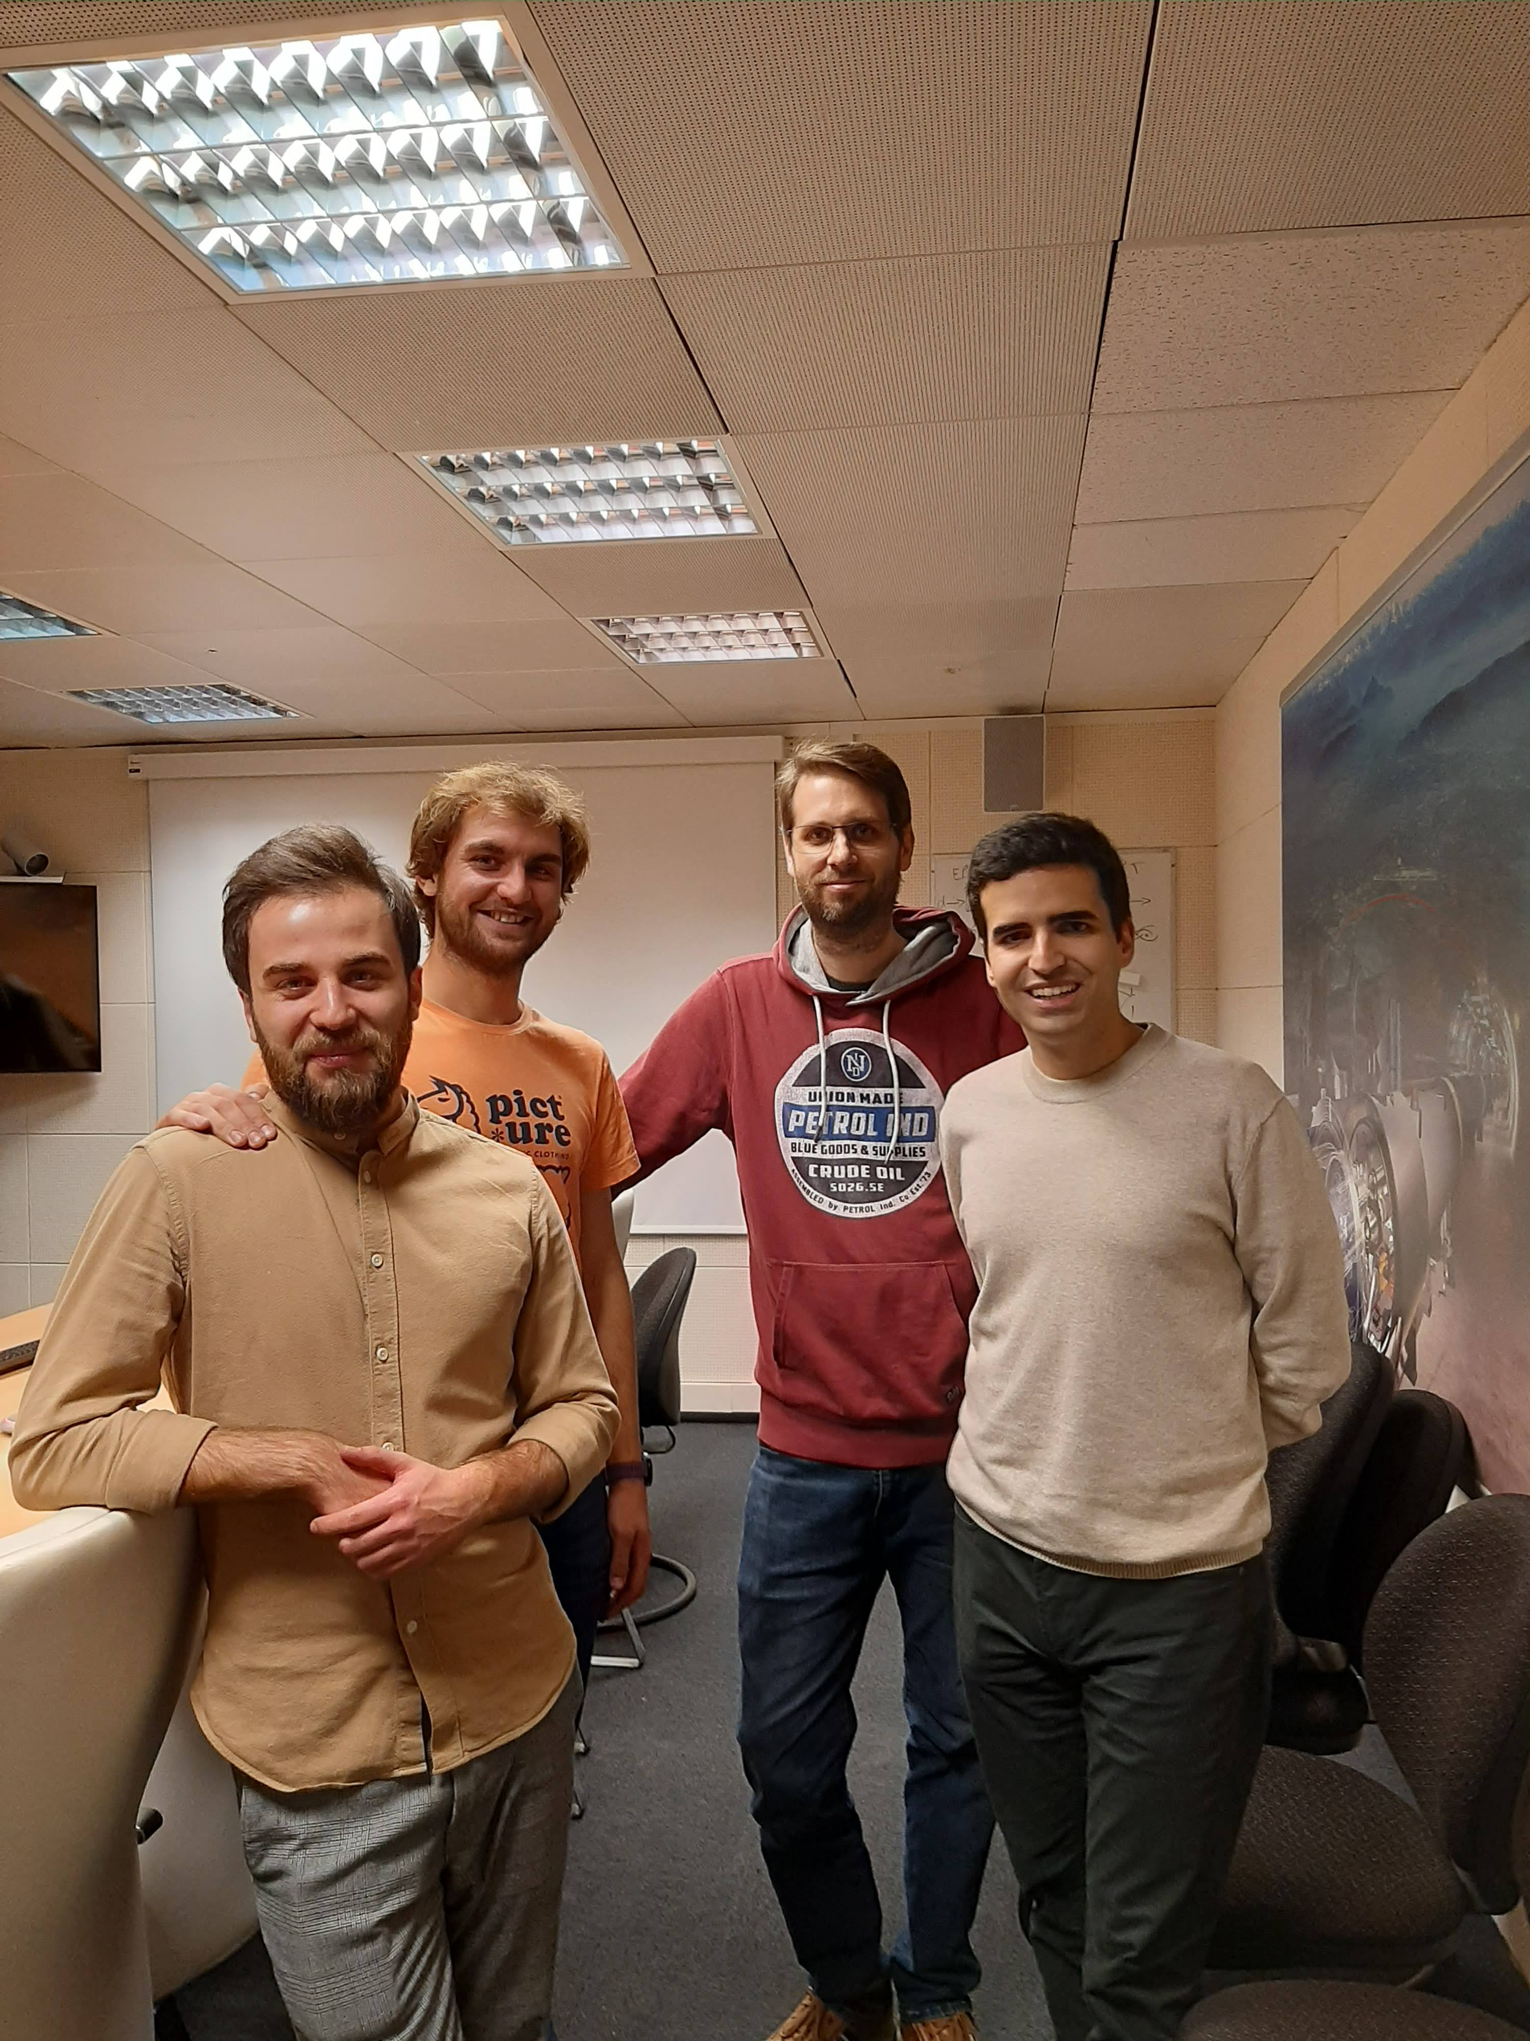
Introduction
MTA section takes care of developing test benches for CEM group’s electronics designs
Initially, we started developing end-of-line testing for SamBuCA project components
Pytest (pytest.org) as a test sequencer/manager
By developing test benches, we learned what fits our needs
These test benches are known as Production Test Suites
Original PTS team, December 2022
Notes:
The team had plenty of experience developing test systems using LabVIEW and NI equipment
Several solutions were considered to use as test manager.
After studying them, Pytest was chosen due to being open-source and flexible for our purposes.

Slide 11
Table of contents
Introduction
Production Test Suite (PTS)
  Software considerations
Production Test Suite Framework
Developing an application
  Workflow as end-user
External users
Impact
Goals
Further steps
Conclusions

Slide 12
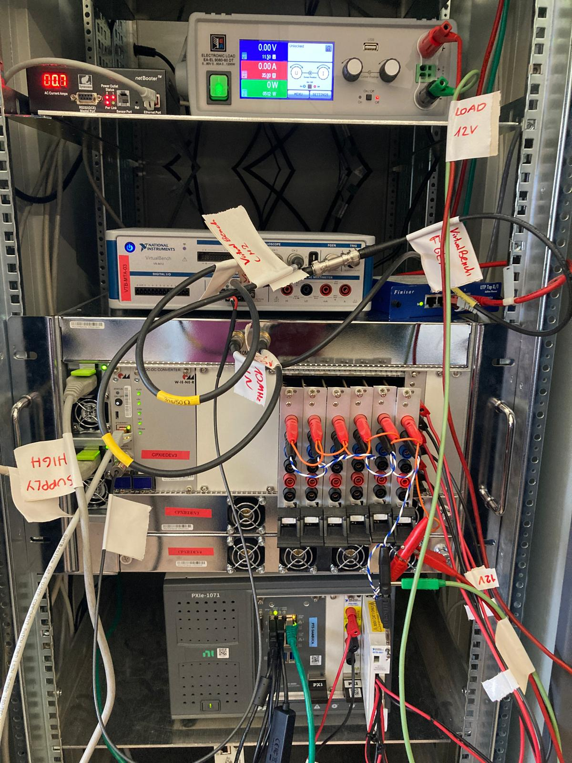
Production Test Suite
Family of validation test benches developed at BE-CEM-MTA targeted at BE-CEM electronics
Covering all kinds of testing stages for SamBuCA and DI/OT components
Test and validation process:
  Factory Acceptance Test plans (with CEM-EDL)
  Reliability Test Plans (with CEM-EPR)
  Gateware validation (with CEM-MRO)
  Development and integration of tests (with CEM-IN)
High Availability Chassis (SamBuCA) PTS
Notes:
We started developing EOL tests, but we ended up covering all stages
Emphasis on collaboration with EDL, EPR, MRO, IN…

Slide 13
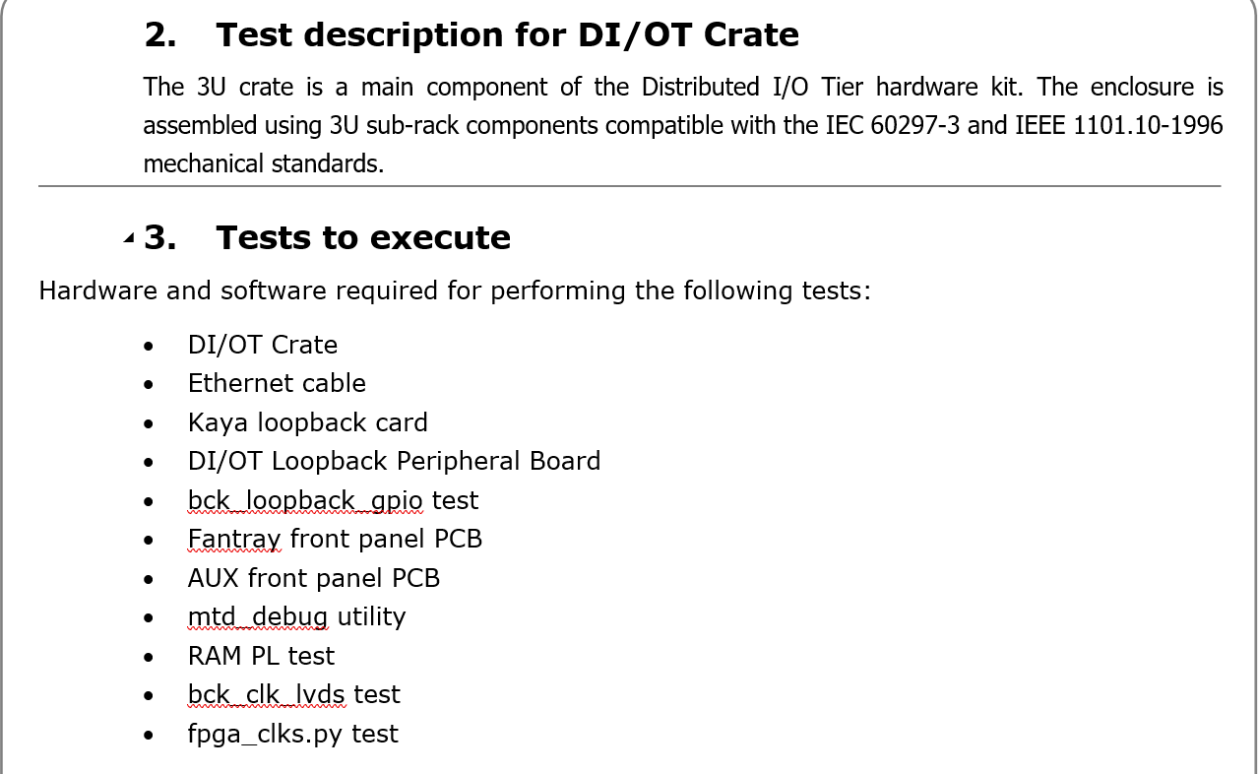
Production Test Suite
Test plans are defined with the stakeholders
Define:
  What to test
  How to test
  Pass/fail criteria
Notes:
As we briefly mentioned, we need a specification for testing

Slide 14
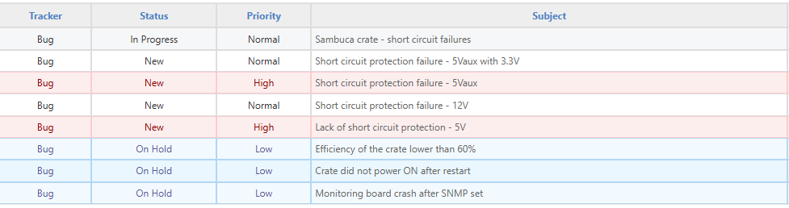
Production Test Suite
Many challenges were discovered during our end-of-line testing development:
  Specifications were sometimes not met
  Hardware issues that required redesigns, iterations
Issues found lead to discussions with designers to report, clarify, troubleshoot
This experience allowed us to broaden our know-how on testing electronics:
  Developing Python interfaces for instruments
  Gaining expertise using Pytest, LabVIEW and custom software developed at the group
Notes:
Emphasize the situation of being prototypes, design issues were discovered

Slide 15
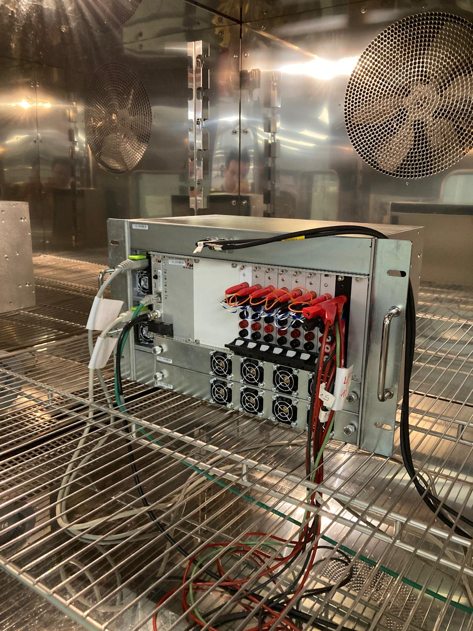
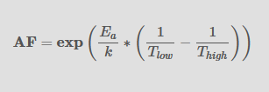
Production Test Suite
PTS started to be used for many other test cases:
  Characterization in climatic chamber
  Stress testing
    Destructive, push to the limits
  Functional testing
  Reliability testing
    To get to know how long devices will last, under normal working conditions
    Lifetime estimation
Notes:
Stress testing, what does it mean at design level
Arrhenius law

Slide 16
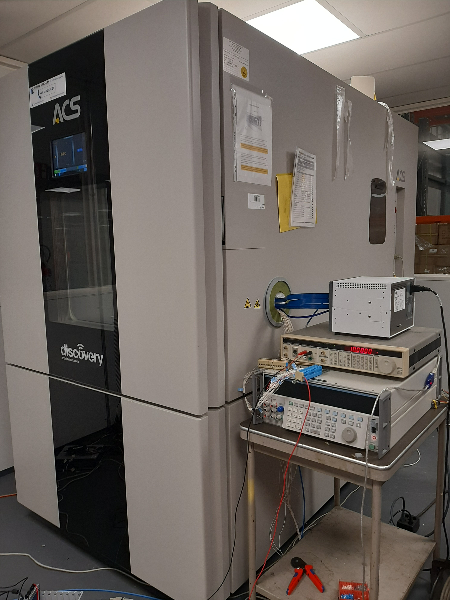
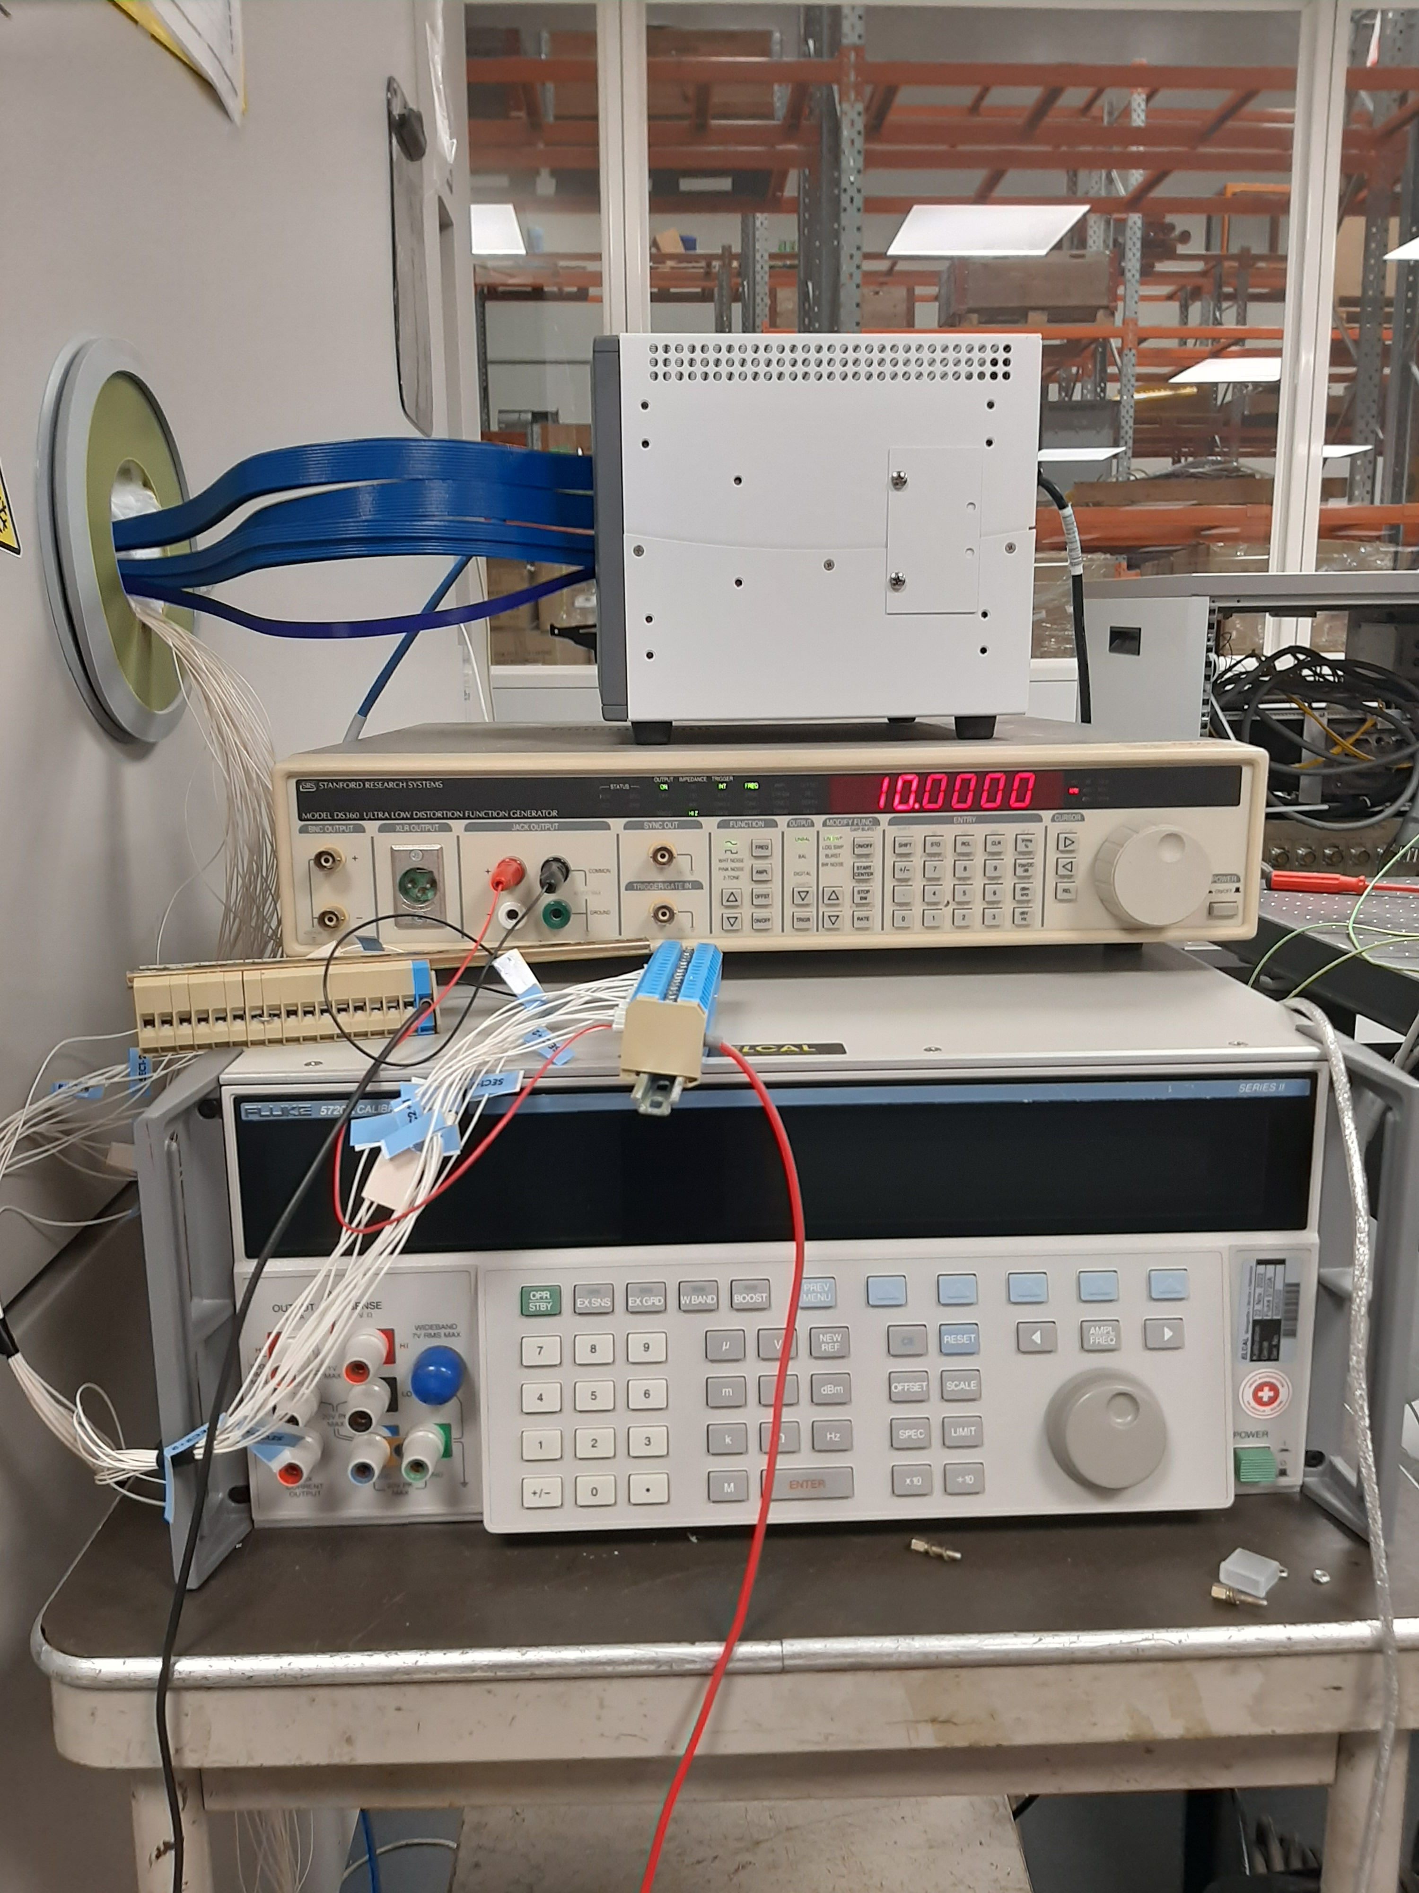
Production Test Suite
Notes:
Characterization of the MFE inside the climatic chamber
Usage of a Fluke calibrator as a reference to validate its specs thoroughly

Slide 17
Production Test Suite: software considerations
Report
A golden rule of testing: if there’s no report, the test didn’t happen
Test themselves
Production Test Suite
Sequencer
Instrument drivers

Slide 18

PTS SW considerations: Pytest
Abstraction model doesn’t fit our needs
Difficult to fix test order
  When testing hardware, sometimes it’s crucial!
No GUI, need to include one each time
No conditional execution
Difficult to access test data from another test
  This makes sense when testing software, but not for hardware
Project structure using Pytest doesn’t allow for a quick, small development
https://docs.pytest.org/en/stable/
Notes:
- Pytest is used for testing the framework

Slide 19

PTS SW considerations: Robot Framework
Domain-Specific Language
  Uses a dedicated syntax, which may require some initial learning for new users.
No GUI, need to include one each time
Looks simpler for end-user, but this overhead doesn’t add much value apart from that
Well-documented, though there are not so many examples
Very generic and customizable, but requires significant work to use it as desired
https://robotframework.org/
Notes:
Emphasize tester and test logic, so test logic is easy to write
Quicker onboarding by using pure Python for example

Slide 20



PTS SW considerations: Commercial options
Notes:
Licensing costs, limitations on usage
Future-proof? How about running them in 10 years?
Some technical limitations: TestStand doesn’t run on Linux
XJTAG only works when the DUT has a JTAG interface

Slide 21
PTS SW considerations: summary
Test Manager | Native GUI | Cross-platform | Quick onboarding | Open-source | Fits our needs natively
Pytest | ❌ | ✅ | ✅ | ✅ | ❌
Robot Framework | ❌ | ✅ | ❌ | ✅ | ❌
TestStand | ✅ | ❌ | ❌ | ❌ | ✅
Qabench | ❌ | ✅ | ❌ | ❌ | ✅
XJTAG | ✅ | ❌ | ❌ | ❌ | ❌

Slide 22
Production Test Suites considerations
One PTS application per use-case, per device means:
  Rewrite the same application over and over again
  Code reusability is limited, especially since each PTS has different configuration that is often hard-coded for Pytest to use.
  Long-term maintenance becomes difficult
    Improvements get to each application individually
    Documentation is different for each application
  Pytest is software-oriented, requires many adjustments each time to make it work as desired:
      Conditional execution
      Error handling
      Test order execution
Test Manager | Native GUI | Cross-platform | Quick onboarding | Open-source | Fits our needs natively
MTA tool | ✅ | ✅ | ✅ | ✅ | ✅

Slide 23
Table of contents
Introduction
Production Test Suite (PTS)
  Software considerations
Production Test Suite Framework
Developing an application
  Workflow as end-user
External users
Impact
Goals
Further steps
Conclusions

Slide 24


Production Test Suite Framework
In order to improve and formalize this workflow:
  Tests should be detached from the test sequencer itself
    Each test is an independent, executable piece of code that validates something of the device
    Being language-agnostic, developers can write tests in any language they already know
    Gentle learning curve
  Unify:
    GUI, as both Robot Framework and Pytest lack of a GUI for operators
    Reporting, only storing what we care about in a sensible, parsable format
  Hardware-oriented:
    Conditional execution
    Strict test order execution
  Flexible enough to run any kind test mentioned: functional, EOL, calibration…
Notes:
Hacer hincapié en que esto se convierte en el framework!
Being something: one hardware component, one functionality of the firmware, the gateware…

Slide 25
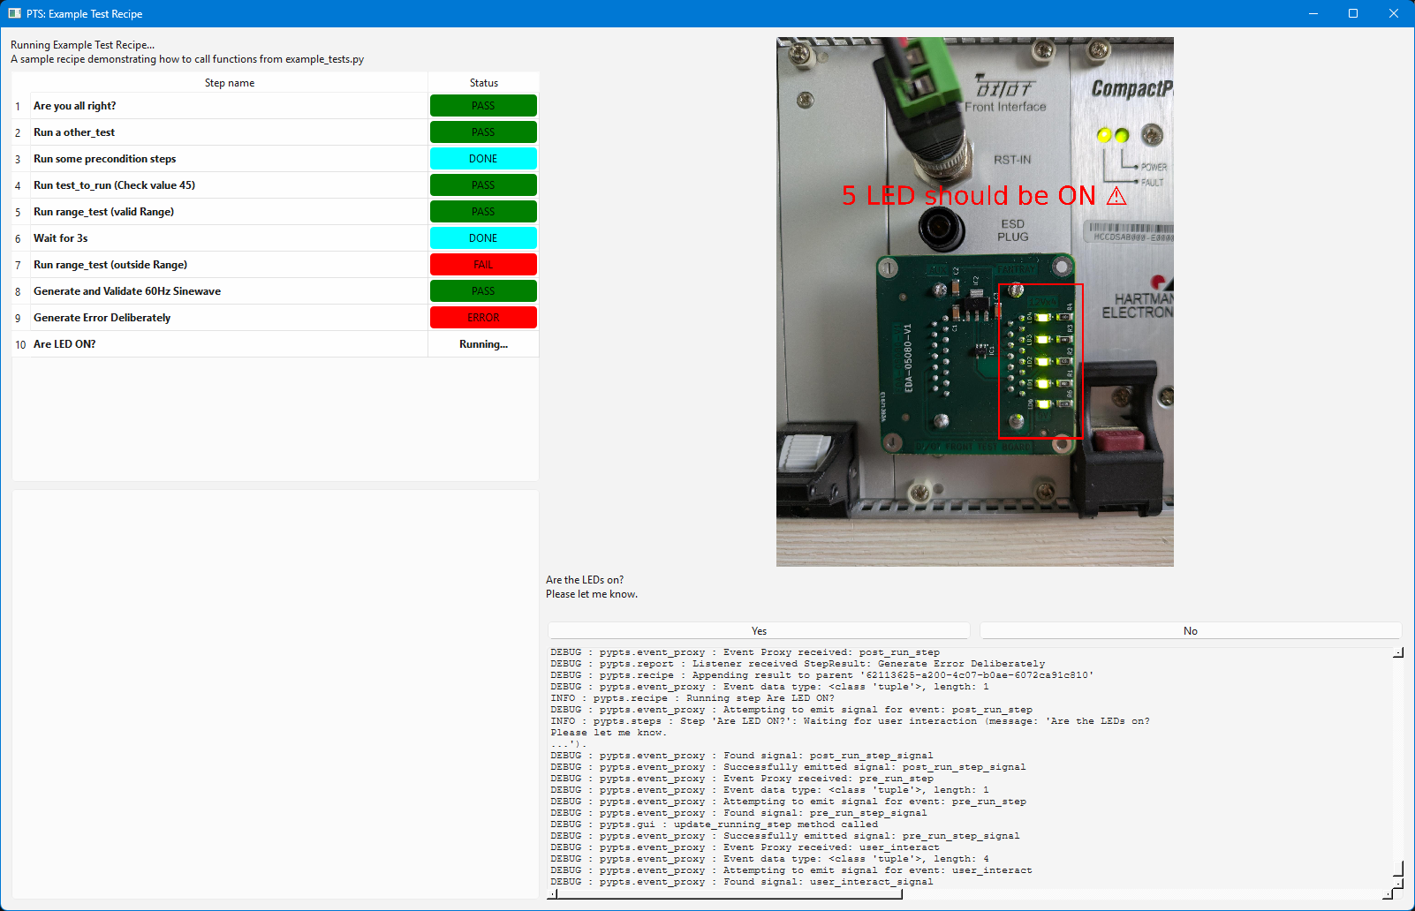
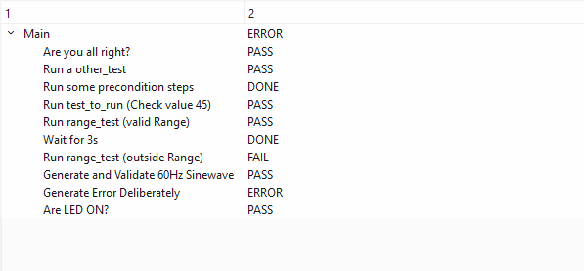
PTS Framework GUI
Notes:
Pragmatic and functional GUI

Slide 26
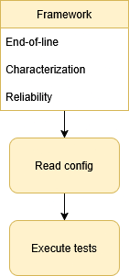
PTS Framework architecture
Due to the varied nature of the test scenarios, the framework architecture must be flexible enough to cover all these cases
There’s an API that creates all the basic inputs/outputs, so it can be easily invoked with and without GUI
  Code is robust, as it allows to test and develop the logic independently from the GUI
  Easy integration into CI for automated functional testing
  Custom interfaces can be developed, for example to be used in embedded systems if required
Notes:
- Test types: functional, reliability,

Slide 27
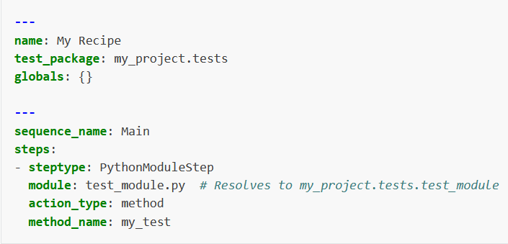
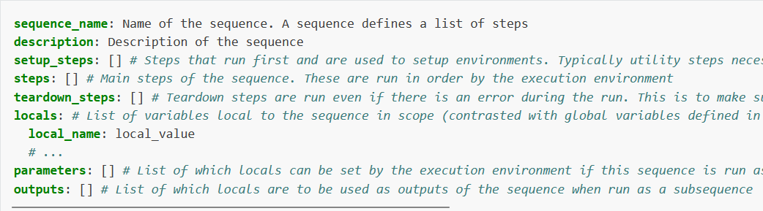
PTS Framework architecture
The sequence is written in a .YML containing:
  Where tests (executables) are located within the package
  Which ones to run
  Which methods to run
  Pass/fail criteria
  Parameters of each test
A recipe contains sequences, that include steps
https://acc-py.web.cern.ch/gitlab/pts/framework/pypts/docs/stable/yaml_format.html
Notes:
- Test types

Slide 28
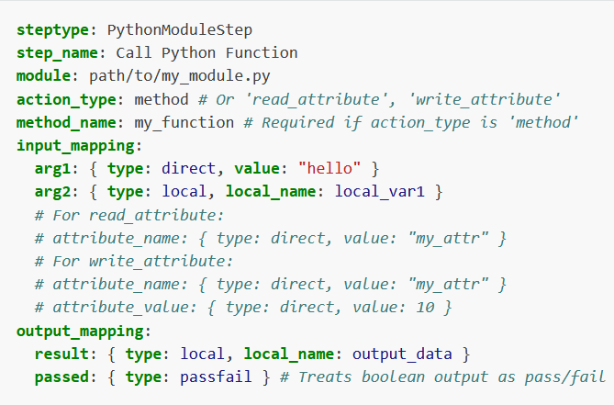
PTS Framework architecture
Each test is defined by one or more ‘steps’
https://acc-py.web.cern.ch/gitlab/pts/framework/pypts/docs/stable/yaml_format.html
Notes:
Test types: functional, reliability,
Mention how flexible and agnostic this approach is

Slide 29
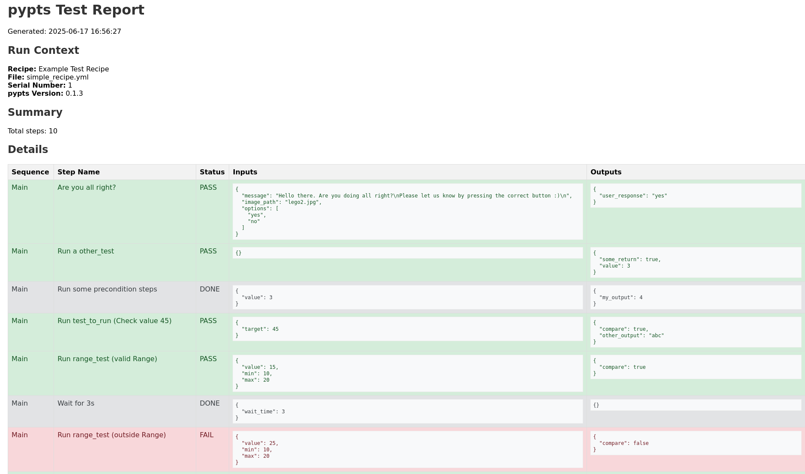
PTS Framework reporting
Reporting is a fundamental step while testing
A test that hasn’t been logged, has never happened
The file format chosen is HTML because it is:
  Lightweight
  Easily-parsable
  Flexible, can be very rich in media
Notes:
-

Slide 30
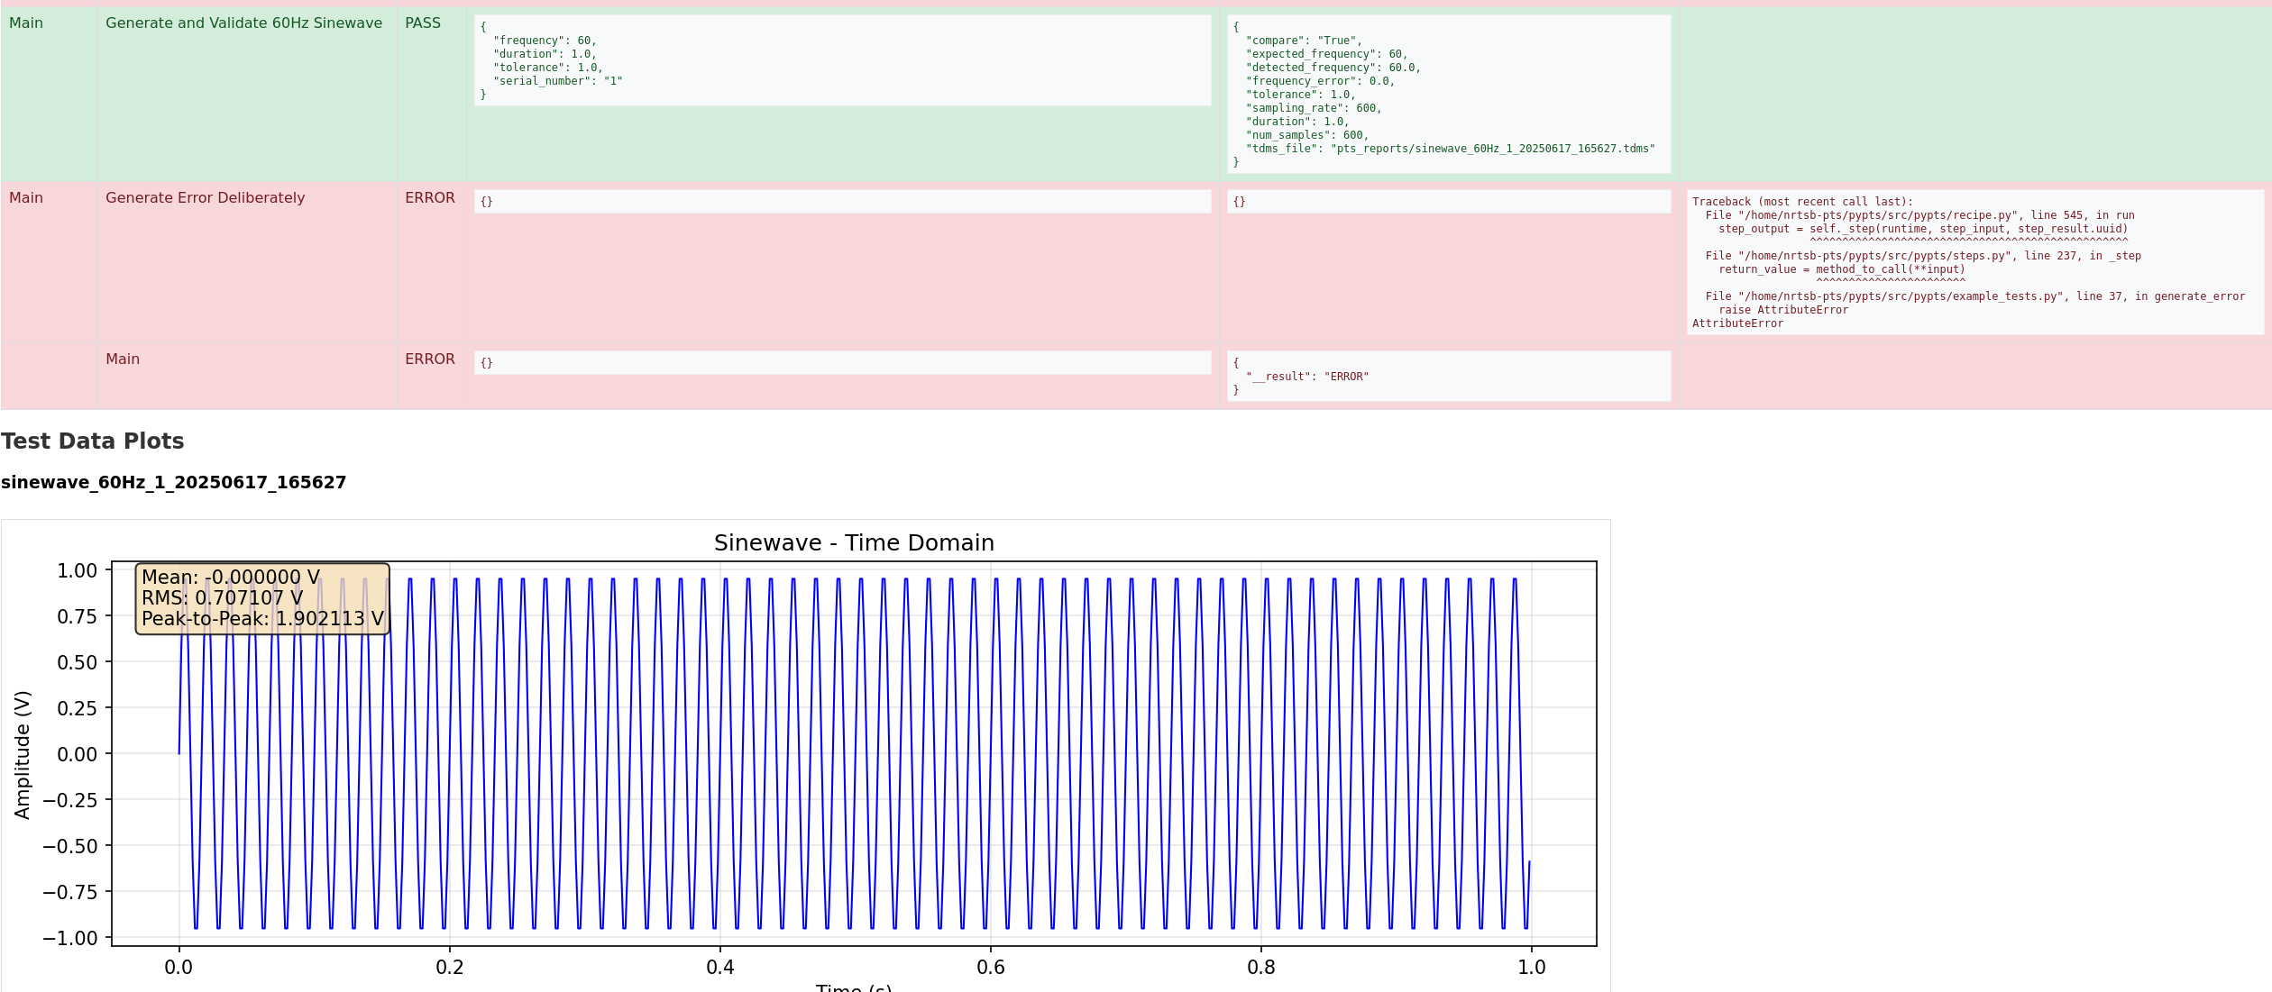
PTS Framework reporting

Slide 31
Table of contents
Introduction
Production Test Suite (PTS)
  Software considerations
Production Test Suite Framework
Developing an application
  Workflow as end-user
External users
Impact
Goals
Further steps
Conclusions

Slide 32
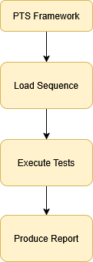
Developing an application
The PTS application becomes a plug-in of the framework, by adding the corresponding tests and resources
The PTS only contains what’s required for the specific DUT, and relying on the framework as a dependency that provides:
  The GUI
  Execution sequencing
  Error handling
  Reporting
Notes:
- So, how is an application using the framework built?

Slide 33
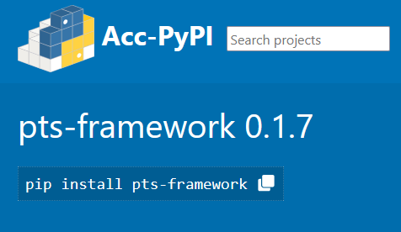
Workflow as end-user
Project is published in Acc-PyPI
https://acc-py-repo.cern.ch/browse/project/pts-framework
Notes:
- How is it to install?
- Where do I get it?

Slide 34
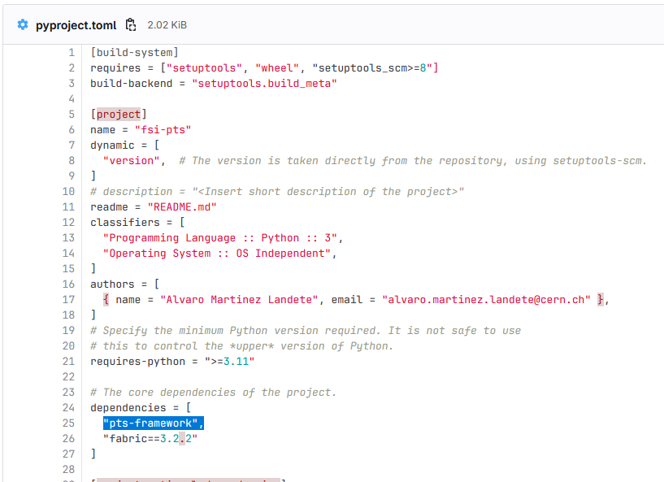
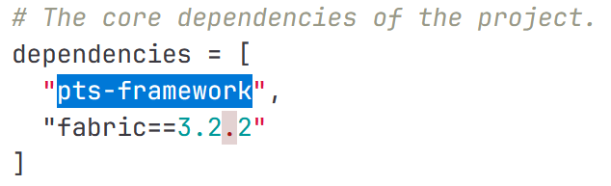
Workflow as end-user
Project is published in Acc-PyPI
Add it as a dependency in the project
https://acc-py-repo.cern.ch/browse/project/pts-framework
Notes:
- How is it to install?
- Where do I get it?

Slide 35
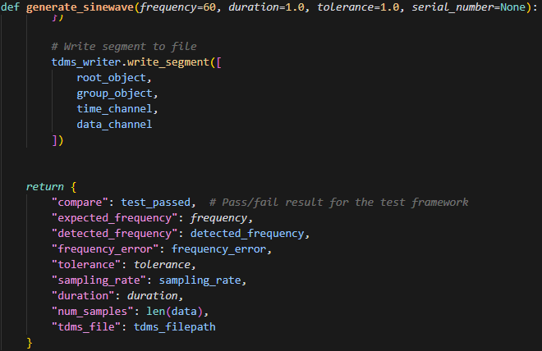
Workflow as end-user
Tests are self-runnable pieces of code that return the data
‘PythonModuleStep’ type of test
Notes:
How do I write tests?
Do I need to translate?
How long does it take to translate?

Slide 36
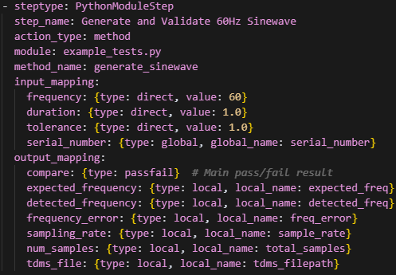
Workflow as end-user
Tests are self-runnable pieces of code that return the data
Return is compared against the pass criteria
‘PythonModuleStep’ type of test
Notes:
- Where do I write my pass criteria?

Slide 37
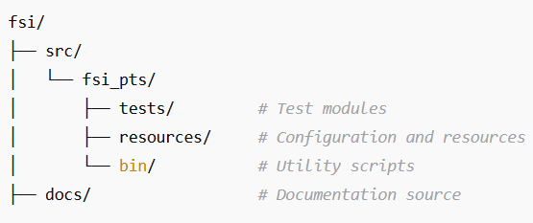
Workflow as end-user
The file structure of a PTS becomes minimal
Only test files and relevant resources are included in the deployed application
Every PTS application is the same, except for the tests that are run

Slide 38
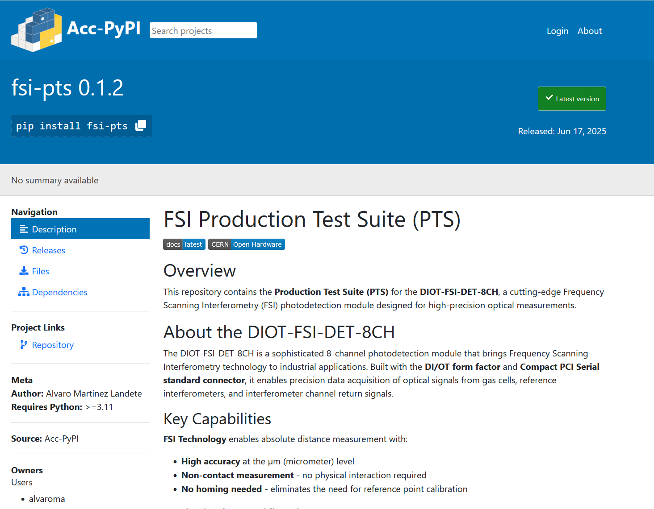

Workflow as end-user
Acc-Py: Python service offered by BE-CSS
By leveraging Acc-Py services it’s possible to:
  Build a PTS
  Build its documentation
  Publish everything
  Deploy efficiently on the test benches
Notes:
Acc-Py services run Sphinx server and pip repositories as well as providing templates for CI

Slide 39
Table of contents
Introduction
Production Test Suite (PTS)
  Software considerations
Production Test Suite Framework
Developing an application
  Workflow as end-user
External users
Impact
Goals
Further steps
Conclusions

Slide 40
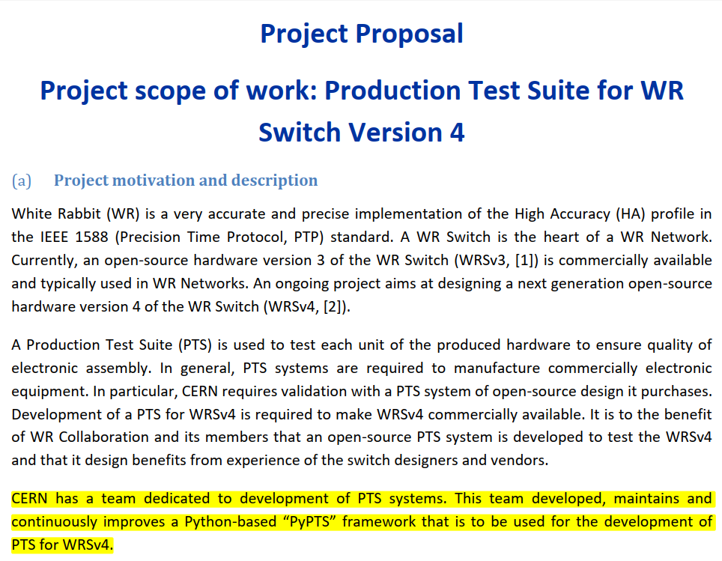


External users
White Rabbit Switch V4 (White Rabbit Collaboration)
Notes:
The PTS Framework will be used as the basis for the PTS of the next generation (V4) White Rabbit switch.

Slide 41
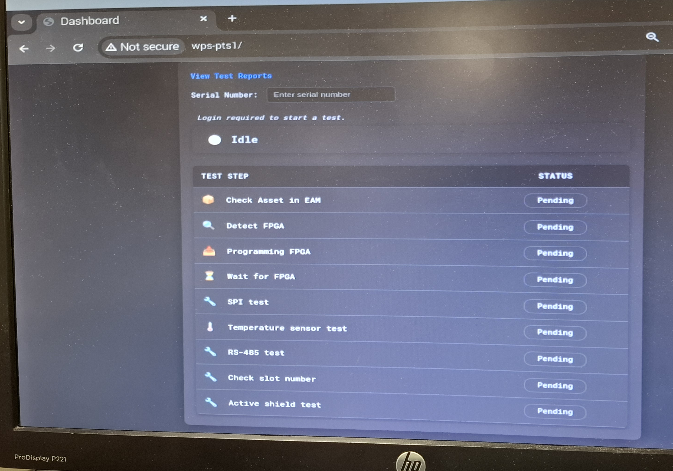
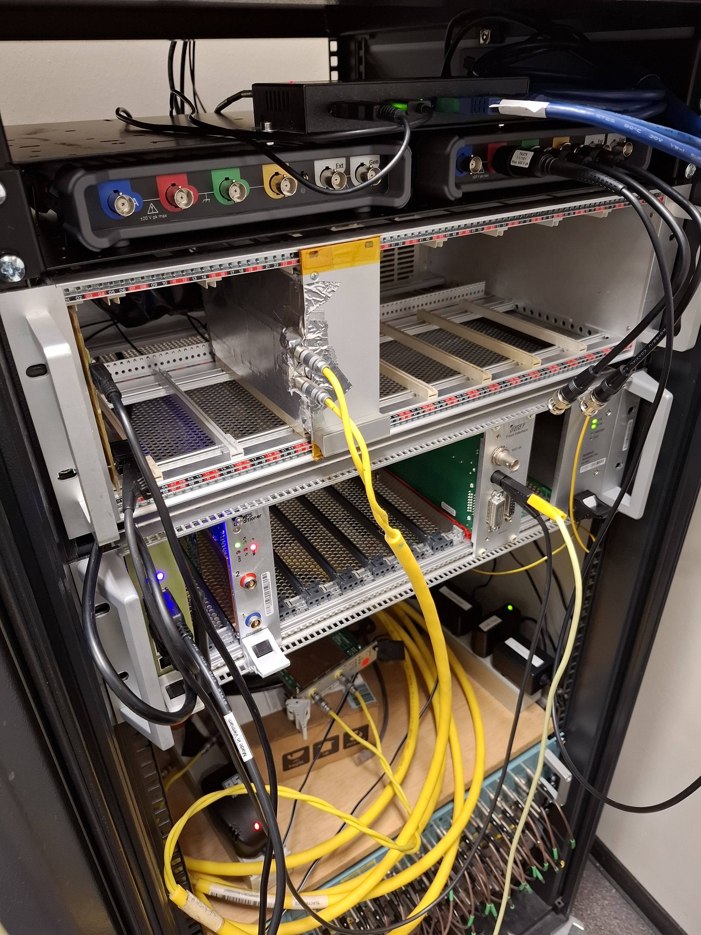
External users
Wire Positioning System Test Bench (Bauke Robbert Spoelstra, BE-GM-HPA)
Notes:
Development of an automated test bench for Wire Positioning System data acquisition electronic cards
Test bench used at CERN
Storage of results directly into EAM

Slide 42
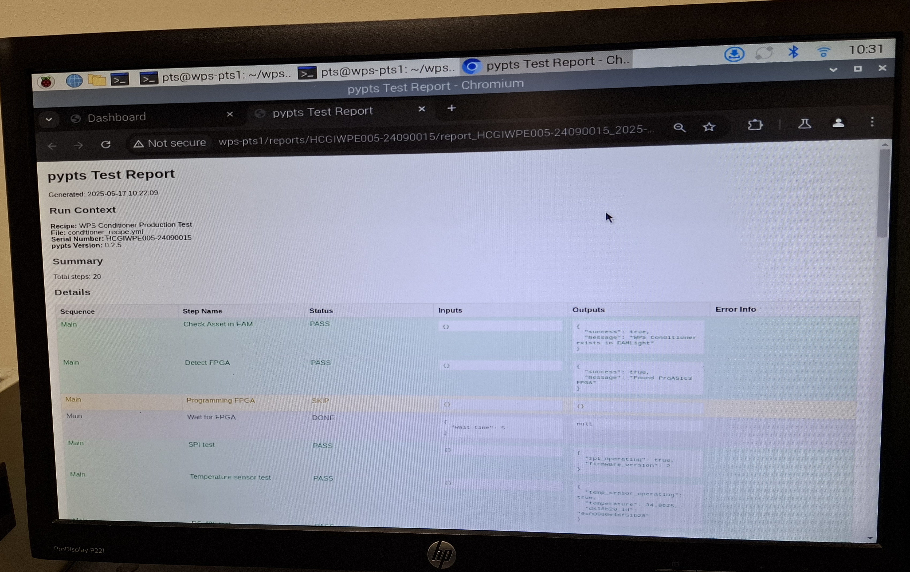
External users
Wire Positioning System Test Bench (Bauke Robbert Spoelstra, BE-GM-HPA)

Slide 43
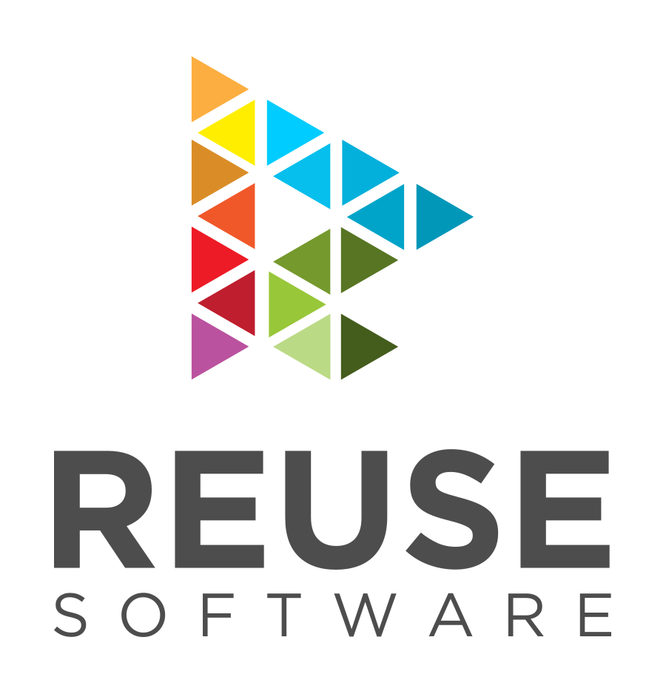
Open-source framework
Following BE-CEM-EDL licences guidelines:
  LGPL-2.1-or-later is used for source code
  CC-BY-SA-4.0 is used for documentation
Allow external users, companies, developers to benefit from the framework
REUSE specification compliant

Slide 44
Table of contents
Introduction
Production Test Suite (PTS)
  Software considerations
Production Test Suite Framework
Developing an application
  Workflow as end-user
External users
Impact
Goals
Further steps
Conclusions

Slide 45
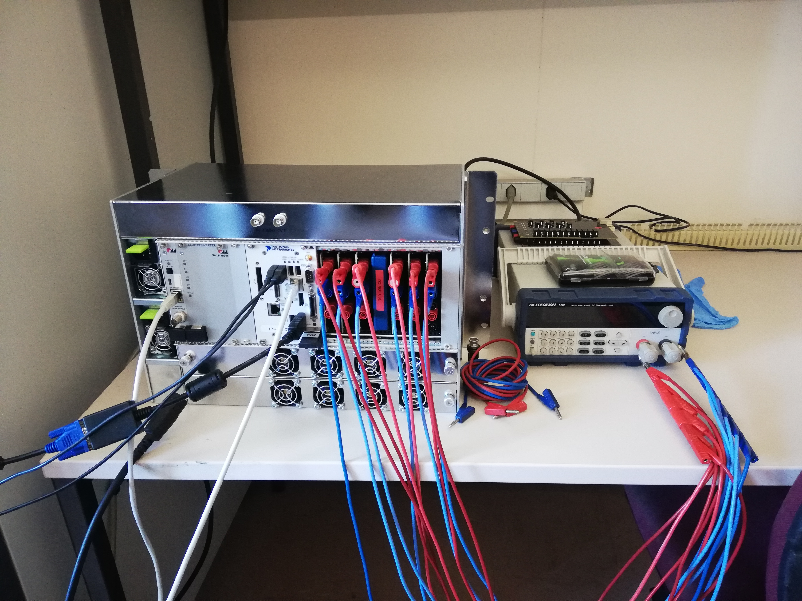
Impact
SamBuCa chassis
Invalid BNC reboot wiring
  BNC was wired as GPIO, and sometimes would not work
Ethernet communication lost after 1-3 months
  With 160 deployed, would mean one/week
SamBuCA test bench

Slide 46
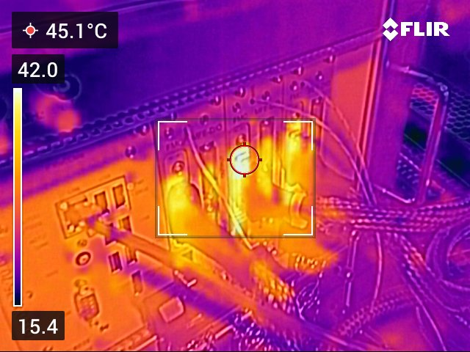
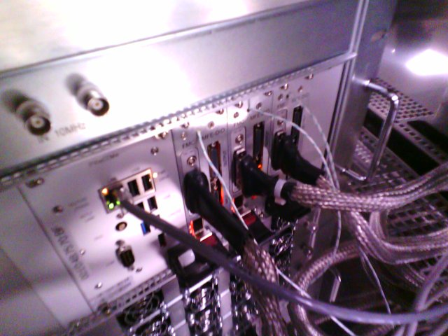
Impact
Motion Front-End
  ADC characterization in the climatic chamber
  DAC amplifiers thermal characterization
    Allowed to use the amplifier design with no changes on the schematic
MFE running underload, thermal image
MFE running underload, visible light image

Slide 47
Table of contents
Introduction
Production Test Suite (PTS)
  Software considerations
Production Test Suite Framework
Developing an application
  Workflow as end-user
External users
Impact
Goals
Further steps
Conclusions

Slide 48
Medium to long term goals
Cover all PTS testing needs within ATS
Provide comprehensive documentation, examples and drivers to streamline workflow
Create and maintain templates covering main interfaces

Slide 49
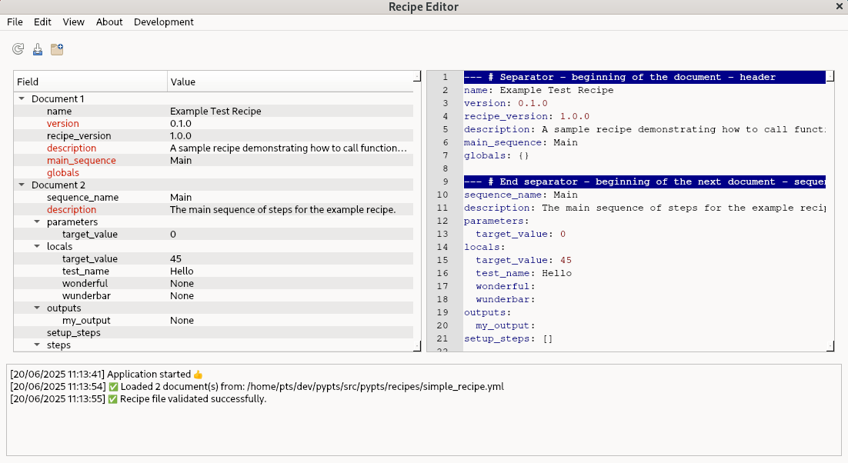
Further steps
Use the framework in all PTS developed in the group
Get more feedback from stakeholders and users
  Already meeting an external company during the WR Workshop
Ensure support to answer questions, maintain the framework itself
Tool to assist writing the config file

Slide 50
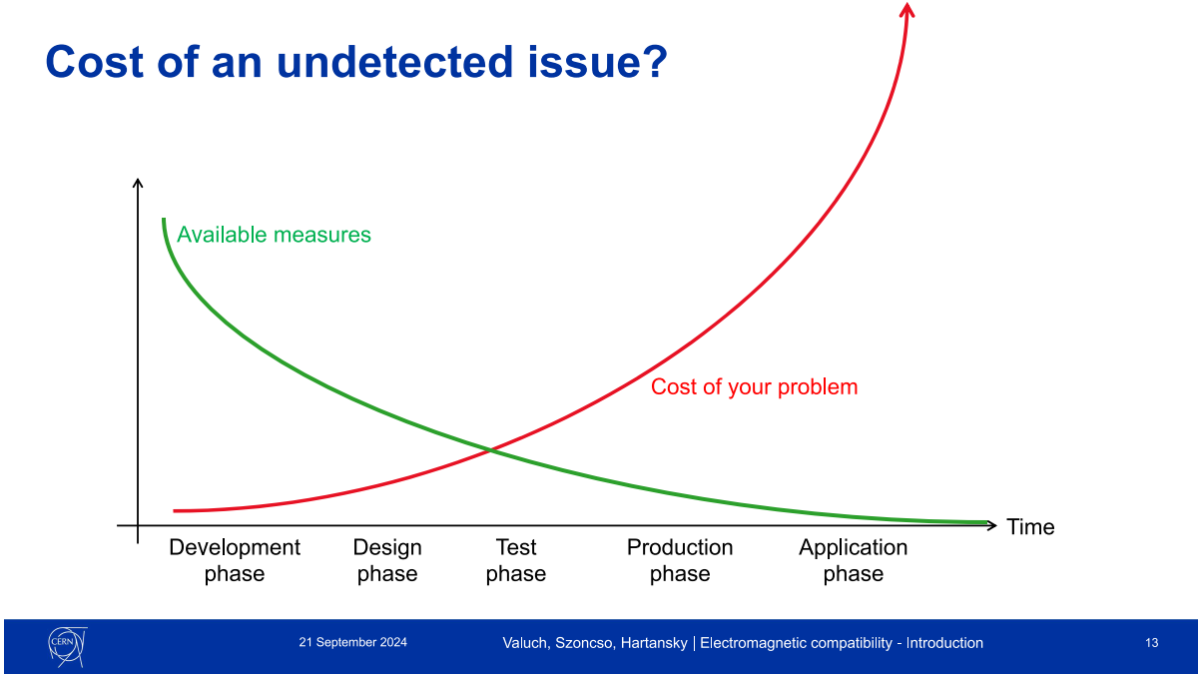
Conclusions

