Slide 1

D2 Field Quality Updates
S. Izquierdo Bermudez based on data and discussions with A. Pampaloni, B. Caiffi,
S. Farinon, A. Foussat
WP2/WP3 Joint meeting – 17th June 2025

Slide 2
Introduction
WP2 (see HL-LHC collaboration meeting, 2024) pointed out the difficulty to deal with magnets with a large difference in a₂ between the two apertures
With our current understanding, we expect MBRD6 (last series magnets, in the baseline today is a spare) to have large a₂.
Goal of today:
  Describe the process to predict field harmonics and quantify the reliability of our predictions
  Possible mitigations?

Slide 3
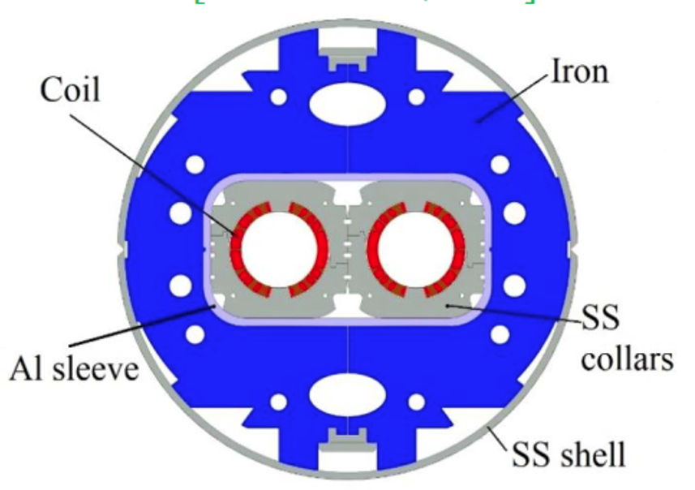
D2 Field Quality Challenge: ideal case
Room Temperature after yoking
1.9 K, I_{nom}
AP1&AP2:
b2, b3 ≈ 0
AP1&AP2:
b2, b3 ≈ 0
AP1:
b2 ≈ 200
b3 ≈ 150
AP2:
b2 ≈ -200
b3 ≈ 150

Slide 4
D2 Field Quality Challenge: ideal case
MBRD Acceptance Criteria: EDMS 2051868
Target table for multipole errors, in units 10⁻⁴ relative to main field at R_{ref} = 35 mm
 | uncertainty | random | lower limit | upper limit
b₂ | 1.000 | 1.000 | -4.000 | 4.000
b₃ | 1.667 | 1.667 | -6.667 | 6.667
b₄ | 0.600 | 0.600 | -2.400 | 2.400
b₅ | 1.000 | 1.000 | -4.000 | 4.000
b₆ | 0.060 | 0.060 | -0.240 | 0.240
b₇ | 0.165 | 0.165 | -0.660 | 0.660
b₈ | 0.027 | 0.027 | -0.110 | 0.110
b₉ | 0.065 | 0.065 | -0.260 | 0.260
b₁₀ | 0.008 | 0.008 | -0.030 | 0.030
b₁₁ | 0.019 | 0.019 | -0.076 | 0.076
a₂ | 0.679 | 0.679 | -2.716 | 2.716
a₃ | 0.282 | 0.282 | -1.128 | 1.128
a₄ | 0.444 | 0.444 | -1.776 | 1.776
a₅ | 0.152 | 0.152 | -0.608 | 0.608
a₆ | 0.176 | 0.176 | -0.704 | 0.704
a₇ | 0.057 | 0.057 | -0.228 | 0.228
a₈ | 0.061 | 0.061 | -0.244 | 0.244
a₉ | 0.020 | 0.020 | -0.080 | 0.080
a₁₀ | 0.025 | 0.025 | -0.100 | 0.100
a₁₁ | 0.007 | 0.007 | -0.028 | 0.028
 | Room temperature, Collared coil |  | Room temperature, after yoking |  | 1.9 K , I_{nom}
 | AP1 -94 mm | AP2 +94 mm | AP1 -94 mm | AP2 +94 mm | AP1 -94 mm | AP2 +94 mm
b2 | -210,92 | 210,92 | -9,68 | 9,68 | -2,30 | 2,30
b3 | 61,76 | 61,76 | -0,15 | -0,15 | 2,29 | 2,29
b5 | -7,61 | -7,61 | 1,44 | 1,44 | -0,27 | -0,27
a2 | -3,20 | 3,20 | 2,87 | -2,87 | -1,41 | 1,41

Slide 5

Reality
The coils have not nominal size, shims are used to compensate difference I side
  The effect of the shimming can be predicted.
Manufacturing and assembly tolerances introduce errors
Coil geometry measurements
shimming layout
Field quality after collaring
=
+
$$shims$$

Slide 6
Available data from series production
shimming layout
Field quality after collaring
Coil geometry measurements
$$shims$$
=
+
All coils (24 manufactured),
all geometrical measurements available
Defined for all apertures (12)
EDMS 3194189
9* out of 12 collared coils have been assembled
*1 to 2 apertures to be disassembled after magnet completion due to an NCR

Slide 7
Data overview
 | After collaring | Warm after yoking | Cold at I_{nom}
MBRD1 |  |  | 09/2025
MBRD2 |  |  | 11/2025
MBRD3 | * disassembled | * disassembled | 05/2026
 | * disassembled
MBRD4 |  |  | 02/2026
MBRD5 |  | 11/2025 | 08/2026
 | 09/2025
MBRD6 | 01/2026 | 04/2026 | 01/2027
 | 01/2026
* disassembled: the data presented here corresponds to the first assembly of MBRD3. The magnet was fully disassembled, field errors in the final assembled magnets expected to be similar to the ones of the first assembly/

Slide 8
How good predictions are? Collared coil MM
Systematic offset of:
  ≈ 10 units on b₂ (average Δ_{meas-sim} = 9.7, STD = 2.93, for a measured average b₂ of 200.20 units)
  ≈ 5 units on b₅ (average Δ_{meas-sim} = 5.34 , STD = 0.57, for a measured average b₅ of 2.11 units)
No systematic effect on b_{3 ,} with an average Δ_{meas-sim} = 2.70 , STD = 2.89 for a measured average b₃ of 156.65 units
Systematic offset of ≈ 27 units on a₂ (average Δ_{meas-sim} = 26.52, STD = 5.95, for a measured average a₂ of -29.52 units)
  Note that it has the same sign in AP1/AP2, while from the simulation we expect a change on sign in AP1/AP2 → the source is not something with capture in our model.
Nominal coil geometry
 | AP01 -94 mm | AP02 +94 mm
b2 | -210,92 | 210,92
b3 | 61,76 | 61,76
b5 | -7,61 | -7,61
a2 | -3,20 | 3,20
 | MAGNET 1 - INTEGRATED - SA @ RT |  |  |  |  |  |  |  | MAGNET 2 - INTEGRATED - SA @ RT
 | AP01 @ -94 mm (AP1) |  |  | AP02 @ +94 mm (AP2) |  |  |  |  | AP04 @ -94 mm (AP1) |  |  | AP03 @ +94 mm (AP2)
 | SIMU | MEAS | MEAS-SIMU | SIMU | MEAS | MEAS-SIMU |  |  | SIMU | MEAS | MEAS-SIMU | SIMU | MEAS | MEAS-SIMU
b2 | 209.79 | 197.93 | -11.87 | -209.93 | -199.88 | 10.06 |  | b2 | 209.93 | 198.44 | -11.49 | -209.93 | -202.97 | 6.96
b3 | 156.85 | 154.31 | -2.55 | 153.19 | 156.43 | 3.24 |  | b3 | 153.19 | 157.97 | 4.78 | 153.19 | 159.65 | 6.46
b5 | -3.53 | 1.58 | 5.10 | -3.15 | 1.94 | 5.09 |  | b5 | -3.15 | 2.39 | 5.55 | -3.15 | 2.15 | 5.30
a2 | 1.03 | -34.87 | -35.90 | -1.03 | -21.01 | -19.98 |  | a2 | 1.03 | -23.64 | -24.66 | -1.03 | -27.94 | -26.91
 | MAGNET 3 - INTEGRATED - SA @ RT |  |  |  |  |  |  |  | MAGNET 4 - INTEGRATED - SA @ RT
 | AP05 @ -94 mm (AP1) |  |  | AP06 @ +94 mm (AP2) |  |  |  |  | AP07 @ -94 mm (AP1) |  |  | AP08 @ +94 mm (AP2)
 | SIMU | MEAS | MEAS-SIMU | SIMU | MEAS | MEAS-SIMU |  |  | SIMU | MEAS | MEAS-SIMU | SIMU | MEAS | MEAS-SIMU
b2 | 209.93 | 197.17 | -12.77 | -209.88 | -206.59 | 3.29 |  | b2 | 210.02 | 197.74 | -12.28 | -209.79 | -200.17 | 9.62
b3 | 153.19 | 157.07 | 3.88 | 154.41 | 156.79 | 2.38 |  | b3 | 150.75 | 156.81 | 6.05 | 156.85 | 156.98 | 0.13
b5 | -3.15 | 2.00 | 5.15 | -3.28 | 3.37 | 6.64 |  | b5 | -2.90 | 1.88 | 4.79 | -3.53 | 2.01 | 5.53
a2 | 1.03 | -38.77 | -39.80 | -1.03 | -20.39 | -19.36 |  | a2 | 1.02 | -22.47 | -23.50 | -1.03 | -27.00 | -25.97

Slide 9
How good predictions are? Warm after yoking MM
Good control on b₂/b₃/b₅
a₂ is trickier:
  Most of the unexplained a₂ measured in the collared coils is compensated when assembling the two apertures together ☺
  Still, not easy to predict the final a₂ based on the collared coil data (see next slide)
Nominal coil geometry
 | AP01 -94 mm | AP02 +94 mm
b2 | -9,68 | 9,68
b3 | -0,15 | -0,15
b5 | 1,44 | 1,44
a2 | 2,87 | -2,87
 | Δ_{meas-sim}, units
 | Δb₂ | Δb₃ | Δb₅
average | -1.87 | 11.39 | 5.32
sigma | 0.77 | 2.37 | 0.30
 | MAGNET 1 - INTEGRATED - SA @ RT |  |  |  |  |  |  |  | MAGNET 2 - INTEGRATED - SA @ RT
 | AP01 @ -94 mm (AP1) |  |  | AP02 @ +94 mm (AP2) |  |  |  |  | AP04 @ -94 mm (AP1) |  |  | AP03 @ +94 mm (AP2)
 | SIMU | MEAS | MEAS-SIMU | SIMU | MEAS | MEAS-SIMU |  |  | SIMU | MEAS | MEAS-SIMU | SIMU | MEAS | MEAS-SIMU
b2 | -3.19 | -5.19 | 1.99 | 3.38 | 5.17 | -1.79 |  | b2 | -3.26 | -3.59 | 0.34 | 3.26 | 5.36 | -2.10
b3 | -10.76 | -3.26 | -7.50 | -13.83 | -0.87 | -12.96 |  | b3 | -13.76 | 0.29 | -14.05 | -13.76 | 0.10 | -13.86
b5 | -1.61 | 4.01 | -5.63 | -1.32 | 3.61 | -4.93 |  | b5 | -1.31 | 4.38 | -5.69 | -1.31 | 3.94 | -5.25
a2 | 0.79 | 6.00 | -5.21 | -0.79 | 3.66 | -4.45 |  | a2 | 0.79 | -1.05 | 1.84 | -0.79 | 1.35 | -2.13
 | MAGNET 3 - INTEGRATED - SA @ RT |  |  |  |  |  |  |  | MAGNET 4 - INTEGRATED - SA @ RT
 | AP05 @ -94 mm (AP1) |  |  | AP06 @ +94 mm (AP2) |  |  |  |  | AP07 @ -94 mm (AP1) |  |  | AP08 @ +94 mm (AP2)
 | SIMU | MEAS | MEAS-SIMU | SIMU | MEAS | MEAS-SIMU |  |  | SIMU | MEAS | MEAS-SIMU | SIMU | MEAS | MEAS-SIMU
b2 | -3.34 | -4.73 | 1.38 | 3.28 | 5.70 | -2.42 |  | b2 | -3.46 | -6.66 | 3.20 | 3.46 | 5.17 | -1.70
b3 | -13.78 | -0.27 | -13.51 | -12.76 | -3.97 | -8.79 |  | b3 | -10.81 | -0.99 | -9.82 | -10.81 | -0.18 | -10.63
b5 | -1.31 | 3.98 | -5.30 | -1.41 | 4.15 | -5.56 |  | b5 | -1.62 | 3.21 | -4.82 | -1.62 | 3.79 | -5.41
a2 | 0.79 | -4.02 | 4.80 | -0.79 | 1.17 | -1.96 |  | a2 | 0.79 | -1.77 | 2.55 | -0.79 | -0.36 | -0.43

Slide 10
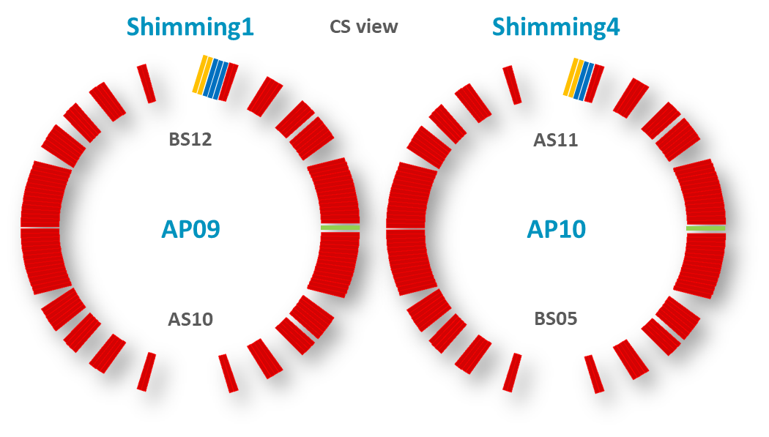
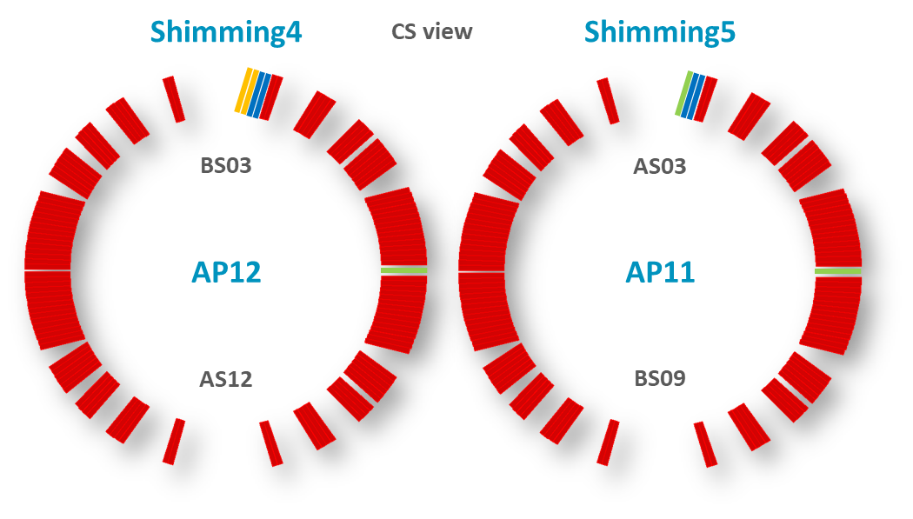
a₂
MAGNET 5
Systematic offset in the collared coil of ≈ 27 units on a₂ (average Δ_{meas-sim} = 26.52, STD = 5.95, for a measured average a₂ of -29.52 units)
Most of the unexplained a₂ measured in the collared coils is compensated when assembling the two apertures together ☺
Maybe something to say if we add the data from the prototype (what we say during yoking remains at cold?
Based on the data we have so far, the difference in a₂ between the two apertures remains below 5 units
  The target a₂ (EDMS 2051868) is -2.7/2.7 units, so this remains still within the expected range in terms of difference in a₂ between the two apertures.
0.46 mm
0.54 mm
0.43 mm
0.57 mm
 |  | Room temperature |  |  |  |  |  | 1.9 K, I_{nom}
 |  | Collared coil (CC) |  |  | After yoking |  | CC (a2 - average a2)
 |  | SIMU | MEAS |  | SIMU | MEAS
 |  |  |  |  |  |  |  | SIMU | MEAS
 |  | a₂ | a₂ | average a₂ | a₂ | a₂ |  | a₂ | a₂
PROTO |  | -0.19 | -16.55 |  | -0.14 | -0.34 |  | -0.16 | 1.07
 |  | 0.19 | -7.57 |  | 0.14 | -4.23 |  | 0.16 | 5.69
MAGNET 1 | AP01 | 1.0 | -34.9 | -27.9 | -0.8 | 6.0 | -6.93 | 0.9
 | AP02 | -1.0 | -21.0 |  | -0.8 | 3.7 | 6.93 | -0.9
MAGNET 2 | AP04 | 1.0 | -23.6 | -25.8 | 0.8 | -1.1 | 2.15 | 0.9
 | AP03 | -1.0 | -27.9 |  | -0.8 | 1.3 | -2.15 | -0.9
MAGNET 3* | AP05 | 1.0 | -38.8 | -29.6 | 0.8 | -4.0 | -9.19 | 0.9
 | AP06 | -1.0 | -20.4 |  | -0.8 | 1.2 | 9.19 | -0.9
MAGNET 4 | AP07 | 1.0 | -22.5 | -24.7 | 0.8 | -1.8 | 2.26 | 0.9
 | AP08 | -1.0 | -27.0 |  | -0.8 | -0.4 | -2.26 | -0.9
MAGNET 5 | AP09 | 1.0 | -22.3 |  | 0.78 |  |  | 0.9
 | AP10 | -1.1 |  |  | -0.79 |  |  | -0.9
MAGNET 6 | AP11 | -2.53 |  |  | -1.81 |  |  | 9.7
 | AP12 | -7.79 |  |  | -5.61 |  |  | -1.2
MAGNET 6
0.63 mm
0.67 mm
0.43 mm
0.65 mm
*Magnet disassembled

Slide 11
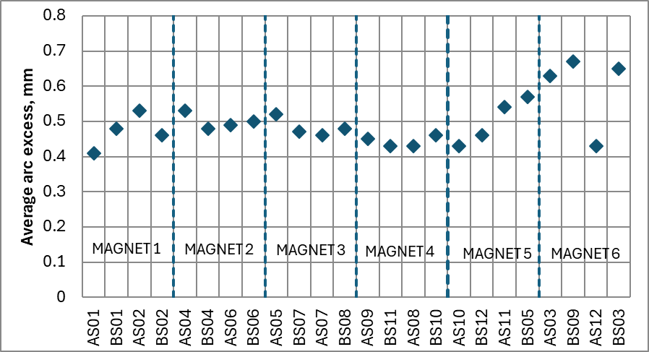
Positive mitigations
Assemble only coils with similar arc length
  We can control coil size to ± 0.120 mm (similar to what was reached during LHC-MB dipole production, and our experience with MQXFB coils)
  If we produce one new coil, we cannot control the coil geometry better than ± 0.120 mm, so there is a high risk we will not solve the problem
  a₂ remains a harmonic difficult to control, in the assembled magnets so far, we have differences between the two apertures up to 3.6 units where the source is not identified.
    This is still well within the target a₂ (EDMS 2051868) in terms of difference in a₂ between the two apertures (5.4 units).
  There are enough components to produce an extra-coil, check with Stefania/Arnaud what to say such that it is clear we cannot afford it
0.9/-0.9
0.9/-0.9
0.9/-0.9
0.9/-0.9
0.9/-0.9
9.7/-0.9
Local correction
  The area is very crowded, based on a quick discussion with Paolo Fessia, integration will be almost impossible.
    Study could be done after LS3 installation, since it is mitigation for the second spare magnet.

Slide 12
Conclusion
Produce one extra coil does not guarantee the problem mitigation
Today we expect to have a difference in a₂ between the two apertures of 10.6 units, but the uncertainty is high
  This is a factor 2 what was specified in terms of difference in a₂ between the two apertures 5.4 units
In ≈ 1 year time, all magnetic measurements after yoking will be available for all magnets, and two magnets will be measured at cold, so we can have a more precise assessment

Slide 13
Additional slides

Slide 14
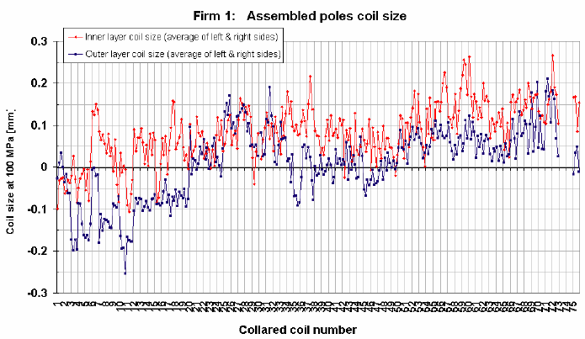
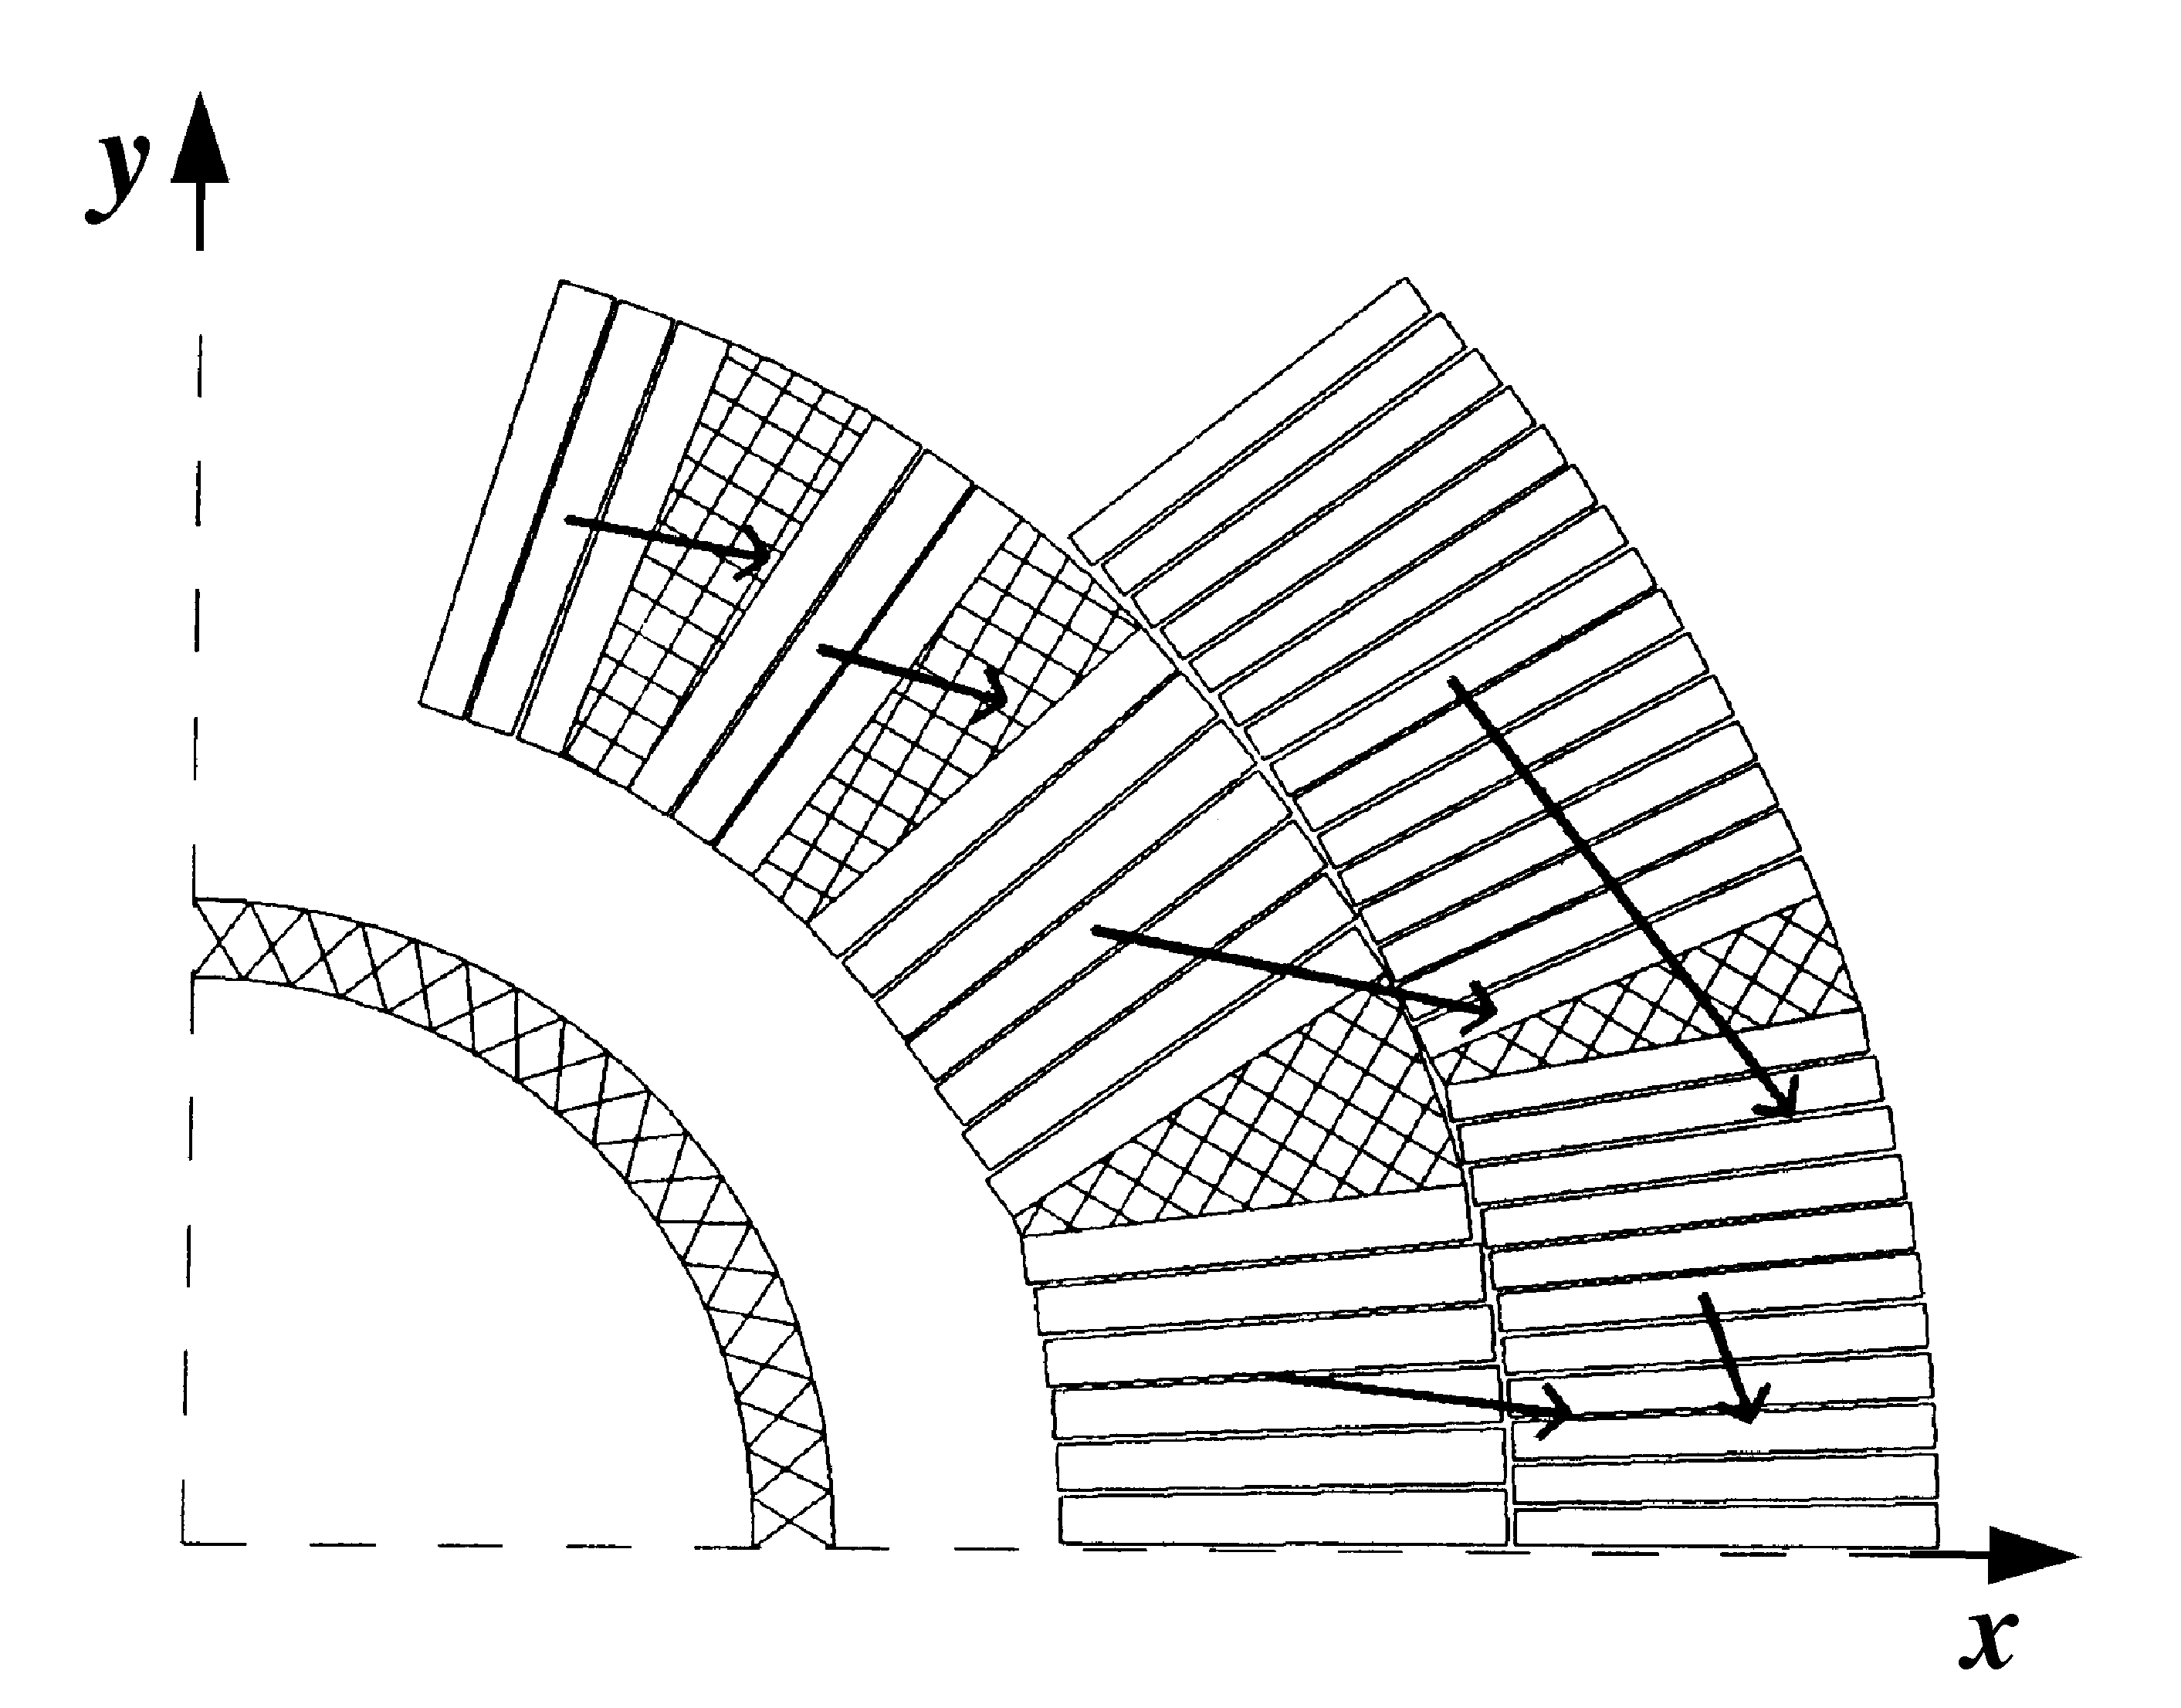
Critical Process
Winding-Curing-Coil
30 µm

Slide 15
References
https://docs.google.com/document/d/1eMs_jPFzSWx_ZJIHeAAAlSXCmFS8tsvJA9iybpqaMqM/edit?usp=sharing
HL-LHC collaboration meeting, 2024

Slide 16
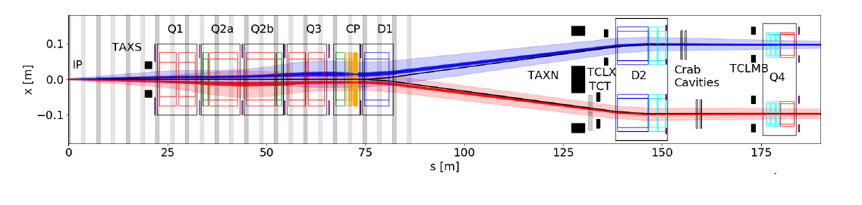
Correction options
I reviewed the discussions with Tobias and Paolo but these were not so conclusive.
In the radiation task force they studied using the magnet SPLQS__NWP next to D1, but this is not helping us and it is a bulky normal conducing quadrupole that would not fit where beams are separated next to Q4.
There is some space next to Q4, that is reserved for the BBLR wire with some space margin. Integration would no be easy, powering, FRAS, etc.
Would you see possible a warm design with the same integrated strength as the 8 units of a2 fitting in between the 2 beams? FQ might not be an issue so maybe some long air coils (2-3m?)?

