Slide 1
Brief update on Hawaii (Vahsen) group activities on MPGD based TPCs
Sven Vahsen (U. Hawaii)

Slide 2
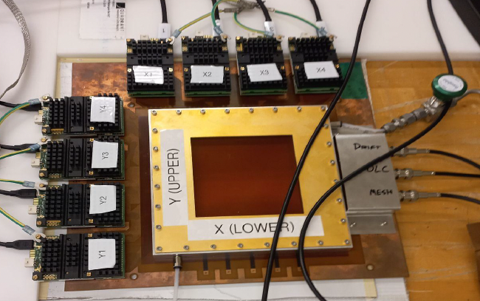
Strip readouts for cost effective TPC scaleup
(for directional detection of nuclear and electronic recoils*)
Micromegas amplification
200 um pitch x/y strips
CERN SRS DAQ system
Nine strip configurations configurations compared
Published in NIMA (2025):
A Comparison of Micromegas with x/y Strip Charge Readouts for Directional Recoil Detection
Identified optimal Micromegas configuration for 40l demonstrator
10 cm x 10 cm
sensitive area
*Related publication currently in review: Angular Resolution of Electrons in Gaseous Targets

Slide 3
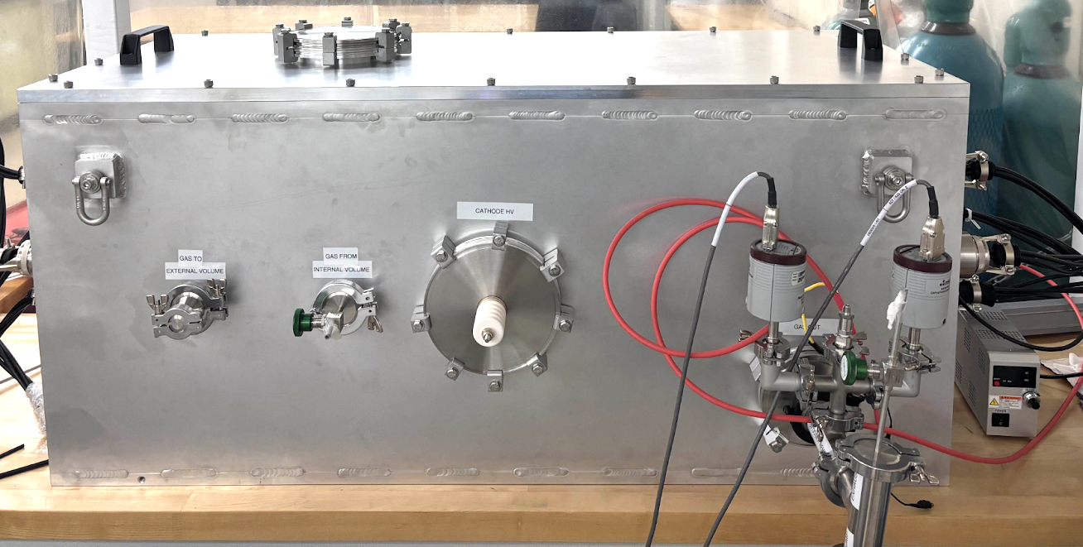
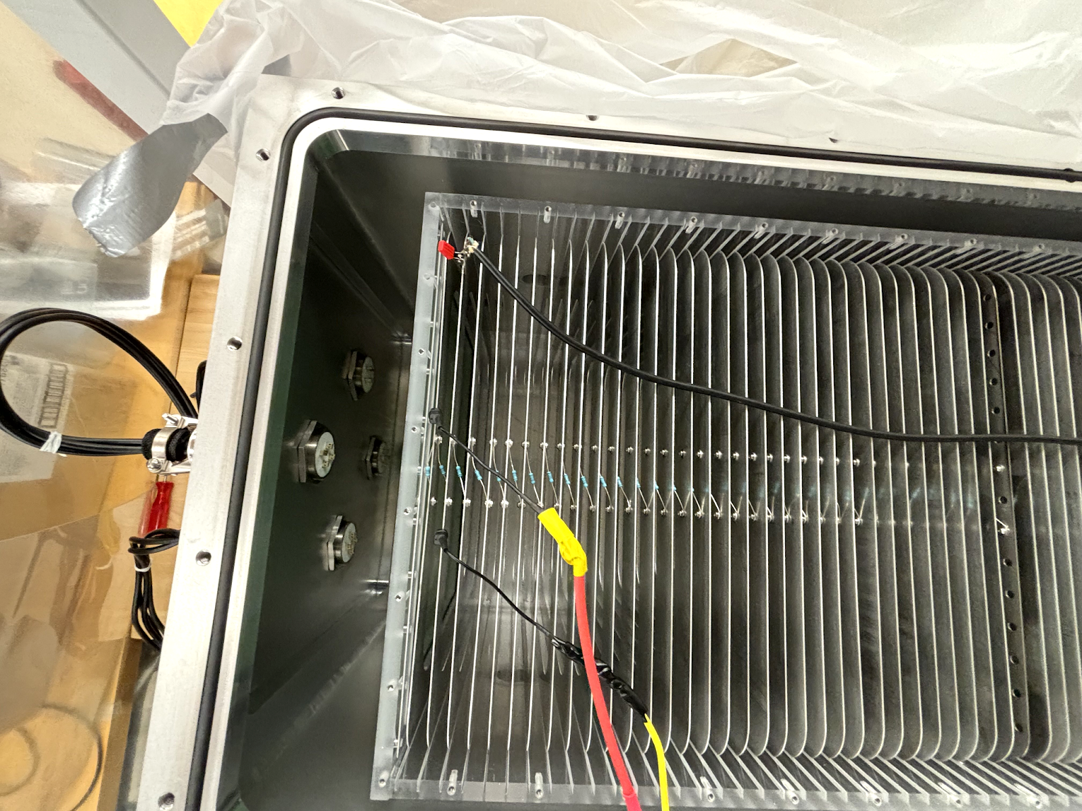
40l TPC demonstrator with x/y strip readout
2 x 50 cm drift, double-sided cm x/y strip Micromegas readout; 20 cm x 20 cm
Two-vessel concept: only clean parts in sensitive volume –> improved gas- and radiopurity.
Digitization between inner and outer vessel –> minimal vacuum feedthroughs –> simplified, less costly design.
Readout planes completed June 2025 at CERN! Currently in transit to Hawaii.
HV and vacuum systems commissioning successful. Commissioning with test sources begins July 2025!
Investigating feasibility of directional neutrino-nucleus scattering (CEvNS) measurement, see
talk by graduate student Michael Litke at 2025 Magnificent CEvNS conference

Slide 4
There are now two more PIs/ groups working with /on MPGDs at U. Hawaii:
  Prof. Peter Lewis (HEP – also working on MPGD-based TPCs)
  Prof. Peter Englert (Space Sciences and neutron detection)
Their activities were not covered here

