Slide 1



Meson spectroscopy at LHCb
Zeqing Mu
on behalf of the LHCb collaboration
Peking University
@ Implication Workshop
Nov. 6, 2025

Slide 2
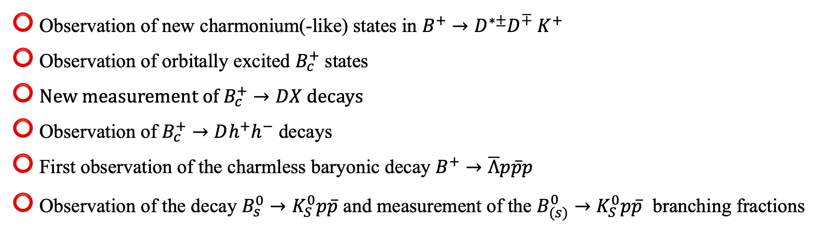
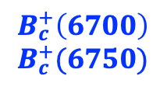
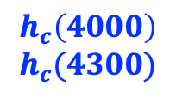
Overview of recent results
$$h_{c}\left(4000\right)$$
$$h_{c}(4300)$$
Observation of new charmonium(-like) states in $B^{+}→D^{∗±}D^{∓} K^{+}$
Observation of orbitally excited $B_{c}^{+}$ states
New measurement of $B_{c}^{+}→DX$decays
Observation of $B_{c}^{+}→Dh^{+}h^{−}$ decays
First observation of the charmless baryonic decay $B^{+}→\overline{Λ}p\overline{p}p$
Observation of the decay $B_{s}^{0}→K_{S}^{0}p\overline{p}$ and measurement of the $B_{(s)}^{0}→K_{S}^{0}p\overline{p}$ branching fractions
PRL 133, 131902 (2024)
$$B_{c}^{+}\left(6700\right)$$
$$B_{c}^{+}(6750)$$
arXiv:2507.02149
[LHCb-PAPER-2024-035, in prep.]
arXiv:2509.15873
arXiv:2508.16259
JHEP 07 (2025) 121

Slide 3
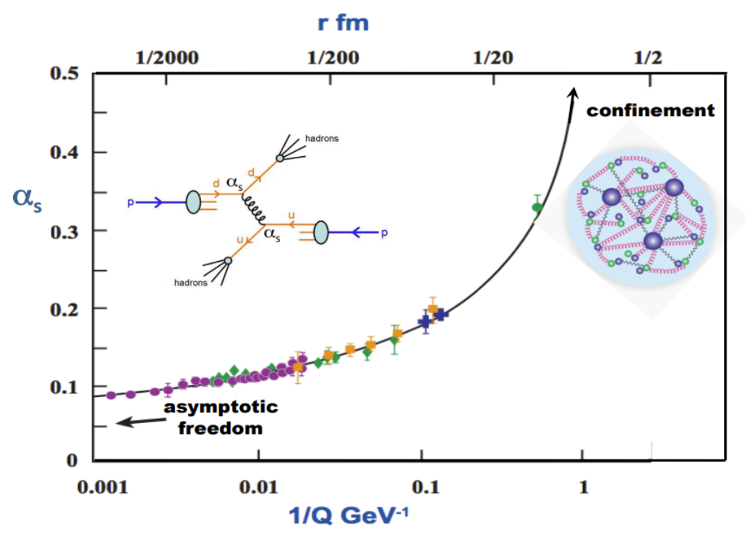
Hadron spectroscopy and QCD
Hadron spectroscopy study
  Structure: How do quarks and gluons form hadrons
  Dynamics: How is the force governing hadron properties (QCD at low energy)
Mass
Width
Spin
Parity
…
Structure
Important input to theoretical calculation
Lattice QCD
Chiral theory
QCD sum rules
Theory
CPC 40 (2016) 10, 100001
Dynamics

Slide 4
Conventional mesons observed at LHCb
World’s largest dataset to study heavy-flavor mesons
Detailed in this talk
Mesons
Following a hiatus of almost four years, four new mesons are observed.

Slide 5
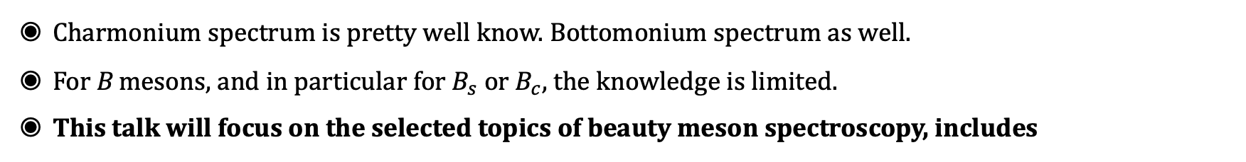

Quarkonium and Beauty Meson Spectrum
Charmonium spectrum is pretty well know. Bottomonium spectrum as well.
For B mesons, and in particular for $B_{s}$ or $B_{c}$, the knowledge is limited.
This talk will focus on the selected topics of beauty meson spectroscopy, includes
Observation of new charmonium(-like) states in $B^{+}→D^{∗±}D^{∓} K^{+}$
PRL 133, 131902 (2024)

Slide 6
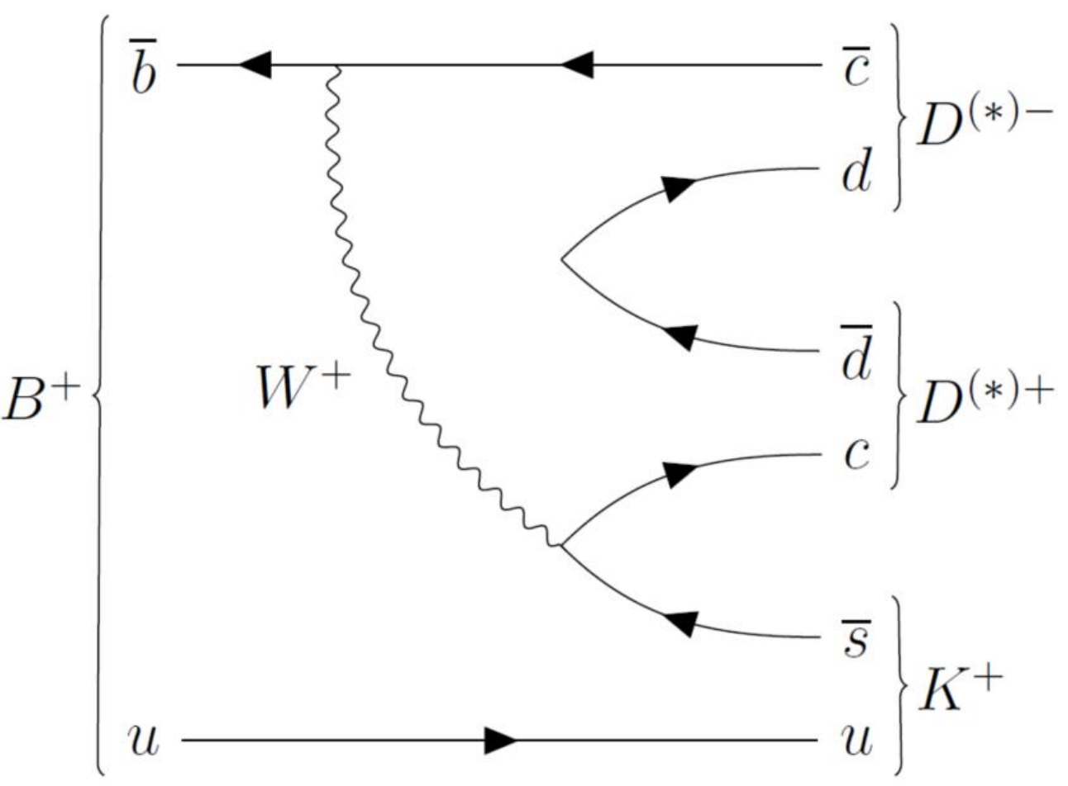
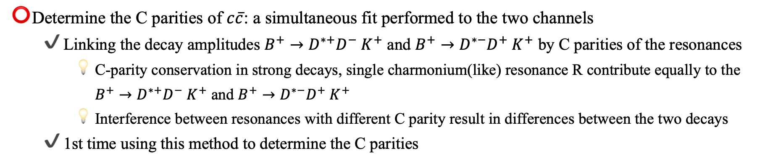
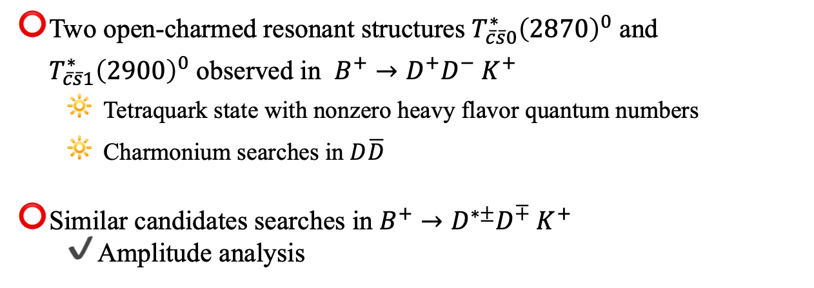
Observation of new charmonium(-like) states in $B^{+}→D^{∗±}D^{∓} K^{+}$
PRL 133, 131902 (2024)
Two open-charmed resonant structures $T_{\overline{c}\overline{s}0}^{∗}{\left(2870\right)}^{0}$ and $T_{\overline{c}\overline{s}1}^{∗}{\left(2900\right)}^{0}$ observed in $B^{+}→D^{+}D^{−} K^{+}$
  Tetraquark state with nonzero heavy flavor quantum numbers
  Charmonium searches in $D\overline{D}$
Similar candidates searches in $B^{+}→D^{∗±}D^{∓} K^{+}$
  Amplitude analysis
PRL 125, 242001 (2020)
PRD 102, 112003 (2020)
Determine the C parities of $c\overline{c}$: a simultaneous fit performed to the two channels
  Linking the decay amplitudes $B^{+}→D^{∗+}D^{−} K^{+}$ and $B^{+}→D^{∗−}D^{+} K^{+}$ by C parities of the resonances
    C-parity conservation in strong decays, single charmonium(like) resonance R contribute equally to the $B^{+}→D^{∗+}D^{−} K^{+}$ and $B^{+}→D^{∗−}D^{+} K^{+}$
    Interference between resonances with different C parity result in differences between the two decays
  1st time using this method to determine the C parities

Slide 7
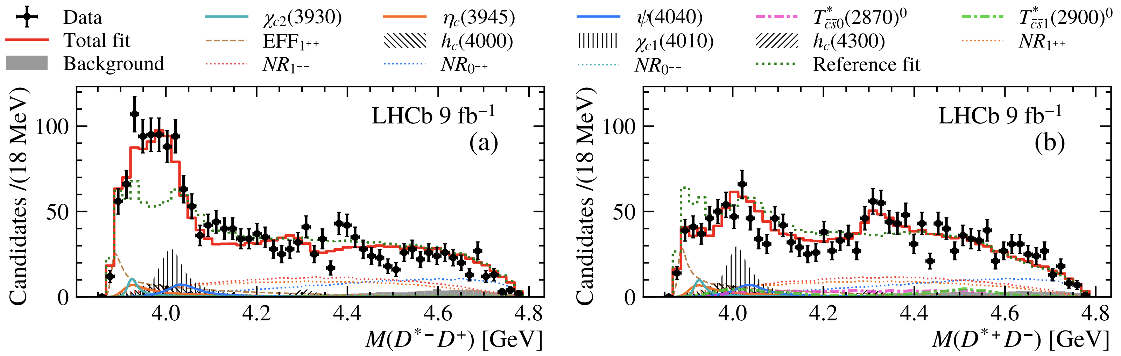
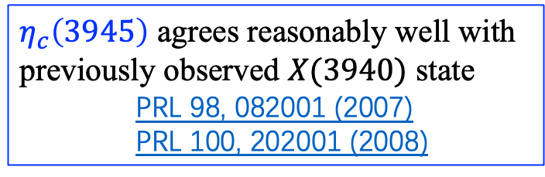
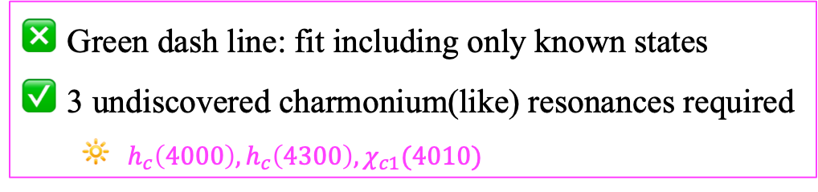
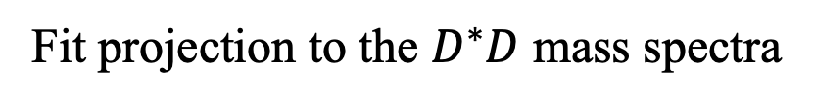
Observation of new charmonium(-like) states in $B^{+}→D^{∗±}D^{∓} K^{+}$
Fit projection to the $D^{∗}D$ mass spectra
PRL 133, 131902 (2024)
$η_{c}\left(3945\right)$ agrees reasonably well with previously observed $X(3940)$ state
    PRL 98, 082001 (2007)
    PRL 100, 202001 (2008)
Green dash line: fit including only known states
3 undiscovered charmonium(like) resonances required
  $h_{c}\left(4000\right),h_{c}\left(4300\right), χ_{c1}(4010)$

Slide 8








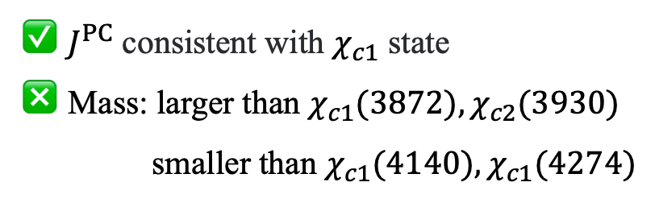





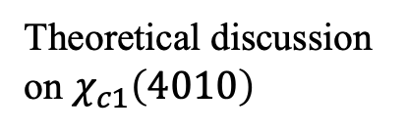









Observation of new charmonium(-like) states in $B^{+}→D^{∗±}D^{∓} K^{+}$
1st observation of two new charmonium states
PRL 133, 131902 (2024)
Theoretical predictions
States
$$J^{PC}$$
Mass/Mev
Width
States
$$J^{PC}$$
Mass/Mev
Width
$$h_{c}\left(4000\right):9.1σ$$
$$1^{+−}$$
$${4000}_{−14 −22}^{+17 +29}$$
$${184}_{−45 −61}^{+71 +97}$$
$$h_{c}\left(2P\right)$$
$$1^{+−}$$
3956
87
$$h_{c}\left(4300\right):6.4σ$$
$$1^{+−}$$
$${4307.3}_{−6.6 −4.1}^{+6.4 +3.3}$$
$${58}_{−16 −25}^{+28 +28}$$
$$h_{c}\left(3P\right)$$
$$1^{+−}$$
4318
75
($6.1σ$ with sys)
PRD 72, 054026 (2005)
$$χ_{c1}\left(4010\right):16σ$$
$$1^{++}$$
$${4012.5}_{−3.9 −3.7}^{+3.6 +4.1}$$
$${62.7}_{−6.4 −6.6}^{+7.0 +6.4}$$
$$χ_{c1} \left(2P\right)$$
$$1^{++}$$
3953
165
$J^{PC}$ consistent with $χ_{c1}$ state
Mass: larger than $χ_{c1}(3872), χ_{c2}(3930)$
smaller than $χ_{c1}(4140), χ_{c1}(4274)$
Indicate the exotic contributions in $χ_{c1}\left(4010\right)$
Sci.Bull. 69 (2024) 3036-3041
arXiv:2312.10296
Theoretical discussion on $χ_{c1}\left(4010\right)$
arXiv:2402.14541

Slide 9
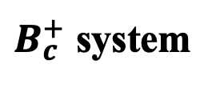
Quarkonium and Beauty Meson Spectrum
$B_{c}^{+}$ system
Charmonium spectrum is pretty well know. Bottomonium spectrum as well.
For B mesons, and in particular for $B_{s}$ or $B_{c}$, the knowledge is limited.
This talk will focus on the selected topics of beauty meson spectroscopy, includes
Observation of the orbitally excited $B_{c}^{+}$ states
[arXiv:2507.02149]
[arXiv:2507.02142]

Slide 10
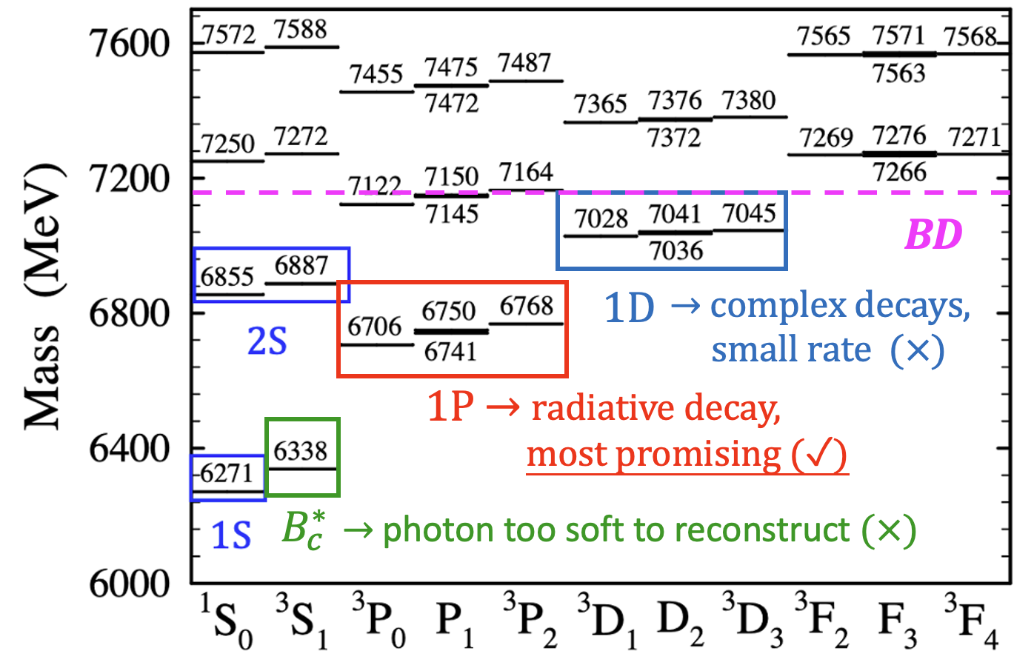
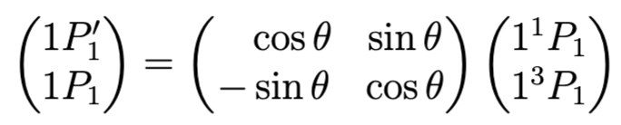
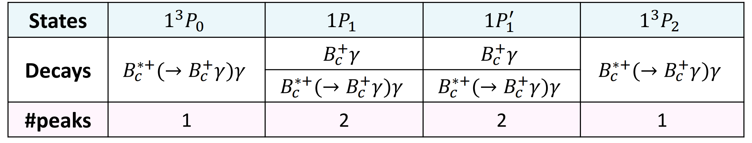



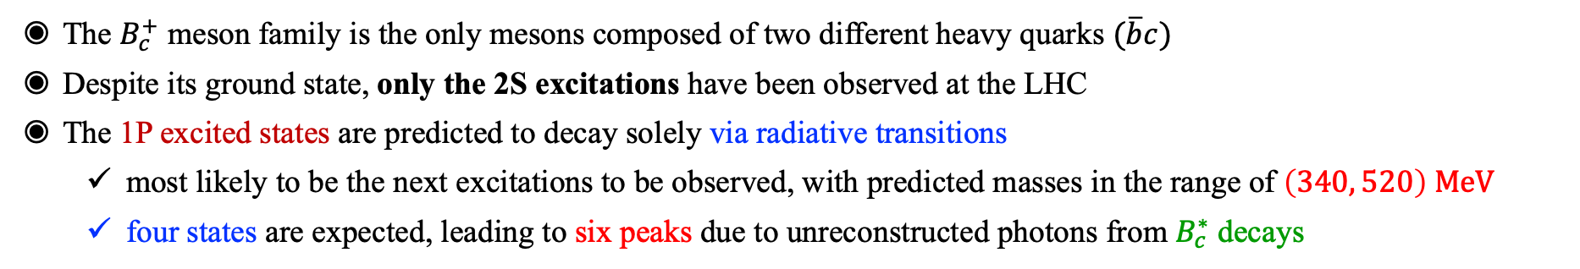


Observation of the orbitally excited $B_{c}^{+}$ states
The $B_{c}^{+}$ meson family is the only mesons composed of two different heavy quarks $(\overline{b}c)$
Despite its ground state, only the 2S excitations have been observed at the LHC
The 1P excited states are predicted to decay solely via radiative transitions
  most likely to be the next excitations to be observed, with predicted masses in the range of $\left(340, 520\right) MeV$
  four states are expected, leading to six peaks due to unreconstructed photons from $B_{c}^{∗}$ decays
[arXiv:2507.02149]
[arXiv:2507.02142]
[PRD 70 (2004) 054017]
$$S=0 →$$
$$1^{1}P_{1}$$
$$\left(L=1\right)⊗\left(S=0, 1\right)$$
$$S=1 → 1^{3}P_{0},{ 1}^{3}P_{1}, { 1}^{3}P_{2}$$
Four physical states
mixing
$$1^{3}P_{0},{ 1}^{3}P_{2}$$

Slide 11

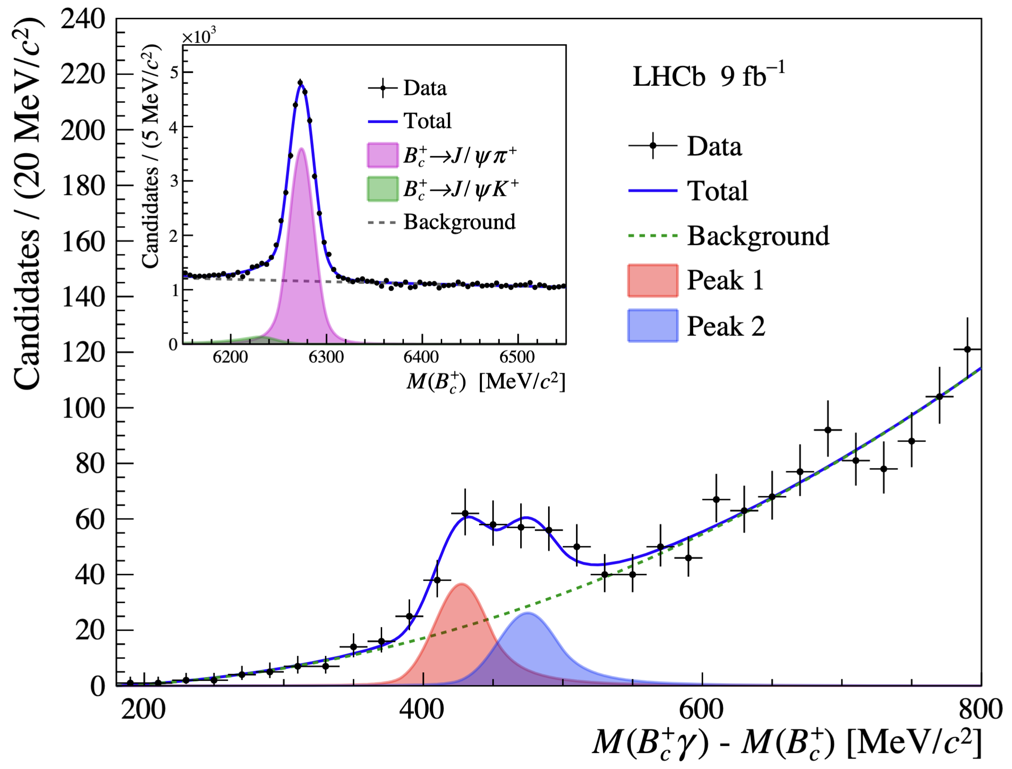
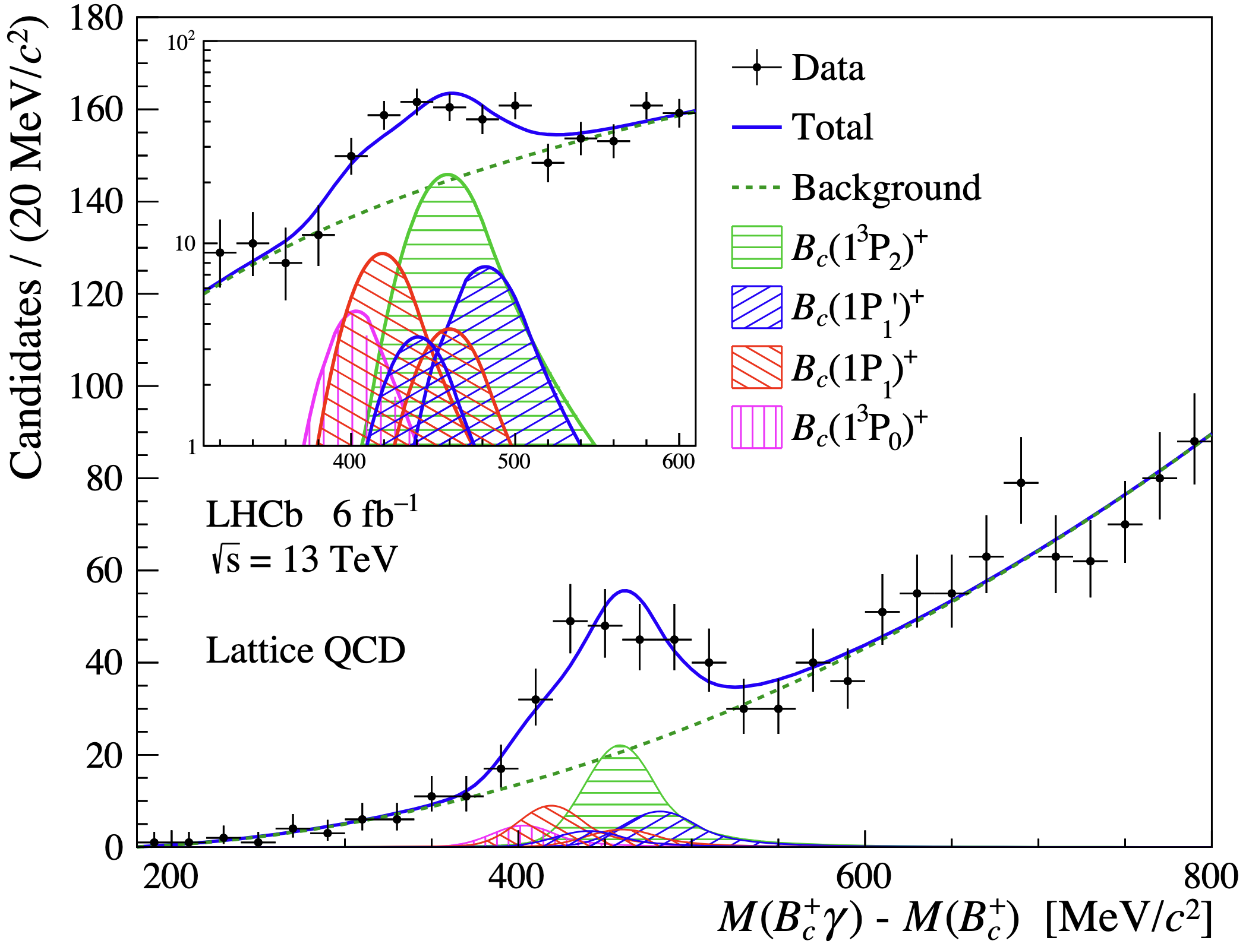
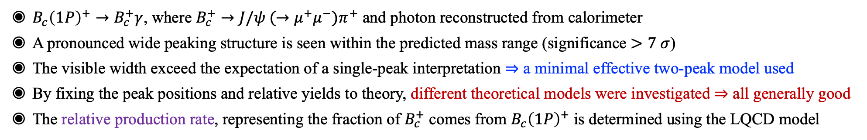
Observation of the orbitally excited $B_{c}^{+}$ states
$B_{c}{\left(1P\right)}^{+}→B_{c}^{+}γ$, where $B_{c}^{+}→J/ψ (→μ^{+}μ^{−})π^{+}$ and photon reconstructed from calorimeter
A pronounced wide peaking structure is seen within the predicted mass range (significance $>7 σ$)
The visible width exceed the expectation of a single-peak interpretation $⇒$ a minimal effective two-peak model used
By fixing the peak positions and relative yields to theory, different theoretical models were investigated $⇒$ all generally good
The relative production rate, representing the fraction of $B_{c}^{+}$ comes from $B_{c}{\left(1P\right)}^{+}$ is determined using the LQCD model
[arXiv:2507.02149]
[arXiv:2507.02142]

Slide 12
Quarkonium and Beauty Meson Spectrum
Charmonium spectrum is pretty well know. Bottomonium spectrum as well.
For B mesons, and in particular for $B_{s}$ or $B_{c}$, the knowledge is limited.
This talk will focus on the selected topics of beauty meson spectroscopy, includes
New measurement of $B_{c}^{+}→DX$decays
[LHCb-PAPER-2024-035, in prep.]

Slide 13
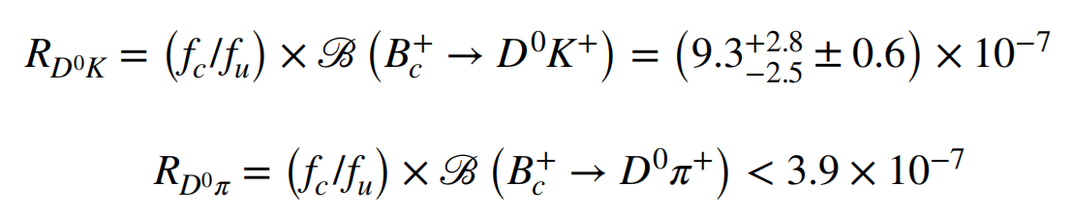
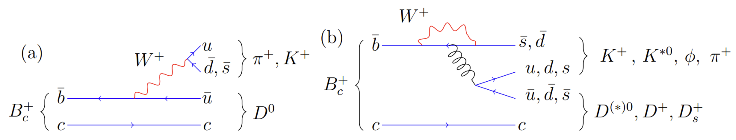
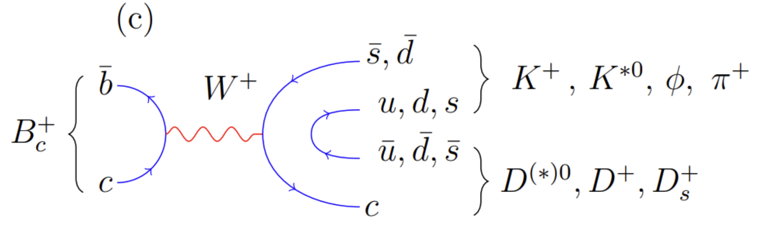

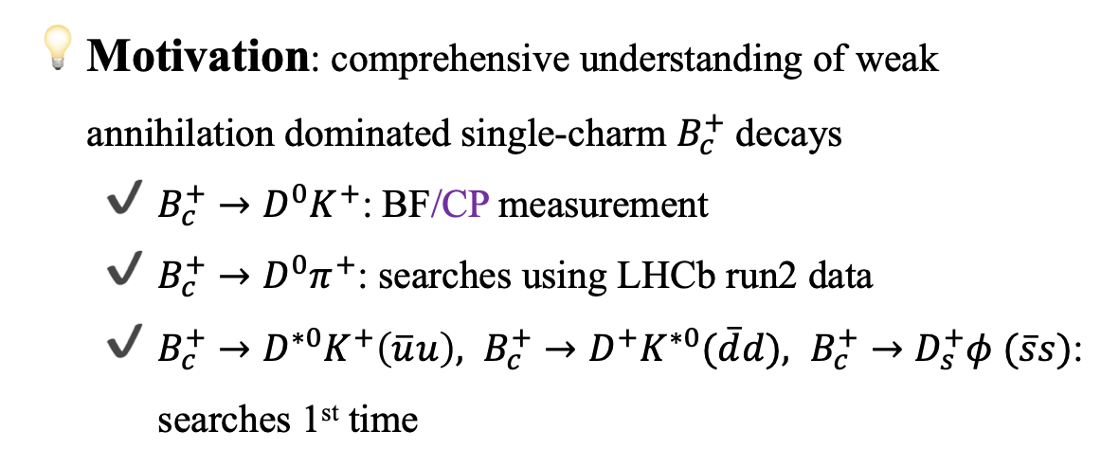
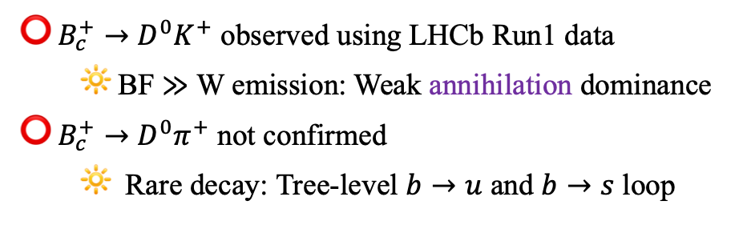


New measurement of $B_{c}^{+}→DX$decays
[LHCb-PAPER-2024-035, in prep.]
Previous achievements
$B_{c}^{+}→D^{0}K^{+}$ observed using LHCb Run1 data
  BF $≫$ W emission: Weak annihilation dominance
$B_{c}^{+}→D^{0}π^{+}$ not confirmed
  Rare decay: Tree-level $b→u$ and $b→s$ loop
seen
not seen
PRL 118 (2017) 111803
Motivation: comprehensive understanding of weak annihilation dominated single-charm $B_{c}^{+}$ decays
  $B_{c}^{+}→D^{0}K^{+}$: BF/CP measurement
  $B_{c}^{+}→D^{0}π^{+}$: searches using LHCb run2 data
  $B_{c}^{+}→D^{∗0}K^{+}\left(\overline{u}u\right), B_{c}^{+}→D^{+}K^{∗0}(\overline{d}d), B_{c}^{+}→D_{s}^{+}φ (\overline{s}s)$: searches 1st time
Quark hadronization
$$\overline{u}u$$
$$\overline{d}d$$
$$\overline{s}s$$
13

Slide 14
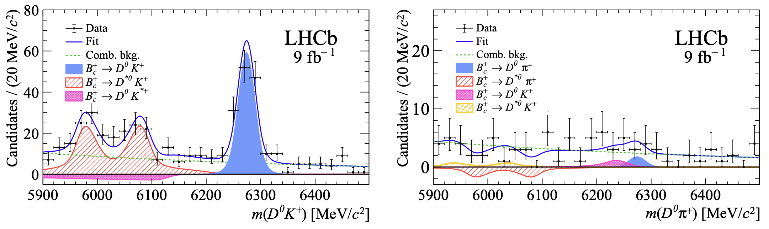
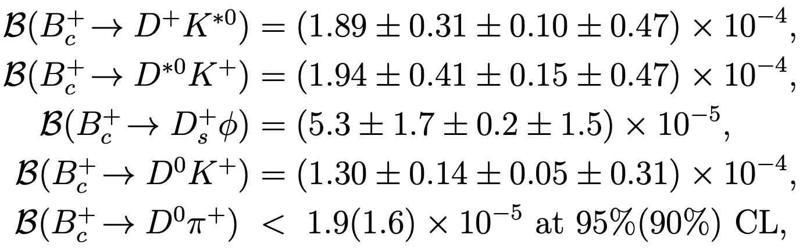
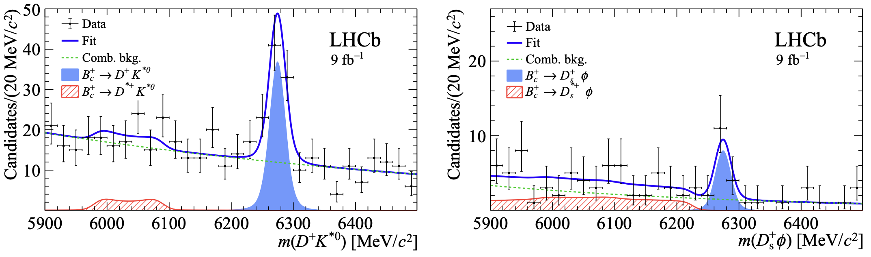

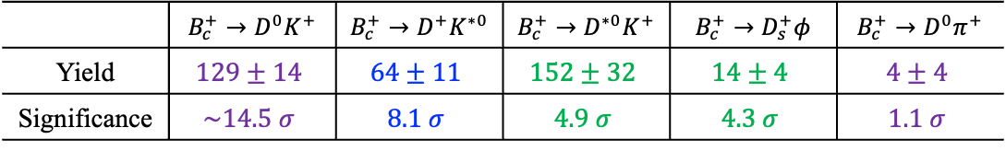


New measurement of $B_{c}^{+}→DX$decays
[LHCb-PAPER-2024-035, in prep.]
Conclusion
1st observed
preliminary
preliminary
stat
sys
ext
Strong evidence
CP symmetry: absent of $b→u$ amplitude
preliminary
preliminary
$s\overline{s}$ suppressed compared to $u\overline{u}/d\overline{d}$
BF of vector meson modes ($D^{∗0}K^{+},D^{+}K^{∗0}$) 1.5× more likely than $D^{0}K^{+}$
BF $\sim O({10}^{2})$ higher than the expected W emission and penguin amplitudes: annihilation dominance
also seen in $B_{u/d}$
 | $B_{c}^{+}→D^{0}K^{+}$ | $B_{c}^{+}→D^{+}K^{∗0}$ | $B_{c}^{+}→D^{∗0}K^{+}$ | $B_{c}^{+}→D_{s}^{+}φ$ | $B_{c}^{+}→D^{0}π^{+}$
Yield | $$129±14$$ | $$64±11$$ | $$152±32$$ | $$14±4$$ | $$4±4$$
Significance | $$\sim 14.5 σ$$ | $$8.1 σ$$ | $$4.9 σ$$ | $$4.3 σ$$ | $$1.1 σ$$

Slide 15
Quarkonium and Beauty Meson Spectrum
Charmonium spectrum is pretty well know. Bottomonium spectrum as well.
For B mesons, and in particular for $B_{s}$ or $B_{c}$, the knowledge is limited.
This talk will focus on the selected topics of beauty meson spectroscopy, includes
Observation of $B_{c}^{+}→Dh^{+} h^{−}$decays
arXiv:2509.15873

Slide 16
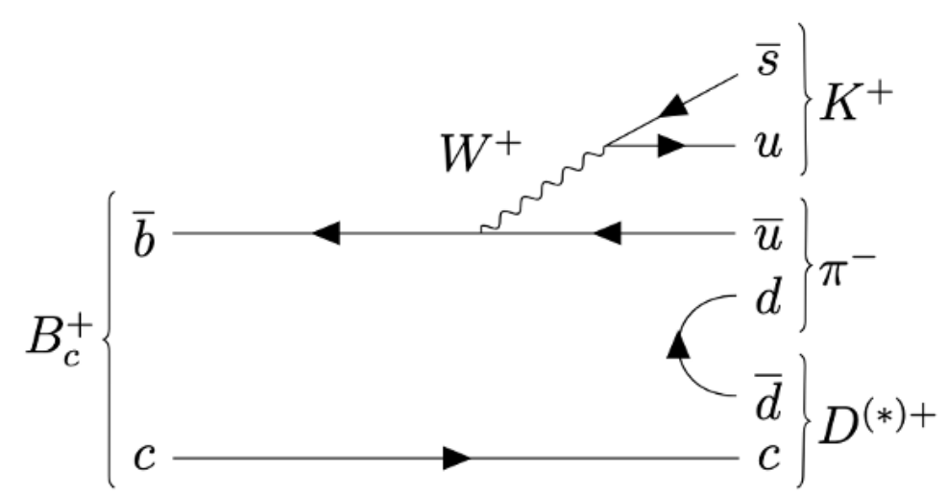
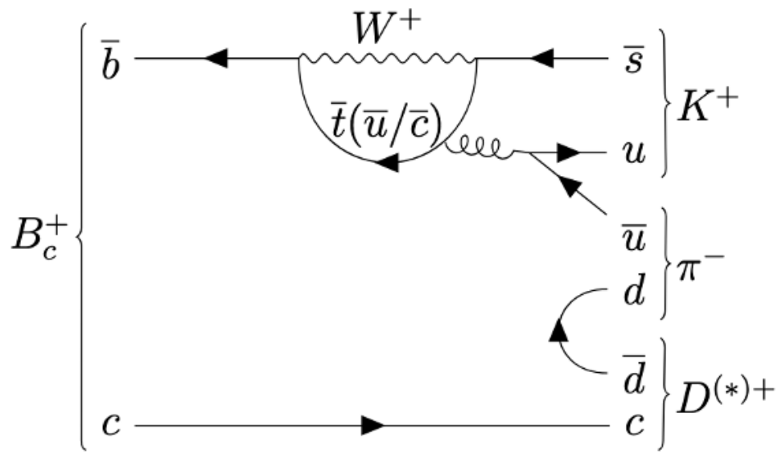
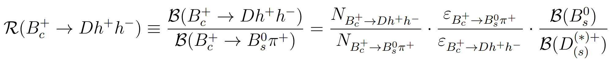
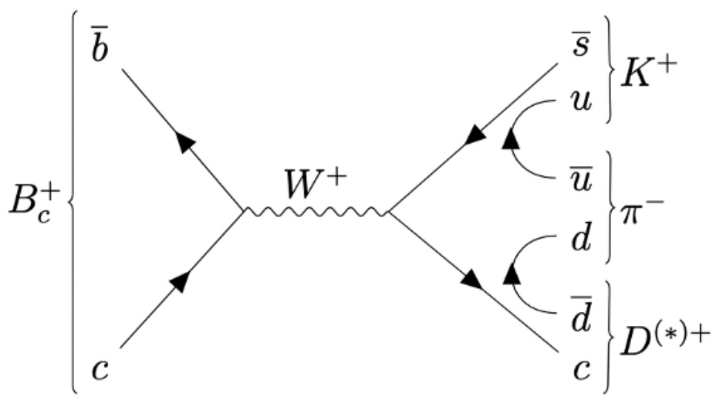
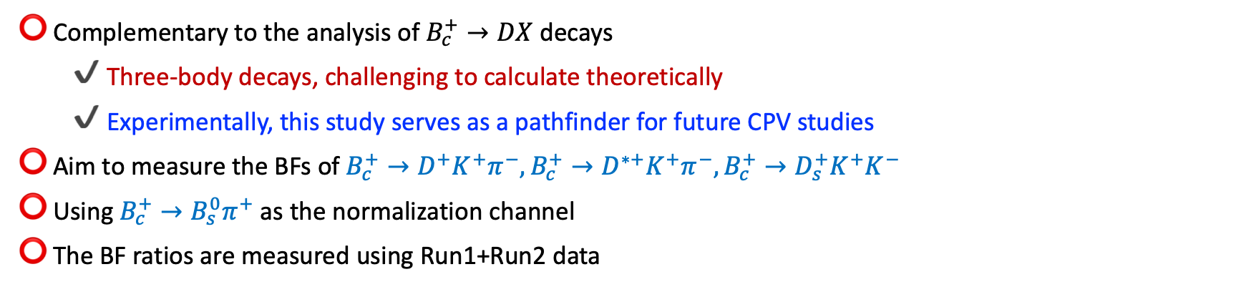
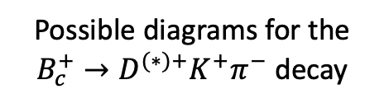
Observation of $B_{c}^{+}→Dh^{+} h^{−}$decays
arXiv:2509.15873
Complementary to the analysis of $B_{c}^{+}→DX$ decays
  Three-body decays, challenging to calculate theoretically
  Experimentally, this study serves as a pathfinder for future CPV studies
Aim to measure the BFs of $B_{c}^{+}→D^{+}K^{+}π^{−}, B_{c}^{+}→D^{∗+}K^{+}π^{−}, B_{c}^{+}→D_{s}^{+}K^{+}K^{−}$
Using $B_{c}^{+}→B_{s}^{0}π^{+}$as the normalization channel
The BF ratios are measured using Run1+Run2 data
Signal yield
Estimated from simulation
BF rom PDG
Possible diagrams for the $B_{c}^{+}→D^{(∗)+}K^{+}π^{−}$ decay

Slide 17
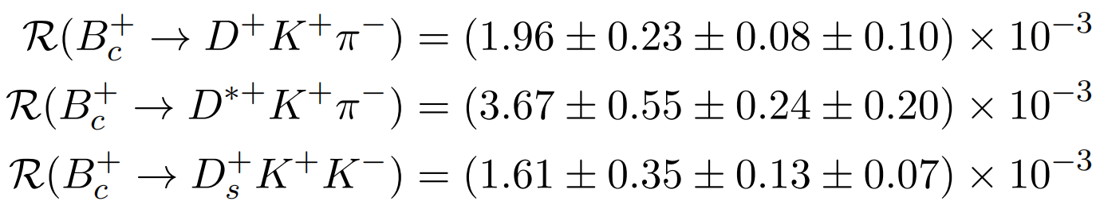
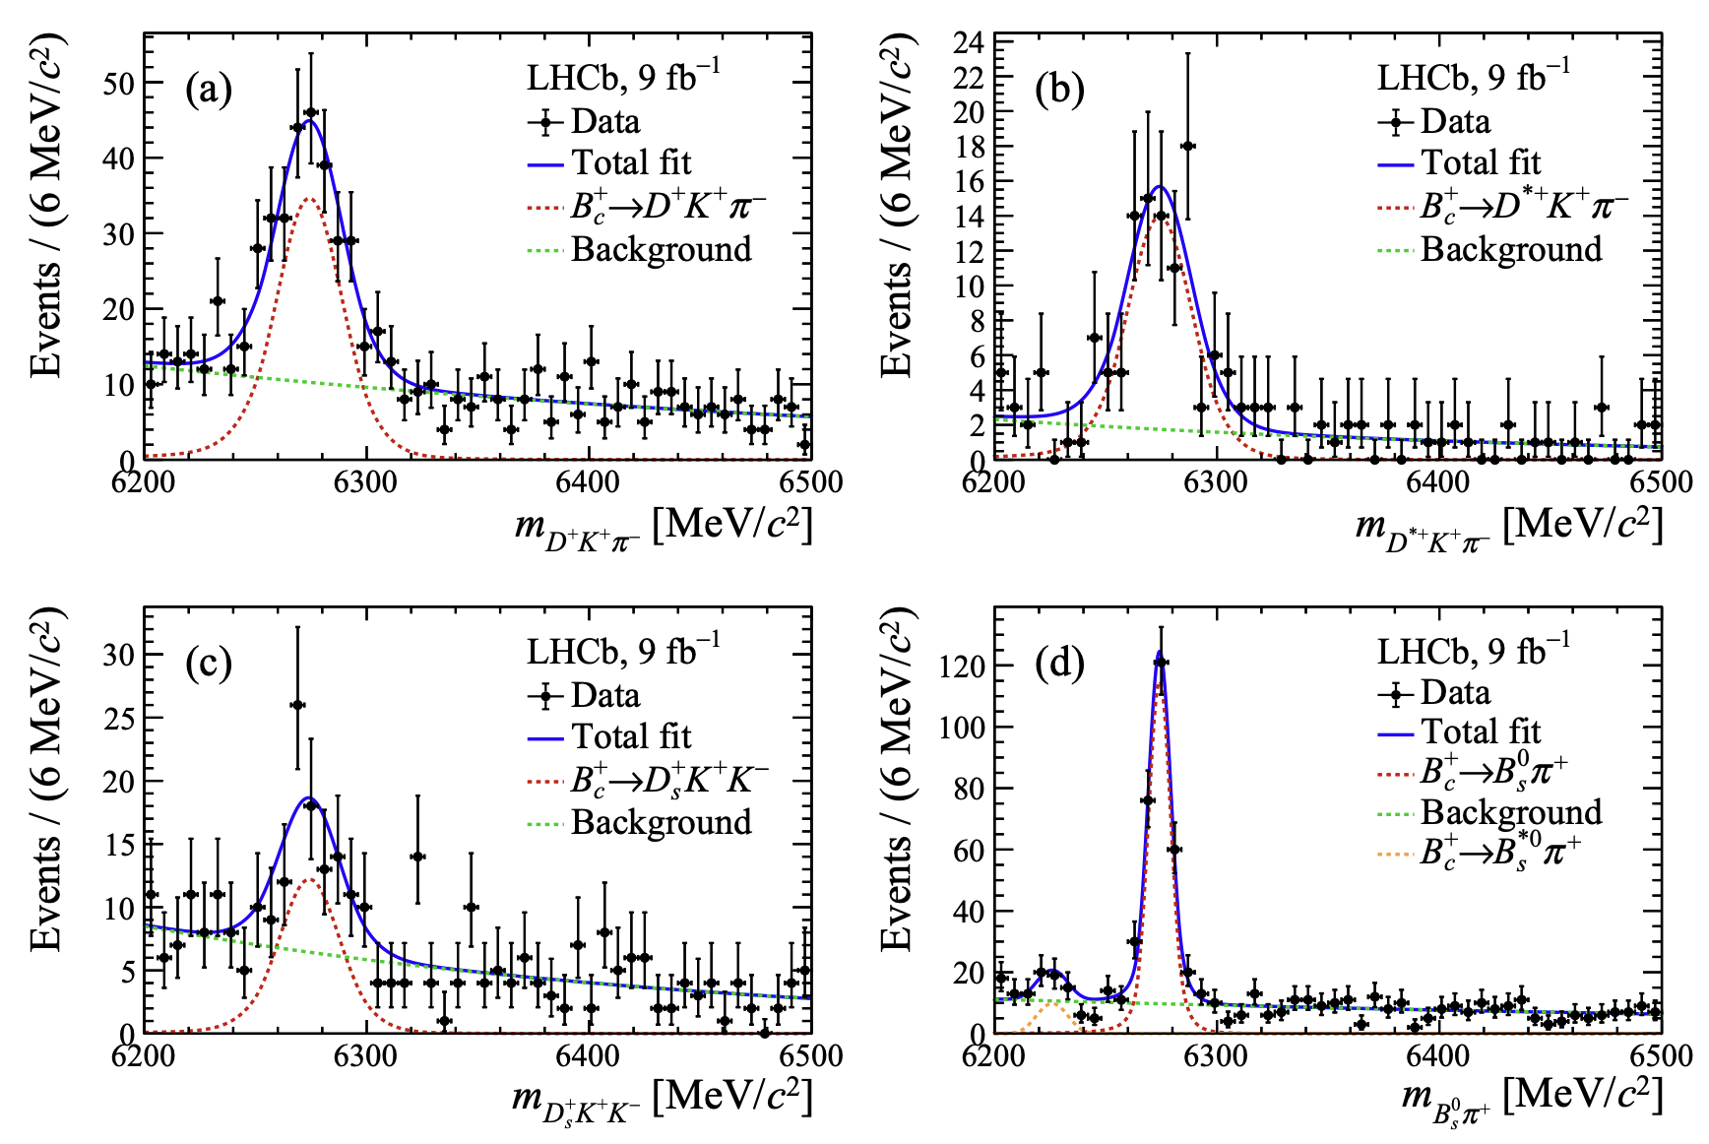
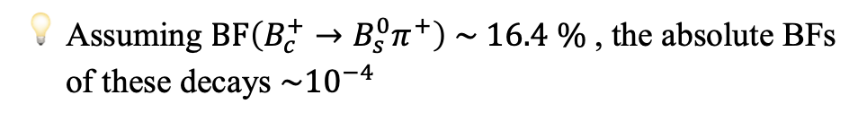
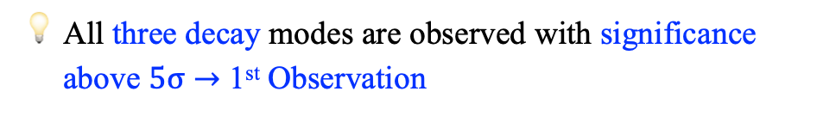
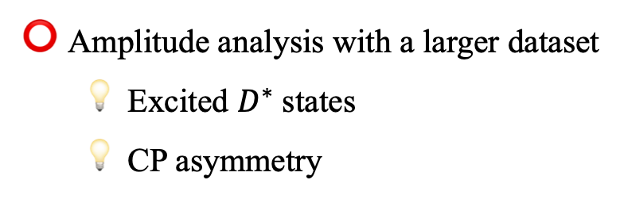
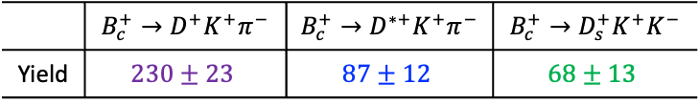
Observation of $B_{c}^{+}→Dh^{+} h^{−}$decays
arXiv:2509.15873
Conclusion
 | $B_{c}^{+}→D^{+}K^{+}π^{−}$ | $B_{c}^{+}→D^{∗+}K^{+}π^{−}$ | $B_{c}^{+}→D_{s}^{+}K^{+}K^{−}$
Yield | $$230±23$$ | $$87±12$$ | $$68±13$$
All three decay modes are observed with significance above $5σ→$ 1st Observation
Simultaneous fit results
stat
sys
ext
Assuming $BF\left(B_{c}^{+}→B_{s}^{0}π^{+}\right) \sim 16.4 \%$ , the absolute BFs of these decays $\sim {10}^{−4}$
[arXiv:hep-ph/0211021]
Amplitude analysis with a larger dataset
  Excited $D^{∗}$ states
  CP asymmetry

Slide 18

Quarkonium and Beauty Meson Spectrum
Baryonic B decays
Charmonium spectrum is pretty well know. Bottomonium spectrum as well.
For B mesons, and in particular for $B_{s}$ or $B_{c}$, the knowledge is limited.
This talk will focus on the selected topics of beauty meson spectroscopy, includes
First observation of the charmless baryonic decay $B^{+}→\overline{Λ}p\overline{p}p$
arXiv:2508.16259

Slide 19
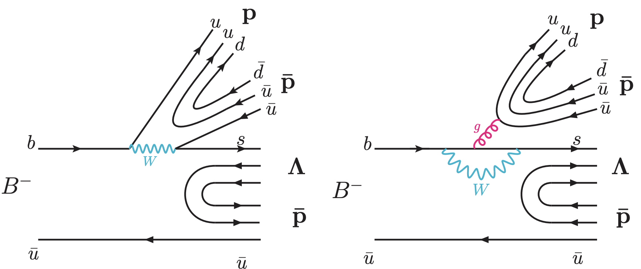
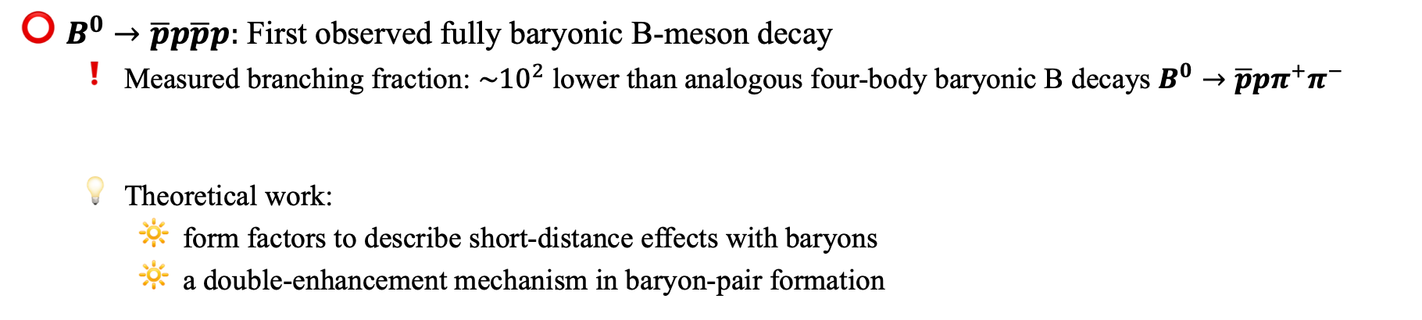
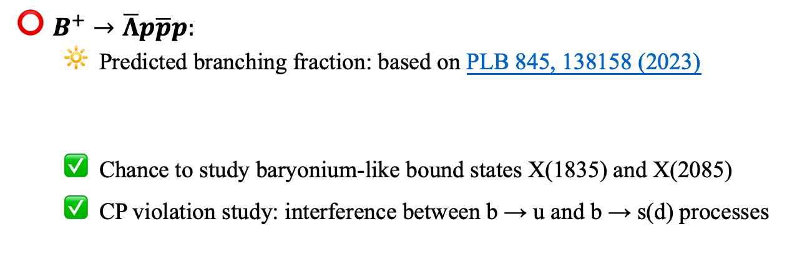
First observation of the charmless baryonic decay $B^{+}→\overline{Λ}p\overline{p}p$
arXiv:2508.16259
$B^{0}→\overline{p}p\overline{p}p:$ First observed fully baryonic B-meson decay
  Measured branching fraction: ${\sim 10}^{2}$ lower than analogous four-body baryonic B decays $B^{0}→\overline{p}pπ^{+}π^{−}$
  Theoretical work:
    form factors to describe short-distance effects with baryons
    a double-enhancement mechanism in baryon-pair formation
PRL 131, 091901 (2023)
PLB 845, 138158 (2023)
$B^{+}→\overline{Λ}p\overline{p}p:$
  Predicted branching fraction: based on PLB 845, 138158 (2023)
  Chance to study baryonium-like bound states X(1835) and X(2085)
  CP violation study: interference between b → u and b → s(d) processes
Feynman diagrams

Slide 20
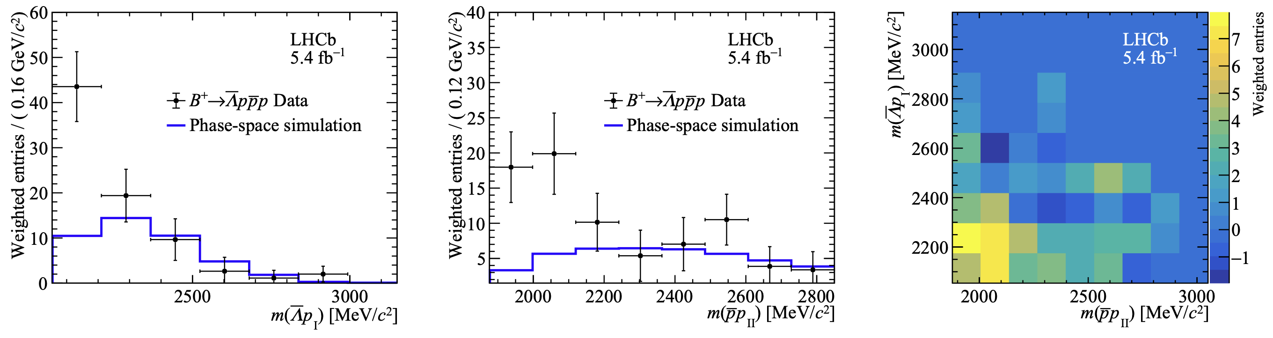
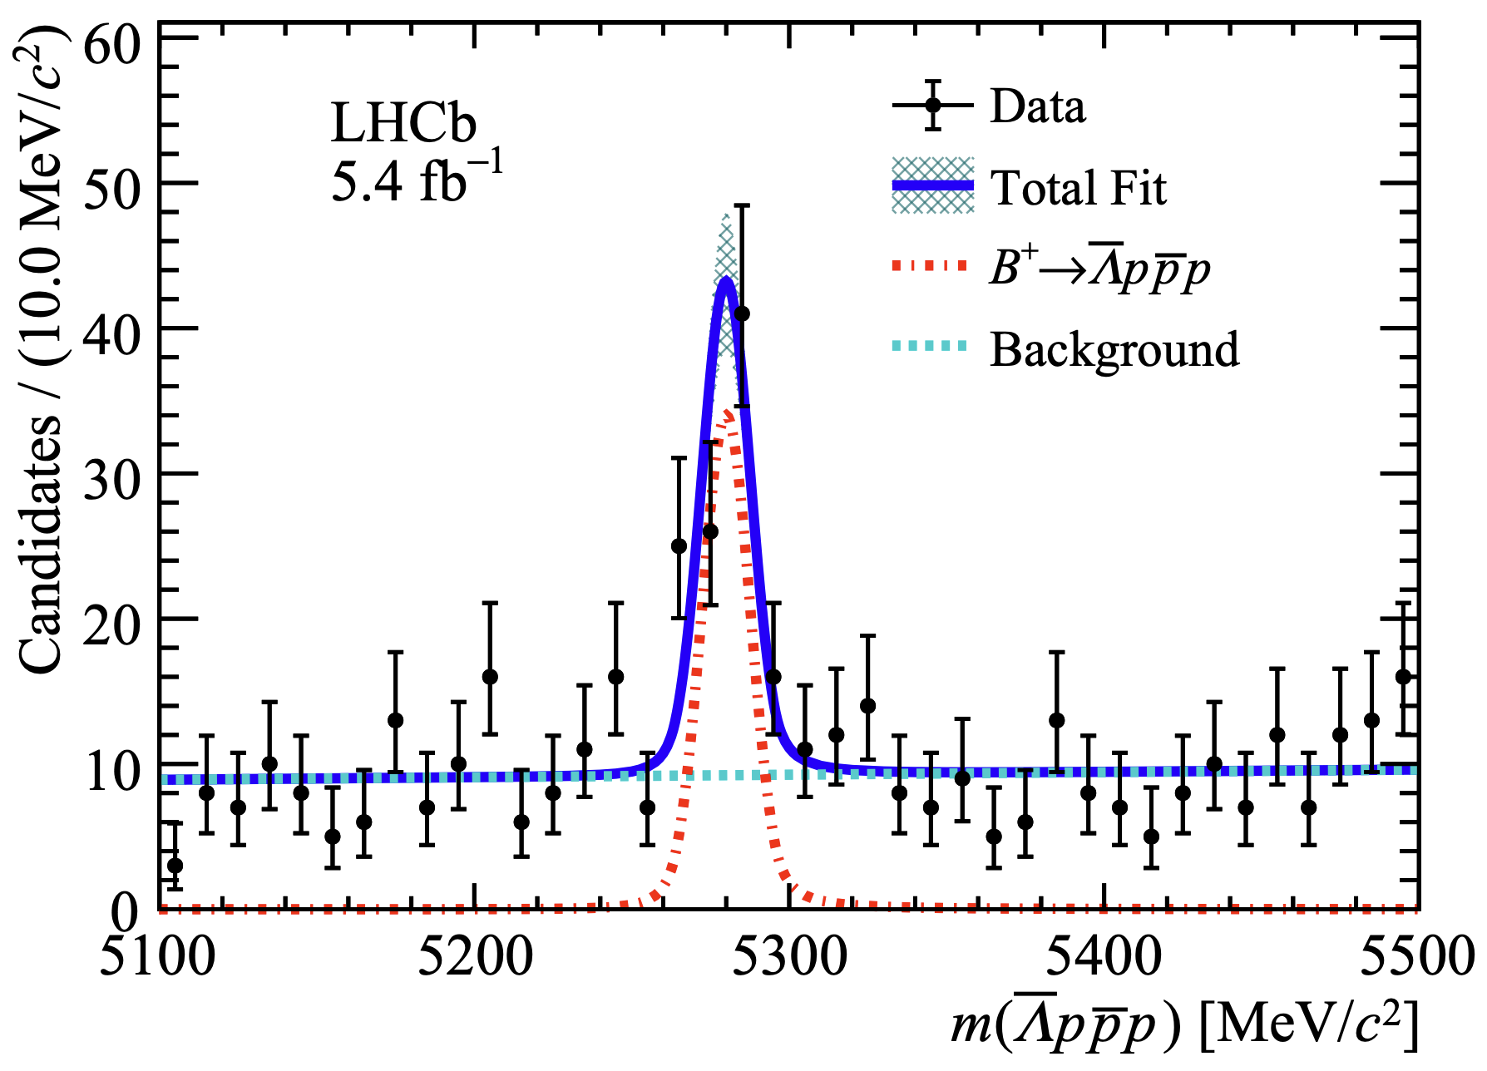

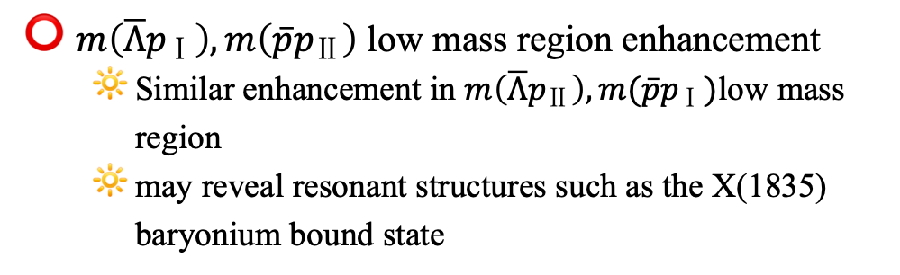
First observation of the charmless baryonic decay $B^{+}→\overline{Λ}p\overline{p}p$
arXiv:2508.16259
1st observed
Lower than SM prediction, but reasonable agreement
Influenced by
Nonfactorizable QCD corrections
CKM matrix-element inputs
Form-factor modeling
Measured CP asymmetry
Limited by statistics
$m\left(\overline{Λ}p_{Ⅰ}\right),m\left(\overline{p}p_{Ⅱ}\right)$ low mass region enhancement
  Similar enhancement in $m\left(\overline{Λ}p_{Ⅱ}\right),m(\overline{p}p_{Ⅰ})$low mass region
  may reveal resonant structures such as the X(1835) baryonium bound state
2-baryon invariant mass spectra

Slide 21

Quarkonium and Beauty Meson Spectrum
Charmonium spectrum is pretty well know. Bottomonium spectrum as well.
For B mesons, and in particular for $B_{s}$ or $B_{c}$, the knowledge is limited.
This talk will focus on the selected topics of beauty meson spectroscopy, includes
Observation of the decay $B_{(s)}^{0}→K_{S}^{0}p\overline{p}$ and branching fractions measurement
JHEP 07 (2025) 121

Slide 22




Observation of the decay $B_{(s)}^{0}→K_{S}^{0}p\overline{p}$ and branching fractions measurement
$b→u$ and $b→qqs(d)$: a valuable probe into underlying dynamics of B meson decays
  Respective BF measurement: testing theoretical models
  Relative BF between $B_{(s)}^{0}→K_{S}^{0}p\overline{p}$: tests of flavor symmetries
  CPV measurement: beyond SM physics (Dalitz analyses can measure CP-violating parameters)
$p\overline{p}$ enhancement near threshold: how nontrivial intermediate states influence the decay dynamics
Observed decay rate hierarchy
  $B^{0}→K^{0}p\overline{p}$rate significantly lower than that of the $B^{+}→K^{+}p\overline{p}$ mode,
  similar rate in other decay modes: $B^{0,+}→ π^{0}K^{0,+}$and $B^{0,+}→J/ψK^{0,+}$
JHEP 07 (2025) 121

Slide 23




Observation of the decay $B_{(s)}^{0}→K_{S}^{0}p\overline{p}$ and branching fractions measurement
JHEP 07 (2025) 121
Two optimized procedures to extract $B^{0}→K_{S}^{0}p\overline{p}$ and $B_{s}^{0}→K_{S}^{0}p\overline{p}$ signal yields
Conclusion
1st observation
Most precise measurement to date
Future: time-dependent Dalitz analysis extracting CP-violating parameters
$B^{0}→K_{S}^{0}p\overline{p}$
$B_{s}^{0}→K_{S}^{0}p\overline{p}$

Slide 24


Summary
Observation of new charmonium(-like) states in $B^{+}→D^{∗±}D^{∓} K^{+}$
  $h_{c}\left(4000\right)$, $h_{c}(4300)$
Observation of orbitally excited $B_{c}^{+}$ states
  $B_{c}{\left(1P\right)}^{+}$
Observation of $B_{c}^{+}→Dh^{+}h^{−}$ decays
  $B_{c}^{+}→D^{+}K^{+}π^{−}, B_{c}^{+}→D^{∗+}K^{+}π^{−}, B_{c}^{+}→D_{s}^{+}K^{+}K^{−}$
New measurement of $B_{c}^{+}→DX$decays
  $B_{c}^{+}→D^{∗0}K^{+}, B_{c}^{+}→D^{+}K^{∗0}, B_{c}^{+}→D_{s}^{+}φ$
First observation of the charmless baryonic decay $B^{+}→\overline{Λ}p\overline{p}p$
Observation of the decay $B_{(s)}^{0}→K_{S}^{0}p\overline{p}$ and branching fractions measurement
💥
New states
QCD
💥
New $B_{c}$ decays
CPV
💥
New baryonic decays
Thanks for your attention!

Slide 25
Selected topics
Backup

