Slide 1


IPAC25 presentations ATS Seminar 18 June 2025
Cryogenic Efficiency and Sustainability Aspects for Particle Accelerators and Detectors
A. Perin, B. Bradu, J. Bremer, S. Claudet, D. Delikaris and F. Ferrand, CERN
As presented at the 16th International Particle Accelerator Conference
1 – 6 June 2025, Taipei, Taiwan

Slide 2
Outline
Introduction
Cryogenics for accelerators and detectors
Heat extraction at low temperature and efficiency
Some perspectives for accelerators and detectors
Heat recovery
Helium availability
Conclusions

Slide 3
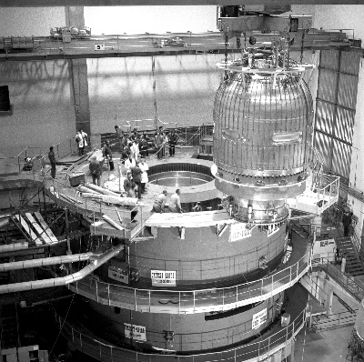
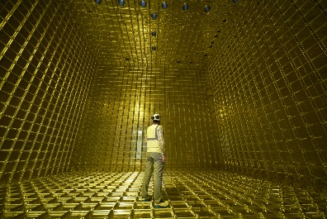
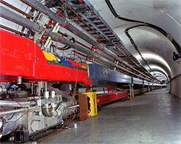
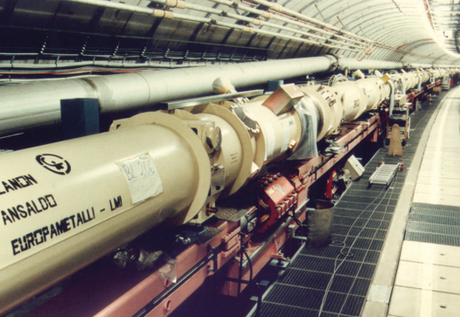
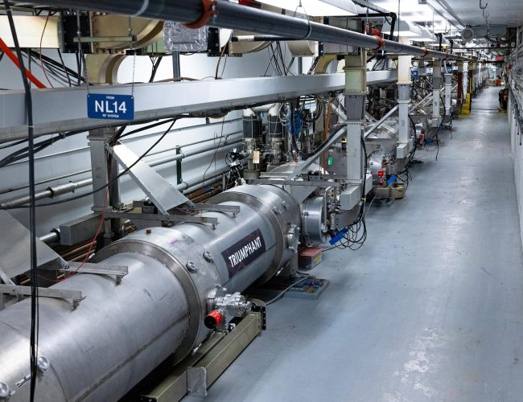
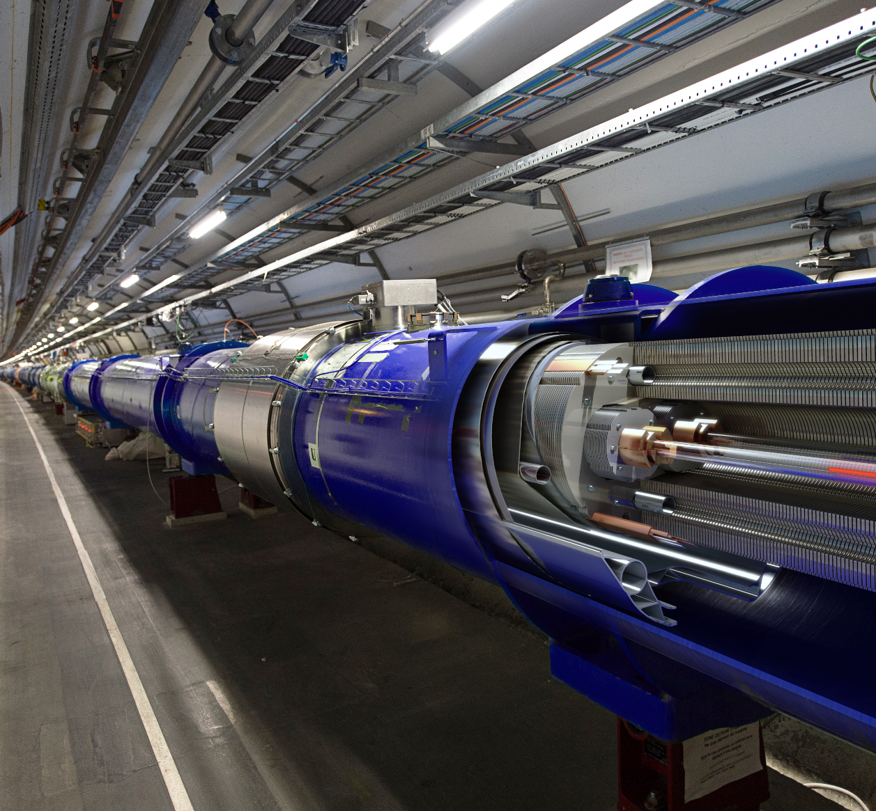
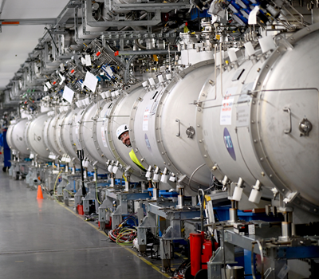

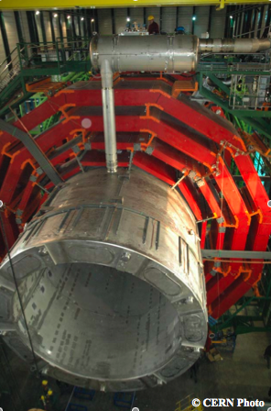
Cryogenics, particle accelerators and detectors
Cryogenics has been a key enabling technology for particle accelerators and detectors since the 1950s.
Non-exhaustive list of particle accelerators with major cryogenics: Tevatron, HERA, CEBAF, RHIC, SNS, LHC, SPIRAL2, European XFEL, LCLS-II, ESS, FAIR, etc.
Most future accelerator studies include cryogenics: EIC, ILC, FCC, Muon Collider
Cryogenics has been used for detectors since the 1950’s for SC magnets and detection
BEBC (1970)
ProtoDUNE
Tevatron
HERA
CEBAF
LHC
ESS
ATLAS
CMS

Slide 4

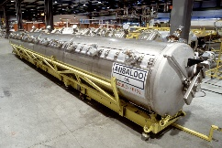
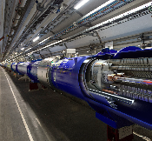
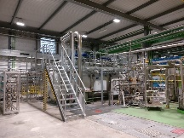
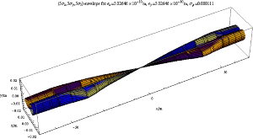
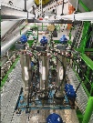
Typical facility: cryogenics at CERN
Increasing cryogenic installed capacity !
BEBC
LEP2
LHC
SM18
HL-LHC
HL-LHC P4

Slide 5
Cryogenics and energy
For existing and most future accelerator and detector projects, cryogenic systems play a major role in both capital and energy costs.
Cryogenics can account for between 20% and 60% of the total energy consumption, with yearly consumption of several hundred GWh
Public acceptance of large scientific infrastructures is more and more dependent on the demonstration that sustainability aspects, like the energy consumption are considered.
Cryogenic energy efficiency is essential to ensure the technical, financial, environmental, and societal viability of these projects.
Power | LHC | FCC-ee (ttbar) | FCC-hh (1.9 K)
Total Power (MW) | 100 | 360 | 350
Cryogenics (MW) | 39 | 46 | 206
Cryogenics (%) | 39% | 13% | 59%
Energy / year
Total (GWh) | 700 | 1800 | 2340
Cryogenics (GWh) | 295 | 400 | 1360
Cryogenics (%) | 42% | 22% | 58%
Power and energy consumption for CERN LHC and FCC studies
NB. Geneva Canton 2023 (about 500 k person): 2700 GWh
CERN total (2023): 1300 GWh

Slide 6
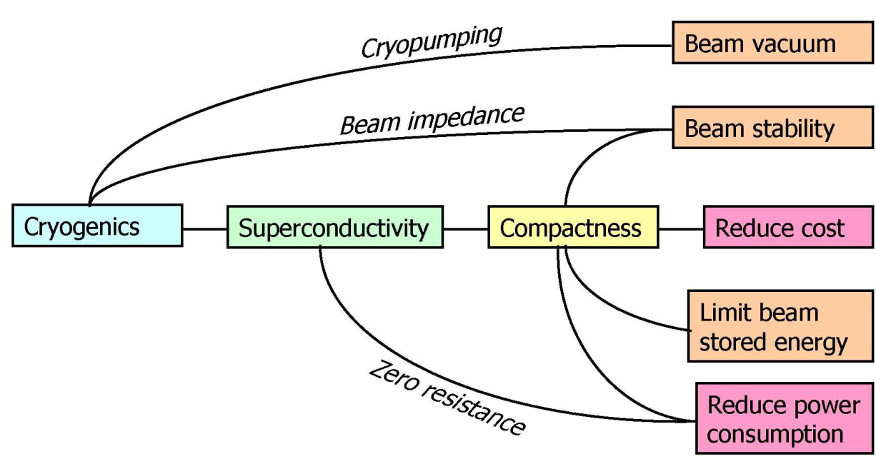
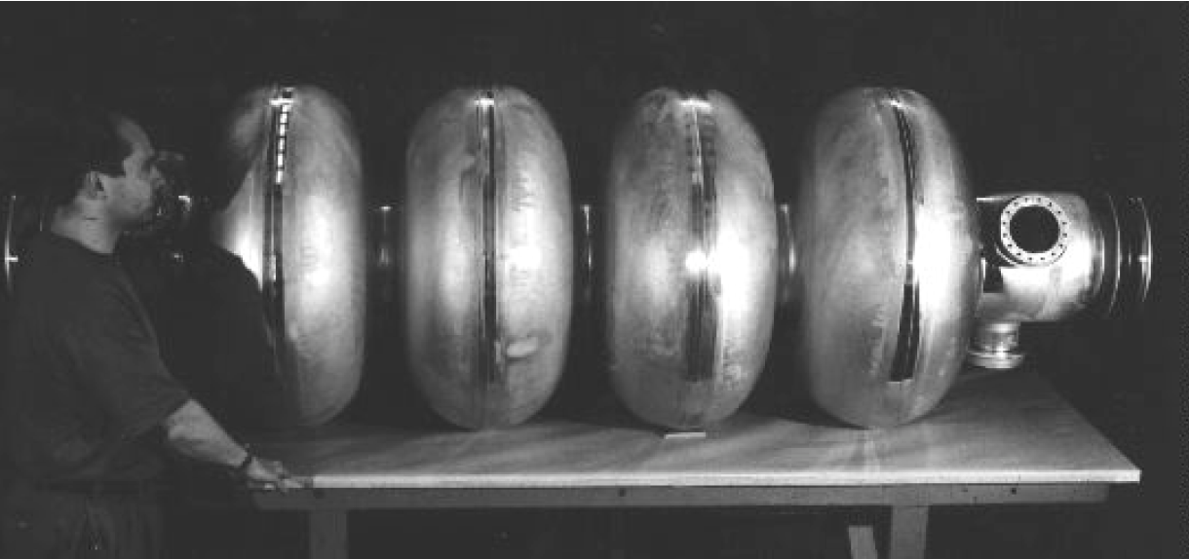
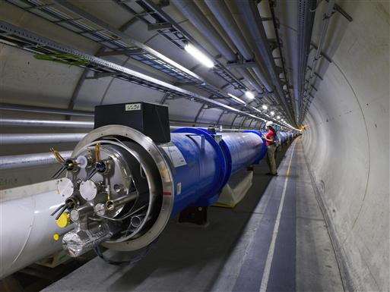
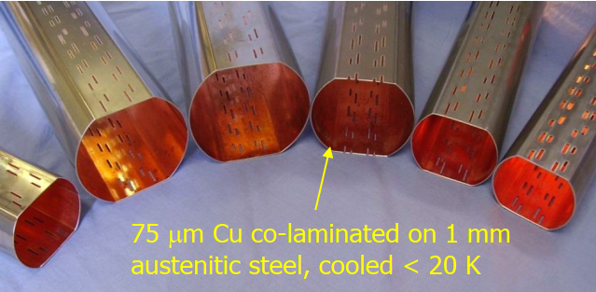
Cryogenics for accelerators
Provide conditions for superconductors
“Compactness” and feasibility
    High field magnets: focusing and high field for circular accelerators.
    e.g for protons: E_{beam} [GeV] ≈ 0.3 · B [T] . R [m]
    RF cavities: higher field possible: E_{beam} [GeV] ≈ E [MV/m] · L [m]
Saving energy: operation cost
Absent or very low resistance
Low impedance for beam stability
Distributed cryopumping
Rationale of cryogenics for accelerators
 | Magnets | RF cavities
Resistive | P_{input} ≈ E_{beam} | P_{input} ≈ R_{s} · L · E²/ω; Q ≈ 1 / R_{s}
Superconducting | P_{input} ≈ P_{cooling} | High Q: Rs ≈ R_{BCS} + R_{o} R_{BCS} ≈ (1/T) exp(-B · T_{c}/T)
LEP SRF cavities
LHC dipole
LHC beam screen

Slide 7
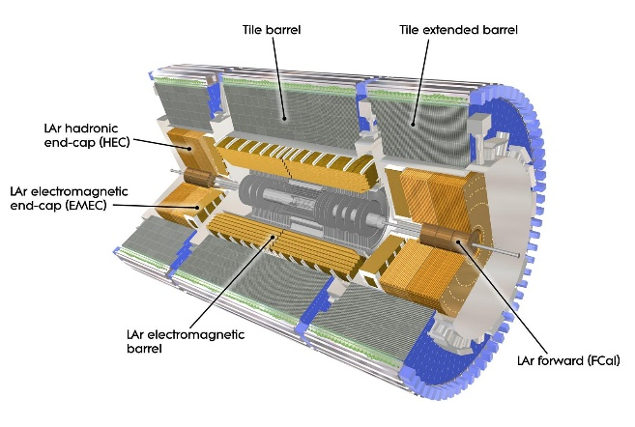
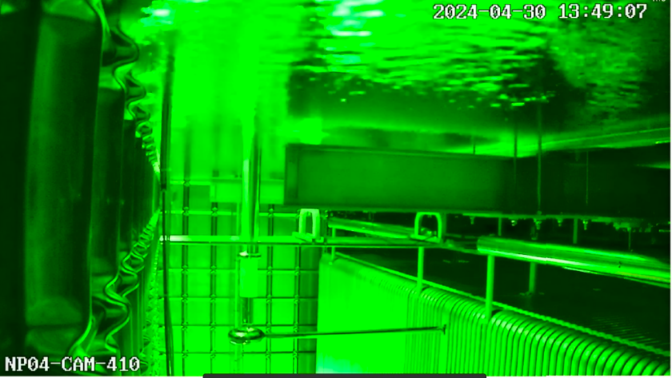
Cryogenics for detectors and other applications
Superconducting magnets for detectors
Particle detectors need moderate magnetic fields 2 T – 4 T
Large volume
Transparency to particles
Solenoid or toroidal fields
Usually NbTi conductors at 4.5 K, cooled by forced flow or thermosyphon.
Particle detection
Liquefied noble gases for calorimeters (Ar, Kr) around 80 K
Targets LH₂
Other detectors: liquid Ar: ICARUS (neutrino), Dune (neutrino), Darkside (dark matter), etc. around 80K
Very low temperature Transition Edge Sensors (low power).
Quantum computing
Large capacity at very low temperature will potentially be needed.
ATLAS forced flow cooled toroid magnets
CMS solenoid thermosyphon cooled magnet
Liquid argon calorimeter of ATLAS
ProtoDUNE (NP04), liquid Argon submerged camera

Slide 8
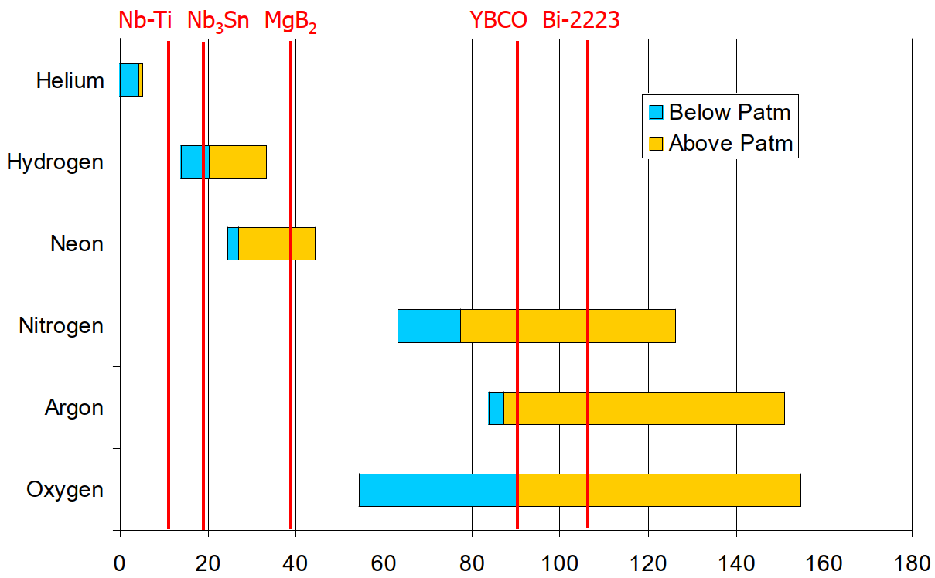
Cryogenics and superconductors
Superconductors need low temperatures !
LT conductors cooling at 1.9 K / 2 K (HeII) / 4.5 K (LHe) / 4.5 – 5.5 K (supercritical He cooling, SC links)
MgB₂ or HTS at 20 K – 80 K
HTS current leads in the range 4.5 K – 50 K
Superconducting links: MgB₂ 4.5 – 20 K and REBCO 20 K – 60 K
SC RF cavities 2 K, 4.5 K
Range of cryogens and applications
He-Ne mix
Temperature [K]
Low temp. SC (LTS)
High temp. SC (HTS)

Slide 9
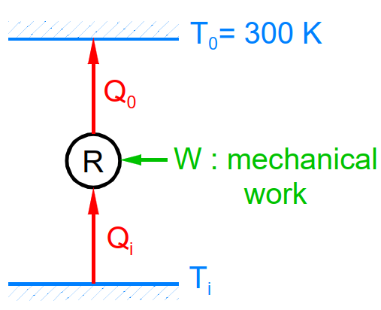
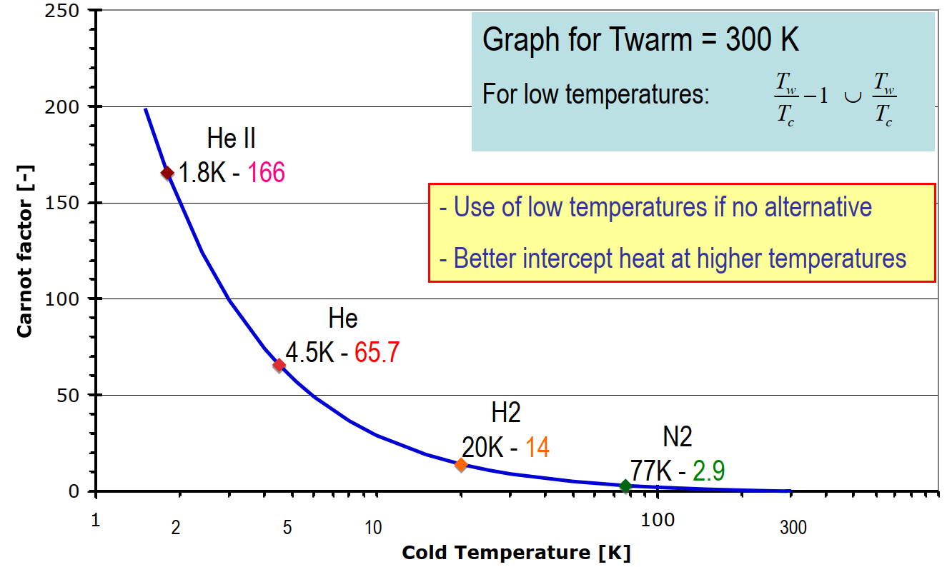
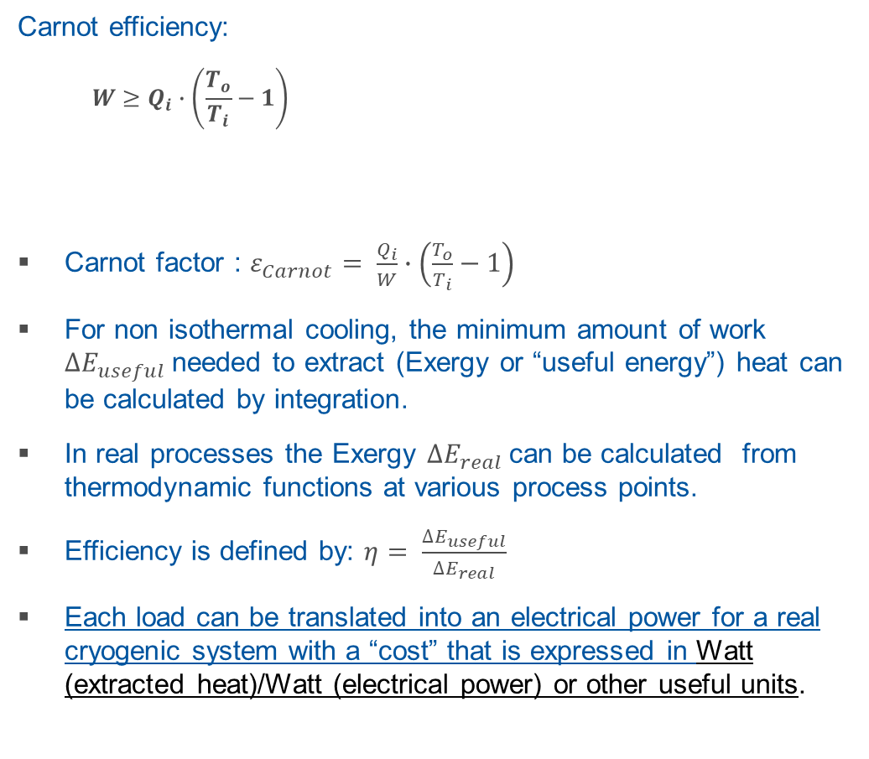
Extracting heat at low temperature
The single most important factor !
Carnot efficiency:
$$W≥Q_{i}∙\left(\frac{T_{o}}{T_{i}}−1\right)$$
Carnot factor : $ε_{Carnot}= \frac{Q_{i}}{W}∙\left(\frac{T_{o}}{T_{i}}−1\right)$
For non isothermal cooling, the minimum amount of work ${∆E}_{useful}$needed to extract (Exergy or “useful energy”) heat can be calculated by integration.
In real processes the Exergy ${∆E}_{real}$can be calculated from thermodynamic functions at various process points.
Efficiency is defined by: $η= \frac{{∆E}_{useful}}{{∆E}_{real}}$
Each load can be translated into an electrical power for a real cryogenic system with a “cost” that is expressed in Watt (extracted heat)/Watt (electrical power) or other useful units.
Load | Temp. Level [K] | Equ. @4.5 [W] | Elec. power [W]* | Description
"cost / Watt" (per W) | 50 – 75 | 0.07 | 18 | Screen cooling, 18.5 bar
 | 4.5 – 20 | 0.55 | 138 | LHC beam screen, 3 bar
 | 20 – 25 | 0.18 | 45 | Typical MgB2, 1.3 bar
 | 4.5 | 1 | 250 | LHe boiling 1.3 bar
 | 1.8 | 3 | 750 | LHe II boiling 16 mbar
liquef. (per g/s) | 4.5–290 | 100 | 25000 | Liqu. of He (per g/s)
Current Leads (per kA) | 4.5–290 | 5.5 | 1375 | Norm. cond. lead (per kA)
 | 20–290 | 2.3 | 580 | Feed at 20 K (per kA)
 | 50-290 | 1.2 | 312 | Feed at 50 K (per kA)
* assuming 250 W electric power per watt isothermal @4.5 K, approx. 26% efficiency

Slide 10
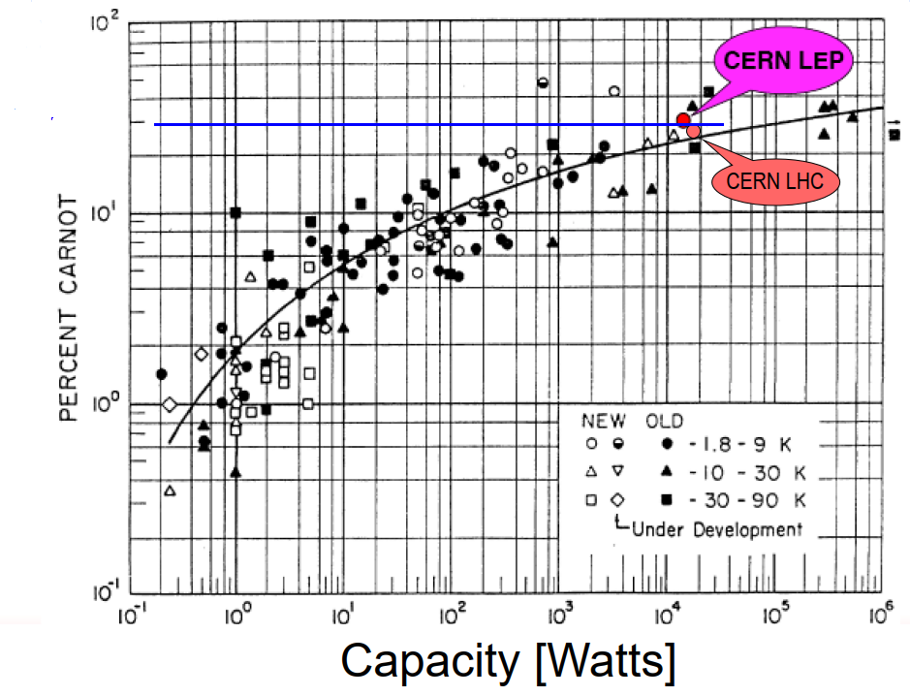
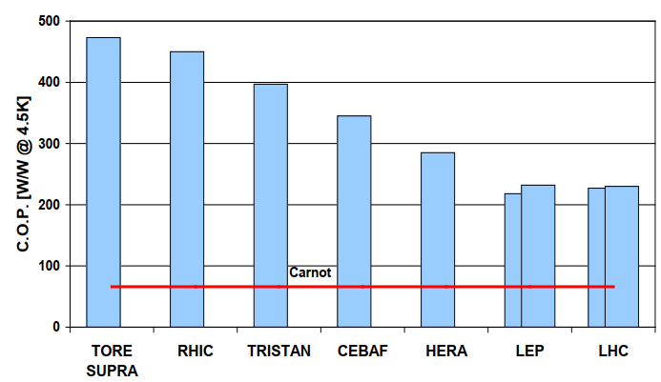
Refrigeration
The Strobridge diagram
Refrigerators (Claude cycle)
In practice the best cryoplants achieve about 25% -30% of ideal (Carnot) efficiency.
The efficiency w.r.t Carnot does not depend on the temperature, but rather on the size !
The largest possible, the best !
Cryocoolers
Convenient for low power and cryogen free
Power available up to 9 W @4.5 K, 6W @4.5 & 100 W @55 K, etc.
Typical power requirements > 1kW / W @4.5 K (<10 % carnot).
30%
250 W/W@4.5K

Slide 11
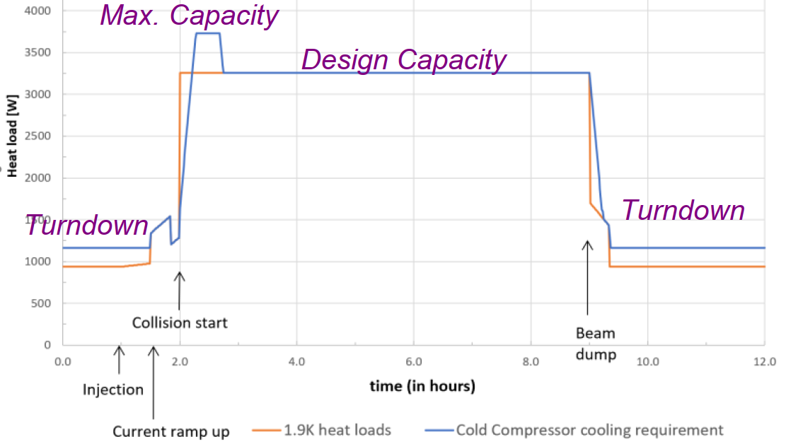
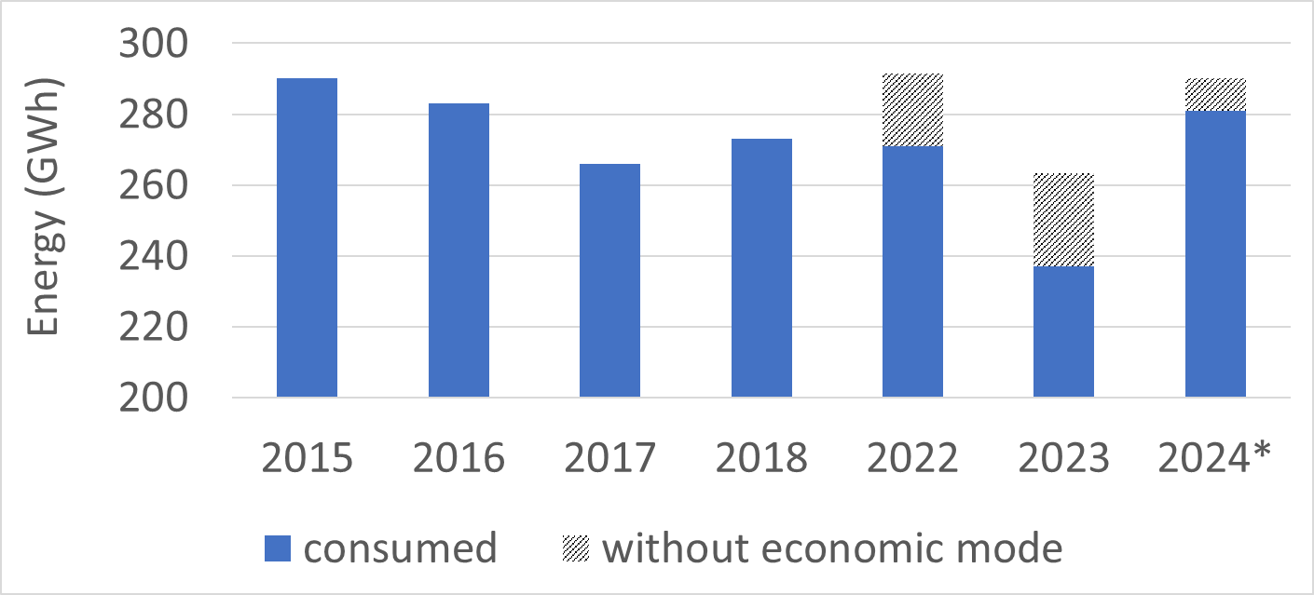
Efficiency for refrigerators
Expansion turbine efficiency is already high (Isentropic efficiency ~ 80 %)
The weak point remains the compression:
  Isothermal efficiency of oil-lubricated screw compressors are usually below 55 %.
  Alternatives in process arrangement or machinery should be considered for future projects requiring high-power refrigeration at high efficiency.
  Potential of improvements: turbo compression, combined turbo Brayton cycle with He-Ne process. Commercial products exist for up to 150 kW at 77 K, with Carnot efficiency up to 40%. Envisaged for FCC-hh, 3.6 MW between 40 K and 60 K. Also no oil !
Turn down efficiency matters ! Non-negligible time spent in “standby modes”.
  Three-pressure Claude cycle allows for efficient turn-down capability by letting the medium and high pressures “float”, e.g. HL-LHC.
Item | Machine | Insertions | Unit | Comments
Turbo-brayton cooling capacity | 3454 | 182.8 | kW @ [40-60] K | incl. current leads cooling
Turbo-brayton electrical power consumption | 46 | 2.8 | MW_elec | /
Envisaged Turbo Brayton refrigeration for FCC-hh @1.9 K study (courtesy L. Delprat)
-20
GWh
-9 GWh
v₂
-26
GWh
v₁
Typical capacity vs time for HL-LHC cryoplants (courtesy E. Monneret)
*prevision
until 31st Dec
LHC energy consumption with gains after introduction of economic mode

Slide 12
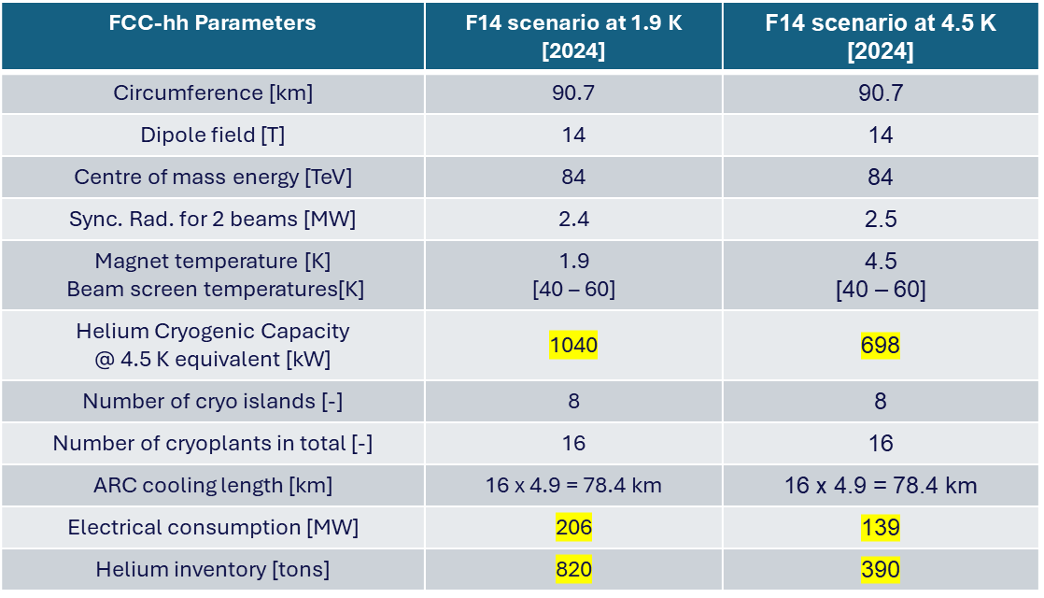
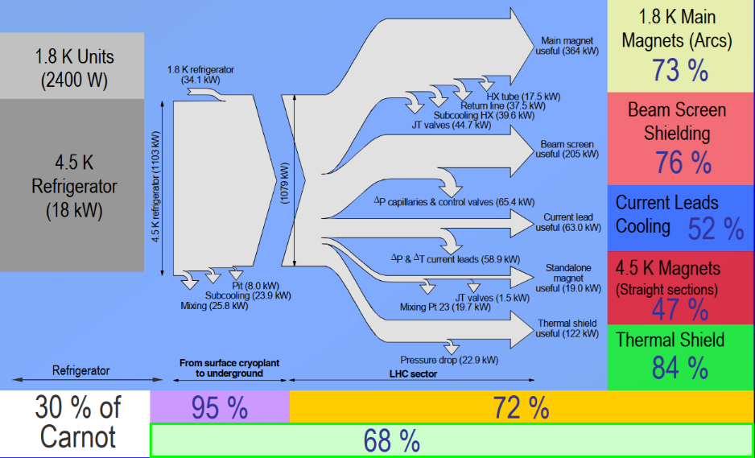
Efficiency for system design
The single most efficient way:
  Use the highest possible temperature
  Minimize heat load at low temperature: HTS current leads, heat shields, beam screens, etc.
System configuration and cryogenic distribution optimization
  For large accelerators the cryogenic distribution can be a significant source of heat leads.
  first-principle losses: including heat leaks and fluid friction within the distribution system
  second-principle losses: when the cooling provided does not closely match the actual temperature requirements of the cooled system
  Low heat inleak distribution lines and, if possible, avoid cryogenic pumps.
  Match process temperatures with actual needs (possible trade-off with complexity).
Comparison of FCC-hh @1.9 K and 4.5 K study (courtesy L. Delprat)
Exergy flow diagram for an LHC sector

Slide 13
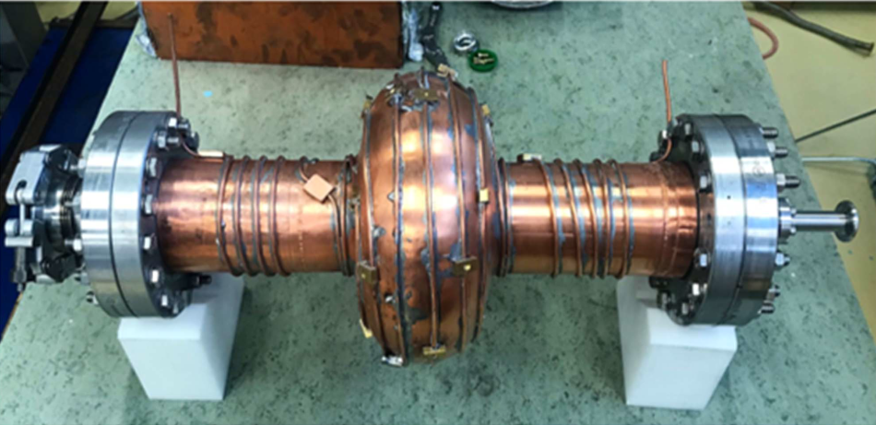
Some perspectives for accelerators
Superconducting magnets
Medium term still require low temperature (1.9 K/ 4.5 K) for High field magnets. Most current accelerator under study plan to use Nb₃Sn at 4.5 or 1.9 K.
Use of Nb3sn opens the possibility to envisage channel/conduction cooled magnets.
In the long-term, development of HTS could enable either low-field-high-temperature applications, or higher fields at intermediate temperature (20 K).
Questions of transient heat load during ramping needs to be addressed.
Superconducting RF cavities
Most current accelerator under study plan to use Nb at 2 K, needed for achieving the required performance.
Development is ongoing for use of Nb3Sn coated RF cavities. This could enable conduction/channel cooling. Possibly with a cryocooler, with however potential difficulties for scalability.
Development for possible use of HTS coated cavities.
Current transport properties of superconductors (Courtesy A. Ballarino)
Mock-up 1.3 GHz Cu cavity with soldered cooling capillary tube for test at CERN (courtesy M. Chioteli).
REBCO cable 2 kA @ 77 K

Slide 14
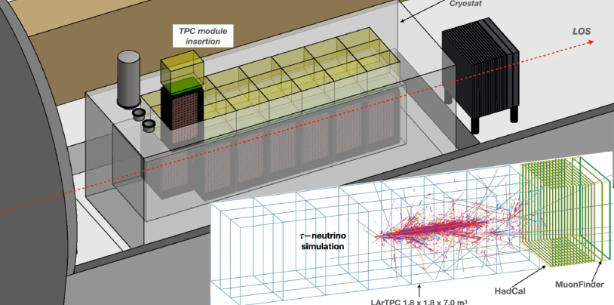
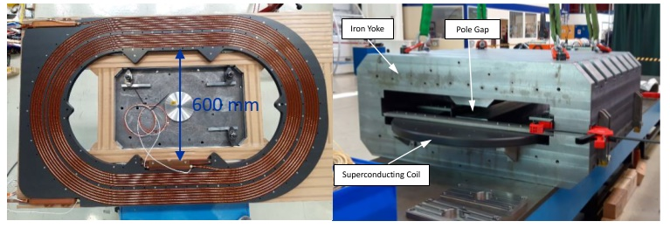
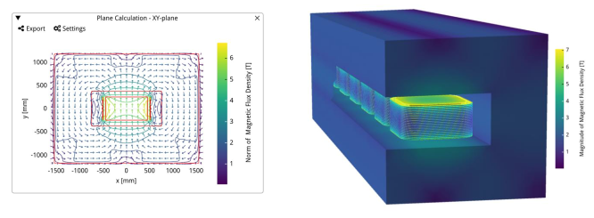
Some perspectives for detectors
Calorimeters
In the typical temperature of 77 K – 80 K, efficiency improvement could be expected with the use of Turbo-Brayton refrigerators (e.g. FLArE experiment study at CERN).
Superconducting magnets
Moderate magnetic fields and mostly static operation: potential for MgB₂ or HTS REBCO conduction cooled magnets.
Several projects envisage using cryocoolers with MgB2 or REBCO (SHiP, IDEA, etc.). Great simplification of the cryogenic system.
The FLarE liquid Argon detector study
MgB₂ Superferric magnets operating at 20 K, development for SHiP experiment at CERN (courtesy L. Baudin)
Study for HTS-REBCO magnet at 30 K for the Muon Shield of the SHiP experiment at CERN (courtesy M. Dam)

Slide 15
Heat recovery
The extraction of heat at low temperature results in the release of large amount of heat to the ambient. Typical temperature < 100°C.
Possibility to integrate heat recovery in specifications for cryoplants (cf. HL-LHC).
Since 2015, CERN has studied and launched 3 multi-MW heat recovery projects. Two of them are under finalisation (heating plants) and a third one with major tenders on-going for a start of production expected respectively autumn 2025 to autumn 2026.
Ongoing studies and projects at PSI, DESY, ESS and other research infrastructures.
Future projects will be able to consider this highly visible societal acceptability factor. The synergy with large users (own site or a user community) will be key for implementation

Slide 17
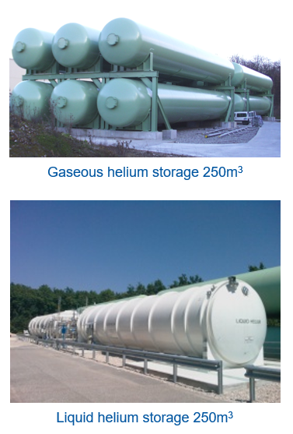
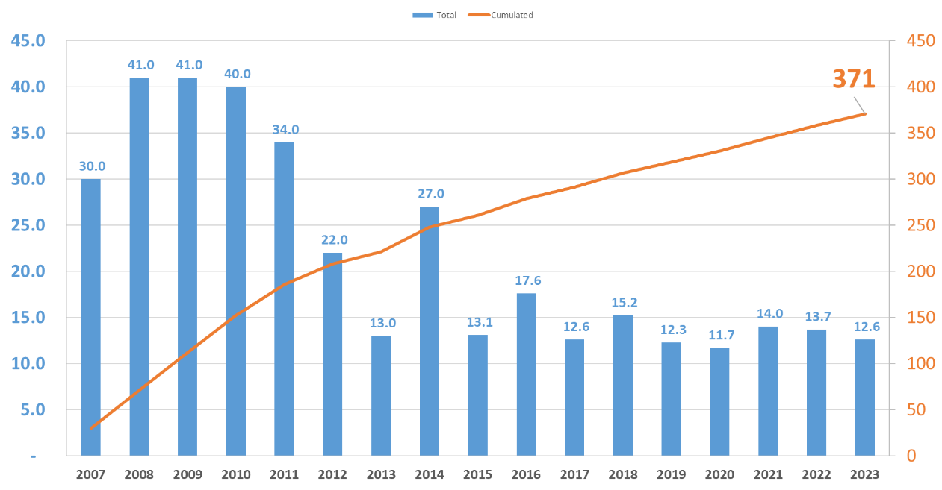
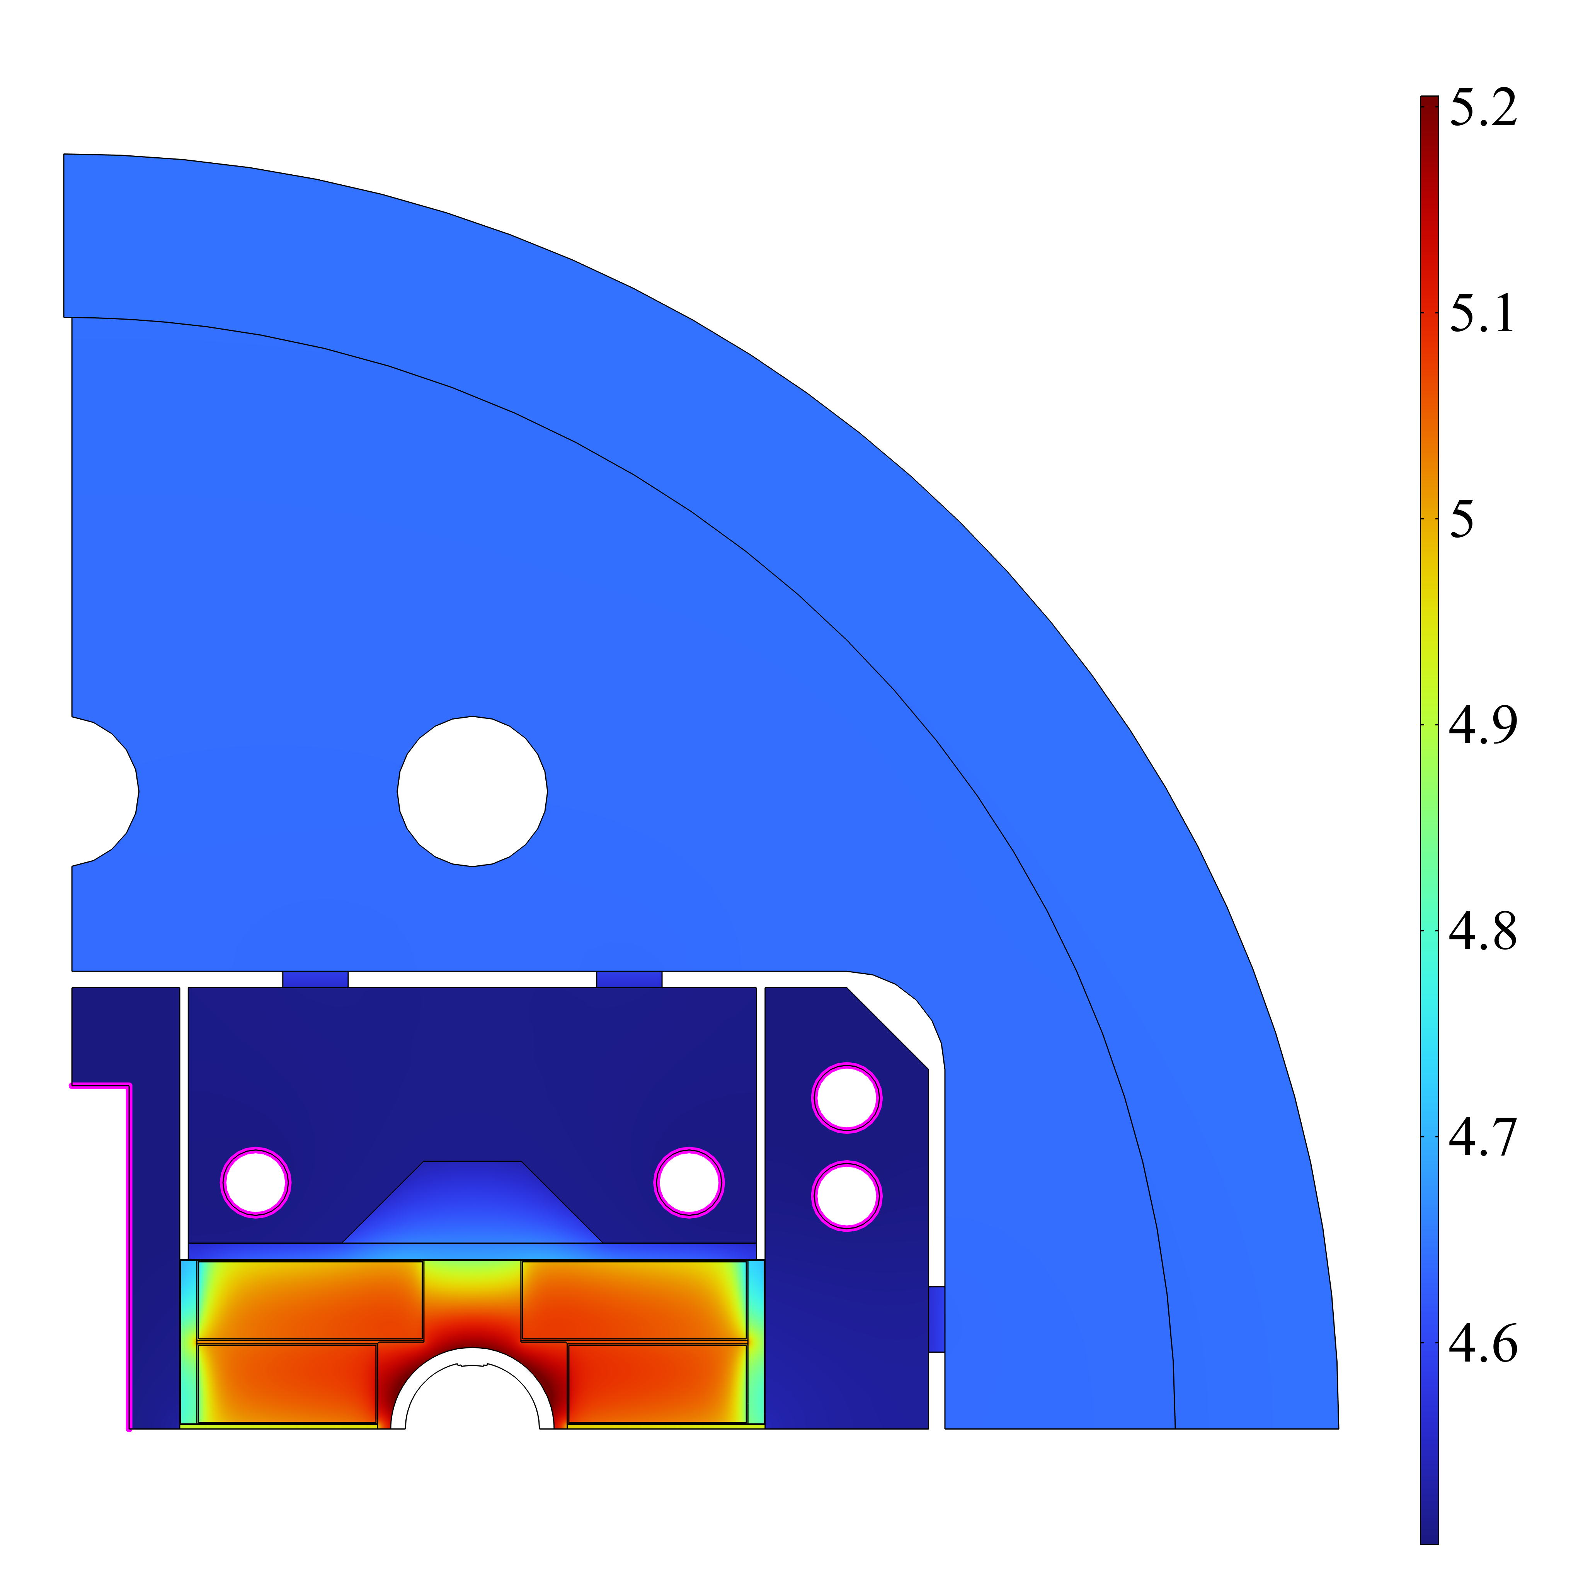
Managing helium
Helium is non-renewable. Losses happen ! Difficult to go below 10% !
Helium is mandatory for cryogenics below 20 K !
Annual production (2023) approx. 28’000 T but recent supply crisis with large price variation. Demand is expected to increase.
Save, plan, manage when needed
Reduce inventory when possible (possible trade-off of buffering at low temperature!)
FCC-hh magnet configuration | Helium inventory
1.9 K immersed | 820 T
4.5 channel/conduction cooled | 390 T
LHC Filling
RUN1
LS1
RUN2
LS2
RUN3
LHC: Gaseous storage 15’200 m³ = 44 tons,
Liquid storage 720 m³ = 90 tons
Study for conduction cooling of FCC-hh magnets at 4.5 K with channel cooling and reduction of helium inventory (courtesy P. Borges de Sousa)
Helium losses during LHC operation: LHC Inventory 140 to 150 T , <10% of losses for the LHC machine
Courtesy F. Ferrand, CERN

Slide 18
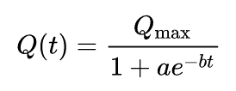
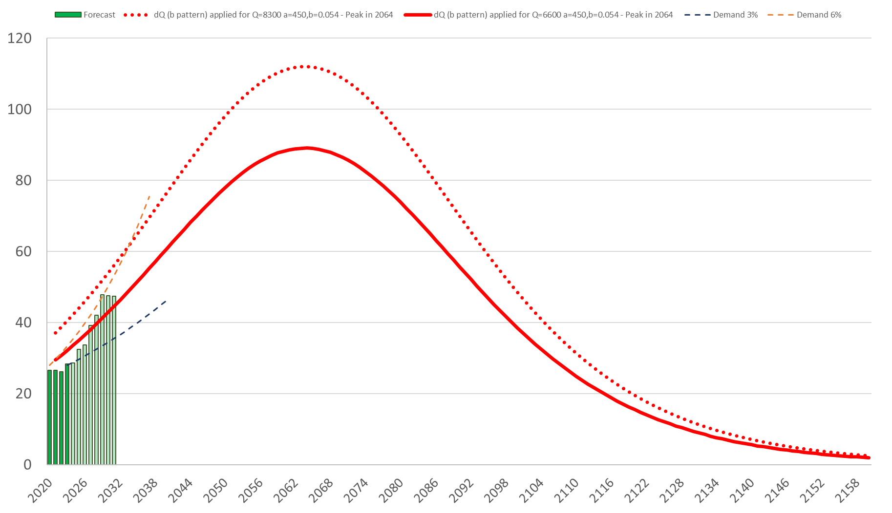
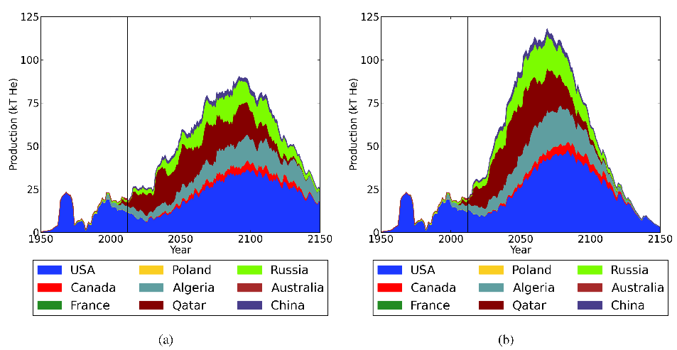
Helium: tentative forecast for the next century ?
Theoretical exercise with high level of uncertainty
Long term projections are risky, but some models are published based on exponential decrease model:
Source Minerals 2014 by Steve Mohr and James Ward
based on WW estimated reserve of 8’300 Kt
“The elephants” behind the figures:
To obtain helium as a by-product, LNG must be extracted from the relevant sources. How does this align with the current fossil fuel trajectory?
Without a business model that justifies investment in helium liquefaction at the source, there is a high risk of losing the molecules anyway.
Exponential decrease model (b) compared to production capacity forecast
Slide Courtesy F. Ferrand, CERN

Slide 19
Conclusions
Cryogenics can represent a significant portion of the total energy consumption of large facilities.
A careful design of the cryogenic system, matching as closely as possible the actual cooling needs, remains essential for efficiency.
Improvements in the efficiency of large cryogenic refrigerators can be expected from the future introduction of turbo compression.
Introduction of new materials has the potential to increase the operating temperatures and/or simplify the cryogenic systems.
Heat recovery can improve the social acceptability of large-scale refrigeration.
Cryogenic energy efficiency is essential to ensure the technical, financial, environmental, and societal viability of large-scale projects!

Slide 21
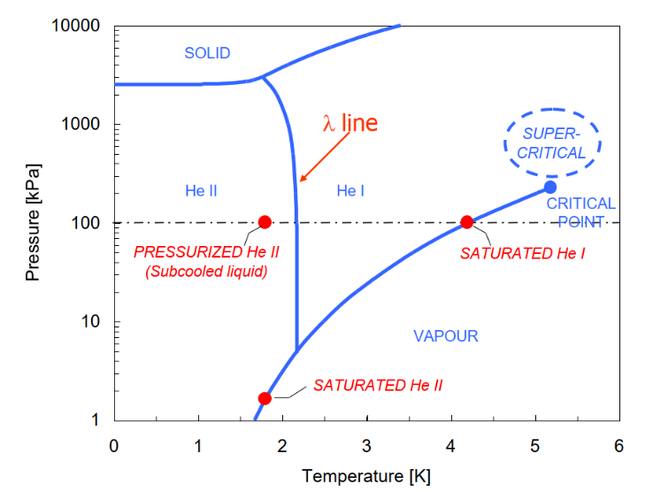
Cryogenic fluids (helium, nitrogen, argon, krypton)
Helium inventory at CERN: 170 t (today) : needs to be managed !
      LHC (accelerator & detectors) helium full inventory: 136 t
      Strategic permanent storage : 20 t
Nitrogen liquid for LHC (accelerator & detectors) full cool down: 11’500 t
      (equivalent to 500 ISO-transportable containers delivered), normal consumption CERN wide about 6’000 t/year.
Argon liquid for Neutrino platform and ATLAS calorimeter: up to 1’800 t
Krypton liquid for NA62 calorimeter: 24 t (detector cryostat 30 years in continuous operation)
Hydrogen small amount in targets
Phase diagram of helium < 6 K
Characteristic temperatures of cryogenic fluids [K]
Fluid | Triple point | Normal boiling point | Critical point
Methane | 90.7 | 111.6 | 190.5
Oxygen | 54.4 | 90.2 | 154.6
Argon | 83.8 | 87.3 | 150.9
Nitrogen | 63.1 | 77.3 | 126.2
Neon | 24.6 | 27.1 | 44.4
Hydrogen | 13.8 | 20.4 | 33.2
Helium | 2.2 (λ point) | 4.2 | 5.2
ProtoDUNE (NP04), liquid Argon submerged camera

