Slide 1
Manpower and Financial Structure
of ELENA Construction
and AD Consolidation
Vacuum System
P. Chiggiato
TE-VSC

Slide 2
Main topics
ELENA vacuum system feasibility
Proposed technical solution
Costs
Manpower needs
AD consolidation
Costs and manpower

Slide 3
ELENA Vacuum System feasibility
The vacuum chamber diameter will be 70mm.
Pressure requirement | 10⁻¹² Torr
Total surface area of the ring | About 10 m²
Gas load after bakeout non-fired st. Steel (H₂) | 2x10⁻⁷ Torr l s⁻¹ | Required S for (H₂): 2x10⁵ l s⁻¹ -> unfeasible
Gas load after bakeout fired stainless steel (H₂) | 2x10⁻⁸ Torr l s⁻¹ | Required S for (H₂): 2x10⁴ l s⁻¹ -> feasible
Conductance of a ID 70 beam pipe aperture (H₂) | 1693 l s⁻¹
Maximum applicable effective S (H₂) in the beampipe (lump pump) | about 800 l s⁻¹
Minimum number of pumps needed | 25 | 4 to 5 per straight section

Slide 4
ELENA Vacuum System feasibility
P_{o}+ΔP
P_{o}
1.3 m
5.1 m
P_{o} = Q/S = 5.7x10⁻¹⁰ / 800= 7.1x10⁻¹³ Torr
ΔP= Q/8C =7.5x10⁻¹⁰/ (8x118)=6.0x10⁻¹³ Torr
P_{max} ≈ 1.3x10⁻¹² Torr
Effective pumping speed at the pressure maximum:
1/S_{eff}=1/S + 1/C _{(half pipe)} = 1/800 + 1/236
S_{eff} = 182 l/s
Maximum gas load of installed monitors and devices:
Q_{max}= 1.10⁻¹² x 182 x 2 = 3.6 x 10⁻¹⁰ Torr l/s

Slide 5
ELENA Vacuum System feasibility
NEG coating solution
Ti-Zr-V thin film coating onto all inner walls of the vacuum chambers.
Total pumping speed for H2:
S=A C_{H2} α_{H2}=10⁵ x 44 x 8 10⁻³=35200 l s⁻¹
P=Q/S=2 10⁻⁸/3.5 10⁴=6x10⁻¹³ Torr
(this is an upper limit because the outgassing rate of a NEG coated surface is much lower than that of a bare surface).
Maximum pumping speed of the beampipe aperture:
S_{H2}= σ(α) x 1693 = 0.17 x 1693 = 288 l s⁻¹
Maximum allowed outgassing rate of any device installed in the beampipe:
Q_{MAX}= 10⁻¹² x 288 x 2 = 6 x 10⁻¹⁰ Torr l s⁻¹
For 3 x 10⁻¹² Torr ->Q_{MAX}= 1.8 x 10⁻⁹ Torr l s⁻¹

Slide 6
Proposed Technical Solution
The pressure requirement is within our reach. The proposed solution can be based on either:
  vacuum fired beampipes pumped by NEG lump pumps, or
  NEG coated vacuum chambers.
  A safety margin can be obtain by combining the two solutions.
A severe limitation must be imposed to the outgassing rate of any device installed in the vacuum system (Q<1x10⁻⁹ Torr l s⁻¹) including kickers and beam position monitors.
Ion pumps
Rough estimation of the CH₄ gas load:
Q_{CH4} ≈ 5x10⁻¹⁶ Torr l s⁻¹ cm⁻² x 10⁵ cm² = 5 x 10⁻¹¹ Torr l/s
Estinated pumping speed for CH₄ :
S_{min} = Q_{CH4} /1x10⁻¹² = 50 l/s ≈ 3 ‘VACION-PLUS 40 starcell’ installed in the ring.

Slide 7
Costs of ELENA’s Ring
Total cost of the Elena ring and injection lines’ vacuum system
Items | Cost [KCHF] | Comment
Studies and prototyping | 170 | Mechanical design and integration not included
Vacuum chambers, bellows and supports | 400 | Including surface and thermal treatments, NEG coating
Local pumps and power supplies | 120 | NEG cartridge and ion pumps
Valves | 225
Vacuum instruments | 90 | Pirani-Penning + Bayard-Alpert, including power supplyes
Bakeout equipment and control | 175
Commissioning | 140 | Including TMP group and leak detector
Control, cabling, interlock | 160
Quality control and acceptance tests | 35
Total cost ≈ 1.5 MCHF

Slide 8
Manpower for ELENA’s Ring
Manpower FSU [KCHF] | TE-VSC FTE [MY] | Needed manpower contribution FTE [MY]
100 | 3 | 2
TE-VSC APT line
 | 2012 |  | 2013 |  | 2014
 | Cat2 | Cat3 | Cat2 | Cat3 | Cat2 | Cat3
ELENA Project |  |  | 1 | 1 | 1 | 2

Slide 9
Experimental Lines (Vacuum)
Beam lines to transport the 100-keV antiprotons to the experimental areas
Total length of 63 m:
15 m common ejection line from ELENA to the beam switchyard
15 m ASACUSA line to entrance of the present RFQD
20 m ALPHA line
two 3-m long beam-lines for the two ATRAP zones
8 m AEGIS line
Effective beam aperture: 60 mm (70 mm on both sides used for in-vacuum electrodes and insulation).
Beam pipe diameter: 200 mm (CF250).
Vacuum: 10⁻⁹ – 10⁻¹² Torr depending on the position.

Slide 10
Experimental Lines (Vacuum)
Cost an Manpower Estimation
The estimation was done by Masaki Hori.
The vacuum layout should by reviewed by TE-VSC in the next months.
Cost estimation (Vacuum system only)* | TE-VSC FTE [MY]* | Needed manpower contribution FTE [MY]*
1557 KCHF (not in TE-VSC APT) | 0 | 3
* Excluded from Masaki Hori’s estimation: electrostatic steering system, beam profile monitors and magnetic shielding.
We need expertise and manpower for the new experimental lines

Slide 11
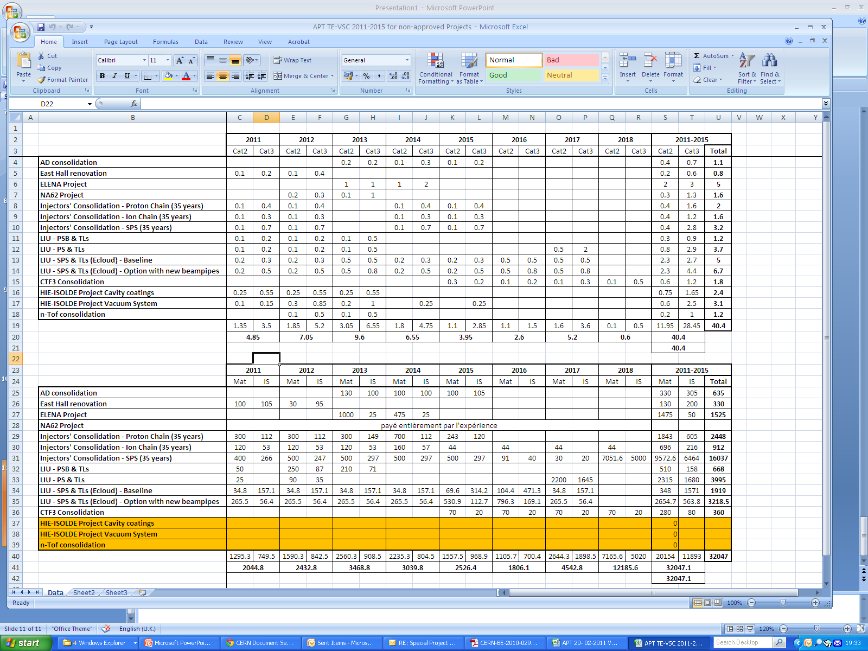
AD consolidation
TE-VSC APT line
The TE-VSC group activity for AD consolidation is mostly focused on the replacement of power supplies of ion pumps and instrumentation.
The final aim is the full integration of AD in the PVSS system.
The estimated cost is 635 KCHF (Material: 330, FSU: 305)
The consolidation will be undertaken entirely in the TE-VSC group.
A machine shut-down longer than 5 months is needed.

Slide 12
Conclusions
To tackle the ELENA project we need help from the collaborations, in particular for the experimental lines, in the period 2012-2014:
Beam line | Needed FTE [MY]
ELENA ring | 2
Experimental lines | 3

