Slide 1
Radiation Protection for ELENA
Joachim Vollaire on behalf of DGS-RP

Slide 2
What do we do ?
Design and installation phase
  Perform radiological risk analysis
  Support project for integration of RP requirements in design and installation phase
Commissioning and Operation phase
  Risk assessment at work places and radiological classification
  Monitor radiation levels with permanent monitoring system (RAMSES/ARCON)
  Ensure compliance with RP requirements
End of project
  Supervise decommissioning and dismantling
  Radioactive Waste characterization and elimination

Slide 3
RP studies during design
Identification ionizing radiation sources (input from BE)
  Beam parameters
  Conservative estimate of beam losses
  Assessment for normal operation and accidental beam losses
  Other sources of radiation (X-ray from cavities, e⁻ cooler…)
Definition of mitigation measures
  Shielding design (use of state of the art Monte-Code for complex situations)
  Implementation of active monitoring system

Slide 4
Current situation in the AD Hall
AD Hall is a Simple Controlled Area (except the visitor platform which is a Supervised Radiation Area)
Detailed radiation measurement campaign in 2010
  Shielding improvement was recommended at some specific locations to allow the possible classification of the AD Hall as a Supervised Radiation Area
  Relocation of counting rooms for ASACUSA and ALPHA outside the AD Hall planned
  Design objectives for ELENA should be compatible with classification of the hall as a Supervised Radiation Area
Radiation limits (permanent - non-permanent workplace)
  Supervised Radiation Area (3 μSv/h – 15 μSv/h)
  Simple Controlled Radiation Area (10 μSv/h – 50 μSv/h)

Slide 5
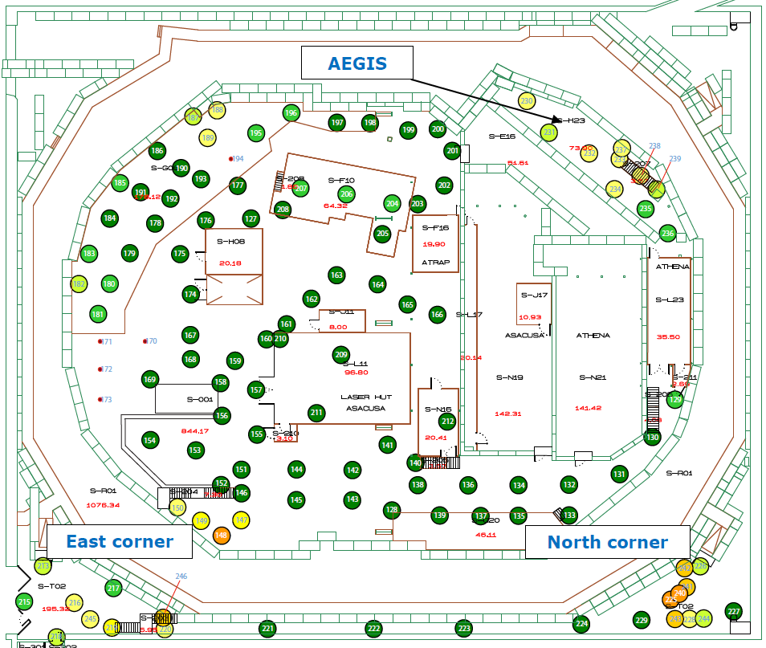
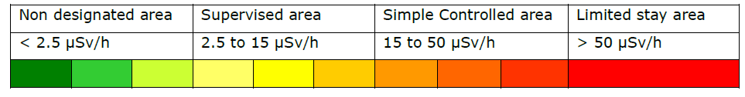
Example of results from the AD Hall survey
Results for low occupancy
working places (edms 1110025)

Slide 6
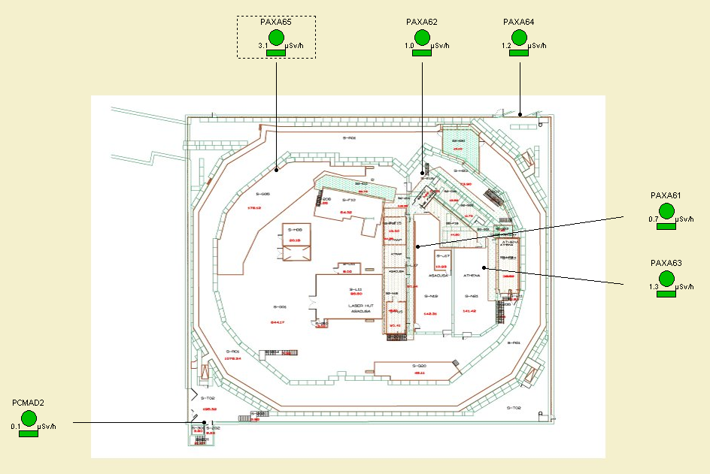
Permanent monitors in the AD Hall

Slide 7
THANK YOU FOR YOUR ATTENTION

