Slide 1
HTS in Common Coils
https://wpw.bnl.gov/rgupta/common-coil-design/
https://wpw.bnl.gov/rgupta/hts-magnet-program/
Ramesh Gupta
HFM Forum at CERN
June 25, 2025

Slide 2
Overview
A few strategic consideration and background of HTS in common coil
Status of HTS cables and their use in the common coil
Possibilities of leveraging R&D by fusion in accelerator magnets
BNL experience with HTS in common coils (including lessons learned)
Related R&D programs worldwide
Summary and conclusions

Slide 3
A Few Strategic Consideration
Given that the next hadron collider is several decades away, the R&D program must have a longer-term vision and a longer-term outlook.
Need to move away from “incremental” to “game changer” approach.
We should be mindful, however, that it takes a long time to develop and demonstrate new designs and technologies - no time to wait.
Facilitate innovative and systematic R&D which is cost-effective with a rapid-turn-around (with demos every few months, not every few years).
At this stage, we need to develop not only the magnet designs, but the program strategies as well, which set the R&D on a dynamic course.
Magnet is one of the key part of the accelerator technology. What we demonstrate provides input to future planning (may even change that).

Slide 4
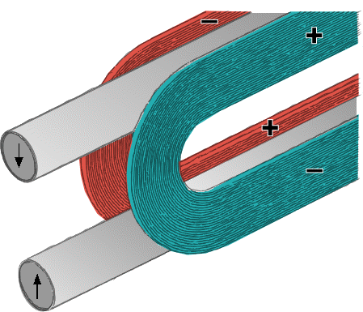
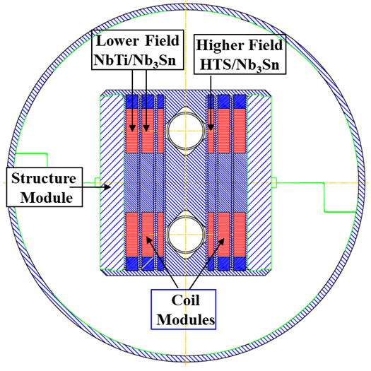
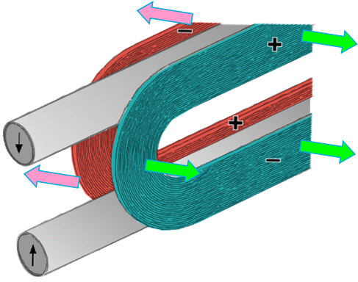
Common Coil Dipole Design and it’s suitability for HTS
Conceptual Design
Simple 2-d geometry for 2-in-1 collider dipoles
Large bend radii, determined by the separation between the two borees rather than the bore itself
Allows use of most ReBCO cables, including high current fusion cables requiring large bend radii
Allows both “React & Wind” and “Wind & React” Technologies for Nb₃Sn and HTS
Modular design for mixing HTS, Nb₃Sn NbTi in hybrids, and for lower cost, rapid-turn-around R&D
Easier incorporation of stress-managed structure
Allows large horizontal displacement of the entire coil as a whole, without much internal strain
Beam #1
Coil #1
Beam #2
Coil #2

Slide 5
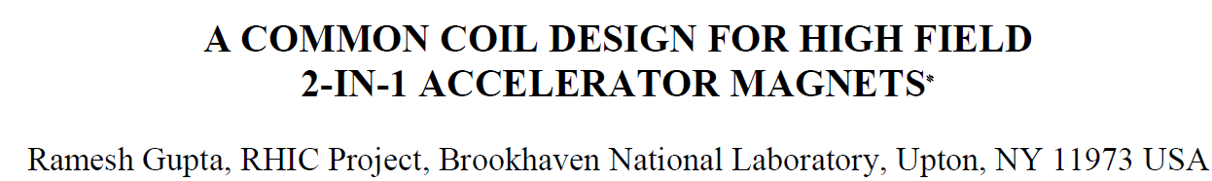
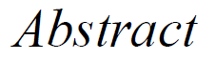
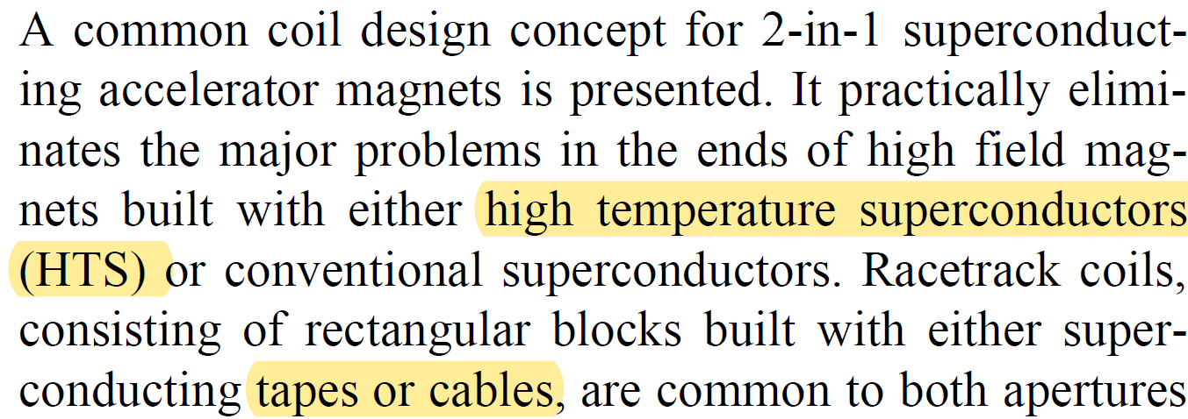
In fact, the common coil design was developed for HTS tapes/cables
PAC’97
(28 years ago)

Slide 6
ReBCO Coils for High Field Accelerator Magnets
Several accelerator magnet coils have been made with the ReBCO tapes. Also, a few HTS/LTS hybrid dipoles have been tested. This includes ~8.3 T in 2016 and ~12.3 T in 2020. Early tests helped understand issues with a new technology.
ReBCO cable, rather than the single tape, is desired in magnets (next slide).
Cables in magnet coils needs to be well supported (in grooves?) and protected.
Therefore, the structure becomes important part of the design.
Rectangular cables (including CICC) could be an interesting possibility.
The overall current density of tape is reduced significantly in a magnet structure
  Question: Is the performance of the cable available now sufficient for representative magnet R&D, and will it be sufficient for accelerator magnets in foreseeable future with the progress underway.

Slide 7
Viability of ReBCO in Accelerator Magnets and in Fusion
ReBCO comes in tape form and that poses several challenges:
A local defect, not always detectable at 77 K QA test of ReBCO tape, could cause an irrecoverable damage to the accelerator magnet coils, when operated at high fields and/or high stresses. This challenge is faced in fusion magnets as well.
Tape conductors (rather than round wire) create field errors that may be too large for accelerator magnets. Similarly, tape conductors cause large losses that may be too much for fusion devices.
Quench protection of the large high stored energy HTS magnets is a major issue for the accelerator magnets. This is also a major issue for the large fusion devices.
High current HTS cables are essential to deal with the above issues.
Will that and other development in technologies be sufficient? Fusion community has made a massive investment and is counting on developing a reliable solution.
Can/should accelerator community partially align its program to benefit from above?

Slide 8
Emphasizing the Similarities
Accelerator magnets and fusion applications both need coupled tapes (wires) either to reduces losses or to reduce field errors.
Both applications need high current ReBCO cables.
Both applications need significantly longer length cables with more uniform performance along the length.
Both need the price of the HTS cable to go down by a large amount to make the devices being developed viable.

Slide 9
Pointing out the Differences and Possible Path Forward
The conventional magnet designs need HTS cables that can be bent in small bend radii; fusion cables typically don’t require that.
Can a relatively small strategic investment leverage the development of the cables that can be bent in small radii with a little to no loss in the full potential of REBCO?
----------- AND/OR ------------
Can accelerator magnet community become open to developing and demonstrating magnet designs that can use fusion cables despite them having large bend radii?

Slide 10
Food for Thought
There is a large investment on the development of the ReBCO (HTS) cable from the private investors for fusion industry.
Current HTS wire and HTS cable market (and hence development of the HTS cables) is primarily driven by the privately funded fusion industry; and is likely to remain so for a foreseeable future.
Several decades ago, private MRI industry benefitted from the development of NbTi superconductors from a large investment from the government agencies on the accelerator magnet R&D.
Now, can the accelerator magnet community draw similar benefit from the development of the ReBCO cable from an unprecedented funding from the private investors on the fusion R&D?
Suggestion: Accelerator community should use its limited funds strategically to drive the aspects of technology development that are critical to it, rather than try to drive the general development.

Slide 11
A Dialogue Between Users and Manufacturers
Challenge for accelerator magnet designers:
What can be done to develop and demonstrate new magnet designs that can allow the most efficient ReBCO cables as getting developed now? Example: magnet designs that can use large fusion cables.
Challenge for ReBCO wire/cable manufacturers:
What can be done to modify cable architect (to the extent possible with incremental funding) to allow their use in a wide variety of magnet designs for accelerators? Example: cables that bends with small radii.
Challenge for both to work jointly to improve the end-product:
What can be done to find integrated solutions to develop cable and magnet designs together? Examples: dealing with large stresses (CICC?), internal cooling (hole in the middle?), etc..

Slide 12
Update from some Cable Manufacturers
(not a complete list)
Question posed was:
What would be the current density if bending radius requirement is relaxed?
(for HTS in common coil)

Slide 13
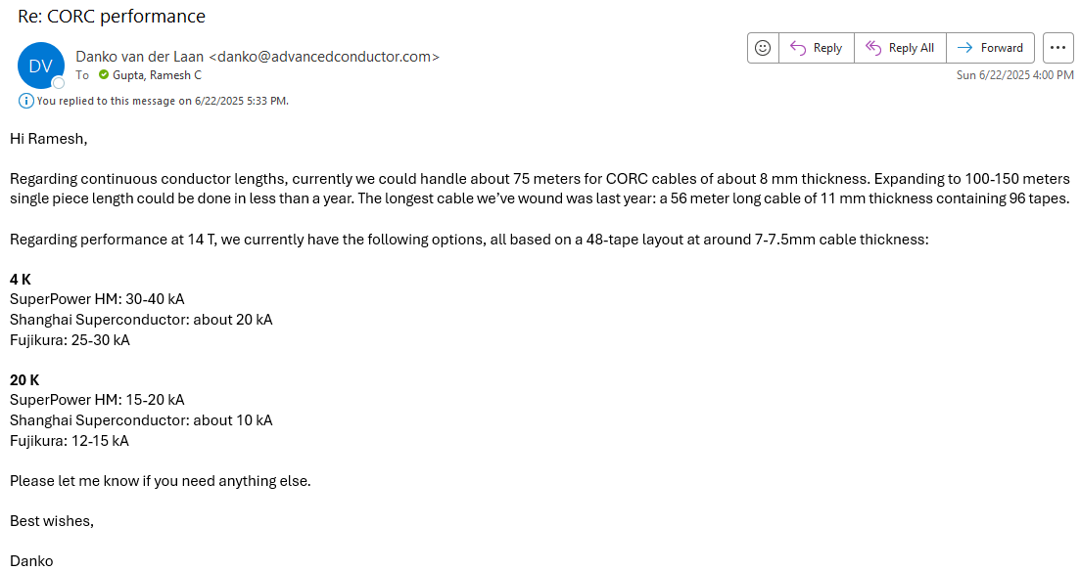
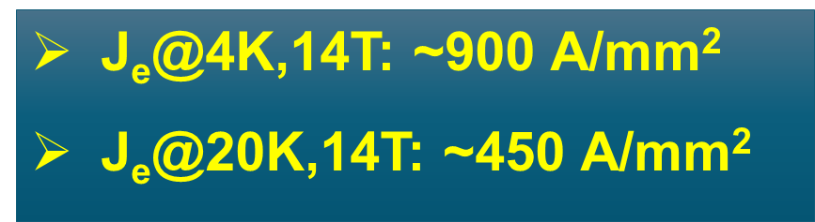
CORC® Cable
J_{o}(in structure), may go down by 20-30%

Slide 14
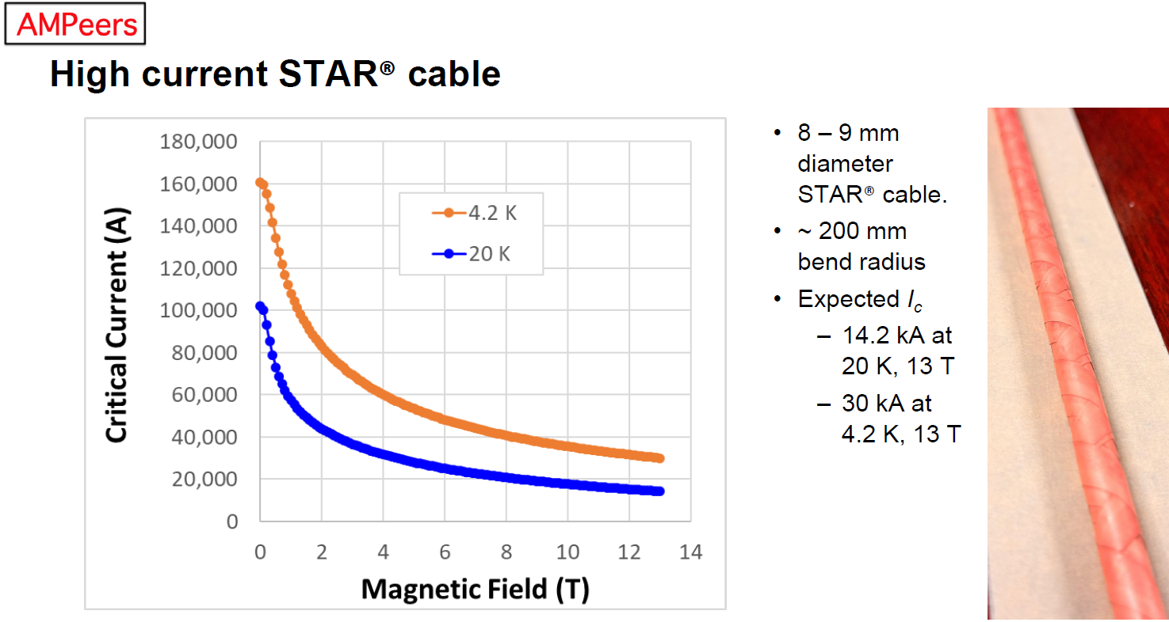
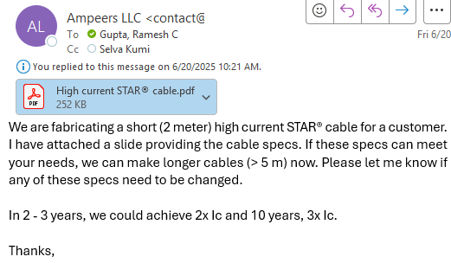
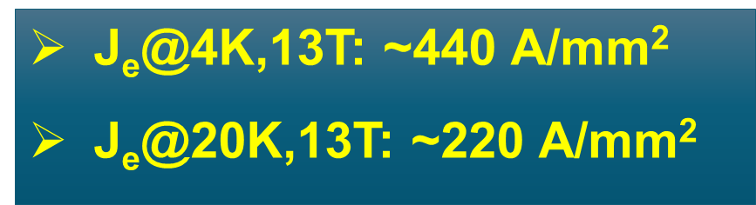
STAR® Cable
J_{o}(in structure), may go down by 20-30%

Slide 15
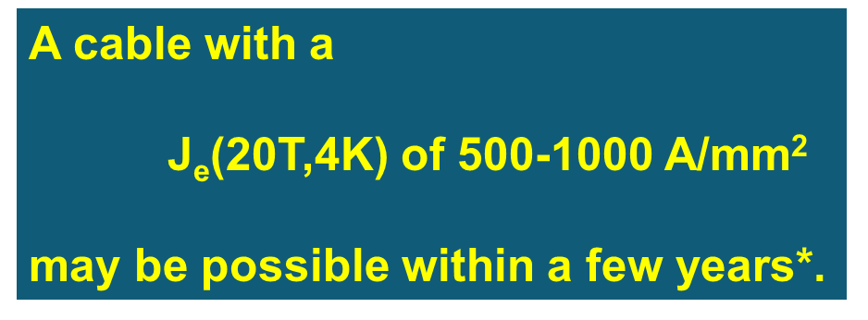
Possible VIPER® Cable for Accelerator Magnets
Possible parameters of a VIPER cable with the state of the art (2022)*:
Cable I_{c}(20T, 4K) = 62 kA
Cable J_{e}(20T, 4K) = 255 A/mm²
Cable J_{cu}(20T, 4K) = 420 A/mm²
Cable outer diameter = 16 mm
Bending Radius = 100 mm
J_{o}(in structure), may go down by 20-30%
*Zachary Hartwig, MIT, Private communication

Slide 16
Prospects of HTS Cable in Common Coil Dipole
Question posed was:
Is the performance of the cable available now sufficient for representative magnet R&D, and will it be sufficient for accelerator magnets in foreseeable future with the progress underway.
The answer seems to be positive.

Slide 17
BNL Experience with HTS in Common Coils

Slide 18
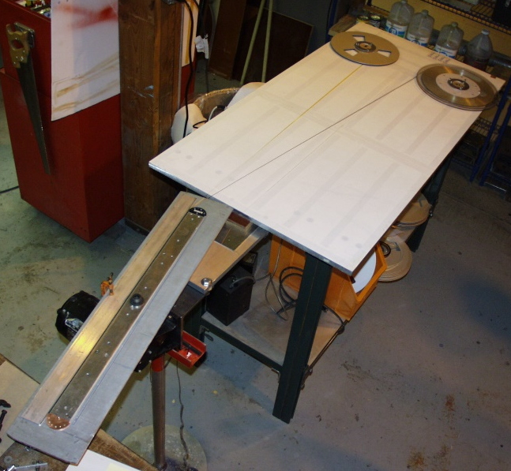
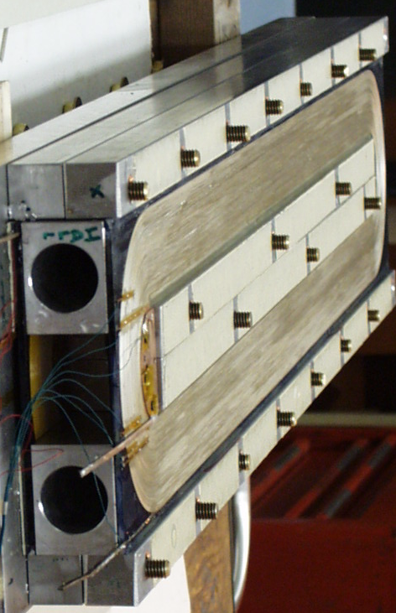
Common Coil Magnets With HTS Tapes
4.2K tests
HTS coils wound and assembled in the common coil geometry
I_{c} measured
Magnetization
measured
2000

Slide 19
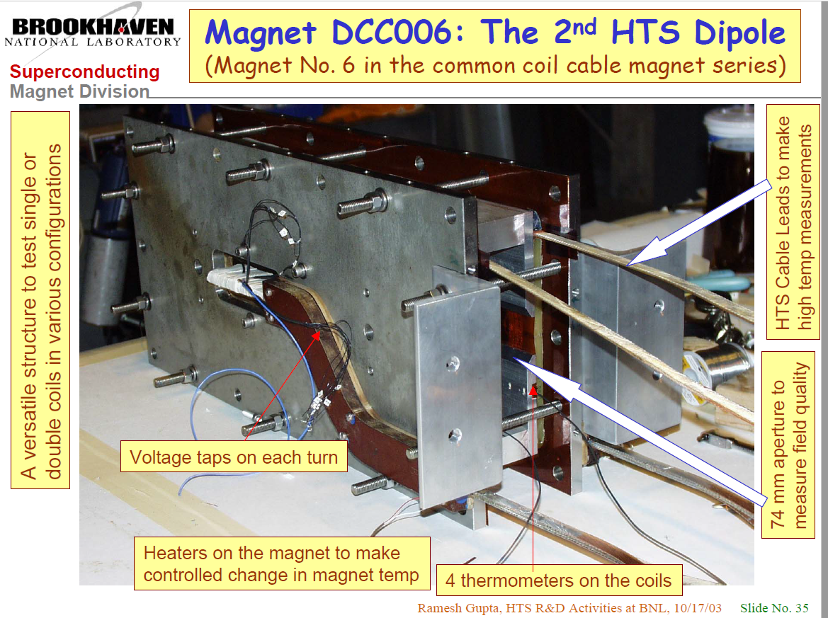
Field harmonics measured

Slide 20
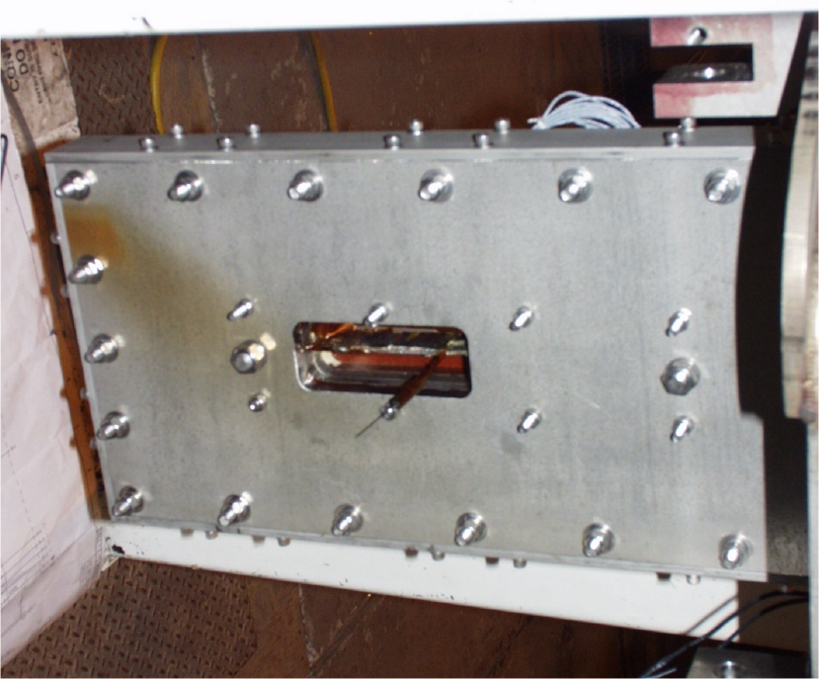
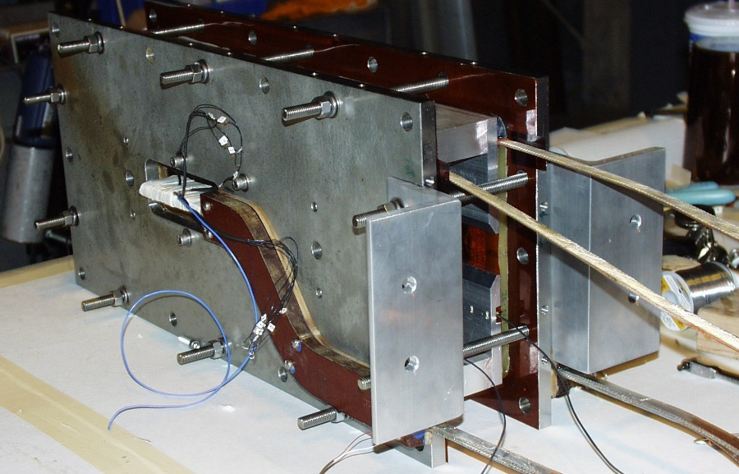
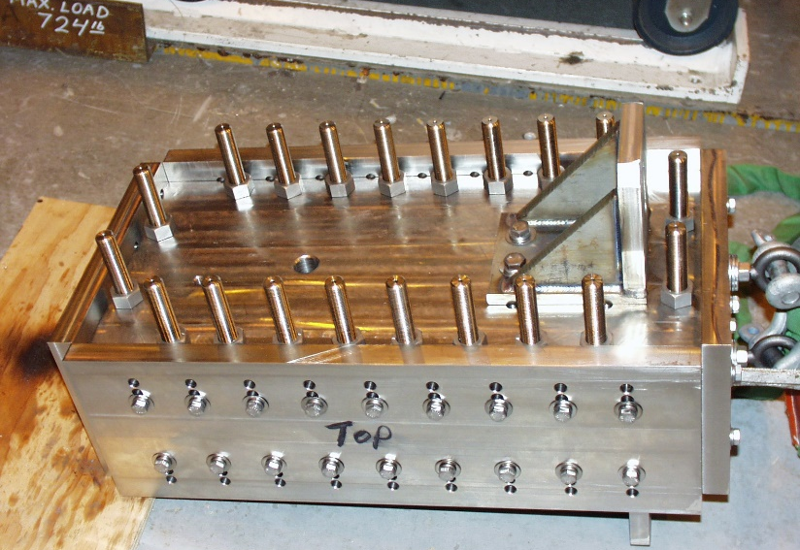
Early Structures for R&D Common Coil Dipoles
Bolted structures have benefit for easy reassembly (good for early R&D)
Can change aperture
Can change number of coils (2 to 6) and can change pre-stress
(later high field common coil magnets had more traditional structure with SS shell)

Slide 21
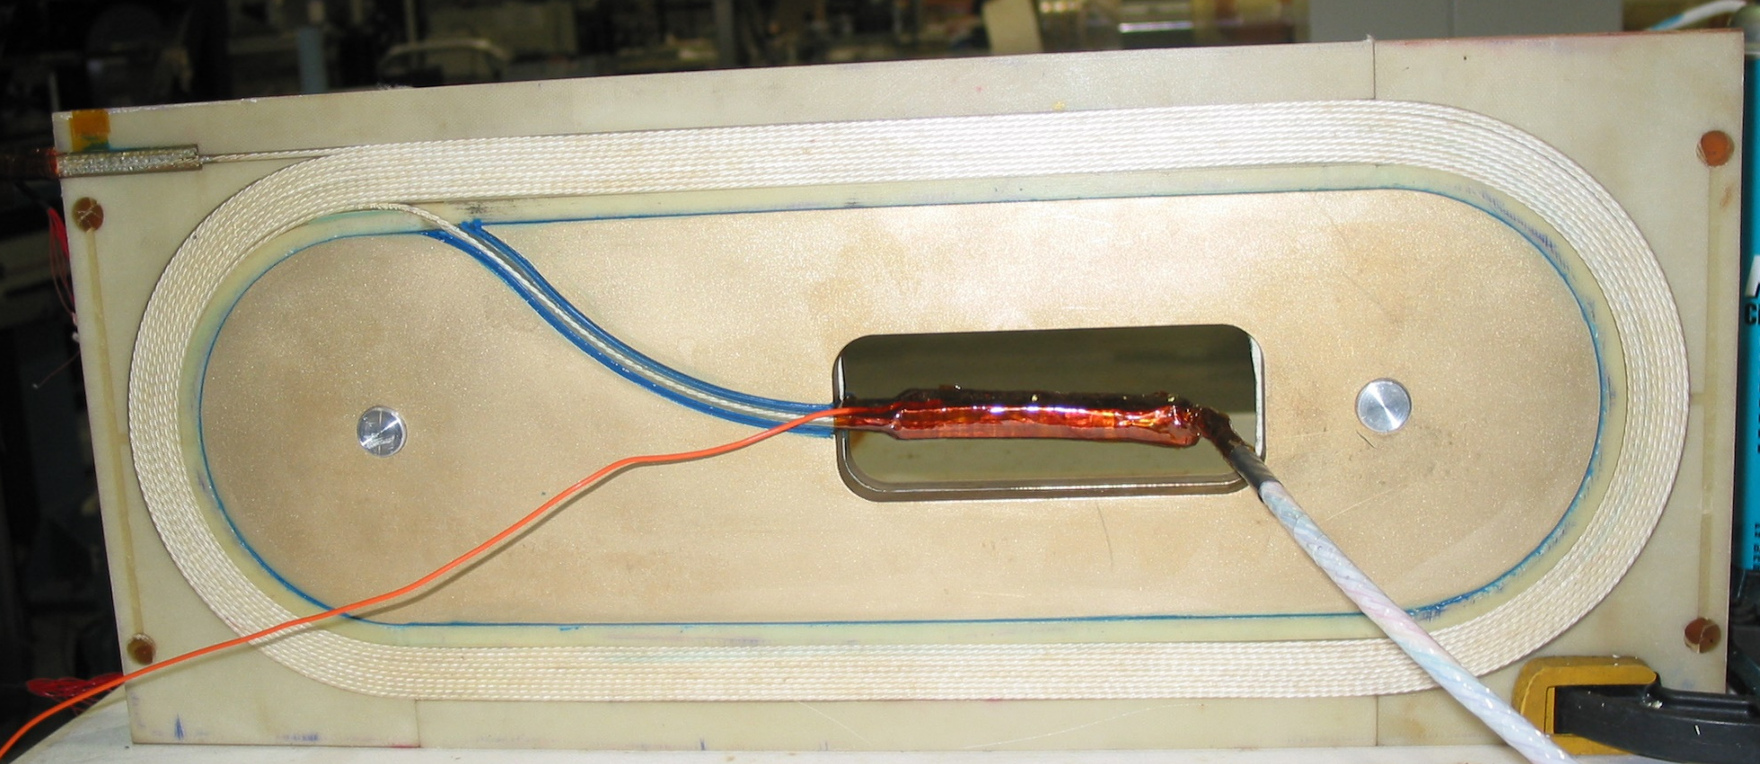
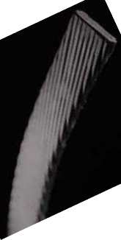
Racetrack coil made with React & Wind Bi2212 Rutherford cable for the common coil dipole
Most of this presentation will focus on ReBCO though

Slide 22
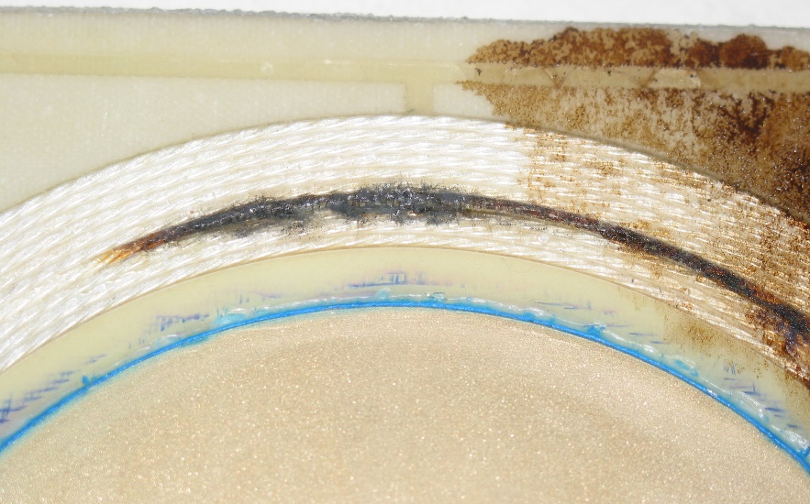
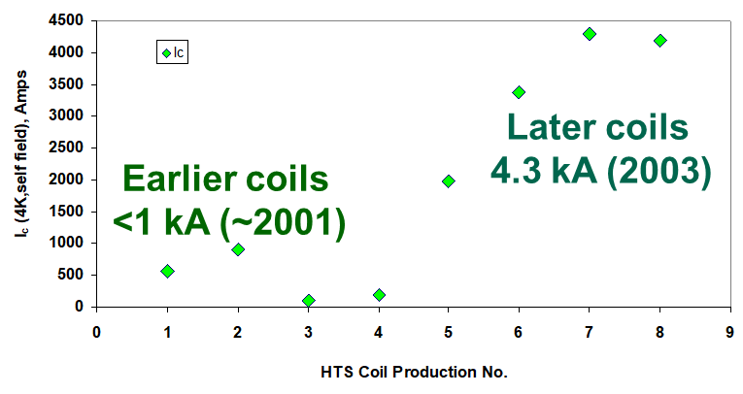

A Learning Experience
To learn, perhaps one has to burn! … and we certainly did that!!
In magnet DCC014 one of the two HTS coils was damaged (burnt-out) during the test after two quenches.
The quench protection (as used in LTS coils) was unable to protect the high current HTS coil at 4K.
Now, of course, we do things very differently.
Presented at MT13 in 2003
Before Test
After Test

Slide 23
High Field HTS/LTS Hybrid Dipole
(with ReBCO)
HTS/LTS Hybrid magnet R&D is desired and useful at this stage for practical reasons (even if the ultimate goal is not hybrid magnets)
This provides a less expensive way to perform high field HTS coil and magnet R&D (without building a very expensive and too risky all HTS magnet at this stage)

Slide 24
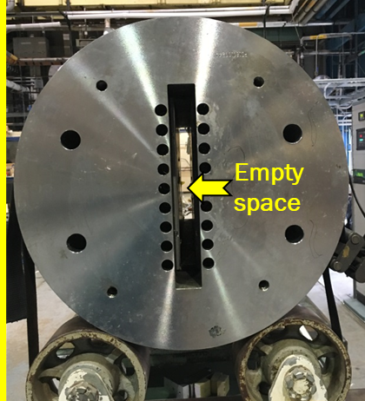
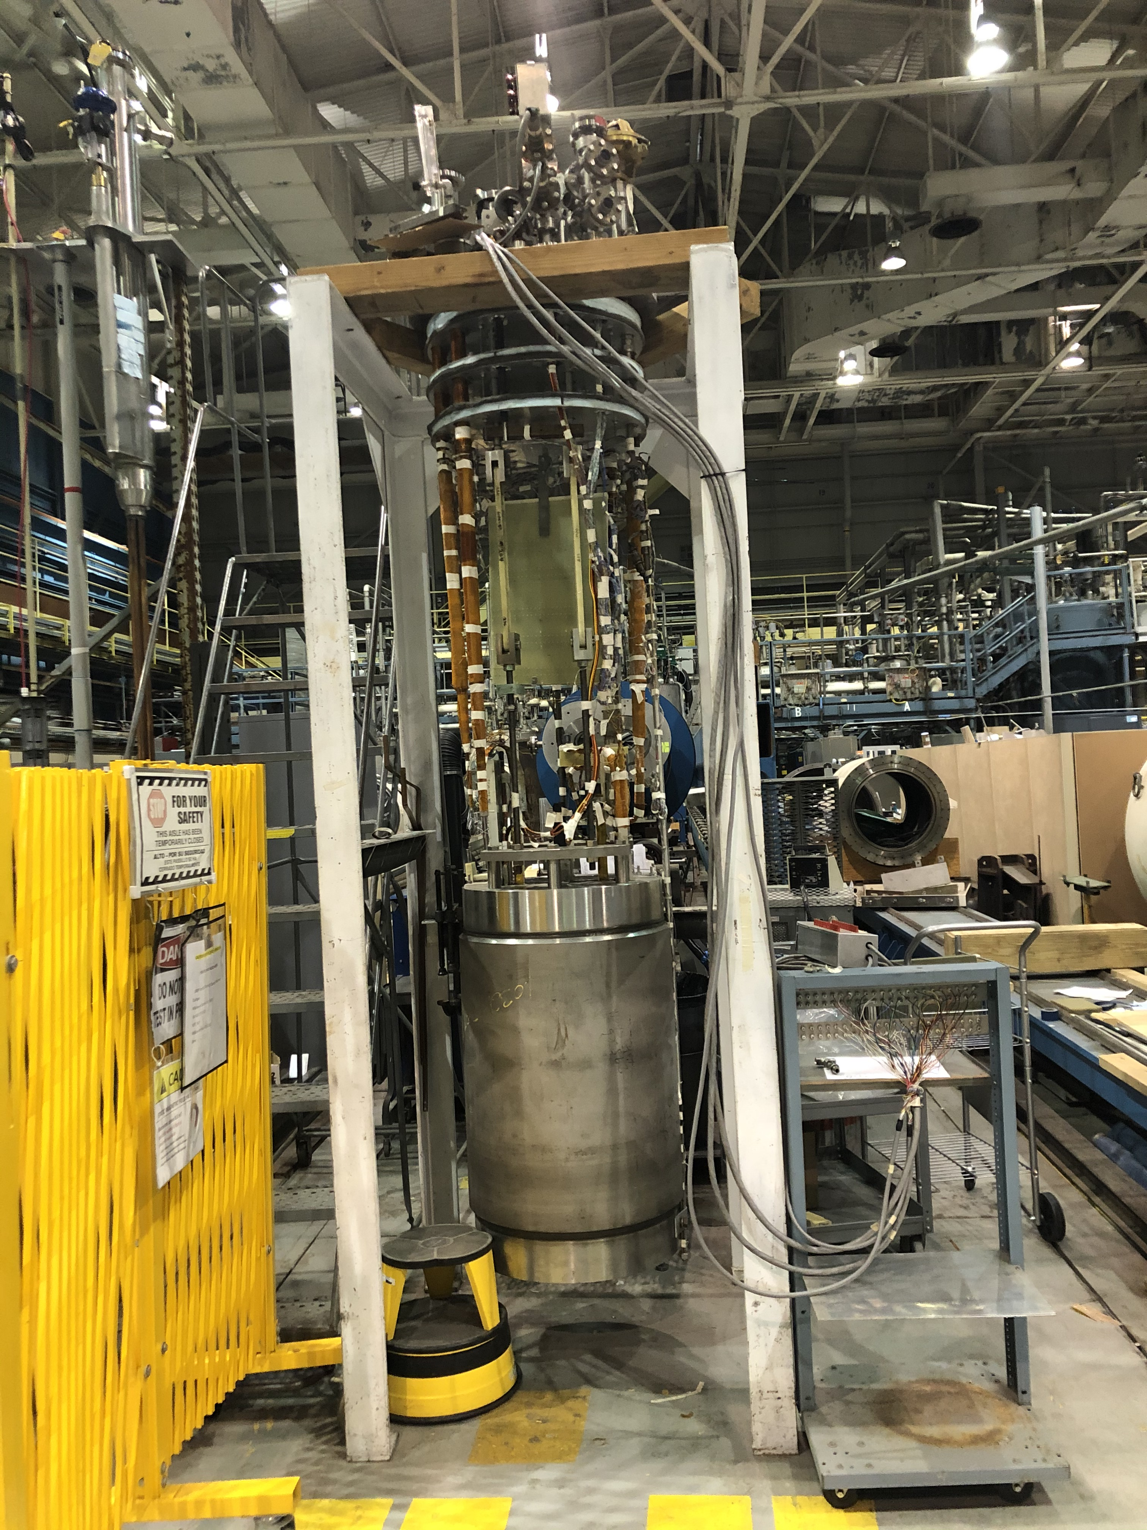
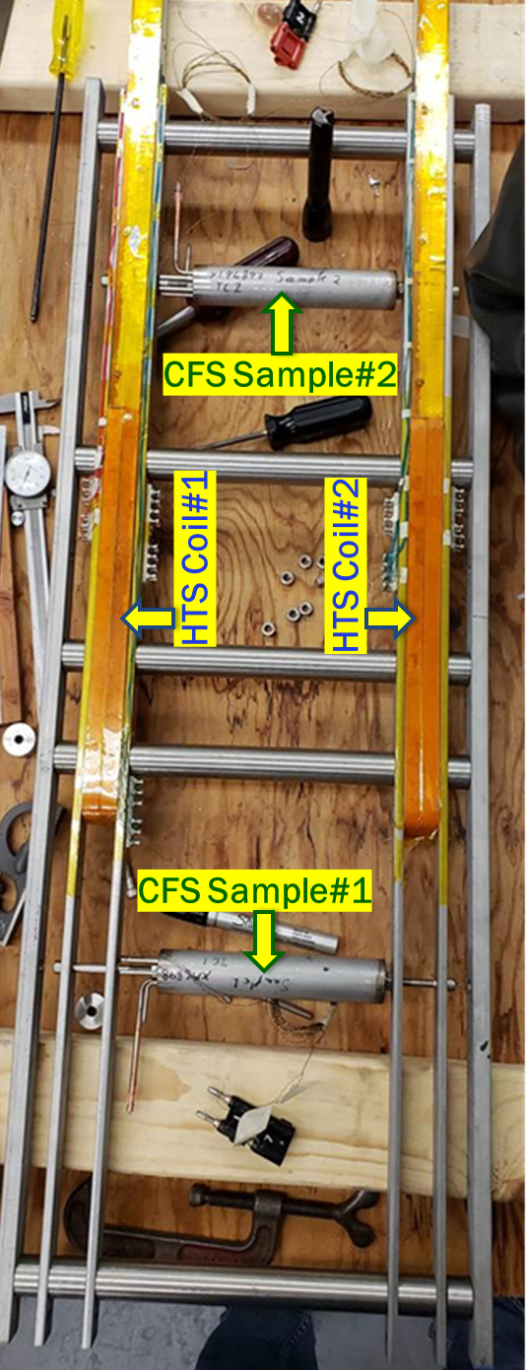
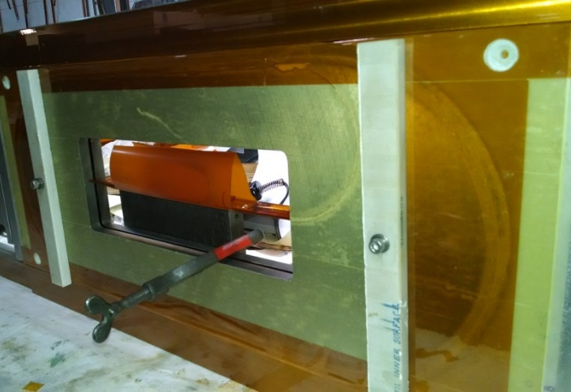
BNL common coil dipole as a test bed for high field magnet R&D
Key components/steps for Rapid-turn-around R&D
ReBCO Coils
Field
Parallel
10 T, Nb₃Sn R&W dipole with a large open space for high field insert coil testing
New coil(s) in the magnet without any disassembly
Coils become an integral part of the dipole magnet
A new coil test essentially becomes a new magnet test
USMDP HTS/LTS 12.3 T Hybrid Dipole
ReBCO Insert Coil Field Perpendicular PBL/BNL STTR
High field technology demo possible in ~1 year & ~$200k
Positive experience with a variety of programs. Suggest that CERN and other laboratories consider a similar approach as an integral part of R&D for proof-of-principle magnet tests.

Slide 25
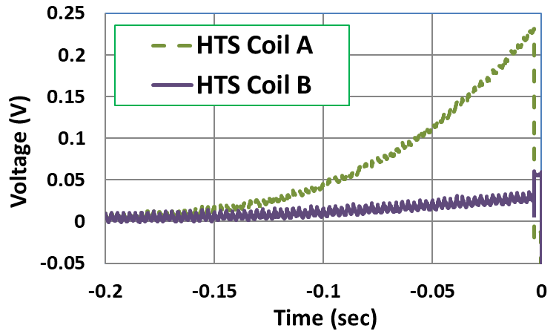
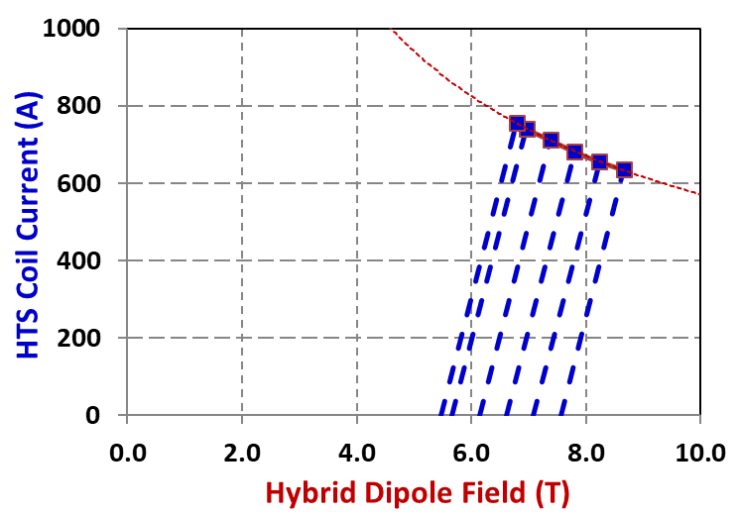
HTS/LTS Hybrid Dipole Test (2016)
ReBCO coils were ramped till they quenched (different background field from Nb₃Sn coils)
Quench threshold
200mV
(just like in LTS)
No training: different from LTS
No damage, no degradation despite many quenches with high threshold
Hybrid field ~8.3 T
(record at that time)
Note: These coils were made with two HTS tapes soldered together.
Did that make a difference? Perhaps.

Slide 26
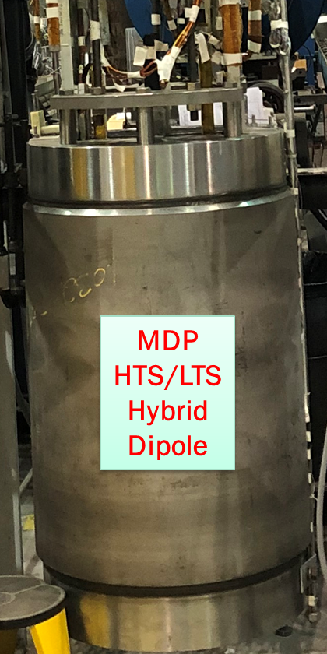
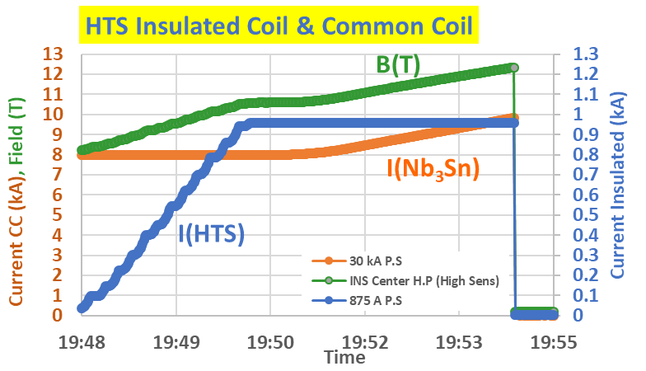
HTS/LTS Hybrid Dipole Test (2020)
~12.3 T hybrid field (still a record)
(~3 T from HTS)

Slide 27
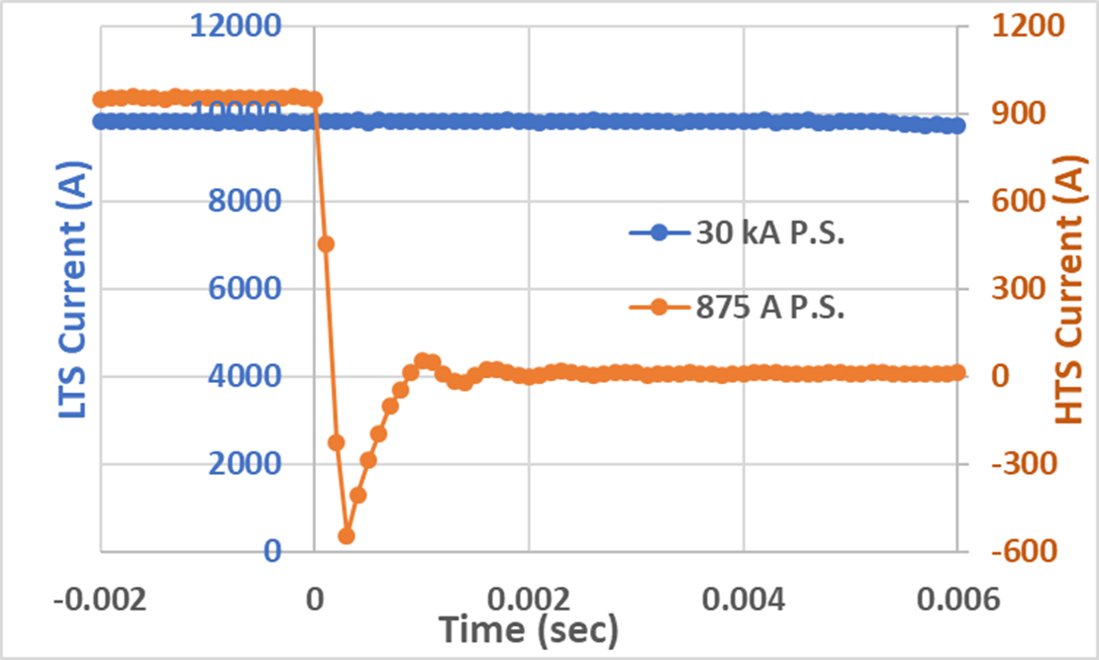
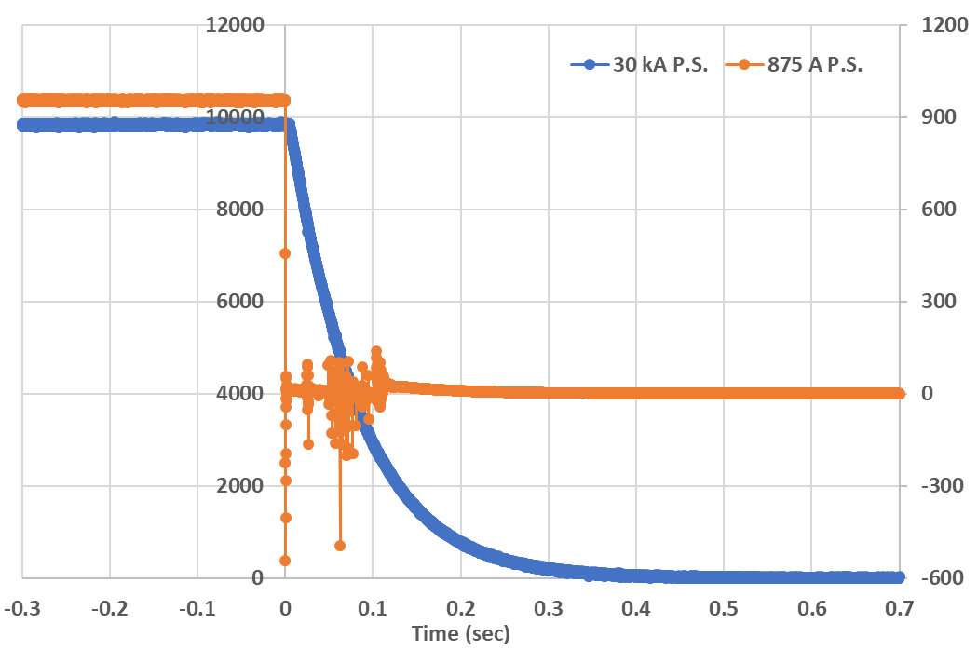
Quench Protection of HTS/LTS Hybrid Dipole when LTS Quenches
Major concern was: what will happen if LTS coil quenches, and dumps large energy on inductively coupled HTS coil? Will HTS coil survive?
Courtesy:
Piyush Joshi
LTS
HTS
LTS Current (A)
HTS Current (A)
HTS
LTS coils are powered down after the HTS coils are deenergized.
Much less energy to dump from smaller HTS coils on LTS coils (situation changes when HTS coils become larger).
LTS

Slide 28
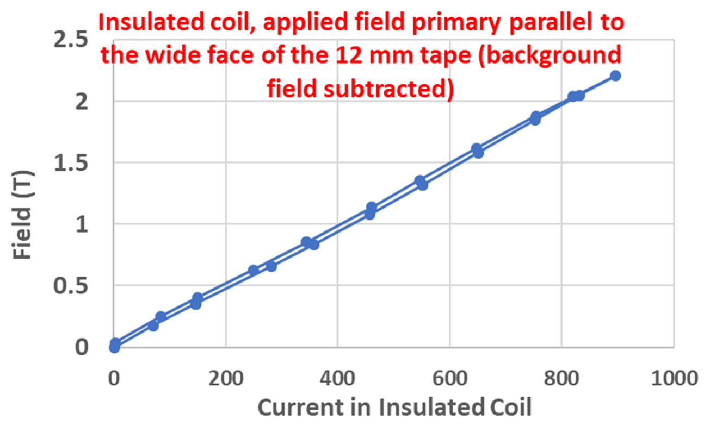
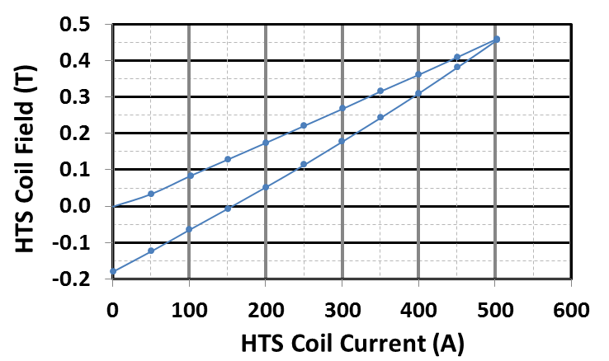
Comparison of Residual fields between Field Perpendicular and Field Parallel as an indication of Persistent Harmonics
(concern because of coils made with tape, not round wire)
Field perpendicular (2016)
Field parallel (2020)
Additional field from the HTS coils in up and down ramp (Field from LTS coil subtracted)
Order of magnitude reduction in the magnetization when the field is primarily parallel to the HTS tape
A large remnant field (-0.2 T) due to magnetization in tape

Slide 29
Related Worldwide R&D Programs
(a quick tour)

Slide 30
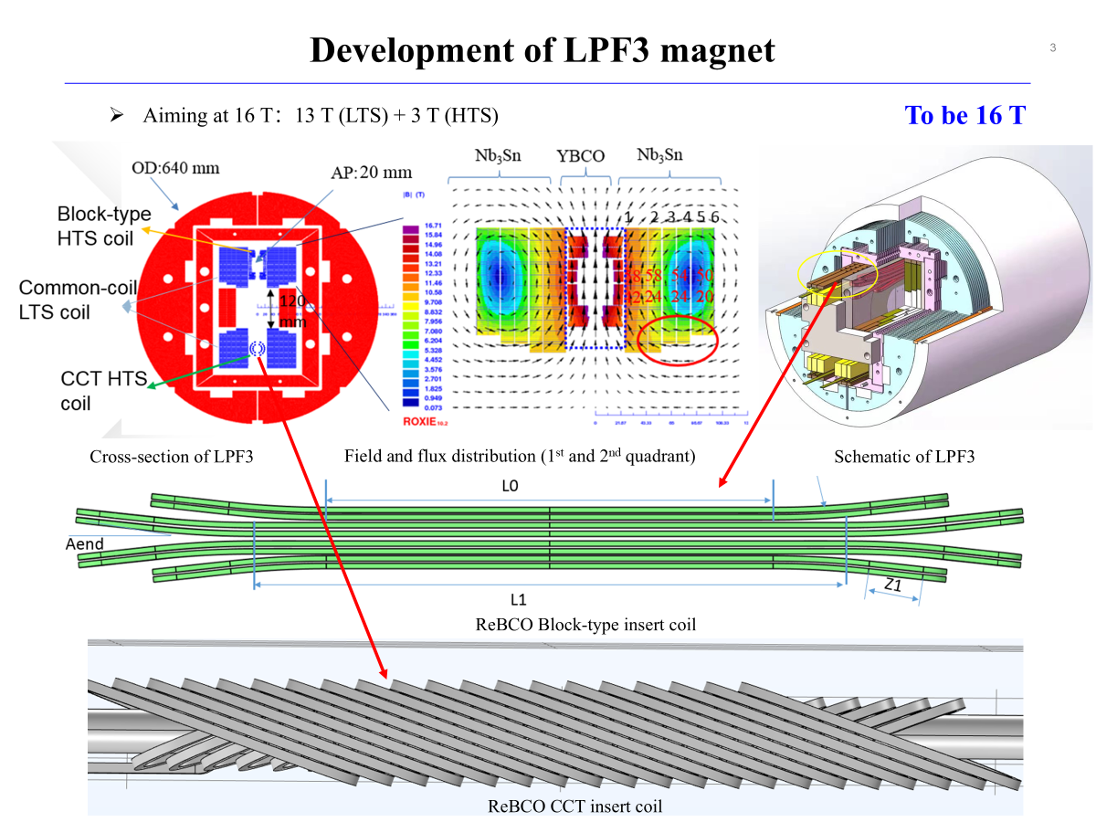
IHEP

Slide 31
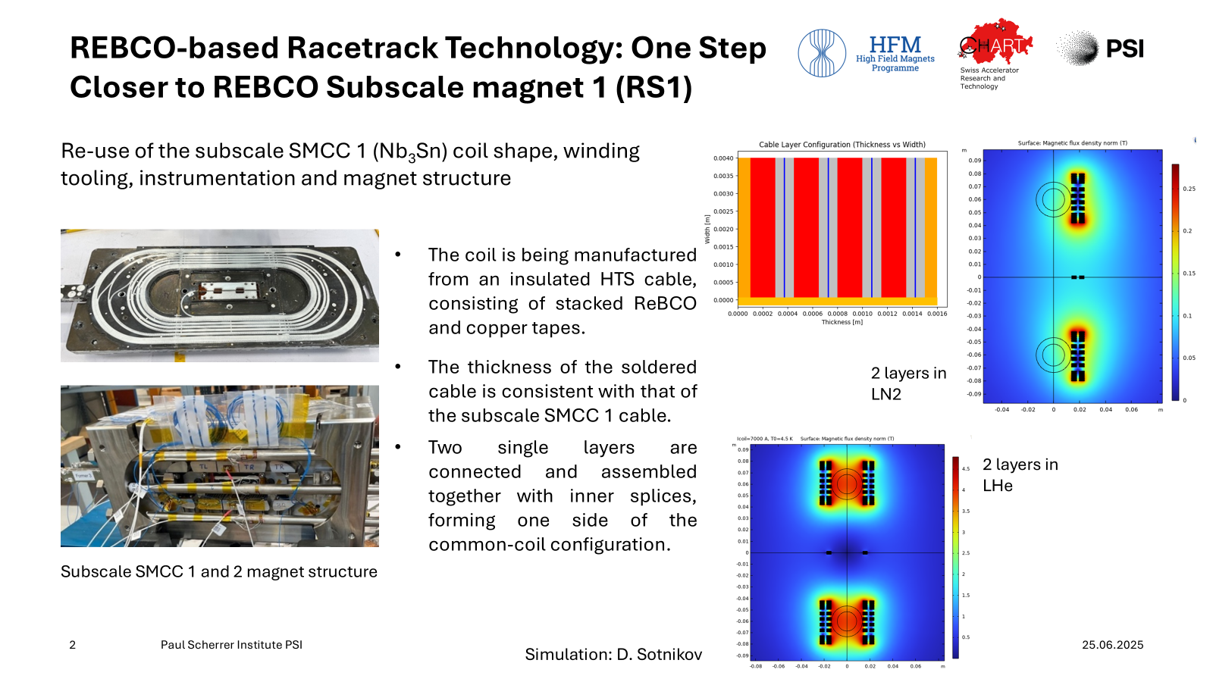


Slide 32
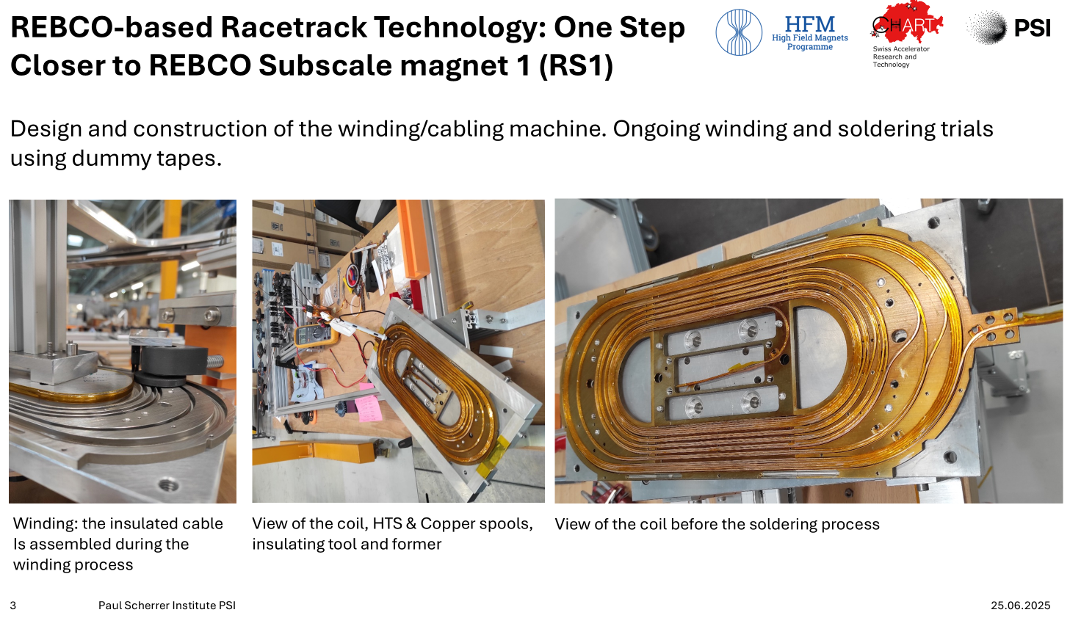

Slide 33
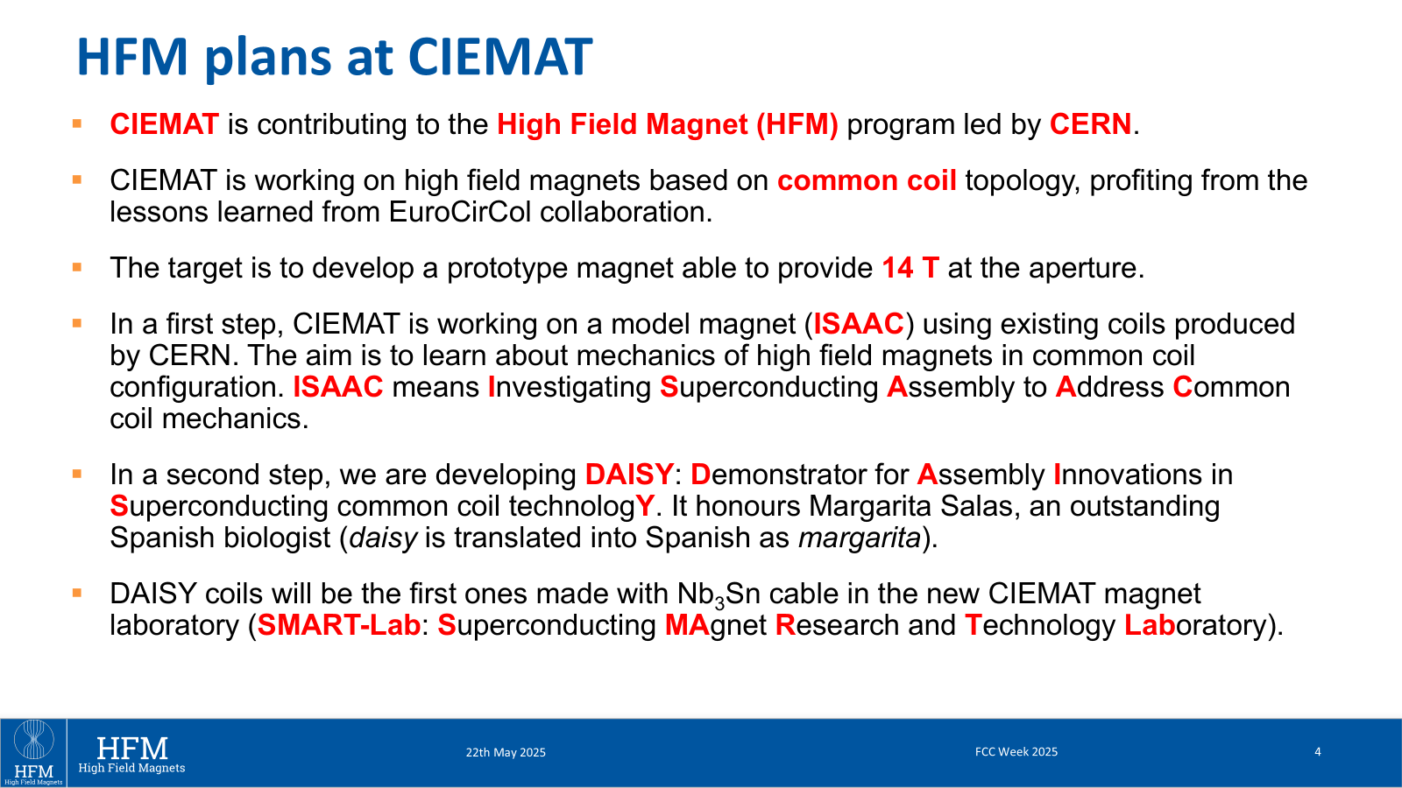




Slide 34
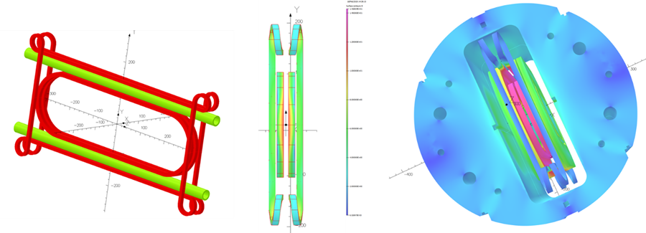
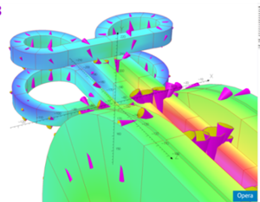
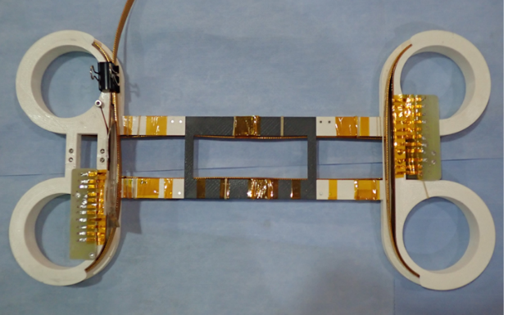
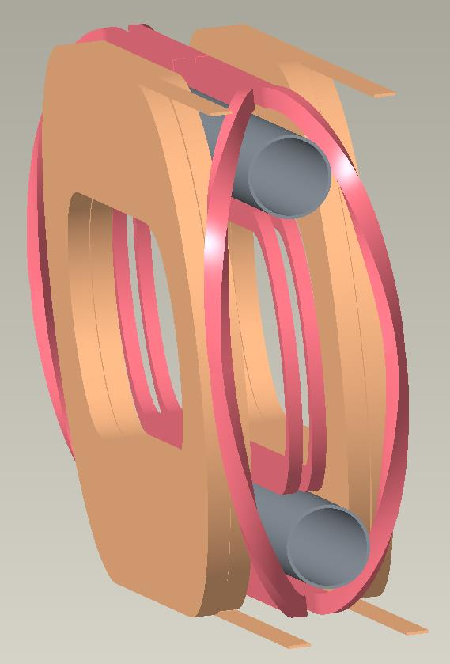
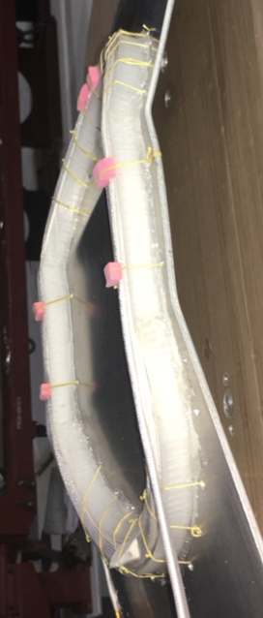
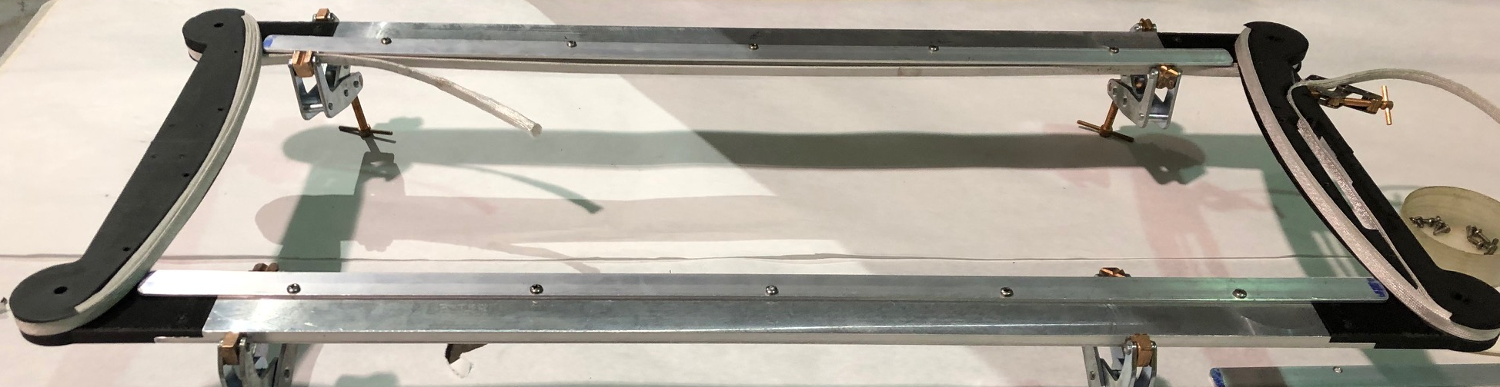
A Few Possible Layouts of Pole Coils Clearing the Bore
Also Clover-leaf Program at CERN
Overpass/underpass (cloverleaf) design
Pole coil windings and preliminary designs of coils that can be built and tested at 10⁺ T field.
HTS Coil
Nb₃Sn Coil

Slide 35
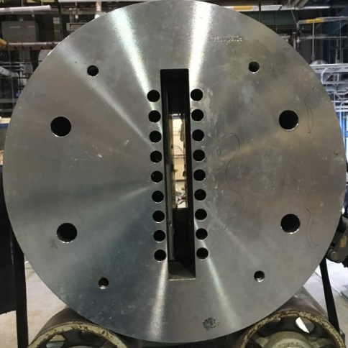
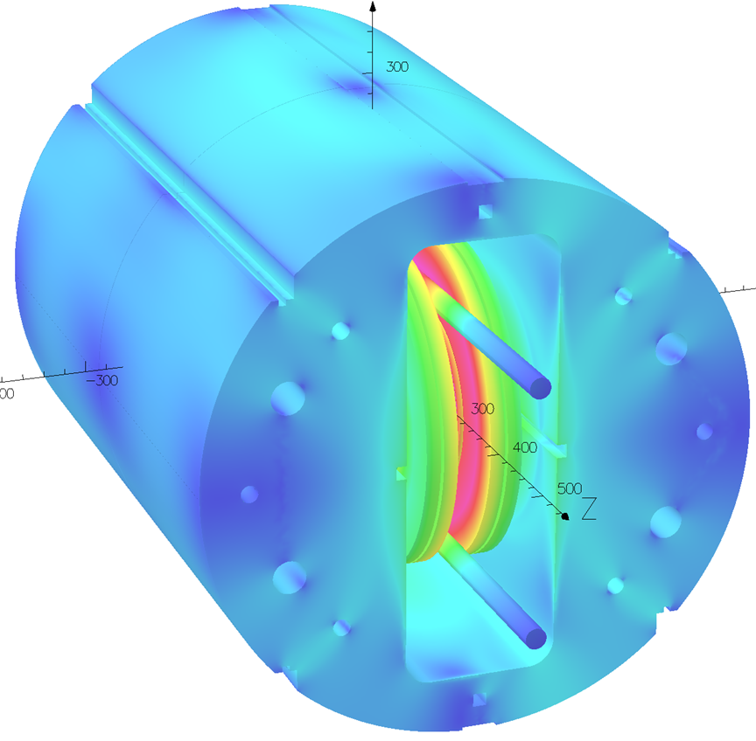
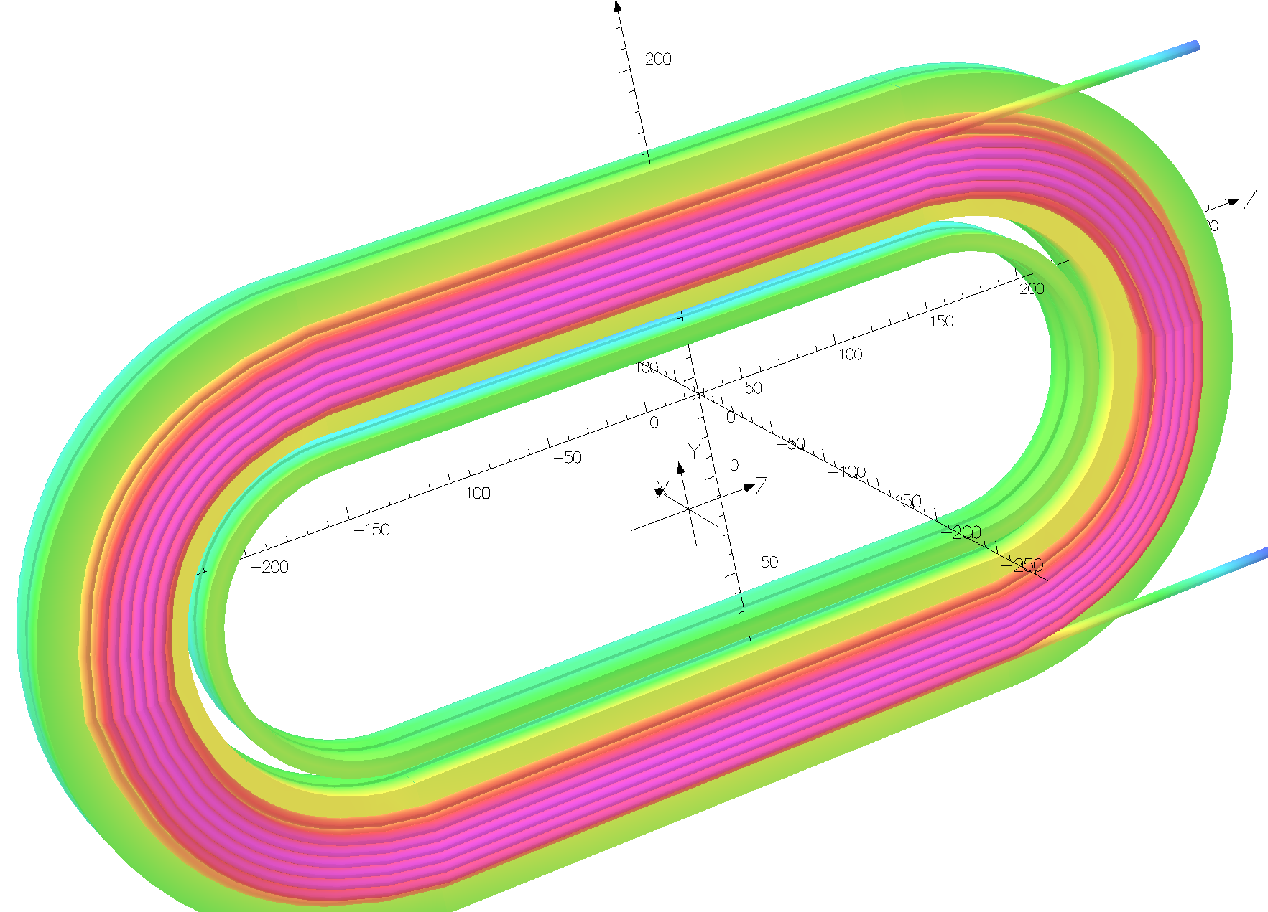
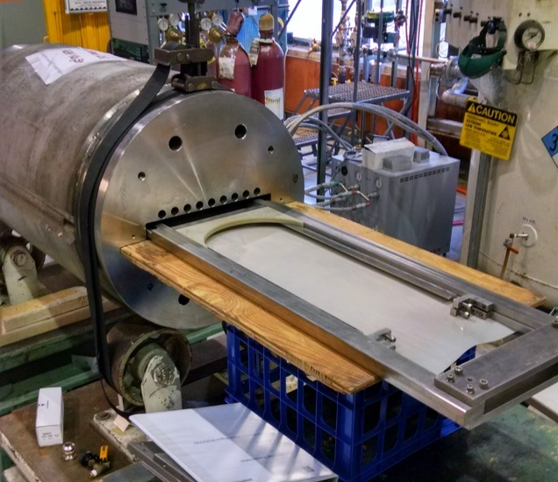
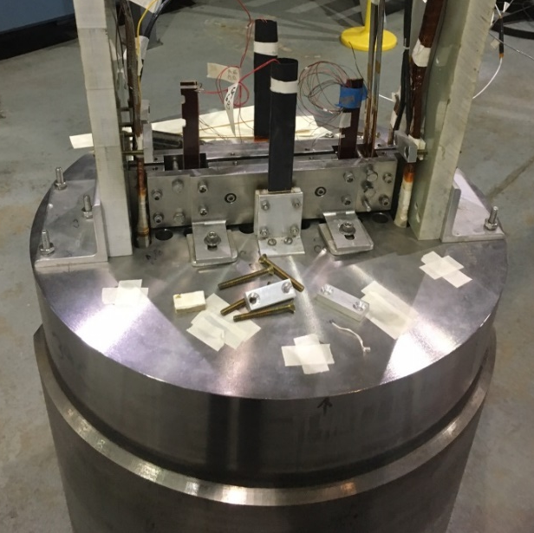
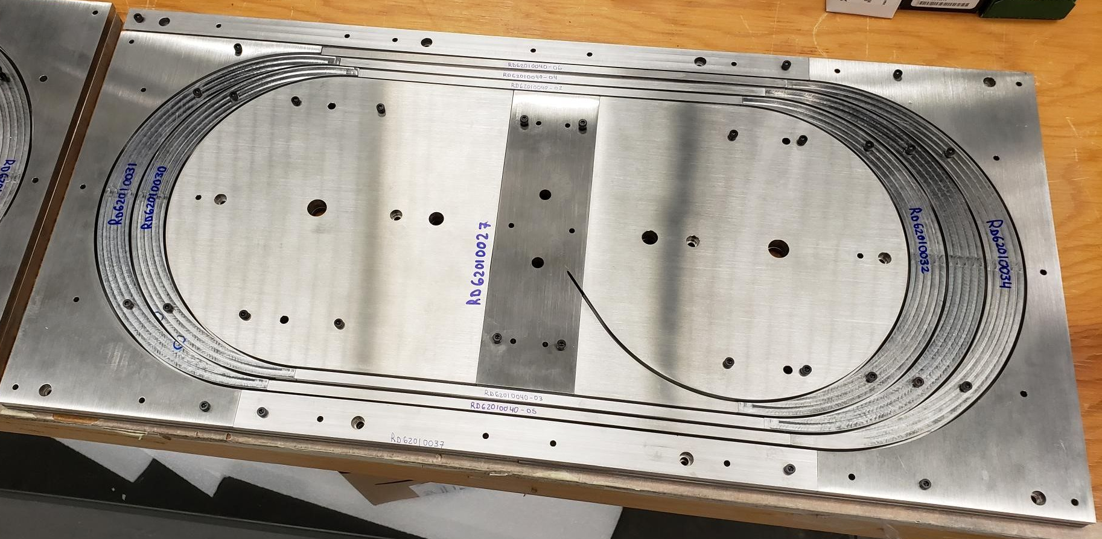
Common Coil Hybrid R&D with ACT with CORC® Cable
1
Empty space
PBL STTR
2
3
4
Insert coils in Empty space

Slide 36


Initial Design Studies of 20 T Hybrid Common Coil (BNL)
25 mm clear bore

Slide 37



Test of various fusion cables at the BNL common coil dipole

Slide 38
React & Wind Approach and its Advantages
(since design and techniques needs to be developed for pre-reacted ReBCO cable, why not consider this for Nb₃Sn)
In the “React & Wind” approach, the coil and associated structures are not subjected to the high temperature reaction. This allows one to use a variety of insulation and other structural materials in the coil modules.
“React & Wind” approach appears to be more adaptable for building production magnets in industry by extending most of present NbTi manufacturing techniques. Once the proper tooling is developed and the cable is reacted, most remaining steps in industrial production of magnets remain nearly the same in both Nb-Ti and Nb₃Sn magnets.
Since no specific component of “React & Wind” approach appears to be length dependent, demonstration of a particular design and/or technique in a short magnet, should be applicable in a long magnet in most cases.

Slide 39
Summary and Conclusions
HTS coils for high field accelerator magnets must be built with the HTS cable.
Common coil geometry, allowing large bend radii, offers unique advantage for using high current HTS cables, including similar to those being developed for fusion.
Present HTS cable market (and hence development of most HTS cables) is primarily driven by fusion applications; and it is likely to remain so for a foreseeable future.
Can accelerator magnet community benefit from that in designs such as common coil and use the available resources more strategically for a few focused enhancement?
If we can, then both accelerator and fusion technologies could benefit in many ways.
HTS/LTS hybrid and low cost, rapid-turn-around approach should encourage both innovation and systematic approaches. We should be looking for technical results with a proof-of-principle demos once every few months, rather once every few years.
HTS coils with high current cables in a modular common coil structure should be a platform for an exciting R&D for the next generation magnet scientists and engineers.
https://wpw.bnl.gov/rgupta/common-coil-design/
https://wpw.bnl.gov/rgupta/hts-magnet-program/

