Slide 1
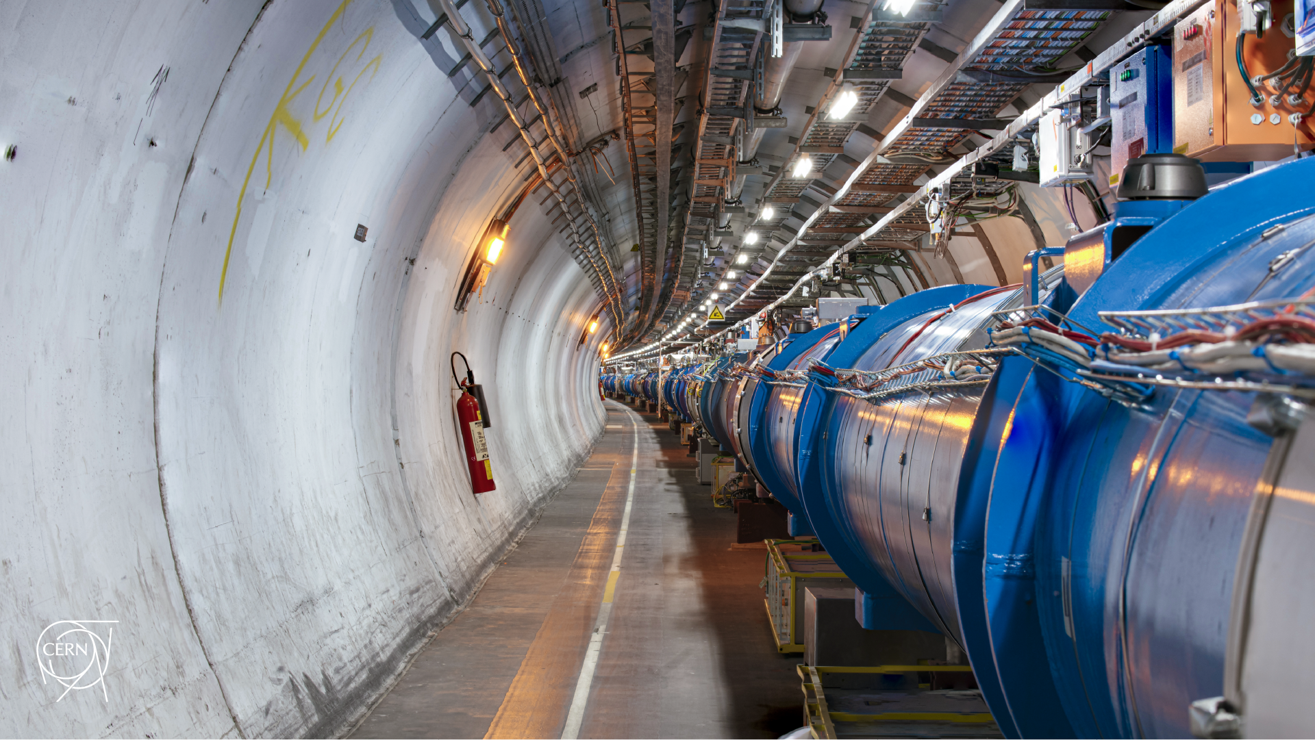
Summary of beam loss limitations for operation
D. Mirarchi
106th BLM Thresholds WG

Slide 2
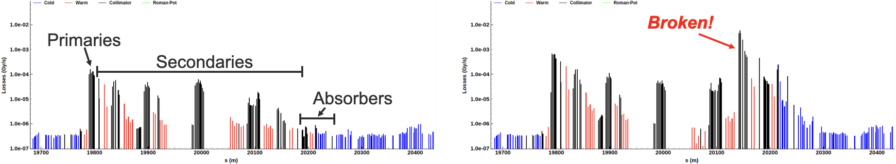
Broken hierarchy at start of ramp
Significant fraction of off-momentum losses at start of ramp on TCSG.6R7.B1 instead of on primaries
Main correlation found: octupole sign and strength, octupole resonant driving terms
Investigations on-going to eventually deploy a fix after TS1
Temporary patch: increased MF by 30% on BLMTI.06R7.B1E10_TCLA.D6R7.B1,
BLMTI.06R7.B1E10_TCLA.C6R7.B1, BLMQI.06R7.B1E10_MQTL RS09

Slide 3
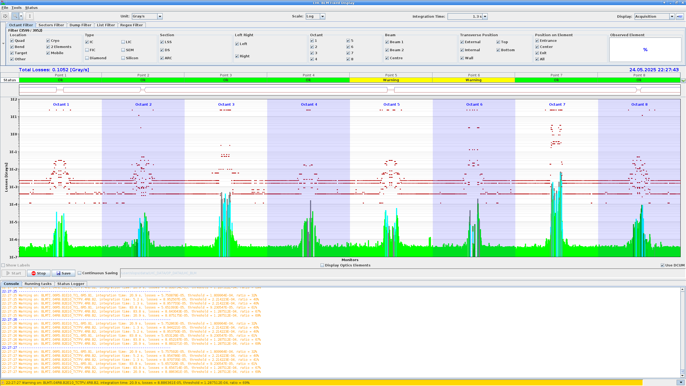
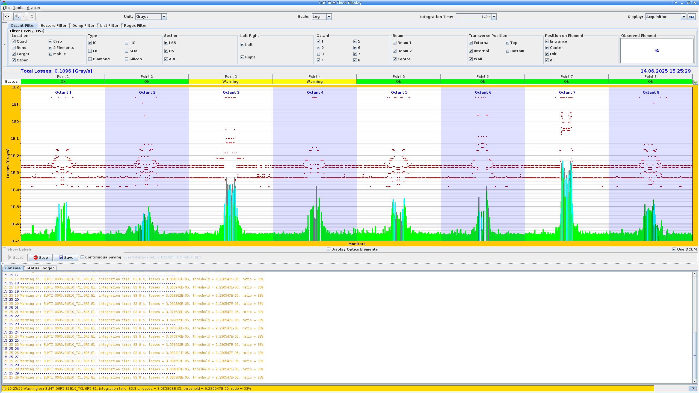
Warnings during ramp
Main BLMs affected: TCL.6R5.B1, TCTPV.4R8.B2
Losses due to e-cloud conditioning in rotated XRP and MKI
Warning disappear after FT corrections applied
Decided to do not apply any change to monitor e-cloud conditioning
Indeed only warning at TCL.6R5.B1 still there, presently at max ~33%, starting from ~60%

Slide 4
Warnings in Stable Beams
TCTPV.4R8.B2:
Identified possible correlation with BLM orientation (see Belen’s slides)
Presently warning removed by retracting BRAN copper block
Intervention planned in TS1 to restore old BLM orientatin
To be followed up after TS1
TCL.6R5.B1:
Probably linked to e-cloud conditioning at rotated XRPs
Quantitative comparison wrt 2024 pending
To be followed up

Slide 5
IR6 losses (1)
Significant over reaction in the last days regarding asymmetric losses in IR6
Let’s make some clarifications for the sake of completeness:
The higher losses in IR6 - B1 are due to broken hierarchy
Essentially the TCSP becomes the secondary stage of the TCSG.6R7.B1 that became primary
This because there is less than 1s clearence between the two stages and they are in phase
High losses on TCSP.B1 are seen only in events of broken hierarchy
Initial ABT concerns that this large losses were correlated to smaller beam size than should be,
because of changes on BETS wrt 2024 in only one beam
I then remembered them that B1 settings are essentially identical to 2024,
the BETS were changed in B2 because a 14% larger beam size ratio at TCSP was measured in 2025
This is known by everybody involved since settings generation on 22/4
This caused a dramatically overreaction because <1s larger settings than with nominal beam size are present, where >4s margins are present on aperture and >5s margins on TCTs

Slide 6
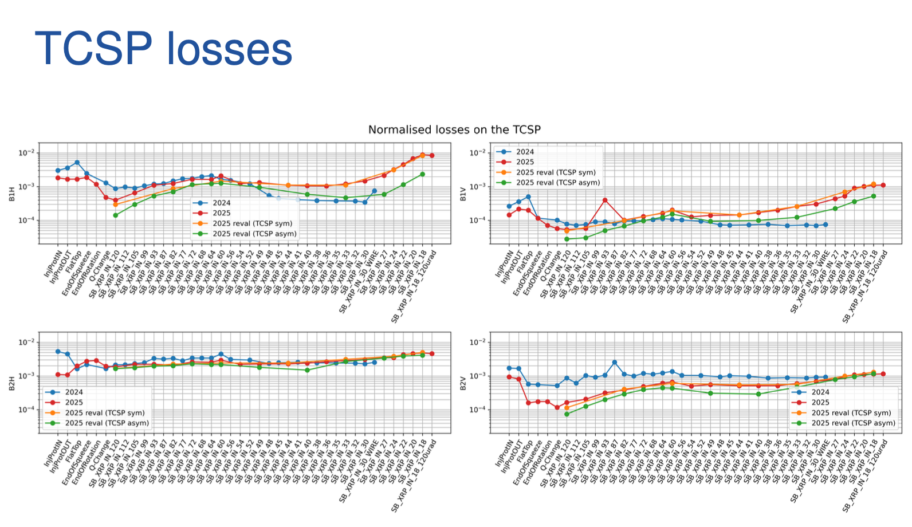
IR6 losses (2)
This went below the radar because both beam size ratio and centre difference wrt 2025 where within acceptance
It went unnoticed also in validation loss maps and ASD because the impact on local losses in marginal
N. Triantafyllou

Slide 7
IR6 losses (3)
What’s really needs to be assessed is the increase of losses during b* levelling due to increasing dispersion
We did our homework and can safely increase by a factor 2 MF at Q4/Q5 in IR6 because of nature of losses
see here: https://indico.cern.ch/event/1547015/
Let’s hope everybody is doing their homework and we won’t need to increase thresholds :)

