Slide 1
BLM signal increased in TCTPV.4R8.B2
S.Morales, B. Salvachua, C.Zamantzas SY-BI group
Important contributions from D.Mirarchi, M.Hostettler, A.Lechner

Slide 2
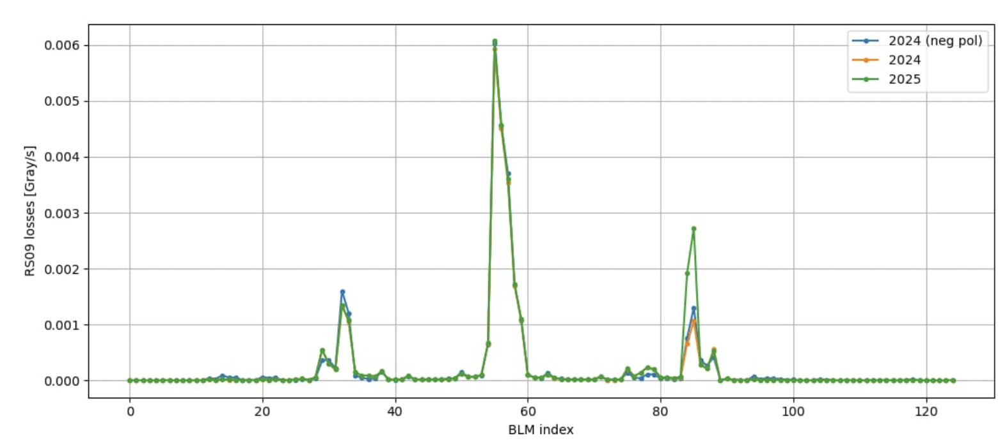
Introduction
Observation of an increase of signal on the BLM at TCTPV.4R8.B2 , nearly a factor of 2 during collisions compared to previous years. Increase of signal was assumed it come from physics debris.
Investigation if the increase of signal was related to change on the BRANs during YETS, since the insertion of the BRAN copper module had an effect on the measured signal.
Concerned BLM
TCTPV.4R8.B2
M.Hostettler
IP8
BRAN
BRAN
TCTPH.4L8.B1
TCTPV.4L8.B1
TCTPV.4R8.B2
TCTPH.4R8.B2

Slide 3
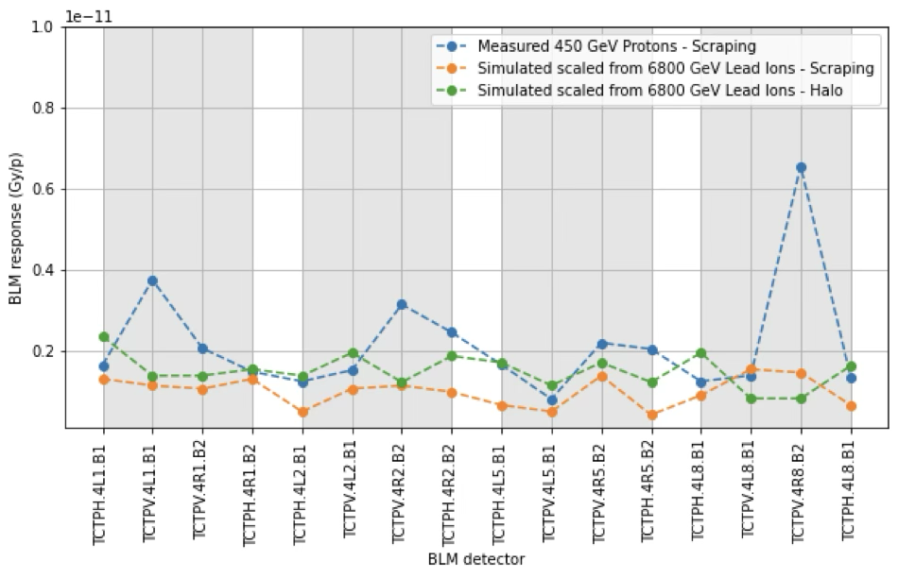
TCT scraping data at injection
In the frame of reviewing the TCT thresholds. During this year commissioning, scraping data was taken to calcualte the TCT response at injection (thanks D.Mirarchi!)
The BLM IC TCTPV.4R8.B2 response is also higher for the beam scraping scenario.
The LIC in the same location shows similar increase wrt last year
An inspection was carried out in the tunnel.

Slide 4
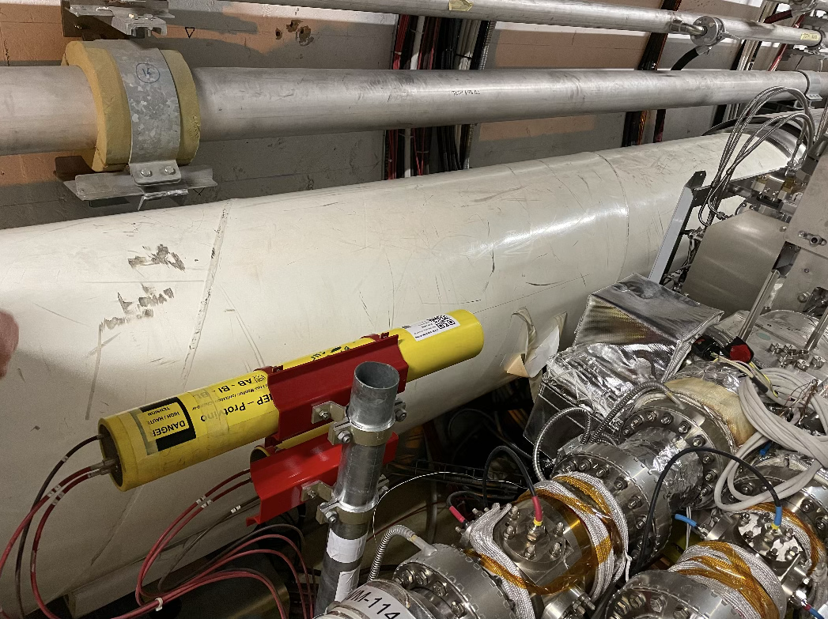
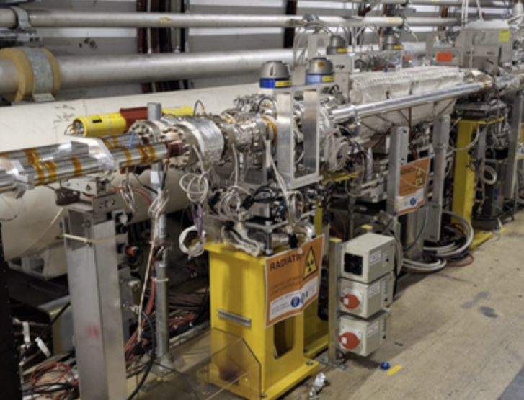
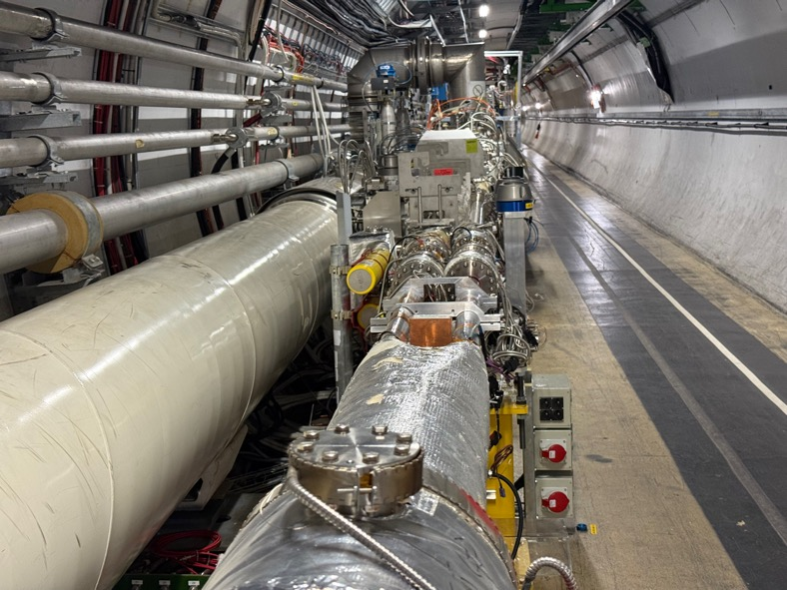
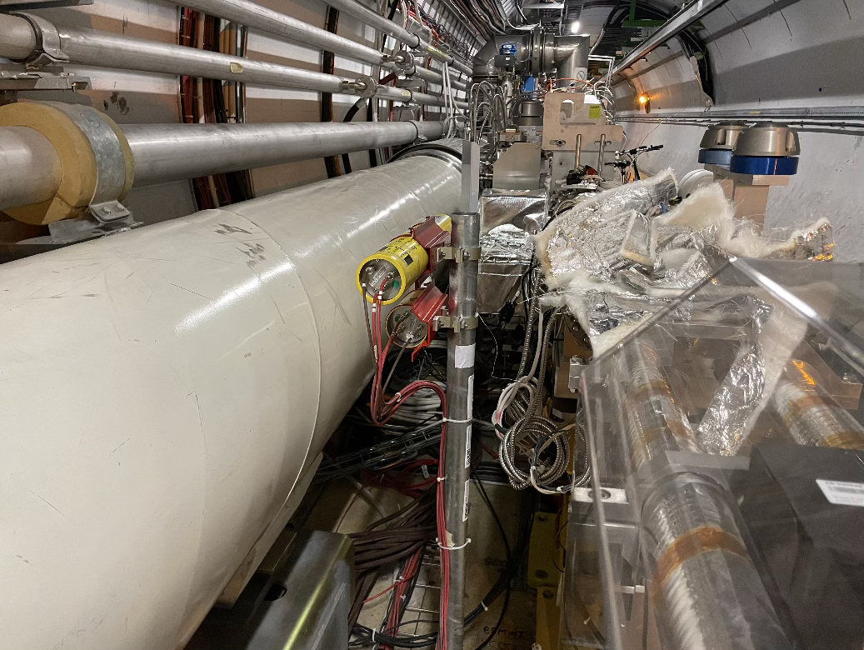
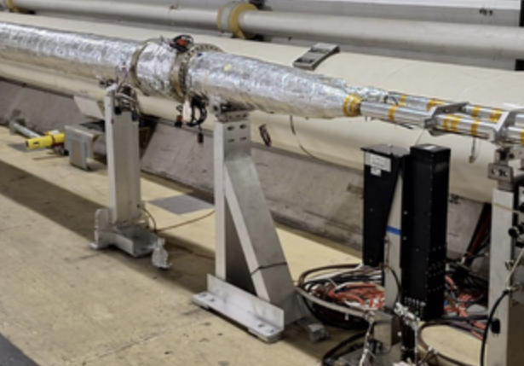
BLM signal increase in TCTPV.4R8.B2
TCTPV.4R8.B2 after LS2
TCTPV.4R8.B2 before YETS24-25
TCTPV.4R8.B2 after YETS24-25
BLM close to the QRL
IC and LIC in the same support
BLM close to the Beam Line
BLM close to the QRL
BLM rotated by mistake 180 degrees, at present it is closer to the beam line, which could explain the increase of signal of the IC and LIC both for collimator losses and luminosity. During TS will be corrected.
Temporary removal of BLM during YETS24-25 for vacuum interventions (BIBML-3097)

Slide 5
Conclusion
Increased response of the BLM IC and LIC on TCTPV.4R8.B2 in 2025 was found for regular cleaning losses and physics debris losses.
The higher response is explained by the displacement during the EYET24-25 re-installation.
  Both detectors had to be removed to allow for vaccum activities.
  They were installed with the wrong orientation, thus being closer to the beam line.
The BLMs will be corrected during TS1.

