Slide 1
LCC Lectures Objectives
Describe analytical methods in order to:
- Design an “Ultimate Cell” that deliver the “most possible” Achromatic and Anharmonic ring
- Develop a method to insert Straight Sections in the ring with minimum impact due to the breaking of the ring periodicity
- Design the “most possible” Achromatic and Anharmonic Final Focus system that minimally impacts the ring properties (machine parameters, DA/MA etc) and ring hardware
- Develop mathematical/numerical procedures to reach optimal DA&MA and performances for a complete ring: “ARC+SS+FF”

Slide 2
ARC design studies for FCC
June 25th ,2025
Pantaleo Raimondi
Fermilab/CERN

Slide 3
Outline
ARC scaling laws
Optics beyond FODO
Ring Beam Dynamic
Hardware requirements

Slide 4
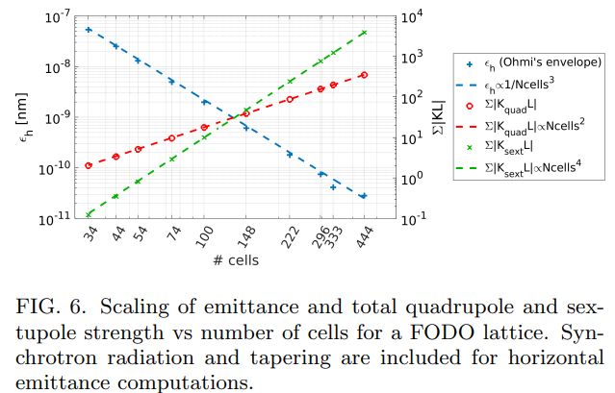
Lattice parameters scaling with the number of cells
Doubling the number of cells:
- makes the emittance 8 times smaller
- requires 2 times more quads with
2 times more integrated gradient
- requires 2 times more sexts with
8 times more integrated gradient
When the required fractional space for quads
and sexts becomes increases (>10%) all the
scaling laws worsen
DA roughly scales with 1/n^3
MA roughly scales with 1/n
P. Raimondi and S. M. Liuzzo, Toward a diffraction limited light source,
Phys. Rev. Accel. Beams 26, 021601 (2023)
To reduce the DA&MA shrinking, deviations from a pure a FODO can help
- “Second generation” factories based on LPA&CW do require very small emittances
- Most powerful emittance-knob for a FODO lattice is the number of cells
- Higher Horizontal phase advance helps (optimum around 120deg, Ex ~30% lower wrt 90deg lattice)
- Maintain satisfying DA&MA becomes harder
- Issues to be addressed are very similar to the ones faced by fourth gen Synchrotron Light Sources

Slide 5
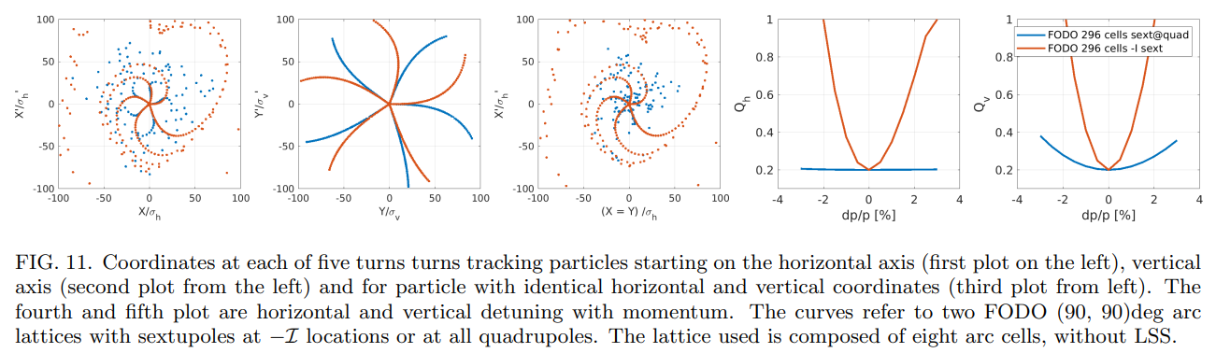
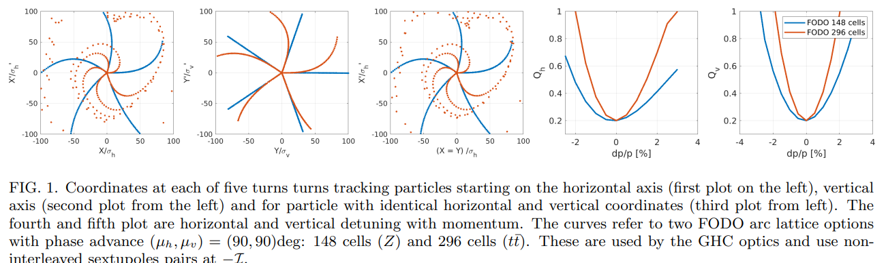
Detunings and chromaticities for a FODO9090 and a
FODO9090-NI (with not interleaved sextupoles)
Only a few turns tracking is sufficient to have a quick look at the RDTs combined effects
FODO lattices in general have flat MA given the very local chromatic correction
FODO9090-NI greatly reduces the detuning, because only sextupoles, –I paired, are retained
Second (and highr) order chromaticity is generated because the non-local chromaticity correction.
Some detuning still remains because the long sextupole aberration (scaling roughly with n_cell^3)

Slide 6
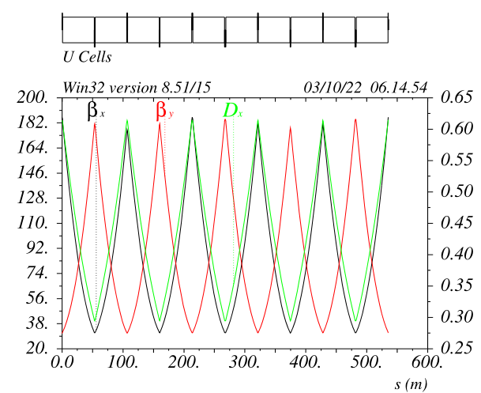
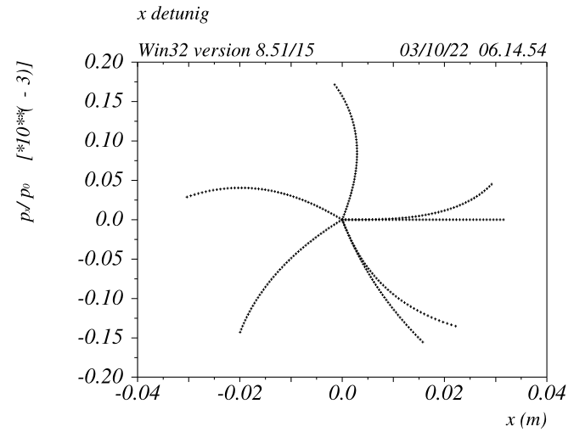
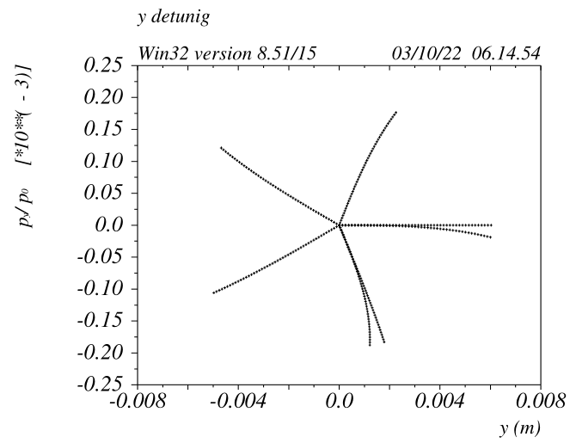
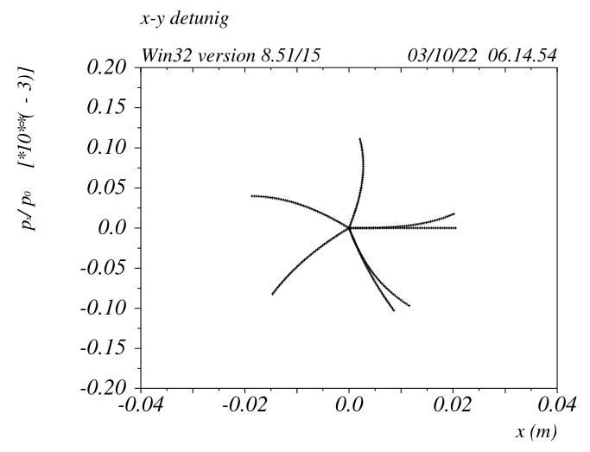
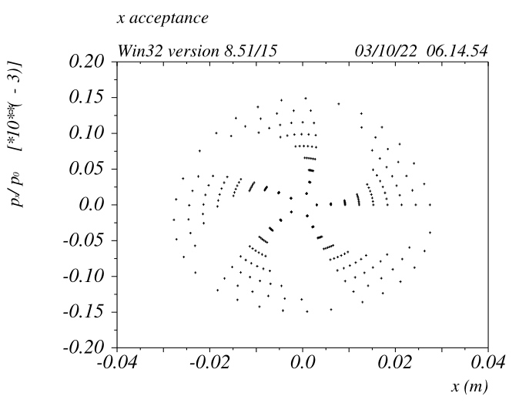
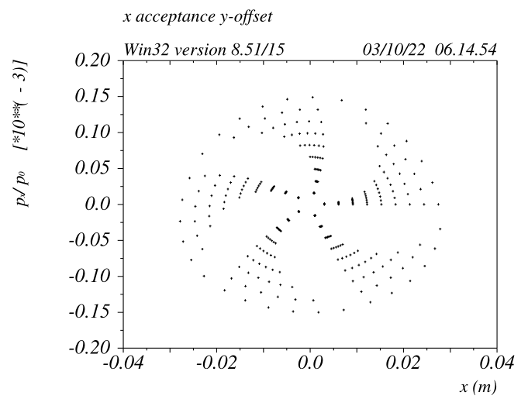
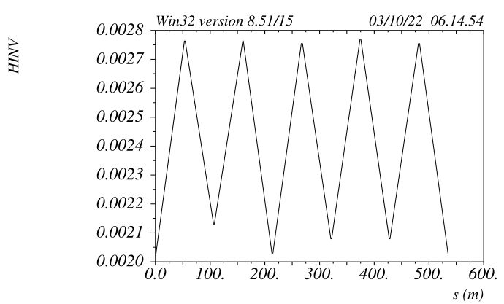
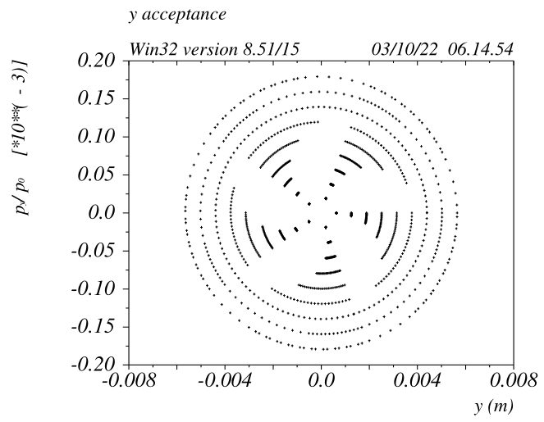
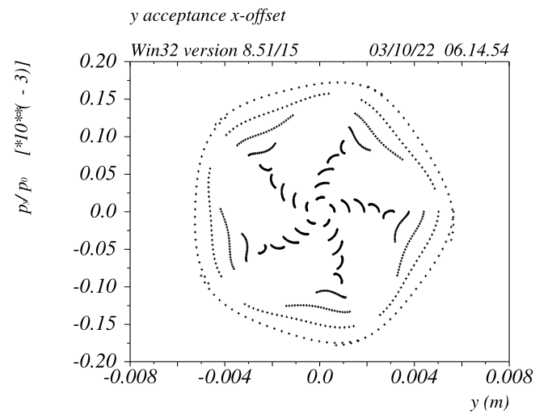
ARC lattice 148 long cells made of FODO9090-NI (~80KM)
SD -I
SF -I
Quick transverse beam dynamics checks made on 5 turns only.
Ideally particle coordinate x/xp/y/yp should come back to initial after 5 turns
(ring tunes set to mux=muy=0.2 for clarity)

Slide 7
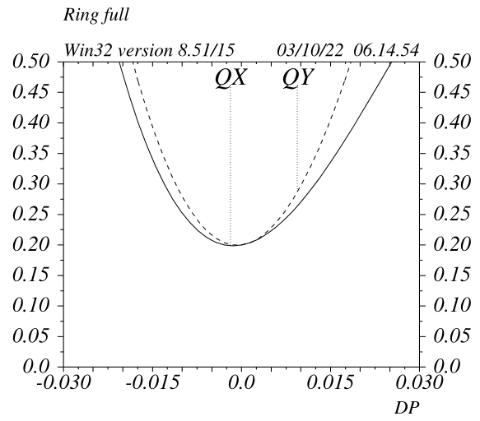
ARC lattice: 148 long FODO9090-NI chromaticity
FODO9090-NI cell is a first order Achromat
Second and third order chromaticities ultimately limit the MA
*CEPC reduces the second order chromaticity with
sextupole families encompassing 8 cells

Slide 8
FODO9090-NI dynamic properties
Ultimate source of SOC is uncorrected chromaticity and
second order dispersion originated by the
quads with no nearby sextupoles.
In general Montague functions (Ws, ddx) are larger wrt a pure FODO
It is also very difficult to cancel simultaneously the detuning from
long sextupole aberration in X, Y and XY (dQx/dJy)
Detunings ultimately limit the DA
SD -I
SF -I
With additional degrees of freedom, it is possible to cancel the second order chromaticities while simultaneously zeroing the 3 linear detuning terms

Slide 9
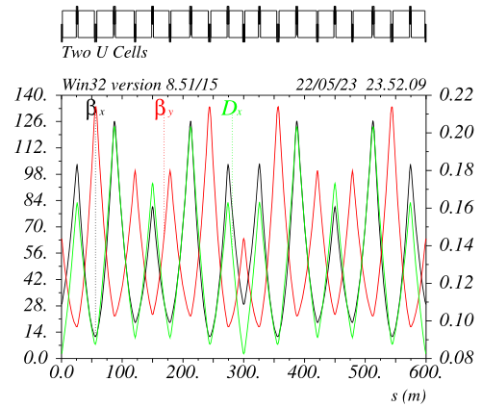
Hybrid FODO lattice: HFD~9090 (ttbar case) with beta modulation
Two cells (300mt long) are displayed
One cell is built with the following matching constraints:
Mux => minimize emittance
Muy => optimize Y chromaticity
Dmux between SFs => zero X-detuning
Dmuy between SFs => zero XY-detuning
Dmuy between SDs => zero Y-detuning
Betay @ SD => zero second order y chromaticity
Betax @ SF => zero second order x chromaticity
One “cell” consists of 10 dipoles and 10 quadrupoles
- 6 quadrupoles (4 quads are paired) families are
varied to match the constraints
- the relative length of the dipoles in between the
sextupoles pairs is varied as well
~-Ix
~-Iy
Fodo9090

Slide 10
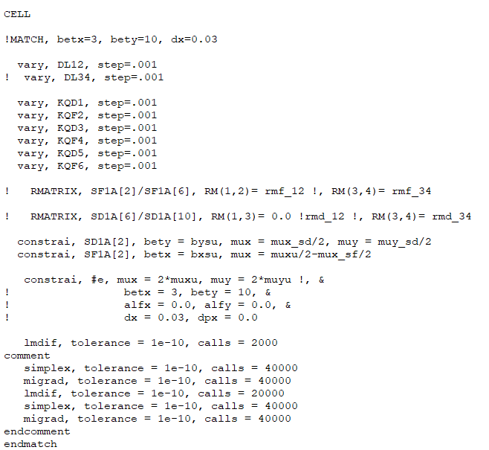
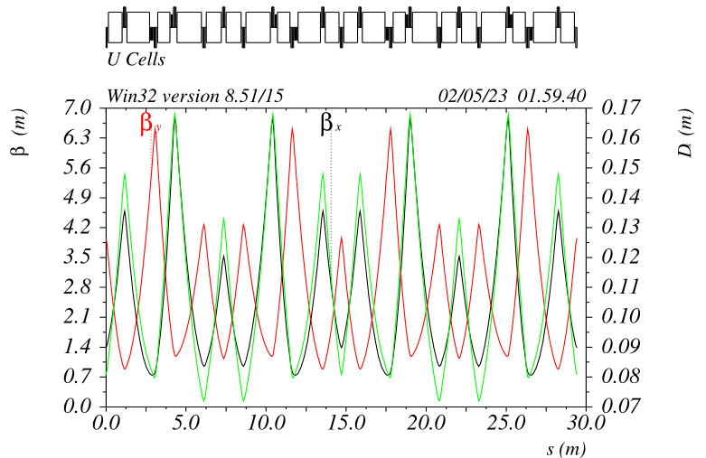
HFD lattice matching routine
~-Ix
~-Iy
This routine generates a linear and
second order achromatic lattice*
*It would be nice to replace the conditions at the sextupoles
with the corresponding affected “RDTs”

Slide 11
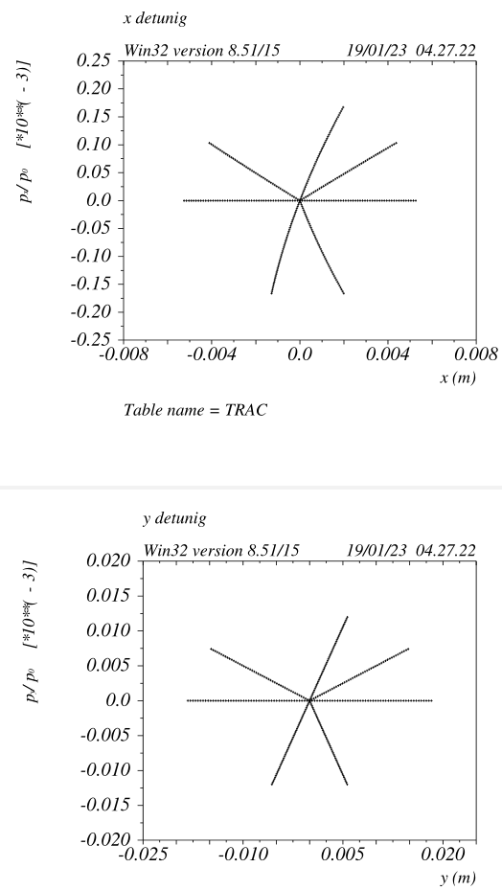
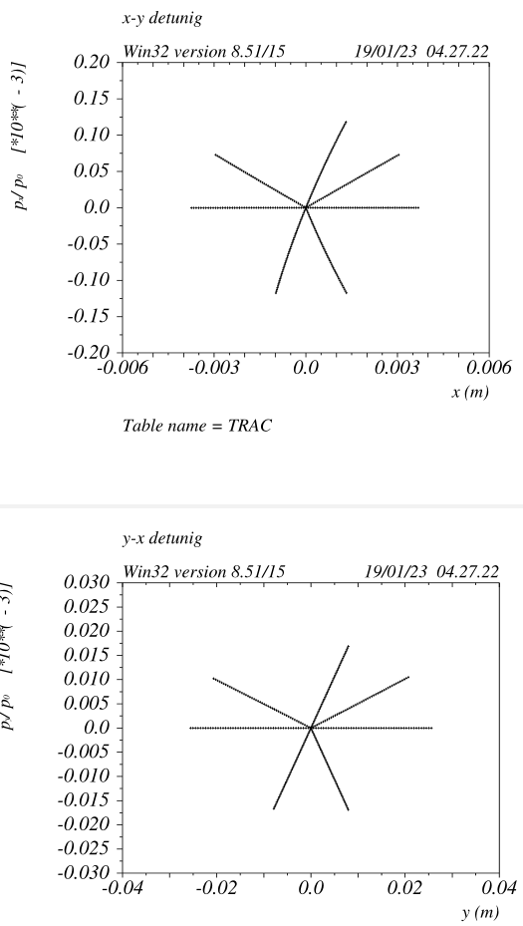
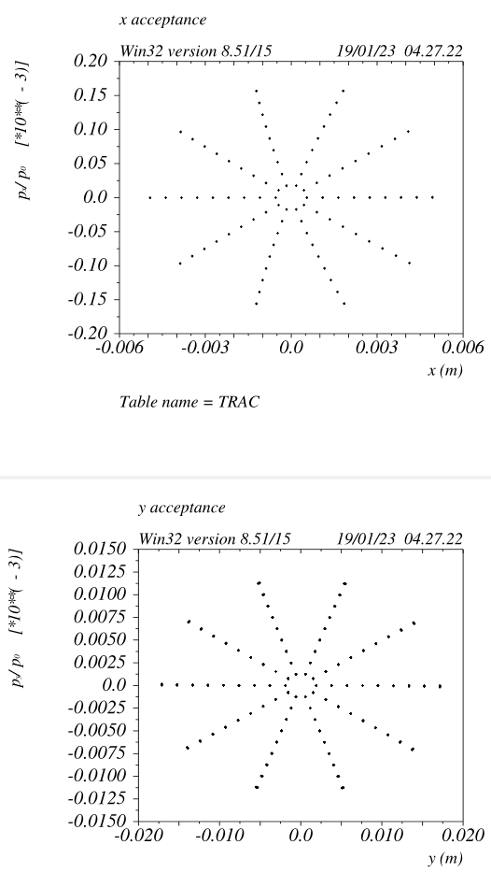
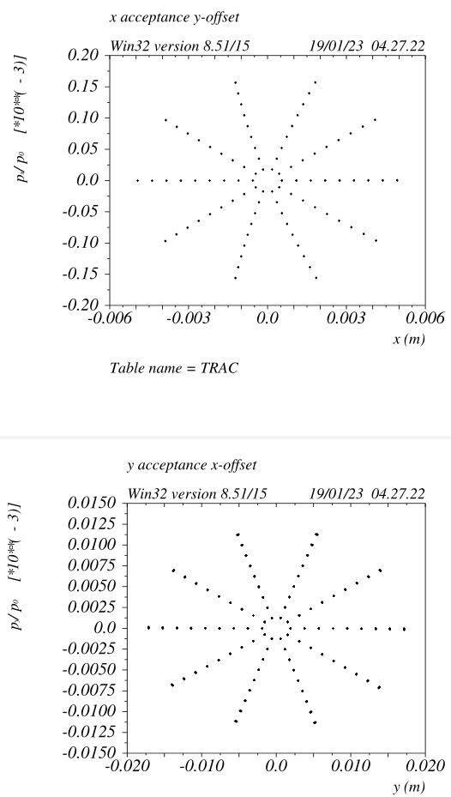
HFD~9090 dynamic properties
Cell “average” phase advances are 95/83

Slide 12
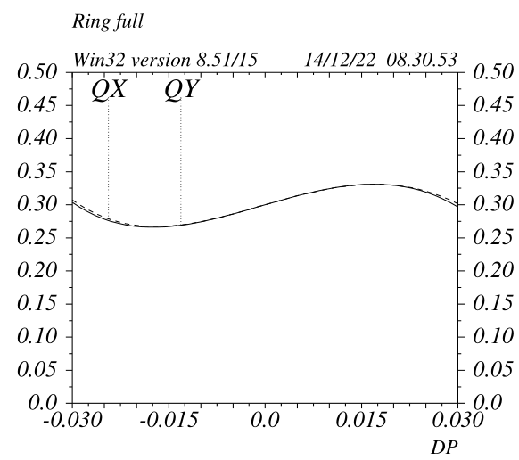
HFD~9090 Energy Acceptance
The ARC+LSS has zero second order chromaticity in both planes, only third and higher orders remain.
Given the aberration scaling laws:
- the linear detuning remains ~0 for any n_cell
- The third order chromaticity increases ~linearly with n_cell

Slide 13
HFD~9090 magnets requirements
~-Ix
~-Iy
HFD cell is the most compact sequence (that I know) that is
achromatic and anharmonic up to the second order
HFD~9090 meets (or exceed) all the “optics requirement” for FCC
From an engineering point of view it has some disadvantages wrt a FODO:
1) the dipoles have not all the same length (4 lengths, possibly fewer)
2) it requires 6 quadrupole families (3 QFs and 3 QDs)
3) as for the FODO9090-NI, it requires at least 2 additional
X&Y correctors in the middle of the –I sextupole pairs to control
the orbits at all the sextupoles
4) The implementation of the twin-quads solution, might degrade its
performances

Slide 14
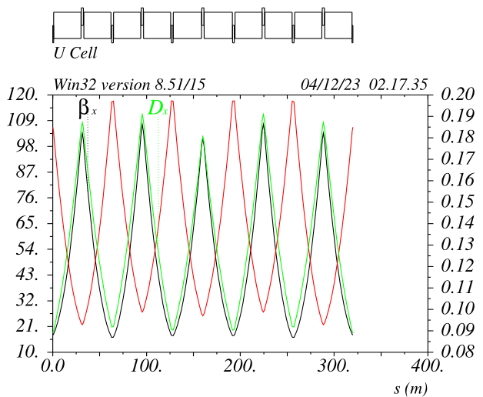
Beyond HFD~9090: HFD-100/74 with 4 sextupole families (ttbar mode)
The cell structure is quasi-periodic:
2 quads families: QF&QD
The dipoles have all same length
The matching conditions are:
Mux (QF) for desired emittance/alphac
Muy (QD) to zero y_det (dQy/dJy)
(solution with lower chrom are preferred)
SF1/SF2 unbalance to zero x_det (dQx/dJx)
SD1/SD2 unbalance to XY_det (dQy/dJx)
Average sexts strengths are set to zero the chromaticities
Sextupoles are placed left-right symmetric.
Their position wrt the nearby quad (before or after) has been chosen to minimize aberration
Given the fact that only 2 sextupoles out of 10 possible are missing the second order chromaticities do remain very small
SF1 SF2
SD1 SD2
4 sextupole families are indeed very effective to cancel the first order detunings of a FODO lattice for a large range of the horizontal phase advance

Slide 15
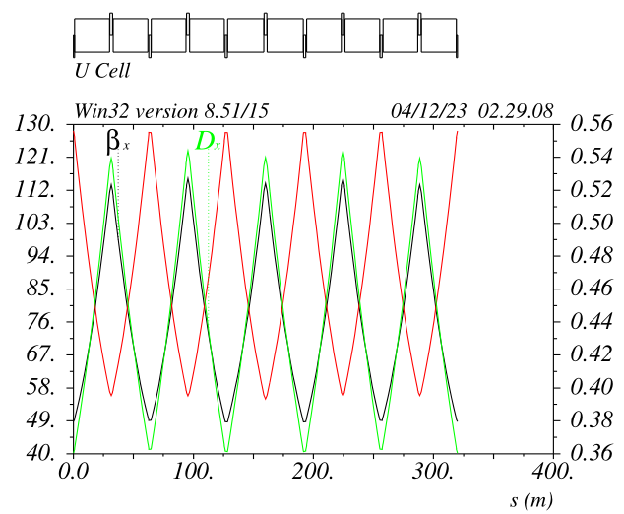
Large alphac option: HFD-51/44 Z mode
Given the additional degree of freedom from
the 2 additional sexts families, good tunes working points do exist almost continuously.
HFD_51/44 delivers:
Ex = 0.70nm Alphac =3.30e-5
(Ex = 0.69nm Alphac =2.94e-5 for full ring)
Muy has been chosen as best compromise between
chromaticities, detunings and sensitivitiy to collective effects.
Peak betas are very similar to the HFD100/74
(Long FODO9090-NI has twice larger betas wrt the short)
HFD100/74
HFD51/44

Slide 16
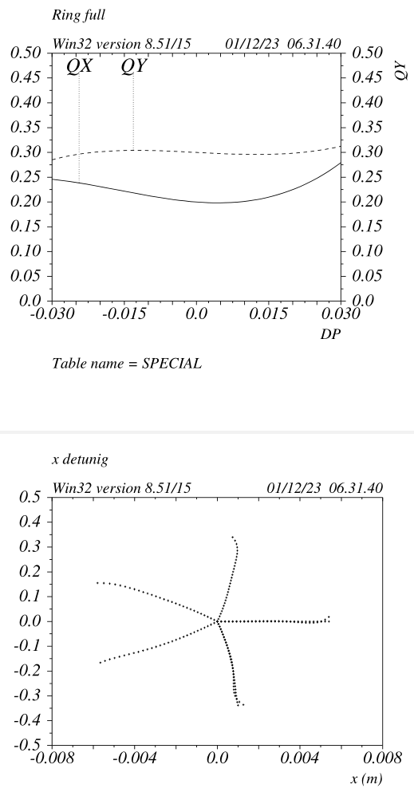
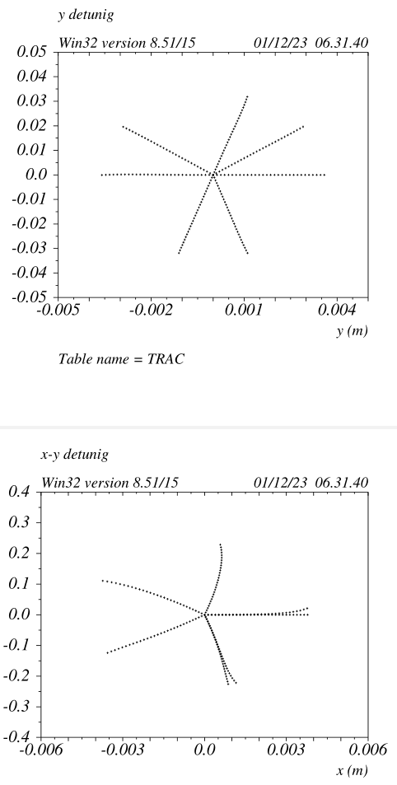
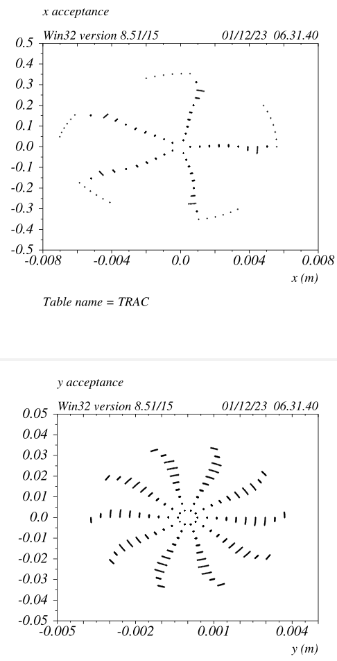
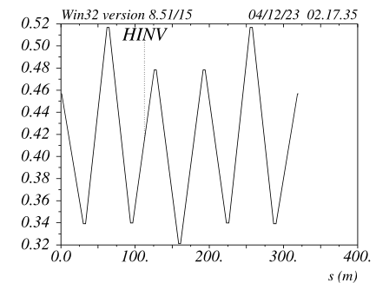
Chromatic and DA properties HFD100/74 ARCs only
High order chromaticities
are small, MA>+/-5%
Only high order x detuning is
Visible
Energy dependent detuning is
very small as well (not shown)

Slide 17
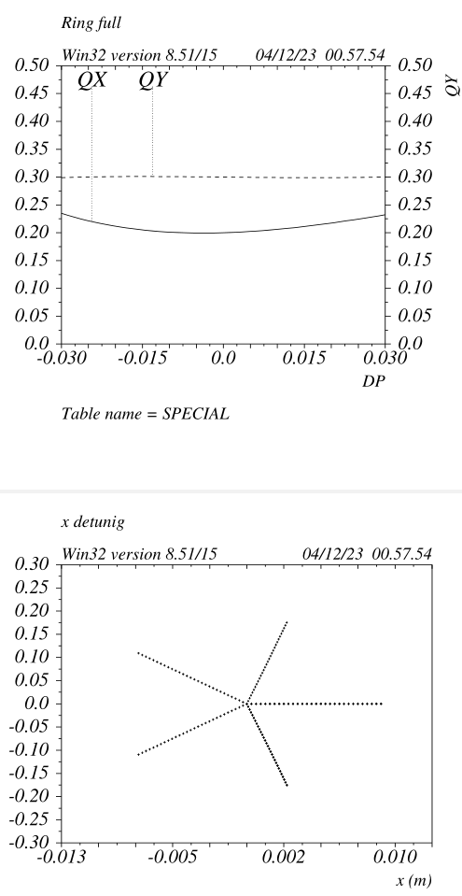
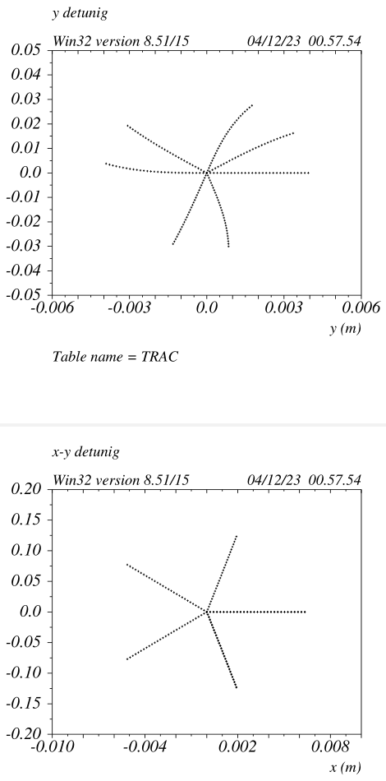
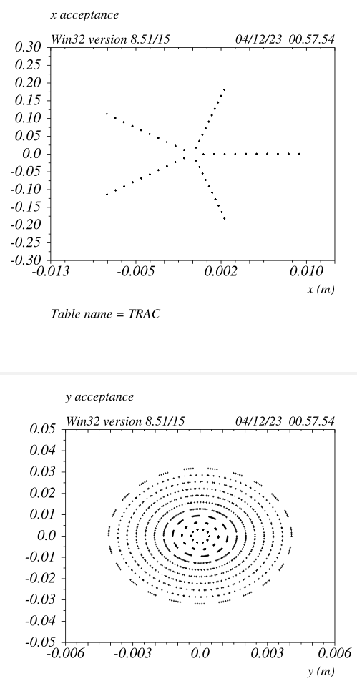
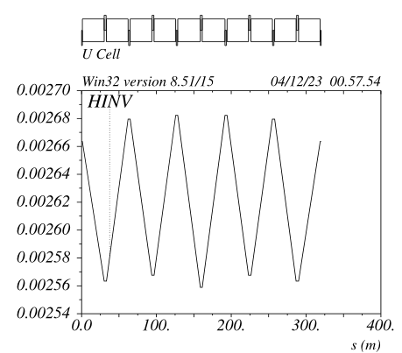
Chromatic and DA properties HFD51/44 ARCs only
Nearly optimal

Slide 18
HFD with four sextupole families highlights
Lower intrinsic emittance for a given cell
Large DA&MA, small detunings for all modes
Horizontal emittance can be continuously varied (a good possibility for the intermediate modes)
Vertical chromaticity is lower wrt Horizontal (muy<mux)
Sextupoles are short (~30-50cm) and easy to mechanically align to the nearby quad
Favourable dipoles filling factor
Alignment tolerances relaxed because the weak sextupoles
Higher mux is possible but “high order” detuning reduces the horizontal DA. It should be studied if
this can be mitigated by having more sextupole families (over more cells)
Interestingly, the 2 “missing sextupoles” do seem very harmful to the DA for all the
analyzed phase advances
Good phase advance between consecutive sextupoles ensures the effectiveness of the steering,
considering only correctors (and BPMs) at the sextupole locations.

Slide 19
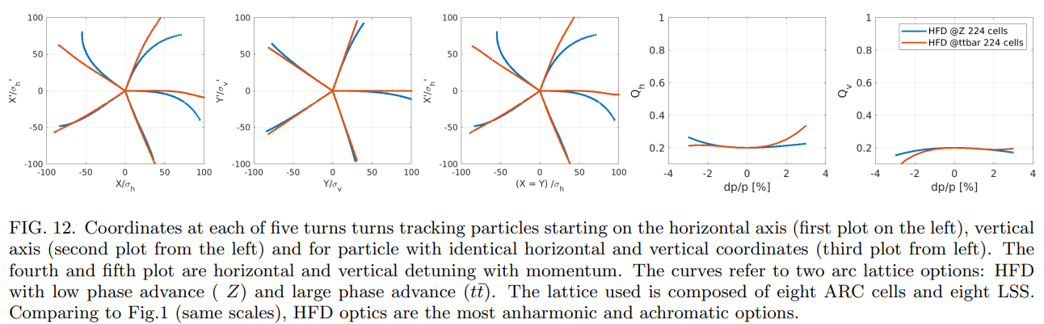
More details can be found in the publication:
Local chromatic correction optics for FCC-ee

Slide 20
HFD with 4 sexts wrt a FODO
4 sexts HFD in fact is a FODO with 3 sextupole families/plane with the strength of 2 families (SF3 and SD3) set to zero
Another small difference is that the sextupoles are placed symmetrically in the cell and not sequentially
To be noted that the chosen mux&muy result in a small imbalance of the SF1/SF2 and SD1/SD2 families
(set to zero the detunings)
In principle “machine-learning” or “quasi-random” alghoritms should have been able to derive such very effective setting. I have not checked the literature to see if this has indeed happened
Nevertheless, it should be stressed that the setting can be derived by formulating proper conditions and solving corresponding equations
SF1 SF2 SF3
SD1 SD2 SD3

Slide 21
Summary
It is possible to develop low emittance quasi-fodo lattices with large DA&MA
Matching routines that determines the sextupoles (and muy) settings to
zero the detunings can be easily derived
It should be studied the possibility of adding more sextupole families =>
larger DA, smaller emittance (higher mux)
Given the “n_cells” scaling laws, smaller emittance/ring eventually leads to a significant fraction (if not all) of the ring taken by quads and/or sexts.
Lattice solutions that further deviate from a FODO could overcome this problem

Slide 22
Backup

Slide 23
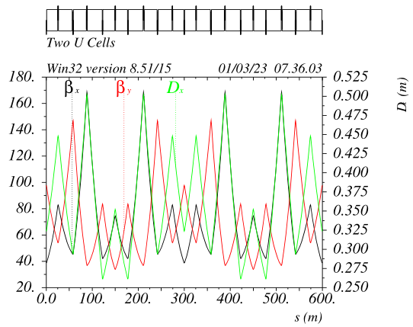
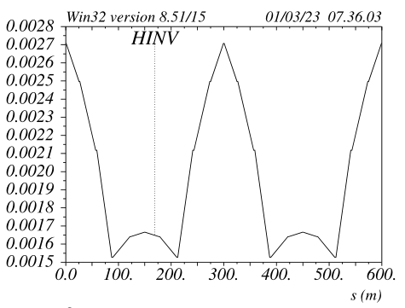
HFD lattice optimization: HFD~4545 for Z v_51a1
Cancel the linear detuning by adjusting the phase between
the sextupole pairs can be applied for any given Cell phase advance.
It works better (less linear detuning as starting with and residual non-linear
detuning ) if the fractional X-cell phase advances is around pi/2,
For the Z-mode the cell has been optimized around:
mux_C = 1.235 muy_C = 1.251
The detuning “knobs” are:
X det : mux_C
Y det : mux between the SF pairs
XY det: muy between the SD pairs
betaY@SD and betax@SF are set (as in HFD9090) in order to cancel
the second order chromaticity.
Muy_C has not been fully optimized yet
The cell has 6 independent quads to meet the constraints, Ks values
about twice weaker wrt to ttbar.
The sextupoles become very weak, Ks about 5 times weaker wrt to ttbar
optics, no detuning is visible up to 100sigmas
The DA/MA is extremely large.
A small second order chromaticity is left (for now) to keep betax below 170m
quasi -Ix
quasi -Iy

Slide 24
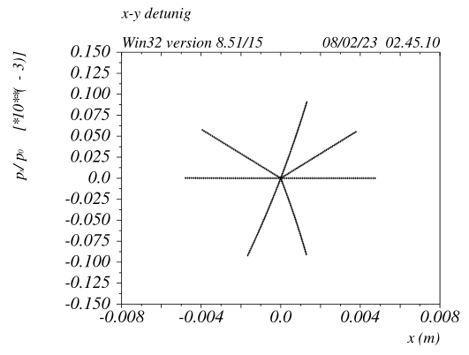
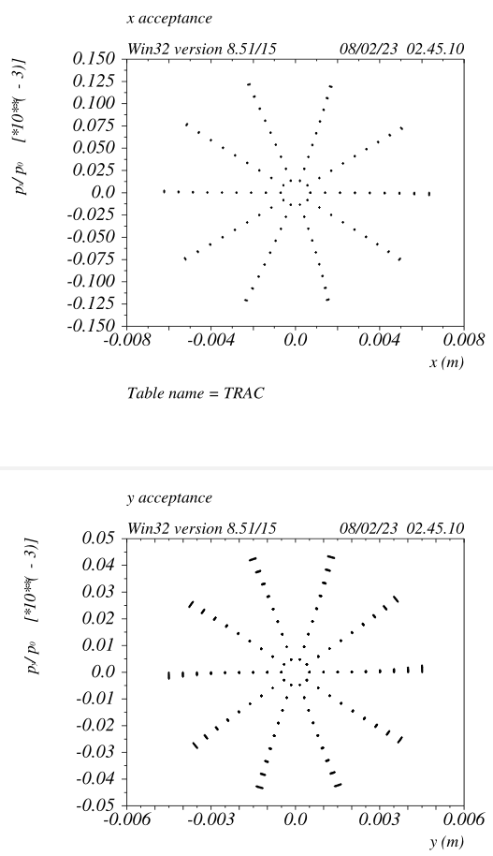
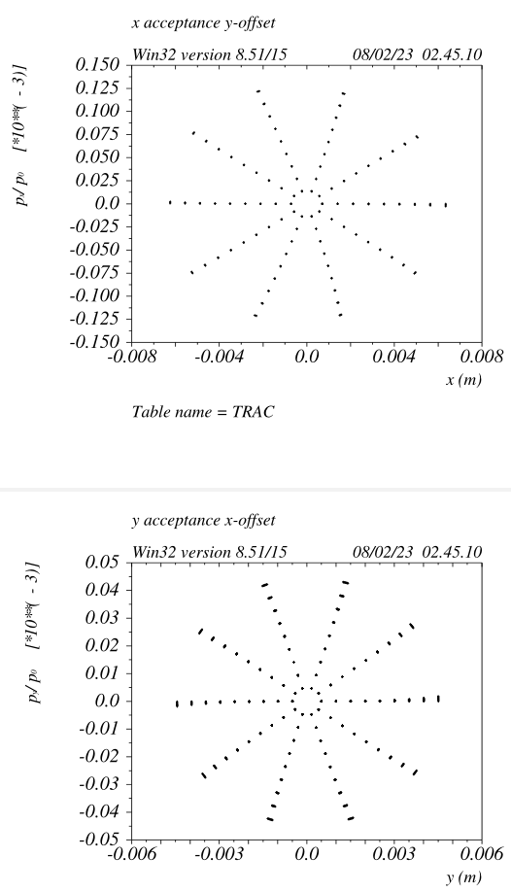
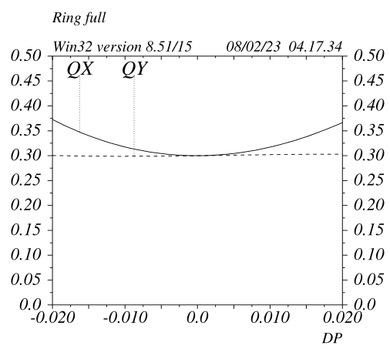
Z ARCs dynamic properties v_51a1
betax= 45m betay = 100m
HFD4545 dynamic properties are excellent

Slide 25
ARC hardware requirements: HFD vs baseline @ttbar (and Z)
ARC quadrupoles@ttbar HFD Baseline
Number of quads: 2240 2836
Total quads length (m): 5712 8224
Total integrated gradient K1L : 118 160
QFs: 2.40mt K1 = 0.020 B = 0.48T@40mm K1 = 0.011@Z
QDs: 1.85mt K1 = -0.020 K1 =-0.013
ARC sextupoles@ttbar
Number of sextupoles: 1792 2336
Total sextupoles length (m): 734 3036
Total integrated gradient K2L : 880 2171
SFs: 0.30mt K2 = 1.20 B=0.64T@40mm K2 = 0.27/0.24@Z
SDs: 0.52mt K2 = -1.20 K2 =-0.27/-0.16
ARC BPMs 1792 (see S Liuzzo presentation)
Correctors (X/Y/Skew/Quad) in sexts only 1792
Energy loss per turn@ttbar (GeV): 8.8 0.0343@Z 10.4

