Slide 1


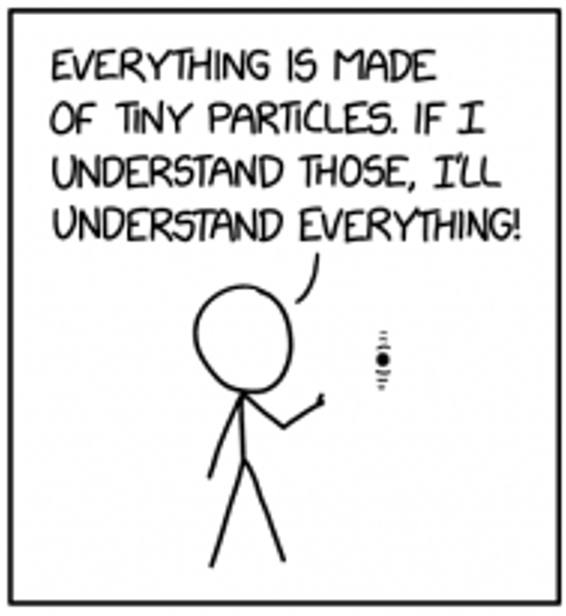
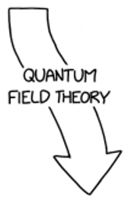
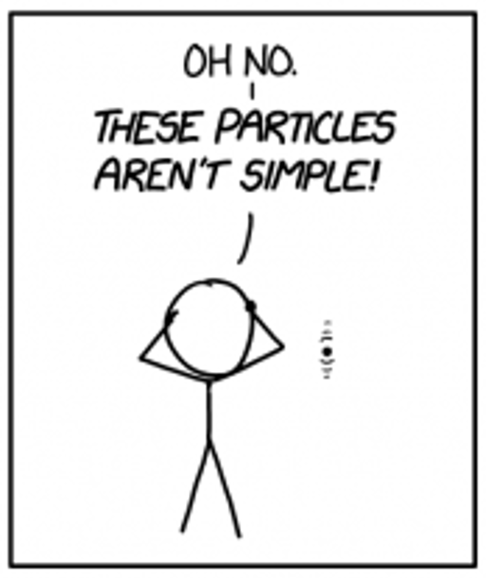
Transverse-Spin Dependent Azimuthal Asymmetries in COMPASS Drell-Yan data
HADRON PHYSICS
Towards a 3D Picture of the Nucleon
13 VI 2025
High Energy Physics Seminar
Małgorzata Niemiec,
Faculty of Physics, University of Warsaw

Slide 2



The Proton: Small, Common, and Still Full of Mysteries
In High School
First College Classes
Hadron Scientists
Proton is a balls with one unit each of positive electric charge!
Oh…the ball is actually a bundle of three quarks.
More complicated you could possibly imagine.
Visual inspired by Rick and Morty
13 VI 25, M.Niemiec
Transverse spin-dependent asymmetries at COMPASS experiment
HEP Seminar, 2/33

Slide 3

QCD: A Brief Overview
Do you know how it all started?
13 VI 25, M.Niemiec
Transverse spin-dependent asymmetries at COMPASS experiment
HEP Seminar, 3/33

Slide 4
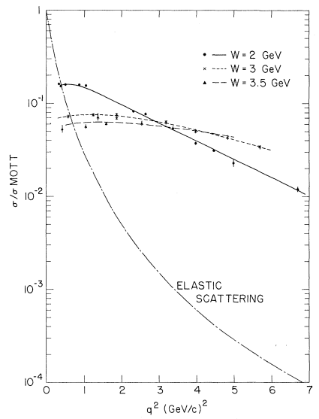
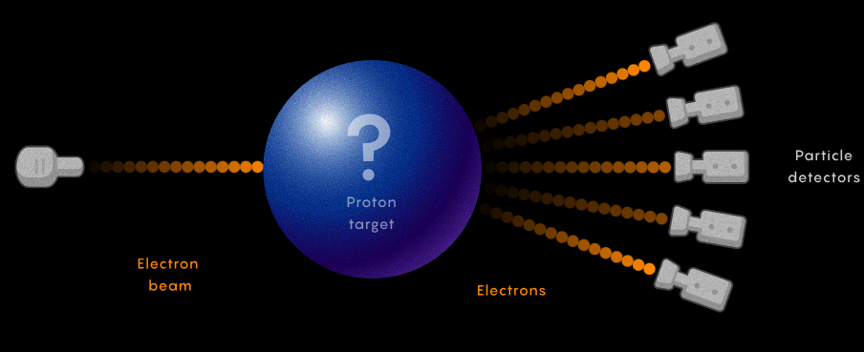
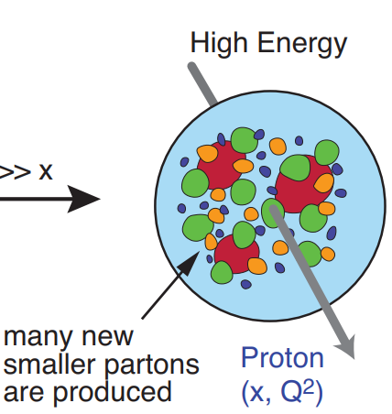
Cracking Open the Proton: Deep Inelastic Scattering (DIS)
1. Experiment
2. Results
Invariant mass of recoiling target system
[M. Breidenbach et. al., Phys. Rev. Lett 23 (1969) 935]
3. Interpretation
$$e^{−}$$
$$e^{−}$$
Scattering off point-like constituents: interpreted as partons
$$γ^{∗}$$
$$X$$
Partons
$$p$$
four-momentum transfer
13 VI 25, M.Niemiec
Transverse spin-dependent asymmetries at COMPASS experiment
HEP Seminar, 4/33

Slide 5

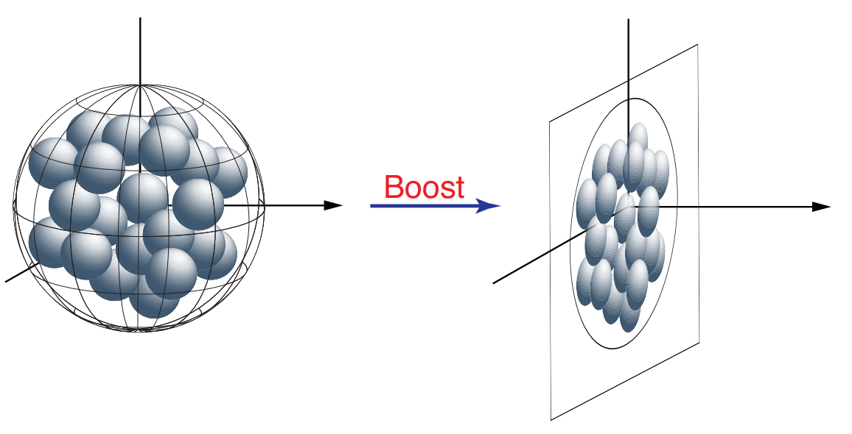
Quark Parton Model (QPM): A Closer Look Inside the Proton
The Proton as an Aquarium of Partons
Analogy
Fishes in Aquarium = Partons inside Proton
The Scooter = Infinite Momentum Frame
13 VI 25, M.Niemiec
Transverse spin-dependent asymmetries at COMPASS experiment
HEP Seminar, 5/33

Slide 6
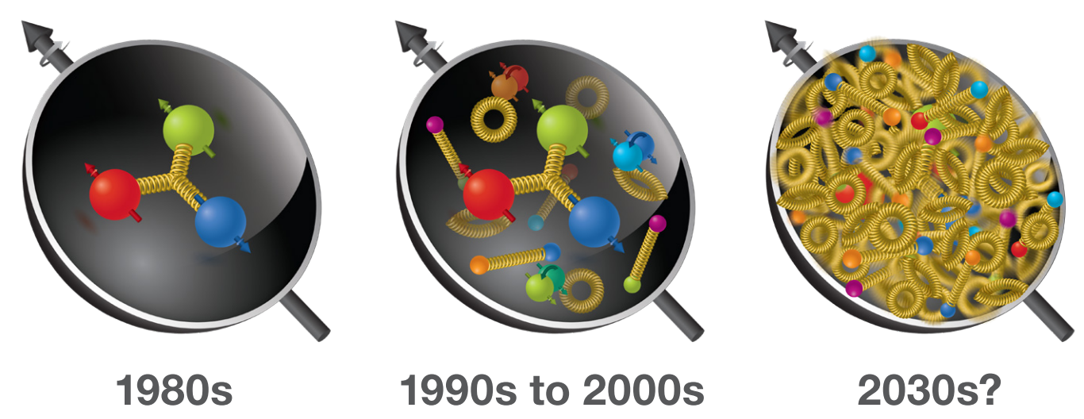
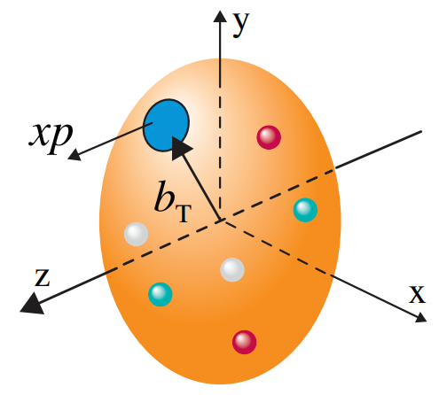
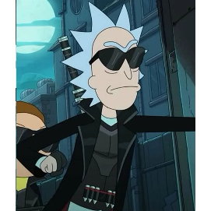
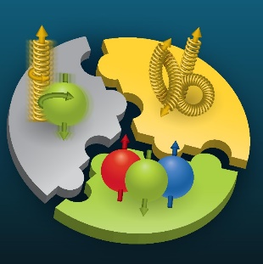
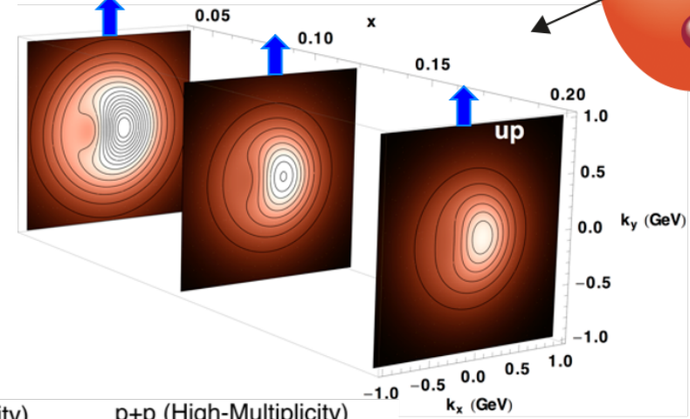
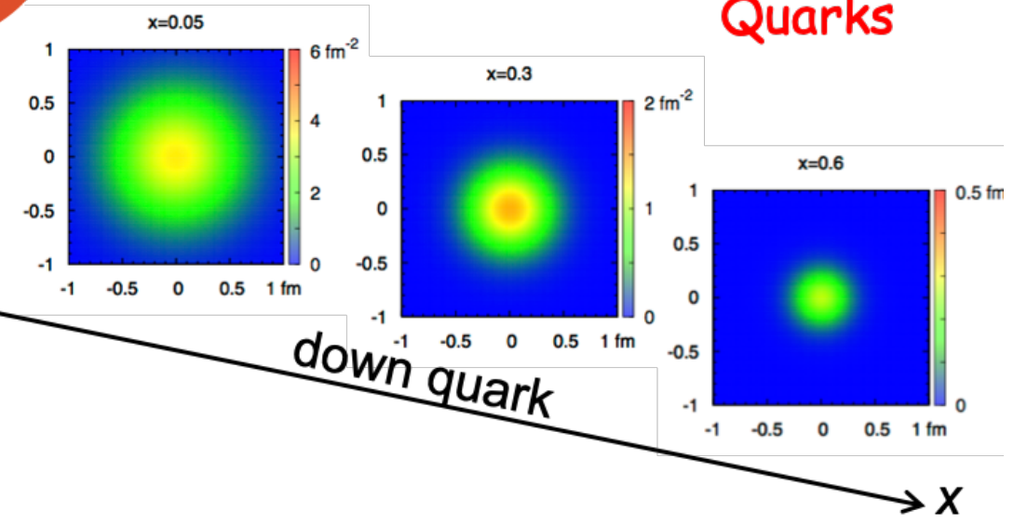
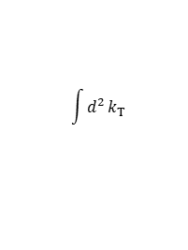
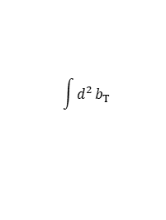
The Joy of Why
Hadron Structure
Hadron Tomography
Wigner Distribution
$$W(x, b_{T}, k_{T})$$
Much More Than Three Quarks
Open Topics
$$\int{d^{2}}b_{T}$$
$$\int{d^{2}}k_{T}$$
Spin Puzzle
$$f(x, k_{T})$$
$$f(x, b_{T})$$
$$x$$
$$x=0.05$$
$$x=0.3$$
$$b_{y}(fm)$$
$$x=0.6$$
$$k_{y}(GeV)$$
$$down$$
$$b_{x}(fm)$$
$$x$$
$$x$$
$$x$$
$$k_{x}(GeV)$$
13 VI 25, M.Niemiec
HEP Seminar, 6/33
Transverse spin-dependent asymmetries at COMPASS experiment

Slide 7


Proton Spin Structure: Collinear Approach
Twist-2
collinear PDFs
Nucleon polarisation
U
L
T
Nucleon
In collinear approach, three twist-2 PDFs in QCD
U
Nucleon
spin
$$f_{1}^{q}(x)$$
Number Density
Number Density
Quark
$$→$$
$$−$$
$$→$$
Quark Polarisation
L
Quark
spin
$$g_{1}^{q}(x)$$
$$f_{1}^{q}(x)$$
Well known
$$→$$
L
Helicity
T
$$→$$
$$−$$
$$→$$
$$→$$
$$−$$
Helicity
$$→$$
$$h_{1}^{q}(x)$$
Less well known
Transversity
$$g_{1}^{q}(x)$$
$$x_{i}P$$
$$→$$
$$→$$
Transversity
$$−$$
Poorly known
Proton momentum
$$P$$
$$x_{l}P$$
$$h_{1}^{q}(x)$$
$$γ^{∗}$$
$$x_{k}P$$
Analogy
$$x_{j}P$$
Longitudinal momentum
$$x_{m}P$$
$k^{+}=xP^{+}$
partons
13 VI 25, M.Niemiec
Transverse spin-dependent asymmetries at COMPASS experiment
HEP Seminar, 7/33

Slide 8
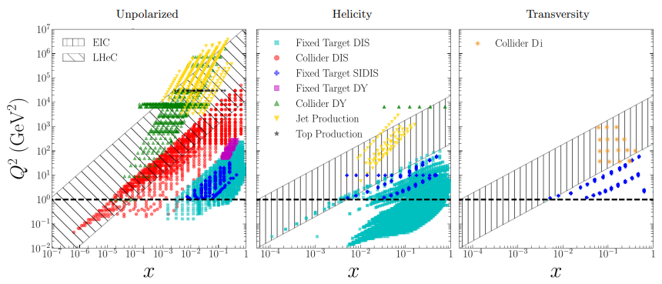

Map of Experimental Results
$\text{Fraction} \text{of} \text{the} \text{nucleon}\text{’}\text{s} \text{momentum} \text{carried} \text{by} \text{a} \text{quark}$ $x$
Photon virtuality$Q^{2}$
[Ethier and Nocera, Annu. Rev. Nucl. Part. Sci. 2020. 70:43–76]
13 VI 25, M.Niemiec
Transverse spin-dependent asymmetries at COMPASS experiment
HEP Seminar, 8/33

Slide 9
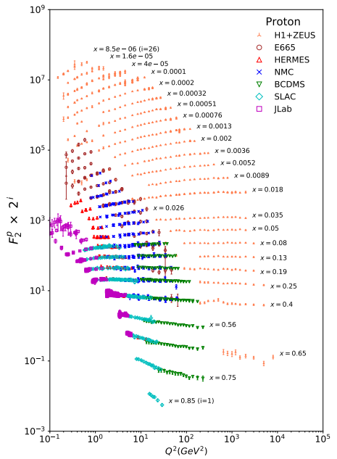
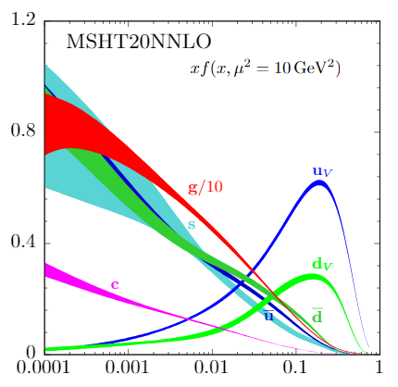

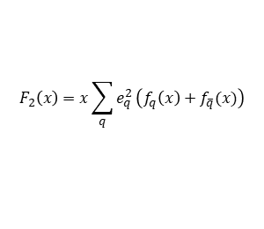

Number Density
Structure function $F_{2}$ - sum of the momentum distribution of quarks.
Well known
At leading order
$$F_{2}\left(x\right)=x\sum_{q}{e_{q}^{2}}\left(f_{q}\left(x\right)+f_{\overline{q}}(x)\right)$$
$$f_{1}^{q}(x)$$
The unpolarized parton distribution
$$x$$
[R.L. Workman et al. (Particle Data Group), Prog. Theor. Exp. Phys. 2022, 083C01 (2022) and 2023 update]
13 VI 25, M.Niemiec
Transverse spin-dependent asymmetries at COMPASS experiment
HEP Seminar, 9/33

Slide 10
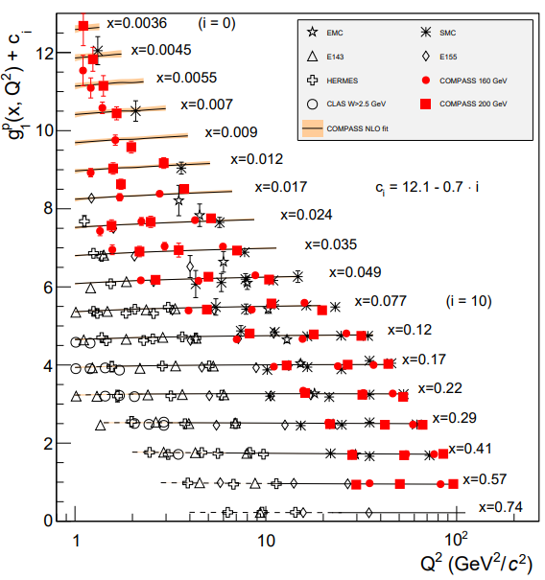
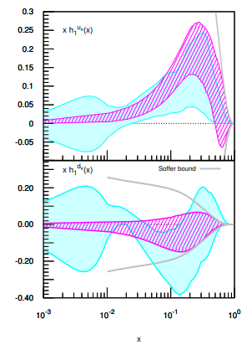
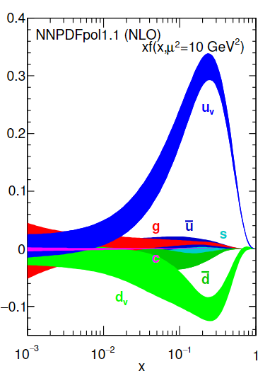
Helicity
Transversity
$$→$$
$$−$$
$$→$$
Less well known
$$→$$
$$→$$
$$−$$
Poorly known
$$g_{1}^{q}(x)$$
$$h_{1}^{q}(x)$$
[Bacchetta and Radici, Phys. Rev. Lett. 120, 192001 (2018)]
[Benel et. al., Eir. Phys. J. C 80 (5), 465 (2020)]
The polarized parton distribution
[R.L. Workman et al. (Particle Data Group), Prog. Theor. Exp. Phys. 2022, 083C01 (2022) and 2023 update]
13 VI 25, M.Niemiec
Transverse spin-dependent asymmetries at COMPASS experiment
HEP Seminar, 10/33

Slide 11

Helicity
Transversity
$$→$$
$$−$$
$$→$$
Less well known
$$→$$
$$→$$
$$−$$
Poorly known
$$g_{1}^{q}(x)$$
$$h_{1}^{q}(x)$$
[Bacchetta and Radici, Phys. Rev. Lett. 120, 192001 (2018)]
[Benel et. al., Eir. Phys. J. C 80 (5), 465 (2020)]
The polarized parton distribution
$$x$$
[R.L. Workman et al. (Particle Data Group), Prog. Theor. Exp. Phys. 2022, 083C01 (2022) and 2023 update]
13 VI 25, M.Niemiec
HEP Seminar, 11/33
Transverse spin-dependent asymmetries at COMPASS experiment

Slide 12


Proton Structure Beyond the Collinear Picture
Nucleon
Nucleon
spin
$$k_{T}$$
Quark
Quark
spin
$$→$$
$$→$$
Twist-2
TMD PDFs
Nucleon polarisation
$$k_{T,i}$$
U
L
T
$$x_{i}P$$
$$−$$
$$→$$
$$→$$
$$k_{T,l}$$
$$k_{T,j}$$
Including transverse motion of quark inside the proton
U
$$f_{1}^{q}(x, k_{T}^{2})$$
Proton momentum
Number Density
$$f_{1T}^{q⊥}(x, k_{T}^{2})$$
$$x_{l}P$$
Sivers
$$P$$
$$−$$
$$→$$
$$→$$
$$x_{j}P$$
$$→$$
$$−$$
$$→$$
$$k_{T,k}$$
$$→$$
$$→$$
$$x_{k}P$$
$$k_{T,m}$$
L
Quark Polarisation
$$g_{1L}^{q}(x, k_{T}^{2})$$
$$g_{1T}^{q}(x, k_{T}^{2})$$
Helicity
Worm-Gear T
$$x_{m}P$$
$$→$$
$$→$$
$$h_{1}^{q}(x, k_{T}^{2})$$
$$→$$
$$→$$
$$−$$
Transversity
$$→$$
$$→$$
T
$$→$$
$$−$$
$$→$$
$$−$$
$$→$$
$$→$$
$$h_{1T}^{q⊥}(x, k_{T}^{2})$$
$$h_{1}^{q⊥}(x,k_{T}^{2})$$
$$h_{1L}^{q⊥}(x, k_{T}^{2})$$
$$→$$
$$→$$
Pretzelosity
$$−$$
$$→$$
$$k_{T}$$
Boer-Mulders
Worm-Gear L
$$→$$
Longitudinal momentum
$$k^{+}=xP^{+}$$
8 leading-twist Transverse-Momentum Dependent PDFs (TMD PDFs)
Analogy
partons
Transverse plane
Transverse spin-dependent asymmetries at COMPASS experiment
HEP Seminar, 12/33
13 VI 25, M.Niemiec

Slide 13


From Theory to Experiment: Probing TMD PDFs in Practice
When the target nucleon is transversely polarized, the probability of scattering depends not only on the kinematics, but also on the spin orientation.
This leads to…
modulations (asymmetries) in the angular distributions
of final-state particles.
We count events for spin-up and spin-down target orientations.
$$−$$
$$Asymmetry=\frac{N^{↑}−N^{↓}}{N^{↑}+N^{↓}}$$
$$+$$
13 VI 25, M.Niemiec
Transverse spin-dependent asymmetries at COMPASS experiment
HEP Seminar, 13/33

Slide 14
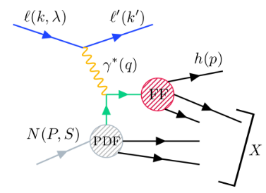
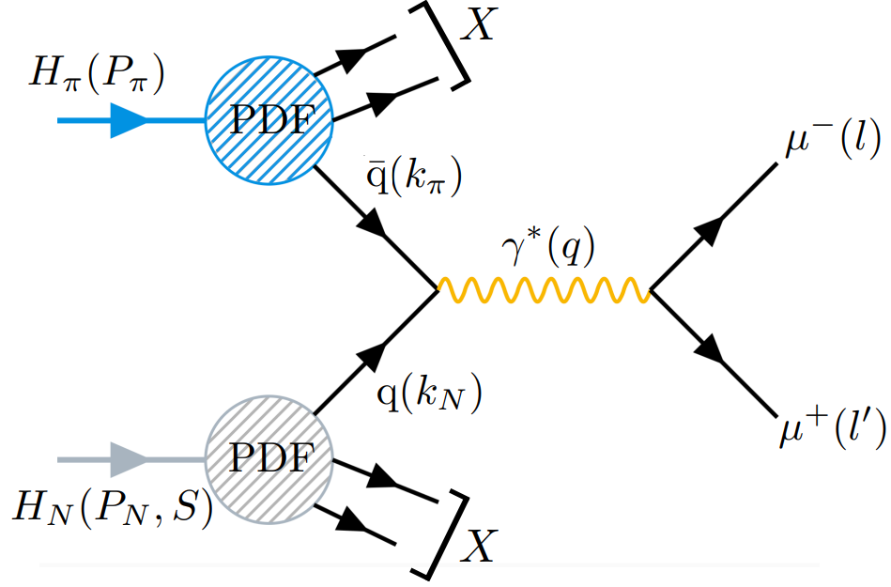







From Drell–Yan to SIDIS: Completing the Picture
Both SIDIS and Drell–Yan provide complementary access to TMD PDFs via transverse–spin dependent azimuthal asymmetries (TSAs).
Semi-Inclusive Deep Inelastic Scattering (SIDIS)
Drell-Yan (DY) process
Incoming particle:
Incoming particle:
lepton
hadron
muon pair
Final state:
$$ℓ$$
Final state:
$$π^{−}$$
$$ℓ^{′}$$
hadron
$$μ^{−}$$
Photon scatters off a quark
Quark and antiquark annihilate
$$μ^{+}$$
$$N$$
$$N$$
$$A_{SIDIS }∝PDF_{N}⨂FF$$
Target:
$$A_{DY }∝PDF_{N}⨂PDF_{π^{−}}$$
transversely polarized nucleon
13 VI 25, M.Niemiec
Transverse spin-dependent asymmetries at COMPASS experiment
HEP Seminar, 14/33

Slide 15
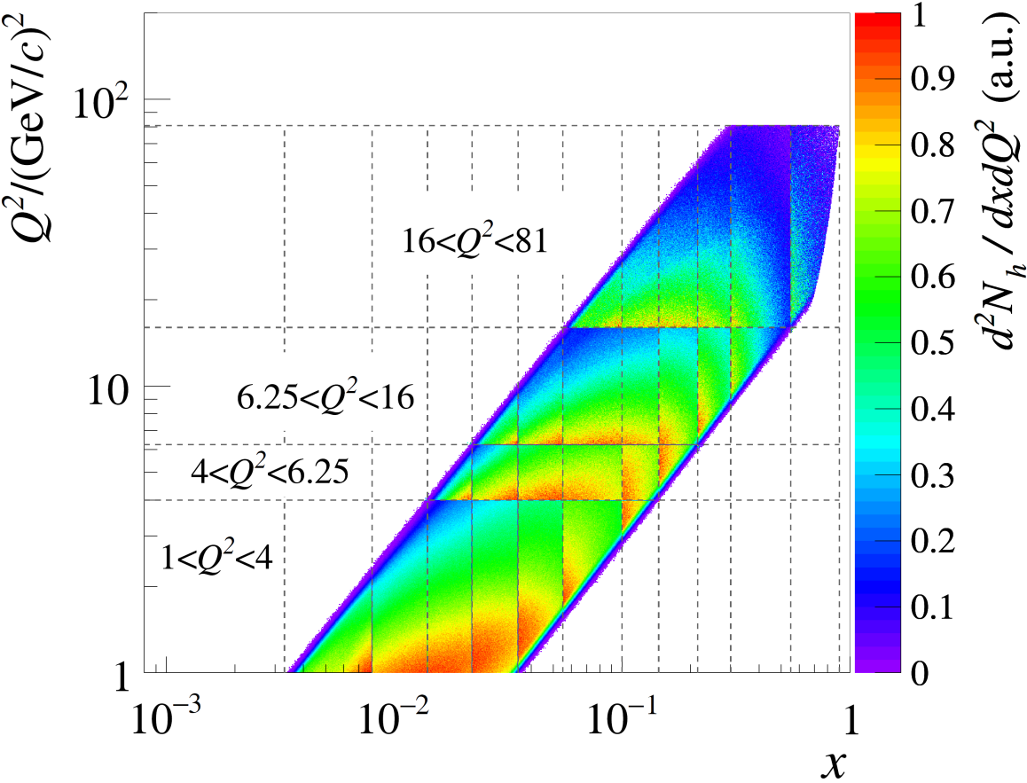
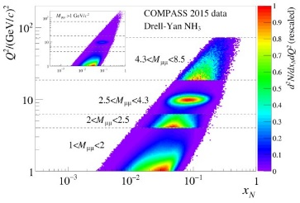





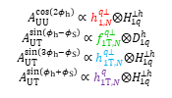
From Idea to Experiment: COMPASS as a unique tool
Both SIDIS and Drell–Yan reactions were measured in COMPASS.
SIDIS
DY
Thanks to comparable $Q^{2}−x$ kinematic coverage:
Systematic uncertainties are reduced.
$Q^{2}$ evolution effects are minimized.
$$A_{UU}^{cos\left(2φ_{h}\right)}∝h_{1,N}^{q⊥}⨂H_{1q}^{⊥h}$$
$$A_{UT}^{sin\left(φ_{h}−φ_{S}\right)}∝f_{1T,N}^{q⊥}⨂D_{1q}^{h}$$
$$A_{UT}^{sin\left(3φ_{h}−φ_{S}\right)}∝h_{1T,N}^{q⊥}⨂H_{1q}^{⊥h}$$
$$A_{UT}^{sin\left(φ_{h}+φ_{S}\right)}∝h_{1T,N}^{q}⨂H_{1q}^{⊥h}$$
Boer-Mulders
$$A_{U}^{cos\left(2φ\right)}∝h_{1, π}^{q⊥}⊗h_{1, N}^{q⊥}$$
$$A_{T}^{sin\left(φ_{S}\right)}∝f_{1,π}^{q}⊗f_{1T, N}^{q⊥}$$
$$A_{T}^{sin\left(2φ+φ_{S}\right)}∝h_{1, π}^{q⊥}⊗h_{1T, N}^{q⊥}$$
$$A_{T}^{sin\left(2φ−φ_{S}\right)}∝h_{1, π}^{q⊥}⊗h_{1,N}^{q}$$
Sivers
Pretzelosity
Transversity
TMD
universality
But that's not all!
This allows for a direct comparison of asymmetries between SIDIS and DY $−$critical to test TMD universality.
From the Lion King
13 VI 25, M.Niemiec
HEP Seminar, 15/33
Transverse spin-dependent asymmetries at COMPASS experiment

Slide 16
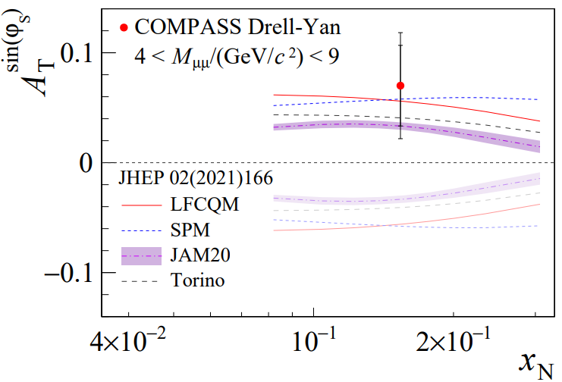
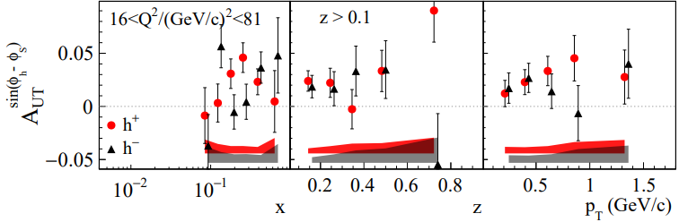



Example of TMD universality: Sivers sign change
The Sivers TMD PDF describes how the distribution of unpolarized quarks inside a transversely polarized proton depends on the quark’s transverse momentum.
Prediction from QCD
DY Sivers TSA
$$A_{T}^{sin\left(φ_{S}\right)}∝f_{1,π}^{q}⊗f_{1T, N}^{q⊥}$$
$$f_{1T}^{q⊥}\left(SIDIS\right)=−f_{1T}^{q⊥}\left(DY\right)$$
Sign Change
SIDIS Sivers TSA
$$A_{UT}^{sin\left(φ_{h}−φ_{S}\right)}∝f_{1T,N}^{q⊥}⨂D_{1q}^{h}$$
No Sign Change
[COMPASS, PRL 133 (2024) 071902]
[COMPASS, PLB 770 (2017) 138]
13 VI 25, M.Niemiec
HEP Seminar, 16/33
Transverse spin-dependent asymmetries at COMPASS experiment

Slide 17
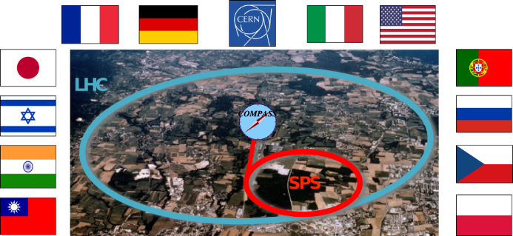

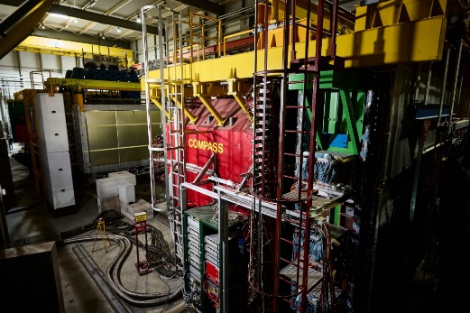
Probing TMD PDFs with COMPASS: A Unique Opportunity
Common Muon and Proton Apparatus
for Structure and Spectroscopy
COMPASS Experiment
24 institutions from 13 countries (approximately 220 physicists)
CERN SPS North Area
Fixed target experiment
An extensive research programme on the structure of nucleons, including spin and on hadron spectroscopy
13 VI 25, M.Niemiec
HEP Seminar, 17/33
Transverse spin-dependent asymmetries at COMPASS experiment
An extensive research programme on the structure of nucleons, including spin and on hadron spectroscopy

Slide 18

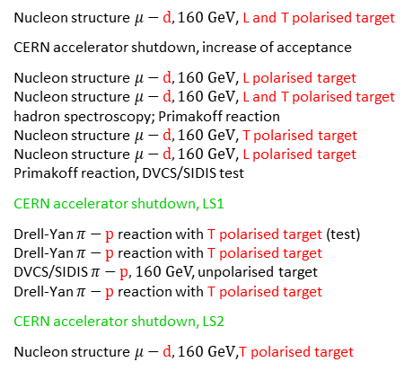
Panorama of COMPASS
From COMPASS to AMBER: The Story Continues
2002-2004
t
2005
t
2006
2007
2008-2009
2010
2011
2012
t
2013
t
2014
2015
2016-2017
2018
t
2019-2020
t
2021-2022
Nucleon structure $μ−d, 160 GeV$, L and T polarised target
t
CERN accelerator shutdown, increase of acceptance
t
Nucleon structure $μ−d, 160 GeV$, L polarised target
Nucleon structure $μ−d, 160 GeV$, L and T polarised target
hadron spectroscopy; Primakoff reaction
Nucleon structure $μ−d, 160 GeV$, T polarised target
Nucleon structure $μ−d, 160 GeV$, L polarised target
Primakoff reaction, DVCS/SIDIS test
t
CERN accelerator shutdown, LS1
t
Drell-Yan $π−p$ reaction with T polarised target (test)
Drell-Yan $π−p$ reaction with T polarised target
DVCS/SIDIS $π−p,160 GeV$, unpolarised target
Drell-Yan $π−p$ reaction with T polarised target
t
CERN accelerator shutdown, LS2
t
Nucleon structure $μ−d, 160 GeV$,T polarised target
COMPASS is in the data analysis phase.
PHASE I (2002-2011)
New experiment
PHASE II (2012-2022)
13 VI 25, M.Niemiec
HEP Seminar, 18/33
Transverse spin-dependent asymmetries at COMPASS experiment

Slide 19
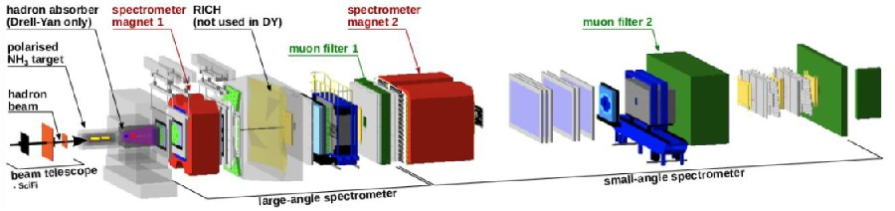
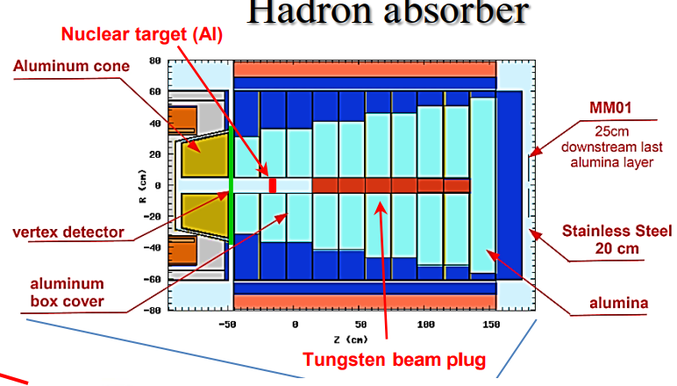
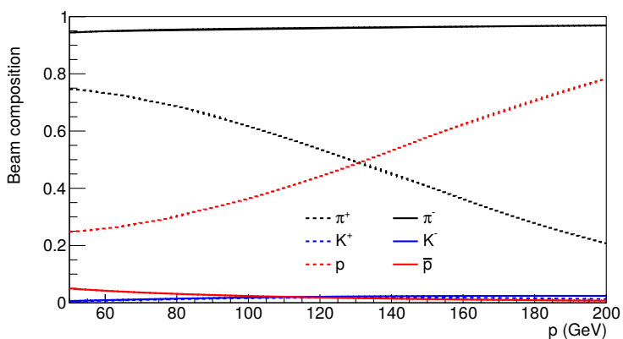

COMPASS Setup: Drell-Yan Programme
hadron absorber (DY only)
spectrometer magnet 1
RICH
(not used in DY)
spectrometer magnet 2
muon filter 2
polarised target
muon filter 1
hadron beam
beam telescope
small-angle spectrometer
Beam line
large-angle spectrometer
Hadron absorber
High energy negative hadron beam: 190 GeV
Beam composition:
Targets:
97% $π^{−}$, 2% $K^{−}$, 1% $p^{−}$
polarised NH₃
Al, W
Hadron absorber
Muon filters
Triggering systems
2 spectrometer stages for a wide phase space coverage
13 VI 25, M.Niemiec
HEP Seminar, 19/33
Transverse spin-dependent asymmetries at COMPASS experiment

Slide 20
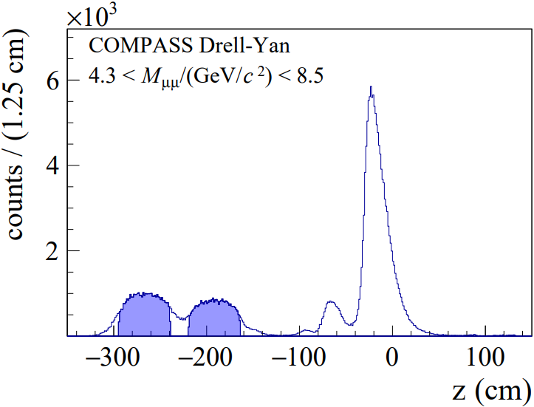
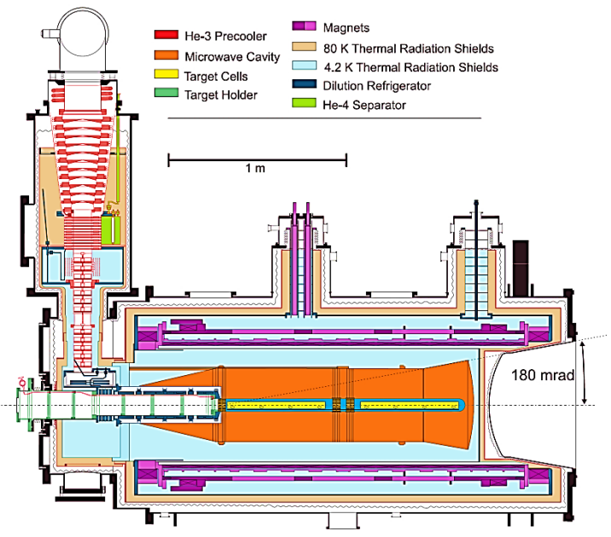
Zoom on the Target Region
hadron absorber (DY only)
spectrometer magnet 1
RICH
(not used in DY)
spectrometer magnet 2
muon filter 2
polarised target
muon filter 1
hadron beam
beam telescope
small-angle spectrometer
large-angle spectrometer
Polarised target
1
W
beam
NH₃
Al
2
Target cells in 2015 + 2018 Drell–Yan
13 VI 25, M.Niemiec
HEP Seminar, 20/33
Transverse spin-dependent asymmetries at COMPASS experiment

Slide 21
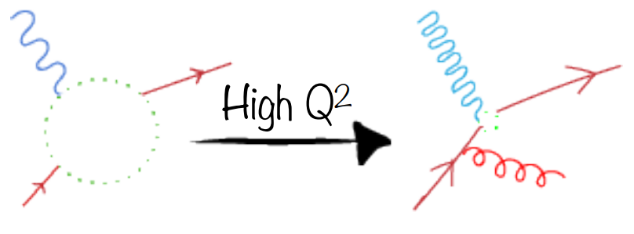








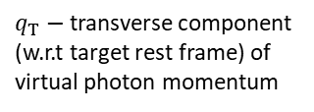
At the Heart of This Talk: Drell–Yan process
Kinematic variables
$x−$ Bjorken $x$
Incoming particle:
hadron
$q_{T}−$ transverse component (w.r.t target rest frame) of virtual photon momentum
muon pair
Final state:
$$π^{−}$$
$$μ^{−}$$
Quark and antiquark annihilate
$M_{μμ}=Q^{2}−$ virtuality of the photon, dimuon invariant mass
$$μ^{+}$$
Reminder
$$N$$
$Q^{2}$ is a photon resolution
Target:
transversely polarized nucleon
High $Q^{2}$
13 VI 25, M.Niemiec
HEP Seminar, 21/33
Transverse spin-dependent asymmetries at COMPASS experiment

Slide 22
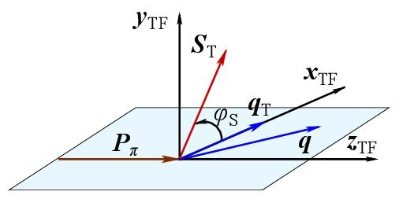
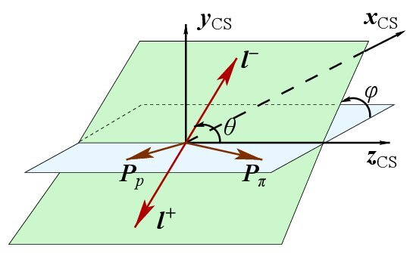




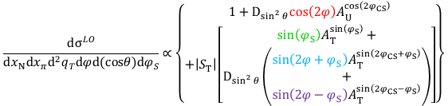

Closer Look at Drell–Yan cross-section
Cross-section, LO TMD approach for transversely polarised target:
$$\frac{dσ^{LO}}{dx_{N}dx_{π}d^{2}q_{T}dφd(cosθ)dφ_{S}}∝\left\{\begin{aligned}1+D_{\sin^{2}{θ}}cos\left(2φ\right)A_{U}^{cos\left(2φ_{CS}\right)} \\ +\left|S_{T}\right|\left[\begin{aligned}sin\left(φ_{S}\right)A_{T}^{sin\left(φ_{S}\right)}+ \\ D_{\sin^{2}{θ}}\left(\begin{aligned}sin\left(2φ+φ_{S}\right)A_{T}^{sin\left(2φ_{CS}+φ_{S}\right)} \\ + \\ sin\left(2φ−φ_{S}\right)A_{T}^{sin\left(2φ_{CS}−φ_{S}\right)}\end{aligned}\right)\end{aligned}\right]\end{aligned}\right\}$$
Target frame
Boer-Mulders
Sivers
$$φ_{CS}$$
$$A_{U}^{cos\left(2φ_{CS}\right)}∝h_{1, π}^{q⊥}⊗h_{1, N}^{q⊥}$$
$$A_{T}^{sin\left(φ_{S}\right)}∝f_{1,π}^{q}⊗f_{1T, N}^{q⊥}$$
Pretzelosity
Transversity
Collin-Soper frame
$$A_{T}^{sin\left(2φ_{CS}+φ_{S}\right)}∝h_{1, π}^{q⊥}⊗h_{1T, N}^{q⊥}$$
$$A_{T}^{sin\left(2φ_{CS}−φ_{S}\right)}∝h_{1, π}^{q⊥}⊗h_{1,N}^{q}$$
13 VI 25, M.Niemiec
HEP Seminar, 22/33
Transverse spin-dependent asymmetries at COMPASS experiment

Slide 23
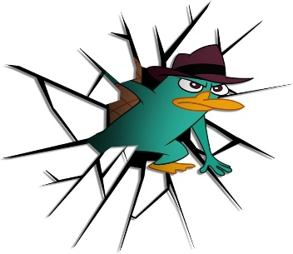








From Convolution to Direct Access: Extracting TMD PDFs
$$A_{U}^{cos\left(2φ\right)}∝h_{1, π}^{q⊥}⊗h_{1, N}^{q⊥}$$
The convolution of TMD PDFs runs over the intrinsic transverse momenta $k_{T}$.
$$k_{T,N}=k_{N}$$
$$q=k_{N}+k_{π}$$
$$A_{T}^{sin\left(φ_{S}\right)}∝f_{1,π}^{q}⊗f_{1T, N}^{q⊥}$$
$$q_{T}$$
$$k_{π}$$
$$k_{T,π}$$
$$A_{T}^{sin\left(2φ+φ_{S}\right)}∝h_{1, π}^{q⊥}⊗h_{1T, N}^{q⊥}$$
$$x_{π}P_{π}$$
$$P_{π}$$
$$A_{T}^{sin\left(2φ−φ_{S}\right)}∝h_{1, π}^{q⊥}⊗h_{1,N}^{q}$$
Momenta in Target Frame
Apply weights based on powers of the transverse momentum of dimuons.
This complex integrals are hard to resolve.
Alternative Approach
Common Strategy:
Removes the convolution
Assume a specific functional form for the transverse momentum dependence (typically Gaussian).
Gives direct access to moments of TMD PDFs
Reduces model dependence
13 VI 25, M.Niemiec
Transverse spin-dependent asymmetries at COMPASS experiment
HEP Seminar, 23/33

Slide 24



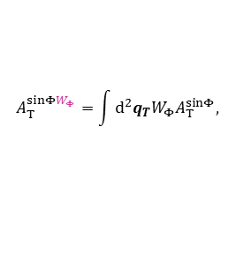
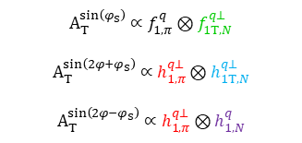
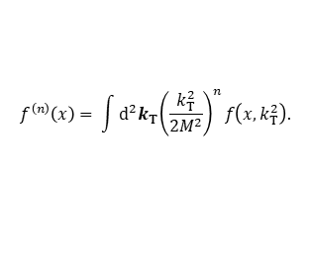

From Model Assumptions to Weighted Extraction
Weighting with powers of the transverse momentum allows to avoid assumptions on $k_{T}$.
Weighted Asymmetries:
The n-th moment of a TMD PDF
of a pion or proton:
$$A_{T}^{sinΦW_{Φ}}=\int{d^{2}q_{T}W_{Φ}A_{T}^{sinΦ}},$$
$$f^{\left(n\right)}\left(x\right)= \int{d^{2}k_{T}{\left(\frac{k_{T}^{2}}{2M^{2}}\right)}^{n}}f\left({x,k}_{T}^{2}\right).$$
where $W_{Φ}$ is weight for$Φ=φ_{S}, 2φ_{CS}+φ_{S}, 2φ_{CS}−φ_{S}.$
Asymmetry (TSA)
Weighted Asymmetry (WTSA)
$$A_{T}^{sin\left(φ_{S}\right)}∝f_{1,π}^{q}⊗f_{1T, N}^{q⊥}$$
$$A_{T}^{sin\left(2φ+φ_{S}\right)}∝h_{1, π}^{q⊥}⊗h_{1T, N}^{q⊥}$$
$$A_{T}^{sin\left(2φ−φ_{S}\right)}∝h_{1, π}^{q⊥}⊗h_{1,N}^{q}$$
Sivers
$$A_{T}^{sin\left(φ_{S}\right)\frac{q_{T}}{M_{N}}}∝f_{1,π}^{q}×f_{1T, N}^{q⊥(1)}$$
$$A_{T}^{sin\left(2φ+φ_{S}\right)\frac{q_{T}^{3}}{{2M}_{N}^{2}M_{π}}}∝h_{1, π}^{q⊥(1)}×h_{1T, N}^{q⊥(2)}$$
Pretzelosity
$$A_{T}^{sin\left(2φ−φ_{S}\right)\frac{q_{T}}{M_{π}}}∝h_{1, π}^{q⊥(1)}×h_{1, N}^{q}$$
Transversity
13 VI 25, M.Niemiec
Transverse spin-dependent asymmetries at COMPASS experiment
HEP Semina, 24/33

Slide 25
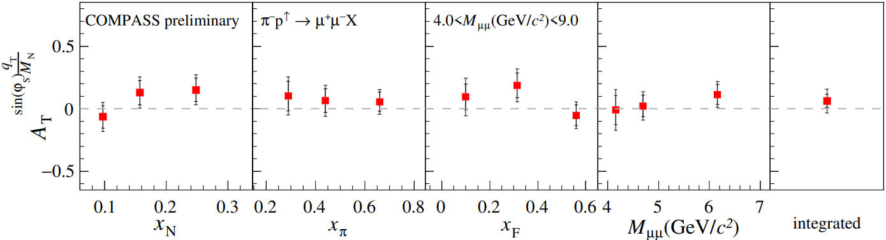

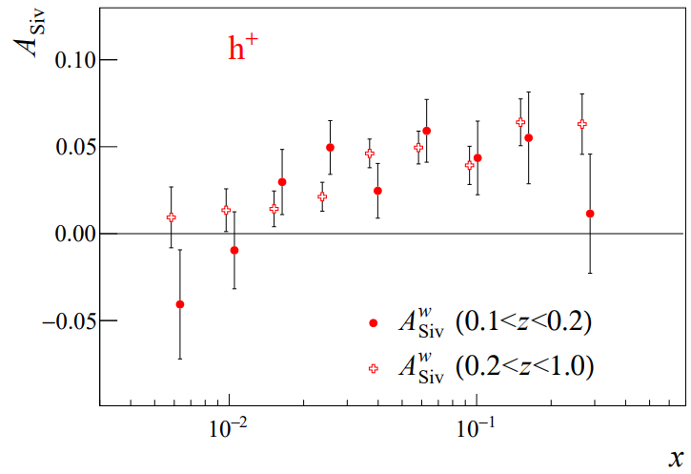
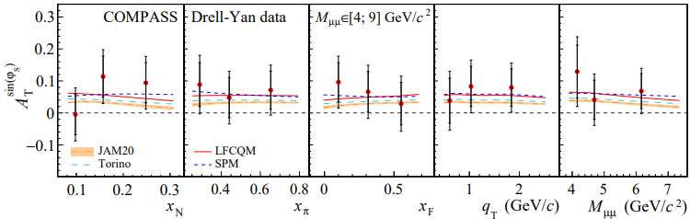



Quark transverse momentum and nucleon spin correlation: Sivers Asymmetries
$$A_{T}^{sin\left(φ_{S}\right)\frac{q_{T}}{M_{N}}}∝f_{1, π}^{q}×f_{1T, N}^{q⊥(1)}$$
Sivers DY WTSA
$$−$$
$$→$$
$$→$$
NEW
$$A_{UT}^{sin\left(φ_{h}−φ_{S}\right)\frac{P_{T}}{zM_{N}}}∝f_{1T,N}^{q⊥(1)}×D_{1q}^{h}$$
$1σ$ positive Sivers WTSA compatible with Sivers TSA
Sivers DY TSA
$$A_{T}^{sin\left(φ_{S}\right)}∝f_{1,π}^{q}⊗f_{1T, N}^{q⊥}$$
[COMPASS, PRL 133 (2024) 071902]
Sivers
SIDIS
WTSA
[COMPASS, Nucl.Phys. B940 (2019) 34]
13 VI 25, M.Niemiec
Transverse spin-dependent asymmetries at COMPASS experiment
HEP Seminar, 25/33

Slide 26


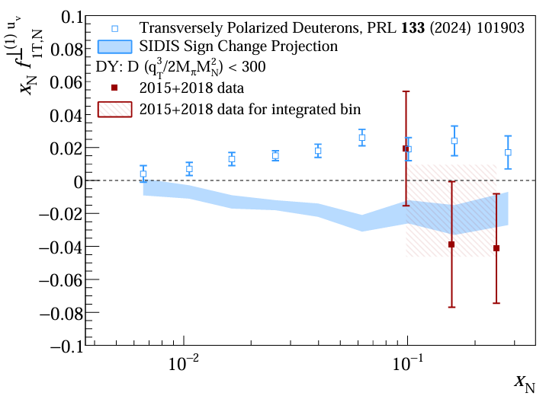


Moving to TMD PDF Extraction: Understanding the Sivers Asymmetry
Measured asymmetries, especially those weighted by transverse momentum $q_{T}$, enable a direct and simplified connection to the underlying TMD PDFs
Remember Sivers Asymmetries?
Sivers TMD PDF also easy to deliver
$$A_{T}^{sinφ_{S} \frac{q_{T}}{M_{N}}}=−2 \frac{f_{1T,N}^{⊥\left(1\right)}\left(x_{N}\right)}{f_{1,,N}^{}\left(x_{N}\right)}$$
$$−$$
$$→$$
$$→$$
Number Density easy to find in database
Pictures from the world of Kiki’s Delivery Service
13 VI 25, M.Niemiec
Transverse spin-dependent asymmetries at COMPASS experiment
HEP Seminar, 26/33

Slide 27





Quark orbital motion and spin–orbit correlations:
Pretzelosity Asymmetries
$$→$$
$$→$$
$$→$$
$$→$$
$$→$$
$$−$$
$$A_{T}^{sin\left(2φ_{CS}+φ_{S}\right)\frac{q_{T}^{3}}{{2M}_{N}^{2}M_{π}}}∝h_{1, π}^{q⊥(1)}×h_{1T, N}^{q⊥(2)}$$
$$−$$
$$→$$
$$→$$
$$→$$
DY Pretzelosity WTSA
NEW
$$A_{T}^{sin\left(2φ_{CS}+φ_{S}\right)}∝h_{1, π}^{⊥}⊗h_{1T, N}^{⊥}$$
DY Pretzelosity TSA
Pretzelosity is expected to be zero
$2σ$ negative Pretzelosity WTSA
[COMPASS, PRL 133 (2024) 071902]
13 VI 25, M.Niemiec
Transverse spin-dependent asymmetries at COMPASS experiment
HEP Seminar, 27/33

Slide 28






Quark spin direction correlated with transverse nucleon spin: Transversity Asymmetries
$$A_{T}^{sin\left(2φ_{CS}−φ_{S}\right)\frac{q_{T}}{M_{π}}}∝h_{1, π}^{q⊥(1)}×h_{1, N}^{q}$$
DY Transversity WTSA
NEW
$$→$$
$$→$$
$$→$$
$$−$$
$$→$$
$$−$$
$$→$$
$$→$$
$$A_{T}^{sin\left(2φ_{CS}−φ_{S}\right)}∝h_{1, π}^{⊥}⊗h_{1,N}$$
DY Transversity TSA
$2σ$ negative Transversity
Results compatible with
Transversity TSA
[COMPASS, PRL 133 (2024) 071902]
13 VI 25, M.Niemiec
Transverse spin-dependent asymmetries at COMPASS experiment
HEP Seminar, 28/33

Slide 29







Transversity Asymmetries: What can we extract from it?
Inspired by the charm of Spirited Away
Transversity of TMD PDFs of pion:
Not directly in the databases, but can be determined from COMPASS SIDIS data
$$A_{T}^{sin\left(2φ_{CS}−φ_{S}\right)\frac{q_{T}}{M_{π}}}=−2\frac{h_{1,N}^{}⋅h_{1, π}^{⊥\left(1\right)}}{f_{1,,N}^{}⋅f_{1,π}^{}}$$
That's what we're looking for:
first moment of Boer-Mulders TMD PDFs of a pion
Number Densities of proton and pion easy to find in database
Having $h_{1,N}^{}$ from COMPASS SIDIS data
and $f_{1,,N}^{},f_{1,π}^{}$ from database,
we can extract first moment of
Boer-Mulders
$$full dataset$$
$$TMD applicability region$$
13 VI 25, M.Niemiec
Transverse spin-dependent asymmetries at COMPASS experiment
HEP Seminar, 29/33

Slide 30



Future of Hadron Physics: Electron Ion Collider (EIC)
Inspired by Wild Robot
Huge efforts in the past&present … and future
What about LHC?
[EIC White Paper, Eur.Phys.J.A 52 (2016) 9, 268]
13 VI 25, M.Niemiec
Transverse spin-dependent asymmetries at COMPASS experiment
HEP Seminar, 30/33

Slide 31



Future of Hadron Physics: LHCspin
Asymmetry sensitive to the quark Sivers effect
$$A_{N}∝f_{1}^{q}⊗f_{1T, N}^{q⊥}$$
[Hadjidakis et al. Phys. Rep. 911, 2021]
Inspired by Wild Robot
13 VI 25, M.Niemiec
Transverse spin-dependent asymmetries at COMPASS experiment
HEP Seminar, 31/33

Slide 32



Conclusions
The structure of the nucleon is interesting, but still not fully understood.
COMPASS helps to study its 3D structure and spin.
This talk contribution: Transverse-Momentum Weighted Asymmetries
A way to overcome the convolution over intrinsic $k_{T}$ 💪
Asymmetries agree with theoretical predictions and consistent with analogous DY/SIDIS measurements! ❤
A direct access to the $k_{T}^{2}$-moments of TMD PDFs 🔎
Paper in preparation 🎉
New experiment is on the horizon!
EIC and LHCspin
13 VI 25, M.Niemiec
Transverse spin-dependent asymmetries at COMPASS experiment
HEP Seminar, 32/33

Slide 33

Thank you for attention!
LOOK, THEY’RE SITTING IN A TREE…
BUT… TAKING INTO ACCOUT TRANSVERSE MOMENTA OF QUARKS INSIDE THE NUCLEON…
WHAT IS THE STRUCTURE OF THE NUCLEON?
IN A COLLINEAR APPROACH IS DESCRIBED BY 3 FUNCTIONS…
OF WHAT?

