Slide 1
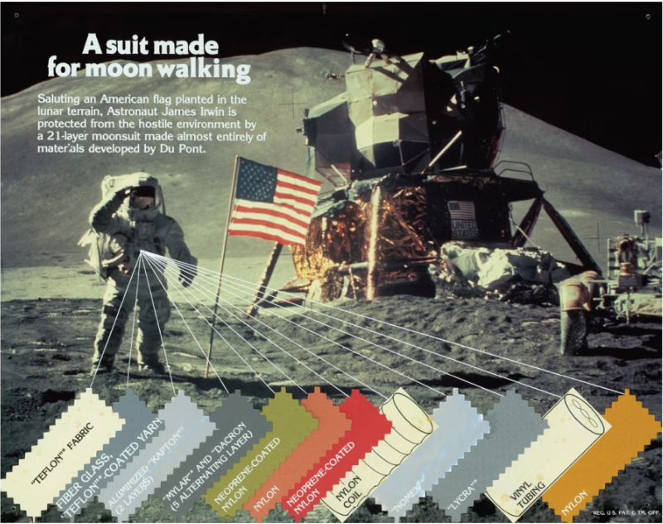
High-Performance Polymers
Kapton/Mylar: First polymers to touch the lunar surface!
Javier Osuna
This presentation was not sponsored by DuPontTM

Slide 2
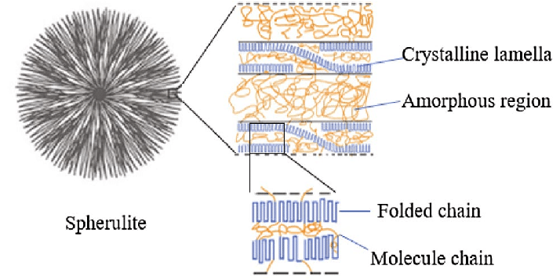
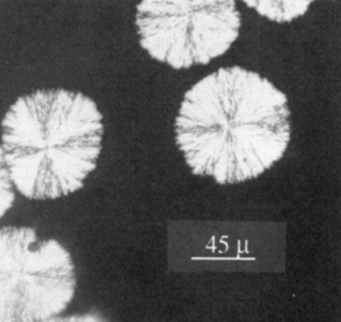
Aims of the presentation
  Introduction to structure-property relationship in polymers.
  “Dictionary” of polymers from trademarked/industry names.
PEEK spherulites
Notes:
Image: https://doi.org/10.1016/j.progpolymsci.2015.11.006

Slide 3
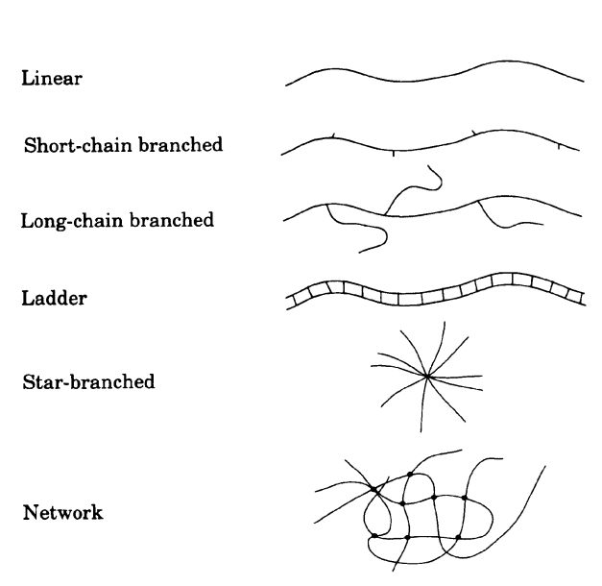
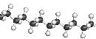

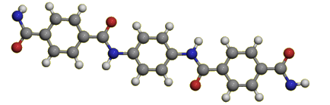
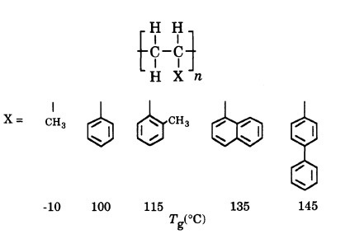

Polymers: Structure - Property Relationship
Where polymers get their properties?
  Main Chain/Backbone
  Pendant groups
  Chain length, flexibility
  Functionality
  Cross-linking/branching
  Crystallinity
  Processing, additives
Polyethylene (PE)
Polytetrafluoroethylene (PTFE)
Molecular architectures of polymers
Para-Aromatic Polyamide (Kevlar)
Polystyrene (PS)
Effect of pendant group on Tg
Notes:
https://www.alamy.com/stock-photo/polyethylene-molecule.html
https://en.wikipedia.org/wiki/File:Perfluorodecyl-chain-from-xtal-Mercury-3D-balls.png
https://en.wikipedia.org/wiki/Polystyrene#/media/File:Polystyrene-chain-from-xtal-3D-bs-17.png
http://www.bbc.co.uk/schools/gcsebitesize/science/edexcel_pre_2011/designerproducts/smartmaterialsrev2.shtml

Slide 4
Trademarked Polymers
Trademark Name | Polymer | Original Developer
Teflon® | Polytetrafluoroethylene, PTFE | DuPontTM
StyrofoamTM | Polystyrene, PS | DuPontTM
Vespel®, Kapton® | Polyimide | DuPontTM
Kevlar® | Para-Aramid, K29 | DuPontTM
Delrin® | Polyoxymethylene, POM | DuPontTM
Tedlar® | Polyvinylfluoride | DuPontTM
Mylar® | Biaxially-Oriented Polyethylene Terephthalate | Dow Chemical
Nomex® | Meta-Aramid | DuPontTM
Tyvek® | Polyethylene | DuPontTM
VitonTM | Fluoroelastomer | DuPontTM
KalrezTM | Fluoroelastomer | DuPontTM
NafionTM | Sulfonated Fluoropolymer Copolymer | DuPontTM
Lycra® | Polyurethane | DuPontTM
UltemTM | Polyether Imide | SABIC
Makrolon® | Polycarbonate | Covestro
Plexiglas® | Polymethylmethylmethacrylate | Imperial Chemical Industries
Neoprene | Polychloroprene | DuPontTM
Nylon | Polyamide 6,6 | DuPontTM
Teflon ®
StyrofoamTM
Vespel®, Kapton®
Kevlar®
Delrin®
Tedlar®
Mylar®
Nomex®
Tyvek®
VitonTM
KalrezTM
NafionTM
Lycra®
UltemTM
Makrolon®
Plexiglas®
(Neoprene) – common name, not a trademark
(Nylon) – common name, not a trademark

Slide 5
General Categories of Applications
Chemical/Durability
  TeflonTM
  Tedlar®
  NafionTM
  VitonTM
  KalrezTM
  Neoprene
Mechanical
  Nylon
  Tyvek®
  Lycra®
  Kevlar®
  Delrin®
  Makrolon®
  Mylar®
  Plexiglas®
Thermal/Electrical
  Vespel®
  Kapton®
  Nomex®
  StyrofoamTM
  UltemTM

Slide 6
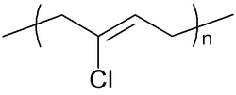
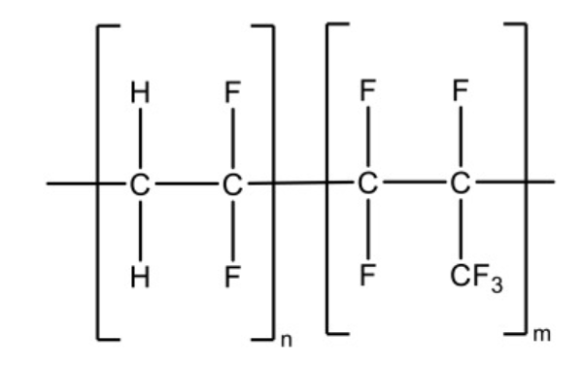
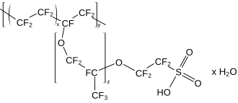
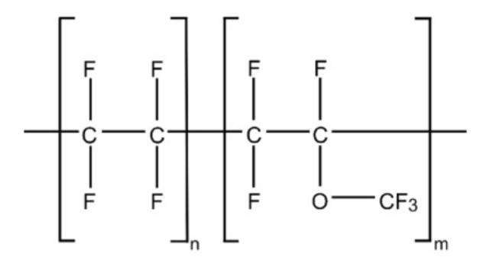
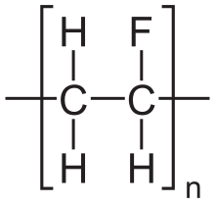
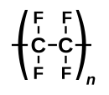
Neoprene
Chemical/Durability
VitonTM
FKM
+ Cross-links
Characteristics
C-F bond
  Extremely Stable
  Unreactive
  Electronegative
Distribution of Fluorine affects:
  Chemical Stability
  Interactions between polymer chains
  Electrical Properties
  Chain rigidity
Properties:
  Low-friction
  Chemical resistance
  Thermal Stability
NafionTM
+ Crosslinks, Fillers
KalrezTM
FFKM
Tedlar®
PVF
Teflon®
PTFE
+ Crosslinks, Fillers
Notes:
Images:
https://en.wikipedia.org/wiki/File:Polytetrafluoroethylene.svg

Slide 7
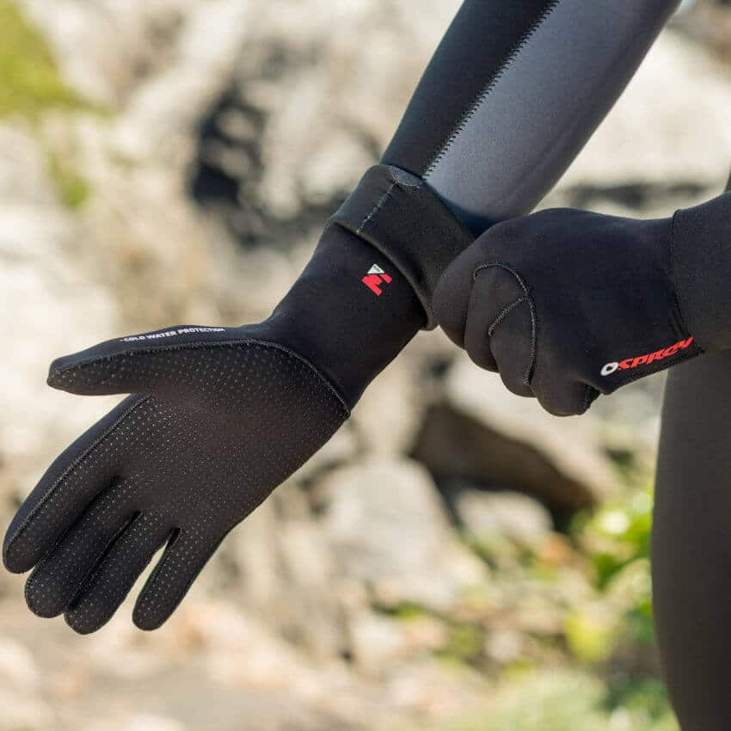
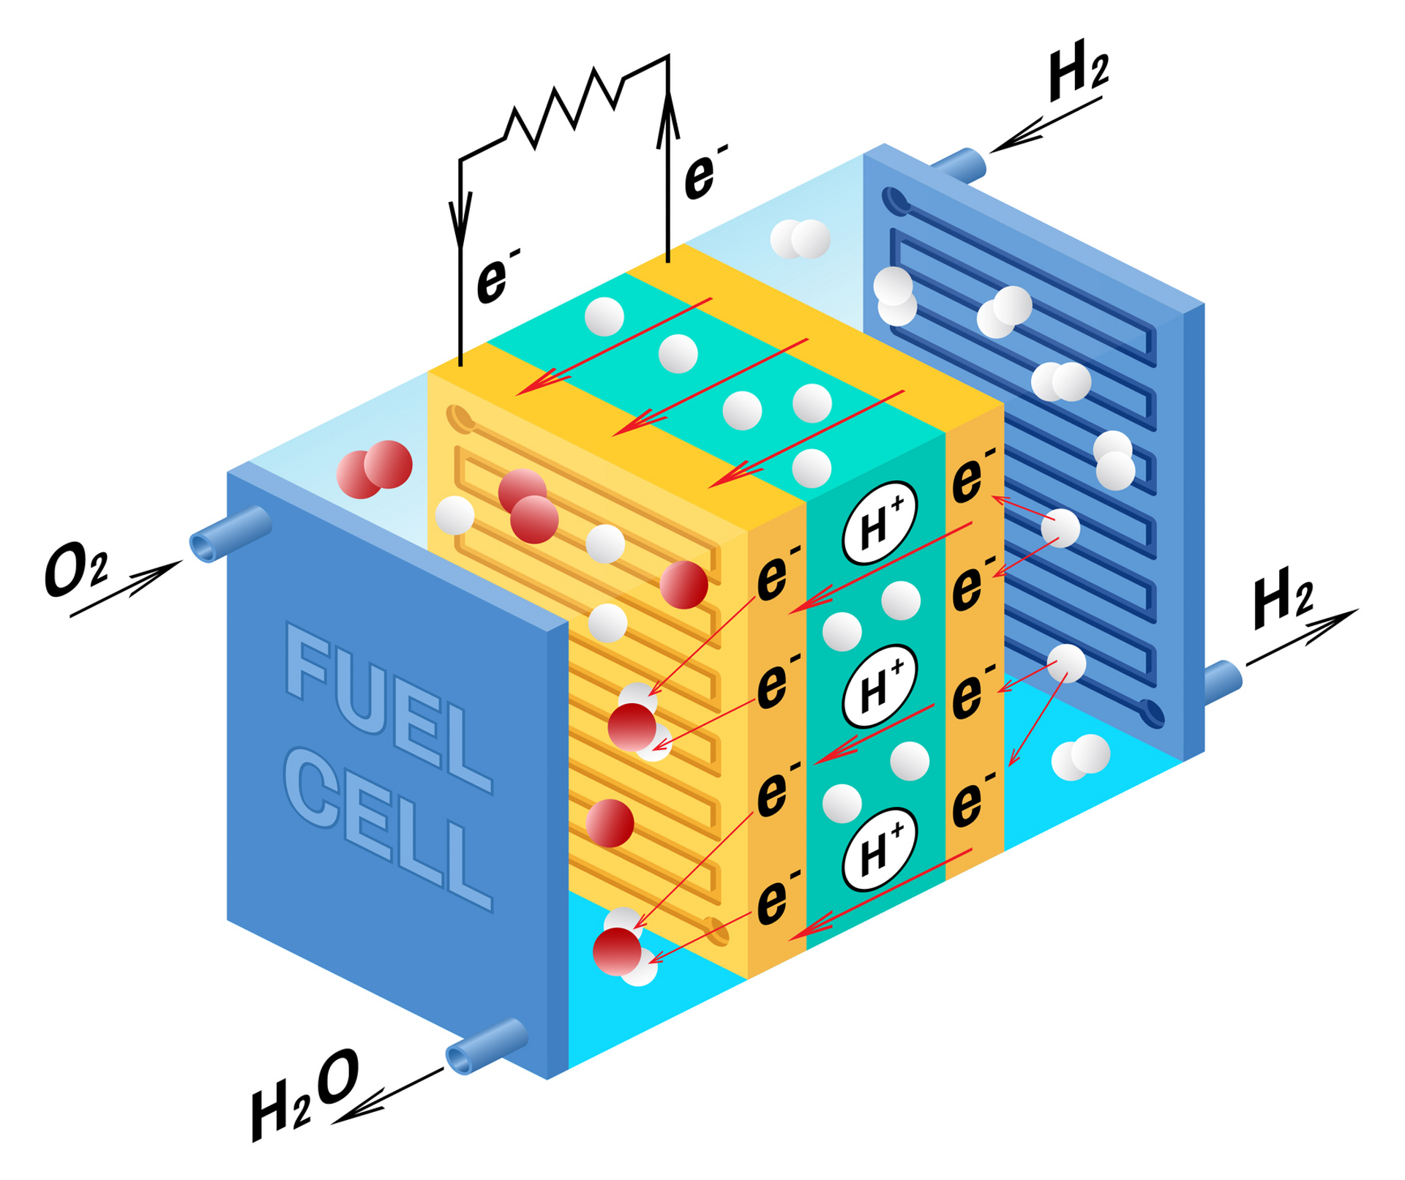
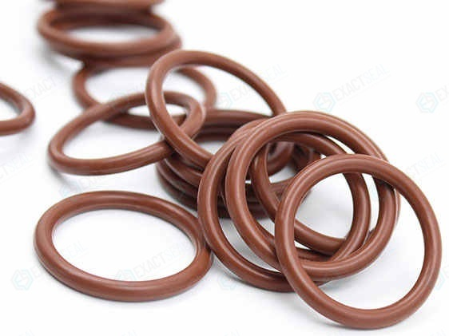
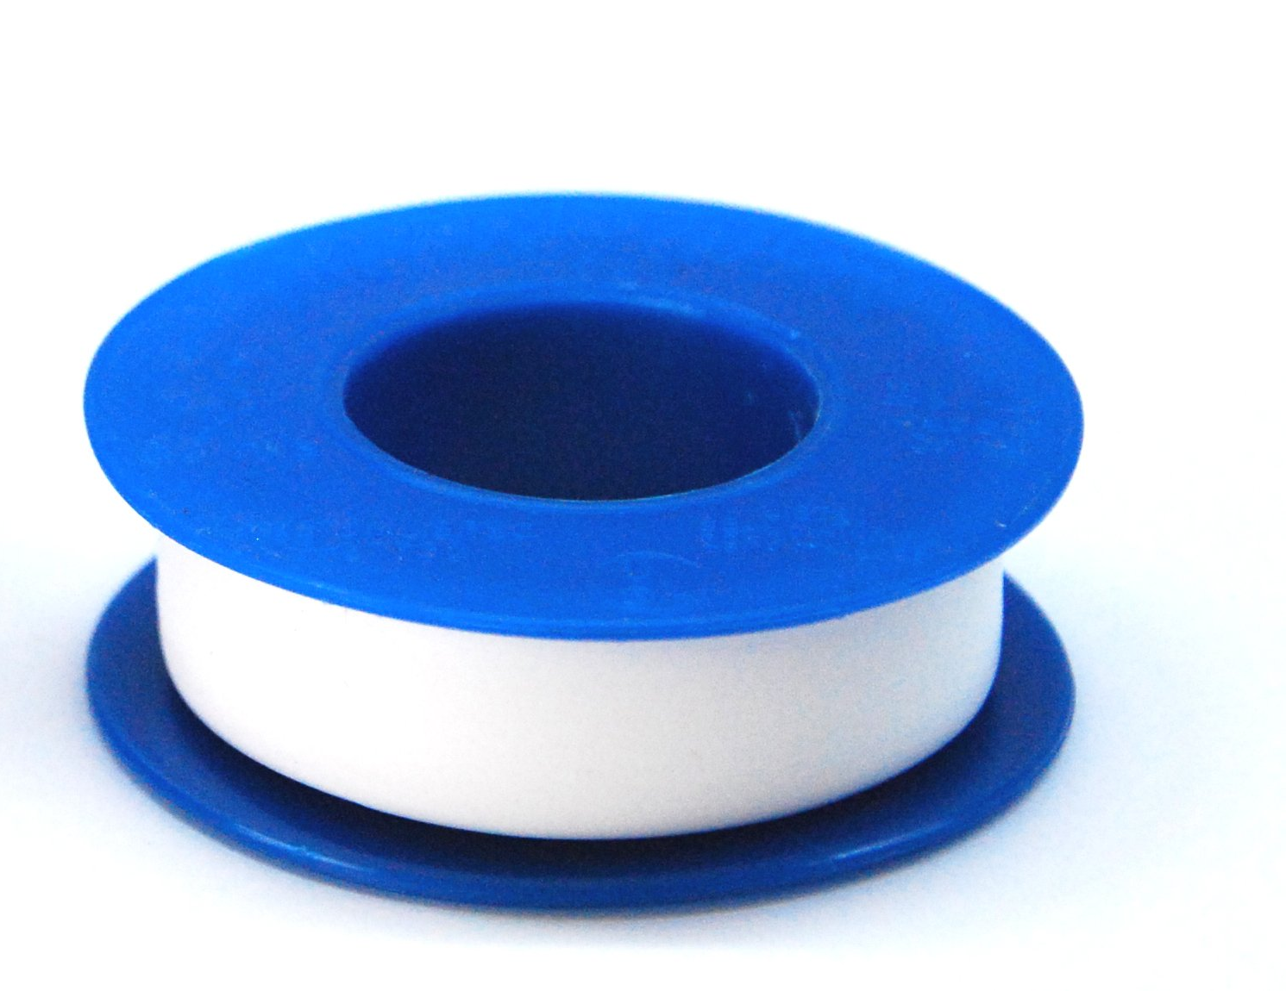

Neoprene
Chemical/Durability
VitonTM
FKM
+ Cross-links
Characteristics
C-F bond
  Extremely Stable
  Unreactive
  Electronegative
Distribution of Fluorine affects:
  Chemical Stability
  Interactions between polymer chains
  Electrical Properties
  Chain rigidity
Properties:
  Low-friction
  Chemical resistance
  Thermal Stability
NafionTM
+ Crosslinks, Fillers
KalrezTM
FFKM
Tedlar®
PVF
Teflon®
PTFE
+ Crosslinks, Fillers
Notes:
Images:
https://en.wikipedia.org/wiki/File:Polytetrafluoroethylene.svg

Slide 8
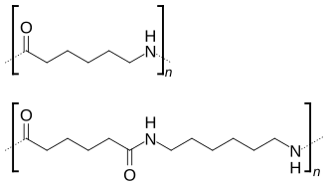
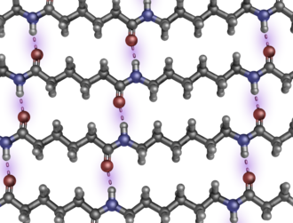
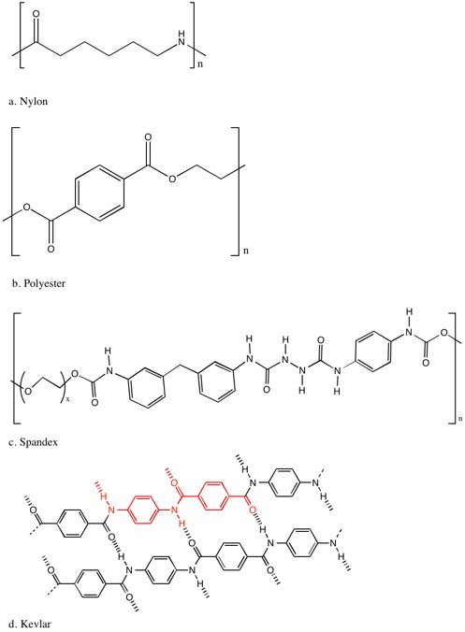
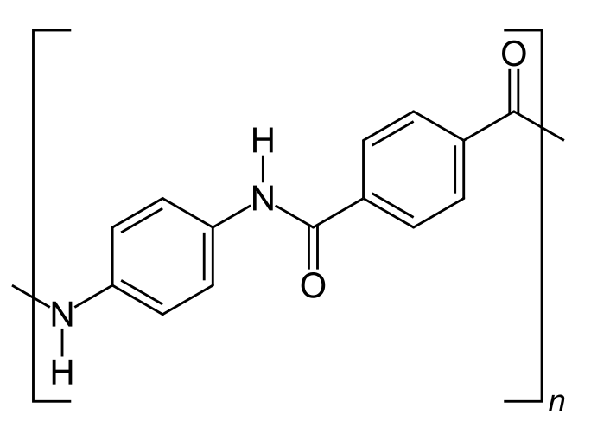
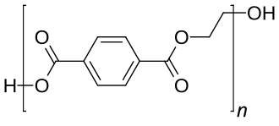
Mechanical
Hydrogen bonding in Nylon 6,6
Characteristics
Aromatic groups
  Tensile strength
  Thermal/Chemical stability.
  Rigidity
Hydrogen bonding
  Promotes ordering of chains
  Hinders chains from sliding.
Backbone linearity
  Determines close-packing of polymer chains.
  Directional properties
Oxygen in backbone
  Rigidity
Polyamide
Nylon
Polyurethane
Lycra®
  Para-Aramid
  Kevlar®
BoPET
Mylar®
Notes:
Images:
By User:Innerstream - Own work, Public Domain, https://commons.wikimedia.org/w/index.php?curid=112727156
This structure was created with PyMOL. - Own work, CC BY 3.0, https://commons.wikimedia.org/w/index.php?curid=18020756
http://www.dupont.com/products-and-services/packaging-materials-solutions/pharmaceutical-packaging/brands/tyvek-sterile-packaging/press-releases/fda-tyvek-functional-equivalence.html
https://external-content.duckduckgo.com/iu/?u=http%3A%2F%2Fteachersinstitute.yale.edu%2Fcurriculum%2Fimages%2F2015%2F4%2F15.04.01.03.jpg&f=1&nofb=1&ipt=e4af24861cdafb698fc32e408511b85630ec2fb865cdad17a6cf89cb0c66e712

Slide 9
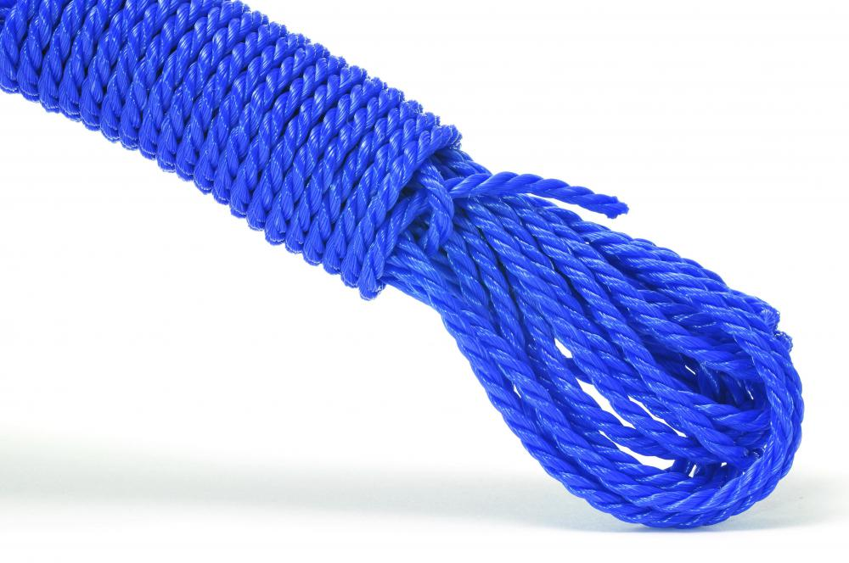
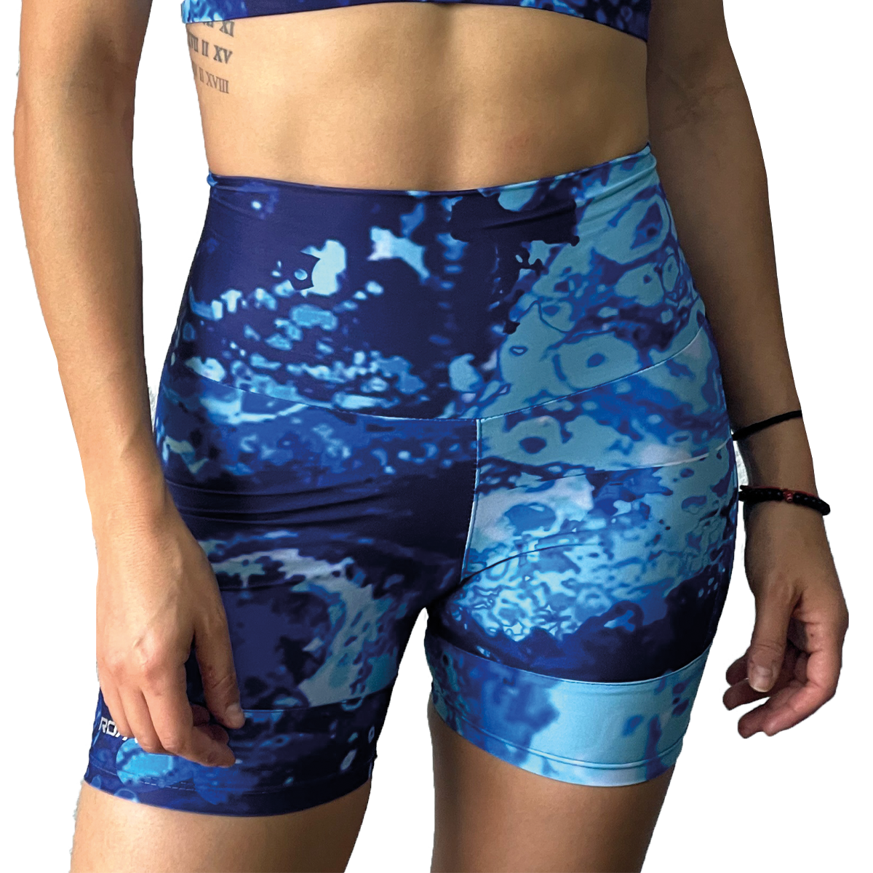
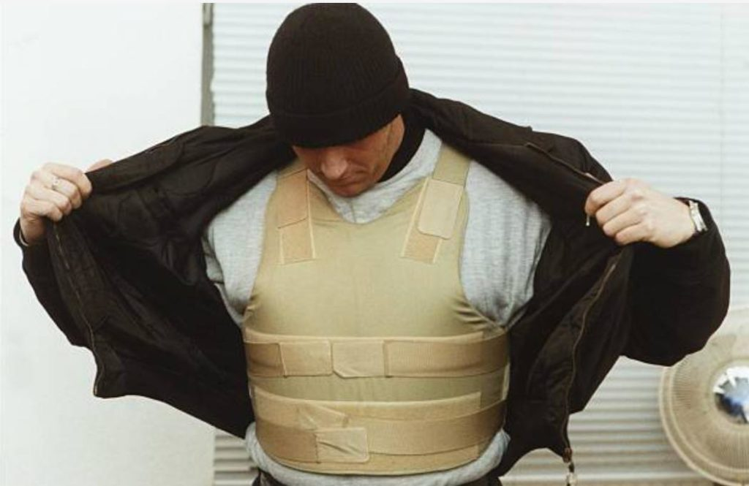

Mechanical
Hydrogen bonding in Nylon 6,6
Characteristics
Aromatic groups
  Tensile strength
  Thermal/Chemical stability.
  Rigidity
Hydrogen bonding
  Promotes ordering of chains
  Hinders chains from sliding.
Backbone linearity
  Determines close-packing of polymer chains.
  Directional properties
Oxygen in backbone
  Rigidity
Polyamide
Nylon
Polyurethane
Lycra®
  Para-Aramid
  Kevlar®
BoPET
Mylar®
Notes:
Images:
By User:Innerstream - Own work, Public Domain, https://commons.wikimedia.org/w/index.php?curid=112727156
This structure was created with PyMOL. - Own work, CC BY 3.0, https://commons.wikimedia.org/w/index.php?curid=18020756
http://www.dupont.com/products-and-services/packaging-materials-solutions/pharmaceutical-packaging/brands/tyvek-sterile-packaging/press-releases/fda-tyvek-functional-equivalence.html
https://external-content.duckduckgo.com/iu/?u=http%3A%2F%2Fteachersinstitute.yale.edu%2Fcurriculum%2Fimages%2F2015%2F4%2F15.04.01.03.jpg&f=1&nofb=1&ipt=e4af24861cdafb698fc32e408511b85630ec2fb865cdad17a6cf89cb0c66e712

Slide 10
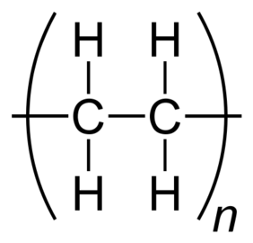
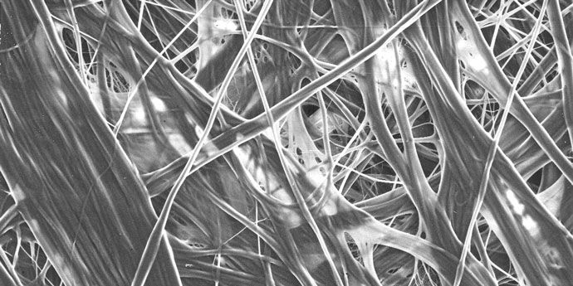
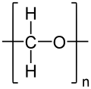
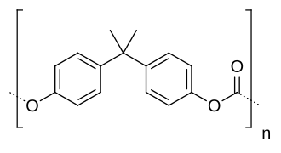
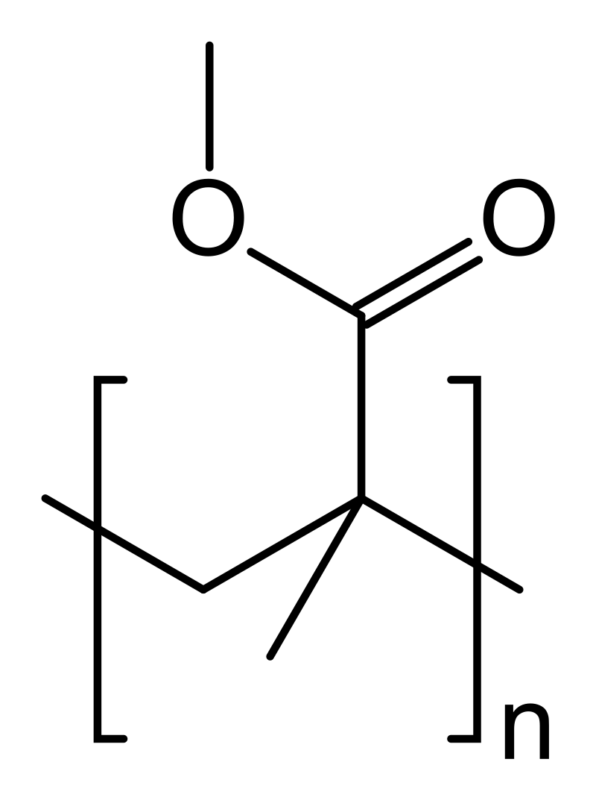
Polyethylene and Tyvek® fibre Structure
Mechanical
Characteristics
Aromatic groups
  Tensile strength
  Thermal/Chemical stability.
  Rigidity
Hydrogen bonding
  Promotes ordering of chains
  Hinders chains from sliding.
Backbone linearity
  Determines close-packing of polymer chains.
  Directional properties
Oxygen in backbone
  Rigidity
Acetal / Polyoxymethylene (POM)
Delrin ®
Polymethyl methacrylate (PMMA)
Plexiglas®
Perspex®
Polycarbonate
Makrolon®
Notes:
Images:
By User:Innerstream - Own work, Public Domain, https://commons.wikimedia.org/w/index.php?curid=112727156
This structure was created with PyMOL. - Own work, CC BY 3.0, https://commons.wikimedia.org/w/index.php?curid=18020756
http://www.dupont.com/products-and-services/packaging-materials-solutions/pharmaceutical-packaging/brands/tyvek-sterile-packaging/press-releases/fda-tyvek-functional-equivalence.html
https://external-content.duckduckgo.com/iu/?u=http%3A%2F%2Fteachersinstitute.yale.edu%2Fcurriculum%2Fimages%2F2015%2F4%2F15.04.01.03.jpg&f=1&nofb=1&ipt=e4af24861cdafb698fc32e408511b85630ec2fb865cdad17a6cf89cb0c66e712

Slide 11
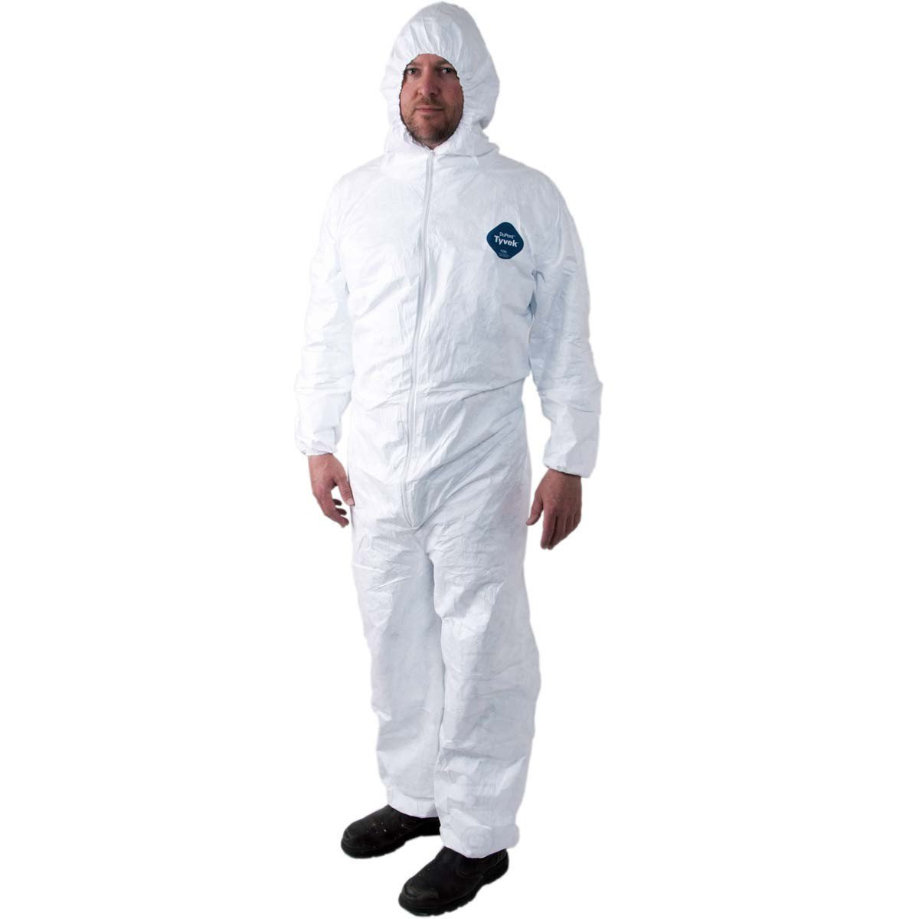
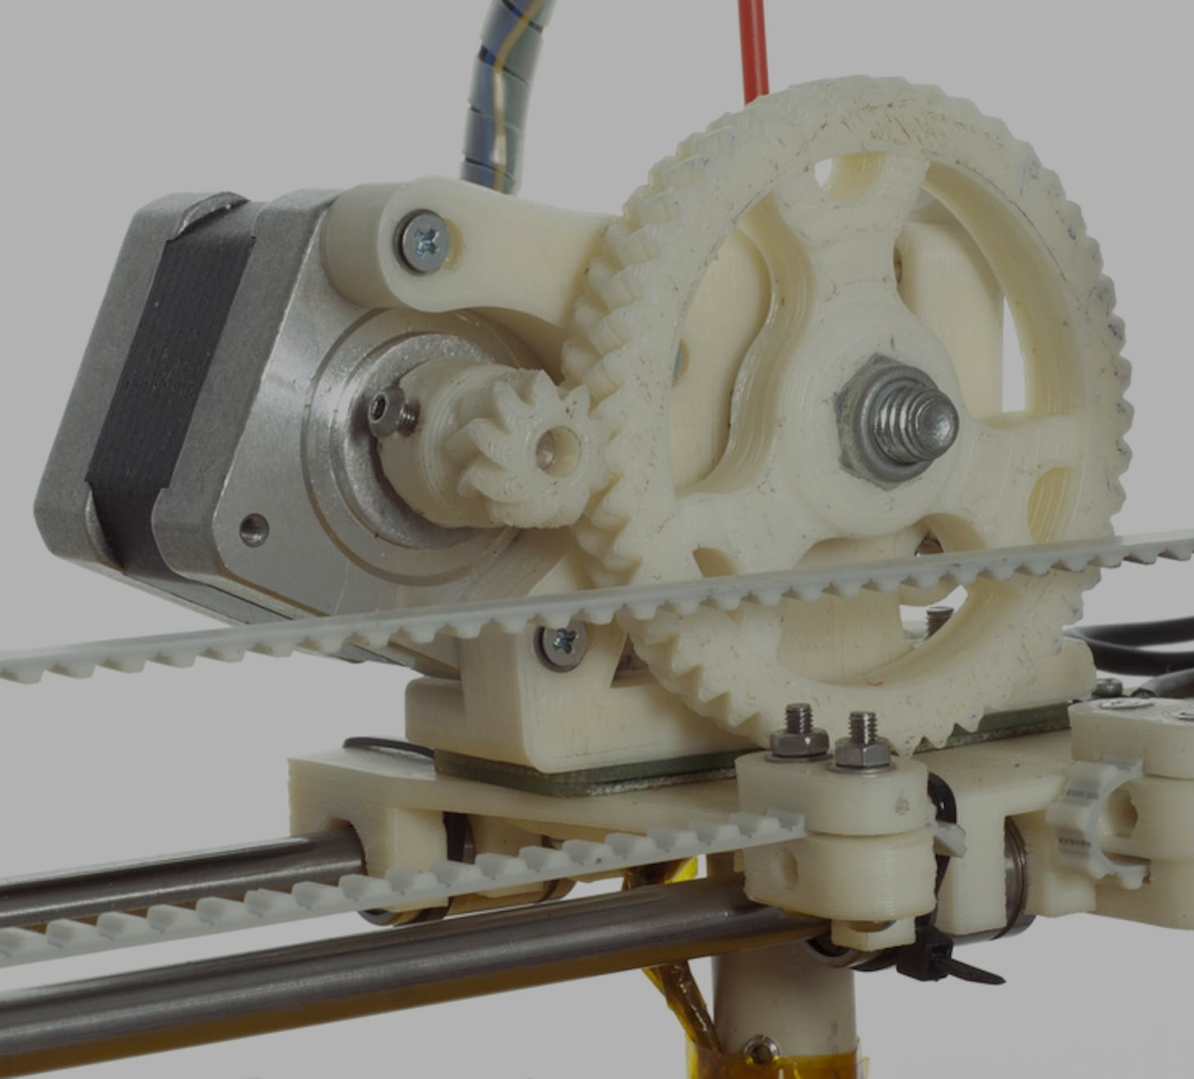
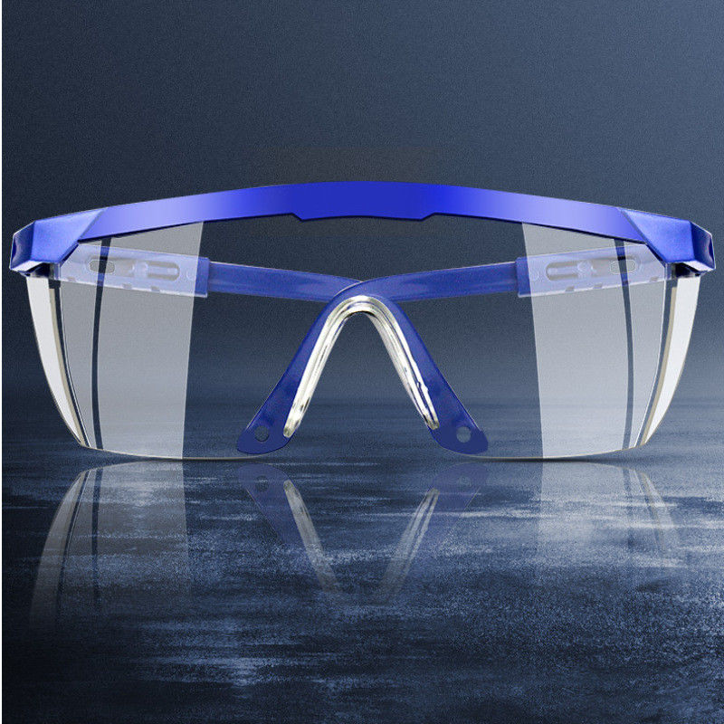
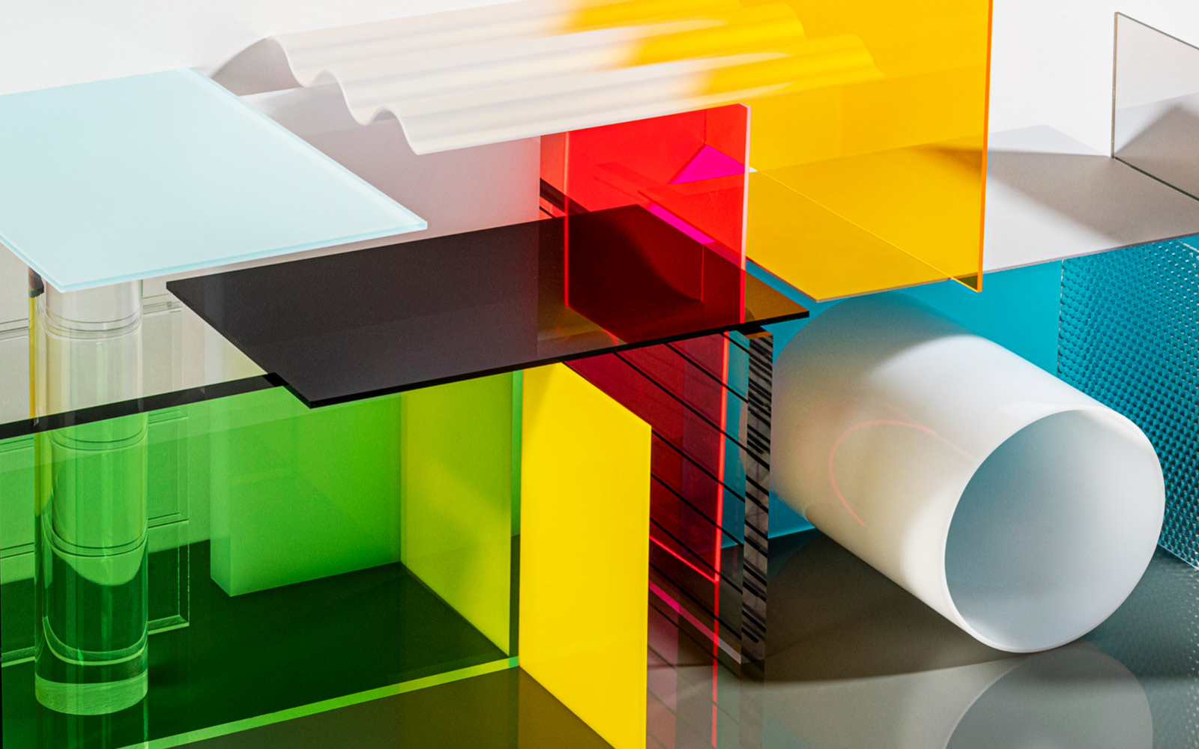
Polyethylene and Tyvek® fibre Structure
Mechanical
Characteristics
Aromatic groups
  Tensile strength
  Thermal/Chemical stability.
  Rigidity
Hydrogen bonding
  Promotes ordering of chains
  Hinders chains from sliding.
Backbone linearity
  Determines close-packing of polymer chains.
  Directional properties
Oxygen in backbone
  Rigidity
Acetal / Polyoxymethylene (POM)
Delrin ®
Polymethyl methacrylate (PMMA)
Plexiglas®
Perspex®
Polycarbonate
Makrolon®
Notes:
Images:
By User:Innerstream - Own work, Public Domain, https://commons.wikimedia.org/w/index.php?curid=112727156
This structure was created with PyMOL. - Own work, CC BY 3.0, https://commons.wikimedia.org/w/index.php?curid=18020756
http://www.dupont.com/products-and-services/packaging-materials-solutions/pharmaceutical-packaging/brands/tyvek-sterile-packaging/press-releases/fda-tyvek-functional-equivalence.html
https://external-content.duckduckgo.com/iu/?u=http%3A%2F%2Fteachersinstitute.yale.edu%2Fcurriculum%2Fimages%2F2015%2F4%2F15.04.01.03.jpg&f=1&nofb=1&ipt=e4af24861cdafb698fc32e408511b85630ec2fb865cdad17a6cf89cb0c66e712

Slide 12
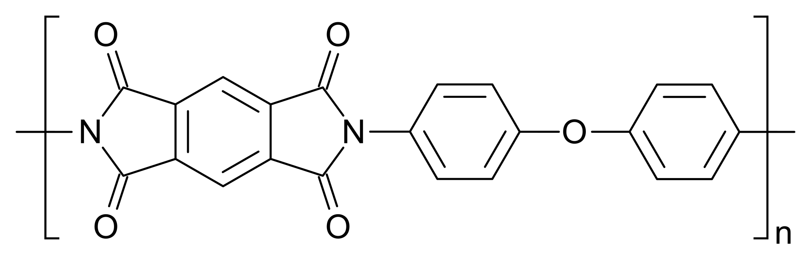
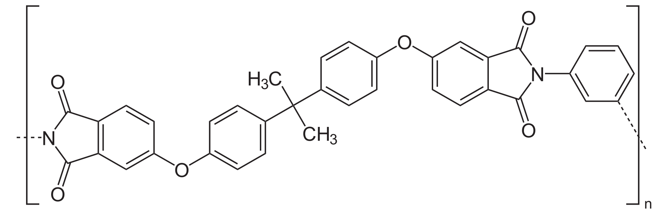
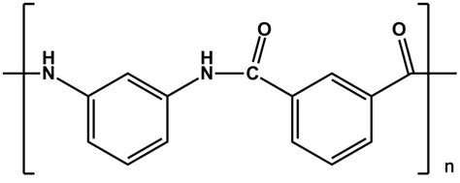
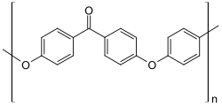
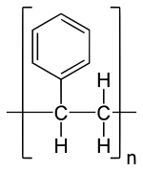
Thermal/Electrical
Polyimide
Kapton ® , (Vespel®)
Polyetherimide (PEI)
ULTEMTM
Characteristics
Cyclic/Aromatic groups in backbone
  ^{Thermal stability}
  ^{Mechanical strength}
Cyclic/Aromatic groups in side-chain
  ^{Disrupts packing of chains.}
  ^{Disrupts movement of chains.}
^{Imide group}
  ^{Chemical and thermal stability}
Meta-Aramid
Nomex®
Polyetheretherketone (PEEK)
VictrexTM
Polystyrene (PS)
StyrofoamTM
Notes:
Images:
Own work, CC0, https://commons.wikimedia.org/w/index.php?curid=64127007
By NEUROtiker - Own work, Public Domain, https://commons.wikimedia.org/w/index.php?curid=3683626

Slide 13
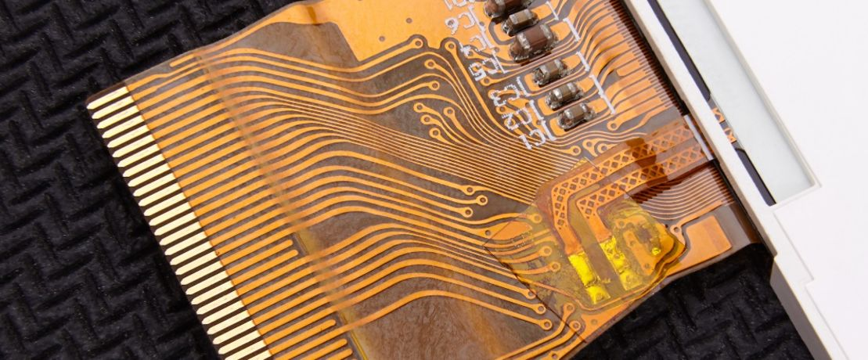
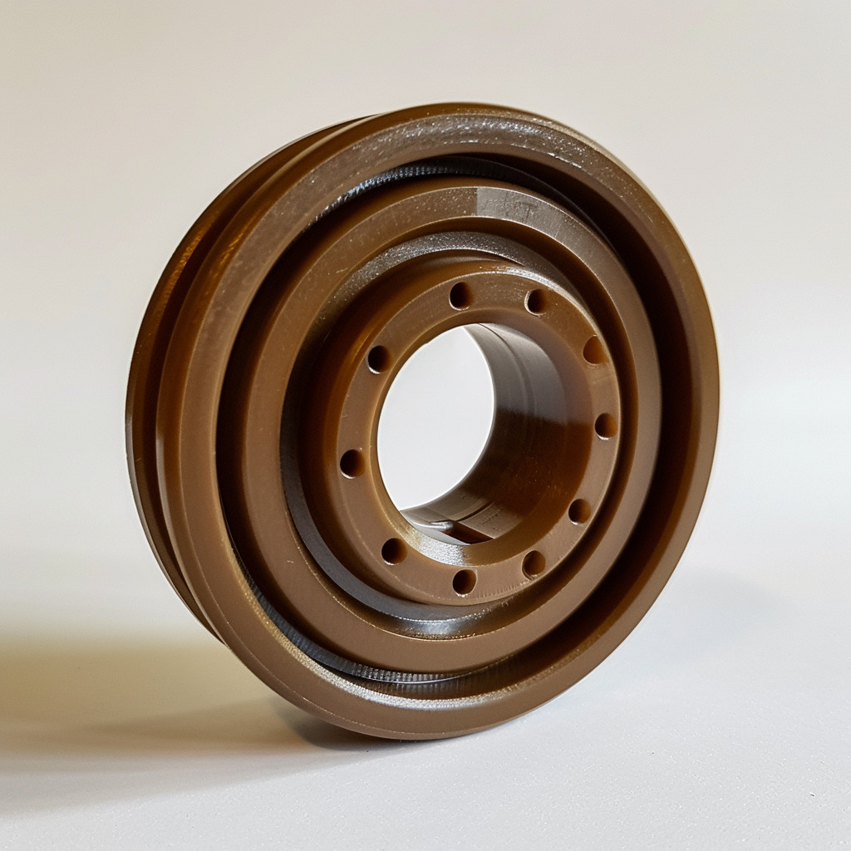
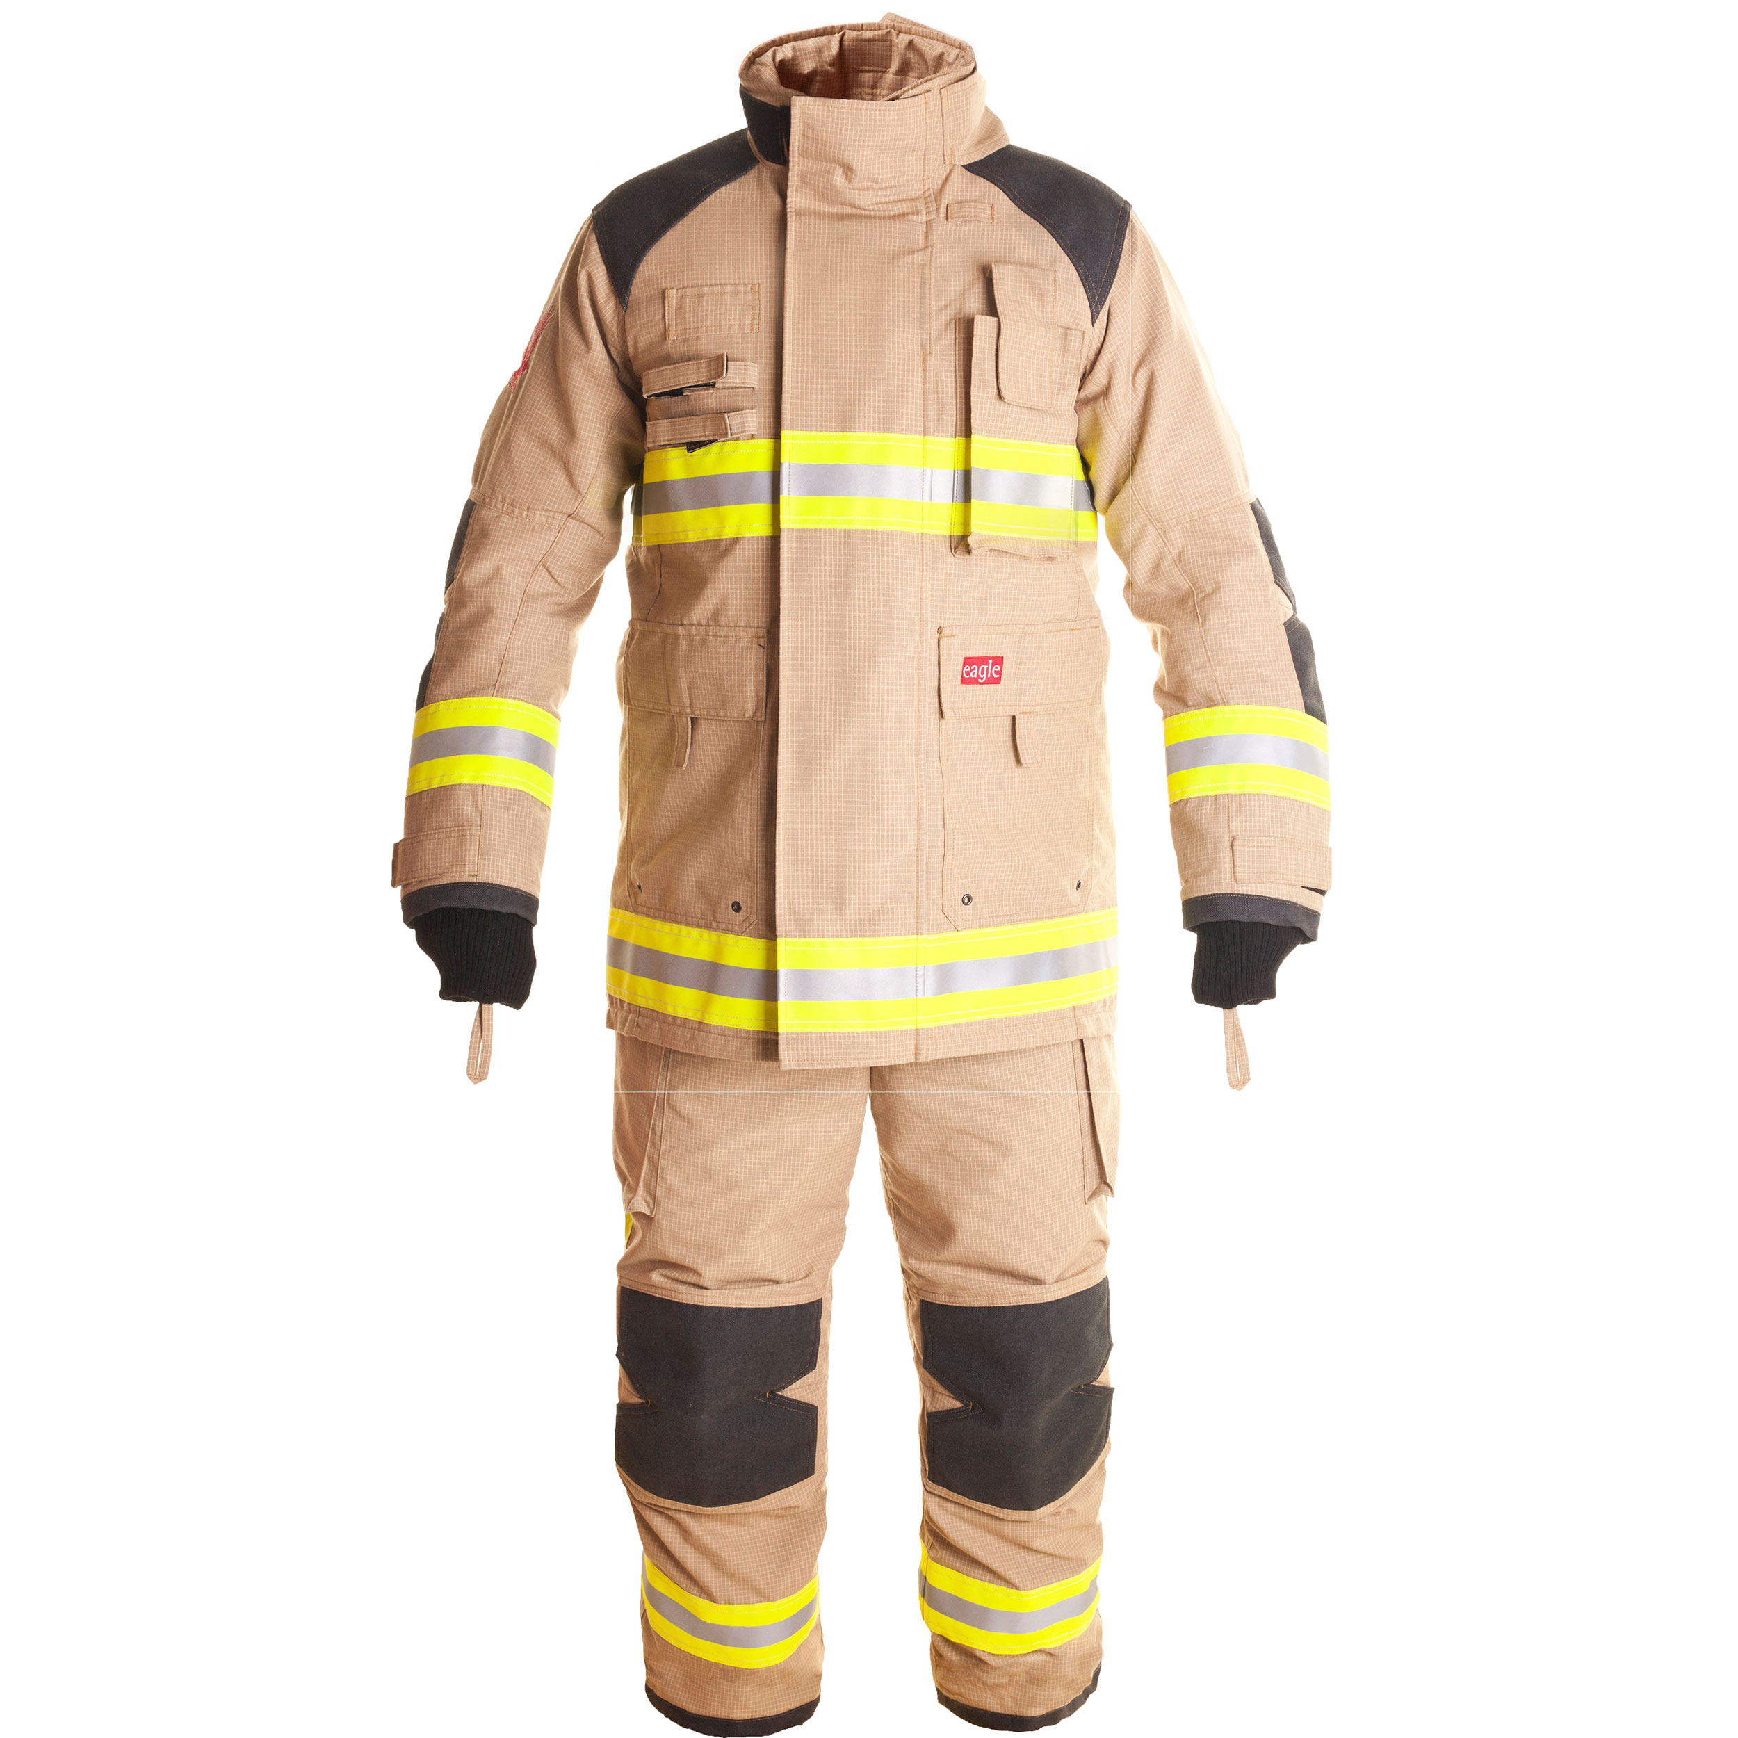
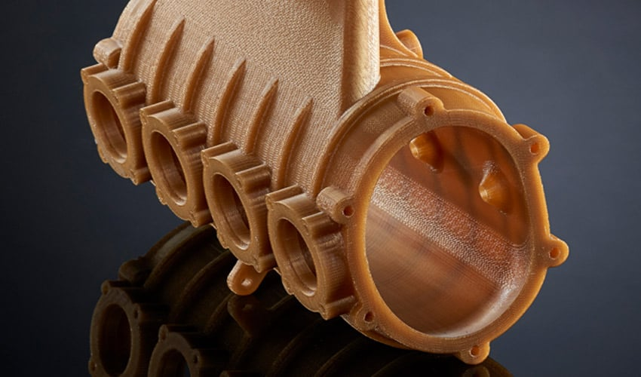
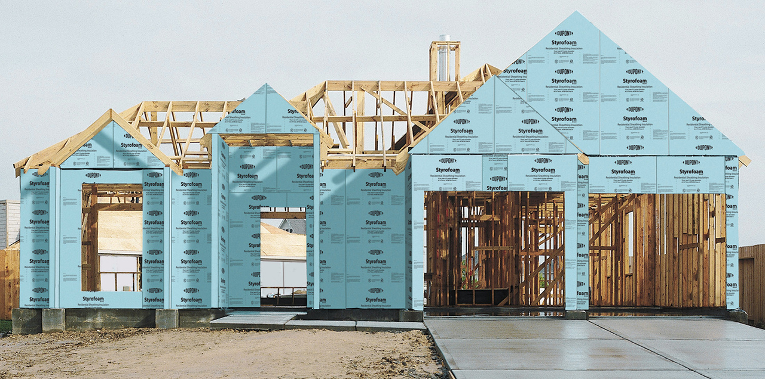
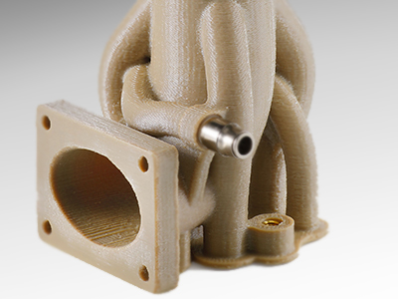
Thermal/Electrical
Polyimide
Kapton ® , (Vespel®)
Polyetherimide (PEI)
ULTEMTM
Characteristics
Cyclic/Aromatic groups in backbone
  ^{Thermal stability}
  ^{Mechanical strength}
Cyclic/Aromatic groups in side-chain
  ^{Disrupts packing of chains.}
  ^{Disrupts movement of chains.}
^{Imide group}
  ^{Chemical and thermal stability}
Meta-Aramid
Nomex®
Polyetheretherketone (PEEK)
VictrexTM
Polystyrene (PS)
StyrofoamTM
Notes:
Images:
Own work, CC0, https://commons.wikimedia.org/w/index.php?curid=64127007
By NEUROtiker - Own work, Public Domain, https://commons.wikimedia.org/w/index.php?curid=3683626

Slide 14
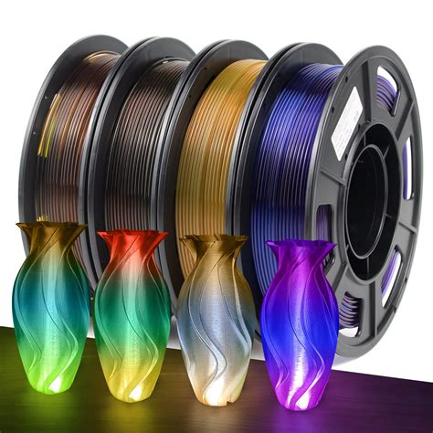
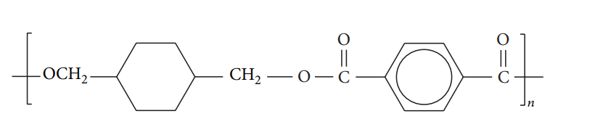
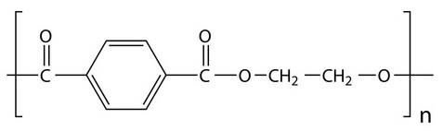
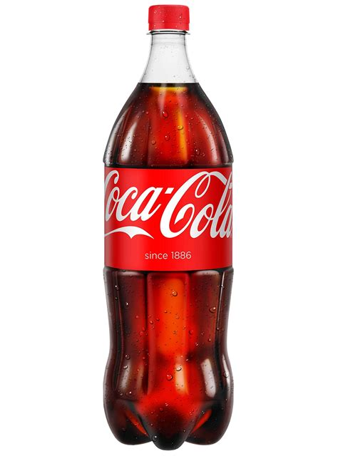
PET-G 3D-printing filament
PET vs. PET-G
Rigid and bulky: disrupts crystallinity
PET - G
PET
+
Highly Crystalline
Stiffness
Strength
Thermal Stability
Non-permeable
Amorphous (very limited crystallinity)
Lower processing temperatures
Toughness
PET bottle for formability, limited gas permeability
Notes:
https://external-content.duckduckgo.com/iu/?u=https%3A%2F%2Fm.media-amazon.com%2Fimages%2FI%2F71l3uLtt55L.jpg&f=1&nofb=1&ipt=9f366863eea55362718fc3fca1c72871ec0ae0fa0c73aea83b870b8fc0b1212f
Significant Enhancement of Mechanical and Thermal Properties of Thermoplastic Polyester Elastomer by Polymer Blending and Nanoinclusion
https://external-content.duckduckgo.com/iu/?u=https%3A%2F%2Fm.media-amazon.com%2Fimages%2FI%2F81oRiuXmn5L.jpg&f=1&nofb=1&ipt=fdba553c0dfbcc82eeec66b1156bba129e59a053f00e259993f35325cb2c5db2

Slide 15
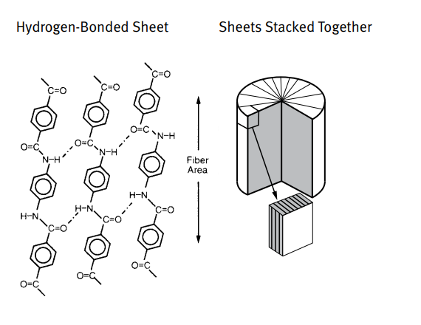



Kevlar® vs Nomex®
Irregular, less linear
Material becomes less crystalline
More compliant
Regular, linear structure
Close-packing of chains with hydrogen bonds
Directional properties
Woven Para-aramid tissue for high strength-to-weight ratio applications
Meta-aramid fire hood for thermal stability
Notes:
https://external-content.duckduckgo.com/iu/?u=https%3A%2F%2Fs3.us-east-2.amazonaws.com%2Fs3.firedex.com%2Fwp-content%2Fuploads%2F2021%2F01%2F18092901%2FFireDex_H41NNF_ZoneCoverage_Laminate-800x800.png&f=1&nofb=1&ipt=469bbd39a393a5f250db809853121ec1ad3c3d426a32328030096e98d3bfc7c9
Fire Resistant Clothing
Kevlar® Aramid Fiber Technical Guide
https://external-content.duckduckgo.com/iu/?u=https%3A%2F%2Fplaywithcarbon.com%2Fwp-content%2Fuploads%2F2020%2F05%2Fkevlar.jpg&f=1&nofb=1&ipt=b9c2118c6fc42bde9401451bc537fb1b4e4ccb896b2b755653227145a65fbc25

Slide 16




PVDF Filtration membranes
PTFE vs. PVDF
PTFE
PVDF
Fluorine
- - - - - - - - - - - - - - - - -
+ + + + + + + + + + + +
PTFE coating for non-stick and thermal stability
Hydrogen
Fully fluorinated
Symmetrical
Rigid chain
Melting point ~300°C
Dielectric constant: ~2
Extreme chemical resistance
Partially Fluorinated
Asymmetrical
Mobile chains
Melting point ~180°C
Dielectric constant: up to ~8.5
Very high chemical resistance
Notes:
https://external-content.duckduckgo.com/iu/?u=https%3A%2F%2Fwww.tefal.com.my%2Fmedia%2Fcatalog%2Fproduct%2Fi%2Fn%2Fingenio-starter-kit_pdp_2.jpg%3Fquality%3D80%26fit%3Dcover%26height%3D1200%26width%3D960%26auto%3Dwebp%26format%3Dpjpg%26keyImg%3D%3FLARGER&f=1&nofb=1&ipt=f1771ac32d86d2f69429bd52897a36b1f98317094b2e718c21ffbfeb74b1b3b9
PROFESSIONAL PLASTICS, INC
https://external-content.duckduckgo.com/iu/?u=https%3A%2F%2Ftse4.mm.bing.net%2Fth%3Fid%3DOIP.6Dn04V16qxf0xwT80GS_xwHaE8%26pid%3DApi&f=1&ipt=d8407a4a057fc7fbb90d8ab3fbc016fcee343950141d37f6d605722e47c3831b
https://external-content.duckduckgo.com/iu/?u=https%3A%2F%2Fwww.researchgate.net%2Fpublication%2F364567095%2Ffigure%2Ffig3%2FAS%3A11431281091284491%401666363952904%2FMolecular-structure-of-the-a-b-and-g-phases-of-PVDF.png&f=1&nofb=1&ipt=531cd50e6c06c559c74a30e1146648150f051e35bb6c61804628e6dfc34a20c8

Slide 17
Summary
Feature | Tensile Strength | Stiffness | Crystallinity | Chemical Resistance | T_{g} | Thermal Stability | Dielectric Strength | Example
Cross-Linking | Increases | Increases | Hinders | Increases | Increases | Increases | Increases | FKM (Viton)
Aromatic Groups (in backbone) | Increases | Increases | Hinders | Increases | Increases | Increases | Increases | Para-Aramid (Kevlar)
Halogens | Not directly Linked | Not directly linked | Not directly linked | Increases | Depends on distribution | Increases | Increases | PTFE (Teflon)
Hydrogen Bonding | Increases | Increases | Promotes | Decreases | Increases | Not directly linked | Not directly linked | Nylon
Linear Backbone | Increases | Increases if crystalline | Promotes | Increases if crystalline | Decreases | Not directly linked | Not directly linked | Polyethylene
Flexible Backbone | Not directly linked | Decreases | Promotes | Increases if crystalline | Decreases | Not directly linked | Decreases | Polyurethane (Lycra)
Large Pendant groups | Decreases | Decreases | Hinders | Decreases | Increases | Not directly linked | Not directly linked | Polystyrene
Dipoles | Increases | Increases | Depends on distribution | Decreases | Increases | Not directly linked | Decreases | PEEK
Example: | Nylon | Kevlar | Delrin | Kalrez | PEI | Chloroprene | Polyimide

Slide 18



Thank you for your attention!
Polyethylene (PE)
Polytetrafluoroethylene (PTFE)
Para-Aromatic Polyamide (Kevlar)

Slide 19
Additional Slides

Slide 20


MolykoteTM
Industrial Lubricant
  Low viscosity
  Film formation
  Durability
  Active component: Molybdenum Disulphide (MoS₂).
https://www.tradekorea.com/product/detail/P758069/grease-friction-modifier-CAS-68412-26-0-MoDTC-Powder.html

Slide 21



Notes:
29.4: Forces Between Polymer Chains - Chemistry LibreTexts

Slide 22

Note that processing and changes in molecular structure can affect crystallinity.
Polyimide for example exists in many forms.
Notes:
https://external-content.duckduckgo.com/iu/?u=https%3A%2F%2Ftse2.mm.bing.net%2Fth%3Fid%3DOIP.lbrsPaoIlKQzGu8bLrrPZAHaE8%26pid%3DApi&f=1&ipt=eb1f5c9b5914b3efe2dd1e3895cd520db888b6ee019d31ccbc6f1a4d5fec7a80

