Slide 1

CERN Basketball Club
General Assembly
13th of June 2025

Slide 2
Season 2025-2026
The committee will announce the CERN1 and CERN2 players roster during the summer when we will have a better idea of who will be still there next year
Results of the pool for the moment:
  13 players are interested in CERN1
  7 players are interested in CERN2
  Quid of players who still don’t reply
The criteria that we would follow for the selection:
  Members of the teams from last year have been given preference
  Attendance to the trainings and/or pickup games
  Basketball level / Team needs

Slide 3
Season 2025-2026
Gyms
  Tuesdays: Chavanne
  Wednesdays: Bude
  Thursdays: Saint Genis - Diamanterie
All info can be found here: https://twiki.cern.ch/twiki/bin/view/SocialActivities/BasketballClub

Slide 4
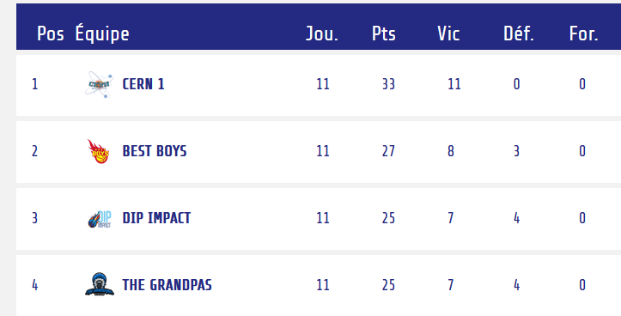
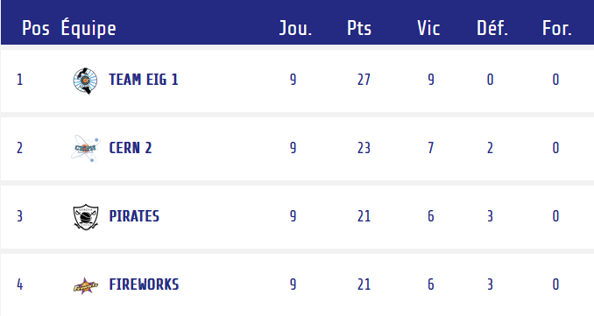
Season 2025-2026
Competitions – GAB
  CERN 1
    https://gabasket.ch/team/cern_1
    League A
    Cup
  CERN 2
    https://gabasket.ch/team/cern_2
    League B
    Cup

Slide 5
2025-2026 Committee
François Boyer– President
Borja Fernandez Adiego– Vice President
Pedro Felix Lopez Macia – CERN1R
Dario Soriano– Treasurer
Manuel Gonzalez Berges – Secretary/CERN2R
Giuseppe Mazzola – CERN2R
Roberto Muriel Maurino– CERN1R
George Iakovidis– Member
Pepe Rodriguez – Social event, marketing and communication manager !!
Anyone else interested?

Slide 6
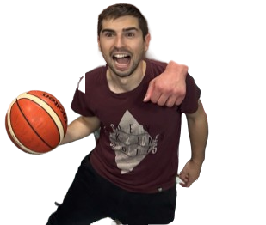
2025-2026 committee
New Member: Dario Soriano!

Slide 7

2025-2026 committee
Farewell: Jeronimo Ortola Vidal

Slide 8
2025-2026 activities
Xmas dinner
Basket tournament ?
Connecting the dots: Several sessions all along the year
  Possibility to present the club
BBQ planned the 28th of June !!
New website (Pepe and Alex)
Project to build a playground court at CERN
…
Any other volunteer?

Slide 9
Any suggestion, complain?

