Slide 1

Status and plans on: _ _
3D Electromagnetic Time-Domain wake and impedance solver
@CEI Section Meeting – 24th July 2025
Elena de la Fuente^{1,2} &
Wakis team: Lorenzo Giacomel, Giovanni Iadarola¹, Carlo Zannini¹, Manuel Cotelo²
¹CERN (BE-ABP-CEI), Geneva Switzerland
²IFN-GV, Polytechnic University of Madrid, Madrid, Spain

Slide 2
Other useful presentations since last CEI…
  21st April 24 @ CEI: Introduction to Wakis & FIT
  9th Aug 24 @ EMWSD #20: PML implementation
  2nd Oct 24 @ ICAP conference: Introduction to Wakis + GPU
  31st Oct 24 @ABP-GIM: Introduction to Wakis
  28th Feb 25 @MLCF: PIML Wake extrapolation in Wakis w/ IDDEFIX
  5th Mar 25 @WUM #1: Wakis community & Hands-on
  2nd April 25 @WUM #2: Wakis MPI implementation
  8th May 25 @ABP-GIM: Wakis status, community and IDDEFIX
  1st – 6th June @IPAC 25: Wakis poster, paper & flash slides
  11th July @CAP: Wakis CI/CD, status and Hands-on

Slide 3

Outline
Introduction:
  Beam-coupling impedance simulations
  Finite Integration technique (FIT)
Status:
  The ImpedanCEI code suite & pipeline
  Hands-on time!
Plans:
  User community plans and applications
  Development plans
    + Extra slides on of some of Wakis features:
      CSG, CAD geometry import & snappy mesh (WIP)
      MPI implementation & Multi GPU
      Wake extrapolation w/ IDDEFIX
Hands-on
python notebooks
@ImpedanCEI/
CEI-meeting-hands-on

Slide 4
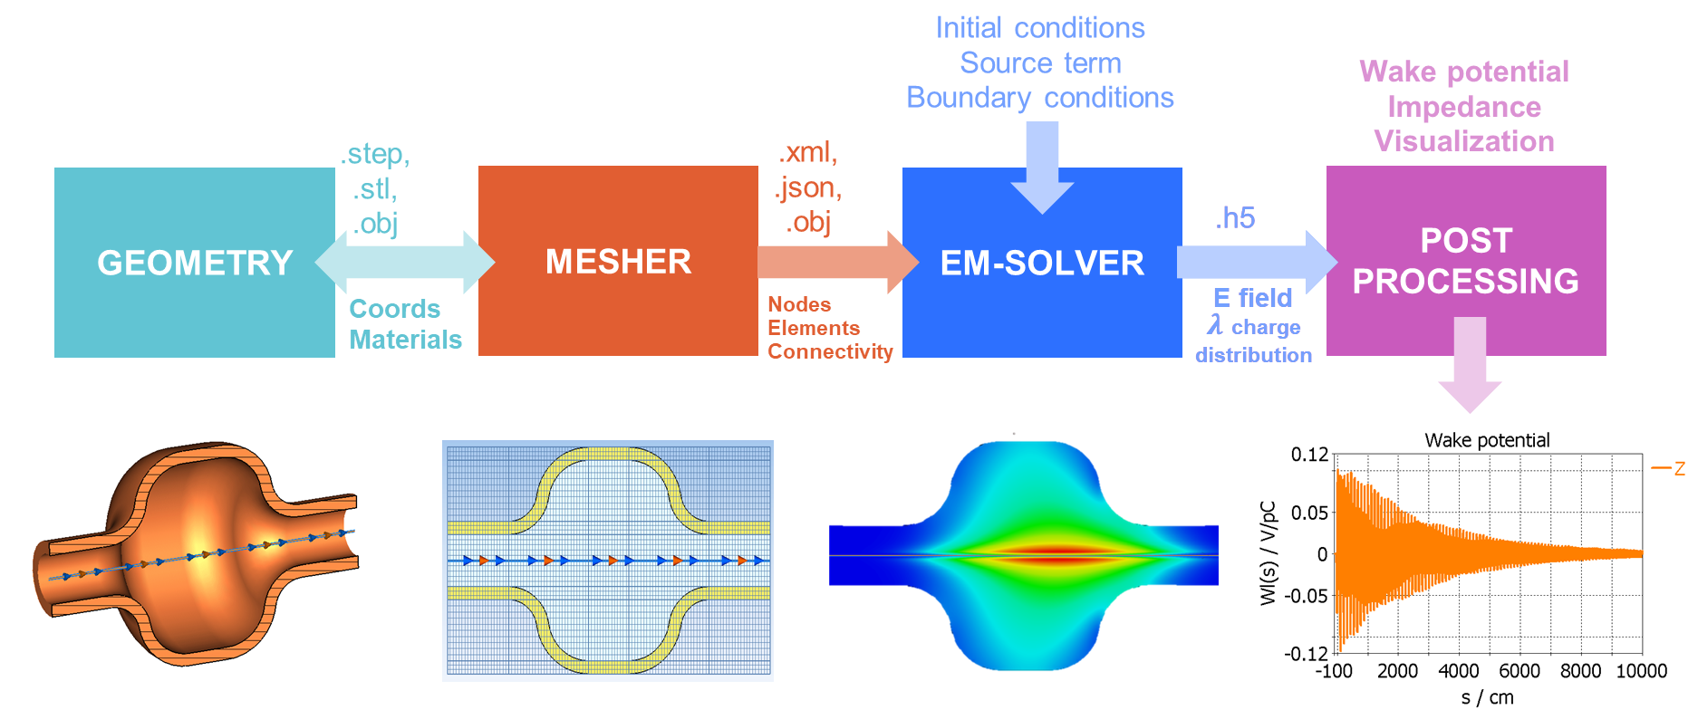
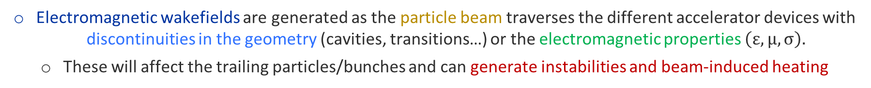
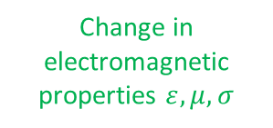
Introduction to beam-coupling impedance
Electromagnetic wakefields are generated as the particle beam traverses the different accelerator devices with discontinuities in the geometry (cavities, transitions…) or the electromagnetic properties $\left(ε, μ, σ\right).$
These will affect the trailing particles/bunches and can generate instabilities and beam-induced heating
Accelerator device
Passing beam current
Change in geometry
Change in electromagnetic properties $ε, μ, σ$

Slide 5
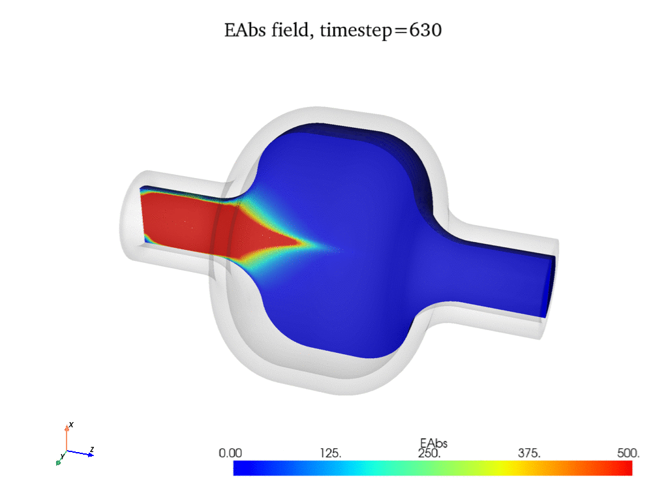
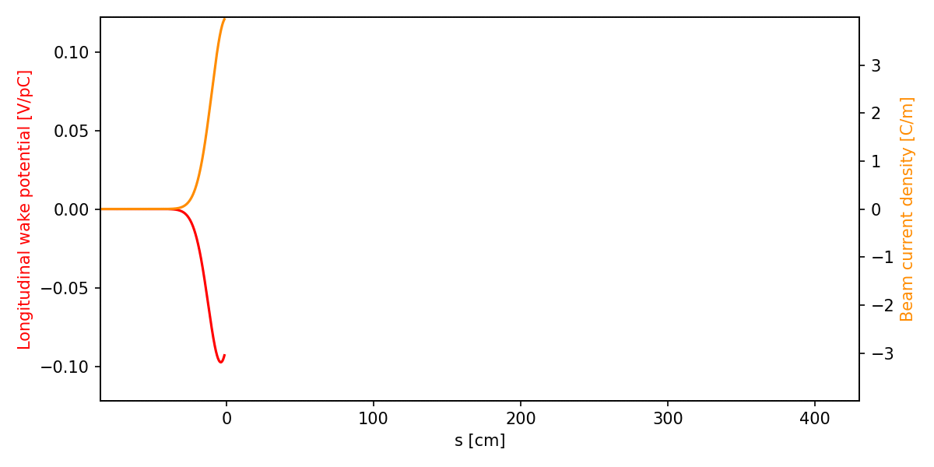
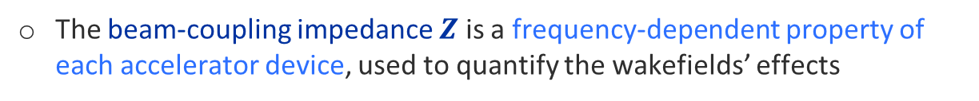
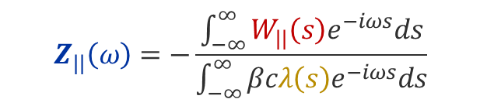
Introduction to beam-coupling impedance
Electromagnetic wakefields are generated as the particle beam traverses the different accelerator devices with discontinuities in the geometry (cavities, transitions…) or the electromagnetic properties $\left(ε, μ, σ\right).$
These will affect the trailing particles/bunches and can generate instabilities and beam-induced heating
Accelerator device
Electromagnetic fields
Wake potential & Impedance
Passing beam current
Change in geometry
Change in electromagnetic properties $ε, μ, σ$
$$Z_{||}\left(ω\right)=−\frac{\int_{−∞}^{∞}{W_{||}\left(s\right)e^{−iωs}ds}}{\int_{−∞}^{∞}{βcλ\left(s\right)e^{−iωs}ds}}$$
The beam-coupling impedance $Z$ is a frequency-dependent property of each accelerator device, used to quantify the wakefields’ effects

Slide 6
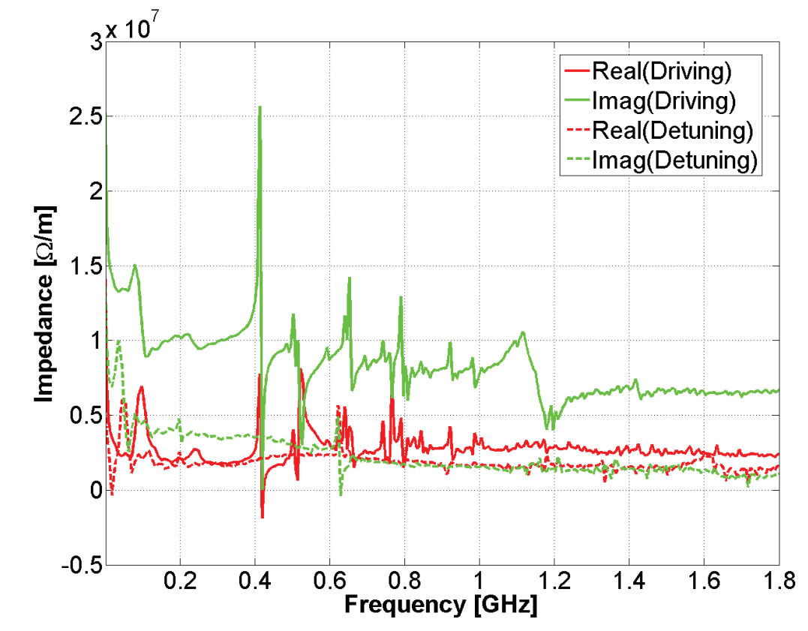
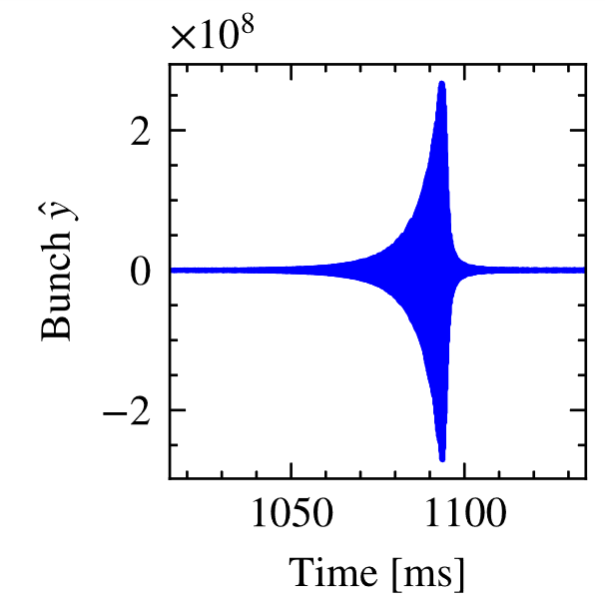
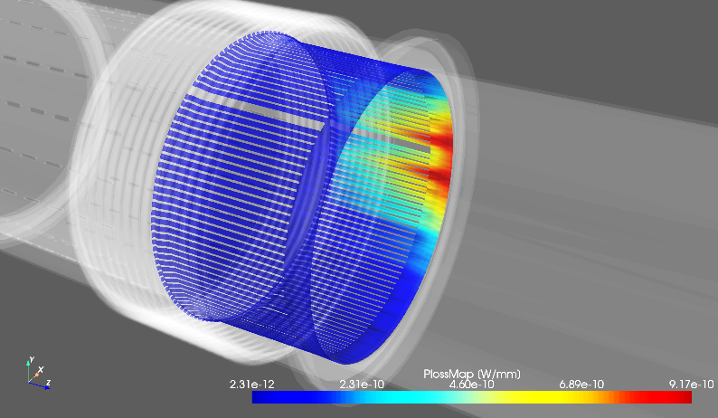
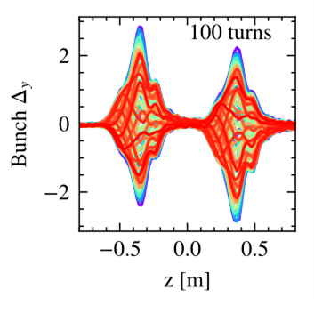

Importance of beam-coupling impedance
[1] C. Zannini, MOPJE049, IPAC’15
[2] E. de la Fuente et al., THAFP01, HB’23
[3] C. Antuono et al., TUAN3, IPAC’24
Impedance model of the accelerator
Beam induced heating
Beam stability
The impedance of all relevant accelerator components is gathered in each accelerator's impedance model
And used in beam-dynamics codes (e.g., pyHeadtail, Xsuite) to predict beam behaviour and stability
Assess beam-induced heating of individual accelerator components and propose mitigation solutions
SPS transverse impedance model^{[1]}
LHC Warm Vacuum modules Power lost map ^{[3]}
Transverse position growth
SPS Head-Tail mode zero instability ^{[2]}
Intrabunch motion (mirrored)
$P_{loss}$ map

Slide 7


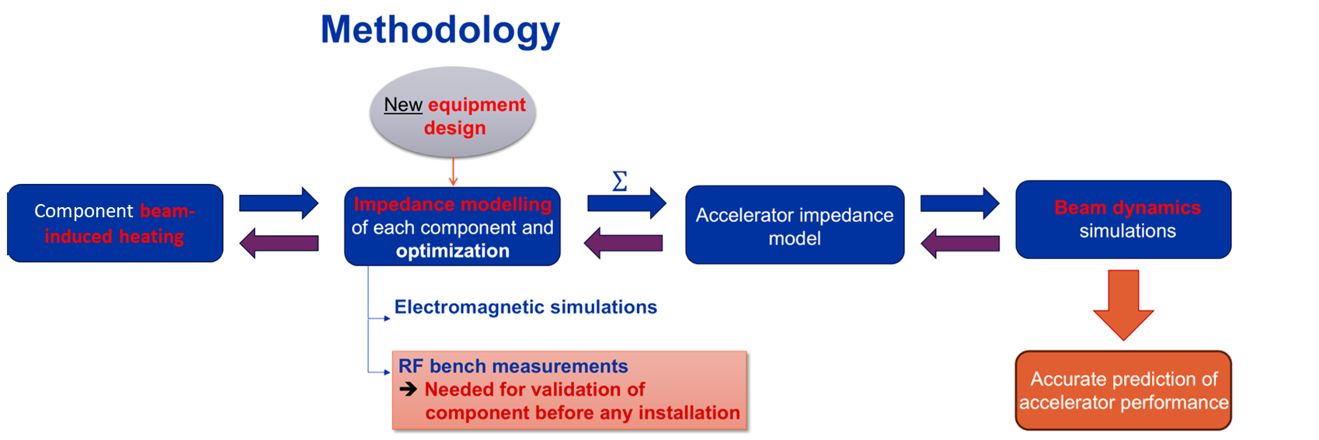




Impedance assessment workflow
pyWIT
Transverse position growth
xwakes
$P_{loss}$ map
/
LHC Warm vacuum modules, 2023
*Workflow from C. Antuono, M. Neroni et. al.,@JAP Workshop’24

Slide 8
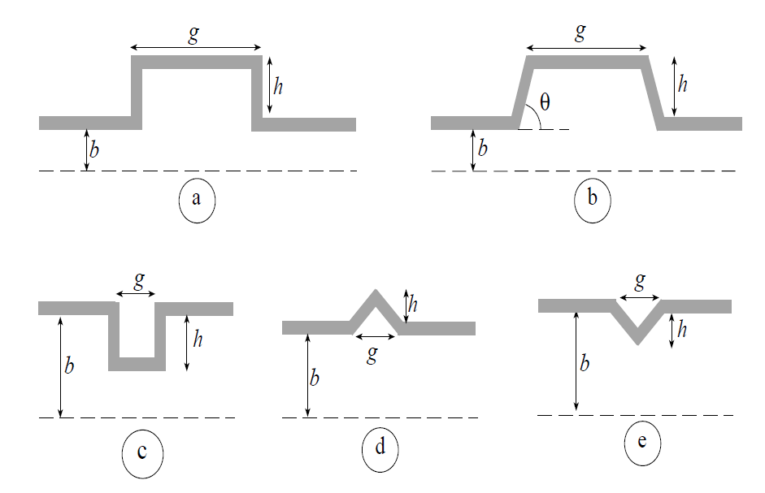
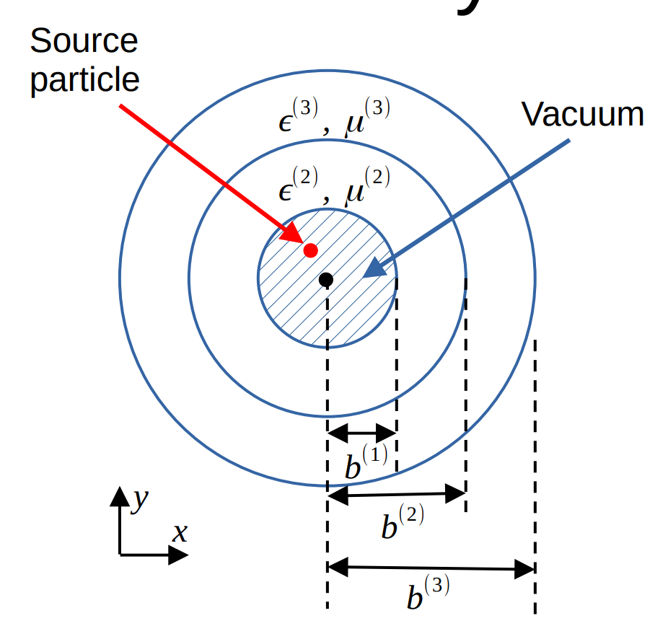
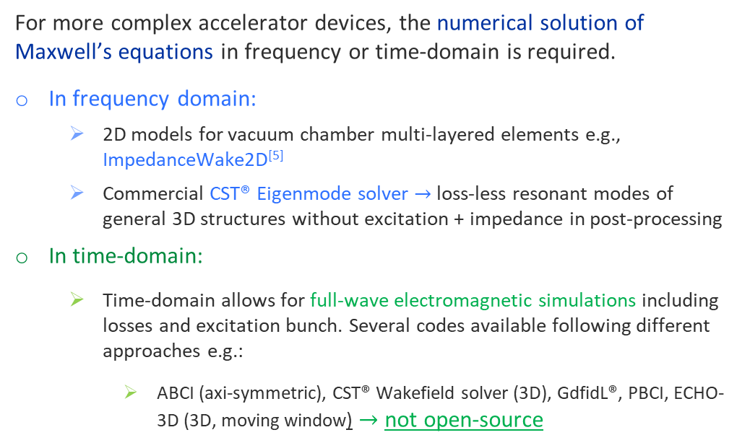
How to compute beam-coupling impedance?
Analytical calculations
Beam-coupling impedance can be derived analytically for simple geometries and material configurations^{[4]}:
e.g., cylindrical pillbox cavities, pipe transitions, single-layer resistive wall
Numerical computations
For more complex accelerator devices, the numerical solution of Maxwell’s equations in frequency or time-domain is required.
In frequency domain:
  2D models for vacuum chamber multi-layered elements e.g., ImpedanceWake2D^{[5]}
  Commercial CST® Eigenmode solver $→$loss-less resonant modes of general 3D structures without excitation + impedance in post-processing
In time-domain:
  Time-domain allows for full-wave electromagnetic simulations including losses and excitation bunch. Several codes available following different approaches e.g.:
    ABCI (axi-symmetric), CST® Wakefield solver (3D), GdfidL®, PBCI, ECHO-3D (3D, moving window) $→$ not open-source
[4] Wake fields and impedance,
L. Palumbo, V.G. Vaccaro, CERN-1995-006.331
[5] ImpedanceWake2D,
N. Mounet, TUO1C02 HB’10
https://gitlab.cern.ch/IRIS/IW2D

Slide 9
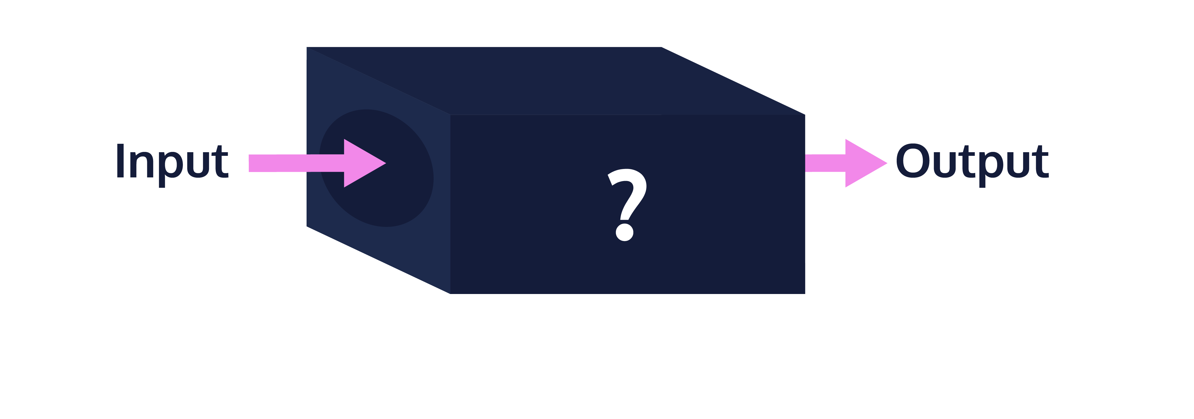




How to compute beam-coupling impedance?
Analytical calculations
Beam-coupling impedance can be derived analytically for simple geometries and material configurations^{[4]}:
e.g., cylindrical pillbox cavities, pipe transitions, single-layer resistive wall
Numerical computations
For more complex accelerator devices, the numerical solution of Maxwell’s equations in frequency or time-domain is required.
In frequency domain:
  2D models for vacuum chamber multi-layered elements e.g., ImpedanceWake2D^{[5]}
  Commercial CST® Eigenmode solver $→$loss-less resonant modes of general 3D structures without excitation + impedance in post-processing
In time-domain:
  Time-domain allows for full-wave electromagnetic simulations including losses and excitation bunch. Several codes available following different approaches e.g.:
    ABCI (axi-symmetric), CST® Wakefield solver (3D), GdfidL®, PBCI, ECHO-3D (3D, moving window) $→$ not open-source
[4] Wake fields and impedance,
L. Palumbo, V.G. Vaccaro, CERN-1995-006.331
Traditionally handled only by
commercial / closed-source software such as
Well-stablished & robust
Flexible / extendable for new accelerator challenges
[5] ImpedanceWake2D,
N. Mounet, TUO1C02 HB’10
https://gitlab.cern.ch/IRIS/IW2D

Slide 10
Outline
Introduction:
  Beam-coupling impedance simulations
  Finite Integration technique (FIT)
Status:
  The ImpedanCEI code suite & pipeline
  Hands-on time!
Plans:
  User community plans and applications
  Development plans
    + Extra slides on of some of Wakis features:
      CSG, CAD geometry import & snappy mesh (WIP)
      MPI implementation & Multi GPU
      Wake extrapolation w/ IDDEFIX
Hands-on
python notebooks
@ImpedanCEI/
CEI-meeting-hands-on

Slide 11
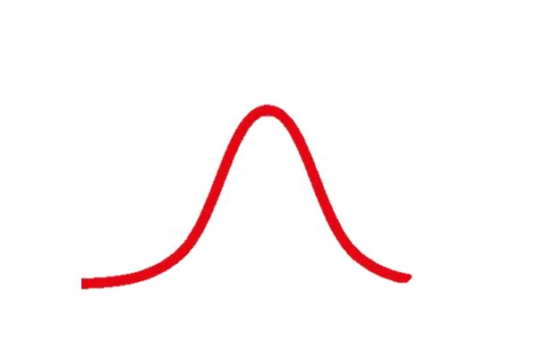
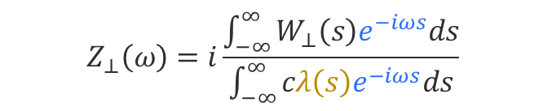
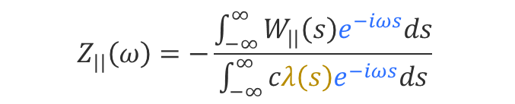
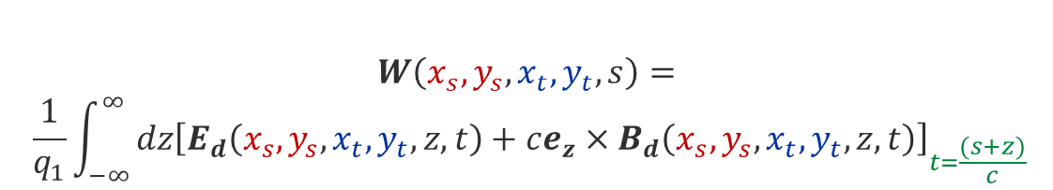
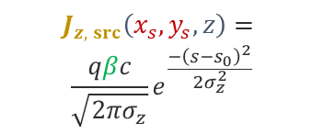
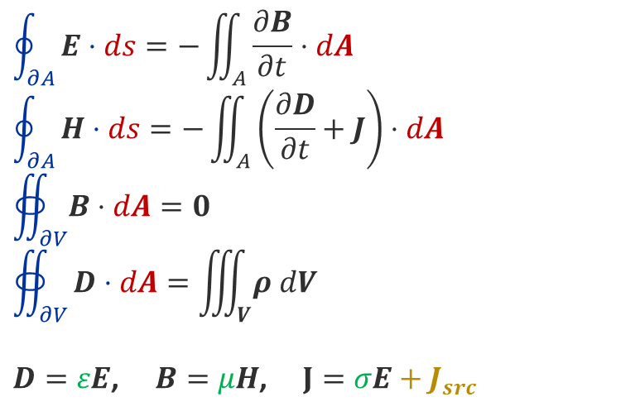

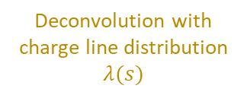
How to compute beam-coupling impedance?
Time-domain Maxwell’s equations….
To obtain figures of merit…
$$\oint_{∂A}^{ }{E⋅ds=−\iint_{A}^{ }{\frac{∂B}{∂t}⋅dA}}$$
$$\oint_{∂A}^{ }{H⋅ds=−\iint_{A}^{ }{\left(\frac{∂D}{∂t}+J\right)⋅dA}}$$
$$∯_{∂V}^{ }{B⋅dA}=0$$
$$∯_{∂V}^{ }{D⋅dA=\iiint_{V}^{ }{ρ dV}}$$
$D=εE$, $B=μH$, $J=σE+J_{src}$
Wake potential in time-domain
$r_{s}:$ beam source path
$r_{t}:i$ntegration path
$$W\left(x_{s},y_{s},x_{t},y_{t}, s\right)=$$
$$\frac{1}{q_{1}}\int_{−∞}^{∞}{dz{\left[E_{d}\left(x_{s},y_{s},x_{t},y_{t},z, t\right)+ce_{z}×B_{d}\left(x_{s},y_{s},x_{t},y_{t}, z, t\right)\right]}_{t=\frac{(s+z)}{c}}}$$
Beam-coupling impedance in frequency-domain
$$Z_{||}\left(ω\right)=−\frac{\int_{−∞}^{∞}{W_{||}\left(s\right)e^{−iωs}ds}}{\int_{−∞}^{∞}{cλ\left(s\right)e^{−iωs}ds}}$$
…with a passing beam current
Deconvolution with charge line distribution $λ(s)$
on each accelerator device geometry…
$$Z_{⊥}\left(ω\right)=i\frac{\int_{−∞}^{∞}{W_{⊥}\left(s\right)e^{−iωs}ds}}{\int_{−∞}^{∞}{cλ\left(s\right)e^{−iωs}ds}}$$
$$J_{z, src}\left(x_{s}, y_{s},z\right)=$$
$$\frac{qβc}{\sqrt{2πσ_{z}}}e^{\frac{−{\left(s−s_{0}\right)}^{2}}{2σ_{z}^{2}}}$$

Slide 12
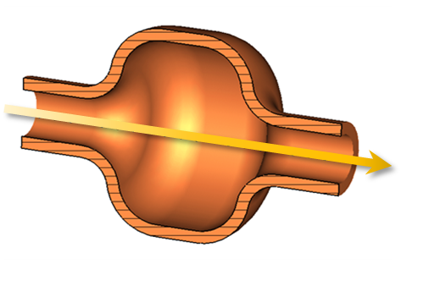
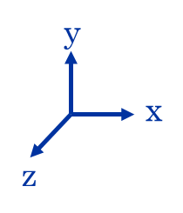
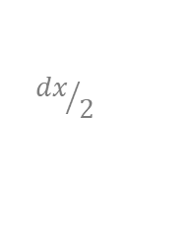
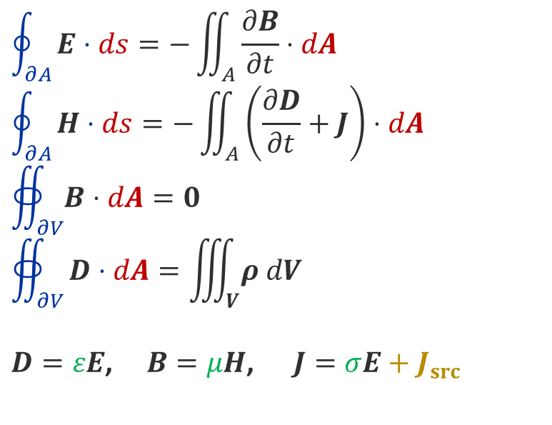


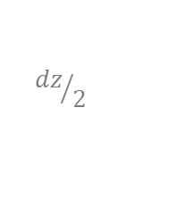
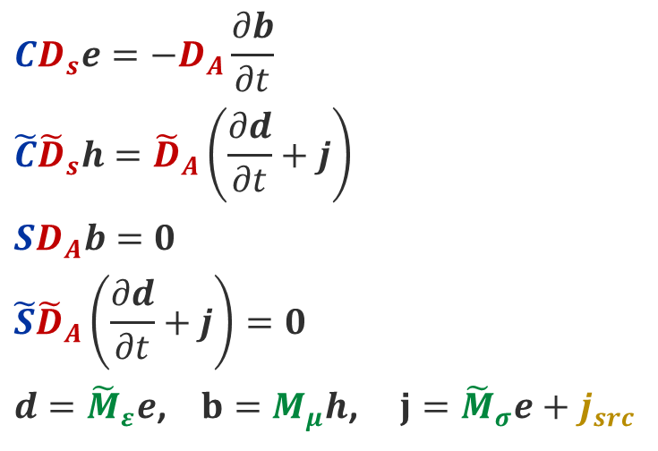

Finite Integration Technique
1st approximation
Maxwell Equations (Integral form)
Domain discretization
$$dx, dy, dz$$
Maxwell Grid Equations
$$\oint_{∂A}^{ }{E⋅ds=−\iint_{A}^{ }{\frac{∂B}{∂t}⋅dA}}$$
$$\oint_{∂A}^{ }{H⋅ds=−\iint_{A}^{ }{\left(\frac{∂D}{∂t}+J\right)⋅dA}}$$
$$∯_{∂V}^{ }{B⋅dA}=0$$
$$∯_{∂V}^{ }{D⋅dA=\iiint_{V}^{ }{ρ dV}}$$
$D=εE$, $B=μH$, $J=σE+J_{src}$
$$CD_{s}e=−D_{A}\frac{∂b}{∂t}$$
$$\tilde{C}{\tilde{D}}_{s}h={\tilde{D}}_{A}\left(\frac{∂d}{∂t}+j\right)$$
$$SD_{A}b=0$$
$${\tilde{S}\tilde{D}}_{A}\left(\frac{∂d}{∂t}+j\right)=0$$
$d={\tilde{M}}_{ε}e$, $b=M_{μ}h$, $j={\tilde{M}}_{σ}e+j_{src}$
$N_{cells}=N_{x}N_{y}N_{z}$
y
$${dy}/2$$
Operators
Grid areas and lengths
Material tensors
$${dz}/2$$
$${dx}/2$$
x
Hexahedral cells
z

Slide 13
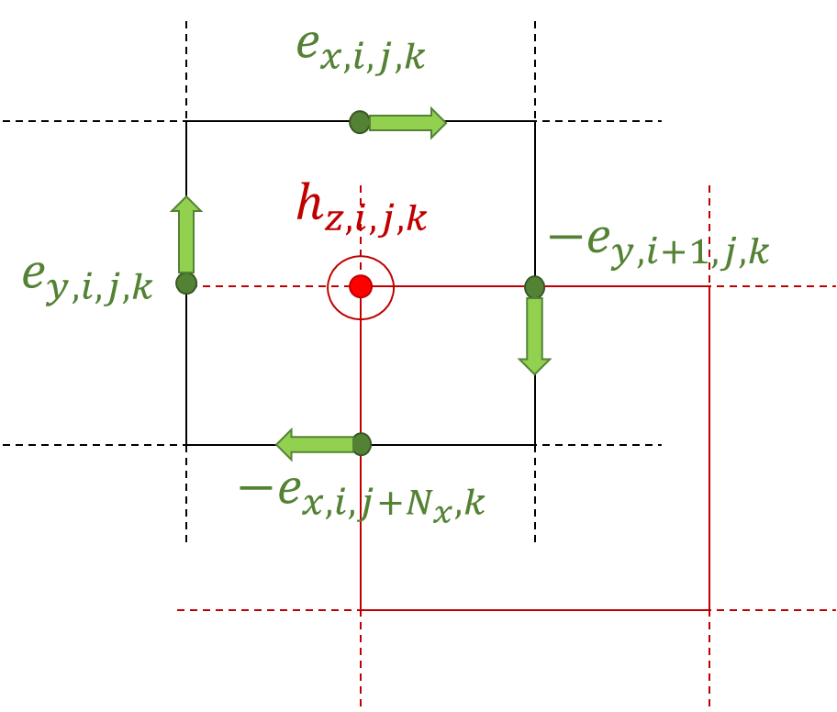

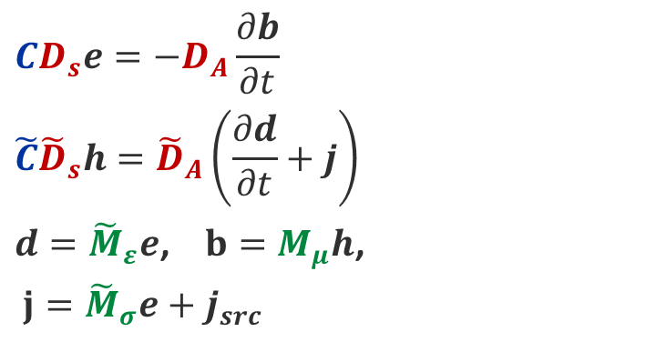
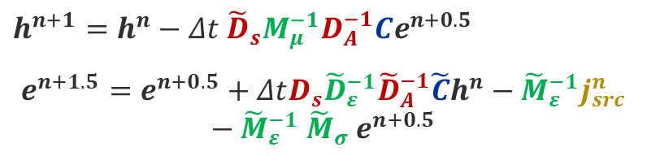
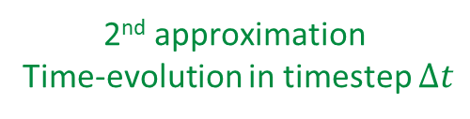
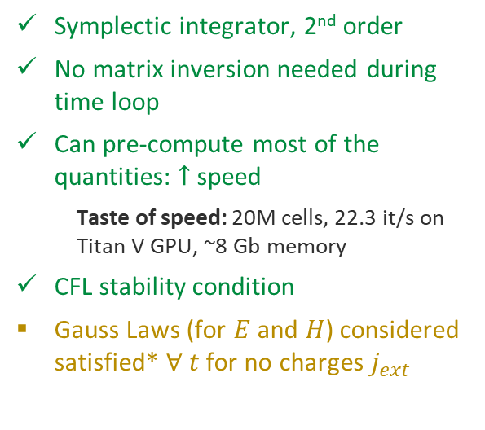
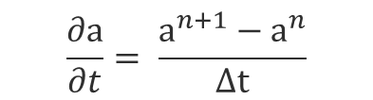
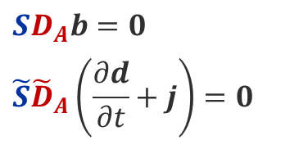

Finite Integration Technique (II)
2nd approximation
Time-evolution in timestep $Δt$
Time-stepping scheme (leapfrog)
Maxwell Grid Equations
$$CD_{s}e=−D_{A}\frac{∂b}{∂t}$$
$$\tilde{C}{\tilde{D}}_{s}h={\tilde{D}}_{A}\left(\frac{∂d}{∂t}+j\right)$$
$d={\tilde{M}}_{ε}e$, $b=M_{μ}h$,
$j={\tilde{M}}_{σ}e+j_{src}$
$$h^{n+1}=h^{n}−Δt{ {\tilde{D}}_{s}M_{μ}^{−1}D}_{A}^{−1}Ce^{n+0.5}$$
$e^{n+1.5}=e^{n+0.5}+ΔtD_{s}{\tilde{D}}_{ε}^{−1}{\tilde{D}}_{A}^{−1}\tilde{C}h^{n}−{\tilde{M}}_{ε}^{−1}j_{src}^{n}$ $−{\tilde{M}}_{ε}^{−1}$ ${\tilde{M}}_{σ}^{ }$ $e^{n+0.5}$
$$\frac{∂a}{∂t}= \frac{a^{n+1}−a^{n}}{Δt}$$
Symplectic integrator, 2nd order
No matrix inversion needed during time loop
Can pre-compute most of the quantities: $↑$ speed
  Taste of speed: 20M cells, 22.3 it/s on Titan V GPU, ~8 Gb memory
CFL stability condition
Gauss Laws (for $E$ and $H$) considered satisfied* $∀ t$ for no charges $j_{ext}$
Domain discretization
With Yee grid
$$SD_{A}b=0$$
$${\tilde{S}\tilde{D}}_{A}\left(\frac{∂d}{∂t}+j\right)=0$$
Dual Grid $\tilde{G}$
Primal grid $G$

Slide 14


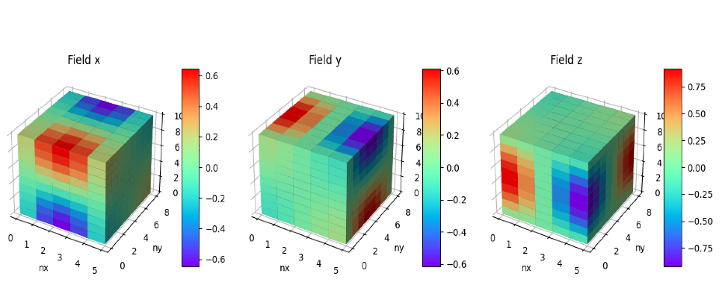
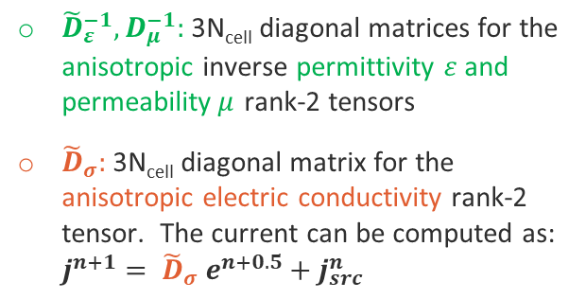
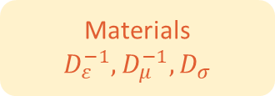
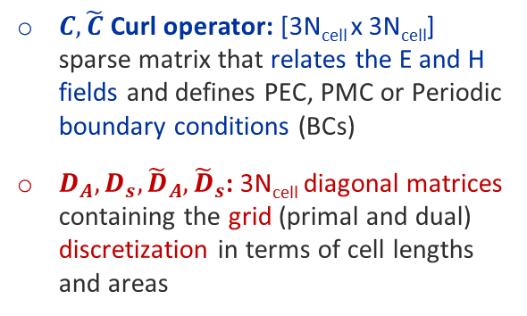
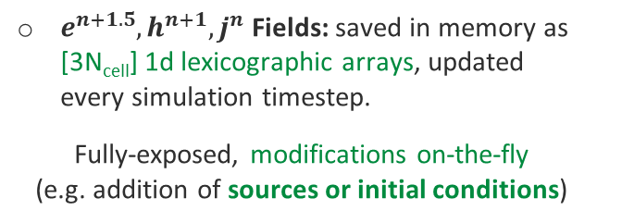
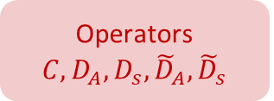

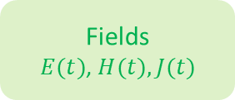
Finite Integration Technique (III)
$$h^{n+1}=h^{n}−Δt{ {\tilde{D}}_{s}M_{μ}^{−1}D}_{A}^{−1}Ce^{n+0.5}$$
$e^{n+1.5}=e^{n+0.5}+ΔtD_{s}{\tilde{D}}_{ε}^{−1}{\tilde{D}}_{A}^{−1}\tilde{C}h^{n}−{\tilde{M}}_{ε}^{−1}j_{src}^{n}$ $−{\tilde{M}}_{ε}^{−1}$ ${\tilde{M}}_{σ}^{ }$ $e^{n+0.5}$
scipy.sparse
scipy.sparse
Operators $C, D_{A}, D_{s},{\tilde{D}}_{A}, {\tilde{D}}_{s}$
Fields
$E(t)$, $H(t),$ $J(t)$
Materials
$$D_{ε}^{−1}, D_{μ}^{−1}, D_{σ}$$
$C,\tilde{C}$ Curl operator: [3N_{cell} x 3N_{cell}] sparse matrix that relates the E and H fields and defines PEC, PMC or Periodic boundary conditions (BCs)
$D_{A}, D_{s},{\tilde{D}}_{A}, {\tilde{D}}_{s}$: 3N_{cell} diagonal matrices containing the grid (primal and dual) discretization in terms of cell lengths and areas
$e^{n+1.5}, h^{n+1}, j^{n}$ Fields: saved in memory as [3N_{cell}] 1d lexicographic arrays, updated every simulation timestep.
Fully-exposed, modifications on-the-fly (e.g. addition of sources or initial conditions)
${\tilde{D}}_{ε}^{−1},D_{μ}^{−1}:$ 3N_{cell} diagonal matrices for the anisotropic inverse permittivity $ε$ and permeability$μ$ rank-2 tensors
${\tilde{D}}_{σ}^{ }:$ 3N_{cell} diagonal matrix for the anisotropic electric conductivity rank-2 tensor. The current can be computed as: $j^{n+1}= {\tilde{D}}_{σ}^{ }$ $e^{n+0.5}+j_{src}^{n}$
wakis E.inspect3d() method

Slide 15
Outline
Introduction:
  Beam-coupling impedance simulations
  Finite Integration technique (FIT)
Status:
  The ImpedanCEI code suite & pipeline
  Hands-on time!
Plans:
  User community plans and applications
  Development plans
    + Extra slides on of some of Wakis features:
      CSG, CAD geometry import & snappy mesh (WIP)
      MPI implementation & Multi GPU
      Wake extrapolation w/ IDDEFIX
Hands-on
python notebooks
@ImpedanCEI/
CEI-meeting-hands-on

Slide 16
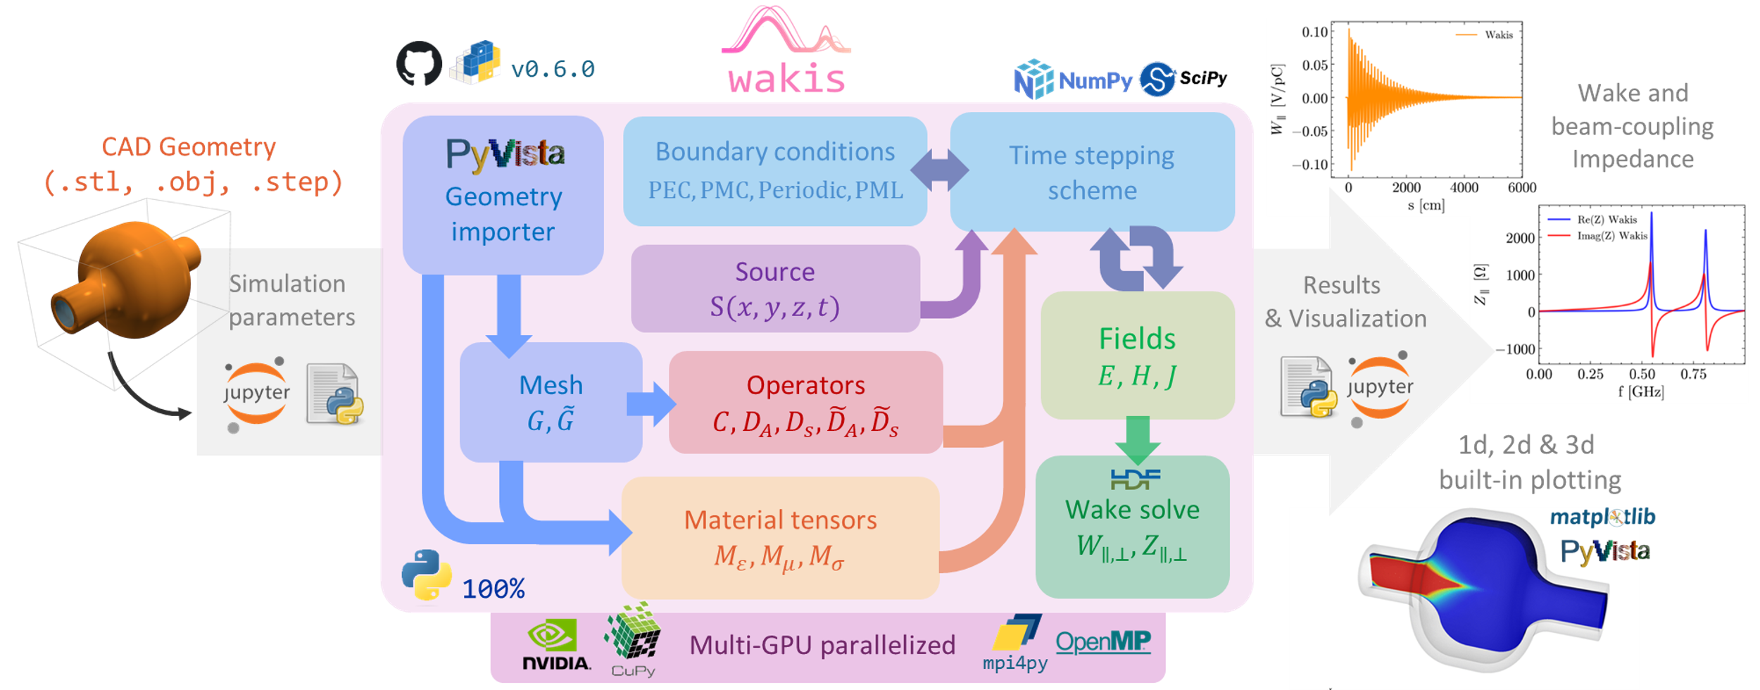
Wakis code overview
Wakis is the 1st open-source time-domain electromagnetic solver tailored for wakefield simulations to compute beam-coupling impedance.
It computes the integral general form of Maxwell’s equations using the Finite Integration Technique (FIT)

Slide 17
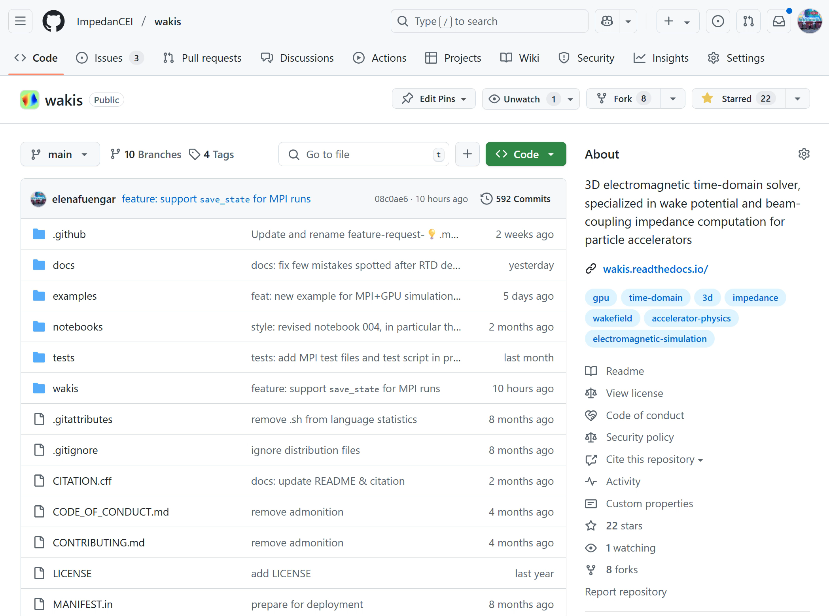
Wakis GitHub repository
Benchmarks against CST studio®
CPU-GPU-MPI
Simulation examples
⏳~2’ to 20’
Nightly tests
CI/CD pipeline
Open source code
Documentation with Sphinx
Complete
impedance workflow playground notebooks
Check the repository
@ImpedanCEI/wakis

Slide 18
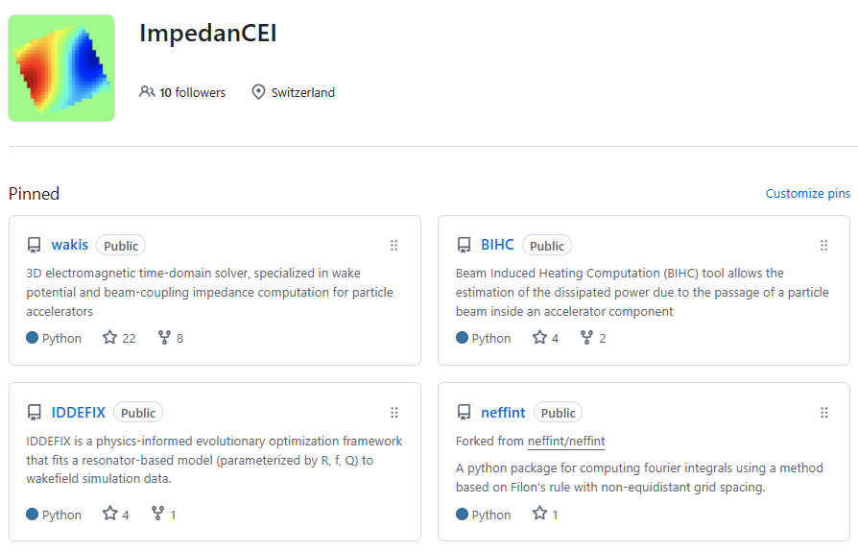
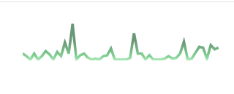




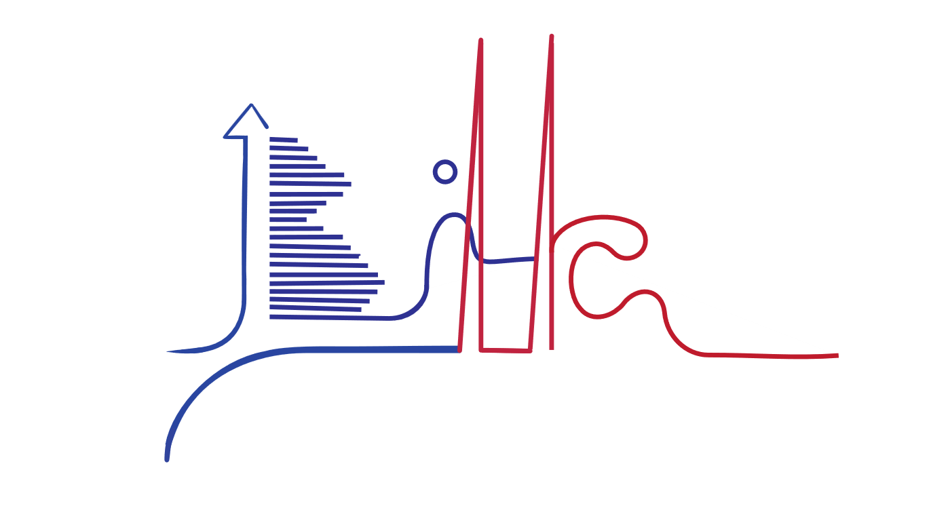


ImpedanCEI code suite
refactor
integrate
reuse
Actively maintained, documented, pip-deployed packages
Modular for flexibility, easy maintenance/development
100% python, PEP8 compliant, CI/CD practices
Encapsulate expertise of legacy codes over the years
w/ L. Sito
🔗slides@CEI
w/ S. Joly
🔗slides@MLCF
🔗slides@CEI by E. Vik

Slide 19
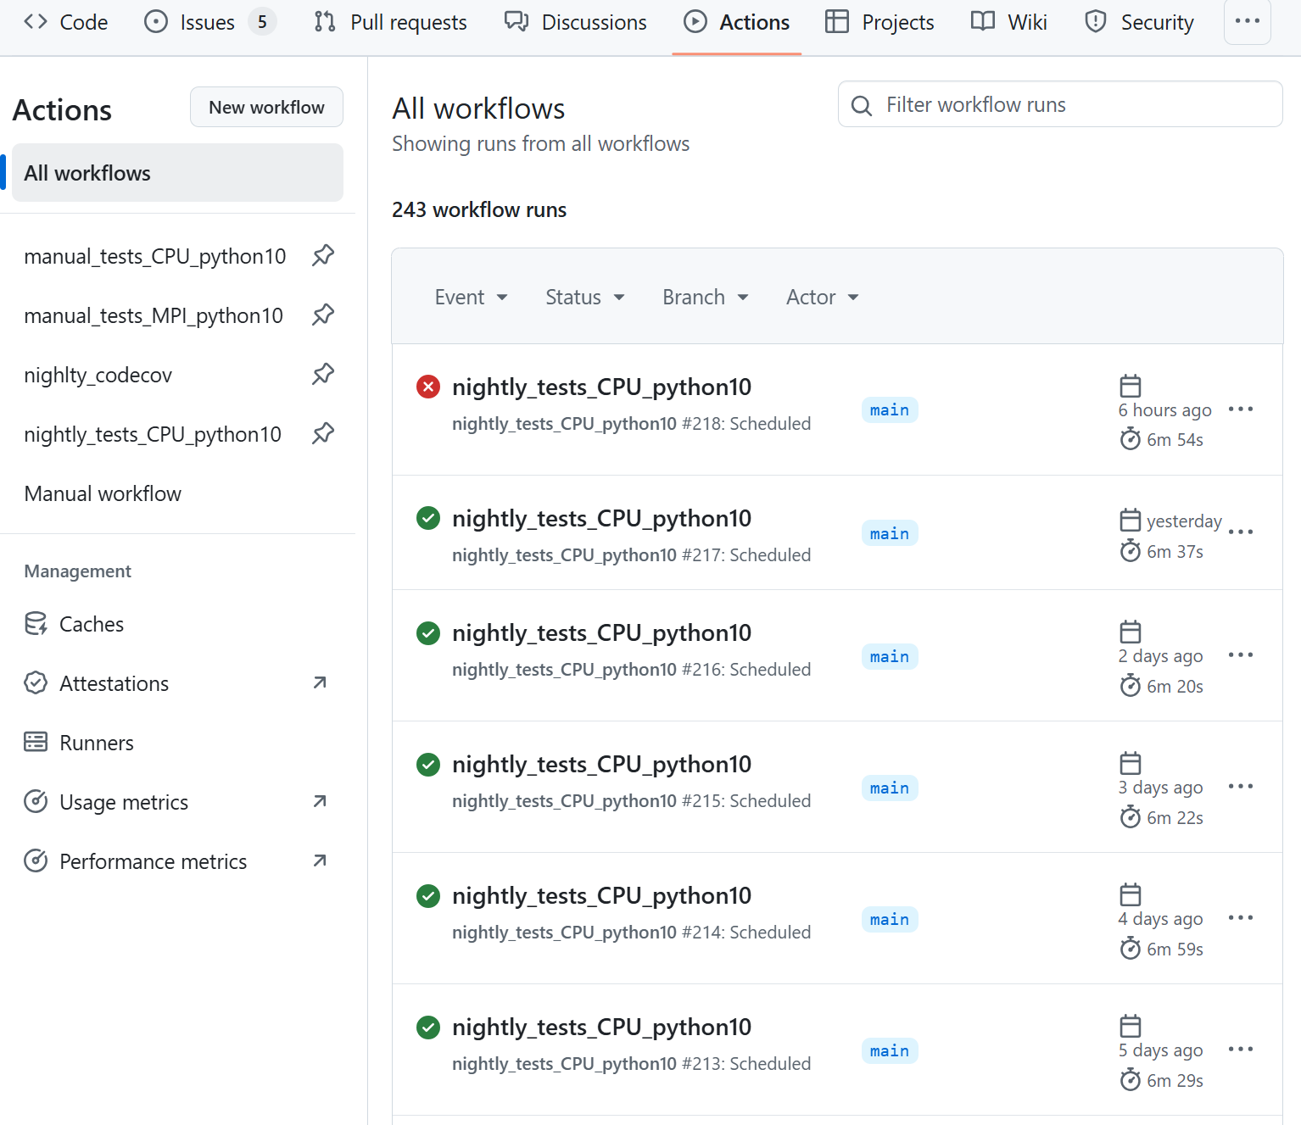
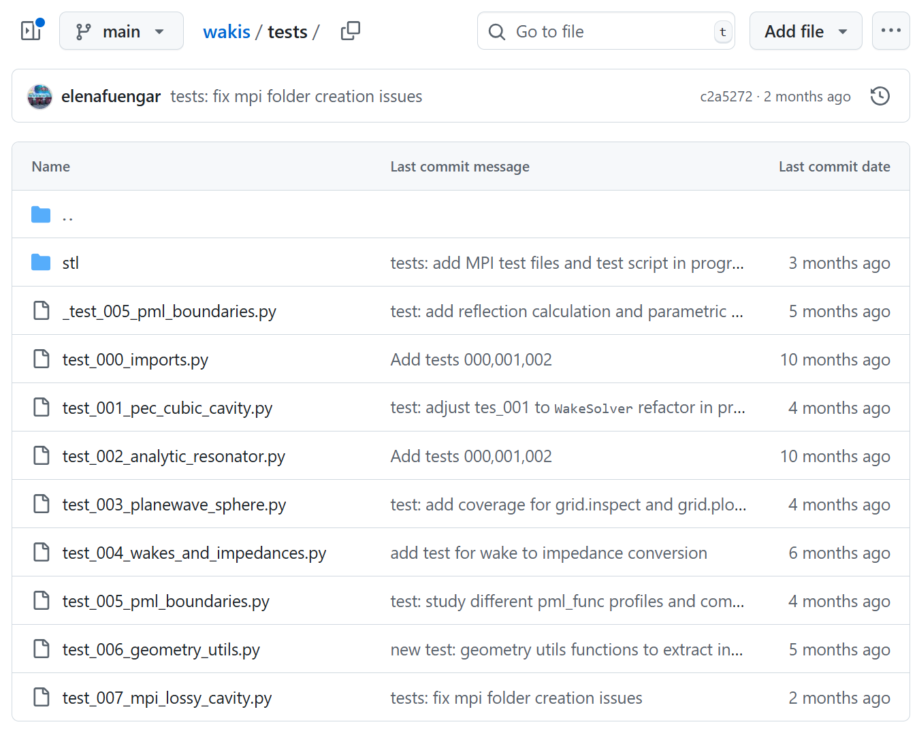
Deployment pipeline in ImpedanCEI
Code development is tracked with GitHub releases
On each release (CI/CD pipeline):
  All the tests are run with GitHub Actions
  Main branch is tagged with a version e.g. #v0.5.1
  Create a summary of features, bugfixes and contributions and changelog
  Deploys a stable version to PyPI
  Updates documentation on ReadTheDocs
  Generates a Zenodo DOI that hosts a snapshot of the code at that stage in a .zip file
The work in progress is tracked in a release draft `release.md`
> pip install wakis

Slide 20



Release example: Wakis #v0.6.0
✨ Automated with Copilot from commit messages
Differentiation between:
Major releases 0.X.0 can include substantial changes in the code and the API (legacy breaking)
Minor releases 0.X.x include small features and bugfixes in the code.
  Usually, the releases solve some GitHub Issue that has been opened by a user

Slide 21

Wakis benchmarks
Ongoing benchmark campaign to improve code robustness @ImpedanCEI/wakis-benchmarks
Wakis comparison with CST simulations, available in the repository
Every challenge is an opportunity to develop!

Slide 22






Results & benchmarking
*presented at
Benchmarking campaign conducted on a lossy Pillbox cavity:
16-core CPU
5h 20’ 11’’
1 Tesla T4 GPU
For different conductivities $σ$
56’ 10’’ x5 faster
Wake potential
Impedance
Above cutoff
Using the PML

Slide 23


Results & benchmarking (II)
*presented at
Benchmarking campaign conducted on a lossy Pillbox cavity:
3D E-field distribution
For low-$β$
beam source
regime

Slide 24



Wakis Documentation
New!
Powered by Sphinx, hosted on ReadTheDocs

Slide 25
Outline
Introduction:
  Beam-coupling impedance simulations
  Finite Integration technique (FIT)
Status:
  The ImpedanCEI code suite & pipeline
  Hands-on time!
Plans:
  User community plans and applications
  Development plans
    + Extra slides on of some of Wakis features:
      CSG, CAD geometry import & snappy mesh (WIP)
      MPI implementation & Multi GPU
      Wake extrapolation w/ IDDEFIX
Hands-on
python notebooks
@ImpedanCEI/
CEI-meeting-hands-on

Slide 26










Wakis user community
The user community is growing by the day:
  Weekly questions / requests of features
  Participation is encouraged through GitHub issues/pull requests
users
Some ongoing projects
Soleil impedance model: Tapers and beampipe
(S. Thakur, A. Gamelin)
CERN FCC: beampipe with absorber
(P. Krotick)
EIC-ESR flanges (Xiaofeng Gu)
Challenges due to PML reflections at high frequency
Helped testing MPI on servers
Need for surface impedance

Slide 27






Users and applications
Collaboration with C. Barbagallo (SY-RF)
Study of the voltage of the muon collider cavities
challenging with CST due to Be windows that forced to use
“Add space open boundaries”
Study of correction of direct space charge from time-domain simulations with low-beta
Beryllium windows
CST
Wakis

Slide 28




Users and applications
Collaboration with E. Lamb (SY-RF)
Study of the modes excited by two counter-rotating beams w/ Wakis
  Completely autonomous user/developer
  Already contributed through pull request
  Implementing Frequency domain monitors: already on Ellenor’s Wakis fork
First results, preliminary

Slide 29


Users and applications
Collaboration with D. Amorim:
Goal: compare 3D EM simulations with model derived from resistive-wall theory by E. Métral
  See his presentation at IMCC annual meeting
Setup:
Cylinder 1 cm radius, 1 m long
X,Y,Z number of mesh cells: 50/50/1000
  Total 2.5 10⁶ mesh cells
PEC background, PML on z axis
(100 cells each side)
Cylinder material
  Vacuum
  Lossy material: ε_{r}=1 / µ_{r}=1 / σ=10⁻³ S/m
  Lossy material with dielectric constant (Lithium Hydride): : ε_{r}=10 / µ_{r}=1 / σ=10⁻¹ S/m

Slide 30





Possible users and applications
Simulation of metamaterials (Leonardo Sito)
Impedance model for FCC-ee
(Dora Gibellieri + Elena Macchia + Jintao Li)
Already using
IDDEFIX
Impedance model for (HL-)LHC (Chiara Antuono + TECH)

Slide 31







Development plans: challenges
Impedance in matter
Simulations with very short bunches
Slowly decaying wakefields
Accurate meshing of geometry
Model & correction of direct space charge impedance
Simulations with
non-ultrarelativistic (low $β)$ beams
Simulation length & stability
Dense meshes > 1000 M cells
Physics models development

Slide 32



Development plans: still a lot to do!
Done
FIT based on numpy & scipy
BCs: PEC, PMC, Periodic, PML
Wake potential and impedance
Anisotropic materials $ε, μ, σ$
CAD geometry import
State of the art 2d, 3d plotting
Automatic testing & CI/CD
EM Sources & beam current with $β$
Parallelized & GPU accelerated
Wakefield extrapolation with EA
To do:
Smart refinement for grid (WIP)
Lossy metal approximation (surface impedance)
Dispersive materials
Improve robustness of PML at high-frequency
Correction of direct space charge for low-$β$ simulations (muCol) (C. Barbagallo)
Short-bunches (FCCee), moving window like ECHO3D?
Impedance in matter (D. Amorim, E. Kvinke)
Ports and field monitors in frequency domain (E. Lamb)
Differentiable simulations & adjoint methods (synergy w/ R. De Maria, A. Lasheen)
Correct for numerical dispersion (longitudinal and transverse) like PBCI
+ maintain and support users of the ecosystem ☺

Slide 33




Conclusions
We’ve come a long way!
19-24th October
Now focus on:
Benchmark & validation, application to limit cases (FCC, MuCol)
Engaging the user/developer community
Continue developing key features: mesh refinement, surface impedance
BE seminar
12th December

Slide 34
Acknowledgements
Code development is a big collaborative team effort:
Thanks to contributors (code or expertise):
Wakis team: Lorenzo Giacomel, Giovanni Iadarola, Carlo Zannini, Manuel Cotelo
Iddefix team: Malthe Raschke Nielsen, Sébastien Joly, Bernardo Figueiredo
BIHC team: Leonardo Sito, Francesco Giordano, Jintao Li, Benoit Salvant, Carlo Zannini
Neffint team: Eskil Vik, Nicolas Mounet
+ extended thanks to:
Giovanni Rumolo, Chiara Antuono, Elena Macchia, Szymon Lopaziuck (CERN),
Jean Luc Vay, Weiqun Zhang (LBNL), Erion Gjonaj (TU-Darmstadt)
& Eduardo Oliva (UPM)
for the very useful discussions

Slide 35
Thank you for the attention ☺
Elena de la Fuente García
elena.de.la.fuente.garcia@cern.ch

Slide 36


Bibliography sources
S. Joly, ”Resonator impedance extrapolation of a partially decayed wake” presentation @ CERN ABP-CEI section meeting link
S. Joly,”Recent advances in the CERN PS impedance model and instability simulations following the LHC Injectors Upgrade project” PhD Thesis, Sapienza Universita di Roma, link
M. Raschke, ”Evolutionary Algorithms for Wakefields” @ CERN ABP-CEI section meeting link
N. Mounet, “The LHC Transverse Coupled-Bunch Instability” PhD Thesis EPFL, link
IDDEFIX
T. Weiland and R. Wanzenberg, “Wake fields and impedances,” Lect. Notes Phys., vol. 400, pp. 39–79, 1992, doi: 10.1007/3-540-55250-2_26
I. Zagorodnov and T. Weiland, “TE/TM field solver for particle beam simulations without numerical Cherenkov radiation,” Phys. Rev. ST Accel. Beams, vol. 8, p. 042001, 2005, doi: 10.1103/PhysRevSTAB.8.042001
M. C. Balk, R. Schuhmann, and T. Weiland, “Open boundaries for particle beams within fit-simulations,” Nuclear Instruments and Methods in Physics Research, vol. 558, no. 1, pp. 54–57, 2006, doi: https://doi.org/10.1016/j.nima.2005.11.076.
K. Klopfer, “Computation of Complex Eigenmodes for Resonators Filled With Gyrotropic Materials,” PhD thesis, Technische Universität Darmstadt, Darmstadt, 2014. [Online]. Available: http://tuprints.ulb.tu-darmstadt.de/4210/
J. A. Moreno, E. Oliva, and P. Velarde, “EMcLAW: An unsplit Godunov method for Maxwell ’s equations including polarization, metals, divergence control and AMR,” Computer Physics Communications, vol. 260, p. e107268, Mar. 2021, doi: 10.1016/j.cpc.2020.107268.
U. Niedermayer, “Determination of Beam Coupling Impedance in the Frequency Domain,” PhD thesis, Technische Universität Darmstadt, Darmstadt, 2016. [Online]. Available: http://tuprints.ulb.tu-darmstadt.de/5157/

Slide 37
Outline
Introduction:
  Beam-coupling impedance simulations
  Finite Integration technique (FIT)
Status:
  The ImpedanCEI code suite & pipeline
  Hands-on time!
Plans:
  User community plans
  Development plans
    + Extra slides on of some of Wakis features:
      CSG, CAD geometry import & snappy mesh (WIP)
      MPI implementation & Multi GPU
      Open boundaries: PML
      Wake extrapolation w/ IDDEFIX
Hands-on
python notebooks
@ImpedanCEI/
CEI-meeting-hands-on

Slide 38





CAD geometry import w/
Read CAD geometry and bounds:
geometry = pv.read(CAD_file)
domain_bounds = geometry.bounds
Using capabilities, wakis can:
Assign material properties to each cell inside solid
Find the domain cells inside each CAD solids with optimized collision filters
Generate the domain grid from numpy.meshgrid
grid = pv.StructuredGrid(X, Y, Z)
SotA interactive plotting in ipython/ipynb

Slide 39


Towards smart meshing (work in progress)
Mesh refinement strategy adopted by OpenFoam & Ansys:
  Find STL surface edge features geometry.extract_feature_edges()
  Project points to XZ, YZ, XY planes to get snap points
  Refine mesh around snap points using an optimizer:
  Penalties: small cell sizes, abrupt changes, spread
Example:
LHC unshielded bellows
Snap points in XY plane
Snap points in XZ plane
Small cell sizes decrease max. stable timestep
(CFL)

Slide 40
Outline
Introduction:
  Beam-coupling impedance simulations
  Finite Integration technique (FIT)
Status:
  The ImpedanCEI code suite & pipeline
  Hands-on time!
Plans:
  User community plans and applications
  Development plans
    + Extra slides on of some of Wakis features:
      CSG, CAD geometry import & snappy mesh (WIP)
      MPI implementation & Multi GPU
      Wake extrapolation w/ IDDEFIX
Hands-on
python notebooks
@ImpedanCEI/
CEI-meeting-hands-on

Slide 41

MPI implementation
The major feature in the #v0.6.0 release will be the possibility to run parallel simulations using several cores, leveraging CERN resources like
the Openstack impedance machines and the HTCondor cluster
This is handled through MPI: Message Passing Interface protocols

Slide 42




MPI: How does it work?
Any computer with an OpenMPI installation can run parallel jobs:
> python myscript.py
> mpiexec –n 3 python myscript.py
Single core
Core 0
Core 1
Core 2

Slide 43





MPI: How does it work?
However, to properly optimize the resources, each core should compute 1 slice of the domain:
mpi4py
> python myscript.py
> mpiexec –n 4 python myscript.py
Single core
Core 0
Core 1
Core 2
Core 3

Slide 44



MPI implementation in Wakis
mpi4py
Using mpi4py, we can tell each core what to do separately:
GridFIT3D splits the domain in slices among z-dir and imports the geometry to each slice
SolverFIT3D computes the material tensors and Curl matrices for each slice: ${ {\tilde{D}}_{s}M_{μ}^{−1}D}_{A}^{−1}C$, $D_{s}{\tilde{M}}_{ε}^{−1}{\tilde{D}}_{A}^{−1}\tilde{C},{\tilde{M}}_{σ}^{ }$
Time-stepping routine* needs the information of the other slices → need to sync the fields
  Need to communicate each slice efficiently:
    Minimum memory share: send only boundary info
    Minimum operations
  mpi4py.MPI.Comm.SendRecv paired Sync and Recv in 1 sync and avoids deadlocks + is CUDA-aware
* Time-stepping routine solves:
$$h^{n+1}=h^{n}−Δt{ {\tilde{D}}_{s}M_{μ}^{−1}D}_{A}^{−1}Ce^{n+0.5}$$
$$e^{n+1.5}=e^{n+0.5}+ΔtD_{s}{\tilde{M}}_{ε}^{−1}{\tilde{D}}_{A}^{−1}\tilde{C}h^{n}$$
$−{\tilde{M}}_{ε}^{−1}j_{beam}^{n}−{\tilde{M}}_{ε}^{−1}$ ${\tilde{M}}_{σ}^{ }$ $e^{n+0.5}$

Slide 45



MPI implementation in Wakis
No need for duplicate classes! See commits #543-#576
mpi4py
* Time-stepping routine solves:
$$h^{n+1}=h^{n}−Δt{ {\tilde{D}}_{s}D_{μ}^{−1}D}_{A}^{−1}Ce^{n+0.5}$$
$$e^{n+1.5}=e^{n+0.5}+ΔtD_{s}{\tilde{D}}_{ε}^{−1}{\tilde{D}}_{A}^{−1}\tilde{C}h^{n}$$
$−{\tilde{D}}_{ε}^{−1}j_{beam}^{n}−{\tilde{D}}_{ε}^{−1}$ ${\tilde{D}}_{σ}^{ }$ $e^{n+0.5}$

Slide 46


MPI implementation in Wakis
To make everything work, we need to add some overlap between slices, we do that through Ghost cells
Without ghost cell overlap (ghost_cell =0)
With ghost cell overlap (ghost_cell =1)
Many thanks to Manuel Cotelo for his help ☺

Slide 47


MPI implementation in Wakis
To make everything work, we need to add some overlap between slices, we do that through Ghost cells
Without ghost cell overlap (ghost_cell =0)
With ghost cell overlap (ghost_cell =1)
Many thanks to Manuel Cotelo for his help ☺

Slide 48

CUDA-aware MPI

Slide 49
Outline
Introduction:
  Beam-coupling impedance simulations
  Finite Integration technique (FIT)
Status:
  The ImpedanCEI code suite & pipeline
  Hands-on time!
Plans:
  User community plans and applications
  Development plans
    + Extra slides on of some of Wakis features:
      CSG, CAD geometry import & snappy mesh (WIP)
      MPI implementation & Multi GPU
      Wake extrapolation w/ IDDEFIX
Hands-on
python notebooks
@ImpedanCEI/
CEI-meeting-hands-on

Slide 50
Impedance assessment challenges
Impedance in matter
Simulations with very short bunches
Slowly decaying wakefields
Accurate meshing of geometry
Model & correction of direct space charge impedance
Simulations with
non-ultrarelativistic (low $β)$ beams
Simulation length & stability
Dense meshes > 1000 M cells
Physics models development

Slide 51

Wakis+IDDEFIX simulation workflow
Acc. Device’s beam-induced power loss
Table of resonator parameters
$${\{R}_{s,n},Q_{n},f_{r,n}\}$$
Acc. Device under study
Partially decayed wakefield simulation
(e.g. -30dB)
Resonator fitting with IDDEFIX
Fully decayed, analytically represented impedance & wake
Acc. Impedance model
pyWIT
Verification with longer simulation (-60dB) if needed
Beam dynamic simulations
xwakes

Slide 52






IDDEFIX partially decayed resonator formalism
Derivation of the resonator formalism for partially decayed wakefield simulations by S. Joly, N. Mounet and N. Shipman
Longitudinal
$$Z_{∥,p.d.}\left(ω, R_{s}, Q, ω_{r}, T\right)=\frac{A_{∥}\left(1−e^{−\left(B−i\left(C−ω\right)\right)T}\right)}{B−i(C−ω)},$$
  $$where A_{∥}=\frac{R_{s}ω}{2Q}, B=\frac{ω_{r}}{2Q}, C=ω_{r}\sqrt{1−\frac{1}{4Q^{2}}}, T=\frac{s}{c}$$
Transverse
  $$Z_{⊥,p.d.}\left(ω, R_{s}, Q, ω_{r}, T\right)==\frac{iA_{⊥}C}{C^{2}+{\left(B+jω\right)}^{2}}\left[1−e^{−T\left(B+jω\right)}\left(\cos{CT}+\frac{B+jω}{C}\sin{CT}\right)\right]$$
  $$where A_{⊥}=\frac{R_{s}ω_{r}}{Q\sqrt{1−\frac{1}{4Q^{2}}}}, T=\frac{s}{c}$$
Parameter T: Accounts for truncated wakelength
here $ω=2πf$

Slide 53






IDDEFIX working principle:
Fitting the resonator formalism for partially decayed $Z_{∥,p.d.}^{mode}$, $W_{∥,p.d.}^{mode}$ wakefield simulations derived by S. Joly, N. Mounet and N. Shipman (equations in backup)
${\{R}_{s},Q,f_{r}$} $×2$
Minimize SSE:
$$\sum{\left\{{\left[Re\left(Z_{∥,p.d,}^{True}\right)−Re\left(Z_{∥,p.d.}^{x_{i}}\right)\right]}^{2}+{\left[Im\left(Z_{∥,p.d.}^{True}\right)−Im\left(Z_{∥,p.d.}^{x_{i}}\right)\right]}^{2}\right\}}$$
Partially decayed impedance with 2 resonators
Courtesy of
M. Raschke @ABP-CEI
Assess
fitting SSE error
*Evolutionary algorithm used in IDDEFIX
*CMA-ES also available thanks to B. Figueiredo
Obtain the fully-decayed resonator parameters ($R_{s,1},Q_{1},f_{r,1}, R_{s,2},Q_{2},f_{r,2}$), from a partially decayed impedance

Slide 54



IDDEFIX in action: user cases
Courtesy of Jintao Li
Courtesy of Leonardo Sito
@WUM#2 - 2nd April
BPMs impedance & wake reconstruction by fitting most relevant modes up to 35 GHz
Study of metamaterial insertions in cavities
Fully decayed wake computationally inaccessible (and unstable), made possible with IDDEFIX

Slide 55




Impact on impedance assessment
Represent each component’s
impedance analytically
by $Σ$($R_{s}, Q, f_{res}$, …)
Analytic wake function
from $Σ$($R_{s}, Q, f_{res}$, …)
*
*
*
*
Individual resonator ($R_{i}, Q_{i}, f_{i}$) contribution to beam-induced $P_{loss}$
/
$P_{loss}$ map
Drastically cut simulation time for slowly decaying wakes
* Python packages developed in ABP

