Slide 1
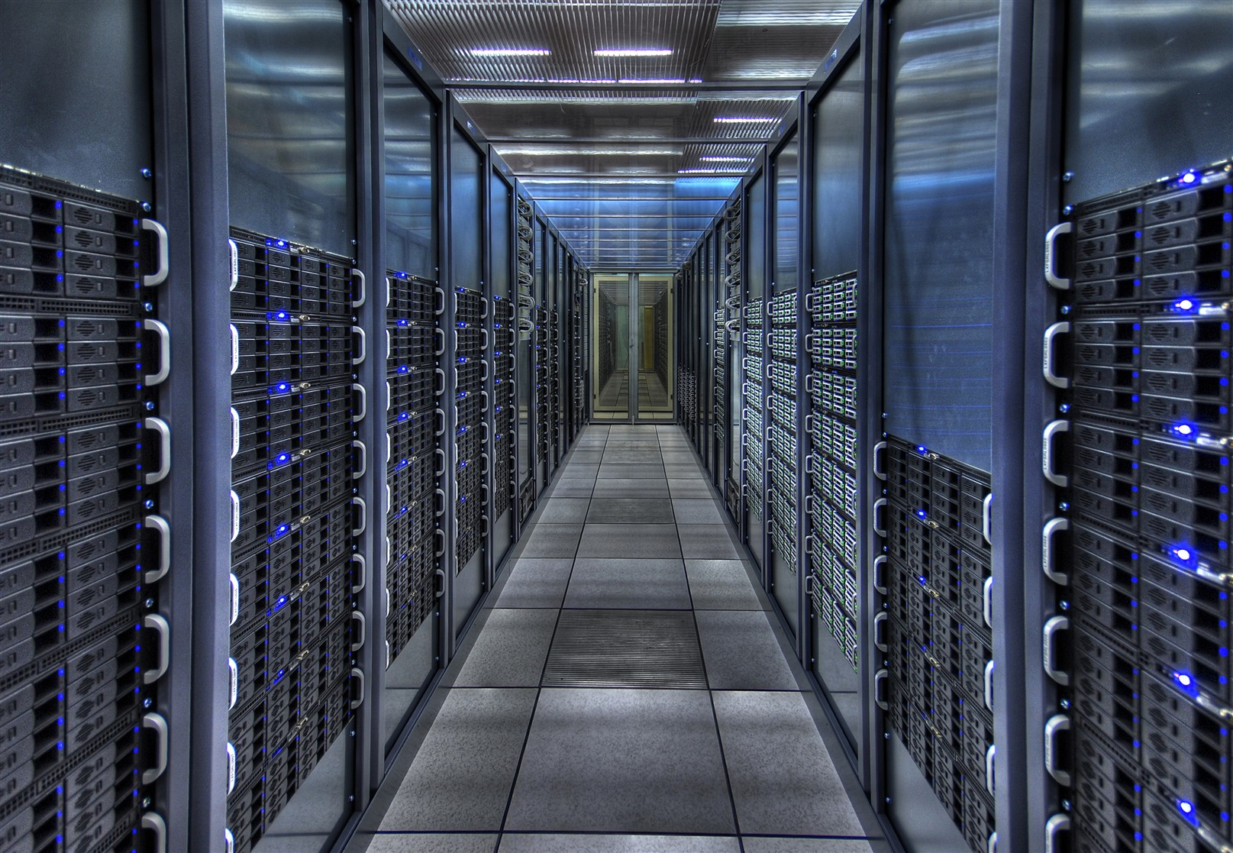
HELP!
I have DataCenter Nightmares
Dr. Stefan.Lueders@cern.ch
CERN Computer Security Office
https://cern.ch/security
Openlab SUMM, 2025/7/4
Notes:
Timing 30‘

Slide 2
The Two Mantras of Cyber-Security
“Defense in Depth”: Protective means must be deployed at every level of the hardware & software stack, e.g.
    Agile & timely updating + vulnerability management, secure & professional S/W development + SBOM, tested business continuity & disaster recovery plans, logging & IDS, access control + 2FA, …
    Network segregation & compartmentalization, firewalls + email quarantines, data diodes, bastion hosts, gateways & proxies, …
“KISS --- Keep It Simple, Stupid”: Avoid over-complication, too much complexity &
too many deviations from or exceptions to the “standard”.
Disclaimer:
I will not discuss best-practices of this Defense-in-Depth,
let’s just concentrate on a DataCenter architecture.
Notes:
2

Slide 3
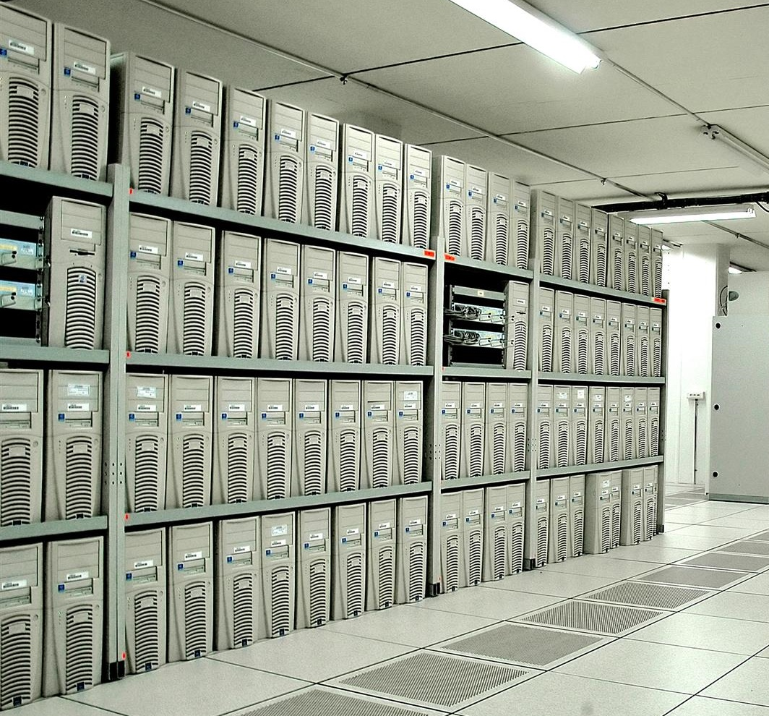
A DataCentre Stack from the Past: PC Farms
An
interactive/user application
O/S
H/W
Notes:
3

Slide 4
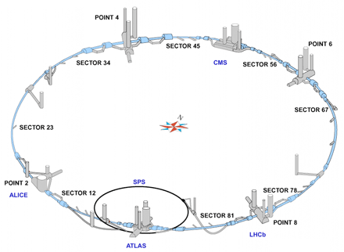
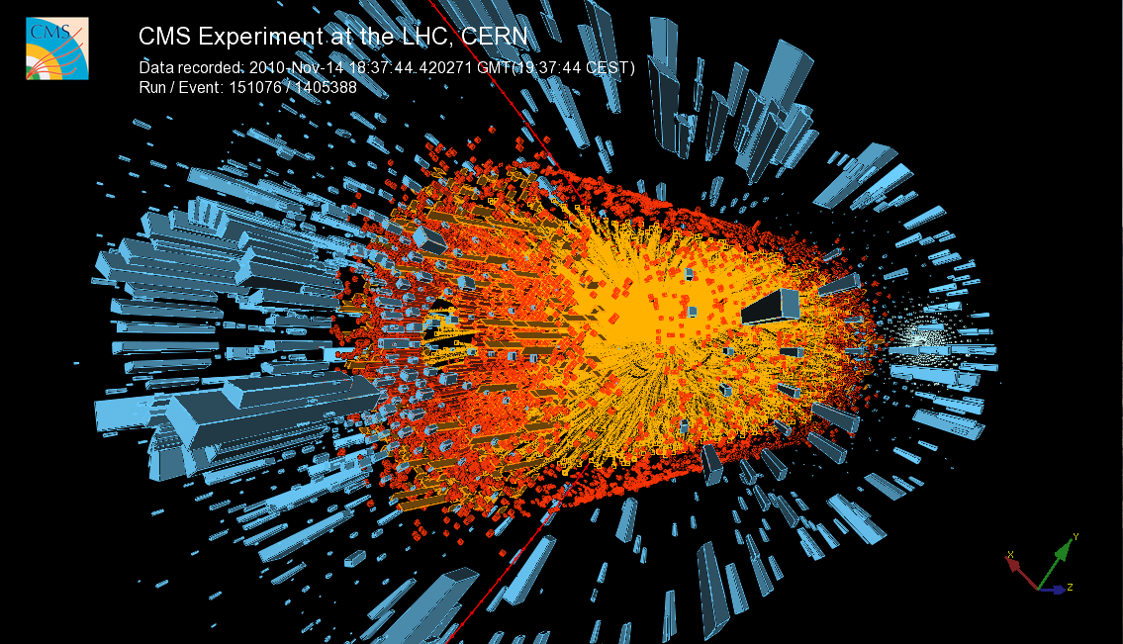
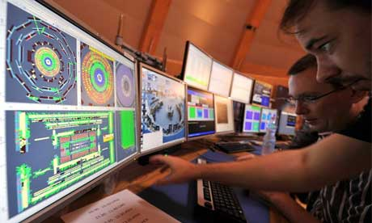
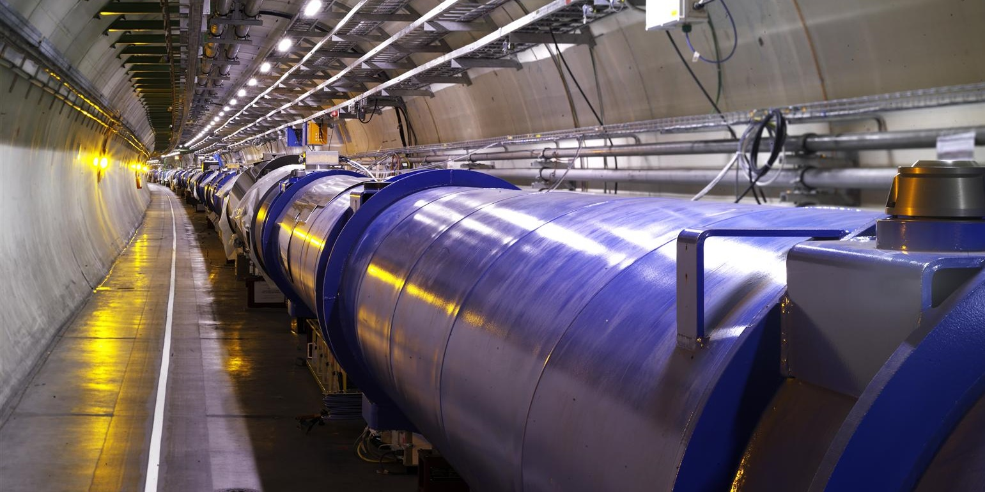
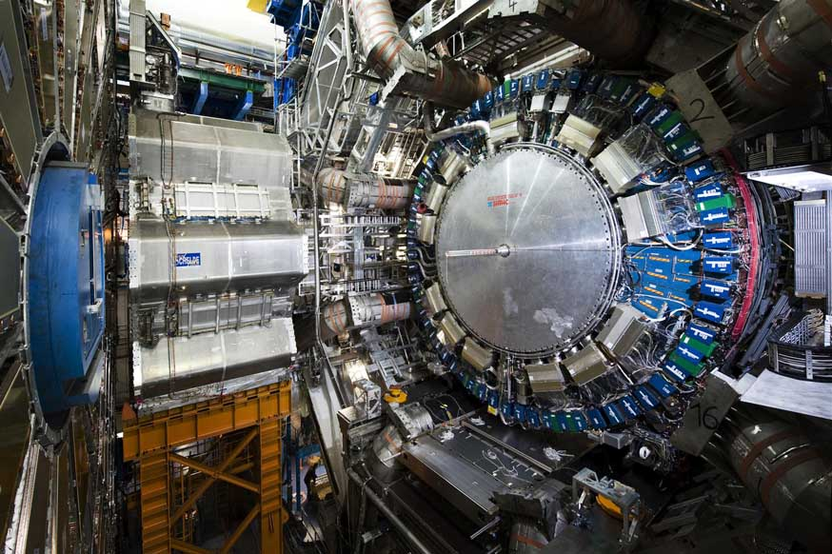
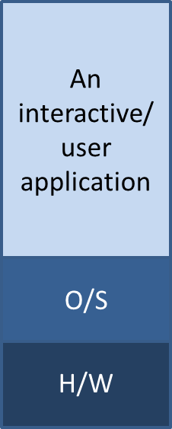
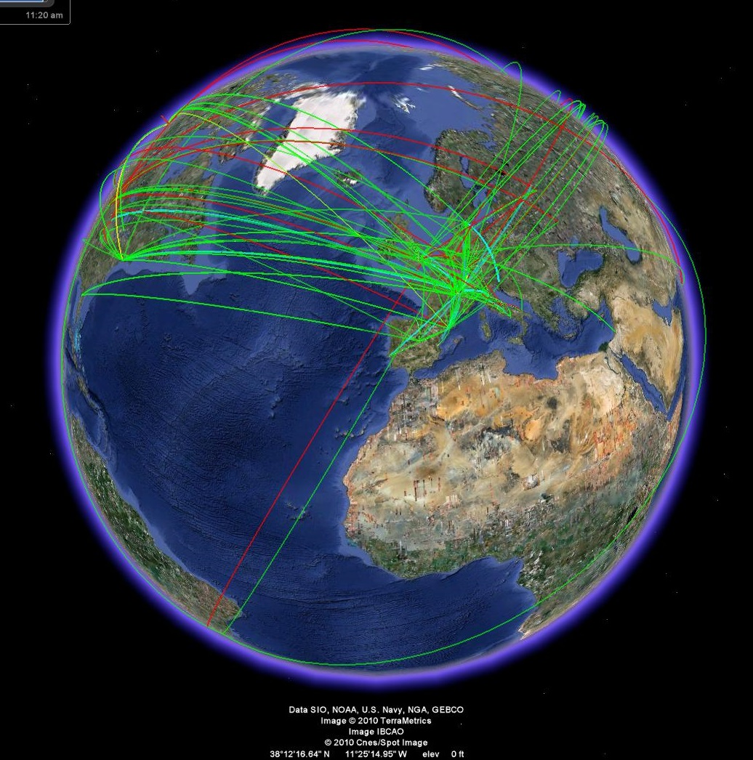
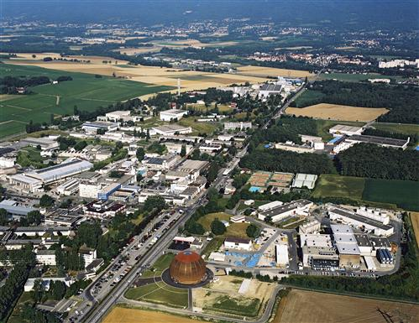
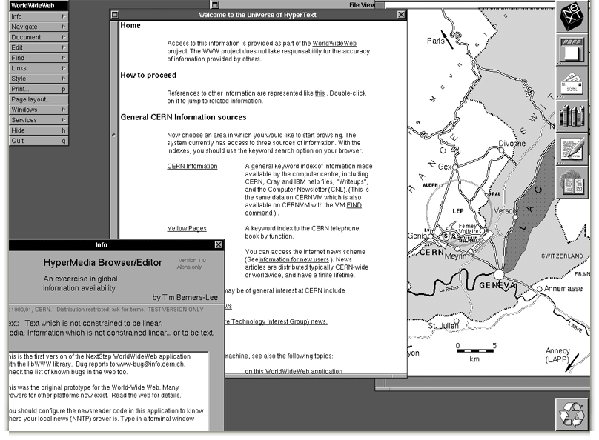
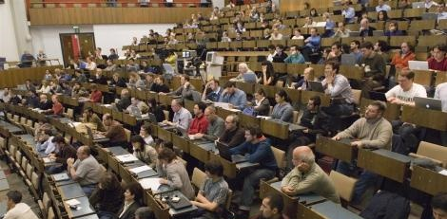

Slide 5
Thank you very much!

Slide 6
The Two Three Mantras of Cyber-Security
“Defense in Depth”: Protective means must be deployed at every level of the hardware & software stack, e.g.
    Agile & timely updating + vulnerability management, secure & professional S/W development + SBOM, tested business continuity & disaster recovery plans, logging & IDS, access control, …
    Network segregation & compartmentalization, firewalls + email quarantines, data diodes, bastion hosts, gateways & proxies, …
“KISS --- Keep it simple, stupid”: Avoid over-complication, too much complexity &
too many deviations from or exceptions to the “standard”. Unfortunately, it is the complexity of today’s IT infrastructures which makes security a nightmare.
“Convenient, cheap, secure − Pick two”:
No wonder that “security” looses as it brings no immediate benefits
“Defense in Depth”: Protective means must be deployed at every level of the hardware & software stack, e.g.
    Agile & timely updating + vulnerability management, secure & professional S/W development + SBOM, tested business continuity & disaster recovery plans, logging & IDS, access control, …
    Network segregation & compartmentalization, firewalls + email quarantines, data diodes, bastion hosts, gateways & proxies, …
“KISS --- Keep it simple, stupid”: Avoid over-complication, too much complexity &
too many deviations from or exceptions to the “standard”.
.
Notes:
6

Slide 7
Bye-Bye KISS: Today’s Shitty Convenience Stack
Another interactive/ user application
Yet another application
One more application
Other apps
Agile & elastic
Business continuity/
disaster recovery (BC/DR)
Big Data/ML/LLM/ChatGPT
Public/hybrid/private clouds
GPUs/Quantum computing
Container
More containers
VM
(incl. O/S)
More VMs
Hypervisor
More hardware (IPMI/BMC)
Notes:
7

Slide 8
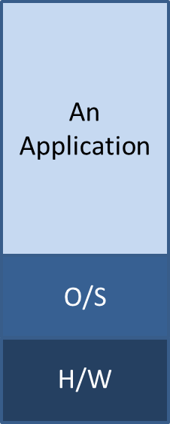
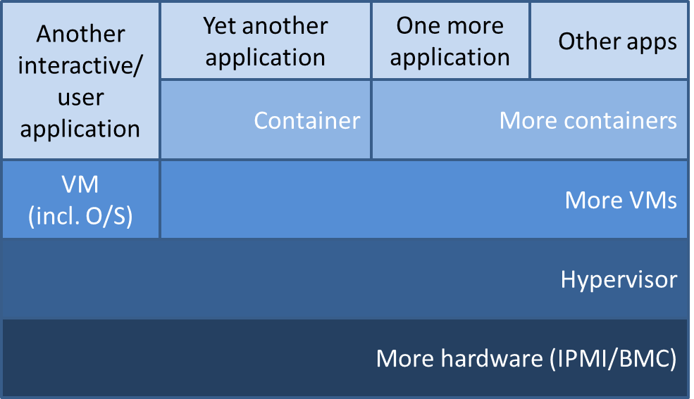

Slide 9
Let’s cable up our stack!
…
…
…
App
…
Container
…
VM
Hypervisor
Hardware (IPMI/BMC)
Management
Provisioning
OT
Industrial
Intranet
Notes:
9

Slide 10
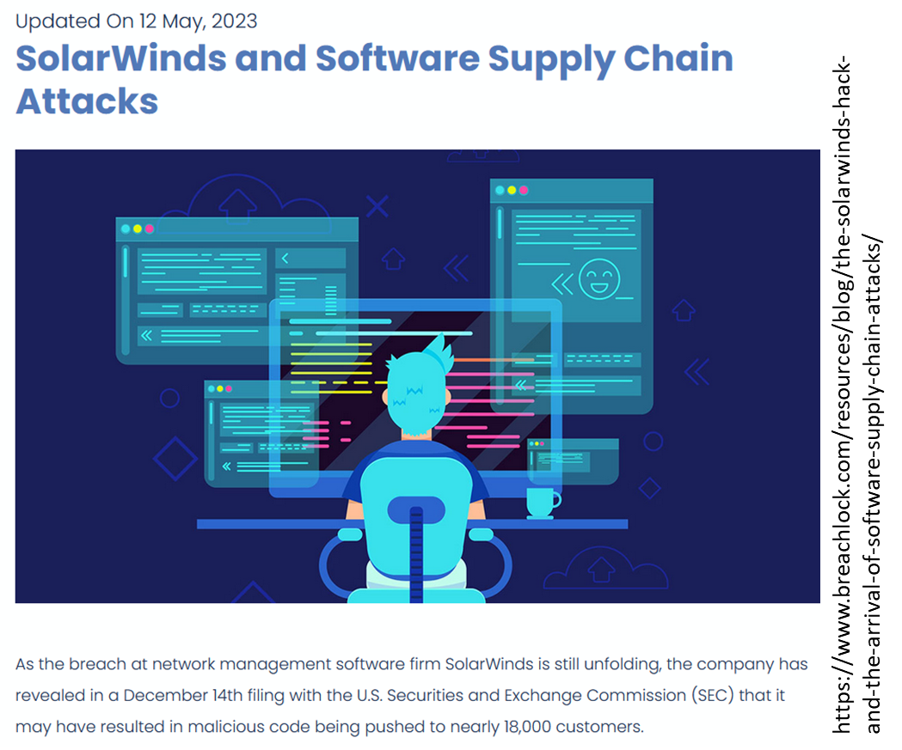

Complication (1): Common Network Infrastructre
VLANs, SDNs
(Mantra #3)
Alternatives:
Fully separated router/switch infrastructure
…
…
…
App
…
Container
…
VM
Hypervisor
Common central network services
Alternative: Duplication, but this requires Primary/Replica synchronization
DNS, {S|D}HCP, NTP, …
Hardware (IPMI/BMC)
Management
Provisioning
OT
Industrial
Intranet
Notes:
10

Slide 11

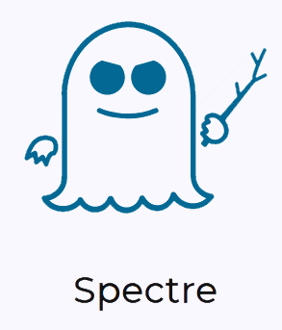


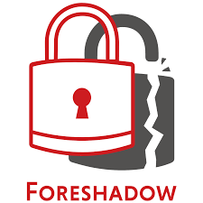
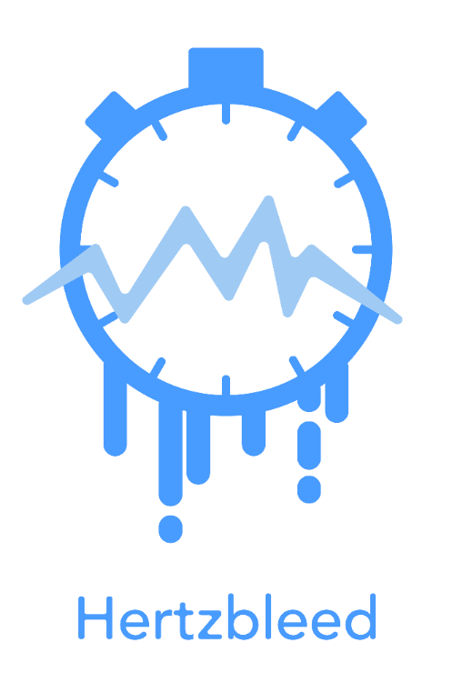
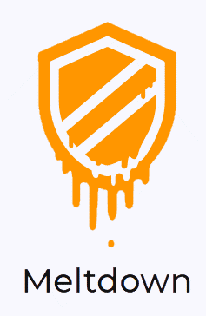
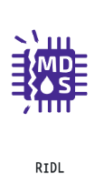
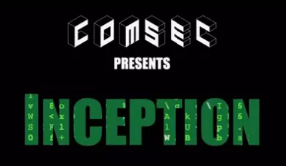
Complication (2): Common Bare-Metal
Mantra #3: Containerization allows hosting completely
different services
Alternatives:
Separate stacks
…
…
…
App
…
Container
…
VM
2019
2023
Mantra #3: Hypervisor
allows hosting completely different services
Alternative:
Separate stacks
Hypervisor
DNS, {S|D}HCP, NTP, …
Hardware (IPMI/BMC)
2017/18
2022
Management
Provisioning
OT
Industrial
Intranet
Notes:
11

Slide 12
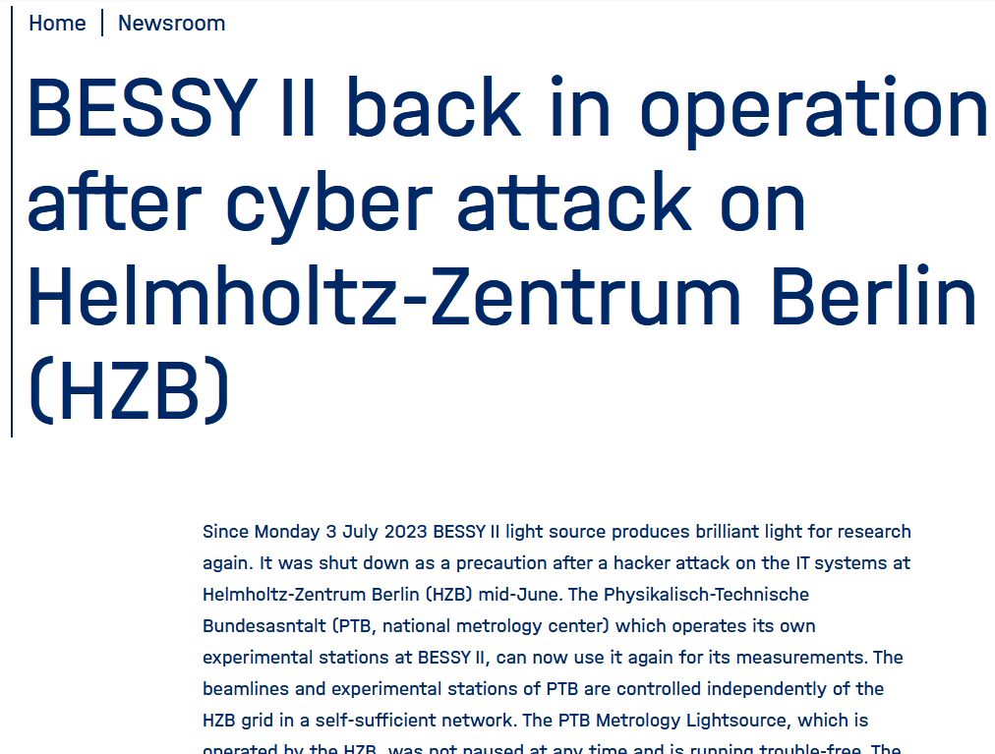

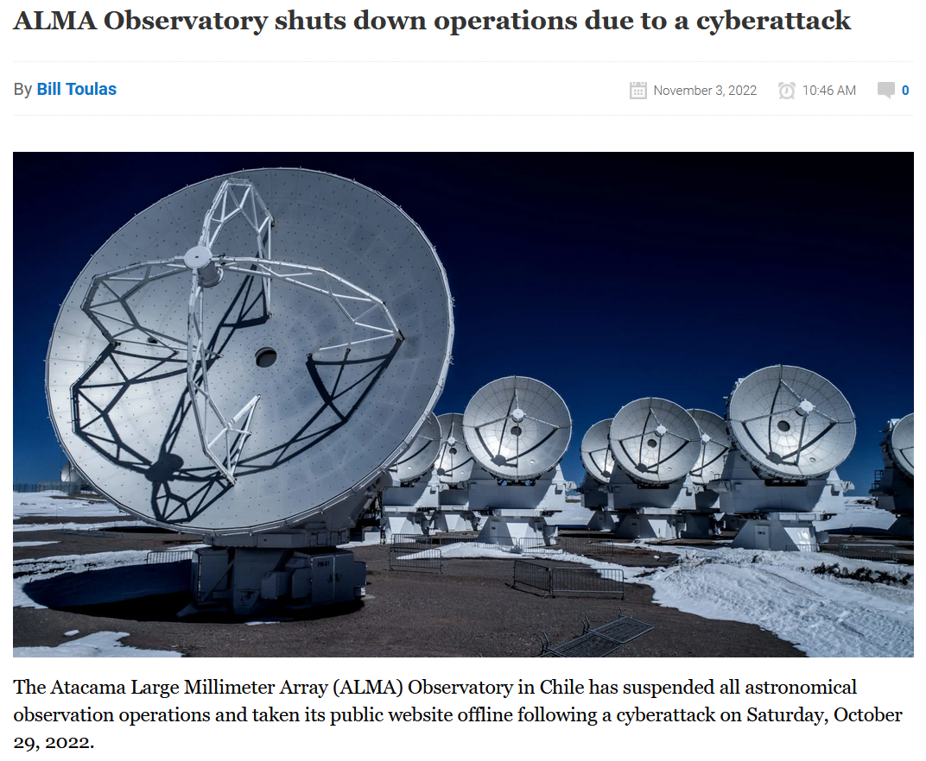
Complication (3): Multi-Network Exposure
Might need to expose service(s) (also) to Internet
…hoping the outer perimeter firewall / WAF does its job
…
…
…
App
…
Container
…
VM
Might need to provide service(s) to OT/Industrial network and Intranet
Alternative:
Data Diodes
Hypervisor
DNS, {S|D}HCP, NTP, …
Hardware (IPMI/BMC)
Management
Provisioning
OT
Industrial
Intranet
Internet
Notes:
12

Slide 13
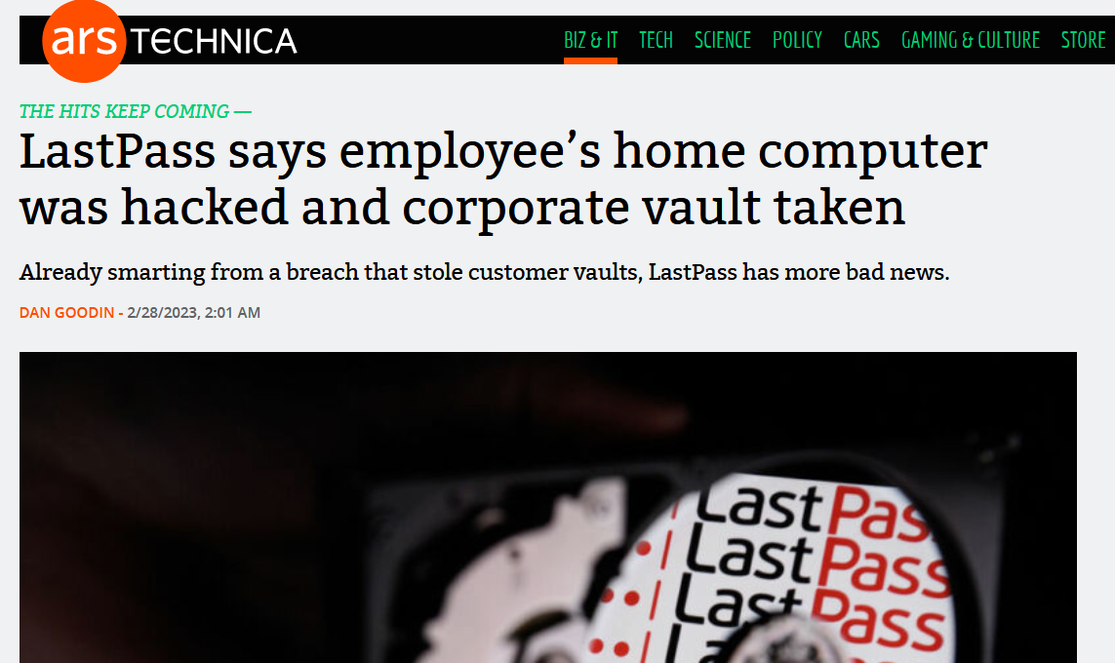
Complication (4): Administration & Administrators
Administrators are lazy agile/flexible
…
…
…
App
…
Container
(2-factor) AuthN
& AuthZ
to the rescue?
…
VM
SSO
LDAP/AD
Hypervisor
Admin Console
DNS, {S|D}HCP, NTP, …
Hardware (IPMI/BMC)
Admin Console
For convenience
(Mantra #3)
Management
Provisioning
OT
Industrial
Intranet
Internet
Notes:
13

Slide 14
Complication (5): Monitoring
…
…
…
App
…
Container
Monitoring needs ICMP “ping”…
…
VM
SSO
LDAP/AD
Monitoring
Hypervisor
Admin Console
DNS, {S|D}HCP, NTP, …
Hardware (IPMI/BMC)
Admin Console
Management
Provisioning
OT
Industrial
Intranet
Internet
Notes:
14

Slide 15
Complication (6): Provisioning
…
…
…
App
Docker
Kubernetes
Storage, DBs, …
Did we get all dependencies?
…as this can impact BC/DR plans…
…
Container
Puppet
Ansible
…
VM
SSO
LDAP/AD
Monitoring
Hypervisor
Admin Console
DNS, {S|D}HCP, NTP, …
Hardware (IPMI/BMC)
Admin Console
Management
Provisioning
OT
Industrial
Intranet
Internet
Notes:
15

Slide 16
Complication (7): Recursive (Self-)Hosting
A too big DMZ:
AuthZ & AuthN,
SSO, home folders,
DBs-on-demand, …
…might be employed by users for their own purposes, too
…
…
…
App
Docker
Kubernetes
Storage, DBs, …
…
Container
Puppet
Ansible
…
VM
SSO
LDAP/AD
Monitoring
All these service(s) shall run on the same DataCenter stack (bare-metal,
VM or container)…
But: Dependency loops can spoil
a DataCenter
cold start
Hypervisor
Admin Console
DNS, {S|D}HCP, NTP, …
Hardware (IPMI/BMC)
Admin Console
Management
Provisioning
OT
Industrial
Intranet
Internet
DMZ
Notes:
16

Slide 17
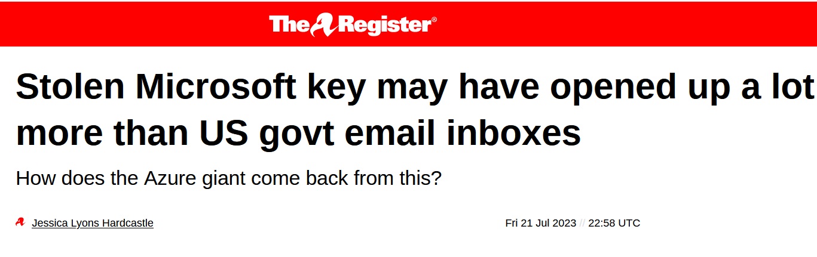
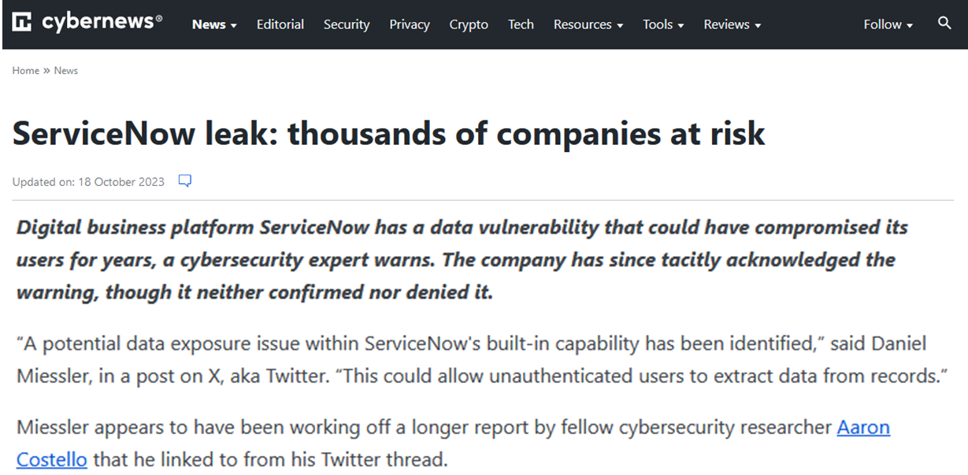
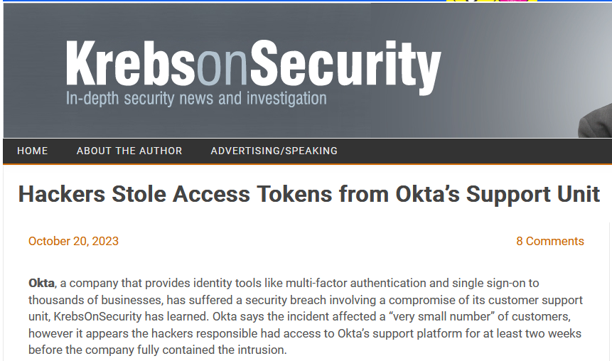
Complication (8): Clouds (Why, oh, why?)
…
…
…
App
Docker
Kubernetes
Storage, DBs, …
AWS
Azure
Google
Oracle CI
…
Container
Puppet
Ansible
…
VM
SSO
LDAP/AD
Monitoring
Hypervisor
Admin Console
How to funnel thru external cloud services?
IP-based filtering reaches its limits...
DNS, {S|D}HCP, NTP, …
Hardware (IPMI/BMC)
Admin Console
Management
Provisioning
OT
Industrial
Intranet
Internet
DMZ
Notes:
17

Slide 18
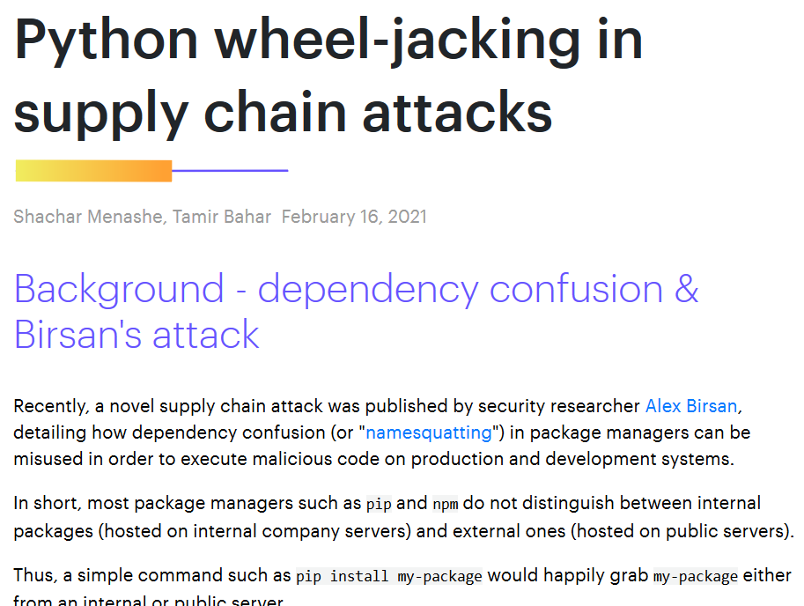
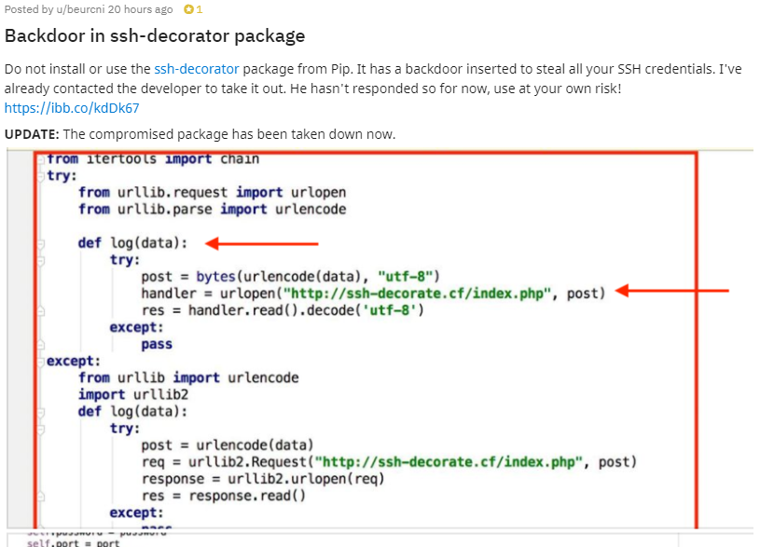
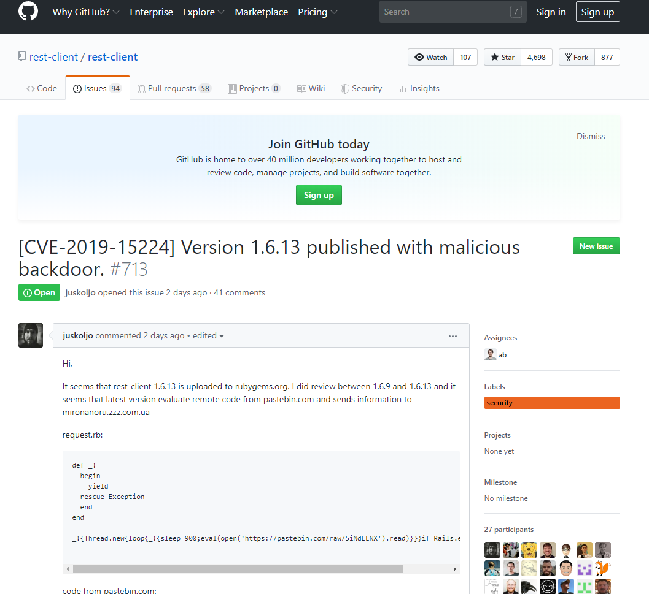
Complication (9): External Software
…
…
…
App
Docker
Kubernetes
Storage, DBs, …
AWS
Azure
Google
Oracle CI
…
Container
Puppet
Ansible
…
VM
SSO
LDAP/AD
Monitoring
DockerIO
Git(hub)
npm
PyPI
Hypervisor
Admin Console
DNS, {S|D}HCP, NTP, …
Hardware (IPMI/BMC)
Admin Console
How to securely import external VMs, packages & libraries?
Management
Provisioning
OT
Industrial
Intranet
Internet
DMZ
Notes:
18

Slide 19
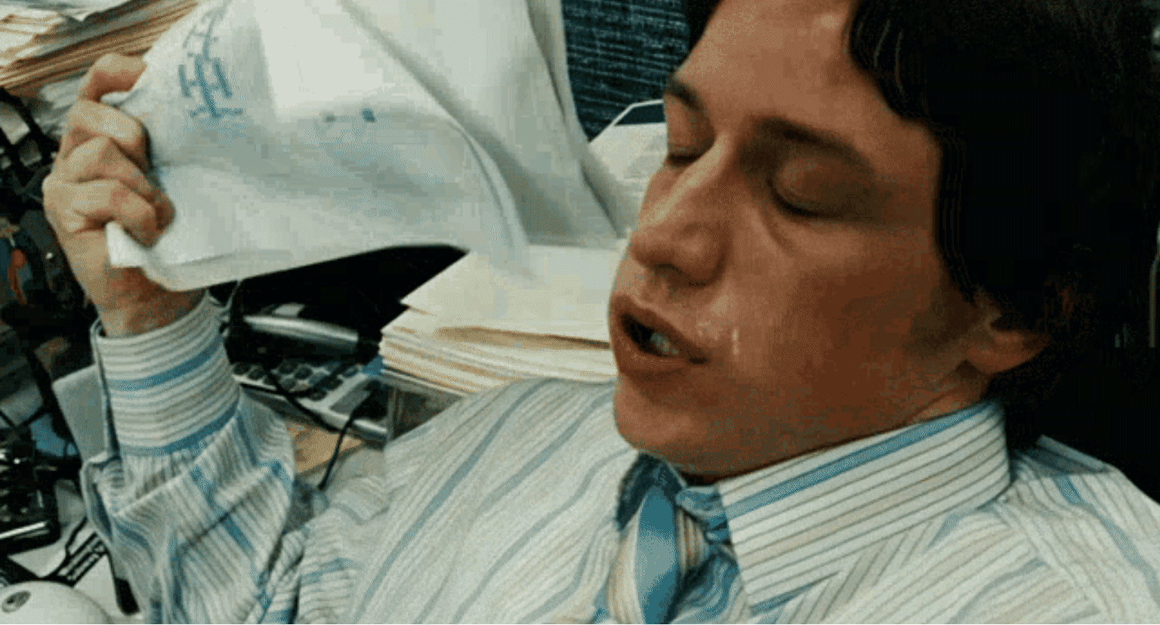
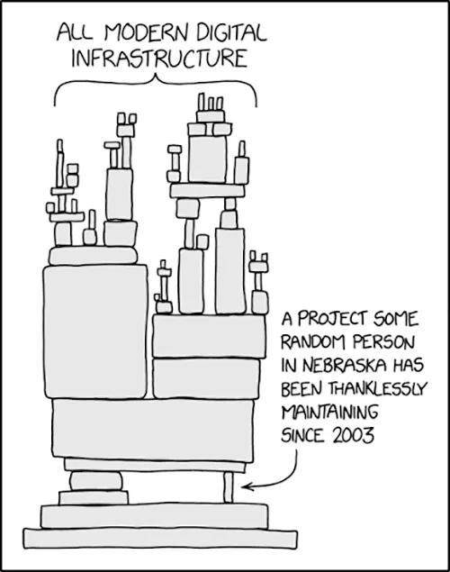

Summary (for your Nightmares)
“KISS” is done, long live “AC/DC“
(Always Convenient/Damn Cheap)
This got damn complex, complicated & convoluted.
How the hell to mitigate the risks:
Common H/W vulnerabilities (HV, network, …)
Basic services across networks (DNS, SSO/LDAP, DBs, …)
Quickly growing cacophony of dependencies.
Agile. Elastic. Heterogenous.
Forced onto Benefits of external cloud services
External S/W dependencies & auto-import (npm, PyPI, …)
https://xkcd.com/2347/
“Zero Trust” is the new mantra…
...needing much more
Defence-in-Depth (which is costly)
…already violating AC/DC again
Notes:
19
And that’s the moment when I usually wake up

Slide 20
Thank you very much!

