Slide 1
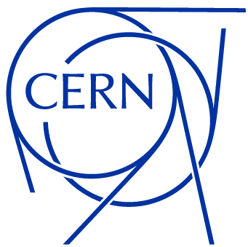
Status update
July 2025
Antonio Cristiano
EP-ESE-BE
BRATOL Meeting

Slide 2
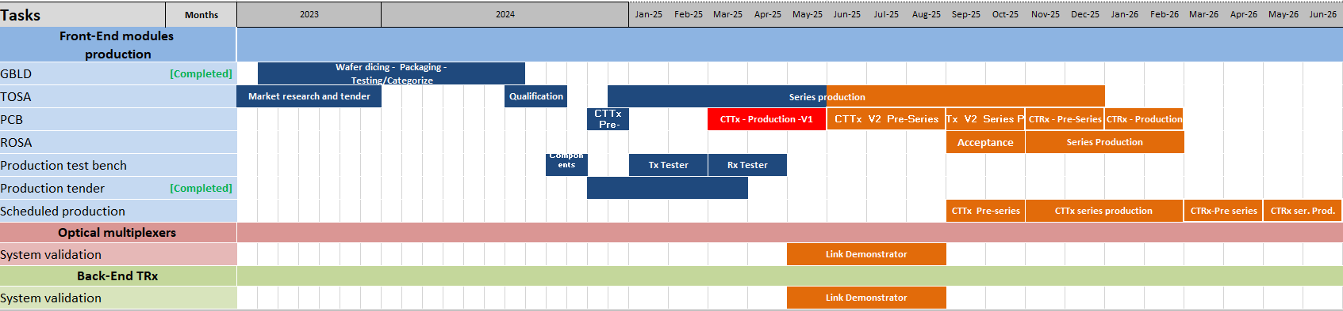
Status of the project
CTTx PCBs
  Production of 360 PCBs on going.
  Shipping foreseen on the 22nd of July.
  Possible shipping of test bench and production components on the 18th of August to start the production early September.

Slide 3
Status of the project
CTTx PCBs
  Production of 360 PCBs on going.
  Shipping foreseen on the 22nd of July.
  Possible shipping of test bench and production components on the 18th of August to start the production early September.
Module Production
  ROMPAL postponed the discussion of delivery dates to September.

Slide 4
Status of the project
CTTx PCBs
  Production of 360 PCBs on going.
  Shipping foreseen on the 22nd of July.
  Possible shipping of test bench and production components on the 18th of August to start the production early September.
Module Production
  ROMPAL postponed the discussion of delivery dates to September.
ROSA
  GBTIA were shipped to Albis for ROSA manufacturing.
  Delivery foreseen by end of August.

Slide 5
Link Demonstrator
The following tests were performed in order to define the minimum required technical specifications for the Back-End QSFP and the optical multiplexers.
CTTx V1
(ID : 55)
QSFP SkyLane
Part NB: QFPQL010400D
Tests performed with:
  1 ch
  2 ch
  4 ch
With CTTx and Mux in a climate chamber at:
  25 °C
  60 °C
Mux AcalBfi
CTTx V2
(ID : 87)
Mux HiFiber
QSFP SkyLane
Part NB: QFPQL010410D
CTTx V1
(ID : 124)
CTTx V2
(ID : 94)
Mux HuberSuhner
QSFP EdgeOptical

Slide 6
Link Demonstrator
The following tests were performed in order to define the minimum required technical specifications for the Back-End QSFP and the optical multiplexers.
CTTx V1
(ID : 55)
QSFP SkyLane
Part NB: QFPQL010400D
Tests performed with:
  1 ch
  2 ch
  4 ch
With CTTx and Mux in a climate chamber at:
  25 °C
  60 °C
Mux AcalBfi
CTTx V2
(ID : 87)
Mux HiFiber
QSFP SkyLane
Part NB: QFPQL010410D
CTTx V1
(ID : 124)
CTTx V2
(ID : 94)
Mux HuberSuhner
QSFP EdgeOptical
Not ready to report the results.

Slide 7
Link Demonstrator
CTTx V1
VOA
MUX
3 km fibre
QSFP
CTTx V2

Slide 8
Link Demonstrator
Scope
CTTx V1
MUX
3 km fibre
QSFP
CTTx V2
 | Tx Only | Tx-VOA | Tx-MUX | Tx-Fibre | Tx-QSFP
25 °C | Eye diagram
60 °C

Slide 9
Link Demonstrator
Scope
CTTx V1
VOA
MUX
3 km fibre
QSFP
CTTx V2
 | Tx Only | Tx-VOA | Tx-MUX | Tx-Fibre | Tx-QSFP
25 °C | Eye diagram | Eye diagram BER
60 °C

Slide 10
Link Demonstrator
Scope
CTTx V1
VOA
MUX
3 km fibre
QSFP
CTTx V2
 | Tx Only | Tx-VOA | Tx-MUX | Tx-Fibre | Tx-QSFP
25 °C | Eye diagram | Eye diagram BER | Eye diagram BER
60 °C

Slide 11
Link Demonstrator
Scope
CTTx V1
VOA
MUX
3 km fibre
QSFP
CTTx V2
 | Tx Only | Tx-VOA | Tx-MUX | Tx-Fibre | Tx-QSFP
25 °C | Eye diagram | Eye diagram BER | Eye diagram BER | Eye diagram | BER
60 °C

Slide 12
Link Demonstrator
Scope
CTTx V1
VOA
MUX
3 km fibre
QSFP
CTTx V2
 | Tx Only | Tx-VOA | Tx-MUX | Tx-Fibre | Tx-QSFP
25 °C | Eye diagram | Eye diagram BER | Eye diagram BER | Eye diagram | BER
60 °C

Slide 13
Link Demonstrator
Scope
CTTx V1
VOA
MUX
3 km fibre
QSFP
CTTx V2
 | Tx Only | Tx-VOA | Tx-MUX | Tx-Fibre | Tx-QSFP
25 °C | Eye diagram | Eye diagram BER | Eye diagram BER | Eye diagram | BER
60 °C | Eye diagram | Eye diagram BER

Slide 14
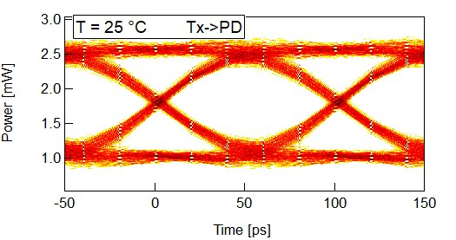
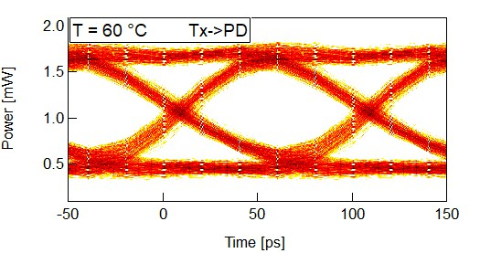
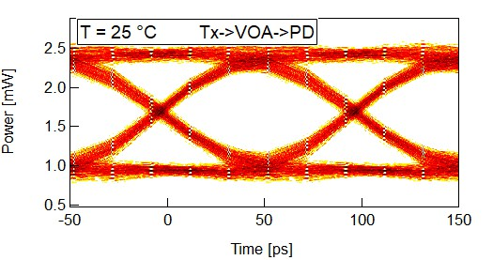
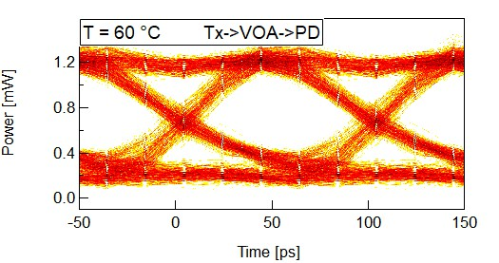
Link Demonstrator
  Link perfectly working at 25 °C in all the combinations.
  Missing signal lock at 60 °C when only VOA is present the in optical chain.
  Probable cause is anomalous jitter increase due to VOA.

Slide 15
BPM Back-End components procurement timeline
For the commit and payment of components in 2025:
Option not achievable -> three weeks for Departmental request, Technical specifications and contract edit from the procurement office.

Slide 16
BPM Back-End components procurement timeline
For the commit and payment of components in 2025:
Option not achievable -> three weeks for Departmental request, Technical specifications and contract edit from the procurement office.
Earliest dates: MUX
Tender start -> Early September
DAI -> Mid October
Single batch delivery -> December
Payment -> January
Earliest dates: QSFP
Tender start -> Mid October
DAI -> Late November
Single batch delivery -> Early February
Payment -> March

Slide 17
Summary and next steps
Front-End modules production:
  PCB Pre-Series delivery foreseen by the end of July.
  Shipping of production components foreseen by mid-August (depending on PCB Delivery and SMD assembly)
  ROSA Pre-Series delivery foreseen by the end of August (to be confirmed by Albis).
MUX and Back-End components validation and procurement:
  Missing optical link lock at 60 °C.
  Anomalous source of jitter from the VOA which could invalidate results at room temperature.
  BPM Back-End procurement timeline options presented.
Next steps:
  Investigate high temperature missing lock of BPM optical link.
  Write technical specifications for MUX and QSFPs.
  Qualification procedure of ROSA (Irradiation test foreseen on the 6th of September).

