Slide 1


CERN Alumni Network
Leaving CERN - Quitter le CERN 08.10.2024
Rachel Bray: Head CERN Alumni Relations

Slide 2
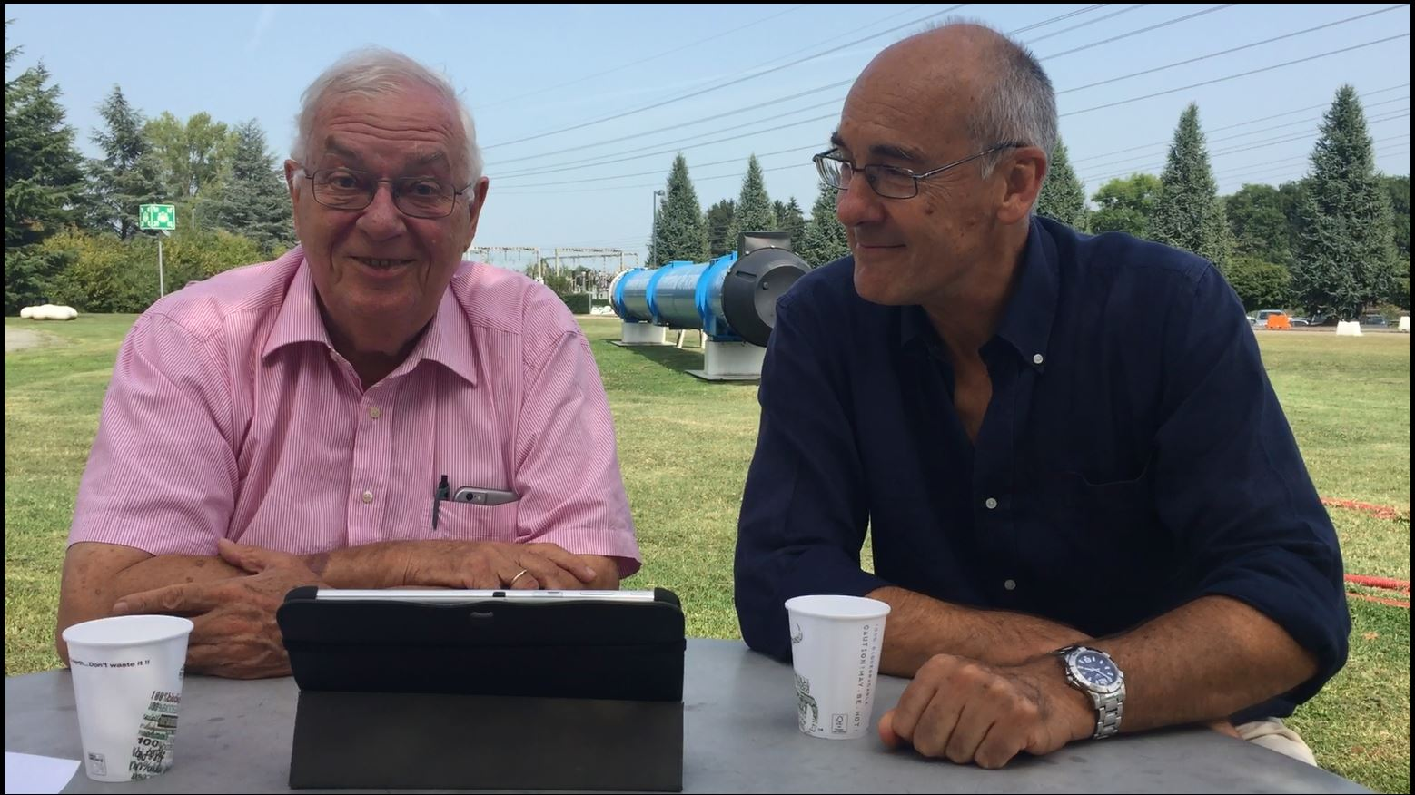
Goals of the CERN Alumni Programme:
Demonstrate impact
Stay connected
Network of ambassadors
Support early careers
Launched June 2017
>10,300
active members

Slide 3
> 10,300 network members
85% alumni or alumni within a year

Slide 4
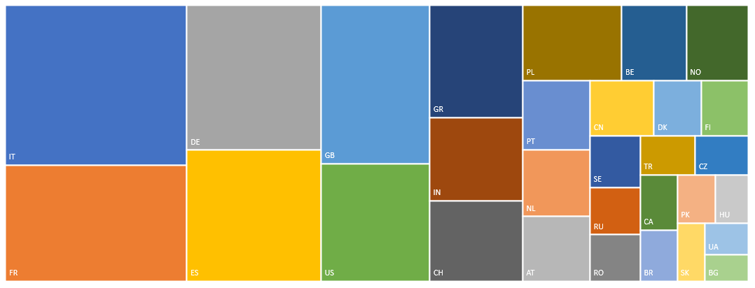

30 Top Represented Nationalities

Slide 5
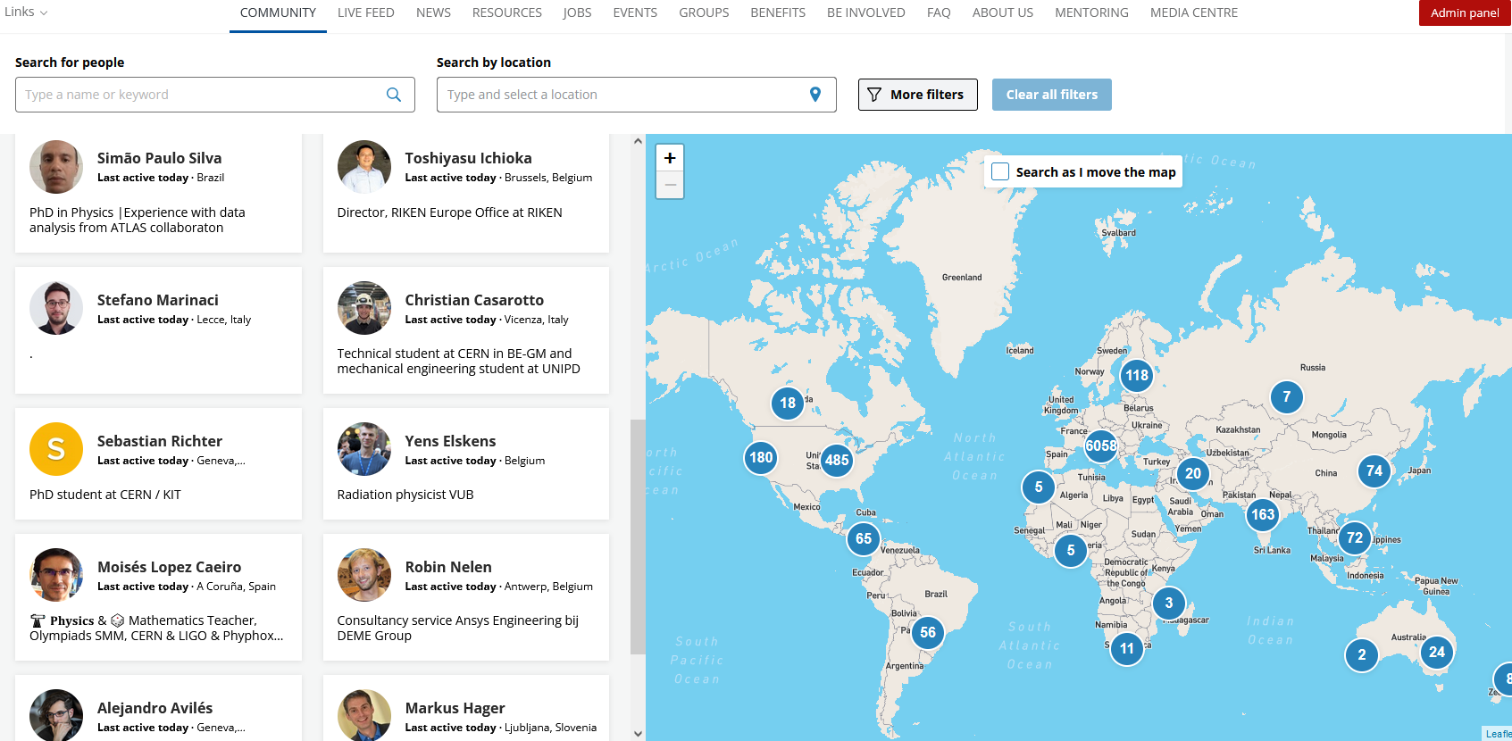
A dedicated platform

Slide 6
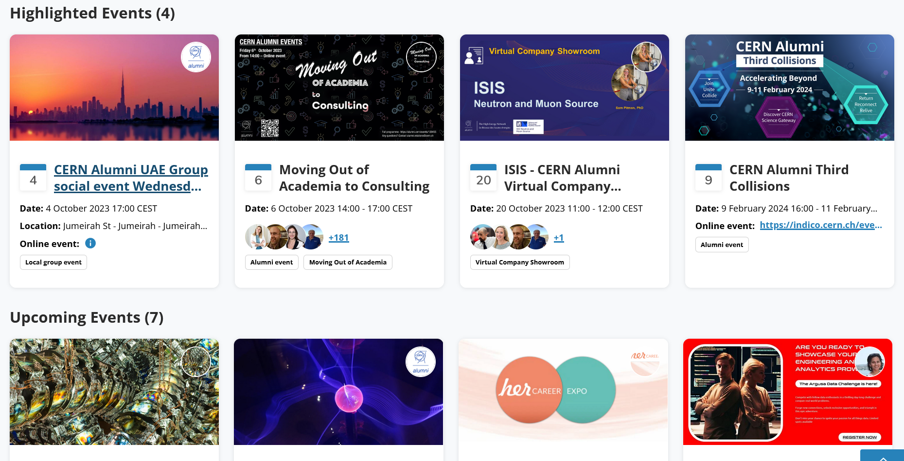
Regular Impactful Events

Slide 7

Regular Impactful Events

Slide 8
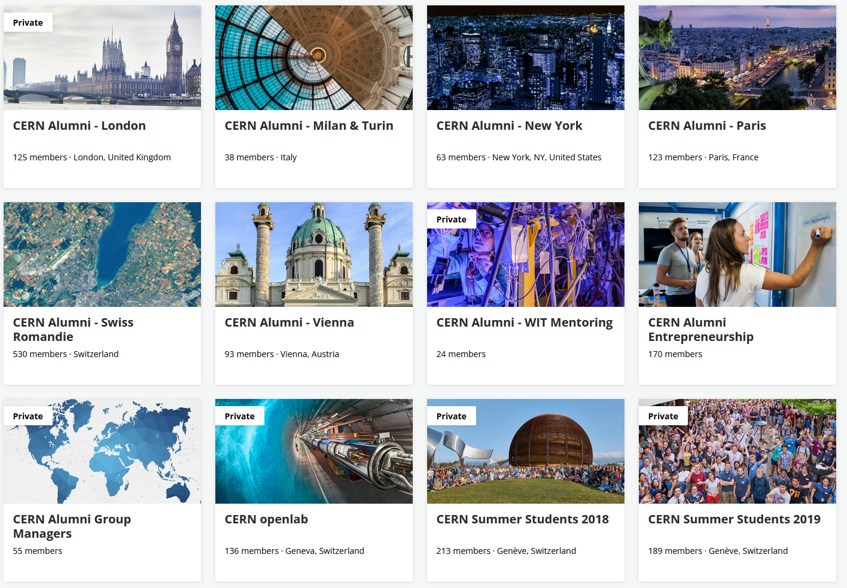
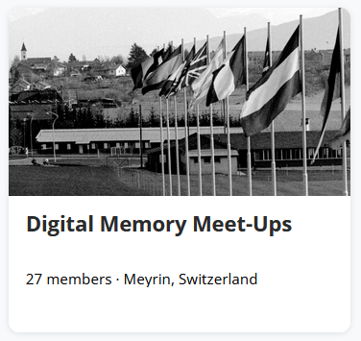
Groups
CERN Partnership (2)
Interest (4)
Regional (18)*
Scientific Collaboration (5)
Student programme (9)
* Athens, Barcelona, Belgium, Berlin, Boston (US), Copenhagen, Eindhoven, London, Madrid, Milan & Turin, Munich, New York, Paris, San Francisco Bay , Swiss Romandie, Vienna, Texas, United Arab Emirates

Slide 9
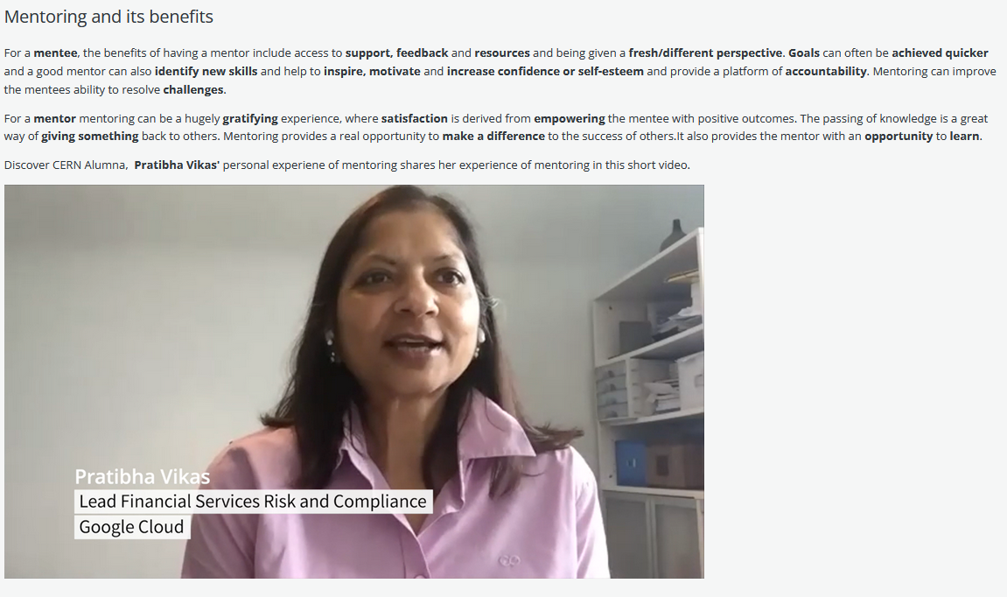
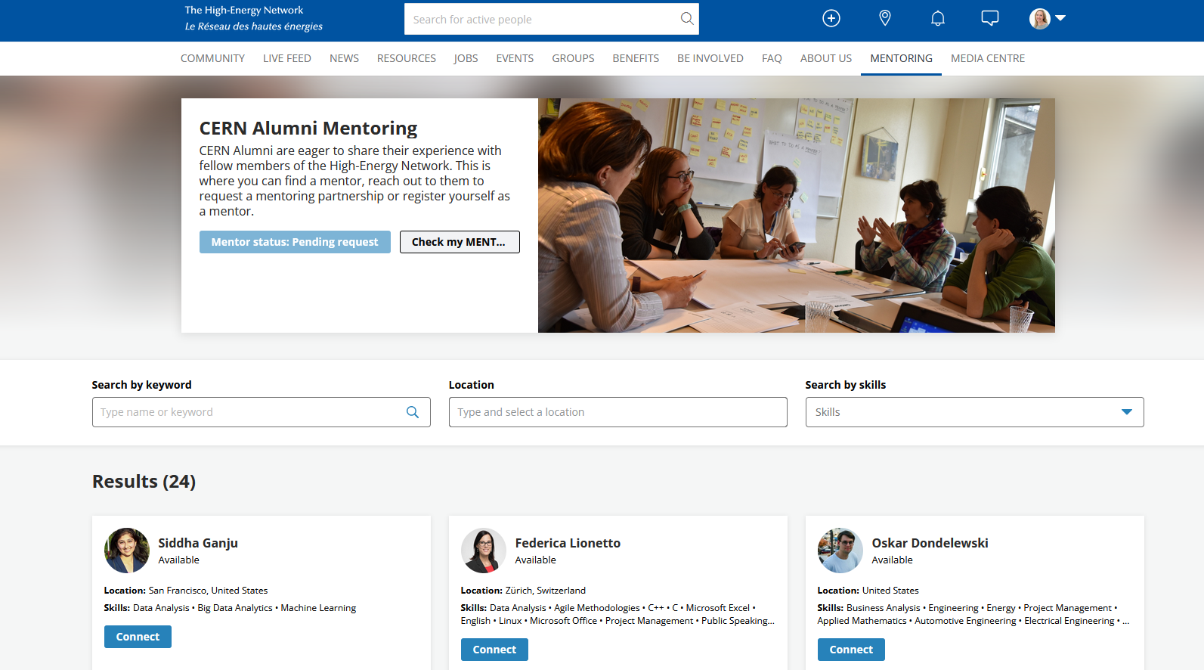
Mentoring

Slide 10
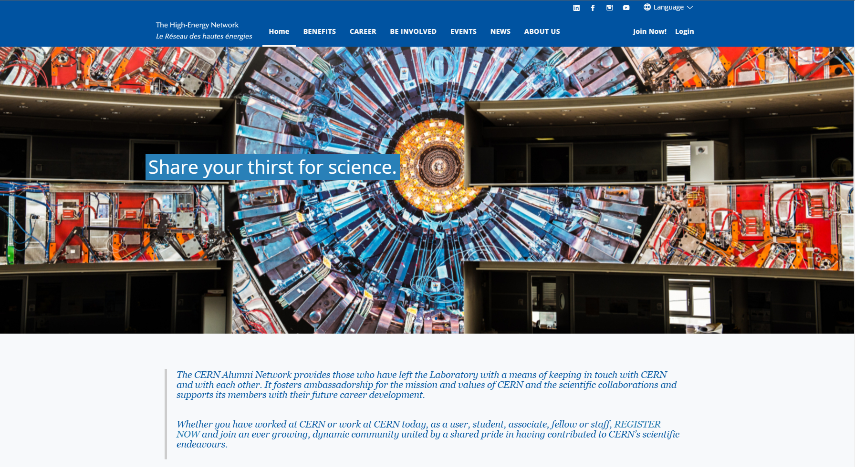
How to Join:
https://alumni.cern/signup

Slide 11
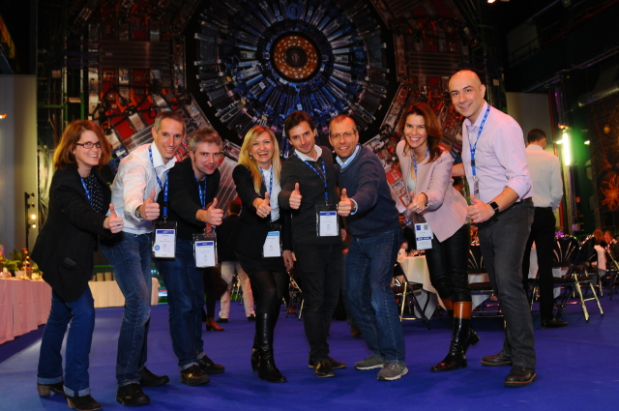
Thank you!
Contact:
Office for CERN Alumni Relations
CERN – International Relations Sector
alumni.relations@cern.ch

