Slide 1


Slide 2

Preparing Your Retirement
Sandrine BAUDAT (HR-LSM-HS)
8 October 2024
2

Slide 3

Topics
Keeping the CHIS: What you must do & when
What does and does not change
Obtaining information
Good to know tips
Questions & answers
8 October 2024
3

Slide 4
Topics
Keeping the CHIS: What you must do & when
What does and does not change
Obtaining information
Good to know tips
Questions & answers
8 October 2024
4

Slide 5
To keep the CHIS
Inform Pension Fund if you want to keep the CHIS, within 30 calendar days of retiring
  by default, your CHIS cover ends on the last day of your employment contract
  if you quit, you will never be allowed back
8 October 2024
5

Slide 6
To keep the CHIS
However, if your spouse is an MPE then you have to keep the CHIS as a Main Member.
Later, when your spouse also retires, both of you may then leave the CHIS (forever); if not, you both remain Main Members
8 October 2024
6

Slide 7
Topics
Keeping the CHIS: What you must do & when
What does and does not change
Obtaining information
Good to know tips
Questions & answers
8 October 2024
7

Slide 8
What does & does not change
You become a “Post-compulsory Member”
8 October 2024
8

Slide 9
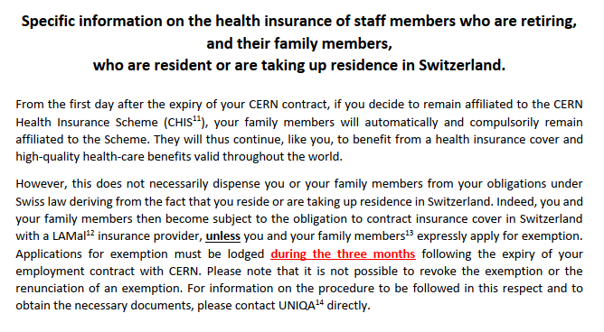
Specific information
chis.cern
8 October 2024
9

Slide 10
What does & does not change
Spouse and dependent children fully covered
***Keep PF informed of any change in family situation***
Supplementary contribution required for spouse or partner with income from professional activity (or retirement pension) and no other adequate insurance; use paper SHIPID to keep CHIS informed of your spouse’s situation
8 October 2024
10

Slide 11
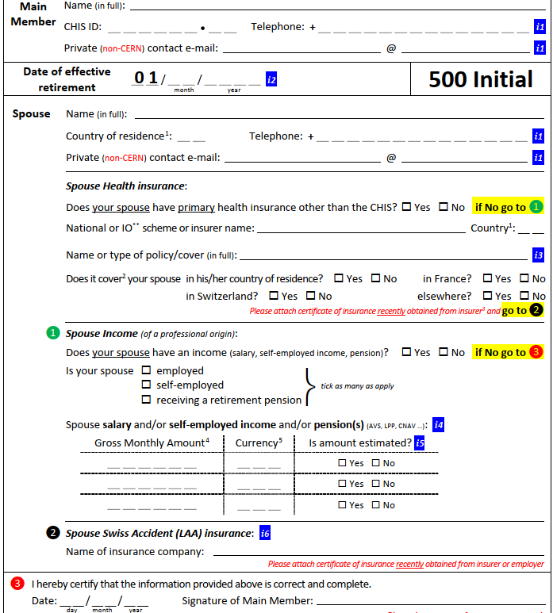
SHIPID
Spouse Health Insurance & Professional Income Declaration
Exists only on paper for retirees
8 October 2024
11

Slide 12
What does & does not change
You have to remember to ask, fill-in and send back a SHIPID every time there’s a change
  your spouse retirees : her/his income drops, your supplementary contribution may drop too
  your spouse reaches retirement age after a period without work & income : his/her income increases, your supplementary contribution may increase too
8 October 2024
12

Slide 13
Topics
Keeping the CHIS: What you must do & when
What does and does not change
Obtaining information
Good to know tips
Questions & answers
8 October 2024
13

Slide 14

Obtaining Information
General questions : uniqa@cern.ch or +41.22.718.63.00
Claims: www.MyUNIQA.ch
CHIS Rules, general advice
https://chis.cern
8 October 2024
14

Slide 15
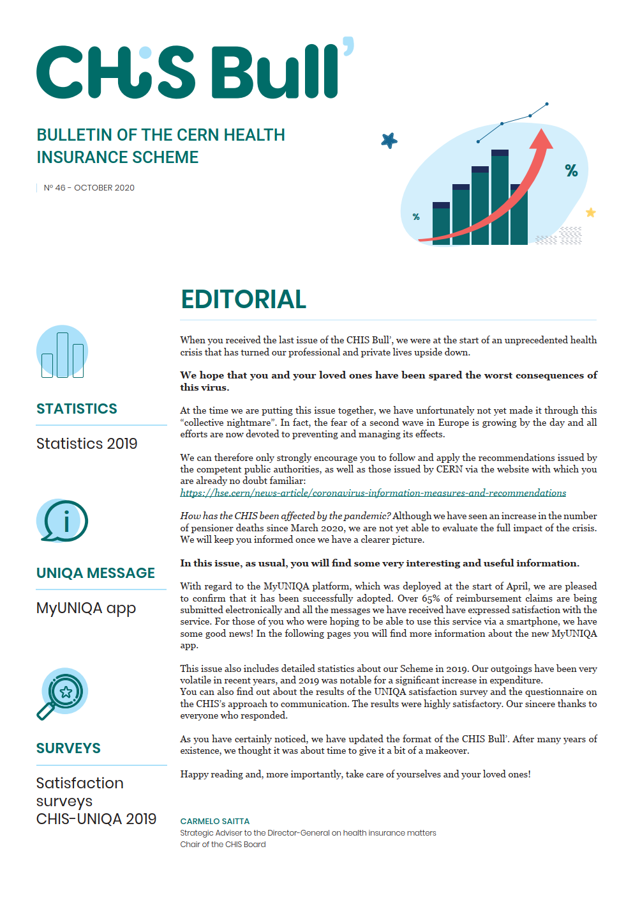
Obtaining Information
CHIS Bull’
newsletter: general info, news
sent by email or postal mail
available on the CHIS website
CERN’s Official news
formal notices, major changes
home.cern/cern-people
8 October 2024
15

Slide 16
Topics
Keeping the CHIS: What you must do & when
What does and does not change
Obtaining information
Good to know tips
Questions & answers
8 October 2024
16

Slide 17
Good to know tips
Long Term Care (LTC) benefits are there to help when dependency impacts daily life
  three dependency levels (low, moderate, high)
  do not wait for high dependency to act
8 October 2024
17

Slide 18
Good to know tips
  Contact CERN Social Service and ask for guidance (ask relative to help with procedure when needed)
  The amount of the daily allowance, which depends on the level of dependence
8 October 2024
18

Slide 19
Good to know tips
Using CHIS as supplementary insurance
  if you or your spouse or your child(ren) have another insurance (Sécurité sociale, NHS, …)
  use other insurance first, submit other insurance’s reimbursement statement to UNIQA
  ☺ get much better overall reimbursement rate
8 October 2024
19

Slide 20
Good to know tips
Your claims can be sent in 4 ways:
Electronic submission on MyUNIQA website.
Electronic submission on MyUNIQA application for smartphone.
Safe deposit of your "blue envelopes" in the "UNIQA" mailbox (building 33/Visitors' Reception or Main building/UNIQA’s office)
Send your stamped "blue envelopes" by regular mail to the following address : UNIQA, Avenue de la Praille, 26- CP 1431 - 1227 Carouge.
Get attestations and other personal documents through your account on MyUNIQA website.
8 October 2024
20

Slide 21
Topics
Keeping the CHIS: What you must do & when
What does and does not change
Obtaining information
Good to know tips
Questions & answers
8 October 2024
21

