Slide 1



ATLAS Anomaly Trigger Calibration
Ruiyang Xie
7 Aug 2025

Slide 2
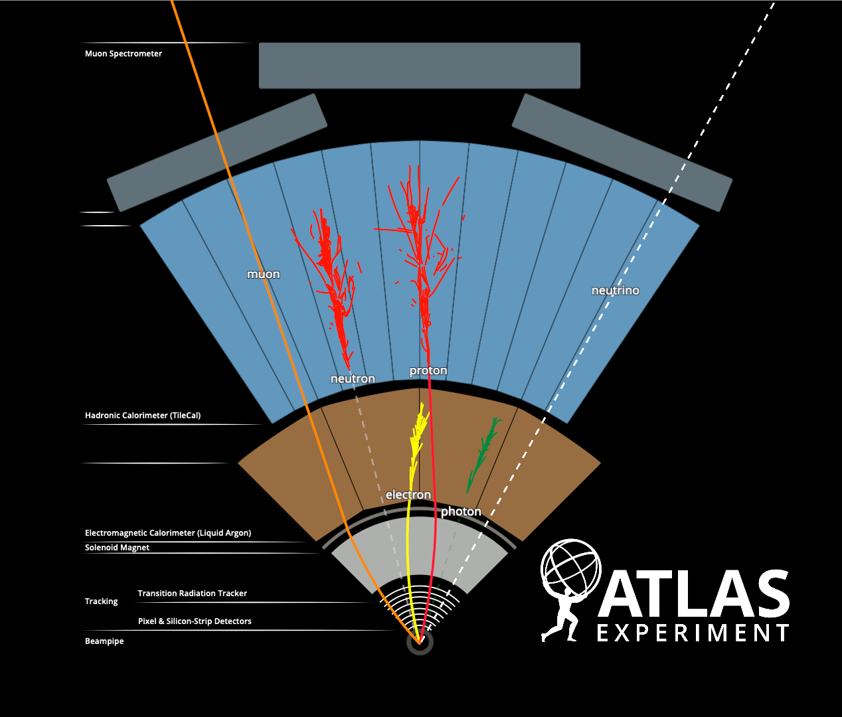
Why Do We Need Anomaly Triggers?
Traditional triggers: optimised for specific signatures (e.g. high-pt jets, leptons, MET)
New challenge: broad coverage for unexpected signals
Need: Model-agnostic approaches
Solution: machine learning–based anomaly triggers

Slide 3
What is the Anomaly Trigger?
ML model (e.g., VAE/VAE-GAN) → anomaly score
High score = more unusual event
Trigger threshold: score > cut
Key concern: mistagging SM events
L1AD
Find New Physics
Events
HLT+HLTAD
L1
Select Known SM

Slide 4
Goal: Calibrate Mistag Rates
Identify SM phase spaces with high anomaly scores
Compare MC prediction with data
Derive scale factors
Apply in downstream analyses to correct for mismodeling
L1AD
Find New Physics
Events
HLT+HLTAD
L1
Select Known SM

Slide 5
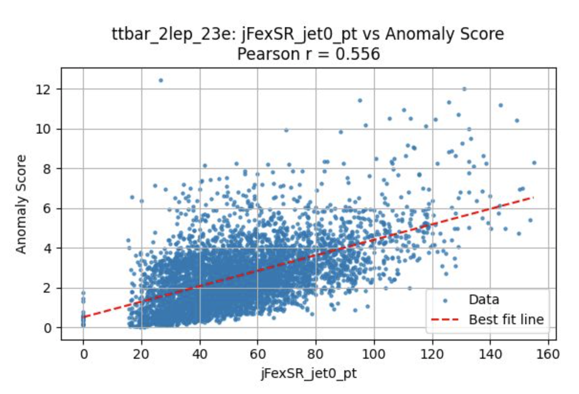
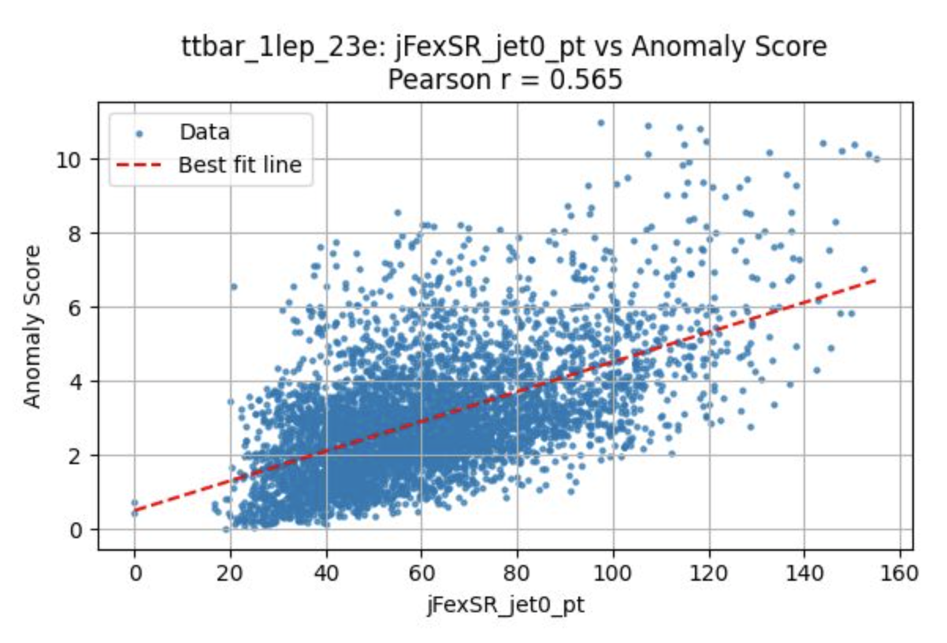
Anomaly Score vs Kinematics

Slide 6
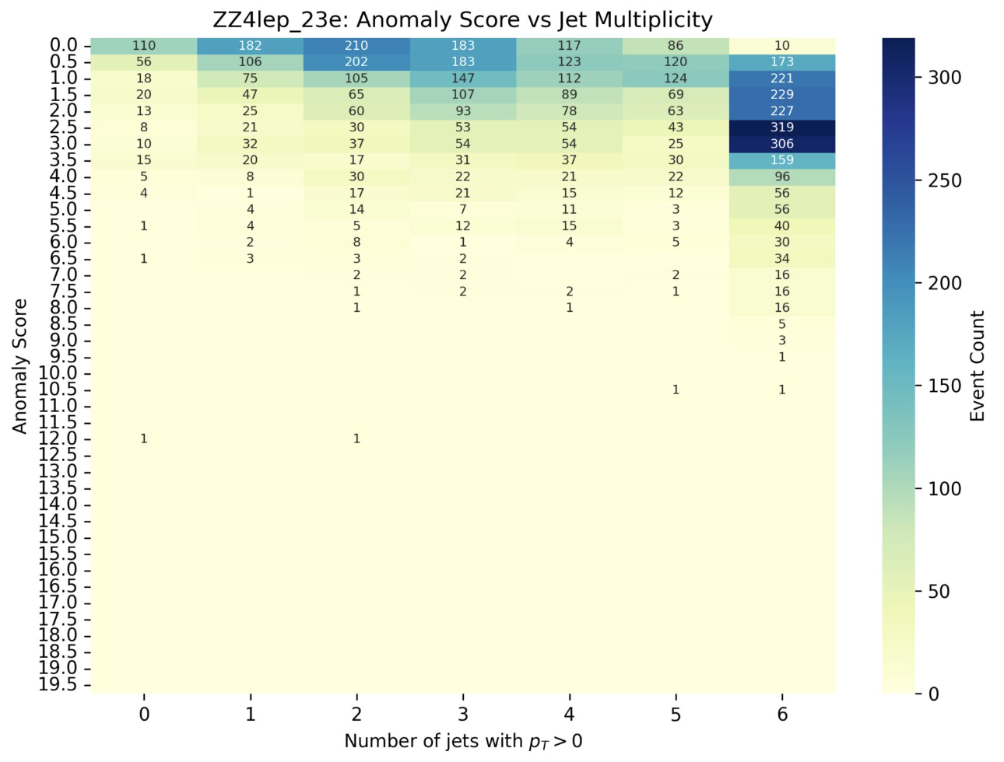
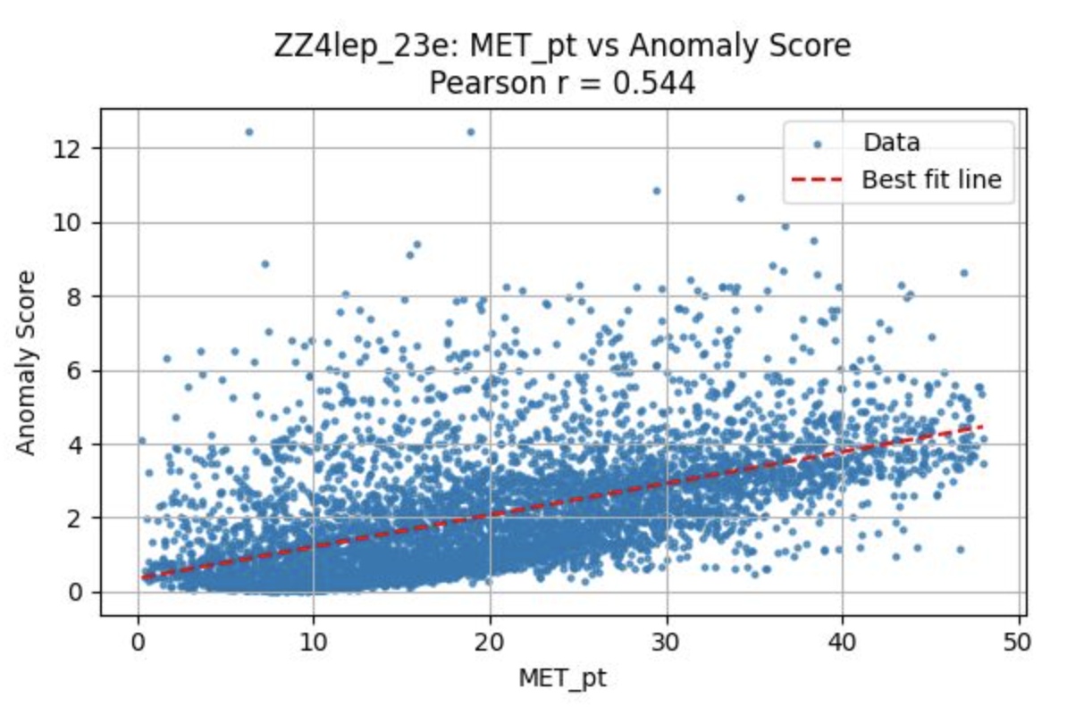
Event Topology: Jet Counts, MET

Slide 7
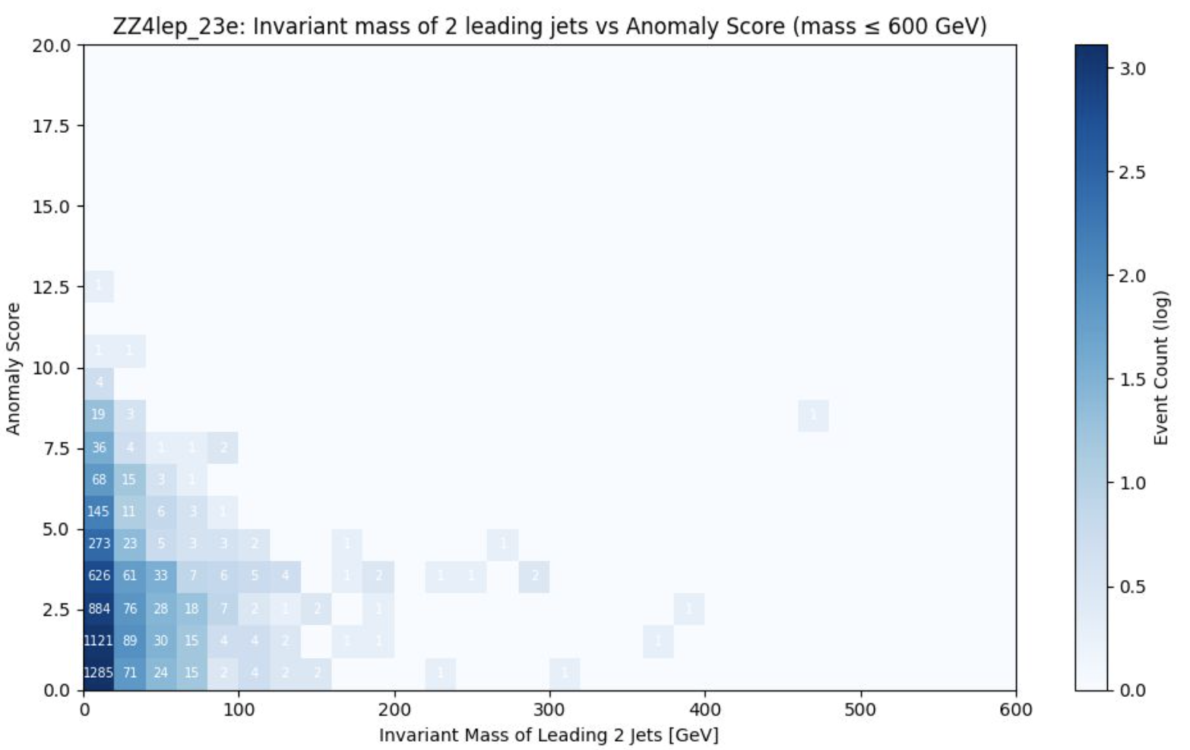
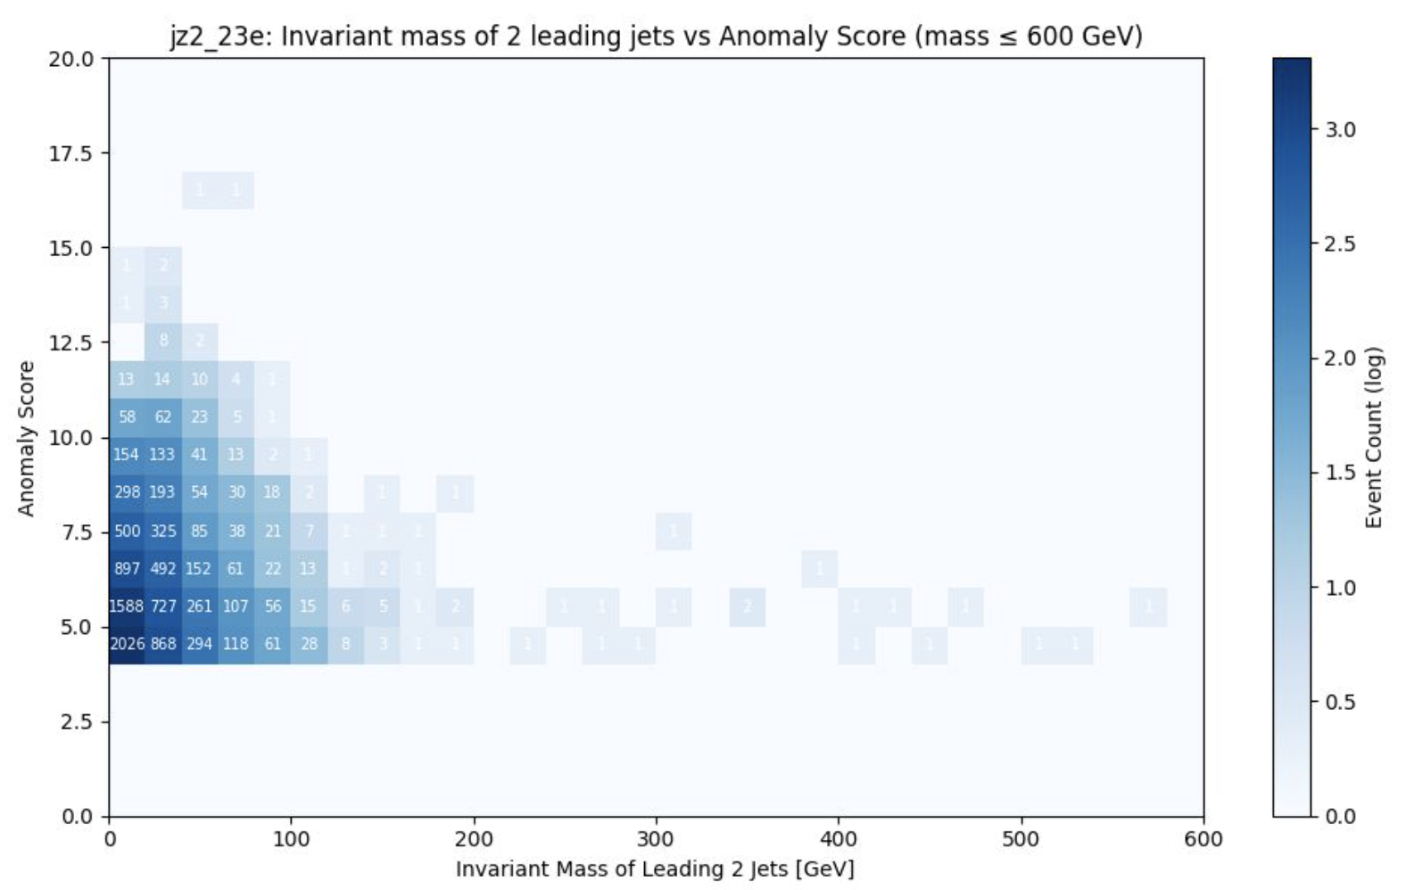
Invariant Mass of Leading Jets

Slide 8
Next Steps
Phase space definition per SM process
Refine phase spaces per process
Compare MC vs data
Derive and validate scale factors
Build a reusable calibration framework
MC vs Data Comparison
in control regions
Derive Scale factors
Validation & Framework Output
ATLAS Analyses Use These Scale Factors

Slide 9
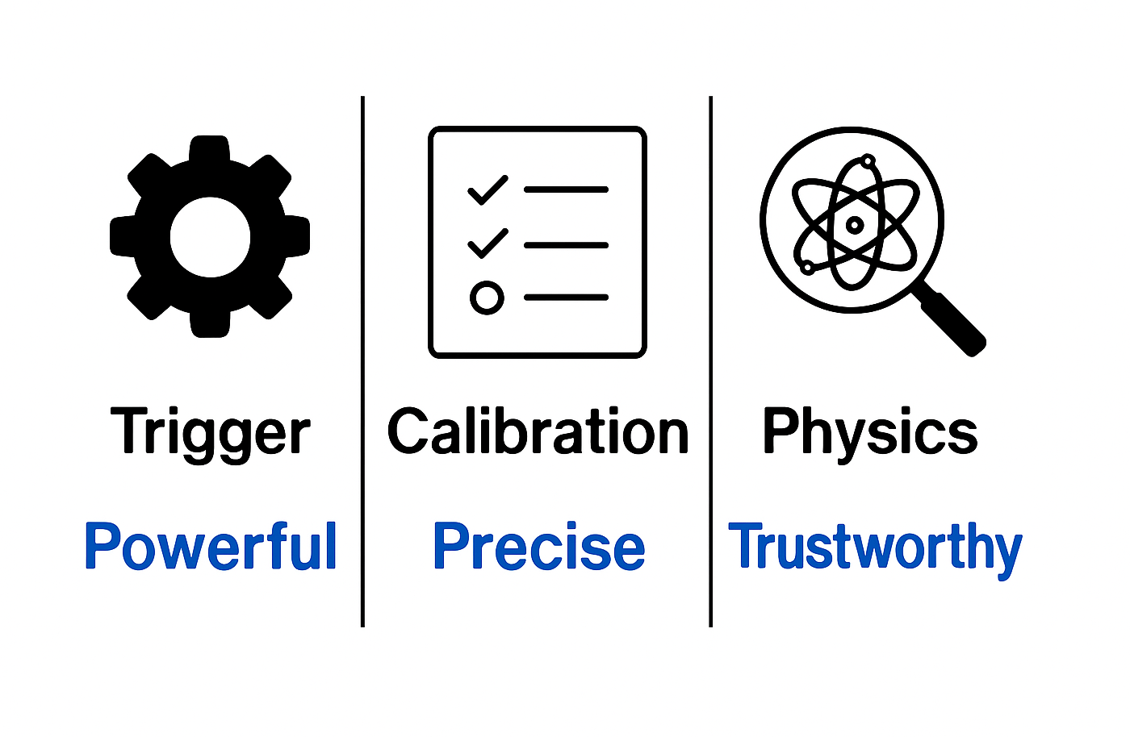
Conclusion
Anomaly triggers are powerful but need calibration
Our work improves trust in their use
Progress so far: kinematic studies and mistag characterisation
Final goal: a systematic calibration toolkit

Slide 10
Thank you!

