Slide 1

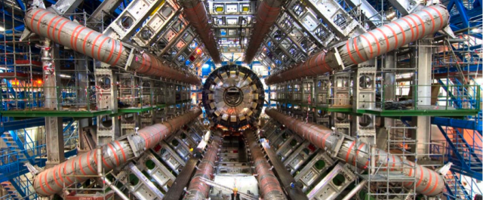

TAU TRIGGER EFFICIENCY MEASUREMENT WITH THE TAG-AND-PROBE METHOD IN $Z→ττ$ FOR 2024 DATA
Primesh A. Kannangara
Supervisors:
Dr. Mansoora Shamim
Prof. Stan Lai
Dr. Antonio De Maria

Slide 2
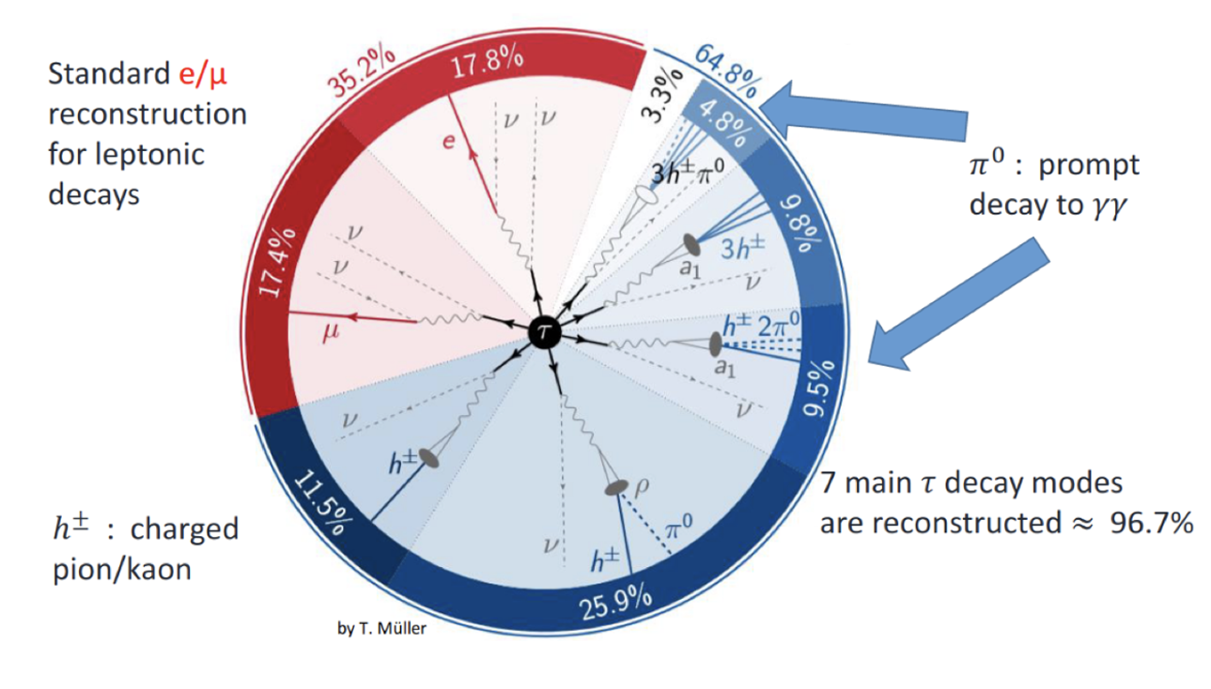
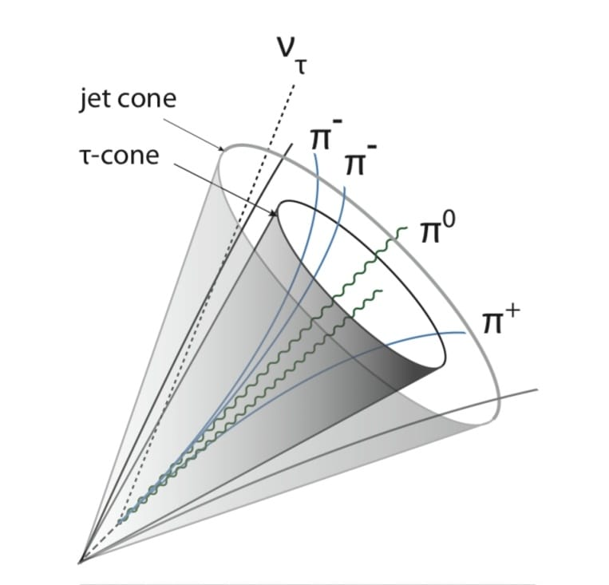
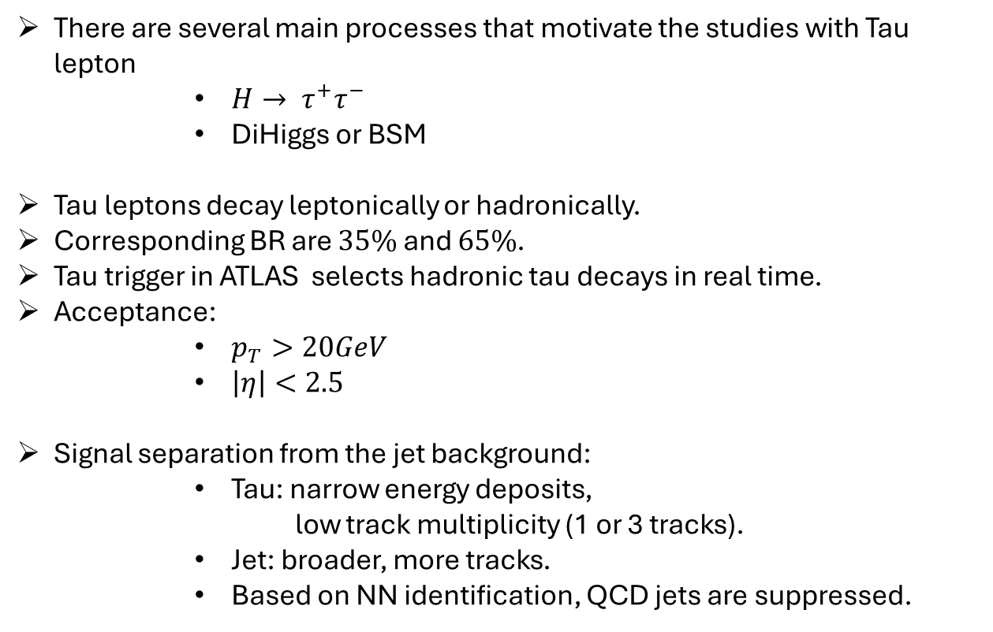
Introduction
There are several main processes that motivate the studies with Tau lepton
$H→ τ^{+}τ^{−}$
DiHiggs or BSM
Tau leptons decay leptonically or hadronically.
Corresponding BR are $35\%$ and $65\%$.
Tau trigger in ATLAS selects hadronic tau decays in real time.
Acceptance:
$p_{T}>20GeV$
$\left|η\right|<2.5$
Signal separation from the jet background:
Tau: narrow energy deposits,
low track multiplicity (1 or 3 tracks).
Jet: broader, more tracks.
Based on NN identification, QCD jets are suppressed.

Slide 3
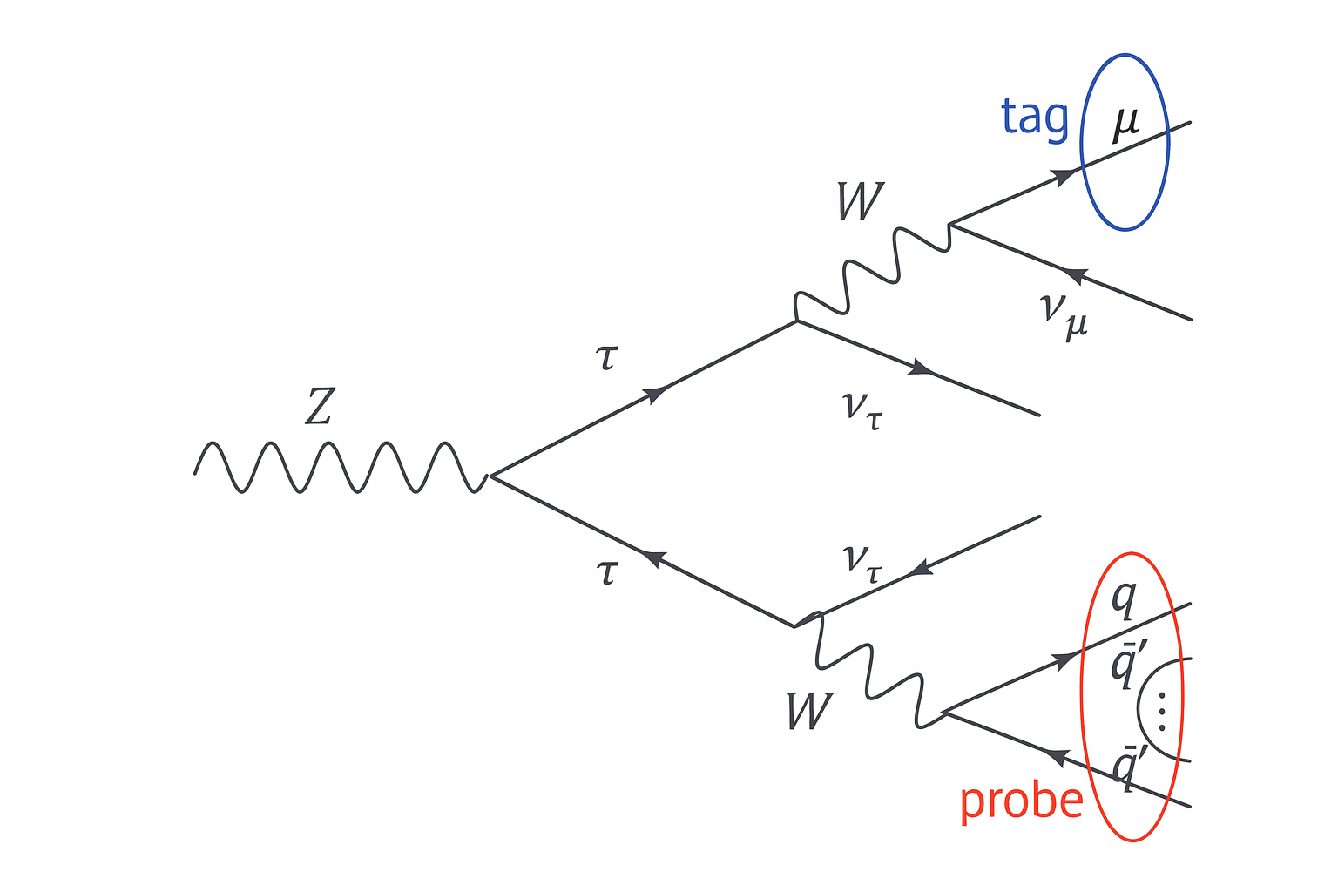

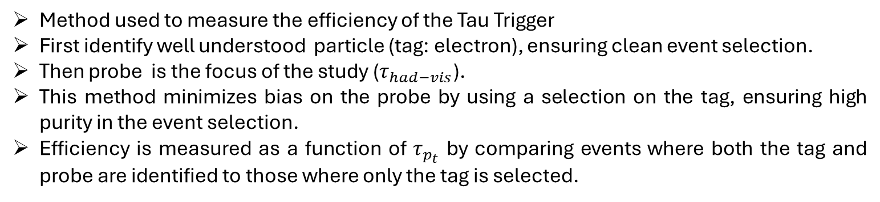


What is Tag and Probe Method?
Method used to measure the efficiency of the Tau Trigger
First identify well understood particle (tag: electron), ensuring clean event selection.
Then probe is the focus of the study ($τ_{had−vis}$).
This method minimizes bias on the probe by using a selection on the tag, ensuring high purity in the event selection.
Efficiency is measured as a function of $τ_{p_{t}}$ by comparing events where both the tag and probe are identified to those where only the tag is selected.
$$e$$
$$ν_{e}$$
$$Z→ττ→eτ_{had−vis}3ν$$

Slide 4
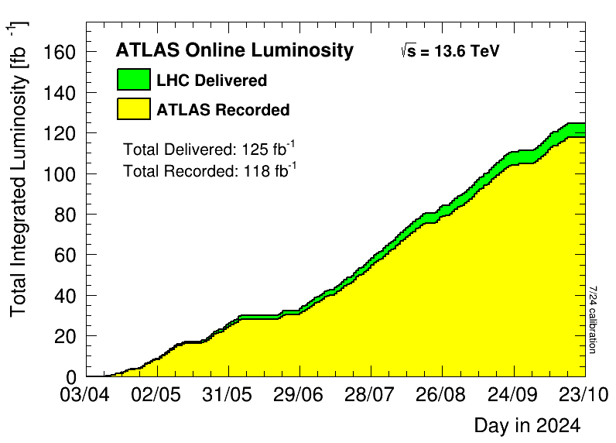
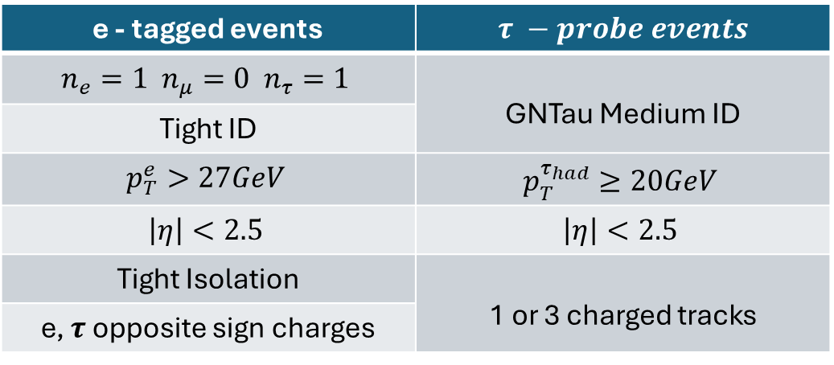
Preselection requirements for event selection
Use 2024 pp collision data
After reconstruction, preselection cuts are applied to all events, depending on the tagged lepton
e - tagged events | $$τ −probe events$$
$$n_{e}=1 n_{μ}=0 n_{τ}=1$$ | GNTau Medium ID
Tight ID
$$p_{T}^{e}>27GeV$$ | $$p_{T}^{τ_{had}}≥20GeV$$
$$\left|η\right|<2.5$$ | $$\left|η\right|<2.5$$
Tight Isolation | 1 or 3 charged tracks
e, $τ$ opposite sign charges

Slide 5
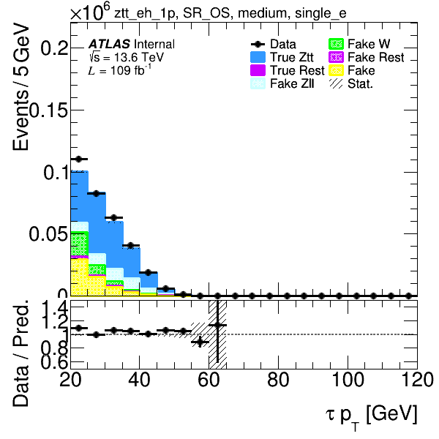
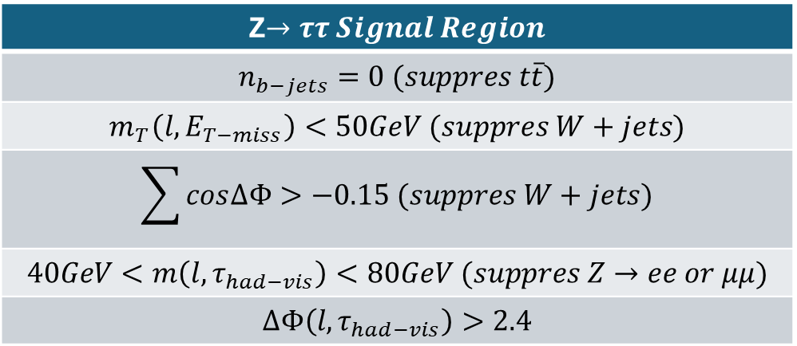
Selection for Signal Region
Signal region is carefully defined to isolate events corresponding to the desired process (signal events)
Z$→ττ Signal Region$
$$n_{b−jets}=0 (suppres t\overline{t})$$
$$m_{T}\left(l,E_{T−miss}\right)<50GeV (suppres W+jets)$$
$$\sum{cos∆Φ}>−0.15 (suppres W+jets)$$
$$40GeV<m\left(l,τ_{had−vis}\right)<80GeV (suppres Z→ee or μμ)$$
$$∆Φ\left(l,τ_{had−vis}\right)>2.4$$
Enriched with the signal, and the signal-to-background ratio is higher.
Important for efficiency measurement, validation

Slide 6
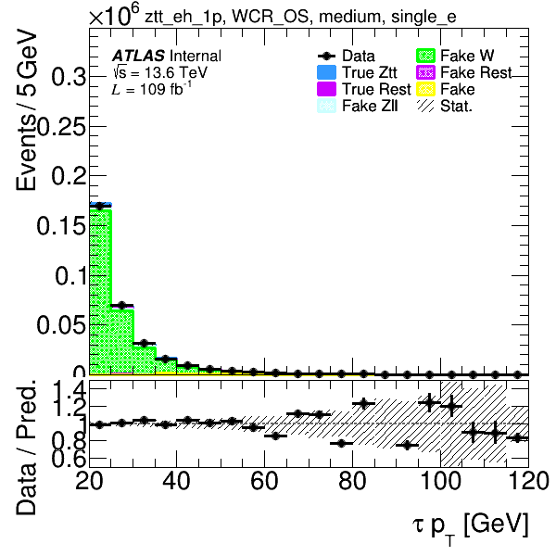
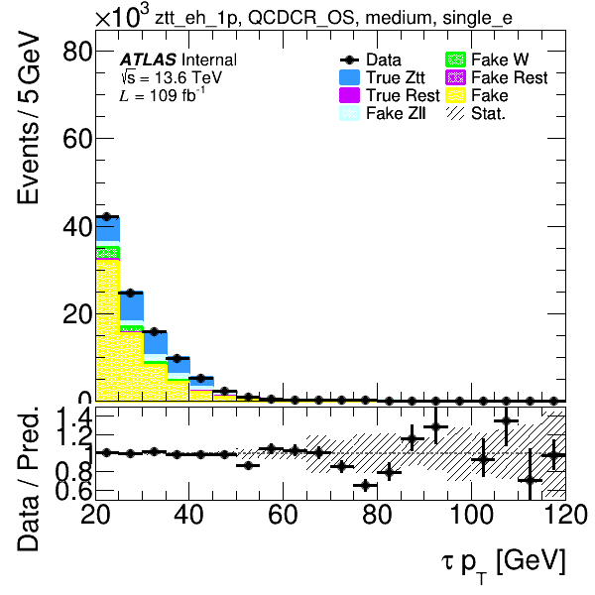


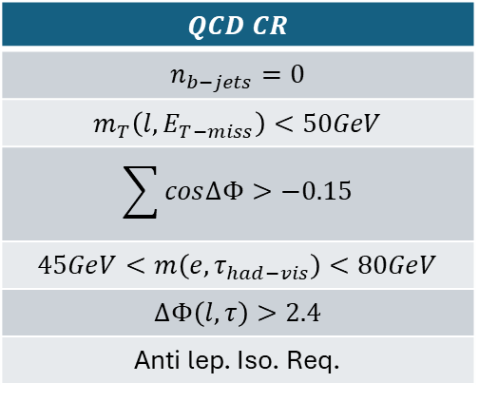
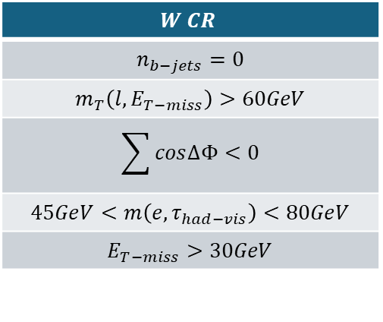
Selection for Control Region
An important use of the control region is modeling and validation of the background in the signal region.
This region is rich in background and very low in signal.
What are the backgrounds we model?
$$W+jets$$
$$QCD$$
$$W CR$$
$$n_{b−jets}=0$$
$$m_{T}\left(l,E_{T−miss}\right)>60GeV$$
$$\sum{cos∆Φ}<0$$
$$45GeV<m\left(e,τ_{had−vis}\right)<80GeV$$
$$E_{T−miss}>30GeV$$
$$QCD CR$$
$$n_{b−jets}=0$$
$$m_{T}\left(l,E_{T−miss}\right)<50GeV$$
$$\sum{cos∆Φ}>−0.15$$
$$45GeV<m\left(e,τ_{had−vis}\right)<80GeV$$
$$∆Φ\left(l,τ\right)>2.4$$
Anti lep. Iso. Req.

Slide 7
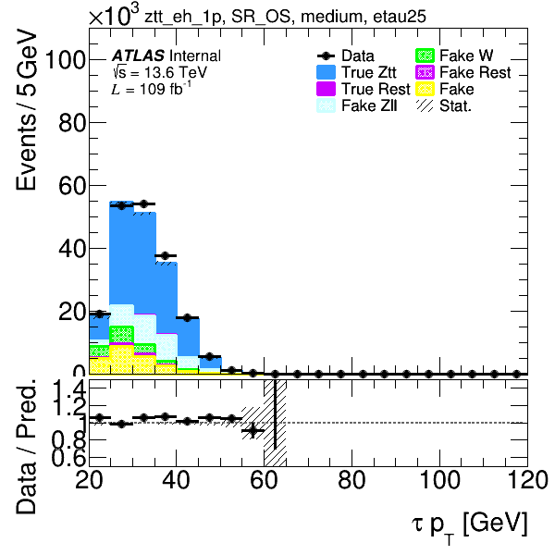
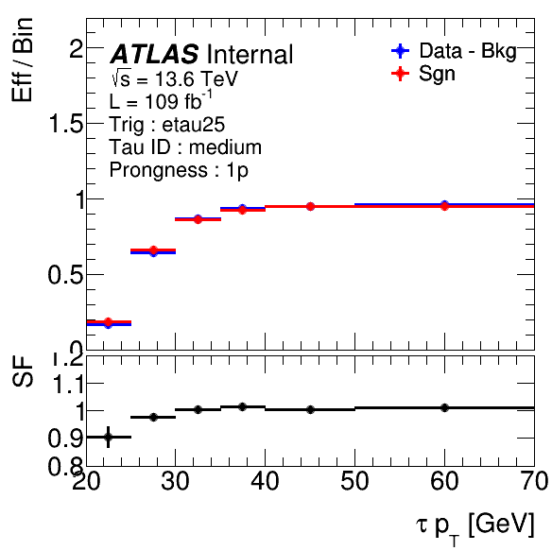


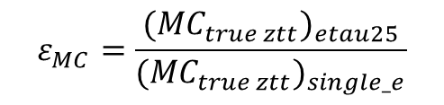
Efficiency and Scale Factor
$$ε_{Data}=\frac{{(Data−{MC}_{BG})}_{etau25}}{{(Data−{MC}_{BG})}_{single_e}}$$
SFs is the ratio of trigger efficiency between real data and MC simulations.
In the study tau25 trigger efficiency was studied.
Efficiencies are measured wrt to the offline medium identified tau candidates.
$$ε_{MC}=\frac{{({MC}_{true ztt})}_{etau25}}{{({MC}_{true ztt})}_{single_e}}$$
$$SF=\frac{ε_{Data}}{ε_{MC}}$$
(SF used to correct the MC)

Slide 8
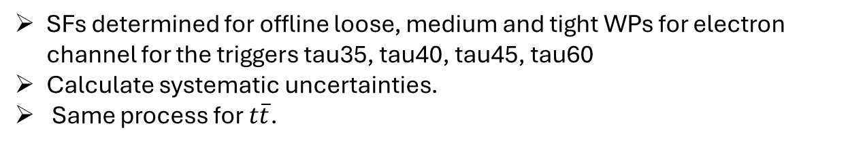
Summary
Tau Trigger efficiency and Scale Factors:
Calculations performed for the 2024 dataset.
SFs determined for offline medium WPs for electron channel.
Future plans
SFs determined for offline loose, medium and tight WPs for electron channel for the triggers tau35, tau40, tau45, tau60
Calculate systematic uncertainties.
Same process for $t\overline{t}$.

Slide 9



THANK YOU
The audience – for your attention, presence, and participation.
My supervisors – for your continuous guidance, encouragement, and expertise throughout this project.
The sponsors –The Simons Foundation, Rolex, and generous individual donors for making this opportunity possible through your invaluable support.
CERN – for hosting me as part of the Summer Student Programme, and for fostering a truly global scientific environment.
The ATLAS Experiment – for allowing me to contribute and learn within one of the most remarkable collaborations in particle physics.

Slide 10
BACKUPS

Slide 11
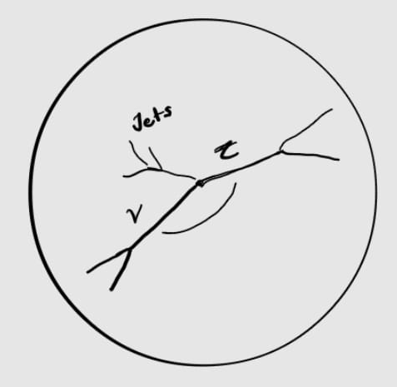
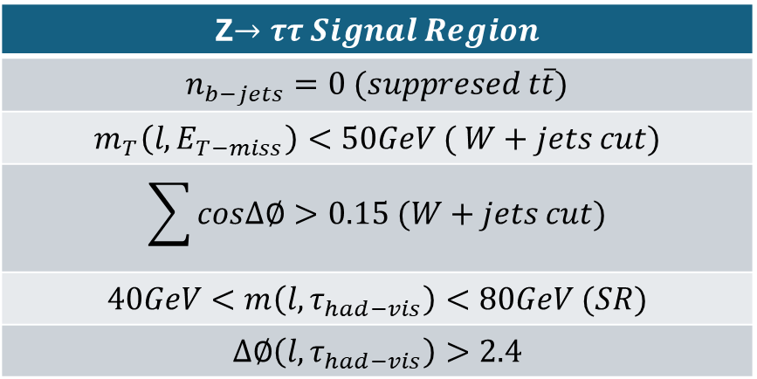
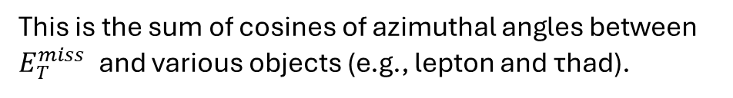
Z$→ττ Signal Region$
$$n_{b−jets}=0 (suppresed t\overline{t})$$
$$m_{T}\left(l,E_{T−miss}\right)<50GeV ( W+jets cut)$$
$$\sum{cos∆∅}>0.15 (W+jets cut)$$
$$40GeV<m\left(l,τ_{had−vis}\right)<80GeV (SR)$$
$$∆∅\left(l,τ_{had−vis}\right)>2.4$$
This is the sum of cosines of azimuthal angles between $E_{T}^{miss}$ and various objects (e.g., lepton and τhad).

