Slide 1
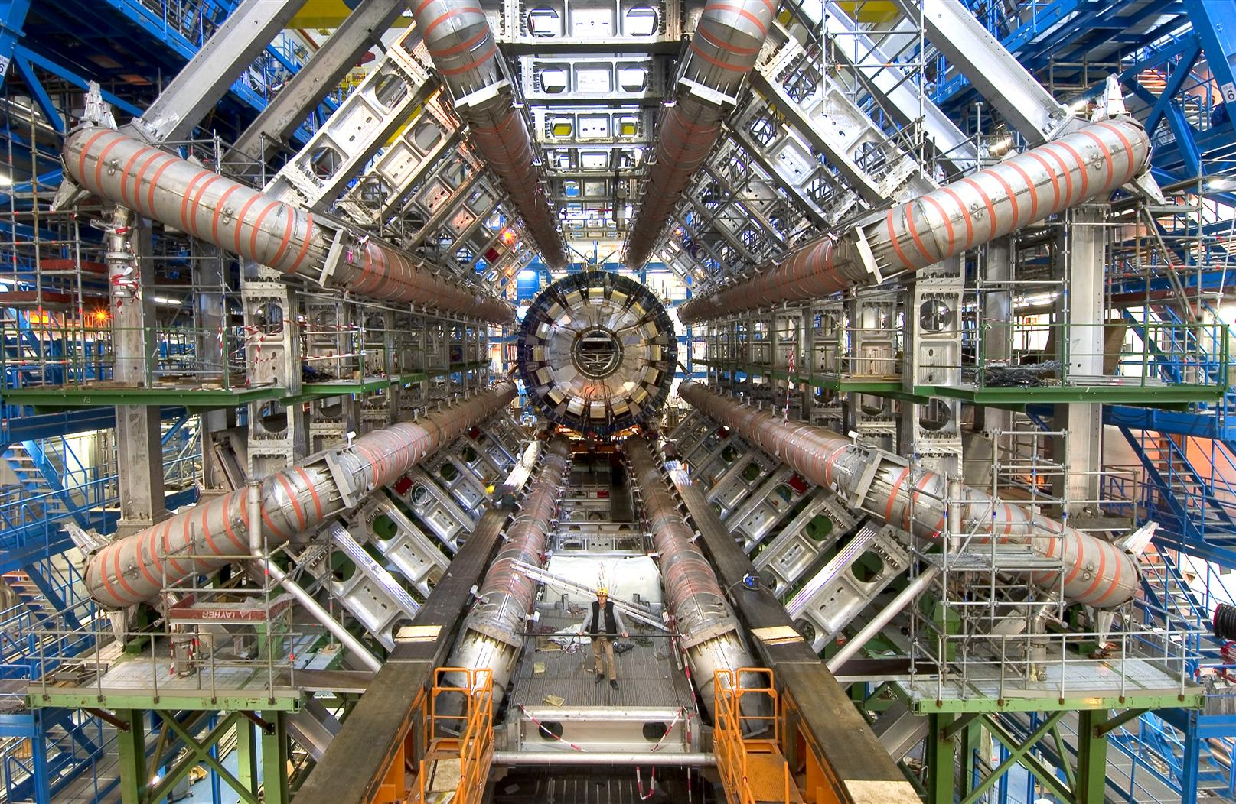




Improving Di-Higgs Boson Detection in 1ℓ3τ Channel Using Machine Learning
Shaikha Albassam
Supervised by André Sopczak

Slide 2
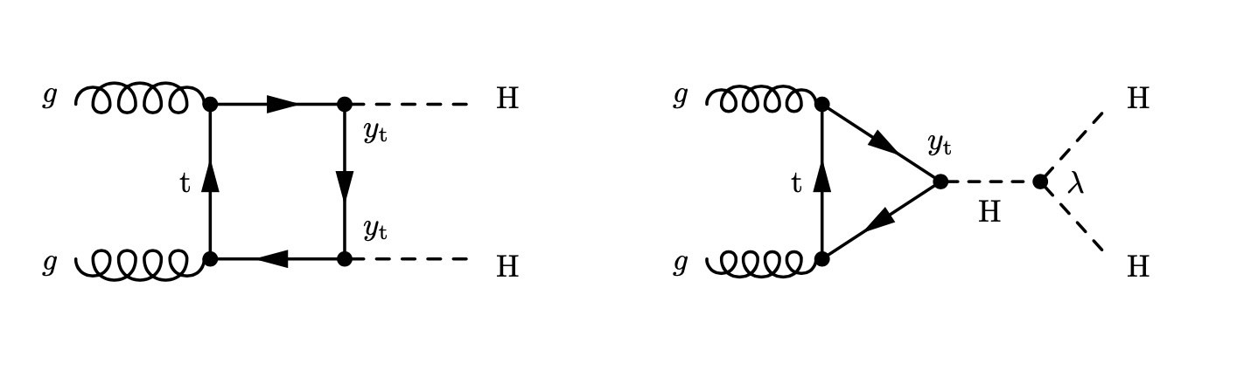
Why Study the Higgs Pair Production?
2

Slide 3
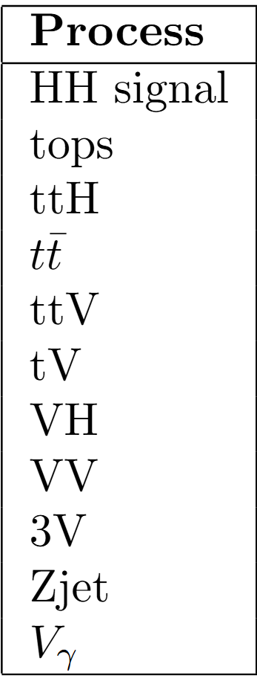
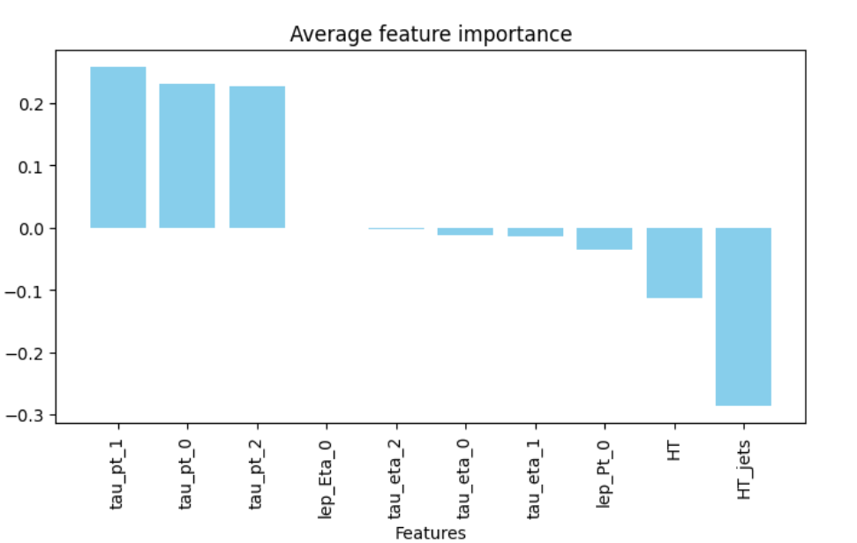
Data
Produced using Common Analysis Framework (CAF)
Ten features were used

Slide 4
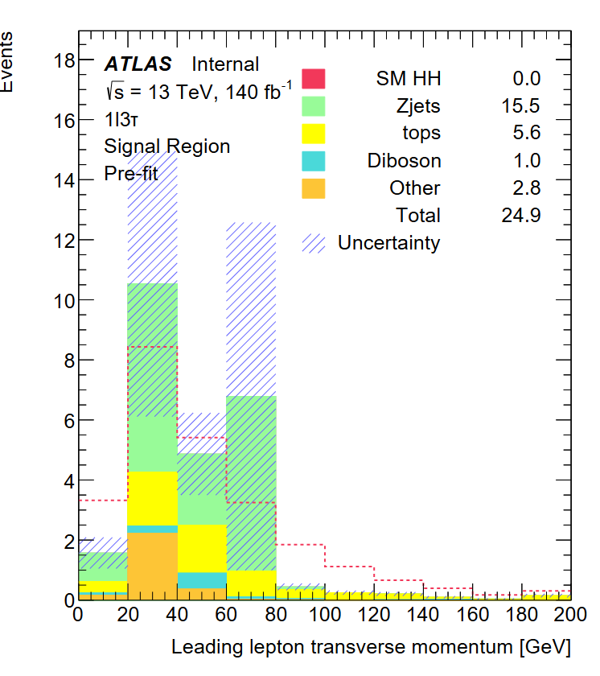
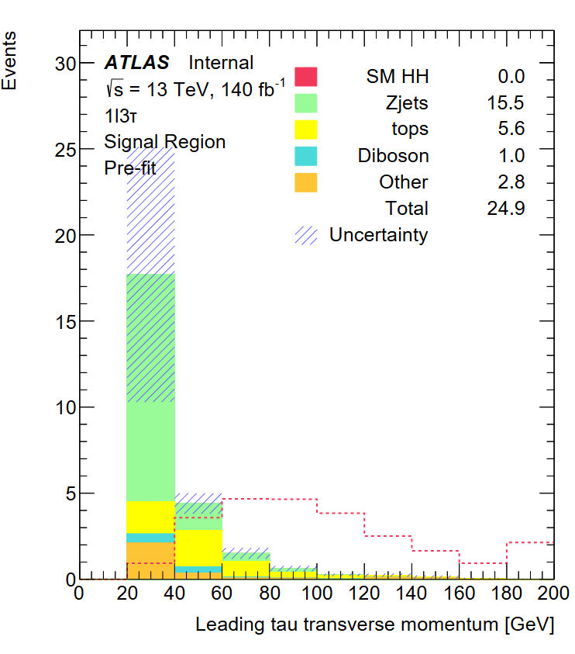
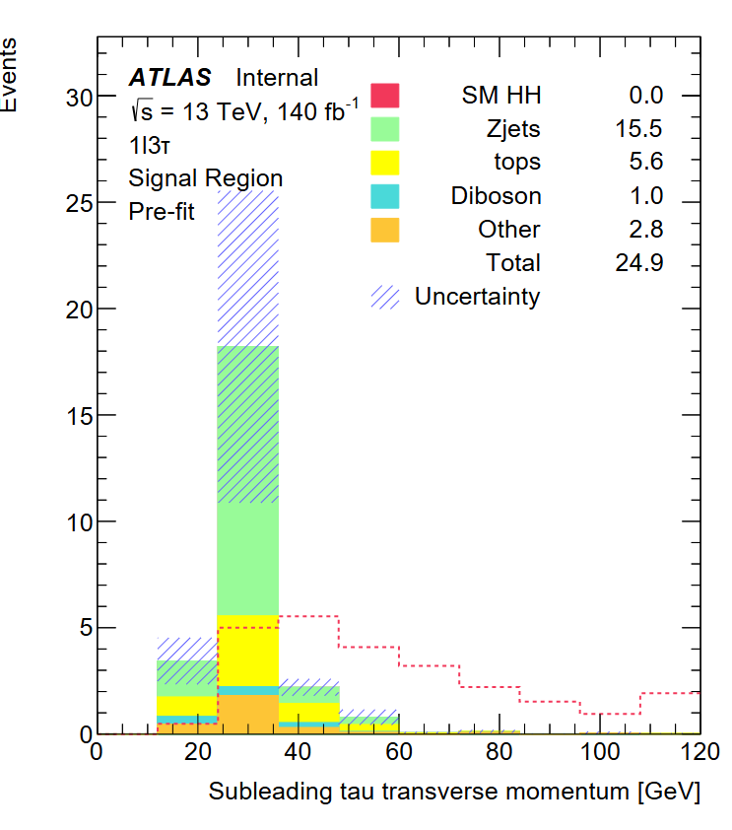
Feature Distributions

Slide 5
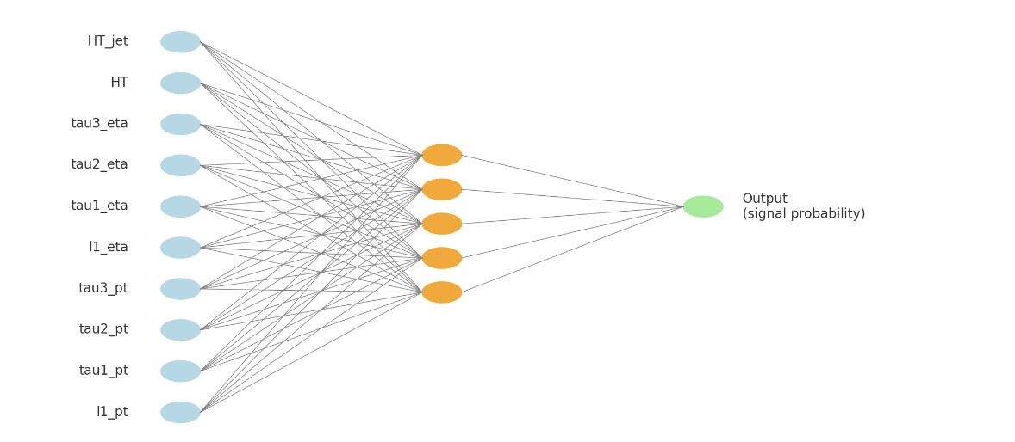
Machine Learning Model
Multilayer Perceptron Network (MLP)
200 epochs
80% of the data was used for training and 20% for validation

Slide 6
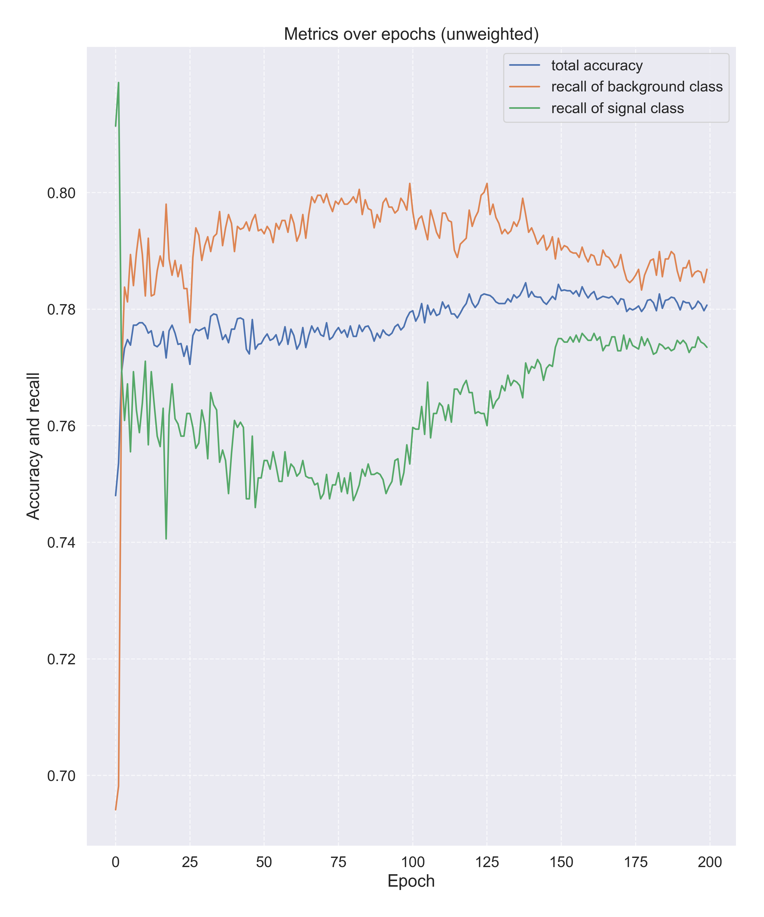
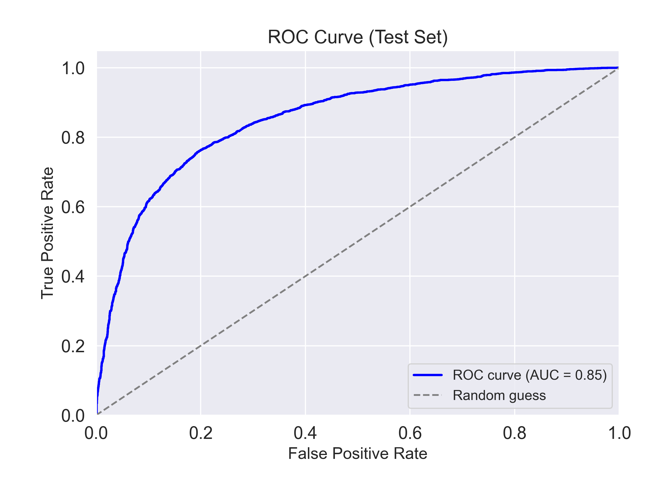
Training results

Slide 7
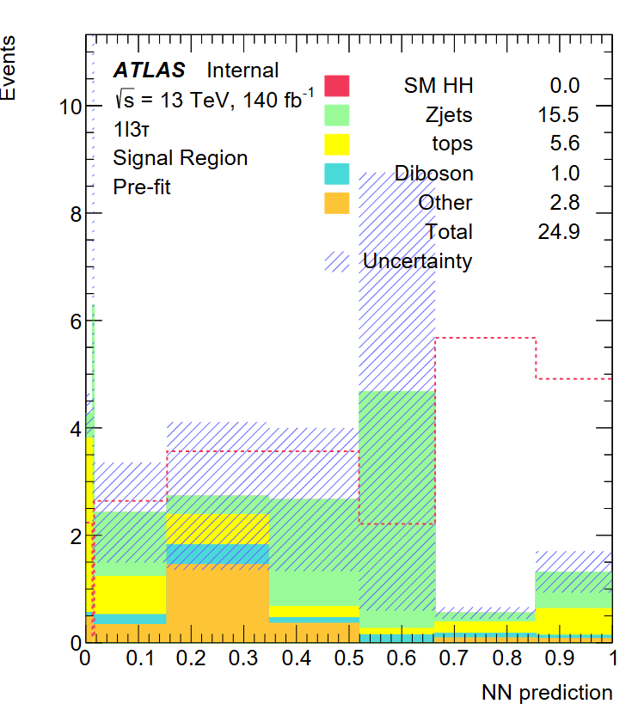
Results
The dashed red line
corresponds to the
HH signal normalized
to the number of
background events.

Slide 8
Conclusions
Analysis of HH in the 1l3tau channel to separate signal and background completed
Good separation of signal and background in the simulated data
Z+jets is the prominent background
Next:
Determination of sensitivity

Slide 9
Thank you for your attention
Q&A

Slide 10
Backups

Slide 11
The loss function of choice for this is Binary Cross Entropy Loss (BCELoss). Mathematically, it is written as l = mean(wn ×[yn ×log(xn) + (1−yn)×log(1xn)]).

