Slide 1
Characterization of losses in a new septum magnet
Thibaut LEMERCIER
7 August 2025

Slide 2
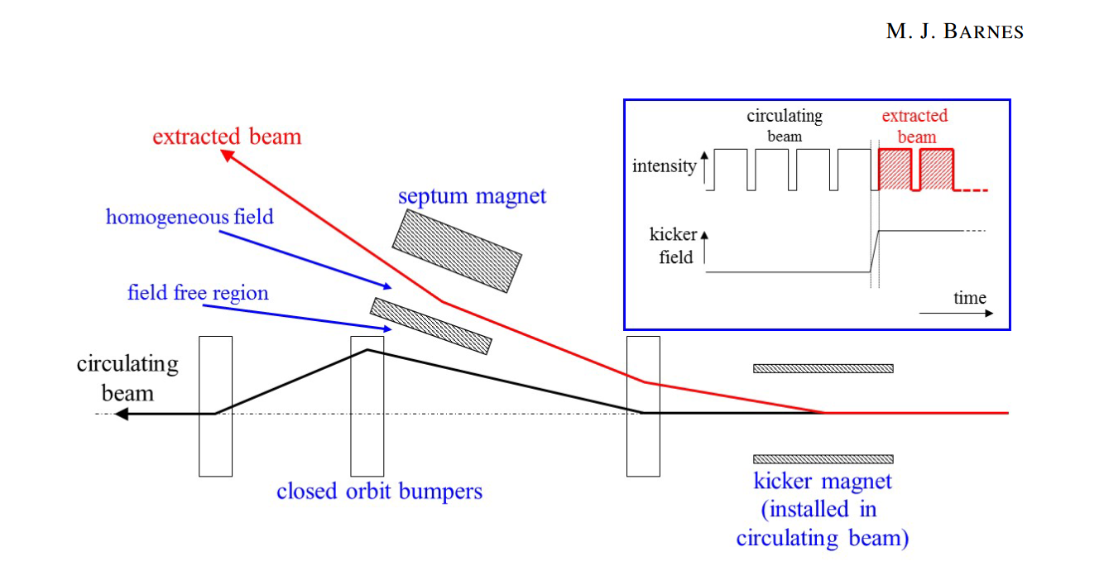
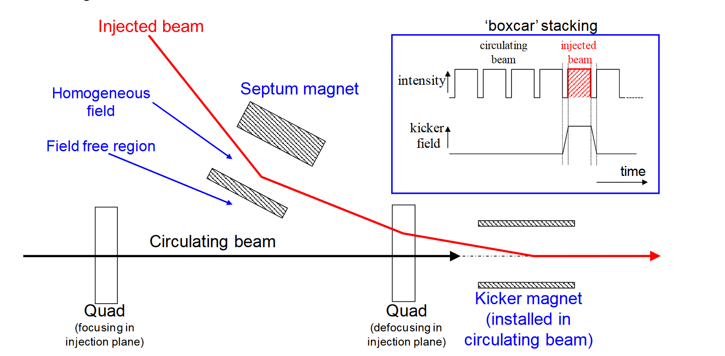
Beam Transfer — A Short Introduction
Key Components of Beam Transfer
Kicker
Perform fast, time-critical deflection
Select specific bunches at the right moment
Provide a small but rapid kick to initiate separation
2. Septum
Provide larger, spatial beam deflection
Operate at slower speeds than kickers
Direct the beam to the new path after the kicker deflection

Slide 3
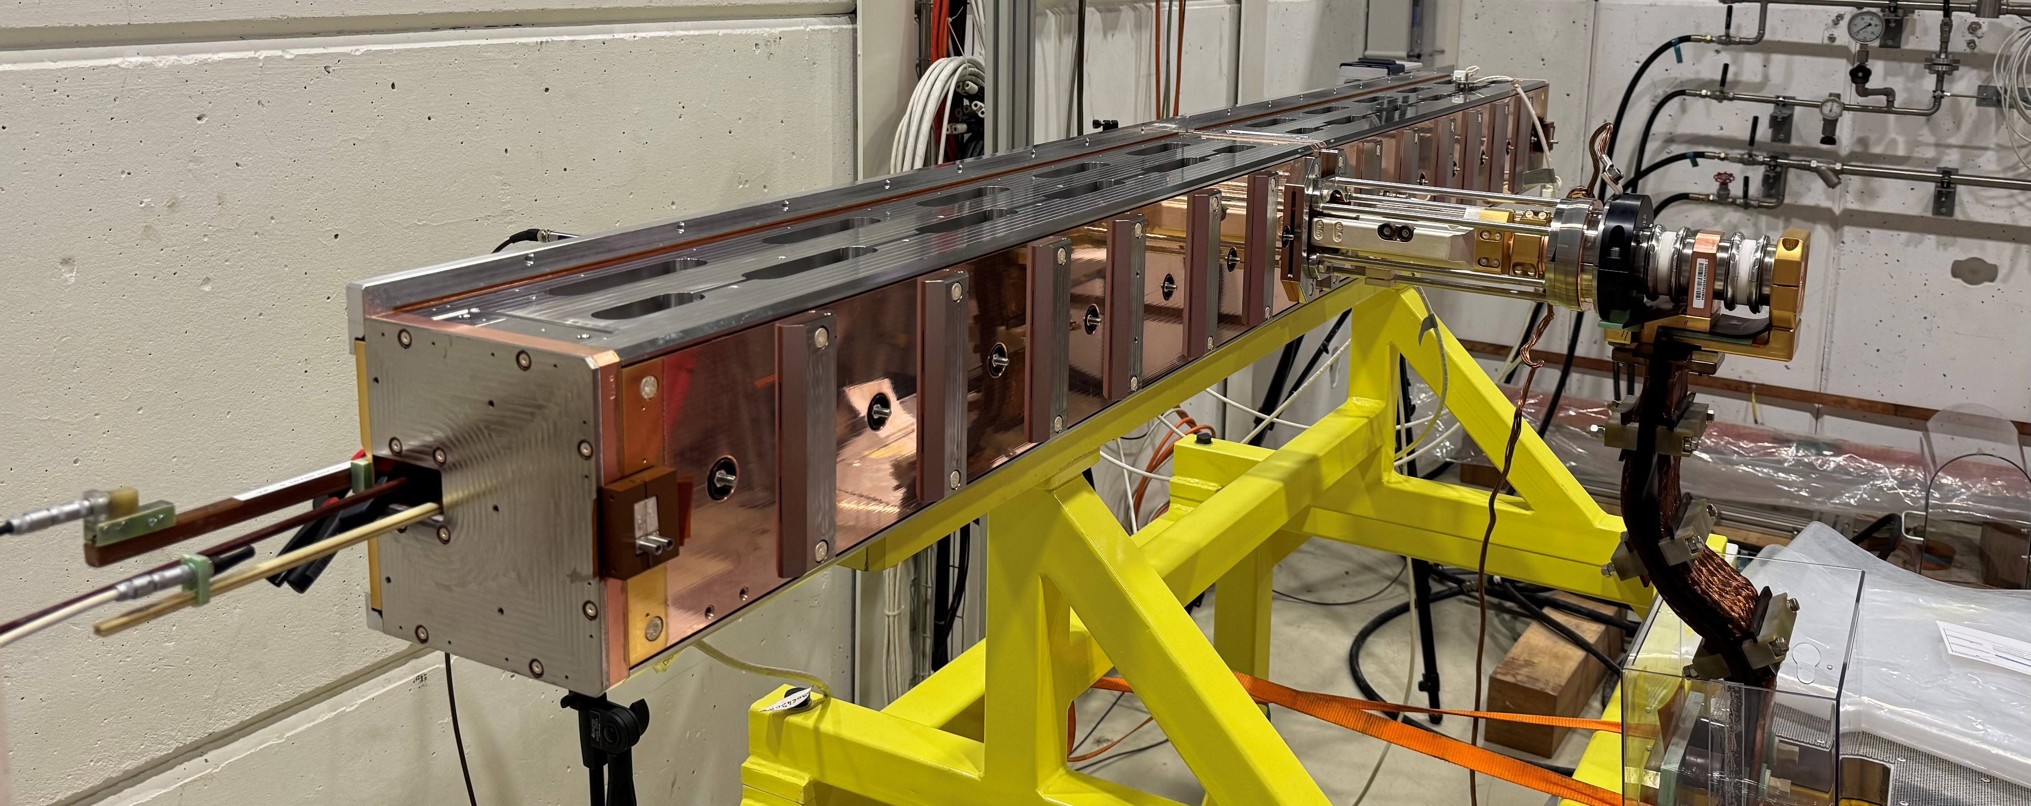
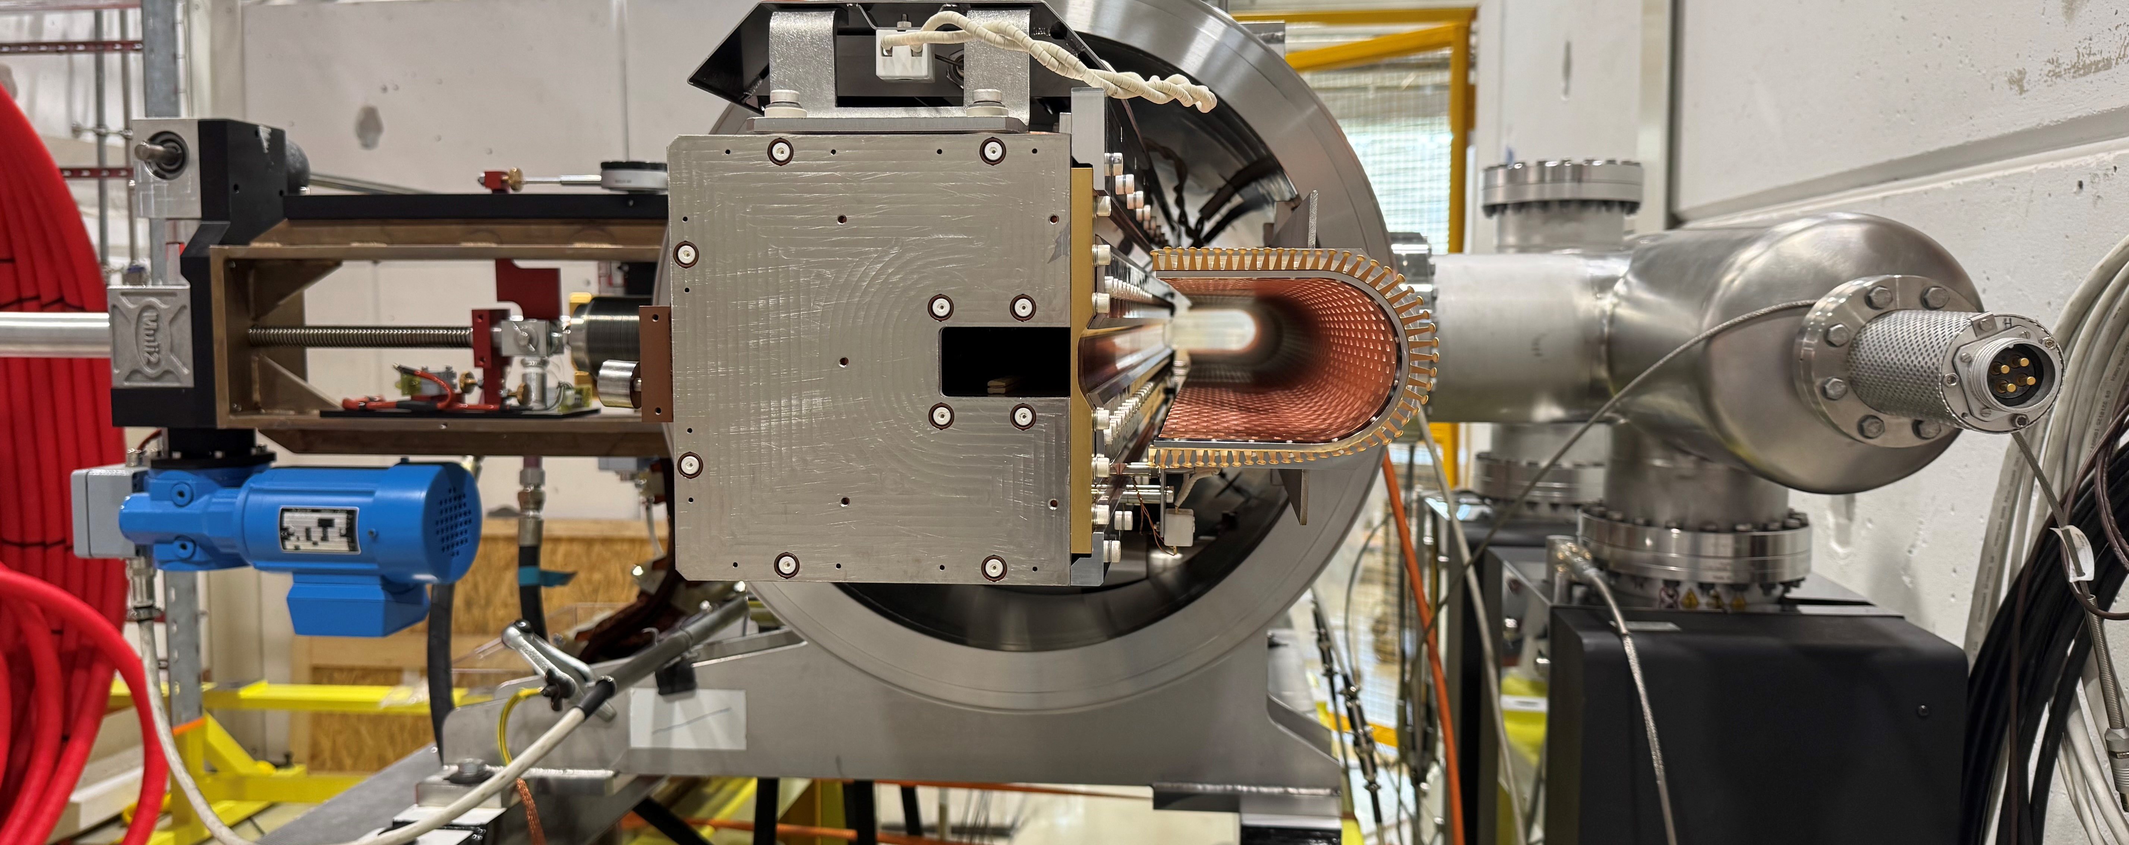
A new magnetic septum for PS Extraction
Why Do We Need a New Septum?
Existing septum is exposed to intense radiation due to beam-blade interactions.
Current septum needs replacing every ~2 years, increasing maintenance and radiation exposure to personnel.
The project aims to develop an alternative topology: the eddy current septum
What Is an Eddy Current Septum?
Powered by high-current pulses :
28.5 kA, 2500 Hz, 1.2 s between pulses
Fast pulses generate eddy currents in a conductor
These induced currents oppose the magnetic field (via Lenz's Law), shielding the field-free region

Slide 4
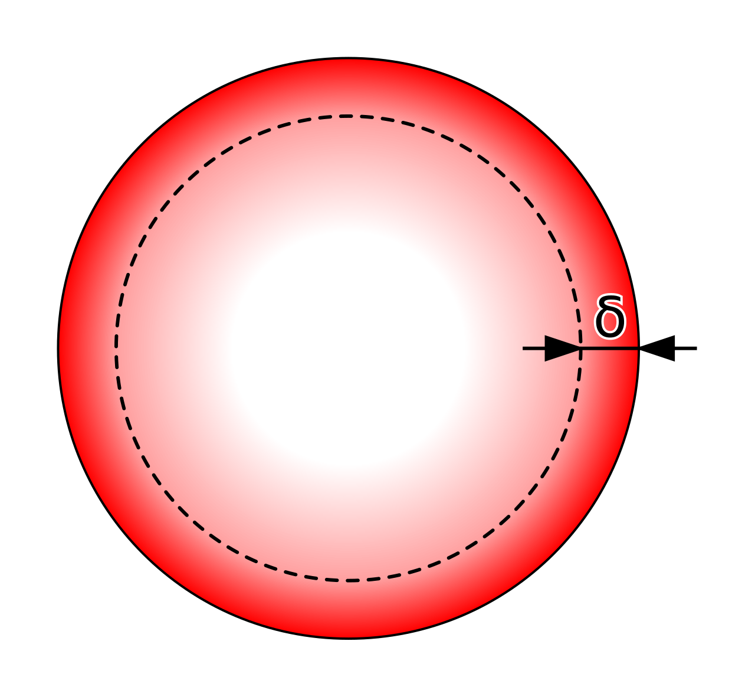
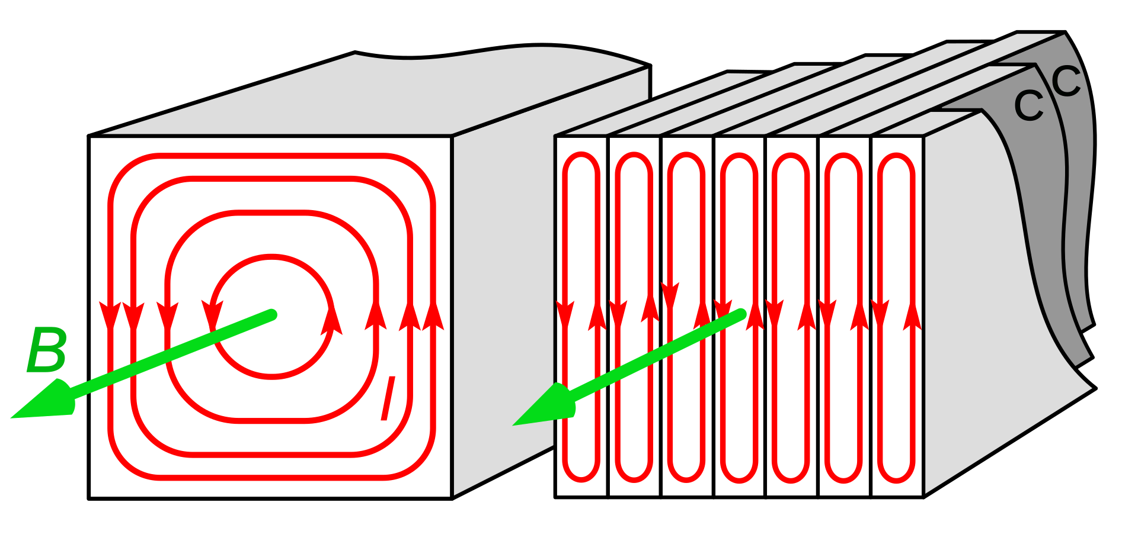
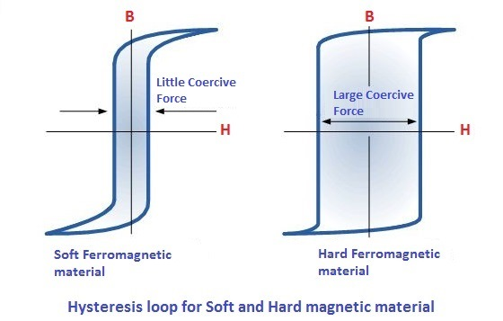
Losses in a Pulsed Magnet
Copper Losses
Caused by the electrical resistance of copper in the windings and the septum blade
At high frequency, the skin effect increases the copper losses.
Iron Losses (Occur in the magnetic yoke)
Eddy Current Losses : Comparable to how induction cooktops heat metal
Hysteresis Losses : Due to the non-linear magnetization properties of iron
Mechanical Losses
Magnetic forces induce small vibrations
Since displacement is minimal, mechanical work is considered negligible
Skin Effect
Eddy currents
Hysteresis Loop

Slide 5
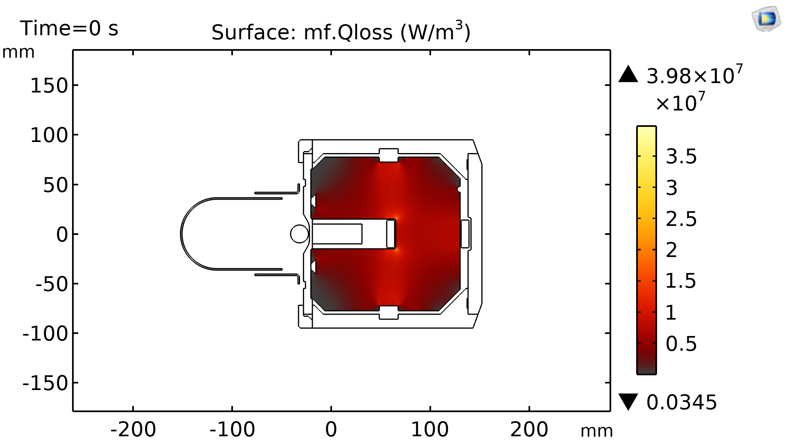
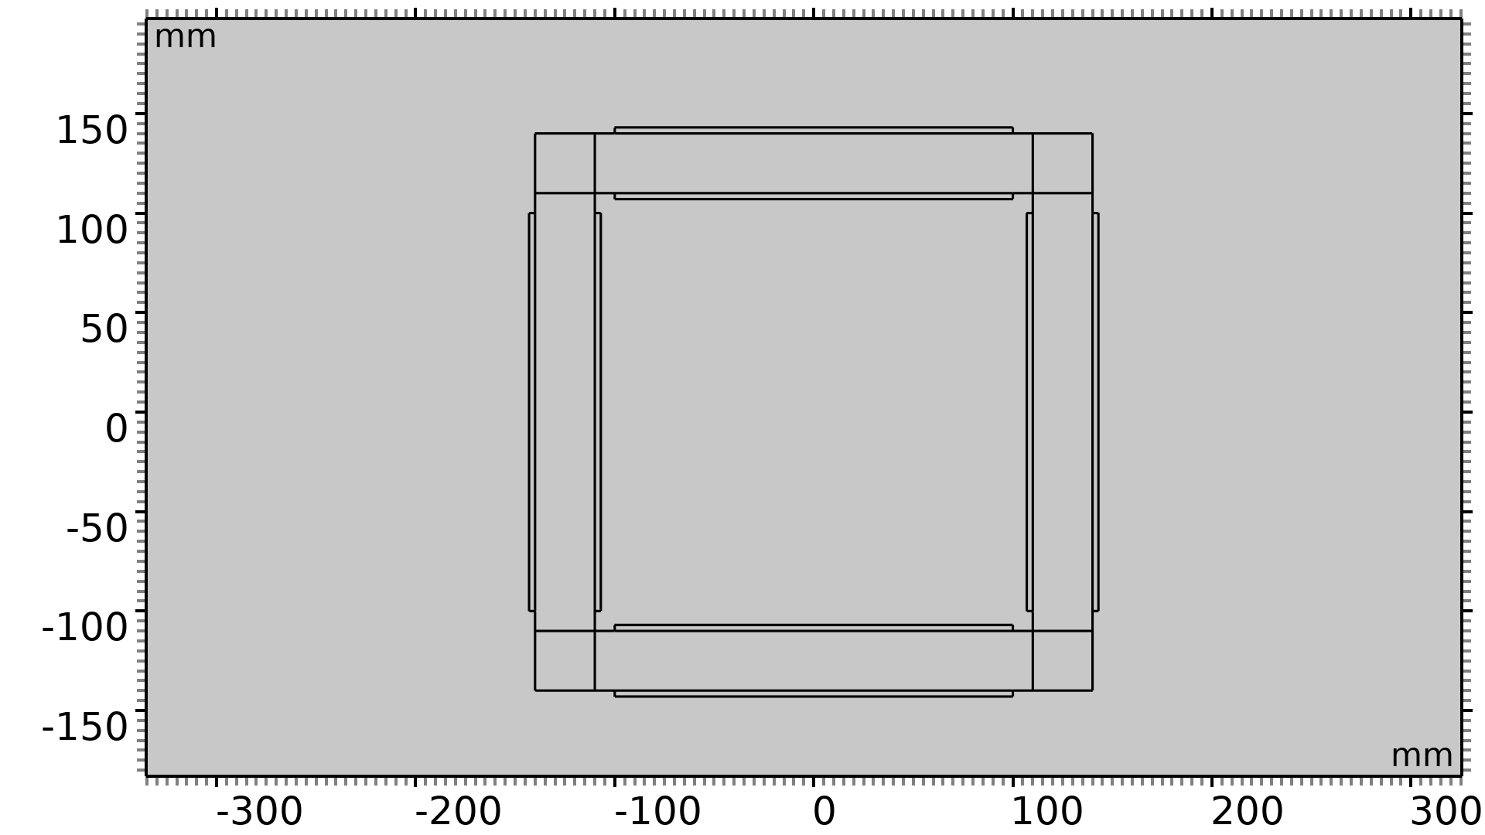
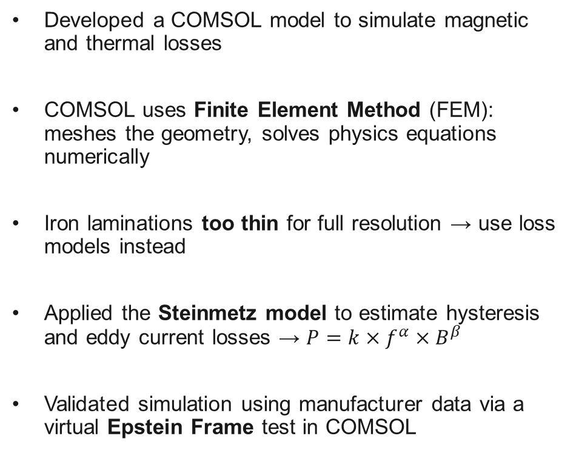
FEM Simulations
Developed a COMSOL model to simulate magnetic and thermal losses
COMSOL uses Finite Element Method (FEM): meshes the geometry, solves physics equations numerically
Iron laminations too thin for full resolution → use loss models instead
Applied the Steinmetz model to estimate hysteresis and eddy current losses → $P=k×f^{α}×B^{β}$
Validated simulation using manufacturer data via a virtual Epstein Frame test in COMSOL
Epstein Frame Model

Slide 6
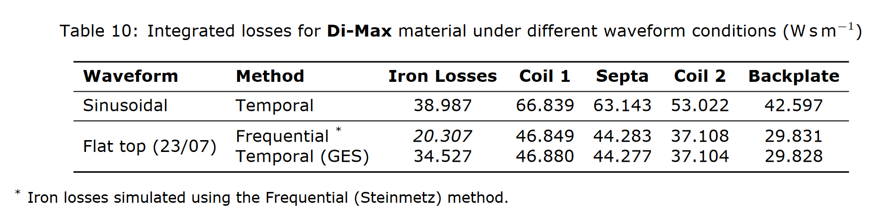
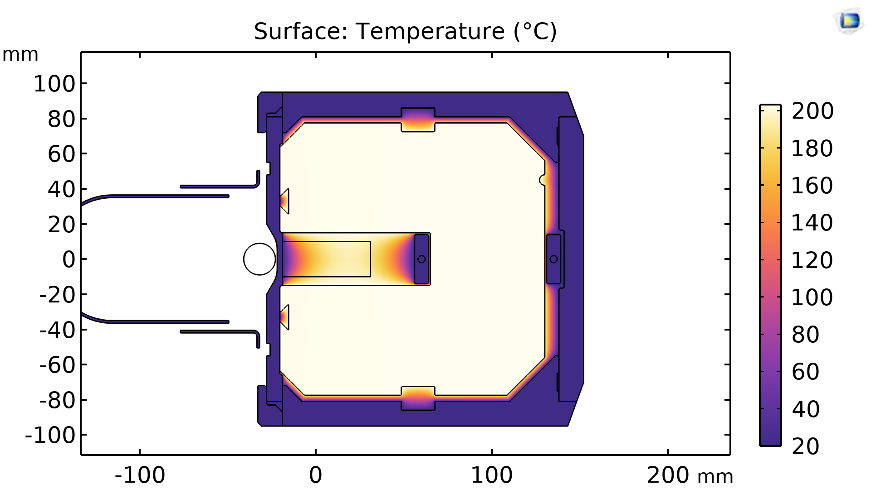
Results
The Epstein Frame simulation matched experimental results → Steinmetz model validated for loss prediction
The total loss is approximately 262 J
A thermal model was also developed → Heating is primarily influenced by the thermal contact resistance between the magnetic core and the copper blade

Slide 7
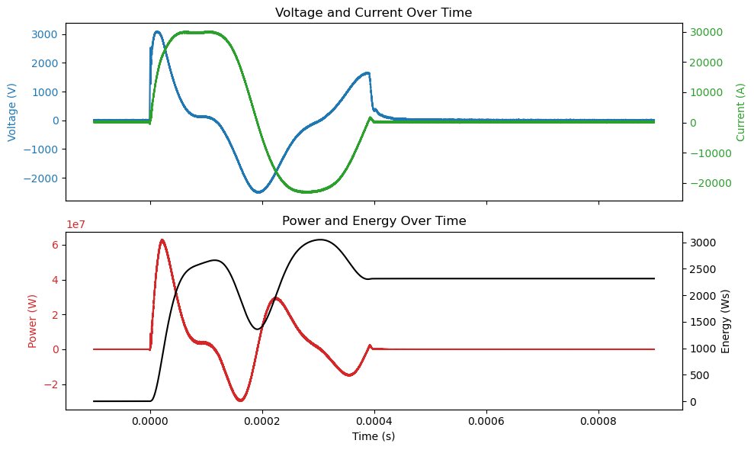
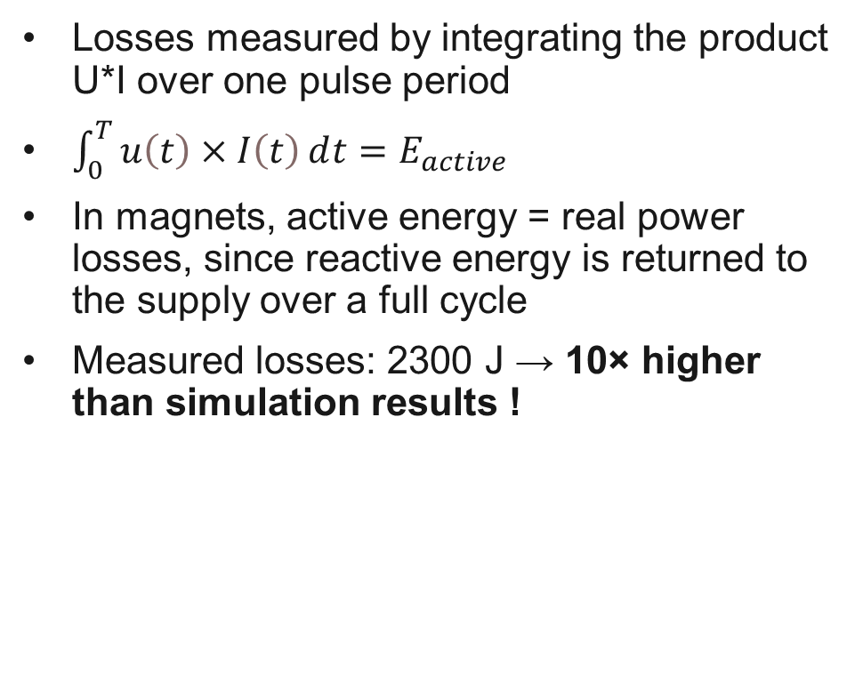
Electrical Measurements
Losses measured by integrating the product U*I over one pulse period
$\int_{0}^{T}{u\left(t\right)×I\left(t\right)ⅆt}=E_{active}$
In magnets, active energy = real power losses, since reactive energy is returned to the supply over a full cycle
Measured losses: 2300 J → 10× higher than simulation results !

Slide 8
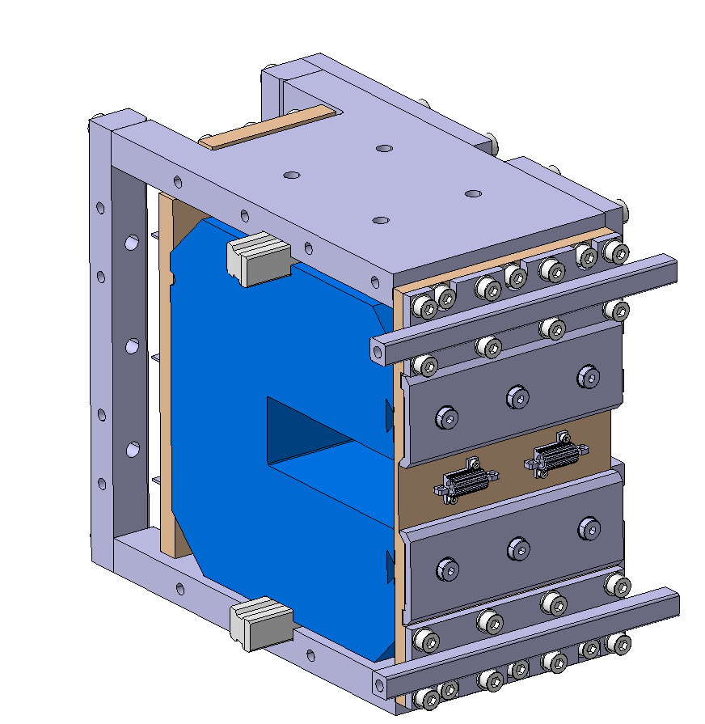
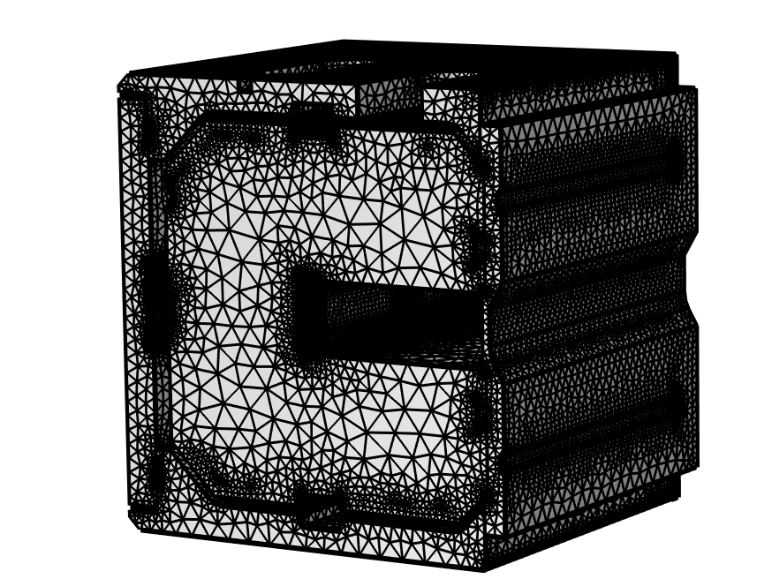
What’s Next?
Build a test stand for thermal and loss characterization
Study heat distribution inside the magnet
Characterize thermal contacts to refine the thermal model
Test the effect of mechanical pressure on the lamination stack → Investigate potential insulation breakdown
Develop a 3D COMSOL model → More accurate simulation of geometry and loss mechanisms
CAD of the test bench
3D COMSOL Model

Slide 9
Thank you for your attention! I’m happy to answer your questions.

