Slide 1


Facility News and Wrap-Up of 2025
A. M. Goillot, P. Alexaki, A. E. Rahmoun, N. Charitonidis
4th December 2025 – 2025 user day

Slide 2
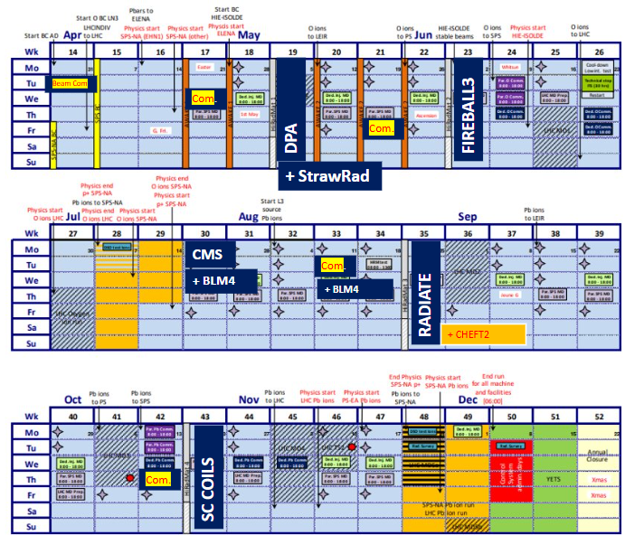
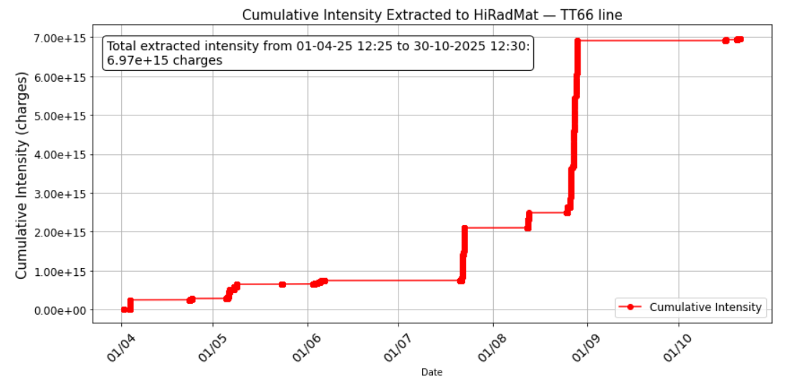
2025 beam times
5 beam times
6 SB approved experiments
1 parasitic one
1 “emergency”
5 facility tests and commissioning
1 low energy (26 GeV) machine development
SC-COILS
Radiate
FIREBALL3
CMS + BLM4
Facility com.
DPA

Slide 3
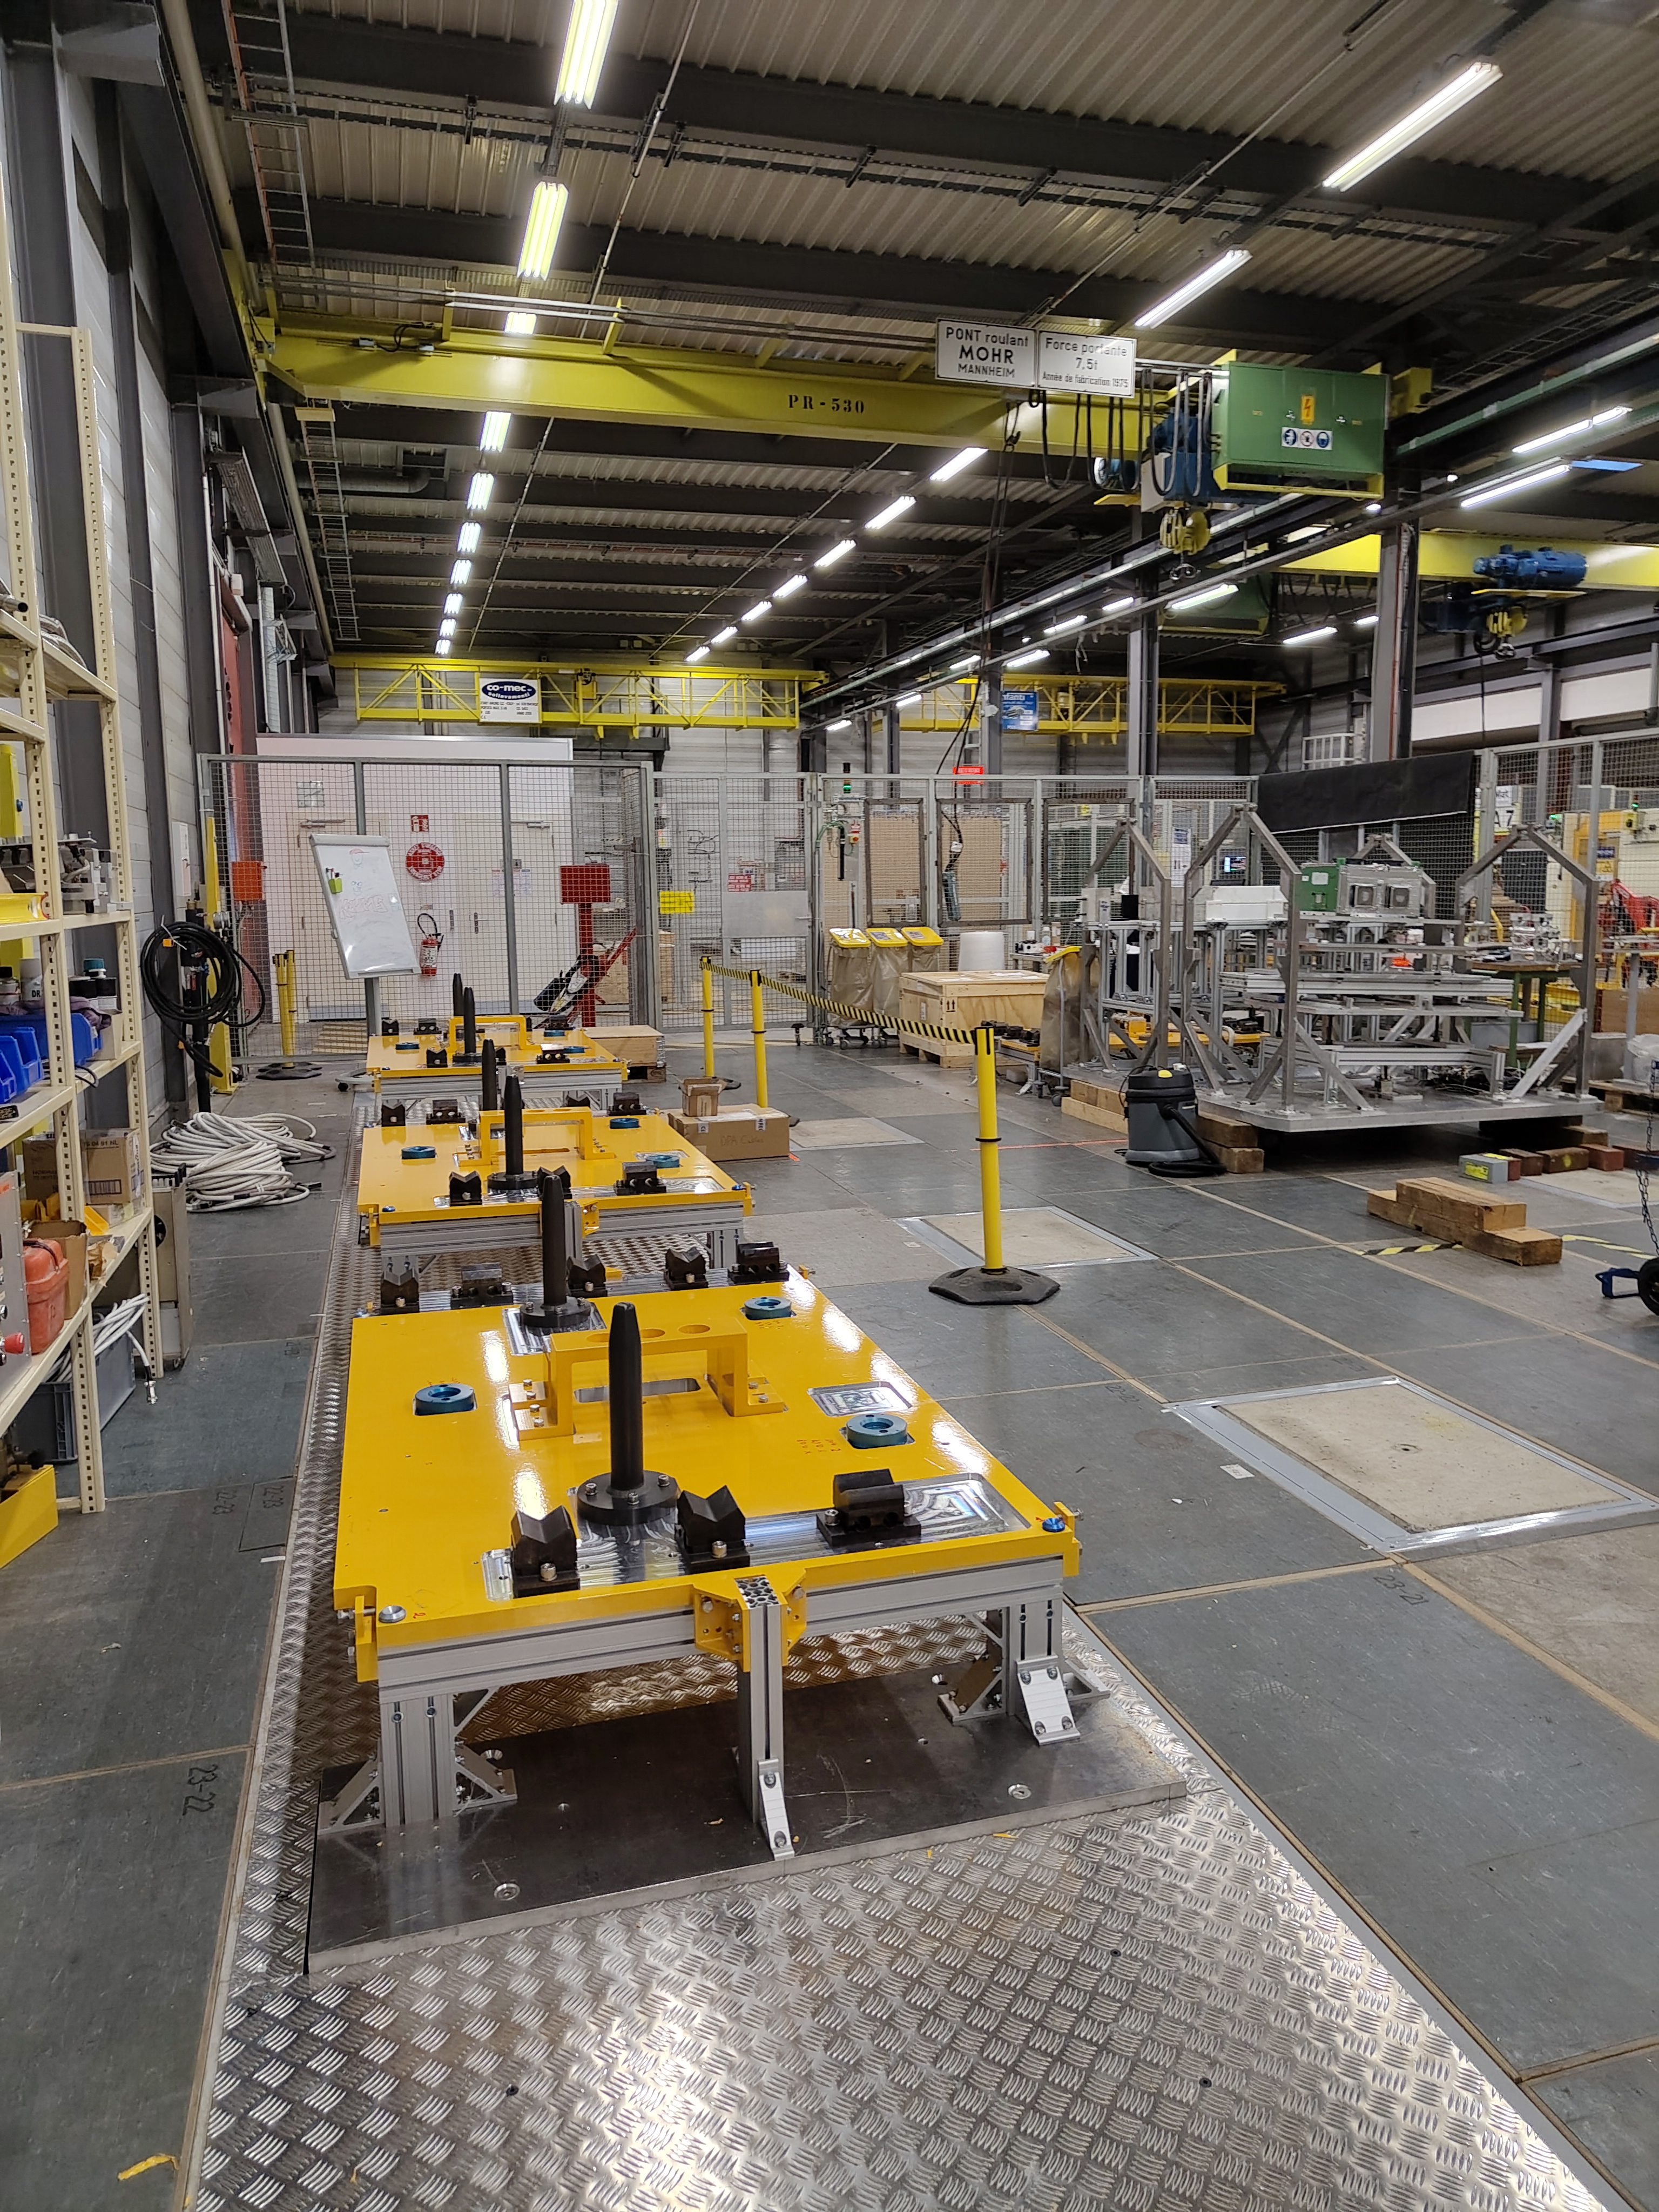
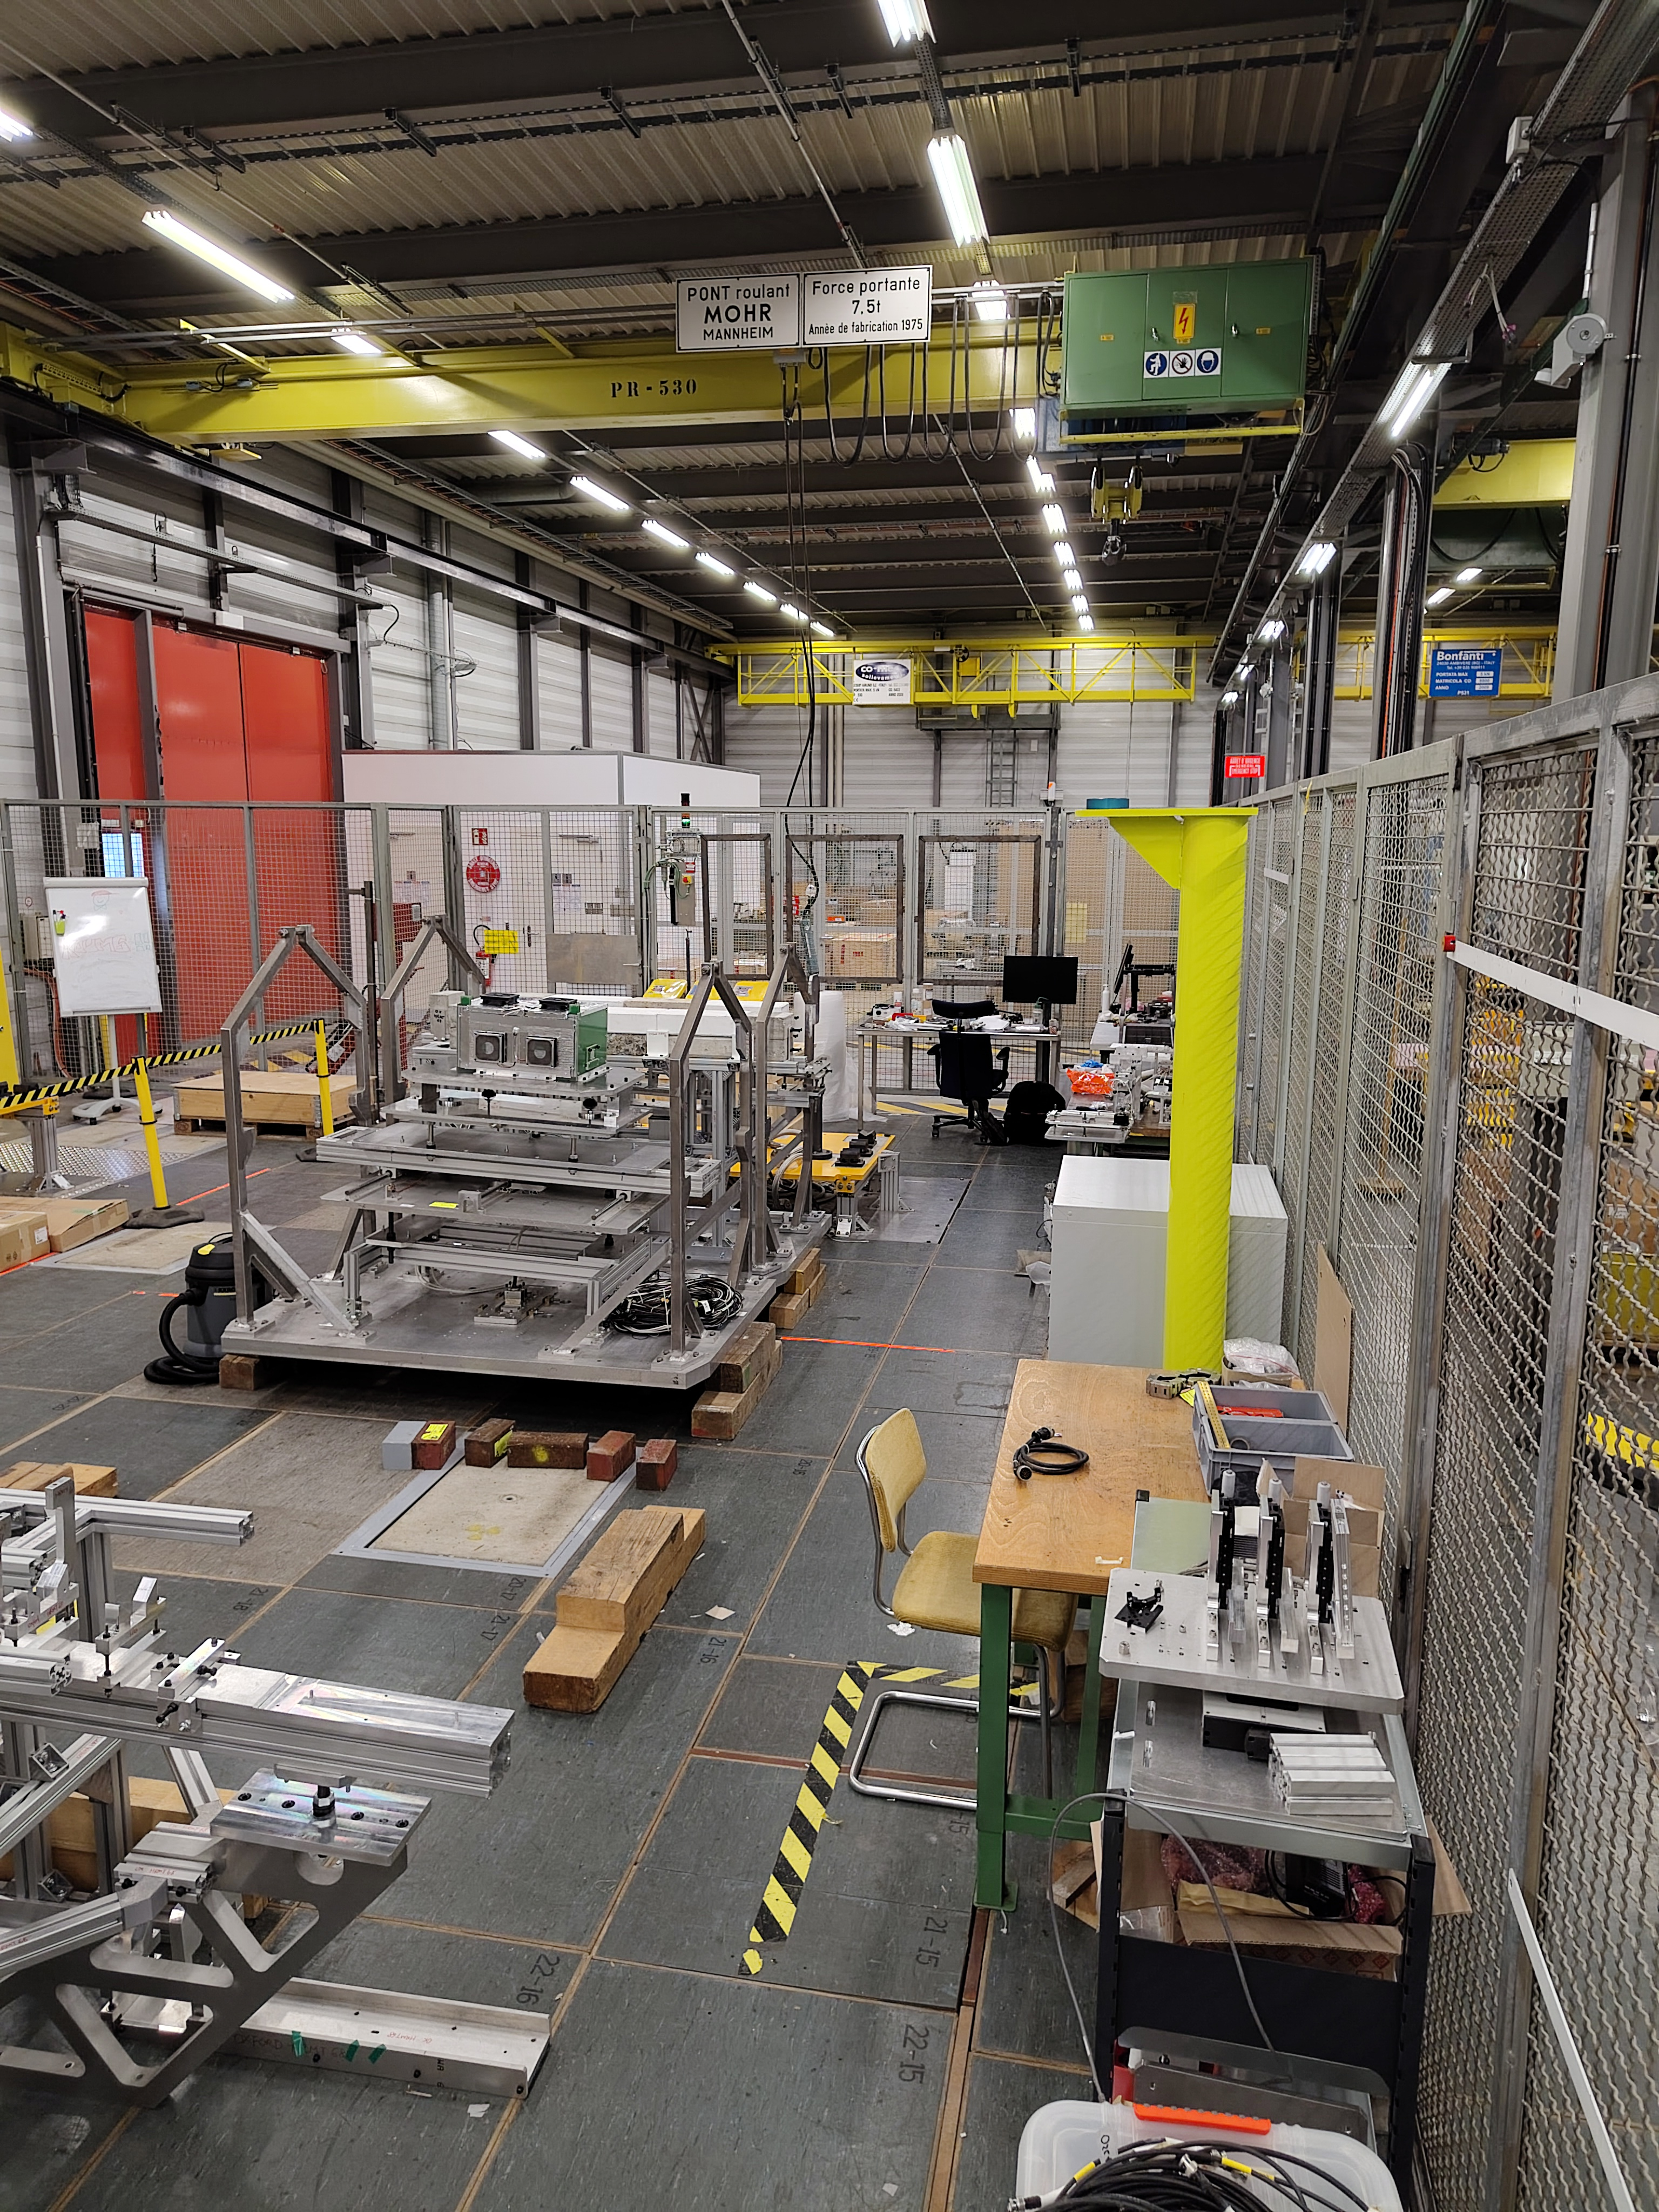
What is new in 2025
Surface lab renovation → fully reproducible setup on the surface, minimizing dose, and allowing for better preparation without access restrictions.
3 new preparation stands
Mechanical and electronical reproduction of tunnel ones
More installation for surveyors
5 concrete stations replacing the false floor inside the surface lab for steady (= precise) measurements
Pole for extra reference points

Slide 4
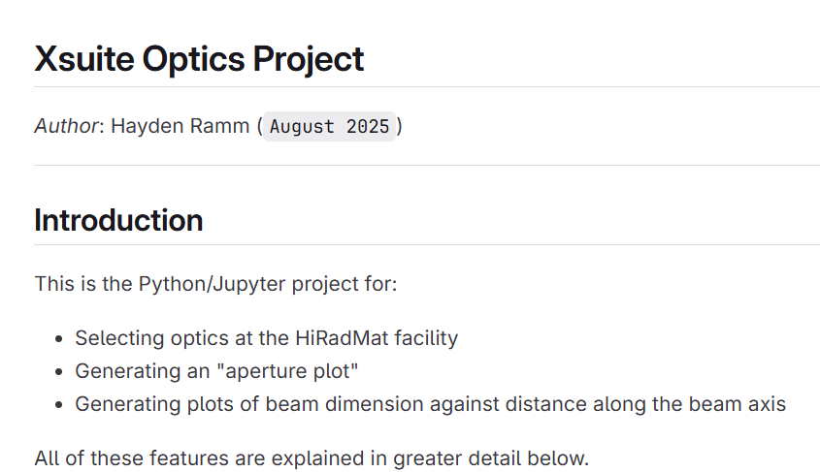
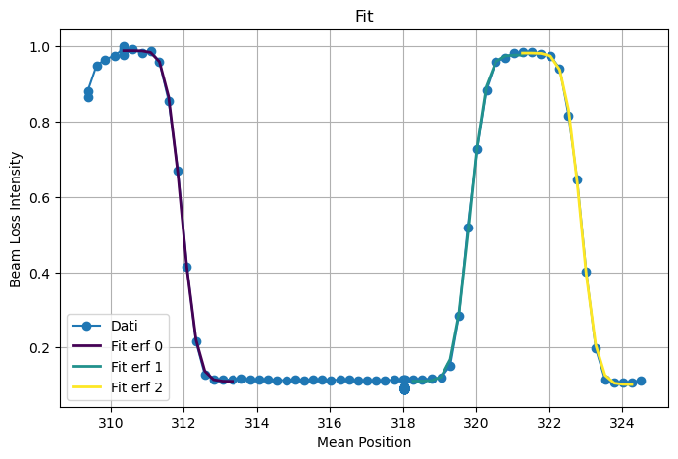
2025 upgrades
Courtesy of Hayden RAMM
Courtesy of Matteo CAPITANI
Softwares
Project to migrate the outdated MAD-X functionality from CERN’s Python cpymad library into the novel, Pythonic XSUITE library.​
Implementing a reliable and stable fit function to the Beam Based Alignment program – crucial for the alignment of the beam with the experimental set up of the teams during the beamtime.

Slide 5
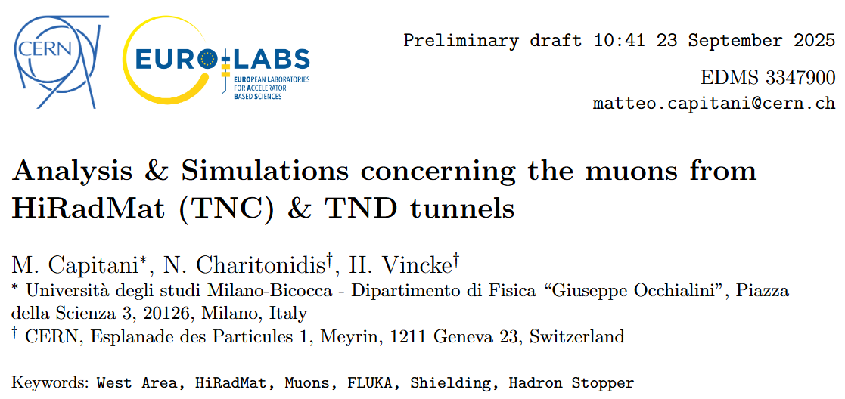
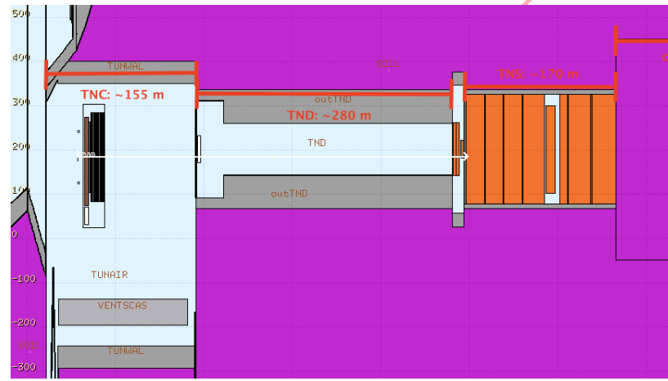
Radiation Protection Studies
Courtesy of Matteo CAPITANI
Radiation Protection study regarding the shielding in the HiRadMat tunnels. Performed FLUKA simulations & in situ measurements to calculate muons fluence generated by the facility at the surface area.

Slide 6
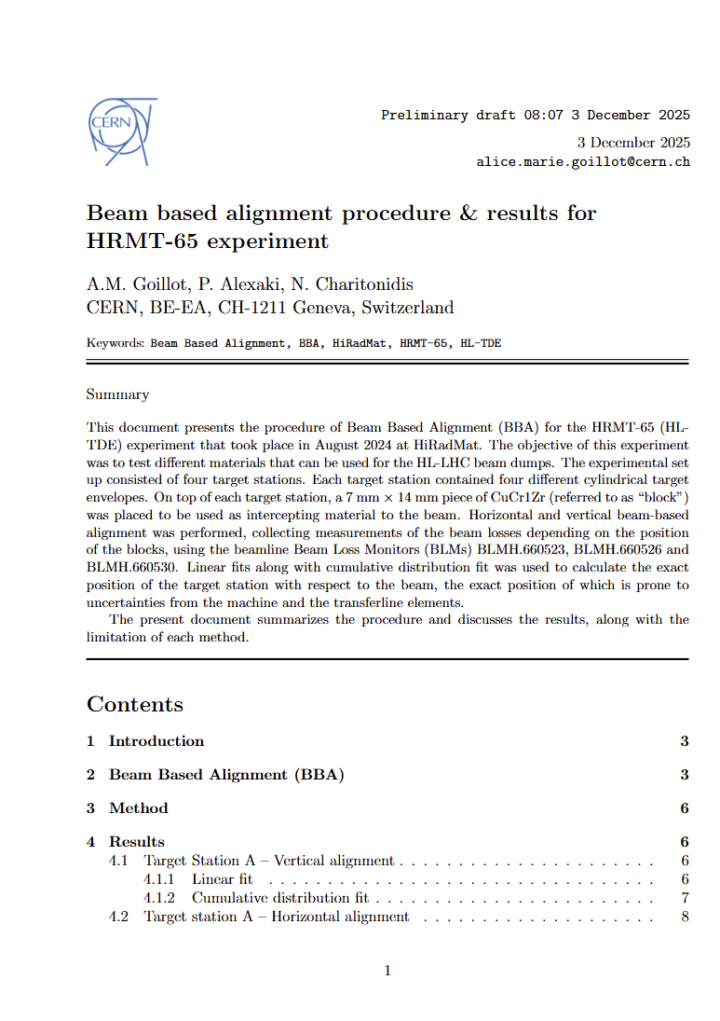
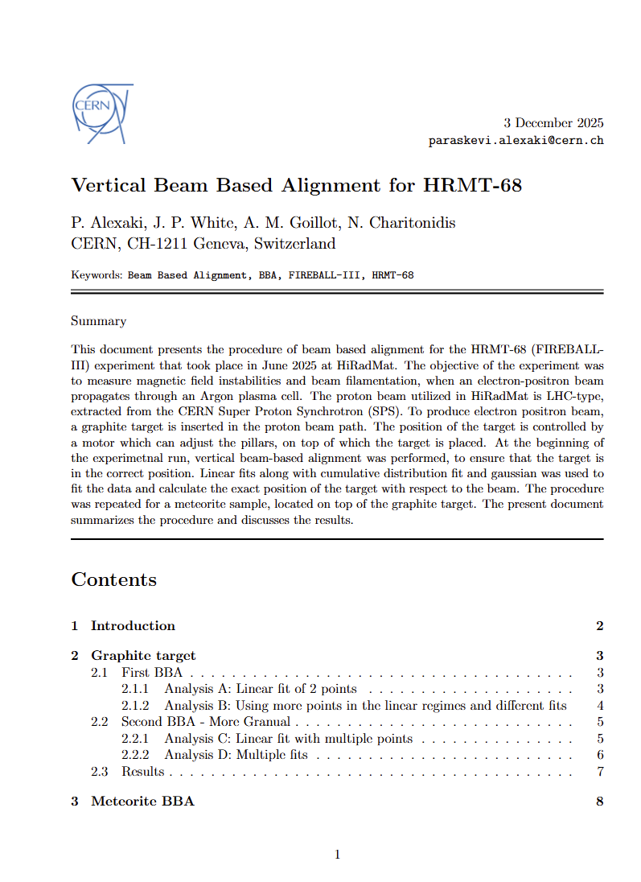
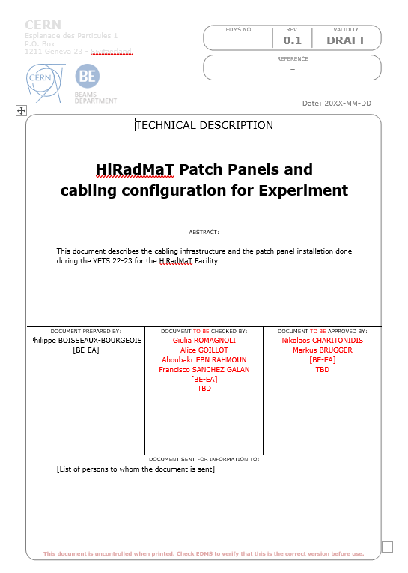
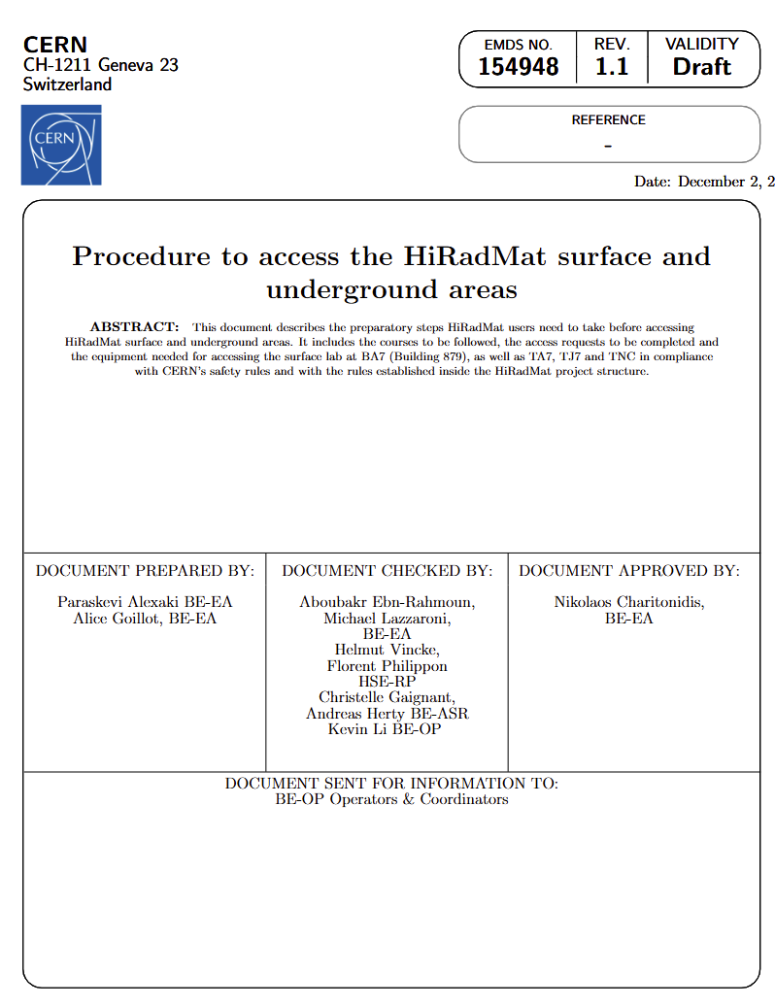
2025 official and technical documentation update
A strong documentation helps us to be more reliable

Slide 7
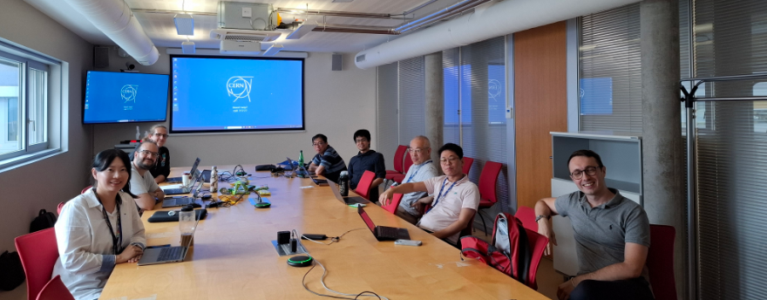
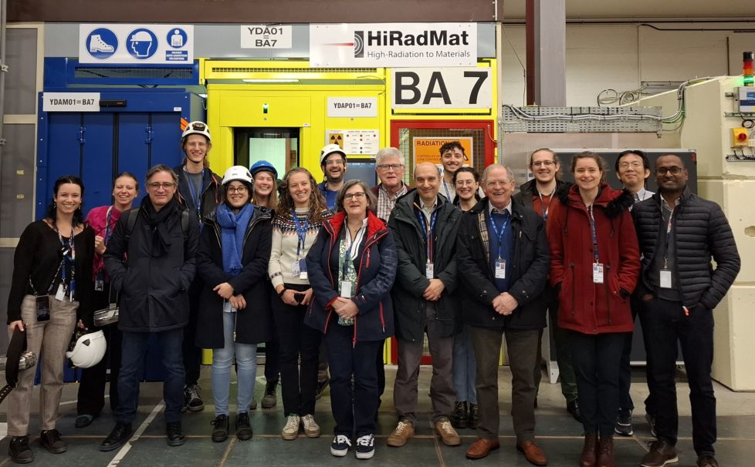
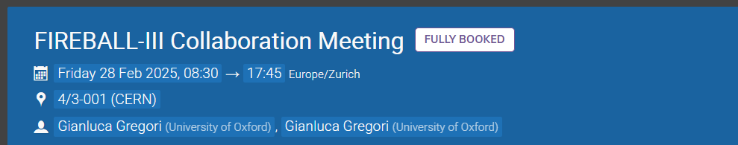
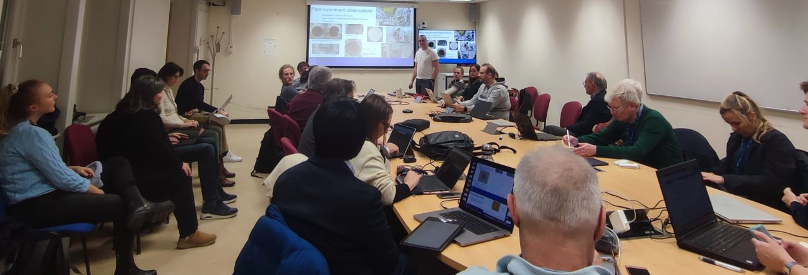
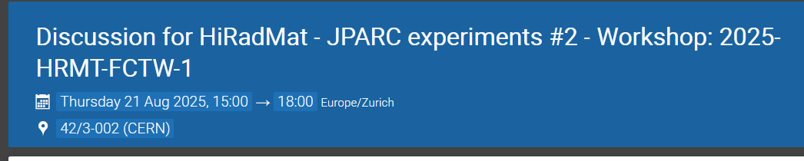
2025 preparing future experiments
Technical support meetings to experiments
Fireball in February
JPARC in August
Technical board
Scientific board
User day!
https://indico.cern.ch/event/1468993/
https://indico.cern.ch/event/1547092/

Slide 8
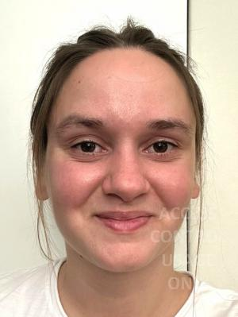
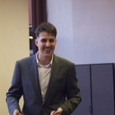
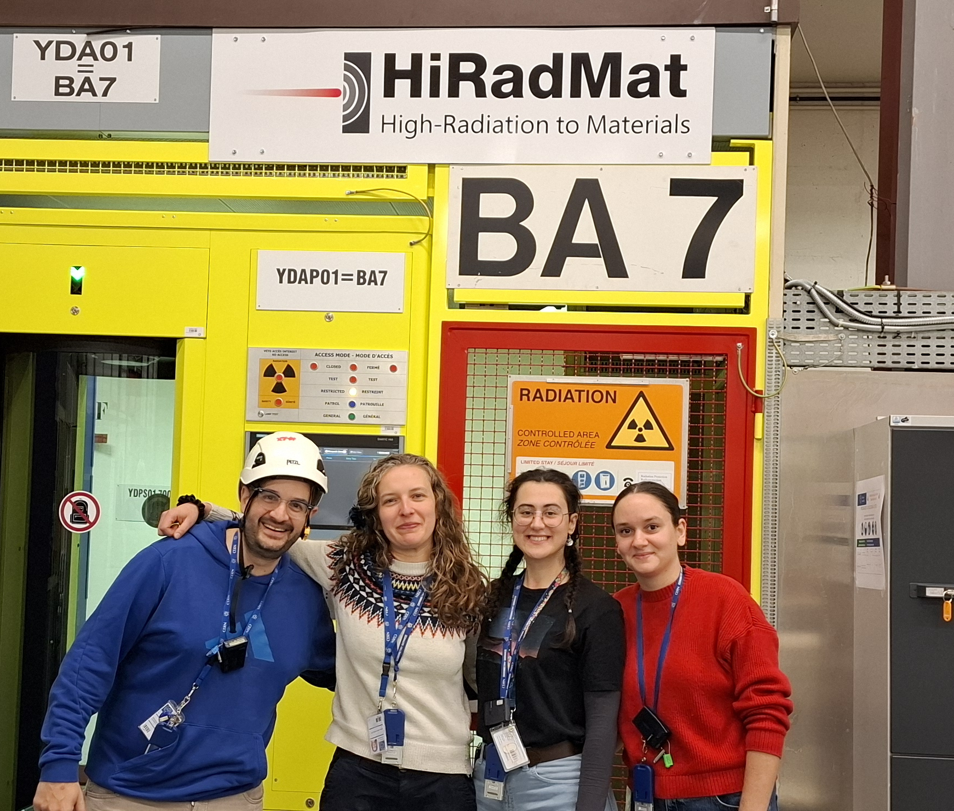
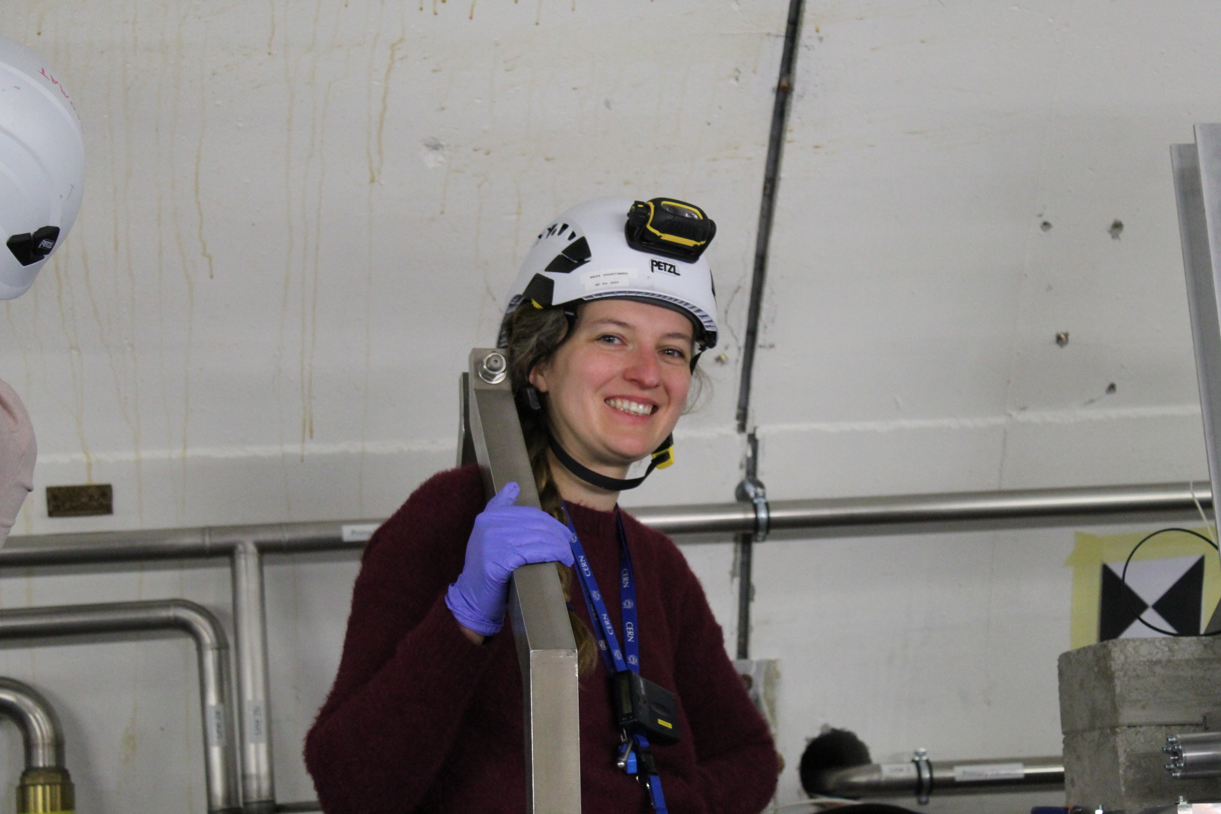
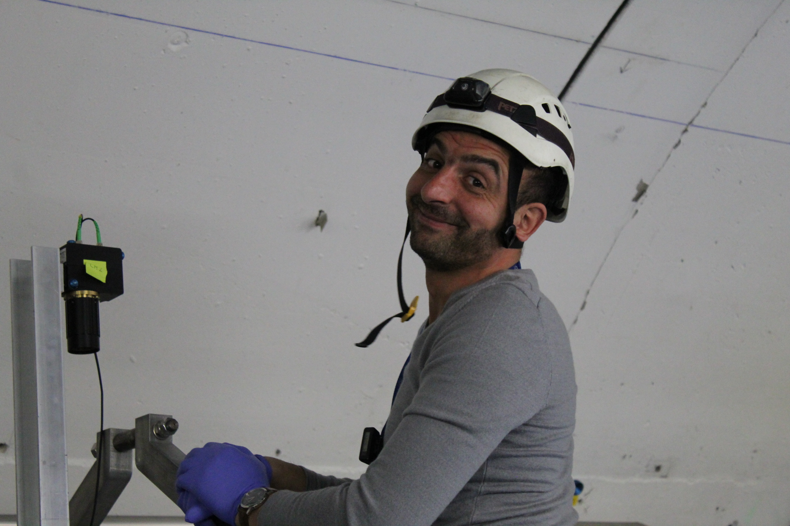
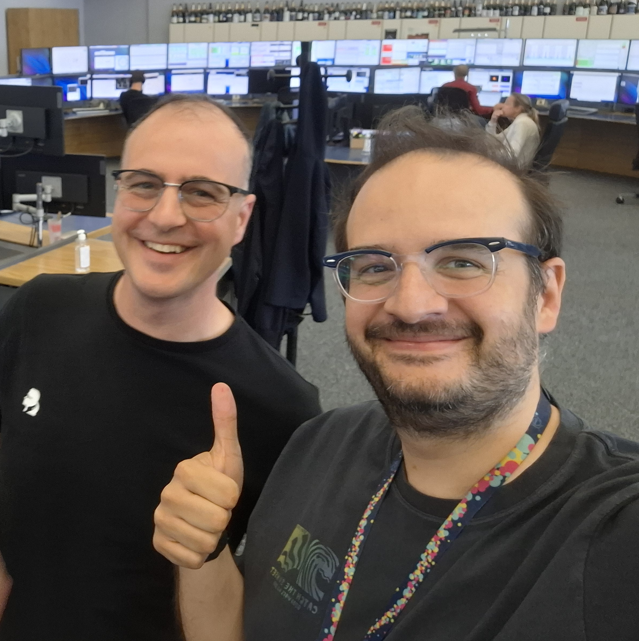
Hiradmat extended team
Paraskevi Alexaki (BE-EA)
Evaluation of novel materials for high - intensity beam diagnostics
Matteo Capitani (EP-SME)
Design and Optimization of a Monitored and Tagged Neutrino beam

Slide 9
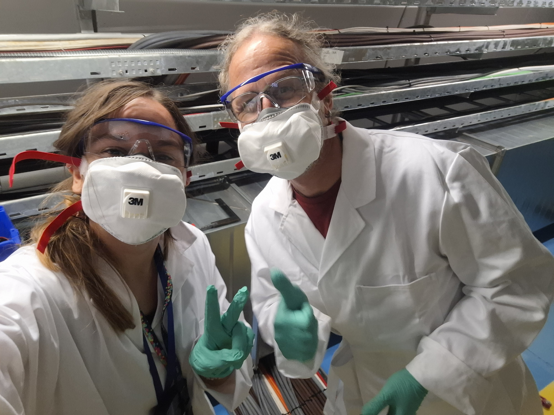
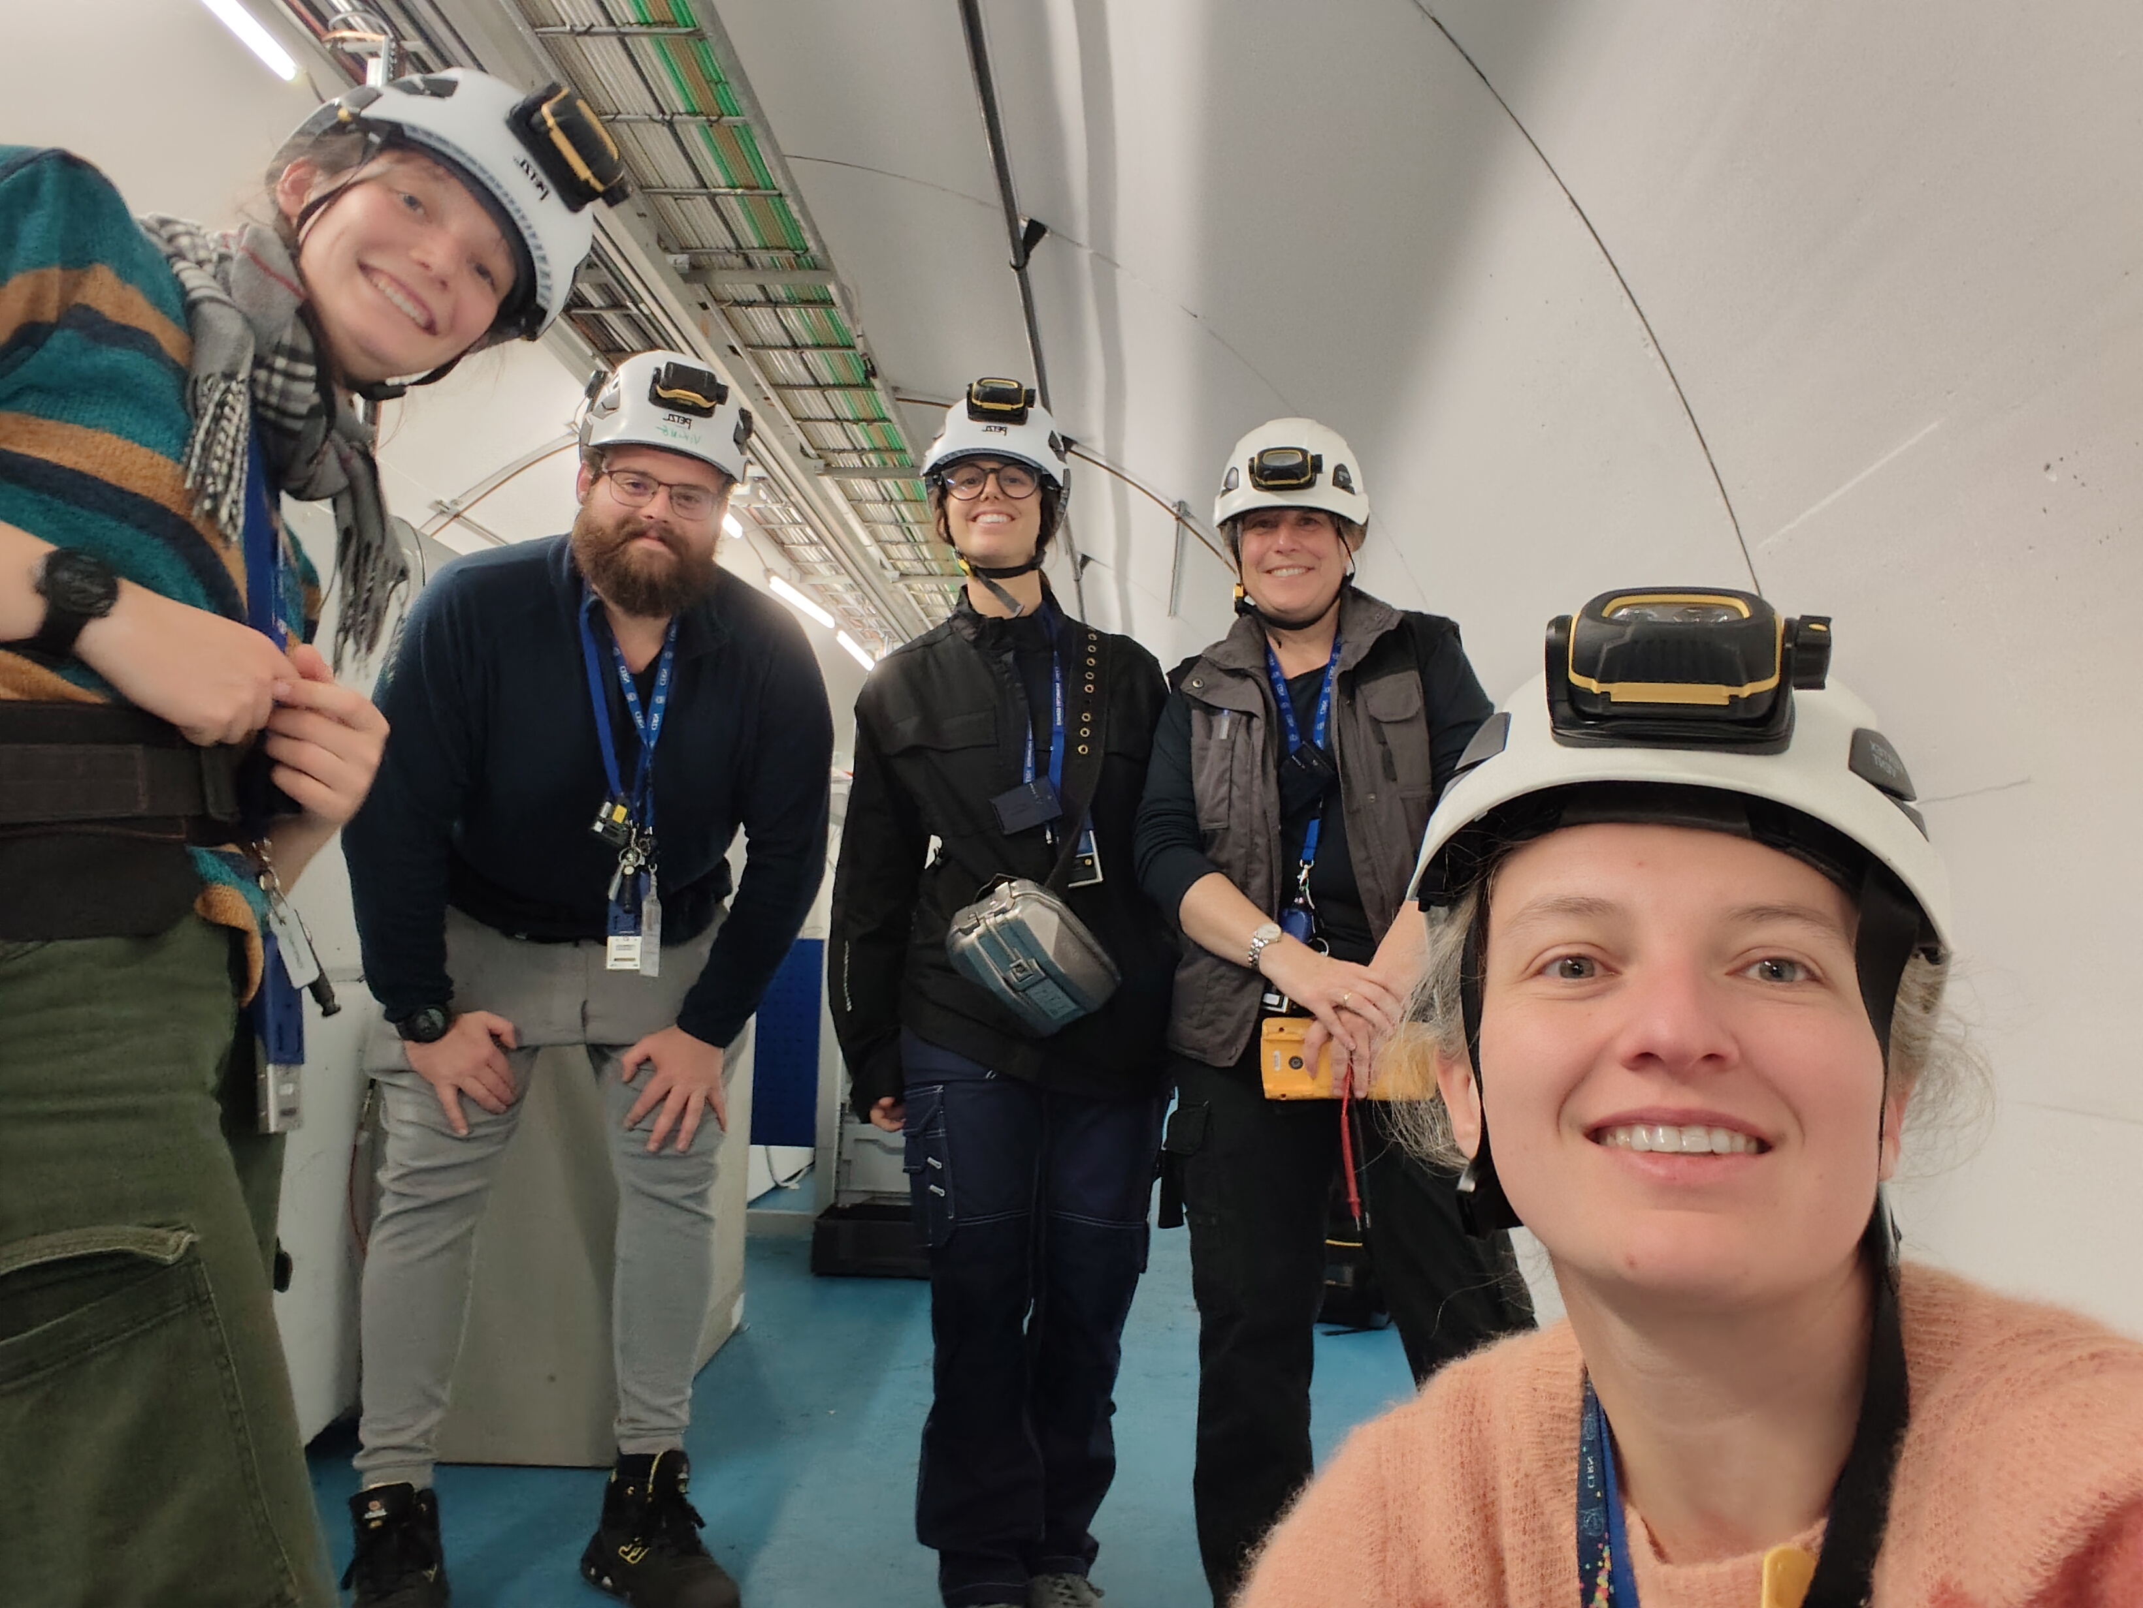
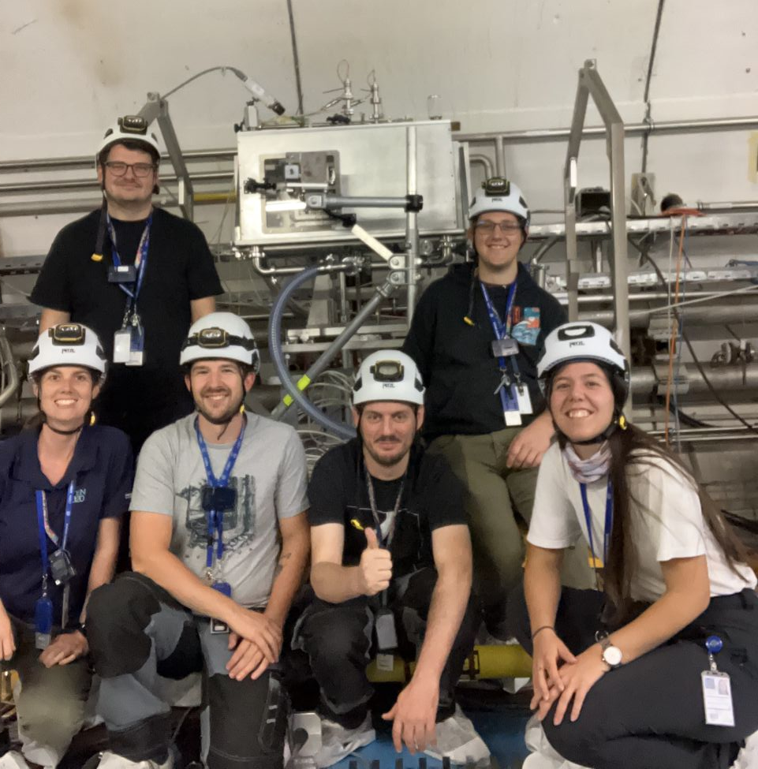
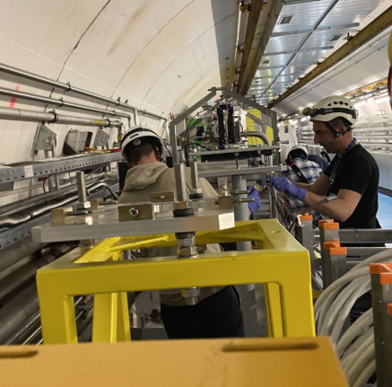
Supporting teams
Beam instrumentation
Survey
Sources, Targets and Interactions
Cooling & Ventilation
Vacuum
Operation
Controls Electronics and Mechatronics
Radiation Protection
Mechanical and Materials Engineering

Slide 10
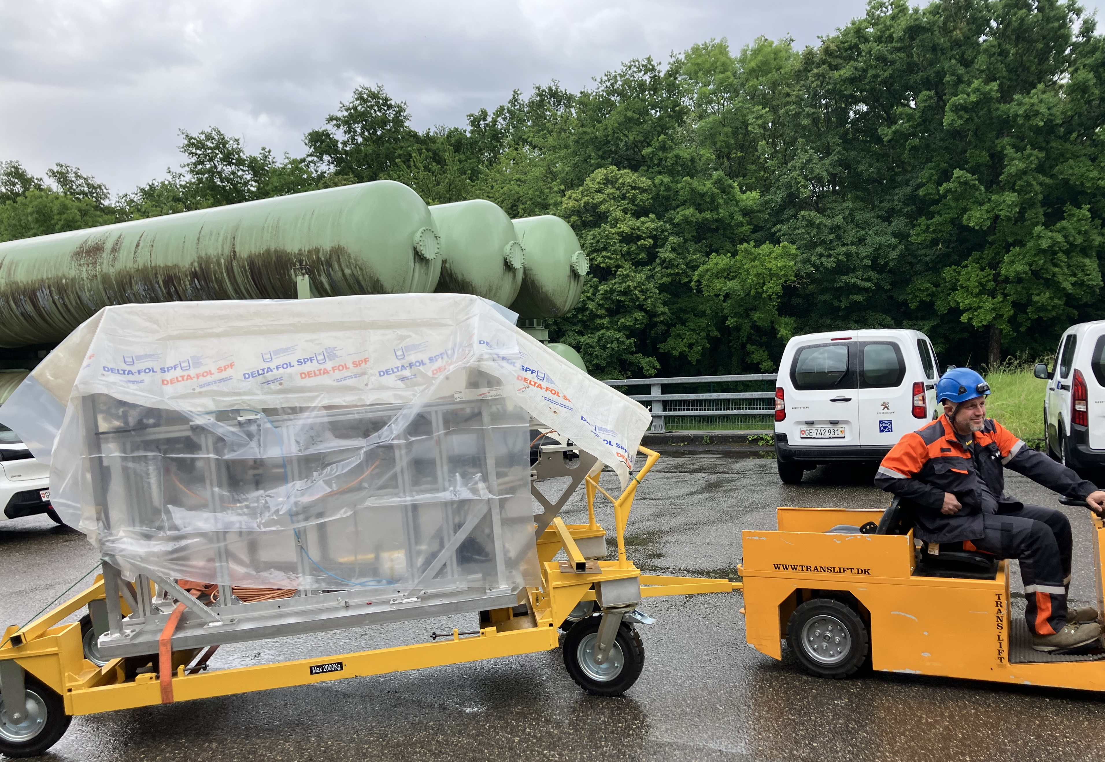
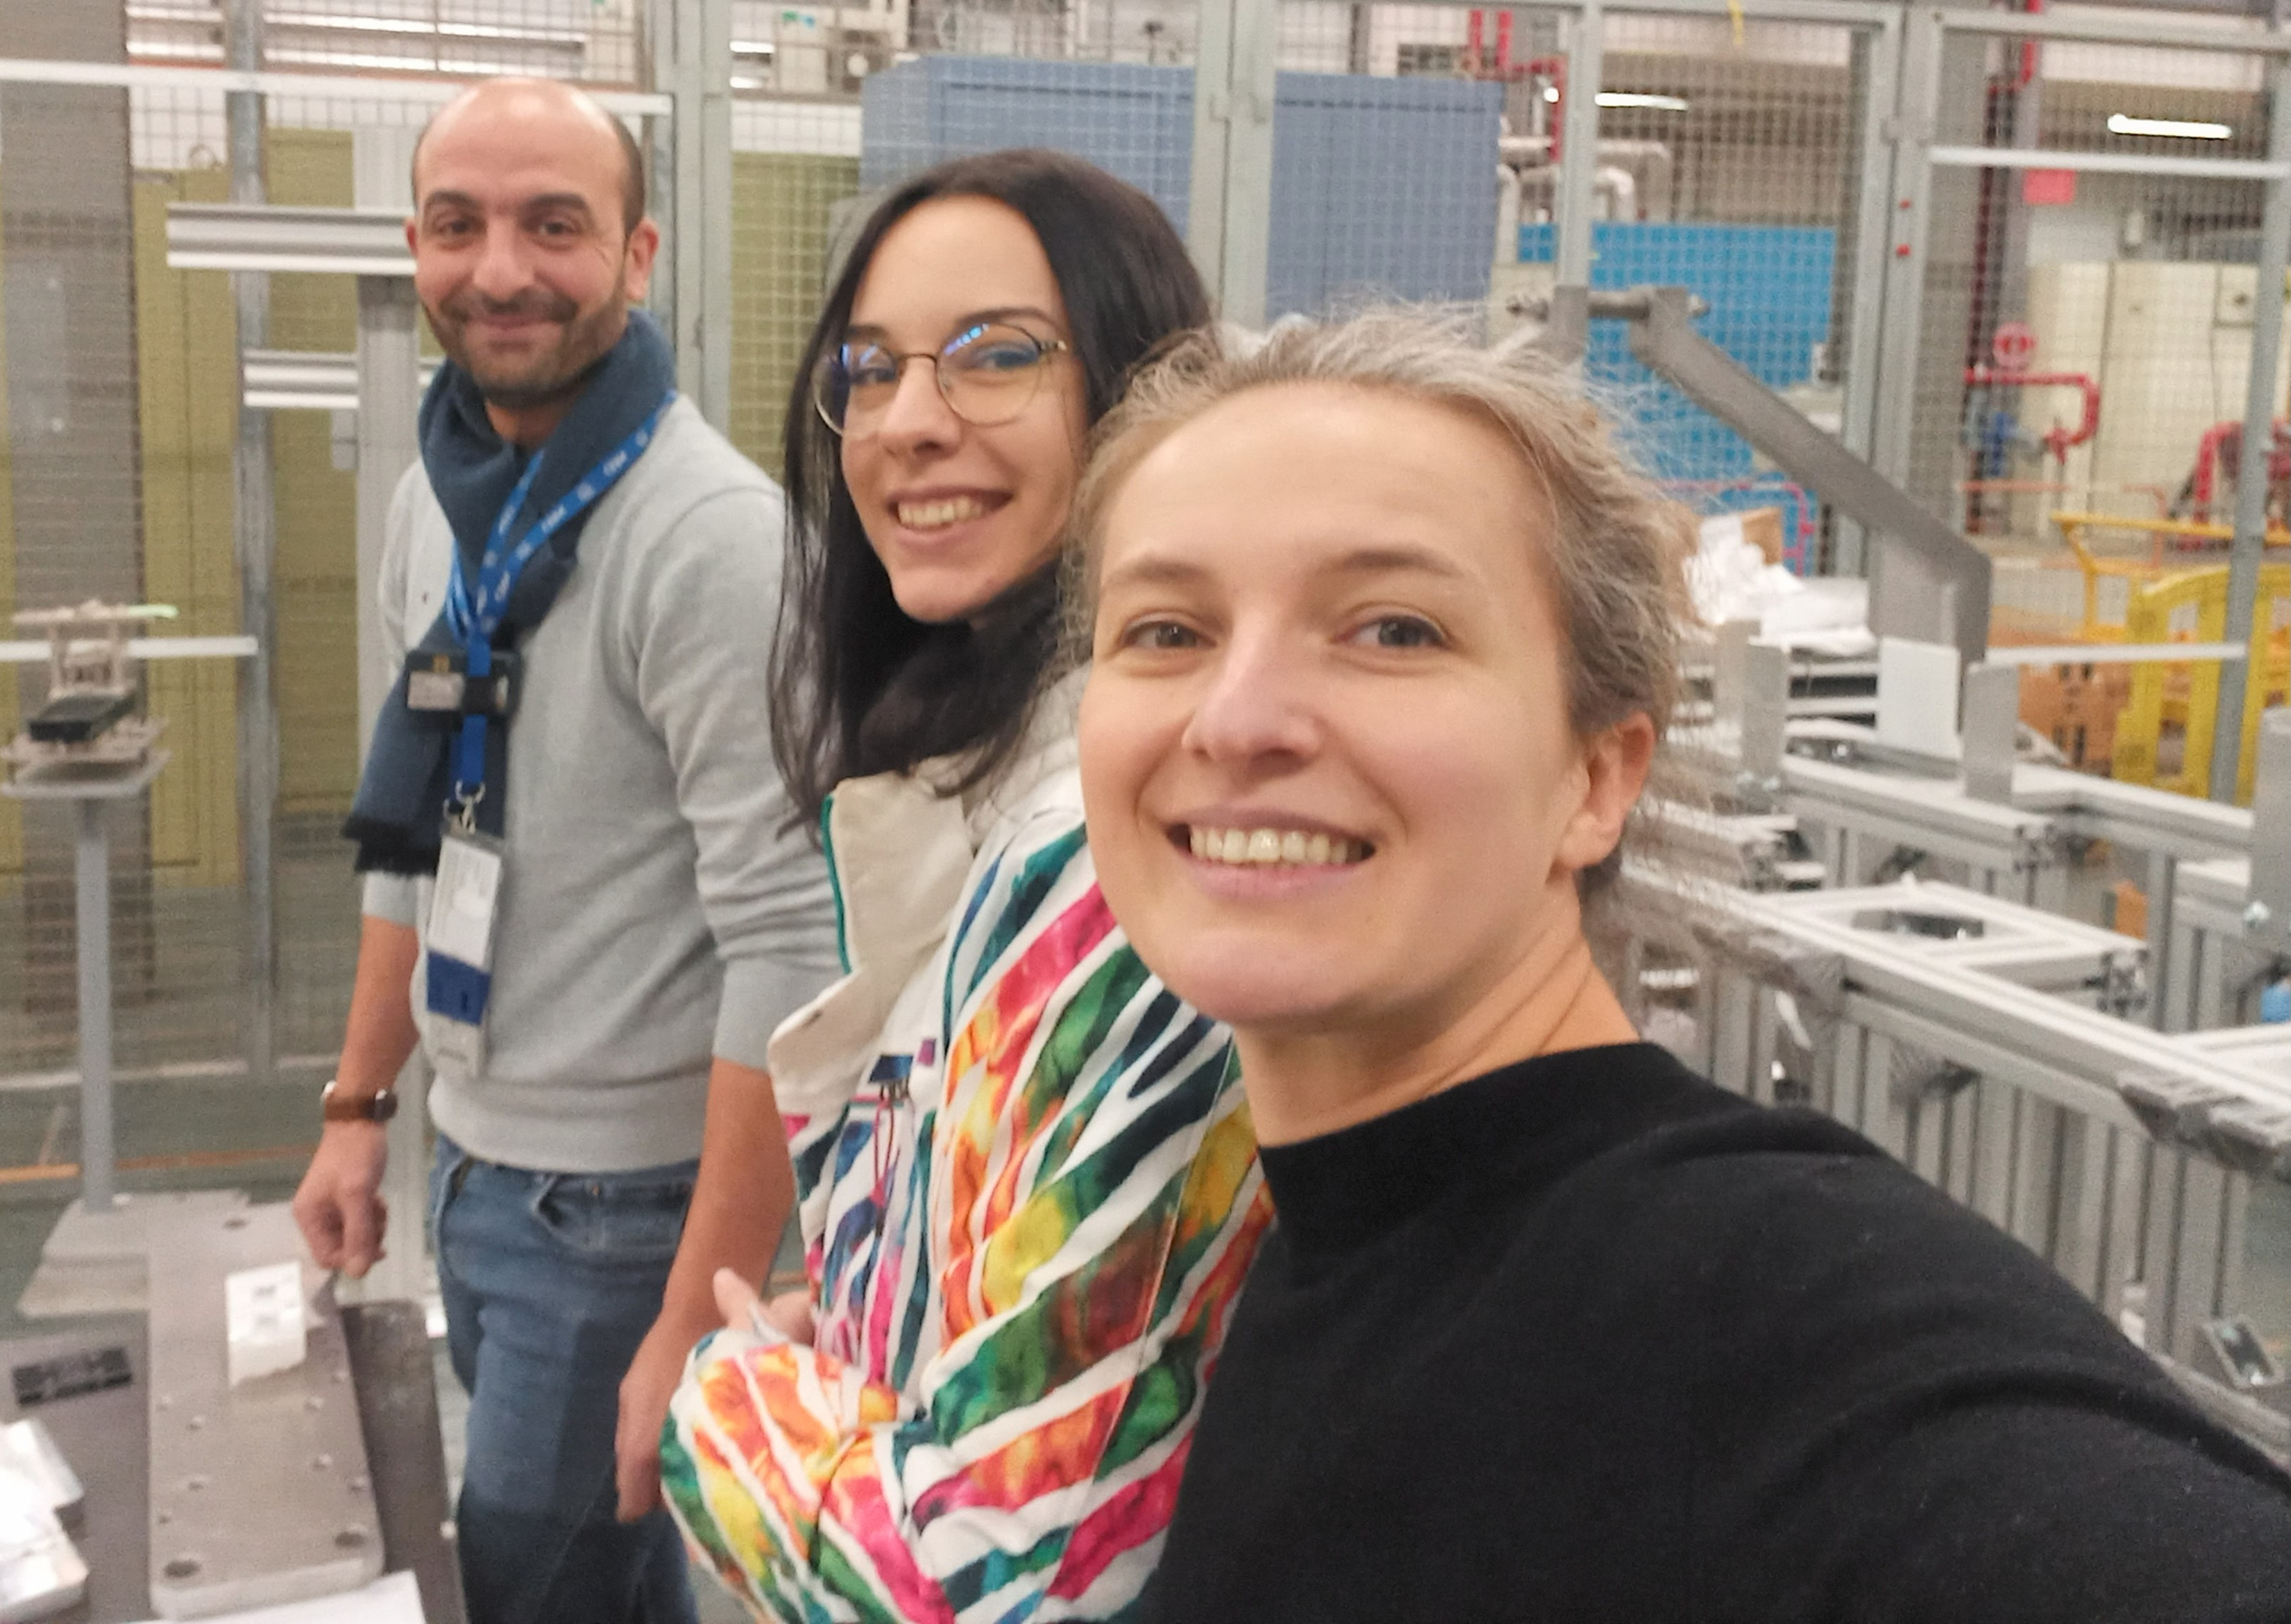
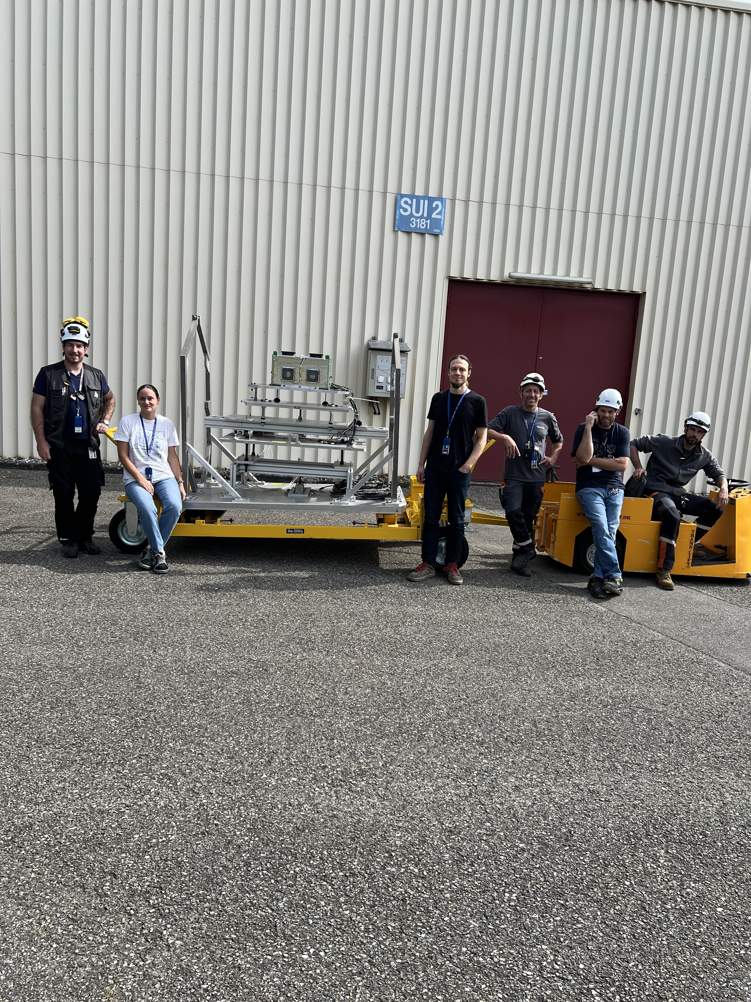
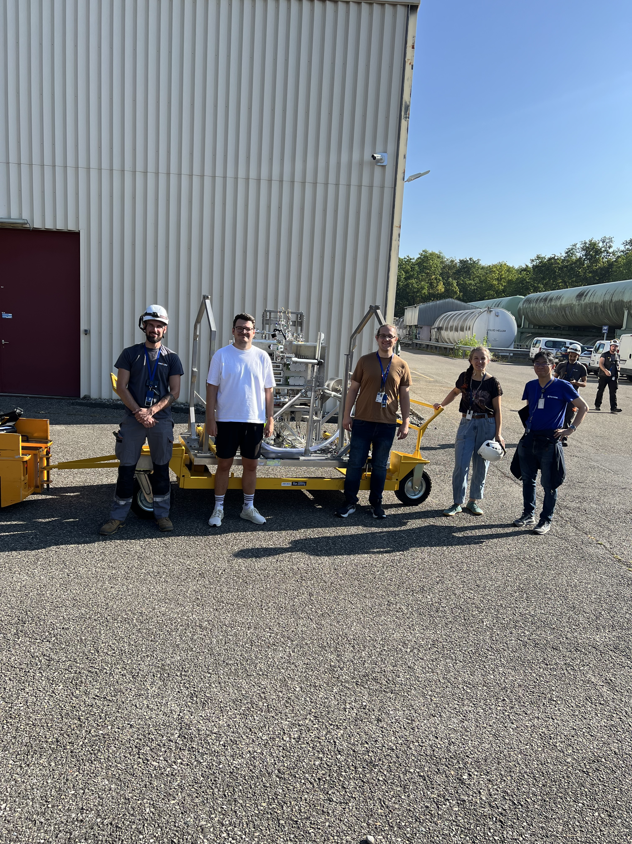
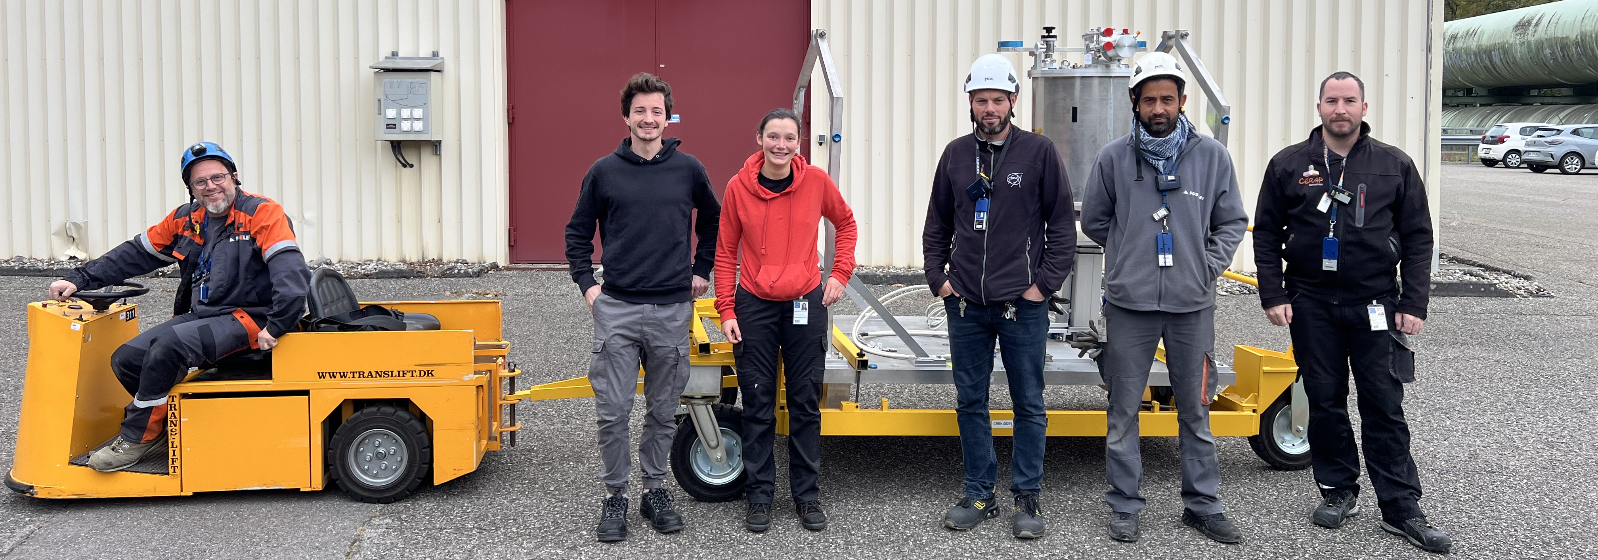
Supporting teams
Transport
& all the other team in Experimental Areas group helping with 3D design, mechanical work, setup, secretariat, cabling, gas, vacuum…

Slide 11
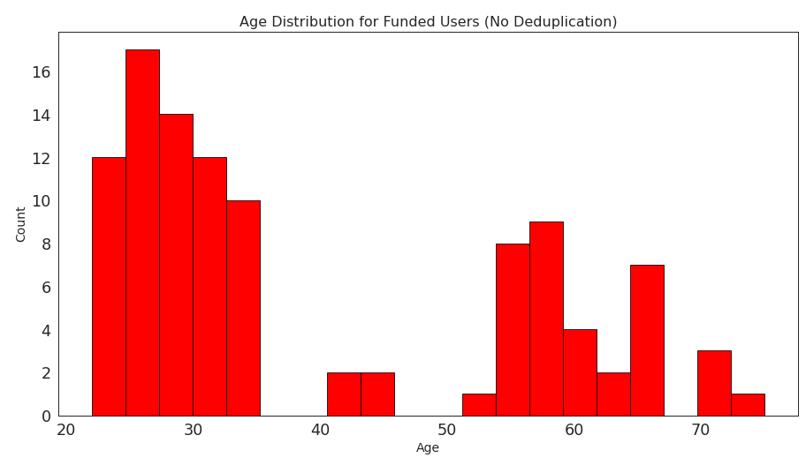
Eurolabs
6400 access units ==> 1AU is 1h, so you can say we supported 267 days
Supporting 9 experiments
Focusing on young scientists
We count on the next TNA call (expected around June 2026)

Slide 12
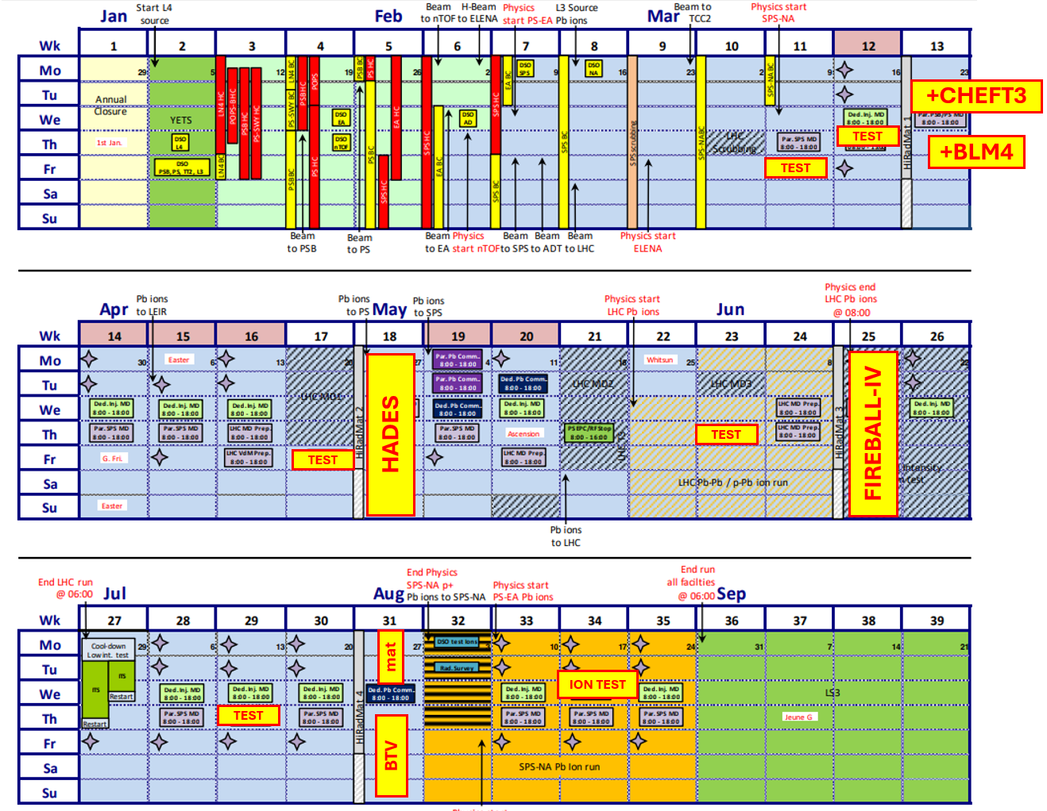
2026 schedule
Shorter beam run stopping in August
3 experiments submitted to the scientific board
CHEFT3
BTVmat
HADES
Two new campaigns from previous experiment
BLM4
FIREBALL4
Further tests with low energy
Extraction test with Pb ions

Slide 13
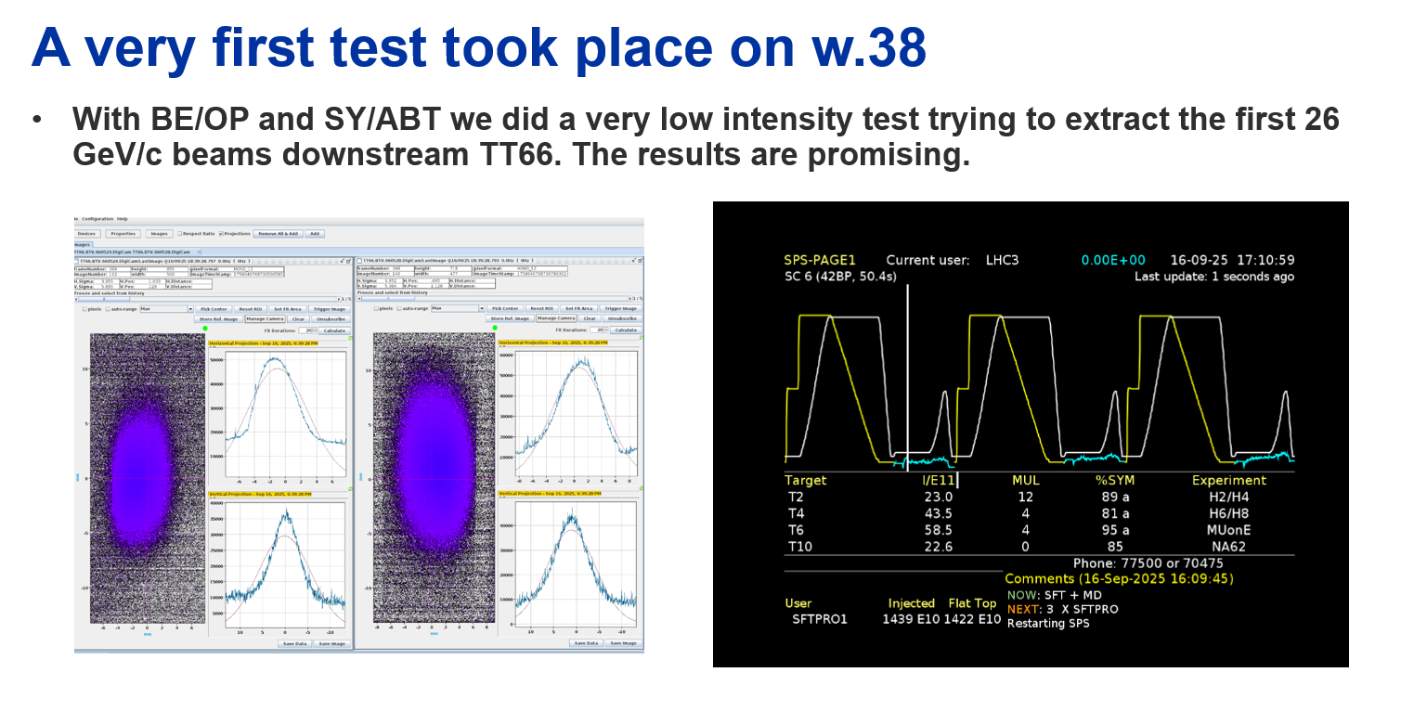
Low Energy Beam
Only 440 GeV available → Many requests for lower momenta for various, different applications
AD target development, novel target concepts for ESS, …
We need to :
Recalculate /adapt optics for 26 GeV/c
Adapt the link rules to allow for the fast ramping post-injections & extraction
Understand better the limitations on TT10 / TT66 intensity
Extraction timing delay needs to be corrected in order to ensure correct triggering of the transferline BCT.
…
We need to prepare/work on these beams in 2026, so that we prepare/accommodate the first experiments with low energy beams in HiRadMat in 2029.

Slide 14
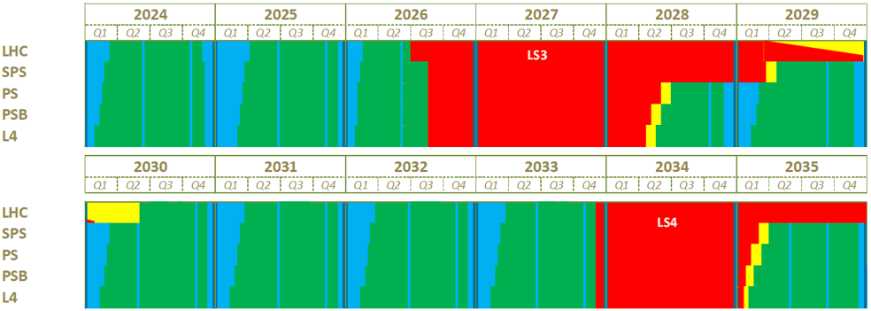
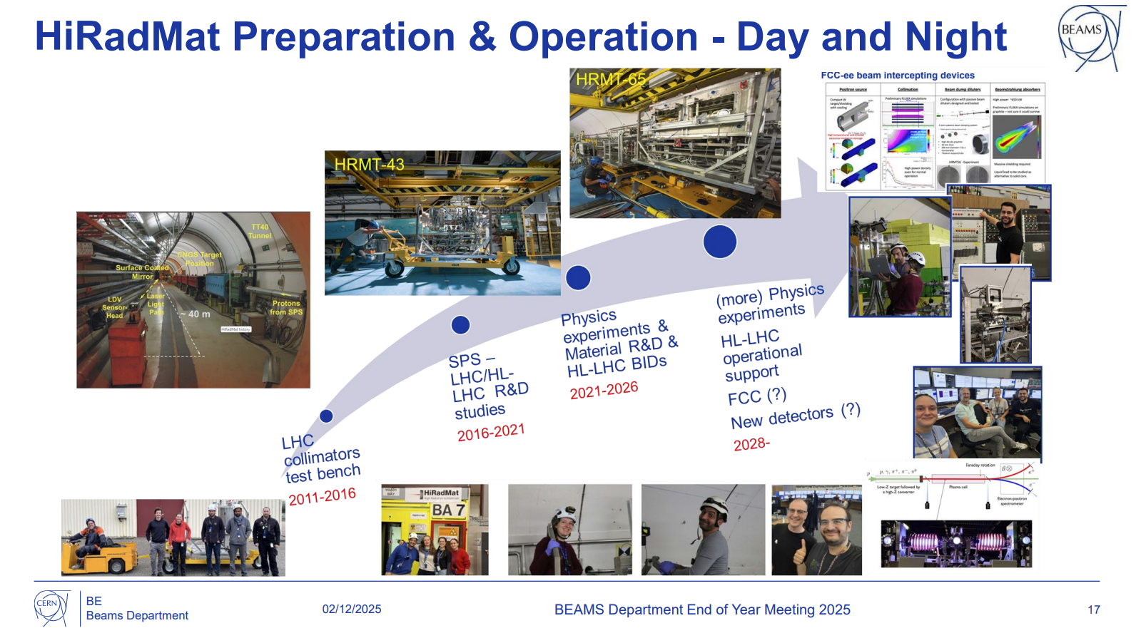
And after?
Long shut down from September 2026
Beam line, dump, vacuum, surface lab upgrades were already done
BTVs upgrades: new tank material
Inputs?
Back in operation in July 2029
Rhodri Jones (Head of Department)
https://indico.cern.ch/event/1618465/

Slide 15
Thank you! ☺ Questions?

Slide 16

This project has received funding from the European Union’s Horizon Europe Research and Innovation programme under Grant Agreement No 101057511.

