Slide 1
FalconD topical structural analysis status
Alessandra Pampaloni
On behalf of the INFN Genova and LASA collaboration
June 17, 2025

Slide 2
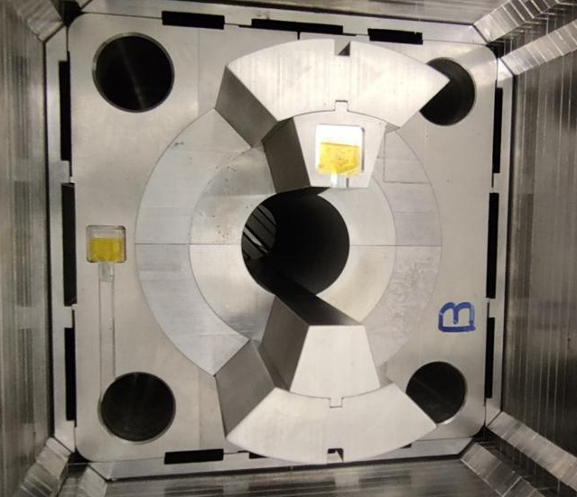
Update on Structural modelling of Mockup
The mockup was assembled in mid March 2025
The strain gauge data analysis is in progress along with the comparison with the results of the finite element model
We received the results of the analysis carried out by the group of Sgobba at the end of May, which underlined the non-conformity of the aluminum used for the shells
  We received a quote of 8000 € plus VAT to buy two additional shells
  We decided to not reassemble this mockup by replacing the broken shell
  We will build a new mockup as soon as we freeze the mechanical structure of FalconD (roughly end of 2025)

Slide 3
FalconD mechanical model
FalconD mechanical design activities resumed in mid-April after the end of work on the mechanical mockup and following the rearrangement of the dedicated working group
Currently, Tommaso and Ludovico are actively working on the mechanical models, but as they are only recently involved in the project, they still need some further training
Our goal is to freeze the 2D and 3D mechanical structure by the end of this year in order to proceed with the next steps of the project

Slide 4
Winding tests in ASG
ASG is modifying winding tooling in collaboration with Fantini
Meanwhile, ASG has reinforced the side pushers and added containment shields that improve the performance of the existing winder machine
Following these local modifications, it was decided to repeat a winding test that will be performed in ASG on the 27th of June

Slide 5
Thank you for your attention!

