Slide 1
STRAW DETECTOR PROTOTYPE STUDY 23_06_25

Slide 2
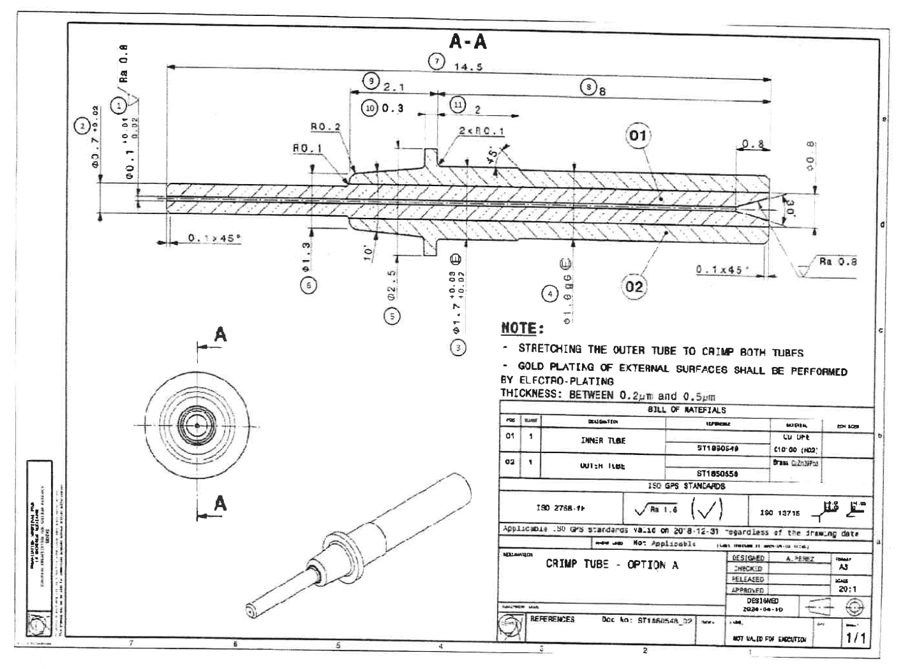
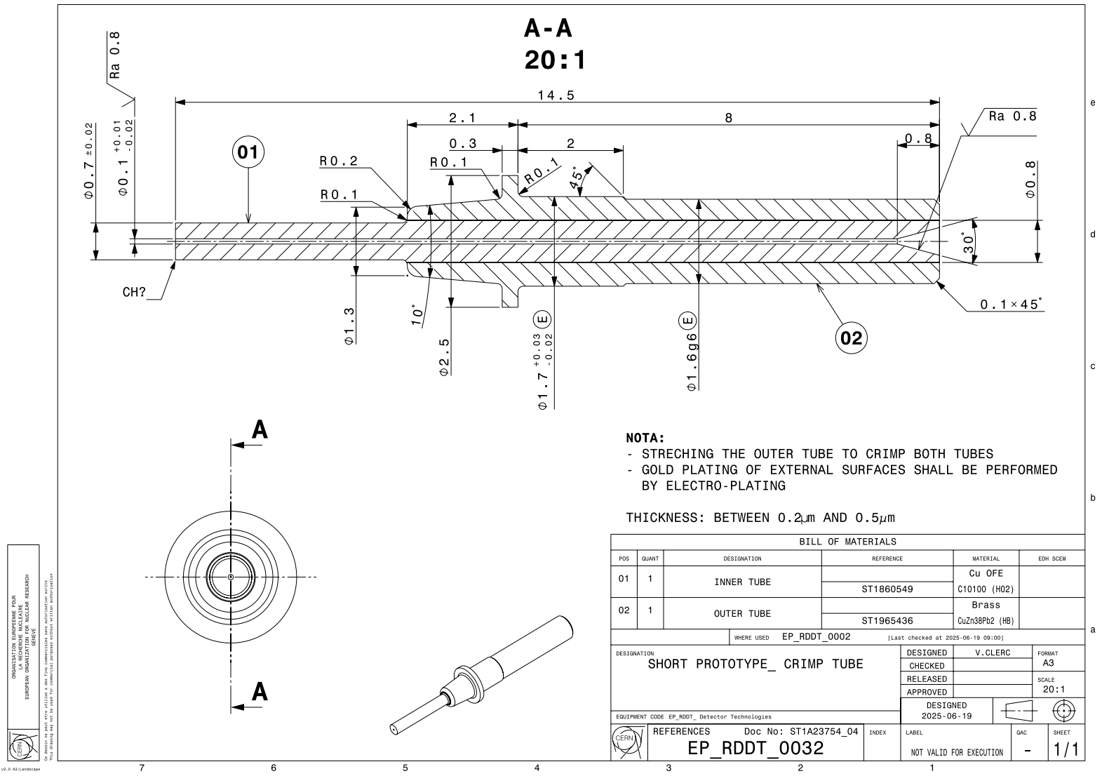
DRAWINGS
The drawings are currently being reviewed.
The drawings names still need to be revised to ensure greater consistency.
CH?

Slide 3
CALCULATION
IN PROGRESS
New assembly. By gluing (Epoxy)
New cut (Ø80)
10mm

Slide 4
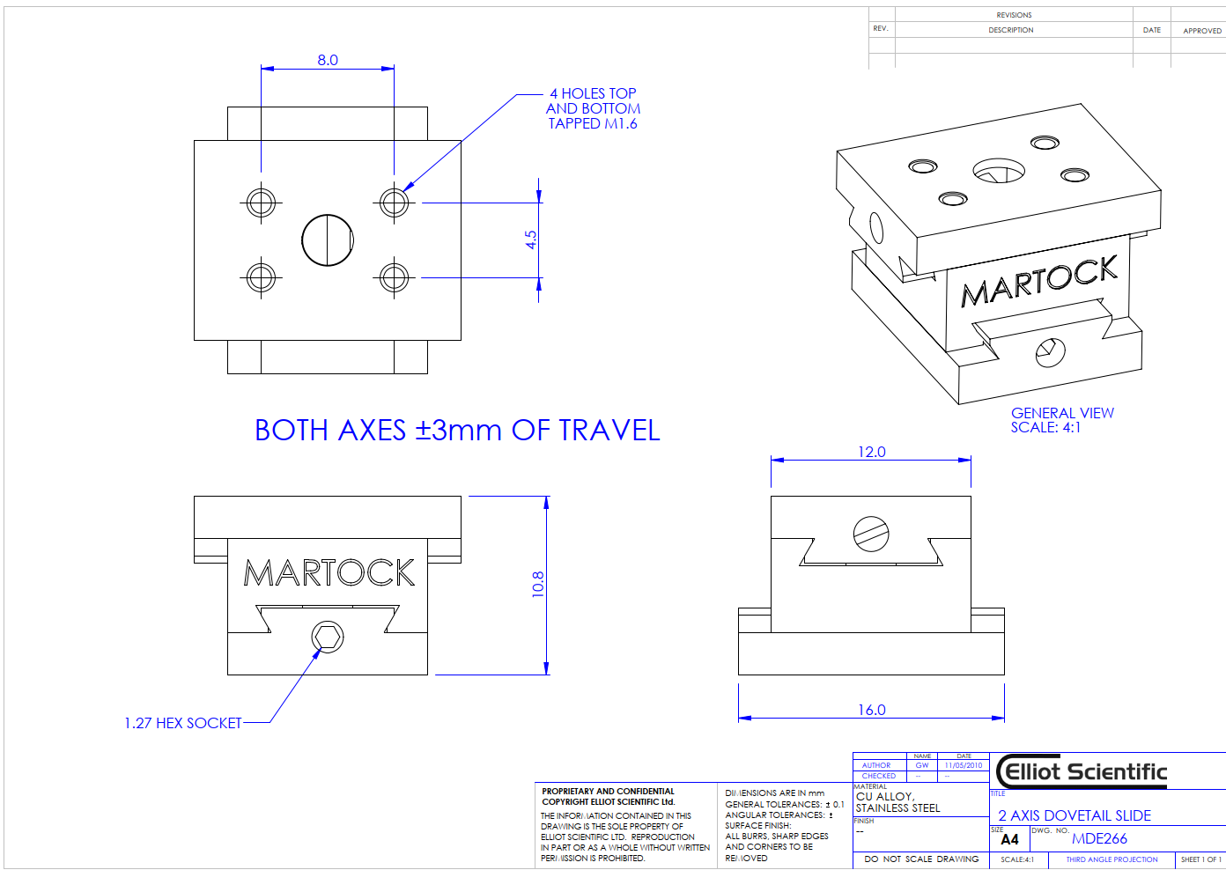
STUDY FOR THE SPACER
System with an adjustable XY + Rotation ring
XY positioning with adjustment tables pre-aligned
on the flanges.

