Slide 1


Status of D1, DQHDS and HPRF
Tatsushi NAKAMOTO, KEK
On behalf of HL-LHC-KEK Collaboration
15th HL-LHC Collaboration Meeting, CERN, Sep. 29, 2025

Slide 2
Collaborators
KEK (in particular)
M. Sugano, K. Suzuki, Y. Arimoto, R. Ueki, Y. Ikemoto, H. Kawamata,
N. Okada, R. Okada, H. Ohhata, A. Terashima, K. Tanaka, N. Ohuchi, T. Ogitsu,
K. Hanagaki (Director)
CERN WP3 for D1
S. Izquierdo Bermudez, J. C. Perez (WPE), H. Prin, D. Duarte Ramos, C. Scheuerlein, H. G. Gavela, G. Willering, F. Mangiarotti, L. Fiscarelli.
CERN WP7 for DQHDS
D. Carrillo (WPE), E. Nowak, M. Pojer, D. Wollmann.
CERN WP4 for HPRF
G. Cipolla (WPE), R. Calaga

Slide 3
Japanese Contribution to HL-LHC

Slide 4
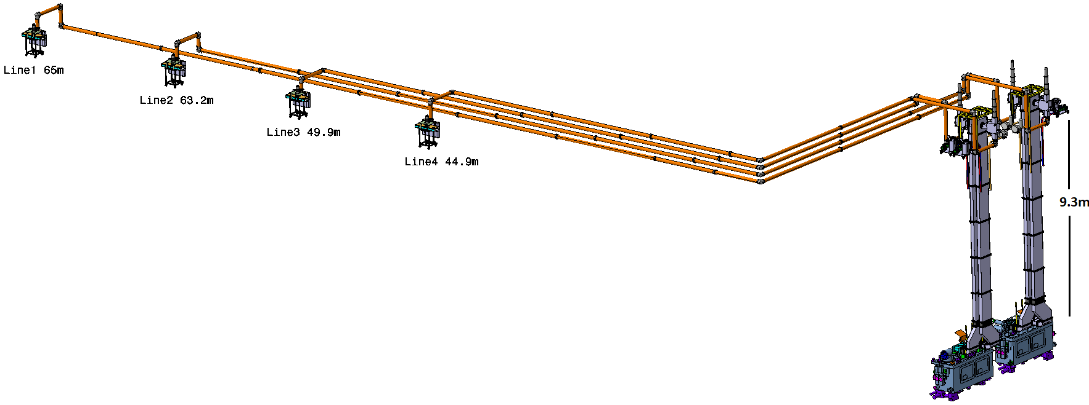
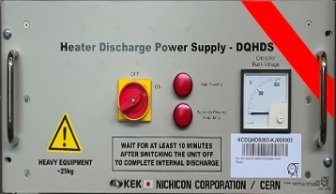
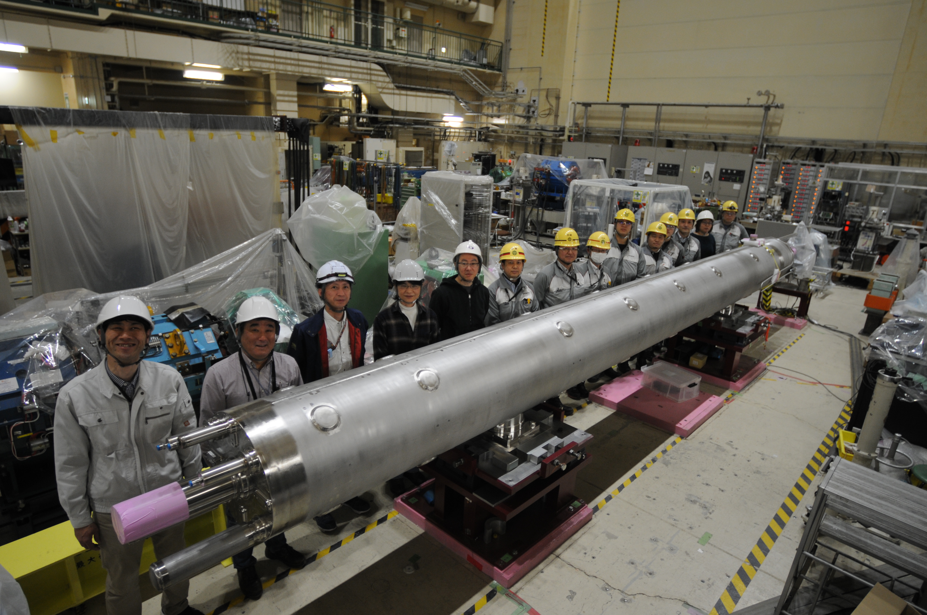
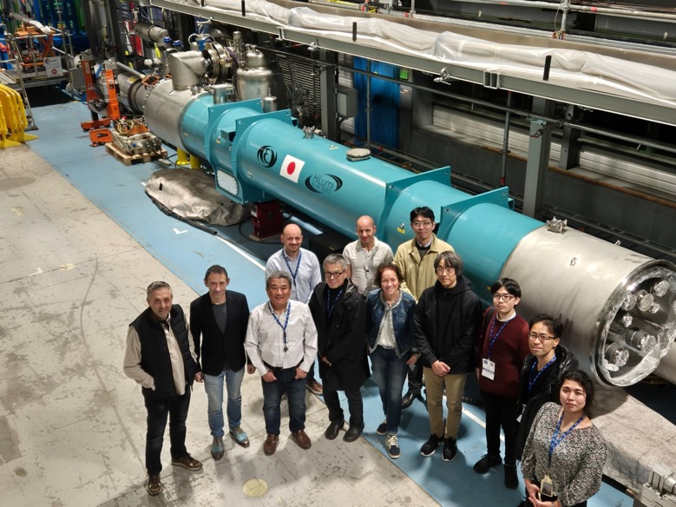
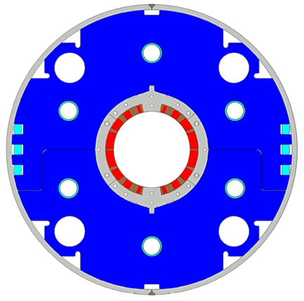
Japanese Contribution to HL-LHC
Quench heater discharge power supply (DQHDS)
High power RF system for Crab Cavity
Beam separation dipole D1

Slide 5
Beam Separation Dipole D1

Slide 6
D1: Training Performance
Series production magnets
Prototype
Number of quenches to nominal or ultimate
 |  | MBXF1 | MBXF5 | MBXF2 | MBXF3
1st cycle | Nominal | 2 | 4 | 10 | 6
 | Ultimate | 7 | 9 | 18 | 18
2nd cycle | Nominal | 0 | 1 | 0 | 3
 | Ultimate | 0 | 5 | 1 | –
All series production magnets so far reached the ultimate current corresponding to 108% of the nominal current.
Reaching the nominal current after a full thermal cycle with less than 3 quenches
Current-holding at the ultimate current for 4 hours was successful.

Slide 7
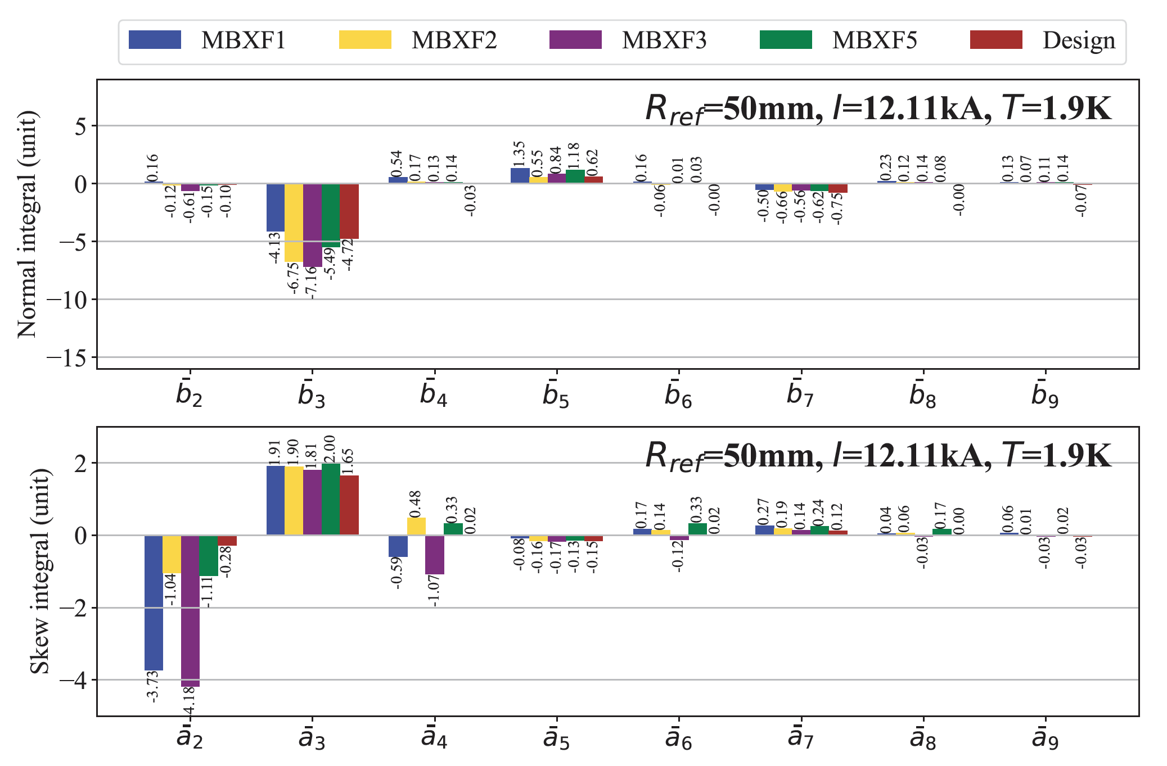
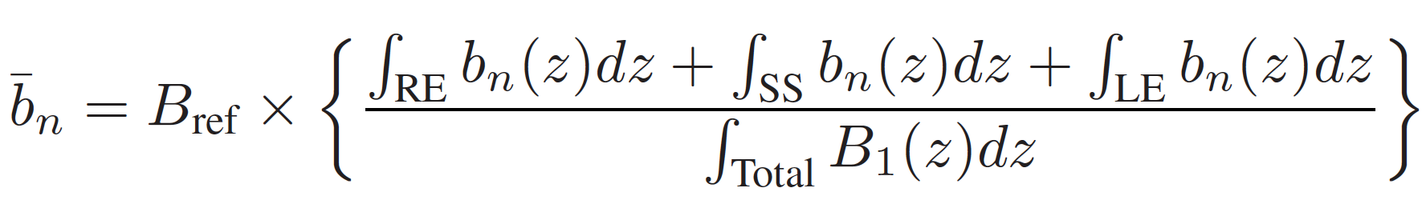
D1: Field Measurement at V Test (KEK)
Major systematics (b₃, b₅) are well controlled and consistent with the design values (Opera3D).
  Coefficients of b₃ and b₅ are influenced by ferromagnetic environments of the cryostats and will be shifted within the criteria in the horizontal cryostat at HL-LHC.
Variation in a₂ is considered to correlate with a dipole (top-bottom) asymmetry caused by different coil size.

Slide 8
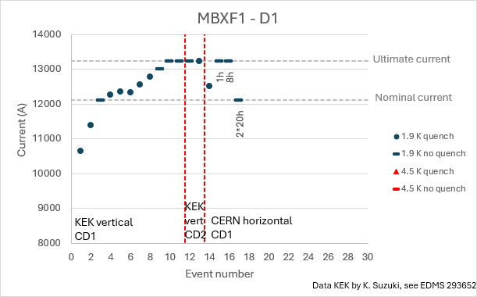
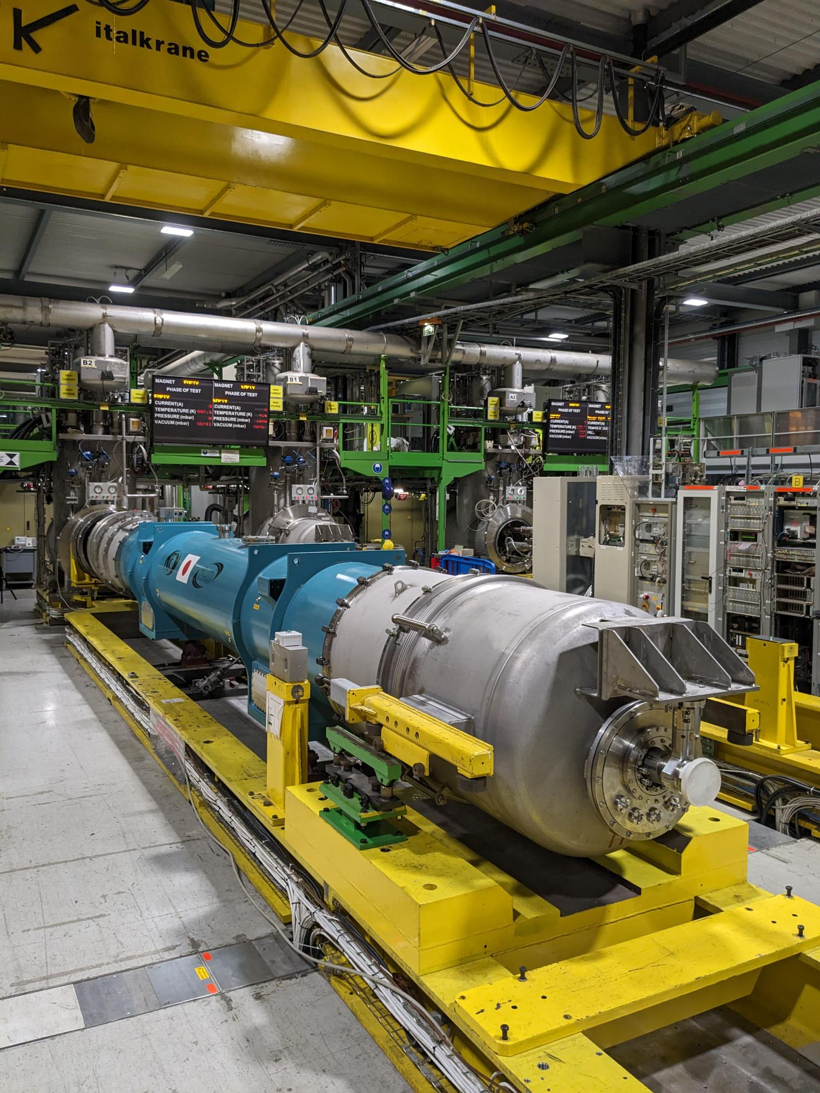
D1- MBXF1: H Test at CERN
Courtesy of L. Fiscarelli, G. Willering
 | Injection 790 A |  | Nominal 12110 A
B1 (Tm) | 2.5618 |  | 35.290
n | bn (units) | an (units) | bn (units) | an (units)
2 | 0.18 | 2.08 | -0.26 | 1.09
3 | -14.37 | -1.98 | 2.33 | -1.80
4 | 0.35 | -0.01 | 0.10 | 0.06
5 | -2.54 | 0.11 | 1.57 | 0.16
6 | 0.09 | -0.14 | 0.12 | -0.16
7 | -0.56 | -0.22 | -0.58 | -0.25
8 | 0.09 | -0.02 | 0.01 | 0.09
9 | -0.19 | -0.04 | 0.12 | -0.02
Good training performance
  one quench needed to reach the ultimate.
Field quality in horizontal cryostat at CERN was confirmed.

Slide 9
D1: Status of Production
 | MBXF1 | MBXF2 | MBXF3 | MBXF4 | MBXF5 | MBXF6
Coils | ✔︎ | ✔︎ | ✔︎ | ✔︎ | ✔︎ | ✔︎
Magnet | ✔︎ | ✔︎ | ✔︎ | Jan. 2026 | ✔︎ | March 2026
V test (KEK) | ✔︎ | ✔︎ | ✔︎ |  | ✔︎
Cold mass | ✔︎ | ✔︎ To be shipped to CERN. | Dec. 2025
H test (CERN) | ✔︎
Prototype (MBXFP1) was installed in the IT String.
4 magnets fulfilled the acceptance criteria at the V test at KEK.
MBXF1 was validated and accepted by CERN.
MBXF2 and MBXF3 will be delivered to CERN by April 2026.
A target of signing contract of MBXF5 is Dec. 2025.
Remaining two magnets for spare will be tested at KEK in early 2026.

Slide 10
Quench Heater Discharge Power Supply
DQHDS

Slide 11
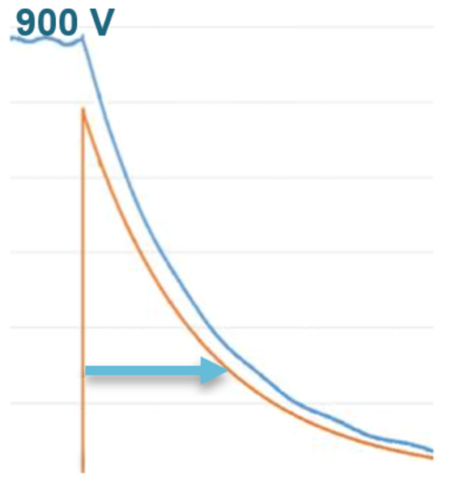
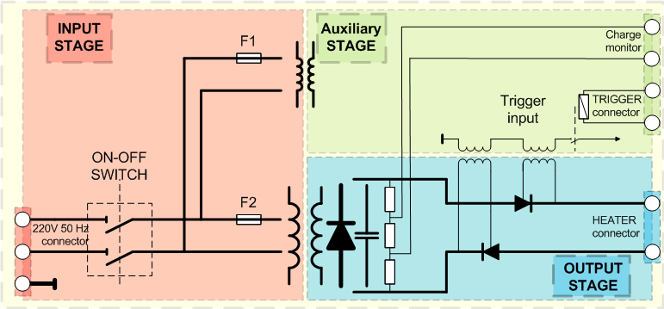
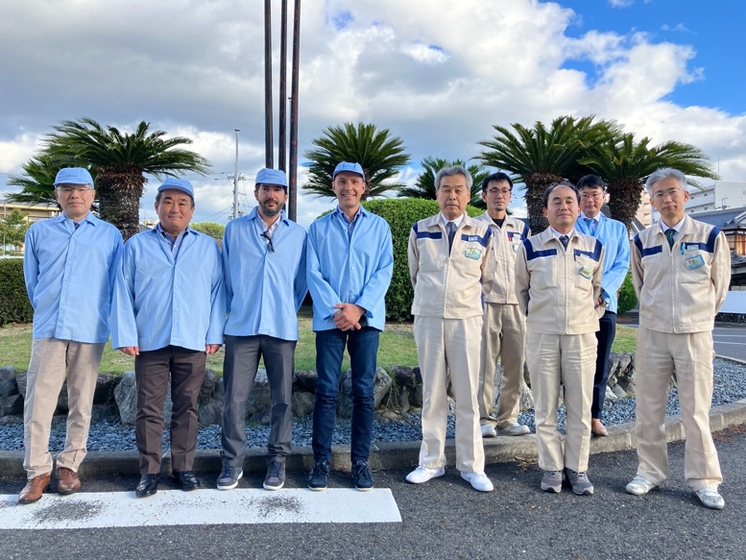
Quench Heater Power Discharge Supply Units (DQHDS)
~940 V
In the event of a quench, the Heater Discharge Power Supplies (DQHDS) energize the heater strips to protect the magnet.
Japanese in-kind contribution: 630 DQHDS units.
  Collaboration with HL-LHC WP7 and TE-MPE-MP.
  Phase 1 in JFY2023: 4 units of pre-series for validation.
  Phase 2 in JFY2024-2025: series production of 626 units.
Manufacturing in accordance with CERN’s Technical Specification (EDMS 2786661).
The contract was awarded to Nichicon and the kick-off meeting was held at Oct. 10-11, 2023.
~200 A
~ 32 ms
at Nichicon

Slide 12
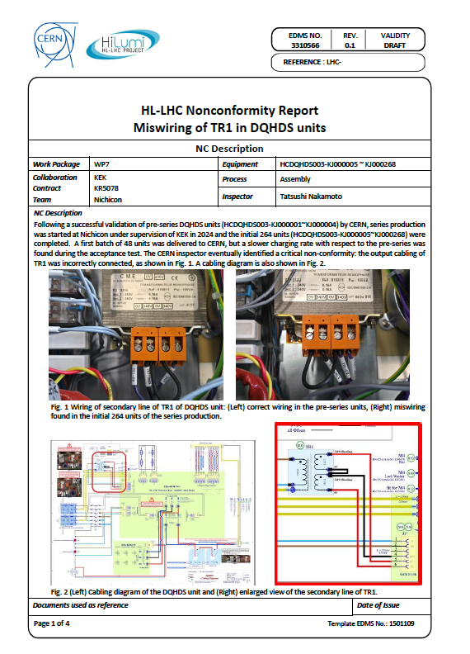
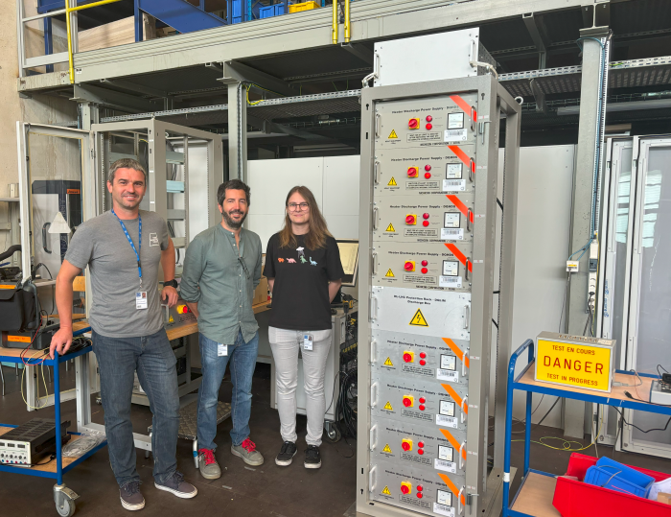
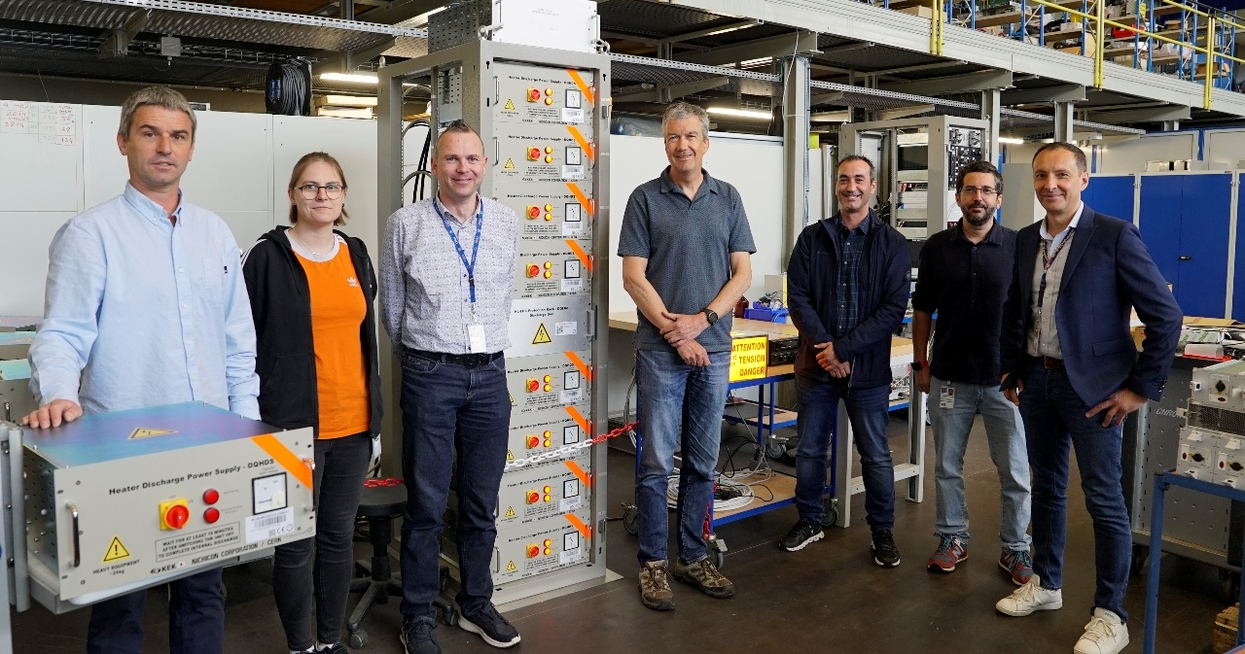
DQHDS: Status and Progress
4 units of the pre-series DQHDS were validated by CERN at June 2024 and green light to start series production was given.
264 series production units were produced (~40%) by March 2025 (JFY2024).
The first batch of 48 units were delivered to CERN. A systematic NC for all 264 units was detected at SAT: miswiring of transformer (EDMS 3310566).
  The first 48 units at CERN were repaired and fully validated.
  All the remaining 216 units were repaired by Nichicon and passed the FAT. Shipping to CERN has resumed today (Sep. 29).
Remaining series production with 362 units will be started soon and be delivered to KEK in March 2026.
First batch of the DQHDS series production delivered (48 units) and acceptance tests finished
Successful qualification of Japanese pre-series units

Slide 13
High Power RF Station (HPRF) and
High Power RF Lines (HPRL) for Crab Cavities
Courtesy of G. Cipolla, R. Calaga

Slide 14
High Power RF Station (HPRF) and
High Power RF Lines (HPRL) for Crab Cavities
HPRL (RF Lines)
(16 sets + spares)
HPRF, IOTs 400MHz amplifiers
(Total: 16 + 4)
16 Crab cavities
(8 Cryomodules +2)
Collaboration agreement: KR5904_SYADD5_RFCC signed 2024.
Project scope: EDMS 2874821: cash contribution from Japan, procurement managed by CERN
Procurement: FY2024-2027

Slide 15
High Power RF Status
Procurement launched for all major items, tight schedule but on track
HPRF Station, IOT based
Transmitters | MS, IT, FC MS dispatched in Nov’24 IT dispatched - Target FC Sep’25 DAI already placed for 3 x 400 MHz SSPA
Trolleys | Extension of existing Blanket Contract B1641 Extension approved in FC Sep’24
IOT Tubes | Extension of existing Blanket Contract B1641 Extension approved in FC Sep’24 DAI already placed for 12 units
RF Lines
6-1/8‘’ – Straight tubes and elbows | EN-MME + SY-RF Purchase of all Cu & Al tubes for coaxial lines via EN-MME (J3096468) in Apr’25
Circulators | IT awarded Jul 2025
Dummy loads | IT awarded Aug 2025
Waveguides WR2300HH | EN-MME + SY-RF in-house (recovery and adaptation)

Slide 16
HPRF: Procurement Profile
Document | Description | FY2024 | FY2025 | FY2026 | FY2027 +FY2028 | Total
DR 10450082 | WG WR2300 | standard | Special adapters | Special adapters |  | 16 lines
DR 10449709 | Coaxial lines |  | standard | Special adapters | Special adapters | 16 lines
DR 10433507 | Circulators |  |  | 2 | 16 | 18
DR 10432515 | Loads |  | 2 | 16 |  | 18
DR 10432432 | SSPA drivers |  | proto | 16+32 |  | 48
DR 10432432 | HPRF cubicles |  |  | 1 | 12+7 | 7
DR 10432536 | IOTs Tubes | 12 | 8
DR 10432536 | IOTs Trolleys |  | 1 | 3 | 12 | 4

Slide 17
Summary
Japanese contributions to the HL-LHC project: D1 magnet, DQHDS units, and HPRF system.
D1 magnet
  Performances have been verified at V test at KEK.
  One cold mass was accepted by CERN. Other two cold masses will be delivered to CERN soon.
  A concern with the 4th cold mass (MBXF5).
DQHDS units
  Repair work for produced 264 units was completed and the shipping to CERN has been resumed.
  Remaining series production of 362 units as scheduled.
HPRF system
  Procurement and fabrication at CERN are on track.

