Slide 1




Status of D2 corrector magnets (MCBRD)
R. Kang, IHEP-CAS
For the CCT Magnet Team:
Q. Xu, Y. Wang, X. Ou, … and A. Foussat, E. Todesco
15th HL-LHC Collaboration Meeting
Geneva, Switzerland, 2025.09

Slide 2
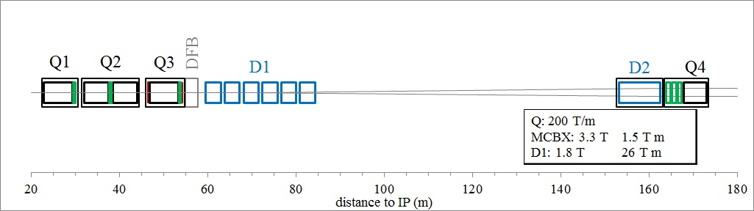
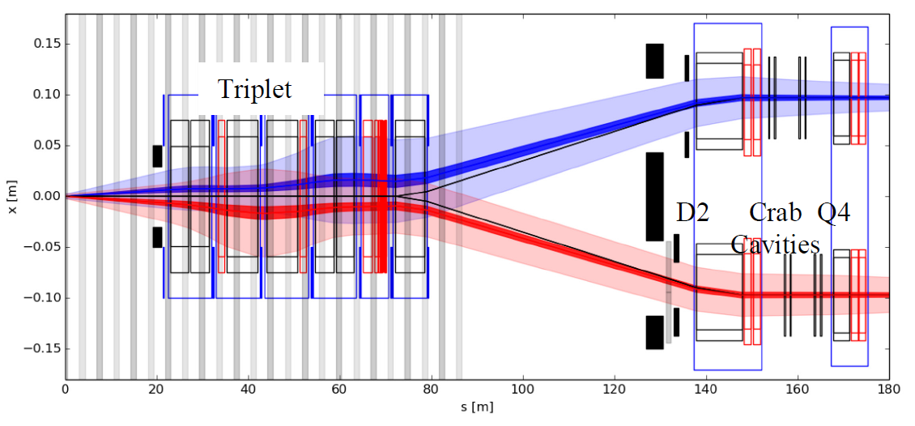
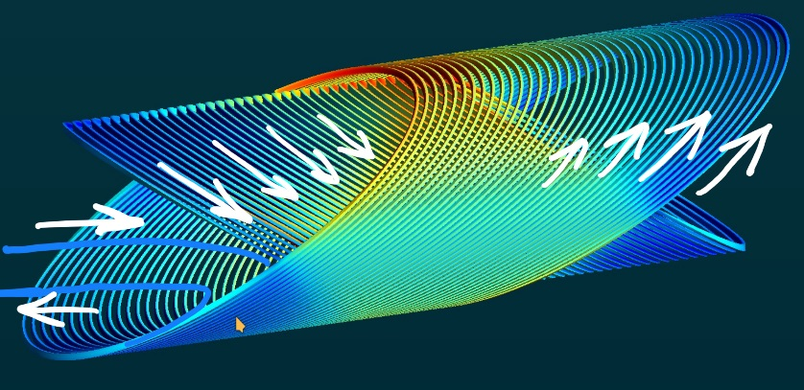
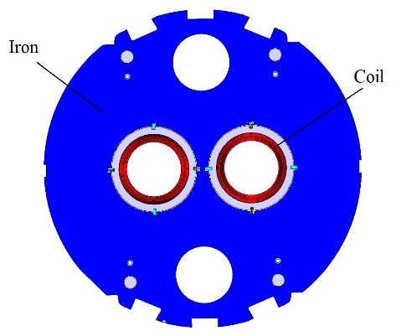
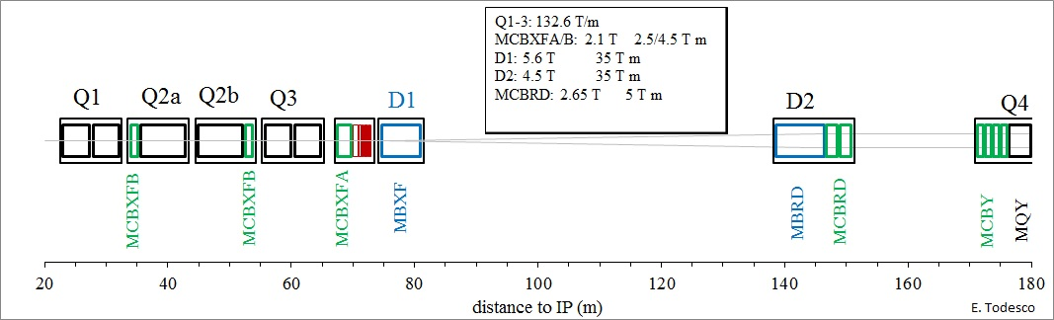
MCBRD: the HL-LHC D2 orbit correctors, 12+1 units, providing a 5 Tm integrated field in two apertures, vertical in one and horizontal in the other.
The first application of the CCT magnet in an accelerator.
LHC 2008-2022
E. Todesco
HL-LHC 2026-2035

Slide 3


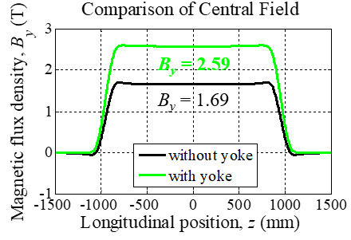
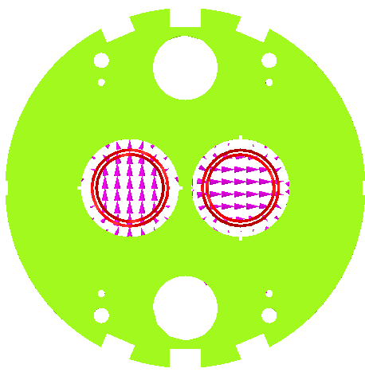

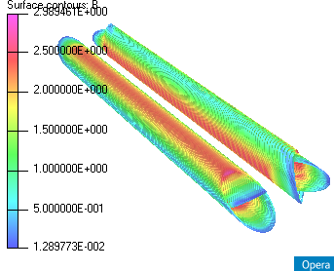
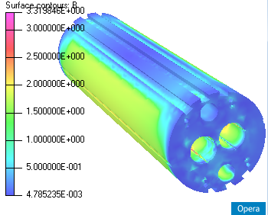
Main design parameters of the MCBRD magnet
Items | Values
CCT skew angle | 30°
No. of turns per layer | 365
Slot size in former (mm) | 2×5 (10 NbTi wires connected in series)
Spacing per turn | 5.222
Inside/Outside diameter of the former (mm) | Inner former:105.35/119.35 Inner former:120.80/134.85
Inside diameter of the groove/slot(mm) | 1st layer: 109.15/119.15 2nd layer: 124.65/134.65
Reference radius (mm) | 35
Diameter of aperture (mm) | 105
Current (A) | 395
Cooling hole
Hole for tie rod
Hole for fixing pin
Aperture
Yoke alignment
CCT Coils
Ø 614 mm
Items | Values
Diameter of yoke (mm) | 614
Thickness of yoke lamination (mm) | 5.8
Diameter of aperture (mm) | 167
Position of aperture (mm) | 94.19
Yoke key slot(mm) | 8(3.01) ×6
Diameter of cooling hole (mm) | 110
Position of cooling hole (mm) | 205

Slide 4

Status of the MCBRDs
 | Coil name |  | Winding method | Location | Coil stand-alone performance (4.2 K) | Status
MCBRD01 | AP1 | MCBRD_CB01 | Wet wind | CERN | 530 A | Both apertures reached ultimate current 422 A, and passed 4-hour stability test
 | AP2 | MCBRD_CB03 | Direct wind |  | 410 A
MCBRD_CB02 |  |  | Direct wind | CERN | Failed to reach the design current
MCBRD02 | AP2 | MCBRD_CB04 | Wet wind | CERN | 422 A | Both apertures reached ultimate current 422 A, and passed 4*1 hour stability test
 | AP1 | MCBRD_CB06 | Wet wind |  | 530 A
MCBRD_CB05，07，08 |  |  | Wet wind | IHEP
MCBRD03 | AP2 | MCBRD_CB09 | Direct wind with new channel size | CERN | 530 A | Both apertures reached ultimate current 422 A, and passed stability test
 | AP1 | MCBRD_CB12 | Direct wind with new channel size |  | 526 A (25 quenches)
MCBRD04 | AP2 | MCBRD_CB13 | Direct wind with new channel size | CERN | 530 A (20+33 quenches) | Both apertures reached ultimate current 422 A, and passed stability test
 | AP1 | MCBRD_CB17 | Direct wind with new channel size |  | 524 A (47 quenches)
MCBRD_CB10, 11, 15, 16 |  |  | Shipped to CERN for fabrication
MCBRD05 | AP1 | MCBRD_CB18 | Direct wind with new channel size | CERN | 532 A (42 quenches) | Both apertures reached ultimate current 422 A, and passed stability test
 | AP2 | MCBRD_CB19 | Direct wind with new channel size |  | 530A (68 quenches)
MCBRD06 | AP1 | MCBRD_CB14 | Direct wind with new channel size | CERN | 530A (30+34 quenches) | Shipped to CERN without Magnet cold testing
 | AP2 | MCBRC_CB21 | Direct wind with new channel size |  | 530A (119 quenches)
MCBRD07 | AP1 | MCBRD_CB20 | Direct wind with new channel size | CERN | 530A (68 quenches) | Shipped to CERN without Magnet cold testing
 | AP2 | MCBRD_CB23 | Direct wind with new channel size |  | 530A (76 quenches)
MCBRD_CB25 |  |  | Direct wind with new channel size | IHEP | 501A (20 quenches), damaged due to a failure of the
MCBRD08 | AP1 | MCBRD_CB27 | Direct wind with new channel size | BAMA | Directly assemble without stand-alone test | Assembly finished
 | AP2 | MCBRD_CB28 | Direct wind with new channel size | BAMA | Directly assemble without stand-alone test
MCBRD09 | AP1 | MCBRD_CB24 | Direct wind with new channel size | IHEP | 530 A(147 quenches) | To be assembled in October
 | AP2 | MCBRD_CB29 | Direct wind with new channel size | BAMA | Directly assemble without stand-alone test
MCBRD10 | AP1 | MCBRD_CB26/CB30 | Direct wind with new channel size | IHEP | 476 A (59 quenches) | To be assembled in October/November Or in next April
 | AP2 | MCBRD_CB22/CB31 | Direct wind with new channel size | IHEP | 522 A (169 quenches)
Over the past year:
3 Magnets delivered
7 coils manufactured (CB23-29)
7 coils tested (CB20-26), 1 damaged, 2 to continue

Slide 5
Status of the MCBRDs
 | Coil name |  | Winding method | Location | Coil stand-alone performance (4.2 K) | Status
MCBRD01 | AP1 | MCBRD_CB01 | Wet wind | CERN | 530 A | Both apertures reached ultimate current 422 A, and passed 4-hour stability test
 | AP2 | MCBRD_CB03 | Direct wind |  | 410 A
MCBRD_CB02 |  |  | Direct wind | CERN | Failed to reach the design current
MCBRD02 | AP2 | MCBRD_CB04 | Wet wind | CERN | 422 A | Both apertures reached ultimate current 422 A, and passed 4*1 hour stability test
 | AP1 | MCBRD_CB06 | Wet wind |  | 530 A
MCBRD_CB05，07，08 |  |  | Wet wind | IHEP
MCBRD03 | AP2 | MCBRD_CB09 | Direct wind with new channel size | CERN | 530 A | Both apertures reached ultimate current 422 A, and passed stability test
 | AP1 | MCBRD_CB12 | Direct wind with new channel size |  | 526 A (25 quenches)
MCBRD04 | AP2 | MCBRD_CB13 | Direct wind with new channel size | CERN | 530 A (20+33 quenches) | Both apertures reached ultimate current 422 A, and passed stability test
 | AP1 | MCBRD_CB17 | Direct wind with new channel size |  | 524 A (47 quenches)
MCBRD_CB10, 11, 15, 16 |  |  | Shipped to CERN for fabrication
MCBRD05 | AP1 | MCBRD_CB18 | Direct wind with new channel size | CERN | 532 A (42 quenches) | Both apertures reached ultimate current 422 A, and passed stability test
 | AP2 | MCBRD_CB19 | Direct wind with new channel size |  | 530A (68 quenches)
MCBRD06 | AP1 | MCBRD_CB14 | Direct wind with new channel size | CERN | 530A (30+34 quenches) | Shipped to CERN without Magnet cold testing
 | AP2 | MCBRC_CB21 | Direct wind with new channel size |  | 530A (119 quenches)
MCBRD07 | AP1 | MCBRD_CB20 | Direct wind with new channel size | CERN | 530A (68 quenches) | Shipped to CERN without Magnet cold testing
 | AP2 | MCBRD_CB23 | Direct wind with new channel size |  | 530A (76 quenches)
MCBRD_CB25 |  |  | Direct wind with new channel size | IHEP | 501A (20 quenches), damaged due to a failure of the
MCBRD08 | AP1 | MCBRD_CB27 | Direct wind with new channel size | BAMA | Directly assemble without stand-alone test | Assembly finished
 | AP2 | MCBRD_CB28 | Direct wind with new channel size | BAMA | Directly assemble without stand-alone test
MCBRD09 | AP1 | MCBRD_CB24 | Direct wind with new channel size | IHEP | 530 A(147 quenches) | To be assembled in October
 | AP2 | MCBRD_CB29 | Direct wind with new channel size | BAMA | Directly assemble without stand-alone test
MCBRD10 | AP1 | MCBRD_CB26/CB30 | Direct wind with new channel size | IHEP | 476 A (59 quenches) | To be assembled in October/November Or in next April
 | AP2 | MCBRD_CB22/CB31 | Direct wind with new channel size | IHEP | 522 A (169 quenches)
The delivery was delayed due to problems during coils’ stand-alone tests:
CB25 was damage due to a failed quench protection
CB22 and CB26 met similar problems, but not damaged

Slide 6
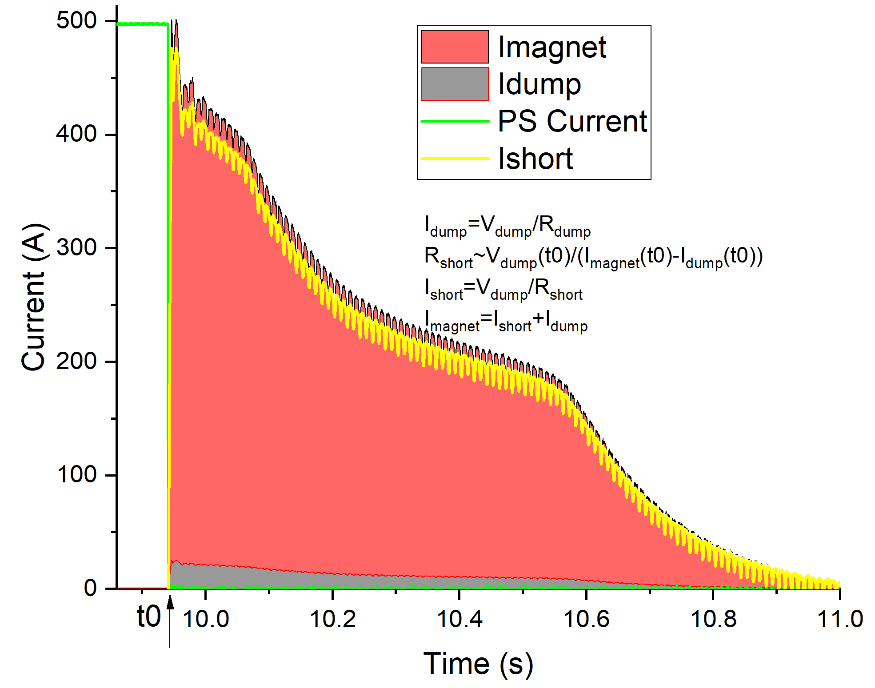
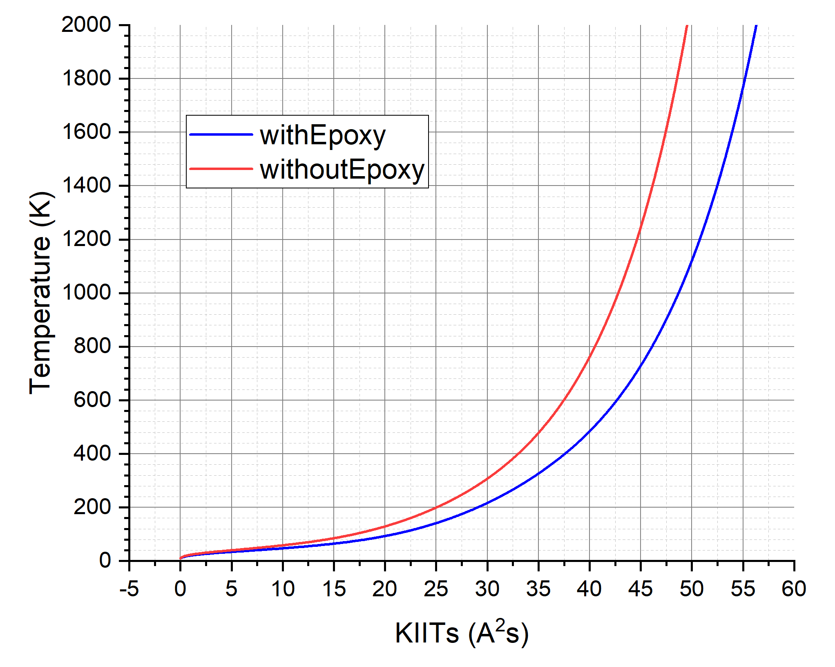
Issues about CB25: the failed quench protection (2025.04)
Measured and estimated current components in the last training test. QI is about 58 KIITs.
Estimated relation between hot spot temperature and KIITs for the WST NbTi wire used in MCBRD coils.
A short-circuit to the dump resistor was created during the last test for CB25, resulted into a very slow discharge.
Unfortunately, CB25 is confirmed damaged.
Resistances later measured at room temperature
Coil sections | Resistance
A1-EE14/EE15 | 73.7 Ω
EE14/EE15-EE17 | 76.9 Ω (V.S. ~98Ω)
EE17-B10 | 0.27 MΩ (V.S. ~74Ω)
A1-B10 | 0.27 MΩ (V.S. ~246 Ω)

Slide 7
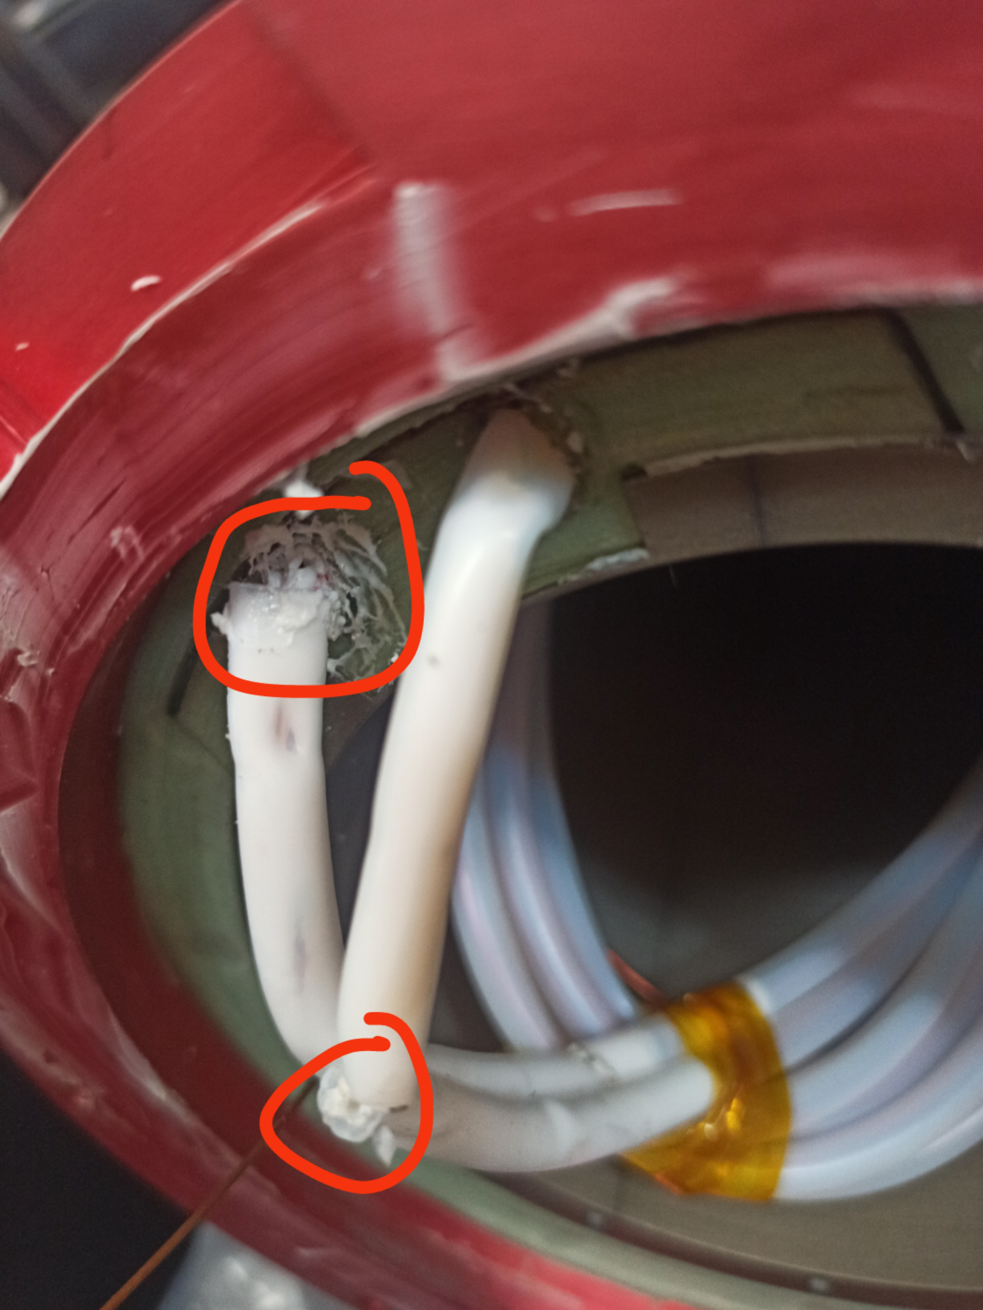
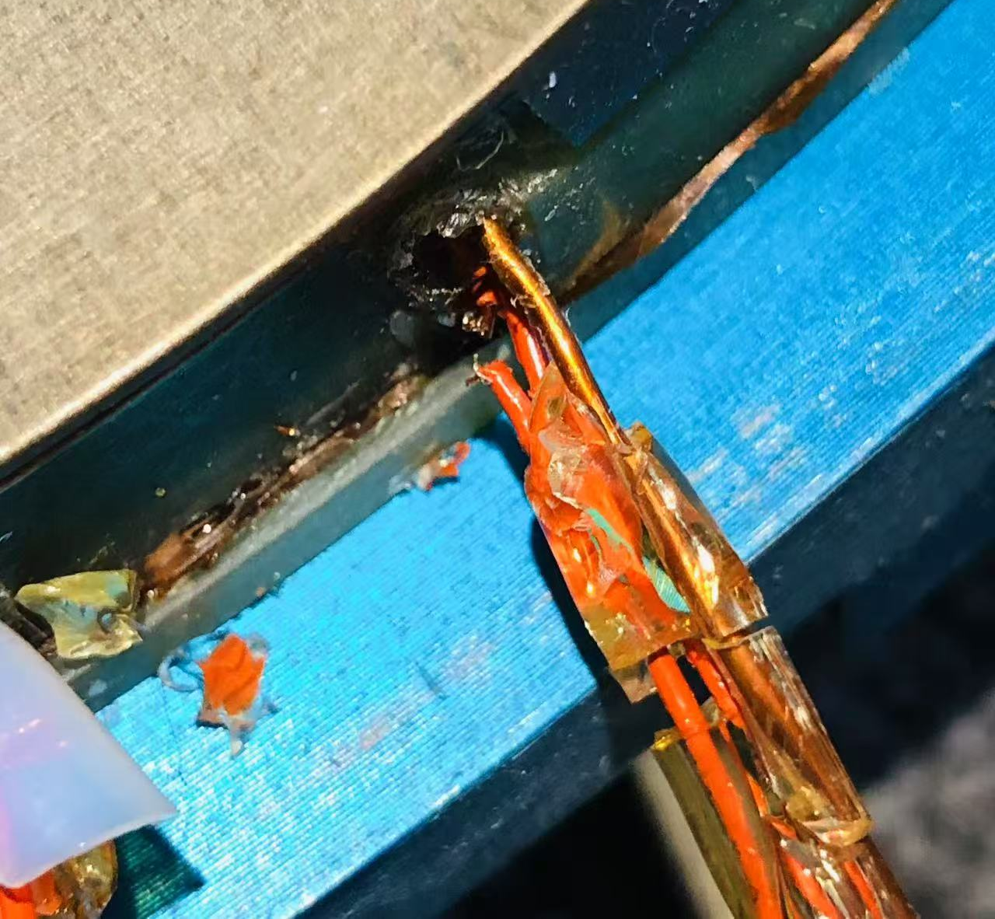
Issues about CB25: defects at Teflon tube
The failure was firstly owned to a broken Vtap:
Defects were found at the Teflon tube of CB25, and the Vtap EE16 is broken at reception.
However, similar problems soon happened in the test of other coils

Slide 8
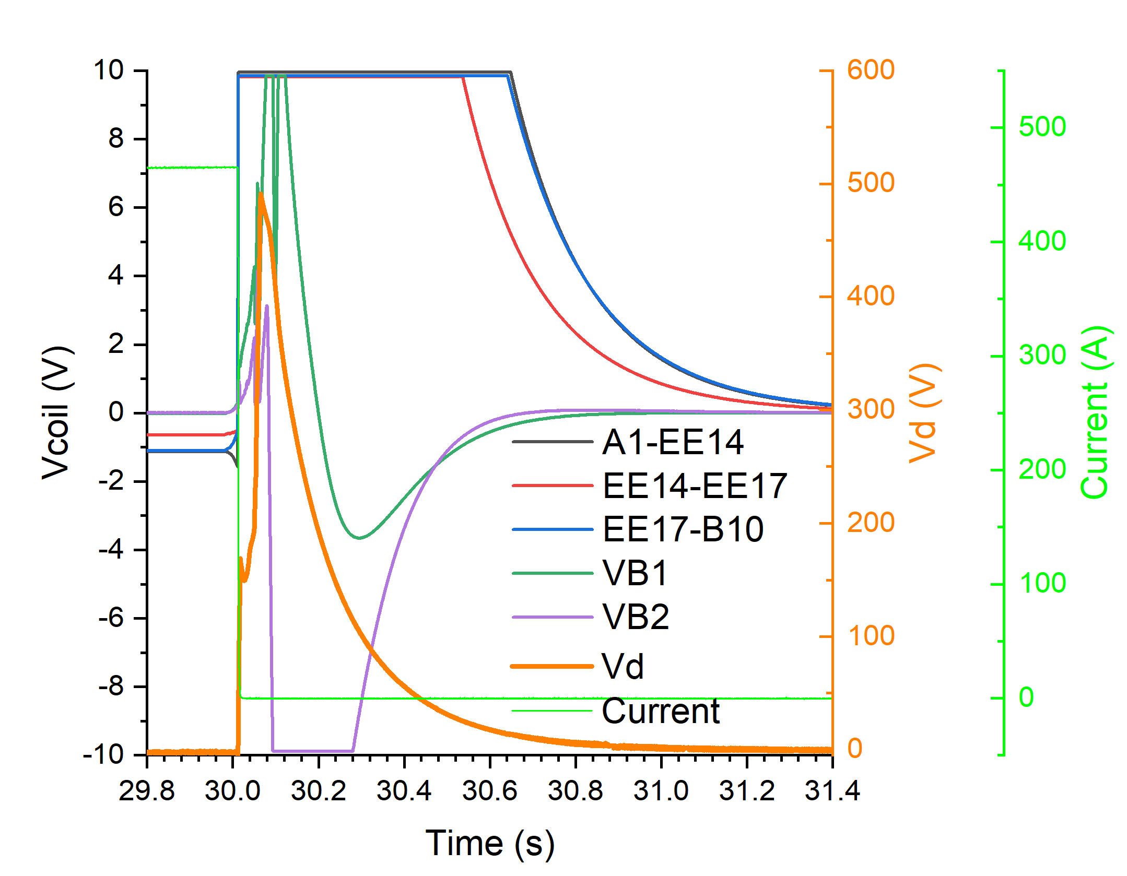
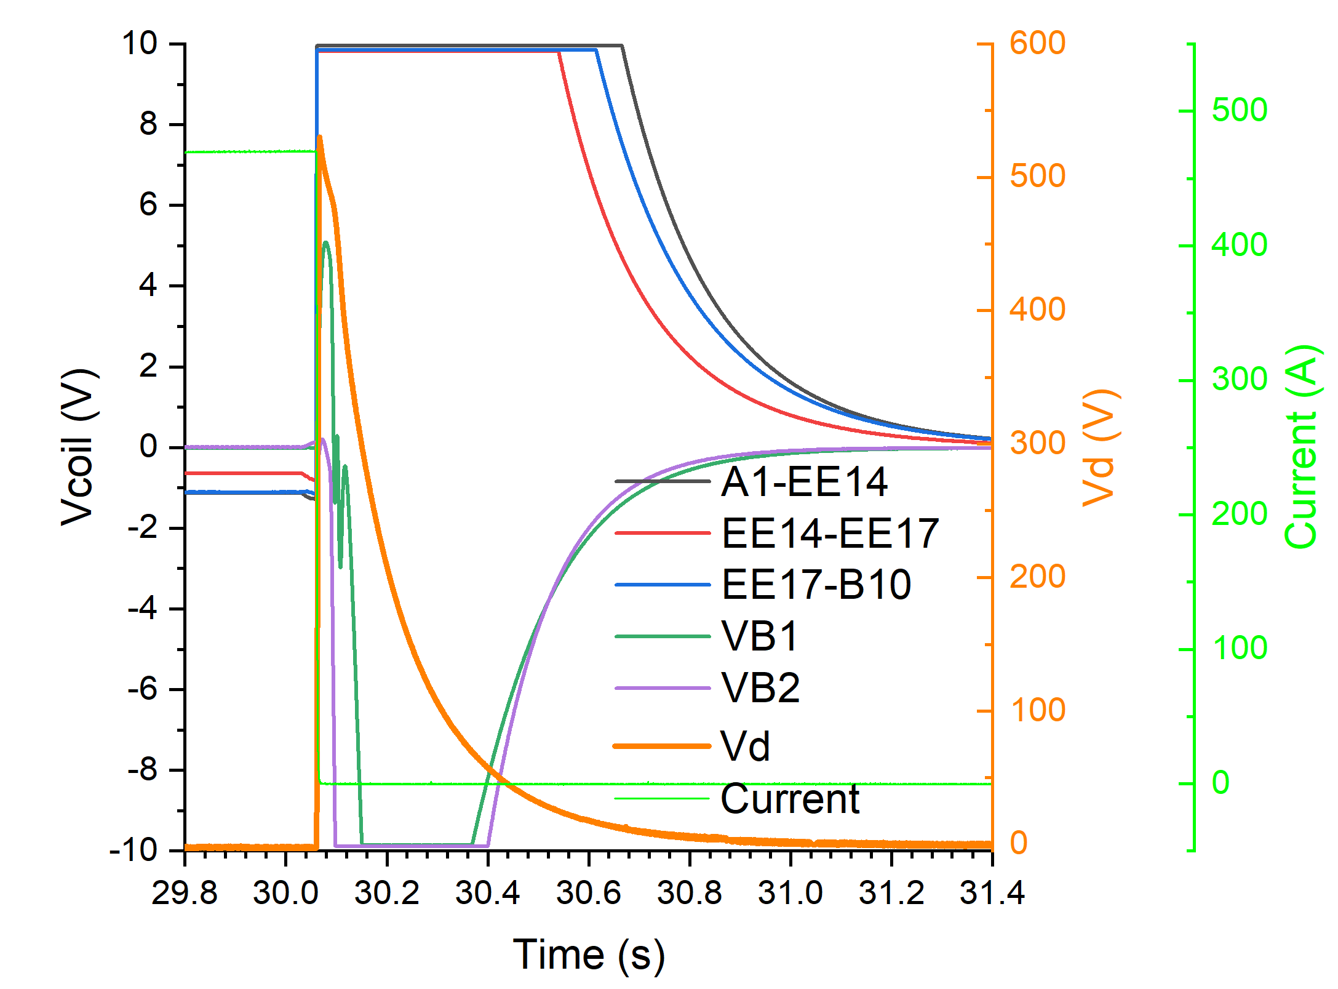
Issues about CB26: abnormal quench voltage (2025.05)
Abnormal Vd
The 52th quench signals for CB26
The 51th quench signals for CB26

Slide 9
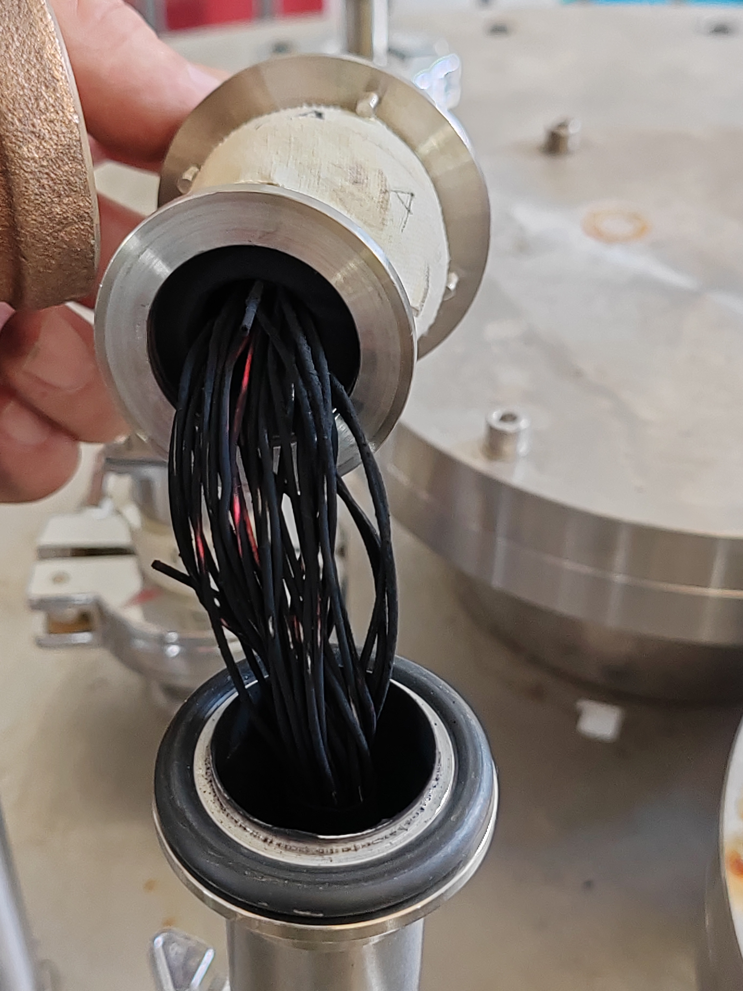
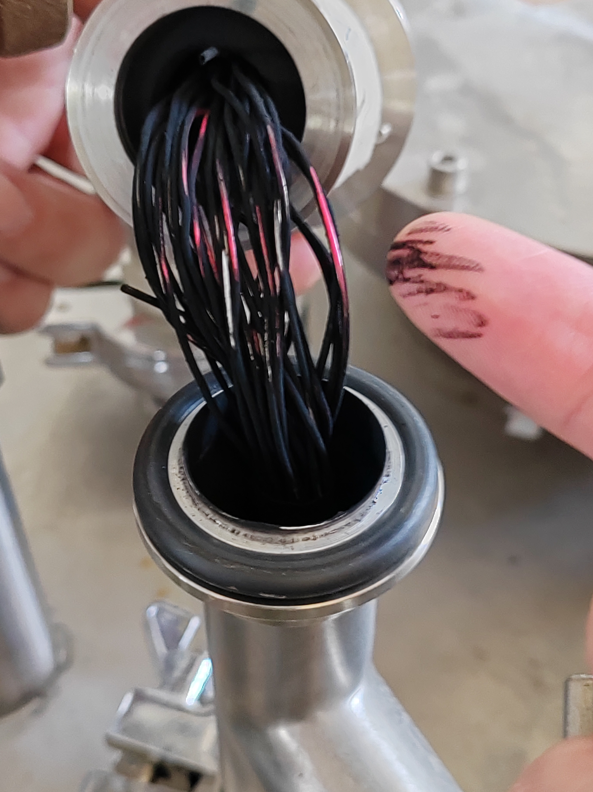
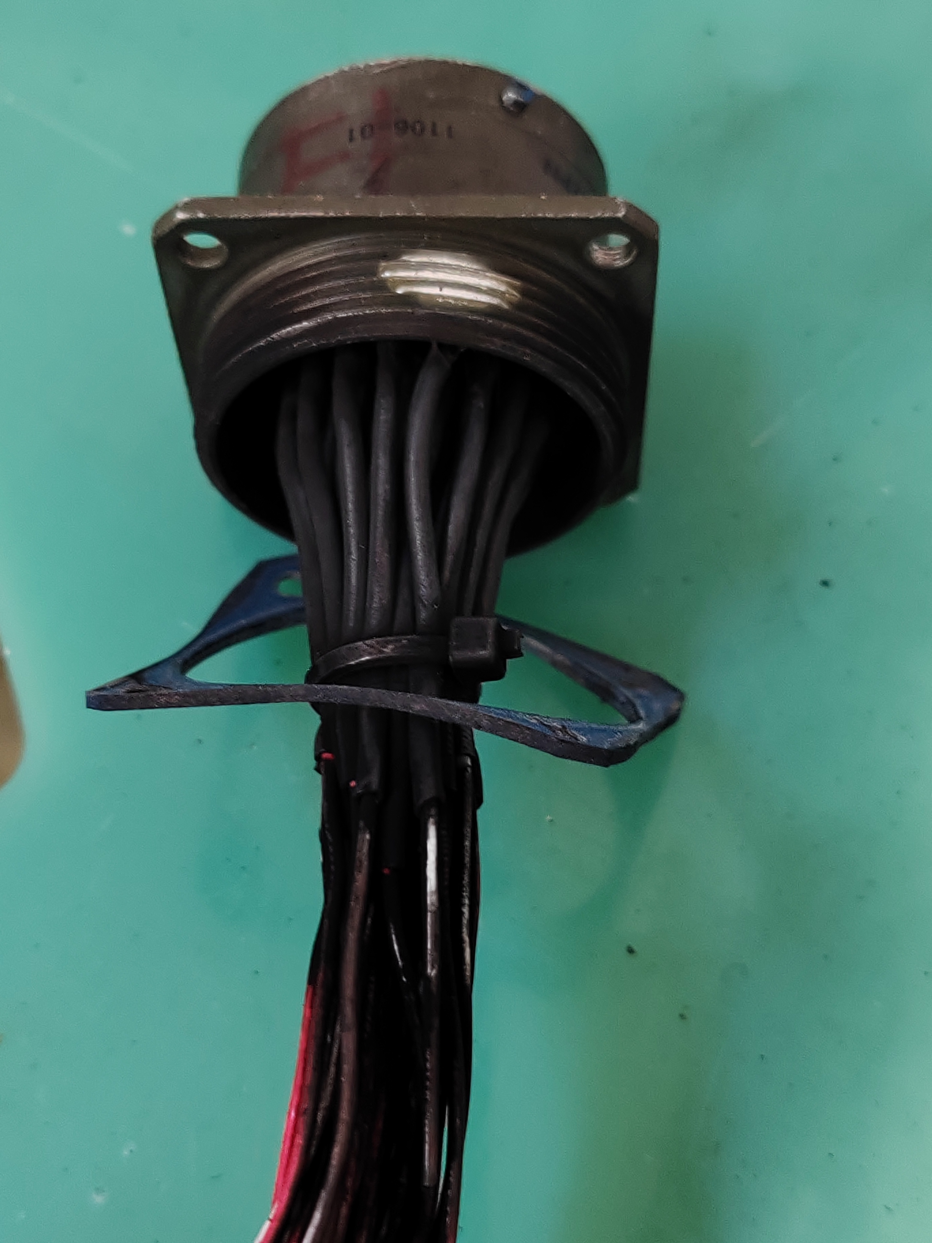
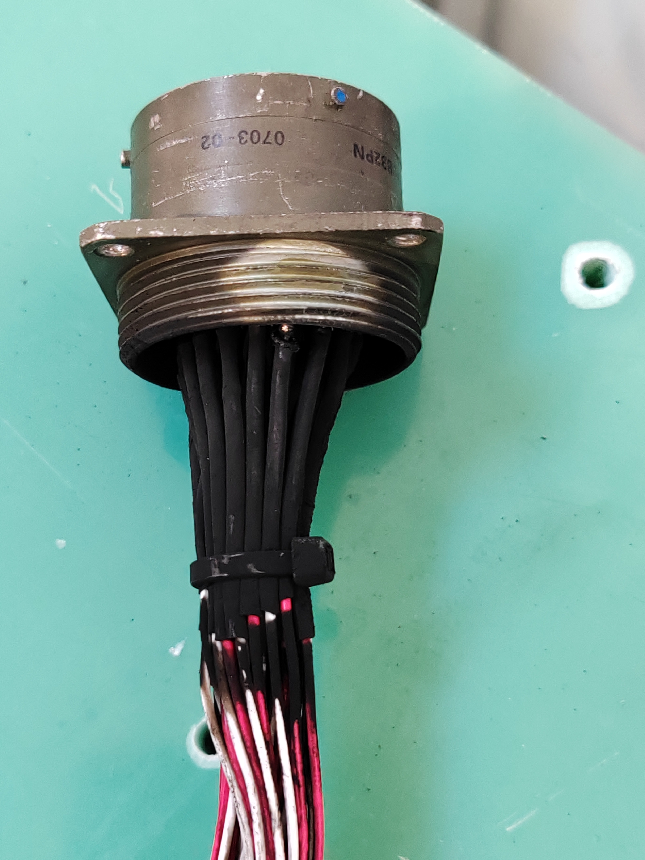
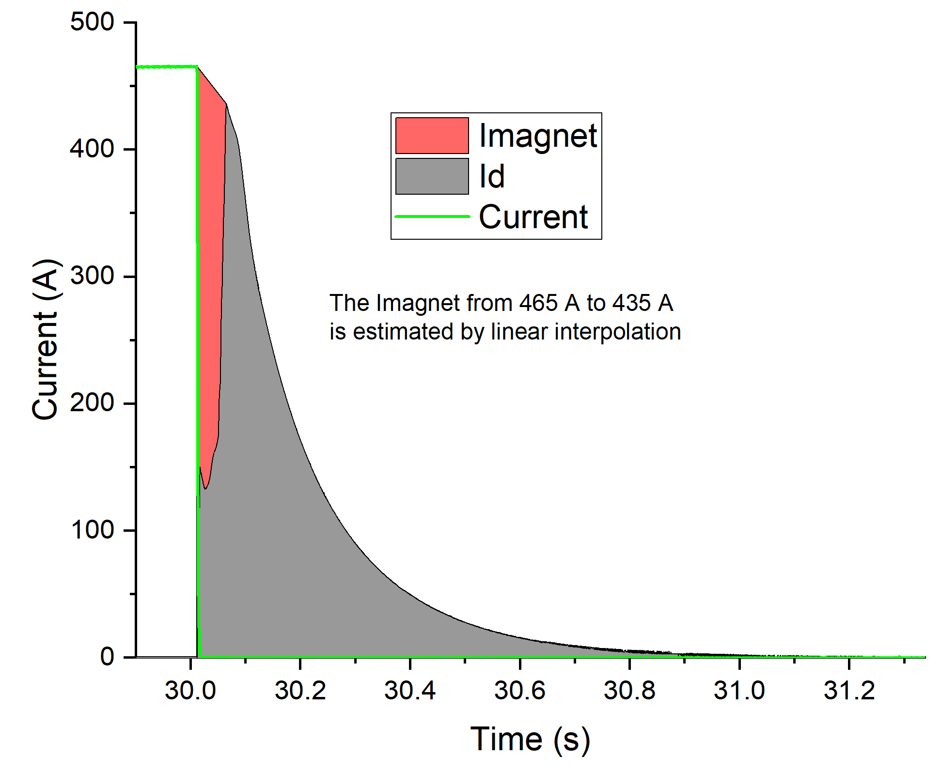
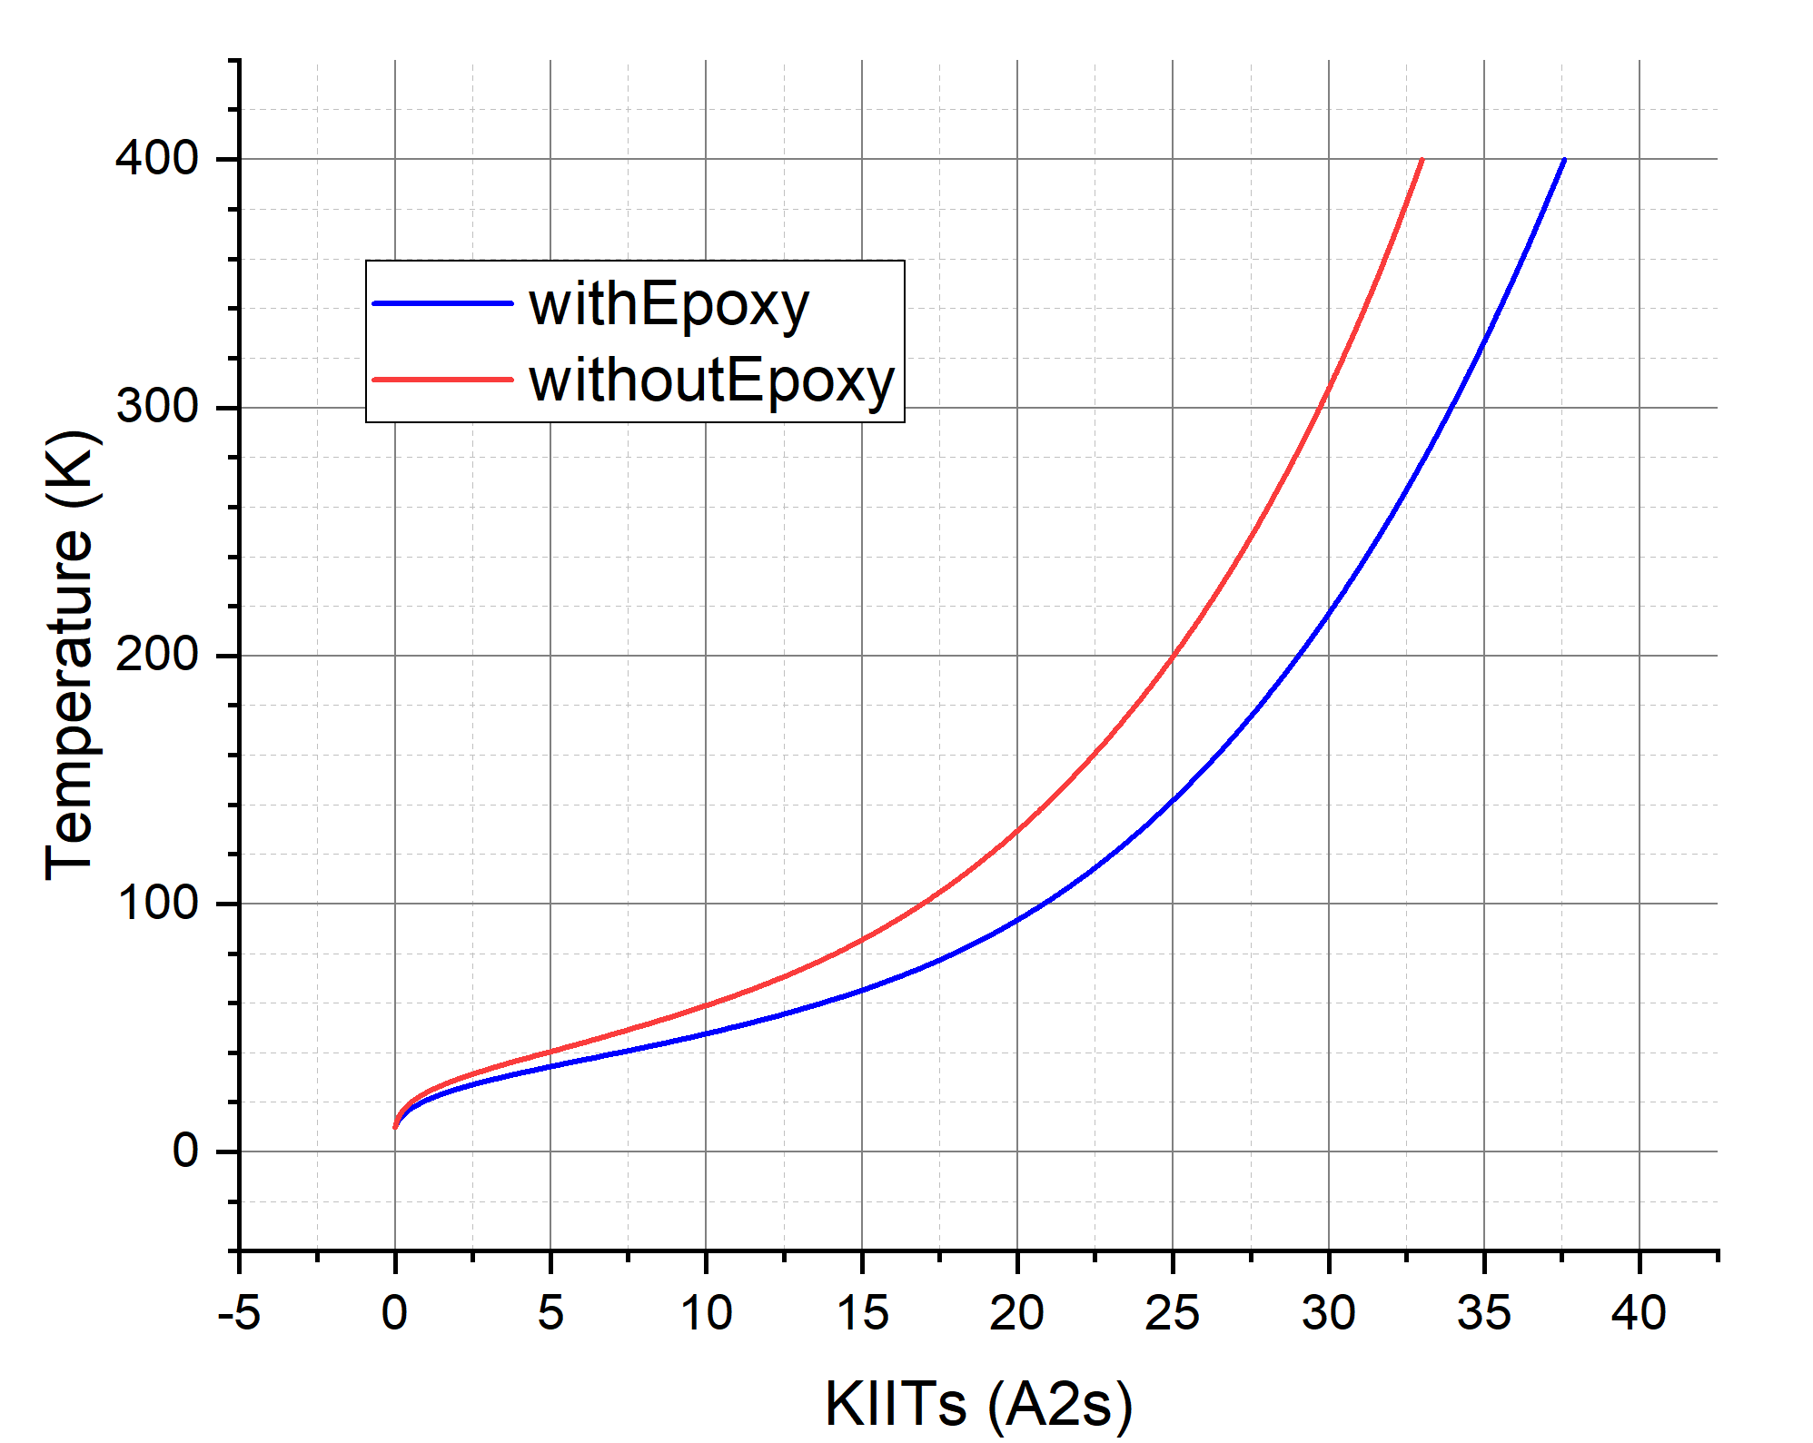
Inspection for CB26 and the test station
Feedthrough for Vtaps were burnt
Coil sections | Resistance
A1-EE14/EE15 | 74 Ω
EE14/EE15-EE17 | 97 Ω
EE17-B10 | 74 Ω
A1-B10 | 247 Ω
Coil to outer former (330V) | 14.5 GΩ
Coil to shell (330V) | 2.89 GΩ
QI~28KIITs
CB26 seems to be fine after this event

Slide 10
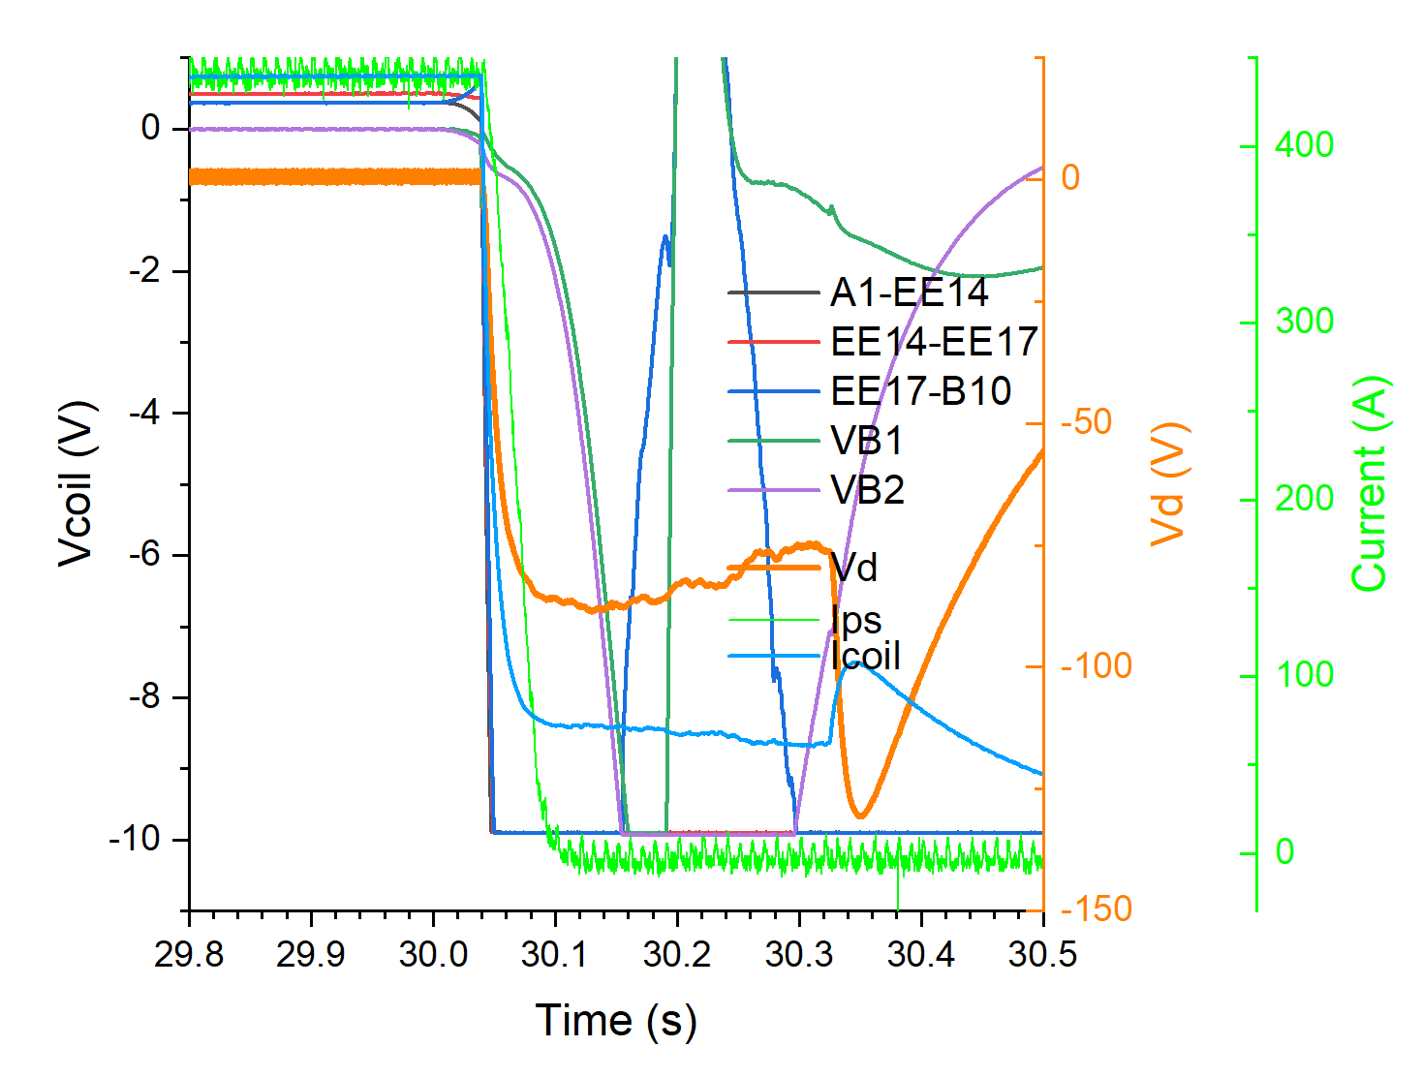
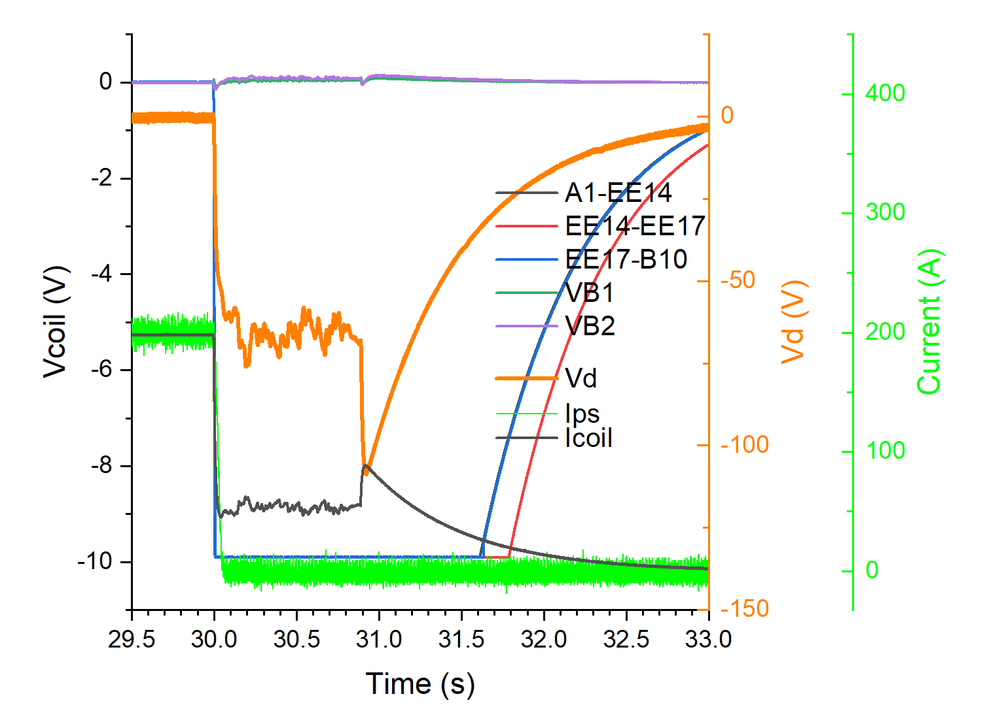
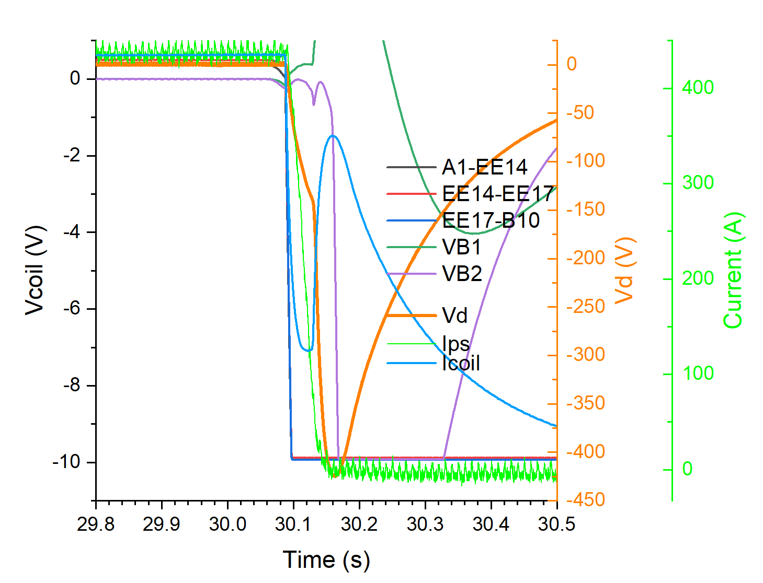
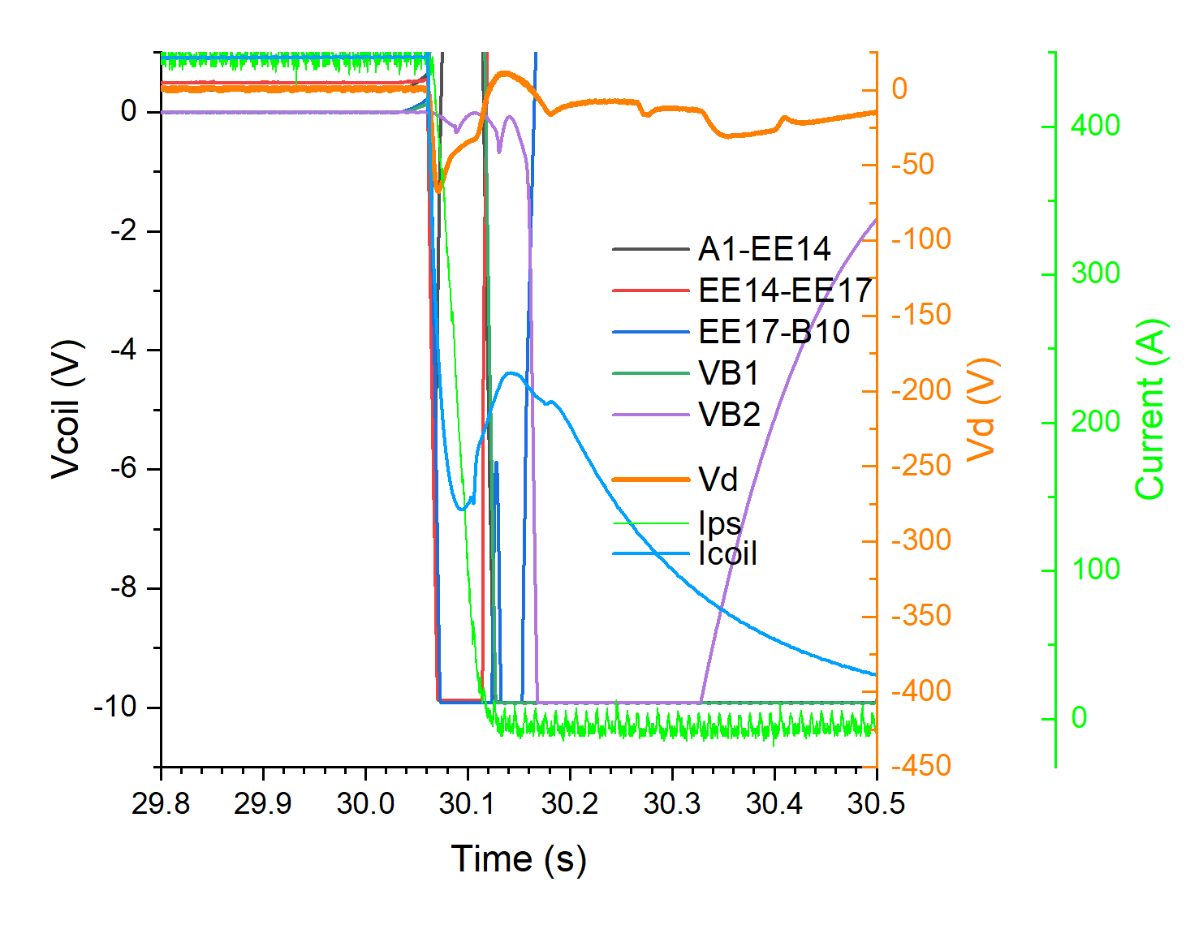
CB26测试结果——440A失超
Issues about CB22 and CB26 (2025.08, feedthroughs repaired)
CB26 quench at 440 A
CB26 discharge at 200 A
CB22 quench at 435 A
CB22 quench at 447 A
Abnormal quench voltage continued to present during tests of CB22 and CB26, even with new feedthroughs passed through high voltage tests.

Slide 11
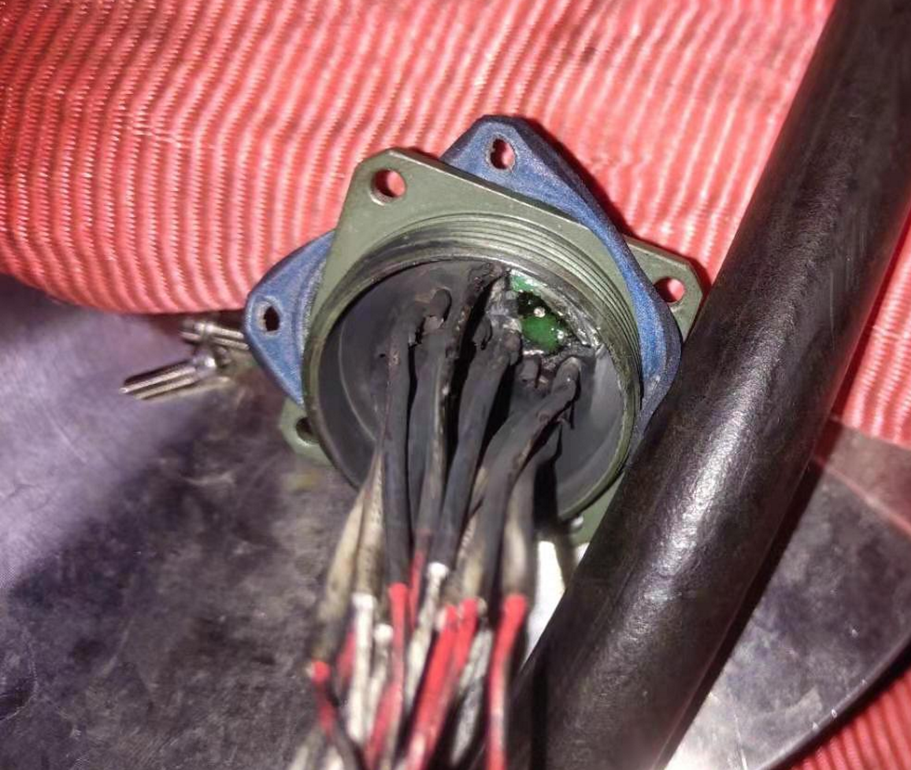
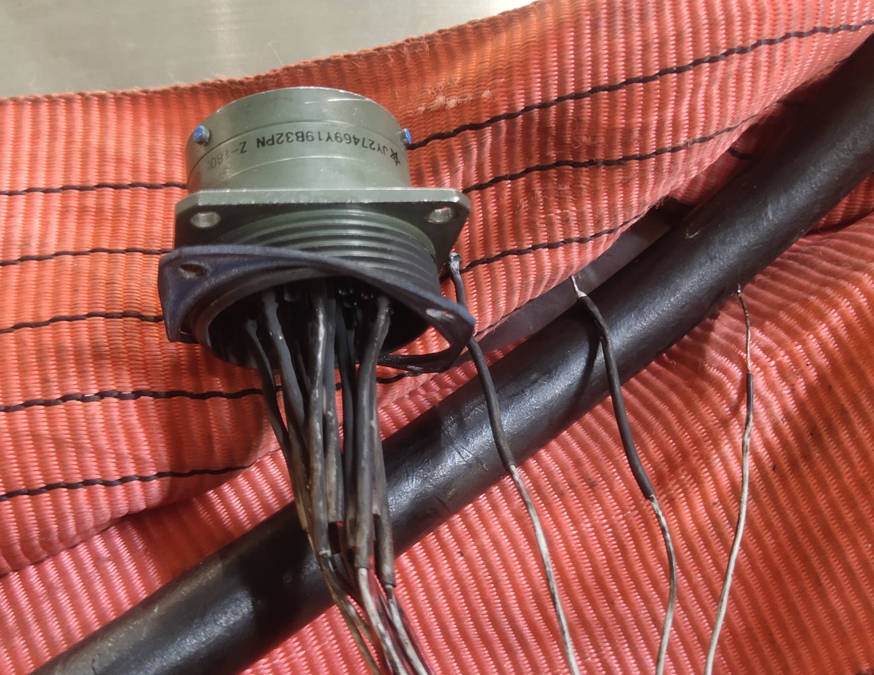
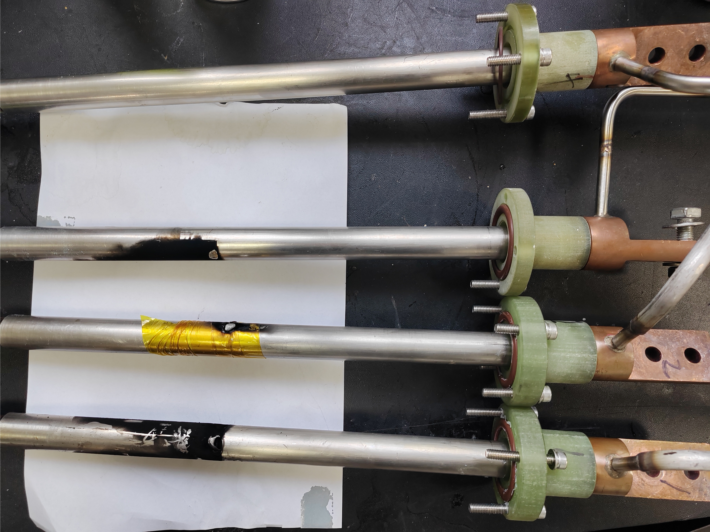
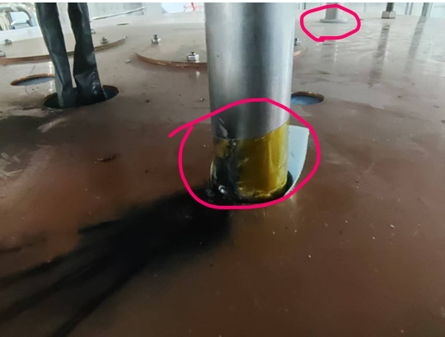
Inspection for the test station
CB22 -
CB22 +
CB26 -
CB26 +
Feedthroughs were found burnt again.
The current lead for CB26 + didn’t pass insulation test (to ground) at around 200 V (the coils are disconnected), corresponding to the test issue of CB26, suggesting the coil might not be degraded.
Three current leads (CB26 ± and CB22 -) were found discharged to the thermal shield.
Most serious energy deposition happened at the one for CB26+, where the steel jacket was burnt a hole.

Slide 12
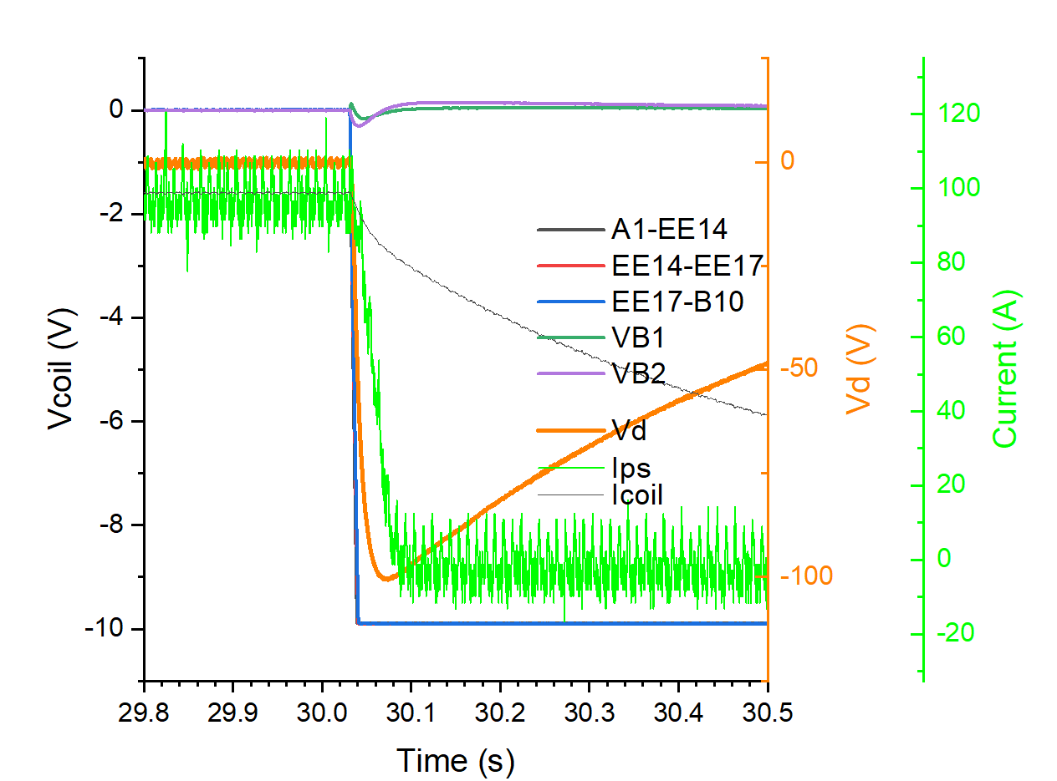
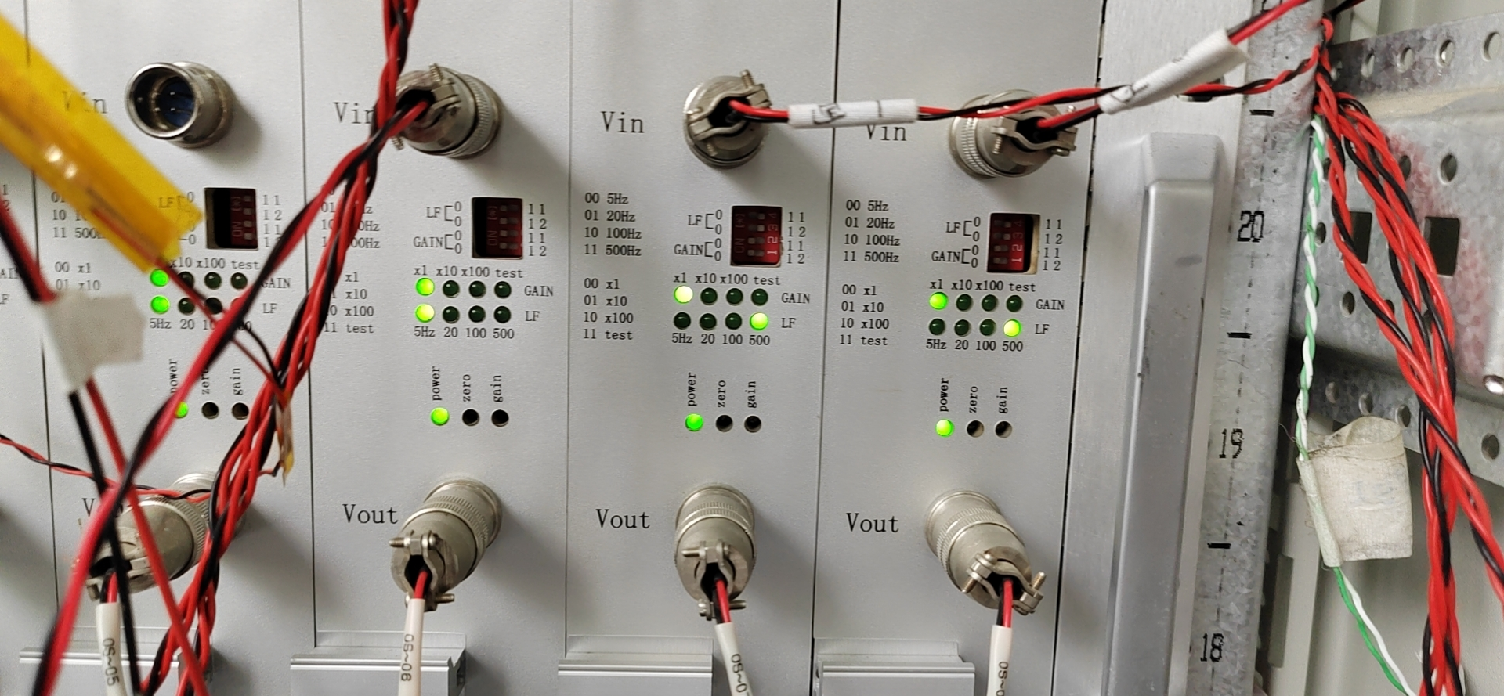
One more issue regarding the test station
During the tests of CB26 and CB22 in August, it was found the peak discharge voltage is corresponding to a dump resistor about 1 Ω, instead of the 1.25 Ω that is used.
The peak voltage appeared after about 40 ms.
After a throughout check of the entire protection circuit, this was confirmed due to the re-set of the filter frequency of the DAQ system, instead of an unexpected capacitor (thanks G. Willering for the helpful discussion).

Slide 13
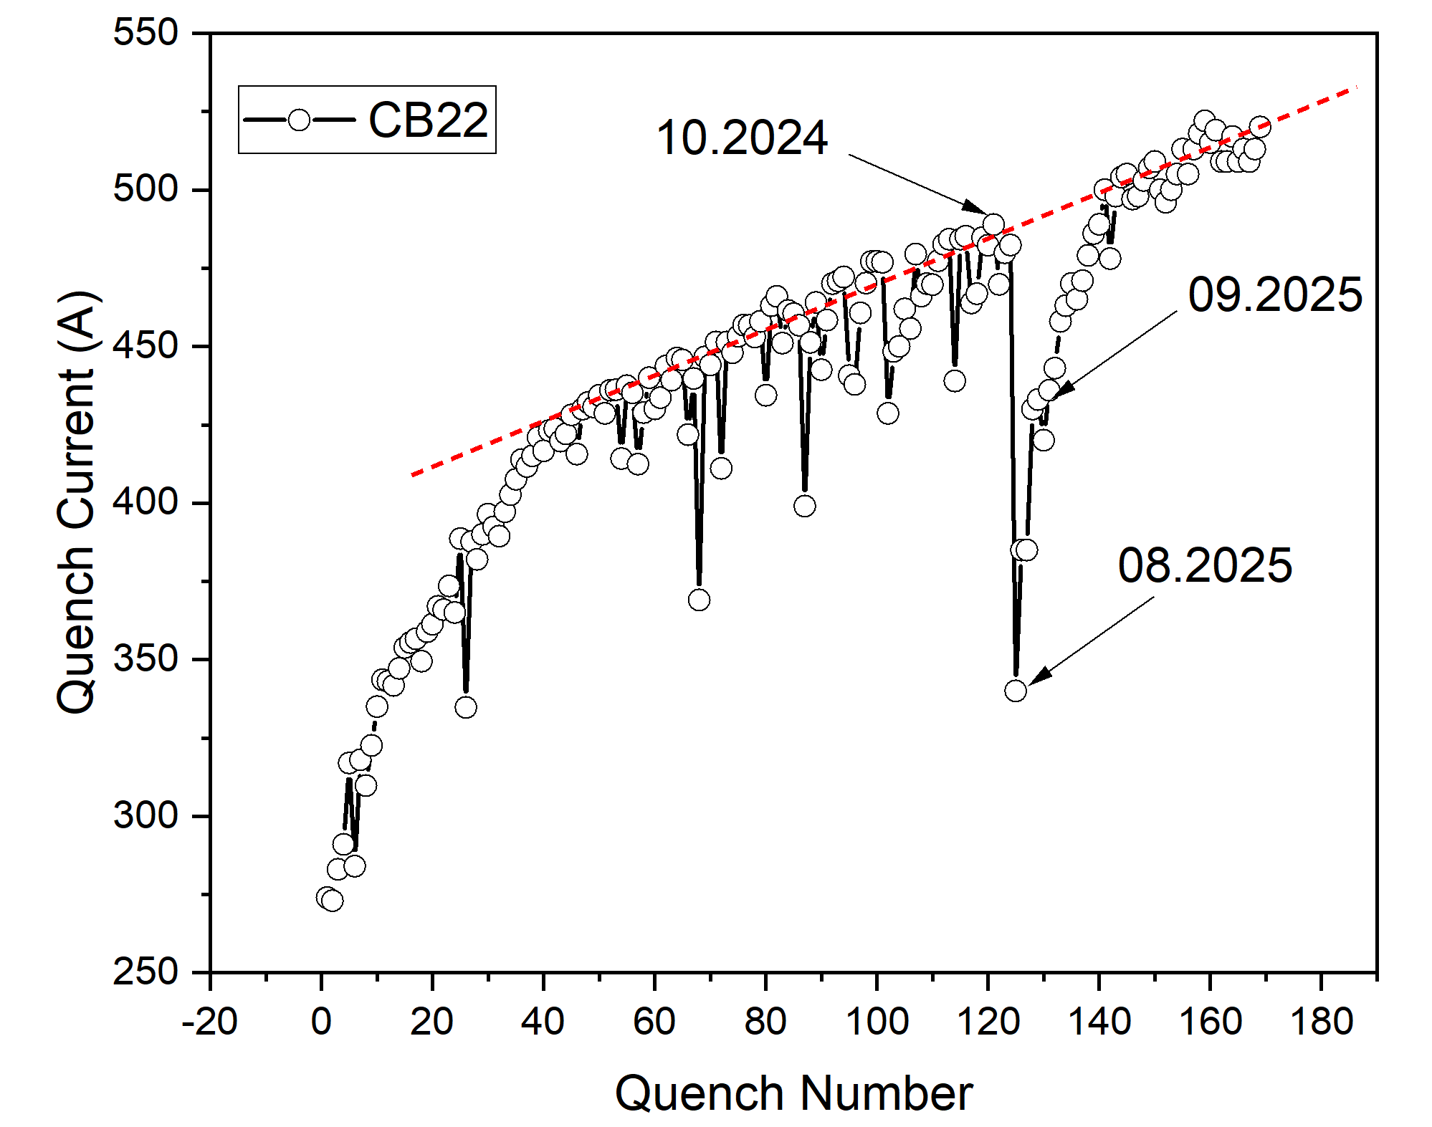
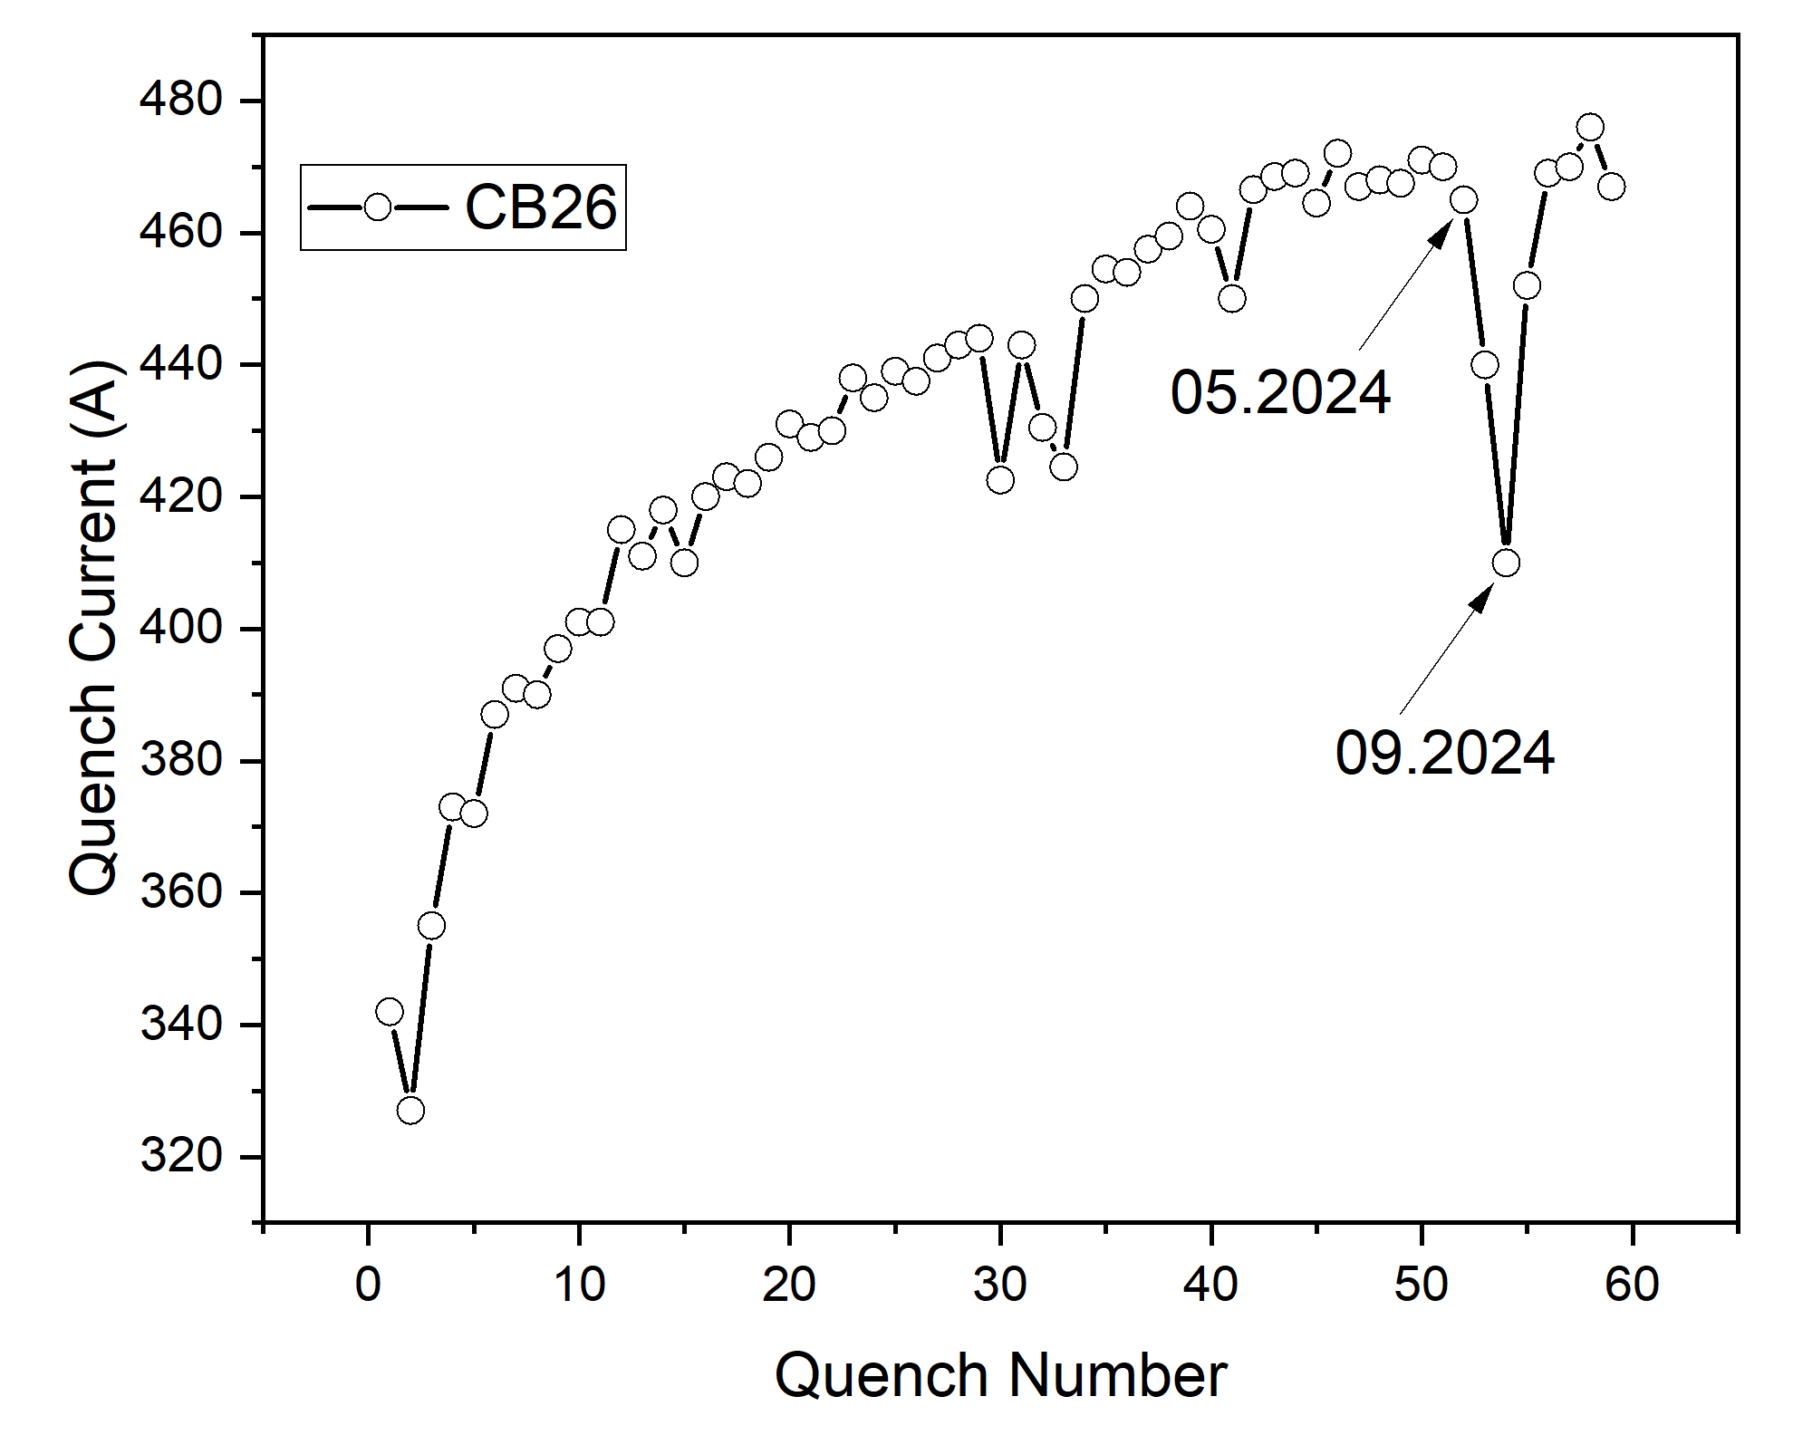
Latest tests for CB22 and CB26 (2025.09, current leads and feedthroughs repaired)
Both coils show no sign of damage or degradation, though they still suffer from the same long training as before, especially for CB22.

Slide 14
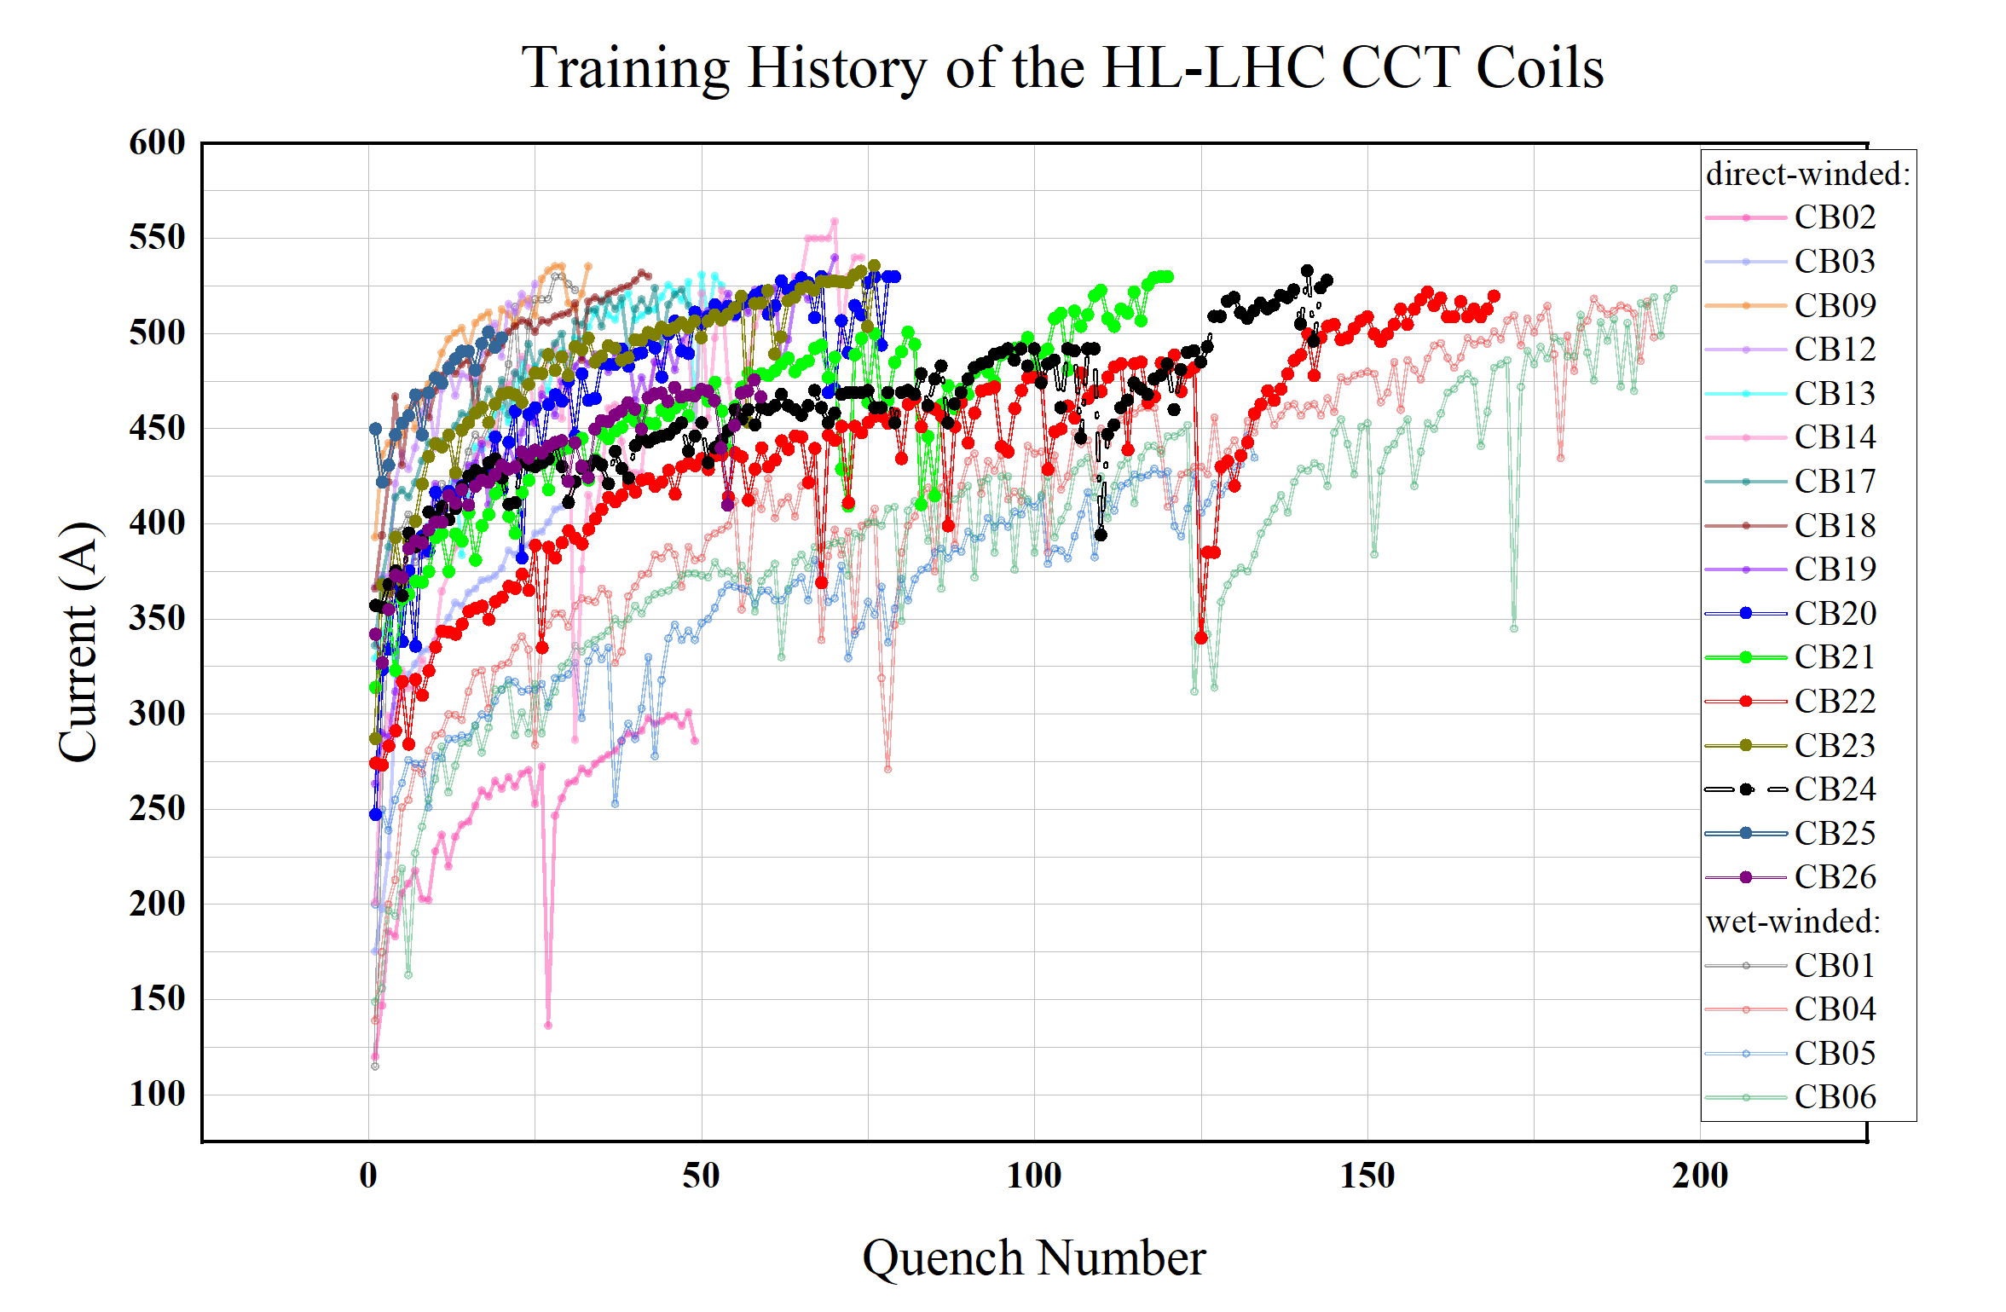

Slide 15
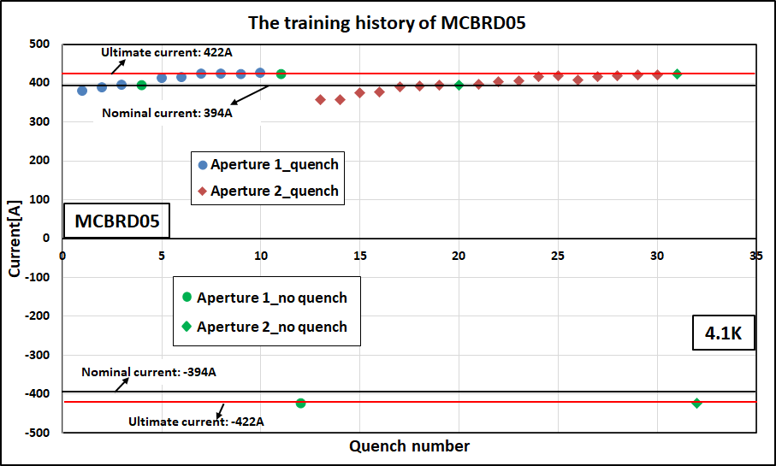
Training history of MCBRD05(before thermal cycle)

Slide 16
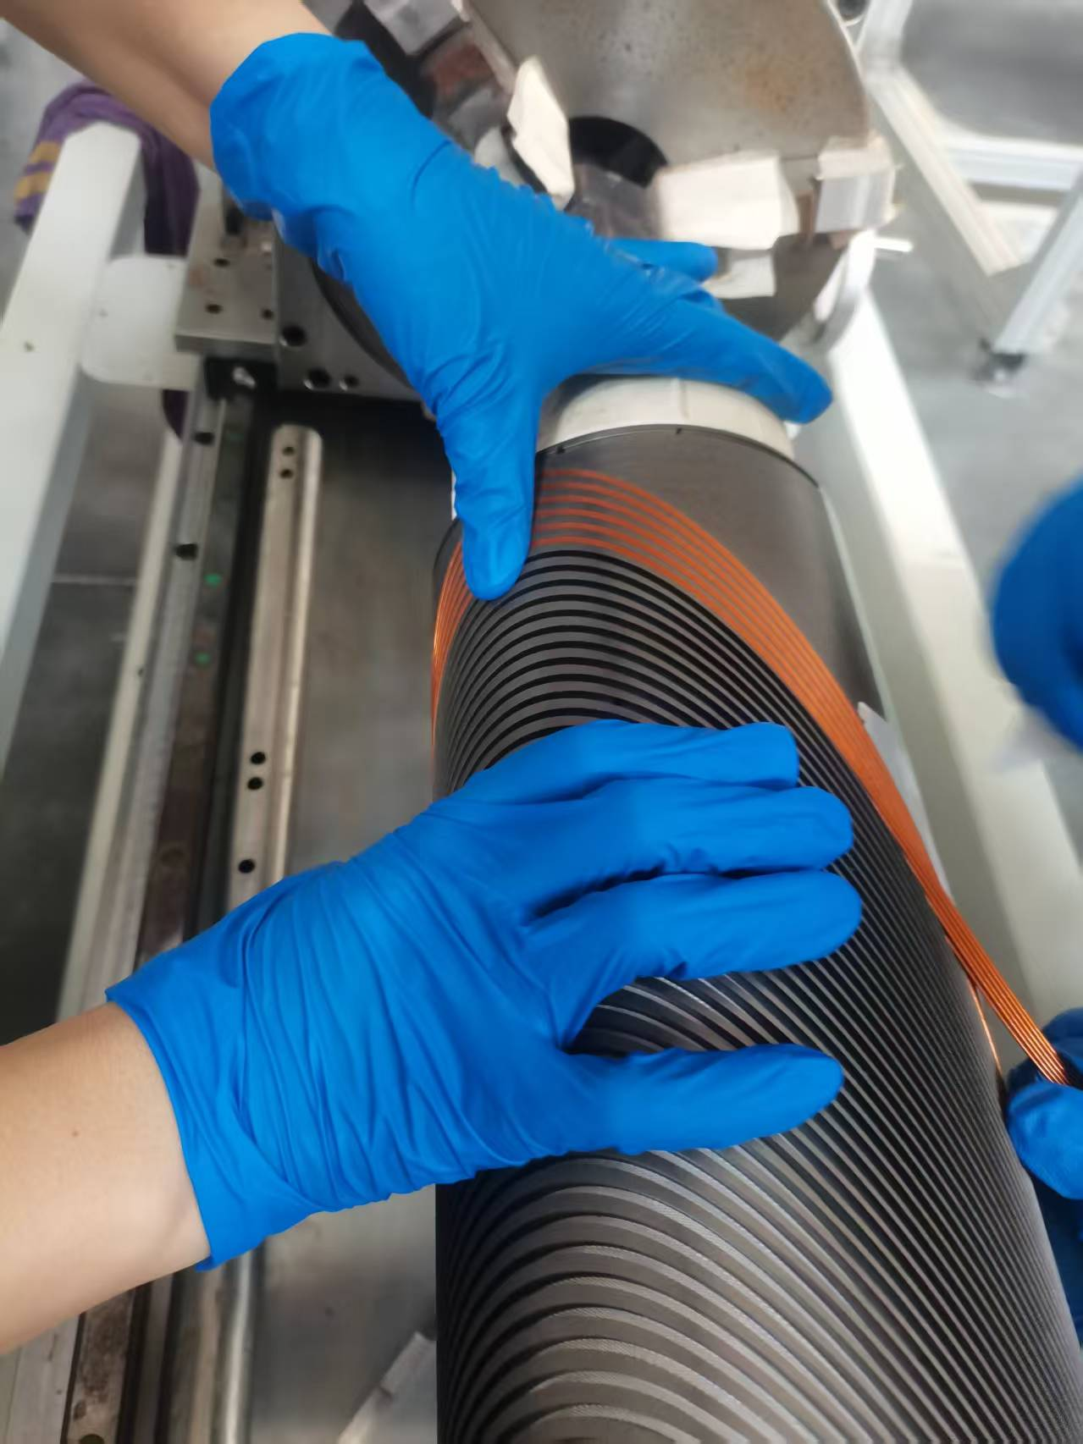
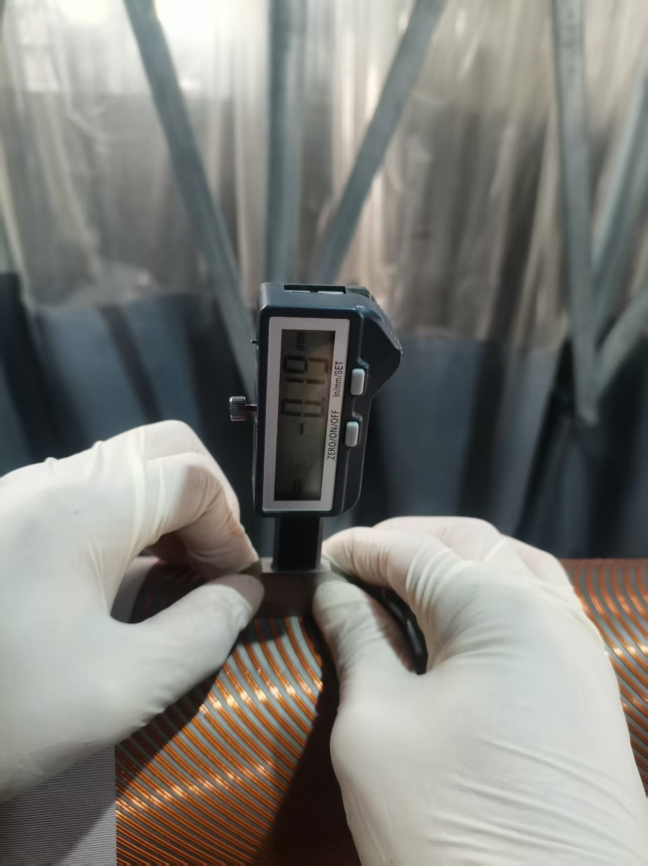
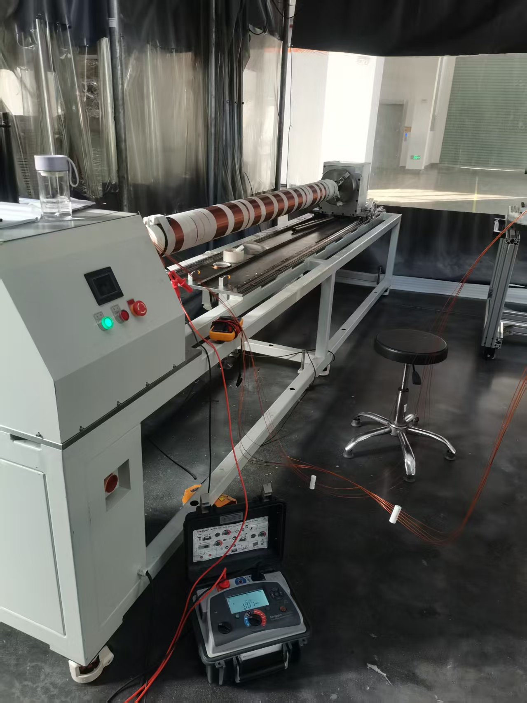
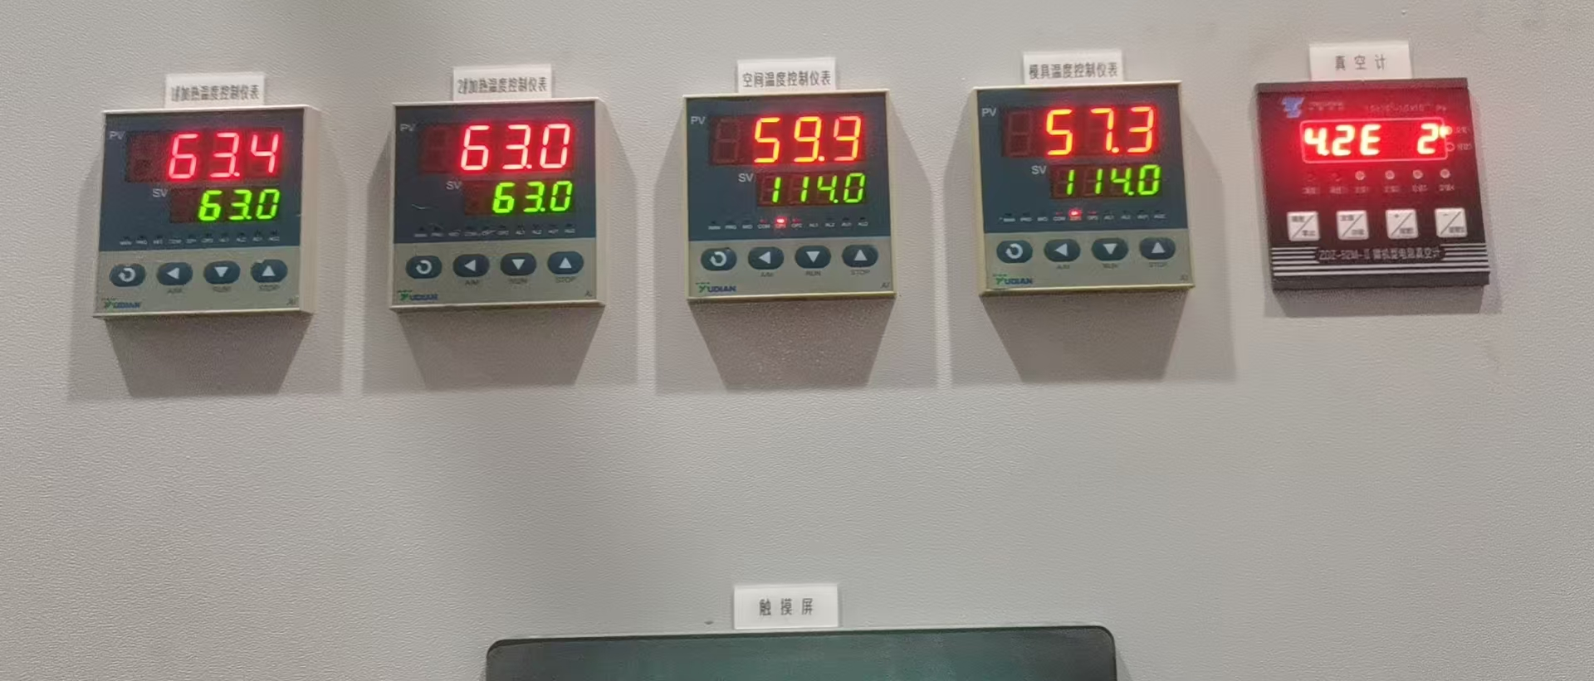
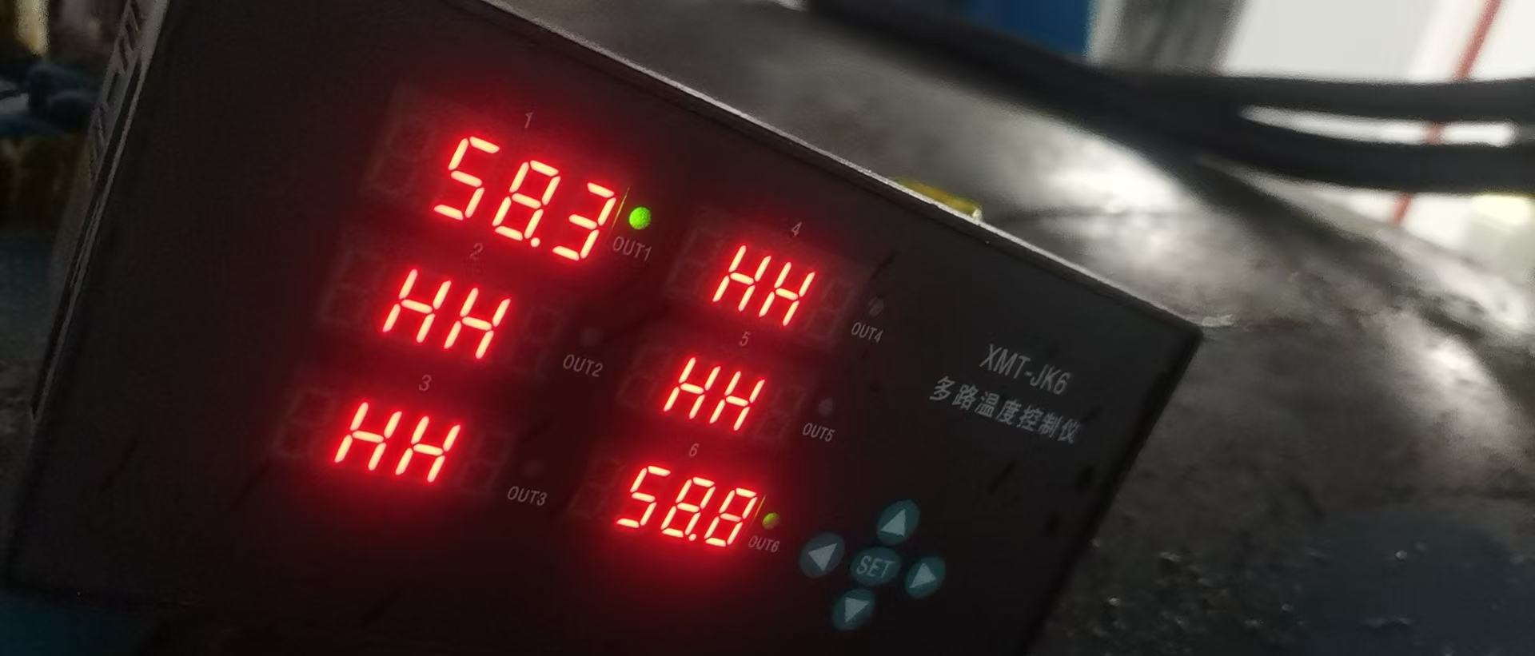
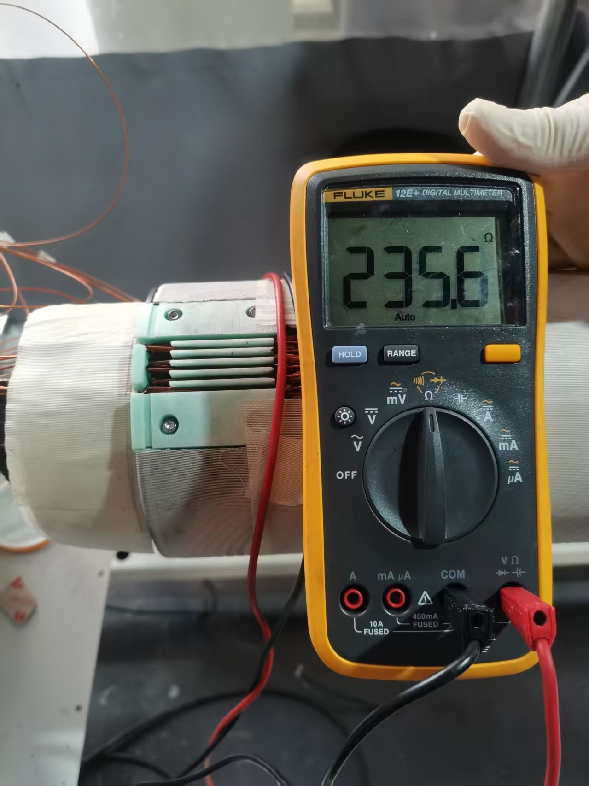
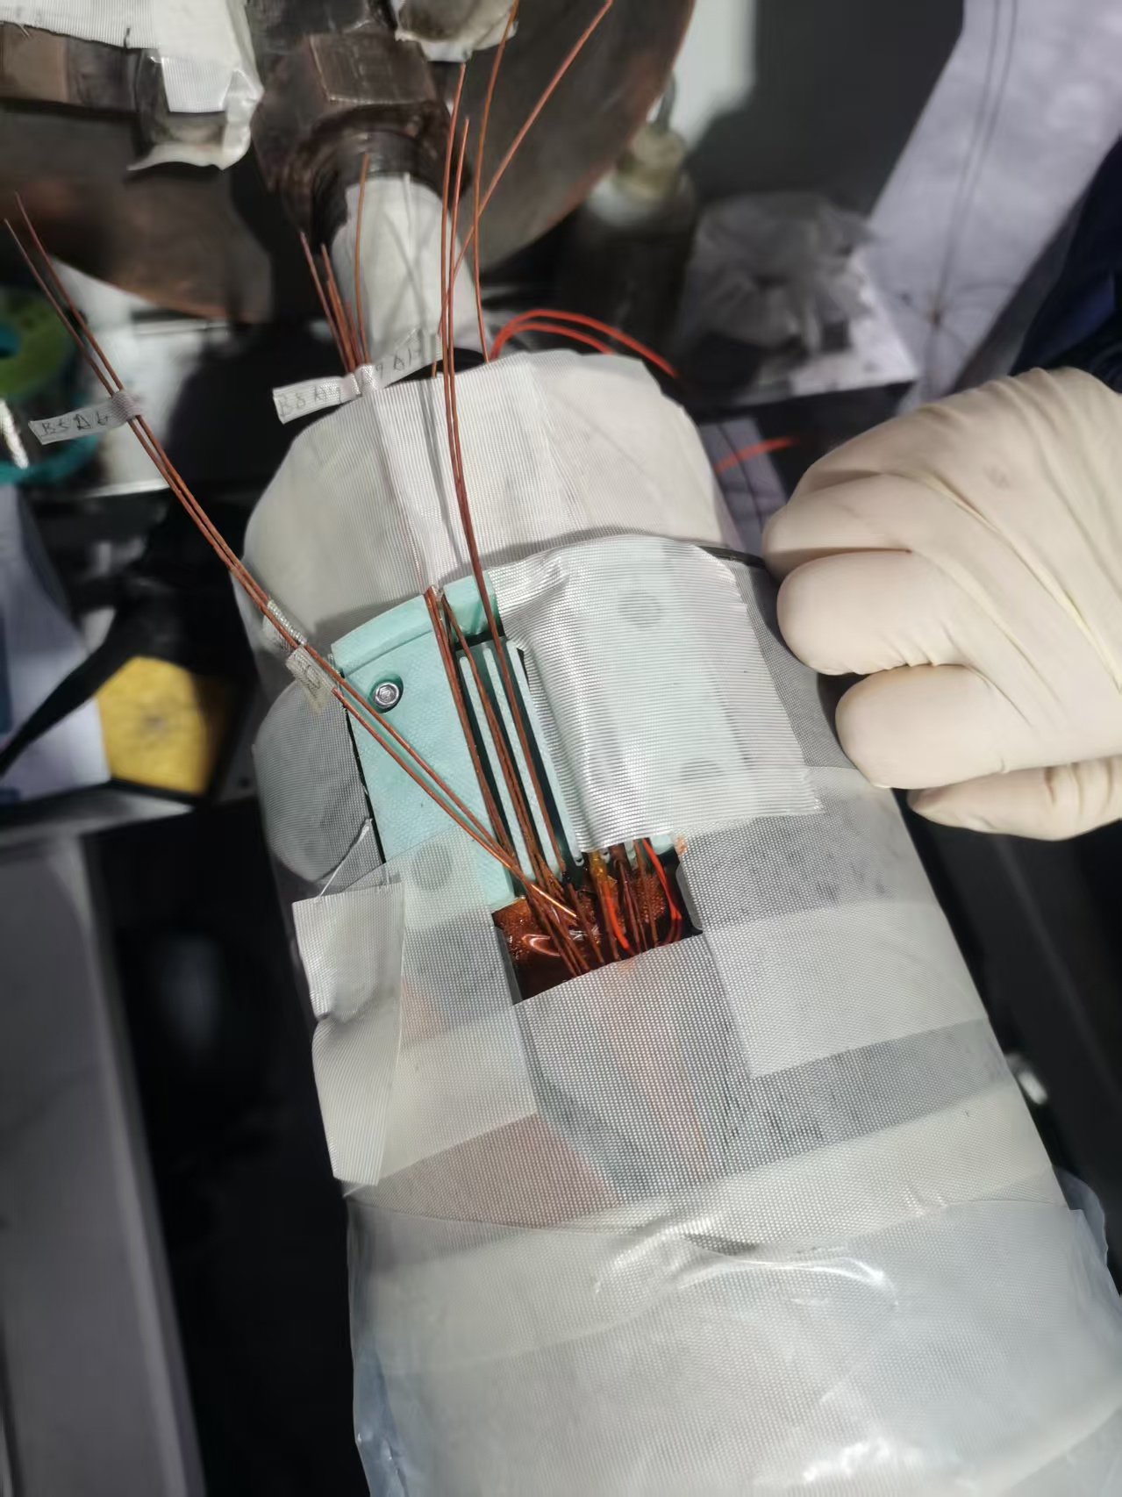
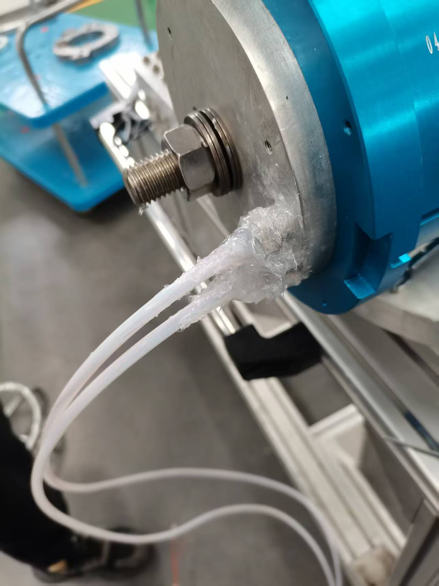
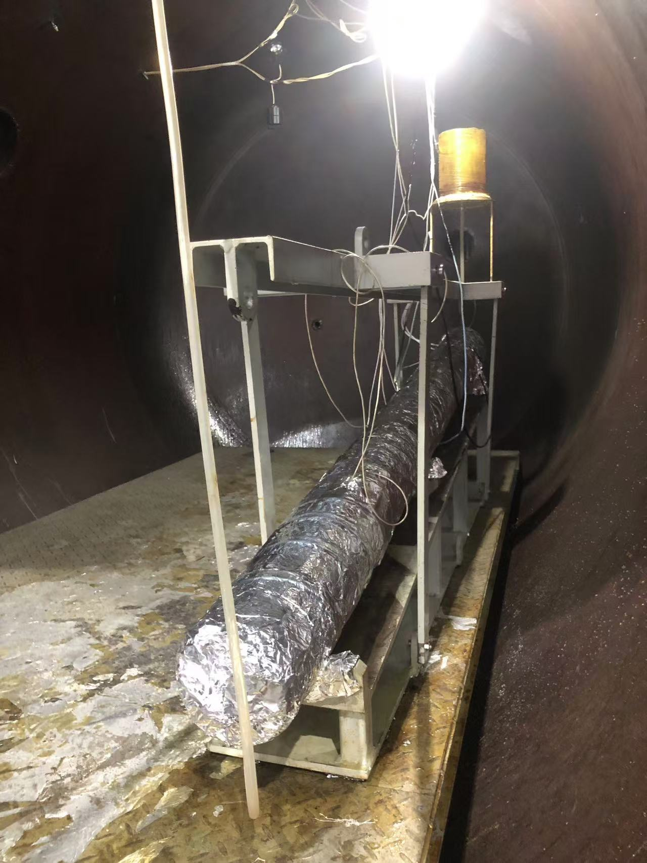
Manufacturing of CB23-29

Slide 17
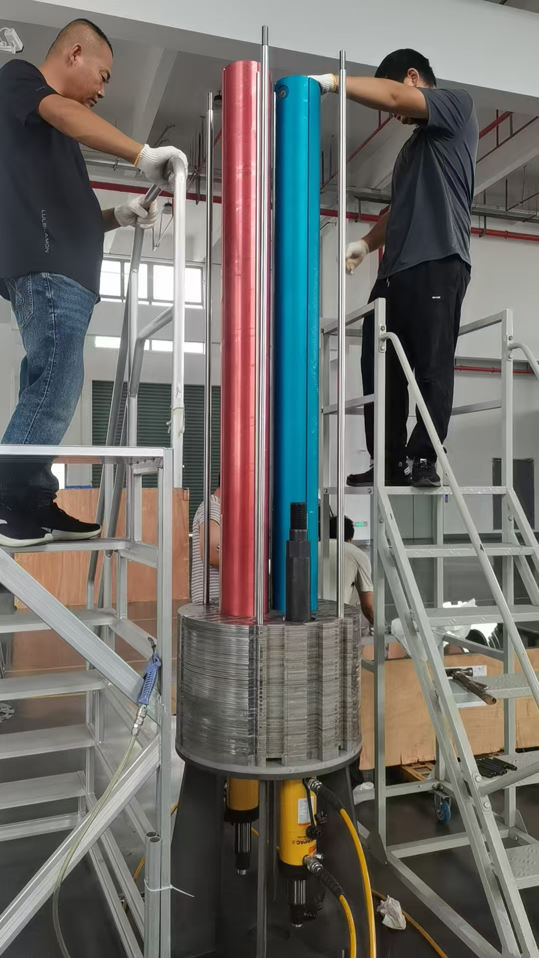
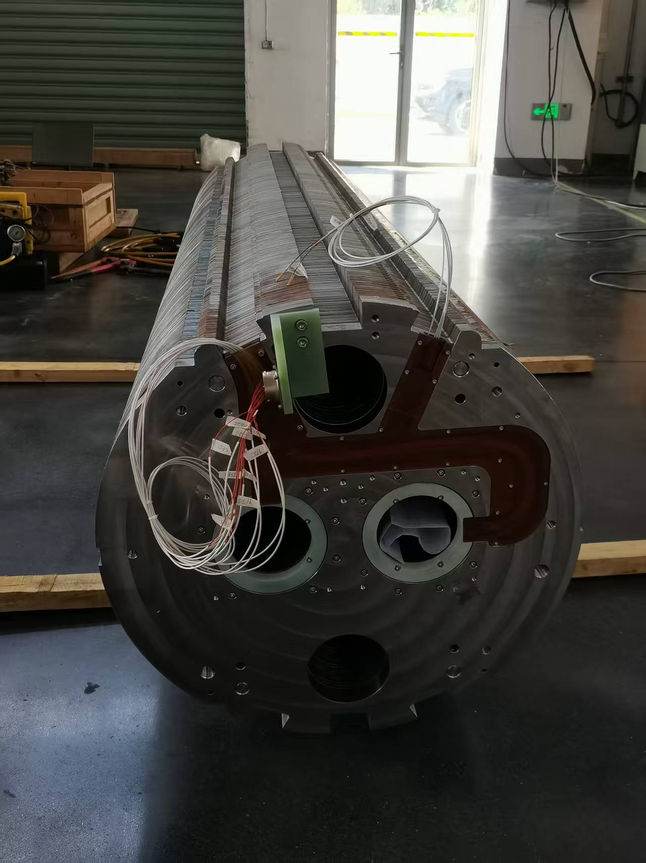
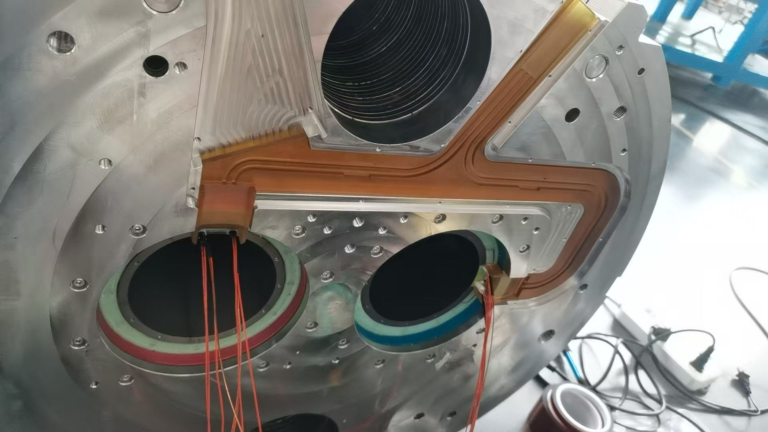
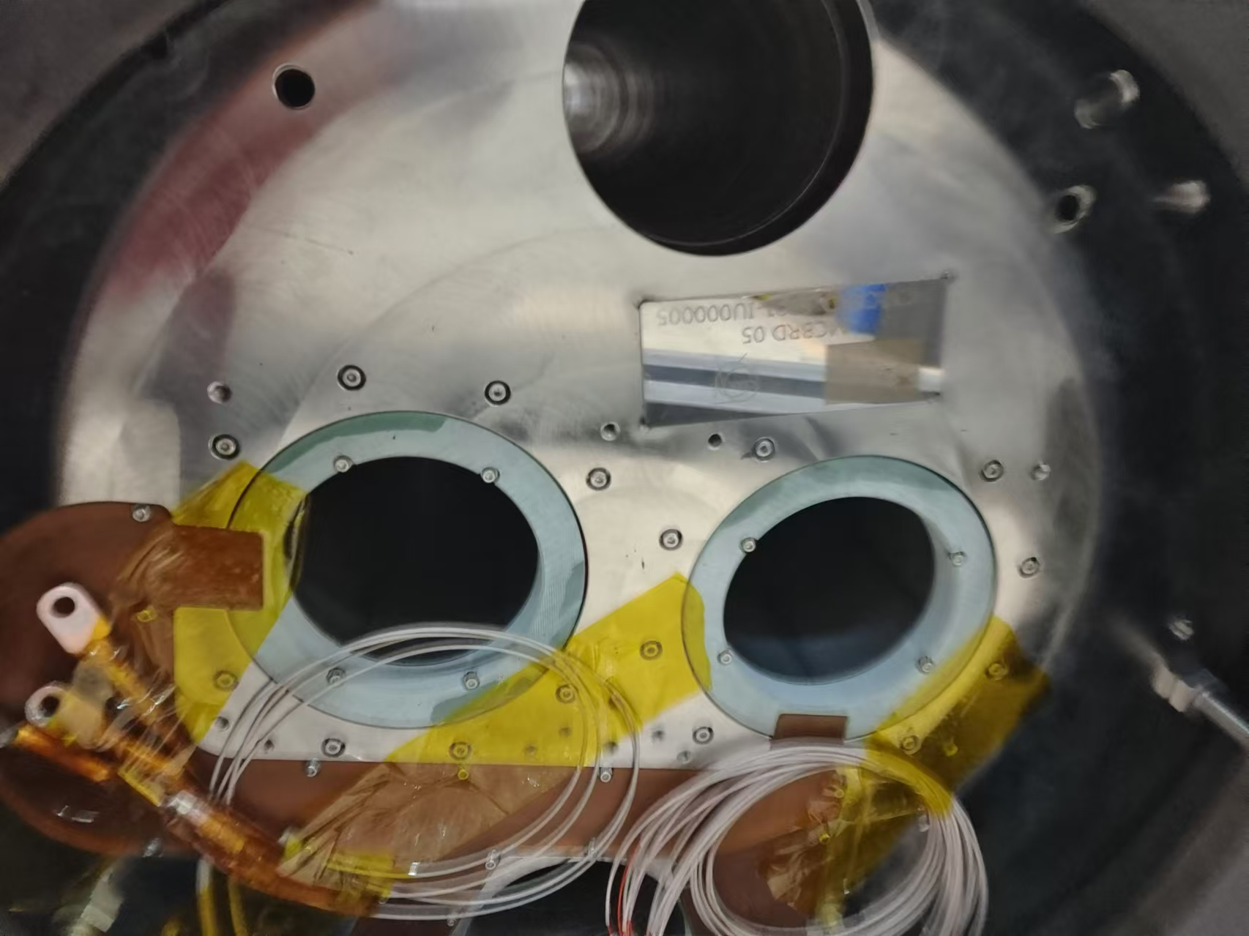
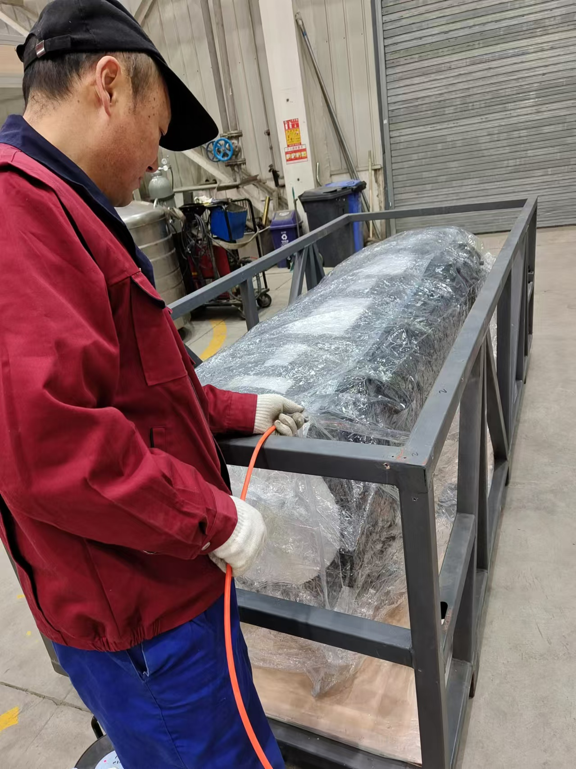
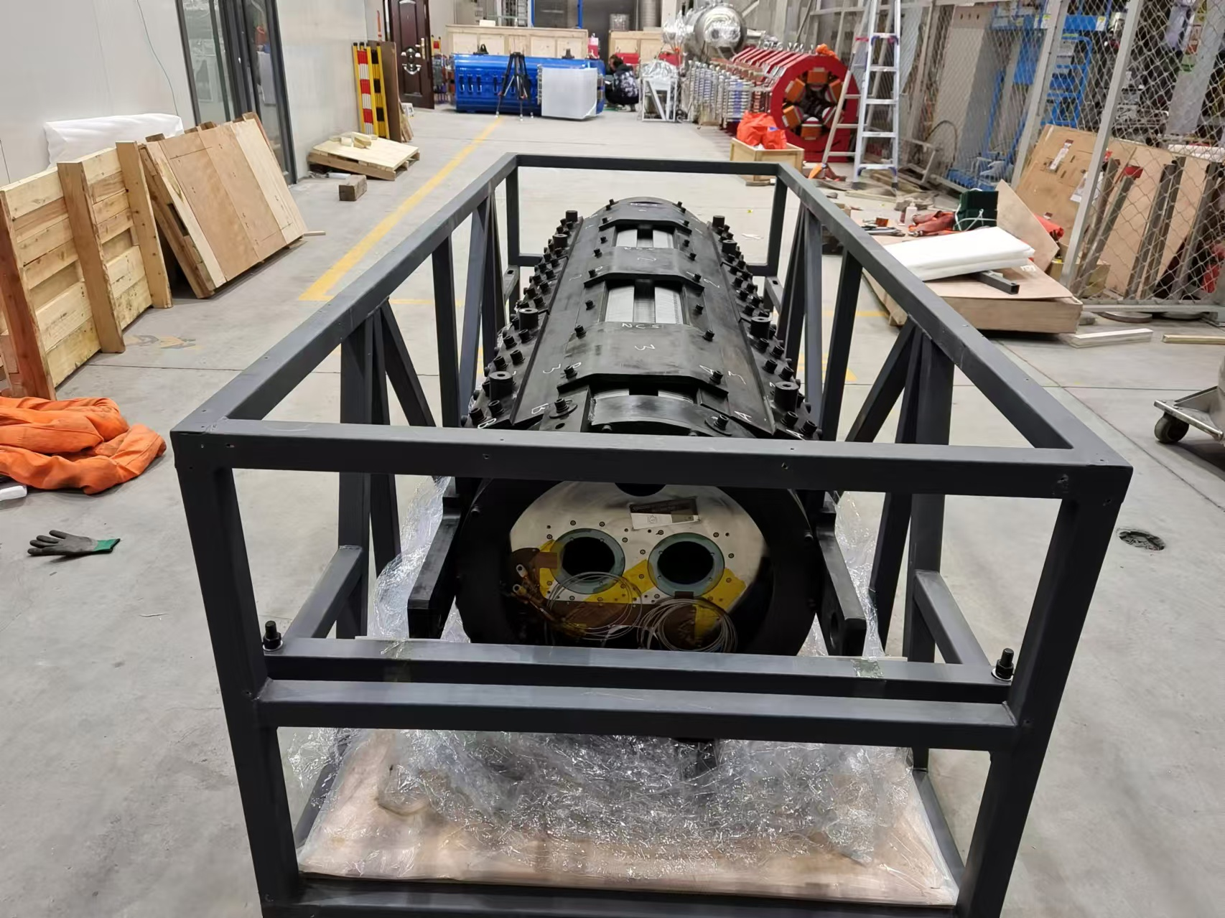




Assembly and package of MCBRD05-08

Slide 18
Summary
7 MCBRD magnets (out of 10 from IHEP side) have been delivered to CERN over the past year.
The un-spotted damage at current lead and/or feedthroughs for voltage taps lead to a failed quench protection of CB25, and serious delay for testing of other coils.
Status of the last 3 Magnets:
MCBRD08: composed of two non-tested coils, ready for delivery, need to be trained at CERN
MCBRD09: coils and materials are ready for assembly, with one coil need to be trained at CERN
MCBRD10: as CB22 and CB26 show no sign of damage or degradation, they could still be used for this magnet after the final training process (to be discussed).

