Slide 1

HL-LHC project Schedule considerations
HL Installation Technical Coordination
EN-ACE-OSS
Presented by P. Fessia
2025 HL-LHC Collaboration Meeting CERN 30/09/2025

Slide 2
Thanks to All HL WPLs, DWPLs, Technical Contacts

Slide 3
Outline
HL-LHC installation schedule
Main changes since September 2024
Installation float for HL-LHC
The Long Straight Sections of IR1 and IR5:
Beam line equipment
Out of the beam equipment
The other LHC locations
The new HL-LHC infrastructures
New HL-LHC facility Installation Schedule

Slide 4
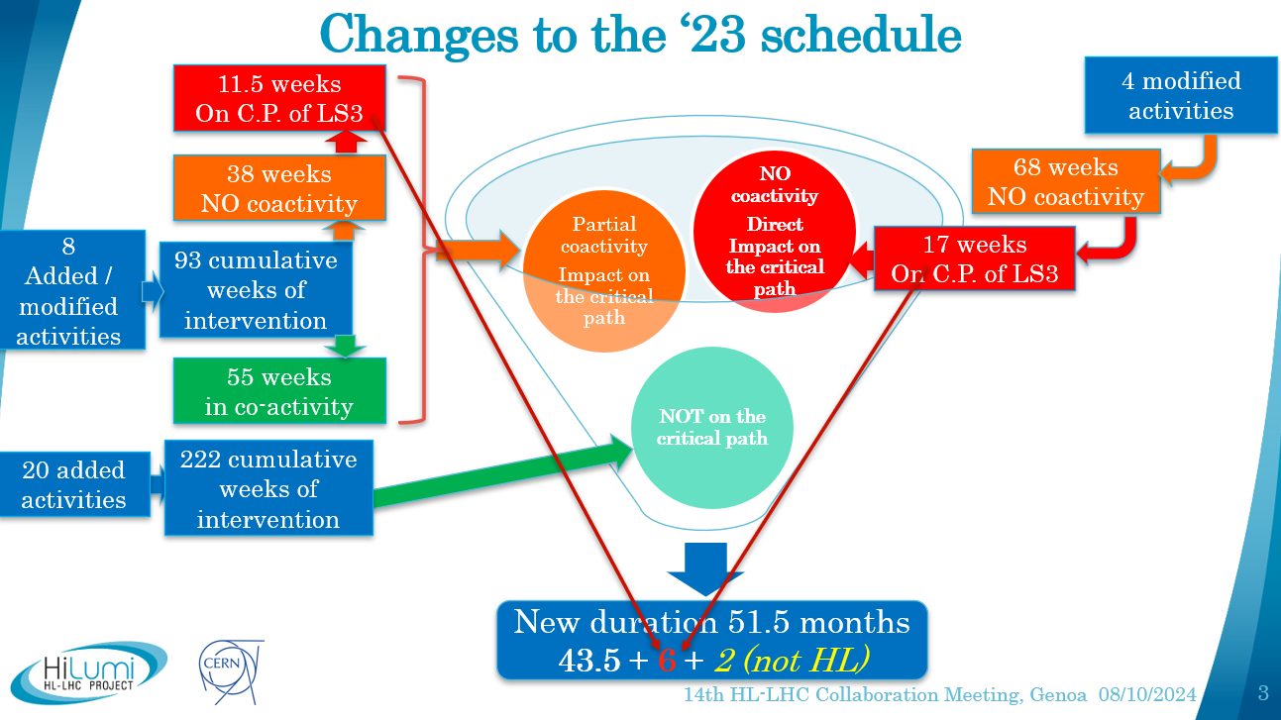
From 2024 Collaboration Meeting
New LS3 starting Date 29/06/2026

Slide 5
Evolution of Critical path duration vs. LS3 allocated window (Beam to Beam)
51.5
49
47 months
47 months
47
HL-LHC
Collaboration meeting 2024
(October ‘24)
LHC Performance Workshop
Chamonix 2025
(January ‘25)
LS3 Countdown days 2025
(September ‘25)
Increased parallelism and geographical granularity.
Revised test sequence
Revised strategies for core excavation and cabling

Slide 6
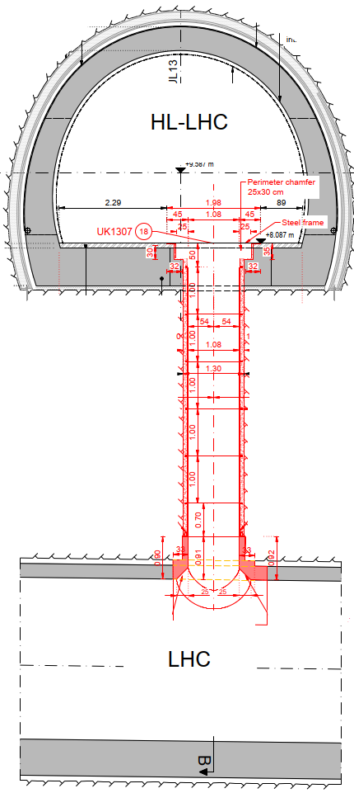
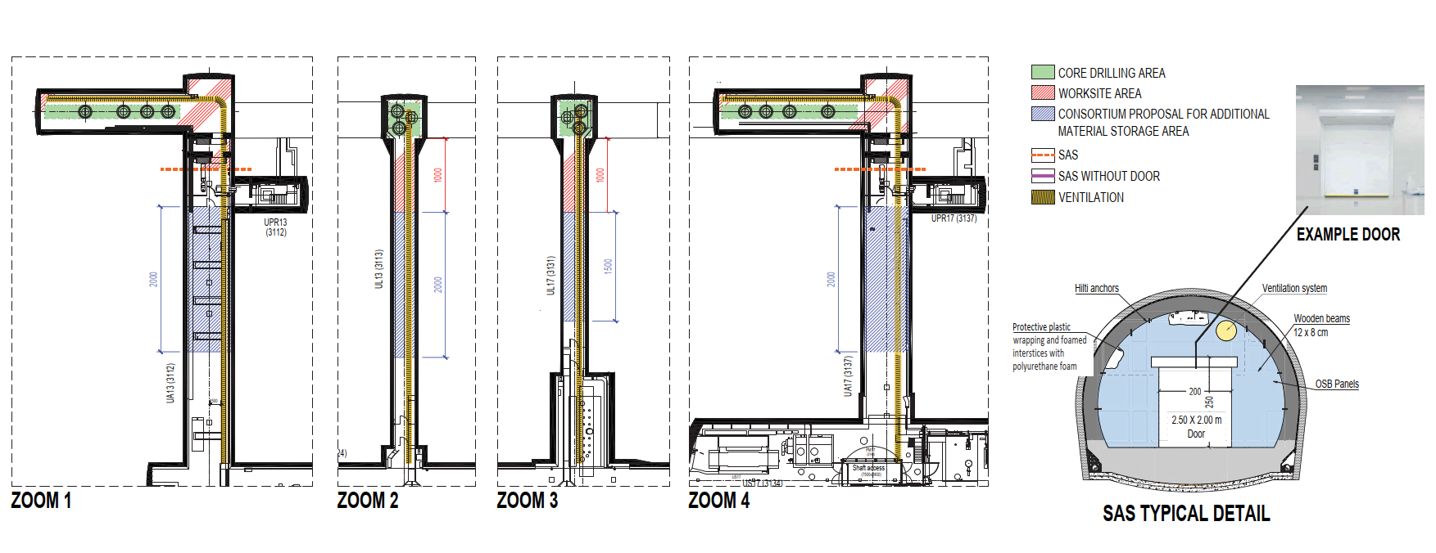
Revised Core Excavation Strategy Following Contract Adjudication
2-phase execution to minimize time in the LHC Tunnel
Phase 1: from HL-LHC, with punctual LHC access allowing LS3 activities.
Phase 2: from LHC with access to HL-LHC.
Phase 1
Phase 2
Courtesy D. Rodriguez Gomez and SCE team

Slide 7
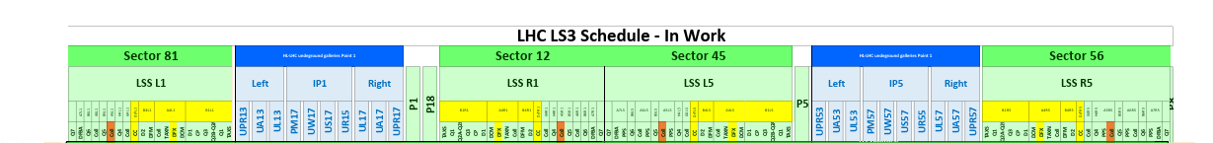
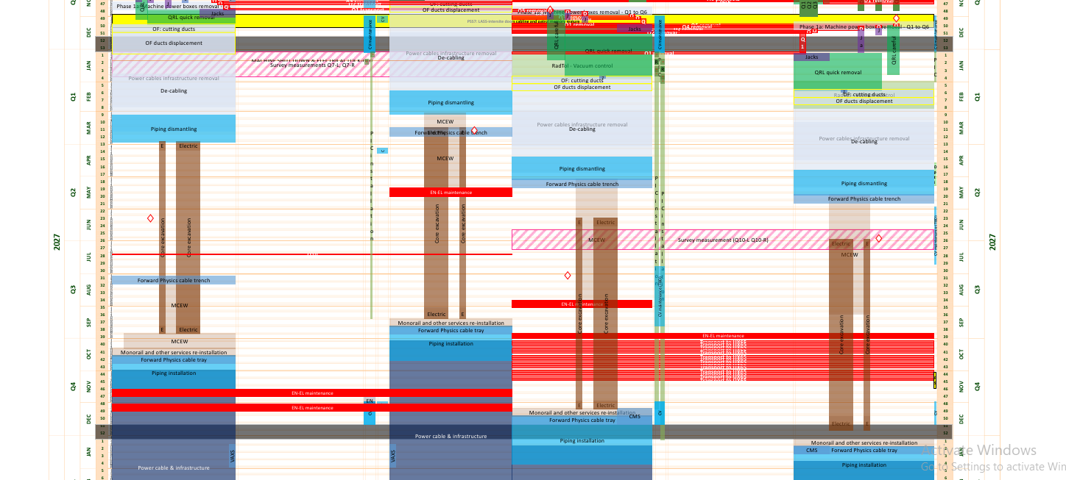
Selected bidder programme
4.2 months / point
Same start/end dates for L and R at each point.
Start -to-start lag of only 5.5 weeks between P1 and P5.
5,5 wk
To be re-assessed after the site test during YETS
See Slide 21
Total duration of
~ 5,5 months between
Start at Pt1 and end Pt5
Courtesy D. Rodriguez Gomez and SCE team

Slide 8
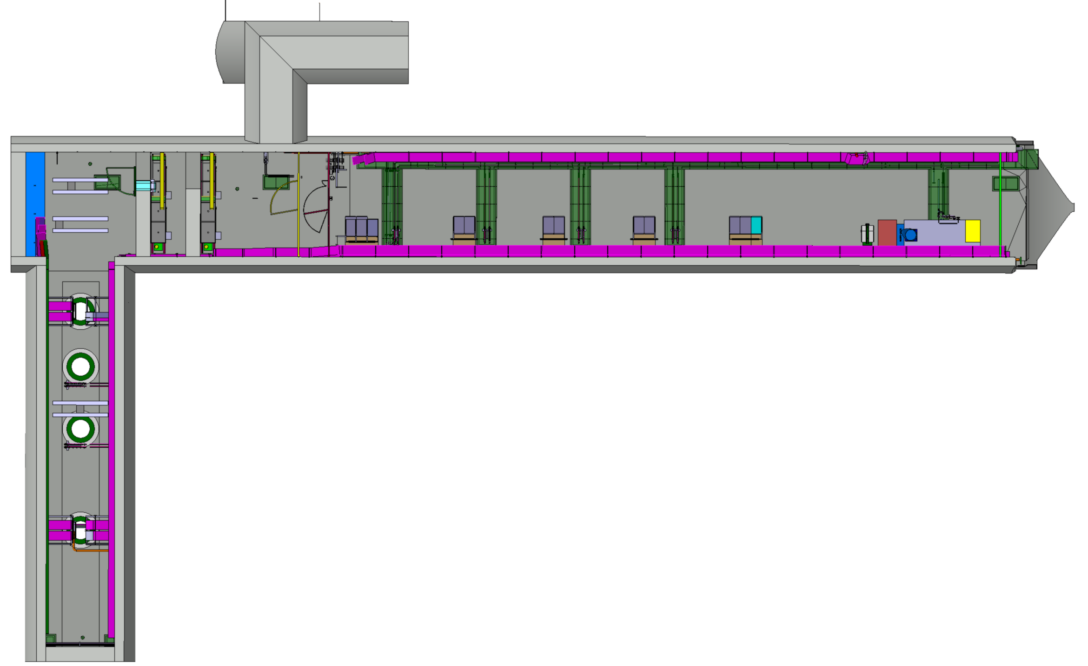
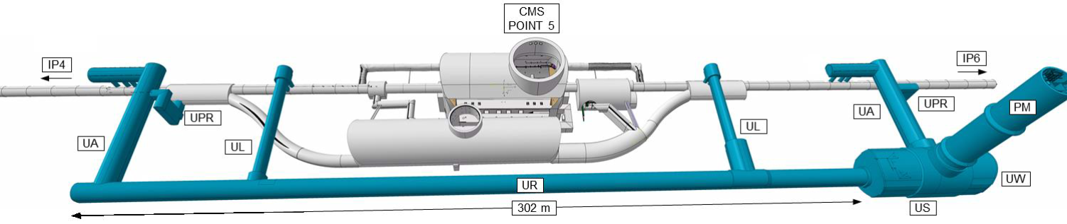
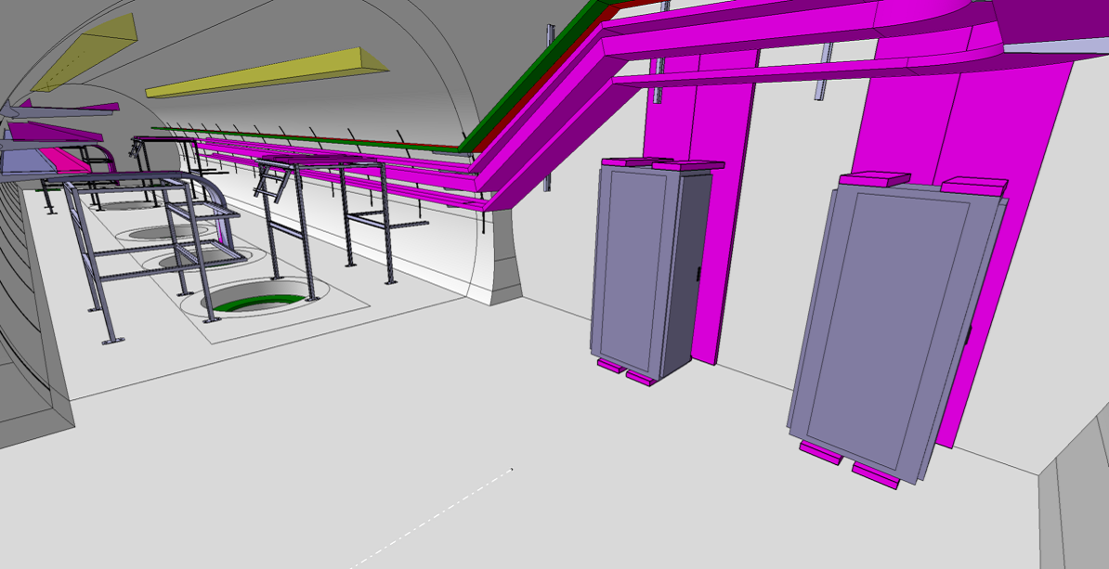
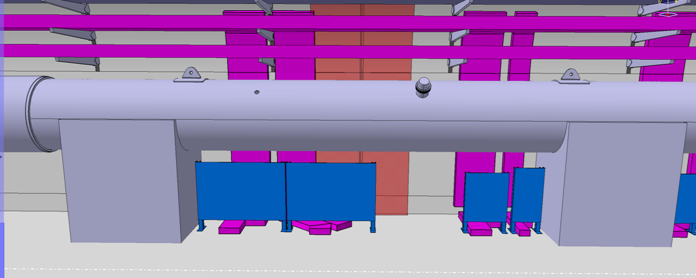
Patch Panel Implementation
Patch panels ensure interconnection of signal cables between HL facilities and LHC tunnel
Implementing patch panels close to the cores allow to shift installation of 335 km from LS3 to 2025-2026.
Volume to be installed during LS3 is reduced to 670 km.
Purchase of the required cables and connectors completed. Production and delivery ongoing
A
B
Patch Panel
R1
R2
R3
Courtesy D. Gameiro, G. Girardot and EN-EL team

Slide 9
Warm-up and related tests
LSS dismantling after cryo lockout
(magnets, QRL, collimators )
Cabling and CV dismantling
Core excavation and MCEW
QXL and QRL
Cabling and CV installation
SC link
Magnets
LSS installation
Crab Cavities
Collimators
Cool-down, related test & HWC
Alignment system

Slide 10
The installation float for HL-LHC

Slide 11
Installation Float Long Straight Section 1 Right
TCM5 CERN

Slide 12
Installation Float Long Straight Section 1 Left

Slide 13
Installation Float Long Straight Section 5 Right
CM1 CERN

Slide 14
Some of the actions implemented to increase/maintain float for critical elements
WP3 (magnets):
Test of MCBRD (D2 correctors) nr. 6/7/8/9/10 to be performed at CERN. Two units (11 and 12) built at CERN using IHEP components
Cryostated assemblies from AUP CA04, CA05, CA07 will be horizontally tested at CERN
Launch the production of 5 additional SC coils at the end of the AUP coil manufacturing. This allows using fully conform coils for magnet assembly (4 already completed)
AUP magnet vertical cold test: as it became evident that 1st thermal cycle was capable to intercept 100% of the issues, second thermal cycle abandoned for good units
WP4 (RF)
Use RFD @ CERN assembled cryomodule for installation on LSS1 R. Making use of components from TRIUMF. TCM5
Fabrication at CERN of 2 RFDs jacketed cavities
Use of CERN assembled DQW cryomodule CM1 for installation in LSS5 R.
Reshuffling of the test sequence to provide preferential test path to the last RFDs, allowing to gain margin in LSS 1, but reducing the float for last DQW cryomodule in LSS5 R
Reconfiguration of RFD prototype module presently installed in SPS to make it compatible with LHC interfaces
WP9 (Cryogenic)
Limited float raises concerns for the LS3 installation; hence CERN has increased and enlarged the engineering support to the contractor to speed up and facilitate design completion for the QXL phase II (LHC Tunnel)

Slide 15
Evolution of Float
Magnet Float LSS R 5
 | Collaboration Meeting 2024 |  | Chamonix 2025 |  | Collaboration Meeting 2025
Magnets Assembly | Vs. transport | Vs. installation | Vs. transport | Vs. installation | Vs. transport | Vs. installation
Q4 | 2 | 12 (+10) (PX24) | 2 | 12 (+10) (PX24) | 21 | 22 (+1) (PMI2)
D1 | 9 | 21 (+12) (PX24) | 11 | 23 (+12) (PX24) | 15 | 20 (+5) (PX24)
Q2b | 11 | 23 (+12) (PX24) | 13 | 25 (+12) (PX24) | 21 | 26 (+5) (PX24)
Q3 | 13 | 15 (+2) | 15 | 17 (+2) | 13 | 14 (+1)
Q1 | 17 | 19 (+2) | 18 | 21 (+3) | 12 | 13 (+1)
Q5 | 18 | 18 (0) | 17 | 18 (+1) | 23 | 24 (+0)
CP | 21 | 23 (+2) | 22 | 25 (+3) | 14 | 15 (+0)
Q2a | 26 | 28 (+2) | 28 | 30 (+2) | 28 | 29 (+1)
Crab cavities cryo modules | Collaboration Meeting 2024 | Chamonix 2025 | Collaboration Meeting 2025
RFD1 (1R) CERN TCM5 | 19 | 6 | 9
RFD2 (1R) | 16 | 3 | 5
RFD3 (1L) | 11 | 2 | 4
RFD4 (1L) | 5 | -1 | 1
DQW1 (5L) | 30 | 39 | 34
DQW2 (5L) | 36 | 31 | 20
DQW1 (5R) CM1 CERN | 17 | 24 | 25
DQW2 (5R) | 11 | 15 | 1

Slide 16
Installation Float Out Of the Beam Equipment LHC Tunnel LSS1 LSS5

Slide 17
Installation Float other LHC tunnel locations
WP13 instrumentation planned to be extensively tested on surface till last moment before installation. Proposed installation dates last possible slots

Slide 18
Installation Float New HL infrastructure P1

Slide 19
New HL-LHC facility Installation Schedule
Concerning the advancement of the HL-LHC technical infrastructures installation please refer to WP17 talk “Infrastructure and Civil Engineering”
Tomorrow 30/09/2025 at 16:30

Slide 20
Some important remarks on the evolution of the New HL-LHC facility Installation Schedule
In October 2024 QXL installation plan was
Phase I-A to be installed in one intervention
Today phase I-A is divided in 3 sub-phases (I-A1, I-A2, I-A3) and the target for phase I-A1 is to carry out the 1st installation at P1 between October and December 2025. Delayed because of NCR detected on QXL elements, that required refurbishment of many already assembled units
Phase I-A will be completed in the last point in December 2026
Major cable campaigns were added for pulling the cables to the patch panels in order to complete the activities before the deployment of EN-EL resources in the LHC complex:
February to June 2026 in P1
June to November 2026 in P5
The selected core excavation approach requires 4.5 months of activities from the HL side (Phase I) plus 4.2 months from both HL and LHC side (Phase 2) with a possible maximum impact of 9 months on the new infrastructures
While solutions to cope with all these changes were found, this has consumed all schedule margin before core completion, and it has led to a very important increase of parallelism and the implementation of thinner geographical granularity.
As it will be visible from the next slides, 2025 and 2026 will be a very packed sequence of activities especially from the large cryogenic contractors.
Changes in installation sequence, duration and methodology will be very complicate to integrate with teams sharing the space, time and logistic means.

Slide 21
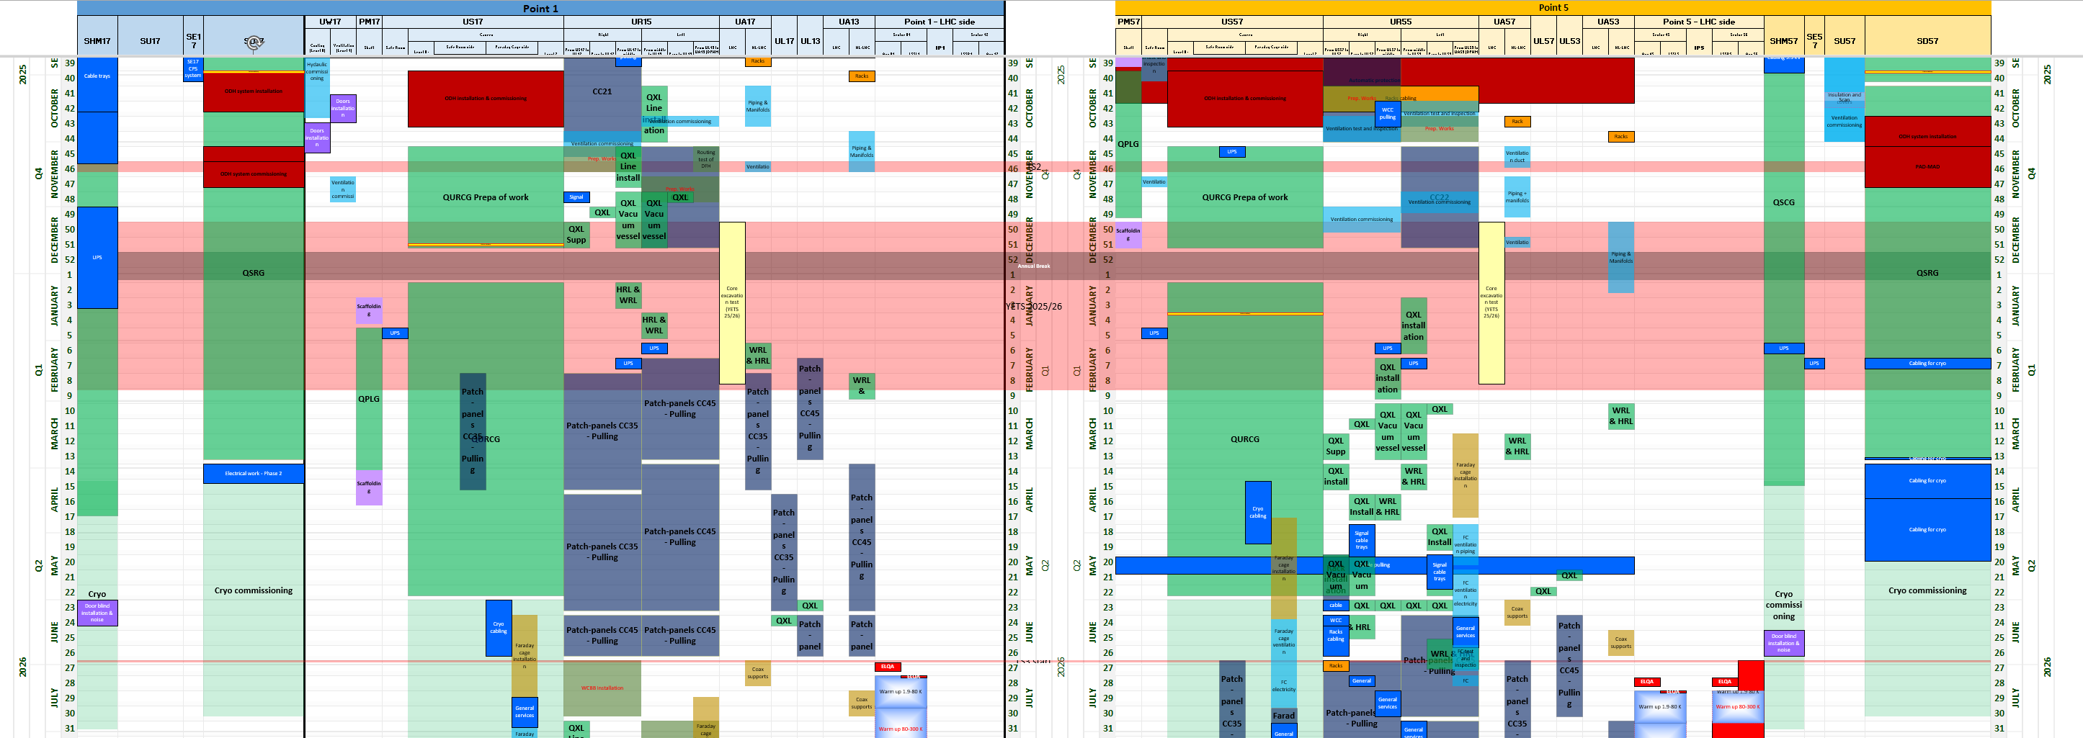
Point 1 till LS3
WP9
SD17
Cold box
Oct. 2025
WP9
UR15
QXL
ph. 1A-1
Oct.-Dec. 2025
WP9
US17
Cold box
Dec. 2025
WP6A
DFHX/DSHX Routing test
WP9
Vertical Transfer line Jan.-Apr. 2026
WP9
UR15
QXL
ph. 1A-2 supp
Dec. 2025
All WPs
Signal cabling to
Patch Panels
Feb-June 2026

Slide 22
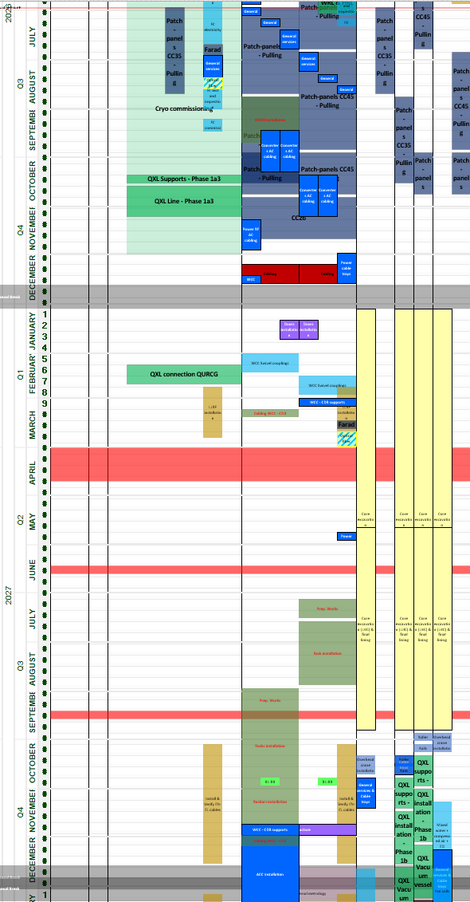
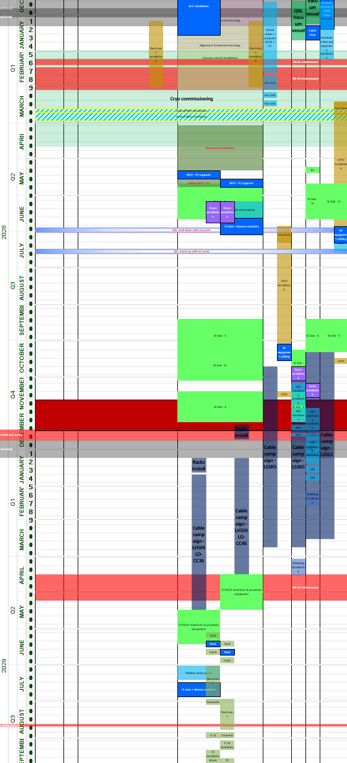
2026
Cabling P.P.
2028
PC infrastr.
HPRF
QXL to C.B.
PC phase II
SC link
2027
HPRF
Faraday cages for RF
SC link
Cores
2029
Cabling to P.P. for LHC tunnel
PC Phase I
Cold Pow. prox. equip.
Cryo QXL UL
Machine protection
DC cabling

Slide 23
Conclusions
The implementation of a long list of actions and optimizations has allowed to reach the goal of a 47 months LS3 schedule albeit without any contingency
The Installation Float for the HL-LHC critical machine components is under control and several actions have been implemented or are under evaluation to increase it or maintain to the present level
The Cryogenic installations are being carefully prepared and monitored
The installation of the refrigeration system and of the distribution line will be the main activities in the new underground in the next 12 months, and they imply very complex logistics and space sharing
QXL design for phase II is being strongly reinforced and upcoming installation activities of phase IA-1 carefully monitored to feedforward to Phase II

Slide 24
Annex slides

Slide 25
Installation Float Long Straight Section 5 Left

Slide 26
Point 5 till LS3
WP9
Vertical Transfer line Oct.-Nov. 2026
WP9
SD57
Cold box
Oct. 2025
WP9
US17
Cold box
Jan. 2026
WP9
UR55 Warm piping 1st phase
WP9
UR15
QXL
ph. 1A-1
Jan.-Mar. 2026
WP9
UR15
QXL supports
ph. 1A-2
Mar. 2026
All WPs
Signal cabling to
Patch Panels
Jun.-Oct. 2026

