Slide 1
UQDS Functional Testing Prior to Installation in IT-String
Magnus Christensen – CERN – TE-MPE-EP
CERN – October 1st

Slide 2
Universal Quench Detection System
The Universal Quench Detection System (UQDS) is CERN’s custom platform for voltage-based quench detection in superconducting circuits.
Instruments circuits with up to 16 fully differential analog-to-digital channels.
Aggregated data are processed by an FPGA running quench detection algorithms.
Upon detection, the FPGA interfaces with other safety systems via the crates front I/O.

Slide 3
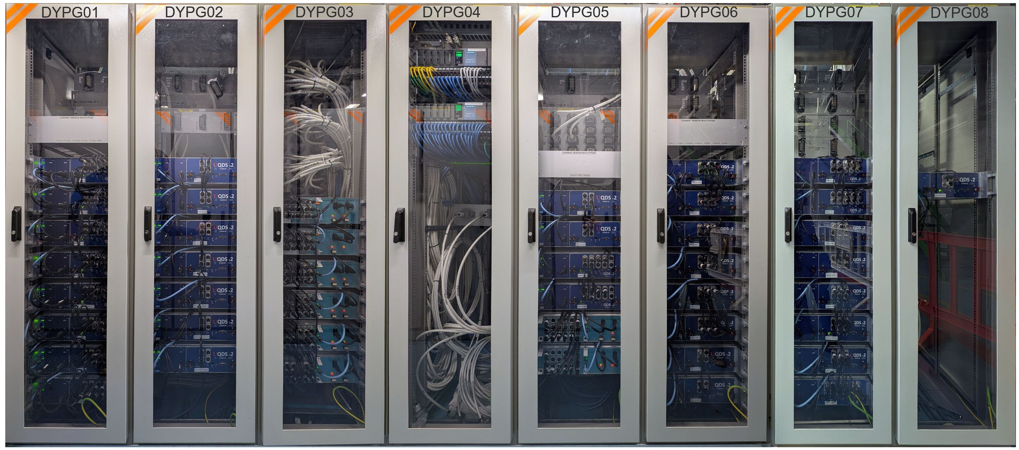
36 UQDS crates installed in IT-String
Notes:
As part of IT-String, 36 UQDS crates have been installed for quench detection and data acquisition.
TE-MPE-EP’s largest installation of the UQDS system

Slide 4
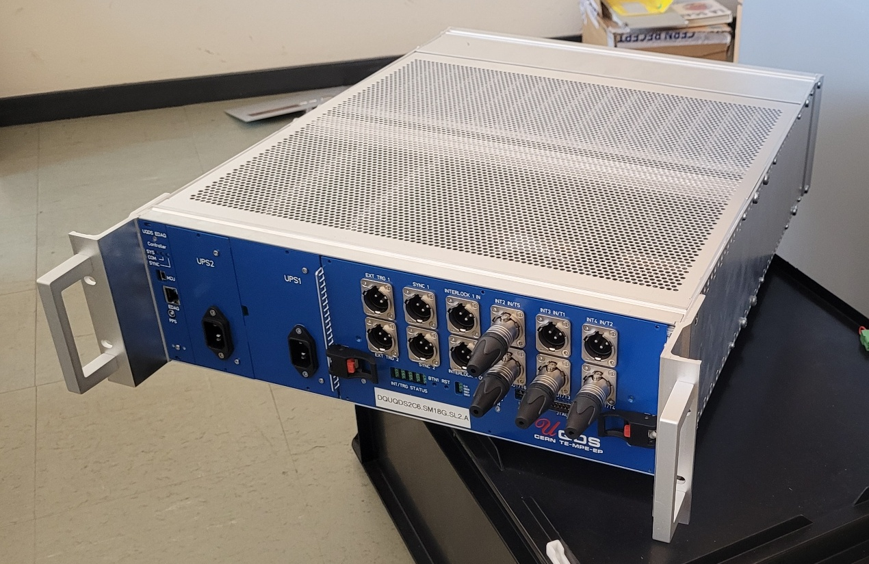
Pre-installation Hardware Validation
Before installation, all hardware was validated for correct functionality, and analog channels were calibrated.
Notes:
To ensure the safe operation of the system and avoid laborious and untimely in field debugging, we performed thorough validation of the functionality of all UQDS’

Slide 5
Types of Test
Analog Channels are calibrated and characterized.
UQDS in IT-String has between 9 and 16 Analog Channels
Each channel supports various gain levels (1x, 9x, 45x, 450x)
Front I/O ports are tested to verify correct functionality (e.g., to detect missing cables or poor connections).

Slide 6
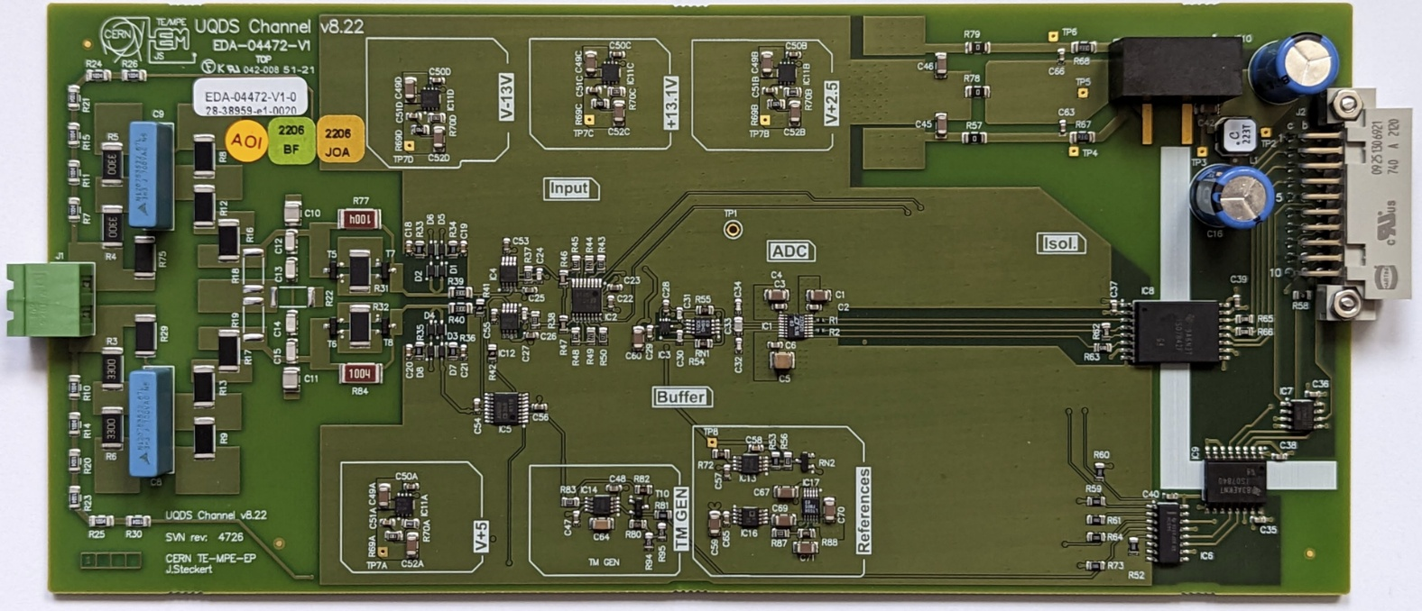
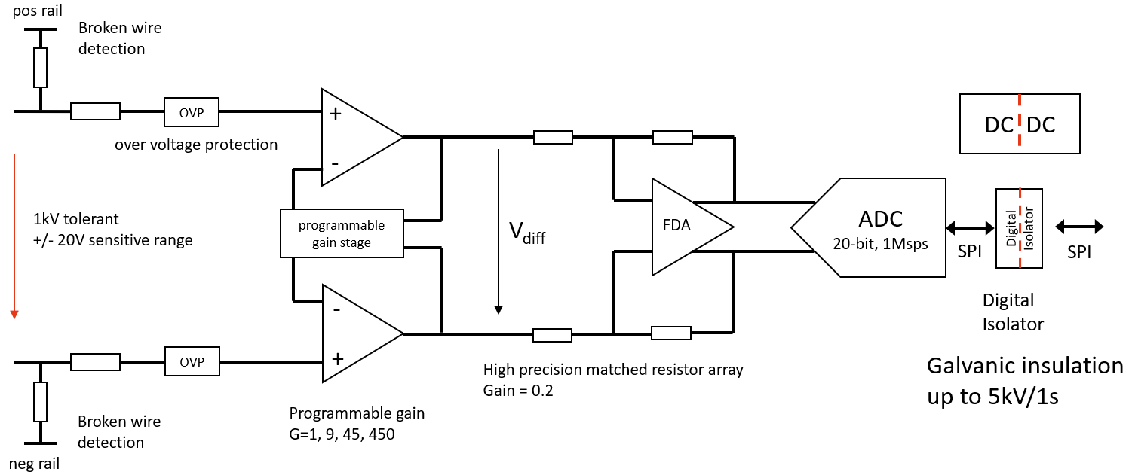
Analog Channel

Slide 7
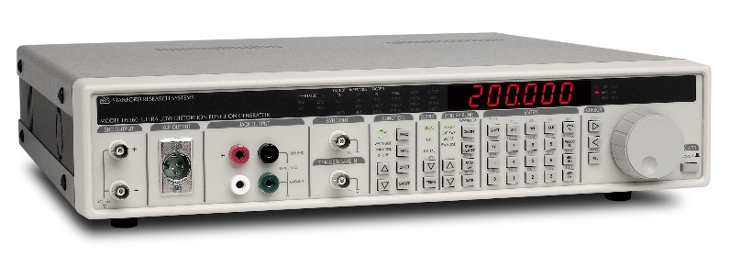
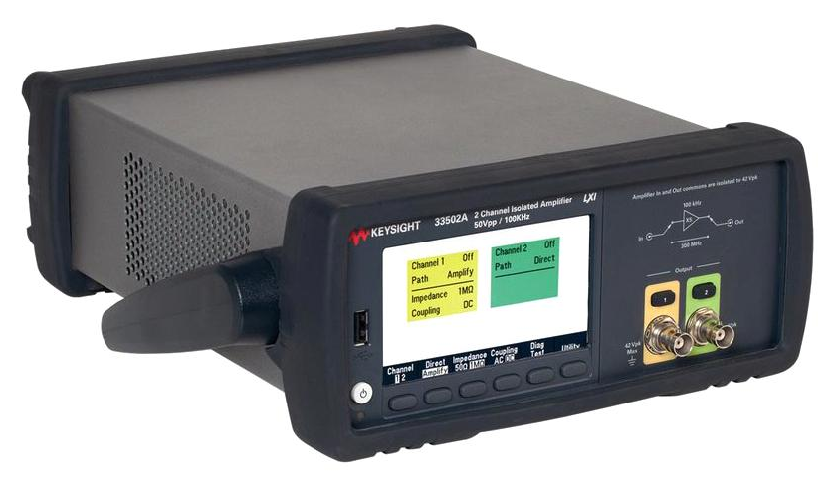
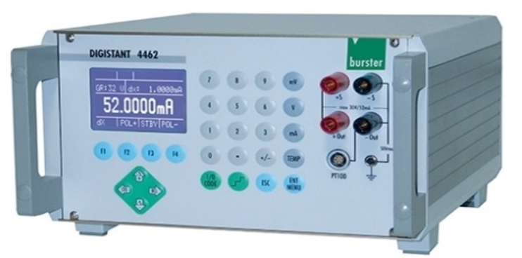
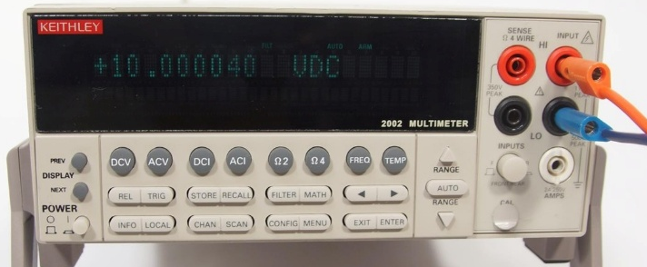
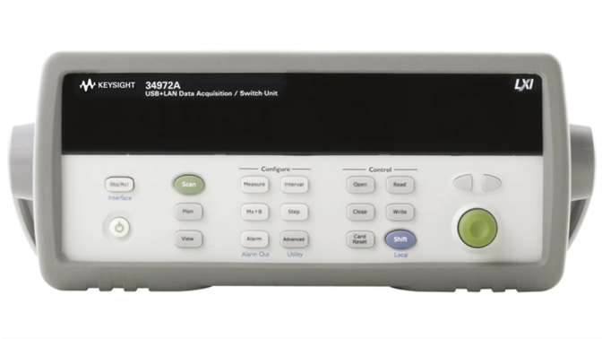
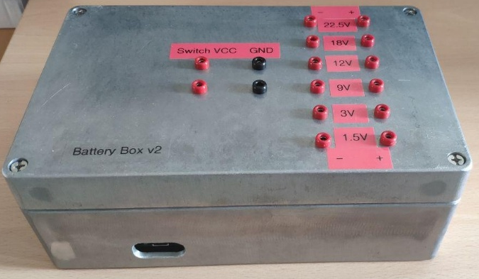
Hardware Test Bench – Equipment, Front End Channels
DS360, low distortion generator
For bandwidth measurements
Total Harmonic Distortion (THD) measurements
Common Mode Rejection Ratio (CMRR) measurements
Keysight 33502A, Isolated Amplifier
To provide sufficient drive strength for high frequency bandwidth measurements
Digistant 4462, Precision DC Source
As part of polarity and linearity measurements
Keithley 2002, Precision Multimeter
To measure digestant 4462 output
(Custom) Battery Box, low noise DC source
For noise measurements
Keysight 34972A, Switch Matrix
To switch channel connections to different test equipment

Slide 8
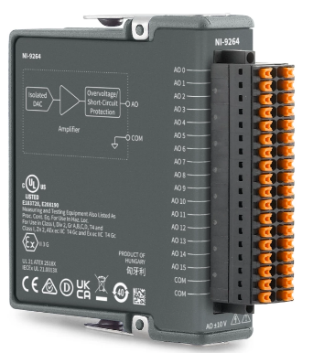
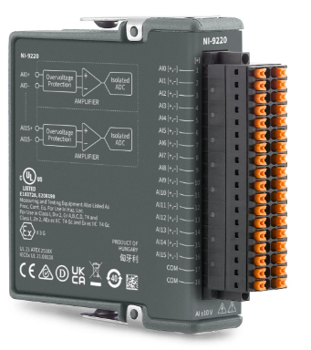
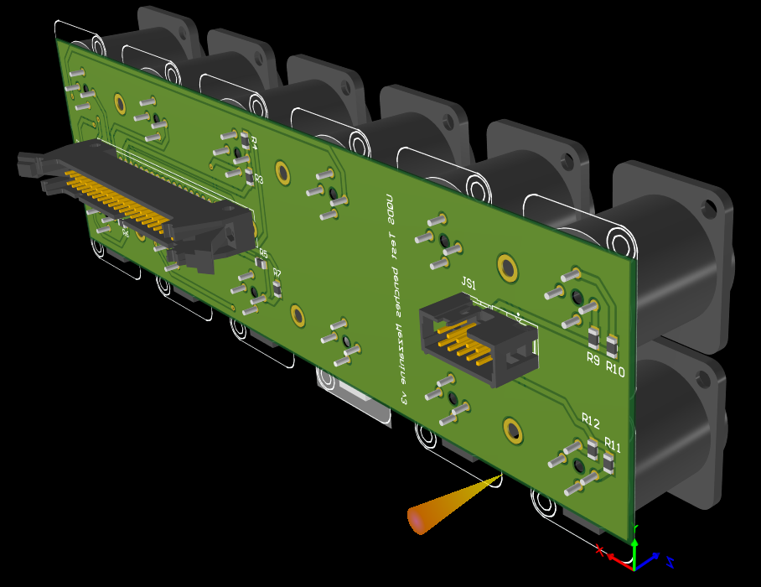
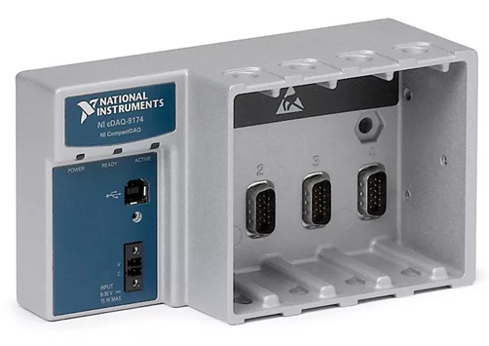
Hardware Test Bench – Equipment, Front IO
Testing done with:
NI cDAQ
NI-9264, DAC
NI-9220, ADC
ADC/DAC channels connect to appropriate IO port through custom PCB.
Three types of front IO ports are supported across three front panel configurations:
Synchronize
Input: When a pulse is received trigger postmortem recording
Output: Emit a pulse
Interlock
Open/close current interlock loop
Trigger
Emits DC voltage when active
These IO characteristics were measured and validated:
Output voltages level
Input activation voltage threshold
Interlock open/close behavior

Slide 9
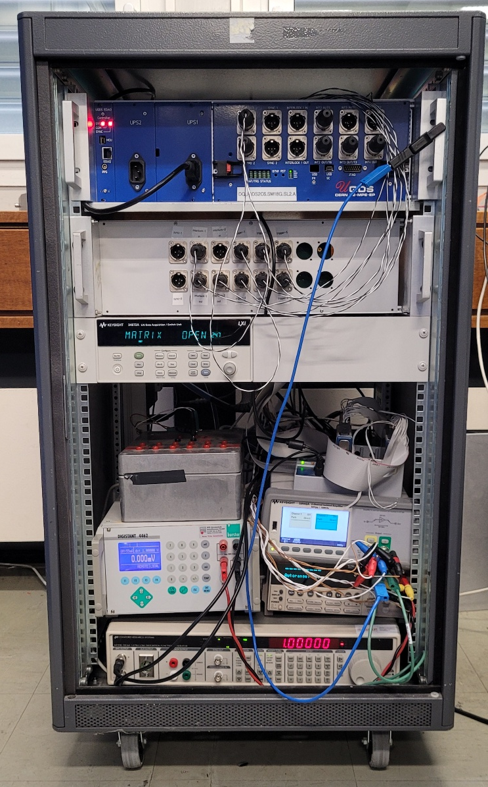
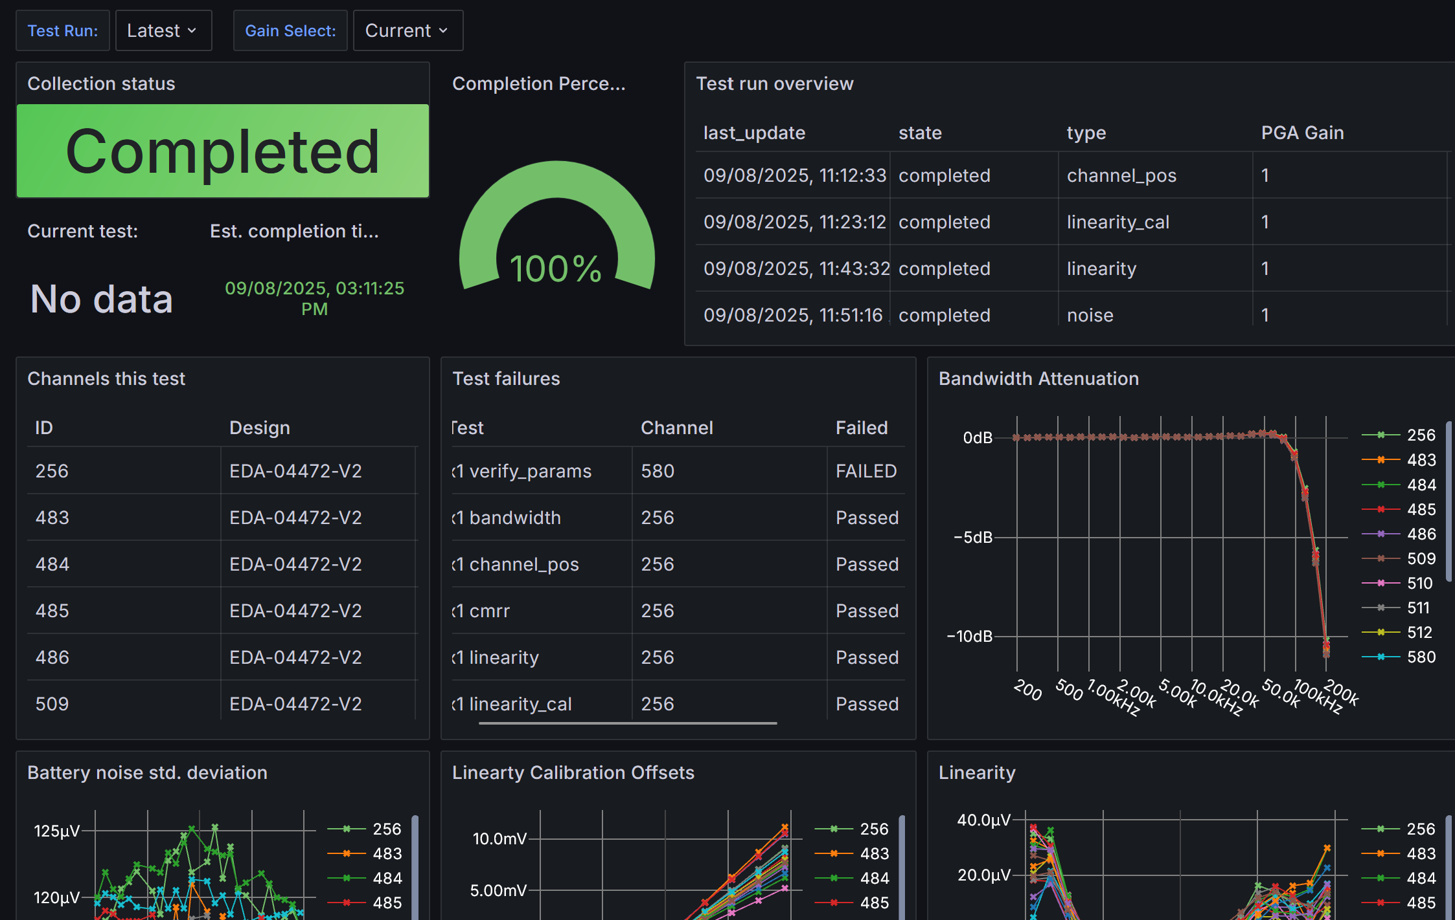
Hardware Test Bench
Final test bench installed in a rack.
Data acquisition from UQDS done with EDAQ.
See talk from Tomasz Podzorny for details!
Result and test progress reported live in a Grafana dashboard.
Analog channels are programmed with IDs matching their labels to ensure future traceability.

Slide 10
Test Results
Total of 36 crates and 477 Channels tested
All crates eventually passed testing and have been installed in IT-String
However certain non-conformities were discovered (and then rectified) due to the rigorous testing procedures:
Assembly Errors:
Some power supplies used 12V DC-DC instead of 15V supply. Caused different voltage output on Trigger Port.
2x bad ribbon cables connecting FPGA main board to Front IO.
3 Channels were initially installed with wrong polarity.
2 Channels were installed in the wrong slot.
Component failure:
1x Dead flash chip on front-end channel.
1x Dead flash on FPGA main board.
1x Dead midplane.
Manufacturing errors:
1x Front End channel was missing a DC-DC converter.

Slide 11
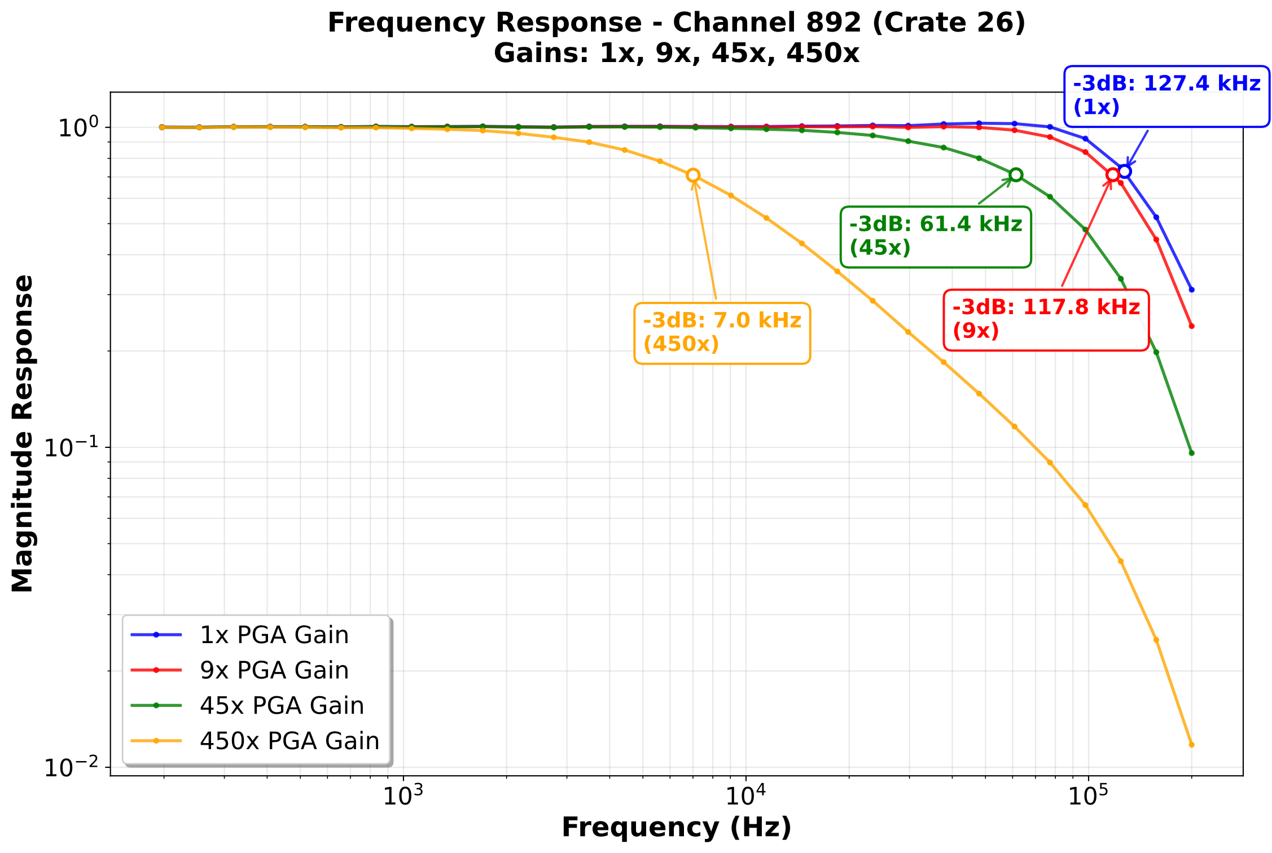
ADC Channel Calibration and Characterization Results
Bandwidth
Measured with DS360 by injection a sine wave with fixed amplitude and sweeping across a range of frequencies.
Higher gain has lower cut-off frequency
Expected due to the gain-bandwidth product of our amplifier chain

Slide 12
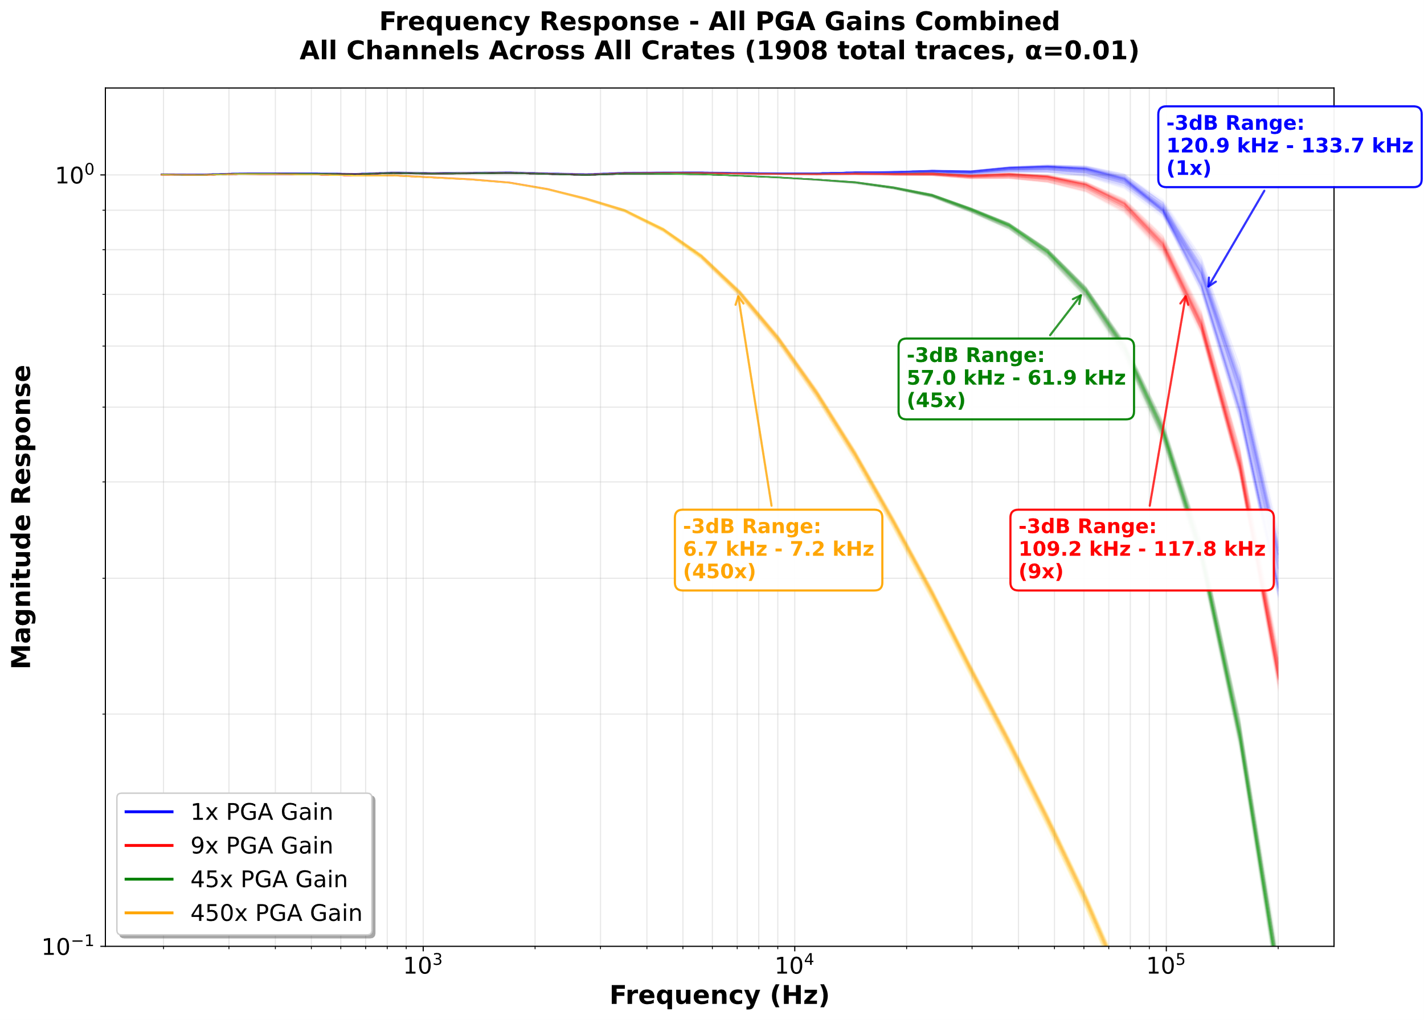
ADC Channel Calibration and Characterization Results
Bandwidth – All Channels
Plotted all traces on top of each other with transparency to convey variation, due to component tolerances.
Spread stays at 10% or less:
1x: 10%
9x: 7.6%
45x: 8.2%
450x gain: 7.2% spread
Such small differences in cutoff frequency are insignificant for quench detection.

Slide 13
ADC Channel Calibration and Characterization Results
Common Mode Rejection Ratio (CMRR), G1 – All Channels
Measured by short-circuiting Analog channels differential input and connecting to waveform generator in unbalanced drive mode.
Generator ground and channel ground not connected!
Notes:
the common mode rejection ratio of a FDA is primarily determined by mismatch in the resistor network of the two input legs.”

Slide 14
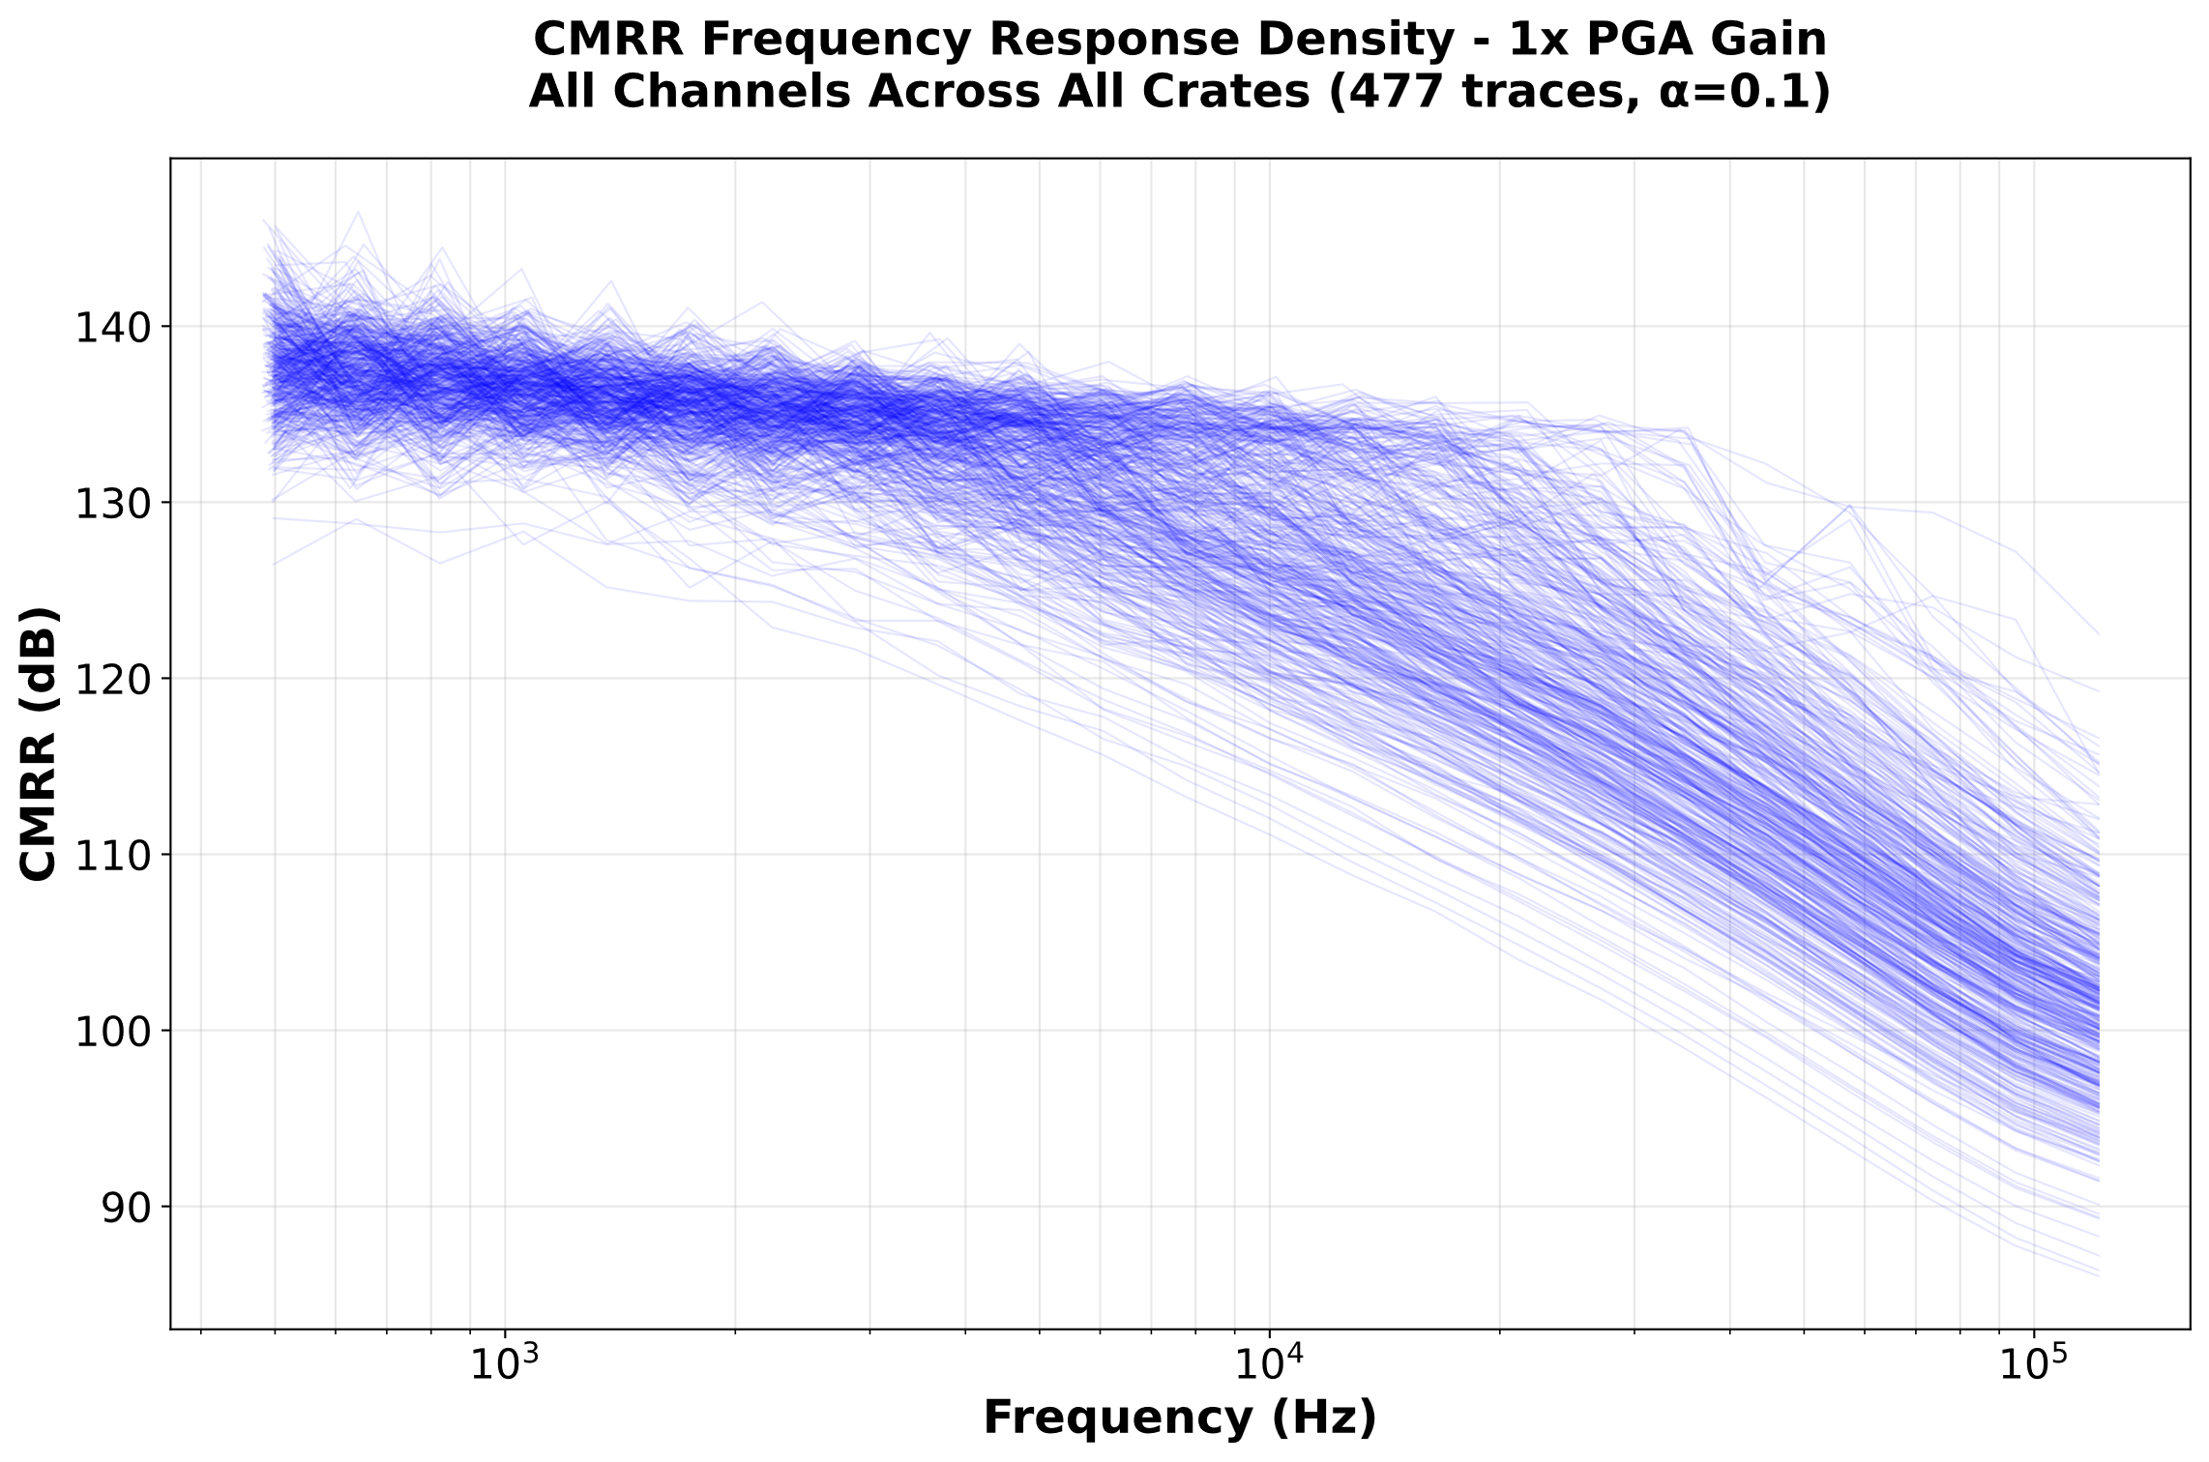
ADC Channel Calibration and Characterization Results
Common Mode Rejection Ratio (CMRR), G1 – All Channels
We see very high CMRR - due to channel ground being isolated
Spread between channels increase with frequency:
At low frequencies, CMRR is dominated by mismatch between resistors; very low due to use of matched array
At higher frequencies, capacitors start to dominate; these inherently have larger variations.

Slide 15
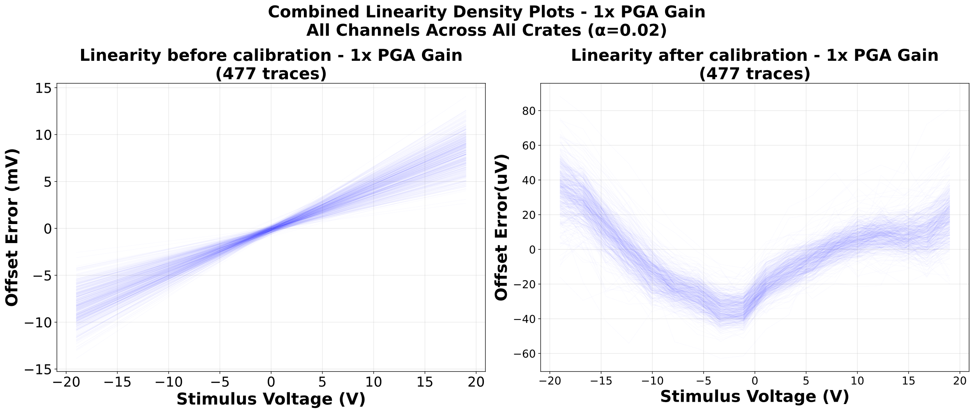
ADC Channel Calibration and Characterization Results
Calibration, G1 – All Channels
Input DC voltage using precision voltage source.
Compared voltage measured using analog front end channels with precision multimeter.
Calculated gain and offset correction parameters for each channel.
Up to 10mV error before calibration.
Reduced to under. 100uV after applying gain and offset corrections.

Slide 16
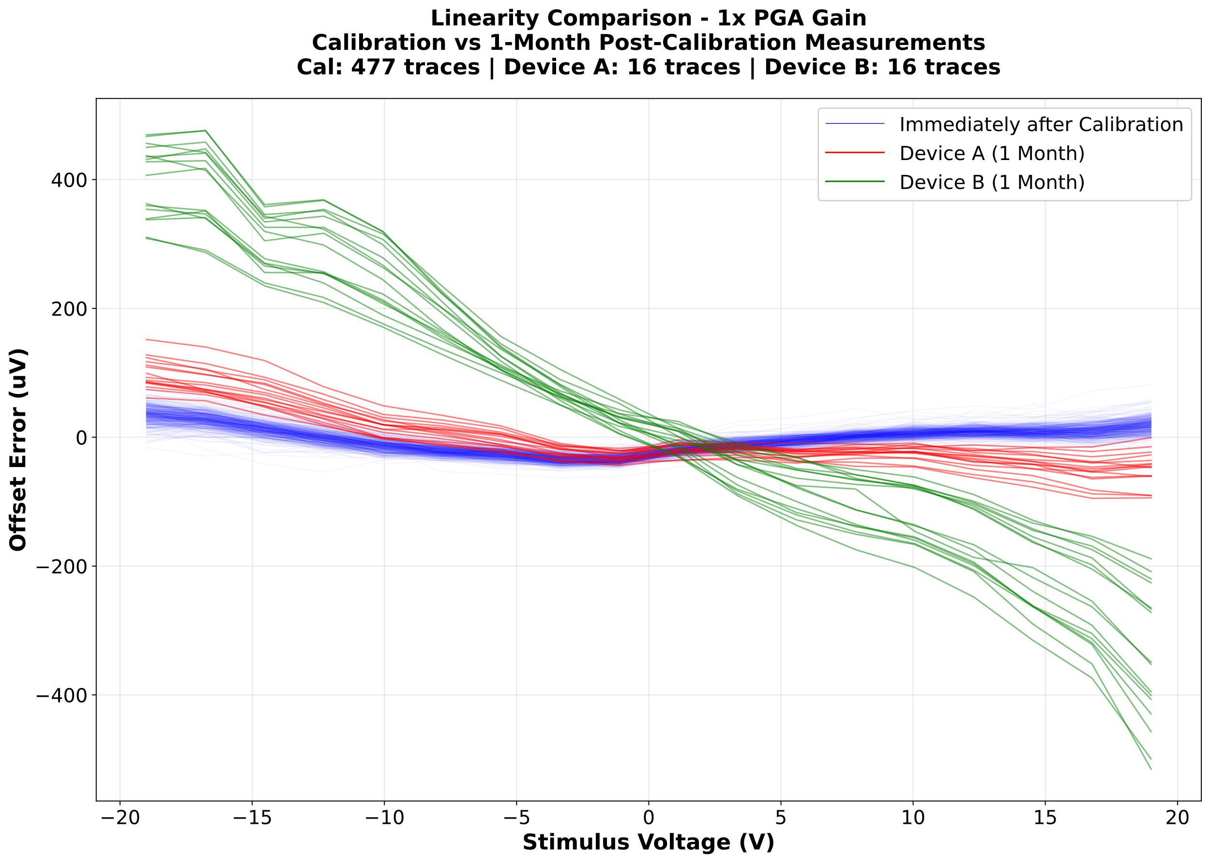
ADC Channel Calibration and Characterization Results
Calibration, G1 – All Channels
Offset error drifts with environmental conditions (e.g. temperature).
Calibration was performed in an uncontrolled environment.
Offset errors were remeasured for two UQDS crates one month after initial calibration; large differences were observed, likely due to different ambient temperatures at the time of calibration.
Only two crates were measured at one instant, so the long-term impact of drift is not fully characterized.
These variations are unlikely to significantly affect quench detection.

Slide 17
Conclusions
36 Universal Quench Detection Systems have been installed in IT-String.
Before installation, hardware behaviour was validated (digital I/O), characterized, and calibrated (analog channels).
The testing campaign allowed correction of several issues before installation, avoiding more difficult in-field debugging.
As part of testing, analog channels were calibrated to maximize their operational performance.

Slide 18
Thank you!
Acknowledgements:
TE-MPE-EP: Jens Steckert, Joaquin Gaite Plaza, Fabienne Boisier
CERN – October 1st

