Slide 1
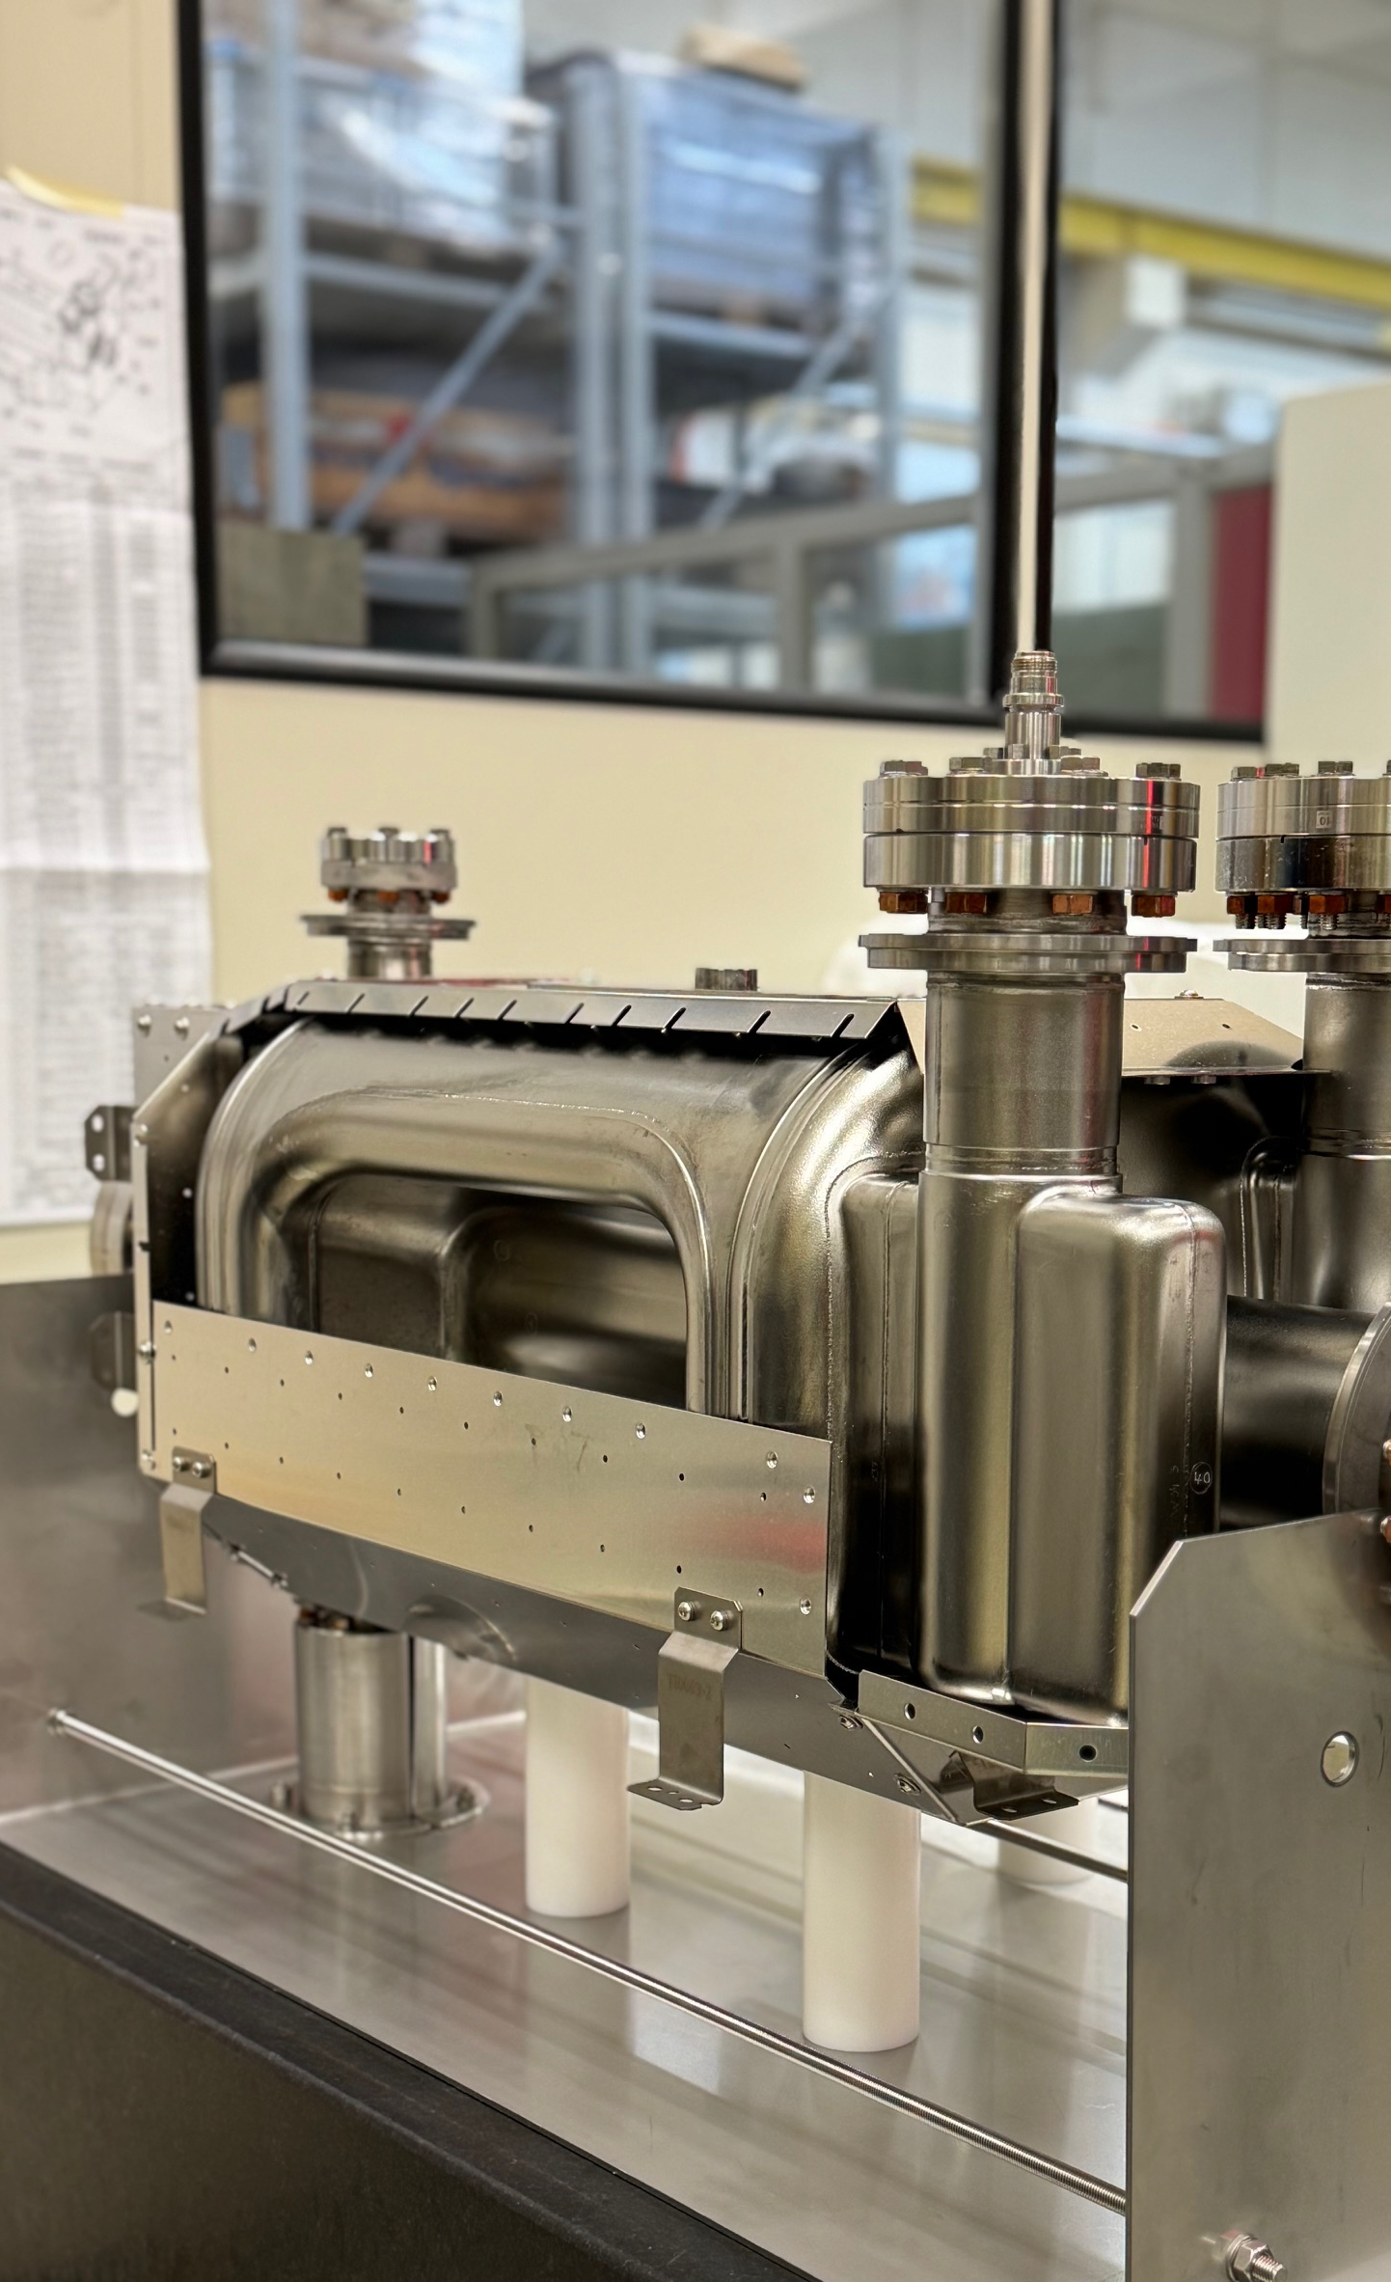

CERN RFD Cavity Fabrication & HOM status
Simon Barrière, CERN
on behalf of the HL-WP4 team
15th HL-LHC Collaboration Meeting – CERN – 1st October 2025

Slide 2
Outline
In the first few slides, I will highlight the good progress we have made in the production of RFD cavities at CERN
Then, a reassuring status update on the fabrication of HL-LHC crab cavities HOM couplers at CERN

Slide 3
Outline
In the first few slides, I will highlight the good progress we have made in the production of RFD cavities at CERN
Then, a reassuring status update on the fabrication of HL-LHC crab cavities HOM couplers at CERN
Let’s now find out how much my optimism is close to reality

Slide 4
RFD Cavities @ CERN

Slide 5
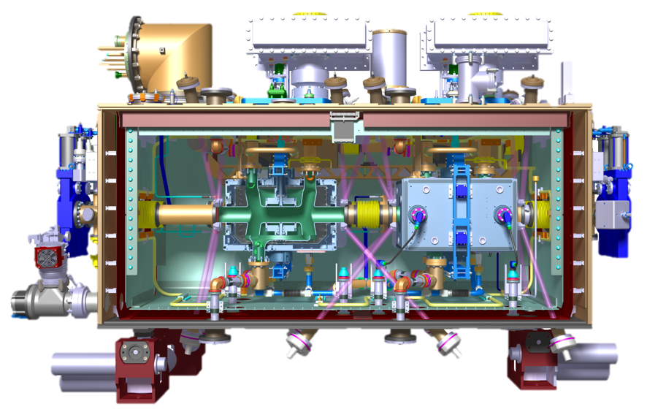
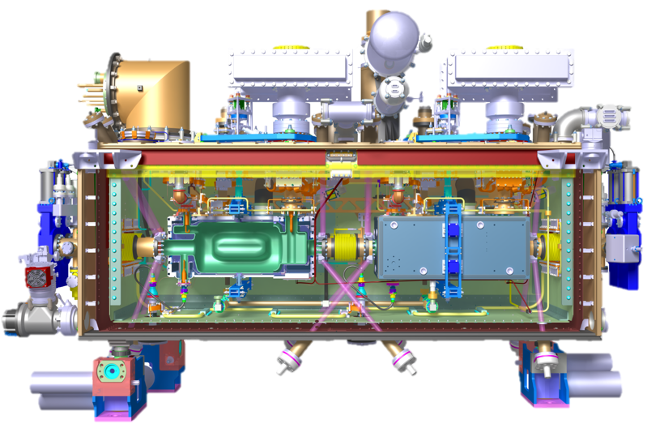
Context
10 crab cavities cryomodules (CMs) including 2 spares are needed for HL-LHC WP4
See Nik Templeton’s talk
STFC – UK
4x DQW CMs
CM-1
CM-3
CM-4
CM-5
See Bob Laxdal’s talk
TRIUMF – Canada
5x RFD CMs
TCM-1
TCM-2
TCM-3
TCM-4
TCM-5
CERN
1x DQW CM
CM-1

Slide 6
Context
10 crab cavities cryomodules (CMs) including 2 spares are needed for HL-LHC WP4
See Nik Templeton’s talk
STFC – UK
4x DQW CMs
CM-1
CM-3
CM-4
CM-5
See Bob Laxdal’s talk
TRIUMF – Canada
5x RFD CMs
TCM-1
TCM-2
TCM-3
TCM-4
TCM-5
CERN
1x DQW CM
CM-1
TCM-5
Following PSM in May 2025, decision to add 1x RFD CM in CERN scope, with 2x CERN-produced RFD crab cavities
See Teddy Capelli’s talk

Slide 7
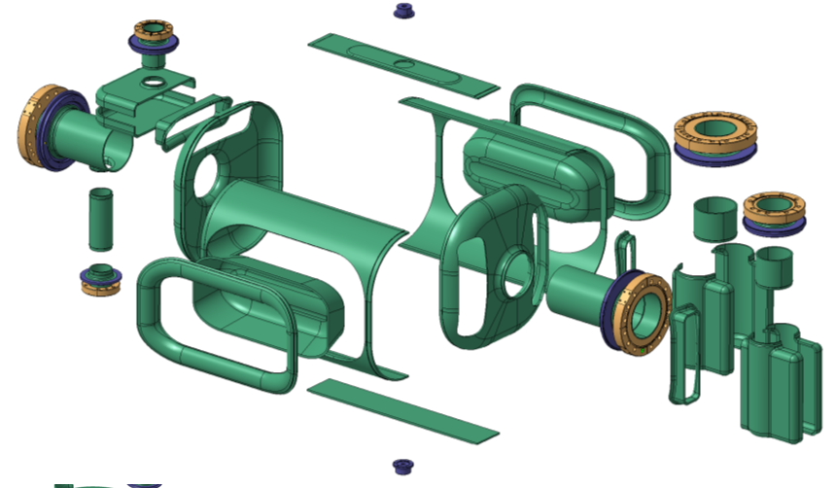
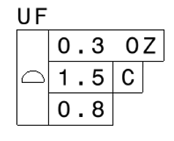
The Challenge
1 additional bare cavity (nickname CERN-RFD#4) to be fully constructed in 1 year…
…and then, tested, jacketed and dressed, in time for integration in its TCM-5 cryomodule
including raw materials procurement,
650+ fabrication steps,
13 technologies…
1x RFD cavity (CERN-RFD#3) already available at CERN (and successfully cold tested), spare from the prototyping programme in 2018-2020

Slide 8
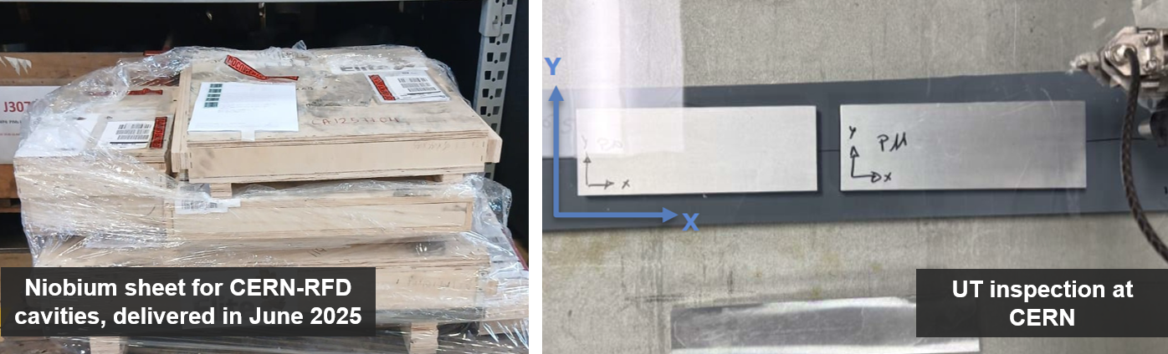
Raw Materials Procurement and Tests
Purchase order placed on 27/02 (Nb & NbTi for 1x RFD cavity)
Supply of 6 spare sheets from US-AUP’s series stock & DQW spare sheets allowed forming of initial components in April 2025
All purchased materials tested and qualified at CERN
See Claudia Santos Maldonado’s talk

Slide 9
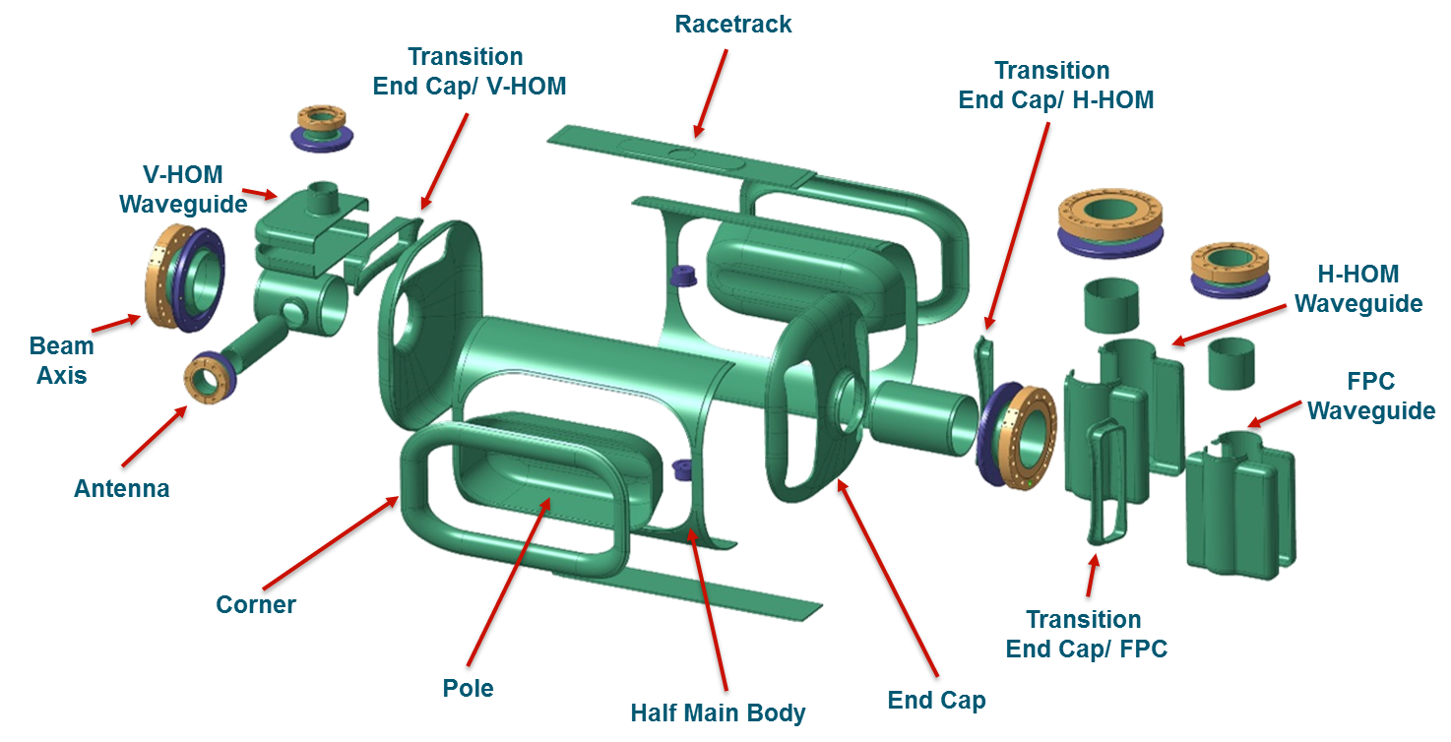

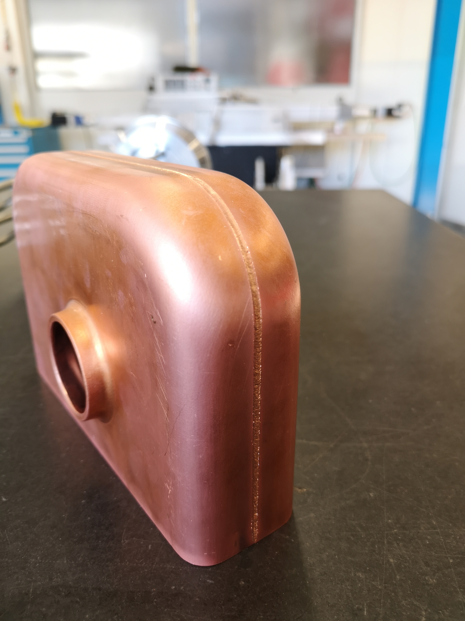
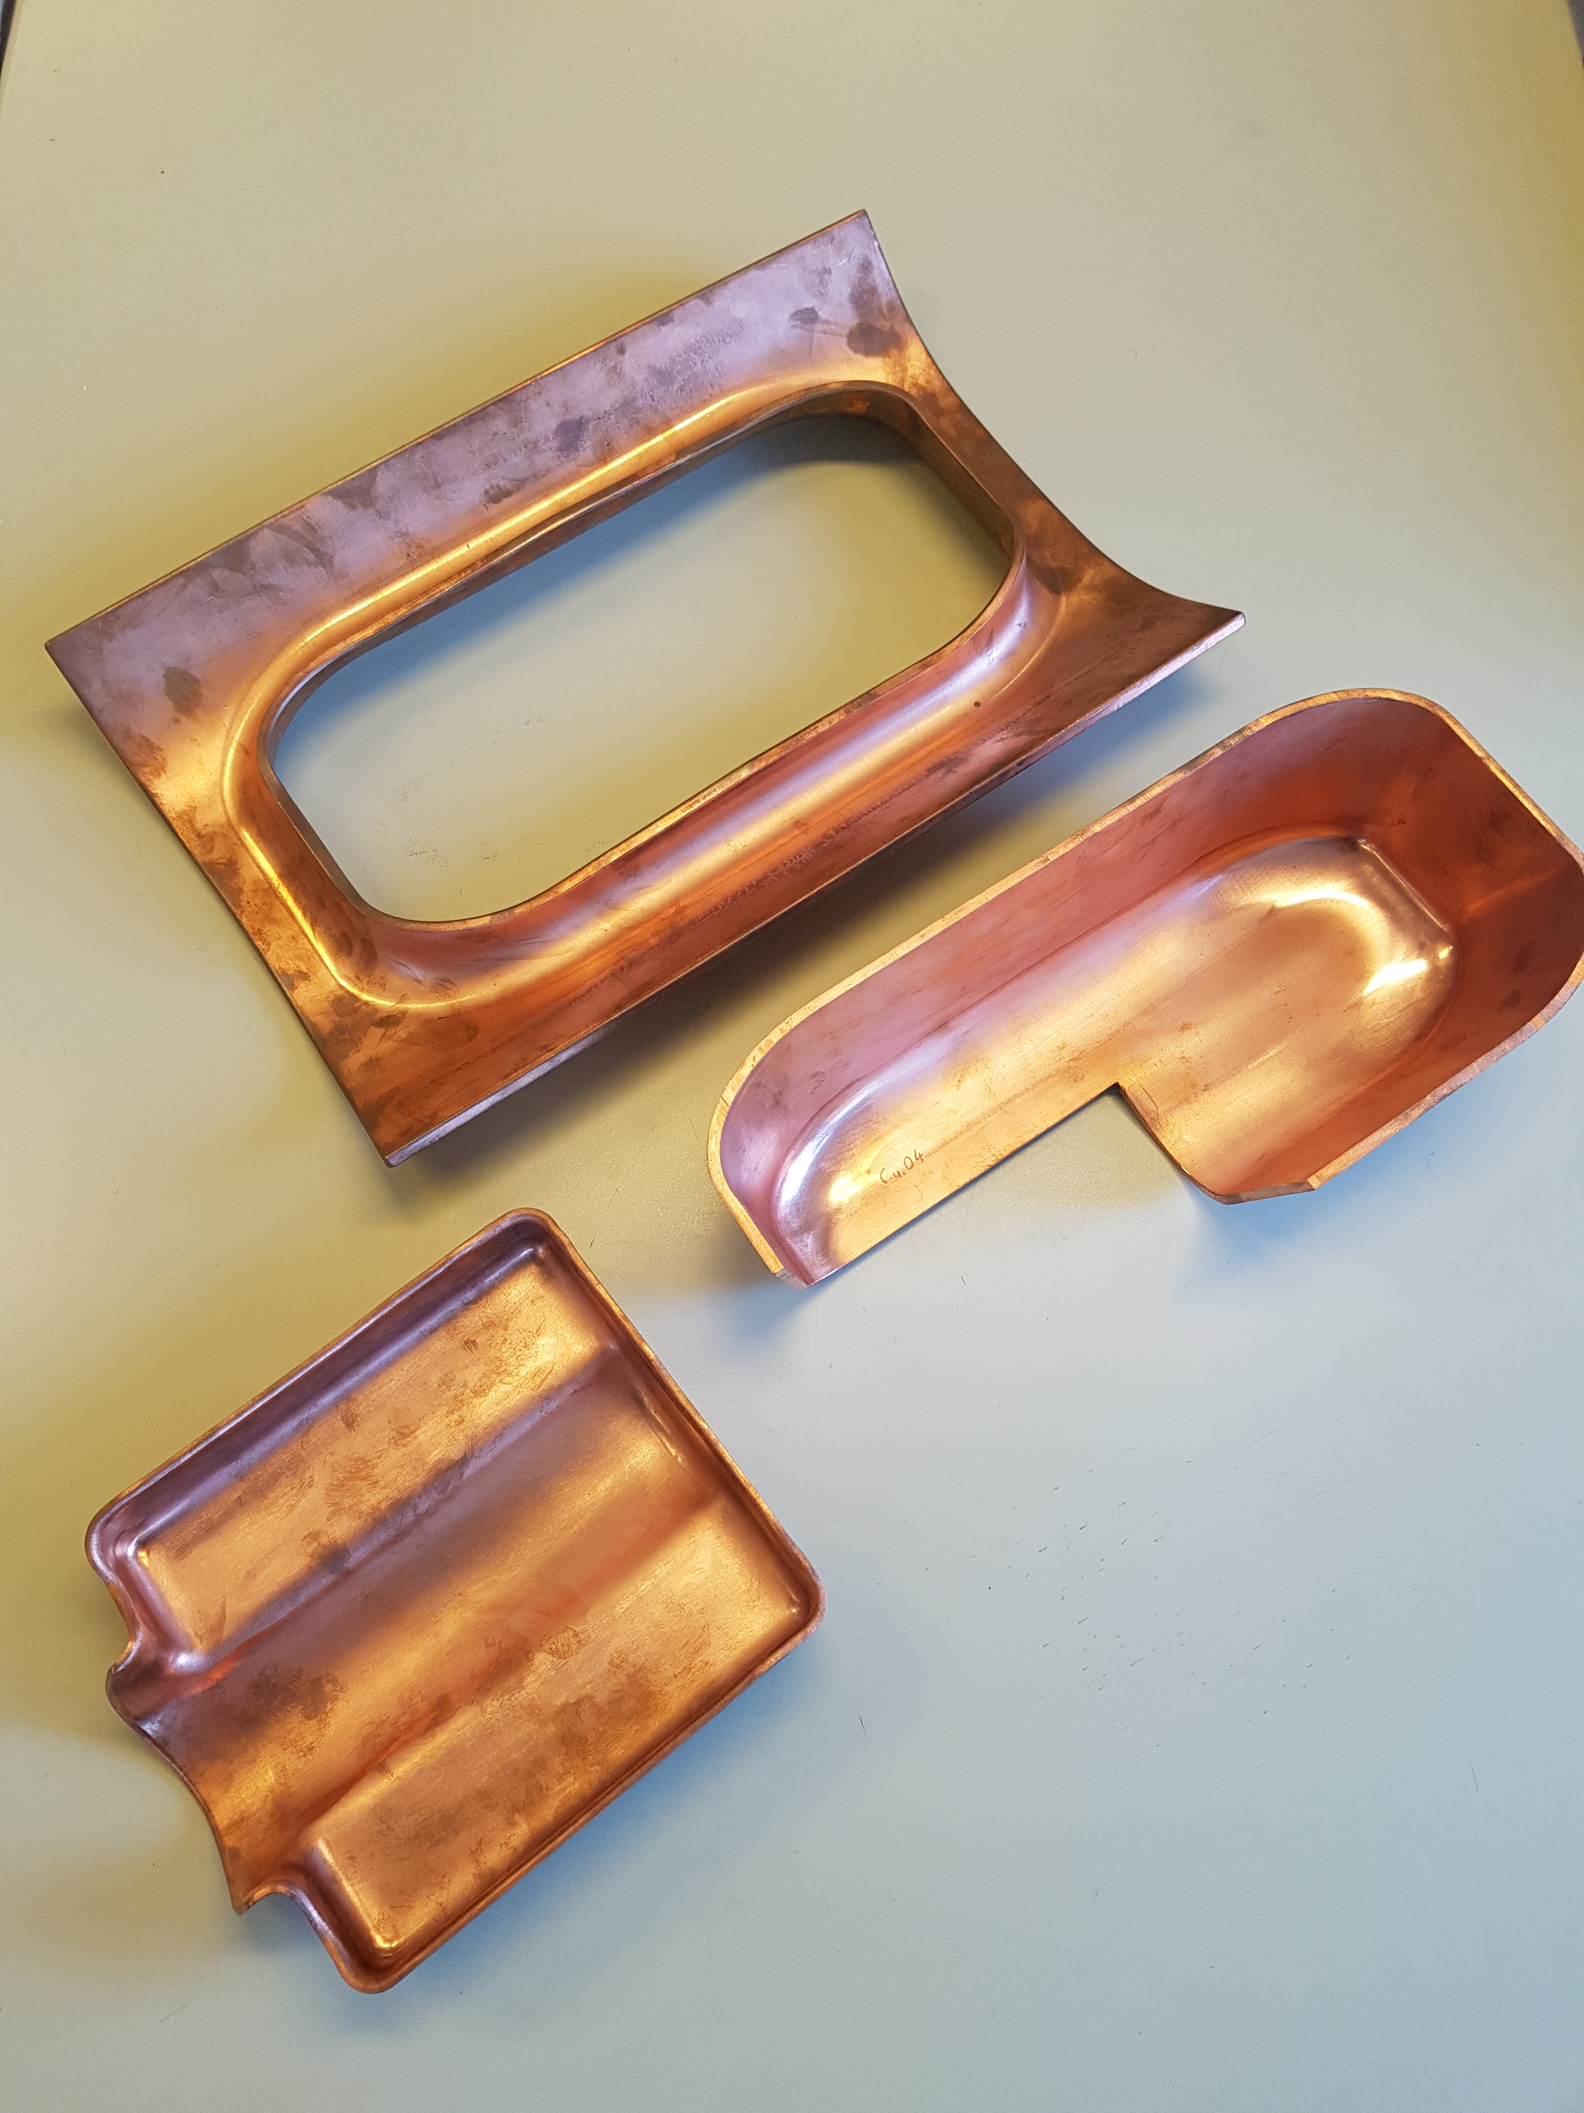
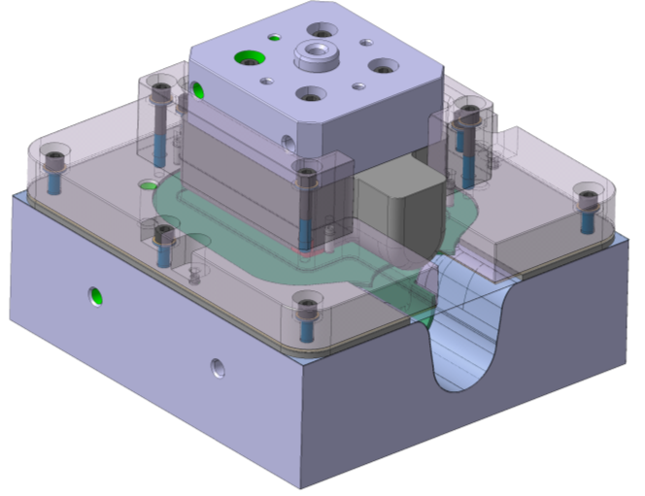
Fabrication Strategy
Kick-off meeting took place on 17/03 with all teams
Same manufacturing philosophy as CERN prototypes back in 2018/2019, same cavity cut-out
Process rehearsal and tooling geometry validation with OFE copper trials, for all technologies
A few days spent locating 70+ production tools and making sure they were complete and in good condition
Notes:
Another important point for strategy

Slide 10






























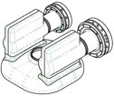
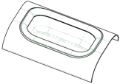

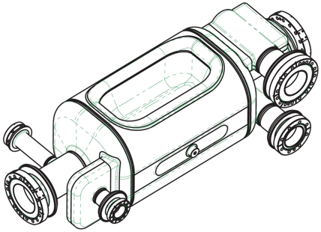
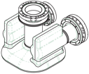
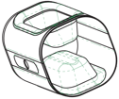

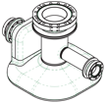


























CERN-RFD#4 Fabrication Status
March 2025
done
FPC Waveguide
End Cap
H-HOM Waveguide
in progress
Beam Axis
Pole
Corner
Half Main Body
End Cap
Tuning Band
& Tuning Pin
Thank you Manuele for the nice chart!
Pick Up
Beam Axis
V-HOM Waveguide

Slide 11
CERN-RFD#4 Fabrication Status
Sept. 2025
done
FPC Waveguide
End Cap
H-HOM Waveguide
in progress
Beam Axis
Pole
Corner
Half Main Body
All main forming activities done!
Now entering the phase where we handle high added-value components: extra care at all stages…
End Cap
Tuning Band
& Tuning Pin
Thank you Manuele for the nice chart!
Pick Up
Beam Axis
V-HOM Waveguide

Slide 12
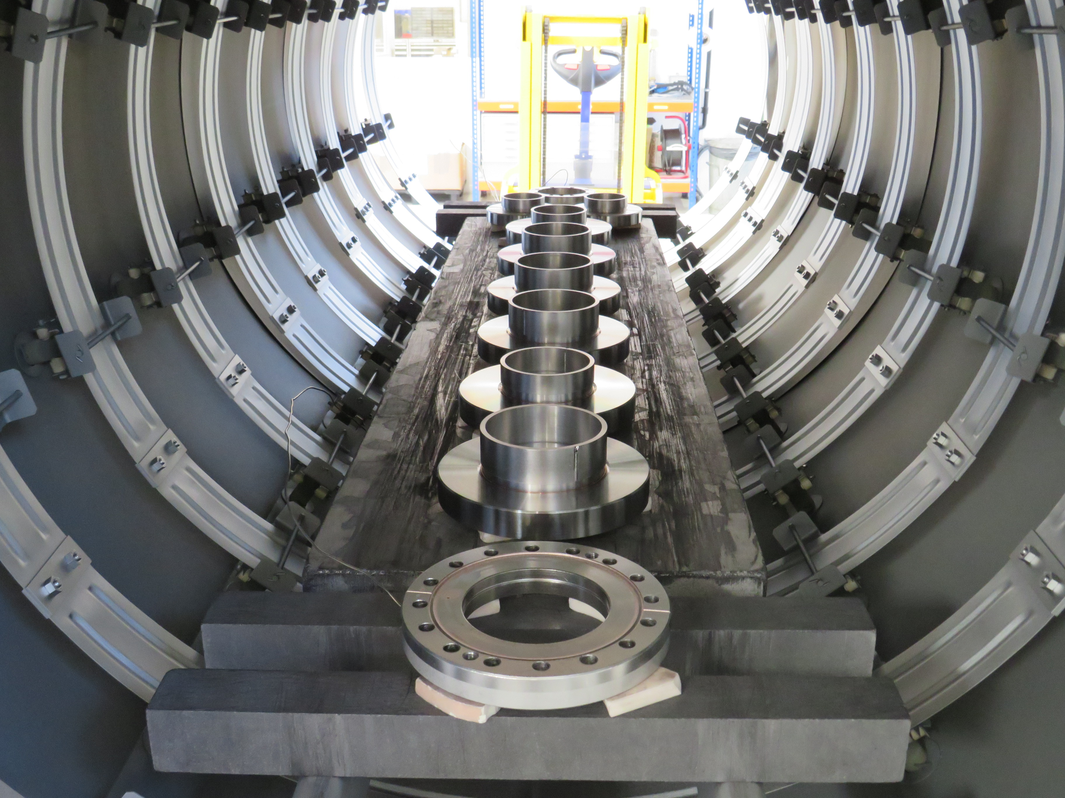
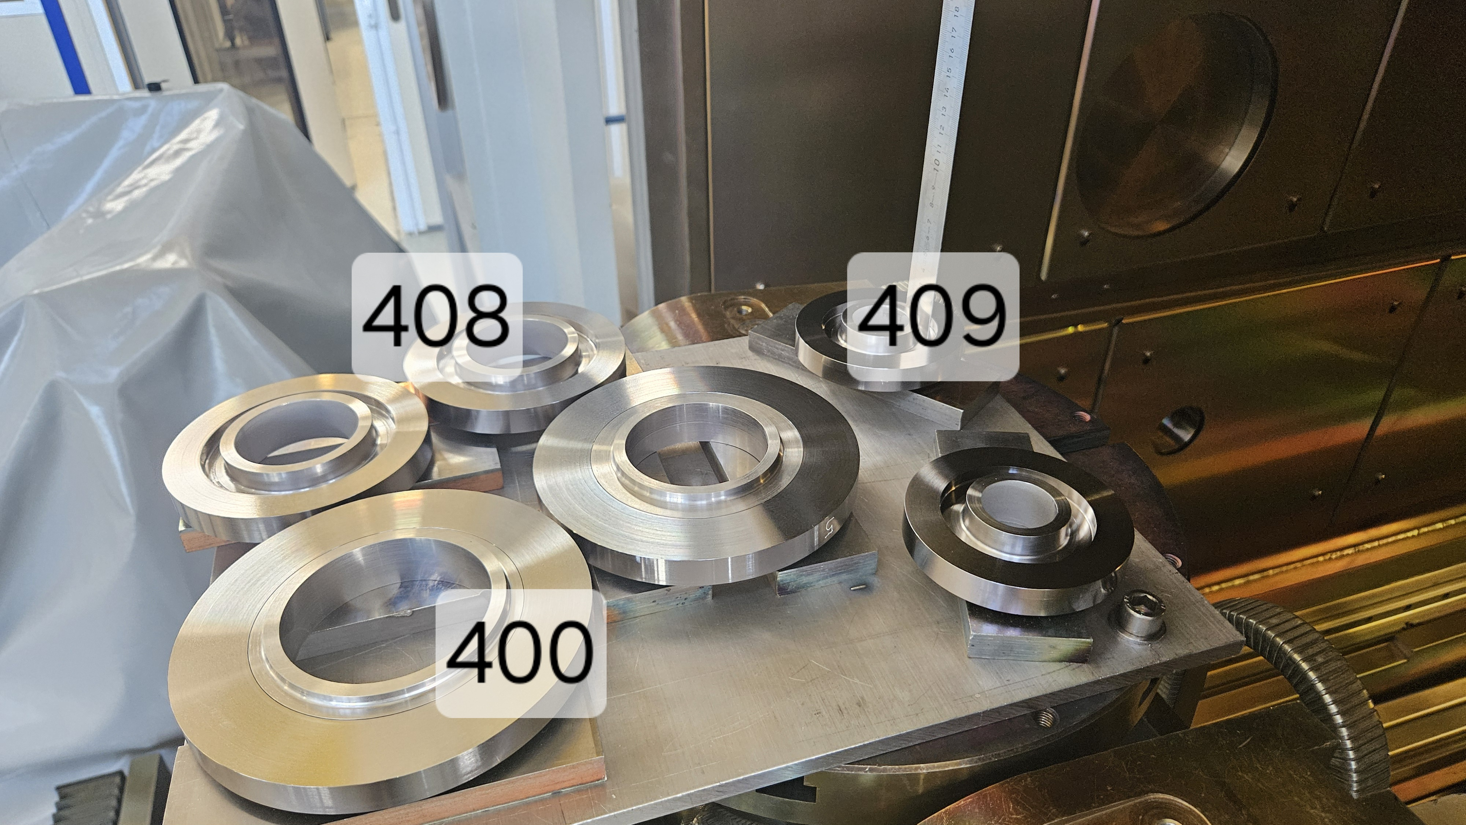
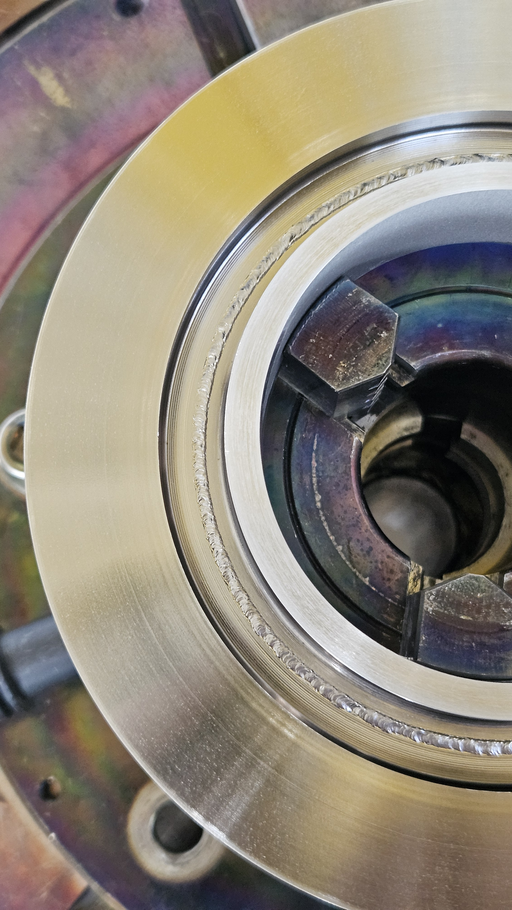
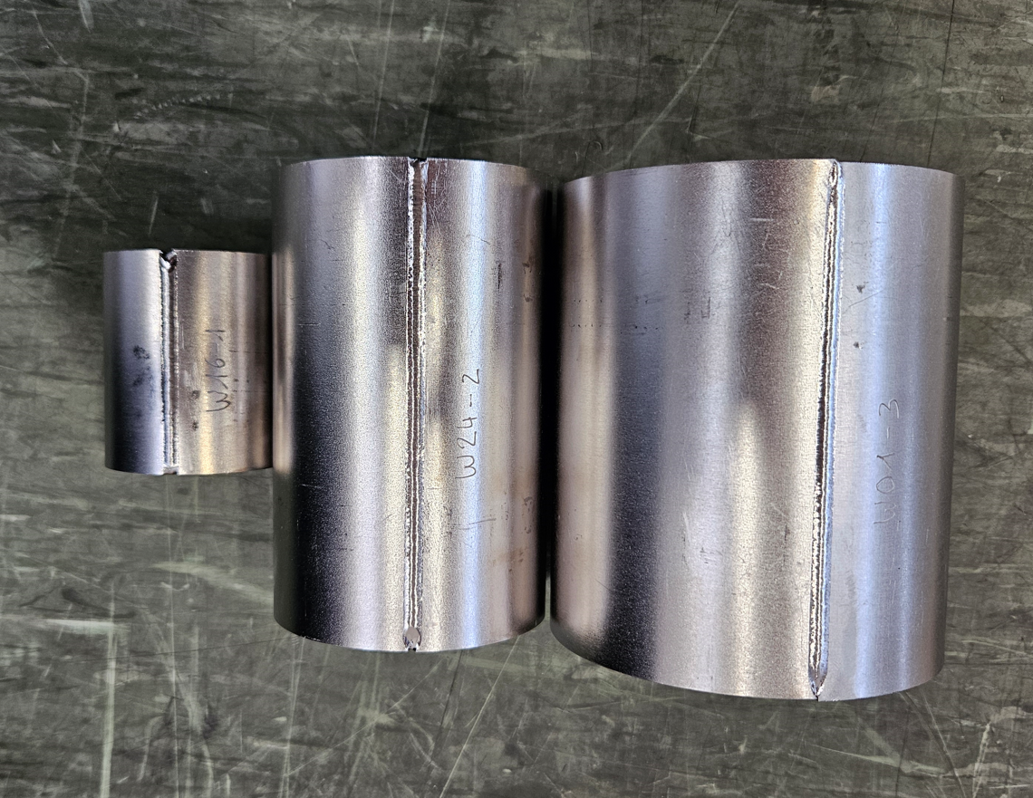
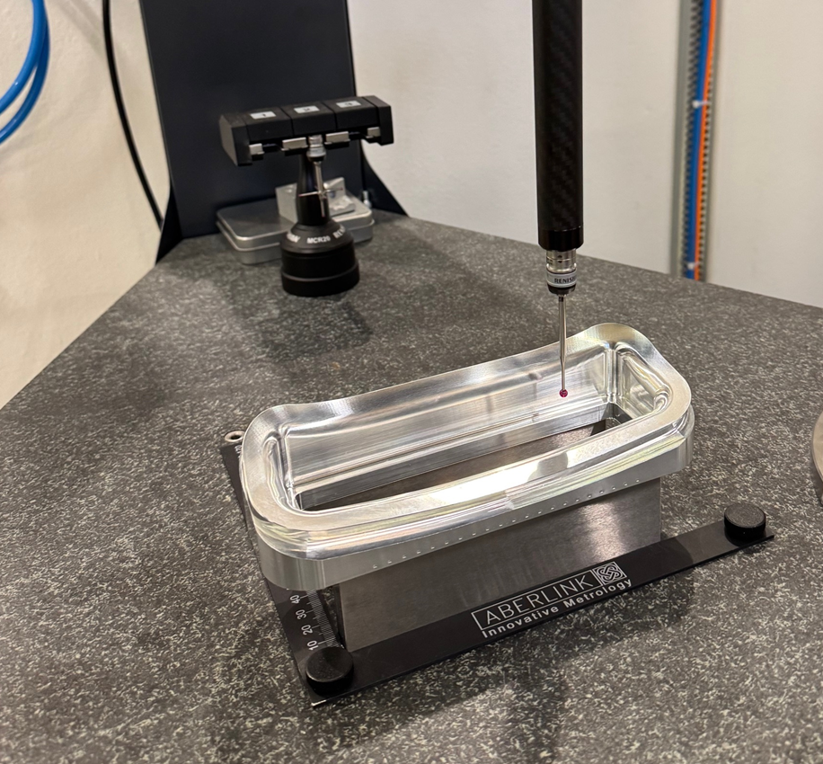
Some Pictures
All extremities brazed
EB weld Nb to NbTi rings
Nb tubes all formed, and EB welded
Bulk transitions

Slide 13
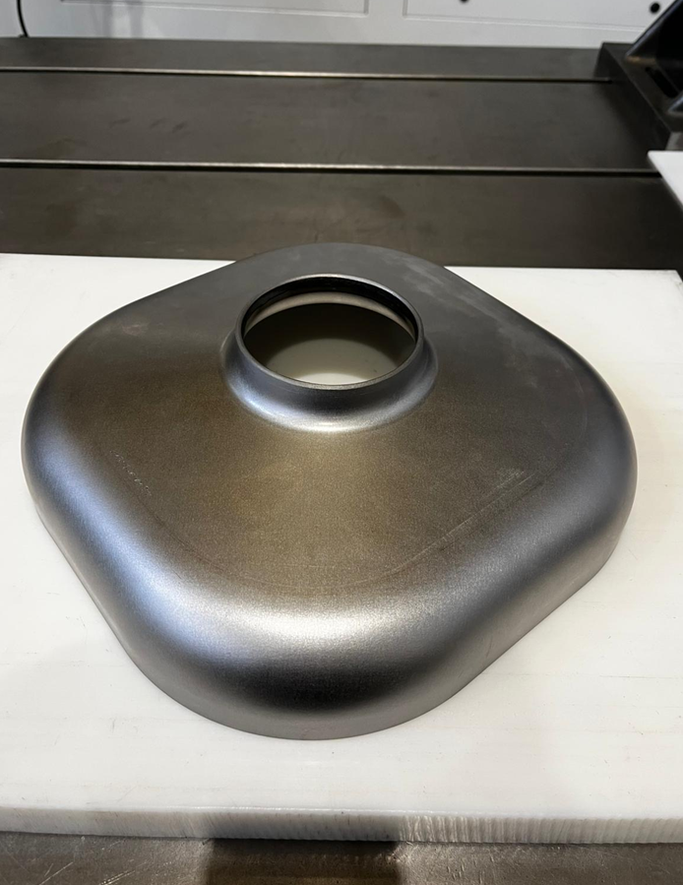
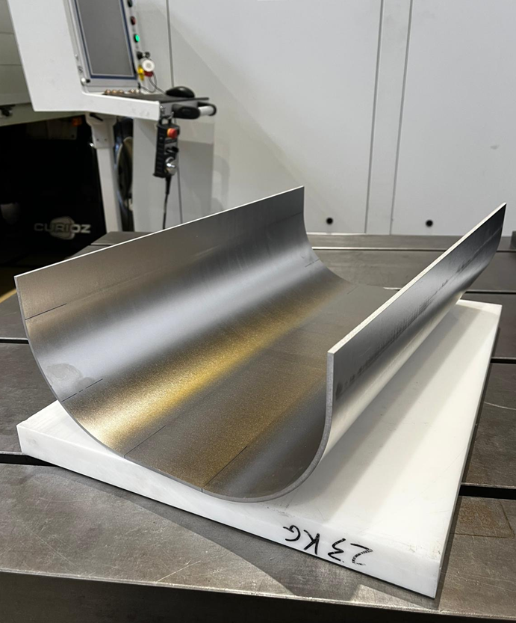
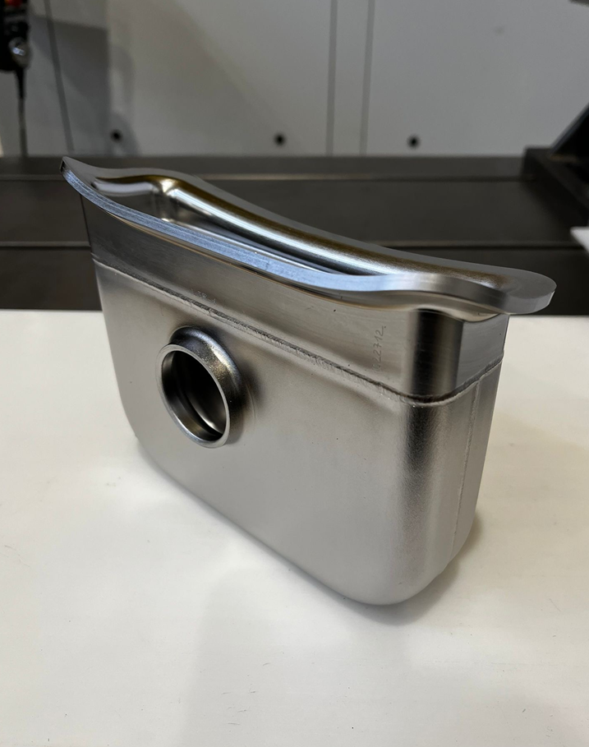
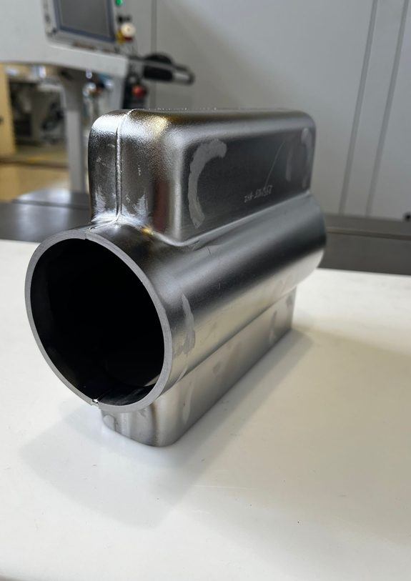
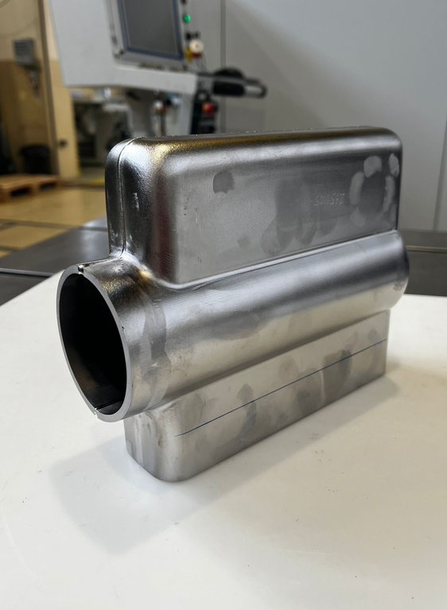
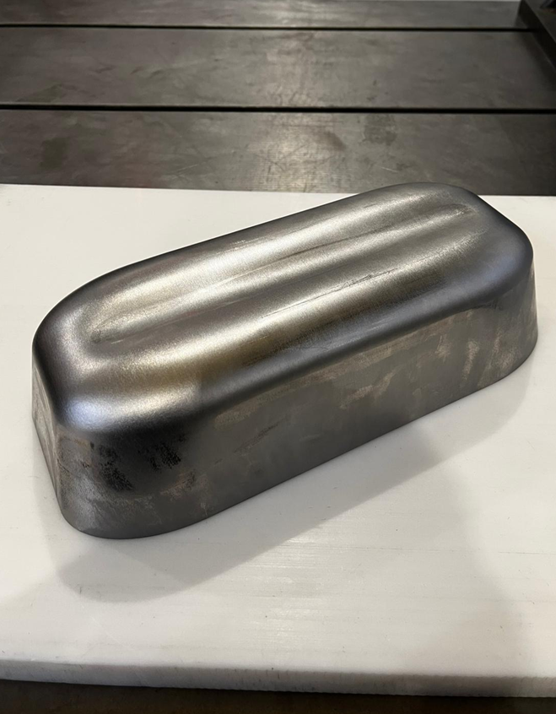
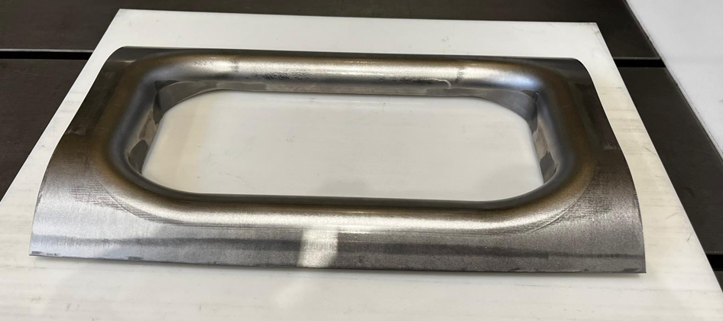
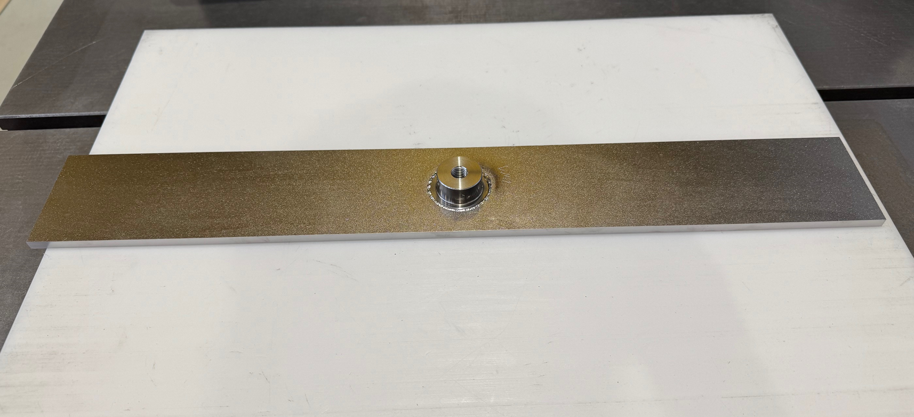
Some Pictures
End Cap
Half Main Body
V-HOM Box
H-HOM Box
FPC Box
Pole
Corner
Tuning Band

Slide 14
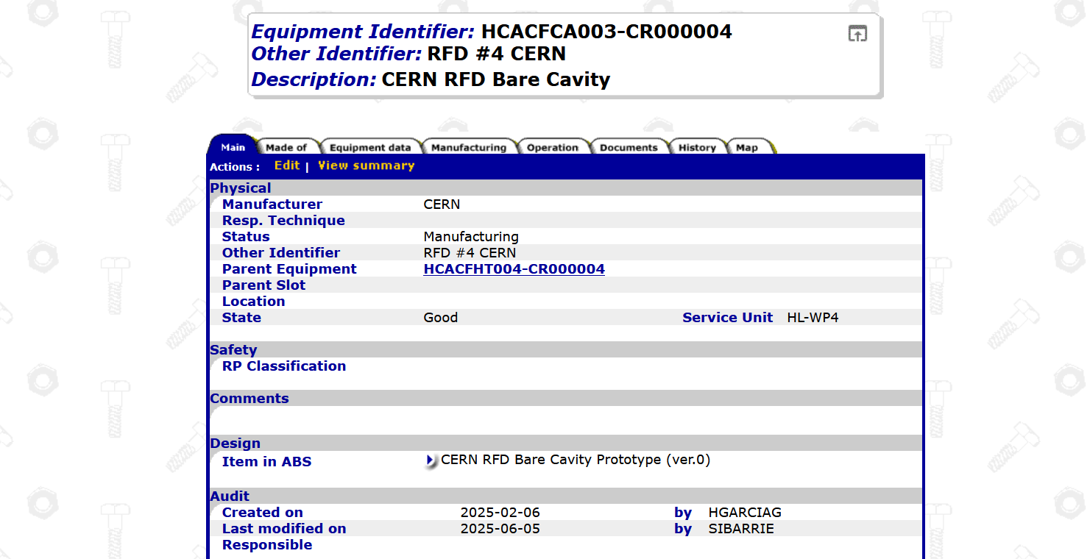
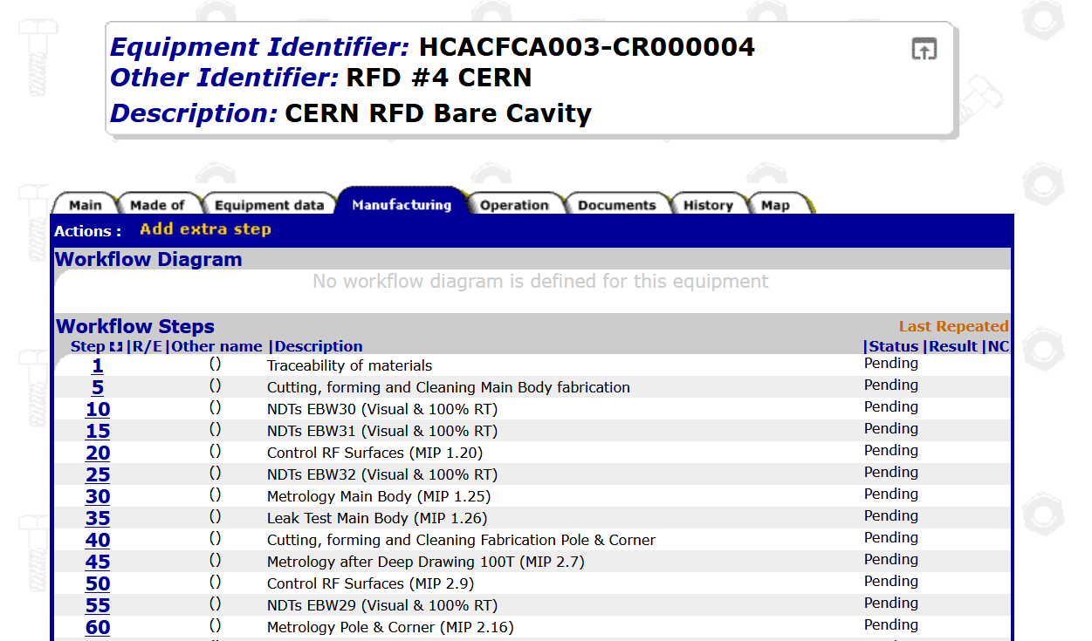
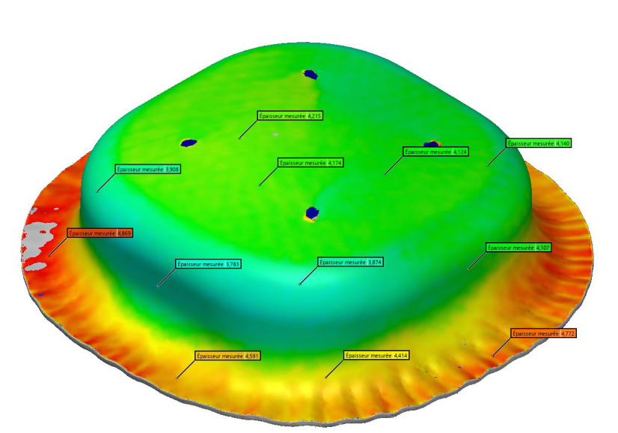
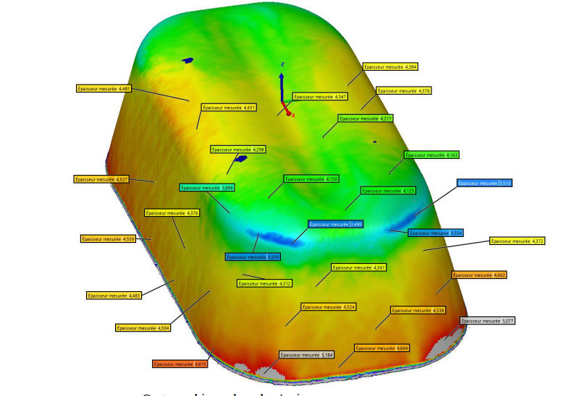
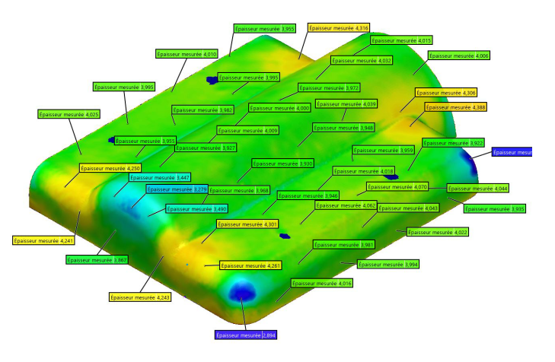
QA/QC and Welding Engineering
See Myriam Benahmed’s talk
All subcomponents traced, compiled in EDMS 3244937, MIP & MTF structure created
Joining processes fully qualified, all documents in EDMS 2726804
Full measurement and tracking of thicknesses’ evolution on sub-components

Slide 15
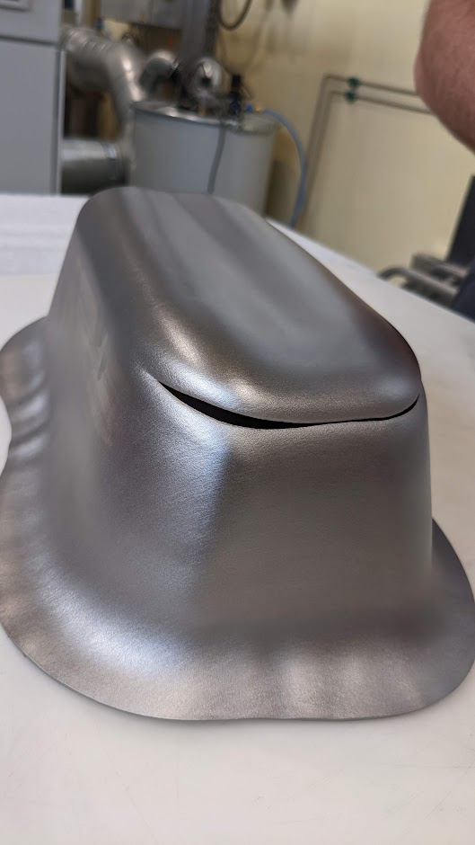
Something Interesting
…I’ll be back!
Pole formed with Zanon/AUP material in 2022
A. Gallifa Terricabras et al. (SRF 2023)
“Optimizing the Manufacture of High-Purity Niobium SRF Cavities Using the Forming Limit Diagram: A Case Study of the HL-LHC Crab Cavities RFD Pole”

Slide 16
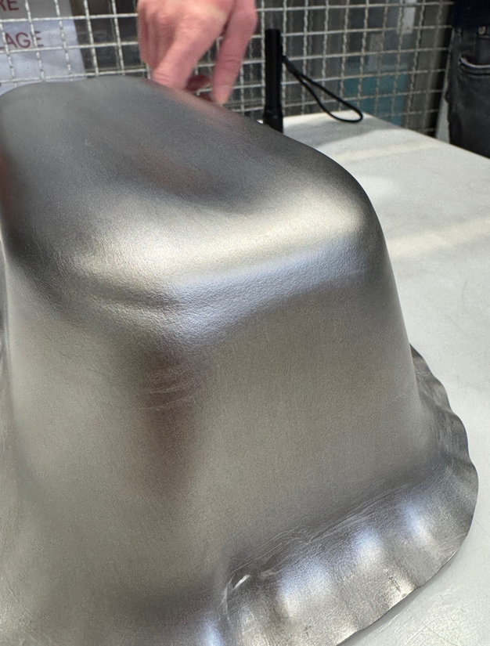
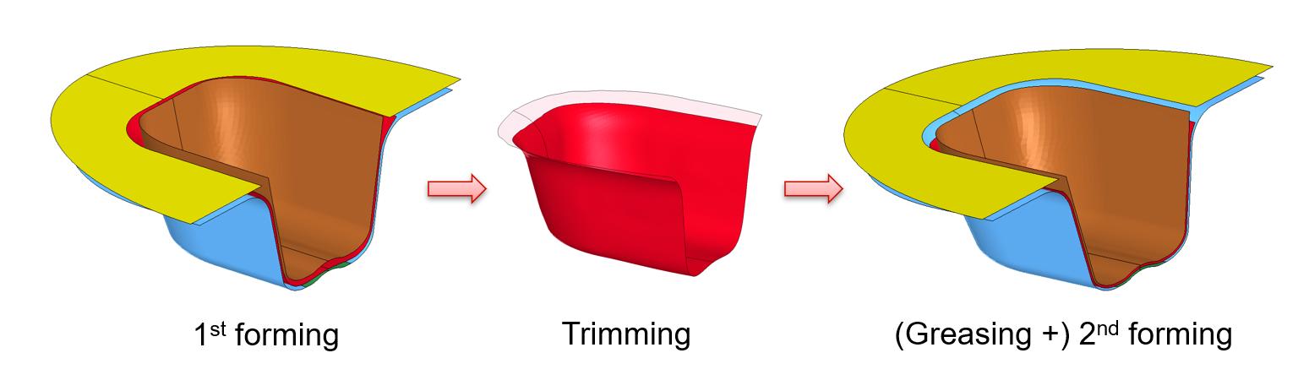
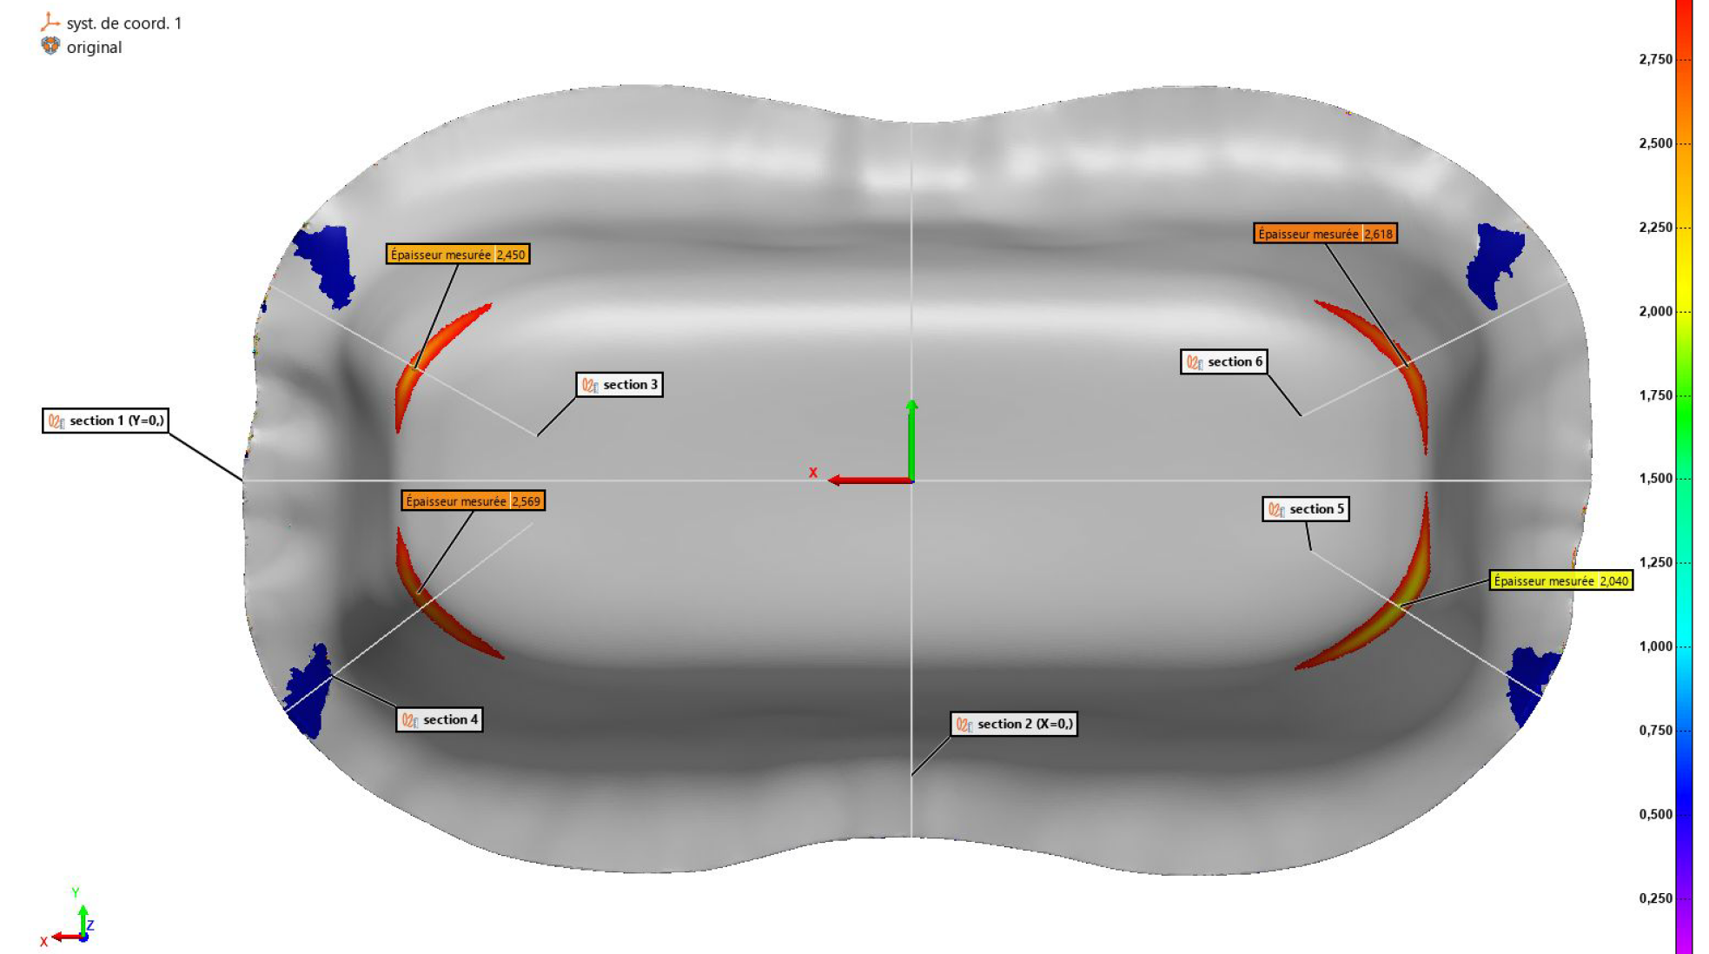
Something Interesting
Heavy thickness reduction on poles formed both with AUP niobium sheets and CERN series material, even using the “2-step” process developed by Zanon RI
Thickness
2,1 mm
Not acceptable
The folded morphology on the outer part of the sheet blocks it from entering the mold, resulting in tearing of the sheet
Root cause is likely to be the high mechanical properties
(Rp0,2 > 80 MPa) of these niobium sheets
CERN pole PO-01
Zanon/AUP material
(March 2025)
A. Gallifa Terricabras et al. (SRF 2023)
“Optimizing the Manufacture of High-Purity Niobium SRF Cavities Using the Forming Limit Diagram: A Case Study of the HL-LHC Crab Cavities RFD Pole”

Slide 17
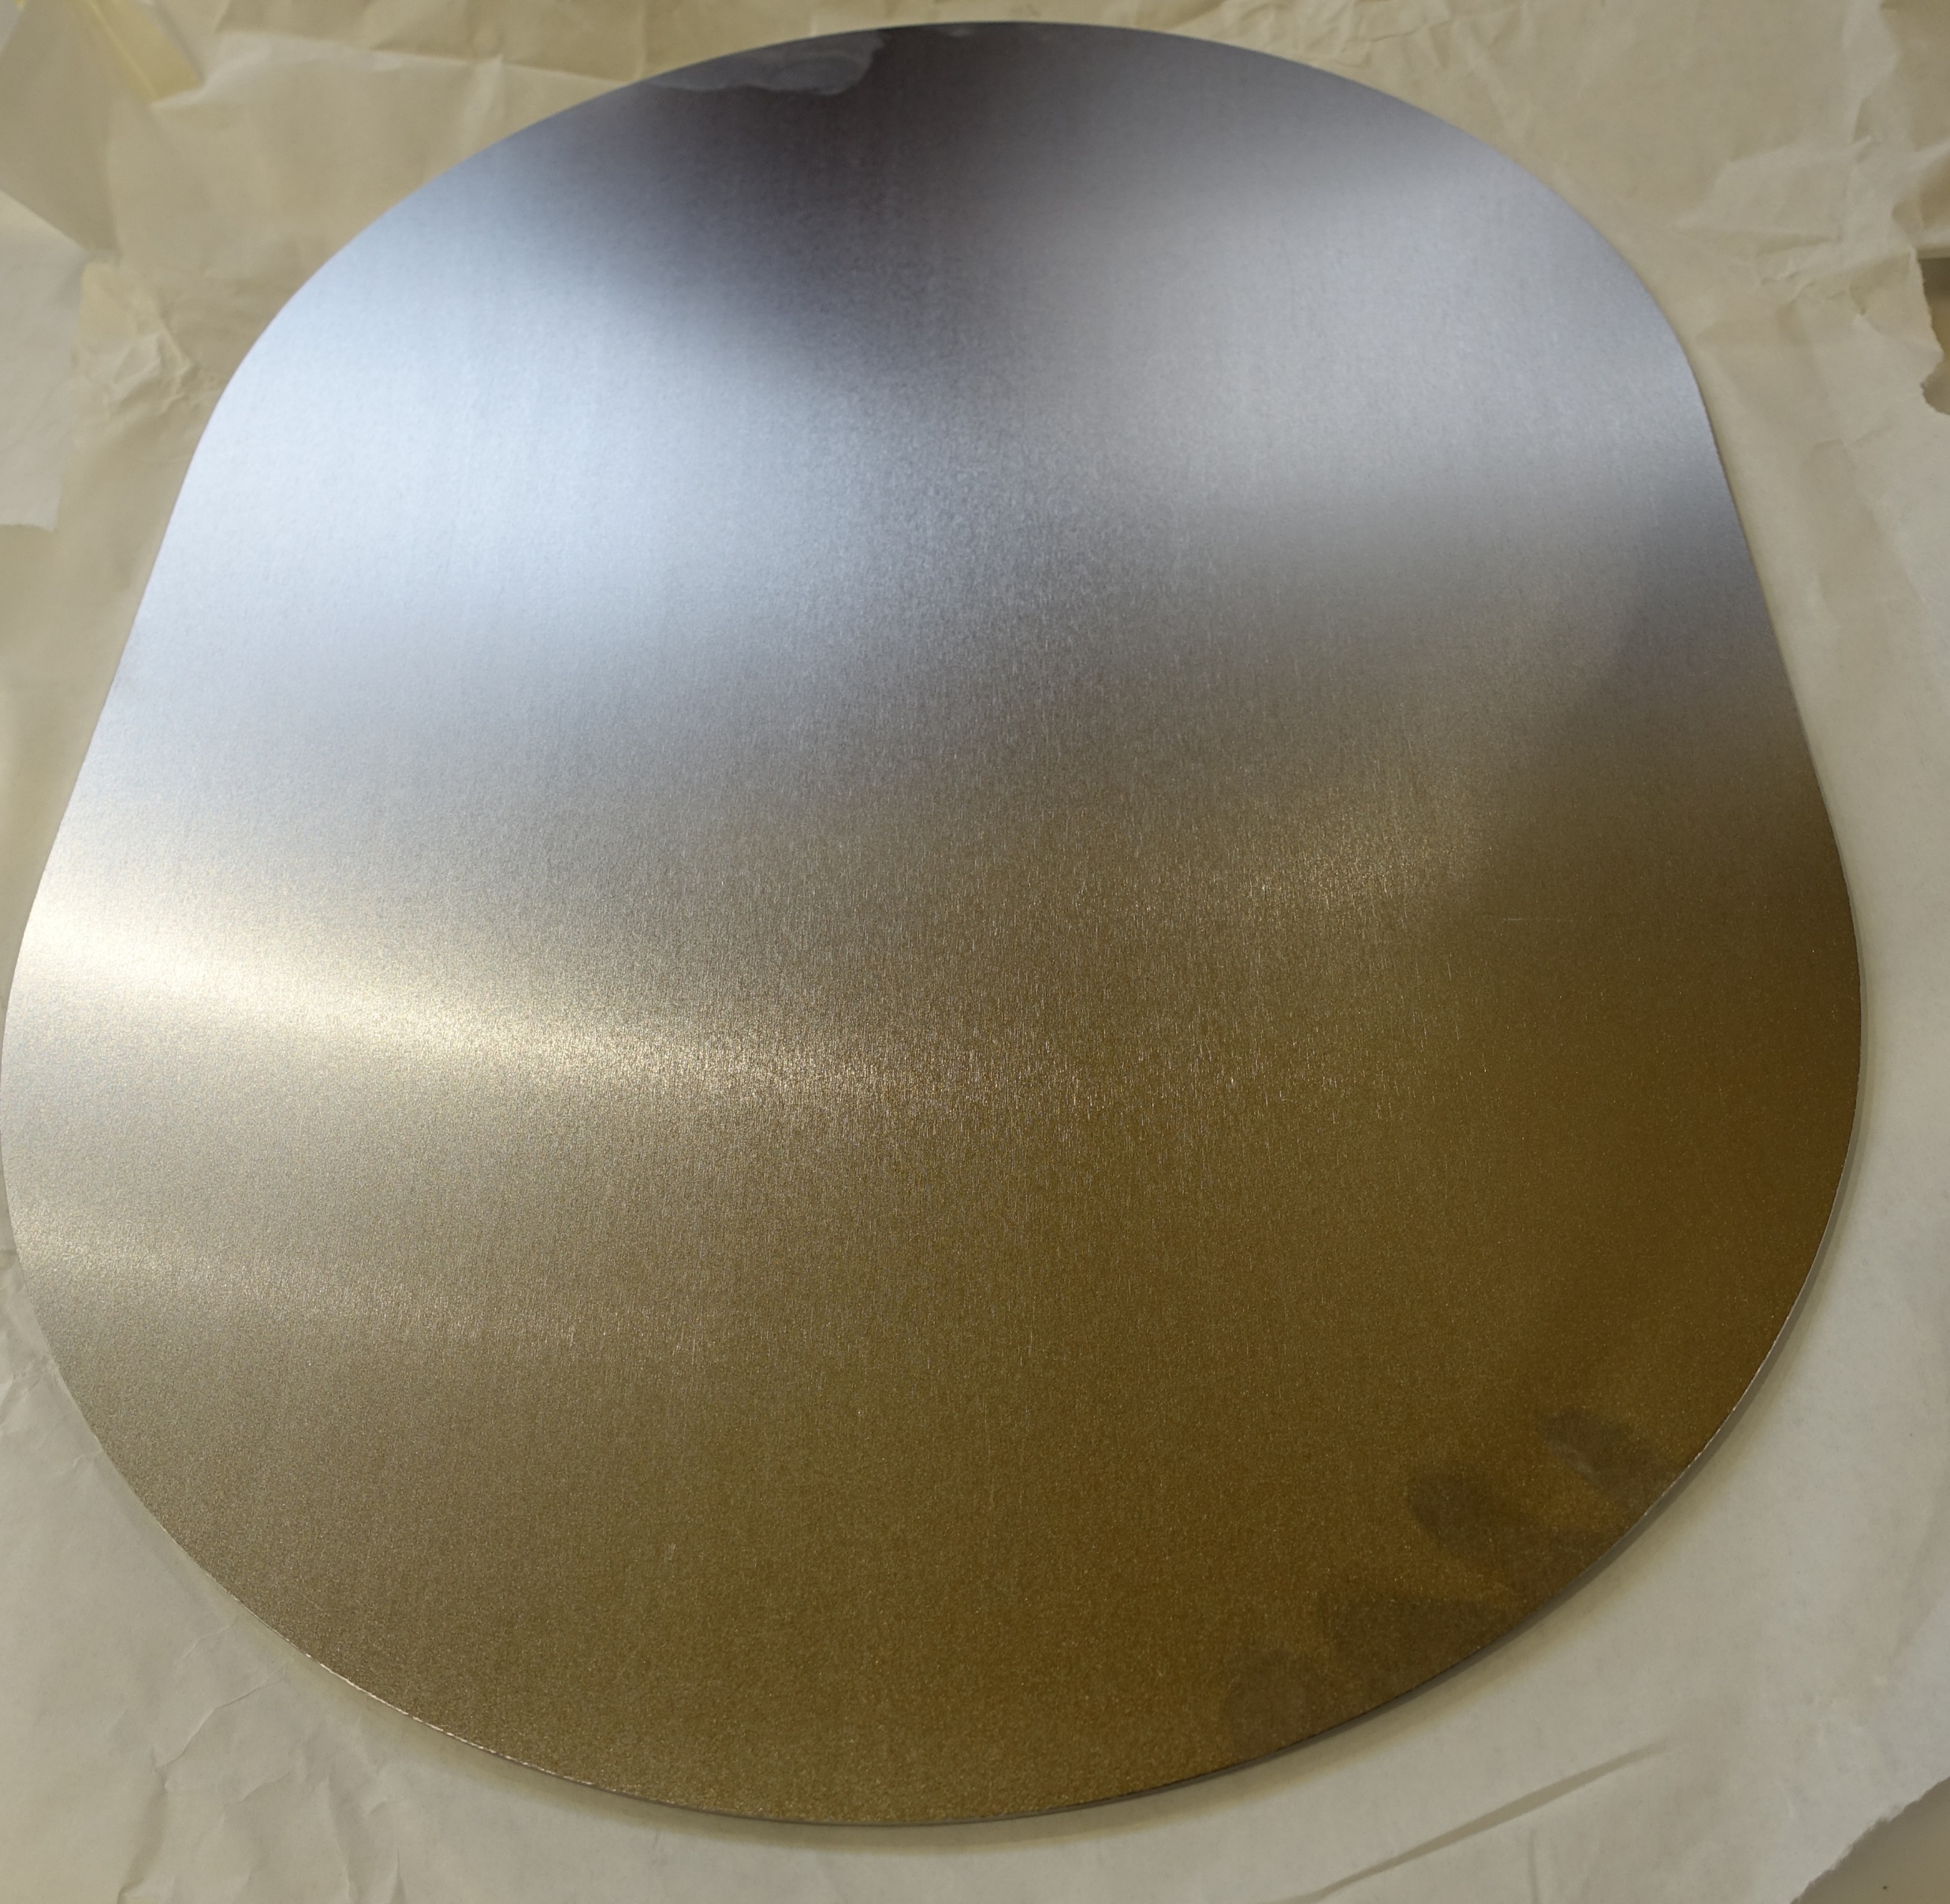
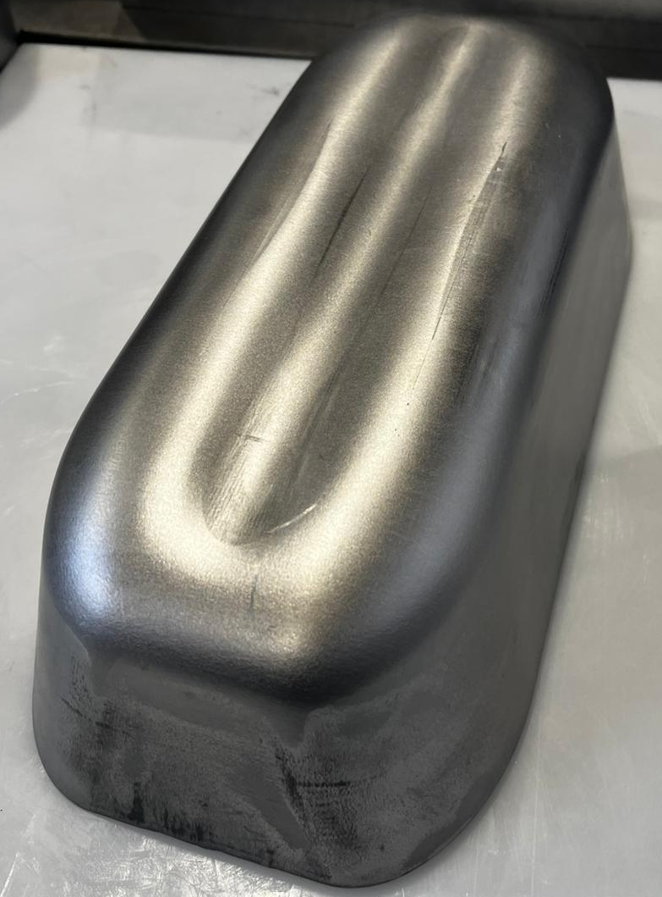
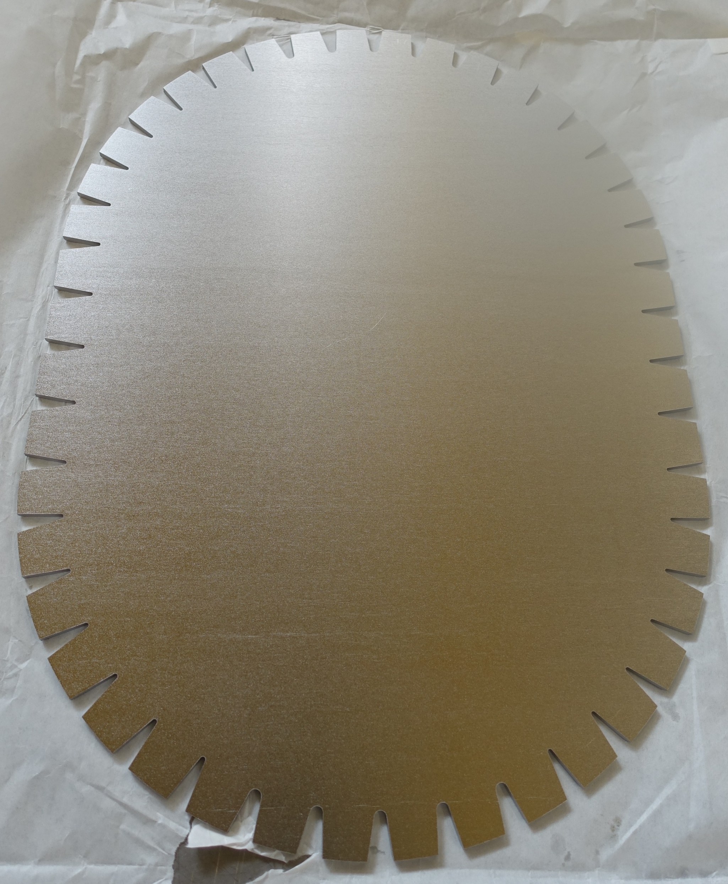
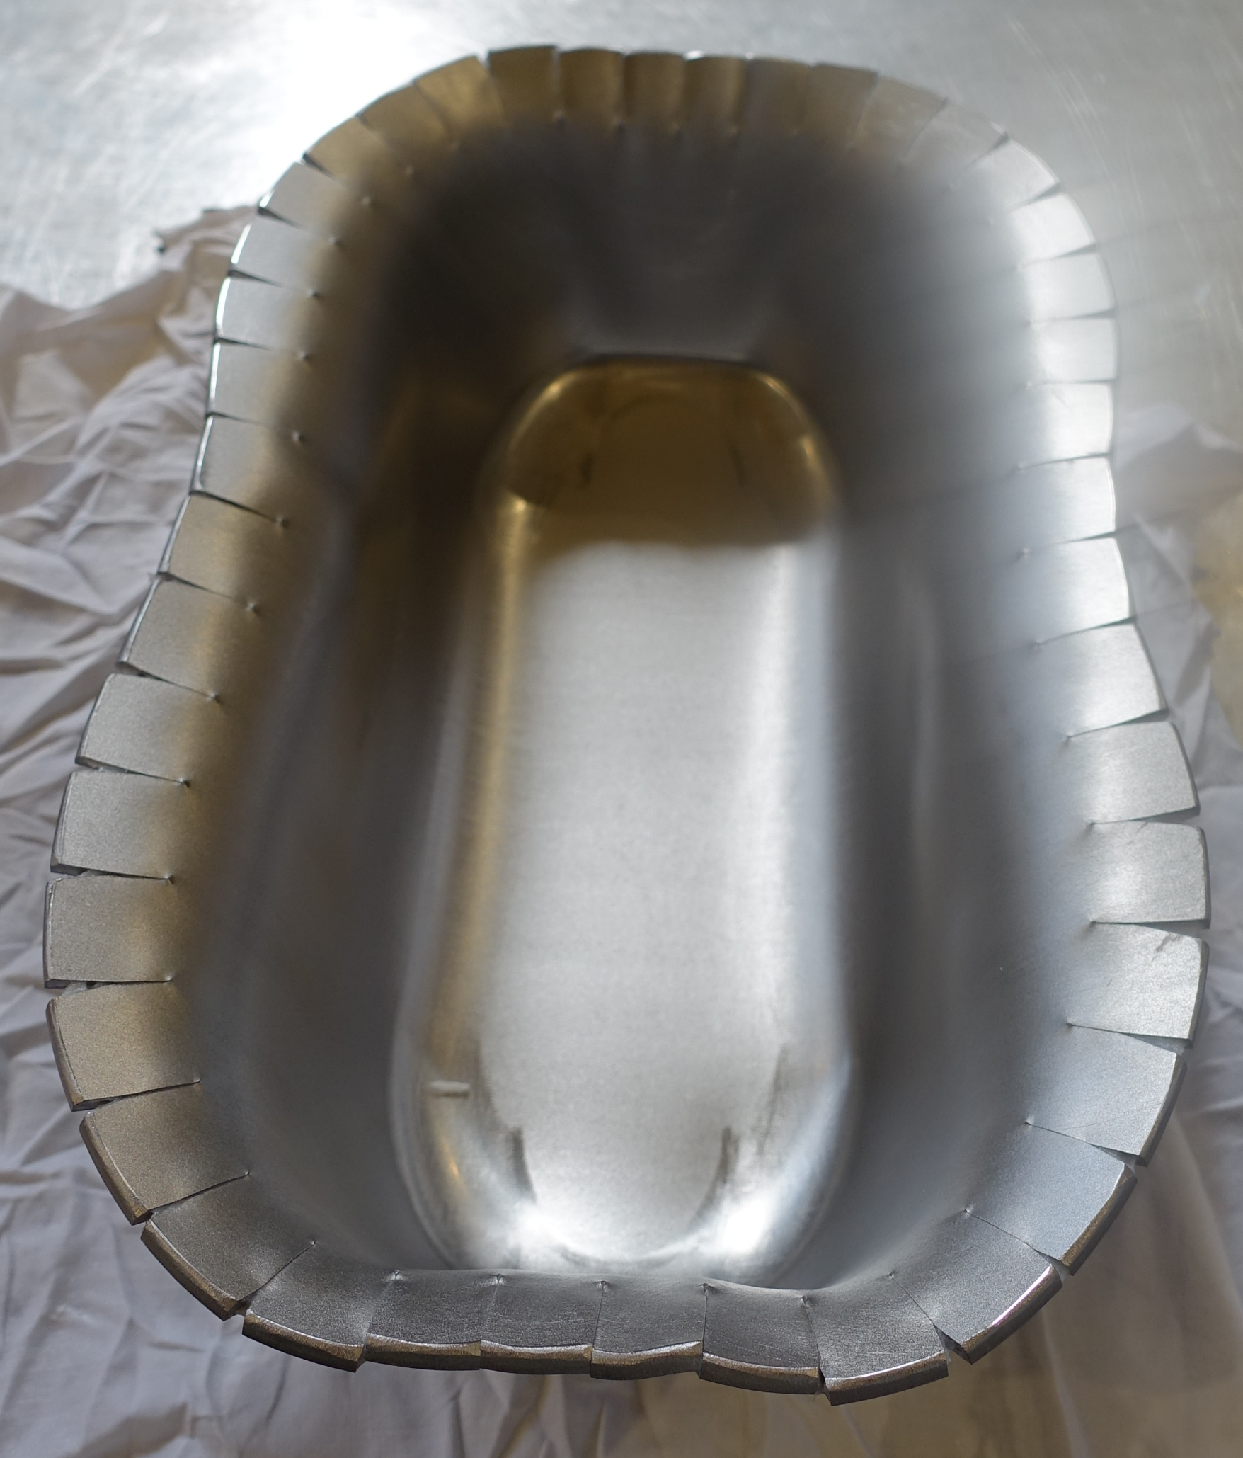
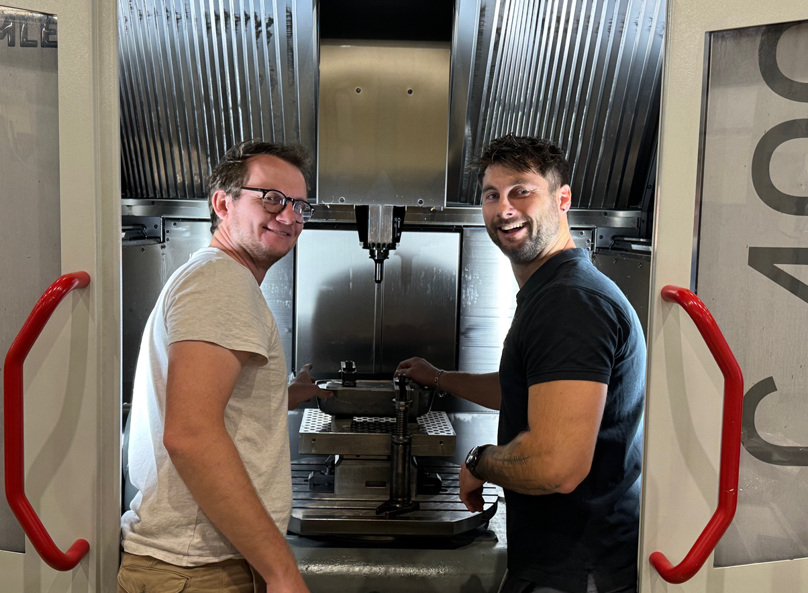
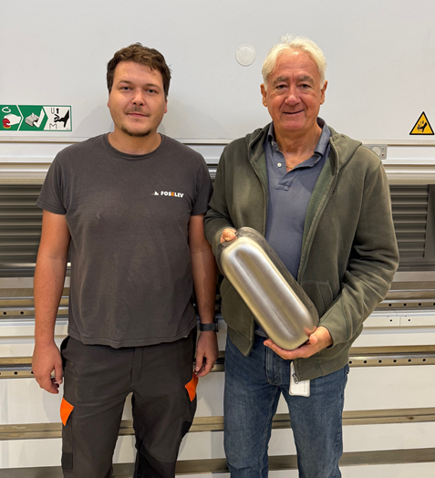
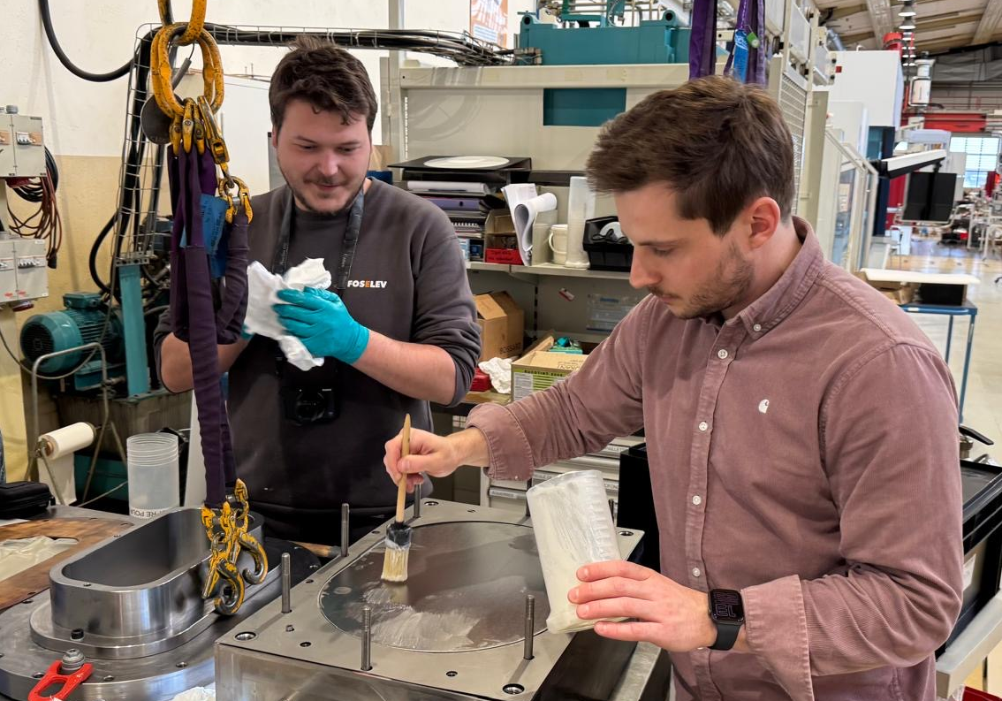
Something (Very) Interesting
Solved using a new initial sheet design!
CERN pole PO-03
Zanon/AUP material
Thickness
3,5 mm
Notches all around the profile
Great teamwork!

Slide 18
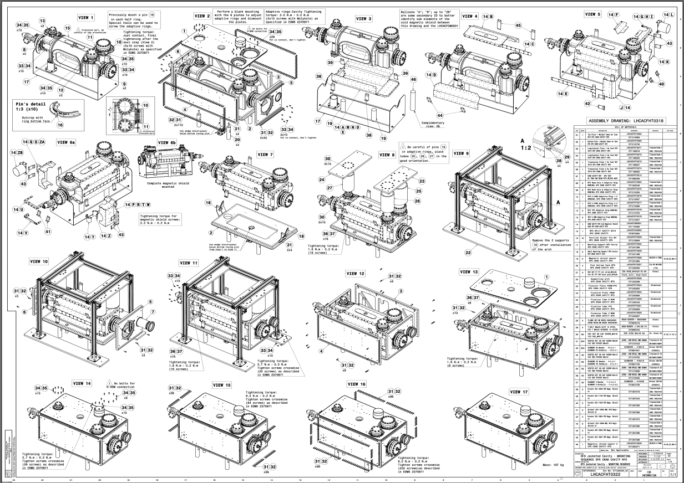
CERN-RFD#3 Jacketing

Slide 19
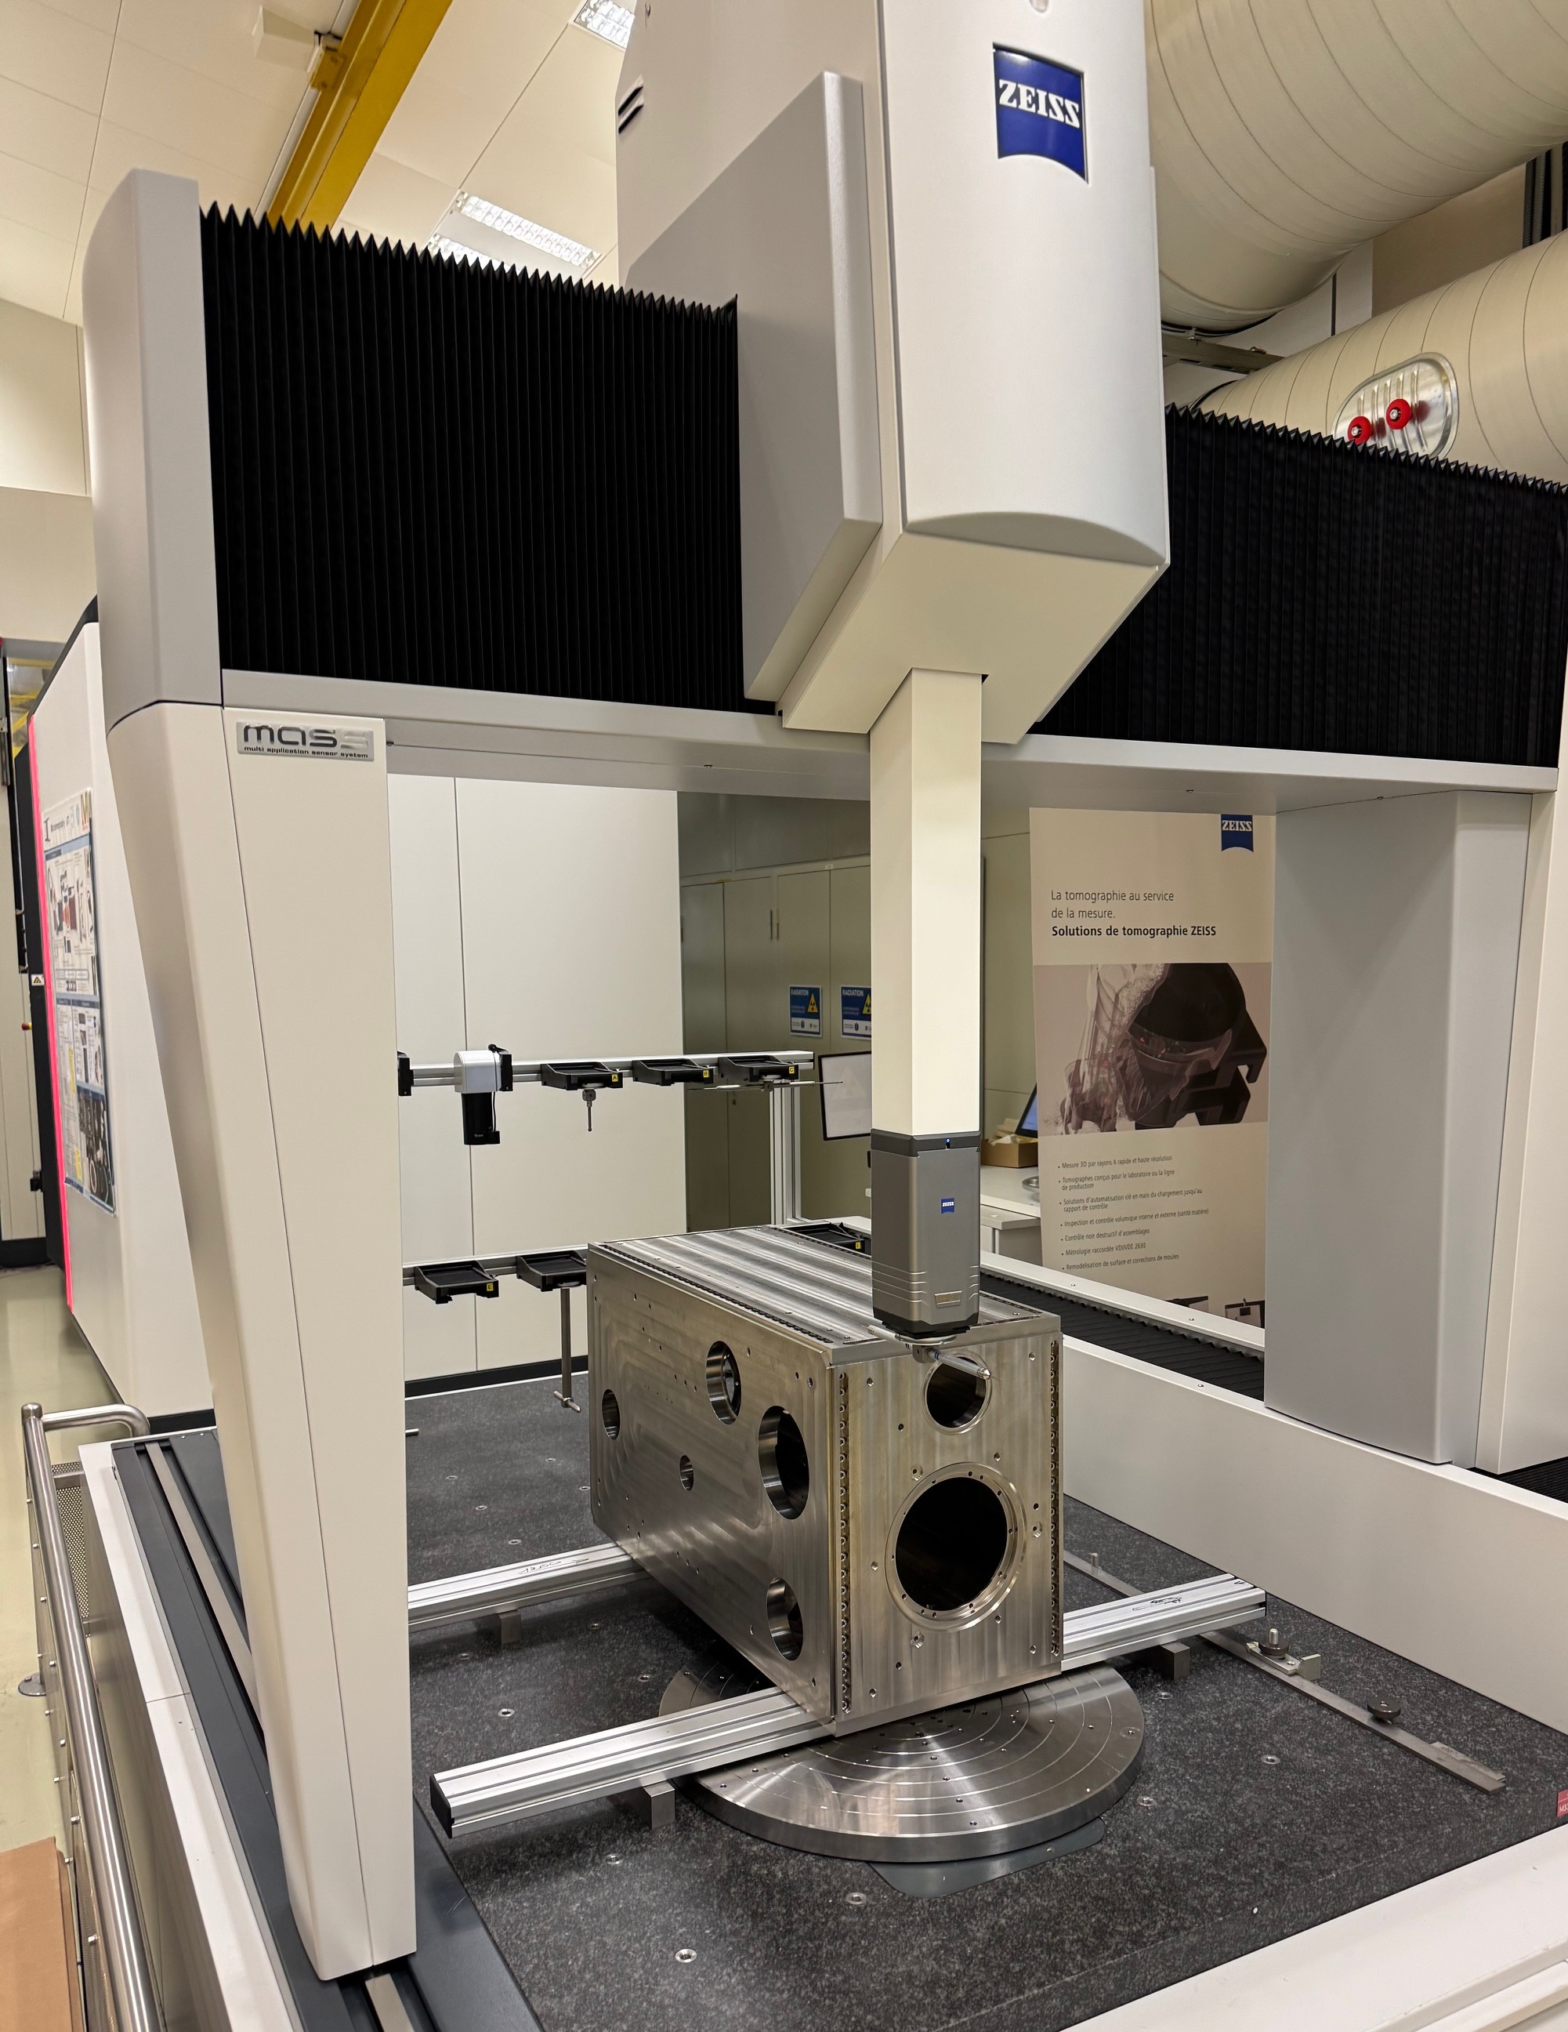
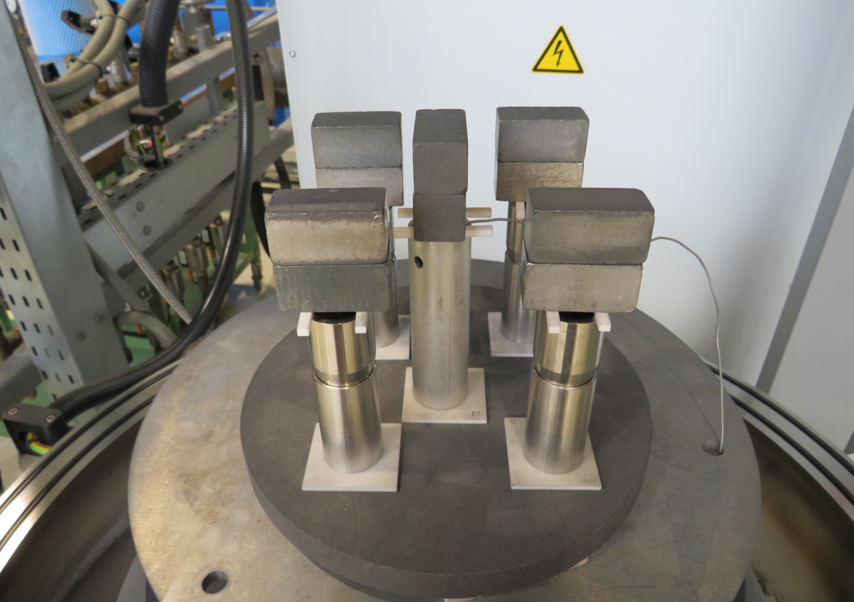
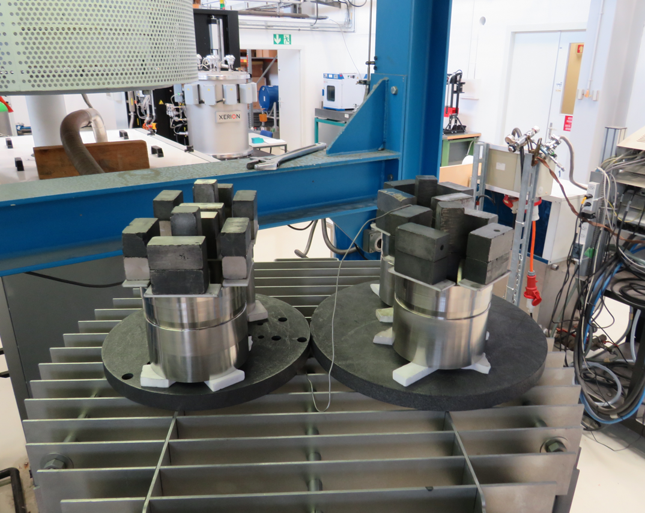
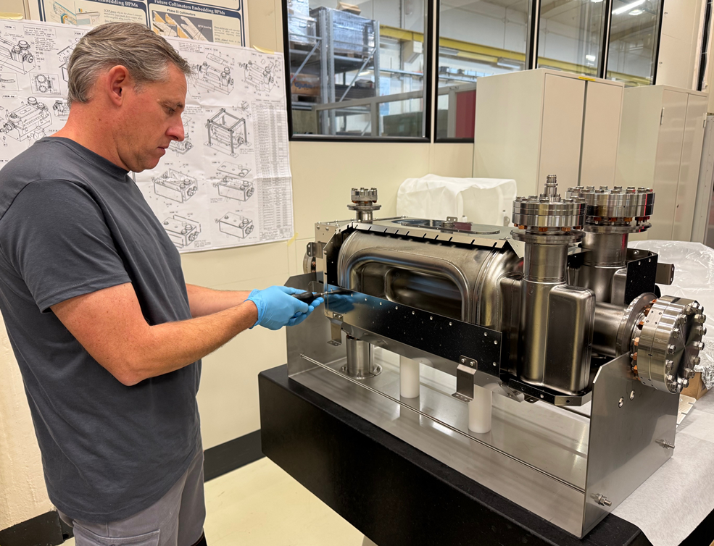
CERN-RFD#3 Jacketing
All hardware (magnetic shields, titanium vessels, fasteners, brazed transitions) manufactured and checked in record time!
Also all ready for CERN-RFD#4
Ti-SS brazed transitions done
Great synergy with MME design office & workshop
RFD#3 helium vessel assembly to start in the next weeks
Metrology of RFD #3 helium tank before final machining
Cold magnetic shield assembled on CERN-RFD#3

Slide 20




Next Steps
Pictures from CERN-RFD#1 and RFD#2 jacketing (2020)
Helium Vessel
assembly
TIG welding in glove box
Pressure test
From bare cavity to final beam screen assembly, more than 13 fabrication and inspection technologies are intertwined, with teams involved in all ATS departments
→ strong coordination and QA/QC follow-up required
Beam screen installation

Slide 21

Planning
Only RFD cryomodules shown here
CERN-RFD#4 bare cavity manufactured and tested
Production currently on-track, but aggressive schedule requiring many MME workshop resources, current focus on main body components (critical path)
CERN-RFD#3 jacketing in the shadow, the goal is to test this jacketed cavity in 2025

Slide 22
HOM Couplers

Slide 23






Production Scope: RFD series
CERN is manufacturing copper HOMC and Field Antennas for AUP RFD cavities
H-HOM Coupler still under US-AUP scope
Additional batch required for CERN RFD cavities
See Naeem Huque’s talk
H-HOM Feedthrough & Coupler
14 units & 2 units
V-HOM Coupler
14 units
RF Field Antenna
14 units*
Fundamental Power Coupler
14 units

Slide 24



RFD – HOMC and Antennas for US-AUP
Pieces | Qty requested (series batch) | Qty produced at CERN
H-HOM Feedthrough | 8 | 4 shipped 4 done*
V-HOM Coupler | 8 | 4 shipped 4 done*
Field Antenna | 8 | 4 shipped 4 done*
RFD
H-HOM Feedthrough
RFD
Field Antenna
* : in final steps of preparation before shipping
RFD
V-HOM Coupler

Slide 25
RFD – HOMC and Antennas for CERN cavities
Pieces | Qty requested | Qty produced at CERN
H-HOM Coupler | 2 | 2 ongoing
H-HOM Feedthrough | 2 | 2 done
V-HOM Coupler | 2 | 2 done
Field Antenna | 2 | 2 done
RFD
H-HOM Feedthrough
RFD
H-HOM Coupler
RFD
Field Antenna
RFD
V-HOM Coupler

Slide 26






RFD – HOMC and Antennas for CERN cavities
316LN St. Steel Jackets
Brazed Nb Bodies
Bulk Nb Hooks
Chemistry & post-treatment processes now clear!
V-HOM Coupler
RF Field Antenna after SUBU
H-HOM Feedtroughs

Slide 27





Production Scope: DQW series
HOM Couplers, HOM Feedthroughs, HF-HOM Couplers and Field Antennas for LHC-series DQW Crab Cavities are being produced at CERN Main Workshop
HOM Coupler + Feedthrough
36 units
Fundamental Power Coupler
14 units
HF-HOM Coupler
16 units
RF Field Antenna
16 units

Slide 28




DQW – HOMC and Antennas
Pieces | Qty requested | Qty produced at CERN
HOM Coupler | 36 | 35 done 2 ongoing
HOM Feedthrough | 36 + 12* | 32 done 16* ongoing
HF-HOM Coupler | 12 + 4* | 12 done 4* ongoing
Field Antenna | 12 + 4* | 12 done 4* ongoing
DQW
HOM Feedthrough
DQW
HOM Coupler
DQW
HF-HOM Coupler
DQW
Field Antenna
*: additional quantities to be produced following PSM in Sept 2024

Slide 29





DQW – HOMC and Antennas
Field Antenna RF Clamp
HOM Feedthroughs
Nb Hook Machining
HF-HOM Final Weld
Field Antenna Assembly
HF-HOM Coupler

Slide 30



DQW & RFD – Coaxial RF Internal Lines
See Alex Verduyn’s talk
DQW / RFD
LHCACFRL0261
Pieces | Qty requested | Qty produced at CERN
LHCACFRL0195 x4 for 1 CM RFD x2 for 1 CM DQW | 36 | 36 ongoing*
LHCACFRL0198 x2 for 1 CM RFD x4 for 1 CM DQW | 36 | 36 ongoing*
LHCACFRL0261 x4 for 1 CM DQW | 24 | 24 ongoing*
DQW / RFD
LHCACFRL0198
*only missing components are ceramic brazed feedthroughs, expected to be finished by Q1-2026
DQW / RFD
LHCACFRL0195

Slide 31
Conclusions
2x RFD cavities in production at the EN-MME main workshop for an additional RFD cryomodule to be assembled at CERN
CERN-RFD#3 is being jacketed, goal to cold test it this year
CERN-RFD#4 bare cavity in fabrication, challenging planning, so far on track
Technical issues solved on-the-field thanks to teamwork and workshop technical expertise, but can lead to potential delays
Series production of HOM couplers for WP4 near completion
Our next main challenge will be to keep momentum on fabrication in parallel of cryomodule assembly activities, ramping-up in 2026

Slide 32


Many thanks to all main workshop and WP4 colleagues for their inputs!

Slide 33
Backup slides

Slide 34
RFD – HOMC and Antennas (1st set)
Pieces | Qty requested | Qty produced at CERN
H-HOM Coupler | 2* | 2** shipped
H-HOM Feedthrough | 2* + 4 | 2** + 4 shipped
V-HOM Coupler | 2* + 4 | 2** + 4 shipped
Field Antenna | 2* + 4 | 2** + 4 shipped
RFD
H-HOM FT
RFD
H-HOM Coupler
* : spares of the prototypes built at CERN for RFD-SPS cryomodule
RFD
Field Antenna
RFD
V-HOM Coupler

Slide 35

DQW & RFD – FPC Air Side
Pieces | Qty requested | Qty produced at CERN
Water Antenna | 28 | 28 done
Water Flanges In/Out | 30 | 30 done
Transmission Line (wevaguide, body) | 30 | 30 done

Slide 36





DQW & RFD – FPC Antenna
Pieces | Qty requested | Qty produced at CERN
DQW Antenna | 14 | 6 done 8 ongoing
DQW Double Tube | 14 | 8 done 6 ongoing
RFD Antenna | 14 | 8 done 6 ongoing
RFD Double Tube | 14 | 8 done 6 ongoing
Vacuum Body | 28 | 28 done
DQW
FPC Antenna
DQW
Double Tube
RFD
FPC Antenna
RFD
Double Tube
RFD / DQW
Vacuum Body
All missing assemblies are at very latest steps of production

Slide 37
Quality & Documentation
TRAVELLER HOM COUPLERS & FEEDTHROUGHS |  |  |  |  |  | N°WB - __
 | CDD Number / Numéro CDD | Bld./ Lieu | Collaborator / Responsable | Signature | Date | Comments / Observations
Ceamic order number |  | 112 |  |  | __/__/20__
Visual inspection of ceramic discs |  | 112 |  |  | __/__/20__
Degreasing |  | 107 |  |  | __/__/20__
Metalization / Mo/Mn 20-45 µm + Ni 5-10 µm |  |  |  |  | __/__/20__
Visual inspection of ceramic discs |  | 112 |  |  | __/__/20__
Metrology |  | AP |  |  | __/__/20__
Machining Titanium flange (rough) |  | AP |  |  | __/__/20__
Machining Copper part (finishing) |  | AP |  |  | __/__/20__
Thermal stress relief treatment |  | 107 |  |  | __/__/20__
Machining final Titanium flange (finishing) |  | AP |  |  | __/__/20__
Etching flange + tube before brazing |  | 107 |  |  | __/__/20__
Visual control before brazing |  | 112 |  |  | __/__/20__
Vacuum brazing |  | 112 |  |  | __/__/20__
Visual control after brazing |  | 112 |  |  | __/__/20__
Ceramic n° engraving |  | 112 |  |  | __/__/20__
Leak test |  | 864 |  |  | __/__/20__
Sandblasting of ceramic |  | 864 |  |  | __/__/20__
Metrology of antenna’s height |  | AP |  |  | __/__/20__
EB Welding of back pieces |  | AP |  |  | __/__/20__
Visual control
Metrology |  | 100 |  |  | __/__/20__
Inspection finale SY-RF |  | 864 |  |  | __/__/20__
Leak test / Contrôle d'étanchéité |  | 864 |  |  | __/__/20__

